Slide 1
ISOTOPES VAPORIZATION TECHNIQUES
A. Galatà on behalf of the PANDORA collaboration
PANDORA: measuring beta-decays in plasmas, Perugia 3o/10/2019

Slide 2
OUTLINE
Evaluation of isotopes vaporization techniques:
Gasses
Ovens
Sputtering
Charge Breeding
Conventional techniques for ECR ion sources
Considerations for PANDORA
First day experiments
Conclusions
Perugia, 2019-10-30
Alessio Galatà
PANDORA: measuring beta-decays in plasmas

Slide 3
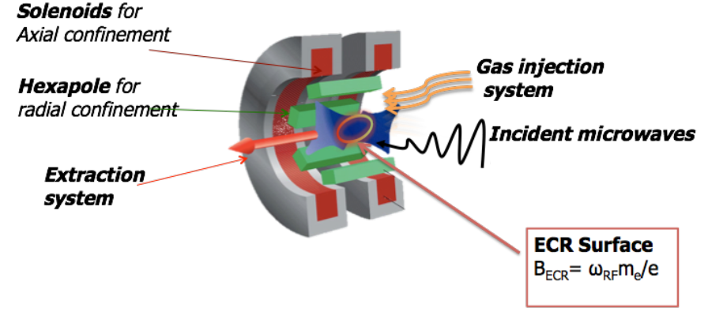
GASSES
The simplest method
Easy tuning with precise leak valves
In case of «dangerous» gases a gas recovery system could be necessary
Total efficiency close to 50%
Takes advantage of wall recycling
Perugia, 2019-10-30
Alessio Galatà
PANDORA: measuring beta-decays in plasmas

Slide 4
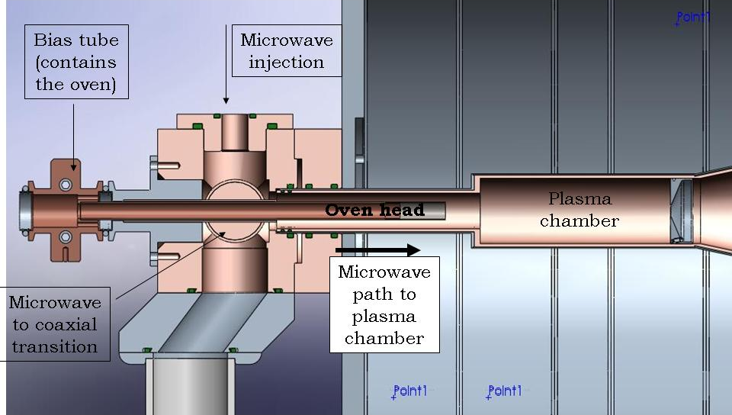
OVENS
Limited dimensions (φ~ 1-2 cm)
Mounting can be difficult
Possible failures (avoidable with a proper design)
Depending on the temperature to be reached the design changes
Heating up to a vapor pressure of 10⁻² mbar (preparation time)
Efficiency ≤ 30%
Uniform contamination of the plasma chamber
Completely decoupled from the plasma
LEGIS ion source @ LNL
Due to thermal inertia cannot be switched off immediately.
Perugia, 2019-10-30
Alessio Galatà
PANDORA: measuring beta-decays in plasmas

Slide 5
SPUTTERING
Once the optimum position is found material emission is immediate
Total efficiency around 10%
The sputtering voltage can perturb the plasma (coupling with the plasma)
When the sputtering voltage is switched off the emission is stopped
It could be necessary to use different gases depending on the material to be sputtered
Uniform contamination of the plasma chamber
Perugia, 2019-10-30
Alessio Galatà
PANDORA: measuring beta-decays in plasmas

Slide 6
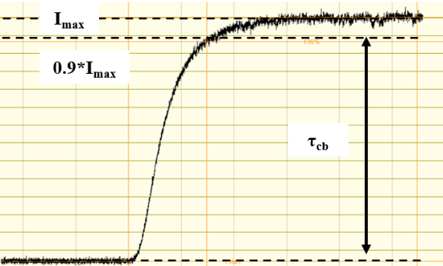
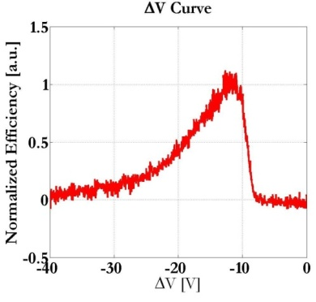
CHARGE BREEDING
Physical processes in common with ECR sources
Particles injected as a 1+ beam (Deceleration, possible magnetic reflections)
Coulomb collisions lead to thermalization with plasma ions
τ_{CB} (half life)
E₁₊=1*V keV
V_{CB} = +(V + ΔV) kV
plasma
ΔV<0
ΔV
Efficiency (Intenisty)
<q+> (energy)
$$ε_{q+}=\frac{I_{q+}}{{q∗I}_{1+}}$$
Perugia, 2019-10-30
Alessio Galatà
PANDORA: measuring beta-decays in plasmas

Slide 7
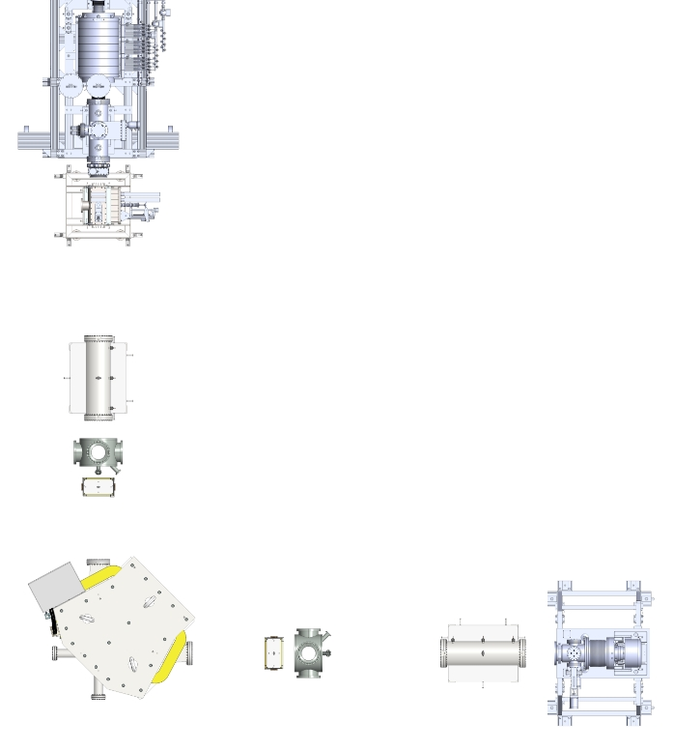
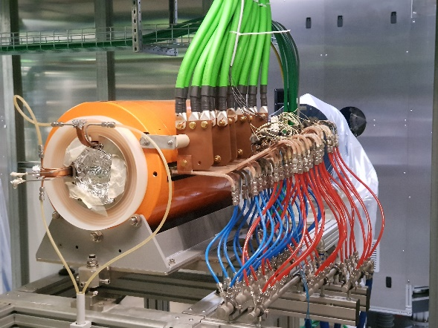
CHARGE BREEDING: LAYOUT
SPES-CB BEAMLINE
ECR-BASED CHARGE BREEDER
plasma
1+ SOURCES ABLE TO IONIZE ALMOST ALL THE ELEMENTS. CAN BE CONNECTED TO A PRODUCTION TARGET
Electrostatic beamline
1+ beam
Magnetic selection
Perugia, 2019-10-30
Alessio Galatà
PANDORA: measuring beta-decays in plasmas

Slide 8
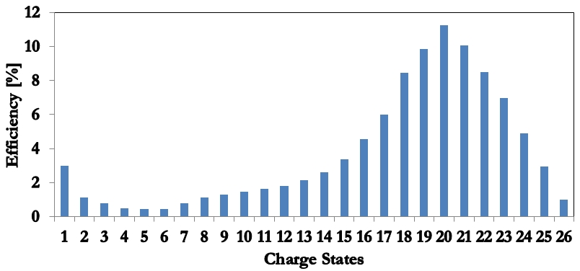
CHARGE BREEDING: RESULTS
HEAVY ELEMENTS
SPES-CB ACCEPTANDE TESTS
Global capture 90%
ΔV=-27 V
Xe
Cs
Global capture 65%
ΔV~-5 V
FREQUENCY TUNING EFFECT
Perugia, 2019-10-30
Alessio Galatà
PANDORA: measuring beta-decays in plasmas

Slide 9
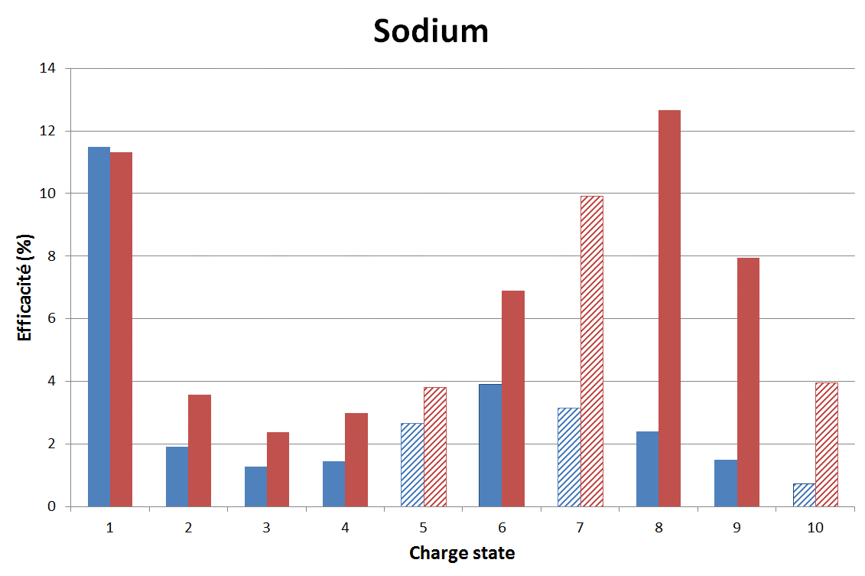
CHARGE BREEDING: RESULTS
LIGHT ELEMENTS
LPSC RESULTS
PANDORA EXPERIMENT WITH ⁷lI AT LPSC (11/2017)
Global capture 65%
ΔV~-5 V
Superposition with N
Low efficiency (<2% on Li³⁺)
Hydrogen can induce chemical reactions
Vacuum cleanliness is mandatory
Efficiency measured even with ΔV=0 due to the energy spread
Courtesy of J. Angot
Improvements due to a modified magnetic structure
WITH VERY LIGHT ELEMENTS BEAM MANIPULATION (RFQC) IS MANDATORY.NEXT STEP→TEST WITH ⁹BE IN 2020
Perugia, 2019-10-30
Alessio Galatà
PANDORA: measuring beta-decays in plasmas

Slide 10
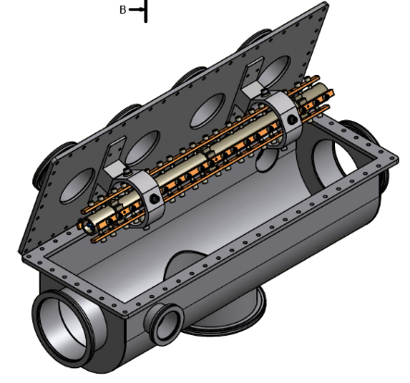
APPLICATION TO PANDORA
PANDORA SMALL SCALE
PANDORA FULL SCALE
Suitable for long lived isotopes (low activity)
Simpler setup
Use of conventional techniques
Necessary for short lived isotopes (high activity)
Solves problem of handling
Setup complex (higher costs)
Wide choice of isotopes to analyze
Allow online production (NB or CB targets for ⁷Be)
Beam manipulation necessary for ⁷Be and very light species(RFQC)
POSSIBLE EXPERIMENTS
ISOTOPE | METHOD | EXPECTED DENSITY | QUANTITY [mg]
¹³⁴Cs | Oven (~150 °C) | 10⁻²-10⁻¹ n_{plasma} | ≤ 10
¹⁷⁶Lu | Oven (~1600 °C) |  | ≤ 500
⁹⁴Nb | Sputtering |  | 20-50
SPES-BC
Perugia, 2019-10-30
Alessio Galatà
PANDORA: measuring beta-decays in plasmas

Slide 11
CONCLUSIONS
The necessary techniques for the first-day experiments have been identified
Activity for 2020: development of the oven
Finalize the design of the trap
Visits to European Laboratories experts in the field (GSI, JYFL)
Points to be addressed
High temperature (~1800 °C)
Long term stability
Reliability
Temperature control (thermocouple, reproducibility)
Choice of the materials (alloys formation must be avoided)
The development of a sputtering system is foreseen for 2021
Perugia, 2019-10-30
Alessio Galatà
PANDORA: measuring beta-decays in plasmas

Slide 12
THANK YOU FOR YOUR ATTENTION

