Slide 1
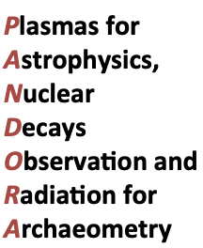
PANDORA: Measuring β-decays in plasmas
Intro and Overview
David Mascali, INFN-LNS Catania, Italy
What we want to do…
How we want to do it…
What it is needed to do it: expertise, know-how… money (!!)
When? (which schedule?)
Who and Where?
Perugia, October, 20 – 2019

Slide 2
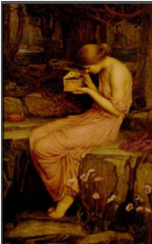

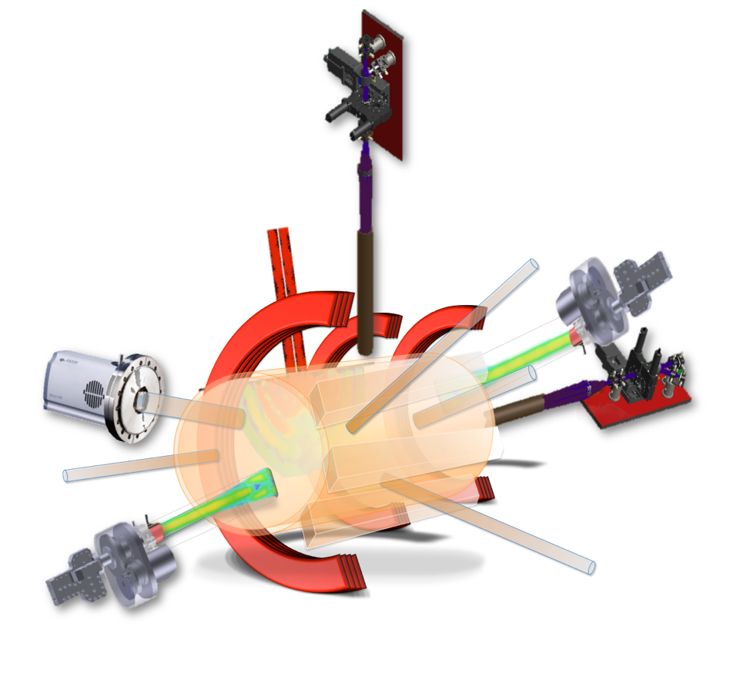




PANDORA: Plasmas for Astrophysics, Nuclear Decays Observation and Radiation for Archaeometry → A New ECRIT – ECR Ion Trap
An Electron Cyclotron Resoance Ion Trap for Interdisciplinary Research

Slide 3
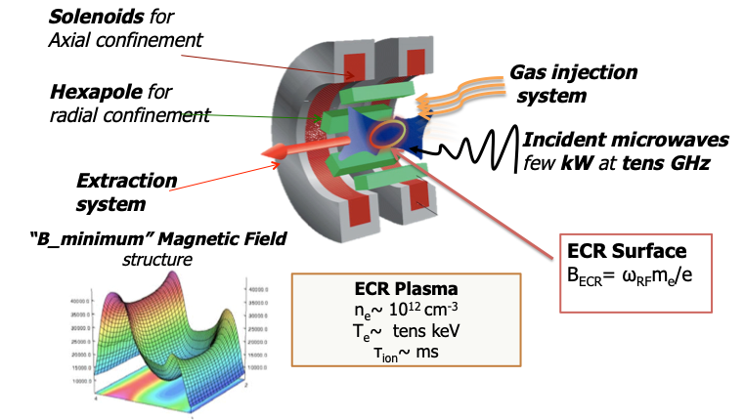
PANDORA: a cross-disciplinary challenge
Plasma Physics
RF and magnetic design
Vaporization techniques
Plasma Diagnostics
Nuclear Physics
Nuclear Astrophysics
γ Spectroscopy

Slide 4
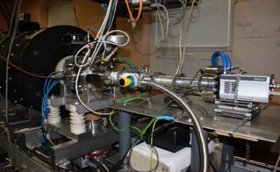
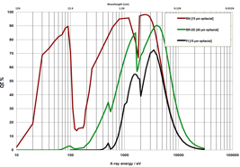
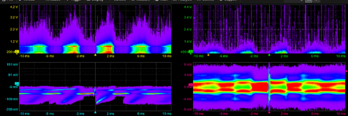
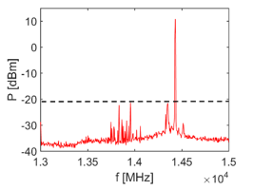
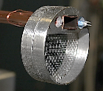
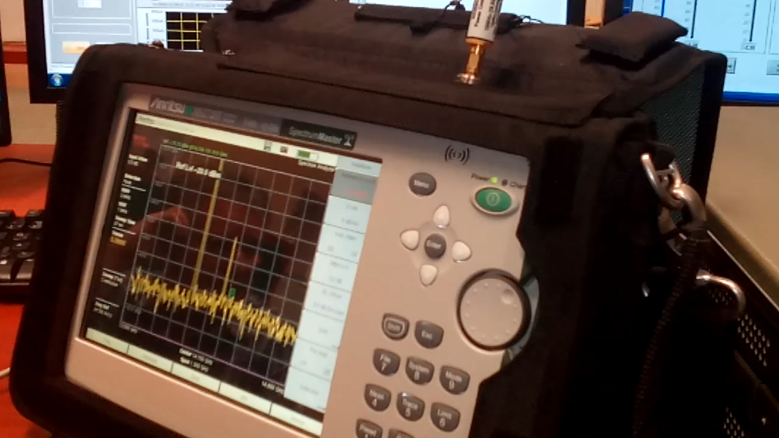
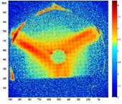



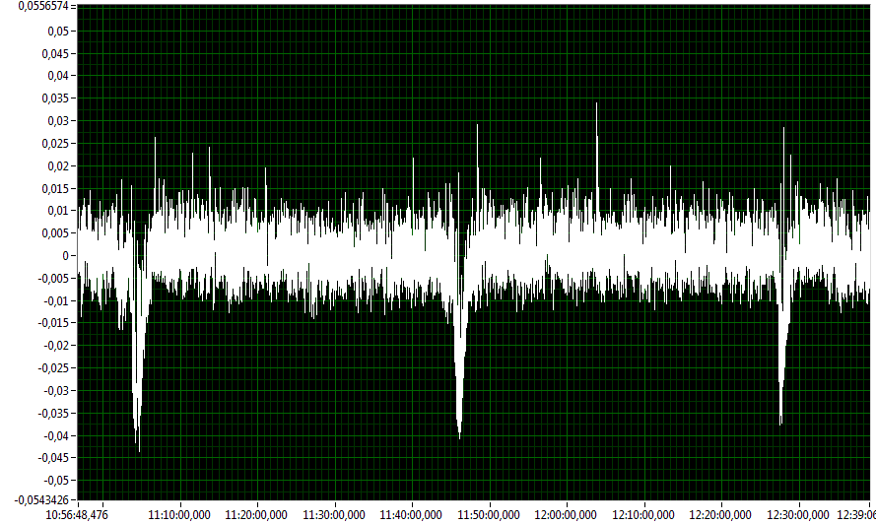
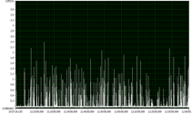
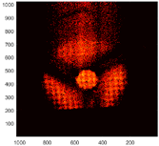
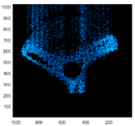
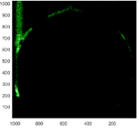
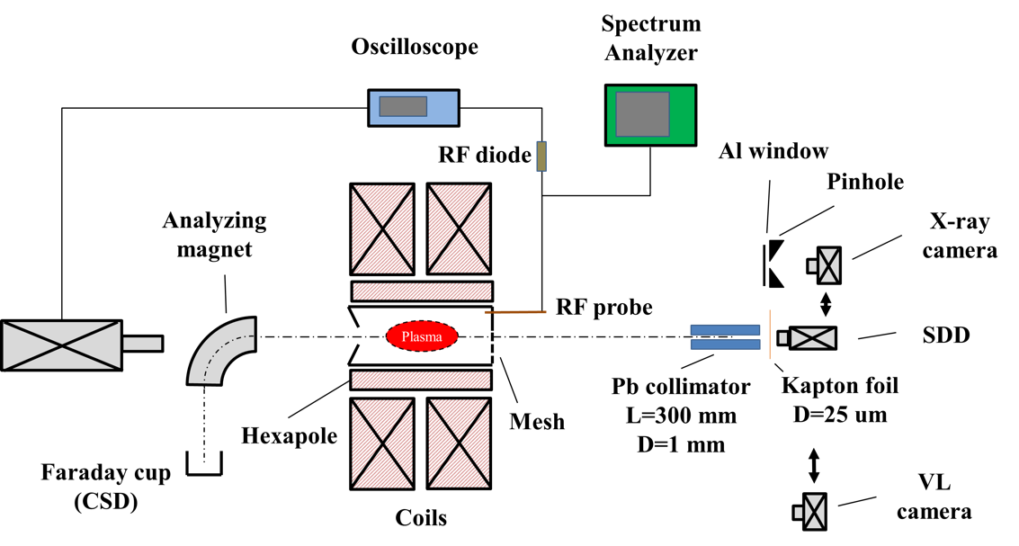
eugenia.naselli@lns.infn.it
A Diagnostics “Arsenal” for probing plasmas with space-time resolution
QE (green)
Pinhole camera, providing structural information for both plasma and plasma losses in the range 2-20 keV
RF probe + Spectrum analyzer: plasma radio-emission analysis
SDD (Silicon Drift Detector): probing volumetric soft X-radiation in the 2 – 20 keV domain
HPGe (High Purity Germanium Detector) providing:
  time integrated X-ray spectra in the 30-300 keV;
Mass spectrometry: simultaneous evaluation of CSD
  Time resolved spectra with 6 μs resolution if triggered by RF probe (useful for instabilities!!)
Plasma
RF
RF probe
Attenuators
Limiter
Spectrum Analyzer
Plasma
RF probe
RF diode
Oscilloscope
HPGe
Mounted to the injection plate
Plasma EMW detection in GHz ranges
Time resolved emw emission
(amplitude in reverse)
RF probe
Plasma
Pb Pinhole
X-ray CCD
Measurement of HPGe signal in coincidence
of the sudden emw emission of the plasma
VL camera, probing volumetric optical radiation in the 1 – 12 eV domain
High EMW emission in GHz region = instability!
Frequency scan from 13.6-14.6 GHz
trigger signal
HpGe detector

Slide 5
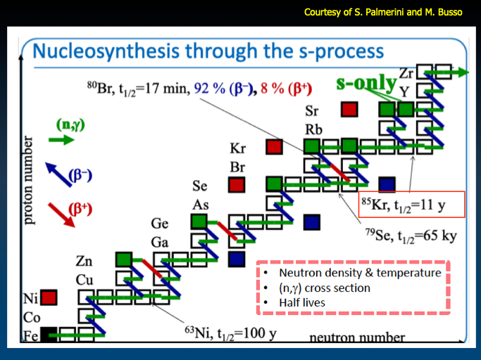
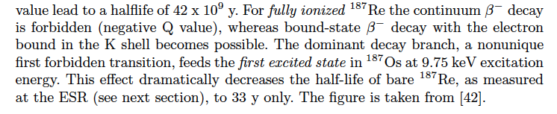
PANDORA: Exploring β-decays for stellar nucleosynthesis → A New Life for ECRIS(T), playing a role in s-processes in stars
The idea is to measure nuclear β-decays in an Electron Cyclotron Resonance Ion Trap
See A. Mengoni and D. Vescovi talks
For ¹⁸⁷Re a lifetime variation of 9 orders of magnitude (!!) was observed in Storage Rings

Slide 6
PANDORA: the overall setutp as modelled and simulated by GEANT-4 code: a big trap surrounded by a detectors array
A “buffer plasma” is created by He, O or Ar up to densities of 10¹³ cm⁻³
The isotope is then directly fluxed (if gaseuous) or vaporized by appropriate ovens and then fluxed inside the chamber to be turned into plasma-state
Relative abundances of buffer vs. isotope densities range from 100:1 (if the isotope is in metal state) to 3:1 (in case of gaseous elements)
See A. Galatà talk
See E. Naselli, F. Odorici and D. Mengoni talks
3 SC coils and a Cu monocoil hexapole are used as magnetic trap
14 HpGe detectors are used for tagging β-decays by the γ-rays emitted from the decay-products in their excited states
The plasma is maintained in dynamical equilibrium by equalizing input fluxes of particles to losses from the magnetic confinement

Slide 7
Physics Cases
Scientific relevance
Expected Effects on the lifetime from charge states or ion temperature
Trap size
Type of element (gas, metal, rare isotope, commercial or not, etc.)
Trap properties fix charge state distribution!
Trap Design
Fix a Maximum B-field
Cu, SC magnets or hybrid?
Trap size? (the bigger the best!)
Accesses for diagnostics
Accesses for decay-product detection
Trap properties fix charge state distribution!
Expected lifetimes fix sensitivity of any detection system
“Plasmization”
Gases
Ovens
Sputtering
Charge Breeding
Availability of single species must be also considered!!
Decay tagging
γ-rays YES/NO? Which Energy?
Which efficiency? S/N ratio?
Other ways: OES? AMS? RIMS?
Feasibility?
Trap size for access allowance
Trap properties fix charge state distribution!
Increasing difficulty!!

Slide 8
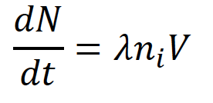
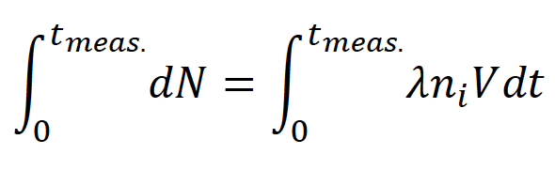
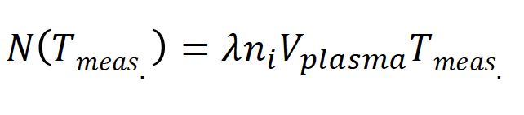
PANDORA: what we are going to measure in a magnetized plasma where isotopes are confined in dynamical equilibrium
Plasma volume (const.)
Typical Charge State Distribution in a ECR plasma
Isotope activity
Number of decays vs. time
Density of the isotope in the plasma (const.)
τ=1/λ
<q>

Slide 9

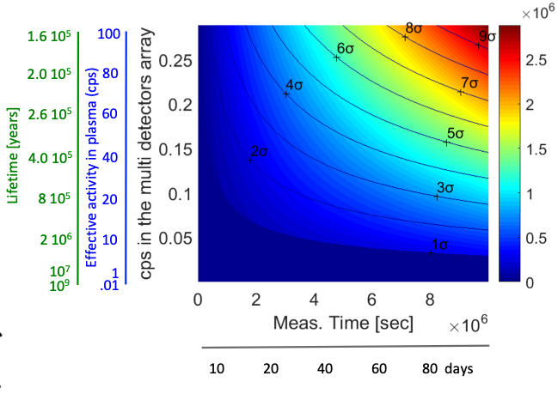
PANDORA’s challenges: “Collapse” of ¹⁷⁶Lu lifetime
3σ level
2 10⁵ years
8 10⁵ years
Reliable estimations of isotopes ionization states are needed: see B. Mishra and A. Pidatella contributions at Round Table
Estimation of lifetime variation as a function of plasma temperature
“Measurability” of ¹⁷⁶Lu lifetime from GEANT-4 simulations (by an array of 14 HpGe-detectors)

Slide 10
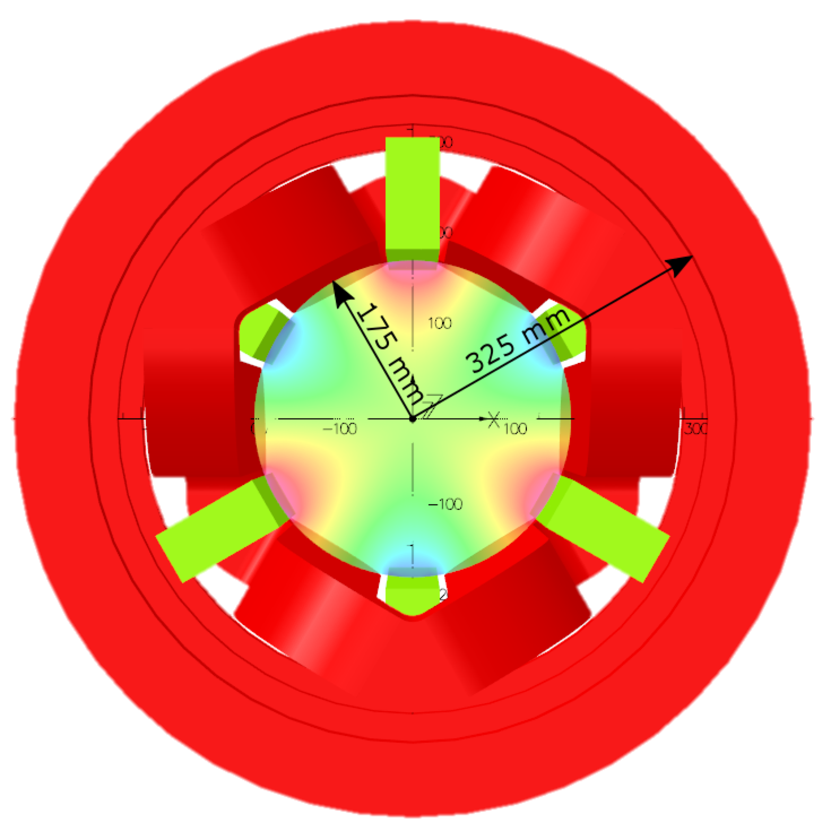
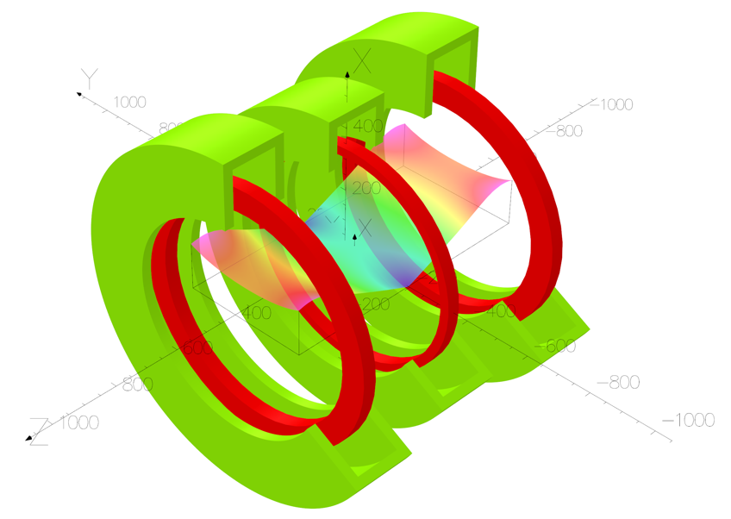
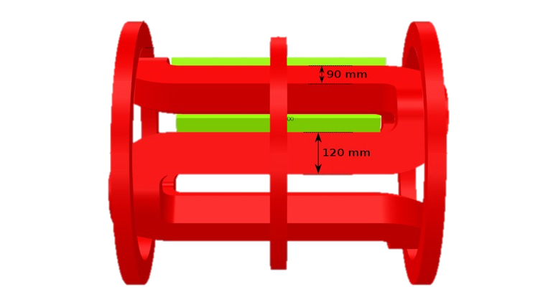
PANDORA: Plasma Trap design in order to have long plasma lifetime and sufficient flexibility and accessibility
The maximum fields of 2.1 T on the axis and 1.2 T on the radial direction will allow stable plasma generation by an RF field at 18 GHz via Electron Cyclotron Resonance.
It is the largest magnetic trap never design in a B-min scheme, having a length of 80 cm and a diameter of 35 cm
See Luigi Celona’s Talks with BREAKING NEWS!
35 cm
80 cm

Slide 11
PANDORA: timescale and deliverables in the next years

Slide 12
PANDORA: budget estimation

Slide 13
PANDORA: status of INFN and international partnership
Experiments driving feasibility study in CSN5 were carried out in the frame of an international partnership:
ATOMKI – Debrecen (Hungary) → multi-diagnostics setups
LPSC-Grenoble (France) → radio-isotopes injection
Max Planck Institute – Inst. Plasma Physics (Germany) → Optical Spectroscopy of magnetoplasmas
GANIL (France) → theoretical studies on multi-ionisation
University Jyvaskyla (Finland) → Ion Cyclotron Heating studies
University of Michigan (USA) → Optical Spectra Databases
INAF in-kind contribution of 1.5 M€ (SARG spectropolarimeter)
Where the facility will be installed

Slide 14
PANDORA: open issues and reviewing process
Funding for 2020 is now for….
Referees recommend to broaden up the collaboration increasing the commitment of nuclear physicists and nuclear astrophysicist
International co-operation must be broaden and reinforced as well
Some project management issues will be applied to PANDORA as a pilot test-case
Breaking news from CVI are coming soon… (but some ”rumors” say the project was deemed “unique worldwide”, even if “challenging”…)

