Slide 1
Focusing DIRC in FullSim
Doug Roberts
University of Maryland

Slide 2
History
We developed a full GEANT4 model the Focusing DIRC design
The primary goal was to study resolution performance and provide feedback into the design process
This is an optically capable model, i.e. it tracks Cerenkov photons, deals with interfaces between different materials (like glue and quartz bars), bounces photons off mirrors, etc.
With this model in place, it wasn’t too much more work to put together something that could be incorporated into Bruno.
  Needed to add all of the support material and write out a gdml file

Slide 3
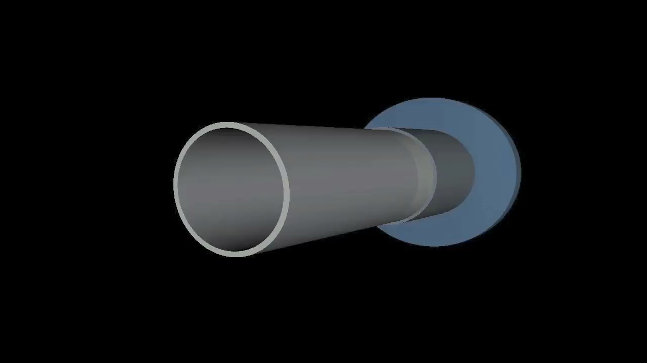
FDIRC w/ Outer Support

Slide 4
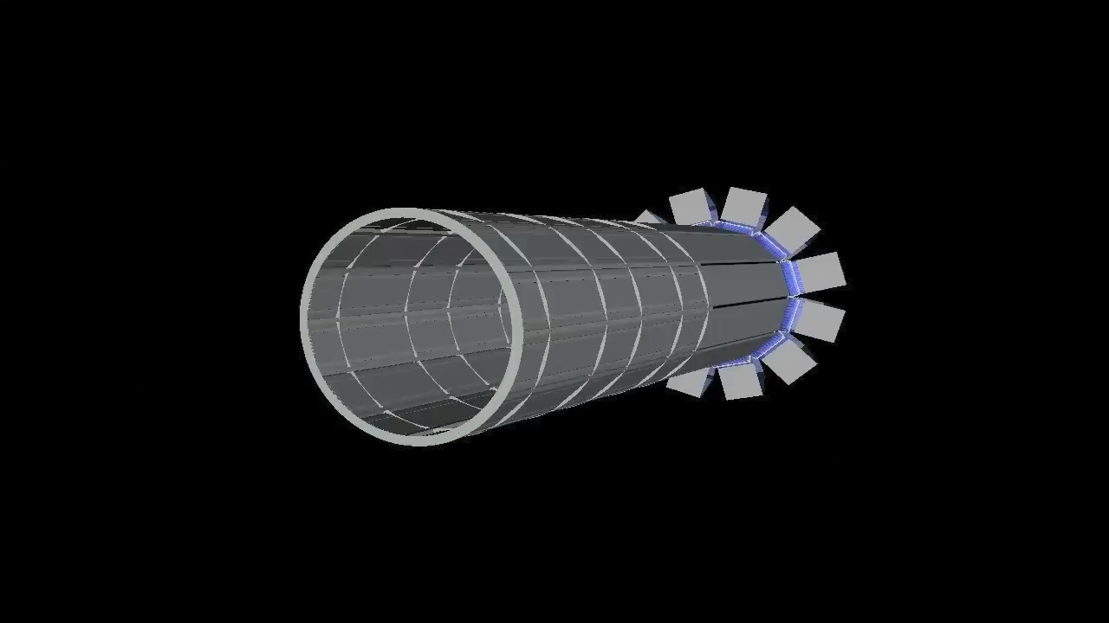
FDIRC, Outer Skins Removed

Slide 5
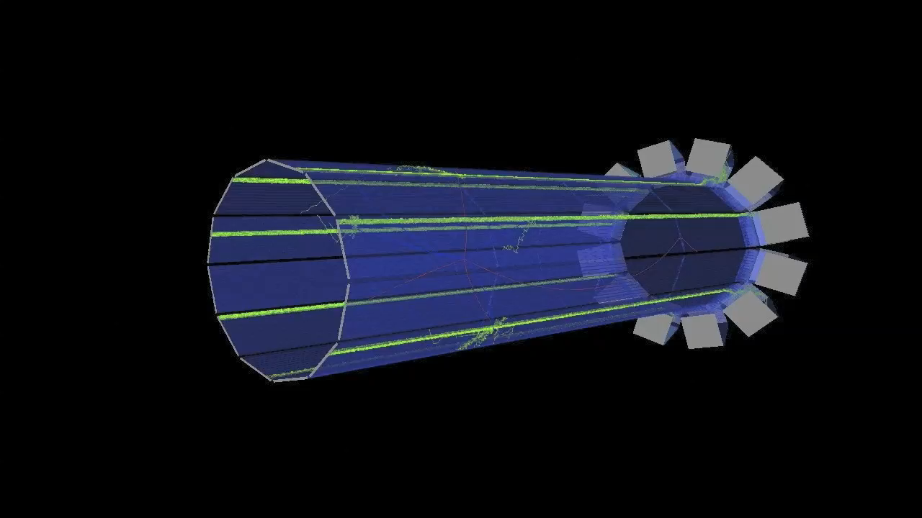
Track and Optical Photon Simulation

Slide 6
Status
The gdml file for this model has been created and was sent to Eugenio. Should be part of Bruno already.
In order for it to be used as an optical model and not just a chunk of material, two things need to happen:
  Need to turn on the Cerenkov process
    Could be costly in terms of CPU time
  Need to be able to specify the optical properties of materials
The existing GEANT4-gdml conversion doesn’t handle optical properties of materials correctly. We need to be able to specify an index of refraction that is a function of wavelength, for example. Same issue for optical absorption.
So current Bruno model just has “normal” materials
I submitted a bug report to the GEANT folks and was told that this will be fixed in the next set of patches to 4.9.3

Slide 7
Plans
We would like to be able to study the effects of backgrounds in the FDIRC using Bruno.
I can see two possible paths
  Turn on Cerenkov process in Bruno and either:
    Wait for the patch to GEANT 4.9.3 or
    Put the material description in C++ instead of gdml
  Just write out list of all charged particles that enter any quartz material and then run stand-alone FDIRC simulation
Path 2. is probably the easiest, but 1. would be the cleanest
  Would be nice to be able to turn Cerenkov process on even if just as an option in Bruno
  Not exactly sure what the CPU cost would be.
  Can be sped up by throwing PMT quantum efficiency in early, for example. Only have to track <20% of the optical photons

