Slide 1
Integration at SR1
17.3.2020
Susanne Kuehn, CERN

Slide 2
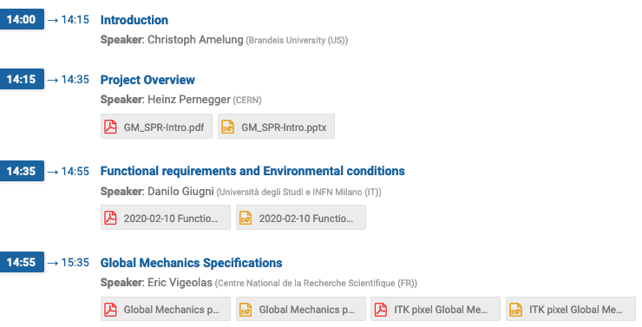
From Global Mechanics SPR Follow-up
Indico link: https://indico.cern.ch/event/885586/
Chair: Christoph Amelung
Two-parts in review
SPR talks
No showstopper seen
Overview of status of global mechanics components and outlook on integration
Peter presented status of EC GM components
Status of integration
Next step: Preparation for PDR to be followed-up in Global Mechanics and Integration meetings

Slide 3
Pixel Setups in SR1 during production
New document in EDMS: ITk Workstation Layout of SR1 During Construction and Commissioning
https://edms.cern.ch/document/2324394/1
Stations related to Outer Endcaps are:
Outer Endcaps
Reception test of endcaps
Integration to Outer System
Outer System
Integration setup of Outer system
QC test setup of Outer system
Continuously system test in DAQ/DCS development bench

Slide 4
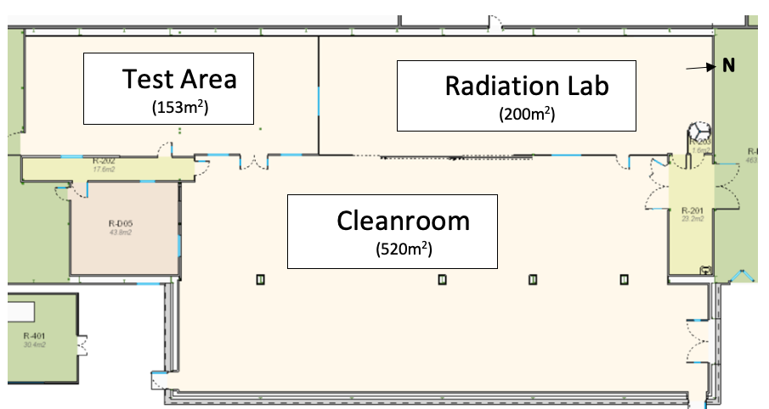
Integration and QC areas in SR1
A 1
A 2
A 3
C 1
B
C 2
D
Location | Component
A1 | Pixel System test
A2, A3 | Longeron and inclined reception
B | Outer Barrel Int. & QC
C1 | Endcap reception
C2 | Inner System Int. & QC
D | ITk: Pixel insertion, surface commissioning
Draft locations for Pixel Integration
Example mid 2024

Slide 5
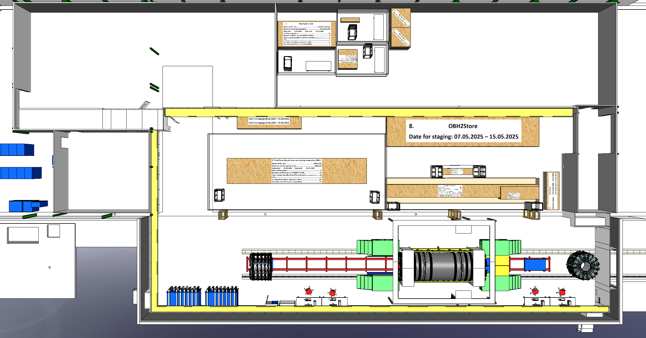
Foreseen CO₂ cooling capacity in SR1
Draft locations for Pixel Integration
A 1
A 2
A 3
C 1
B
C 2
D
Location | Max (with safety factor) power in kW | Max (with safety factor) flow in g/s | Cooling patch panel
A1 | 1.4 | 14 | One side
A2, A3 | 0.5 + 3.3 | 5 + 33 | One side
B | 2x4.6 (5.5) +2x2.6 (2x3.0) | 2x54 (65) + 2x52 (60) | A and C side
C1 | 2x2.6 (2x3.0) | 2x52 (60) | One side (IS barrel 2 lines)
C2 | 2x4.0 (2x5.0) | 2x40 (50) | A and C side
D | B + C2 , 22.4 (27) | B + C2 | Incl. PP1
Example mid 2024

Slide 6
Foreseen CO₂ cooling capacity in SR1
Location | Component | Requested temperature for coolant
A1 | Pixel System test | -30°C
A2, A3 | Longeron and inclined reception | Warm
B | Outer Barrel Int. & QC | Warm and cold (-45°C)
C1 | Endcap reception | Warm
C2 | Inner System Int. & QC | -45°C
Planning vs time on: https://indico.cern.ch/event/895964/contributions/3784252/attachments/2001971/3342152/ITK_SR1_Cooling_Plan_v09_20201103.pdf
Example mid 2024

Slide 7
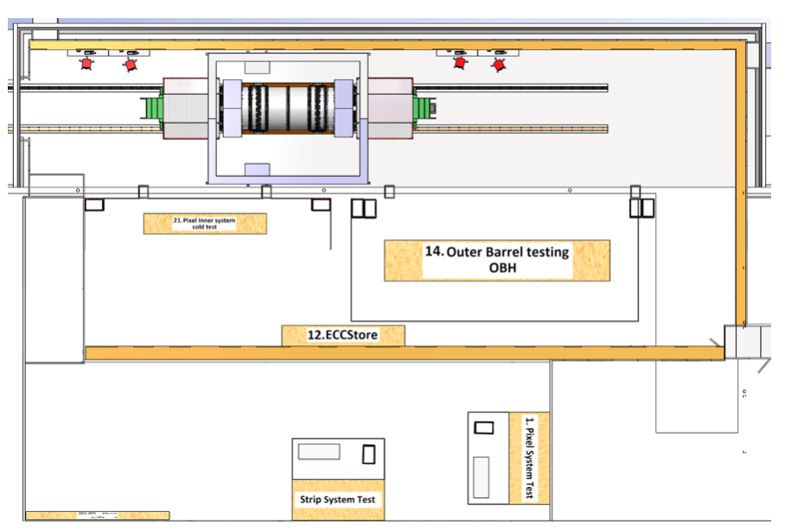
Integration and QC areas in SR1
Outer Endcaps arriving in SR1 (currently 09/2025 )

Slide 8
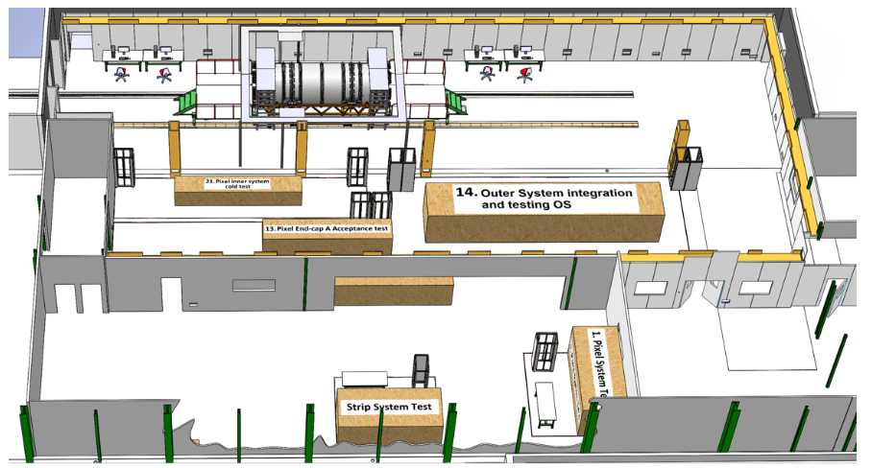
Integration and QC areas in SR1
Outer Endcaps reception test (A-side) in position C1 (currently 10-11/2025 )
EC test equipment in position C1

Slide 9
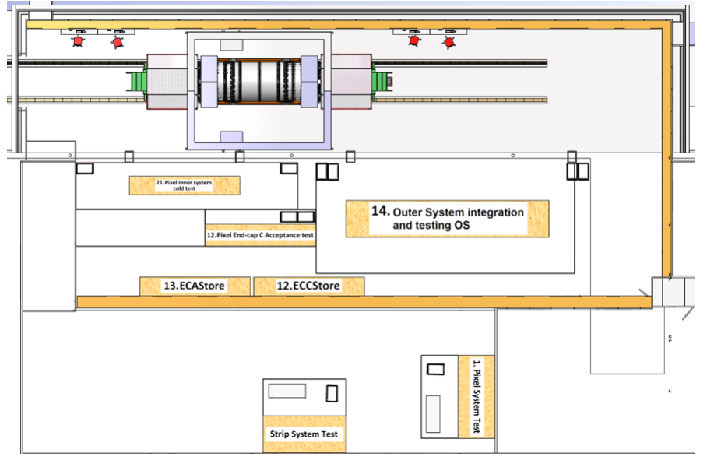
Integration and QC areas in SR1
Outer Endcaps test (C-side) and A-side stored for integration into Outer System (currently 12/2025 )

Slide 10
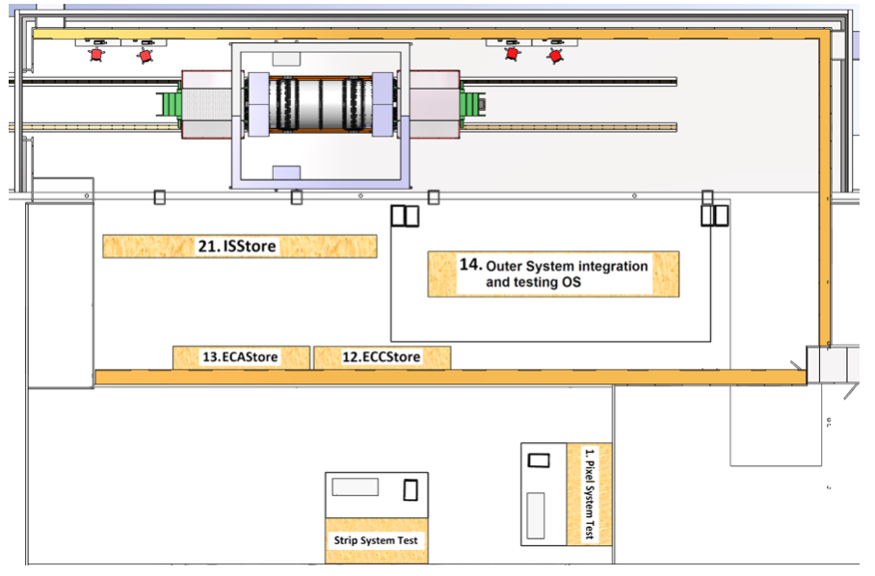
Integration and QC areas in SR1
Outer System integration and test (01-02/2026). Move of EC equipment to position B

Slide 11
Outer System integration
Integration of OBH1 + OBH2 + Outer Endcaps + IST by EC and OB teams
Service Support Shell Open
Service Support Shell Open
Service Support Shell Closed
OBH1
Service Support Shell Closed
EC
EC
IST (on Final supports)
IST (on temporary supports)
EC
OBH2
EC
Service Support Shell Closed
Service Support Shell Closed
Service Support Shell Open
Service Support Shell Open
OB Service support shells rest on endcaps
Assembly of OB with type-1 services temporarily opened to allow insertion of the two ECs from the ends
Once the ECs are in the final position then the service support shells are moved inwards in radius
→ Further combined meeting of EC and OB teams to continue working on integration tooling, trolleys, interfaces etc.

Slide 12
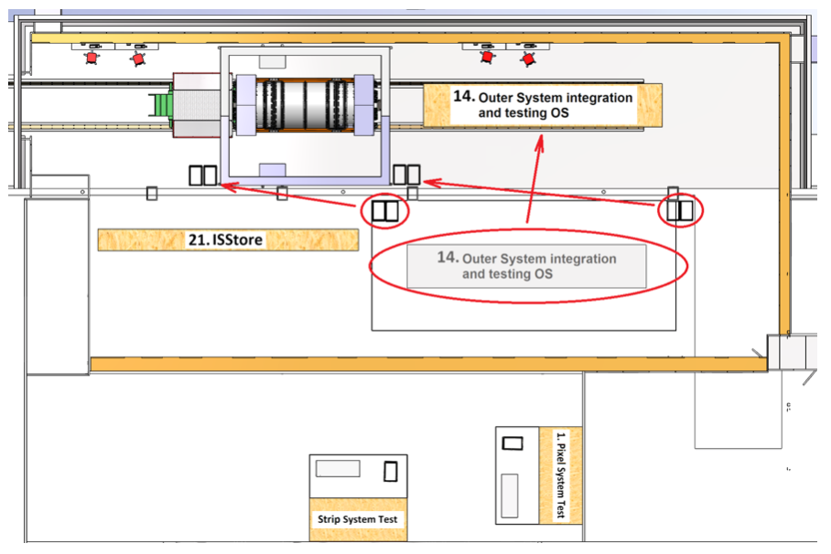
Integration and QC areas in SR1
Insertion of Outer System in ITk (01-02/2026). Move of equipment to position D

Slide 13
Equipment for powering and readout
Racks and electrical test equipment for powering for up to 4 PP1 connectors for the EC, about 18 SP-chains
Readout equipment for about 930 1Gbit uplinks to FELIX boards, 5 Optoboxes, 100 fibres
Equipment foreseen to be first used in Frascati and Liverpool. Then moved with each EC to SR1 and installed there for testing

Slide 14
Further equipment in SR1
From pre-production: Optoboards, optical fibres?, type-2 cables, type-3 cables, type-4 cables, (PSUs), FELIX boards, FELIX PCs, DAQ/DCS FW/SW, PSUs, PP2, PP3, PP4, DCS Computers
Some components first used outside of SR1 and then installed there for final testing
From Common:
CO ₂ cooling plant, piping and manifolding
Ground fault monitors
Leak tester for SR1: Cooling team suggest cheaper ones for each setup and more fancy one for common use
Welder: collect info if common welder in SR1 possible and shared use
Dry-air units and dry-air at all
Clean room: mats, coats, gloves, hairnets etc.
Lab equipment: tools tape, tweezers, etc.
ESD and safety equipment

Slide 15
Some requirements from Pixels for SR1 clean room
Keep dewpoint of room below 16°C (measurements during last months showed values of about 9°C)
Mono-phase cooling close to setups
ITk Pixel requirements for the GPN in SR1 until 2027
40 portable workstations in parallel
10 fixed workstations in parallel
Proposal for the upgrade of the GPN in SR1
One new switch in the star point rack (CYNET03=SR1) connected to GPN back-bone
10 new 1Gb Ethernet sockets in the SR1
additionally for the data network
One new host to connect GPN and data network installed in the rack room

Slide 16
Summary
Planning for SR1 advanced
Sub-system teams to prepared sub-system specific tooling, enclosures
Document listing requirements for infrastructure, cooling, racks, power etc. in preparation
Integration procedures to be defined in more detail to prepare for PDR

Slide 17
SPARE

Slide 18
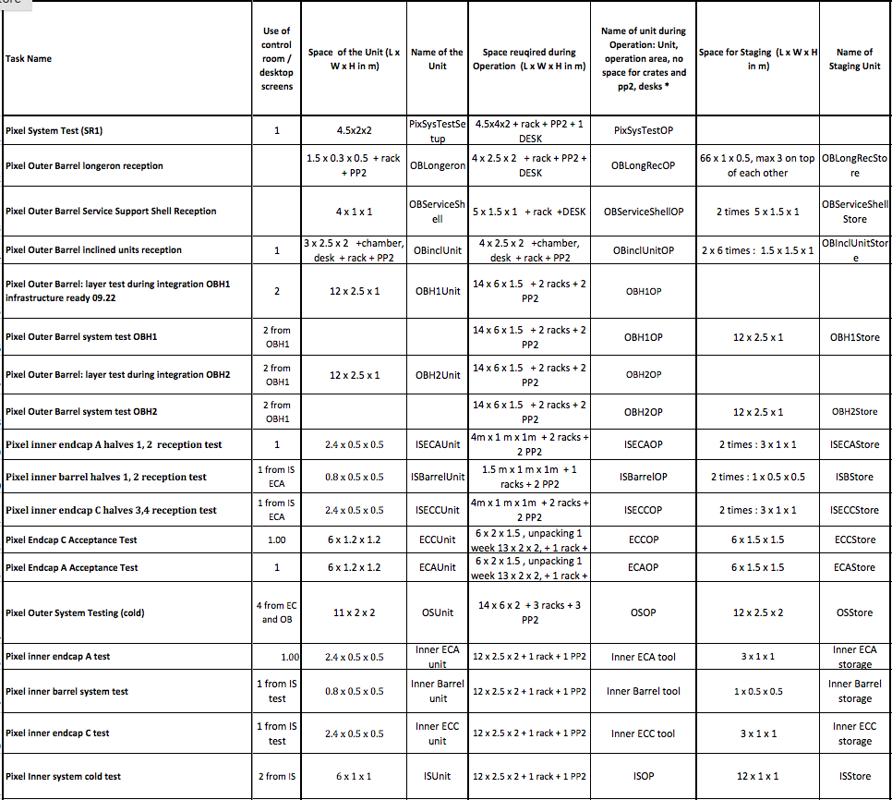
Input to space request
Space requests for different units by sub-systems contacts
Dates based on baseline schedule
Assumptions in spare slides

Slide 19
Requirements from Pixels for SR1 rack room
Readout: 7 racks, racks need cooling, estimated power about 10 - 14.5 kW
About 72 FELIX boards in 36 SWRODs and data handlers
O(30) Optoboxes
DCS units and DCS PCs: 3 racks (about 400 W in total)
Power supplies: 7 racks + eventually 1 rack for DCS PP3 crates
LV PSUs: 3 racks with each about 20 kW (on average 10 kW). Mitigation of required power by mixing HV and LV power crates in one rack. Details to be checked (see discussion on power supplies in cavern). During testing in SR1 worst cases in power more likely to be required than in cavern
HV PSUs: 1 rack 1.2 kW
DCS PSUs: 1 rack 2.2 kW
V_OPTO PSUs: 1 rack 1.2 kW
17 racks
O(50 - 80 kW) - power to be confirmed

Slide 20
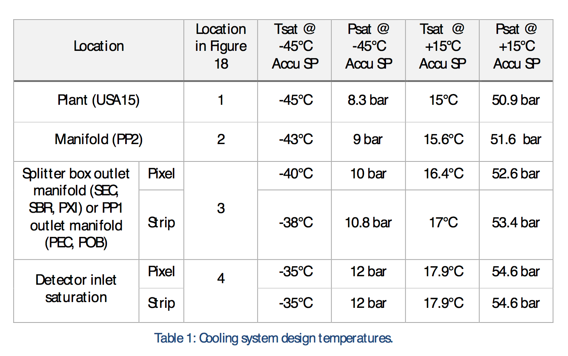
Cooling plant temperatures

Slide 21
CO₂ plant
In the cavern: Cooling system must guarantee a cooling saturation temperature of -40°C for pixel and -38°C for the strips at the level of the concentric flex line connection inside the splitter box. The gradients in saturation temperature (= pressure drop) from the splitter box manifold (or from the manifolds at PP1 area for the pixel outer system) towards the cooling plants are the responsibility of the cooling system design.

