Slide 1
CNAO XPR Status
Pavia, 04/12/2019 for FOOT Collaboration Meeting
Notes:
1

Slide 2
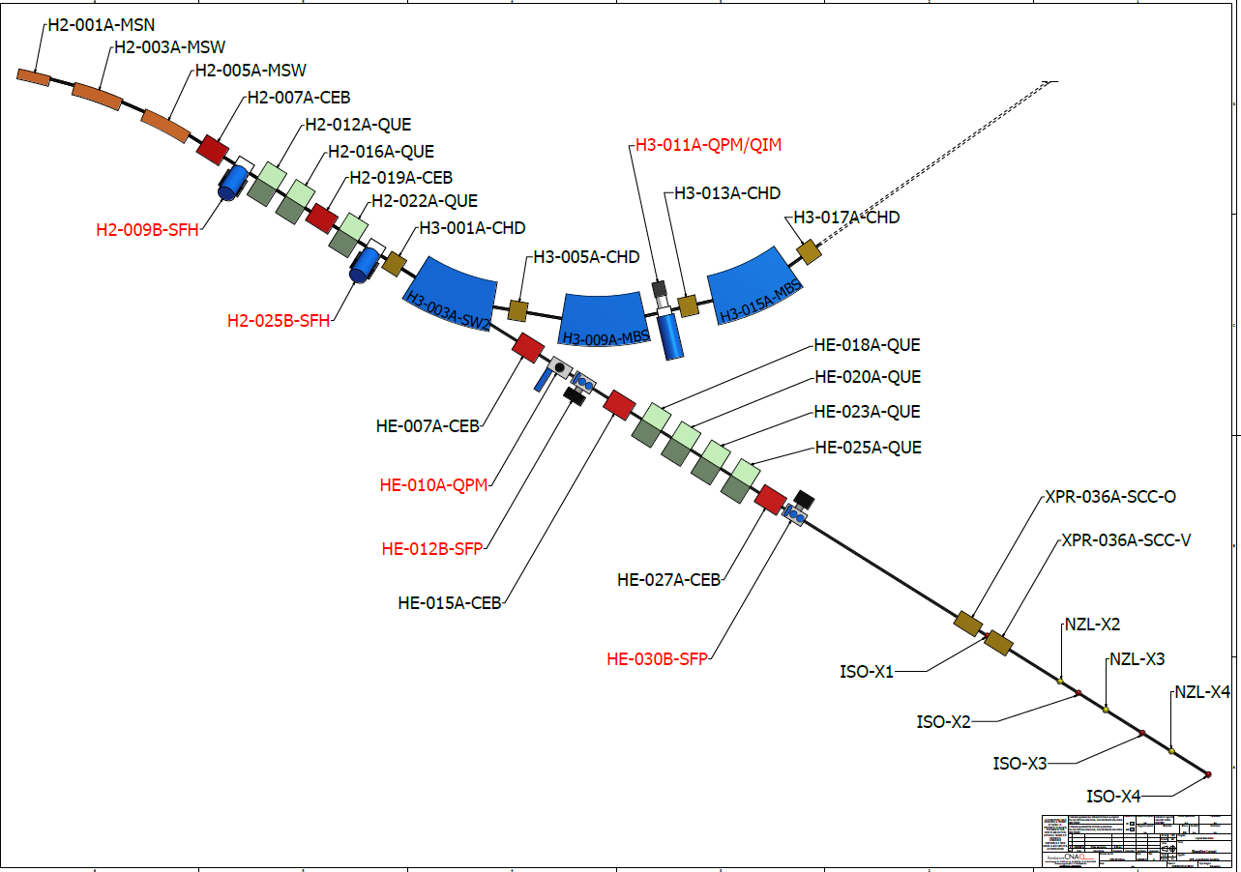
XPR layout

Slide 3
Beam commissioning
Beam optics has been commissioned for:
proton and carbon ion
all energies
all isocenters
Beam characteristics very similar for all ISOs.
All beams are ready to be used.
Measurements performed with QA strip chamber.
XPR line selection has been included in main control room tools.
Tools for treatment delivery at XPR are under test (next week).

Slide 4
DDS commissioning
DDS code has been adapted for XPR maintaning the same functionalities of clinical DDS.
DDS has been included in the control system.
Scanning magnet are operational.
DDS is a movable device and it has been placed at three nozzle positions.
The moving table is missing (arrival foreseen in few days).
The alignment and DDS installation is due by the end of the year.
DDS calibration for ‘treatment’ deliveries due by the end of January.

Slide 5
Room environment
Tenders for UTA are in the final phase.
Contract signed by the end of the year.
Installation due by the end of May.
Tenders for water piping are in the final phase.
Contract signed by the end of the year.
Installation due by the end of March.
Untill UTA has been installed:
very noisy environment
room termally instable

