Slide 1
Status of FLUKA Simulation
Milano group
FOOT Collaboration Meeting
Roma 2019

Slide 2
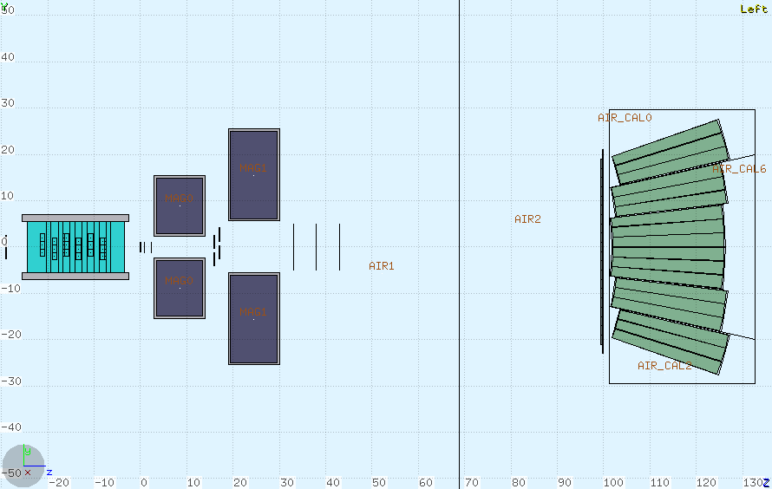
Import of calo branch in newgeom completed also for FLUKA geometry
total 1:1 correspondance for G4 geometry and root geometry for reconstruction
Including materials (with S. Valle, C. Finck, L. Scavarda, E. Lopez-Torres)
MSD positioning as form Servoli mail of July 2019

Slide 3
Basic instructions for FLUKA Footers
http://arpg-serv.ing2.uniroma1.it/twiki/pub/Main/FOOTSimulation/FOOT_simulation.pdf
Wiki page:
http://arpg-serv.ing2.uniroma1.it/twiki/bin/view/Main/FOOTSimulation

Slide 4
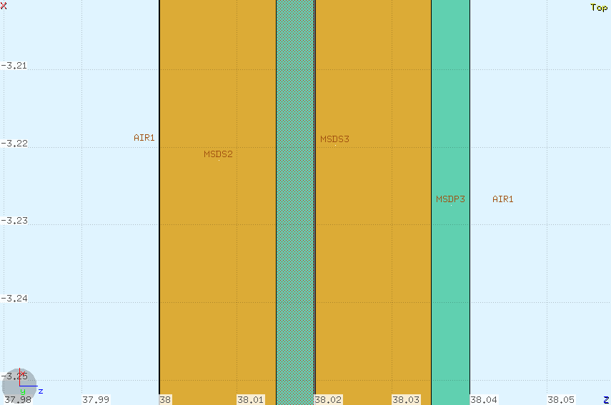
MSD detail
Si0₂ layer
1 μm Al layer

Slide 5
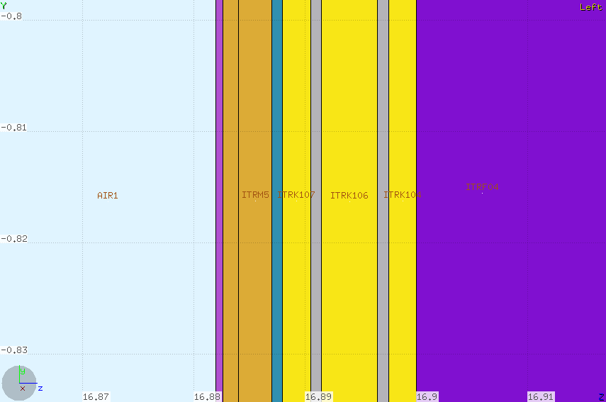
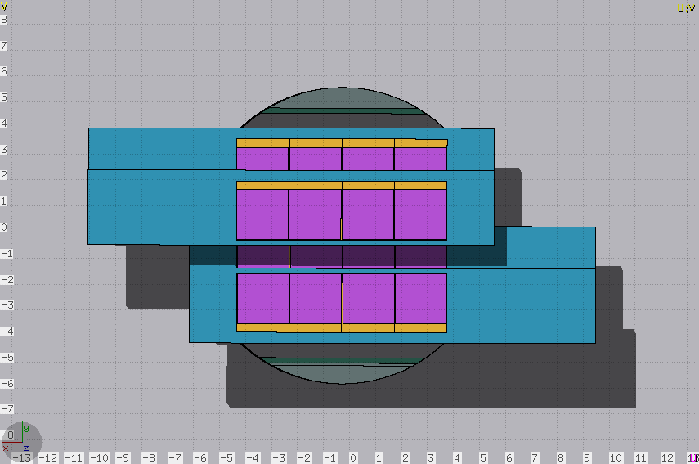
ITR now with support: details
Support was already defined in versions previous to SHOE geometry management
Si layers
SiC foam
SiO₂ layer
Epoxy layer
Kapton layers
Al layers

Slide 6
BGO Crystal geometry
L. Scavarda, E. Lopez Torrs
(Technical questions concerning the way in which «Combinatorial Geometry» of FLUKA is working)

Slide 7
FULL calo geometry
10 different air boxes
with 4 air modules
L. Scavarda, E. Lopez Torrs

Slide 8
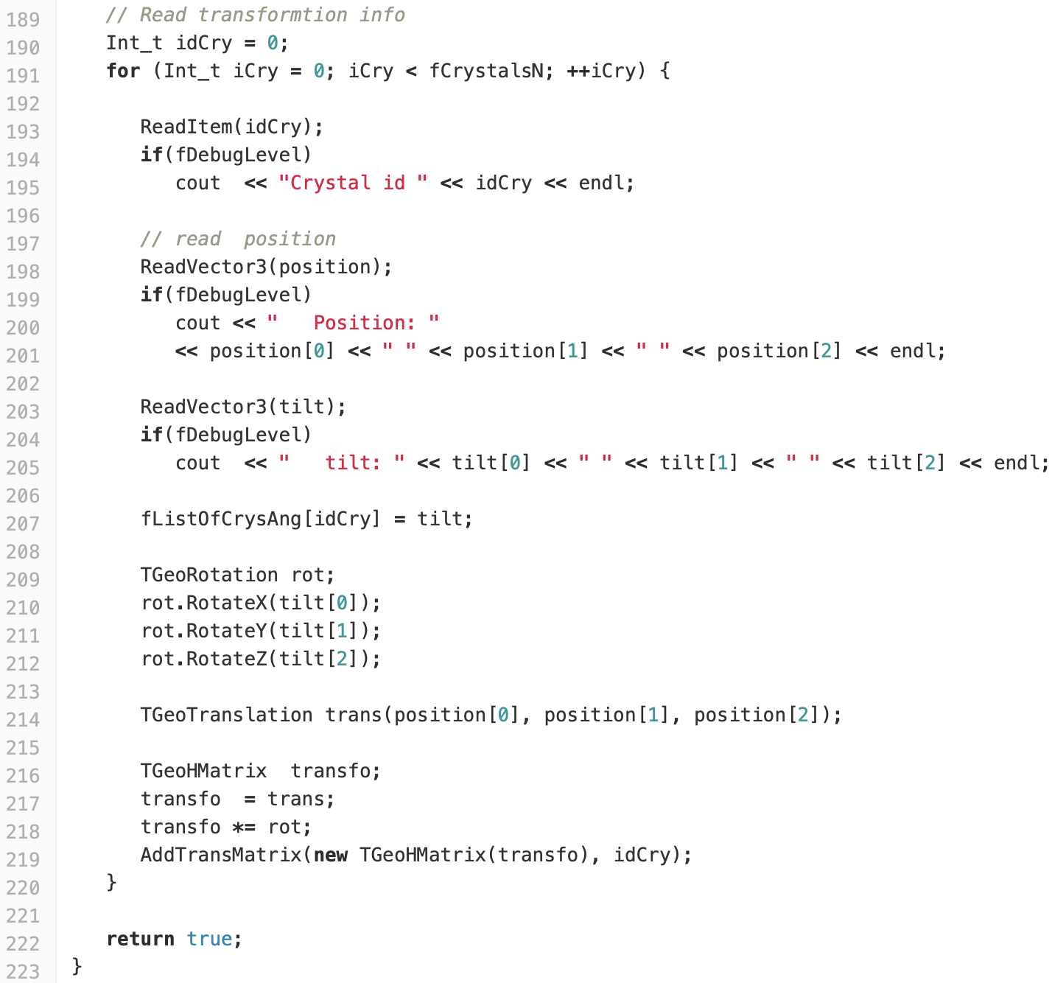
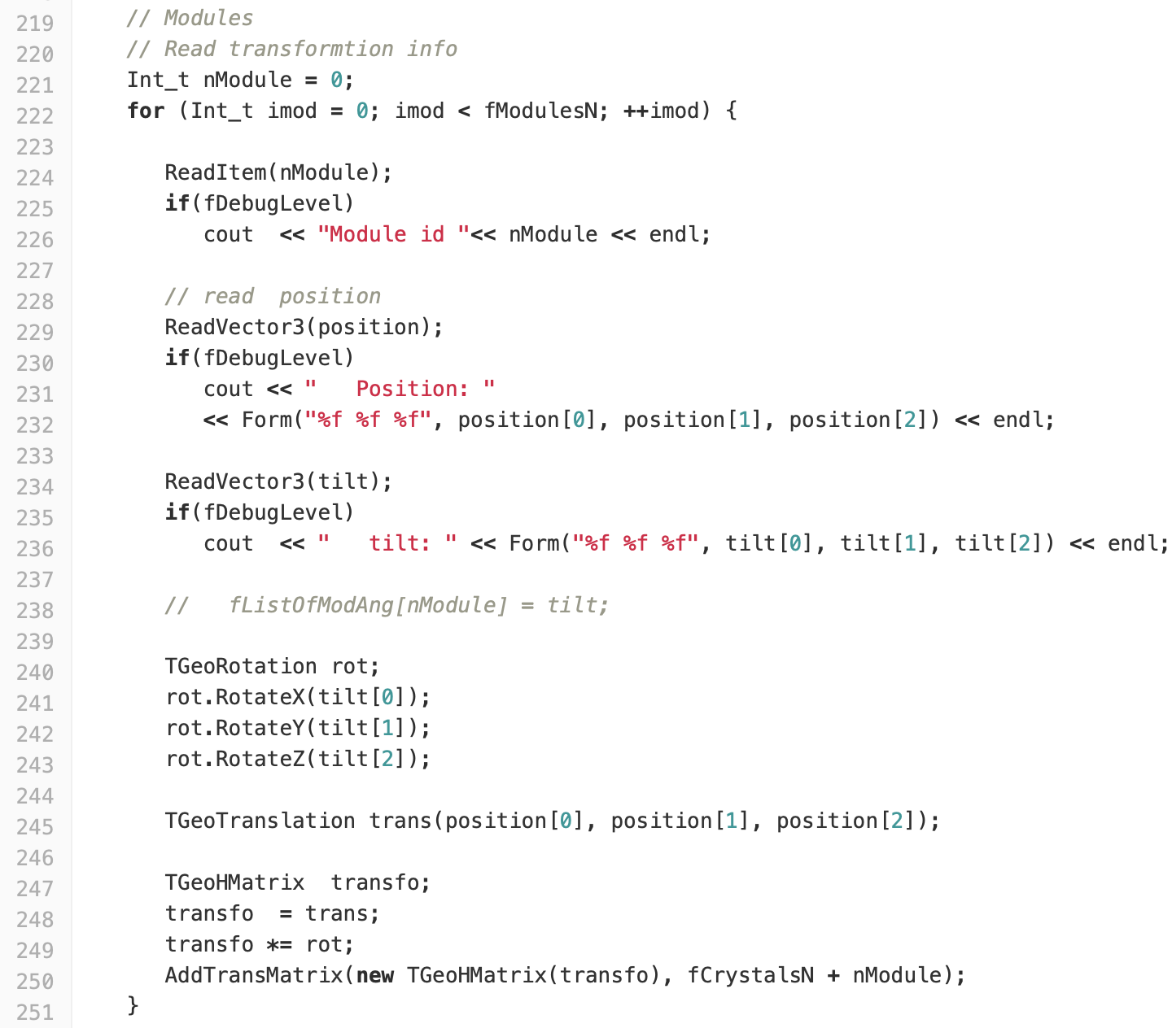
Two different approaches
L. Scavarda,
example:
Newgeom_1.0
makecalogeometry
Crystal information
Module information
missing
“The main reason we need (or will need) the module information is a possible new version of the full calorimeter geometry. This new version could have one more crystal around the whole detector in order to cover the maximum area with the current budget. The idea is to 3D print the same modules containers, but the outside modules could have only 3 crystals. On that configuration the module information (position, angle) can not be retrieved from the central crystal for the outside modules. We think that with the current proposal, we will only need to change the FLUKA part of the geometry and the rest of the code could remained untouched.” mail of E.Lopez Torres 8/10/2019.

Slide 9
Check of energy deposition in Calo
L. Scavarda,

Slide 10
Next improvement starting for FLUKA
Motivated by FOOT:
Introduction of truncated pyramid body with rectangular basis
2 choices:
Parallel to main axes, to be individually rotated
With arbitrary orientation (2 versors are needed)
Which one do we prefer?
Some work needed to introduce in Flair the visualization of the new body (python + Tcl/Tk + C++): help wanted!

Slide 11
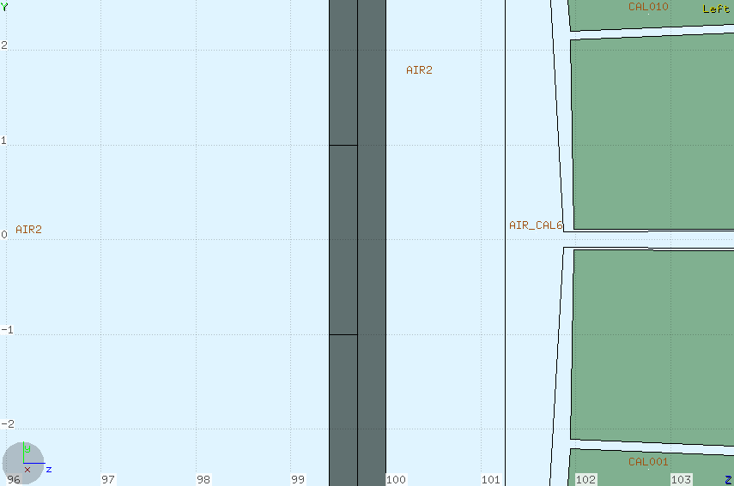
To be done in TW
No gaps between bars
No wrapping of SCN bars

Slide 12
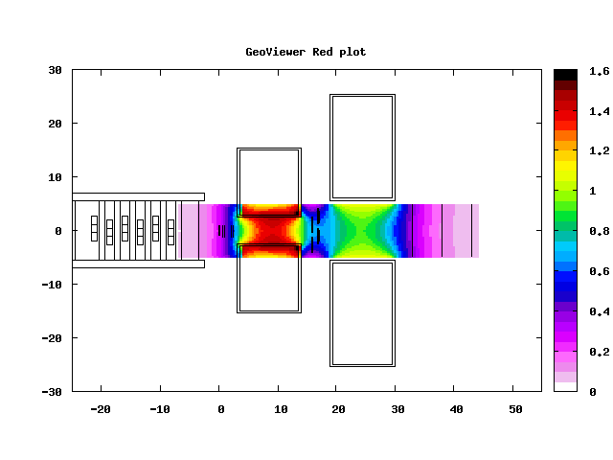
Mag Field Map
Warning: Mag. Map lateral extension does not exactly match the needed size

Slide 13
First production
On Tier3: /gpfs_data/local/foot/Simulation/newgeom_v1.0
Target 3 mm C with density 1.83 g/cm^{^3} as that of GSI run
100 cm target-TW
10^{^7} primaries
12C_C_200_1.root (¹²C at 200 MeV/u on C)
16O_C_200_1.root (¹⁶O at 200 MeV/u on C)
142937 events 5.7 GB
159463 events 7.4 GB

Slide 14
Some preliminary analysis
Re-interactions in the tracking system
Something about acceptance in the detectors
Multiple Scattering in the tracking system

Slide 15
Re-interactions in the tracking system: some preliminary numbers
Case of ¹⁶O primaries
~ 0.5 % of events from inelastic interaction in target have at least 1 secondary interaction in VTX
~ 1.1 % of events from inelastic interaction in target have at least 1 secondary interaction in ITR
~ 1.3 % of events from inelastic interaction in target have at least 1 secondary interaction in MSD
Case of ¹²C primaries
~ 0.5 % of events from inelastic interaction in target have at least 1 secondary interaction in VTX
~ 0.9 % of events from inelastic interaction in target have at least 1 secondary interaction in ITR
~ 1.0 % of events from inelastic interaction in target have at least 1 secondary interaction in MSD

Slide 16
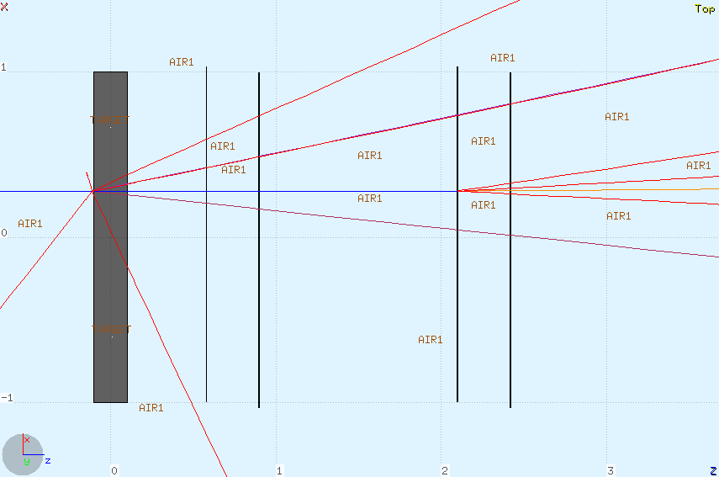
Reinteraction in VTX
Interaction in the last layers:
could be tagged using ITR

Slide 17
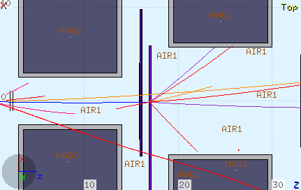
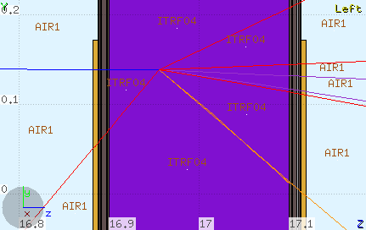
Reinteraction in ITR
could be tagged using MSD

Slide 18
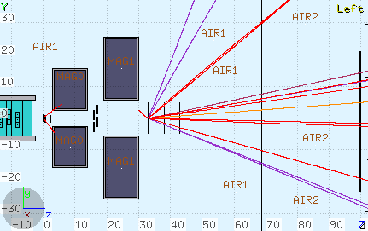
Reinteraction in MSD
Interaction in the first layer should be easily manageable

Slide 19
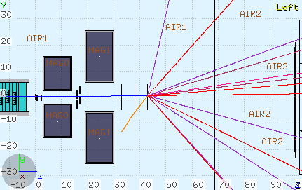
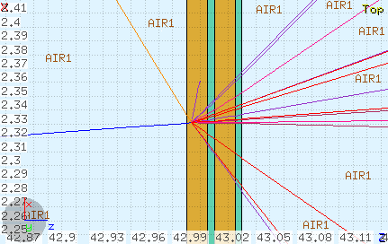
Reinteractions in MSD
Interaction in the last layer:
potentially the most dangerous

Slide 20
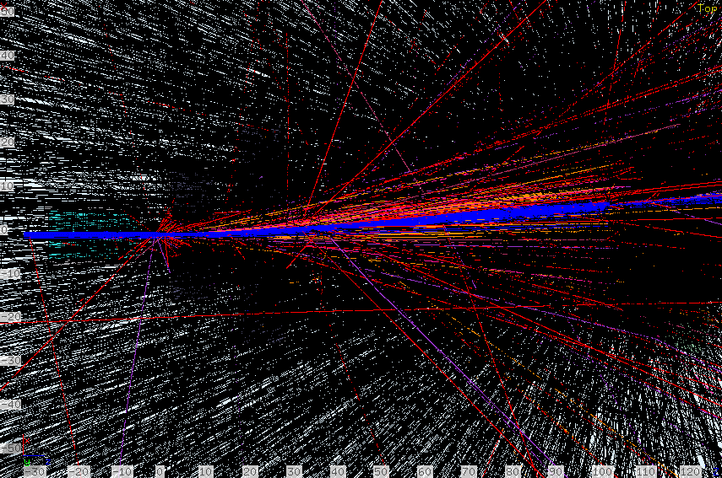
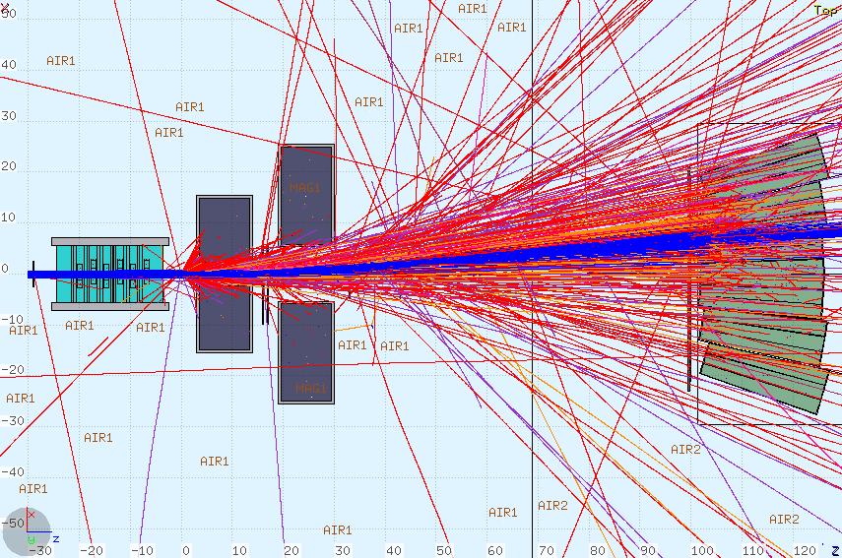
Bending in Magnetic Field and acceptance
with neutrons…
Only charged hadrons
In these plots 3000 events, no trigger, are superimposed

Slide 21
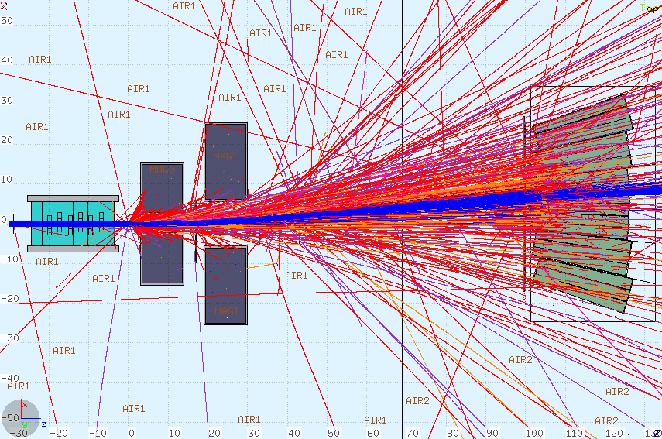
Shift in TW+Calo positioning to match bending
5 cm shift of TW+Calo

Slide 22
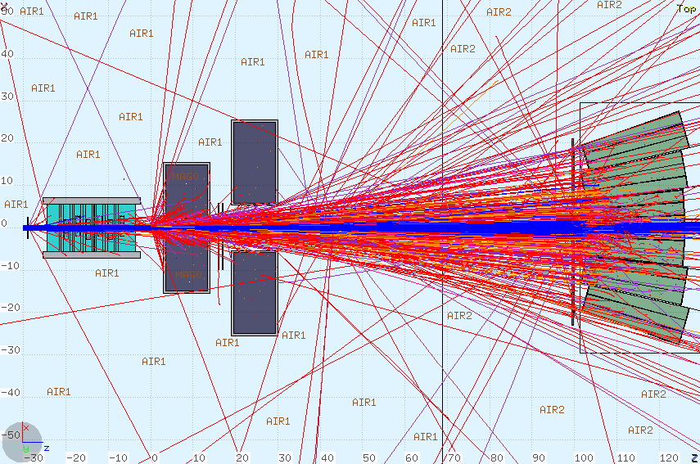
Particle acceptance loss: some preliminary numbers (measured w/o magnetic field)
¹⁶O primaries 200 MeV/u
No. of particles missing MSD 7.7%
No. of particles missing TW 2.0%
No. of particles missing CALO 3.6%
Sometimes there aresail-through in the gaps: are they really true?

Slide 23
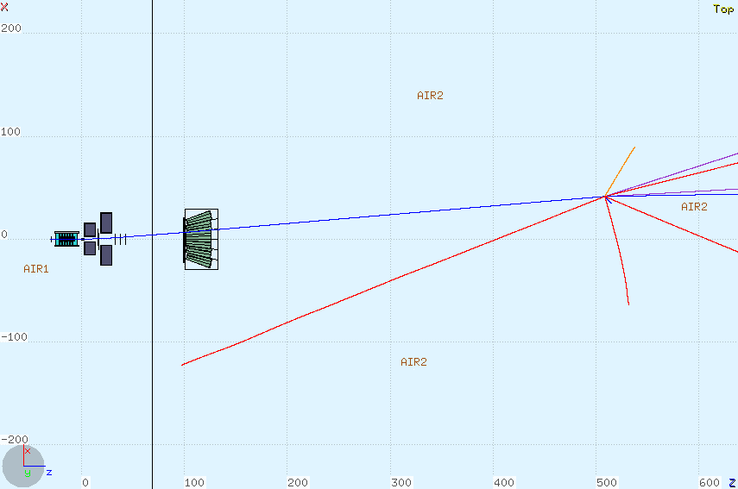
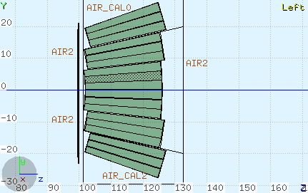
Example of ion sailing through the calo
Orthogonal view
(non-bending plane)

Slide 24
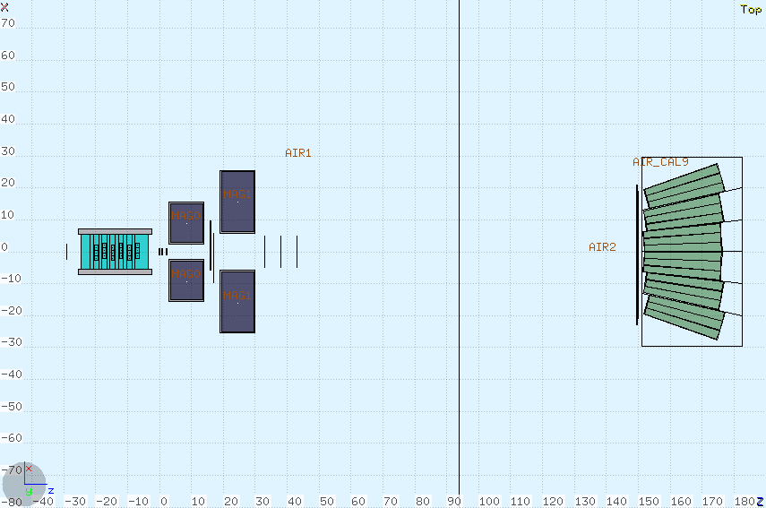
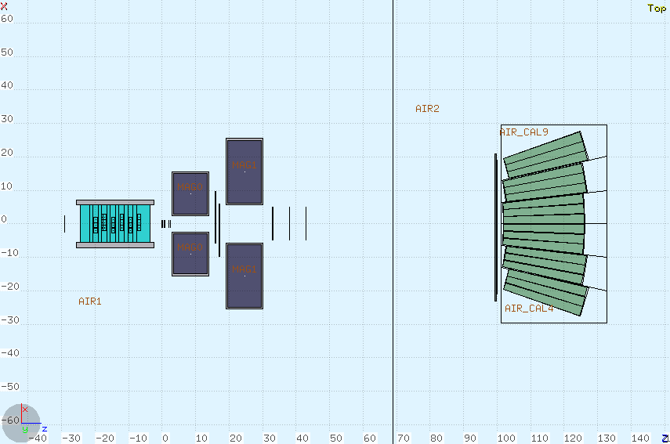
Longer distance from target (150 cm)

Slide 25
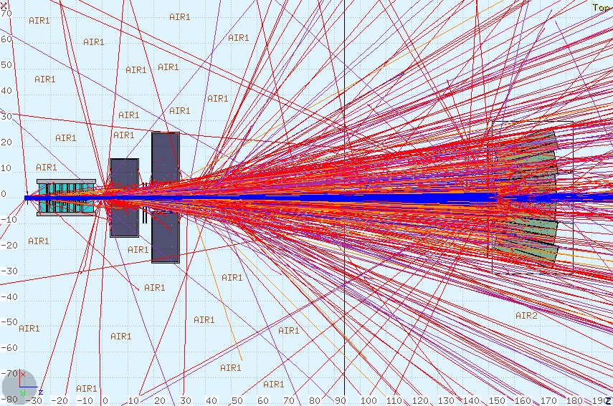
Longer distance from target (150 cm)
¹⁶O primaries 200 MeV/u
No. of particles missing MSD 7.8%
No. of particles missing TW 9.6%
No. of particles missing CALO 10.3%
Numbers at this distance should improve a litte at higher energies

Slide 26
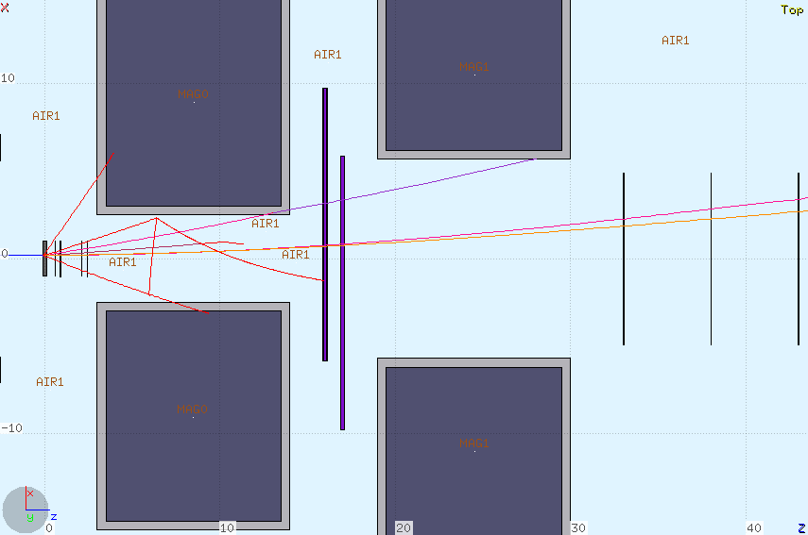
MS in the tracking system

Slide 27
MS in the tracking system
σ_{y} (cm)
σ_{θ} (deg)
projected angle and displacement measured in non-bending view

Slide 28
MS in each element of tracking system
¹⁶O primaries 200 MeV/u
Summed over all secondary energies
Calculated only for particles produced in target
projected displacement RMS_{y} (cm)
θ_{plane} RMS_{θ} (deg)
 | VTX | ITR | MSD
p | 0.0038 | 0.0035 | 0.037
⁴He | 0.0016 | 0.0015 | 0.016
⁷Li | 0.0012 | 0.0013 | 0.015
¹⁰Be | 0.0009 | 0.0013 | 0.012
¹¹B | 0.0010 | 0.0011 | 0.014
¹²C | 0.0011 | 0.0013 | 0.016
 | VTX | ITR | MSD
p | 0.138 | 0.176 | 0.203
⁴He | 0.063 | 0.096 | 0.122
⁷Li | 0.051 | 0.082 | 0.112
¹⁰Be | 0.042 | 0.079 | 0.094
¹¹B | 0.048 | 0.077 | 0.111
¹²C | 0.054 | 0.087 | 0.121
Behaviour for increasing Z has to be understood: maybe it’s not just MS

Slide 29
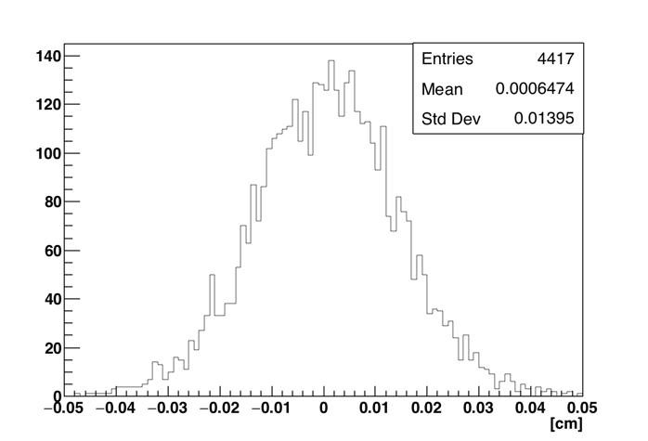
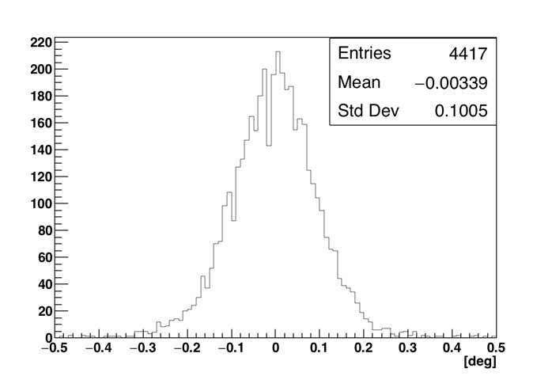
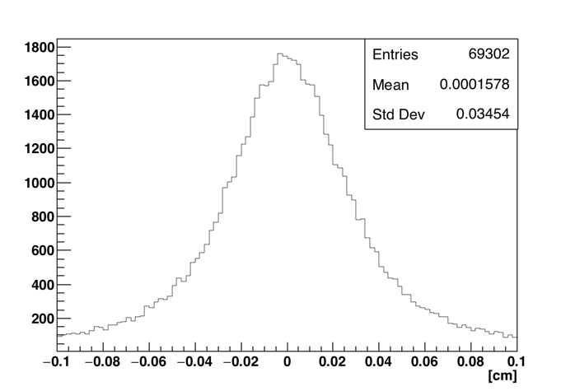
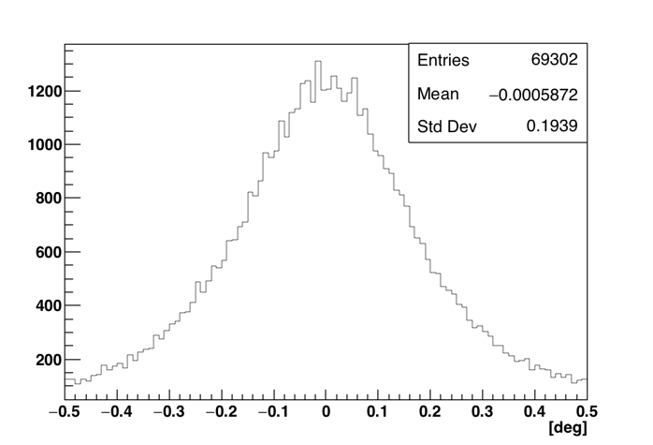
MS for the whole tracking system
Calculated only for particles produced in target
Total (i.e. from first layer of VTX to last MSD)
¹⁶O primaries 200 MeV/u
¹²C
¹²C
Summed over all secondary energies
RMS_{y}~0.014 cm
RMS_{θ}~0.1º
p
p
RMS_{y}~0.034 cm
RMS_{θ}~0.2º

Slide 30
Conclusions
Managing of geometry for the whole electronic apparatus now practically completed in Shoe (remind that some parameters must be necessarily set manually by the user. See references in Slide 3 )
Default (or preferred) distances and positioning (most relevant: distance of TW+calo from target) for our «preferred» sites (GSI, CNAO, …)
To be discussed: some details to be refined (for example: TW wrapping…)
Calorimeter: Module Description? Gaps to be checked. Preparing for the new FLUKA body (truncated pyramid. Help needed for graphic interface)
Strict interaction between reconstruction and simulation developers needed
Still open: investigation of effects of explicit production of δ-rays

