Slide 1
Nuclear emulsions:
status of the analysis
A. Alexandrov, B. Capone, A. Di Crescenzo, G. De Lellis, G. Galati, A. Iuliano, A. Lauria, M. C. Montesi, A. Pastore, V. Tioukov
Università di Napoli “Federico II”, INFN Napoli, INFN Bari

Slide 2
Scanning Status
 | Oxygen 200 MeV/n | Oxygen 400 MeV/n
Carbon | GSI1 | GSI3
Polyethylene | GSI2 | GSI4
520 emulsions exposed
Scanning started on May 7 2019
GSI2: completed (120 emulsions)
GSI1: completed (120 emulsions)
Total: 240/520
Beam
Target
scanning has been interrupted for urgent work in lab for more than one month
now we have a completely new scanning laboratory
we resumed the scanning work one week ago

Slide 3
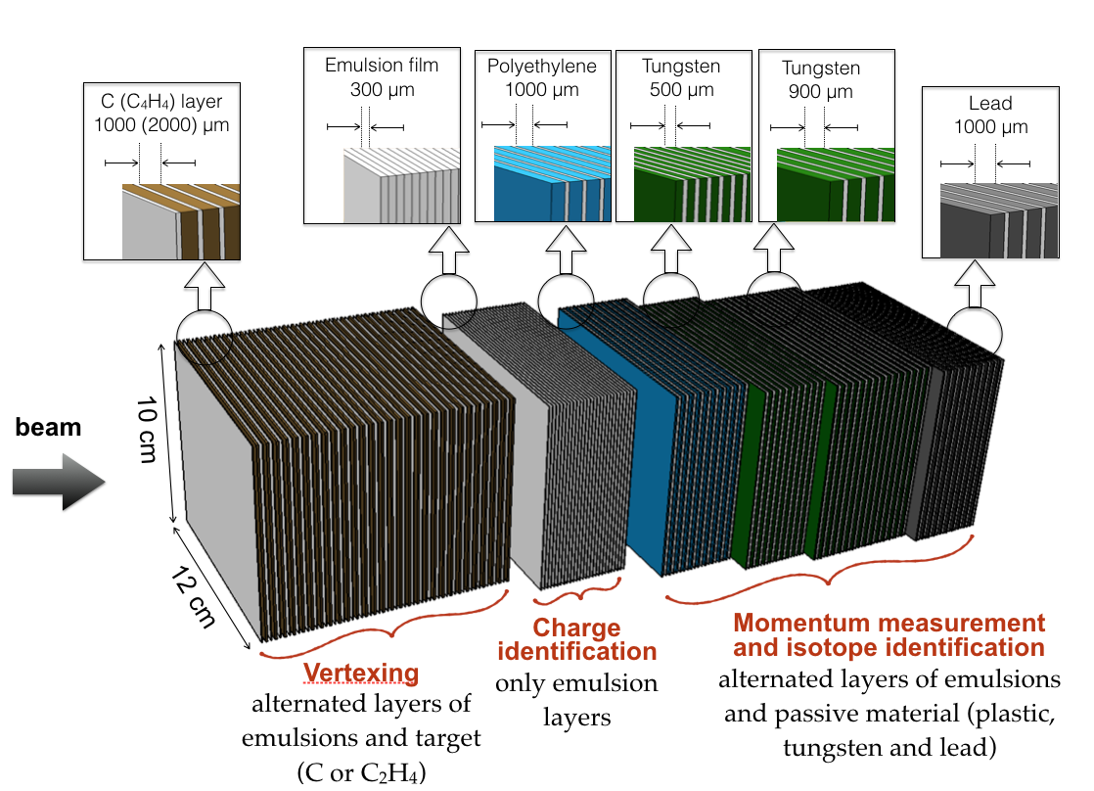
Reminder of Detector Structure

Slide 4
Detector Structure
 | Oxygen 200 MeV/n
S1 | C2H4 (30x2mm) + 30 emu
S2 | Emu (36)
S3 | Lexan (10x1mm)+10emu
S4 | W (7x0.5mm)+7emu
S5 | W (7x0.9mm)+7emu
S6 | Pb (20x1mm)+20emu
S7 | Pb (9x2mm)+10emu
S1
S2
S3
S4
S5
S6
S1
S2
S3
S4
S5
S6
S1
S2
S3
S4
S5
S6

Slide 5
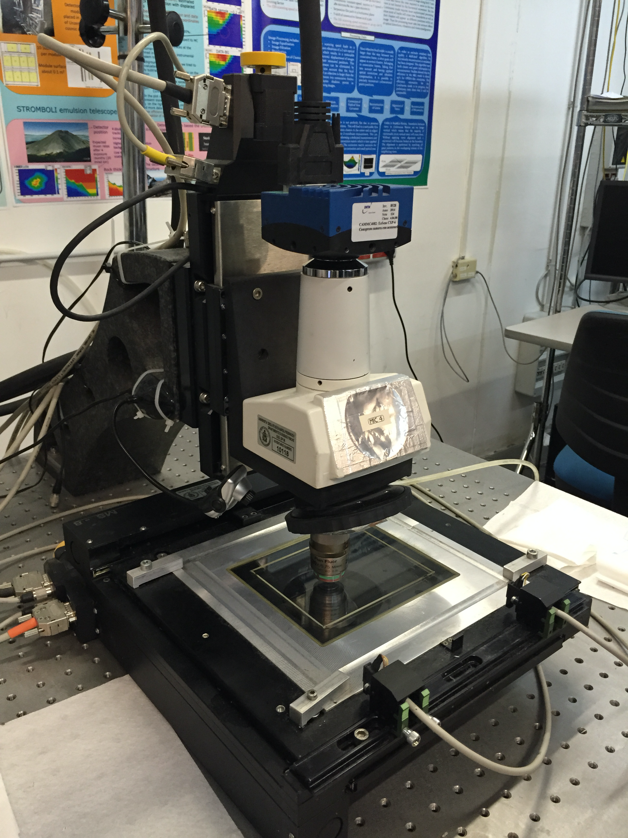
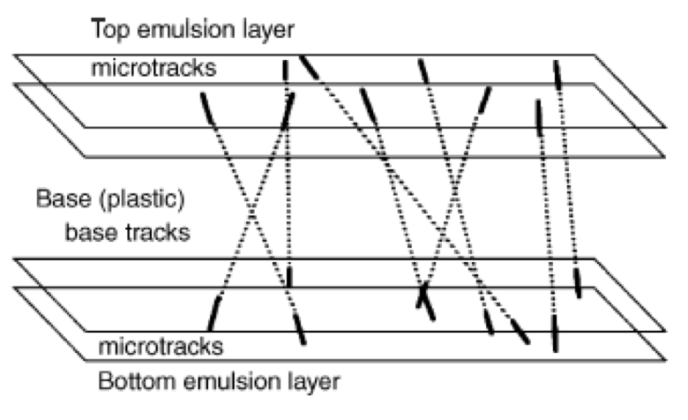
From Scanning to Reconstruction
2. Linking Microtracks into Basetracks
1. Scanning
3. Alignment Between Plates
4. Tracking Reconstruction
5. Vertexing Reconstruction

Slide 6
GSI2 Analysis Status
 | Scanning | Linking | Alignment | Tracking | Vertexing
S1 | ✔︎ | ✔︎ | ✔︎ | ✔︎ | ✔︎
S2 | ✔︎ | ✔︎ | ✔︎ | ✔︎ | /
S3 | ✔︎ | ✔︎ | ✔︎ | ✔︎ | /
S4 | ✔︎ | ✔︎ | ✔︎ | to be done | /
S5 | ✔︎ | ✔︎ | ✔︎ | to be done | /
S6 | ✔︎ | ✔︎ | ✔︎ | to be done | /
S7 | ✔︎ | ✔︎ | ✔︎ | to be done | /
S1
S2
S3
S4
S5
S6
S1
S2
S3
S4
S5
S6
S1
S2
S3
S4
S5
S6

Slide 7
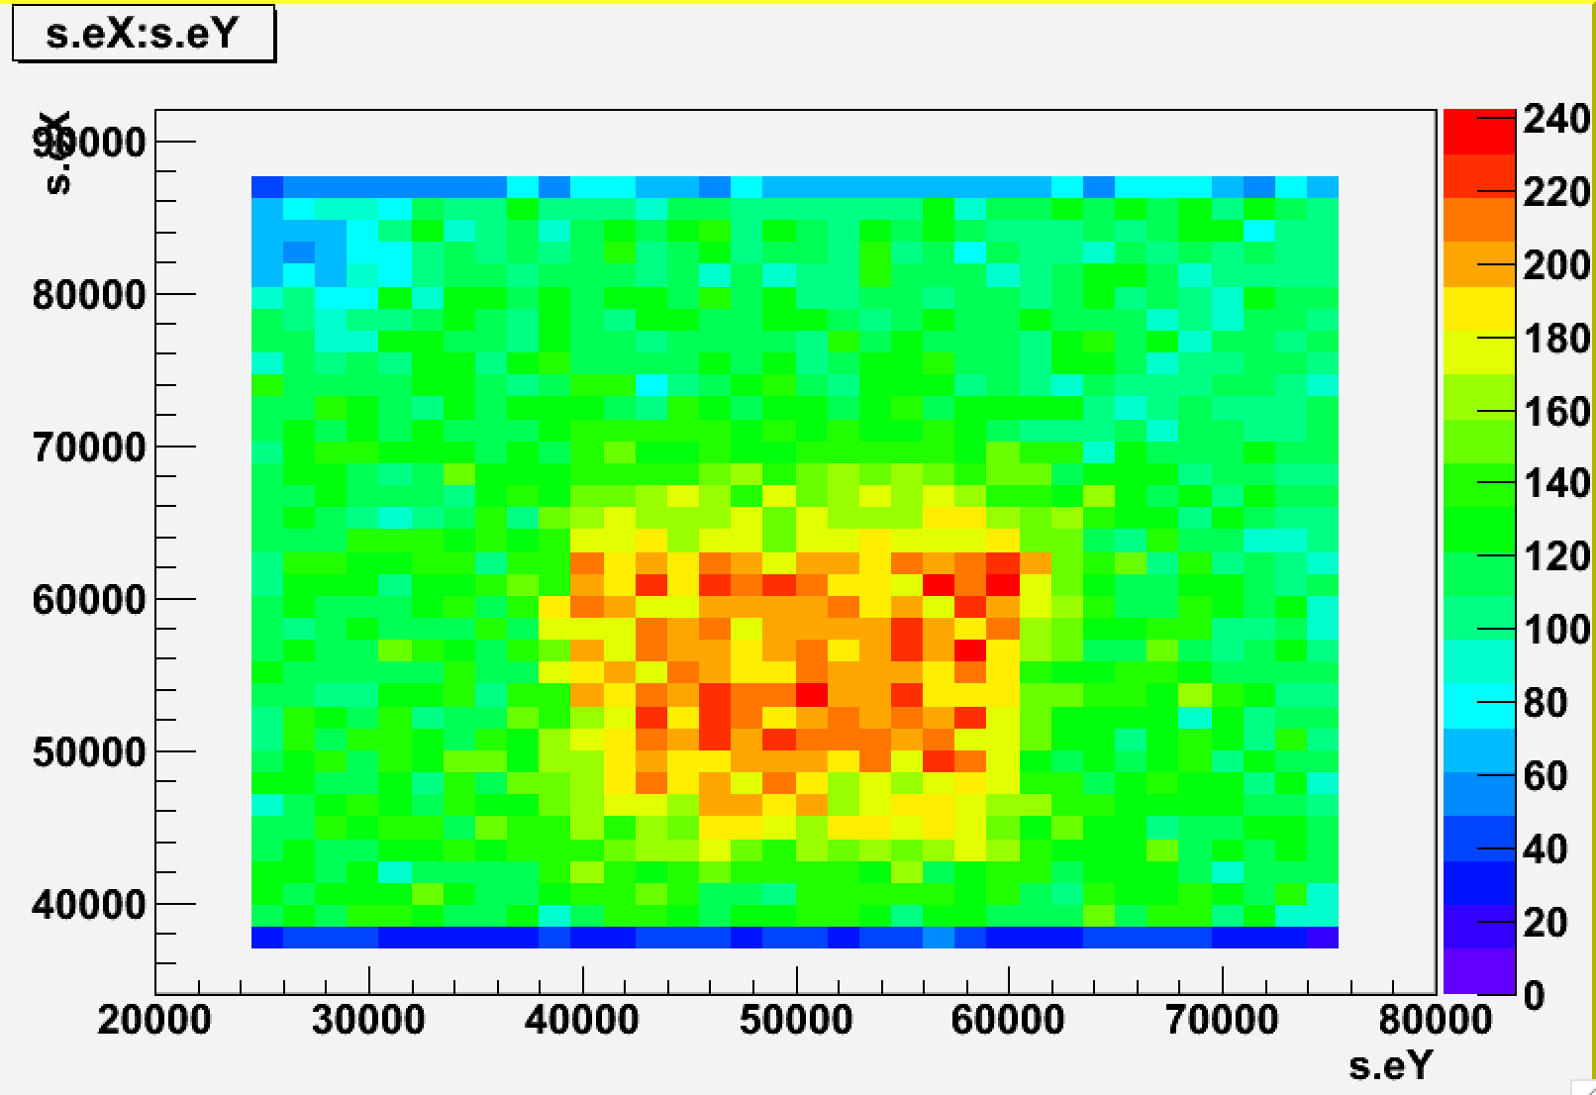
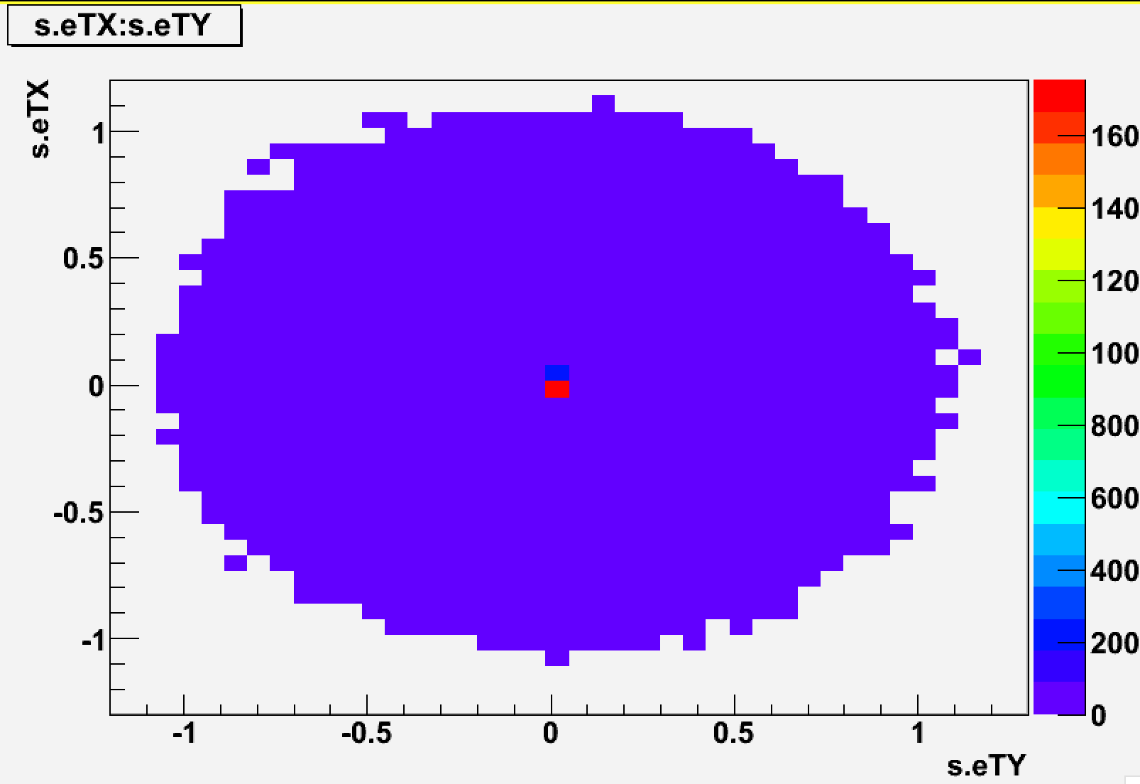
Oxygens on Emulsion #1
All Basetracks (no cuts)

Slide 8
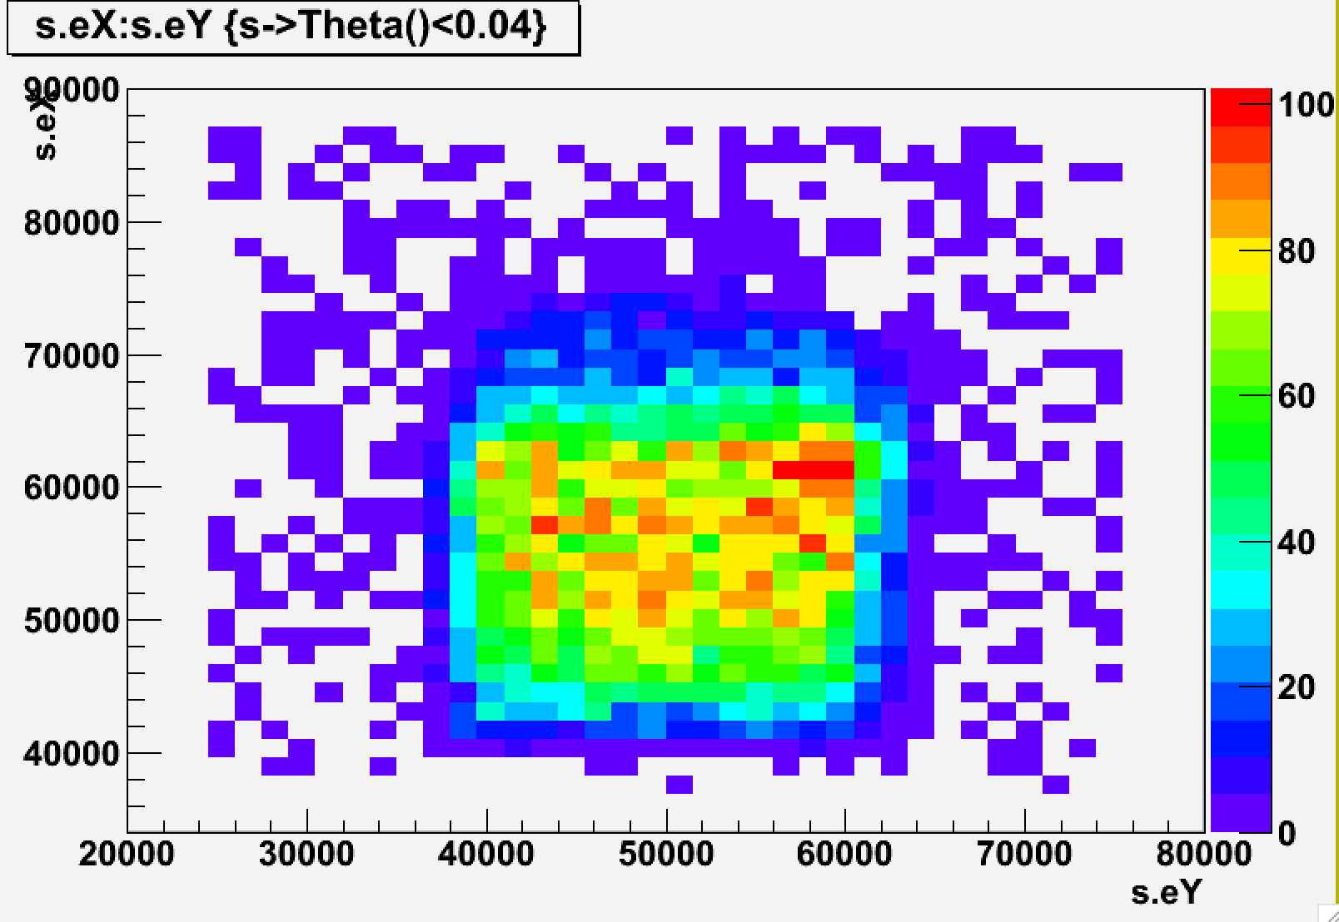
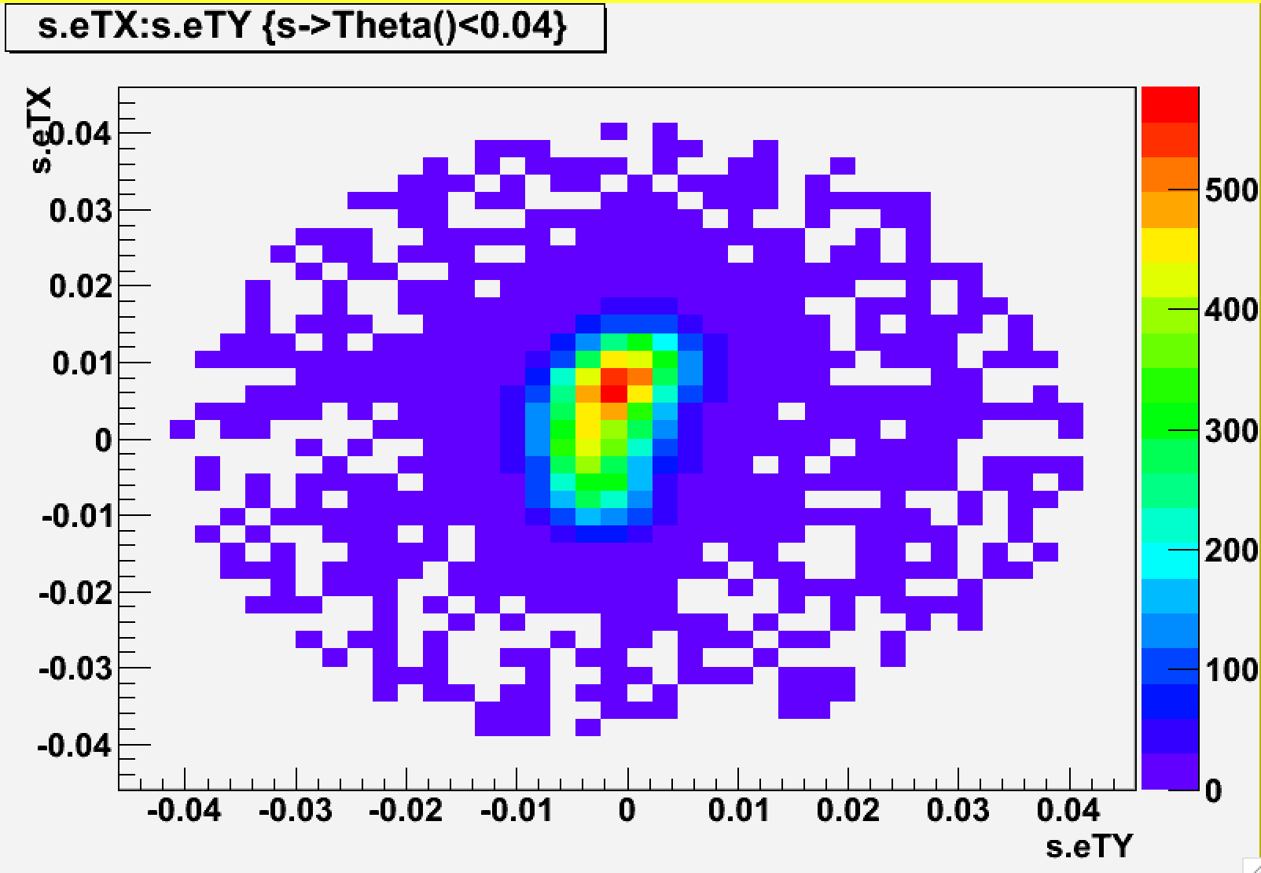
Oxygens on Emulsion #1
Theta<0.04
Oxy Beam: 19375
Counting: 19397!!

Slide 9
Montecarlo Simulation
Beam: 10k Oxygen @200 MeV/n, Rectangular Shape 3x3, Isotropic distribution
Same detector structure (but no thermal treatment simulated in S2)
No cosmic rays or background were simulated
Montecarlo Simulation was converted into the raw data files format and underwent the tracking reconstruction with official software used in OPERA (FEDRA)
Flat efficiency was set at 90% efficiency as a temporary value (see later)
4 mrad smearing was applied on angles (data driven)
No misalignment was simulated

Slide 10
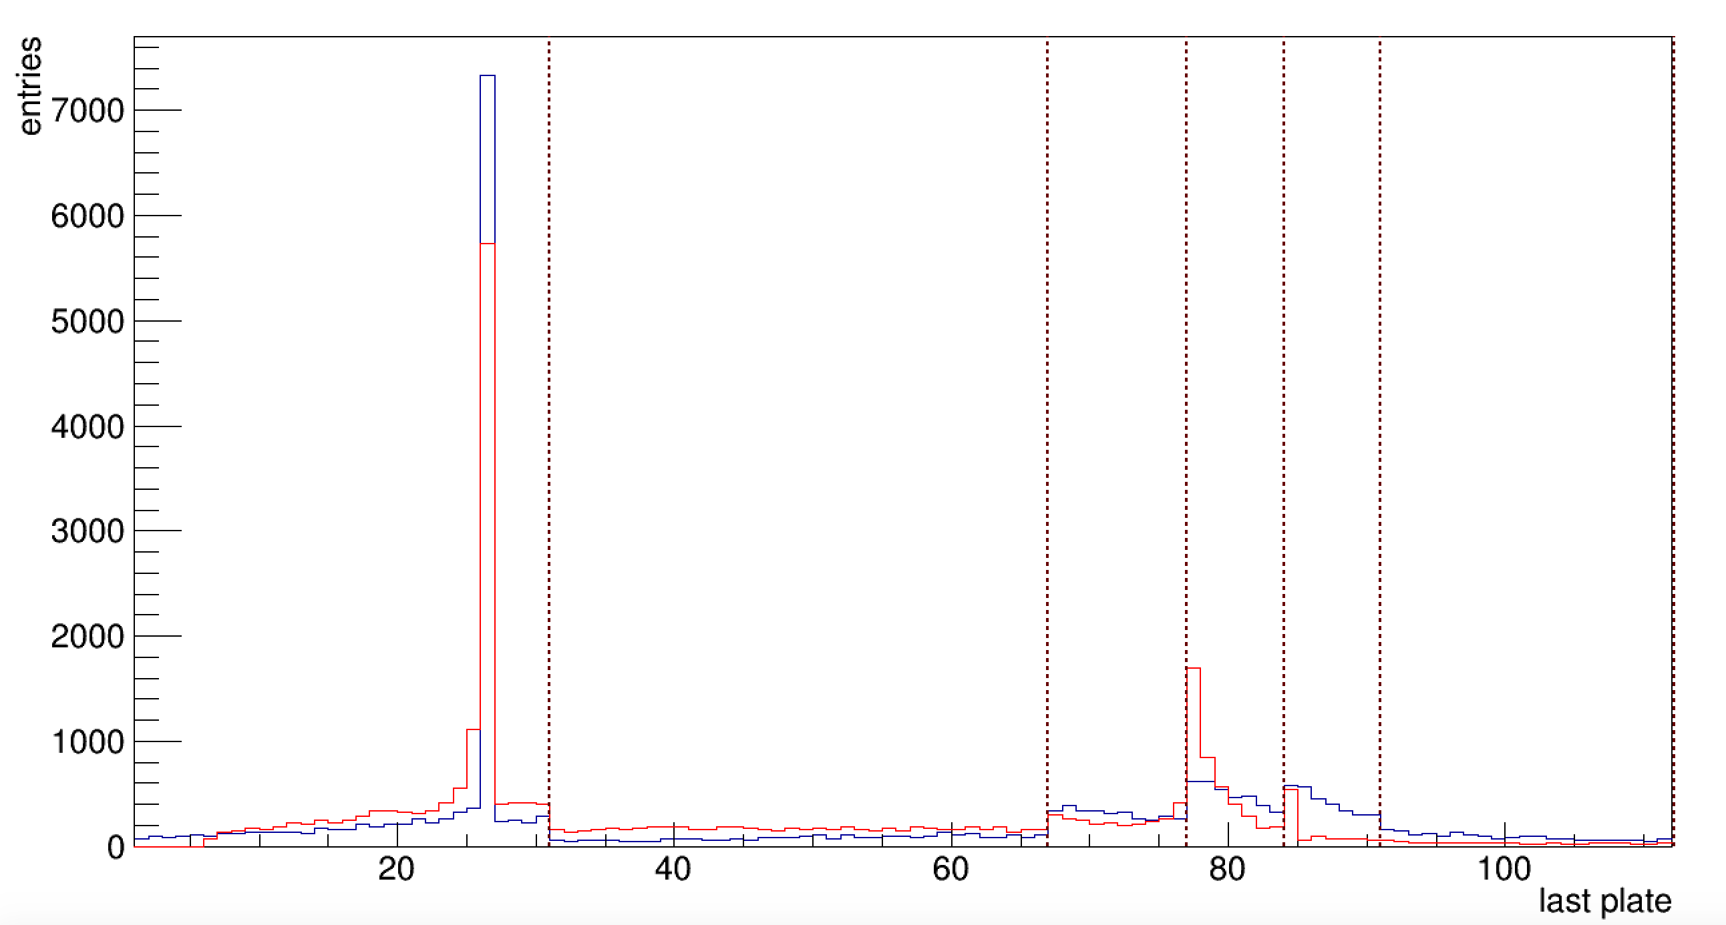
Tracking Validation with Montecarlo
End of the Track
Blue = MC true Red = MC reconstructed
Sudden change in track scattering due to different passive material / different width
Nuclear Emulsions
Lexan
W 0.9mm
Polyethylene
W 0.5mm
Lead
A dedicated tracking should be done for each section
Necessity to implement an algorithm to merge the tracks from different tracking

Slide 11
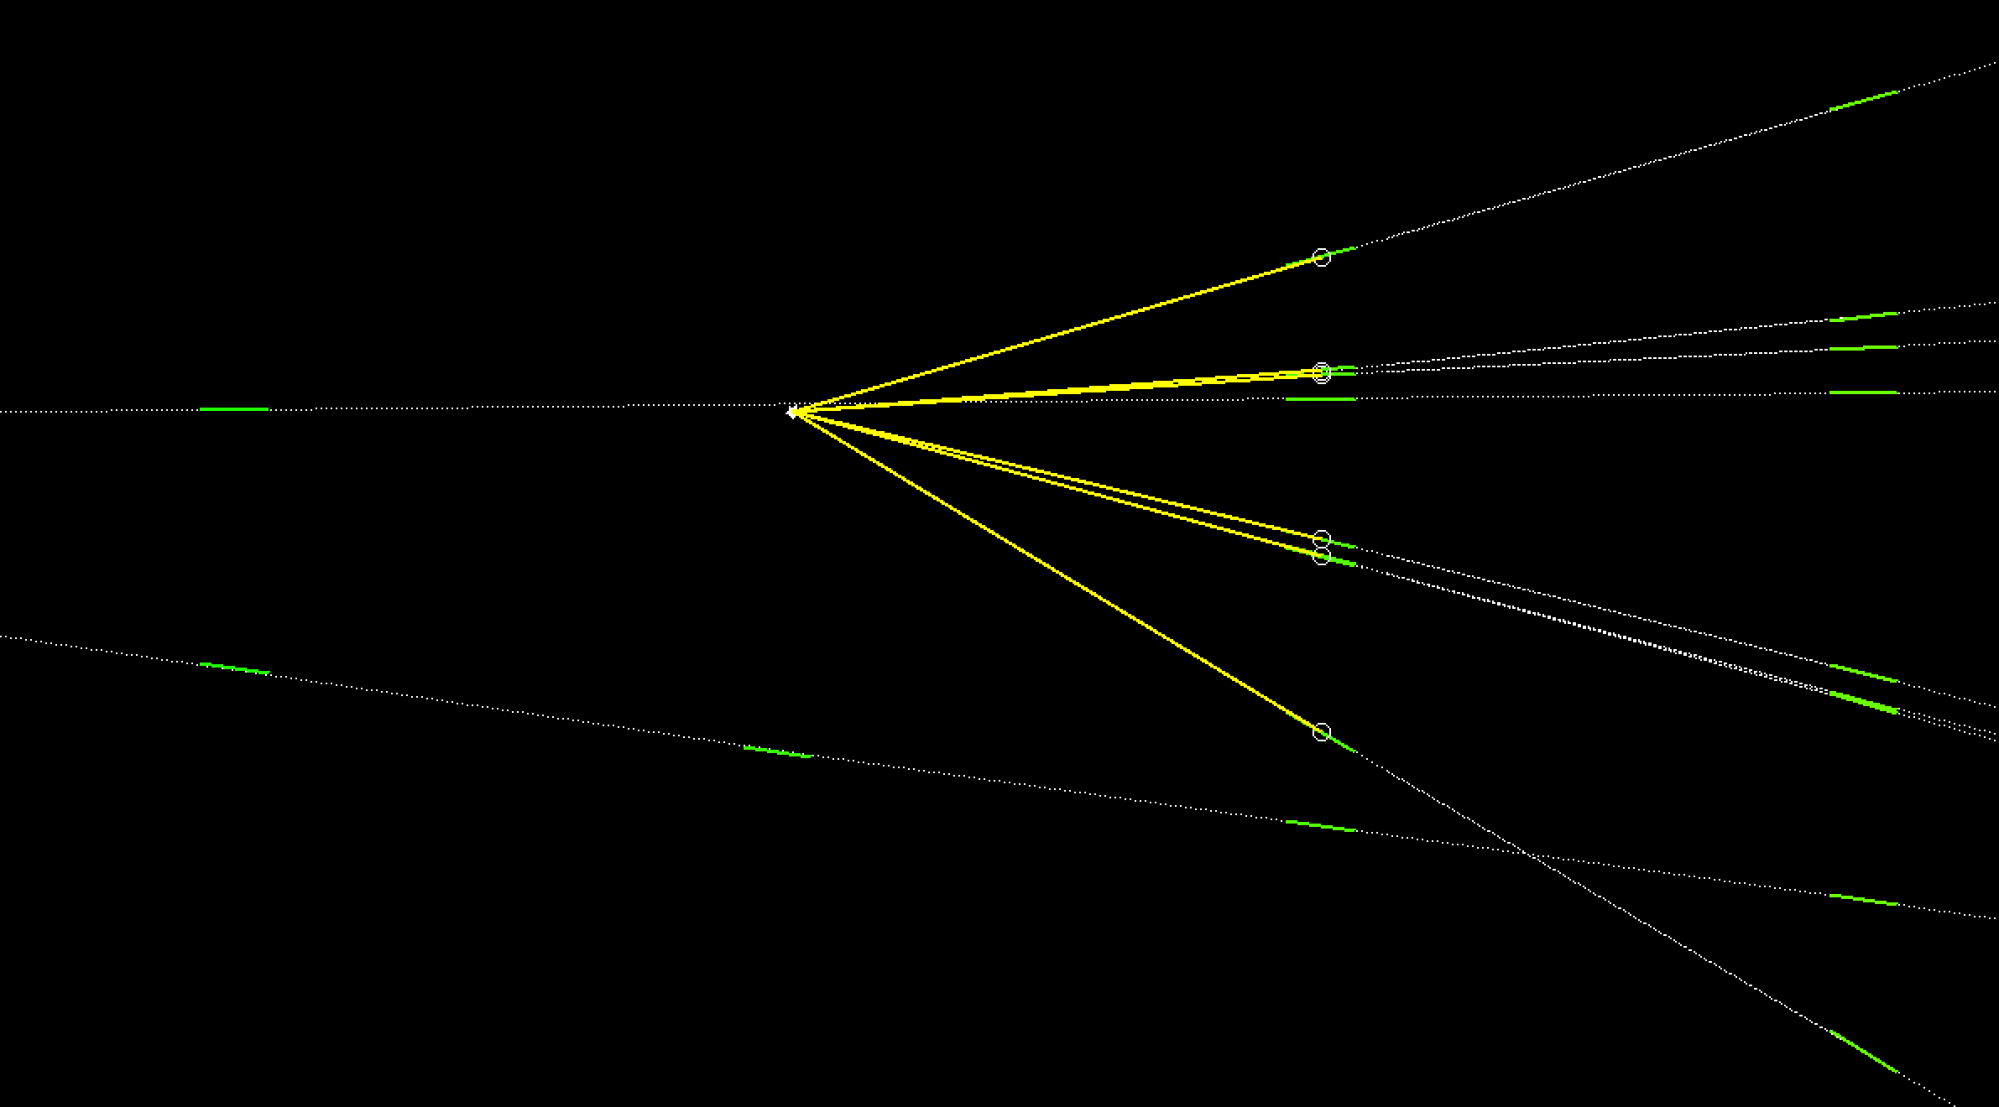
Examples of Tracking Issues
(Montecarlo)

Slide 12
Efficiency Plate by Plate (All Tracks)
Plate Id | Nseg | Nseg expected | Eff_plate all tracks | Eff_plate OXY
1 | 6426 | 6426 | 100.00% | 100.00%
2 | 6357 | 7469 | 85.11% | 85.23%
3 | 12798 | 13526 | 94.62% | 94.44%
4 | 13409 | 14878 | 90.13% | 90.00%
5 | 14337 | 15609 | 91.85% | 91.72%
6 | 14132 | 16105 | 87.75% | 87.72%
7 | 13067 | 16487 | 79.26% | 78.39%
8 | 15048 | 16625 | 90.51% | 90.45%
9 | 15194 | 17017 | 89.29% | 89.18%
10 | 15719 | 17245 | 91.15% | 91.24%
11 | 15570 | 17355 | 89.71% | 89.42%
12 | 15583 | 17342 | 89.86% | 89.66%
13 | 14492 | 17068 | 84.91% | 84.98%
14 | 14811 | 16831 | 88.00% | 87.64%
15 | 13348 | 16651 | 80.16% | 77.90%
Plate Id | Nseg | Nseg expected | Eff_plate all tracks | Eff_plate OXY
16 | 14741 | 16711 | 88.21% | 87.80%
17 | 12406 | 16016 | 77.46% | 75.82%
18 | 13589 | 16185 | 83.96% | 81.85%
19 | 14569 | 16956 | 85.92% | 85.20%
20 | 14129 | 16797 | 84.12% | 83.37%
21 | 10631 | 15761 | 67.45% | 59.35%
22 | 12550 | 15155 | 82.81% | 80.26%
23 | 10681 | 12833 | 83.23% | 80.26%
24 | 9037 | 10230 | 88.34% | 88.53%
25 | 7311 | 8038 | 90.96% | 90.68%
26 | 6886 | 7279 | 94.60% | 96.16%
27 | 5525 | 6393 | 86.42% | 78.18%
28 | 5880 | 6362 | 92.42% | 93.85%
29 | 5839 | 6262 | 93.24% | 93.26%
30 | 5686 | 6208 | 91.59% | 92.34%
Efficiency can be further improved
Optimization still on-going
Notes:
Oxygen basetracks are present in these layers, but form only 2-segments track not attached to plate 3 probably due to distorsions (first plates were more compressed)

Slide 13
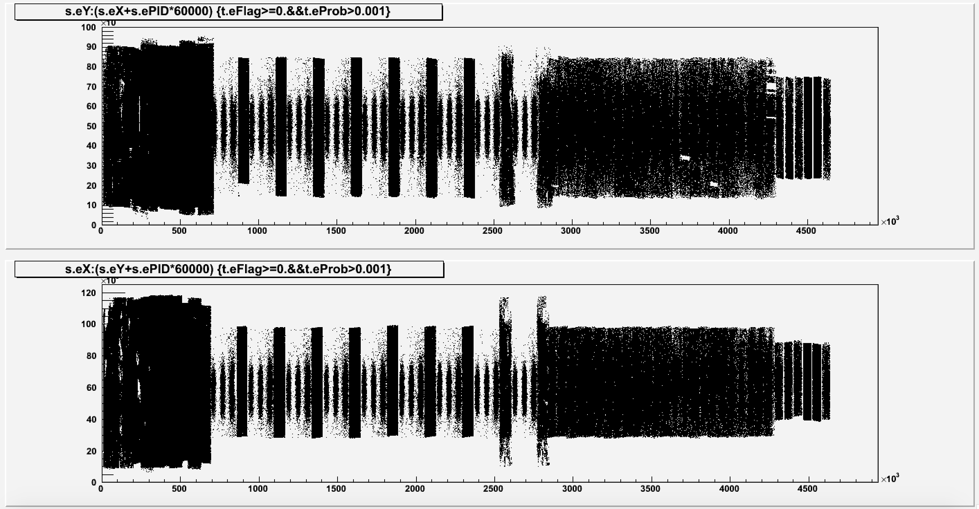
Tracks’ Segments in Each Layer
S3
S2
S1
Plate 77
Plate 1
Plate 77
Plate 1

Slide 14
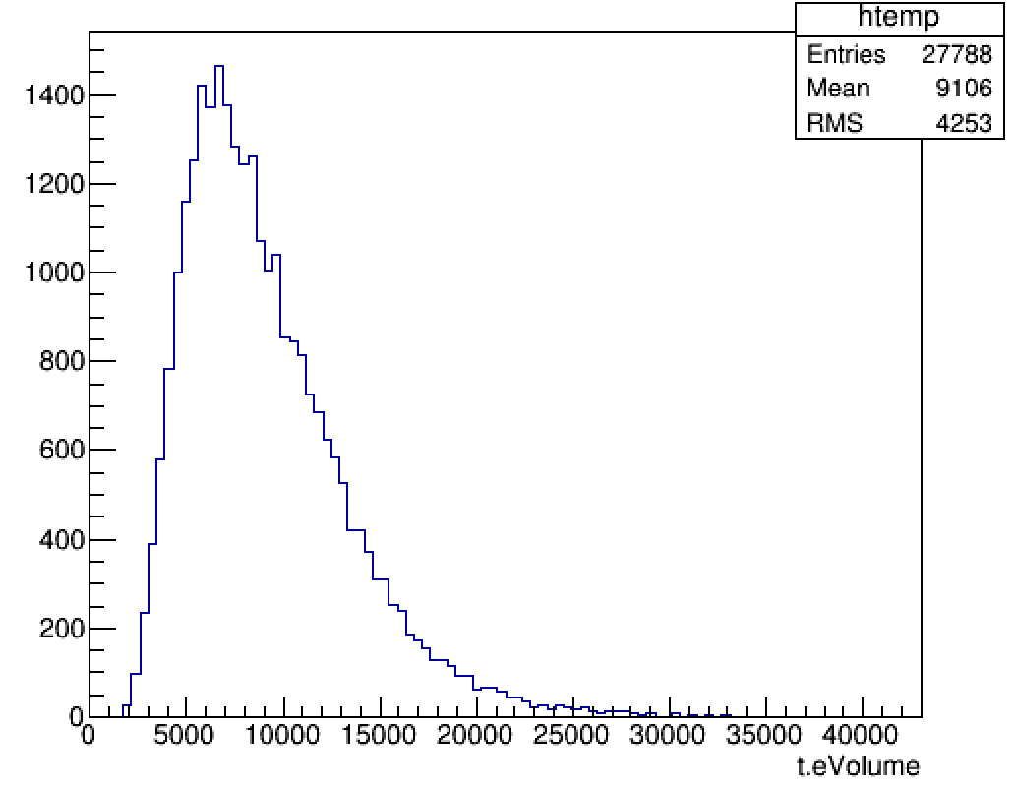
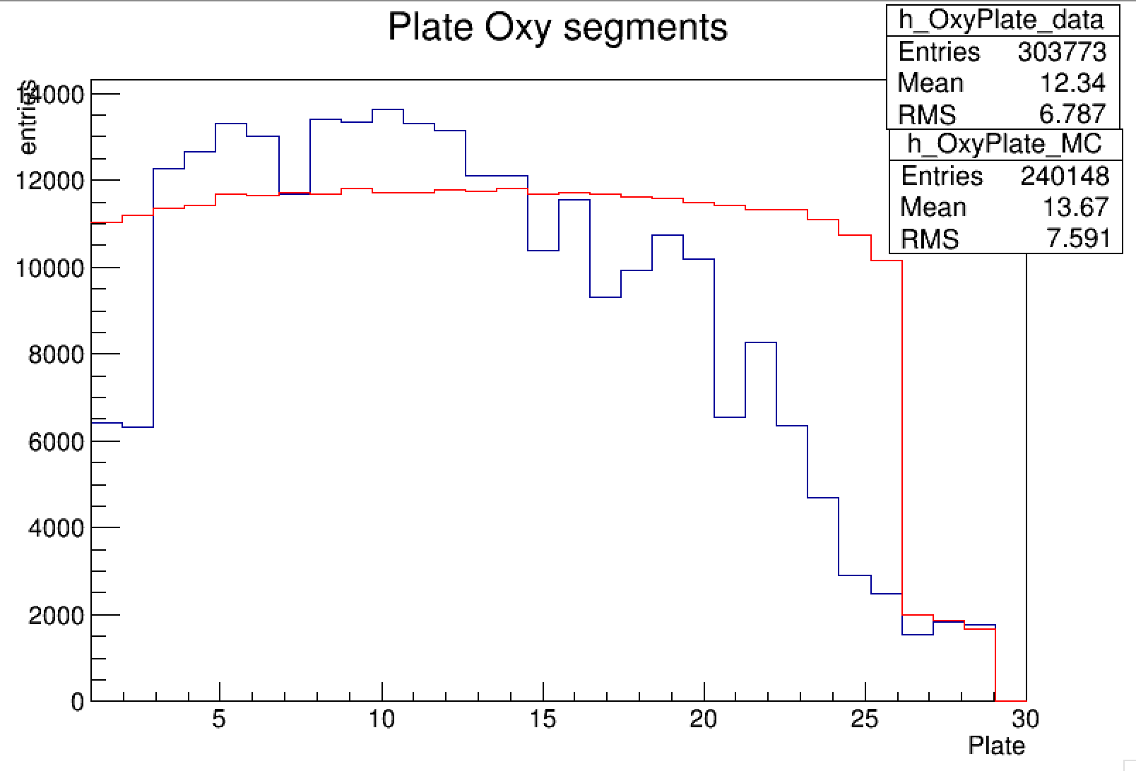
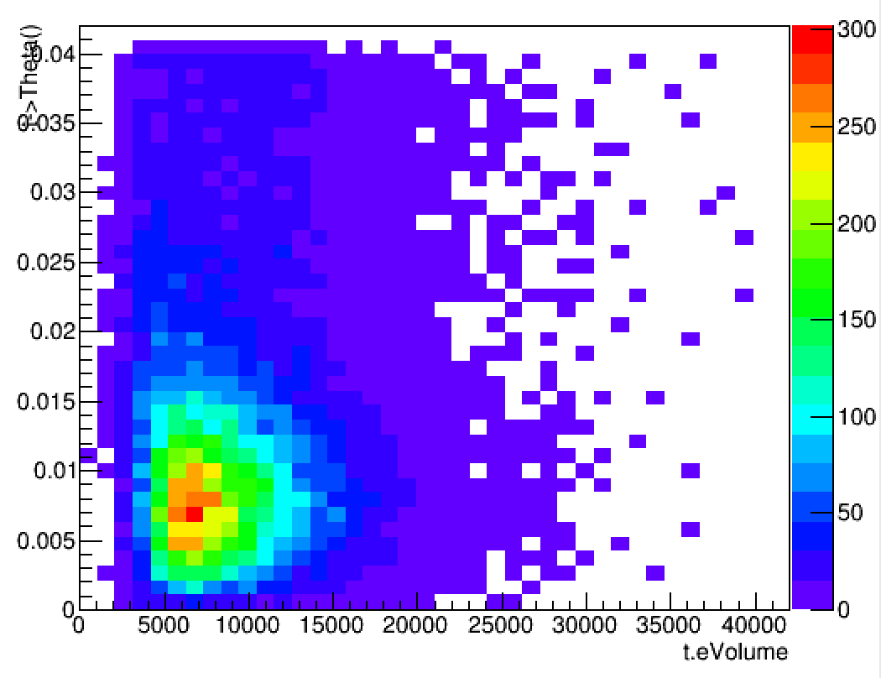
Oxygen segments plate by plate
Segment with theta<0.04 belonging to tracks with at least 4 segments
DATA
MC Reco
Bragg Peak
Mc Normalized to Data

Slide 15
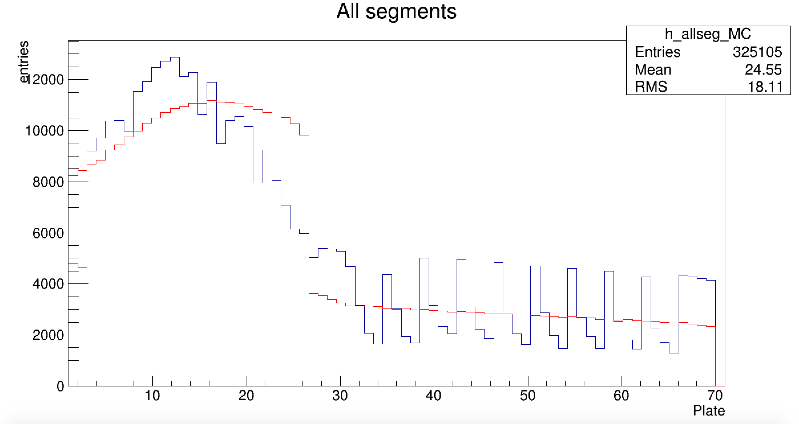
All Segments plate by plate
DATA
Bragg Peak
MC Reco
Expected effect of thermal treatment
(not included in Simulation)
Mc Normalized to Data
Notes:
solo dati
+ commenti

Slide 16
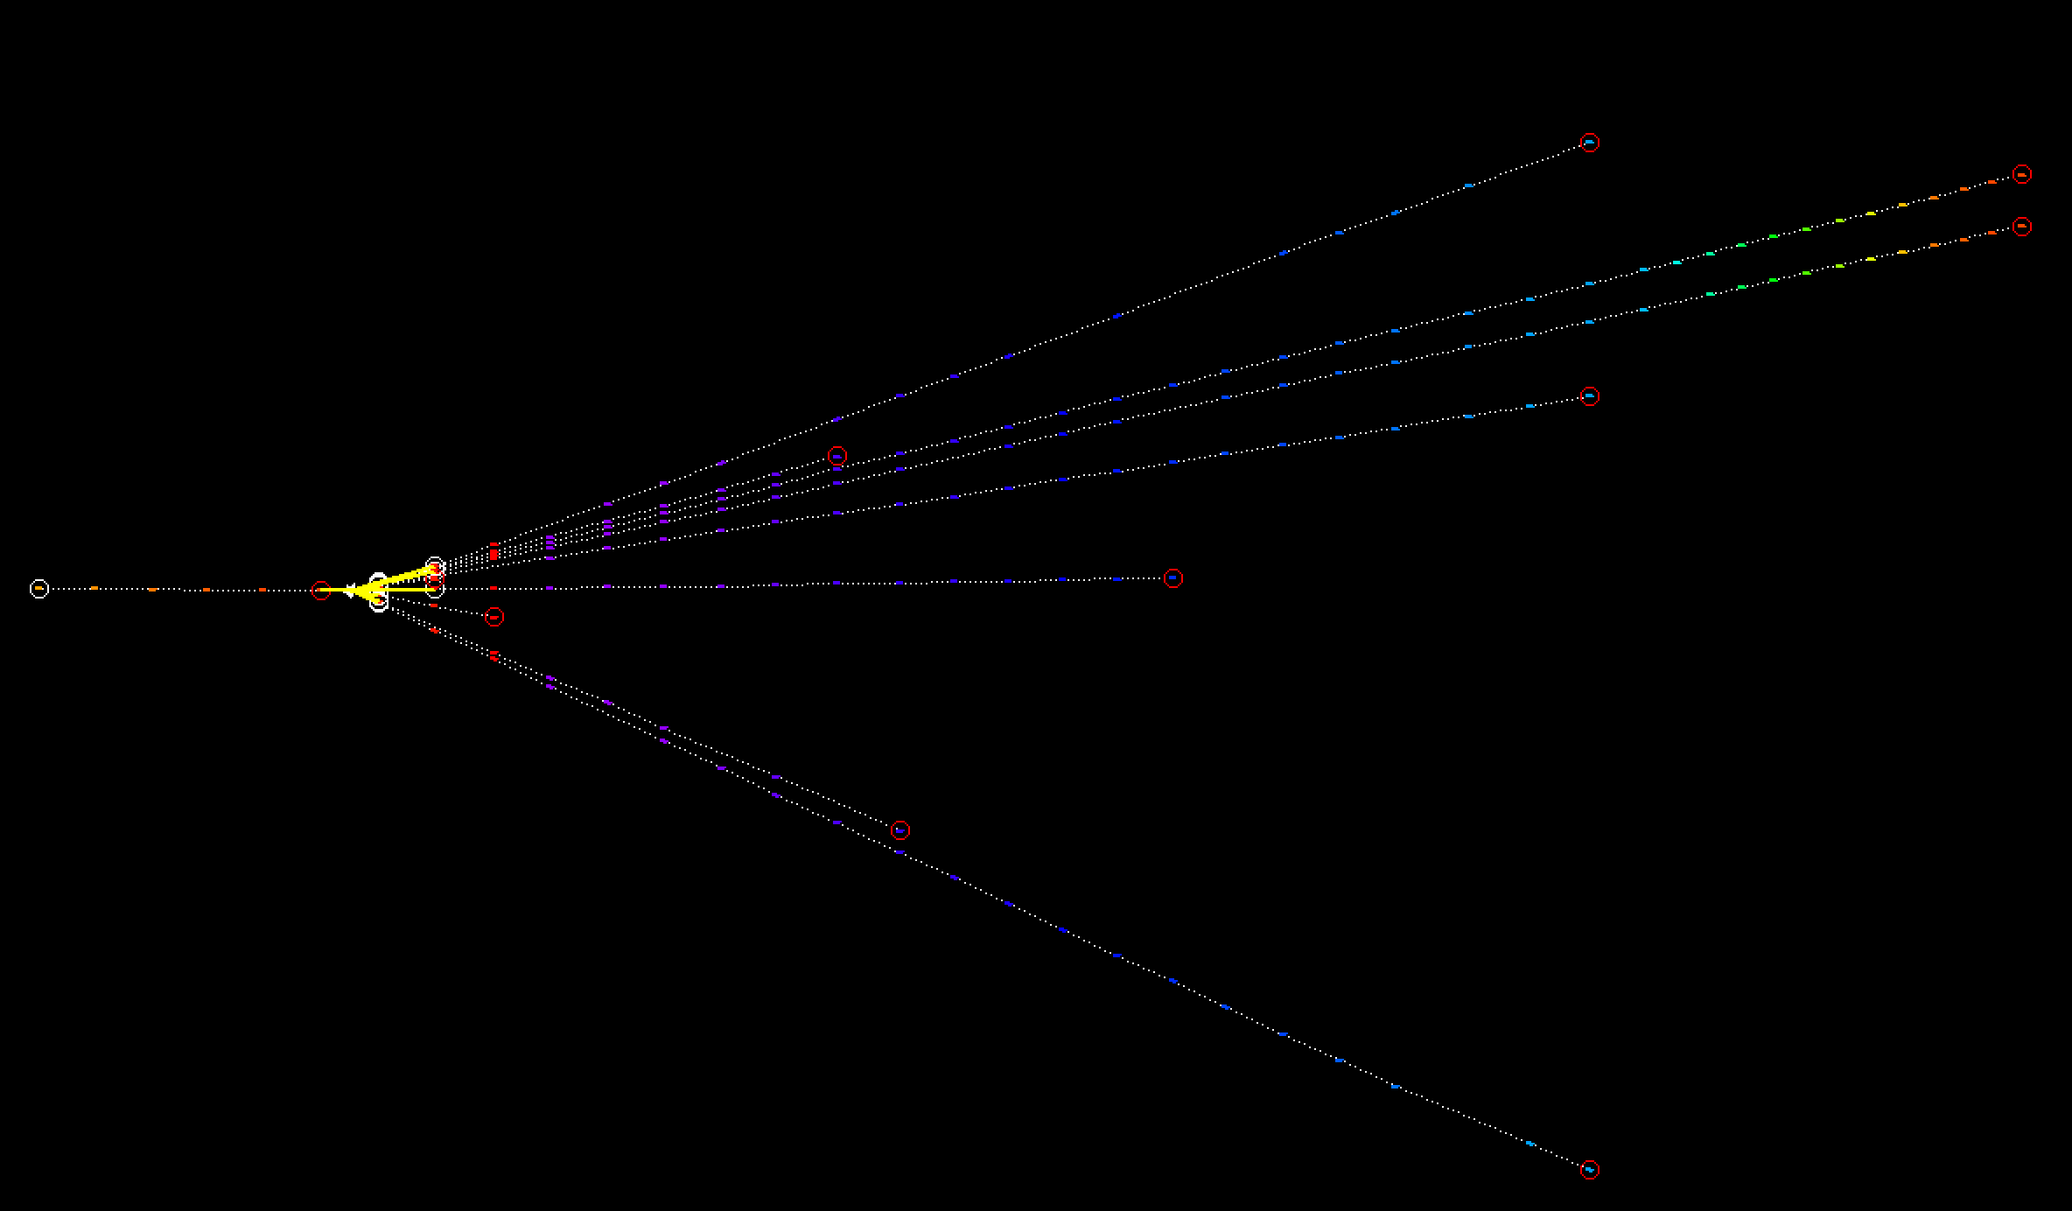
Example of a Vertex with High Multiplicity
(Data)

Slide 17
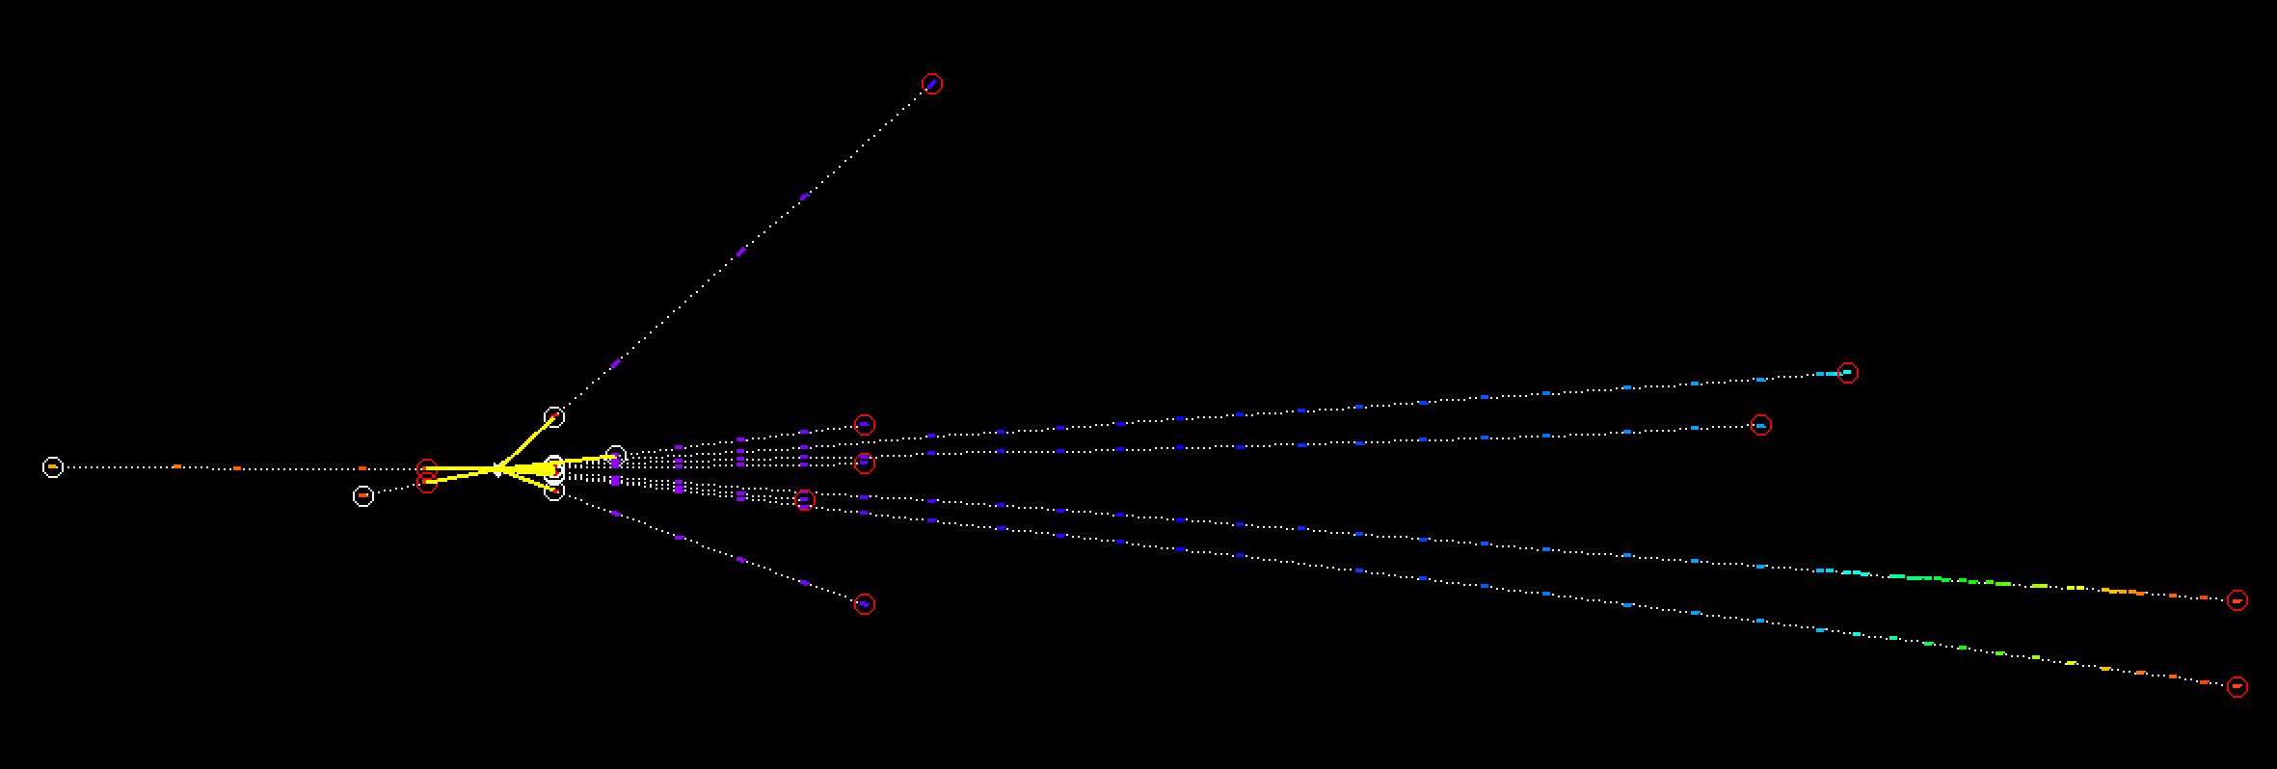
Example of a Vertex with High Multiplicity
backscattering
(Data)

Slide 18
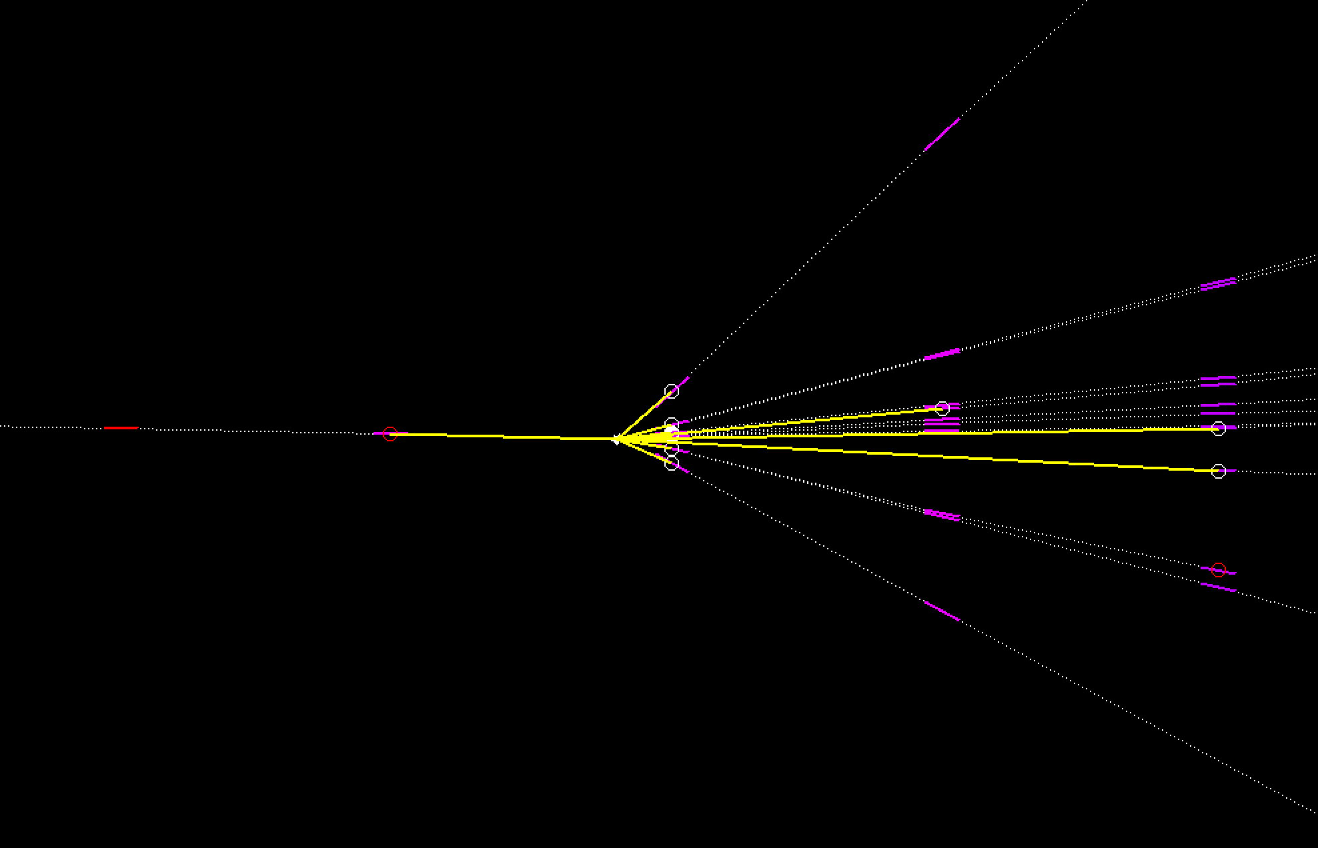
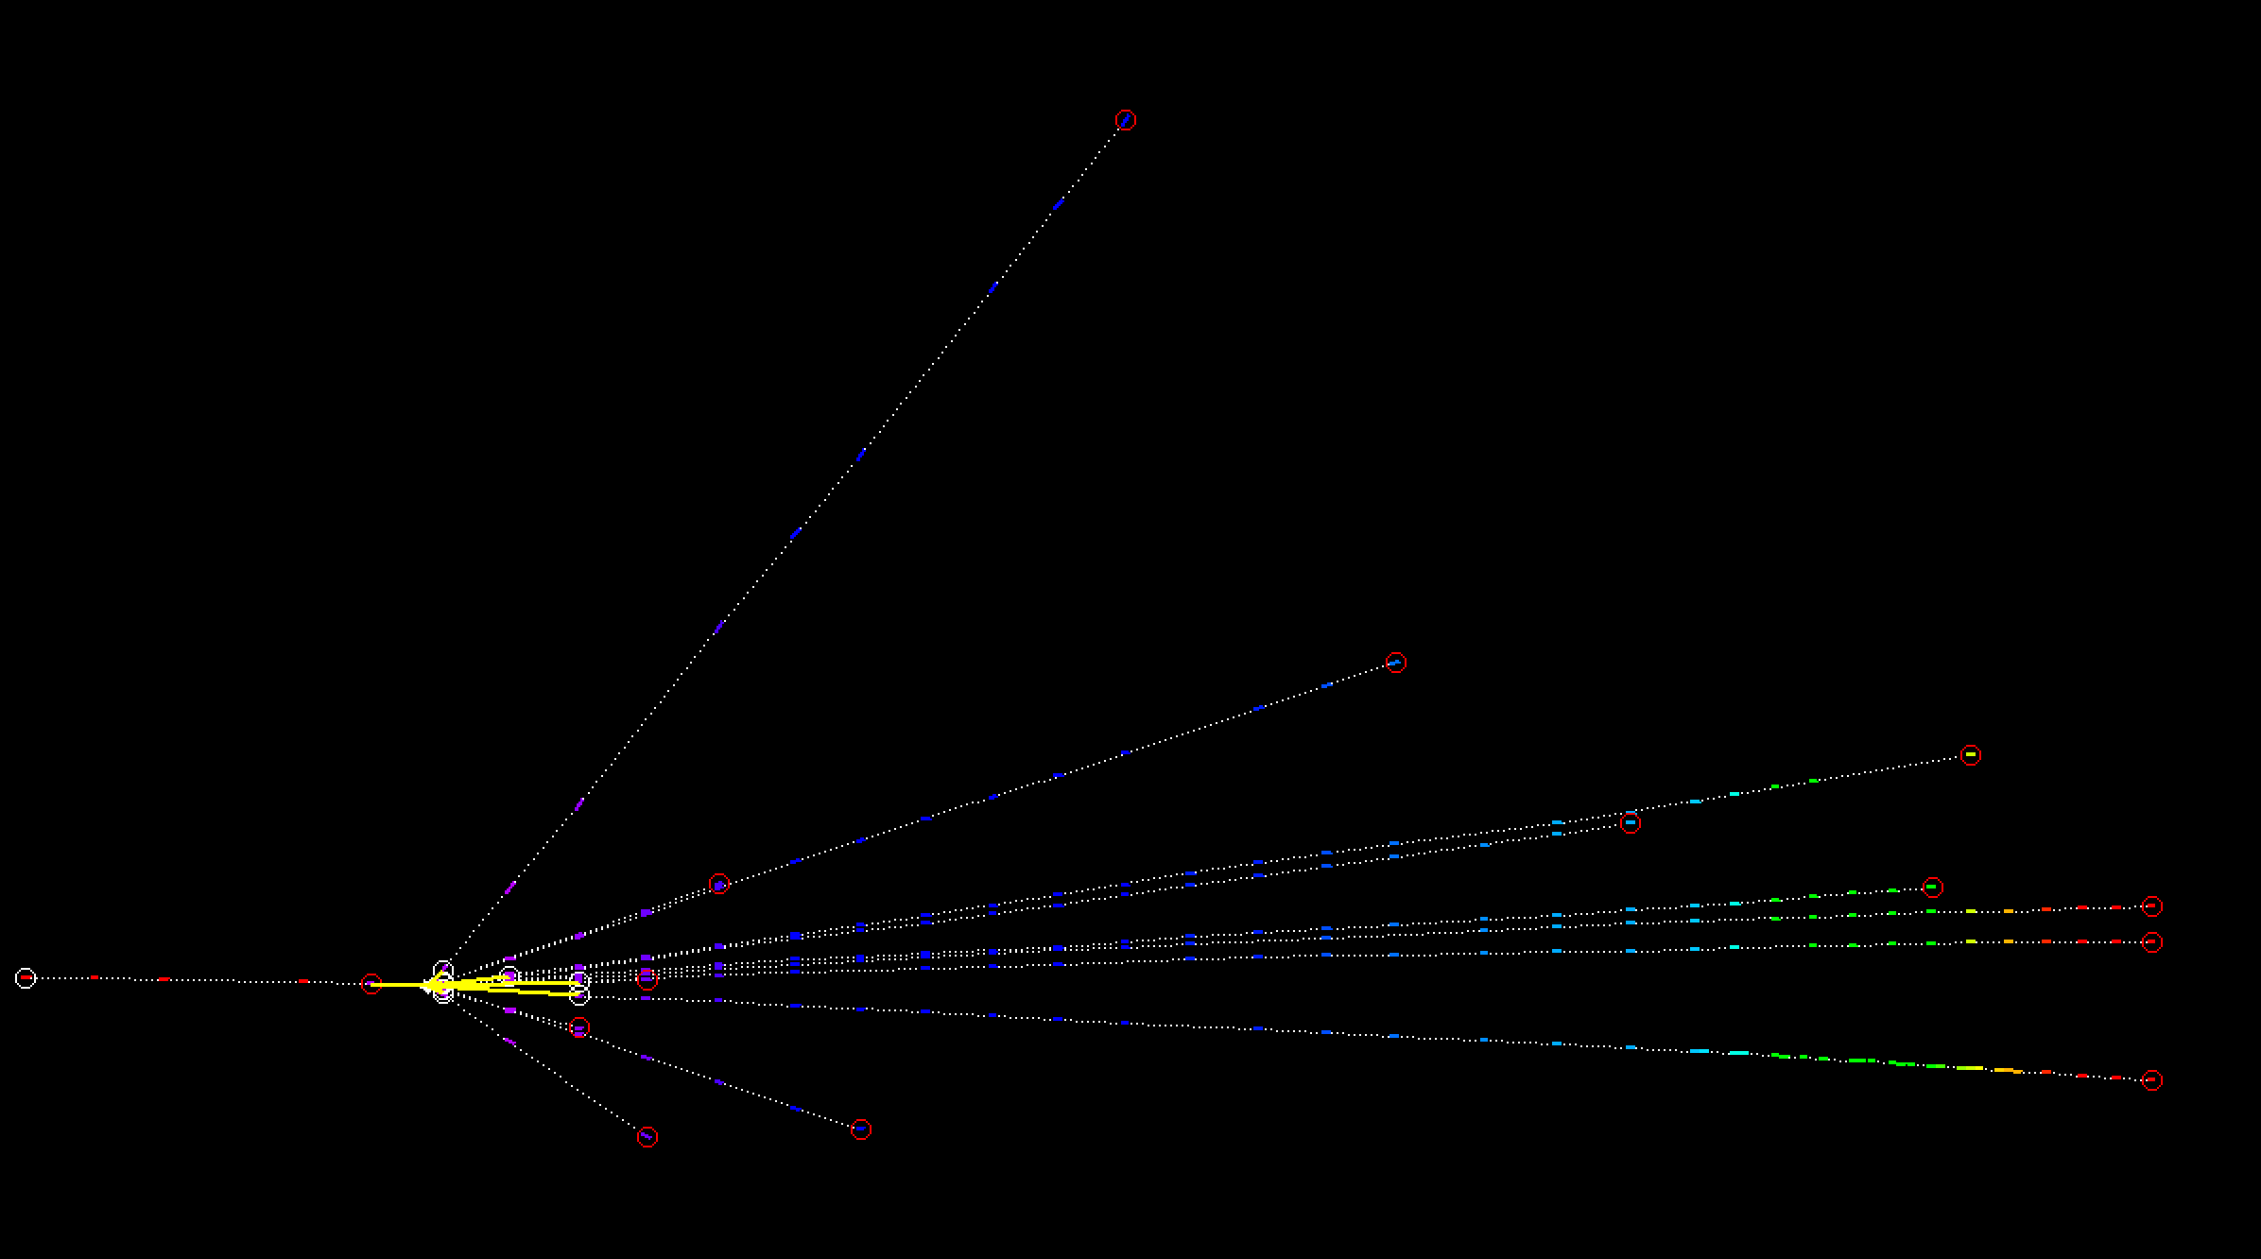
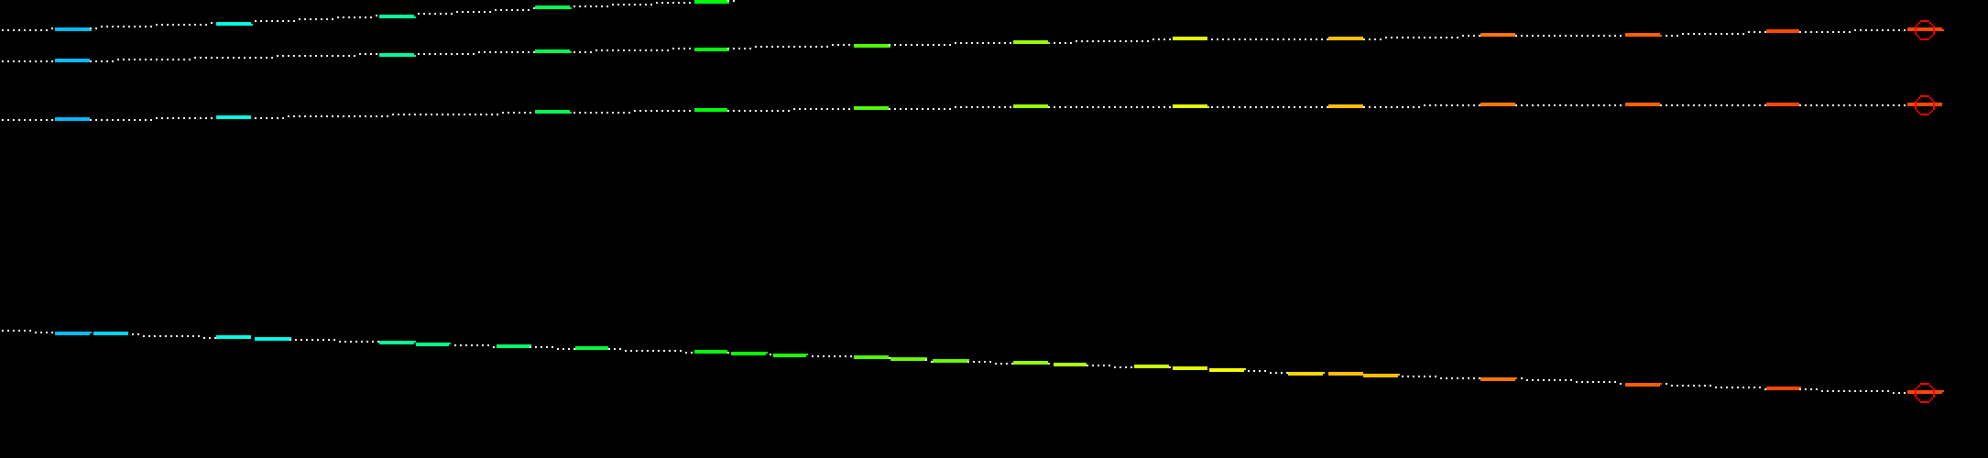
Example of a Vertex with High Multiplicity
(Data)
Notes:
in R0 dove si trovano?

Slide 19
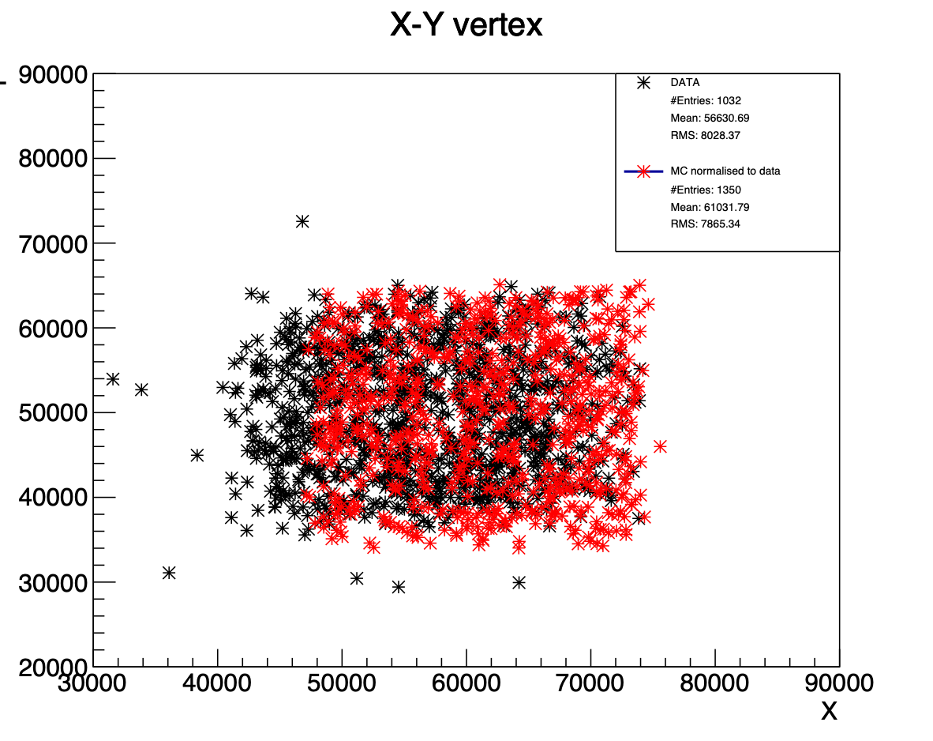
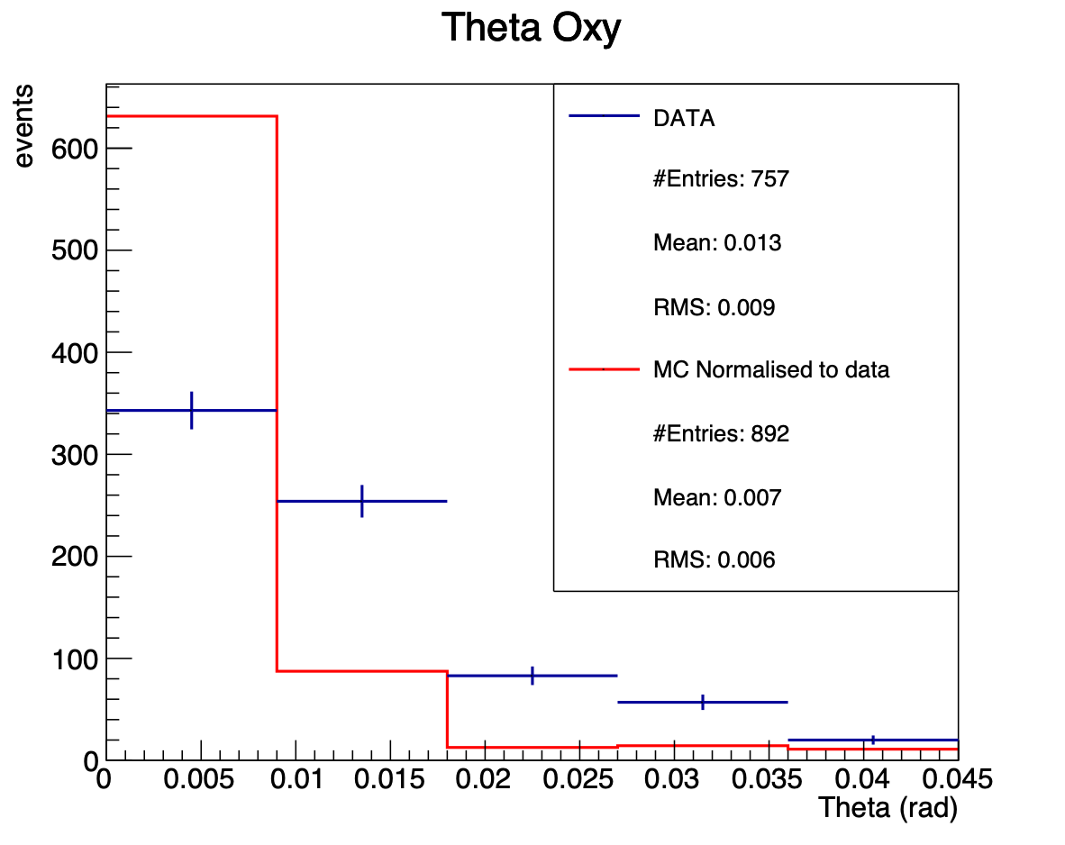
Vertices Reconstruction
Simulation beam: (3x3)cm
Data spot: (2.5x2.5)cm
The angle of simulated Oxygen beam should have a larger smearing
Notes:
vtx_plot/c_vxy.pdf
vtx_plot/c_oxytheta.pdf

Slide 20
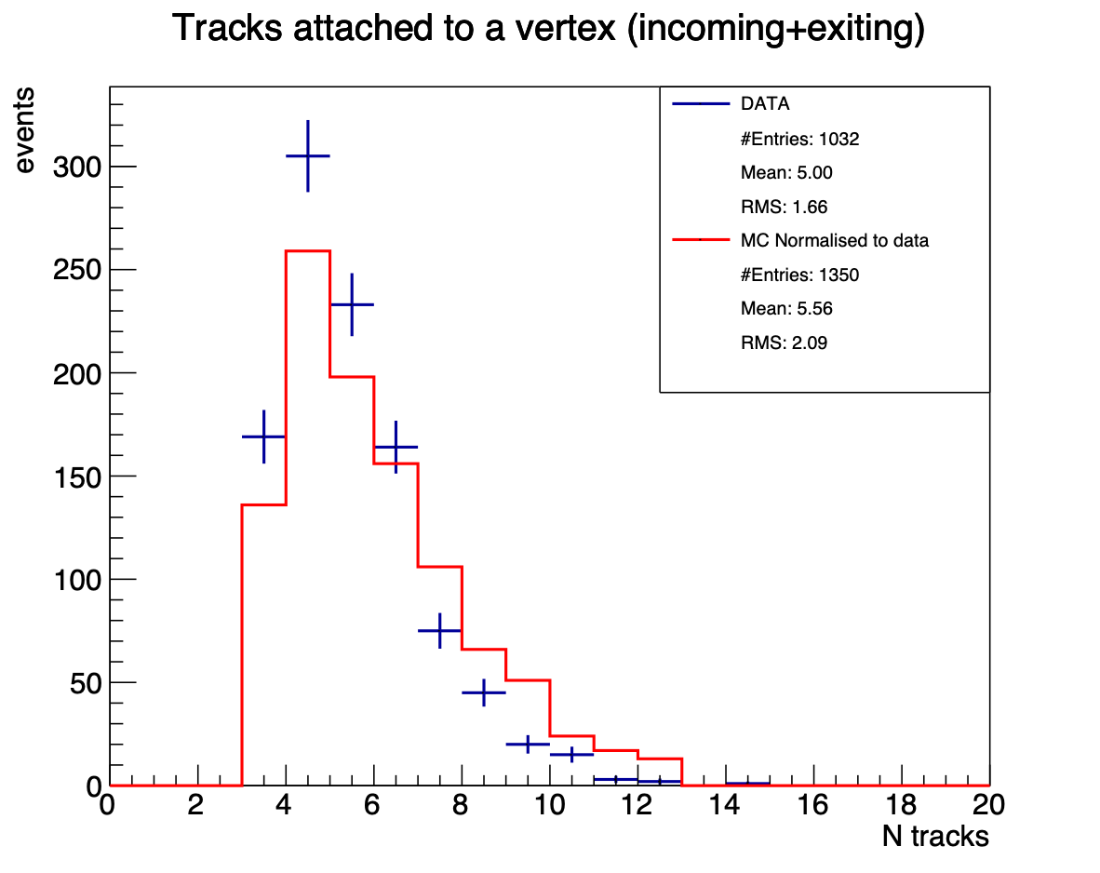
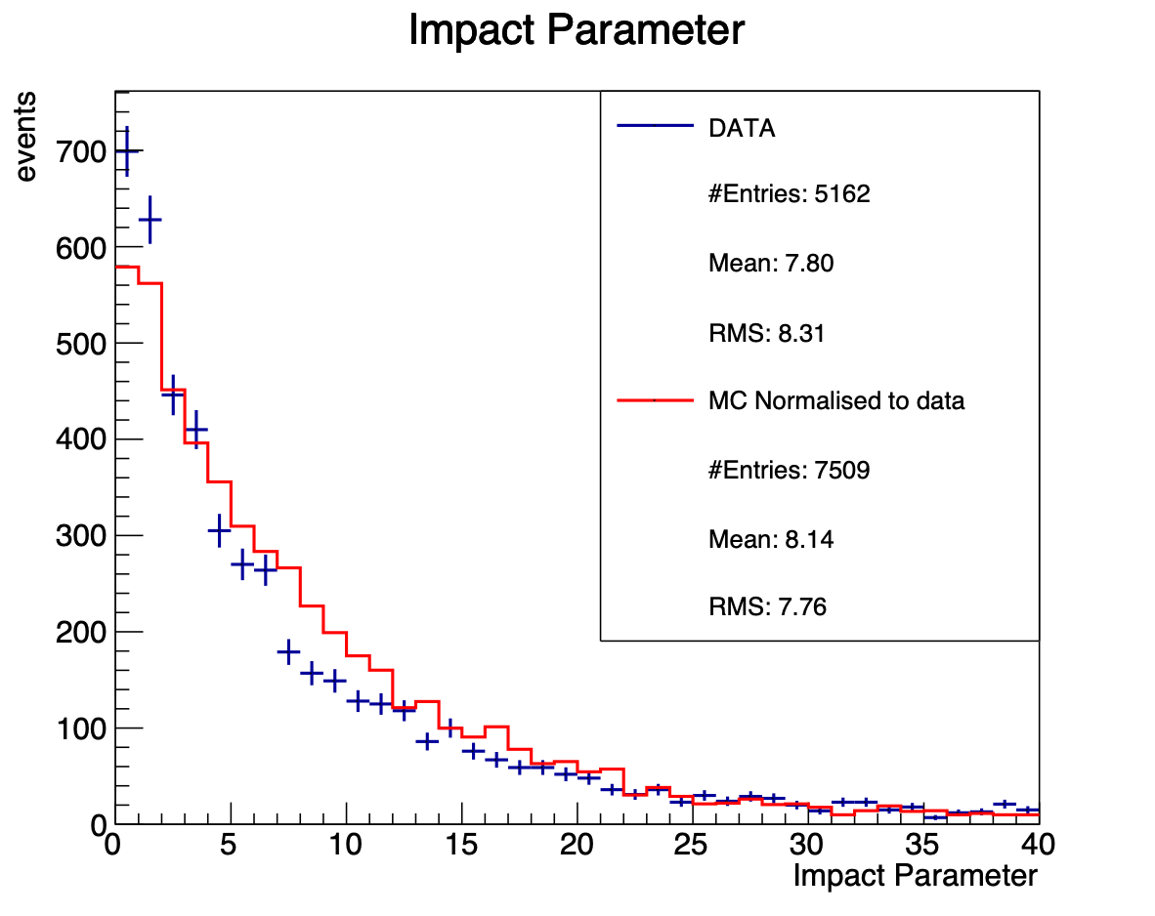
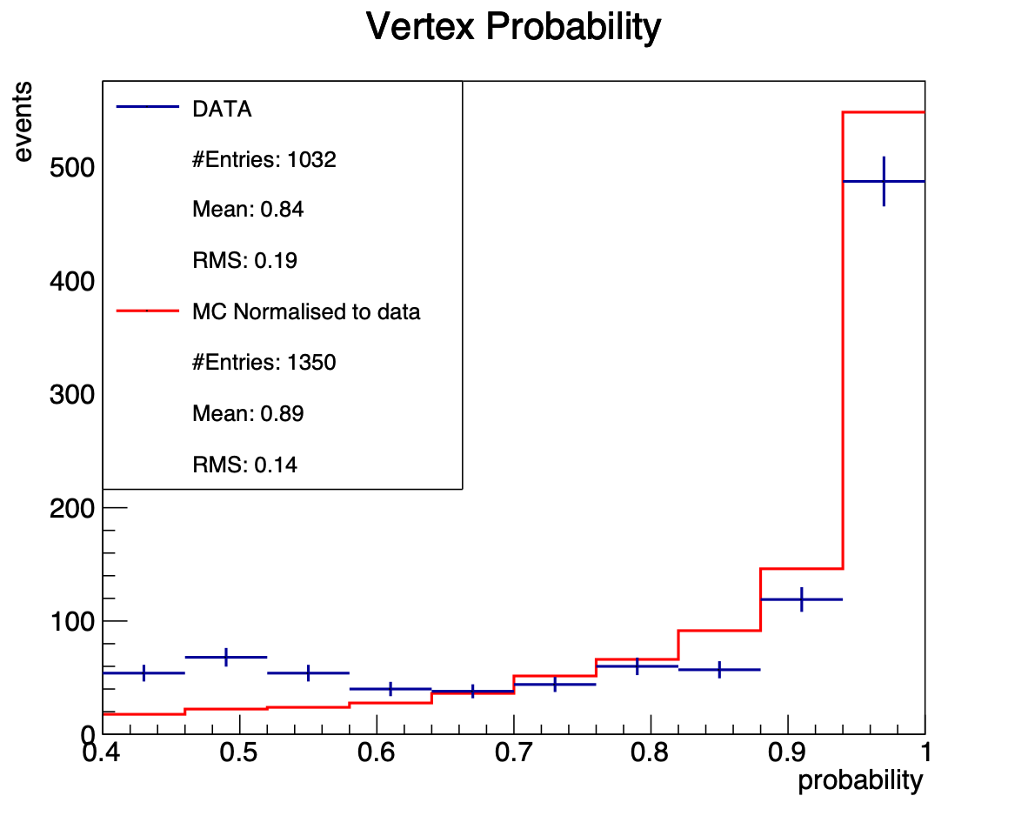
Vertices Characteristics
Notes:
vtx_plot/c_n.pdf
vtx_plot/c_impactparameter.pdf
vtx_plot/c_probability.pdf
vtx_plot/c_maxaperture.pdf

Slide 21
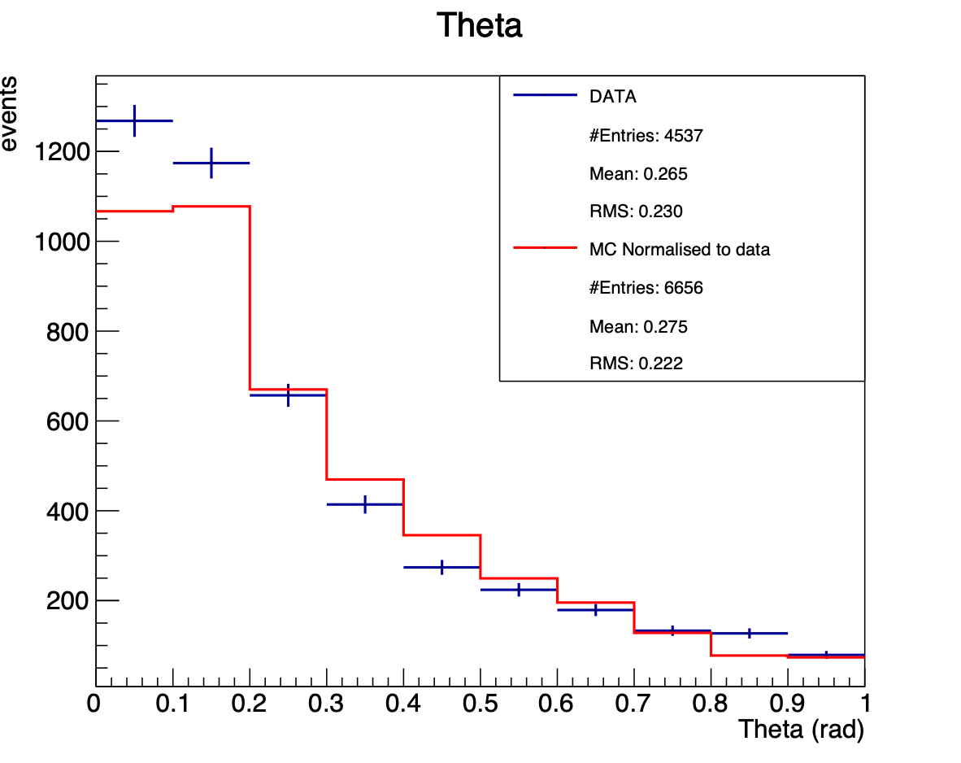
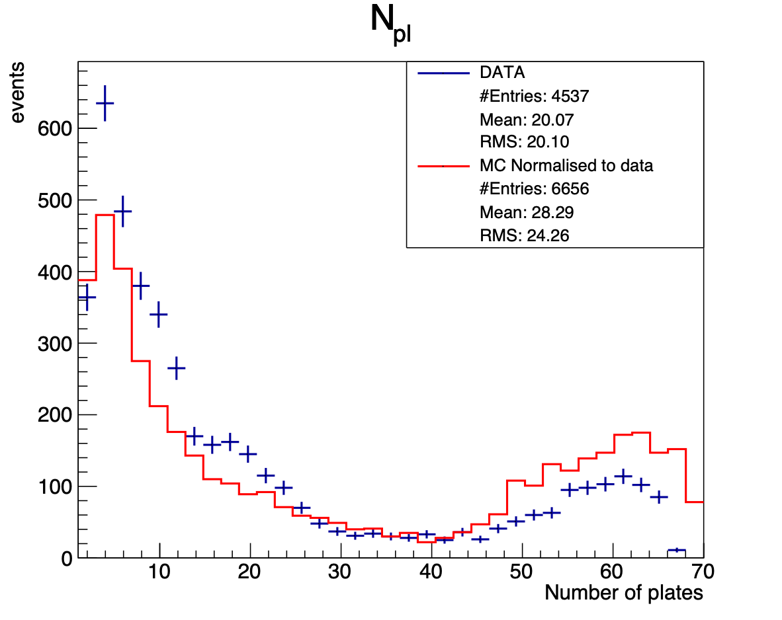
Daughters Characteristics
Particles’ charge identification: see next talk by B. Capone
Notes:
vtx_plot/c_Theta.pdf
vtx_plot/c_npl.pdf

Slide 22
New Idea for High Ionising Particle Acquisition
Oxygen ion track in emulsion
90 µm
90 µm

Slide 23
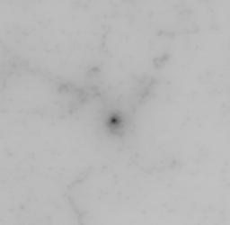
New Idea for High Ionising Particle Acquisition
Average Image

Slide 24
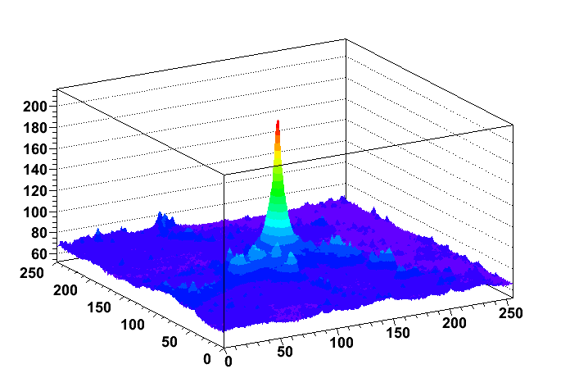
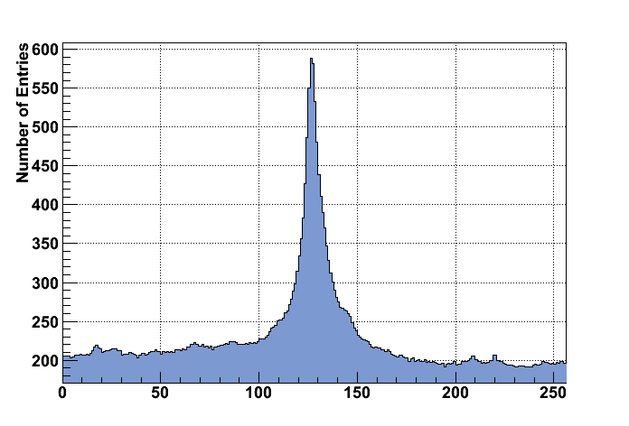
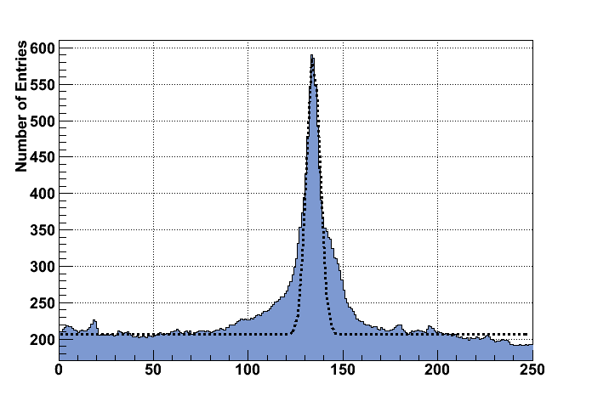
New Idea for High Ionising Particle Acquisition
Due to
delta-rays

Slide 25
Next Steps
Scanning of GSI3 and GSI4 emulsions
Linking and alignment of GSI1 plates already started
Improve scanning efficiency: new approach for images acquisition dedicated to high ionizing particles
Improve tracking efficiency: the optimization of the algorithms used in OPERA is not sufficient to face all the issues faced. New algorithms are needed.
Visual inspection of reconstructed vertices to better understand interactions characteristics and validate the analysis
Mass identification by momentum (MCS) and range measurements in S3…S7

