Slide 1
Review of fragmentation and radioprotection in space
Chiara La Tessa

Slide 2
Roadmap to space exploration

Slide 3
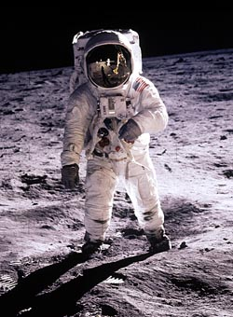
ROUGH GUIDES
Health in Deep Space
Protection from space radiation (particularly very high energy heavy ions)
Psychosocial and behavioural problems
Physiological changes caused by microgravity
THE ROUGH GUIDE to
The Moon & Mars

Slide 4
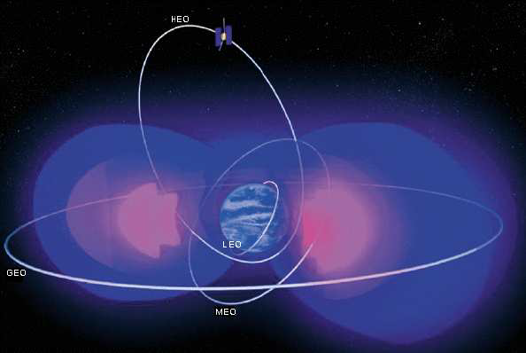
Solar Particle Events
Built by NASA and for NASA
Construction: 2000-2003
Purpose: carry out experiments for studying the effects of radiation (mainly biology)
Space radiation environment
Galactic Cosmic Rays GCR (all ions)
Solar Particle Events SPE (mainly protons)
Trapped particles (protons and electrons)
Albedo radiation (electrons, protons, neutrons)
Solar Wind

Slide 5
Solar Particle Events
Injection of charged particles originating from:
solar flares
fast coronal mass ejections
Particle energies from few MeV/u to tens of GeV/u
They last from 1 hour to several days
Flux can be high enough to kill a man if directly exposed (SPE 1972)
Their occurrence is related to the sun spot (solar activity) but they are unpredictable
SPE energy spectra

Slide 6
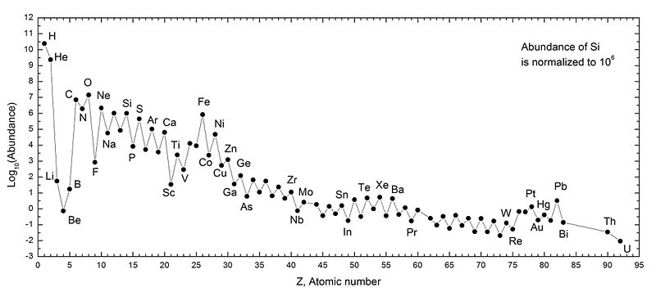
Galactic Cosmic Rays (GCR)
It is omnipresent in space and fluctuates between solar minimum and solar maximum on an approximate 11 year cycle
Broad spectrum of particles (most of the periodic table) and energies (from keV to TeV)
Exposures differ by approximately a factor of 2 between nominal solar extremes
GCR composition
(normalized to Si)

Slide 7
Quantify space radiation
Fluence, abundance
Dose $D=\frac{dE_{abs}}{dm}=\frac{Fluence×LET}{ρ}$
c) Dose equivalent H$=D×w_{R,T}$
Dose equivalent
Dose
Fluence

Slide 8
The fundamental questions are:
What is the risk associated to the exposure on the radiation environment?
How can we decrease it to an acceptable level?
The parameters involved are:
Radiation fluence
Radiation field quality (species, energy, LET…)
Dose
Biological effectiveness (RBE)
Health outcomes

Slide 9
Exposure analysis overview

Slide 10
Physical processes of interest
Energy loss
Multiple Coulomb scattering
Nuclear fragmentation
They can all influence the dose delivered by radiation and thus its biological effect
Space
Space craft hull and structure
Shielding
Astronaut’s body

Slide 11
In-flight measurements
Collaboration with AMS II will fill some important gap
Mars Science Laboratory/Radiation Assessment Detector (MLS/RAD) on Curiosity has provided precious cruise and surface data

Slide 12
What ground-based facilities reproduce
*
, FAIR
*
, FAIR
*
* These energies are also available at radiotherapy centers for selected ions

Slide 14
Transport Codes for space
Particle transport through materials can be described either with Monte Carlo or deterministic codes
Monte Carlo (Geant4, FLUKA, PHITS, MCNP6, SHIELDHIT)
Deterministic: solve the relevant Boltzmann transport equation using analytic and numerical methods
NASA’s radiation transport code HZETRN is deterministic
Highly time-efficient compared to MC (second vs days or longer)
Efficiency needed to support vehicle design, engineering and optimization activities
Extensive verification against MC and validation against flight measurements

Slide 15
Galactic Cosmic Ray Models
GCR models are necessary to provide the input for radiation transport codes to simulate:
Possible mission scenarios
Test shielding, vessel and habitat configurations
Existing models:
Badhwar O’Neill (BON) used at NASA
Matthia used at ESA (DRL)
ROSCOSMOS tools
SINP

Slide 16
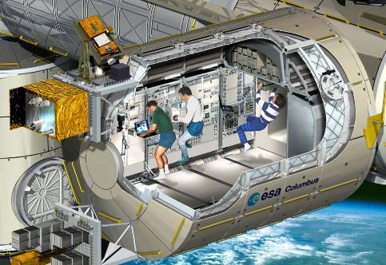
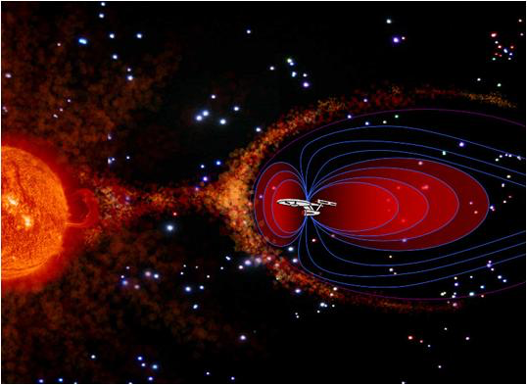
Countermeasures
Passive shielding
Active shielding
Biology-based approaches

Slide 17
Shielding material selection the need of a compass
Electromagnetic interactions
best
Liquid H₂
Slow down and stopping
Nuclear fragmentation
Plastic (PE)
Water
Aluminum
Concrete
worst
Lead
Isotope- and charge-changing

Slide 18
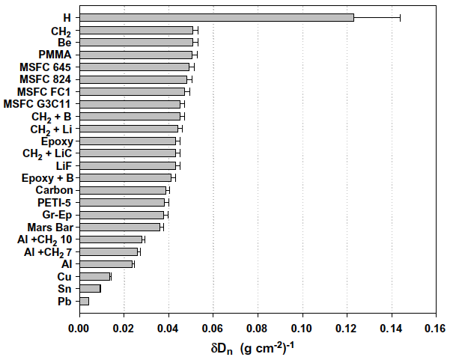
Material effectiveness as shielding (1 GeV/u ⁵⁶Fe as proxy of GCR)

Slide 19
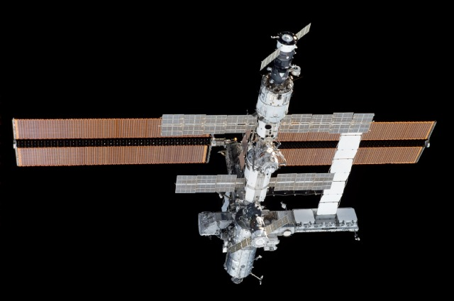
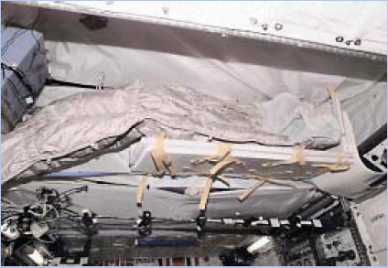
Shielding on ISS
Sleep station outfitted with PE and water
Thin, flat panels are PE shields
Stowage water packaging above the sleep station

Slide 20
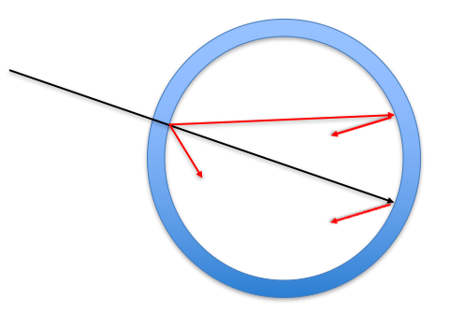
Shielding in deep space
Transport codes however indicate that the strategy of “the more the better” does not always work in space.

Slide 21
Because of nuclear fragmentation, light ions (H and He isotopes) dominate the contribution to both the dose and dose equivalent.
To validate MC predictions, measurements of production cross sections for these isotopes are necessary.

Slide 22
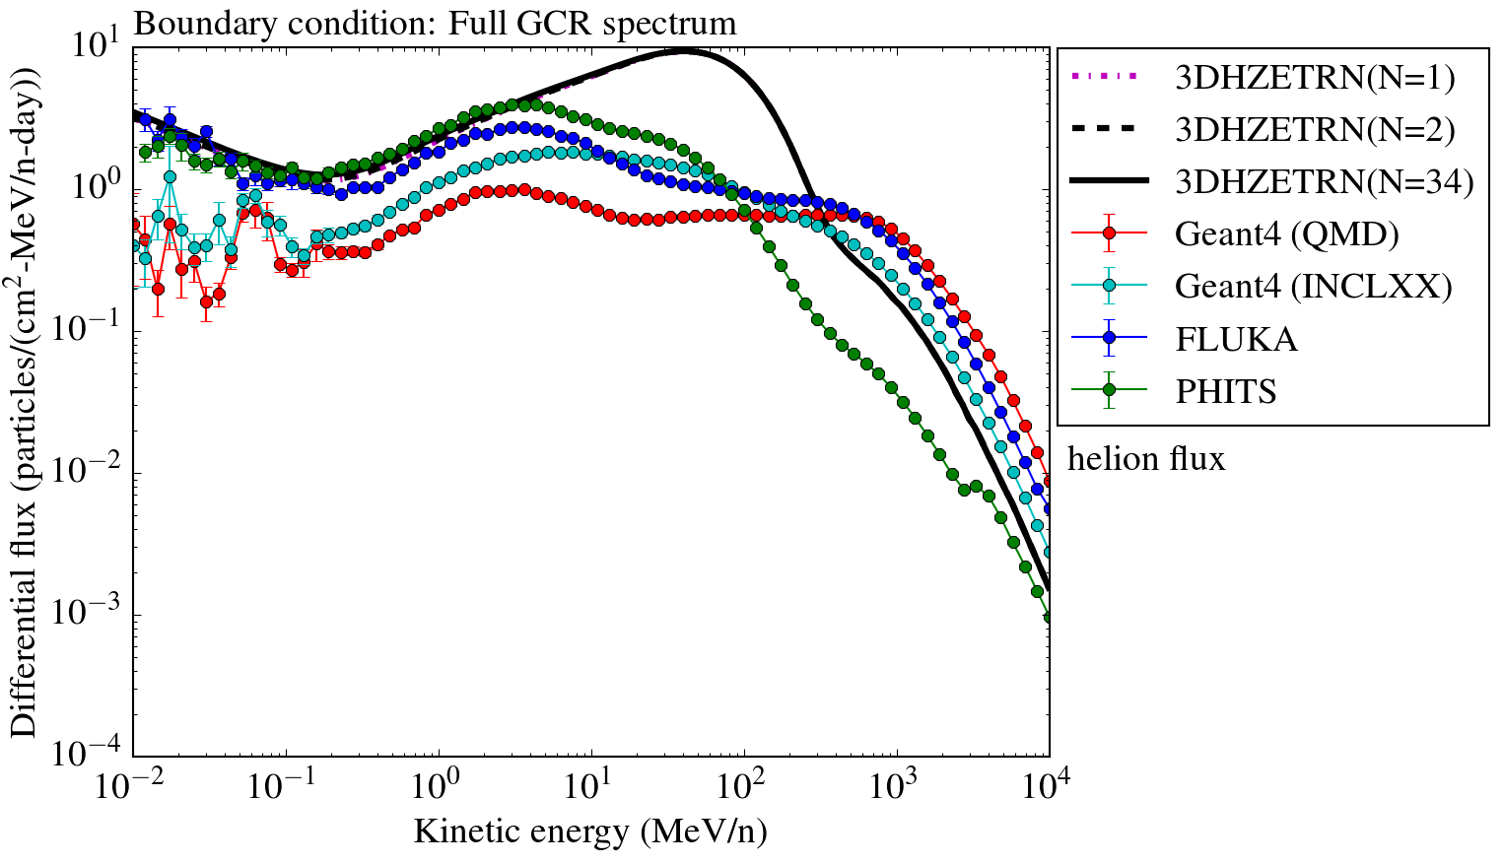
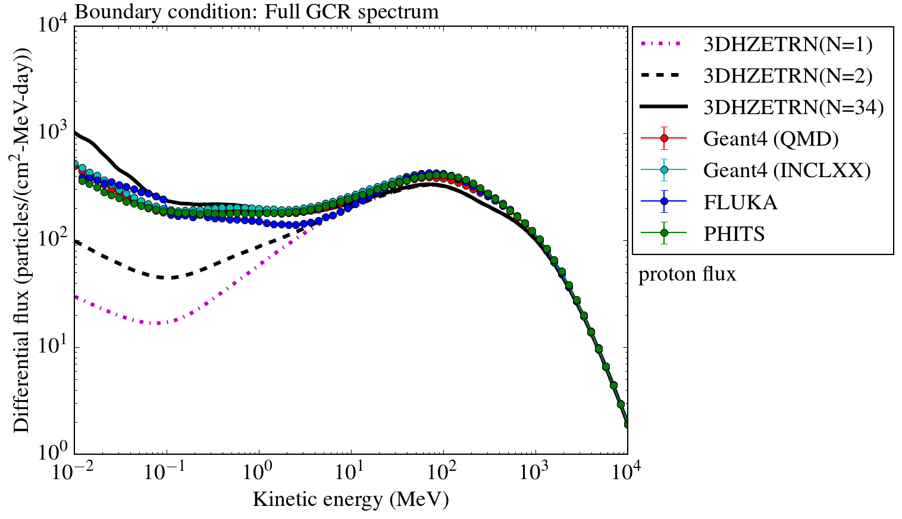
What codes predict light ions production
GCR spectrum interacting with 20 g cm⁻² Al shielding
d, t,
³He, ⁴He
Protons

Slide 23
Existing experimental data for double-differential fragmentation cross sections
NASA recognized the need to decrease the physical uncertainty of light ions cross sections to improve transport codes predictions.
For this reason, a large experimental campaign to measure double-differential cross section for the production of secondary particles in thick shieldings was funded by NASA in 2015.
Full list available at Norbury et al. Rad. Meas. 47 (2012)

Slide 24
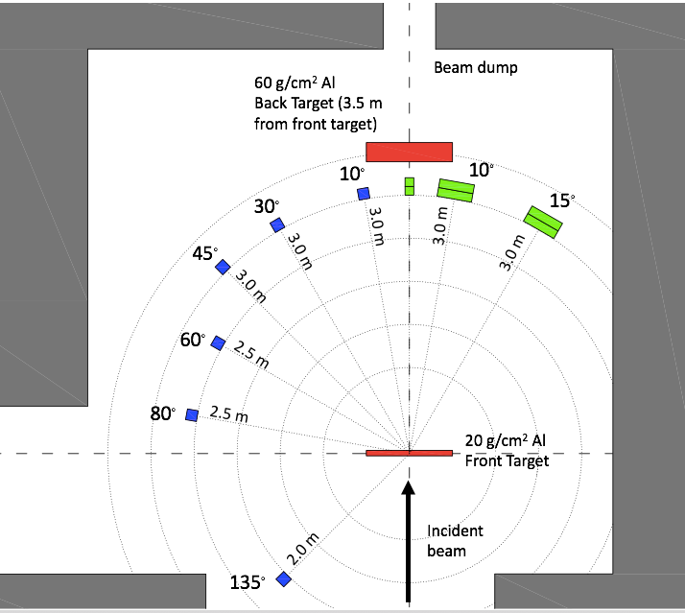
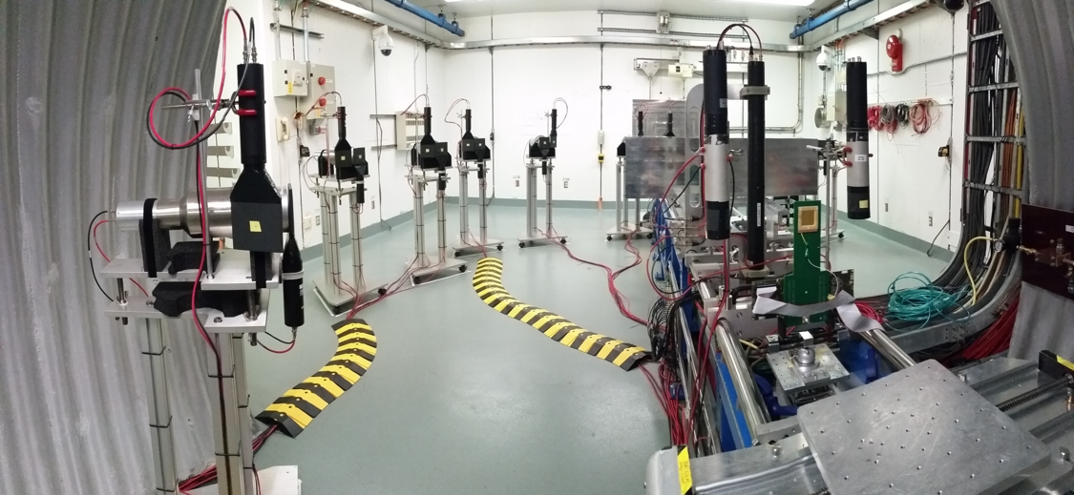
The experiment (performed at NSRL, US)
Beams: H to Fe
Energies: up to 1500 MeV/u
Targets: elemental (C, Al) and composite (PE, H₂O)
Detectors
Pixel chamber
Plastic scintillators
Liquid scintillators
NaI crystals
BaF₂ crystals
Methodologies
Energy deposition (ΔE and E)
Time-of-flight (TOF)

Slide 25
Results
Outputs:
yield
kinetic energy
of all fragments types (including isotope discrimination) at several angles
Double-differential cross sections

Slide 26
Summary
Facts:
Radiation represent a main limitation to space exploration
Nuclear processes (and in particular nuclear fragmentation) strongly influence the radiation biological effect
Deterministic and Monte Carlo codes can provide radiation risk assessment for all mission scenarios in space
The is a huge gap in the isotopic fragmentation cross sections (especially for light ions)
Take home messages:
Double differential fragmentation cross sections (especially for light ions) play a key role in improving the existing theoretical models and in providing measurements for validating and benchmarking them
FOOT can provide data these data!

Slide 27
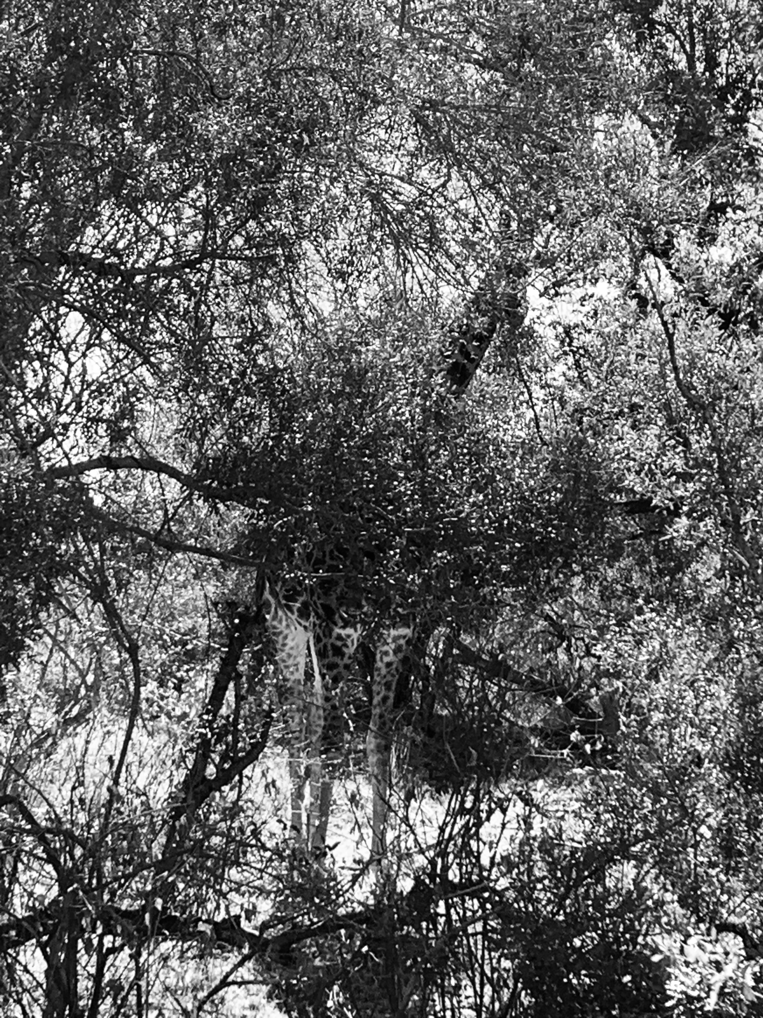
Thank you for your attention.
Questions?

Slide 28
What do particle therapy and space radiation have in common?
Ions used in radiotherapy represent an important subset of the radiation environment found in space

Slide 29
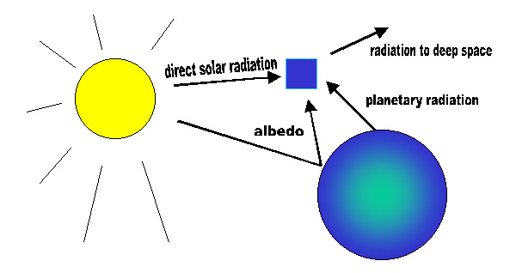
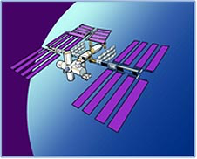
Albedo radiation
Particles (especially protons and neutrons) produced from the interaction of GCR with atmosphere

Slide 30
Comparison between state-of-the-art codes
Differences in nuclear interaction models still present and highlights need for further model development and experimental measurements

