Slide 1
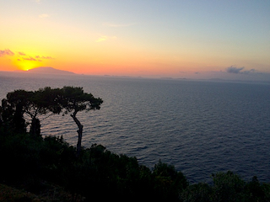
Review of current and future neutrinoless double beta decay experiments
Ezio Previtali
Laboratori Nazionali del Gran Sasso
University of Milano-Bicocca
8th Workshop on Theory, Phenomenology and Experiments in Flavour Physics
Jun 11 – 13, 2022 - Villa Orlandi, Anacapri, Capri Island, Italy

Slide 2
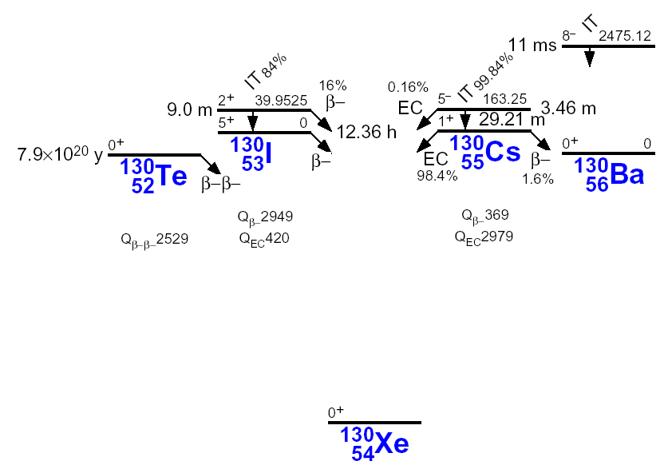
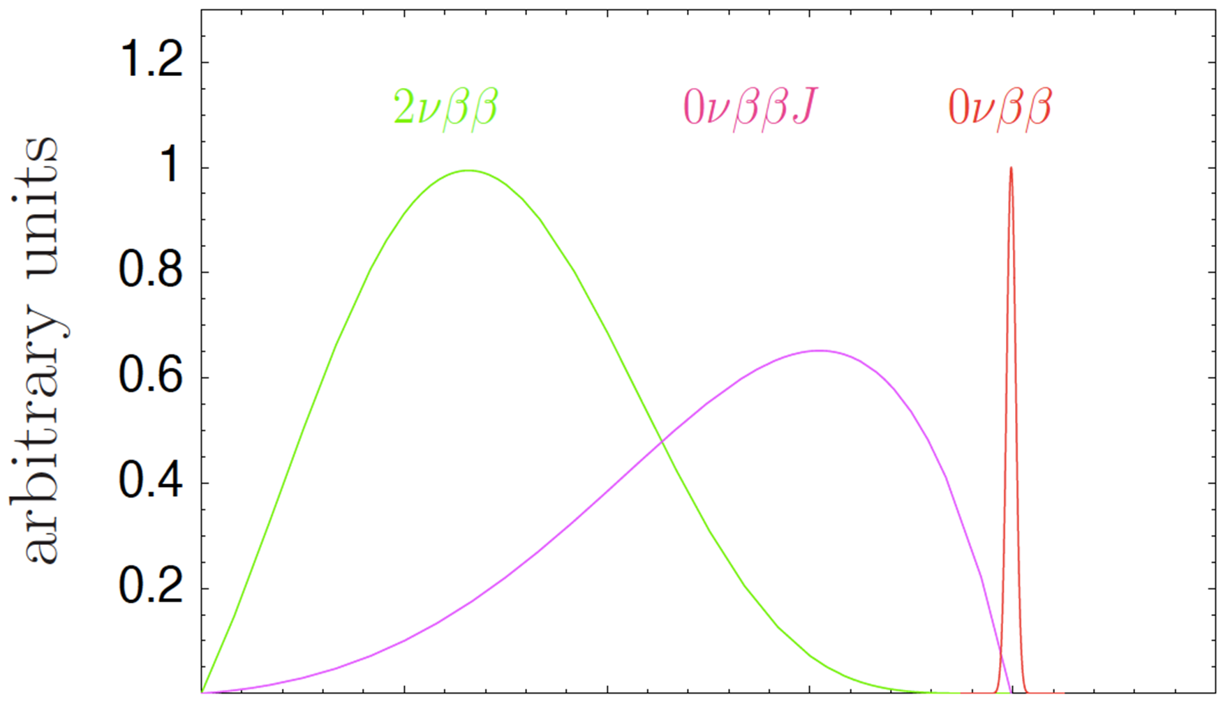
Double Beta Decay
Rare Nuclear Decay
(A,Z) → (A,Z+2) + 2e⁻ + [...]
occurs in a number of even-even nuclei in A even multiplets
e⁻
ν_{e}
ββ-2ν: two neutrino mode
(A, Z) → (A, Z+2) + 2e⁻ + 2ν_{e}
allowed in Standard Model
second order weak transition
e⁻
ν_{e}
ββ-0ν: neutrinoless mode
(A, Z) → (A, Z+2) + 2e⁻
not allowed in SM (ΔL=2, B-L violation)
neutrino is a massive Majorana particle
Majorana phases
e⁻
e⁻
J
ββ-0ν: “exotic” modes
(A, Z) → (A, Z+2) + exotic particles
e⁻
e⁻
Capri, September 12, 2022
E. Previtali

Slide 3
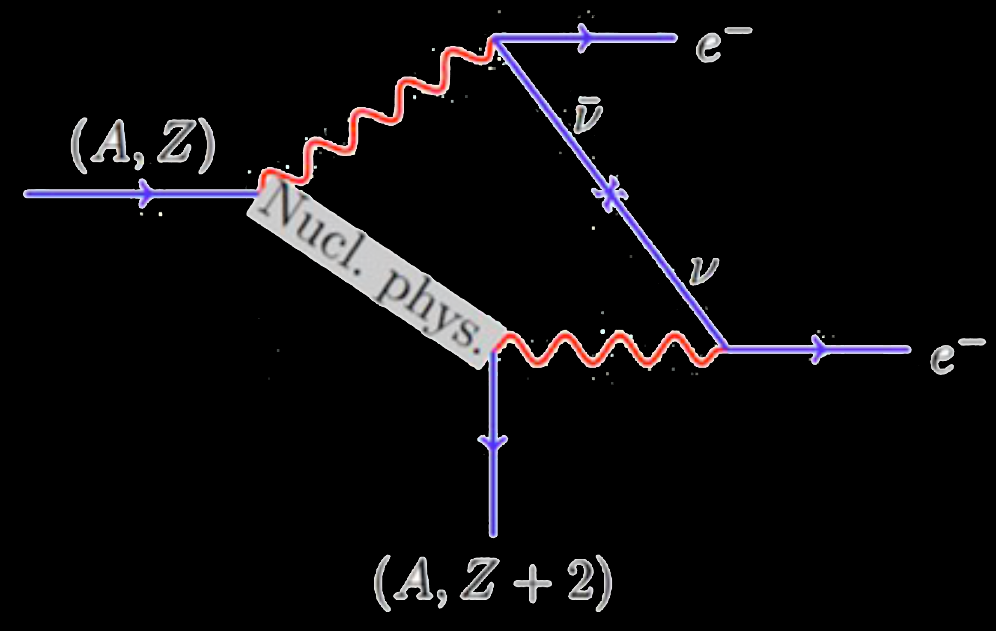
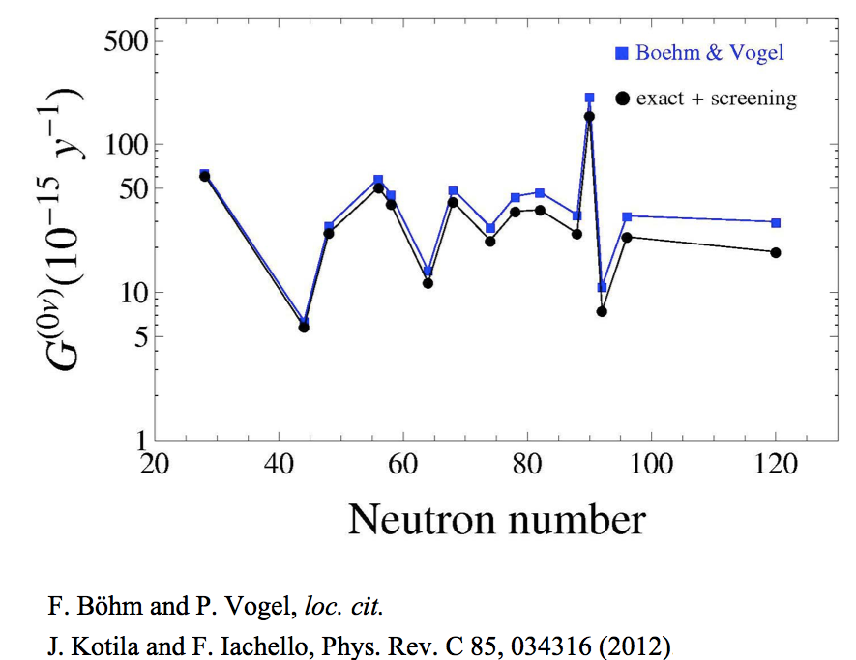
Neutrinoless Double Beta Decay Process
With a specific approach and introducing some important approximations:
phase space factor
calculable precisely
nuclear matrix element
not well established
particle physics parameters
depends on models
massive Majorana neutrinos
GUT’s
SUSY
…
Capri, September 12, 2022
E. Previtali

Slide 4
Nuclear Matrix Elements
M_{0ν} values estimated from different Nuclear Matrix calculation methods
NME calculations:
EDF: large
QRPA: larger spread
NSM: small
IMSRG ⁴⁸Ca ab initio: very small
Significant differences
Results inaccuracy
g_{A} quenching?
Capri, September 12, 2022
E. Previtali

Slide 5

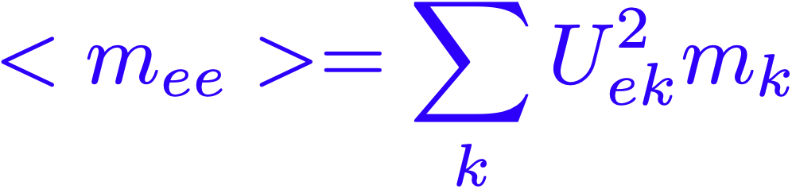
Light Majorana Neutrinos Mechanism
ββ0ν mediated by exchange of light Majorana neutrinos other mechanisms give no contributions
m_{ee} depends on three masses and two Majorana phases
Transition amplitude is proportional to the coherent sum of neutrino masses
Majorana phases play a crucial role: possible cancellations
Oscillation experiments could identify only neutrino mass differences
Capri, September 12, 2022
E. Previtali

Slide 6
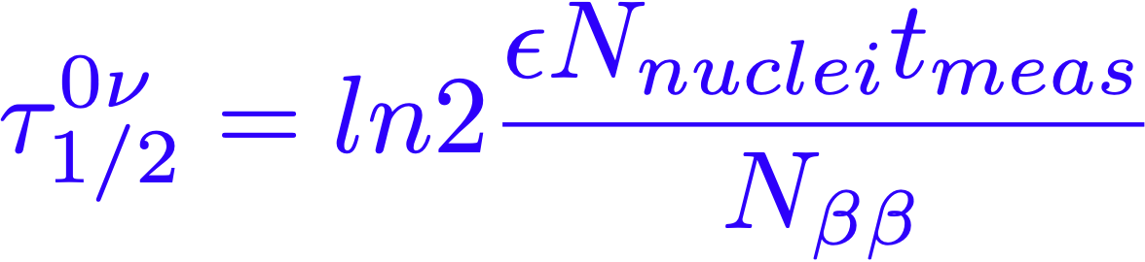
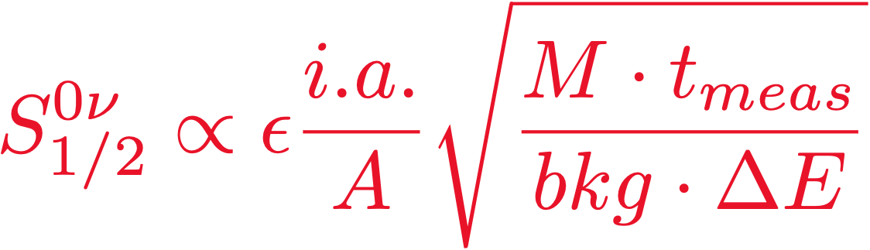
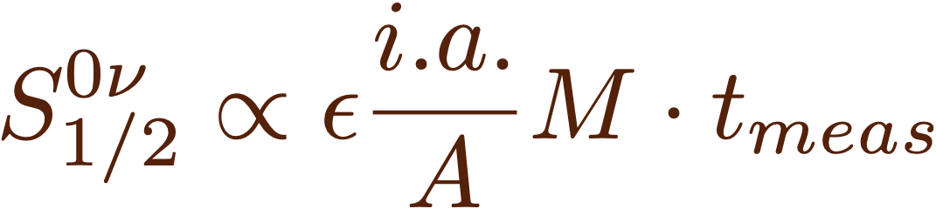
Experimental Sensitivity
Many important Parameters
N_{nuclei} number of active nuclei
t_{meas} measurement time [y]
M mass of the detector [kg]
ε detection efficiency
i.a. isotopic abundance
A atomic number
ΔE energetic resolution [keV]
bkg background index [c/keV/y/kg]
N_{bkg} >> 1
isotope choice/enrichment
experimental approach
scalability
stability
cost
N_{bkg} ~ 1
Capri, September 12, 2022
E. Previtali

Slide 7
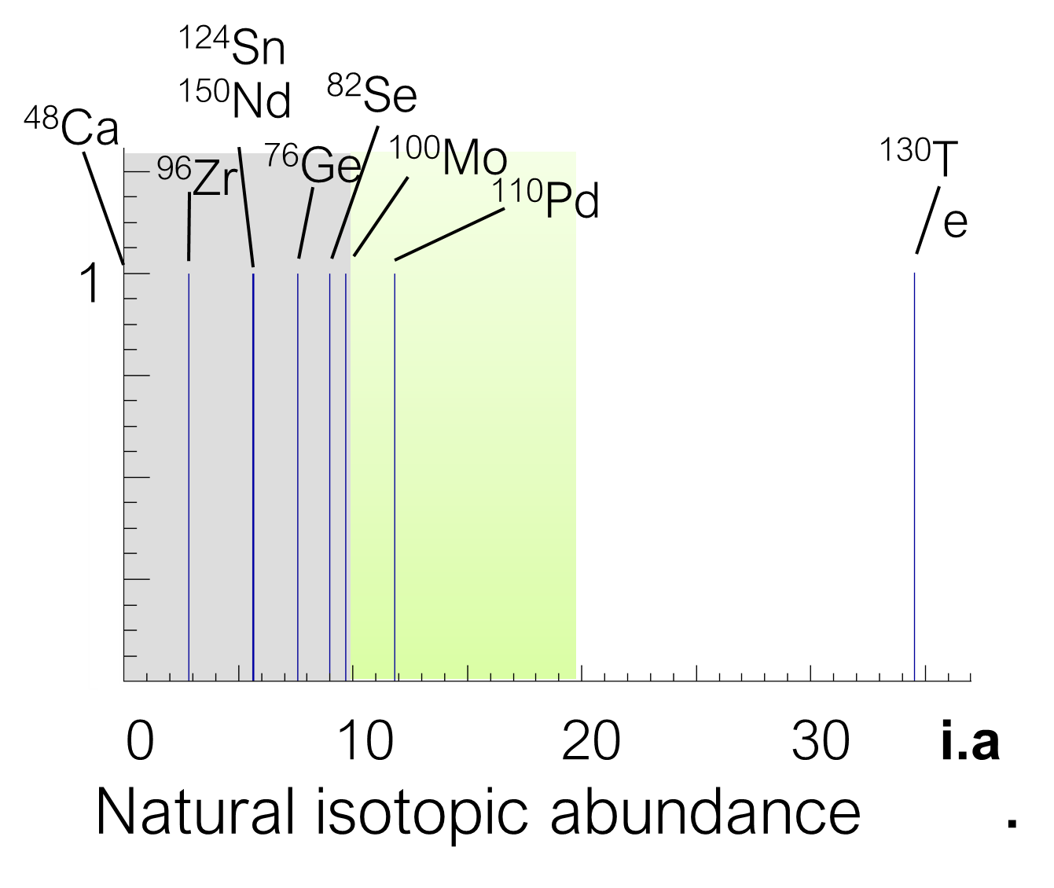
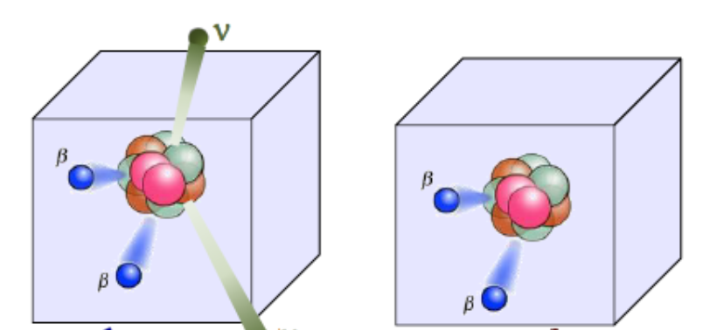
Isotope selection
From the Table of Isotopes
35 isotopes with double beta decay transitions
9 promising for sensitive measurements
most promising candidates: Q_{ββ} > 2-3 MeV
isotope enrichments are needed
Cut-off ²²²Rn
Q (MeV)
Cut-off natural Radioactivity
Mass Number
Considering a calorimetric approach (Source == Detector)
  isotope enrichments are needed
  very clean materials have to be identified
Capri, September 12, 2022
E. Previtali

Slide 8
Background interferences
It is necessary to strongly reduce background events:
  Cosmic Rays
  Radioactivity
Guo et al., Chinese Physics C45 (2021) 025001, arXiv:2007.15925v2
Capri, September 12, 2022
E. Previtali

Slide 9
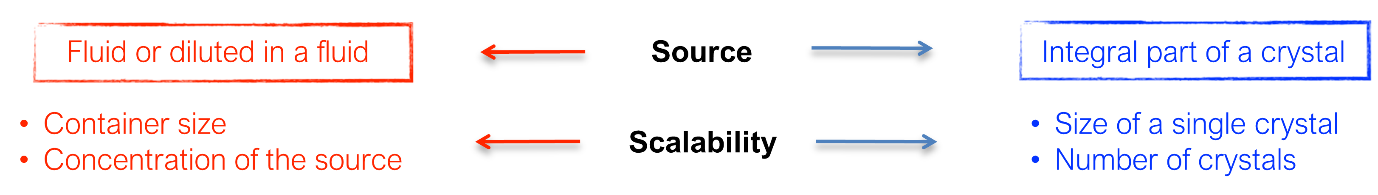


Possible Calorimetric Approaches
Without balloon (SNO+)
With balloon (KamLAND-Zen)
With balloon+Cherenkov (Theia)
Opaque scintillator (LiquidO)
Diluted source in liquid scintillatol
Large volumes of fluid
High-pressure gas
Liquid
Cylindrical(Xe: Next, PandaX, Axel; SeF6:N\nuDEx)
Spherical(R2D2)
TPC
Single phase (Xe: EXO-200, nEXO)
Double phase (Xe: Darwin, LZ)
Inorganic Scintillators (Candles)
Crystal arrays
Germanium diodes
CCD to Se (SELENA)
CdZnTe (COBRA)
Immersed in LAr (GERDA, LEGEND)
Conventional cryostats (MJD)
Semiconductor detectors
Pure bolometers (CUORE)
Scintillating bolometers (CUPID, AMORE)
PSD (CROSS)
Bolometers
Capri, September 12, 2022
E. Previtali

Slide 10
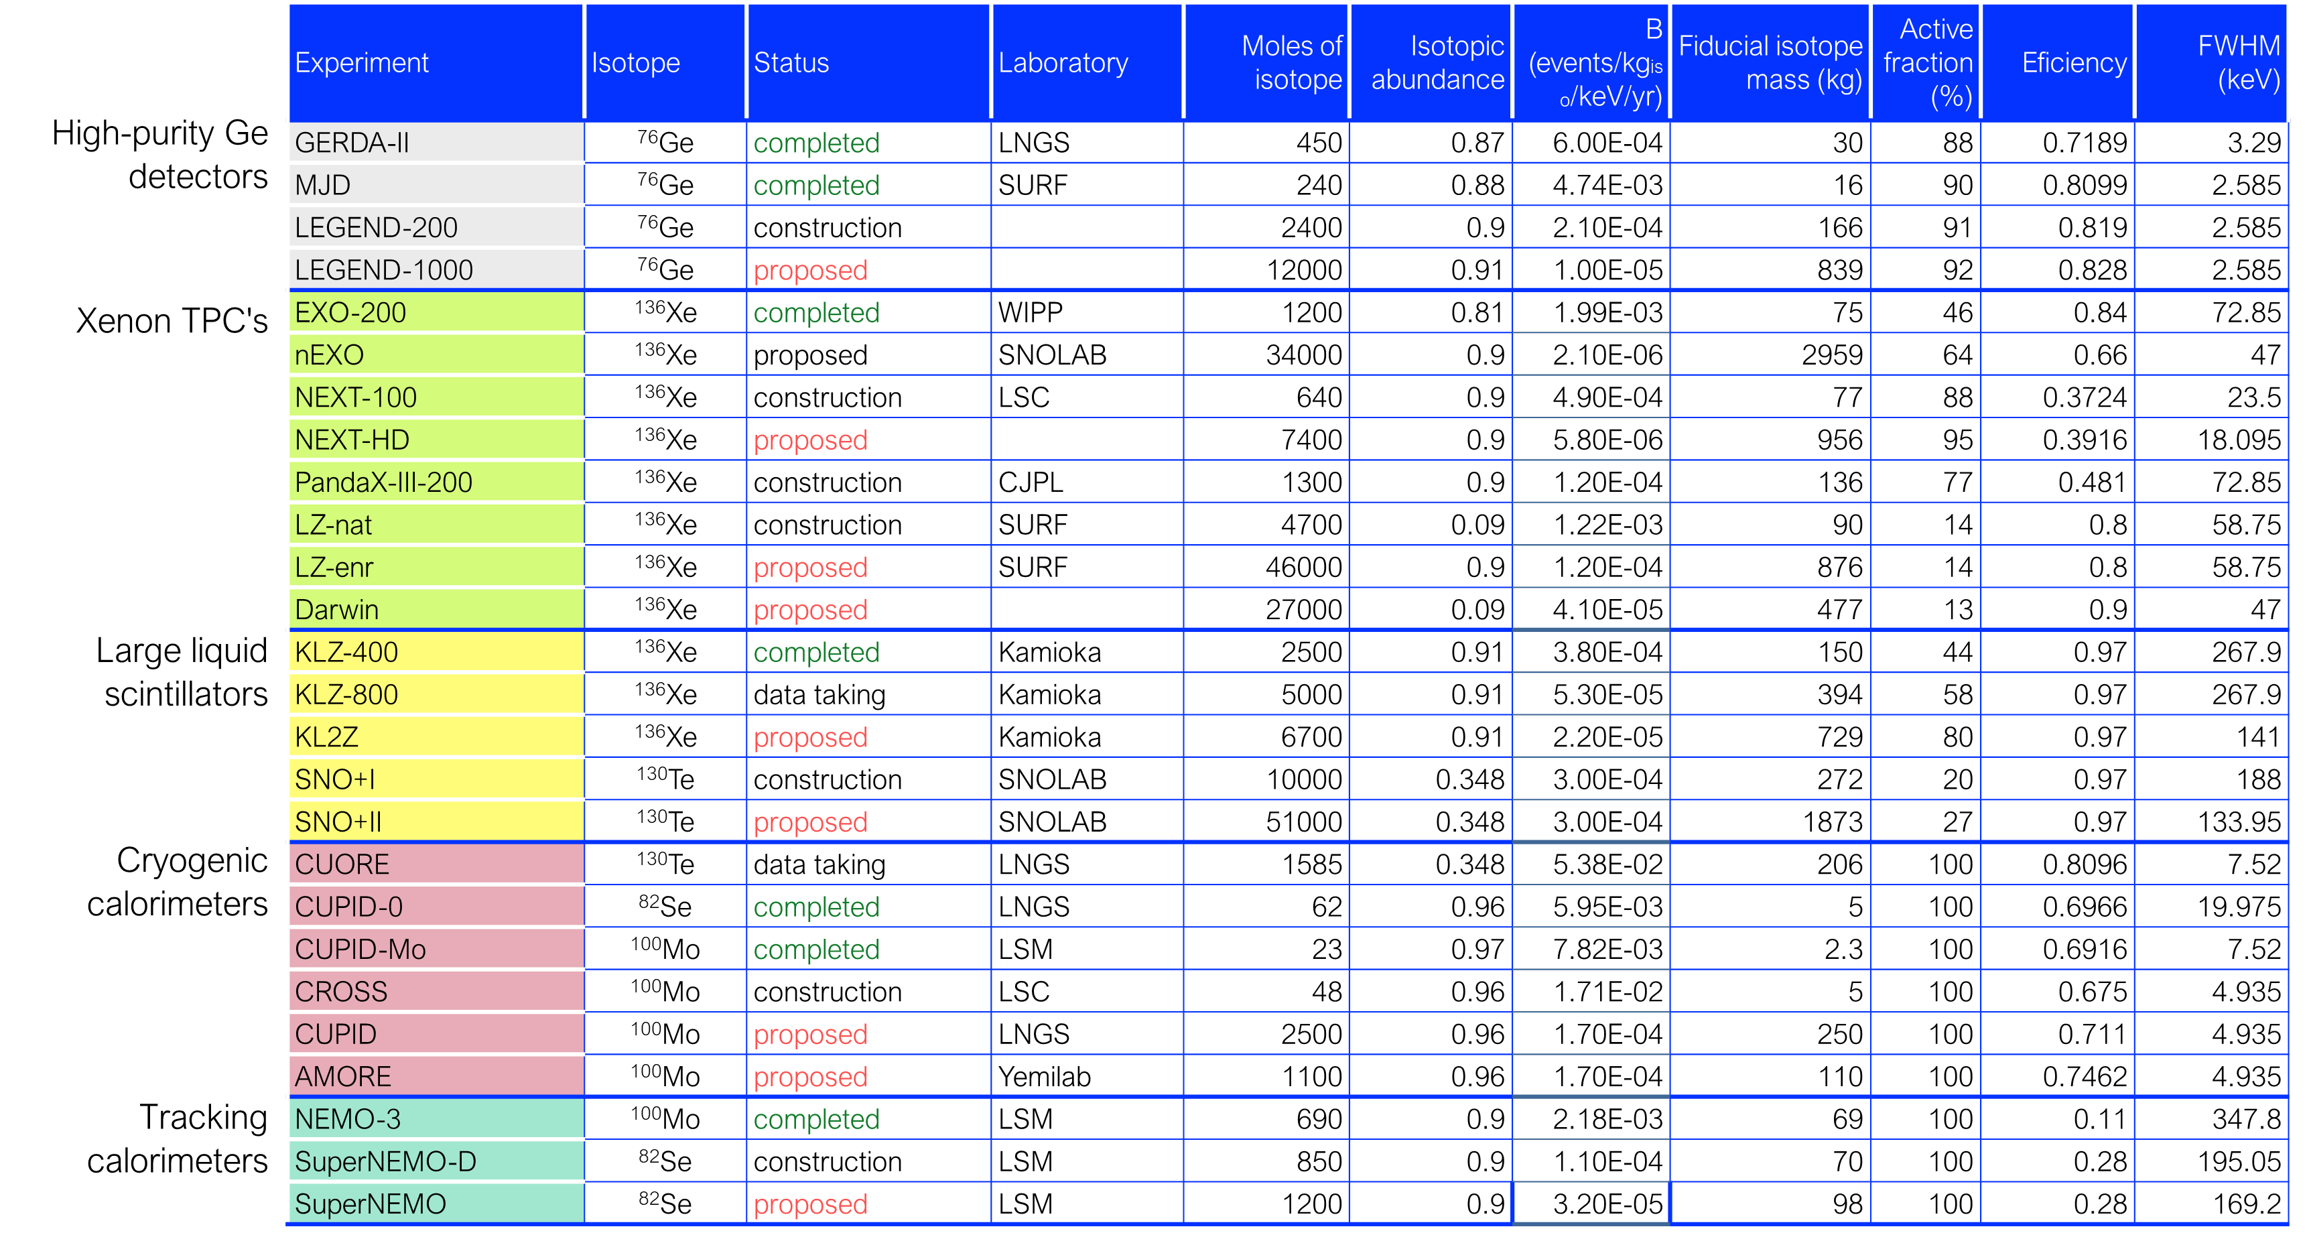
Present and Future experiments
Capri, September 12, 2022
E. Previtali

Slide 11
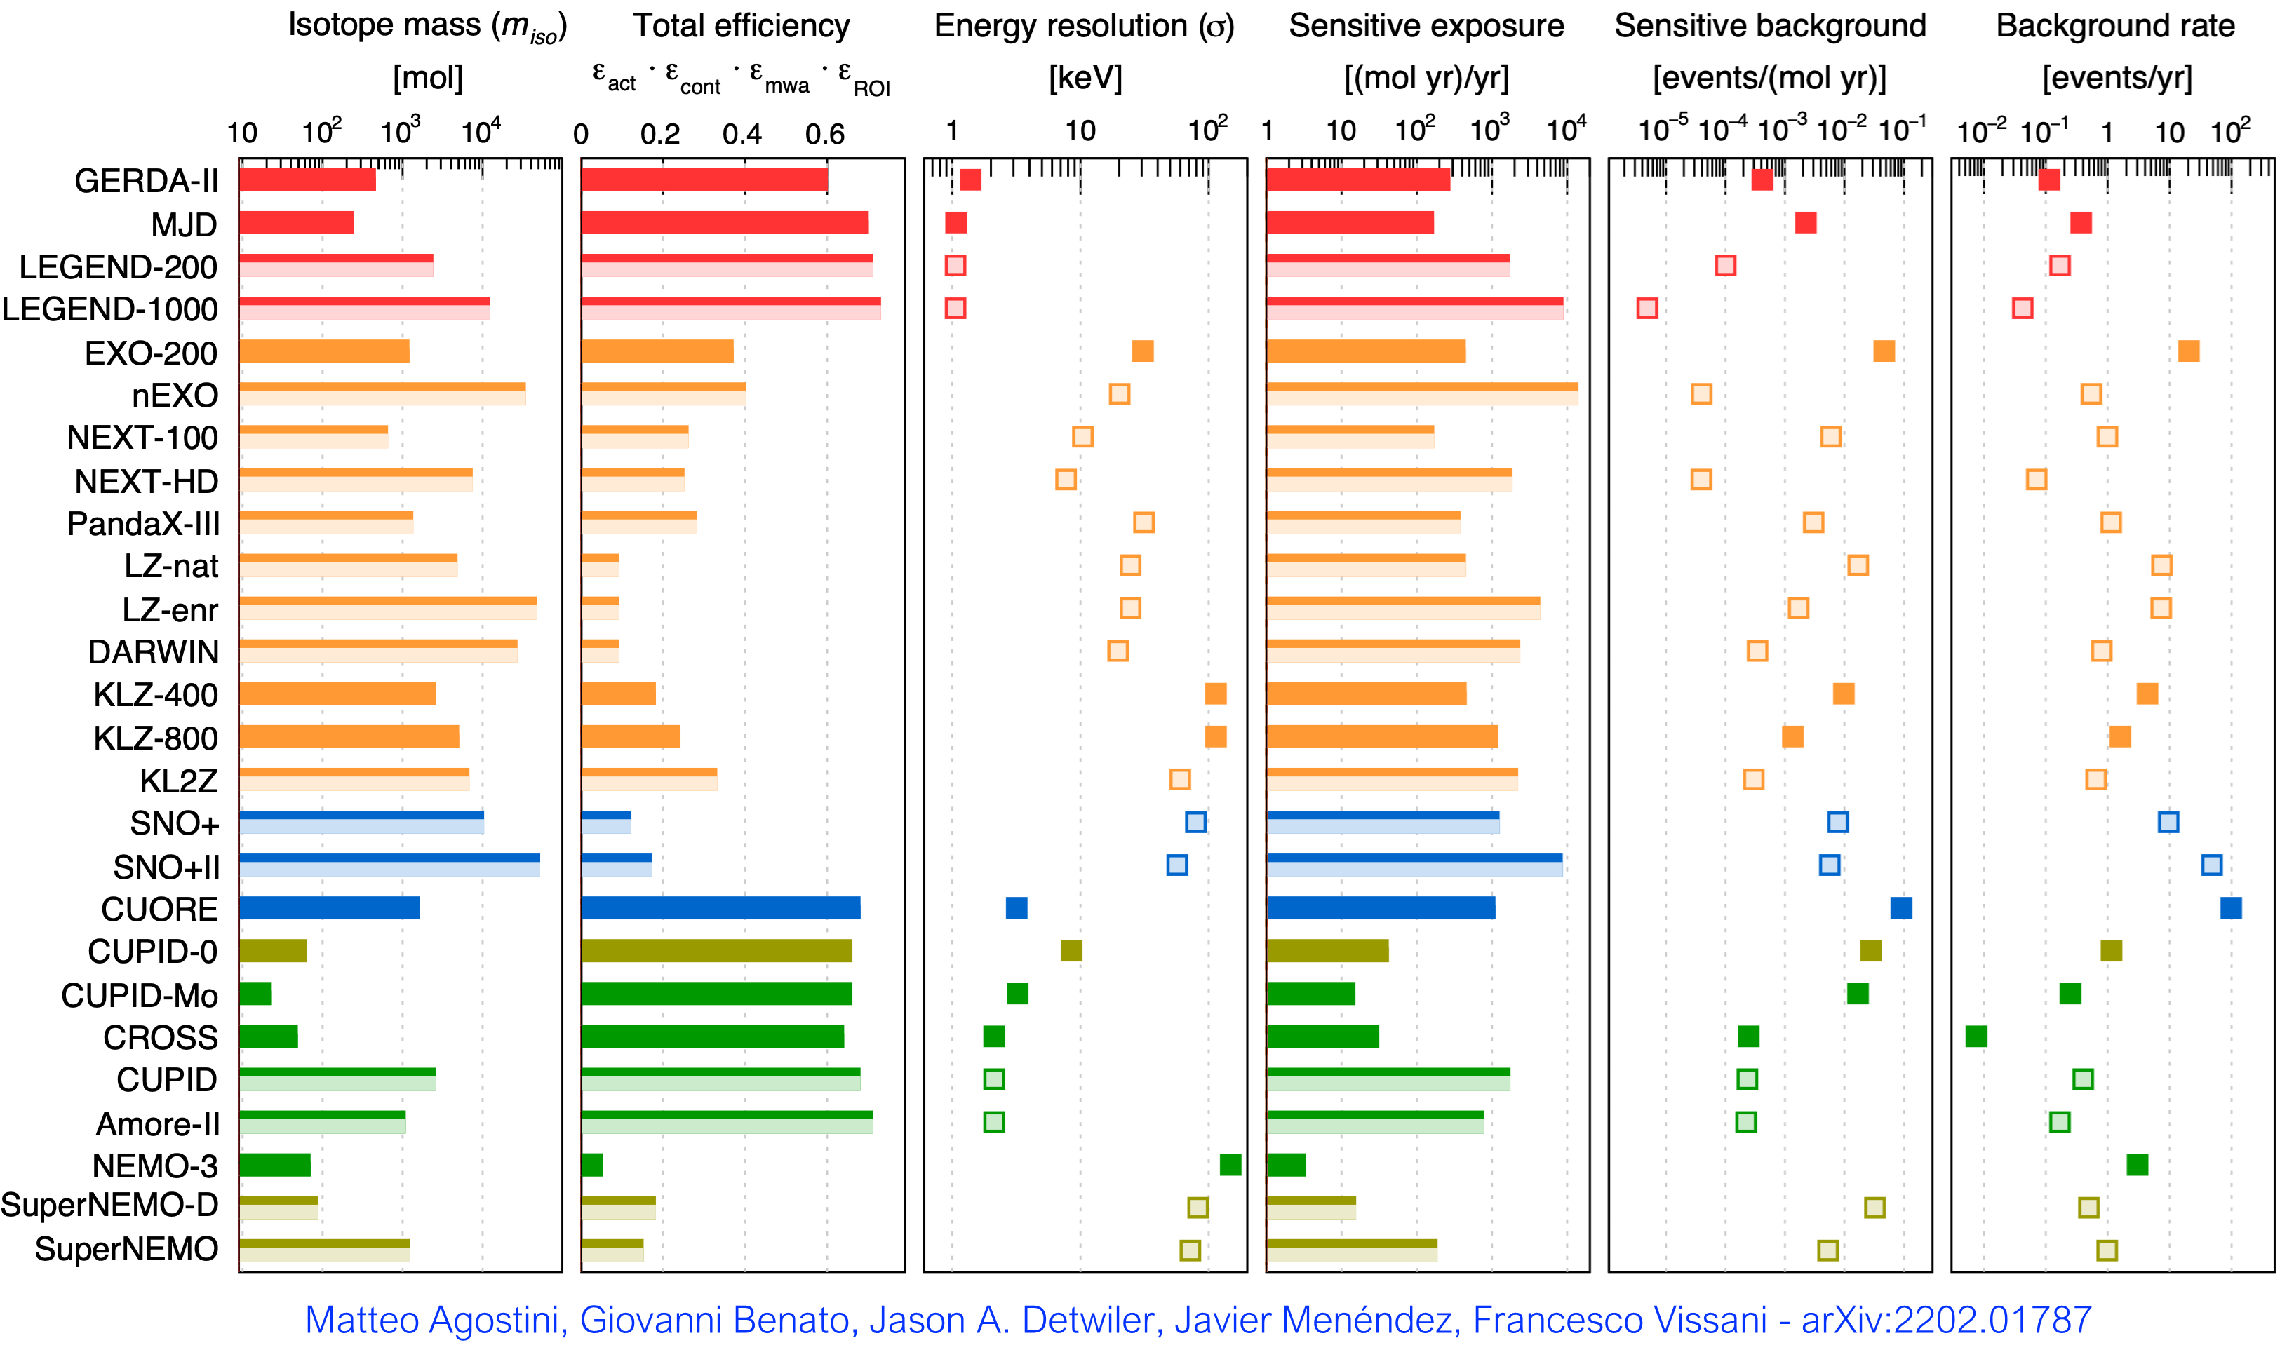
Present and Future Experiments
Ge
Xe
Te
Se
Mo
Capri, September 12, 2022
E. Previtali

Slide 12
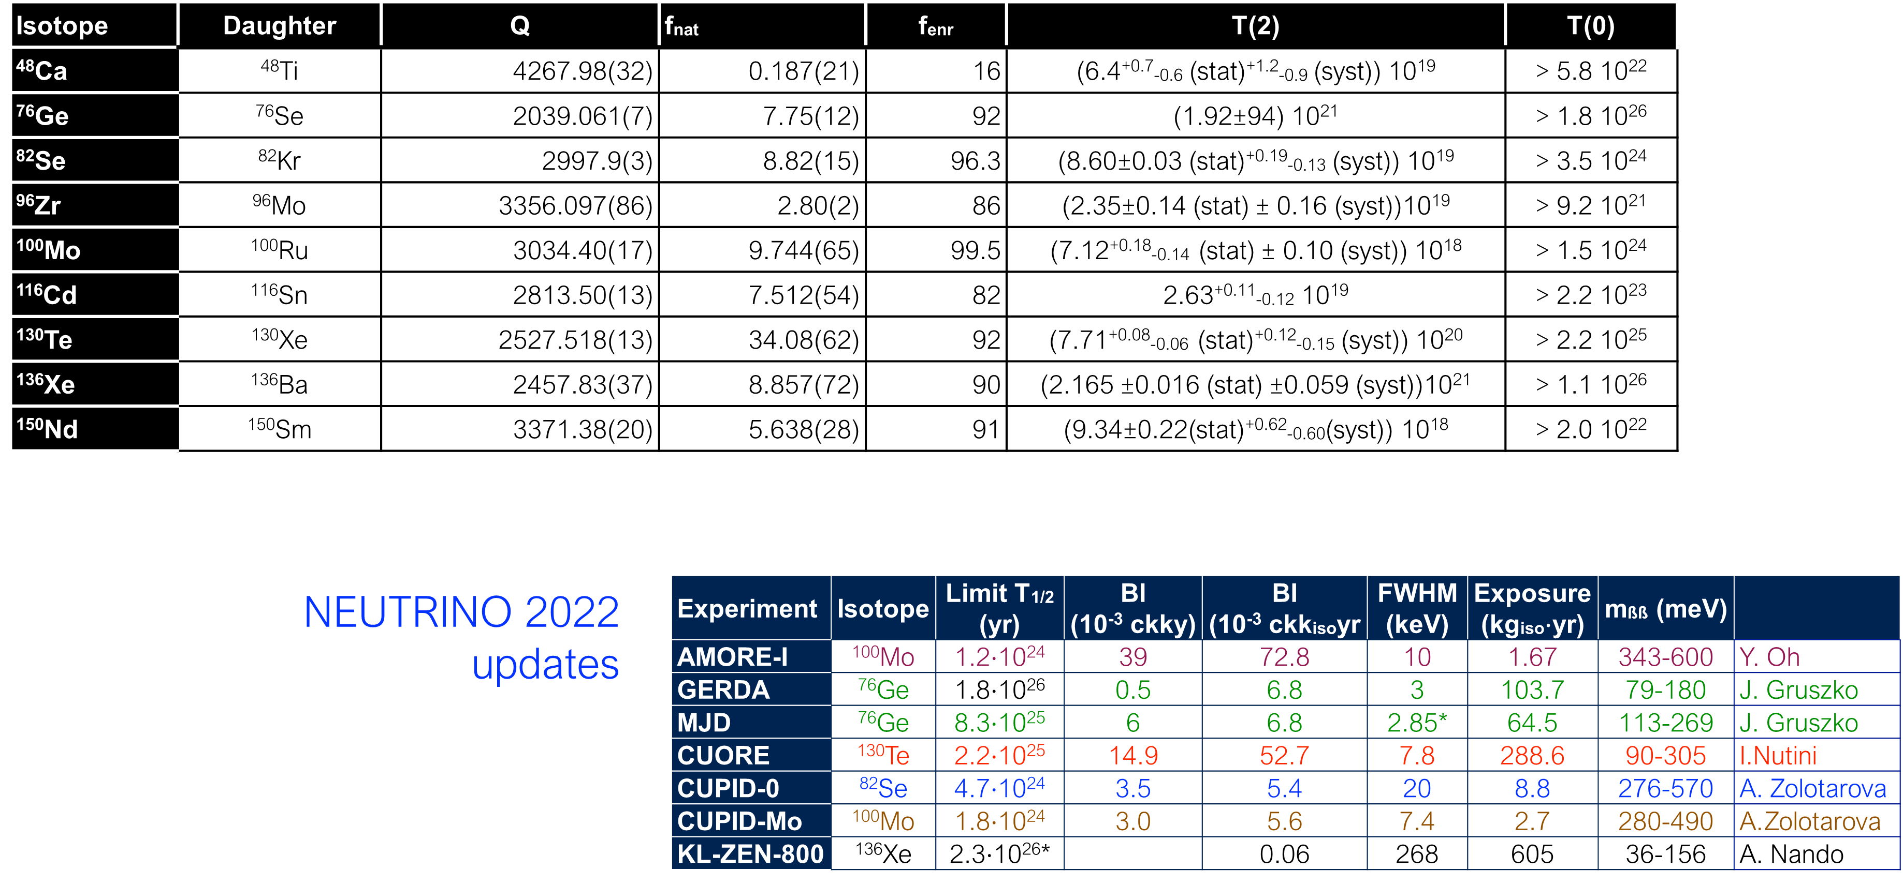
Present Experimental Sensitivities
Capri, September 12, 2022
E. Previtali

Slide 13
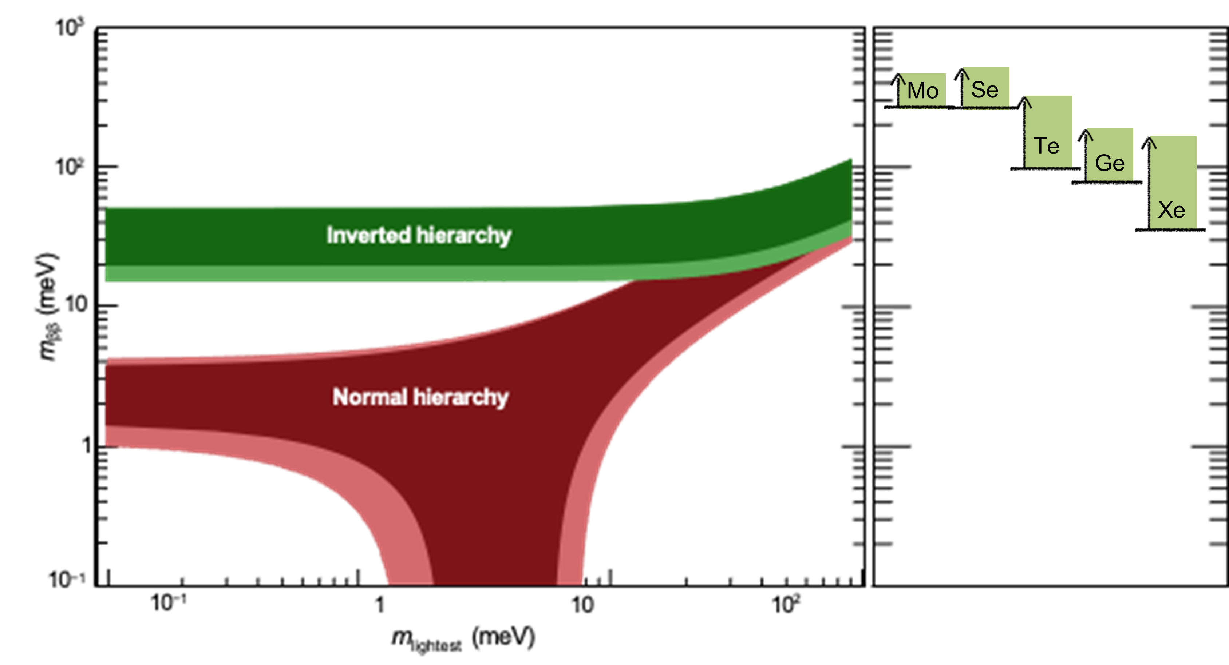
Sensitivities on Light Neutrino Majorana Mass
Capri, September 12, 2022
E. Previtali

Slide 14
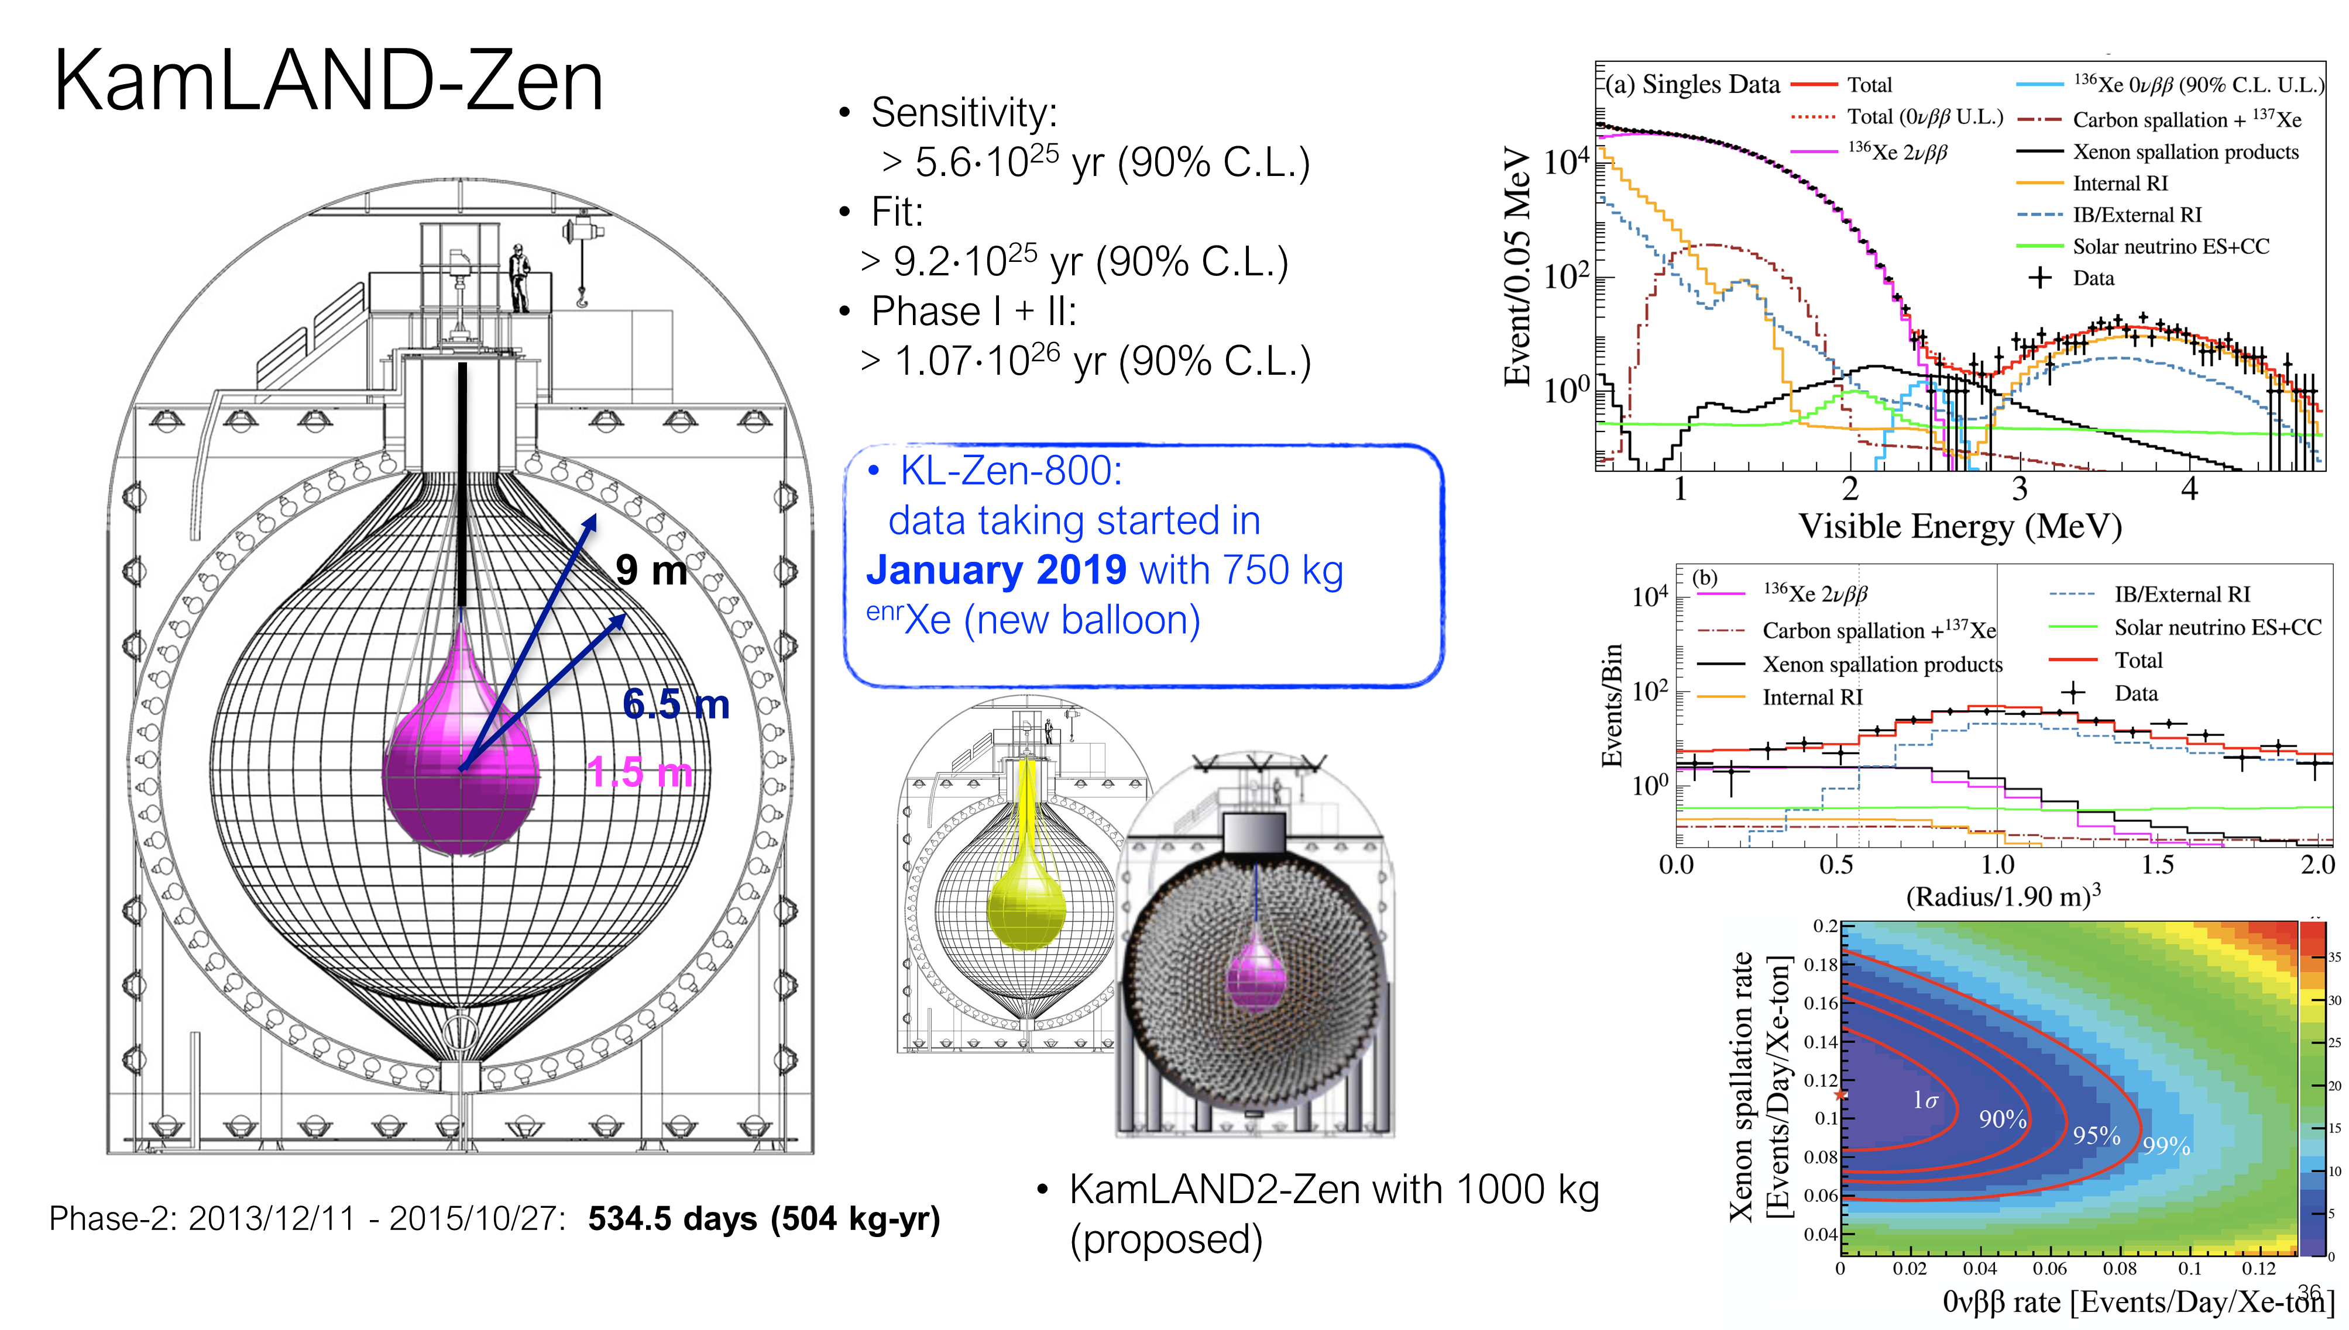
KamLAND-Zen
Large Liquid Scintillator Detector
Capri, September 12, 2022
E. Previtali

Slide 15
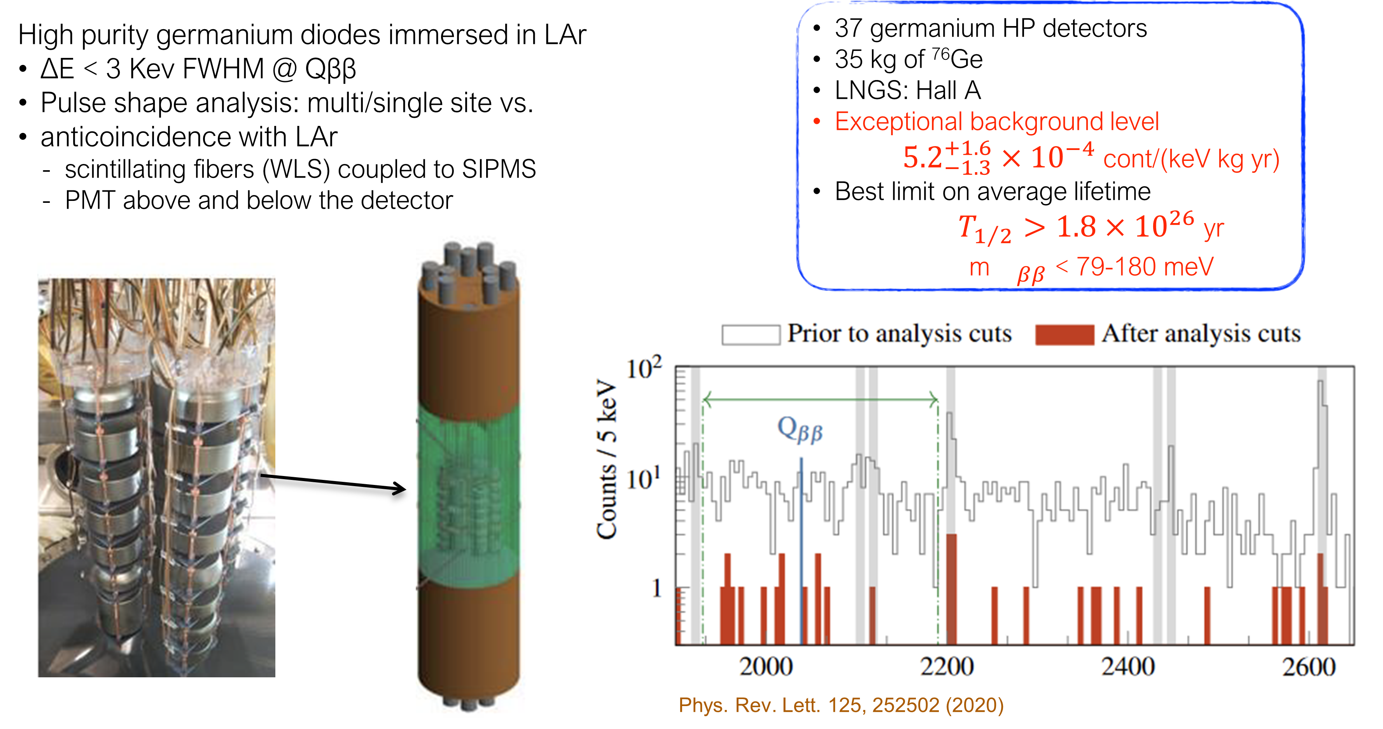
GERDA
Capri, September 12, 2022
E. Previtali

Slide 16
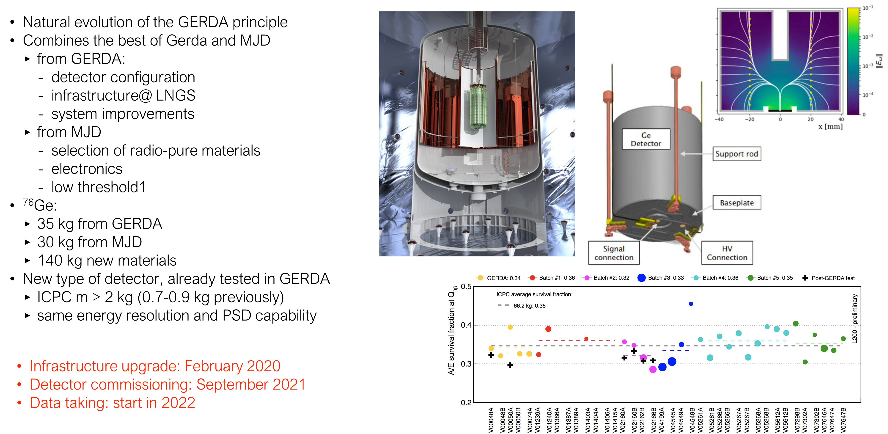
LEGEND-200
Capri, September 12, 2022
E. Previtali

Slide 17
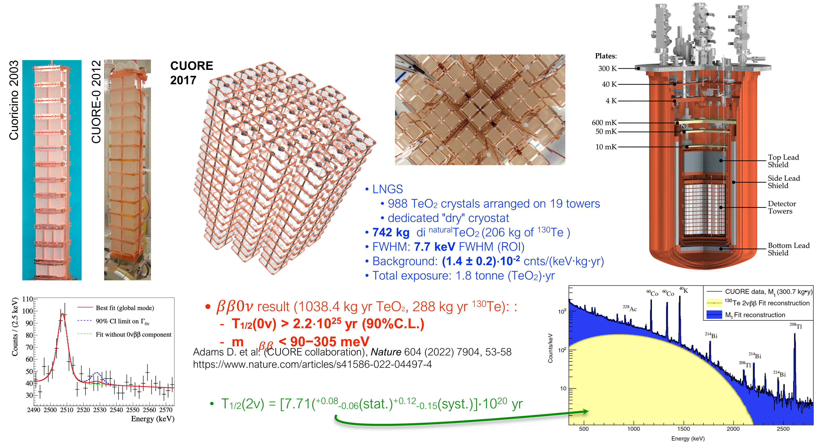
CUORE
Largest cryogenic particle detector ever realized
Capri, September 12, 2022
E. Previtali

Slide 18
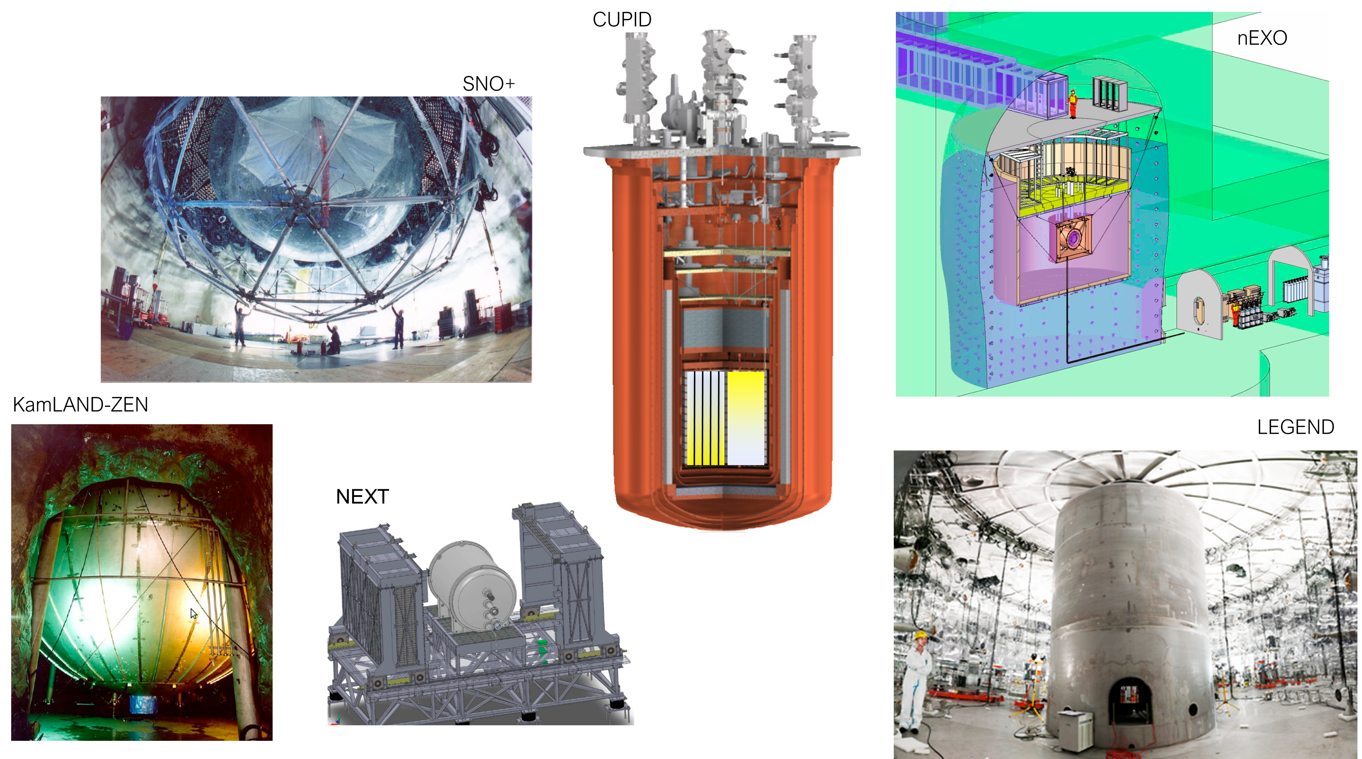
Next Generation Experiments
Capri, September 12, 2022
E. Previtali

Slide 19
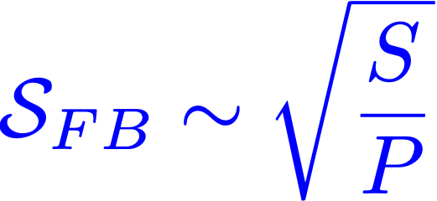

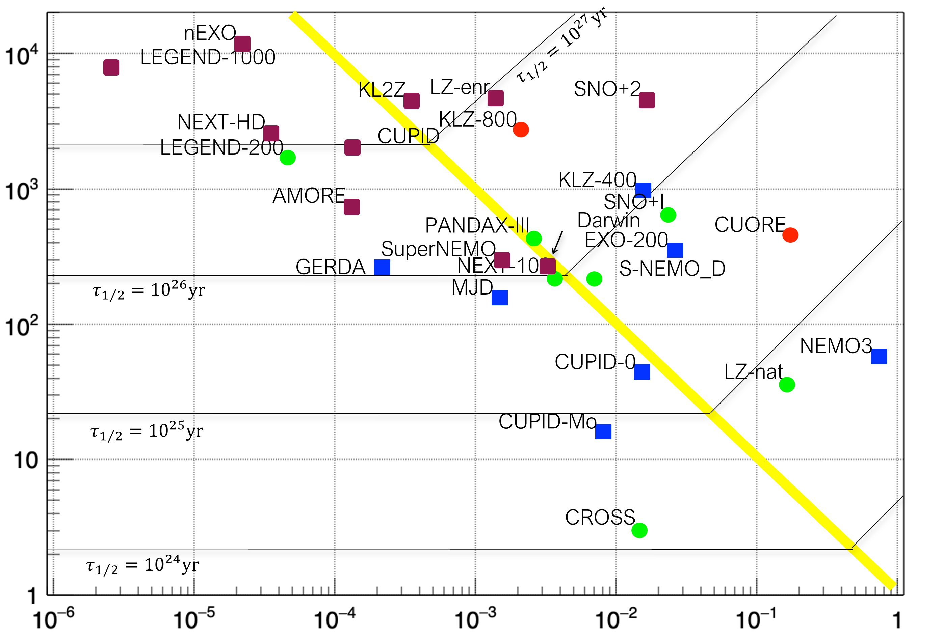

Sensitivity Plot: Present and Future
“normal” region
“zero background” region
Biassoni e Cremonesi, arXiv:1310.3870 - Prog. Part. Nucl. Phys. 114 (2020) 103803
Capri, September 12, 2022
E. Previtali

Slide 20
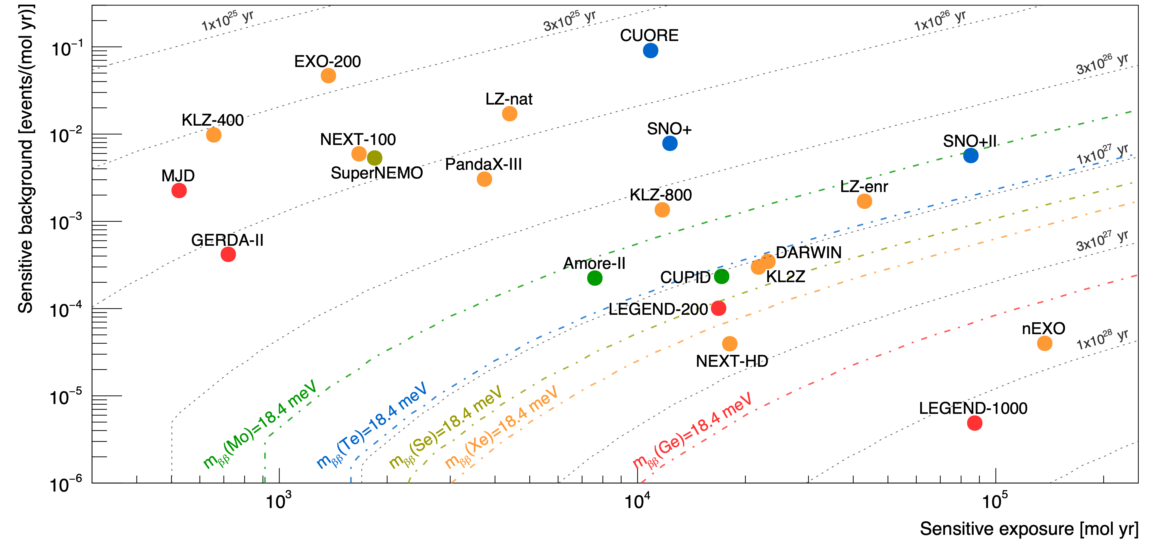
Sensitivities: a different view
Thanks to O. Cremonesi
Capri, September 12, 2022
E. Previtali

Slide 21
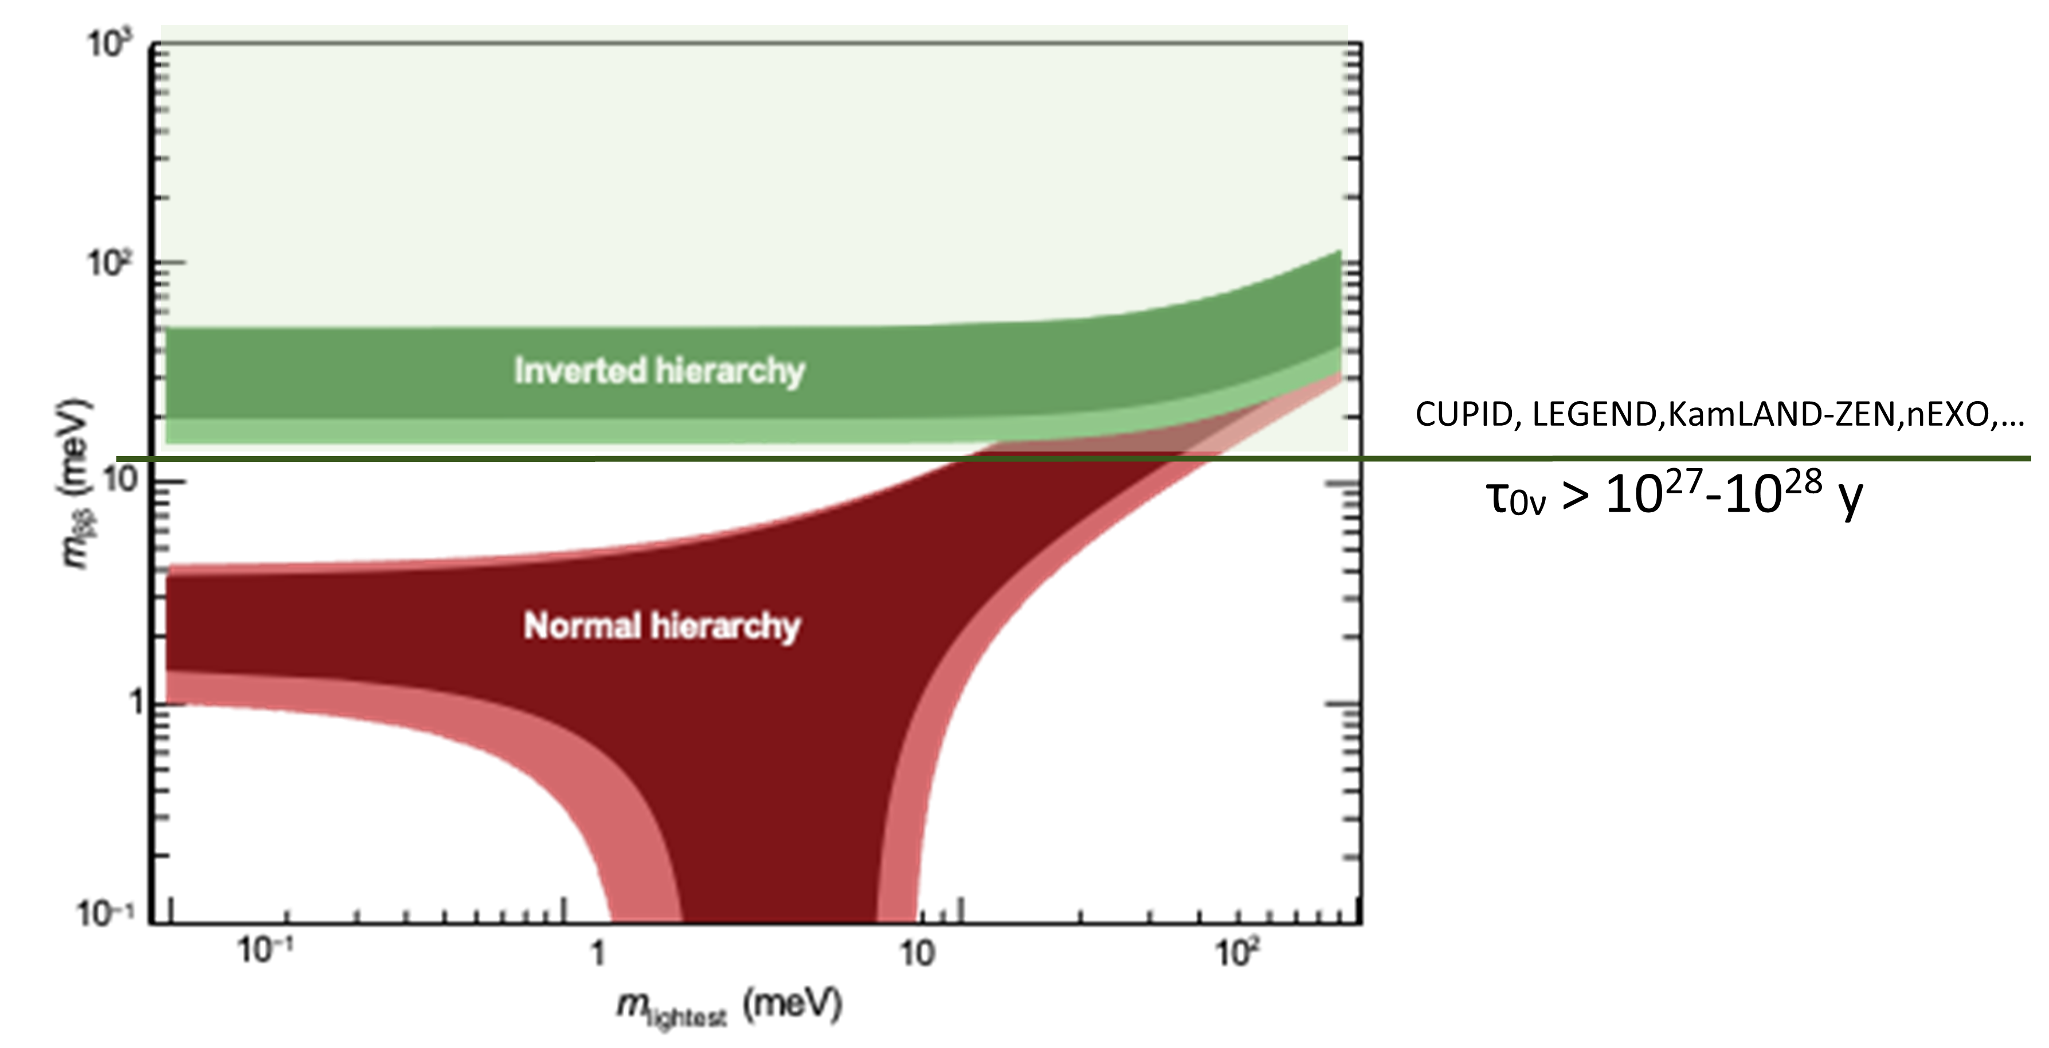
Future Sensitivity
Capri, September 12, 2022
E. Previtali

Slide 22
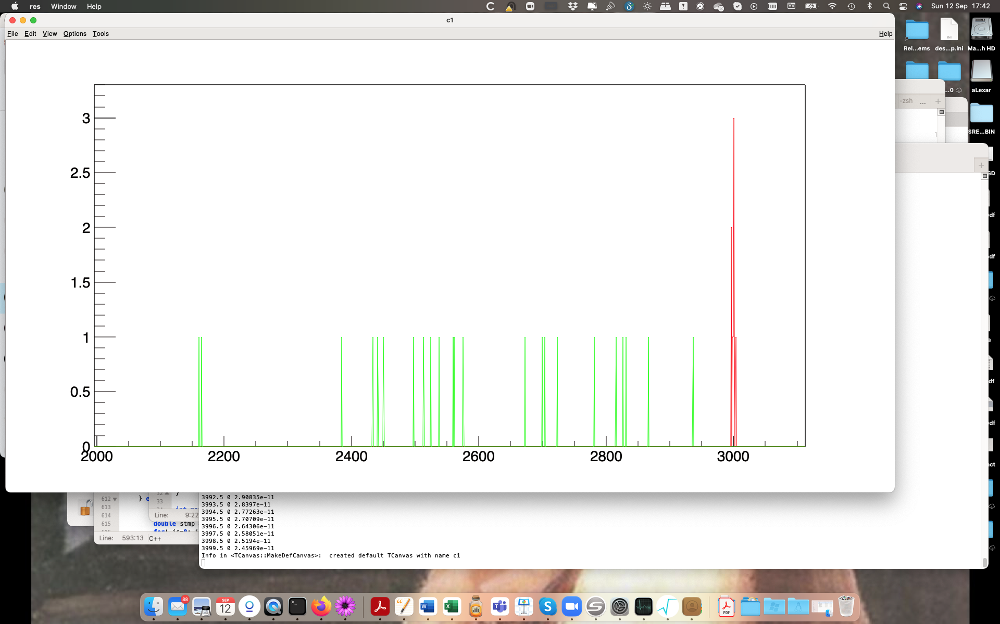
Discovey Potential
If will we see a peak @ ββ decay energy?
There are some important aspects:
  Few isotopes are needed
  High energy resolution detector crucial
  Nuclear matrix element determined
  Clear evaluation of possible interferences
  ……
In that sense a discovery potential sensitivity for each experiment is important
Capri, September 12, 2022
E. Previtali

Slide 23
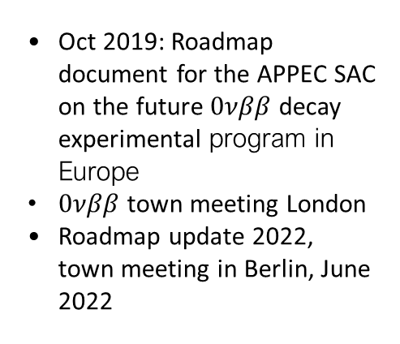
Complicated Strategy for the Future
https://agenda.infn.it/event/27143/
DOE NP Portfolio Review
July 2021
CUPID
LEGEND-1000
nEXO
“The international stakeholders in neutrino-less double beta decay research do agree in principle that the best chance for success is an international campaign with more than one large ton-scale experiment implemented in the next decade, with one ton scale experiment in Europe and the other in North America. “
https://science.osti.gov/np/nsac
https://arxiv.org/abs/1910.04688
“We recommend the timely development and deployment of a U.S.-led ton-scale neutrinoless double beta decay experiment.”
Oct 2019: Roadmap document for the APPEC SAC on the future $0νββ$ decay experimental program in Europe
$0νββ$ town meeting London
Roadmap update 2022, town meeting in Berlin, June 2022
Outcome: Realize international portfolio LEGEND-1000, nEXO and CUPID with European partners
Open discussion in september 2021 @ LNGS.
Capri, September 12, 2022
E. Previtali

Slide 24


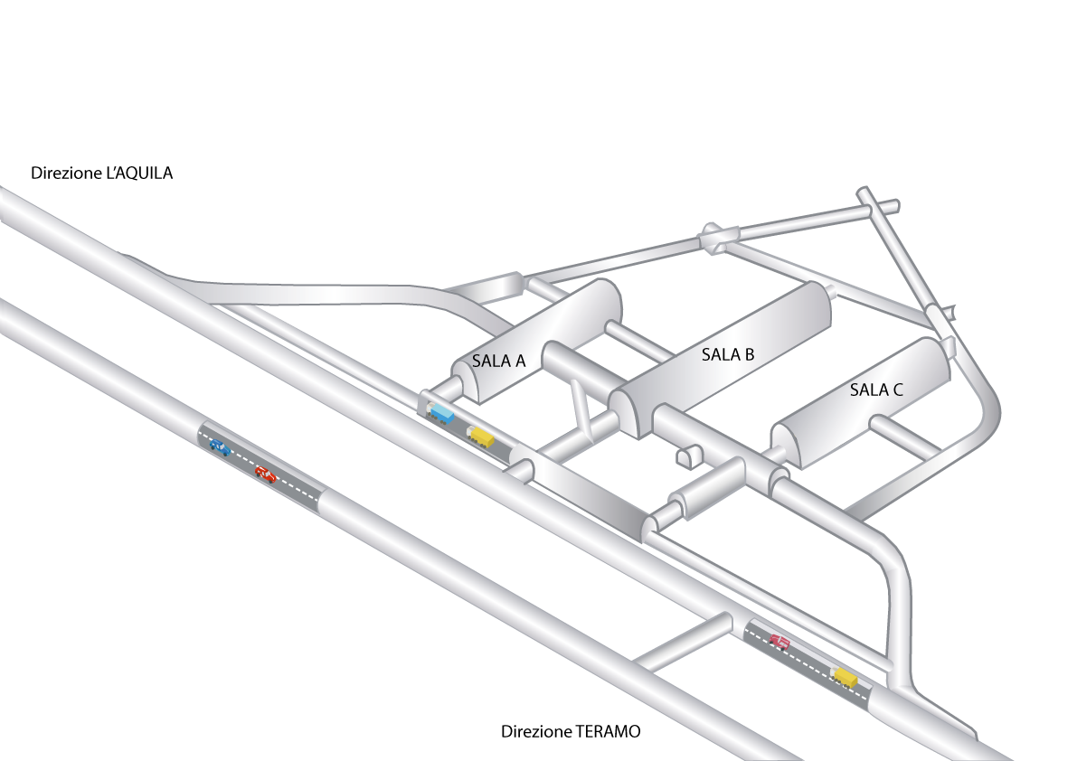
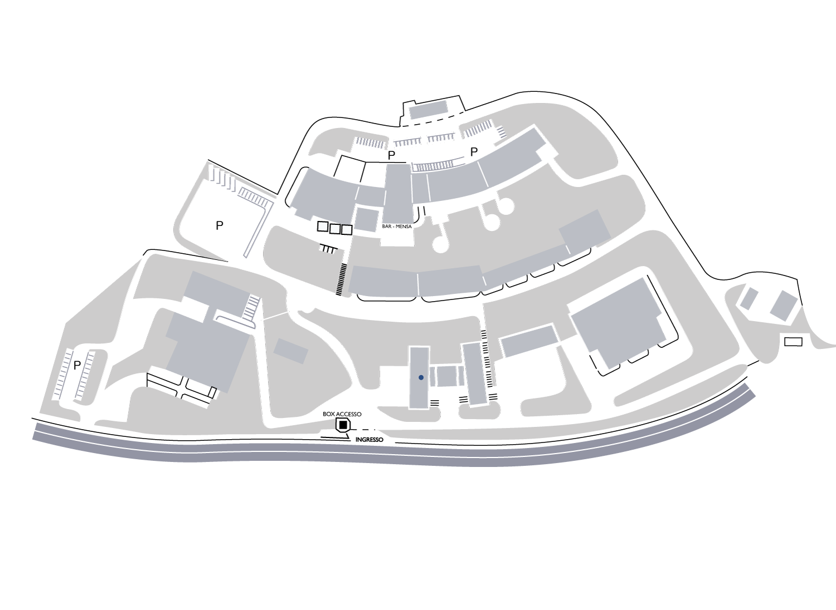

Thank you
Capri, September 12, 2022
E. Previtali

