Slide 1
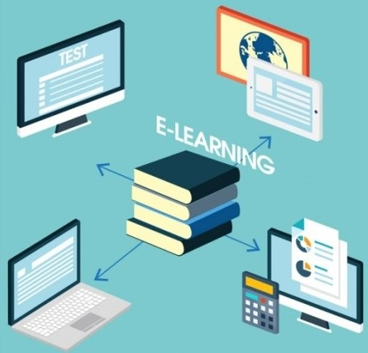
Università Gugli Marconi Roma Italy
Laboratori Nazionali Fisica Nucleare Frascati
Prof. Matteo Martini – Prof. Fabrizio Fontana
E-learning
new strategies and trends
Reference Glossary
e-learning
An online educational or e-learning service is a website which teaches and helps students improve in certain subjects.
These are normally used by schools to let students learn from home and complete online homework. Website owners who own good online educational services may charge schools to use these websites, however, many websites are open to the public
We are intended to put forward one among the possible points of view about the present structure and improvements of the strategies toward the most reliable and propre management of e-learning

Slide 2
Università Gugli Marconi Roma Italy
Laboratori Nazionali Fisica Nucleare Frascati
Prof. Matteo Martini – Prof. Fabrizio Fontana
Reference Glossary
E-learning
new strategies and trends
strat up
The startup costs of something such as a new business or new product are the costs of starting to run or produce it.
Our basic aim being to catch new trends leaving them their “starting up” but leaving them to the proper development whitout interferences (to their development).
Social learning
(social pedagogy) is learning that takes place at a wider scale than individual or group learning, up to a societal scale, through social interaction between peers. It may or may not lead to a change in attitudes and behavior.
Of course we cannot avoid an analysis of the main innovations in digital information theory and the discussion of those points which up to now dont appeared as real problems to cope and, swiftly have converted in real problems.

Slide 3
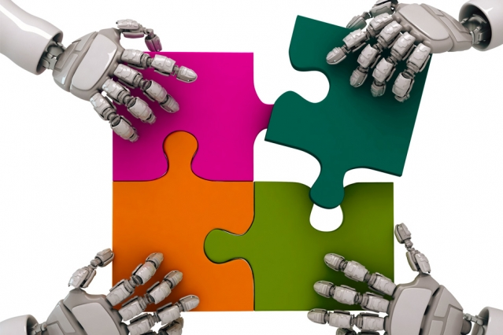
Università Gugli Marconi Roma Italy
Laboratori Nazionali Fisica Nucleare Frascati
Reference Glossary
Matteo Martini – Fabrizio Fontana
DISTANCE LEARNING
also called distance education, e-learning, and online learning, form of education in which the main elements include physical separation of teachers and students during instruction and the use of various technologies to facilitate student - teacher and student - student comm.s. Distance learning traditionally has focused on nontraditional students, such as full-time workers, milit. personnel, and nonresidents or individuals in remote regions who are unable to attend class. lectures. However, distance learning has become an established part of the educational world, with trends pointing to ongoing growth.
E-learning
new strategies and trends
Discussing present strategies is an unavoidable step since the role of e-learning as a tool for distance learning is crowdedly and quickly increasing along whit the role it occupies as a tool of distribute learning and continuous learning.
Meanwhile the tecnologies used to improve all those point are quickly chanching.

Slide 4
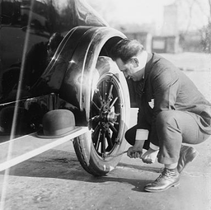
Università Gugli Marconi Roma Italy
Laboratori Nazionali Fisica Nucleare Frascati
Reference Glossary
Continuous learning
Continuous learning is the process of learning new skills and knowledge on an on-going basis. This can come in many forms, from formal course taking to casual social learning. It involves self-initiative and taking on challenges. Continuous learning can also be within an organization, or it can be personal, such as in lifelong learning.
Matteo Martini – Fabrizio Fontana
E-learning
new strategies and trends
Those changes, often, need a time lag shorter thant the time needed to the of users to lead as manage properly these new issues or to become familial whith them or even to feel them as problems.
Innovation in education technology is stronger than ever, mainly thanks to the followings: improvement of virtual reality and of mobile devices, ameliorement of cloud technologies and internet both in hardware and in the software.
Great opportunities are coming, never forgetting that creativity and personal engagement are the key to truly enhance the learning experience.
education technology
In general it is the use of both physical hardware, software, and educational theoretic to improving performance by means of appropriate technological processes and resources. It encompasses several domains including learning theory, computer-based training, online learning, and where mobile technologies are used, m-learning.

Slide 5
Università Gugli Marconi Roma Italy
Laboratori Nazionali Fisica Nucleare Frascati
Reference Glossary
Matteo Martini – Fabrizio Fontana
Adaptive learning
also known as adaptive teaching, is an educational method which uses computer algorithms to orchestrate the interaction with the learner and deliver customized resources and learning activities to address the unique needs of each learner.
In professional learning contexts, individuals may "test out" of some training to ensure they engage with novel instruction. Computers adapt the presentation of educational material according to students' learning needs, as indicated by their responses to questions, tasks and experiences. The technology encompasses aspects derived from various fields of study including computer science, AI, psychometrics, education, psychology, and brain science.
E-learning
new strategies and trends
Advantages and dis-advanteges of asyncronous learning-teaching
As time passes from the new appearance of new disciplines the informations up to now increases. In some cases it becomes much quite difficult to choose among speakeables and unspeakeables topics. Some time it could be hard to fruitfully answer to the learner questions and the strategy to follow becomes: please! let do not open this door. Since the amount of information to be used to explain the answer content could be very huge. This is a question differently faced in different topics.
It could be briefly labelled as: Blubear’s syndrome (let do not open this door). Among the advantages/disadvantages of asyncronous theaching it appens that the matter to be teached could be finelly filtered to avoid the Bluebear syndrome effectes or even erogated in the more appropriate classroom

Slide 6
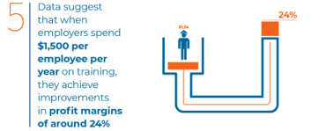
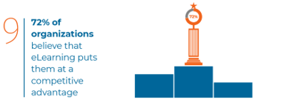
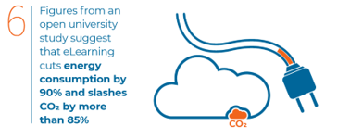
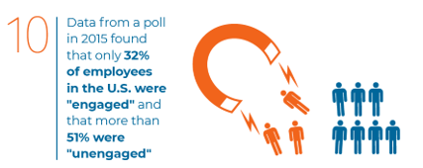
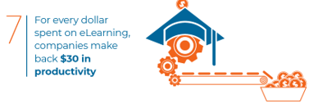
Università Gugli Marconi Roma Italy
Laboratori Nazionali Fisica Nucleare Frascati
Matteo Martini – Fabrizio Fontana
E-learning
new strategies and trends
20 mile stones
in statistics (first)

Slide 7
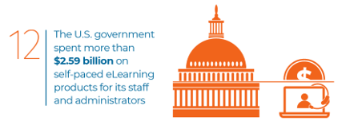
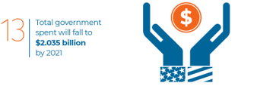
Università Gugli Marconi Roma Italy
Laboratori Nazionali Fisica Nucleare Frascati
Matteo Martini – Fabrizio Fontana
E-learning
new strategies and trends
20 mile stones
in statistics (second)

Slide 8
Università Gugli Marconi Roma Italy
Laboratori Nazionali Fisica Nucleare Frascati
Matteo Martizio – Fabrizio Fontana
E-learning
new strategies and trends
Reference Glossary
e-learning industry
eLearning Industry is a network-based media and publishing company founded in 2012. It is the largest online community of eLearning professionals in the industry, and was created first and foremost as a knowledge-sharing platform to help eLearning professionals and instructional designers connect in a safe online community where they can stay up to date with the latest industry news and technologies, and find projects or jobs.
Basic reflections on some basic statistic (1)
While students choose online learning for a variety of reasons, in statistical analysis reveal steady motivations related to career and employment goals.
Briefly 6 categories of students could be recognized:
Aspiring Academics: usually 18-24 year holds, focused on academic studies

Slide 9
Università Gugli Marconi Roma Italy
Laboratori Nazionali Fisica Nucleare Frascati
Matteo Martini – Fabrizio Fontana
E-learning
new strategies and trends
Basic reflections on some basic statistic (2)
Coming age: usually 18-24 exploring college academics, social offerings, and a variety of activities
Academic Wanderers: Older students who perceive the advantages of a college degree but are unsure about academic and career goals, and how to reach them.

Slide 10
Università Gugli Marconi Roma Italy
Laboratori Nazionali Fisica Nucleare Frascati
Matteo Martini – Fabrizio Fontana
E-learning
new strategies and trends
Career Starters: wider age range, interested in college as a path to a specific career.
Career Accelerators: Older students with some college and job experience interested in college as a way to move forward in their current career field.
Industry sweetcher: Indutry sweetcher.
Basic reflections on some basic statistic (3)

Slide 11
Università Gugli Marconi Roma Italy
Laboratori Nazionali Fisica Nucleare Frascati
Matteo Martini – Fabrizio Fontana
E-learning
new strategies and trends
Further: what to think and how to do? (first)
Investment in workplace learning and development is set to rise yet again next year, with the growth of the global e-learning industry expected to increase 11% by 2020 [10 e-learning trends].
As Jane Hart eloquently puts it: “There is no longer such a thing as a job for a life – only a life of jobs.” [10 e-learning trends].
Add that to the average shelf-life of skills now being less than 5 years, and it no longer makes sense for training departments to focus on siloed, role-based skills. [10 elearning trends].
This time ought to compared fron one side to the speed in which new appliances and technologies appears and on the other side to the time required to properly masterize them.

Slide 12
Università Gugli Marconi Roma Italy
Laboratori Nazionali Fisica Nucleare Frascati
Matteo Martini – Fabrizio Fontana
E-learning
new strategies and trends
Further: what to think and how to do? (second)
There are some themes to cope (briefly): leadership and management, problem-solving, collaboration, communication skills are set to be a rising focus in digital learning and beyond. The kinds of skills that empower people to succeed [10 e-learning trends].
A few of points to kep in mind: tey are collected in the following short review.

Slide 13
Università Gugli Marconi Roma Italy
Laboratori Nazionali Fisica Nucleare Frascati
Matteo Martini – Fabrizio Fontana
E-learning
new strategies and trends
16 reference points defining the courrent evolutions we are expecting (in e-learning industry.
1) Adaptive Learning: The work-life skills
“Learning that focuses only on context-specific techniques or mastering existing stocks of knowledge may be useful, but are prone to fall short in helping us navigate the changing world.” [10 elearning trends].
Adaptive learning, supported by confidence-based assessments and strong analytics and measurement of training effectiveness, is taking learning to the further level. [8 Top eLearning Trends For 2019]

Slide 14
Università Gugli Marconi Roma Italy
Laboratori Nazionali Fisica Nucleare Frascati
Matteo Martini – Fabrizio Fontana
E-learning
new strategies and trends
2) Artificial Intelligence and Learner assistance: ‘Growth’ coaches, not performance managers
It’s time for managers to step up as coaches and mentors who can not only foster an individual’s growth, but help to utilize the real strengths of each team member [10 elearning trends].
Organizations are now offering innovative solutions where bots are able to guide learners both on the learning path, as well as during the courses. organizations will be implementing newer methods of Artificial Intelligence support for their learners in both the learning process and during the moment of need. organizations will be implementing newer methods of Artificial Intelligence support for their learners in both the learning process and during the moment of need. [8 Top eLearning Trends For 2019

Slide 15
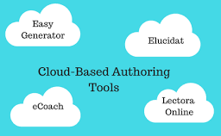
elucidat
Elucidat is a reliable, cloud-based eLearning authoring platform designed to help institutions and freelancers deliver responsive eLearning courses. The platform makes
the development of eLearning content incredibly easy for both tech-savvy and non tech savvy developers.
Università Gugli Marconi Roma Italy
Laboratori Nazionali Fisica Nucleare Frascati
Matteo Martini – Fabrizio Fontana
E-learning
new strategies and trends
Reference Glossary
Elucidat
Elucidat is a reliable, cloud-based e.learning authoring platform designed to help institutions and freelancers deliver responsive e-learning courses. The platform makes the development of e-learning content incredibly easy for both tech-savvy and non tech savvy developers.
3) Cloud technology: More user-generated content (first)
2017 saw a 38% rise in user-generated content. That’s a huge leap, and seeing the amount of customers using Elucidat as a collaborative, grassroots content-sharing tool, we predict a continued rise in this more democratic approach to learning and knowledge-sharing. [10 elearning trends].
With the cloud technologies, students will no longer have to worry about losing important documents, transposing heavy books or exchanging educational materials with USB sticks. [8 Top eLearning Trends For 2019].

Slide 16
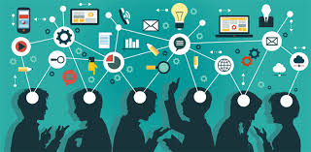
Università Gugli Marconi Roma Italy
Laboratori Nazionali Fisica Nucleare Frascati
Matteo Martini – Fabrizio Fontana
E-learning
new strategies and trends
3) Cloud technology: More user-generated content (second)
The main goal of education technology is to make education accessible to everybody, beyond the country of origin or the wealth level. The aim of the new technologies is to guarantee the same opportunities for learning and professional growth for everyone, with hardware and platforms that cover all territories and all social needs. [8 Top eLearning Trends For 2019].
Social learning involves collaboration between individuals at the workplace through various modes, such as forums, informal chat sessions, sharing sessions, and learning circles. [8 Top eLearning Trends For 2019]
Each of today’s students owns a mobile device, even at a K-12 age, and educational technology can open wider horizons by exploiting the applications and the tasks that can be implemented remotely. [8 Top eLearning Trends For 2019].

Slide 17
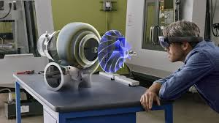
Università Gugli Marconi Roma Italy
Laboratori Nazionali Fisica Nucleare Frascati
Matteo Martini – Fabrizio Fontana
4) Smarter curation
With performance needs constantly changing and a torrent of content available both outside and inside organizations, there’s been a huge rise in L&D teams making the switch from thinking “What do we need to create here?” to “What can we curate to help people with this?”. Smart curation is where it’s. We also expect to see more daily content feeds appearing directly in other digital learning content and tools [10 e-learning trends].
Reference Glossary
Mixed reality
is a significant advancement of augmented reality (AR) – the technology behind 2016’s Pokémon GO phenomenon.
In a “hybrid” environment, interactive virtual objects can be mapped to the physical environment, blending the real and the virtual.
Thanks to tools like Mixed Reality and other ways through which students can experience fun while learning in 2018 there will be the rise of creativity as a driver for educational processes and new learning technologies. [8 Top eLearning Trends For 2019].
LMSs will continue to grow and offer content curation as an important method of sharing information, and provide the right experience to the learners. [8 Top eLearning Trends For 2019]

Slide 18
Università Gugli Marconi Roma Italy
Laboratori Nazionali Fisica Nucleare Frascati
Università Gugli Marconi Roma Italy
Laboratori Nazionali Fisica Nucleare Frascati
Matteo Martini – Fabrizio Fontana
E-learning
new strategies and trends
Reference Glossary
Big data
is a field that treats ways to analyze, systematically extract information from, or otherwise deal with data sets that are
too large or complex to be dealt with by traditional data-processing application software. Data with many cases (rows) offer greater statistical power, while data with higher complexity (more attributes or columns) may lead to a higher false discovery rate. Big data challenges include capturing data, data storage, data analysis, search, sharing, transfer, visualization, querying, updating, information privacy and data source. Big data was originally associated with three key concepts: volume, variety, and velocity.
5) Daily data
Data is no longer the scary elephant in the room or unnecessarily caught up with the daunting talk of “Big Data.”
Rather, data is slowly becoming a desired part and parcel of a learning development team’s toolkit. 70% of L&D teams are keen to develop their skills in using data to design, evaluate and deliver better learning solutions.
Many in L&D are struggling to easily get hold of quality data. As a tool that has four live data dashboards built into every piece of digital content (example Elucidat). Firsthand the power and broad use of data in learning solutions. [10 elearning trends]. [10 elearning trends].

Slide 19
Università Gugli Marconi Roma Italy
Laboratori Nazionali Fisica Nucleare Frascati
Università Gugli Marconi Roma Italy
Laboratori Nazionali Fisica Nucleare Frascati
Matteo Martizio – Fabrizio Fontana
E-learning
new strategies and trends
6) Being braver: Culling what doesn’t work
More good stuff created, less ineffective stuff created – and culling what’s out there but isn’t working. [10 elearning trends].

Slide 20
Università Gugli Marconi Roma Italy
Laboratori Nazionali Fisica Nucleare Frascati
Matteo Martini – Fabrizio Fontana
E-learning
new strategies and trends
Reference Glossary
Mobile content
or mobile learning is any type of electronic media which is viewed or used on mobile phones, like ringtones, graphics, discount offers, games, movies, and GPS navigation. As mobile phone use has grown since the mid-1990s, the significance of the devices in everyday life has grown accordingly. Owners of mobile phones can now use their devices to make calendar appointments, send and receive text messages (SMS), listen to music, watch videos, shoot videos, redeem coupons for purchases, view office documents, get driving instructions on a map, and so forth. The use of mobile content has grown accordingly.
7) Effective mobile learning – not just mobile content
Despite 67% people saying they use mobiles for learning, stats for using “in-house e-learning” on mobiles. What barriers might be in the way? Content being housed on platforms that aren’t mobile-friendly? [10 elearning trends].

Slide 21
Università Gugli Marconi Roma Italy
Laboratori Nazionali Fisica Nucleare Frascati
Matteo Martini – Fabrizio Fontana
E-learning
new strategies and trends
8) Effective mobile learning – not just mobile content
More video content is uploaded in 30 days than the major U.S. television networks have created in 30 years. Selfie videos, live streaming, video assignments, expert tips, best practice demos, bad practice demos – videos can stand alone or be combined with simple polls and discussions, or be built out into experiential learning simulations [10 elearning trends]. [10 elearning trends].
The popularity of video-based sites like YouTube have forced organizations to adopt more videos into their training. The focus is on decreasing the load time and the size of videos using various tools. [8 Top eLearning Trends For 2019]

Slide 22
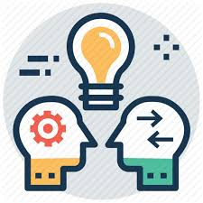
Università Gugli Marconi Roma Italy
Laboratori Nazionali Fisica Nucleare Frascati
Matteo Martini – Fabrizio Fontana
E-learning
new strategies and trends
9) More self-directed learning
“Continuous learning involves collaboration, constantly learning from others, and recognizing that more innovation and change is happening outside your organization than inside.
Thus employees need access to new ideas, developments, research and case studies from outside the organization. It is also not about learning platforms but about integrating learning where employees work and hang out, including employee communication systems such as Slack.” Steve Rayson - Director at BuzzSumo. [10 elearning trends].
10) More self-directed learning
“Today, learning is about ‘flow’ not ‘instruction,’ and helping bring learning to people throughout their digital experience.” Bersin [10 elearning trends].

Slide 23
Università Gugli Marconi Roma Italy
Laboratori Nazionali Fisica Nucleare Frascati
Matteo Martini – Fabrizio Fontana
E-learning
new strategies and trends
Reference Glossary
Game based learning
is a type of game play that has defined learning outcomes. Generally, game-based learning is designed to balance subject matter with gameplay and the ability of the player to retain, and apply said subject matter to the real world.
11) Gamification And Game-Based Learning
Organizations are increasingly looking at investing in game-based learning to empower and engage their learners better. It has been proven through numerous implementations that games help in releasing happy hormones, such as dopamine and serotonin. [8 Top eLearning Trends For 2019]

Slide 24
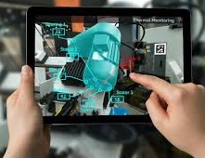
Università Gugli Marconi Roma Italy
Laboratori Nazionali Fisica Nucleare Frascati
Matteo Martini – Fabrizio Fontana
Reference Glossary
E-learning
new strategies and trends
Augmented reality
(AR) is an interactive experience of a real-world environment where the objects that reside in the real world are enhanced by computer-generated perceptual information, sometimes across multiple sensory modalities, including visual, auditory, haptic, somatosensory and olfactory. AR can be defined as a system that fulfills three basic features: a combination of real and virtual worlds, real-time interaction, and accurate 3D registration of virtual and real objects.[3] The overlaid sensory information can be constructive (i.e. additive to the natural environment), or destructive (i.e. masking of the natural environment). This experience is seamlessly interwoven with the physical world such that it is perceived as an immersive aspect of the real environment. In this way, AR alters one's ongoing perception of a real-world environment, whereas virtual reality completely replaces the user's real-world environment with a simulated one. Augmented reality is related to two largely synonymous terms: mixed reality and computer-mediated reality.
12) AR/VR/MR
The great thing about Augmented Reality is that it can augment the existing content through interesting overlays of graphics and images that can pop out and thrill the learners. Virtual Reality continues to grow as it is used in teaching various safety-related procedures. Organizations are now looking at Virtual Reality as an important solution, as eLearning companies use effective Instructional Design strategies to enhance the VR experience. [8 Top eLearning Trends For 2019].MR will move from experimental technology to a new way of teaching and learning, that will allow schools to experience lessons in a completely new way, for example by virtual travelling in past ages or to inaccessible places, by simply wearing a MR headset or looking up at a smartphone. [Education Technology Trends for 2018 | Acer for Education]

Slide 25
Università Gugli Marconi Roma Italy
Laboratori Nazionali Fisica Nucleare Frascati
Matteo Martizio – Fabrizio Fontana
E-learning
new strategies and trends
13. Technology against bullies
The battle against bullying is one of the most discussed topics in recent years. New technologies can help fight this phenomenon that afflicts many young people all over the world. Although social networks have often contributed negatively, worsening the problem in many situations. [8 Top eLearning Trends For 2019].

Slide 26
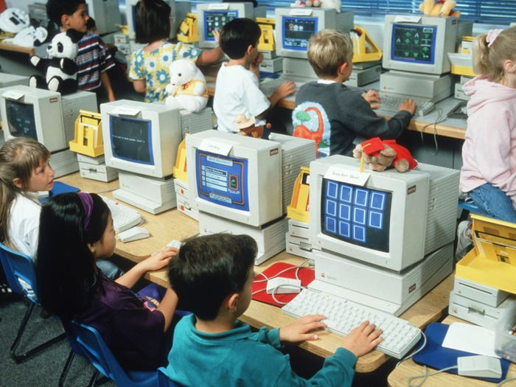
Università Gugli Marconi Roma Italy
Laboratori Nazionali Fisica Nucleare Frascati
Matteo Martizio – Fabrizio Fontana
E-learning
new strategies and trends
14) Coding and IoT
In K-12 schools, the attention dedicated to code learning and the association with the “Makers” movement will increase. Furthermore, schools are starting to build maker spaces in their districts, stimulating students to have a hands-on experience with the Internet of Things. [8 Top eLearning Trends For 2019].
15) Technology and art
While the STEM subjects are covered and easily integrated with the new technologies, 2018 will lead teachers in the STEAM (Science, Technology, Engineering, Math + Art) programs to develop the artistic inclinations of the students – and not only the scientific ones – through technology. Adding art to the mix, in fact, can help students to develop critical thinking. [8 Top eLearning Trends For 2019].

Slide 27
Università Gugli Marconi Roma Italy
Laboratori Nazionali Fisica Nucleare Frascati
Matteo Martizio – Fabrizio Fontana
E-learning
new strategies and trends
16) And last but not least: Microlearning
It is a great method of implementing learning in small chunks that are objective driven and can be easily and quickly deployed within organizations. The great advantage of microlearning is that it can be implemented on any device. [8 Top eLearning Trends For 2019]

Slide 28
Università Gugli Marconi Roma Italy
Laboratori Nazionali Fisica Nucleare Frascati
Matteo Martini – Fabrizio Fontana
An unavoidable concluding remark
The appearance of social networks appears as just the proper answer to former requests which in the past were answered simpler even is less technologically appealing ways.
Please have a look to this 50teen ago years «whatsapp» group (on the left, definitely on line and currently chatting about some current event just what's appended).
Lets notice please! This is what its occurs to many applications: they exist undiscovered and not truly appreciated till wen they receive an appealing setting up or some different or more nice layout.
Thanks a lot for courtesy in listening me
and patience.
Thanks a lot for courtesy in listening me
and patience.

