Slide 1

Mu2e Calorimeter electronics
F. Spinella
INFN Pisa
MUSE Network General Meeting
October 23th 2019

Slide 2
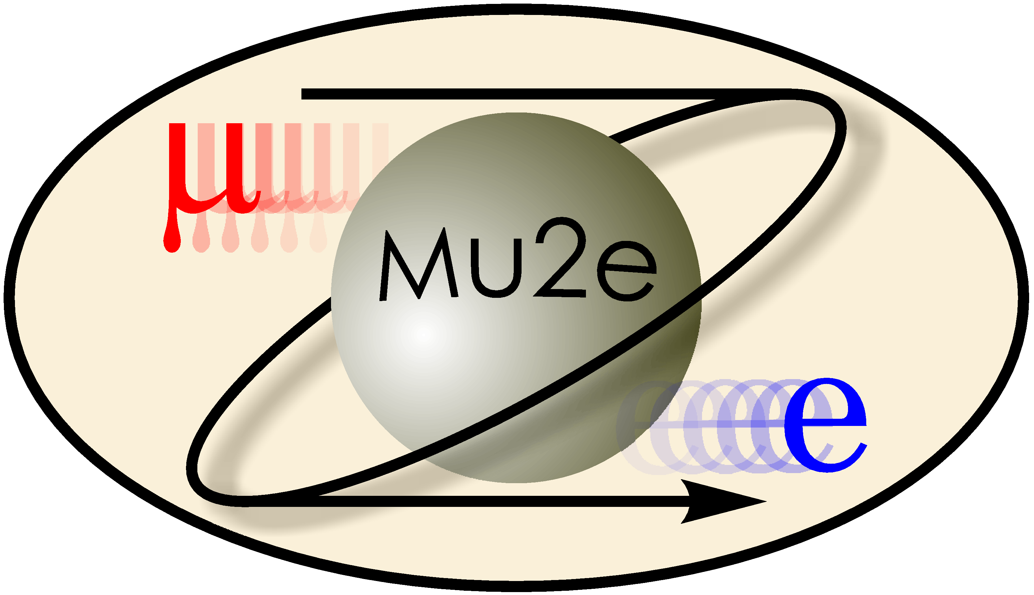

Talk overview
Calorimeter electronics scheme
Front End electronics
DIRAC spec, architecture and design
DIRAC qualification tests
Dirac cooling
Module 0
Slice test
Dirac V2

Slide 3
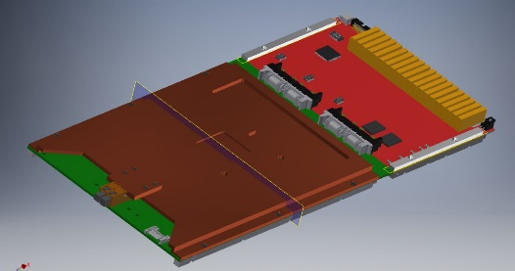
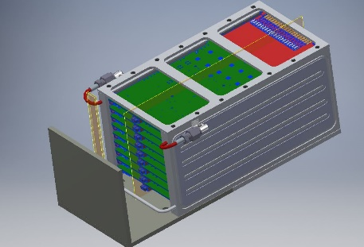
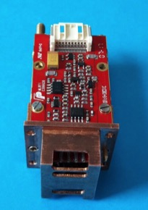
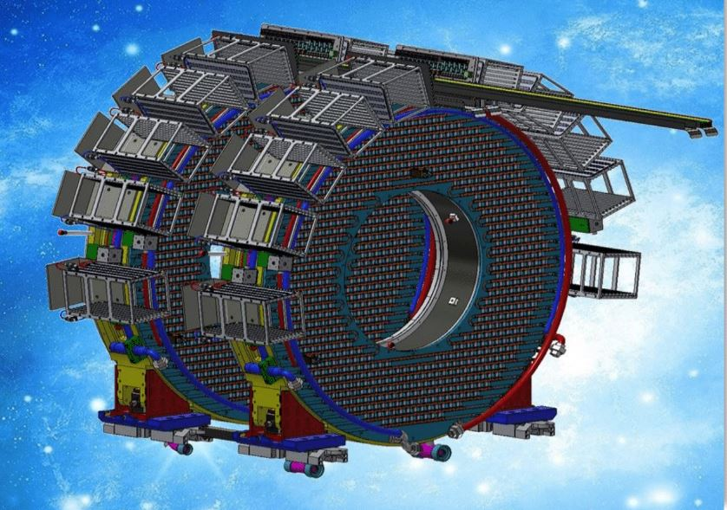
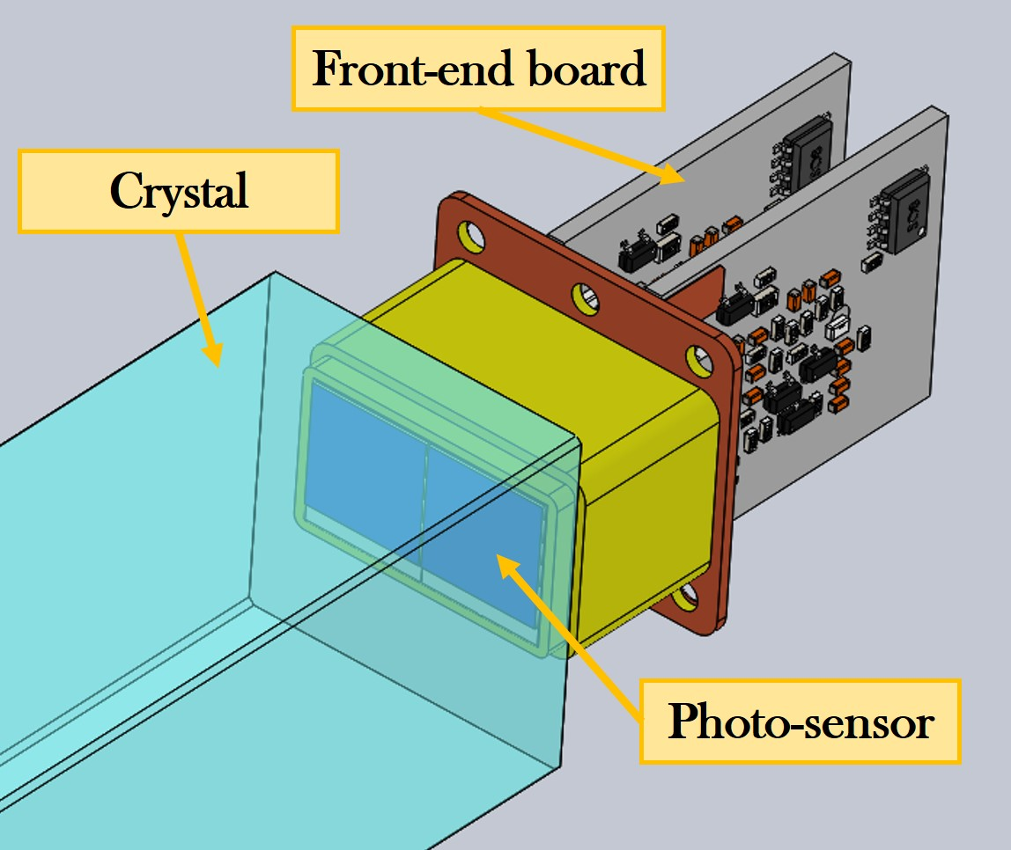
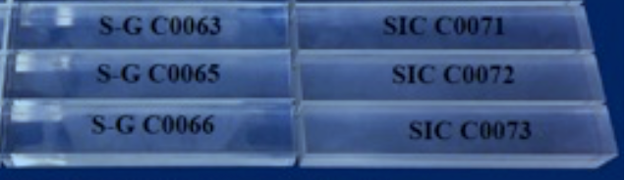
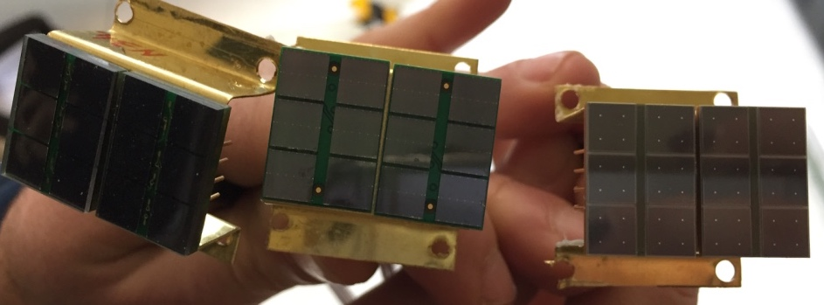
Calorimeter design
High granularity → 1348 undoped CsI crystals (3.4x3.4x20 cm³)
Crystals arranged in 2 disks (inner/outer radius 37.4 cm / 66 cm, separation between disks 75 cm)
1 crystal coupled to 2 UV-extended SiPMs (14x20 mm² area) → 2696 electronic channels
SiPM packed in a parallel arrangement of 2 groups of 3 cells biased in series
DAQ crates located inside the cryostat to limit the number of pass-through connectors
DIRAC + Mezzanine
CRATE
CsI + SiPM + Holder + FEE
Calorimeter disks
SiPM + Holder + FEE
CsI crystals
UV-extended SiPMs

Slide 4
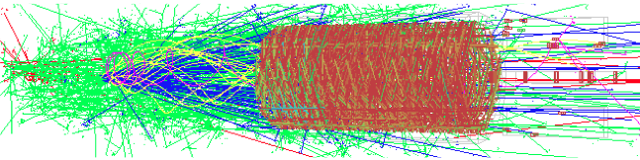
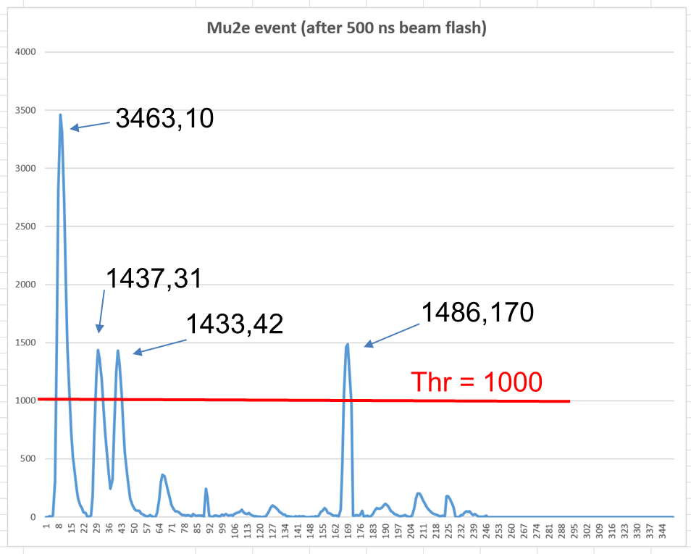
Why a digitizer?
Calorimeter
Disk0 Disk1
Typical 1.7 µs Mu2e event
Very intense particle flux expected in the calorimeter
We need high-sampling rate digitizers to resolve pile-up
Pile Up Example (Front End output)

Slide 5
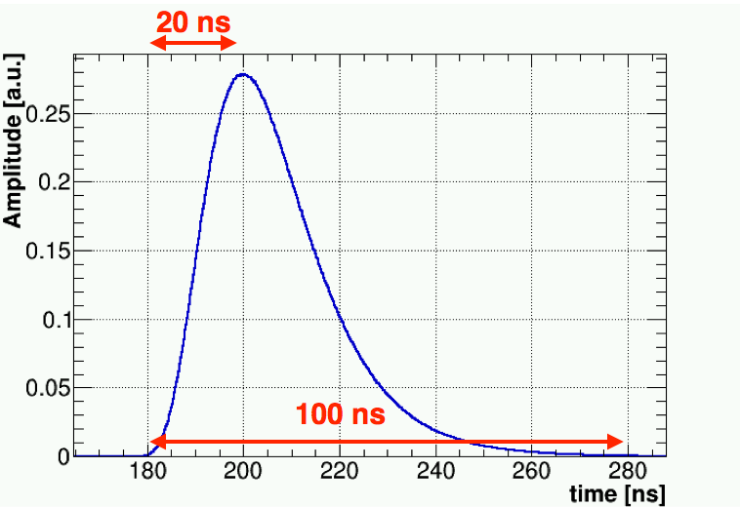
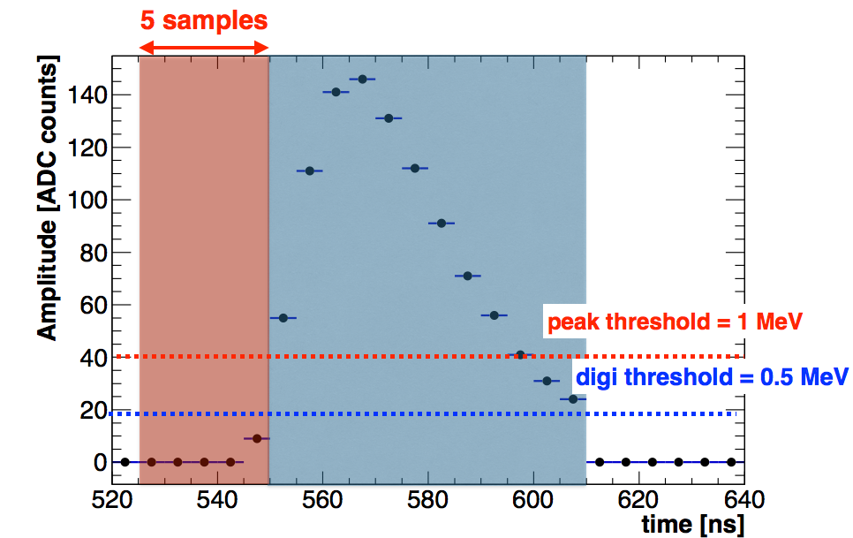
Which requirements? (1)
Digitization requirements = function (calorimeter requirements)
Particle-Id:
  σ_{t} < 500 ps @ 100 MeV
  σ_{E}/E <10% @ 100 MeV
We require the additional contribution due to the digitization procedure itself to be:
  σ_{t} < 200 ps @ 100 MeV
Analog input waveform and calorimeter digitization scheme:
  Sampling frequency and number of ADC readout bits impact time and energy resolution
  Thresholds impact the total data throughput and Energy resolution
Zero suppression: acquire only samples in blue and red regions
Red region needed for time and pedestal calculation
Blue region for energy

Slide 6
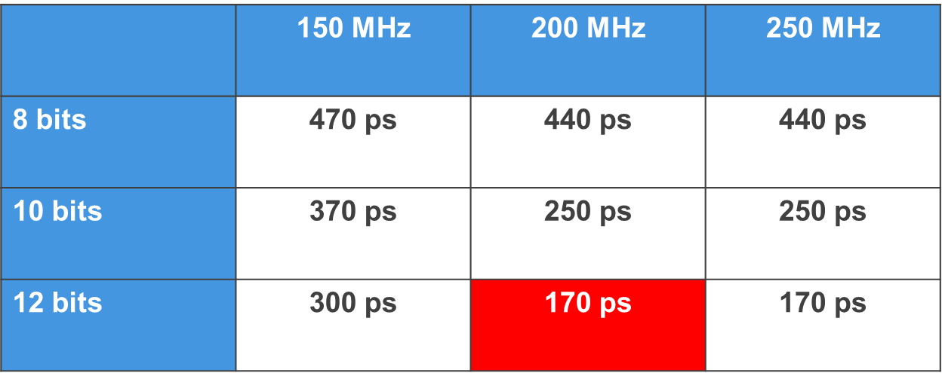
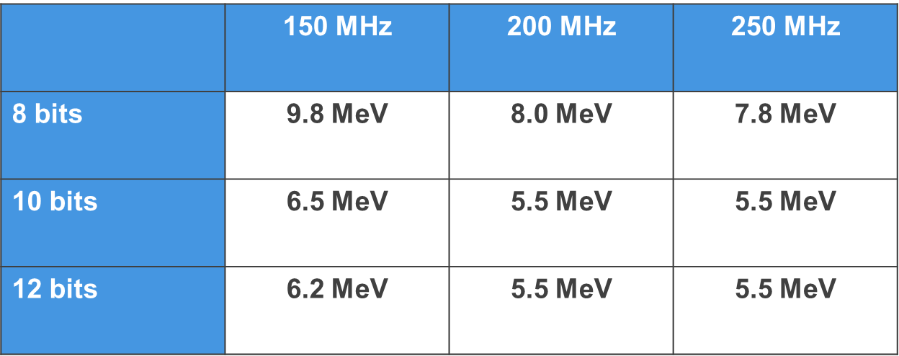
Which requirements? (2)
Simulation results show that a digitizer with:
  Sampling frequency of 200 MHz
  ADC with 12 bits resolution
Matches the calorimeter requirements on time and energy resolution
Time is reconstructed by fitting the leading edge
Time resolution for Conversion Electrons (~105 MeV)
Time resolution versus sampling frequency and ADC-bits
Energy is reconstructed from the total number of ADC counts
Energy resolution (FWHM/2.35) for Conversion Electrons (~105 MeV)
Energy resolution versus sampling frequency and ADC-bits

Slide 7
Which requirements? (3)
System located inside the cryostat → Harsh Environment:
  Magnetic field of 1 T and 10⁻⁴ Torr vacuum
  Total Ionizing Dose (TID):
    0.2 krad/yr (from simulation)
    12 Safety factor (requested from collaboration)
    5 years data taking
    TID 12 krad
  Neutron flux 5x10¹⁰ 1 MeV (Si)/yr (from simulation)
Mechanical constraints → DAQ crates located inside the cryostat:
  Limited space → 20 ADC channels/board
  Limited access for maintenance → Highly Reliable Design mandatory

Slide 8
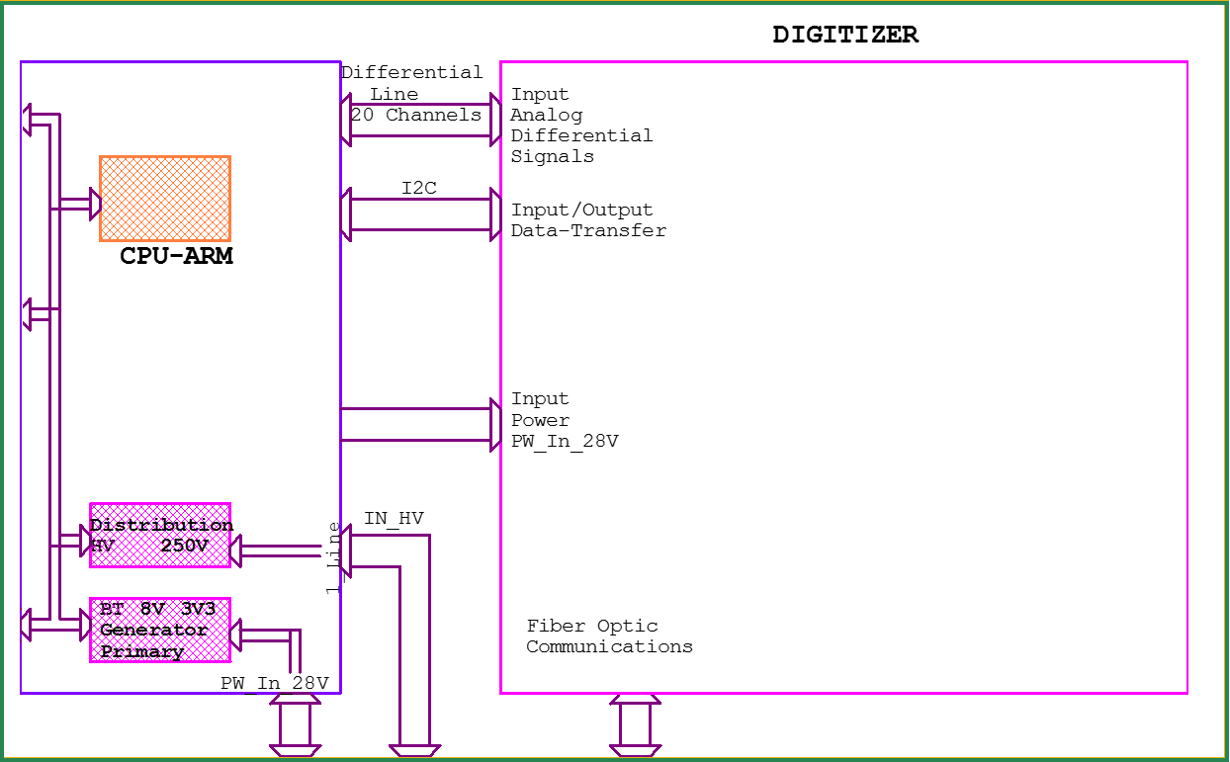
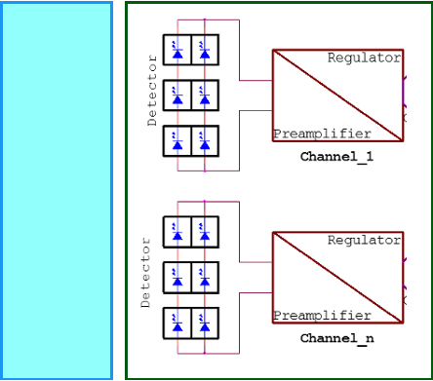
Calorimeter electronics scheme
Disks x2
Crate x10
Waveform Digitizers (DIRAC) x8
FEE x10 / board
(MPPC x2 / FEE)
CsI Crystal
ADC
ADC
CsI Crystal
FPGA
ADC
ADC
DC/DC
ADC
ADC
DC/DC
ADC
ADC
DC/DC
ADC
ADC

Slide 9
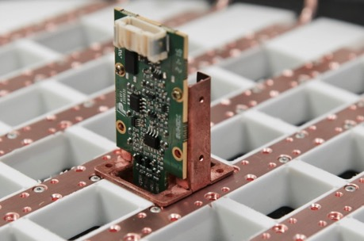
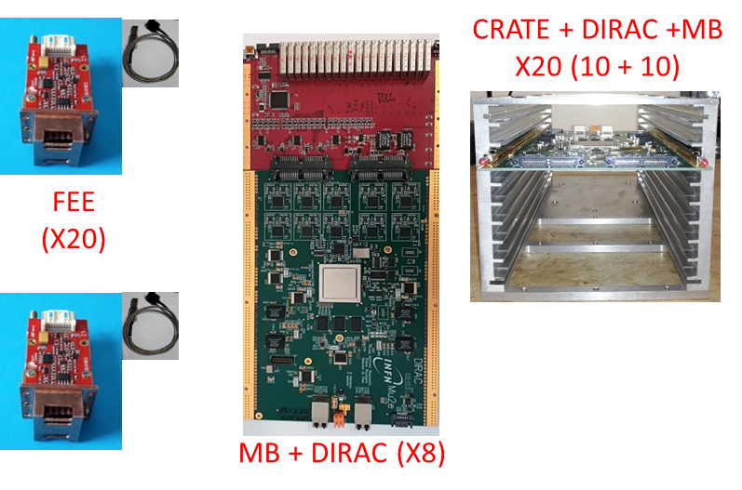
Front End Electronics
FE boards connected to SiPMs to provide:
  Amplification
  Local linear regulation of the bias voltage
  Monitoring of current and temperature
  Test pulse
Mezzanine boards:
  20 FE boards controlled by 1 Mezzanine Board (MB) → SiPM LV and HV distributed by an ARM controller
  Differential signals from 20 FE boards sent to MB and then to 1 DIRAC
DIRAC:
  sampling, processing and data transmission to the Mu2e DAQ

Slide 10
DIRAC v1 architecture
Mezzanine Board
FE
ADC
1
1
FE
ADC
FPGA
SoC
2
2
FE
ADC
Optical
Receiver
3
3
20
Optical
Receiver
FE
ADC
19
9
Jitter Cleaner
DC/DC
&
LDO
FE
ADC
20
10

Slide 11
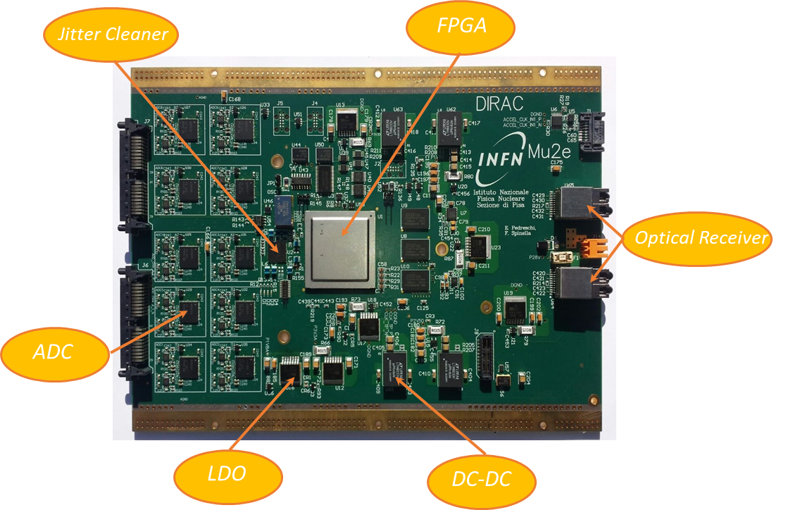
DIRAC v1 design
PCB specs:
Material: FR408-HR
Layers: 16
Dimensions: 233x165 mm
Thickness: 2.127 mm
Differencial lines: 100 Ω
Single ended lines: 50 Ω
After an intense campaign of tests:
ADC: ADS4229 (Texas Instruments®)
FPGA (SoC): SM2150T (Microsemi®)
DC-DC: LTM8033 (Linear Thecnologies®)
LDO: MIC69502 (Micrel®)
Jitter Cleaner: LMK04828 (Texas Instruments®)
Optical Transceiver: RJ-5G-SX (Cotsworks®)

Slide 12
DIRAC qualification tests
  Several test campaigns were performed:
    Total Ionizing Dose (TID) → requested 12 krad:
      ƳELBE @HZDR
        γ from Bremsstrahlung (0<E<14MeV)
        Extimated dose ≈ 20 krad/h @ 600µA
        Single components test
      Calliope @ENEA
        Co60 source
        Dose in function of distance: Max 2krad/h, requested 1krad/h
        Full board test
    Magnetic Field (B):
      LASA @INFN Milano (1T)
    Neutron irradiation test
      FNG @INFN
        Total neutron flux of 1.2 x10^12 n 1 MeV (Si) / cm^2
        Total neutron flux of 6x10^11 n 1 MeV (Si) / cm^2
        DCDC test

Slide 13
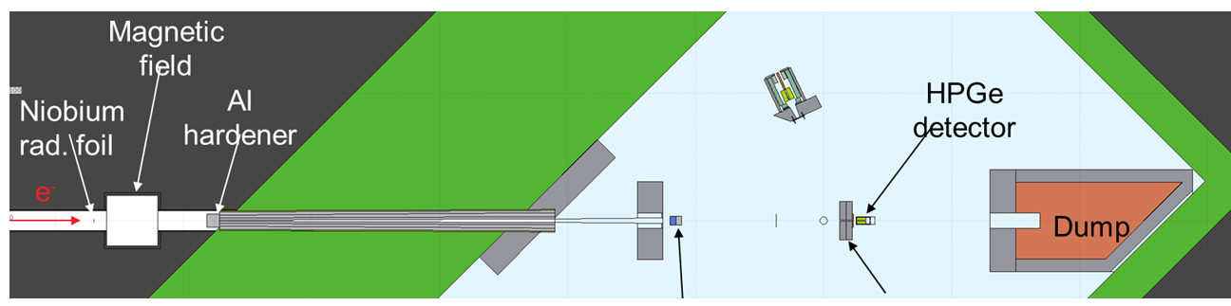
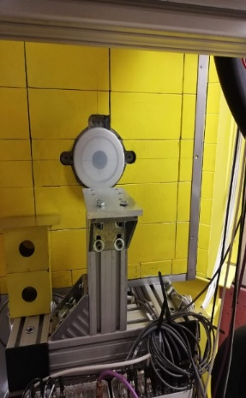
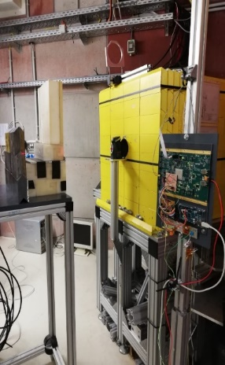
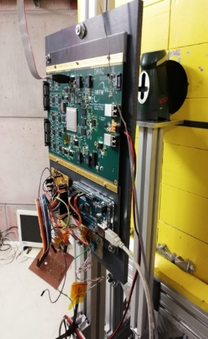
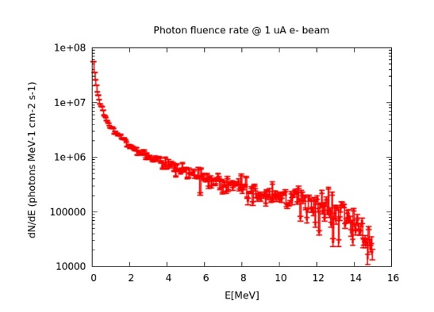
ƳELBE facility
Photons is produced per Bremsstrahlung by the electron beam hitting a niobium foil in the accelerator hall
Nominal beam conditions:
17 MeV electrons, 600uA, 12.4 um niobium radiator foil
Simulated dose rate ≈ 18.6 krad/h
Active dosimetry used to confirm simulated dose rate

Slide 14
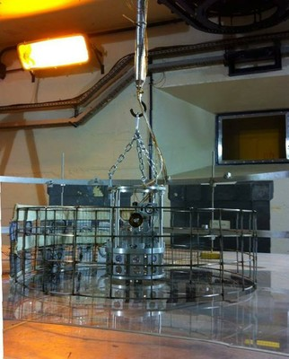
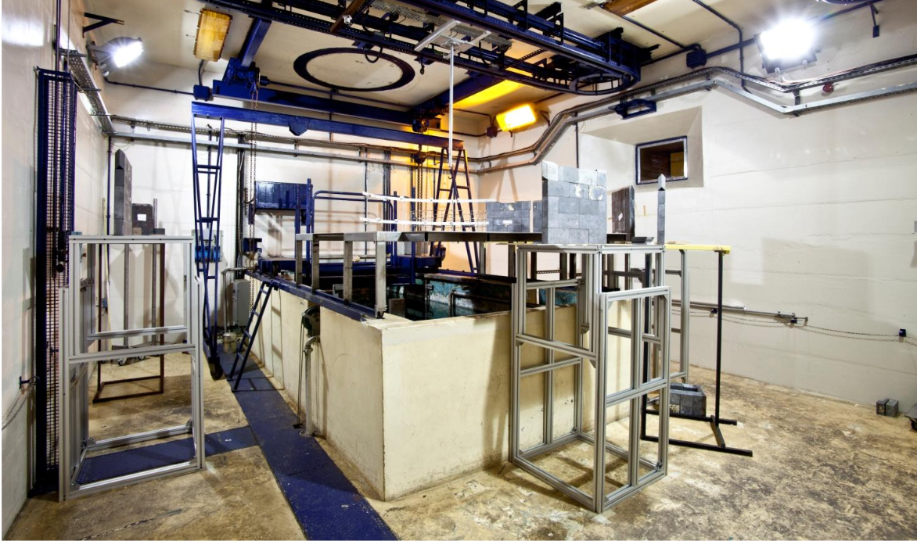
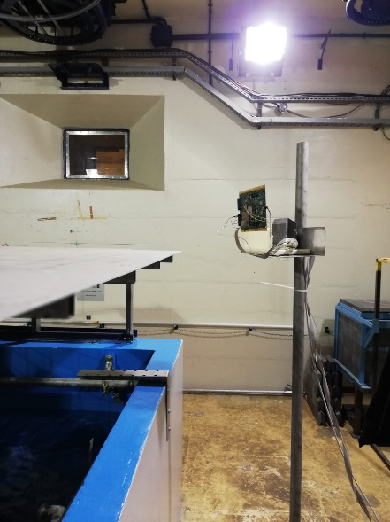
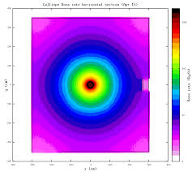
Calliope facility
Gamma rays at 1.17 and 1.33 MeV from Co60.
3.7x10^15 Bq of activity.
Isotropic source, flux scales with r^2
DIRAC

Slide 15
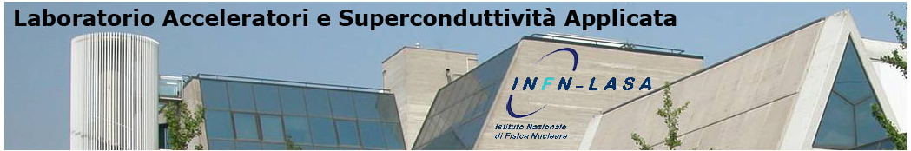
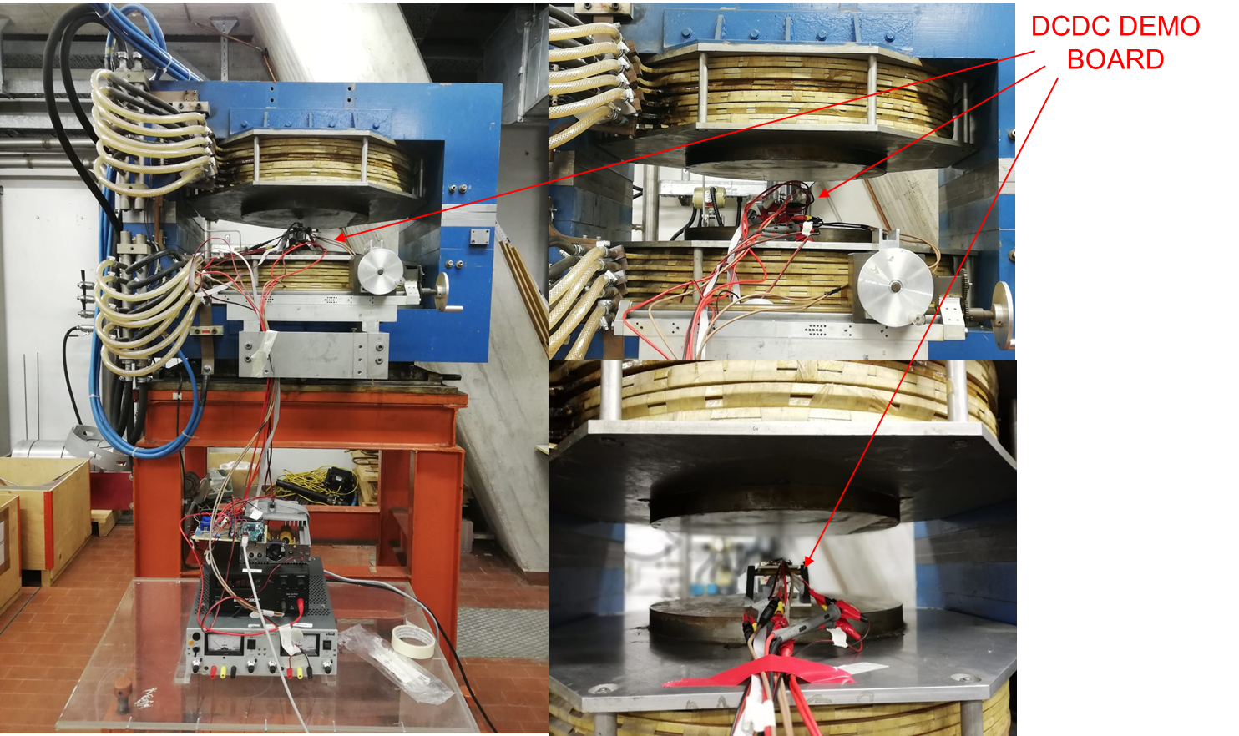
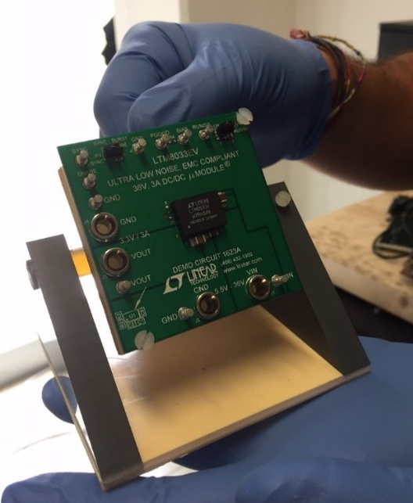
LASA facility
x
Uniform magnetic field up to 1.2 T
We tested different orientations of the DCDC with respect to the magnetic field
Same setup of the radiation tests
y
z

Slide 16
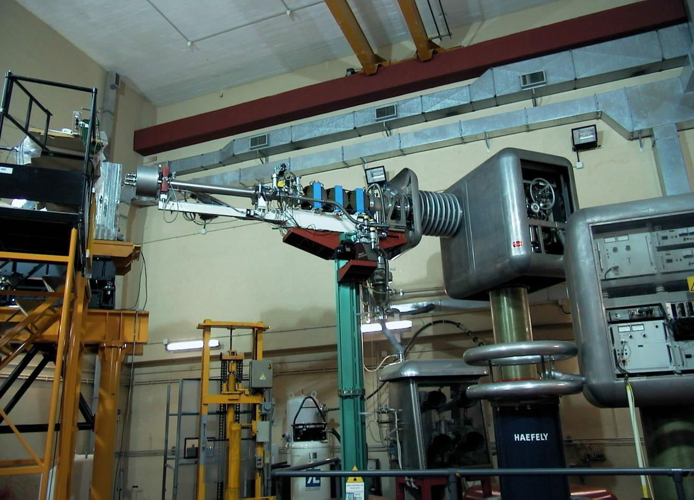
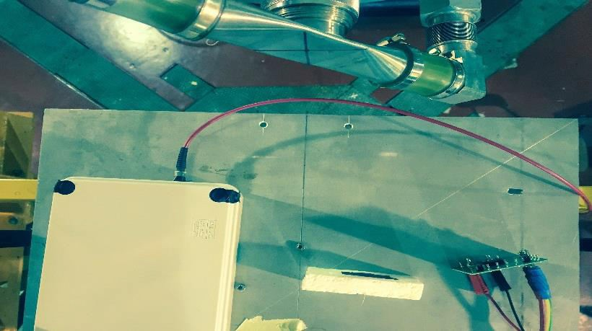

FNG facility
Frascati Neutron Generator (FNG) is a linear electrostatic accelerator in which up to 1 mA D+ ions are accelerated onto a Tritium target
Up to 10^11 14 MeV neutrons/s
almost isotropic source, flux scales with r^2
calibrated at 3% level using alpha particles
r
D+T→ α+n

Slide 17
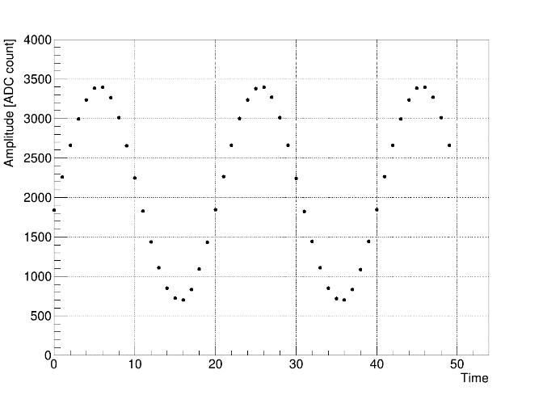
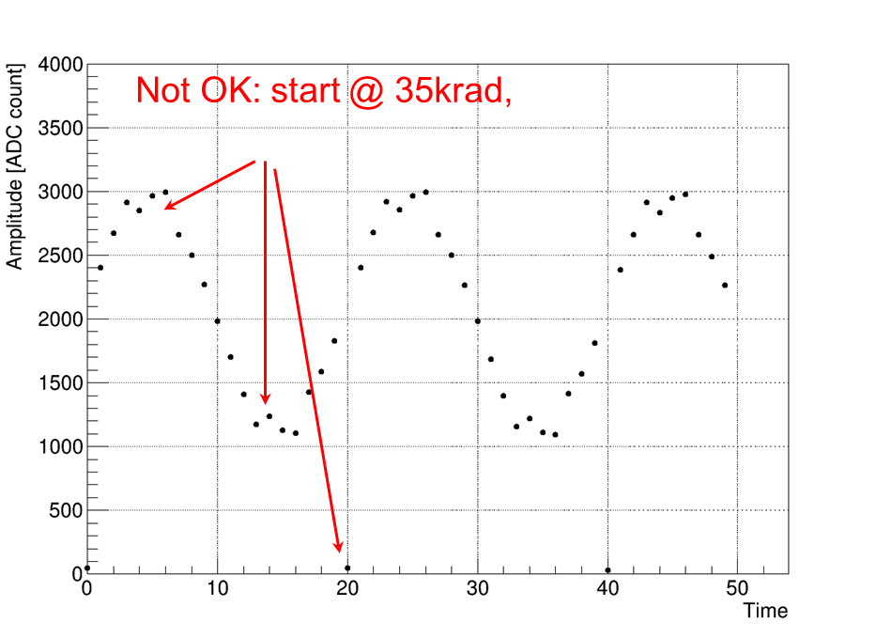
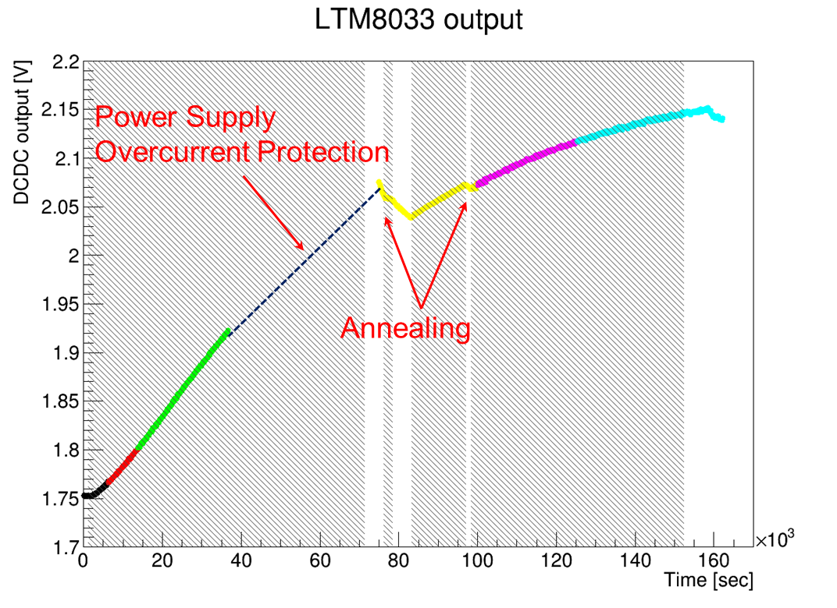
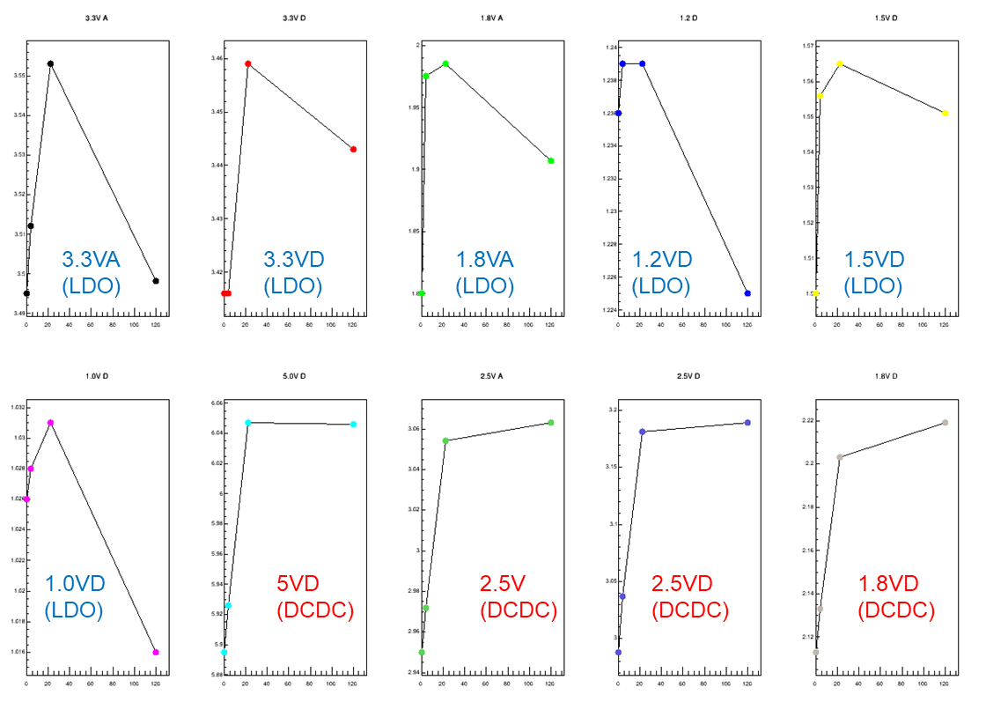
DIRAC: TID test results
Input waveform →4.5@10MHz, readout waveform:
Conclusions:
41 h beam time
Nominal Dose Rate ≈ 1krad/h
TID ≈ 41krad
No evidence of broken components up to 35 krad
After 41 krad SM2 ARM does not restart after power cycle
DCDC converters voltage increase: ≈ 20% @ 41 krad, no recover if no beam
CHANGE IN V2
LDO small increase, fast recover if no beam
LTM8033 and MIC69502 Vout(rad;t)

Slide 18
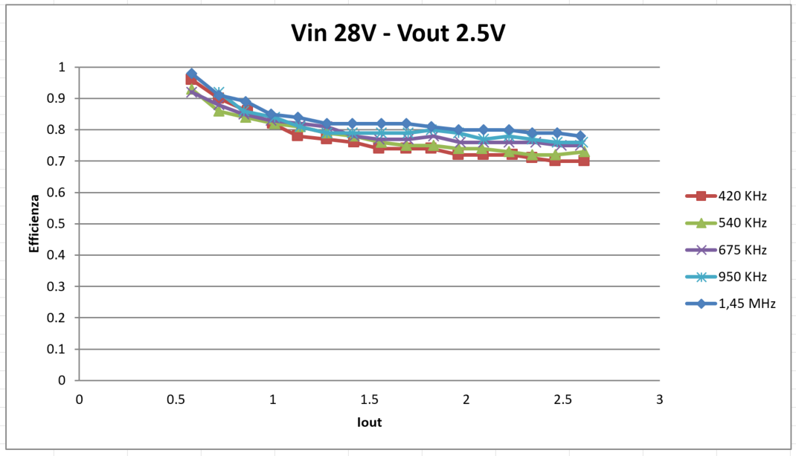
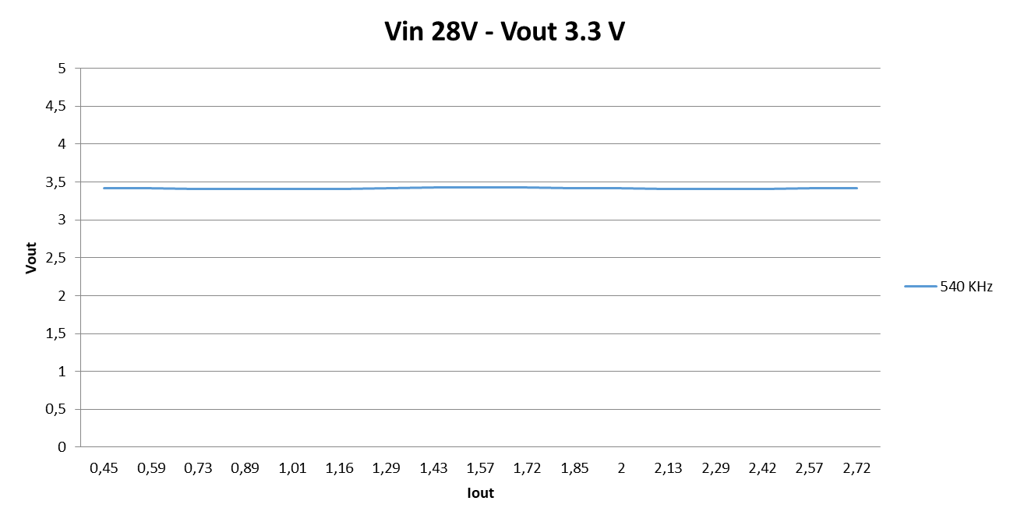
Tests in magnetic field results
Test conditions:
View X (parallel to B)
Vin 28V, Vout 2.5V
Variable load
Switching frequency
Efficiency quite low (still acceptable), higher if Vin lower
Test conditions:
View X (parallel to B)
Vin 28V, Vout 3.3V
Variable load
Constant frequency
Vout constant

Slide 19
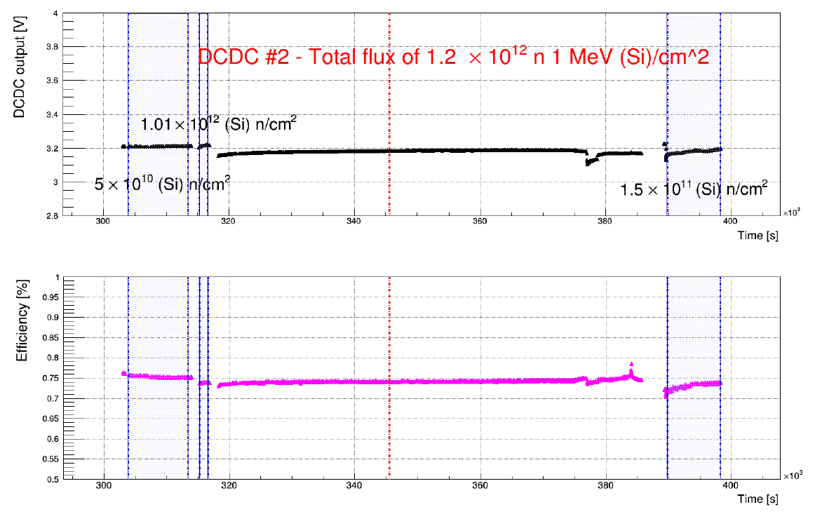
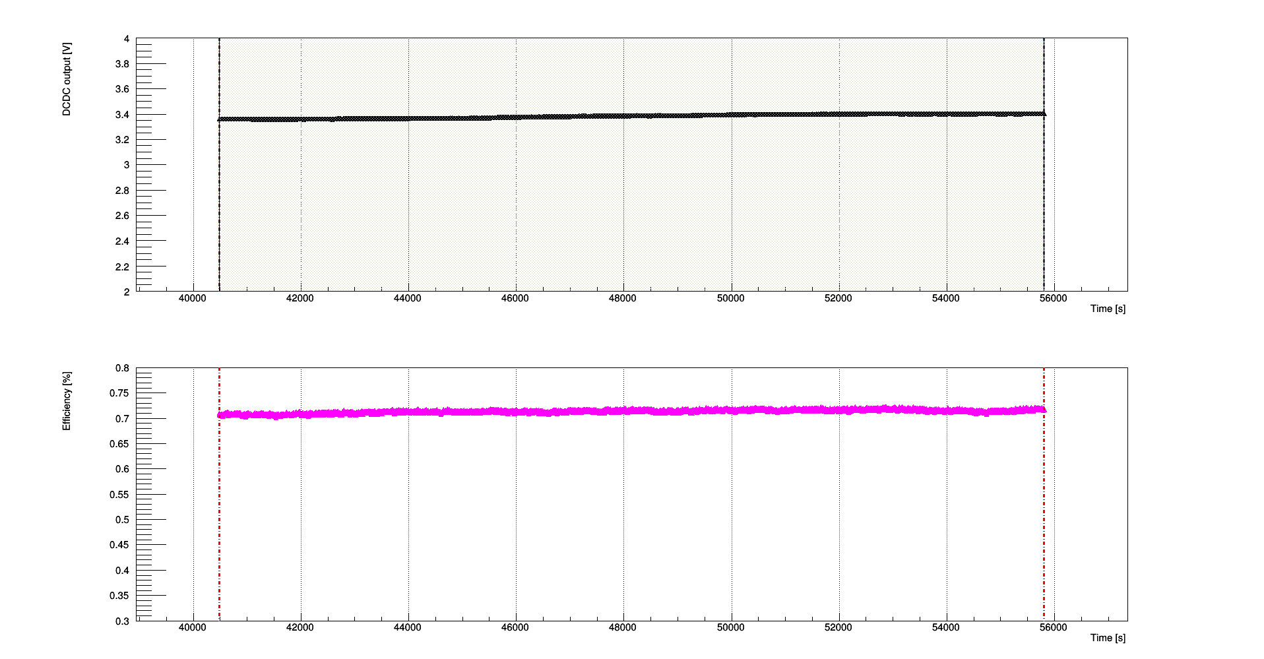
LTM 8033 Neutrons tests
  Test conditions:
  Neutrons over DCDC up to 1.2E12 1MeV-eq-Neutrons/cm2
  DCDC Vout (loaded with 1 ohm resistor):
    Measured before irradiation
    Measured after the test
  Negligible change …
6x10^11 n 1 MeV (Si) / cm^2

Slide 20
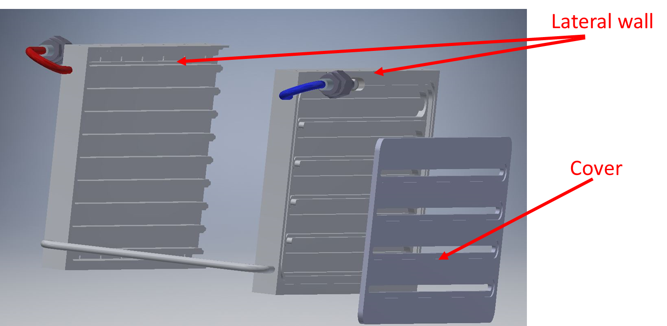
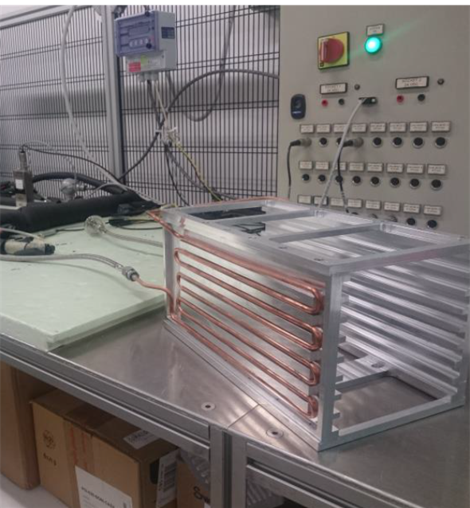
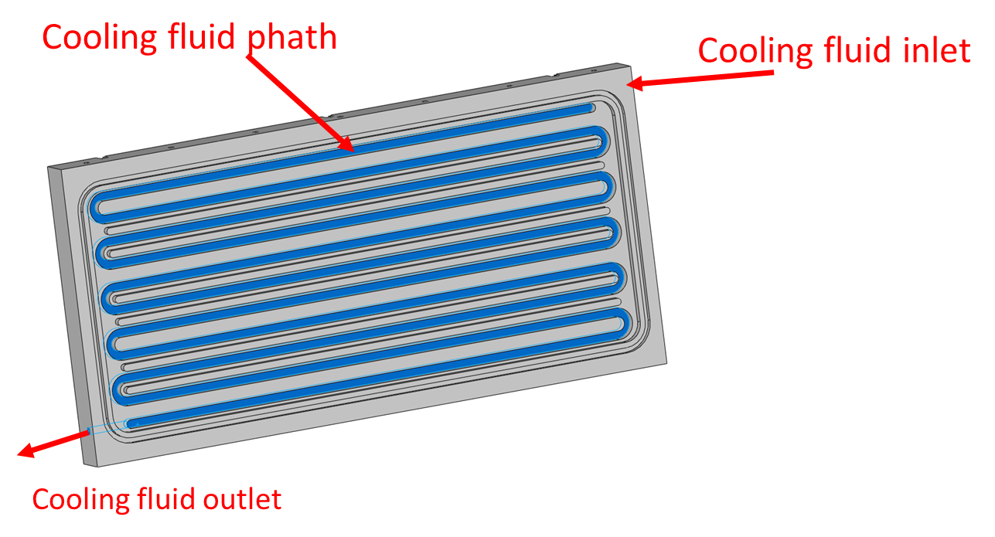
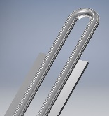
DIRAC cooling (1)
General cooling requirements:
  Maximum temperatures must not be exceed during operation → the max electronic components temperature is set to half specified values → set max temp = 60 ⁰C
  The cooling system must be robust and reliable
  Leak less cooling system
  All component must be compatible with magnetic field
  All parts must have a low outgassing rate for operating in vacuum
  Components must be radiation hard
A compact crate with 9 slots designed → house the boards and provides their cooling
  The cooling channels are milled on the lateral walls of the crate and sealed with a welded covers

Slide 21
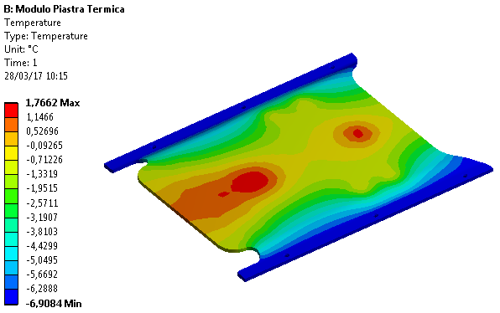
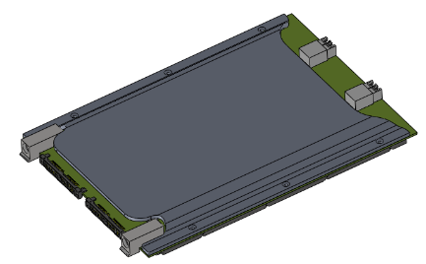
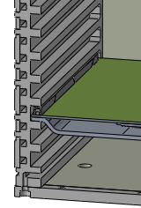
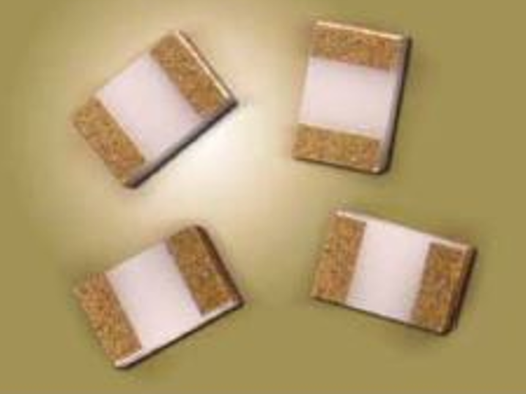
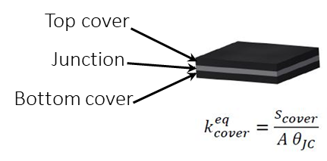






DIRAC cooling (2)
DIRAC estimated power 20W
8 DIRAC/crate + MB → 200 W/crate
Vacuum environment → the heat generated from the components is removed through:
  Thermal plate (Cu) pre-formed (radiator)
  Thermal Interface Material (TIM): thermal grease
  Bridge resistors (Beryllium Oxide)
  Card Lok Retainer (CALMARK® Series 265)
The electronic components modeled in three regions: top cover, junction and bottom cover
TIM allows the thermal contact between the top cover and the thermal plate
TIM
Bridge resistors
Card Lok
DIRAC + Cu Thermal plate

Slide 22

Module-0
Large scale EMC prototype:
  51 CsI crystals
  102 Mu2e SiPMs
  102 FEE boards
  1 DIRAC board handle 20 channels
Mechanics and cooling system similar to the final ones (vacuum and low T)
Goals:
Validate the acquisition chain → Slice Test
Test integration and assembly procedures

Slide 23


Slice test
Calorimeter electronics readout chain test using cosmic rays
Module-0 equipped with FE boards
SIPMs cooled @18°C (external chiller)
1 DIRAC v1 (16 channels) + 1 MB
Firmware → Preliminary version
External trigger → Cosmic ray coincidence

Slide 24

Slice test firmware
Firmware:
Initializes ADCs and Jitter Cleaner
Synchronizes clock phases
Digitizes 20 channels @ 200 MHz (DDR)
Stores 250 samples for channel, with an initial buffer of 60 before the trigger (1.2 µs) without zero suppression
External trigger → 2 plastic scintillator paddles coupled PMTs placed over and below the Module-0 (outside the vessel)
Binary data output through UART interface @ 1 Mbs (event rate 5Hz enough for cosmics)
DAQ software:
Written in python and C++, based on ROOT libraries
Transforms the received binary data in a standard rootopla containing:
  The waveform
  Reconstructed quantities like pedestals, charge and time
Online monitor

Slide 25


Slice test results
An example of the resulting waveform (Fig.A) and the distribution of the peak amplitude versus the integrated charge (Fig.B) is shown
Fig.A: Resulting waveform
Fig.B: Energy distribution deposited by cosmic rays (ADC counts)

Slide 26
DIRAC v2
  Changes due to radiation resistance:
    FPGA: Microsemi PolarFire® MPF300 (FGC1152, 300K LE, 512 user IO, 20.6 Mbits RAM) was M2S150
    Optical tranceiver: CERN VTRX ( radhard up to 1Mrad) was Cotswork RJ-5G-SX
    DCDC converters: Texas Instruments® LMZM33606 was Linear Technology LTM®8033
  Changes due to changes in specifications:
    Clock chain encoded in the data
    Readout point-to-point (only one optical driver)
    CAN BUS
    DDR3 bigger
  DIRAC V2 status:
    TID, neutrons and B tests performed to validate all new components
    Single channel test to verify MPF300/ADS4229 compatibility
    Prototype should arrive in November

Slide 27

DIRAC v2 design

Slide 28



DIRAC v2 PCB
Design @ INFN Pisa: COMPLETED
Routing @ CERN: COMPLETED
PCBs under PRODUCTION
The boards assembled (2 prototypes) will be ready in November

Slide 29
Conclusions
A waveform digitizer designed to operate in hostile environment has been presented
The DIRAC is designed to sample @200 MHz differential signals coming from the FEE of the DAQ of the electromagnetic calorimeter of the Mu2e experiment
The presence of vacuum (10⁻⁴ Torr), high magnetic fields (1T) and radiation (Non-Ionizing Energy Loss 5x10¹⁰ n/cm² @ 1 MeV_{eq} (Si)/y and Total Ionizing Dose 12 Krad) makes the environment particularly harsh and the design of the board very challenging
A slice test on Module 0 has been performed and it validated the acquisition chain
A new version V2 has been designed to strenghten the radiation hadrness

