Slide 1









Highlights of the MU2E Calorimeter 2019
H2020-MSCA-RISE-2015 ⎯ Grant Agreement N° 690835
S.Miscetti (INFN-LNF) Frascati
MUSE General Meeting
LNF FRASCATI – 23-Oct-2019

Slide 2
Talk layout
Status of CsI production
Test of response for “irradiated” SiPMs (DOE-IPR-rec1)
Status of electronics: PCB reviews and Next CRR
Status of Calorimeter vertical slice test (DOE-IPR-rec2)
Status of mechanics, cooling and services
Assembly planning

Slide 3
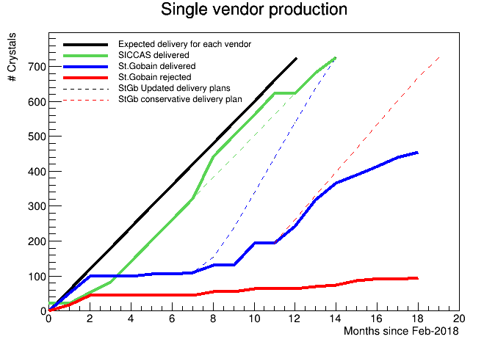
Crystal production status
SICCAS
725/725 crystals received
# out-of-specs crystals: 30
➙ 4% of the production
St.Gobain
After two months of pain, we have closed the contract & we are swapping to SICCAS for the rest of production
Simona
We have to send back to StGB
the out-of-specs crystals (95 tot, 59 shipped)
2. We have asked to SICCAS a quote for
300/330 and 360 crystals
We will buy a number of crystals that
matches the residual budget and will reduce
the # of spares accordingly .
 | SICCAS | St.Gobain | Total
Shipped | 725/725 | 460/725 | 1185/1450
CMM + inspection | 725 | 454 | 1179
Sent to Caltech | 257 | 146 | 403
Out-of-specs | 30 | 95 | 124
Irradiation Caltech | 9 | 3 | 12

Slide 4
SIPM QA plots → See L.Morescalchi

Slide 5
DOE IPR 2018: recommendations
Two recommendations were received @ the closeout of DOE-IPR 2018
REC-1. Calorimeter SiPM were exposed to neutron radiation and increase of dark current measured. Mitigations of lower temperature and voltage were observed to reduce dark current. Recommend that the loss of light yield, gain and resolution also be measured with dark current mitigation applied to irradiated SiPM as a direct test.
REC-2. Add simple pairwise integration tests in the 2019 integration plans in order to verify the validity of the TDAQ design and the compatibility of each of the sub-detectors with that design. Advancing to two or all three sub-detectors into a combined integration test by the end of 2019 should be a goal.
DOE-IPR review 2019 will be held in the usual 2.5 days format
from Dec 10 to Dec 12 – 2019 ➔ reply written (see next)

Slide 6
IPR-2018, rec1: SiPM response to neutrons
SIPM production batches have been exposed to neutron fluxes in two places
→ HZDR at EPOS, average spectrum of O(1 MeV)
→ FNG at ENEA Frascati, average spectrum of O( 14 MeV)
In both cases irradiation have been carried out with the sensors not biased.
From past experience this is a conservative measurement (+30 % of Idark)
SiPM irradiated up to batch # 7 (at EPOS) shows consistent Idark results w.r.t.
neutron flux and temperature. Basic rule is Idark decreases of O(2) each -10 °C.
SiPM irradiated @ FNG show a dark current of 2 x Idark (EPOS). Investigating
→ cross calibration of the two sites needed
→ try to run @ 2 MeV in FNG changing target from Tritium to Deuterium
First Tests done at LNF in Module 0
1 irradiated SiPM/group will be tested also in Pisa in 1 channel-station

Slide 7
Summary of “n” SiPM tests with Laser
First rough estimate: 1 sensor will reach 800 ps @ 5x10¹¹ n/cm for a 30 MeV deposit
Another factor 1/sqrt(2) achievable using two SiPMs/crystal→ 560 ps close to requirement
Time resolution vs Pulse Height
Time resolution vs Vbias
˜20 MeV
Vop
First estimate is that one single sensor will get around 800 ps resolution at
5x10¹¹ n/cm2 for an energy deposit of O(30 MeV).
Factor of sqrt(2) achieved using two sensors/crystal → 560 ps , close to requirement

Slide 8
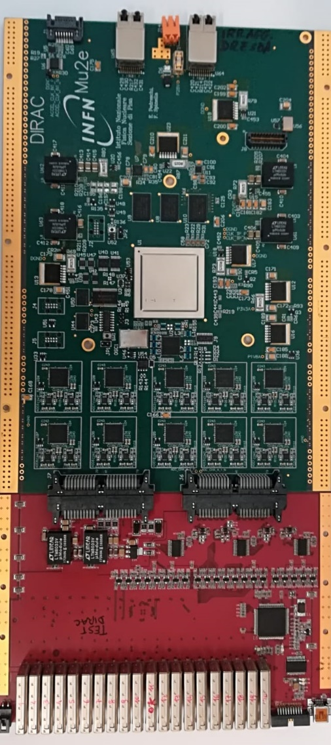
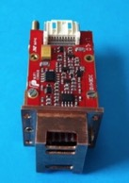
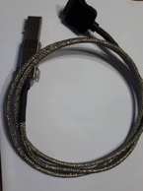
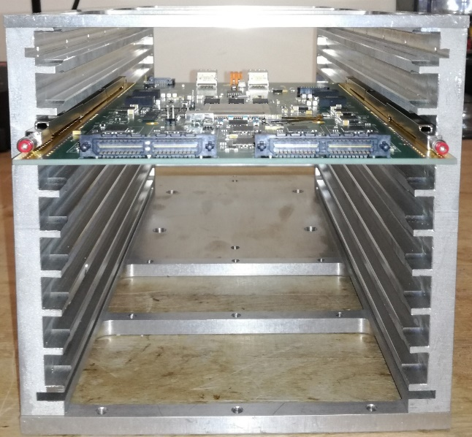
Mu2e Calorimeter Electronics
X20
X20 (10 + 10)
X8
7

Slide 9
FEE production .. F.Spinella DIRAC report
Production of FEE Boards is the most critical path in Calo assembly
start production of FEE boards before the end of 2019
➔ Production line is already set.
Tender for 3100 pieces SUBMITTED
→ It will take 4 weeks for the first 100 pieces, then 500 pieces/week
→ from Italy to DUBNA for QC test then shipped to SIDET
➔ PCB review DONE in July
➔ Light PCB review for DIRAC V2 in coming weeks
➔ Separate CRR for FEE/MB-V2 (fall 2019)
and DIRAC V2 (beginning 2020)
+ a final vertical slice test with the first DIRAC V2 protos
→ Plan is to submit production end 2019/beginning 2020
(INFN money released for production in September 2019)

Slide 10
IPR-2018, rec2: combined slice test
➔ Prototypes of Dirac V2
under construction next slides)
Slice test up to DIRAC V1 done
(reported in June 2019)
Slice test with DIRAC V2 will
be done in coming months
Work on completing the readout by TDAQ fiber and VTRX
➔ Next year plans:
1. a Module-0 BTF electron beam test
2. long run with cosmics in different configurations in vacuum
3. Preparation for Sidet integration → in view of Transition To Operation
SEE Franco Spinella for More Details

Slide 11
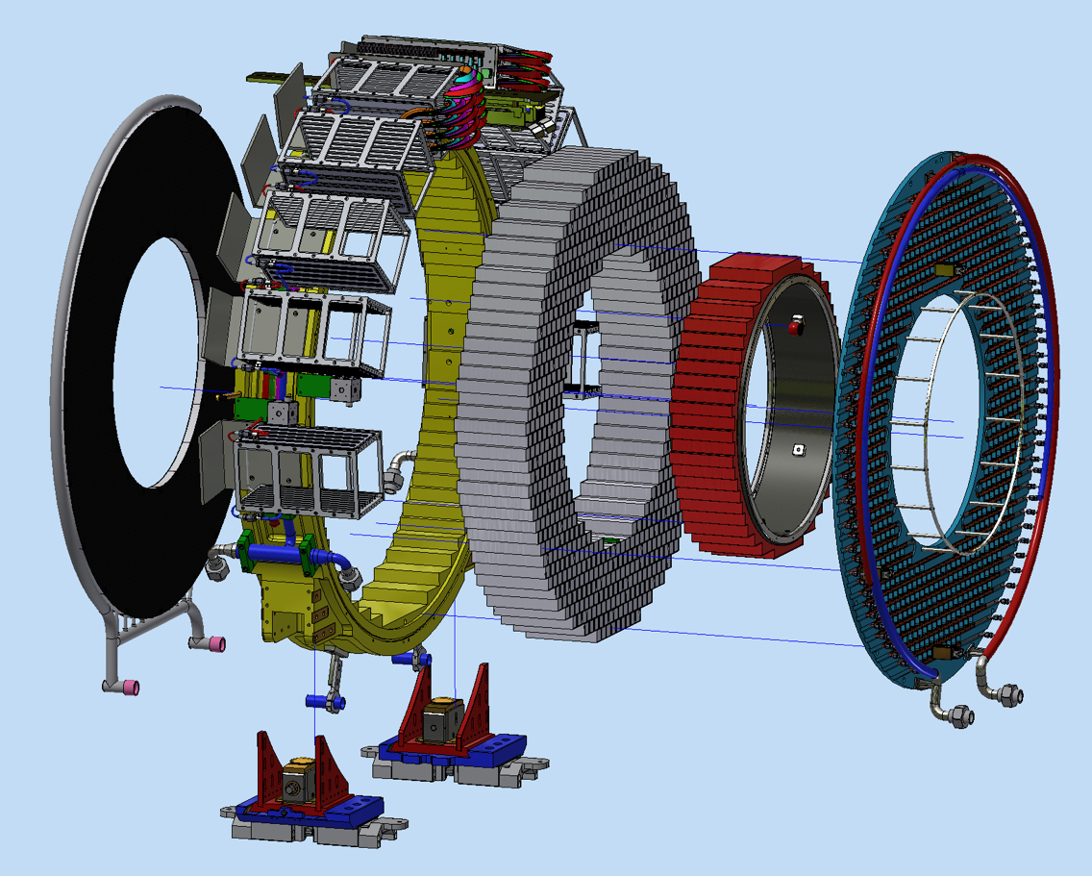
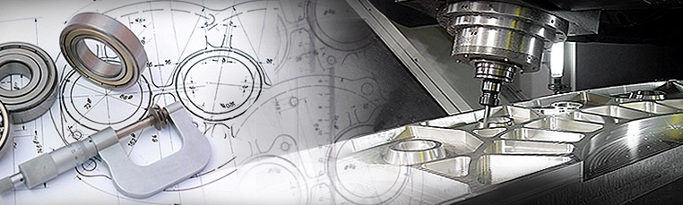
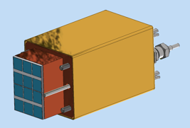


MAIN MECHANICAL COMPONENTS
Each disk consist of:
Front_Plate
Crystals Matrix
Back_Plate
Inner ring
nil volentibus arduum
SiPM holder
Outer Ring
n. 10 Readout elect . crates
Manifolds
Hydraulic connections
Alignment targets
Spacers
calibration
n.2 Feet

Slide 12
Crystal Matrix – final design

Slide 13
Status of Tenders and expected delivery
Outer Al cylinder – Tender Out → Jan 2020
Inner CF cylinder – Tender Out → March 2020
FEE plate – Tender Out → March 2020
Source Plate – Tender Out → March 2020
Crates – Tender Out → April 2020
SiPM Holder – Tender Out → November 2019
Faraday cage – tender in progress
Fiber guide line – tender in progress
Cable trays – finalizing design
Assembly stand –finalizing design
Lifting tool – Conceptual design being engineered

Slide 14
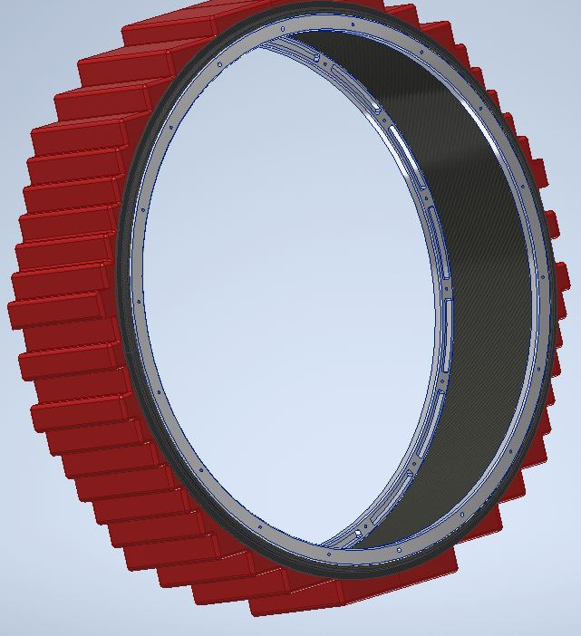
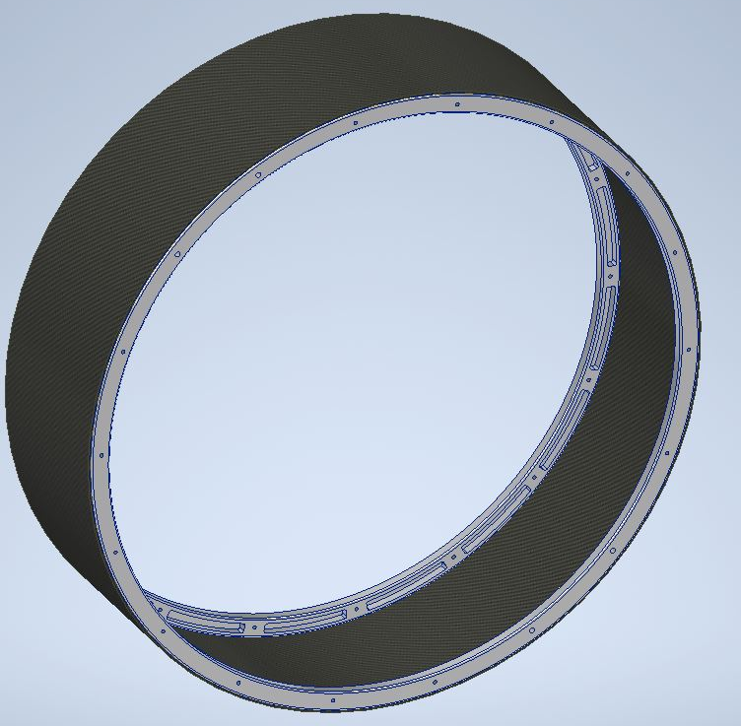
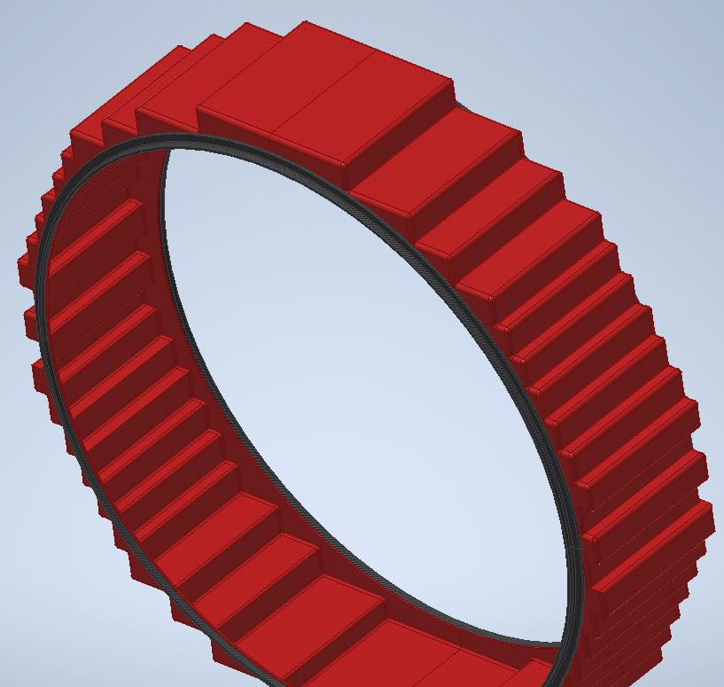
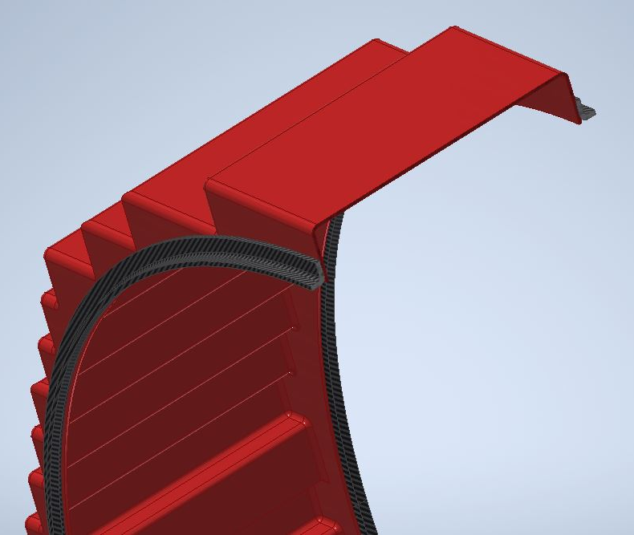
CF inner steps - no foam, CF only
CF inner tube + aluminum rings
CF steps
L connecting profile

Slide 15
Coolant choice for Chiller Station @ -20 °C
Due to the 7 °C drop from chiller to SiPMs to get -10 °C on SiPM surface required to have a coolant different from Water Glycol
Preliminary analysis of a different coolant carried out:
→ Best candidate already used in CMS/LHCb is 3M PF-5060
i.e. the Perfluoro-hexane (C6F14).
→ A novel “improved” eco-friendly coolant is 3M Novec 649 (radiation hardness?)
These coolants have a freezing temperature @ -90 °C so leaving a lot of flexibility
Temperature drop along the line is larger → needs additional -3 °C from Chiller
to SiPM, so coolant should be kept below -20 °C

Slide 16
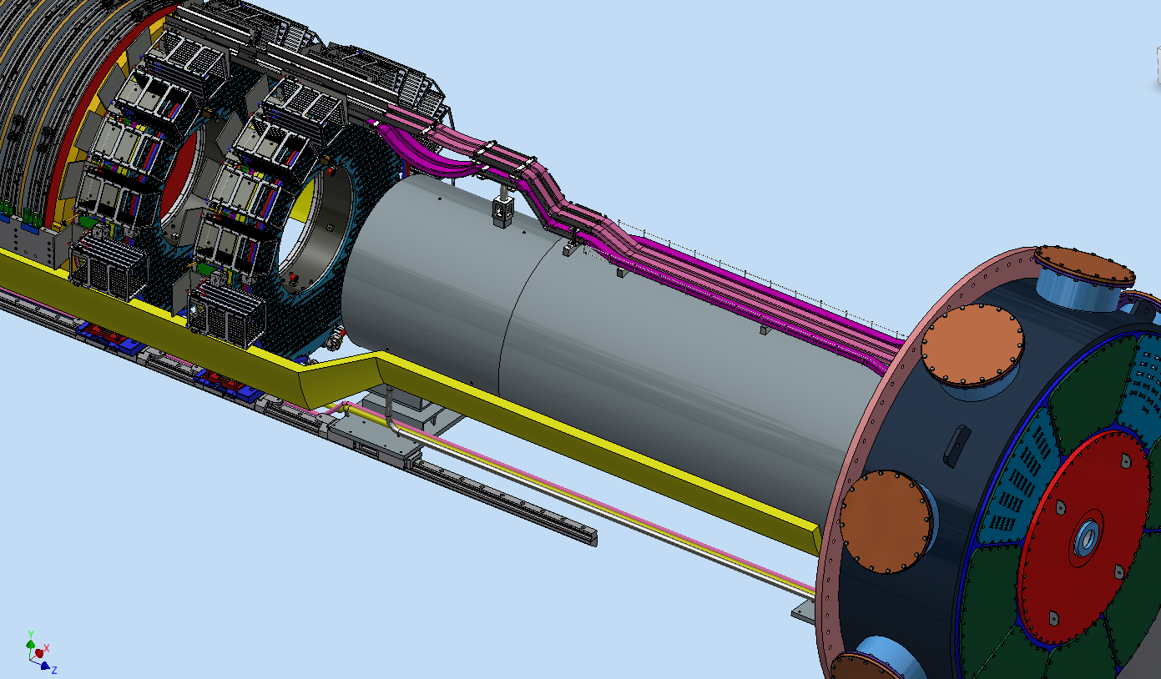
Cable services inside DS and Feedthroughs
Calorimeter internal distribution will be completed at Sidet
Internal distribution inside DS fully specified. In the hands
of Gary /Karen and integration team (100 % completed)
3. List of feed-throughs and flange proposal in progress (90% completed)
IFB-CONNECTORS | Flange # | Num. Connectors per Flange # | Spares # | KIND
Laser Fiber | 0-1 | 2 |  | FIBM3−IR00−02−S−3
TDAQ Fiber | 0-1 | 4 |  | Pavetech VS-18
LV | 0-1 | 10 | 2 | XAVAC9W4M/SI.2/AA
HV | 0-1 | 10 | 2 | XAVAC9W4M/SI.2/AA
GND | 0-1 | 1 |  | XAVAC9W4M/SI.2/AA
CAN | 0-1 | 2 |  | XAVAC15M/SI.0/AA
Inner ring | 0-1 | 1 |  | XAVAC9W4M/SI.2/AA

Slide 17
HV/LV – Cables outside DS and P.Supplies
Configurations (per one DISK):
Missing only the LVTemp cables for the inner ring (4 x 6AWG cables).
Inside requirement with an overall cross section of 9.5 x 11.2 cm² ~ 105 cm²
2 x 1.5’’ Corrugated for the TDaq fibers
1 x ¾’’ Corrucated for the Laser fibers
Single module
½ crate for LV/HV
LV/HV supplies being selected
Prototypes in SIDET
Pre-ORC informal carried out
yesterday
Sign-OFF in 1 month from now

Slide 18
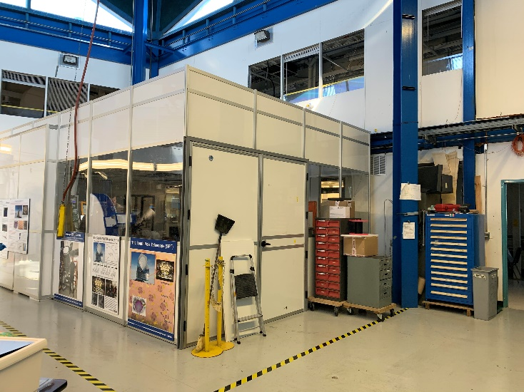
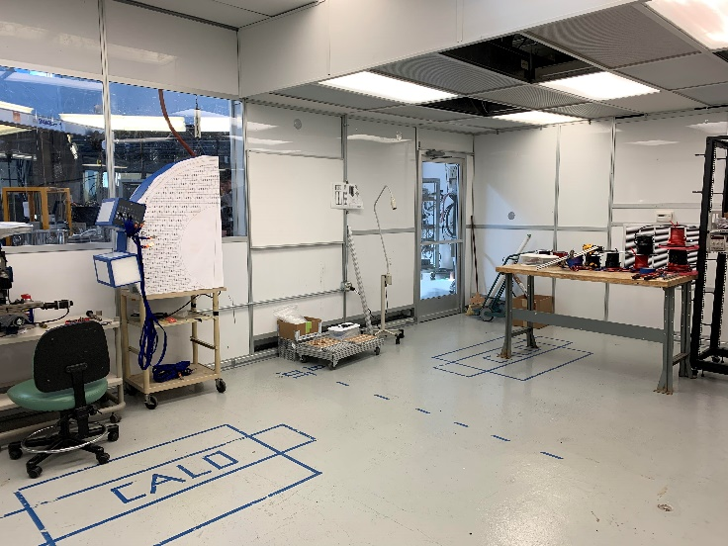
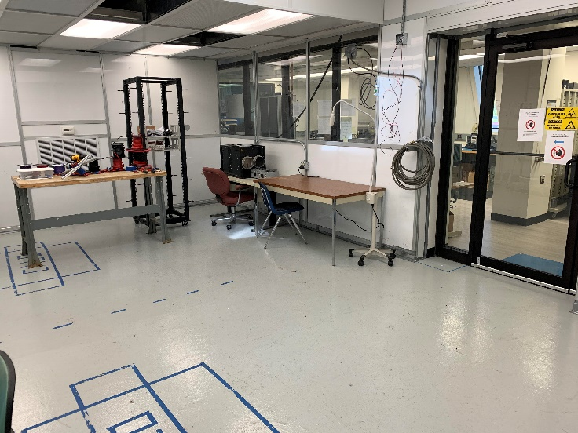
Status of Assembly Area
Almost completed
Access with crane for Calo truck loading
Temperature and Humidity controlled and monitored
Portable crane inside for components
One mechanical assembling region
One electrical and data acquisition region
Testing of half disk a time
Nitrogen and compressed air installed
Electrical implant almost finished
To do:
- fire alarms
- calibrating HEPA and HVAC system
- sealing small openings
- cleanroom class verification
- storage units

Slide 19
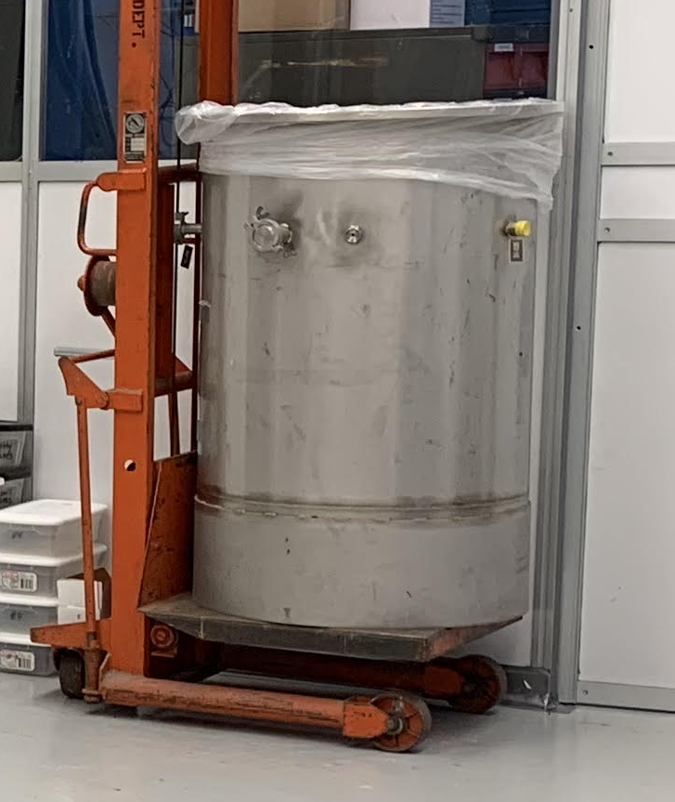
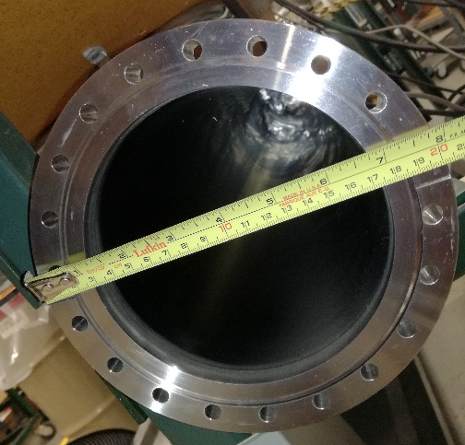
Outgassing facility @ SIDET: status
Heaters stripes outside ∼60°C
Nitrogen refill after outgassing
Estimated time for outgassing (several batches): 2-3 months
Recycled stainless steel vacuum vessel Φ 700 mm × 1000 mm (missing flange, manufacturing in process in Italy)
For Crystals and electronics outgassing
To do: finalize the structure, recovery vacuum pumps
Borrowed vacuum vessel Φ 150 mm × 2000 mm (missing flange, manufacturing in process in Italy) Thanks to thin film facility
For cables
To do: bring at SiDet, recovery vacuum pumps

Slide 20
Detailed INFN Gantt for Calo Assembly: updated
Disk fully assembled for the summer.
Aiming to have a partial disk assembled for reporting milestones
in spring 2020

Slide 21
Conclusions
CsI prod done @ O(85%), SIPM Completed 100%
SICCAS completed its first 750 crystals. St.Gobain contract closed
TEST of response for neutron irradiated SIPMs started
➔ Cal. Performance at limits @ 0 C and 5x1011 → -10 C proposed
Electronics development is excellent:
→ Rad Hard FEE V4. Prototypes in hands
→ Rad Hard DIRAC V2 design completed → Prototypes in November
→ Vertical Slice test completed up to DIRAC V1 →
AIMING TO CRR end 2019 / beg 2020 to start production
Progresses on Mechanics
→ Fabrication drawings for Al disk and FEE plate ready to go
→ Measurements and estimate of outgassing improved
→ Integration of services OK for LV/HV/TDAQ/LASER
→ Integration of hard services and cooling station still in progress
We are organizing the calorimeter assembly operations in SIDET,
starting gluing of SiPMs and production of electronics

