Slide 1

Muon g-2 Status
Mark Lancaster

Slide 2
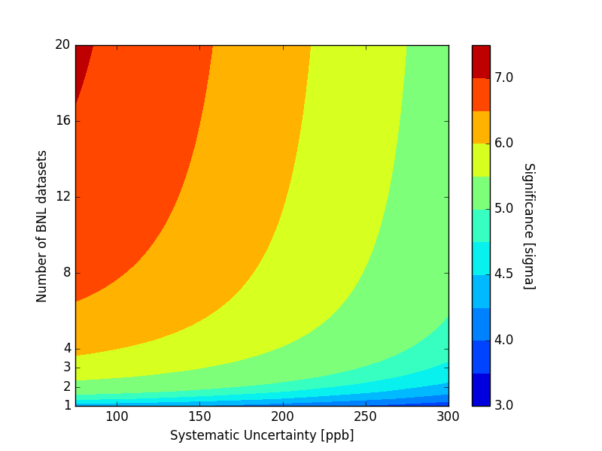
Aim of experiment
BNL exp.

Slide 3
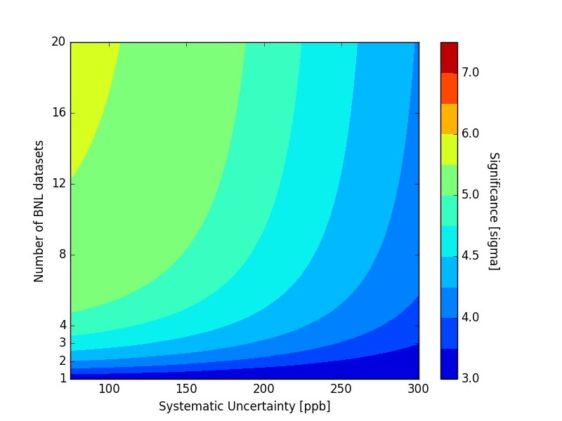
If measure 1𝜎 below BNL value

Slide 4
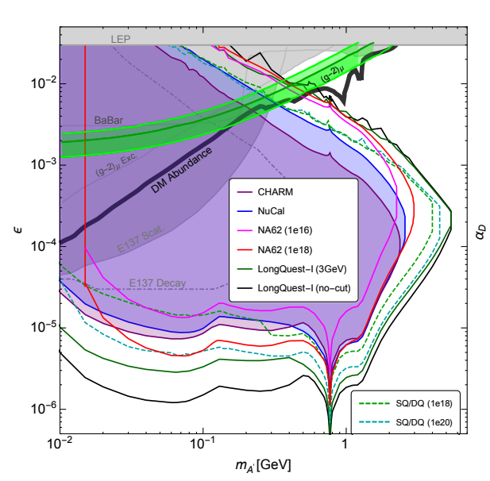
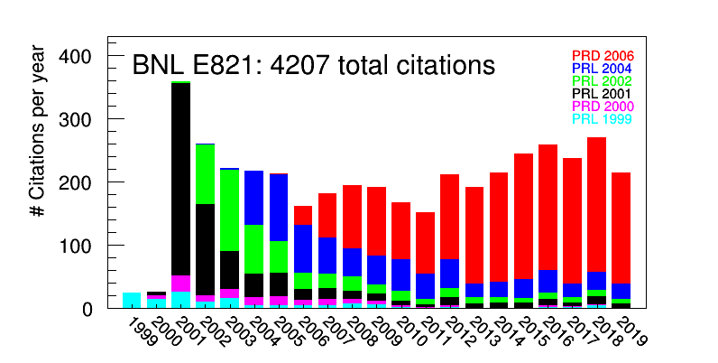
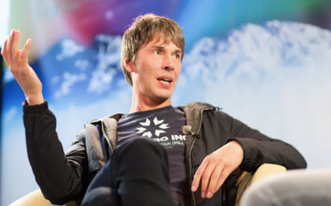
Motivation
arXiv:1908.07525
“.. it’s extremely sensitive to new physics. It’s still running, but if I were to put my money on something that would signal new physics, it’s the
g-2 experiment at Fermilab. I think it’s really fascinating...”

Slide 5
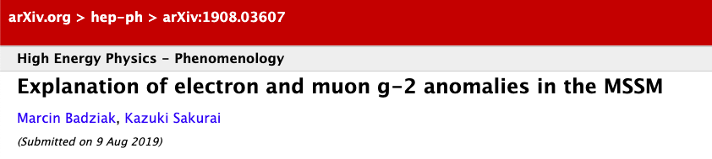
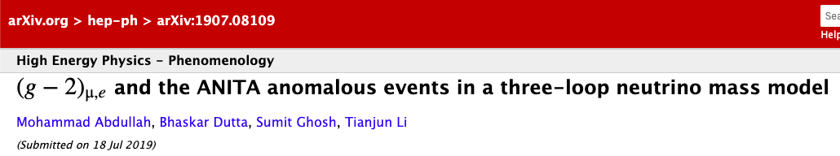
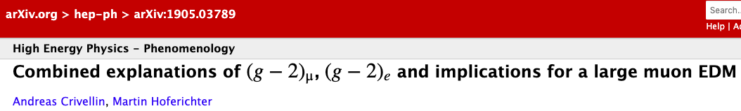
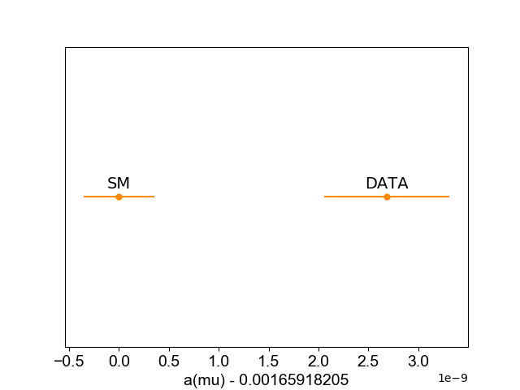
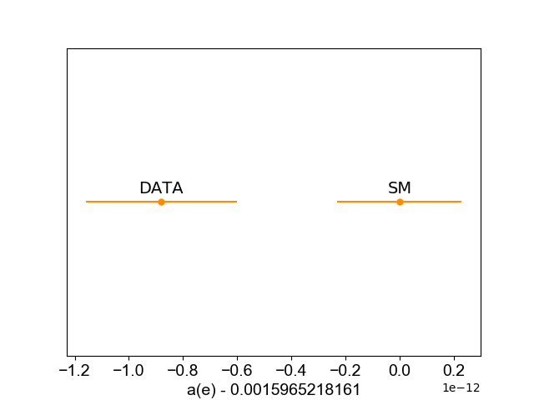
(g-2)_{e} vs (g-2)_{𝜇}
Muons: +3.7𝜎
Electrons: -2.5𝜎

Slide 6
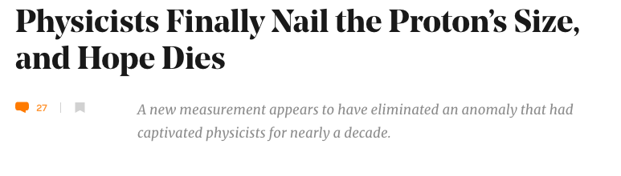
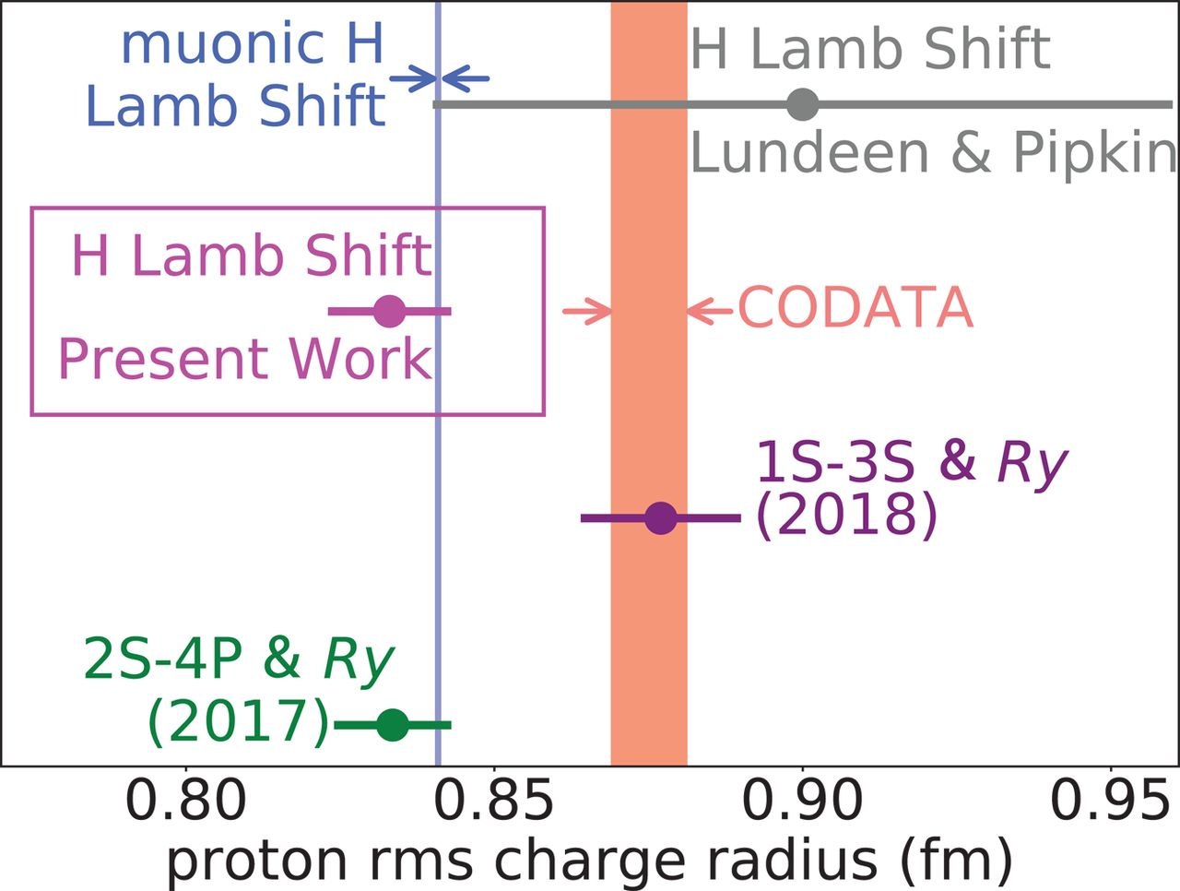
New physics in muon interactions ?

Slide 7
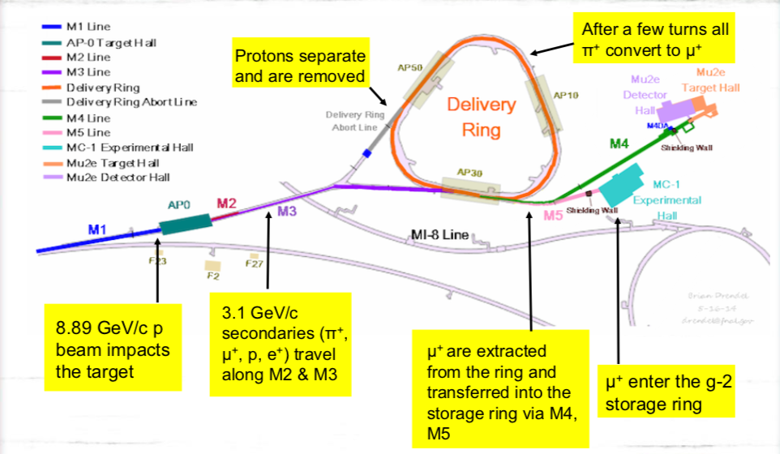
Experiment Overview

Slide 8
Experiment Overview
Inflector Magnet
cancels 1.45 T main field
μ⁺
TDR
7 cm
Q1
Q4
K1
7.1 m
K2
Kicker magnets
K3
radially centers beam
Q3
Focusing quadrupoles
Q2
vertically focuses beam
Collimators

Slide 9
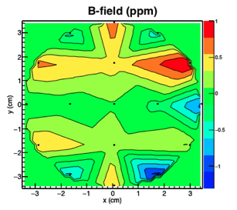
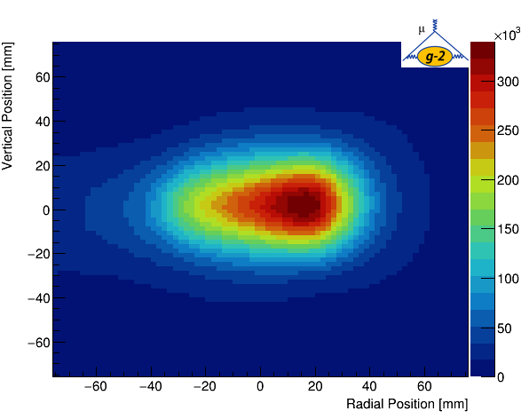
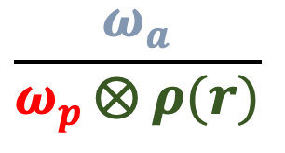
Methodology
3 ppb : Hydrogen Maser
140 ppb
22 ppb : Muonium hyperfine splitting
0.00026 ppb : Electron g-2/QED
⇓
$$\frac{ω_{a}}{ω_{p }⨂ ρ(r)}$$
⊗
⇓

Slide 10
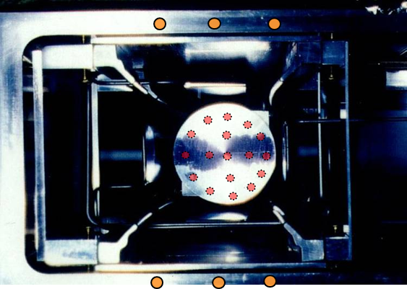
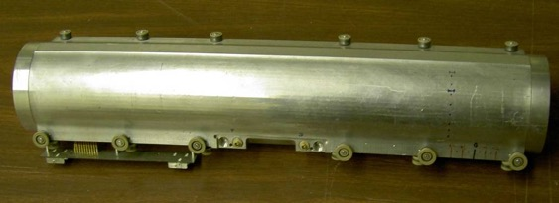
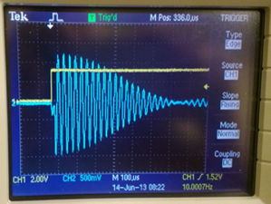
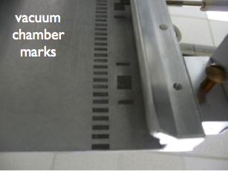
Monitoring the Field
Fixed probes track field at top/bottom of vacuum chamber monitor field 24/7
NMR trolley maps field where muons traverse every 2-3 days
Digitizing FID signals

Slide 11
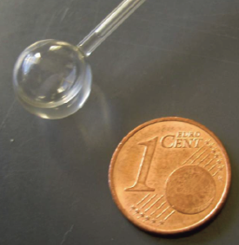
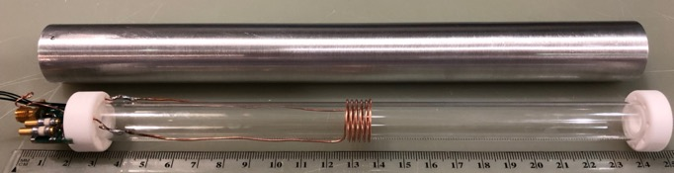
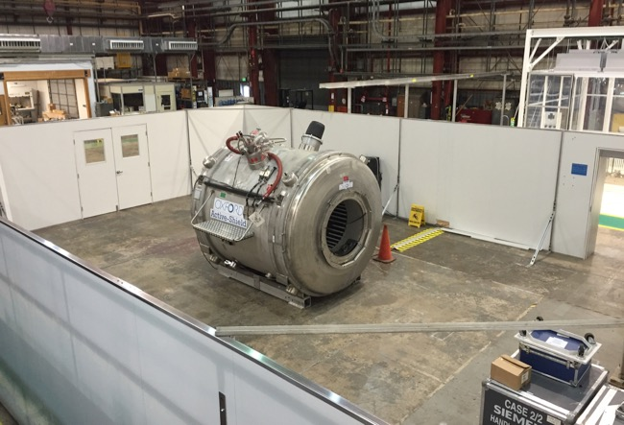
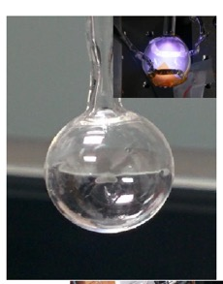
Absolute Field Calibration
New cylindrical H₂O plunging probe
Original BNL H₂O probe
ANL test-magnet
New 3He probe

Slide 12
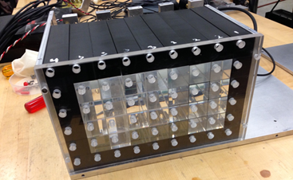
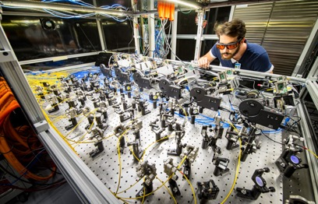
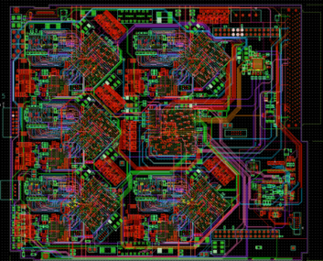
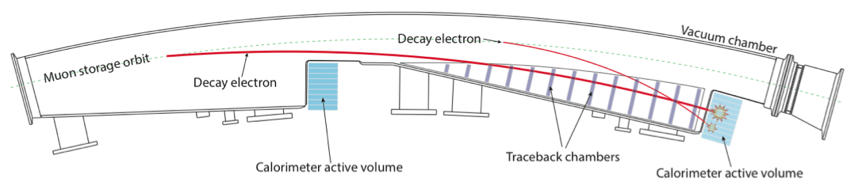
Calorimeters
800 MSPS Digitizers

Slide 13
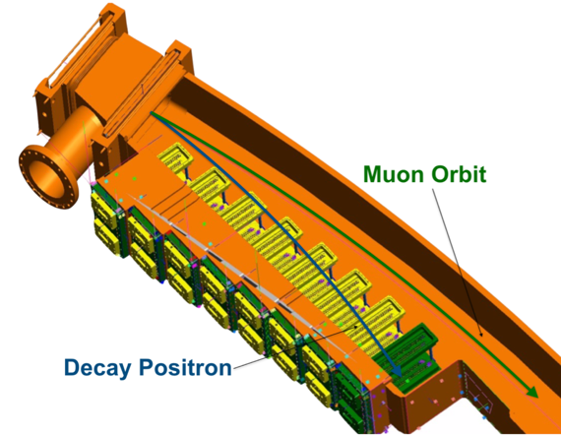
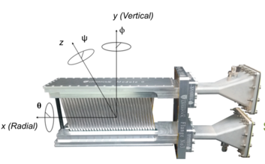
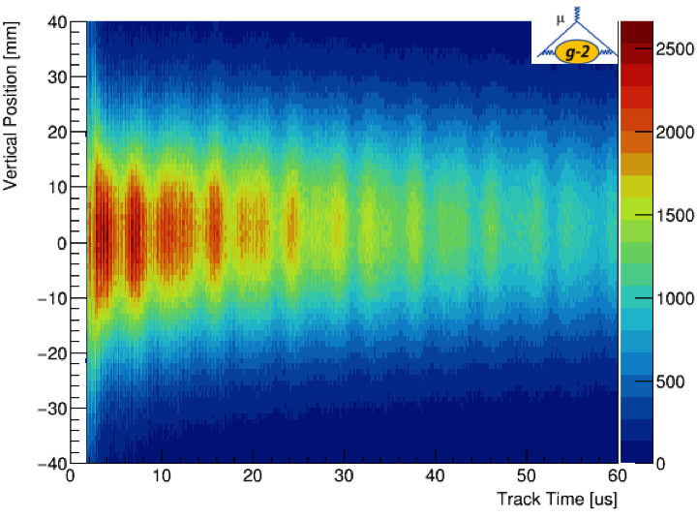
Straw Trackers

Slide 14
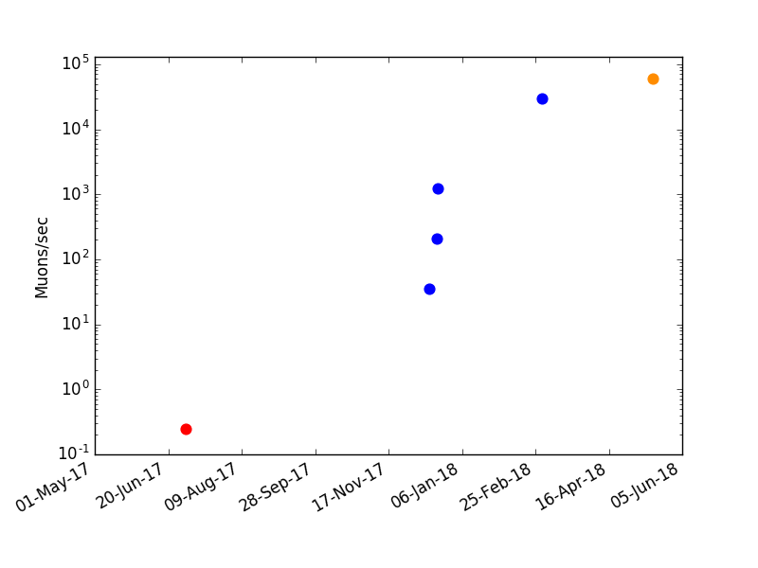
Commissioning Jun-17 → Mar-18
Run-1
PHYSICS
Run-0
Commissioning
Run-1
Commissioning
5 orders of magnitude improvement in muon flux
TDR envisaged 200 days of commissioning (June-17, Nov-17 → Mar-18)

Slide 15
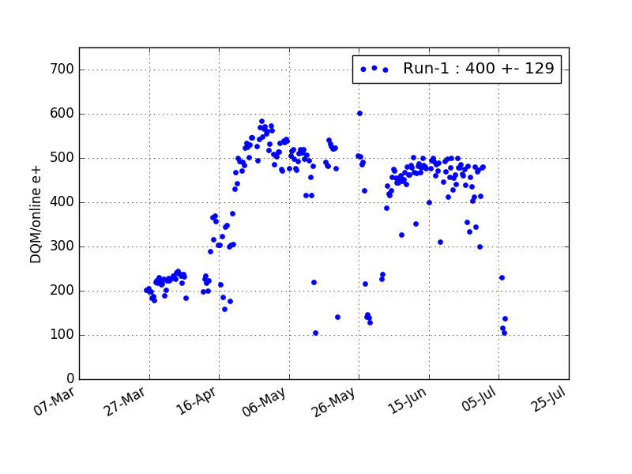
Run-1

Slide 16
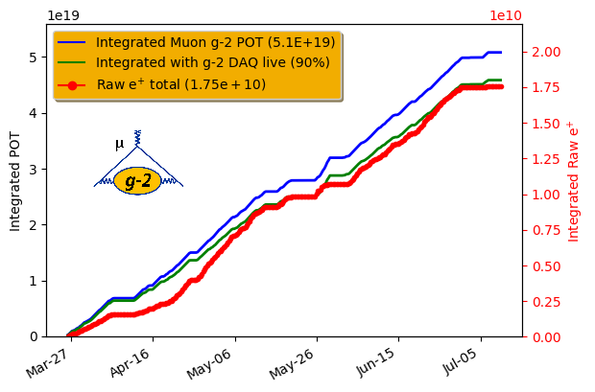
Run-1
Raw data: x2 BNL but several different quad/kicker settings.
Resulted in 7 datasets with approx. x1.4 BNL.
Run-2 aim: fewer datasets with constant conditions

Slide 17
Run-1 to Run-2
Run-1 issues affecting integrated stats (& systematics/ease of analysis)
- kick was too low
- kicker had significant downtime
- significant number of quad sparks
- magnet downtime due to cryo purity issues
Such that fraction of days with > 100M e+ was 57%.
The run-1/2 shutdown addressed these issues

Slide 18
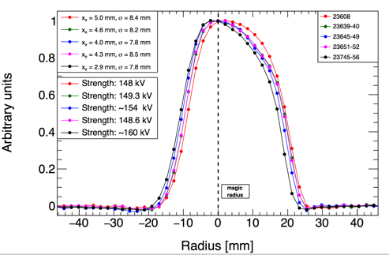
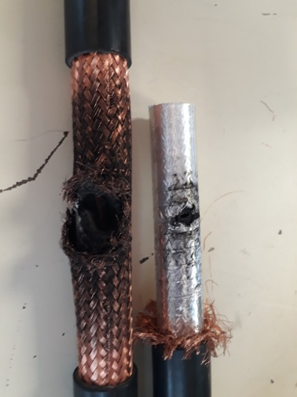
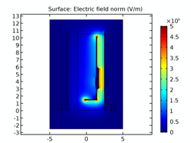
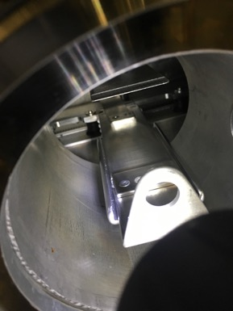
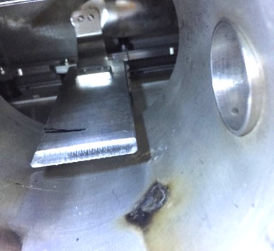
Kicker
Kicker ran very stably at 142 kV for 2 months.
Run-1 average was 124 kV.
Much reduced sparking
Still some cable issues above 145 kV

Slide 19
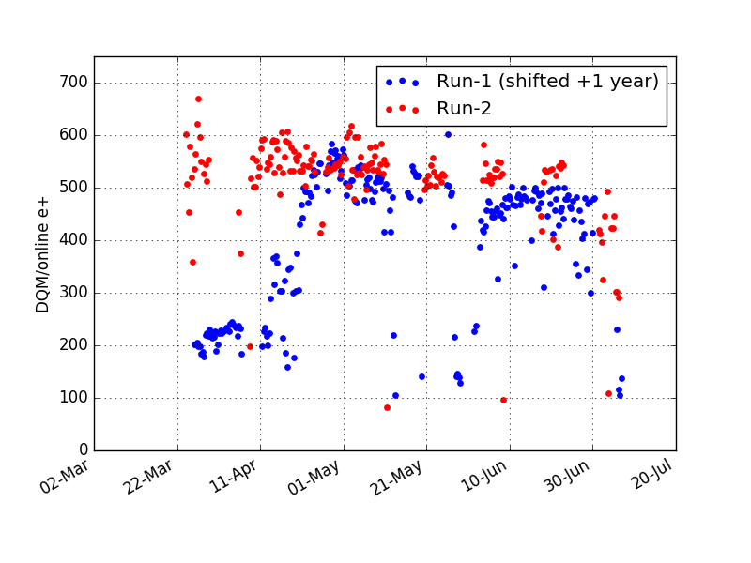
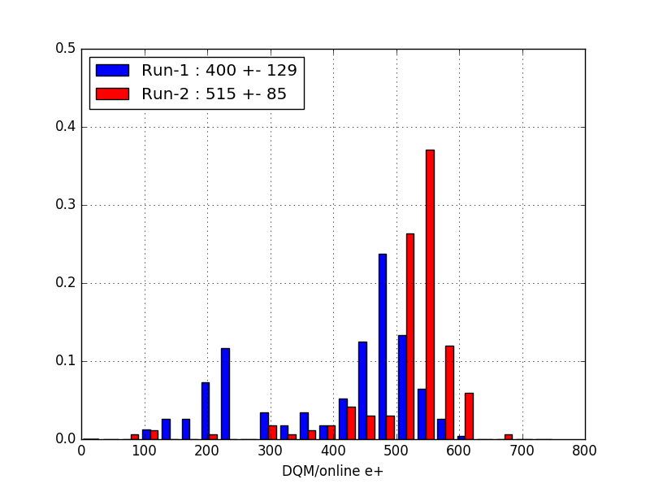
Run-1/2 e⁺ per fill
systematic runs
Run-2: 1.3 x Run-1
from DQM
This despite a 19% reduction in
intensity due to running the Li
lens with 10% lower current

Slide 20
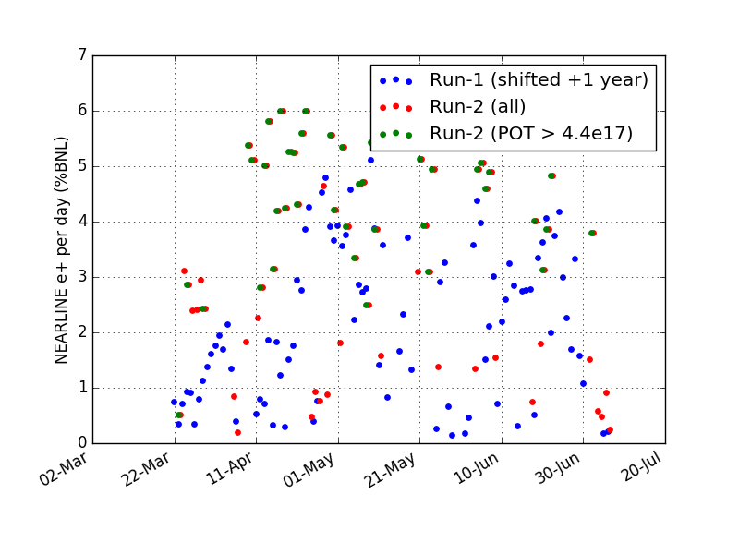
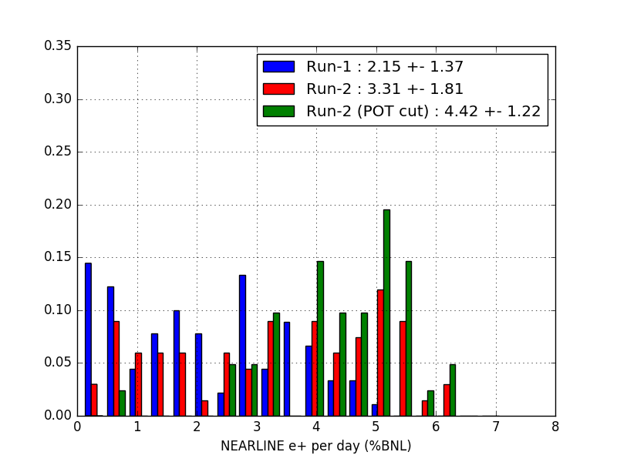
Run-1/2 : e⁺ per day
Average running was 3.3% BNL/day
But when beam was available more
than 12 hrs/day: 4.4% BNL/day
Run-2: 1.5 x Run-1 per day
When providing beam for
more than 12 hrs in a day

Slide 21
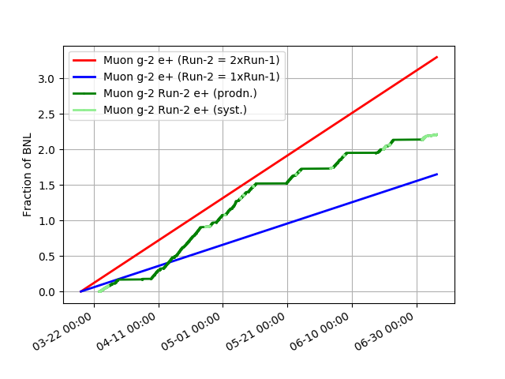
Impact of 5/14 running
5/14 running

Slide 22
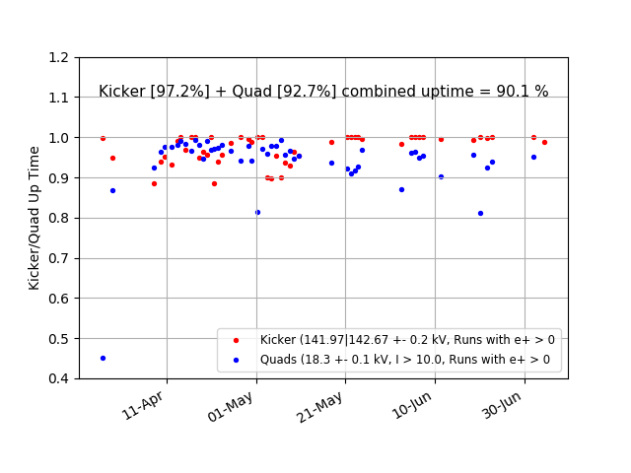
Quad/Kicker Run-2 Uptime
Combined uptime of kicker/quads was 90% : far better than Run-1

Slide 23
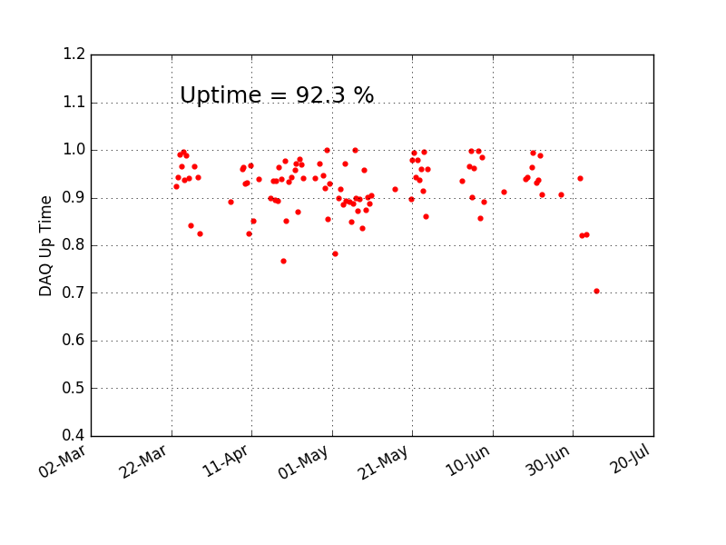
DAQ Uptime

Slide 24
Reduced intensity per fill
 | e+/fill | Effect | Factor
TDR | 1100
 |  | Wedges | 1.06
 |  | Li Lens | 0.81
 |  | Kick (142 vs 155 kV) | 0.84
 |  | Quads (18 vs 28 kV) | 0.92
 |  | Actual beamline apertures | 0.8
 |  | TOTAL | 0.53
RUN-2 Predicted |  |  | 582
RUN-2 Actual |  |  | 525 +/- 85*
*includes some systematic runs where rate was lower.
In physics running intensity is x0.5 that of TDR expectation.

Slide 25
Reduced uptime
 | TDR | Run-2
g-2 systems | 0.9 | 0.77 0.92 (DAQ), 0.90 (kicker/quad), 0.93 (cryo)
MI Cycles 1.4 vs 1.33 sec |  | 0.95
Trolley Runs | 0.94 | 0.94
Testbeam Users |  | 0.91
Accelerator uptime* | 0.85 | 0.82
TOTAL | 0.72 | 0.5
TDR expectation: 1,100 e+/fill and 72% uptime → 825M/day
Predicted Run-2 : x 0.5 (e+/fill) and x 0.7 (uptime) → 290M/day
Run-2 actual : 286M/day (3.3% BNL/day).

Slide 26
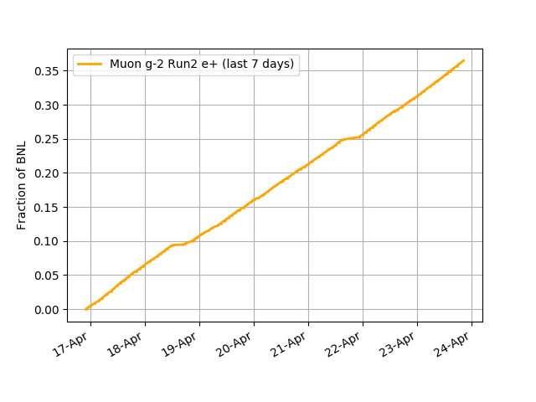
A good week…
5%/BNL per day
Trolley Runs
Anticipate Run-3 period to be more like this

Slide 27
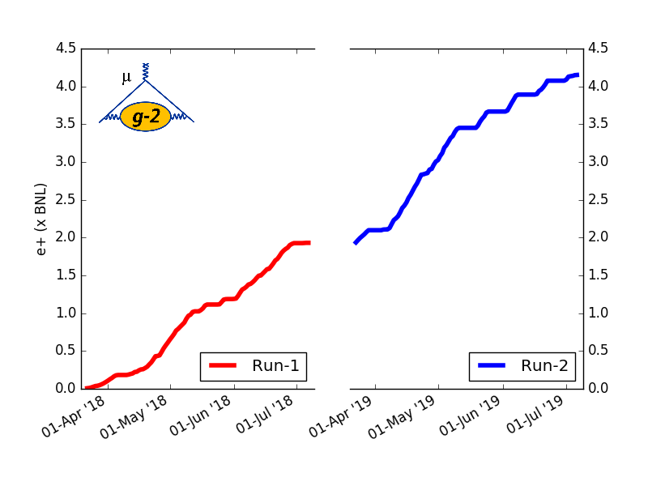
Run-1 & Run-2 Integrated
Over x4 BNL before data-quality cuts (DQC)
Due to smoother running expect Run-2 DQC impact to be modest
and so Run-2 analysis will be on ~ x1.8 BNL vs ~ x1.4 BNL in Run-1

Slide 28
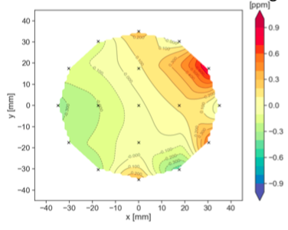
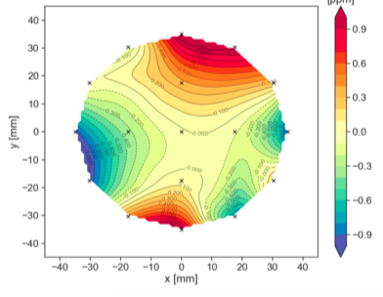
Quick Analysis Highlights
Run-2
Everything is blinded !
Run-1
On average x2 better than BNL

Slide 29

Run-1 : Field Determination (𝜔_{p})
Fixed probe → Trolley → Absolute (plunging probe)
Comparison of trolley and plunging probe
measurements in two independent analyses
Also two independent analysis doing interpolation from fixed probe
measurements to the trolley measurements.

Slide 30

³He cross calibration with H₂O probe
Cross-calibration performed blind
Analysis completed and unblinded
Agreement with original BNL spherical probe and cylindrical plunging probe well within errors
Difference also small relative to 540 ppb BNL error

Slide 31



𝜔_{a} determination
Preliminary

Slide 32

Run-1 Analysis Status
Hardware blinding : x10 size of the BNL discrepancy wrt SM

Slide 33

Present datasets have stat. uncertainty ½ BNL
410 ppb (stat) Run-1 vs 460 ppb (BNL).
With Run-2 data approach
half the BNL stat. uncertainty
Run-1 sub-datasets have statistical variations within expectations

Slide 34
Expectations for Run-3/4
Accelerator uptime to be closer to 90% not 80% assuming overtime
restrictions don’t exist in Run-3/4.
Modest g-2 DAQ improvements: x0.92 → x0.95.
Optimisation of upstream wedges: x1.06 → x1.15
Moves average BNL/day from 3.3% to 4.0%.
Improved temperature control (critical for field & calorimeter gain)
Other potential improvements:
- install new inflector: x1.4
- increase quad / kicker voltage : x1.1
- faster switching PS (mitigates testbeam) : x1.05
In projections we are assuming 4% of BNL per day
When had POT for > 12 hrs a day in Run-2 we had 4.2% BNL/day

Slide 35



Improved temperature control for Run-3
Before
After
Now stable
Large day/night oscillations
Significant overall rise over data taking period

Slide 36

Run-3/4
Gets very close to
21.5 BNL goal
Run-4
Run-3
And reach goal if new inflector deployed
in Run-3/4 shutdown

Slide 37

Possible Run-4 with 𝜇-
Run-4 could alternatively accumulate x8.5 the BNL 𝜇- sample
e.g. if becomes systematics limited with 𝜇+ or 𝜇+ result > 5𝜎
Run-4 (𝜇-)
Requires extra work
in Run-3/4 shutdown
Cryo pumps
Kicker standoffs
New inflector would
give x12 BNL 𝜇-
sample.
Run-3 (𝜇+)

Slide 38
Beyond Run-4
Beam time is prioritised for Mu2e but initial part of Run-5 is likely g-2 running.
Ideas presently being pursued for future use of g-2 ring
- dedicated muon EDM experiment : new Si trackers infront of each calo
- O(10 keV) 𝜈_{𝜇} mass measurement
HEPAP/P5 is summer of 2021 i.e. as Run-4 concludes.

Slide 39
Conclusions
Run-1 and Run-2 were challenging: several technical issues had to be resolved
Run-1 data will by itself surpass BNL precision
Early analysis allowed us to quickly understand where we most needed to make improvements to control systematics for Run-2
Run 2 (1.8×BNL) was taken under much more stable and improved conditions
Expect even higher quality data in Runs 3 & 4 with 1×BNL collected per month
(Blinded) independent analyses making good progress

