Slide 1

Material science and accelerator R&D: Reflectivity and Photo Yield measurements of vacuum chamber technical surfaces
Relatore interno: prof. M. Migliorati
Relatore esterno: dott. R. Cimino
Candidata:
Eliana La Francesca
Dottorato in fisica degli acceleratori
(XXXI ciclo)

Slide 2
Outline
Synchrotron radiation detrimental effects
Reflectivity and Photo Yield
Bessy II measurements
Conclusions

Slide 3
Outline
Synchrotron radiation detrimental effects
Reflectivity and Photo Yield
Bessy II measurements
Conclusions

Slide 4
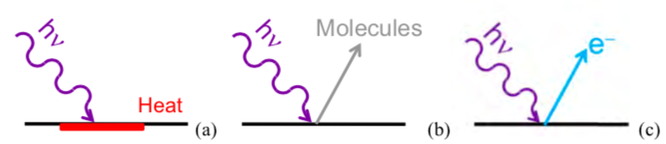
Synchrotron Radiation detrimental effects
Heat load on the accelerator walls
Gas load
Production of photo emitted electrons (e⁻ cloud effect)
Beam instability

Slide 5
Synchrotron Radiation interaction with Matter
Absorbed + Reflected + Transmitted
Photo-electrons
generation
Electron cloud effect

Slide 6
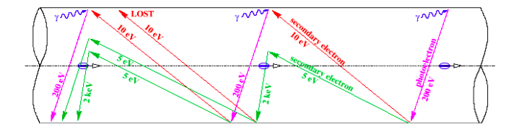
SR and electron cloud generation
Photo-emitted electrons can be:
Produced directly by SR (dipoles): emitted in the orbit plane (not participate to electron cloud build up).
Produced by the reflected or scattered light (dipoles and free field zone): emitted perpendicularly to the orbit plane (generate secondary electrons)
Original representation F. Ruggero
Beam
instability

Slide 7
Synchrotron Radiation interaction with Matter
Absorbed + Reflected + Transmitted
Heat Load
Photo-electrons
generation
Electron cloud effect

Slide 8

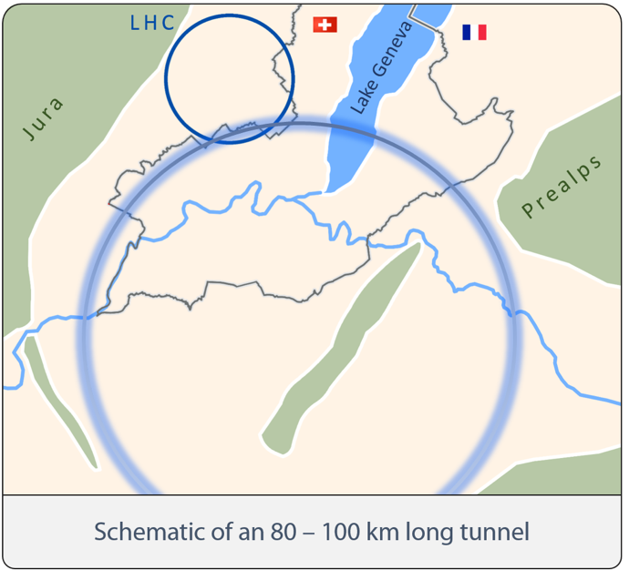
FCC Parameters
http://tlep.web.cern.ch/content/fcc-hh
Version 1.0 (2014-02-11)
Parameters LHC H-L LHC FCC-hh
FCC-hh SR incidence angle: 0.077 deg
(0.62 mrad)
Dipoles at 1.9 K
Total Power to dissipate such HL at cold bore temperature: 3 GW

Slide 9
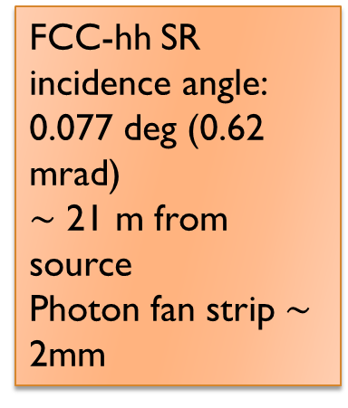
FCC-hh Synchrotron Radiation
X-Ray Range
FCC-hh SR incidence angle: 0.077 deg (0.62 mrad)
$\sim$ 21 m from source
Photon fan strip $\sim$ 2mm
R. Cimino, V. Baglin and F. Schäfers, PRL. 115 (2015) 264804
FCC-hh needs a Beam Screen at the highest possible temperature compatible with vacuum stability, impedance…
Notes:
Let’s focus about FCC SR with more detail.
FCC SR is expected to impinge accelerators walls at 21 m from source, with a very grazing angle (0.035 degree) and with 2mm of photon fan strip.
Critical energy is in X-ray range. SR Power is principally carried by high energy photons.

Slide 10
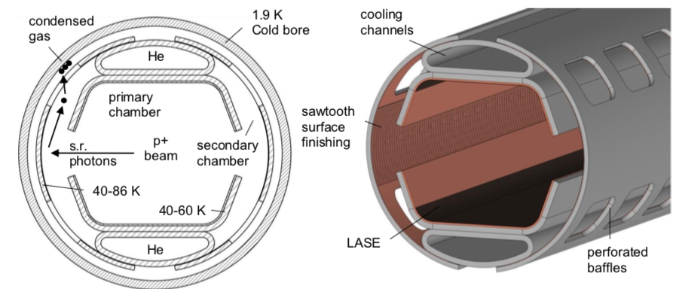
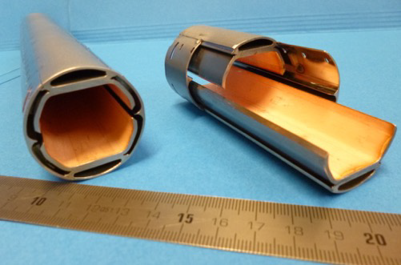
FCC-hh Beam Screen

Slide 11
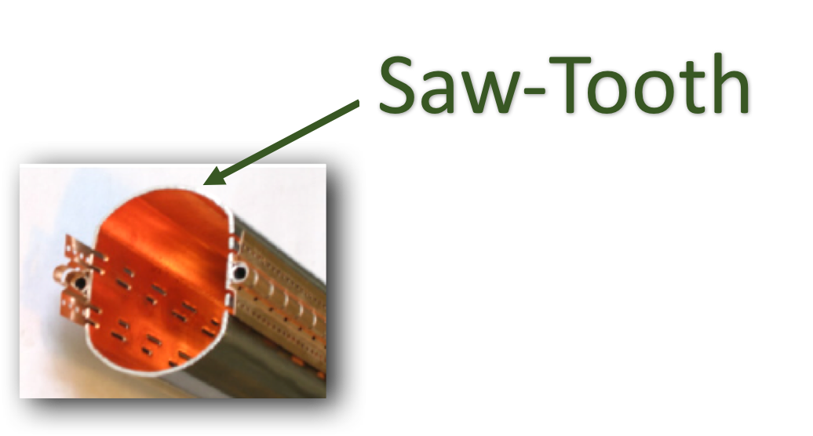
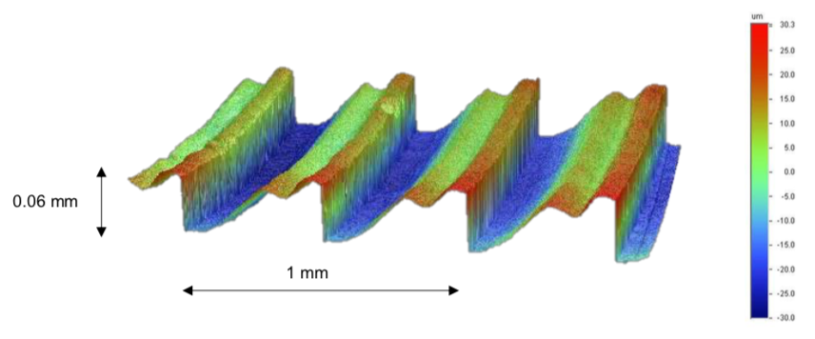
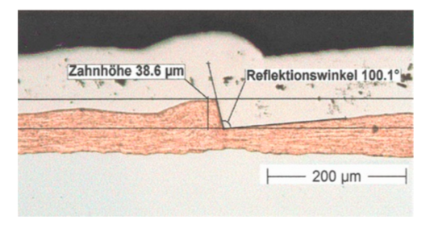
FCC-hh Beam Screen

Slide 12
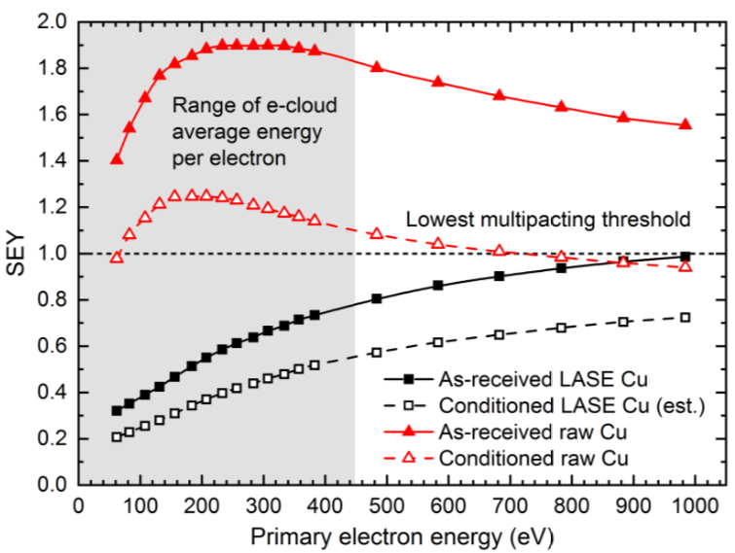
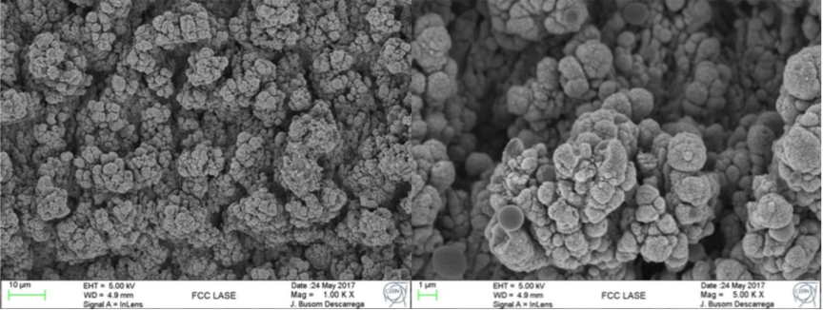
FCC-hh Beam Screen
The Science & Technology Facility Council (STFC)
Roma, 19 November 2018

Slide 13
Synchrotron Radiation interaction with Matter
Absorbed + Reflected + Transmitted
Specular reflected
Scattered

Slide 14
Synchrotron Radiation interaction with Matter
Arc SR Heat Load = 28.4 (44.3) W/m/aperture
Absorbed + Reflected + Transmitted
Specular reflected
Scattered
To be increased in high temperature parts
To be increased in cold parts (Superconductor Magnets)
R. Cimino, V. Baglin and F. Schäfers, PRL. 115 (2015) 264804

Slide 15
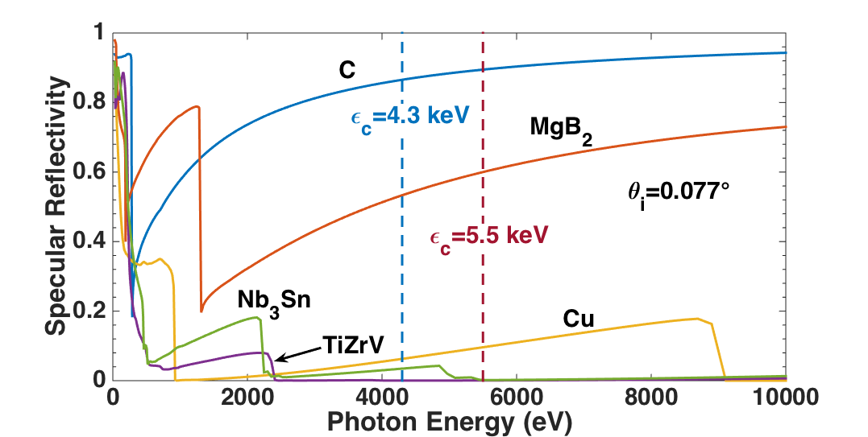
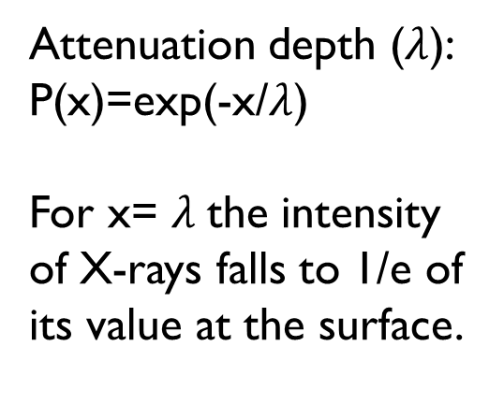
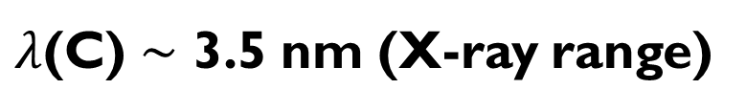
Specular Reflectivity: the case of Carbon
REFLEC simulations
FCC-hh SR incidence angle: 0.077 deg
(0.62 mrad)
R_{a}=50 nm
Attenuation depth ($λ$):
P(x)=exp(-x/$λ$)
For x= $λ$the intensity of X-rays falls to 1/e of its value at the surface.
R. Cimino, V. Baglin and F. Schäefers, PRL. 115 (2015) 264804
20 nm of C can reflect all photons
$λ$(C) $\sim$ 3.5 nm (X-ray range)

Slide 16
Outline
Synchrotron radiation detrimental effects
Reflectivity and Photo Yield
Bessy II measurements
Conclusions

Slide 17
Reflectivity (R) and Photo Yield (PY)
Two main properties of material needs to be
carefully investigated:
Reflectivity
Photo Yield
The part of incident radiation which is reflected by the wall
chambers
How many electrons are
produced per incident photon
To model the generation of photoelectrons in PyECLOUD build- up simulations are needed paramters like PY and R

Slide 18
Reflectivity (R) and Photo Yield (PY)
X-Ray Reflectivity and PY depends on a limited number of parameters:
Photon energy and light polarization
Angle of incidence
Surface roughness and treatment
Chemical composition of surface
Material (coating)

Slide 19
Specular VS Total Reflectivity
Usually, analytical programs are used for optical calculation to calculate Specular Reflectivity
R (specular reflectivity) is the normalized number of photons emerging from the sample with the same divergence of the incoming beam and at the geometrical
Reflection
Rt (total reflectivity) is the normalized (to the incoming flux) number of photons emerging from the sample in all directions.

Slide 20
Roughness and Reflectivity
In optical simulation codes Ra is a considered as a (Debye-Waller) perturbation.
It does not work for:
• high roughness technical surfaces.
• high photon energies
• grazing angles
• also, at very grazing angles
• Different Surface Geometry
• Treated Surface
contaminants should play a major role (difficult to predict)
Saw-Tooth profile (ST)
Laser Treated Samples (LASE)

Slide 21
Outline
Synchrotron radiation detrimental effects
Reflectivity and Photo Yield
Bessy II measurements
Conclusions

Slide 22
Samples
two copper sample polished, Cu 1A and Cu 2A (10 cm long), with and without a-C coating;
one copper sample lapped, Cu 1B (10 cm long), with and without a-C coating;
LHC Beam Screen (BS), flat zone (30 cm long), with and without a-C coating;
LHC Beam Screen (BS), Saw-Tooth zone (30 cm long);
Cu sample treated by Laser Ablation Surface Engineering (LASE, made by the Science & Technology Facility Council (STFC))(30 cm long).

Slide 23
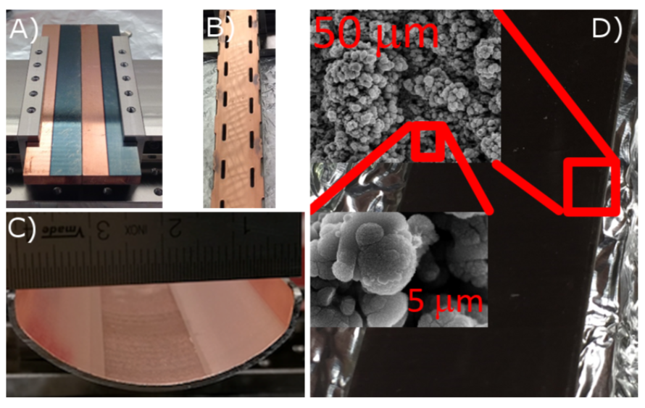
Samples
Cu Flat samples
LHC Flat
Cu Lase
LHC Saw-Tooth

Slide 24

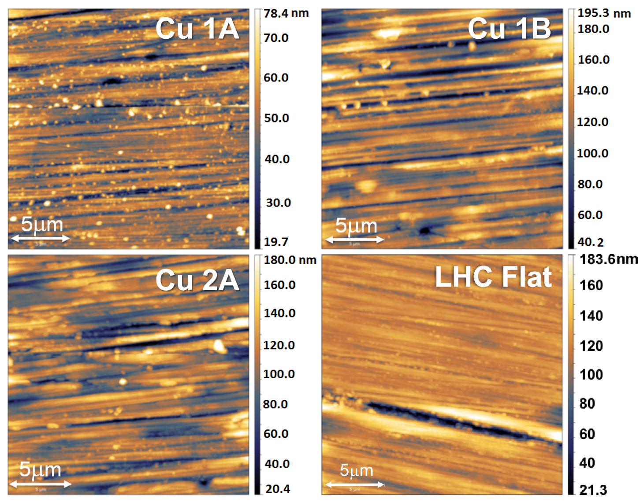
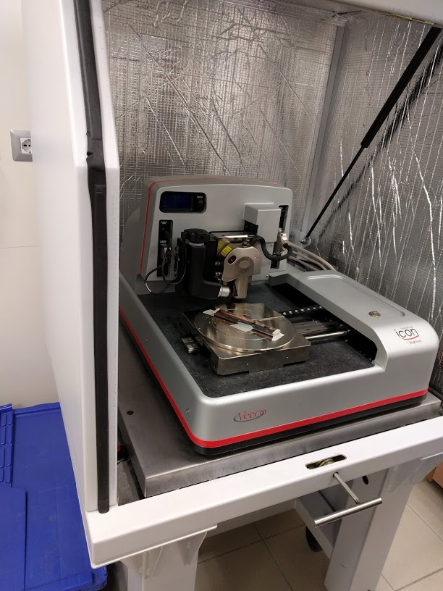
AFM measurements
AFM (20x20µm²)

Slide 25
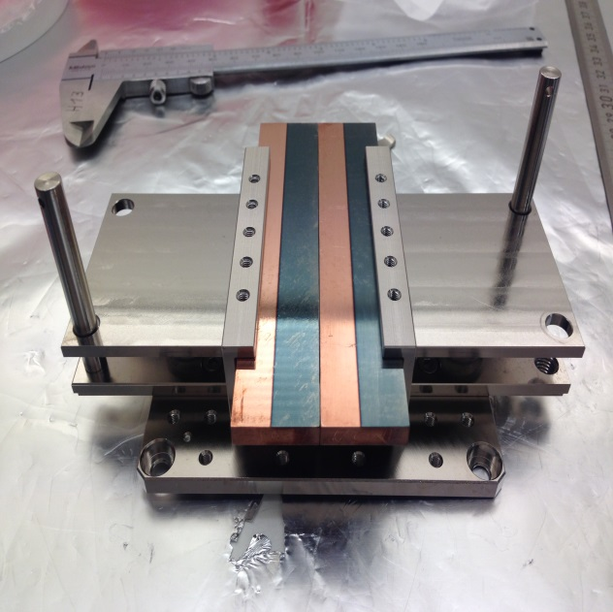
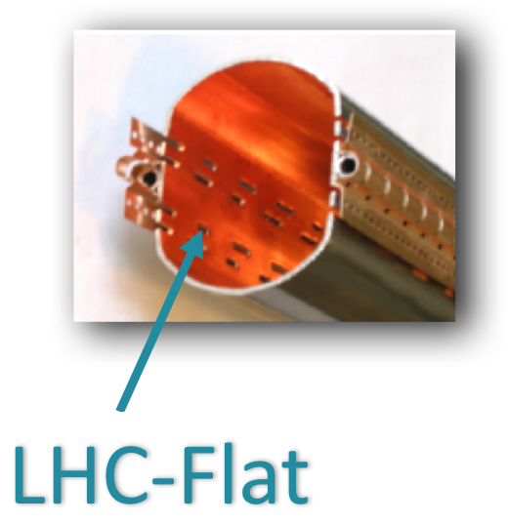
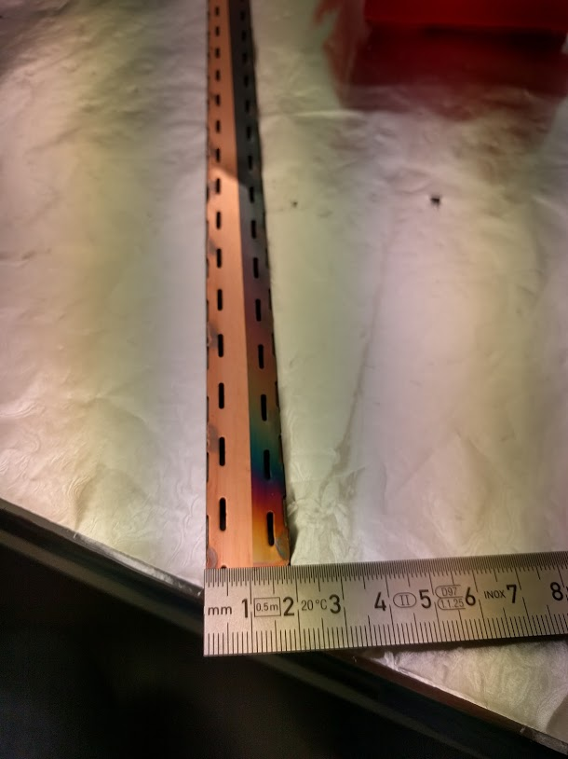
Measured roughness
Sample | RMS Roughness (R_{a}) | RMS Roughness (R_{a}) (Carbon Coating)
Cu 1A | 10 nm | 13 nm
Cu 1B | 25 nm | 31 nm
Cu 2A | 27 nm | 29 nm
LHC-Flat | 15 nm | 20 nm
Cu 1A
Cu 2A
Samples A: polished
Sample B: lapped

Slide 26

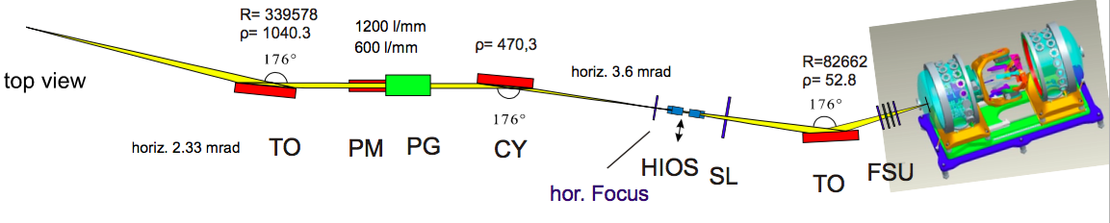
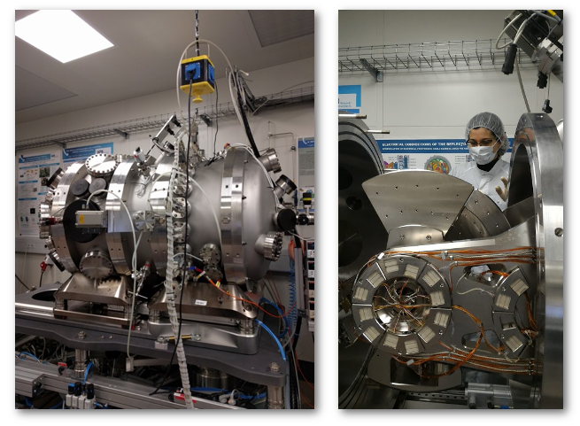
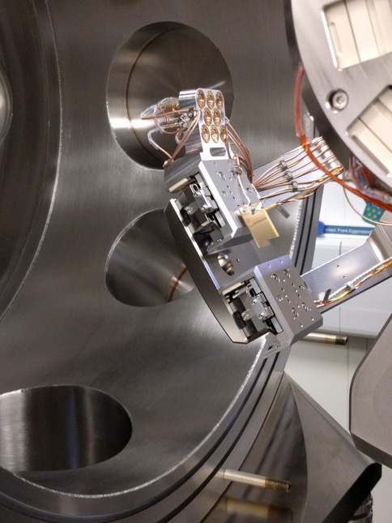
BESSY-II Optic Beamline and Reflectometer
A.A.Sokolov,et al,Proc.of SPIE92060J-1-13(2014)

Slide 27
BESSY-II Optic Beamline and Reflectometer
Incidence angle θ: -90° – 90°
Detector in-plane 2θ: -180° – 180°
Detector off-plane χ : -4° – 4°
Sample – detector: 310 mm
Six axes sample positioning
Sample current measurement
GaAsP-Photodiodes
Detector slits, pinholes
A.A.Sokolov,et al,Proc.of SPIE92060J-1-13(2014)

Slide 28
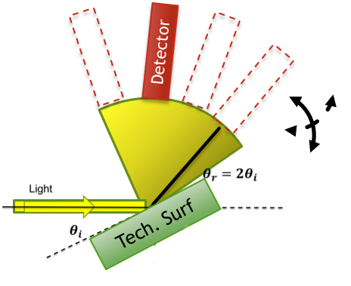
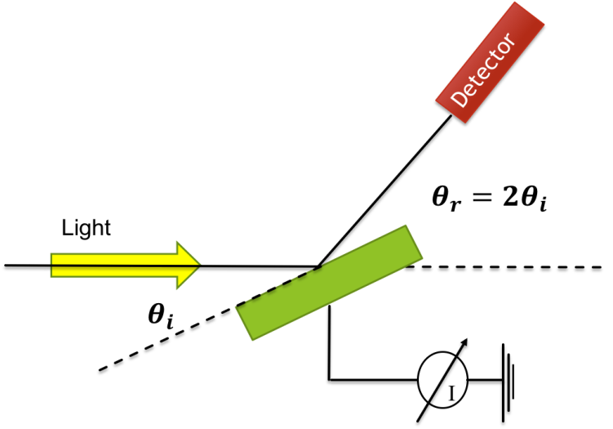
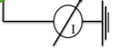
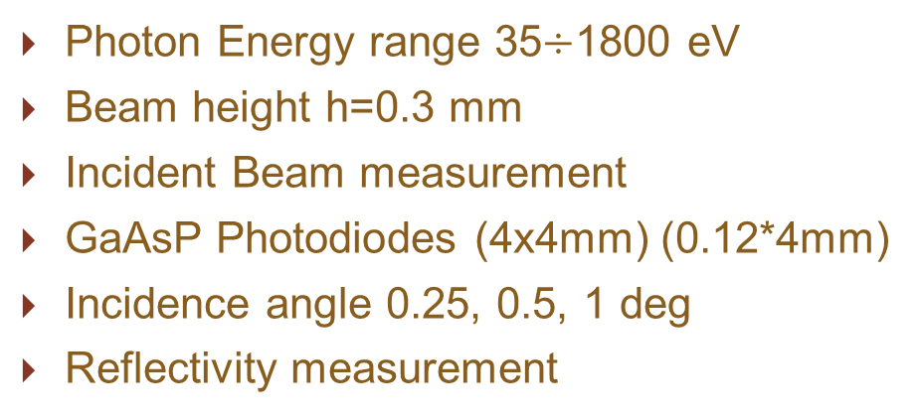



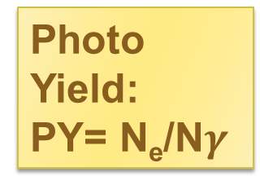
Bessy II Measurements
Photon Energy range 35$÷$1800 eV
Beam height h=0.3 mm
Incident Beam measurement
GaAsP Photodiodes (4x4mm) (0.12*4mm)
Incidence angle 0.25, 0.5, 1 deg
Reflectivity measurement
Photo Yield:
PY= N_{e}/N$γ$
Specular Reflectivity
Scattered Light
Specular
Total
Detector
$$θ_{r}=2θ_{i}$$
Mirror
$$θ_{i}$$
$$θ_{i}$$

Slide 29
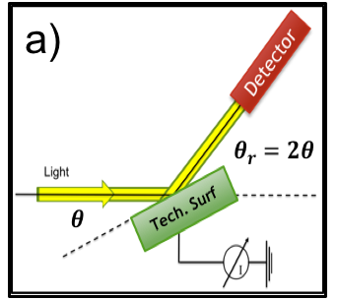
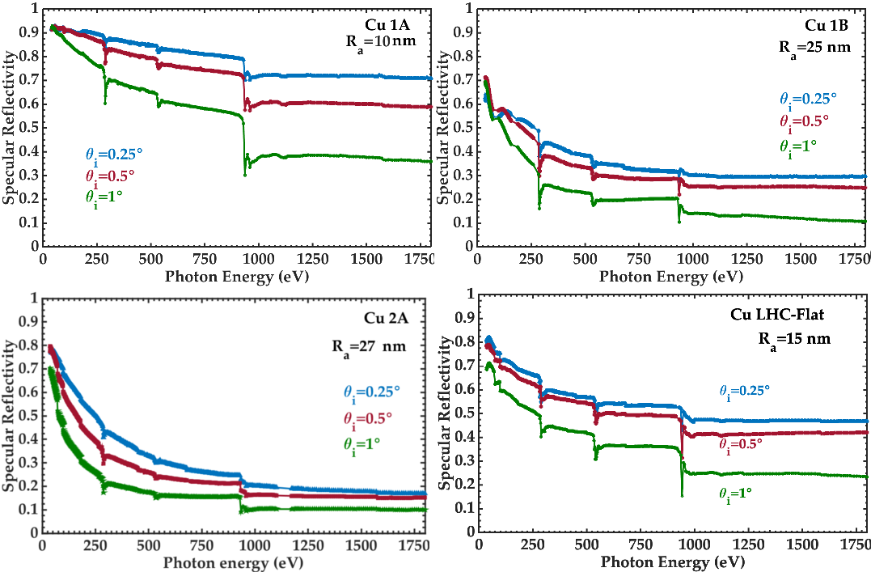
Flat samples: Reflectivity (R)
Cu L_{2,3} edge
At grazing
incidence angle contaminants are influencing Cu Reflectivity
C K edge
O K edge
E. La Francesca et al: submitted to PR ST

Slide 30
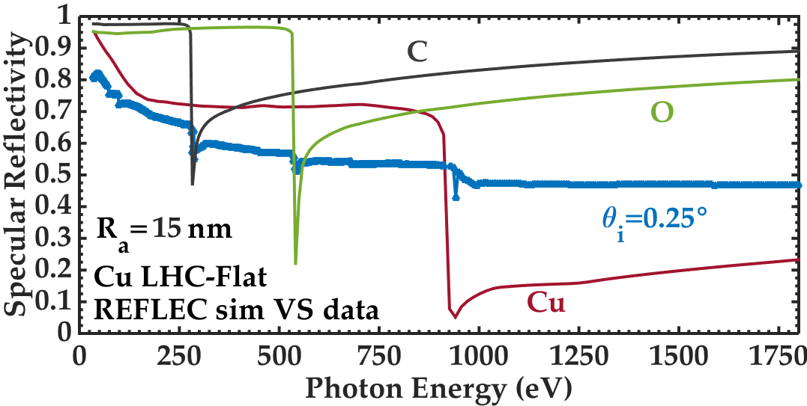
Flat samples: Reflectivity (R)
E. La Francesca et al: submitted to PR ST

Slide 31
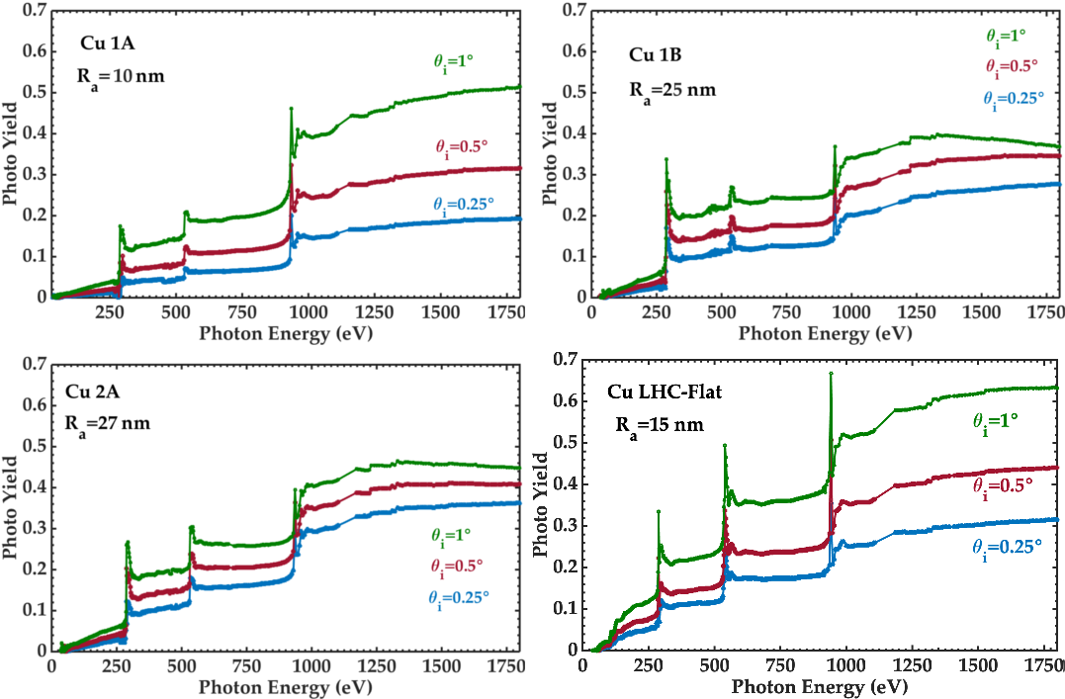
Flat samples:Photo Yield (PY)
C K edge
Cu L_{2,3} edge
O K edge
E. La Francesca et al: submitted to PR ST

Slide 32
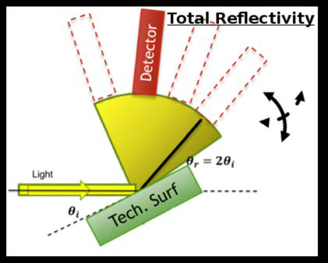
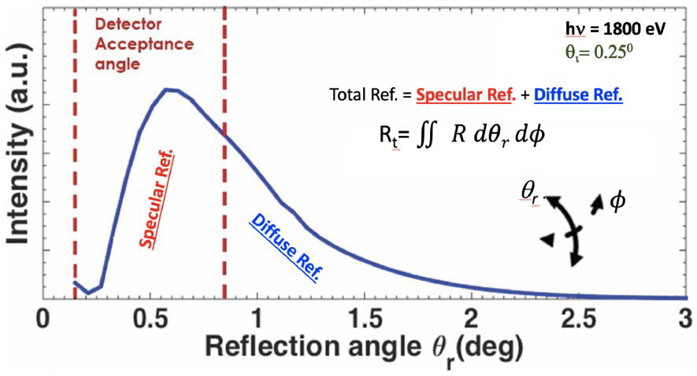
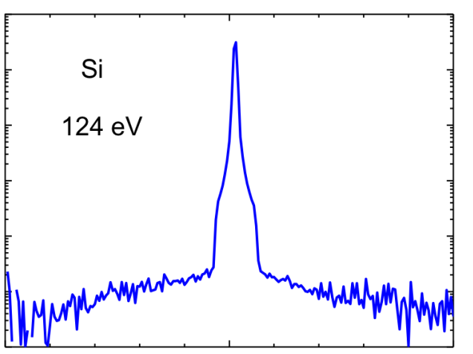

Angular distribution of Reflectivity
For technical surfaces scattered light cannot be neglected
R Rt
specular reflection
Total Reflectivity (Rt) is calculated integrating the angular distribution in θr and Φ
10⁰
10⁻¹
10⁻²
10⁻³
10⁻⁴
10⁻⁵
10⁻⁶
R_{a}=0.5 nm
$θ_{i}$= 5 deg
Reflectivity
small angle
scatter
wide angle
scatter
5 10 15
twotheta (deg)

Slide 33
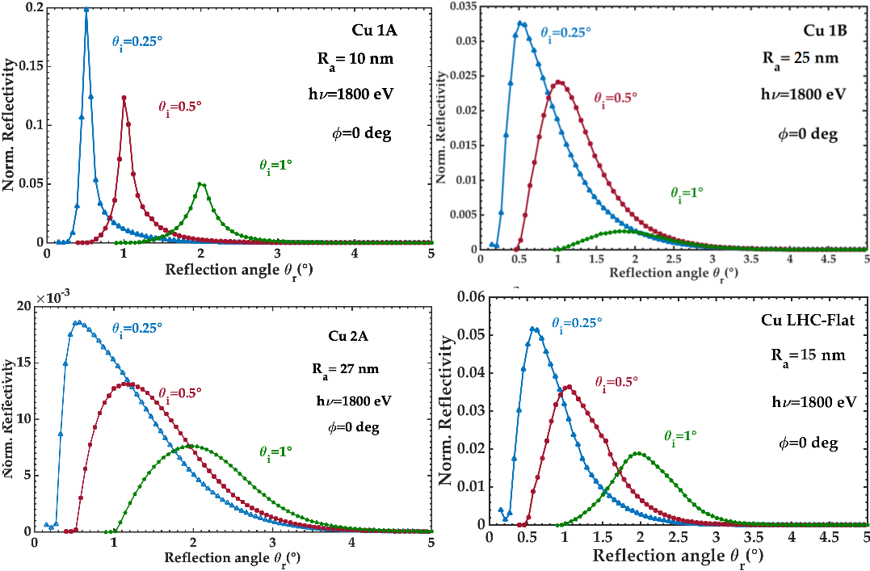
Angular distribution of Reflectivity
E. La Francesca et al: submitted to PR ST

Slide 34
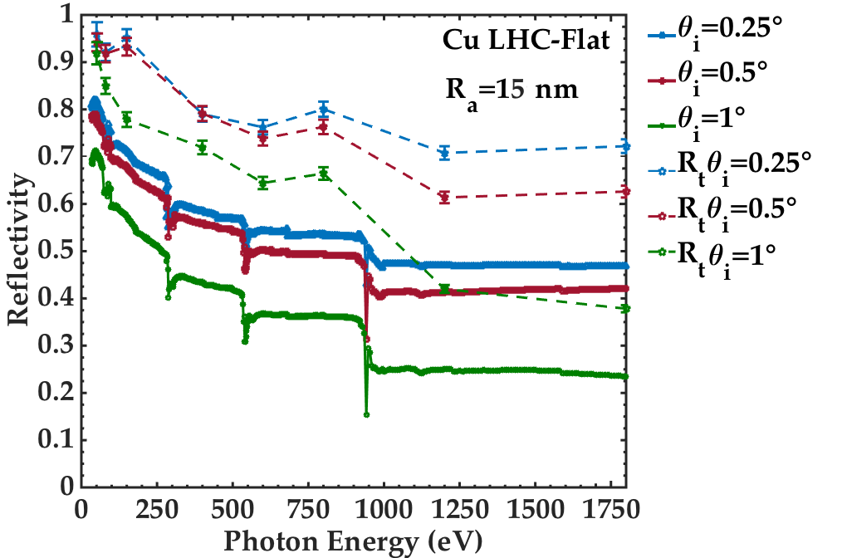
Specular and Total Reflectivity
E. La Francesca et al: submitted to PR ST

Slide 35
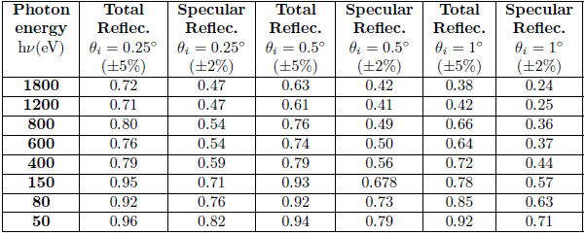
Specular and Total Reflectivity

Slide 36
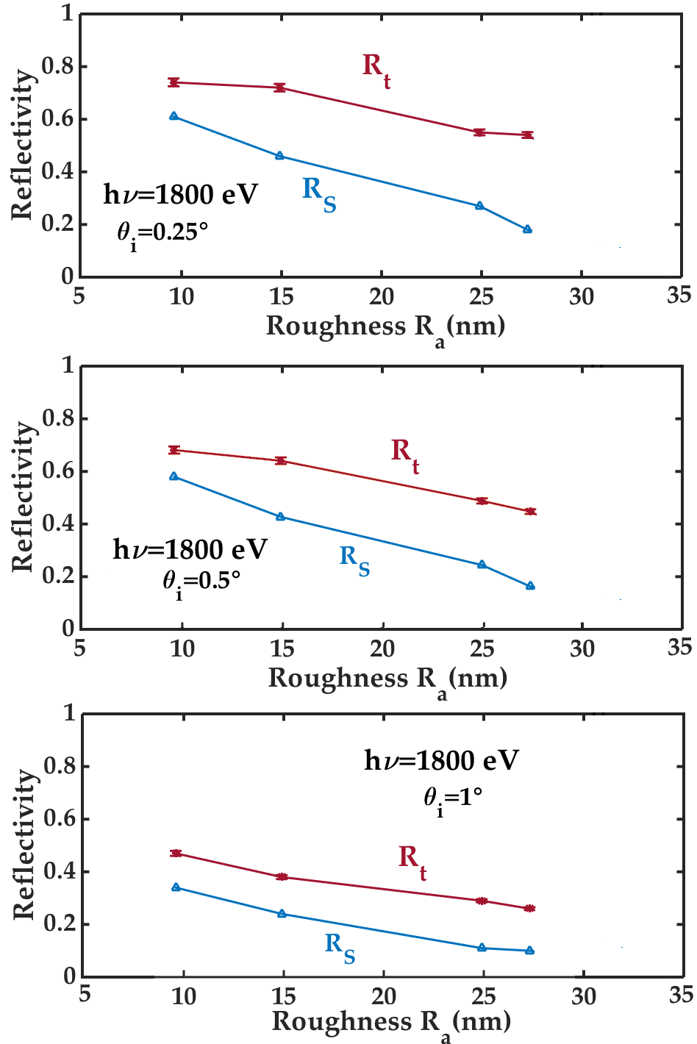
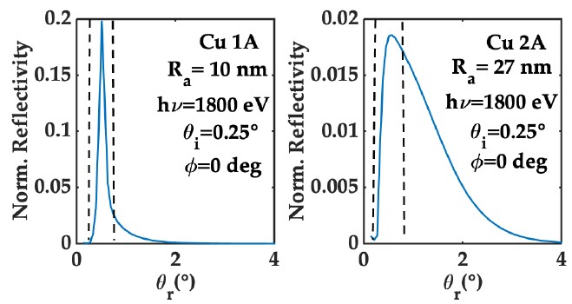
Specular and Total Reflectivity VS Ra

Slide 37
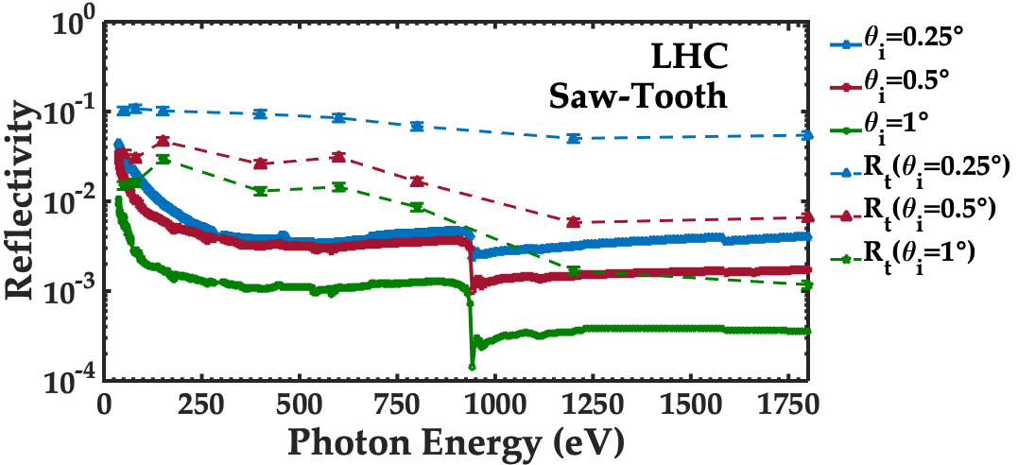
LHC Saw-Tooth
Total Reflectivity higher than Specular Reflectivity
E. La Francesca et al: submitted to PR ST

Slide 38
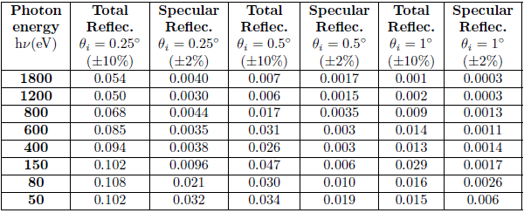
LHC Saw-Tooth
Total Reflectivity higher than Specular Reflectivity

Slide 39
LHC Saw-Tooth
Total Reflectivity higher than Specular Reflectivity

Slide 40
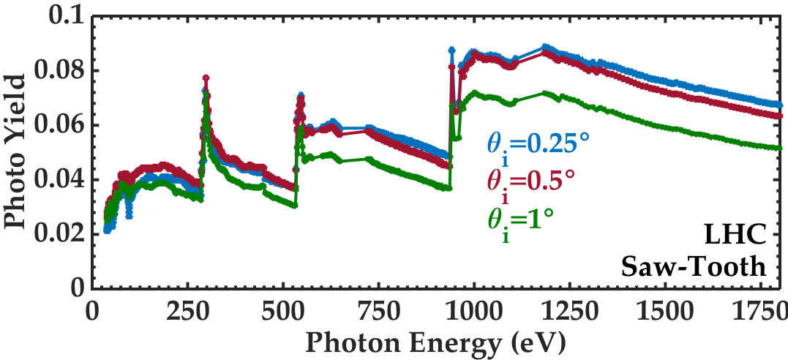
LHC Saw-Tooth
Little difference in PY for the three incidence angle
PY peaks confirm the contaminants presence
E. La Francesca et al: submitted to PR ST

Slide 41
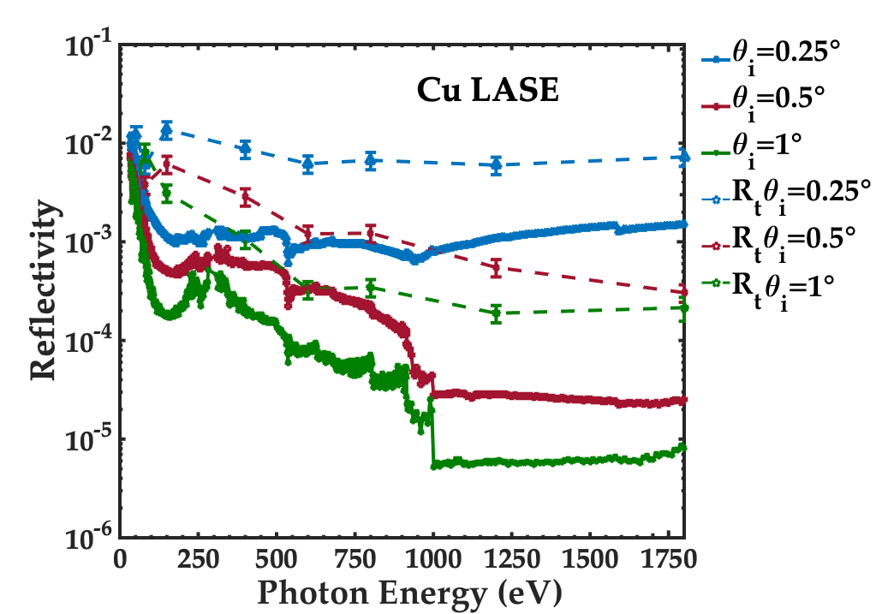
Lase
Total Reflectivity higher than Specular Reflectivity
No carbon evidence
E. La Francesca et al: submitted to PR ST

Slide 42
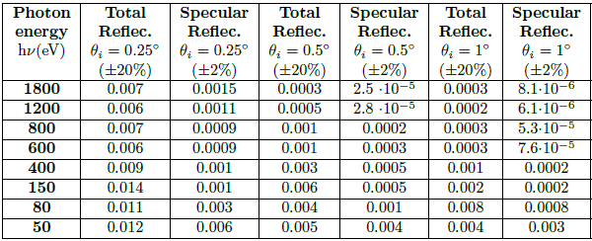
Lase
Total Reflectivity higher than Specular Reflectivity
No carbon evidence

Slide 43
Lase
Total Reflectivity higher than Specular Reflectivity
No carbon evidence

Slide 44
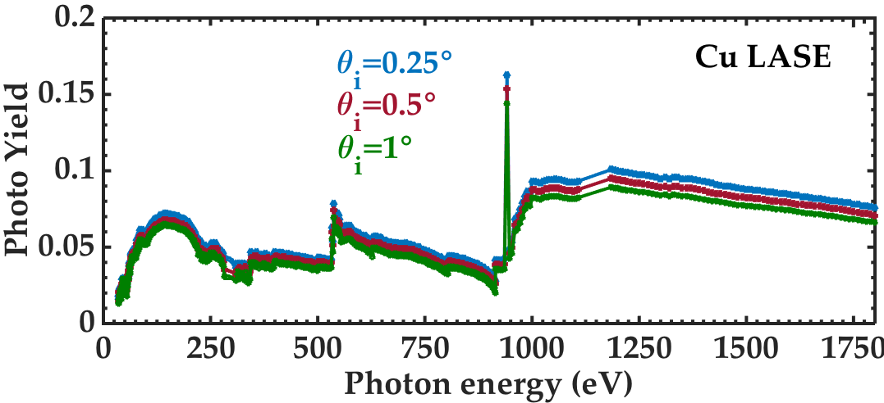
Lase
No carbon evidence
No difference in PY for the three incidence angle
E. La Francesca et al: submitted to PR ST

Slide 45
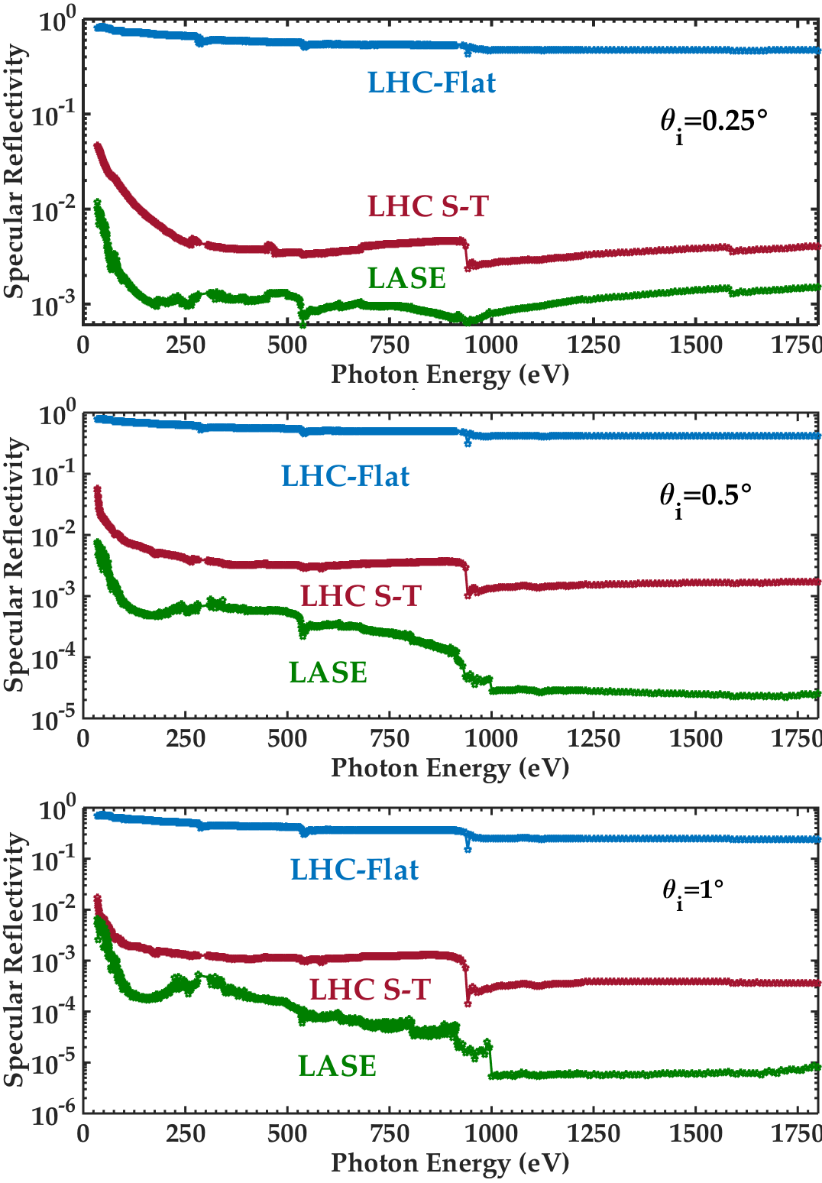
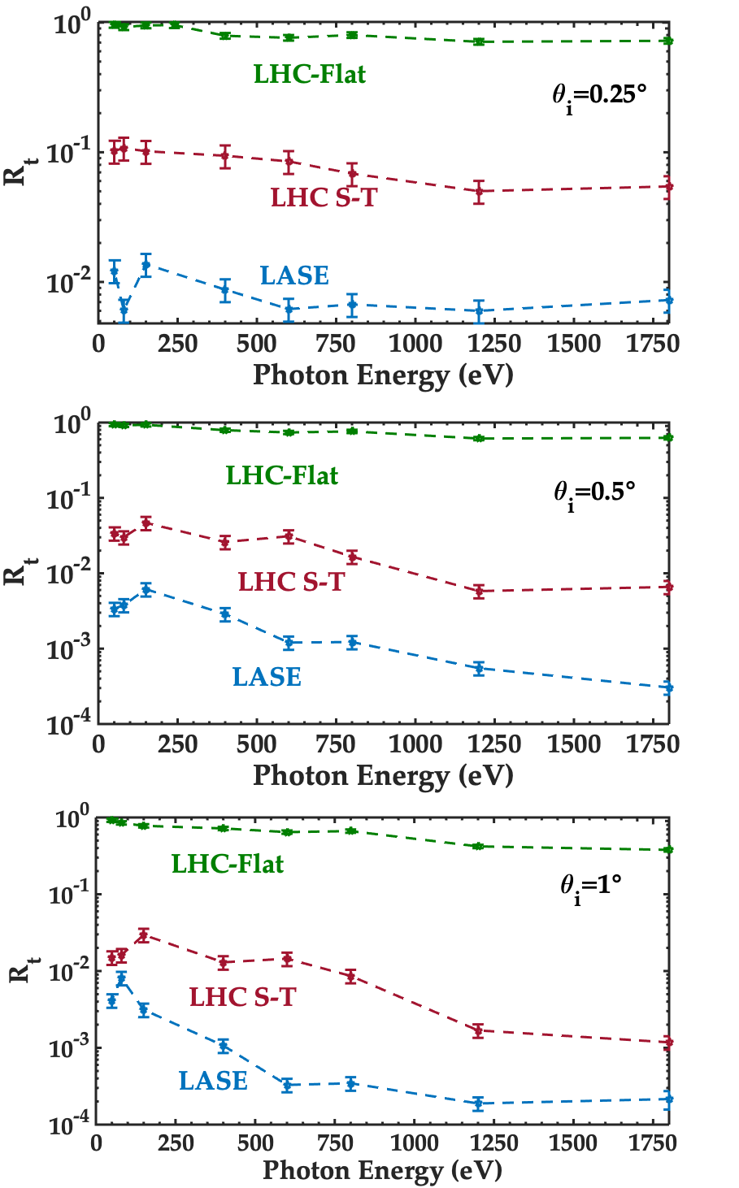
Surface modification effects
LHC S-T Specular Reflectiviy is one order of magnitude lower than LASE.
E. La Francesca et al: submitted to PR ST

Slide 46
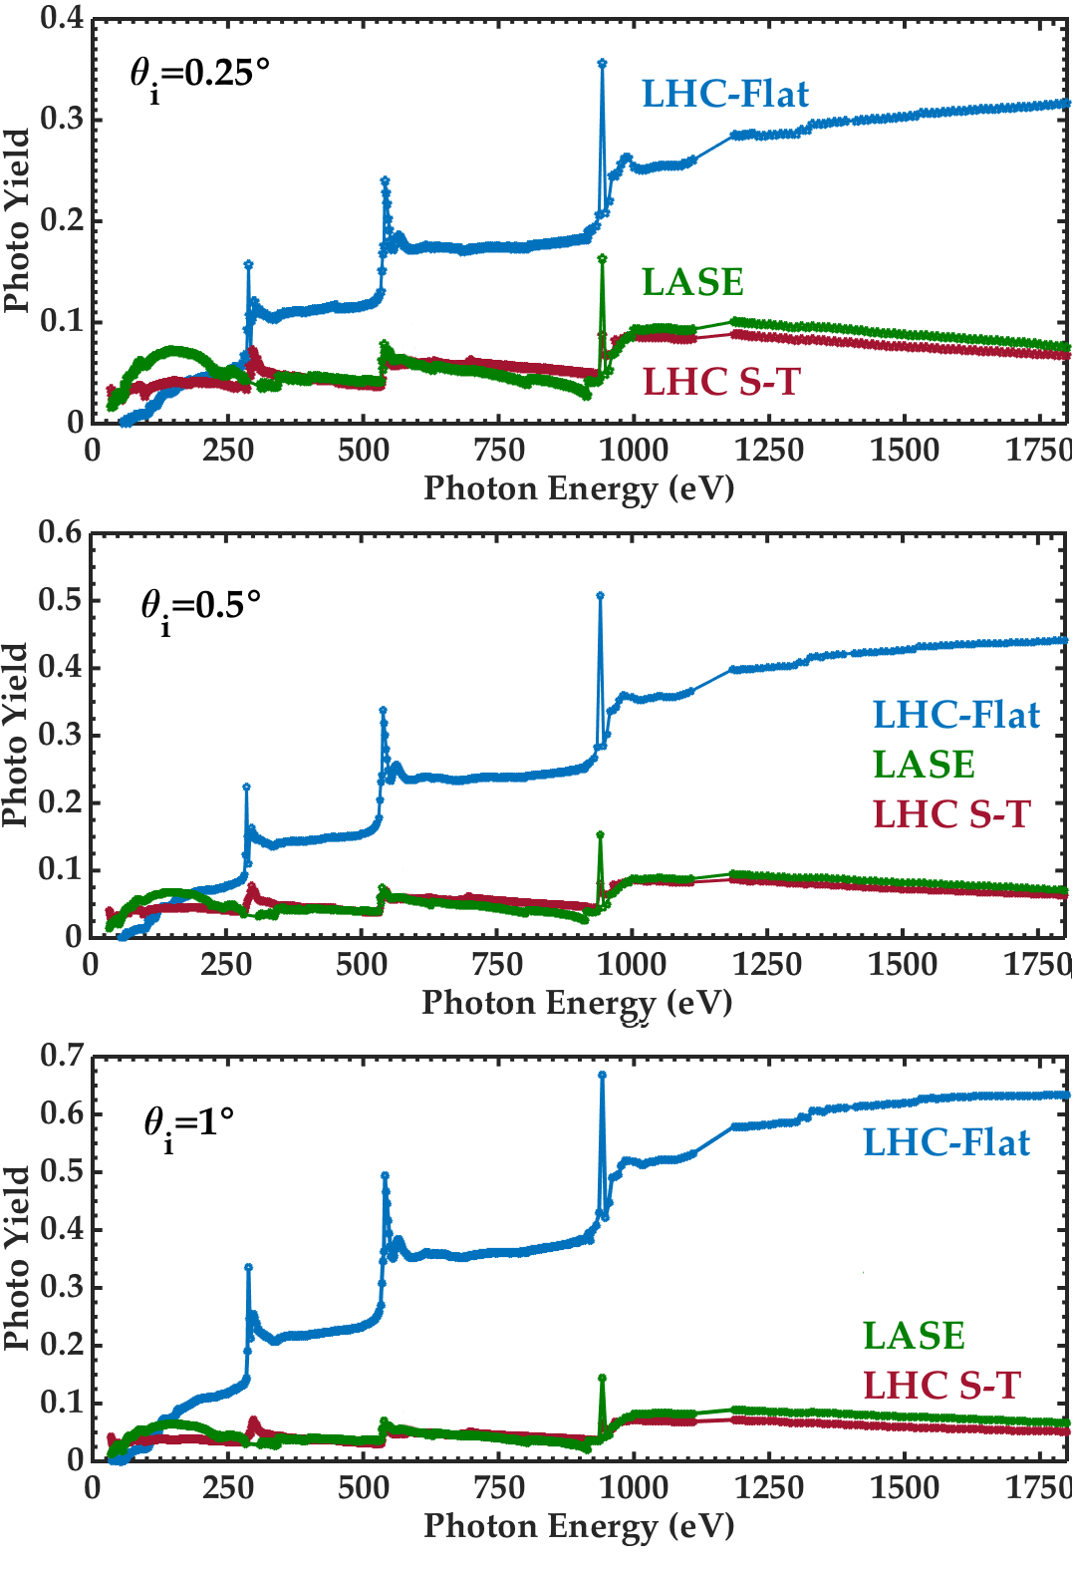
Surface modification effects
LHC S-T Specular Reflectiviy is one order of magnitude lower than LASE.
Photo Yield of LHC S-T and LASE are the same
E. La Francesca et al: submitted to PR ST

Slide 47
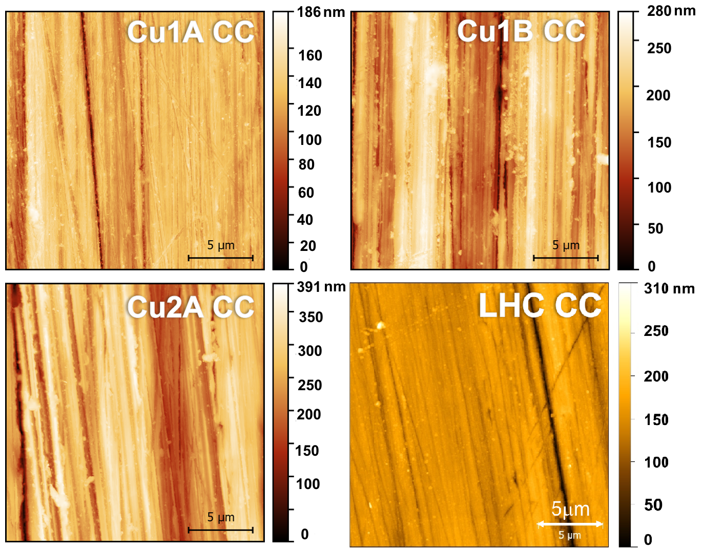
AFM measurements (CC)
AFM (20x20µm²)

Slide 48
Measured roughness
Sample | RMS Roughness (R_{a}) | RMS Roughness (R_{a}) (Carbon Coating)
Cu 1A | 10 nm | 13 nm
Cu 1B | 25 nm | 31 nm
Cu 2A | 27 nm | 29 nm
LHC-Flat | 15 nm | 20 nm
Cu 1A
Cu 2A
Samples A: polished
Sample B: lapped
50 nm CC made by
Magneto-sputtering

Slide 49

Flat samples with carbon coating
Coating process increased roughness
E. La Francesca et al: submitted to PR ST

Slide 50



LHC-Flat with C Coating
Decreasing of reflectivity at $θ_{i}=1°$ is due to the achievement of the critical angle.
Peaks correspond to absorption edges

Slide 51

Flat samples with carbon coating
Peaks correspond to absorption edges
Carbon coating reduces
Photo Yield at high energy

Slide 52

Specular and Total Reflectivity (CC)
Total Reflectivity higher than Specular Reflectivity
E. La Francesca et al: submitted to PR ST

Slide 53

Specular and Total Reflectivity (CC)
Total Reflectivity higher than Specular Reflectivity

Slide 54
Specular and Total Reflectivity (CC)
Total Reflectivity higher than Specular Reflectivity
It stays above 80 %

Slide 55


Specular and Total Reflectivity (CC)
CC increases Total Reflectivity and reduce absorption and related Heat Load.
Does not significantly decreases with Ra
Increases with decreasing θi

Slide 56
conclusions
R and PY on technically relevant samples can be experimentally measured!
At grazing incidence angle air contaminants deeply influence Reflectivity.
For technical surfaces scattered light cannot be neglected (Total Refletivity instead of Specular Reflectivity)
Cu LASE Reflectivity is substantially lower than for untreated copper and for LHC Saw-Tooth sample.
The Photo Yield of Saw-Toothed copper and LASE are the same.

Slide 57
Conclusions
Simulation for Machine Design study must be supported by:
• Experimental data of each individual Material Property
• Dedicated experiments are the only way to produce the necessary inputs close to realistic conditions.
Carbon coating increases Total Reflectivity and reduce absorption and related Heat Load (as long as incidence angle is below its critical angle).

Slide 58
Thank you for your attention.

Slide 59
Flat samples: Reflectivity (R)
In all cases, R is higher at lower photon energies.
In all cases, R is higher at lower angle of incidence θi.
Reflectivity, after the observed Cu-L2-3 absorption edge at 930-950 eV is much higher than in simulation.
In all spectra we measure a significant effect due to the absorption edges of C K-edge at 280 eV and O Kedge at 530 eV (surf. cont.)
C and O K absorption edges are more effective at lower incidence angles.
Roughness, as expected, plays a major role in determining the ability of a surface to specularly reflect impinging photons.

Slide 60
Flat samples:Photo Yield (PY)
In all cases, PY is higher at higher photon energies.
The PY dependence on θi is consistently dimmed and finally washed out when surface Ra is increasing.
In all cases, the Cu-L2-3 absorption edge at 930-950 eV is visible and cause an increase in the measured PY.
In all spectra we measure a significant effect due to the C K-edge at 280 eV and O K-edge at 530 eV (surf. Contaminants)
Roughness does influence the PY. The lower is Ra, the highest is the measured PY.
E. La Francesca et al: submitted to PR ST

Slide 61



LHC Flat
Photo Yield:
PY= N_{e}/N$γ$
Low energy photons can be reflected even at high incidence angles
The maximum of Photo Yield Vs θi depends on the impinging photon energy

Slide 62



LHC Flat (CC)
Photo Yield:
PY= N_{e}/N$γ$
Low energy photons can be reflected even at high incidence angles
The maximum of Photo Yield Vs θi depends on the impinging photon energy

Slide 63



Heat Load Dissipation VS Temperature
P_{TOT} $\sim 6 GW$
Power to dissipate 1W (W)
P_{TOT} $\sim 20 MW$
FCC-hh needs a Beam Screen at the highest possible temperature compatible with vacuum stability, impedance…
5
Notes:
If we consider the Power needed to dissipate 1W VS Temperature we can see that at cold bore temperature would be necessary 3 GW for the whole machine. This means that FCC needs a BS at highest possible temperature compatible with all other constraints (vacuum, impedance ecc).
It is important to underline that the majority of this heat load is in Dipoles.

