Slide 1
FTM prototype Progress
Christos Roskas, Rui de Oliveira, Marcello Maggi, Piet Verwilligen, Michael Tytgat, Ilaria Vai

Slide 2
Outline
Foil production
Defects
Issues encountered
Production of FTMp4_v2 foil
Prototype assembly
Preliminary tests

Slide 3
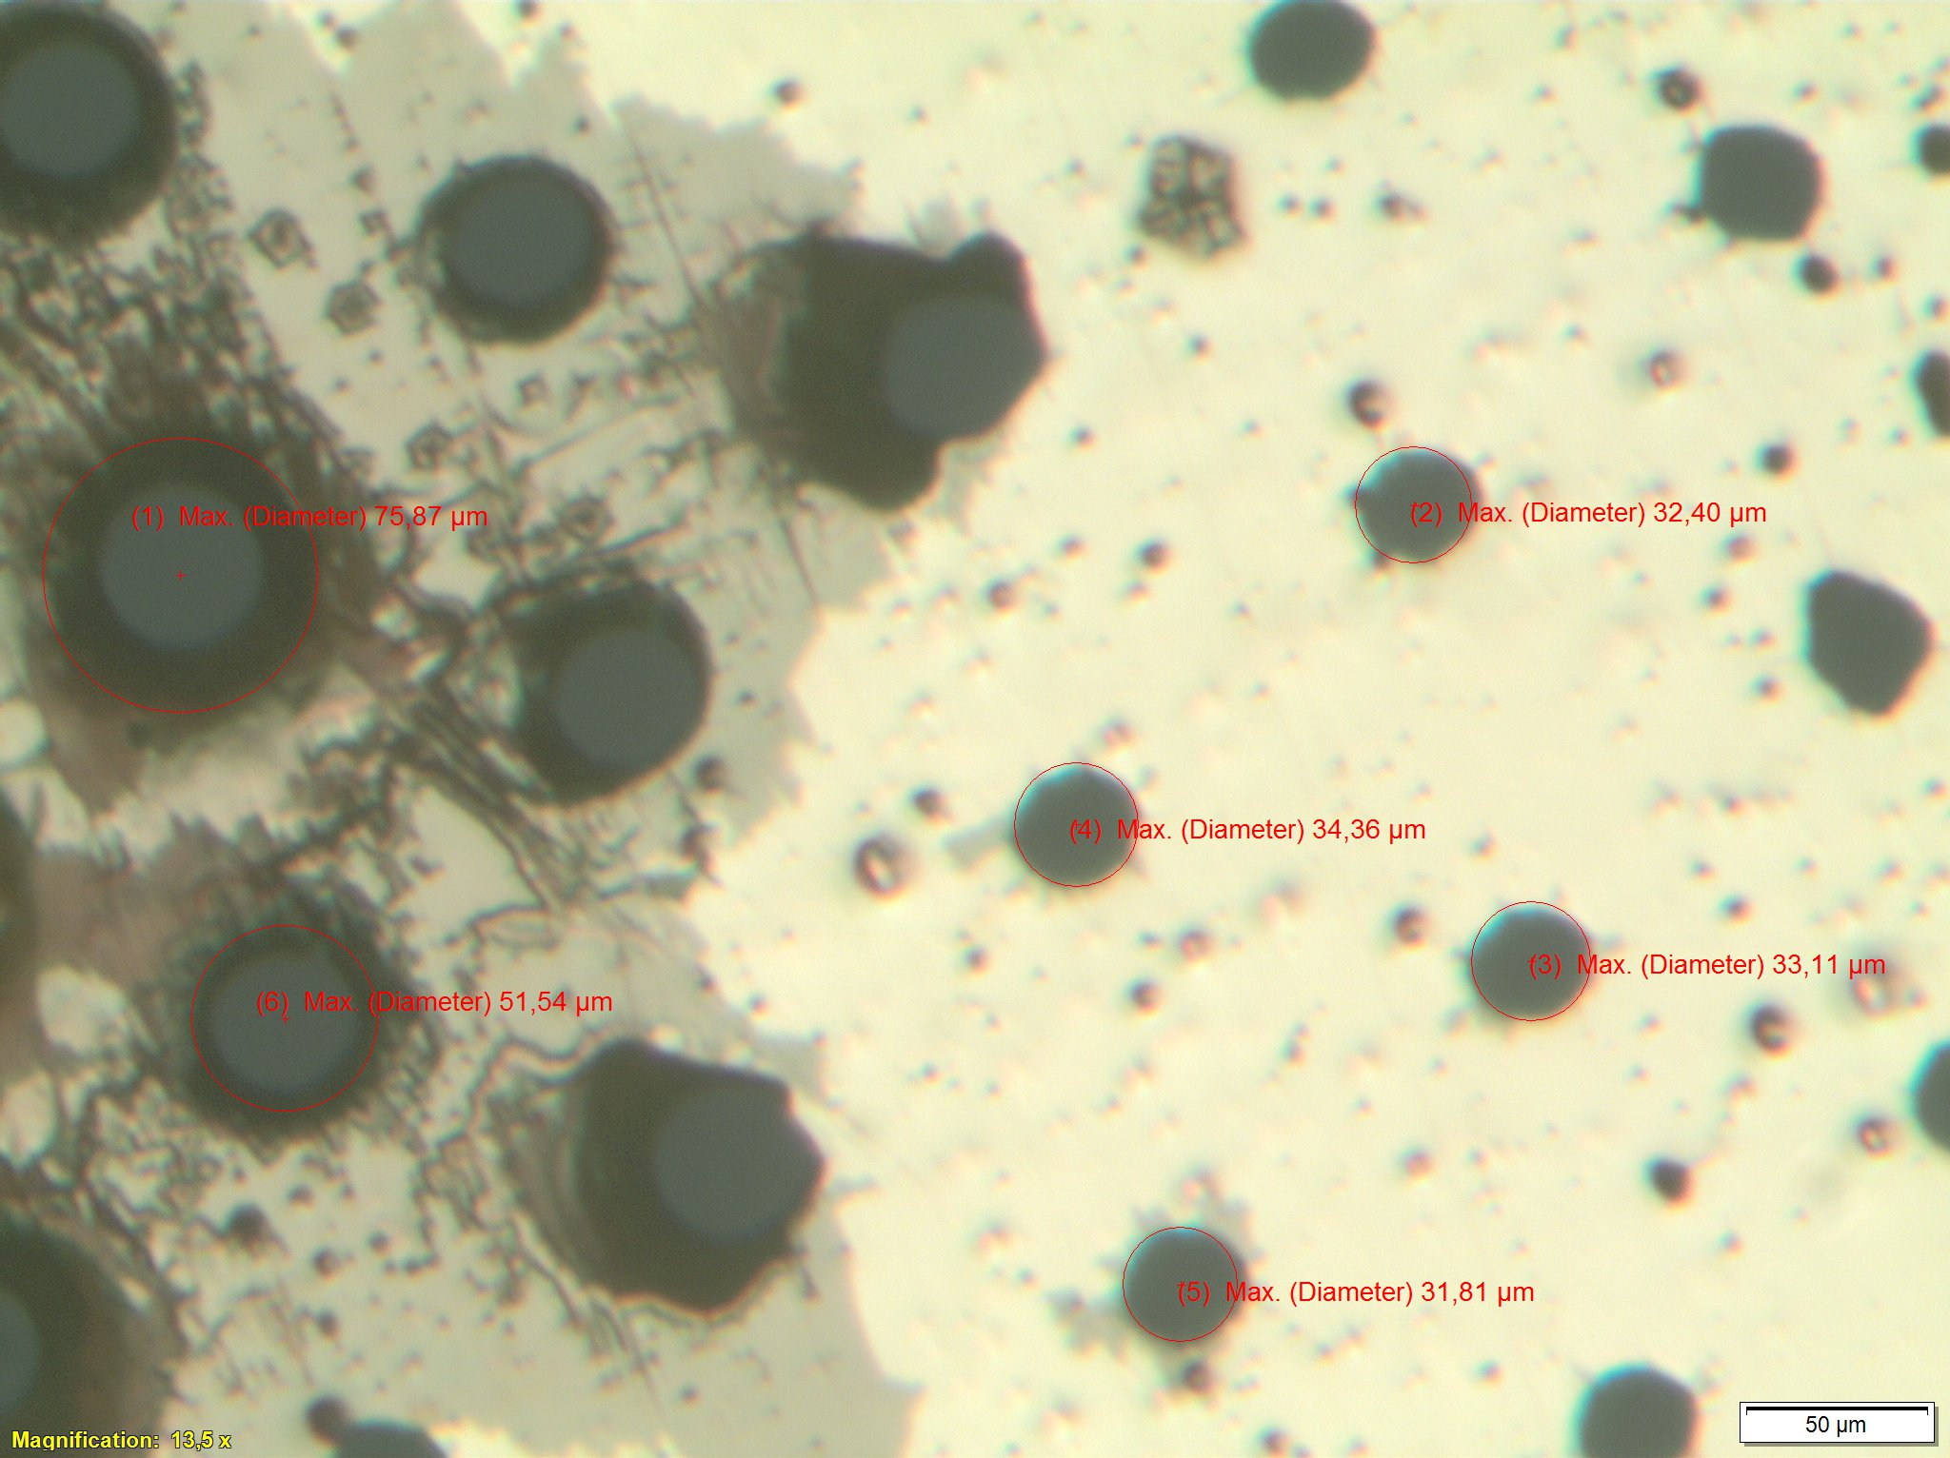
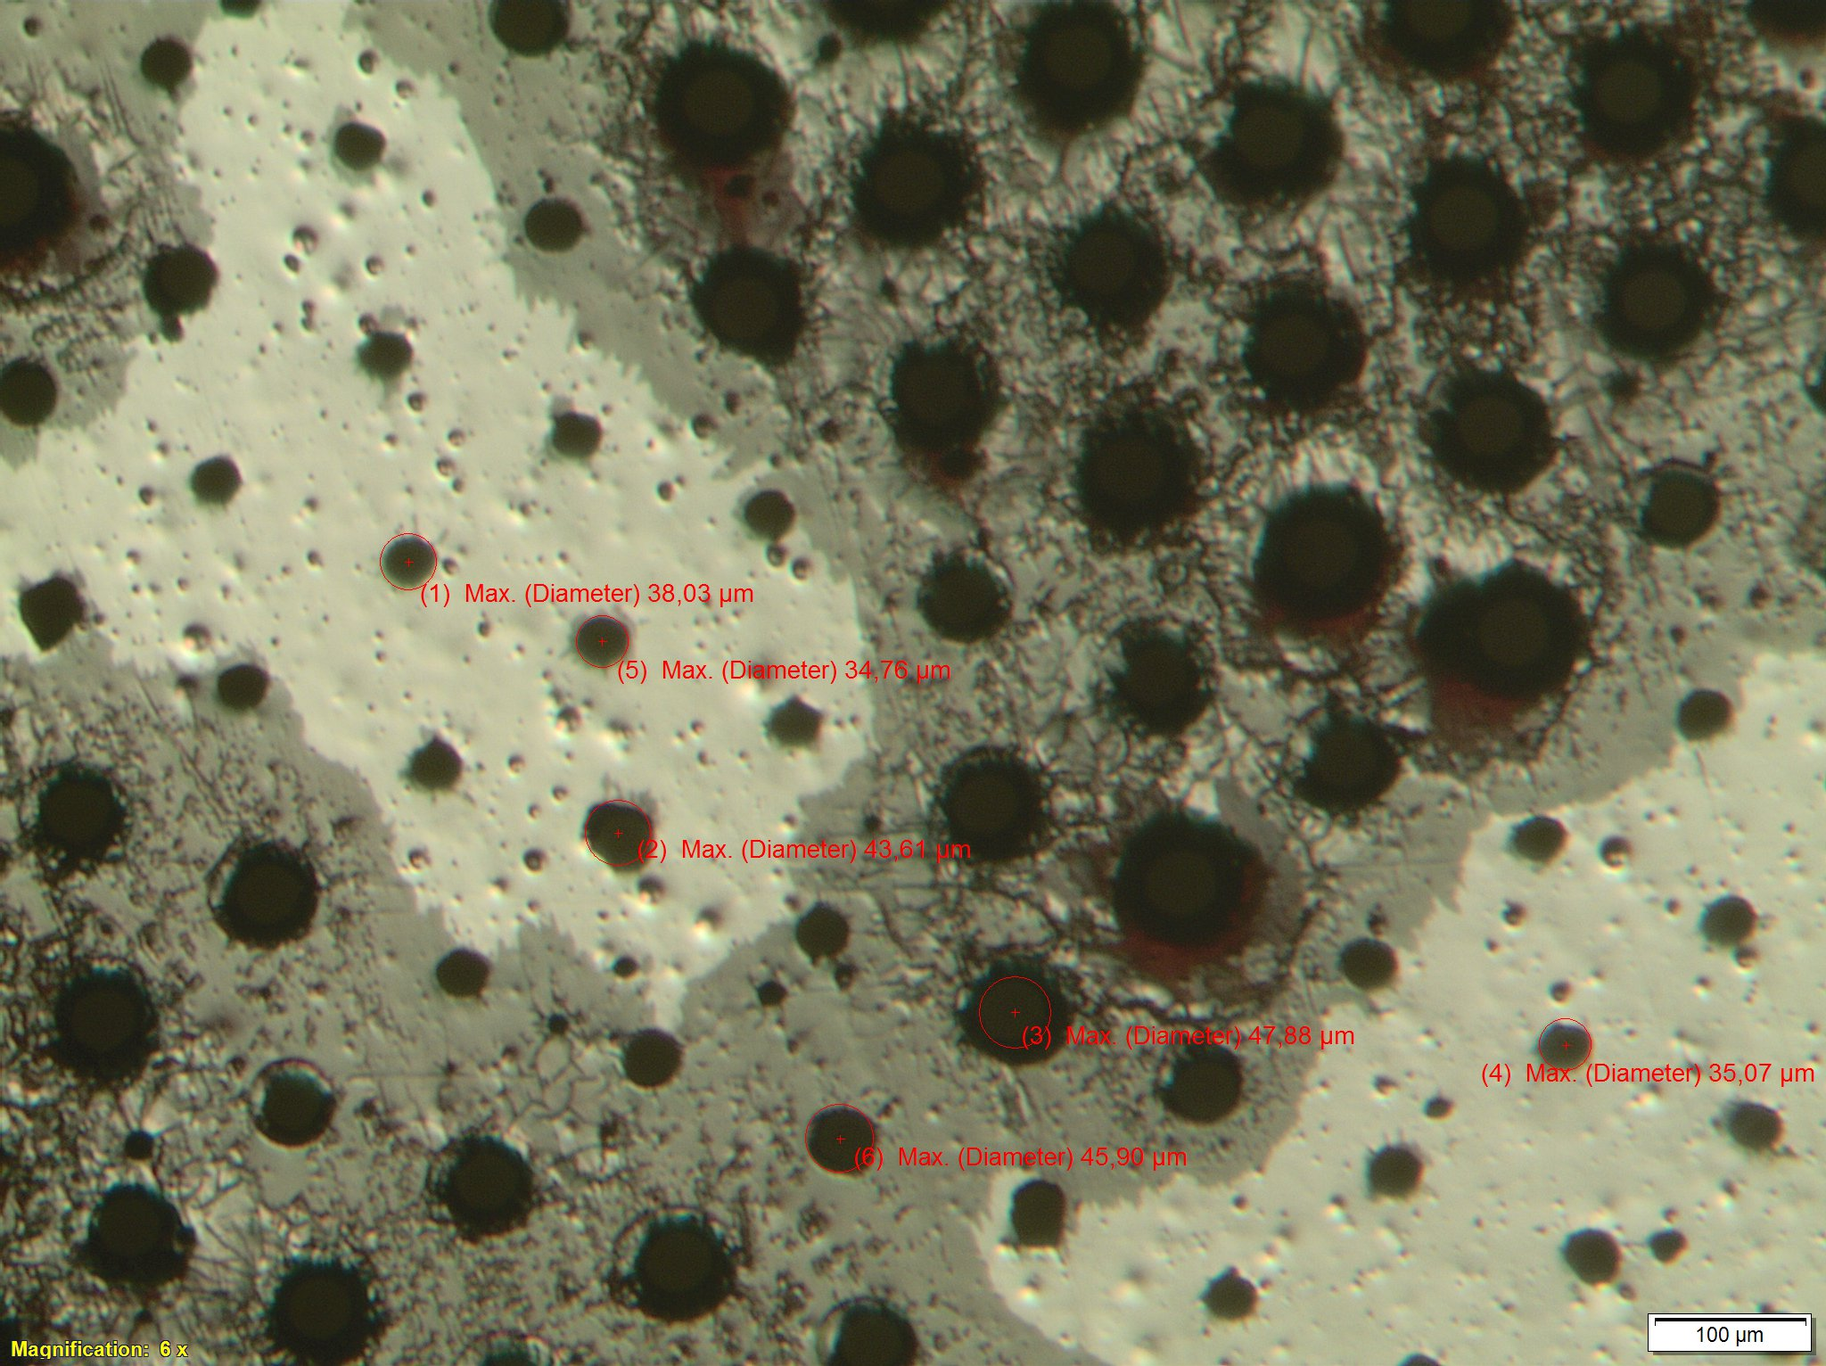
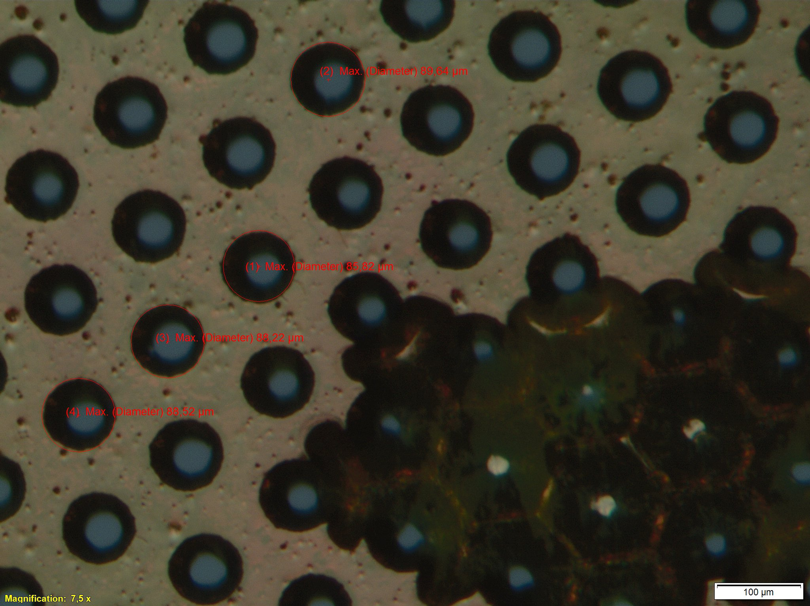
Amplification foil – Previous attempts
Production of a DLC coated foil is tricky
The first batch of foils were defect
Especially on the DLC (top) side of the foil
Cracks on the DLC and also
Hole defects
Bottom side: Hole defects
Cu layer removed in some areas

Slide 4
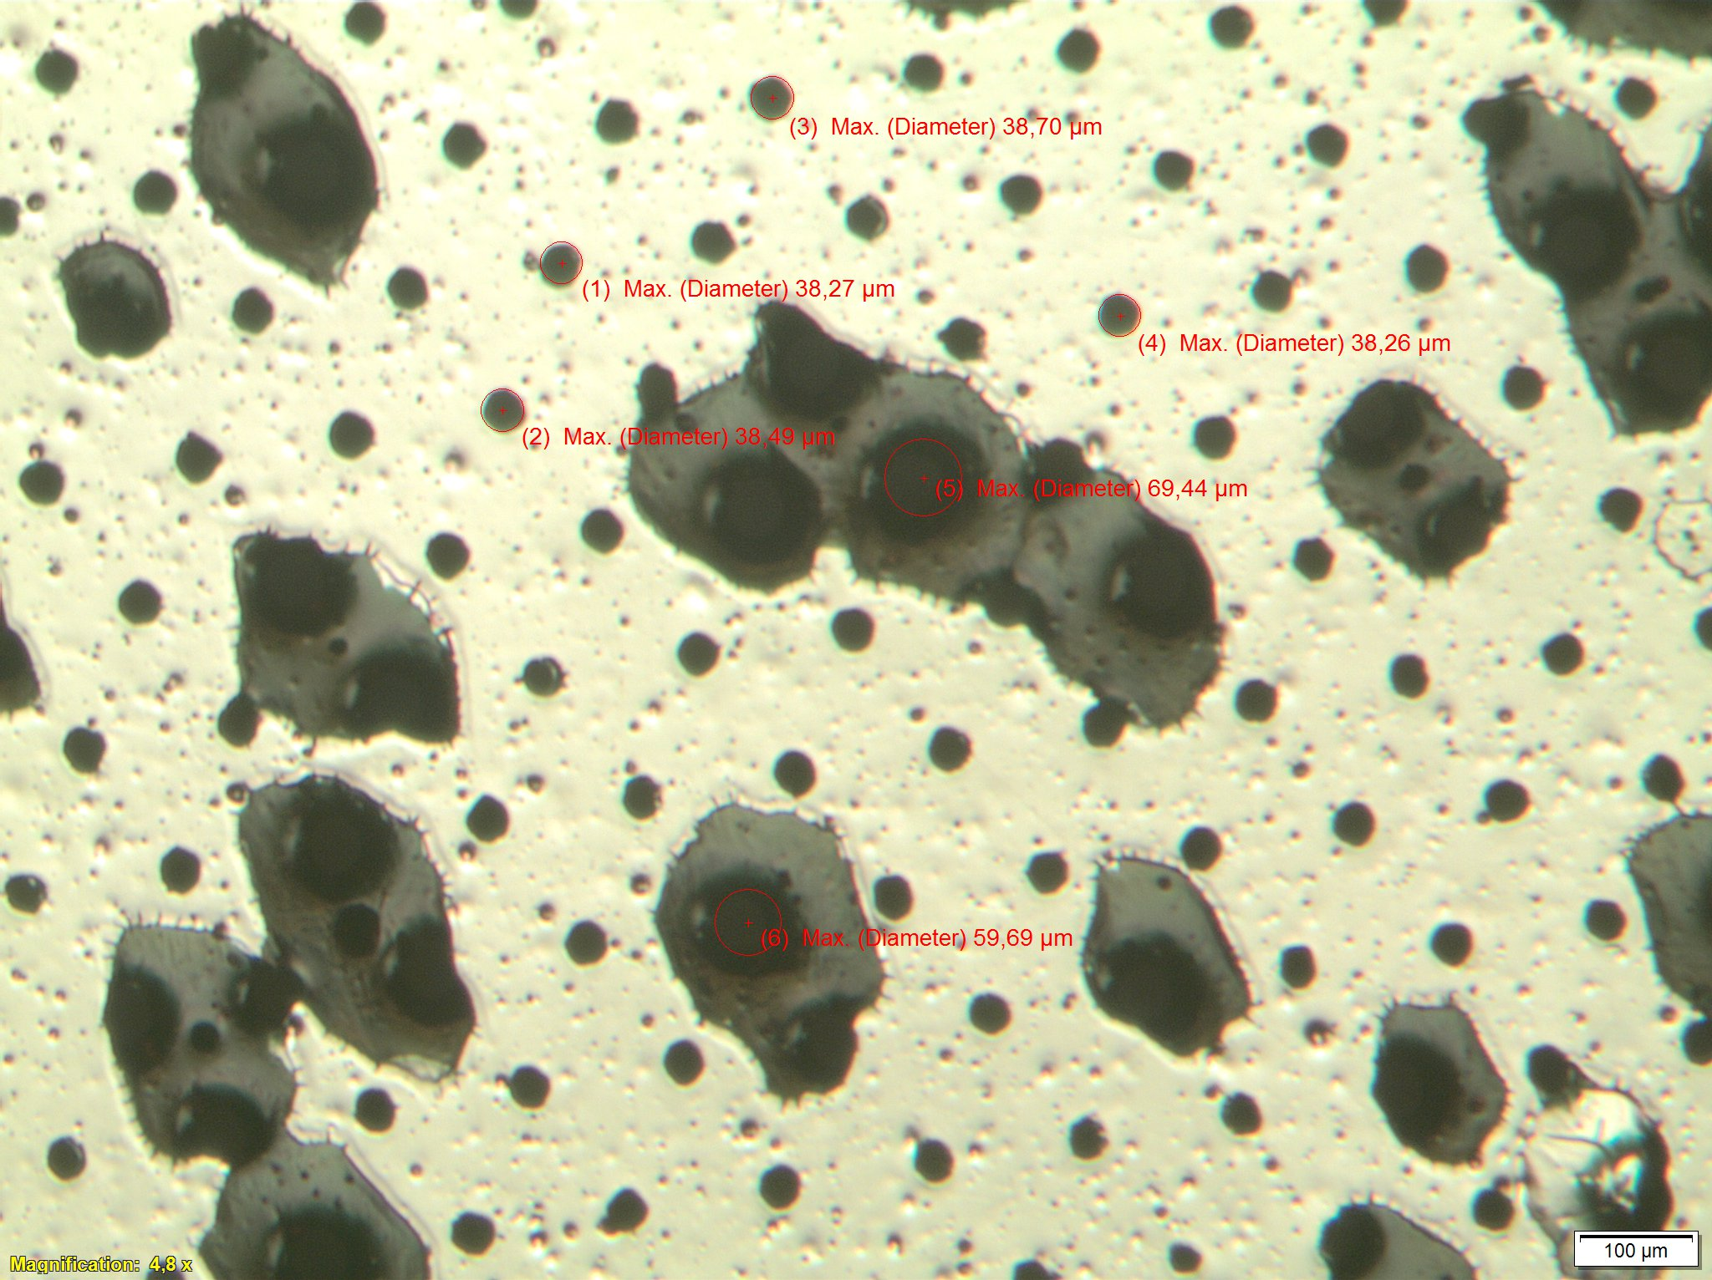
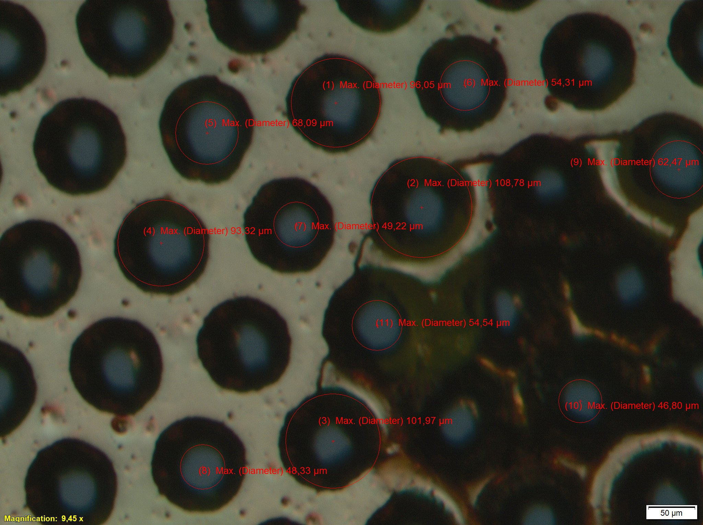
Amplification foil – Previous attempts
2nd example of defect foils
DLC fails to attach to the foil (top side)
Defects on the Cu layer
(bottom side)

Slide 5
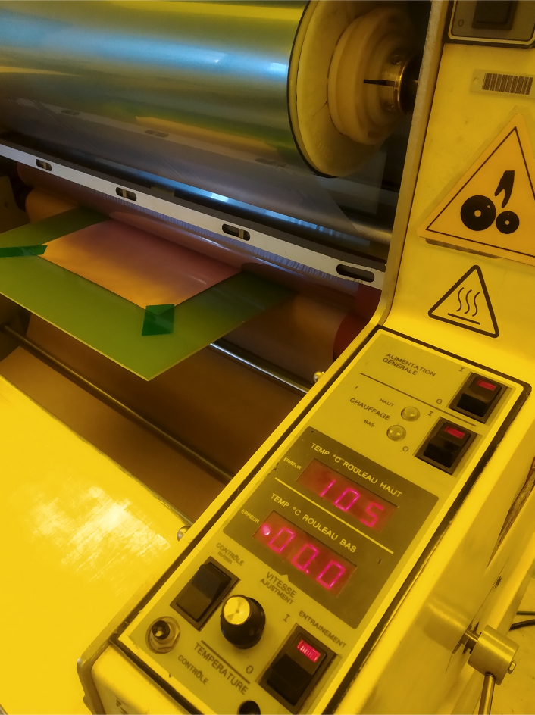
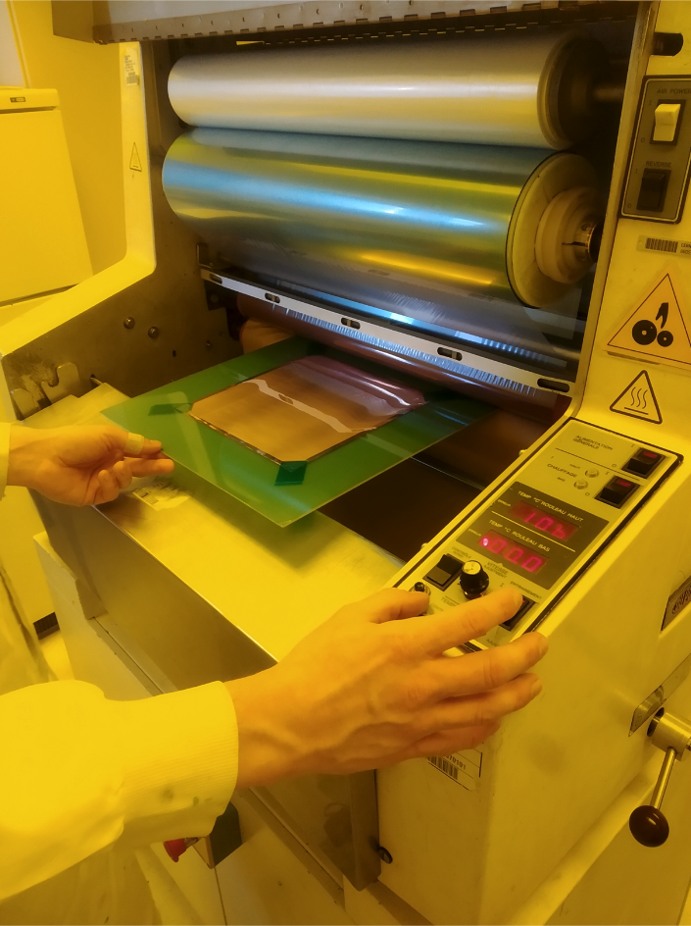
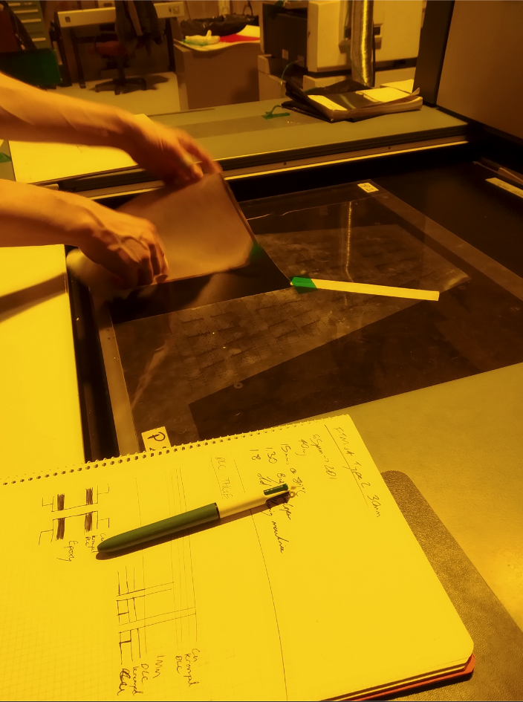
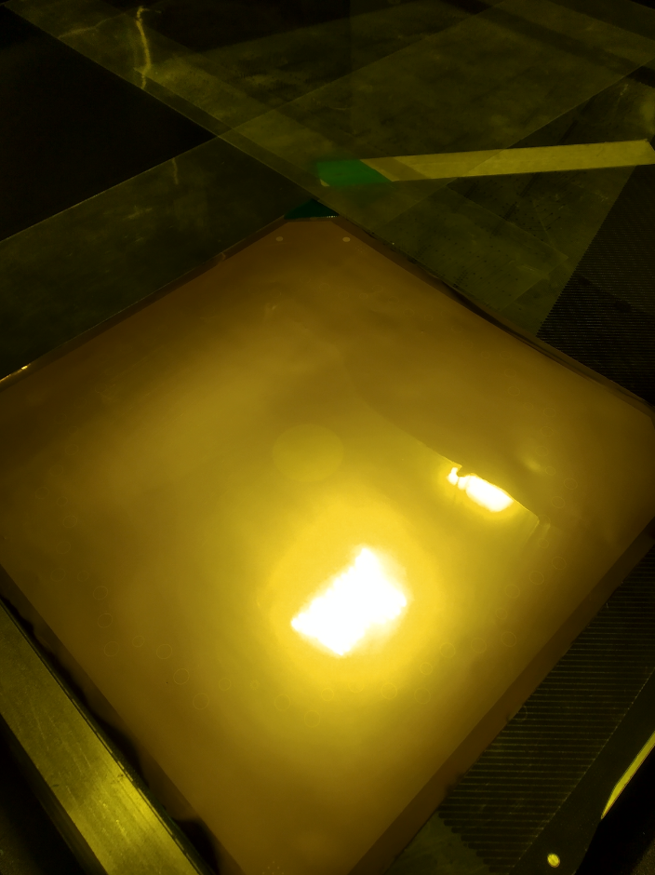
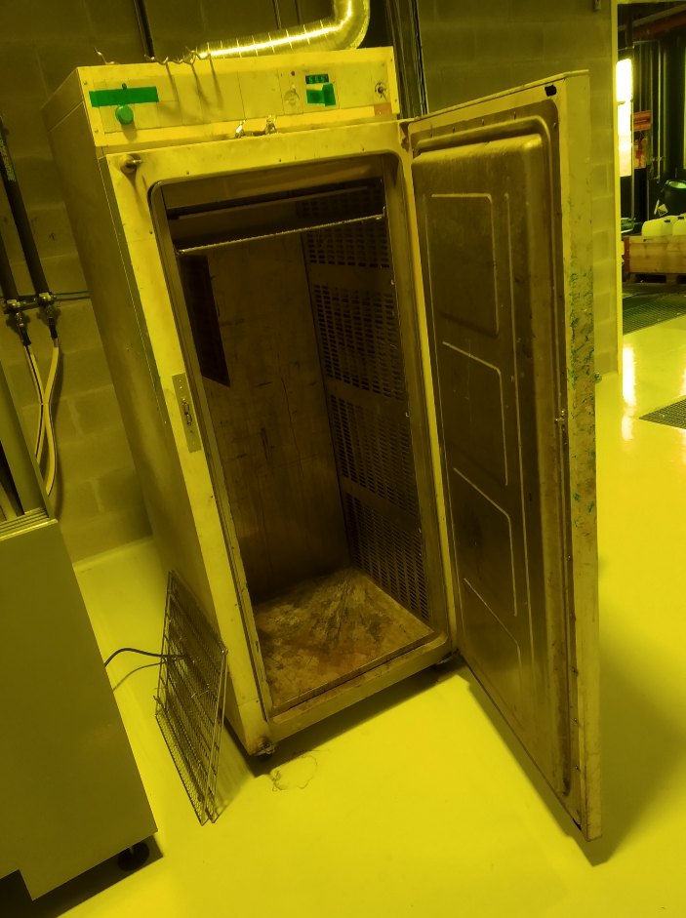
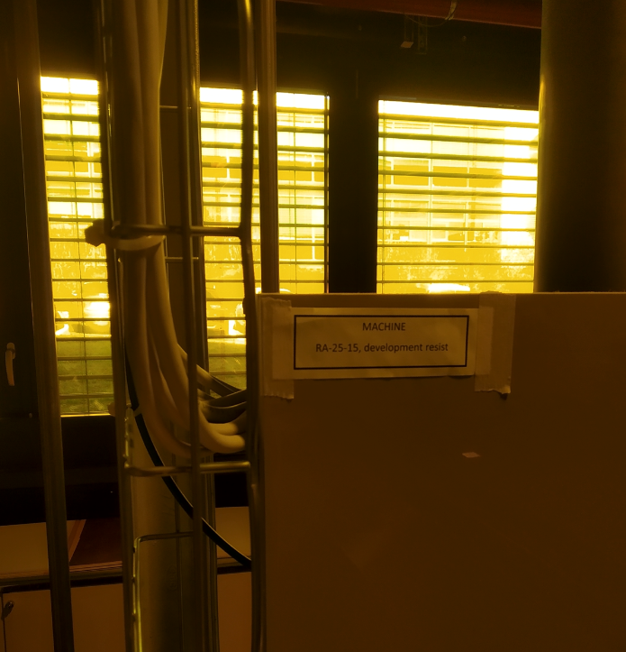
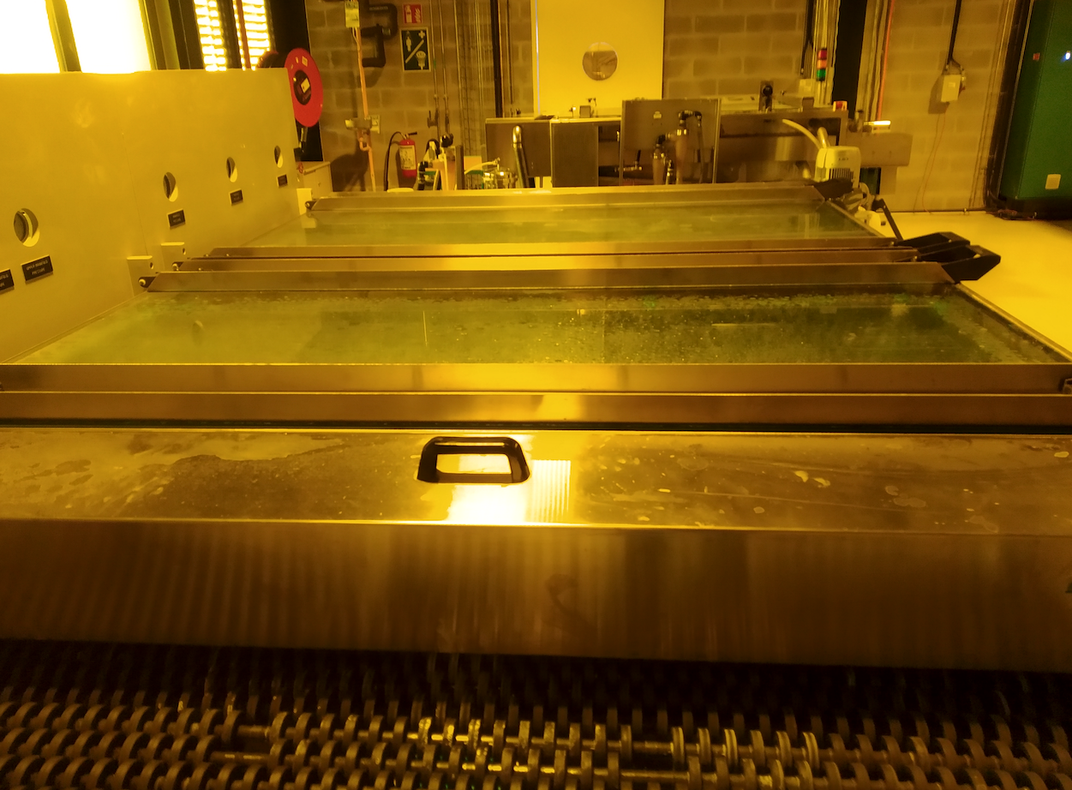
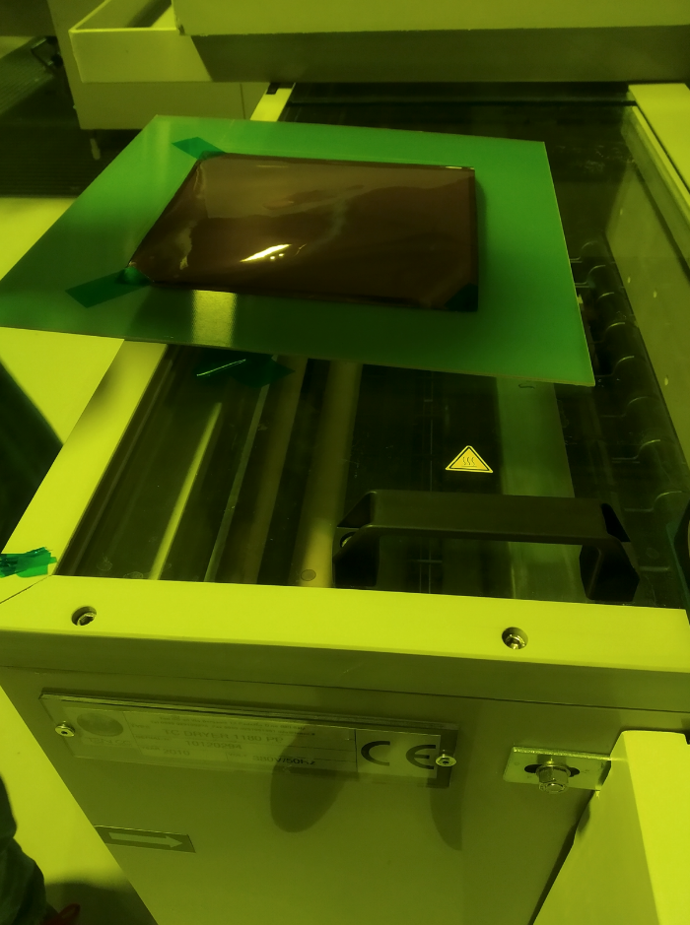
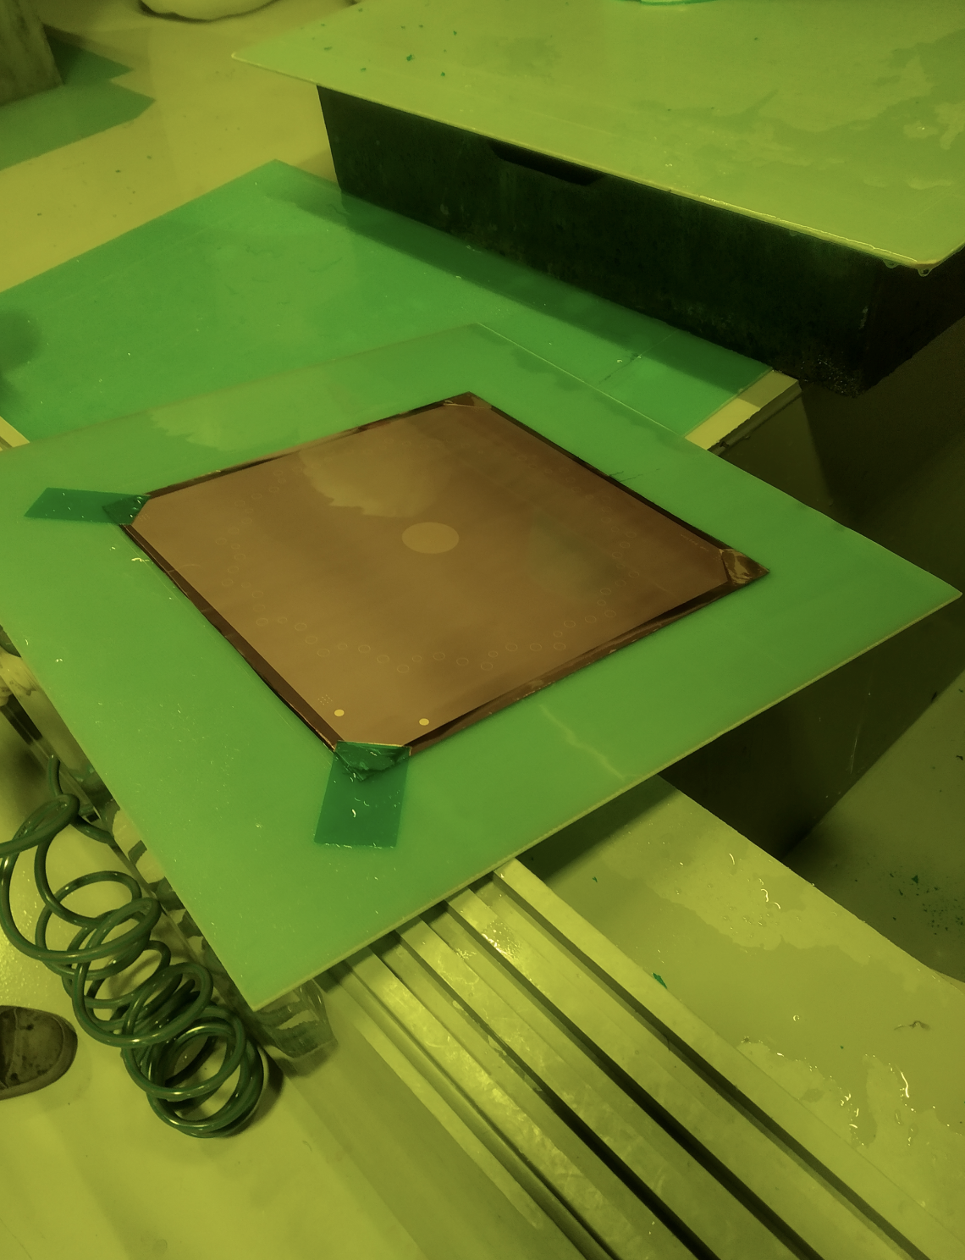
Amplification foil – Production (Lamination, UV exposure, Cu resistive layer)

Slide 6
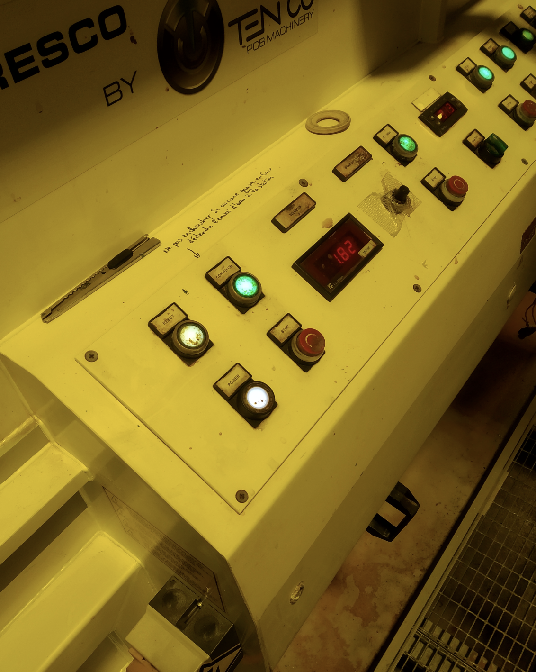
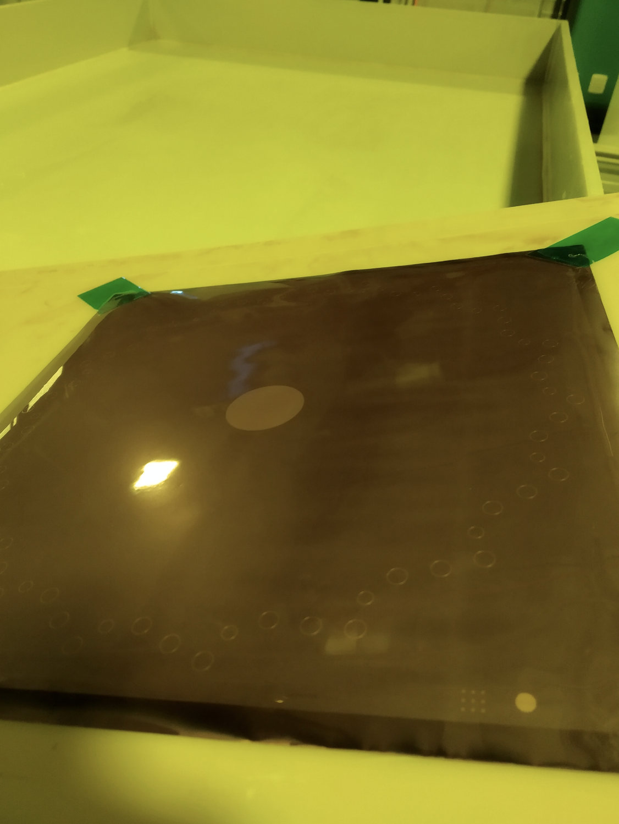
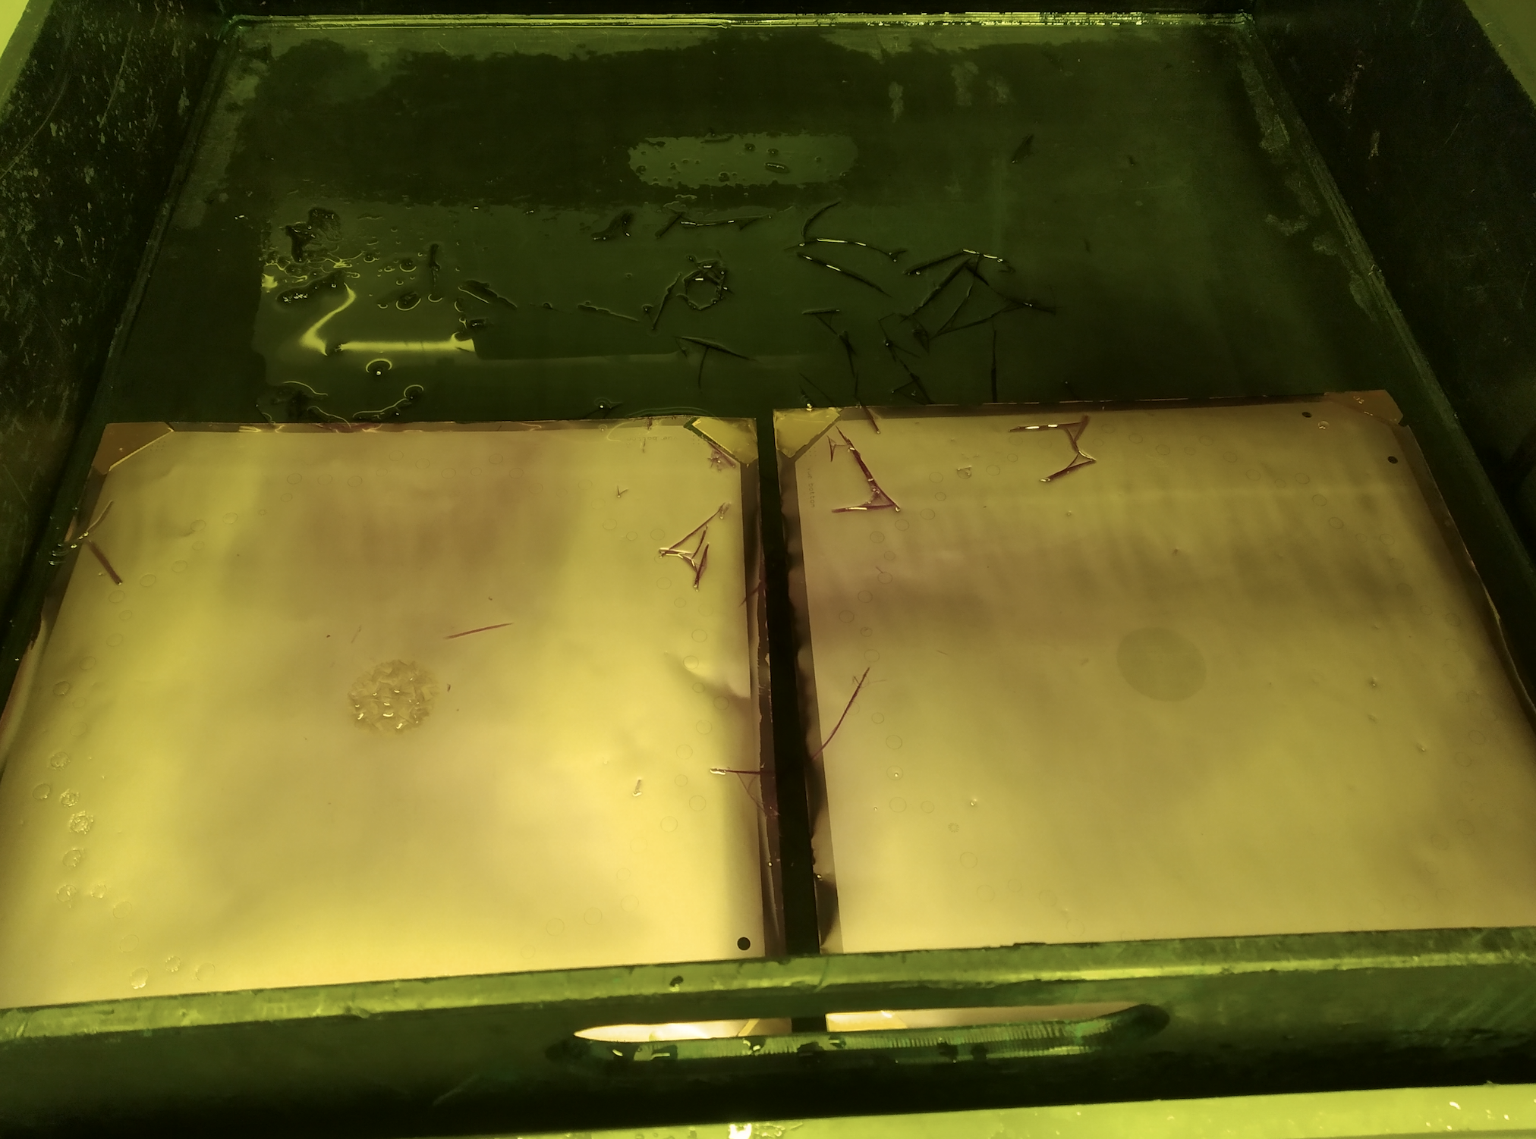
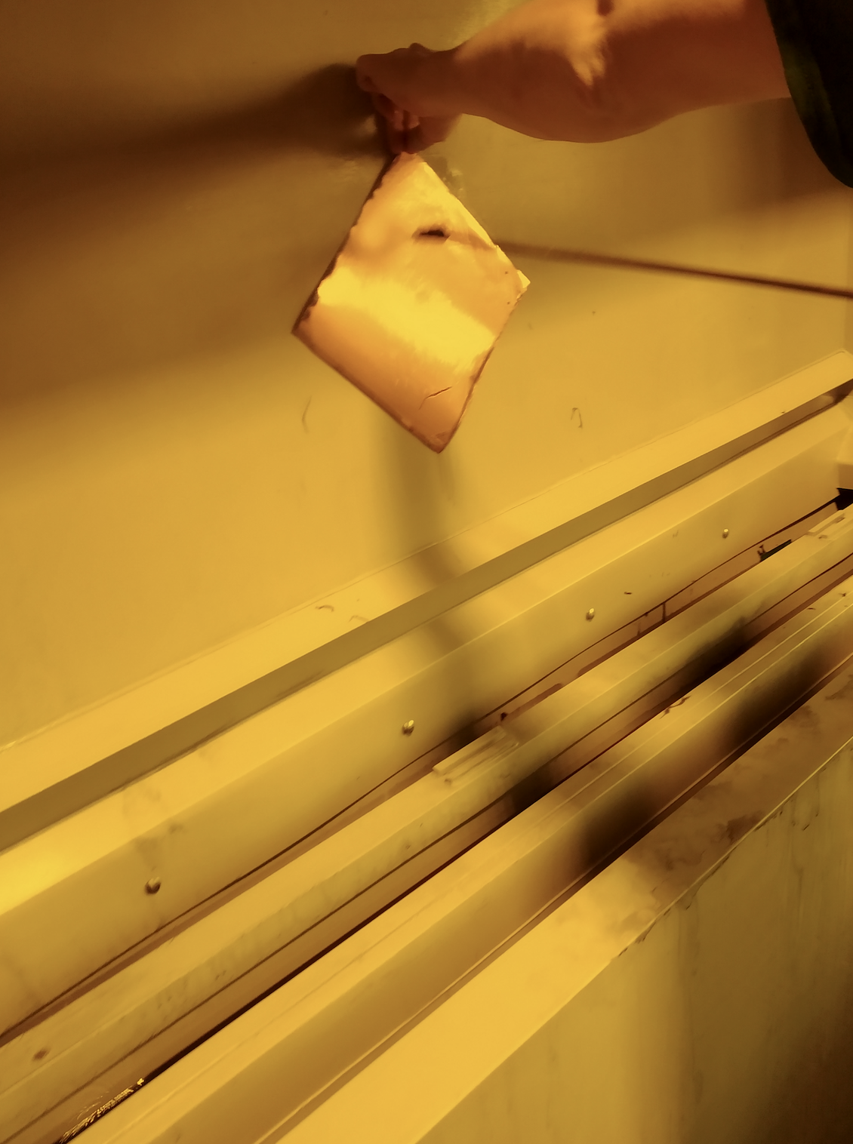
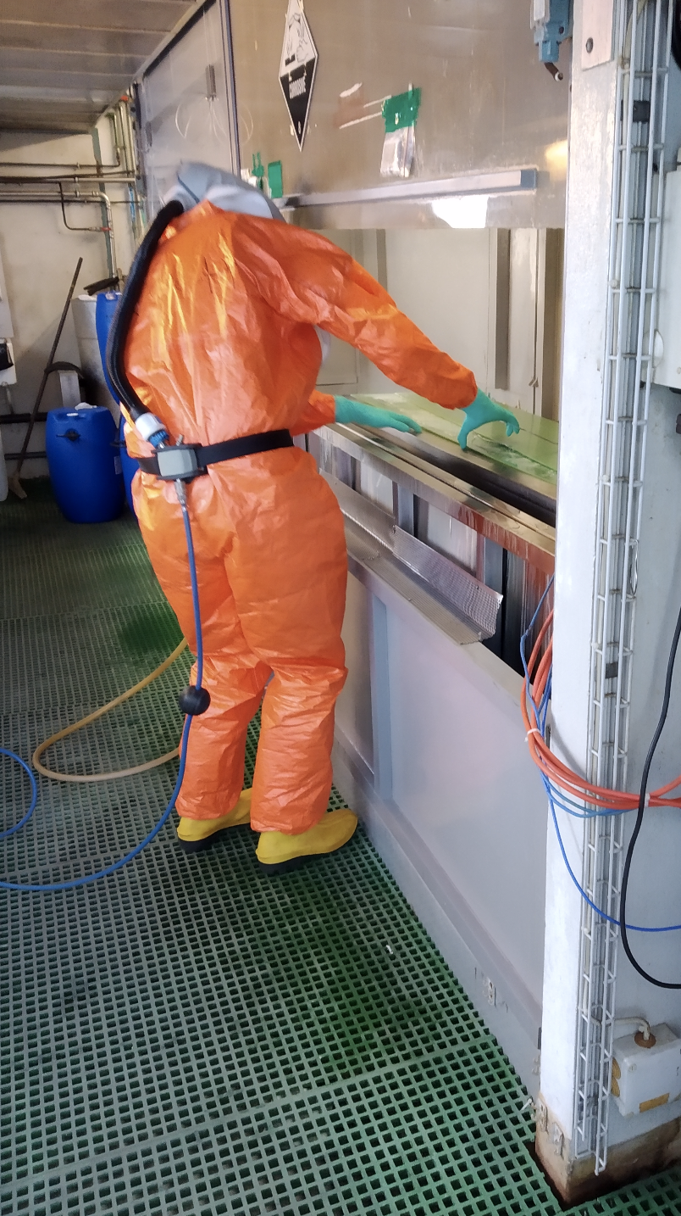
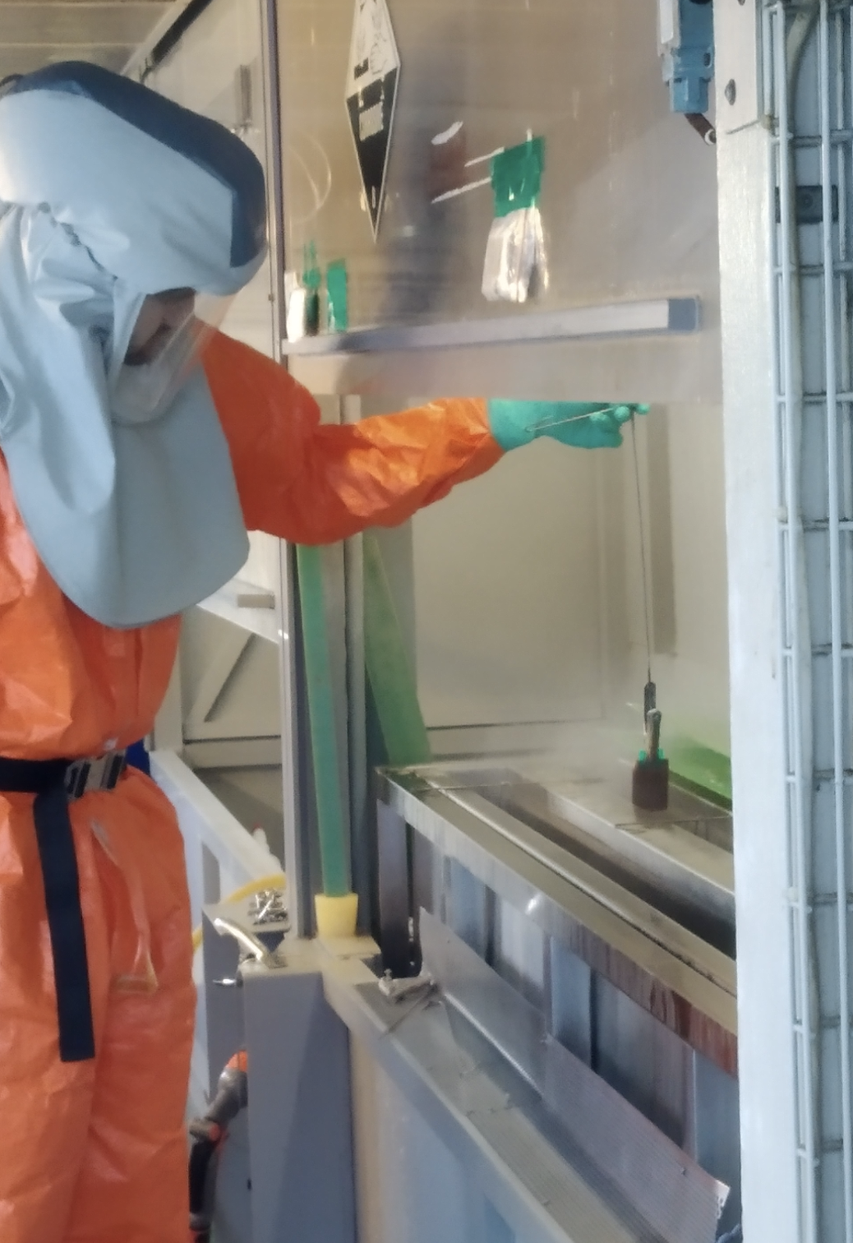
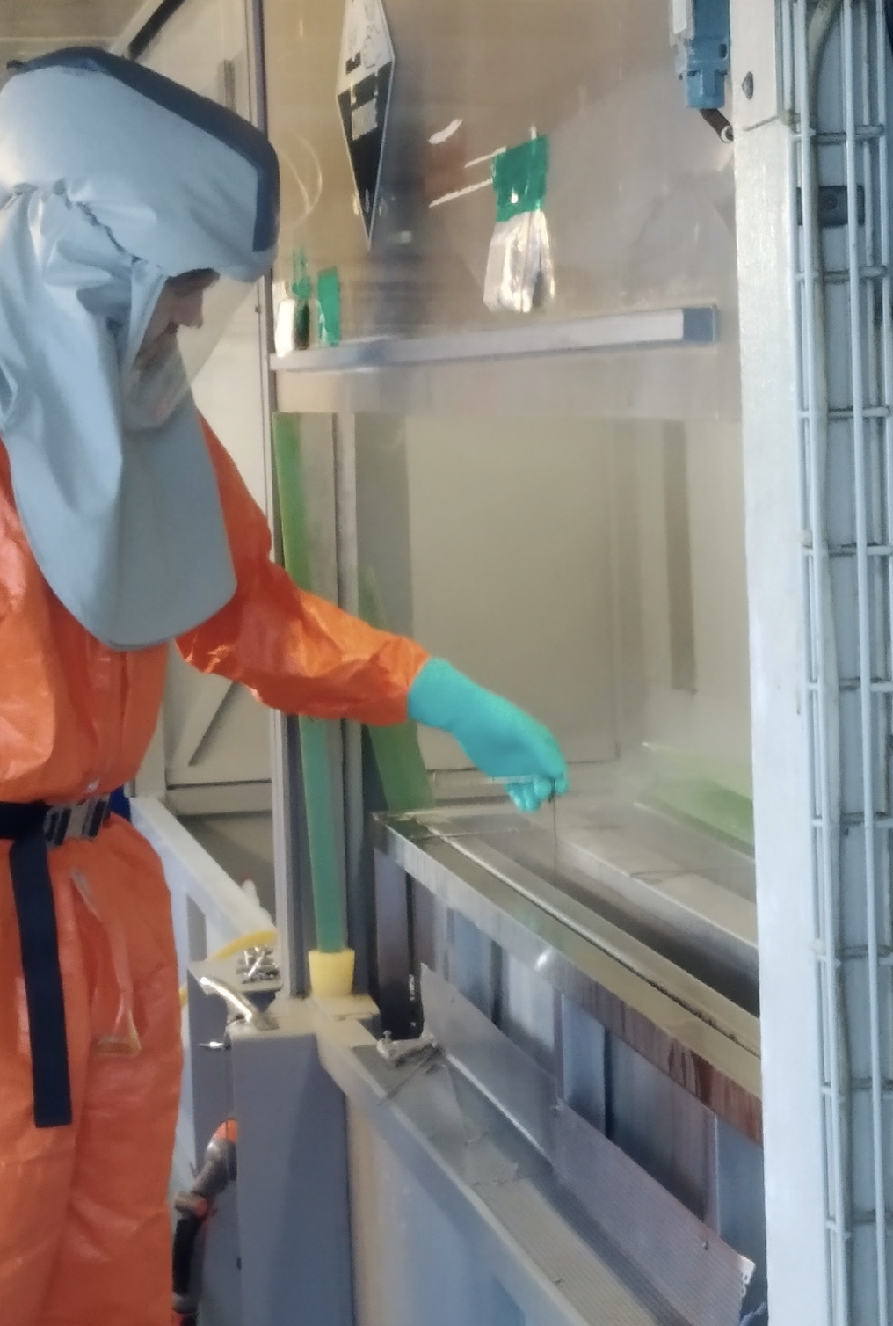
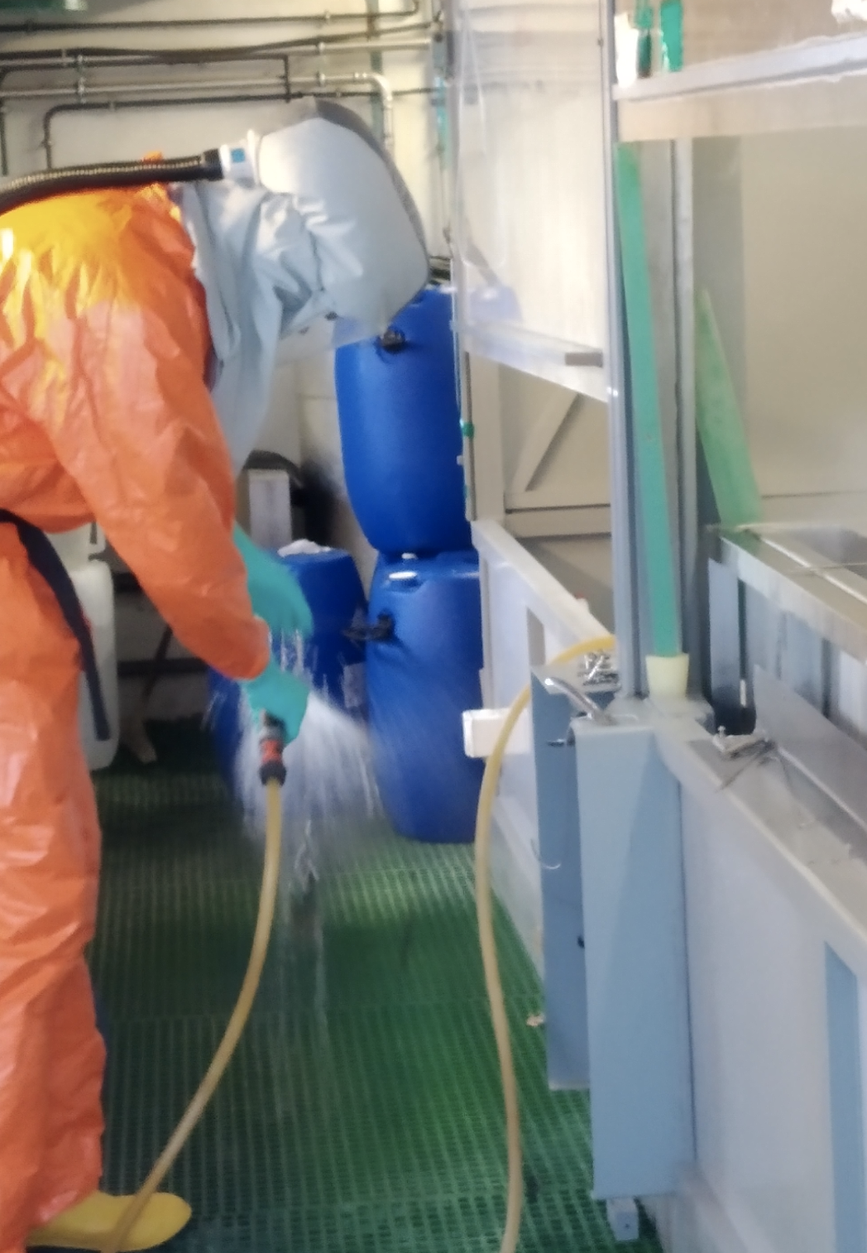
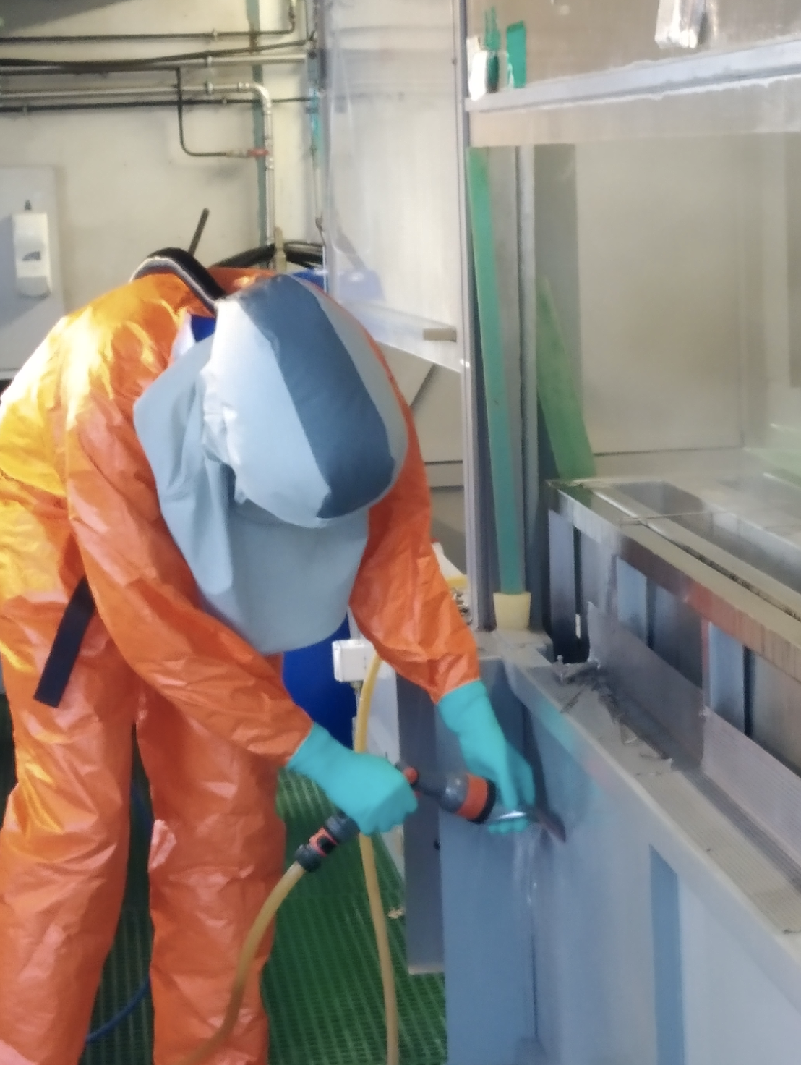
Amplification foil – Production pt2 (Cu etching, Kapton etching)

Slide 7
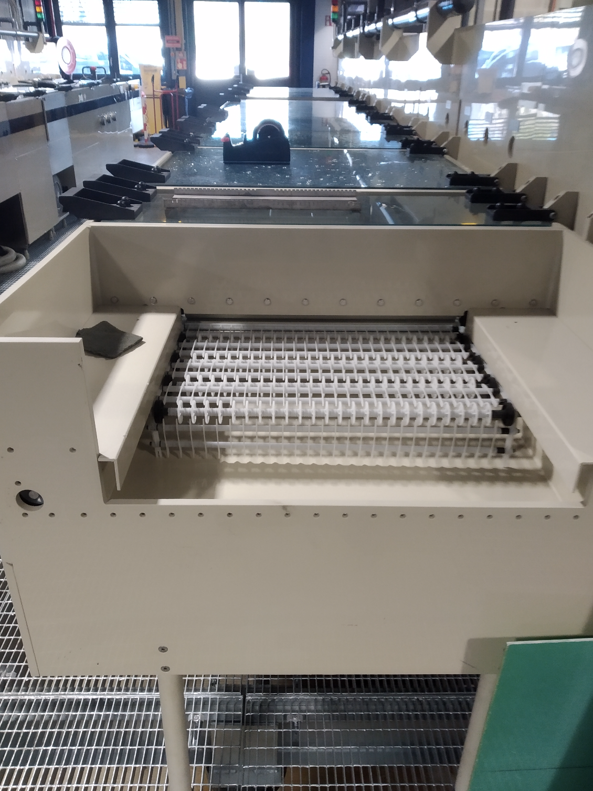
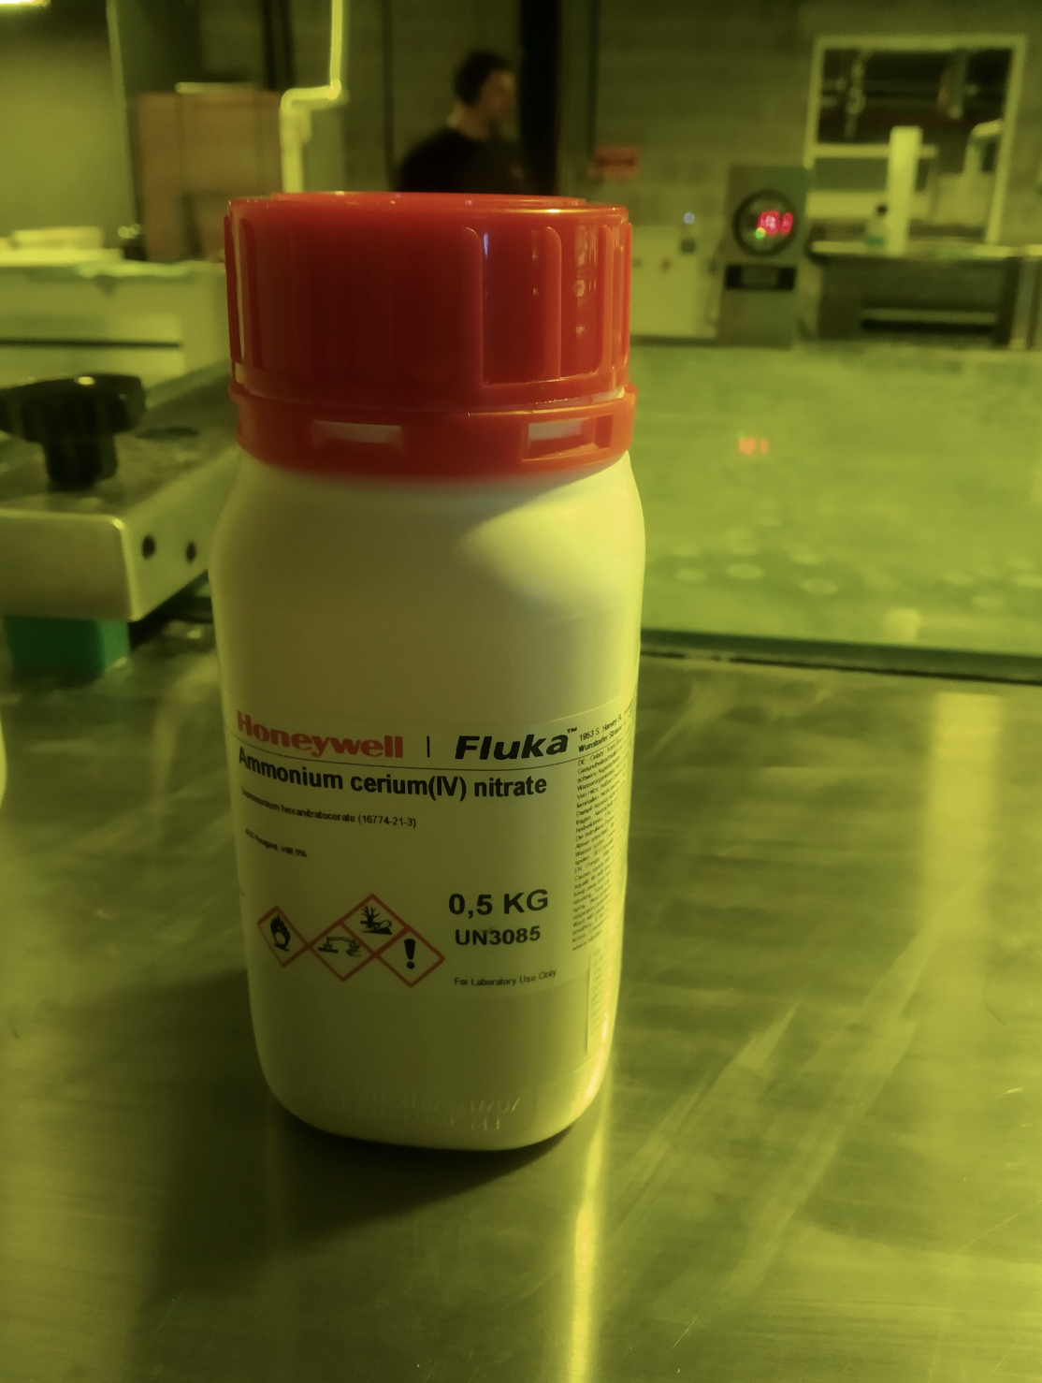
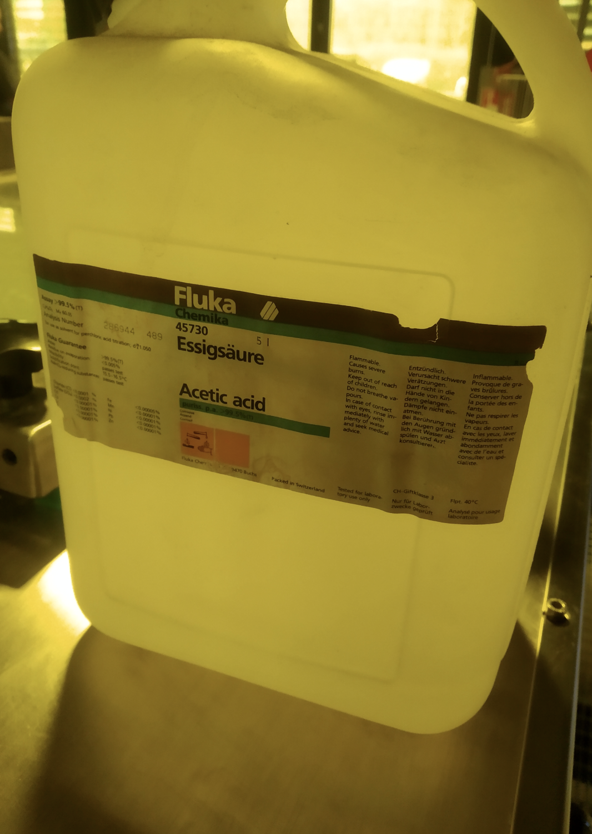
Amplification foil – Production pt3 (Chromium Removal)
2 ways in removing the chromium
Foils with No-DLC → Manganate mixture (1)
Foils with DLC → Smoother dissolver (Ammonium cerium nitrate + acetic acid + water) (2)
(1)
(2)

Slide 8
Amplification foil – During the production
Issues arose in two cases
Kapton etching
Chromium removal
Kapton etching
The biggest problem we encountered is when we dipped samples to the ethylene mixture. The layers on the DLC side of the foils seemed to be completely removed
Solution → Added extra cupper on that side by using electrochemical method
Chromium etching
It appeared that the manganate mixture was too strong for the DLC side, as a result the removal of the DLC as well
Solution → Use of a smoother dissolver in order to control the DLC

Slide 9
Prototype Assembly
The assembly of a FTM prototype is quite simple and does not require complicated methods in order to attach the assembling components
Assembly parts
RO board
Gas tightness jig that is glues on the bottom of the RO
FTMv4_t2 Amplification Foil
Electrode
Drift foil attached to a thick ring with the Cu looking to the RO board
3 O-rings
M2 screws (10mm length)
“Window”
External Frames (3 pieces)

Slide 10
Prototype Assembly

Slide 11
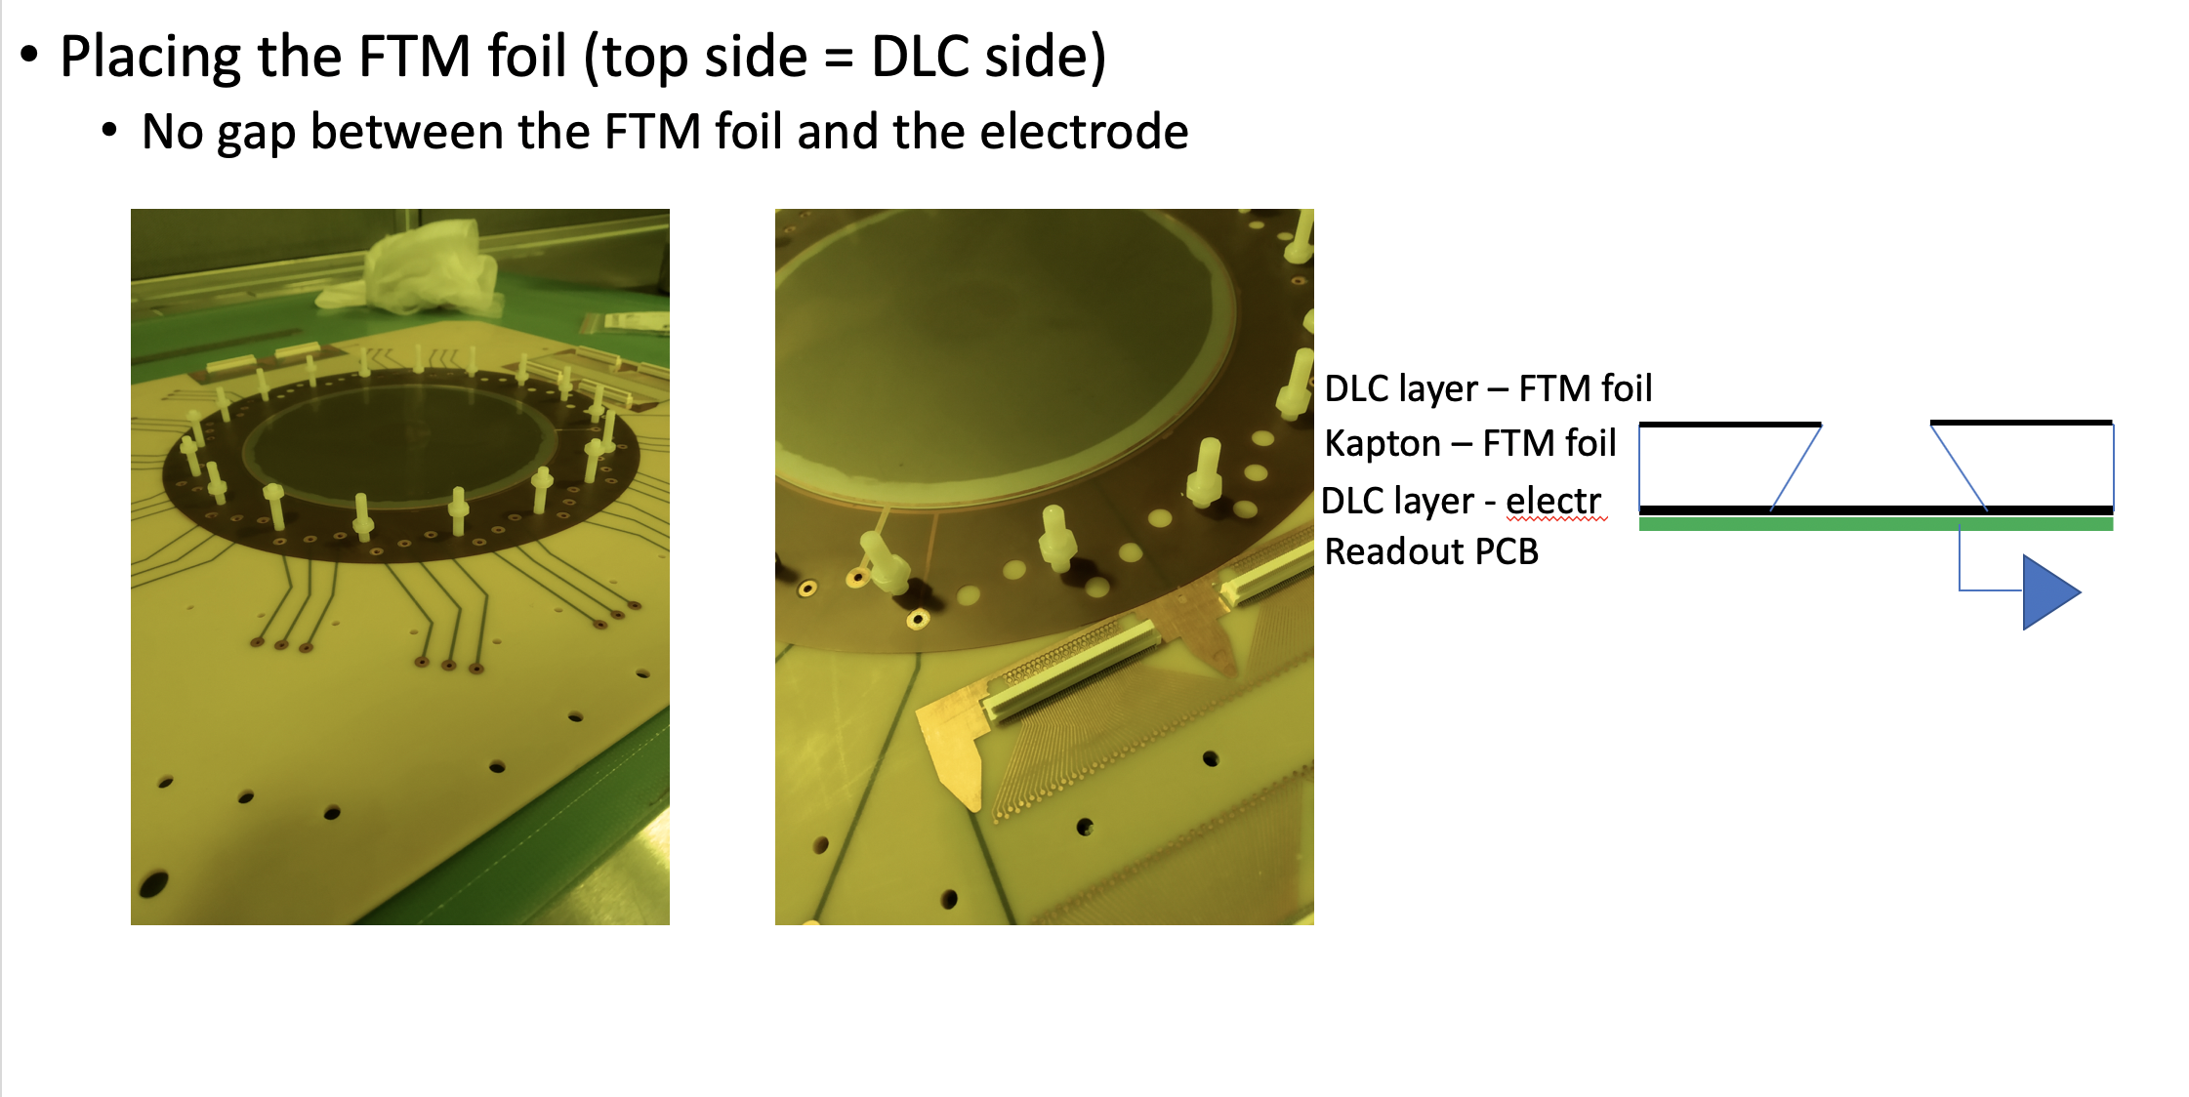
Prototype Assembly
(1)
(2)
(3)
(4)

Slide 12
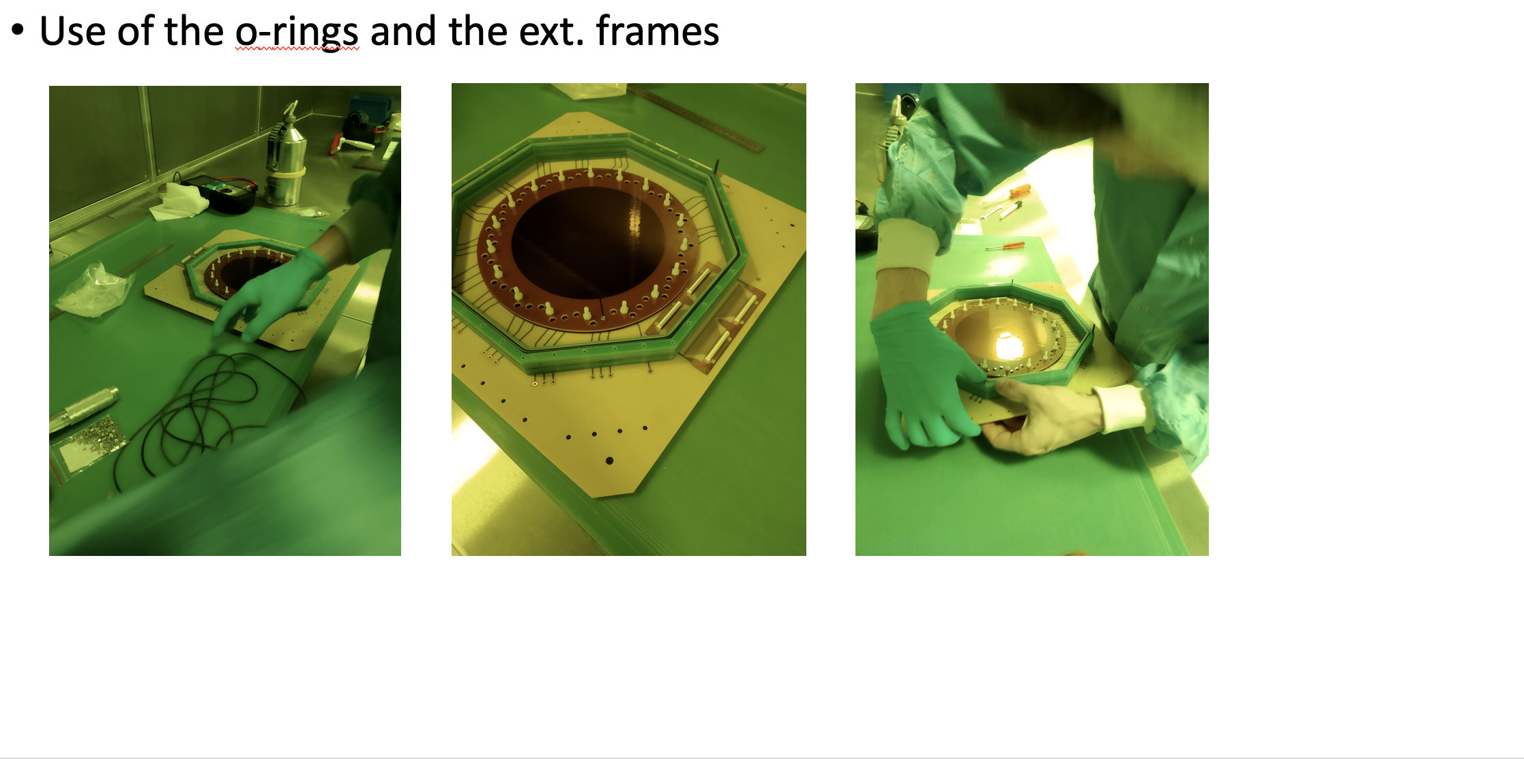
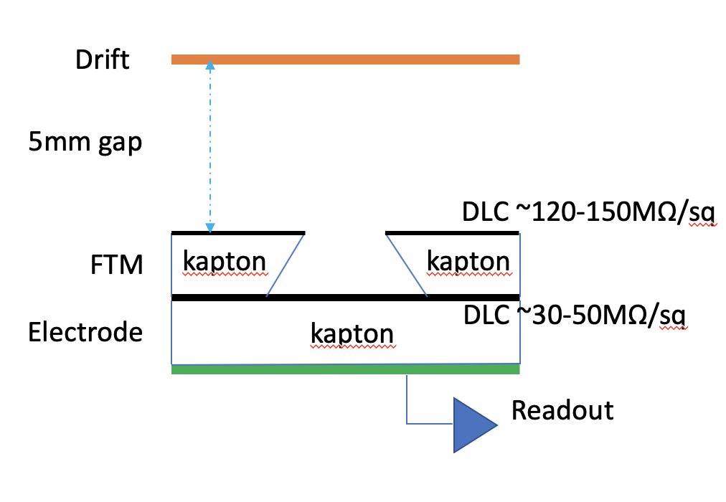
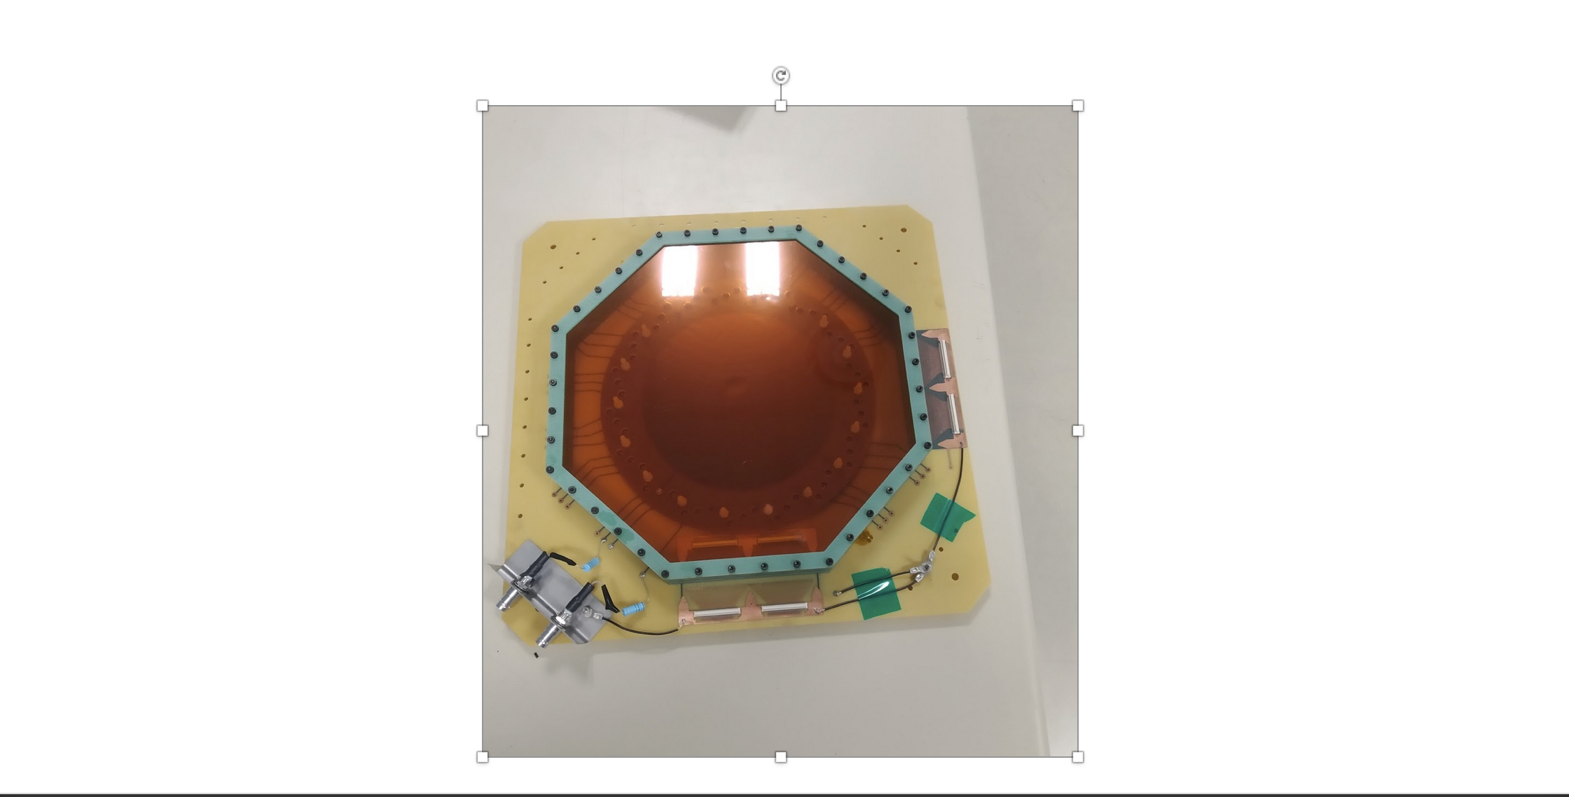
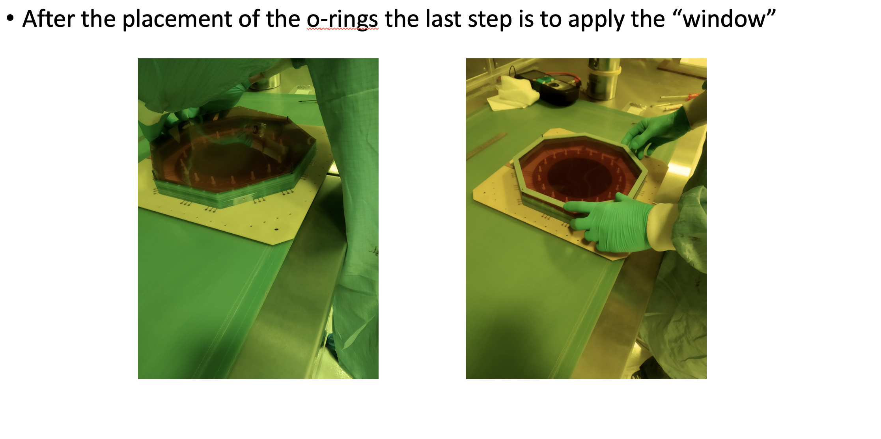
Prototype Assembly
(1)
(2)
(3)
(4)

Slide 13
FTM foil specs
DLC foil – No Cu/Cr
Resistivity 120—150 MΩ/sq (measured with MEGGER)
Holes
DLC side(top) → 40-50 μm
Kapton side(bottom) → 90-100 μm

Slide 14
Prototype Tests – First Indications/results
The prototype after the assembly was moved to CERN’s GEMLab in order to solder HV connectors and manage the grounding
The days that we tested the prototype we did not observe something
High noise - Faraday cage was necessary in order to reduce
In the beginning of April the prototype was transferred to Ghent
We re-arranged the HV connections
Placed extra HV connector in order to keep track of the current collected at the bottom electrode

Slide 15
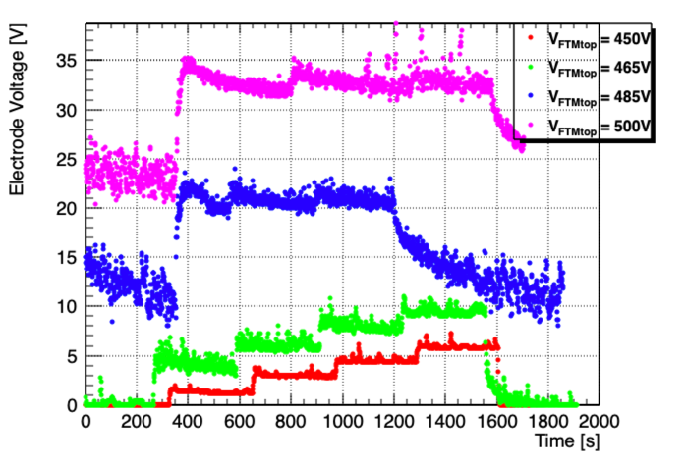
Prototype Tests – First Indications/results
Due to lack of High-res power supply (CAEN 1741H – 50pA) we had to use the pico-ammeter as it is used in the GEMs
We used a custom SHV to LEMO cable in order to connect the DLC electrode directly to the pico-ammeter
During the tests we have realized that the max. Voltage we can go is at ~465V on the amp. Foil as shown in the plot on the right
The foil needed to be trained by flushing only CO2 at high voltage (~700V)

Slide 16
Prototype Tests – First Indications/results
After we managed to read the
Current we observed that there is
A linear relation between the
X-ray flux and the current collected
At the DLC electrode
We still need to be able to observe
Clear signal in order to measure the
Gas gain

Slide 17
Prototype Tests – First Indications/results
On top of the testing
Of the any linearity between the
Current collected on the electrode
And the intensity of the source
We wanted to observe how both Drift
And amp. Foil behave while we ramp-up
and with a steady X-ray flux.
Xray-gun settings : 20kV/ 25μA (red) 20kV/ 50μA (blue)

Slide 18
Gain measurements
We received the high-res power supply in the beginning of August
We proceeded in eff. Gain measurements
We kept on using the pico-ammeter for the collected current as the N1471H does not measure negative current
We need to create an offset with resistors just like Federica did

Slide 19
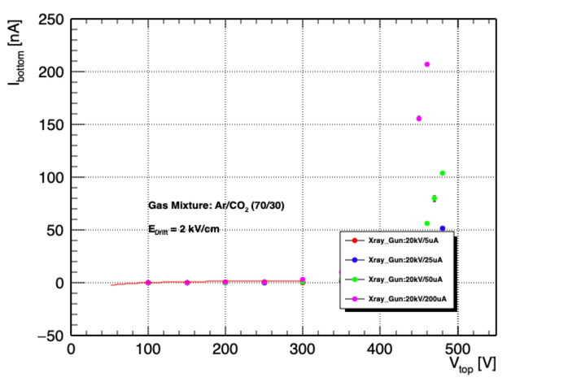
Gain Measurements
Since there is no measurable rate in order to estimate the gain the calculations used the method of the ionization current
Fitting function : I_{bottom}= α + β*1/x
where α is the ionization current induced at
Maximum collection efficiency

Slide 20
Gain Measurements
It seems that the gain is not very high
From the extrapolation made seems that
We have acceptable gain if the voltage applied
On the foil is >600V
So the next step is to try and ramp up the foil
To higher voltage regions
Gain was calculated using the formula:
$$G= \frac{I_{anode,amp}(V_{FTM})}{I_{anode,ionization}}∙\frac{I_{xray,max}}{I_{xray}(V_{FTM})}$$

Slide 21
Gain Measurements – Gain vs Drift
Before we started the training of
The foil to higher voltage regions
We measured the current collected to the FTMtop layer and the gain that this foil gives wrt the voltage applied
On the drift foil

Slide 22
Attempt on training the foil to higher voltages
After the gain measurement → Need to ramp up to higher voltages
Foil need to be ”trained” to be able to reach 650V
Flushed with CO2 left the prototype at 700V
Sparks observed
After 3 days it “cooled” down
Changed the gas mixture with Ar/CO2 (70/30)
Unable to perform measurements for 2 reasons
High current (2-5uA) on the surface of the top layer
Did not observe linearity on the current collected at the bottom
Further investigation as the pico-ammeter cannot ”read” those current values ( > 220nA)

Slide 23
Prototype Tests – Summary
Procedure of making a DLC coated foil
Managed to perform tests and see that the prototype reacts to the radiation
In an expected way however the gain seems to be low
Rui and Simon produced WELL foil with Cu-Cr layer instead of DLC. It is going to be shipped in Ghent in the coming days
Need to make a Resistor filter to create offset in the current so that we can measure the current values collected to the bottom of the FTM foil

