Slide 1
Future RPC developments
R.Cardarelli
INFN sez. Tor Vergata
RPC meeting, Roma 10-14 /02/2020

Slide 2
Introduction
developed in the 80s by R. Santonico and R.Cardarelli
The RPCs chamber developed in the 80s by R. Santonico and R.Cardarelli compared to the wire gas detector are relatively new. For this reason, I think that, the RPC has great potential for development in performance in the near future. The low cost per unit area, high spatial and temporal resolution accompanied a relatively simplicity of construction make it interesting for future high energy physics experiments where high sensitive surface are required.

Slide 3
The RPCs in the 1980s had a space-time resolution difficult to obtain with other detectors. Today many particle detectors, such as silicon detectors and …. , have a space-time resolution higher than the RPCs, but do not have a competitive cost per unit area. What has been said implies that in the future development of RPCs the cost factor per surface unit must be carefully considered.
the main parameters that determine the performance of the RPCs, the current status and any developments will be discussed below.

Slide 4
Future RPC development
Counting rate parameter:
Resistivity of electrode, apparently it is the simplest parameter to modify to obtain an increase in the rate capability . Experience shows that in the current RPC for resistivity values lower than 10^10 the detector becomes unstable. There are attempts with mono-crystal semiconductor electrodes (GaAs, Alessandro Rocchi RPC2020 presentation) that show stability for resistivity value of the order of 10^8. This is a possible development for the future in the range of the MHz/cm² rate capability.
Material of electrode, different material are tested different group:
phenolic paper (10¹¹-10¹⁰ ohm x cm resistivity)
phenolic glass fiber ( 10¹¹-10¹⁰ ohm x cm)
glass high low resistivity ( 10¹¹-10⁸ ohm x cm)
ceramic ( 10¹¹-10⁹ ohm x cm)
mono crystal semiconductor (GaAs, Si, ….) (10⁸-10⁵ ohm x cm)

Slide 5
- Fake pulse (noise), the experience shown the rate of fake pulse depend to the
characteristic and flatness of the electrode surface, very low type of the surface
work in order in the RPC, for instance:
linseed oil
glass
mono-crystal semiconductor
Thickness of electrode, it is another parameter that can be easily to decrease, the experience shows an increase in mechanical instability and a fragility for electric discharges. A large study is underway in the Roma2 laboratory and MRPC group. The thickness of electrode is tested in the range of 2-0.1 mm.
Average charge delivery in the gas , historically, the first major step forward was made in the 1993s with the observation of the avalanche regime, instead of the streamer, that allowed an increase the rate capability by a factor 100, the introduction of a low noise front-end (1000 e⁻ RMS noise) ATLAS muon upgrade project RPC BIS78 allowed a further factor 10 in the rate capability of the order of 10 kHz/cm²
The fake pulse depends on the properties and flatness of the surface at the molecular level,
the possible explanation why glass and linseed oil work very well, is they are high density liquids and therefore have surface oriented molecules .

Slide 6
Current v.s. voltage applied to the RPC
The characteristic current v.s. voltage curve are two basic component:
linear low voltage and exponential in the efficiency voltage
I (uA)
KV
Linear part (ohmic part)
edge resistance effect
Exponential part
surface quality and gas multiplication

Slide 7
Electronic sensitivity, the increase of the RPC rate capability by moving amplification from the detector to the front-end electronics is currently limited by the noise of the electronic (the new front –end of Atlas B7-8 is the limit of the actual electronic device at standard temperature). New components can make this still possible for the future
Gas mixture, the performances of the RPCs depend on the gas mixture, such as the avalanche streamer separation, currently not ecologically compatible gases are used, a big research effort is addressed to ecologically compatible gas mixtures.
Ionic to electron induction charge, The study of the characteristics and correlations between the ionic and electronic signal increase the knowledge of the dynamics of avalanche evolution and can suggest method to increase the performances of the RPC.

Slide 8
Time resolution
Gap thickness, the experience shows that the time resolution depends, linearly, on the inverse of the thickness of the gap. To obtain time resolution of the order of tens ps, the thickness of the gap is reduced a few hundreds micrometers, in these conditions the efficiency is much lower then 100% and therefore a multi gap structure is required.
Signal form, the information of the evolution of the avalanche in the RPC gas is in the electronic and ionic signal. The analysis of this signal is e possible different method to increase the time resolution like multi-gap method with mono-gap.
Different geometry, is the possible approach to increase the time resolution
Reliability
Stability of resistivity the experience shows that the resistivity of electrode increase with integrated charge in the RPC and the rate capability degrees. Alternative material is need to study to solve this problem.
Material reliability (plastic, ……..) break of plastic gas inlet
Gas leak, Problem in ATLAS gas inlet and in CMS gas distribution
HV resistance to the breakdown, problem in the HV connector

Slide 9
Calorimeter application
High linearity for synchronous number of particle, the RPCs can be considered as an array of independent counters with dimensions ranging from 5 to 0.2 mm²(streamer and avalanche working mode) therefore in the case there are many synchronous particles, the signal amplitude is proportional to the number of particle, this property is useful in calorimeter application.
Very small discharge area, 0.1- 5 mm² this area restrict the linearity of RPC v.s. maximum density of particle

Slide 10
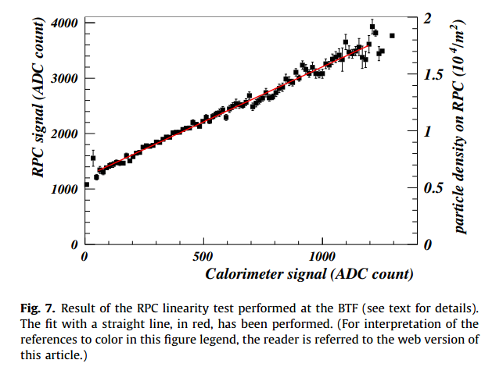
Test @ BTF (LNF)of a RPC working in streamer mode

Slide 11
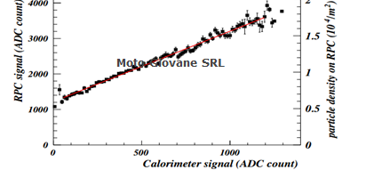
Extrapolation to the avalanche mode
avalanche mode
Particle density up to
2* 10⁵/m²
30 pC charge delivered
in the gas per mip
streamer mode
particle density up to
2*10⁴/m²
300 pC charge delivered
in the gas in per mip

Slide 12
Spatial resolution
Graphite diffusions, the resolution is of the order of 100 um limiting to the graphite uniformity (Improving track resolution in the RPC chamber) R.Cardarelli et al 2006-nuclear physics B –proceeding supplements 158(1); 25-29
Charge centroid reconstruction, the resolution of the order of 100 um limiting to the electronic noise (The RPC space resolution with the charge centroid method) G.Aielli, R.Cardarelli et al Jinst 9 (2014)n°09, C09030
Time difference on the end of the strip, the resolution is of the order of 1 cm limiting to the time resolution and the distortion of the signal in the strip-line.

Slide 13
Detector with uniform field but different geometry
Mono-gap planar geometry
Cylindrical mono-gap geometry
Multi-gap planar geometry
Gas gap
Cylindrical multi-gap geometry

Slide 14
Cylindrical geometry
The cylindrical geometry is very interesting in the case the external pressure is different respect to the internal gas gap pressure, two important cases:
The external pressure is very low, application in space
The internal pressure of the gas gap is very high, for instance 2-10 bar,
this high pressure is useful to increase the performance of the
detector in the range of ps time resolution , high
efficiency per single gas gap and spatial resolution (30-50 um), for this
approach the experience of MDT ATLAS group for large gas distribution at
3 bar, is very important.

Slide 15
Very large installations
A low cost detector is not sufficient to build very large extension apparatus
The cost driver is the readout electronics
For low data rate on very large surfaces, a new fundamental development is the an embedded optical fiber daisy-chain zero-suppression readout and DAQ, chamber by chamber.

Slide 16
conclusion
It is my opinion that RPC detectors have a great potential for development, in particular for large area experiments where a high space-time resolution is required

