Slide 1
An introduction to RPC 2020
Roma Tor Vergata University
10 Feb 2020
By R. Santonico

Slide 2
A warm salutation to all Chinese colleagues who could not come due to the epidemic
They are one of the most active RPC community
Hope that the network connection will help to reduce as much as possible this loss for RPC 2020
Hope to see them again among us asap

Slide 3
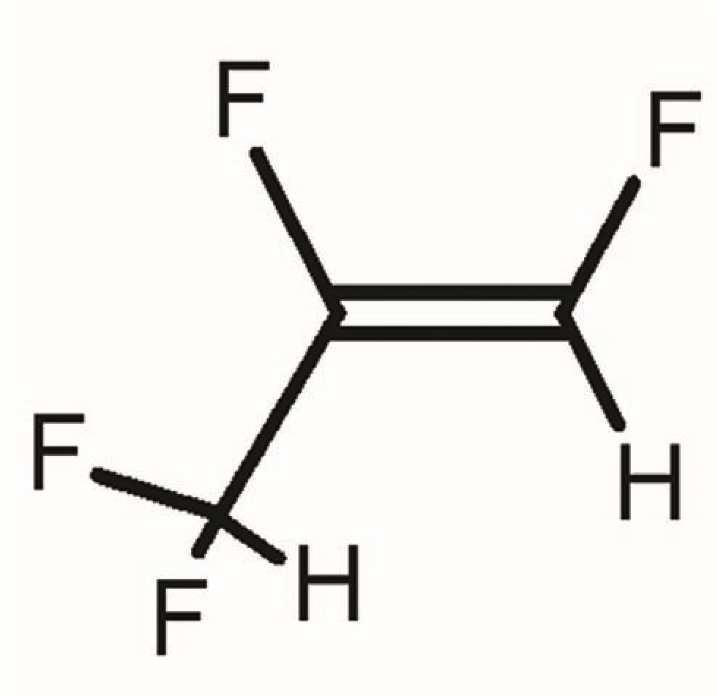
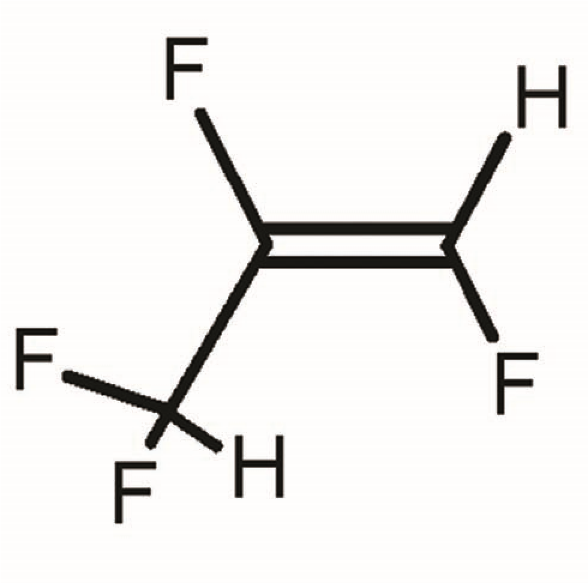
Search for new low GWP RPC gases
Present magic mixture C₂H₂F₄/i-C₄H₁₀/SF₆ = 94.7/5.0/0.3 shows a very large separation, in terms of applied electric field (> 0.5 kV/mm depending on the FE electronics), between avalanche and streamer mode operation
Our efforts to find a new low GWP RPC are mainly directed to reproduce this very confortable feature with the new series of industrial gases HFO (Hydro Fluoro Olefins)

Slide 4
Search for new low GWP RPC gases (2)
The double carbon-carbon bond C=C has a crucial effect in the gas electrical properties:
much larger field required
easyer avalanche-to-streamer transition
Industrial research for a new molecule replacing SF₆ (GWP =24000!) is also very active
C₃H₂F₄ and other molecules replacing SF₆ are presently the most interestring candidates
For future RPCs, the new gas search is easier thanks to the possibility of optimizing the gas gap and the FE electronics for the new gas
For the existing very large LHC systems like those of Atlas and CMS where nothing but the gas can be changed, the solution appears less simple

Slide 5
Self triggered space-time tracking (1)
Collider experiments utilize RPCs for two different functions, triggering and timing, leaving to other detectors the accurate tracking task
Is it possible to integrate these two tasks in the same detector?
Tests carried out by different groups show that space resolution in the range of 100-300 µm are achievable with gas gaps around 1 mm depending on the detector size, the strip pitch and the front end electronics features
The position accuracy with RPCs depends only on the geometrical and mechanical quality of the strip printed board and not on the gas volume geometrical accuracy

Slide 6
Self triggered space-time tracking (2)
The time resolution ranges from 400 ps for large size 1 mm gas gap to tens of picoseconds for thinner gaps in a multigap structure
The FE electronics is crucial for all type of resolution requirements
In this scenario, the idea of a RPC structure capable of space x time resolutions 100-300 micron x 100-200 ps over a sensitive area of 10⁴ m² seems to be reasonable challenge
For these RPCs space-time performance, construction simplicity and cost must be accurately balanced and optimized for each specific application
Simplicity and reliability are RPC key points

Slide 7
Calorimetry with RPCs
The first idea of using RPCs for calorimetry was born in connection with neutrino physics
More recently the tests of the Calice collaboration have shown a relevant progress in the hadron calorimetry with the digital RPC read out

Slide 8
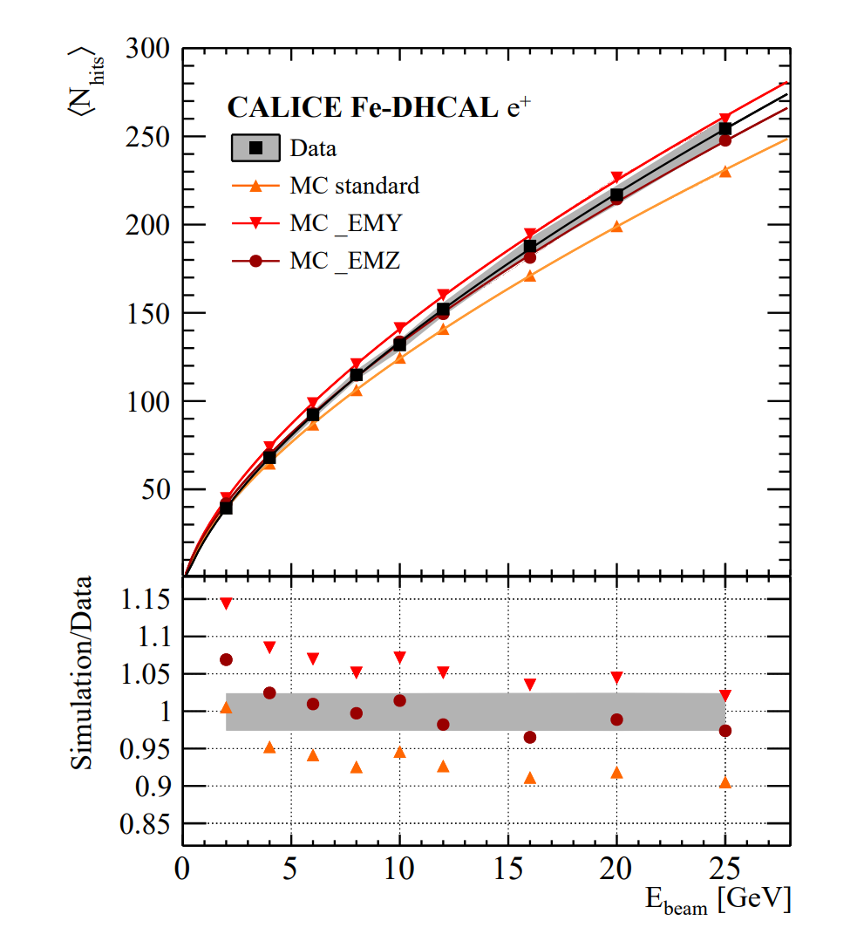
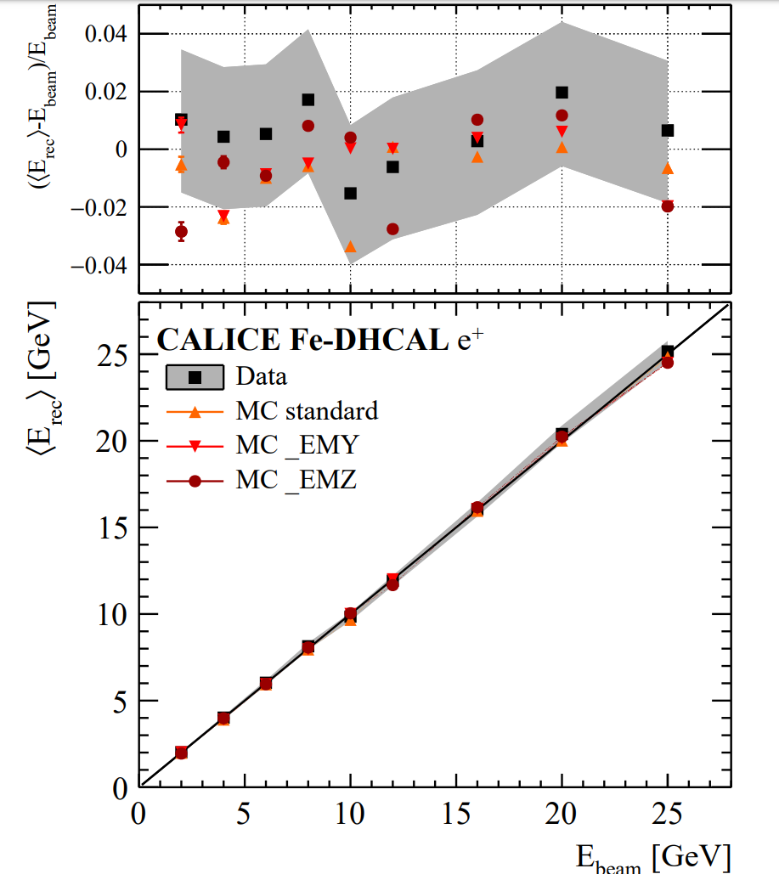
Calorimetry with RPCs $e^{+}$ beam digital read out with $1 {cm}^{2}$ pads

Slide 9
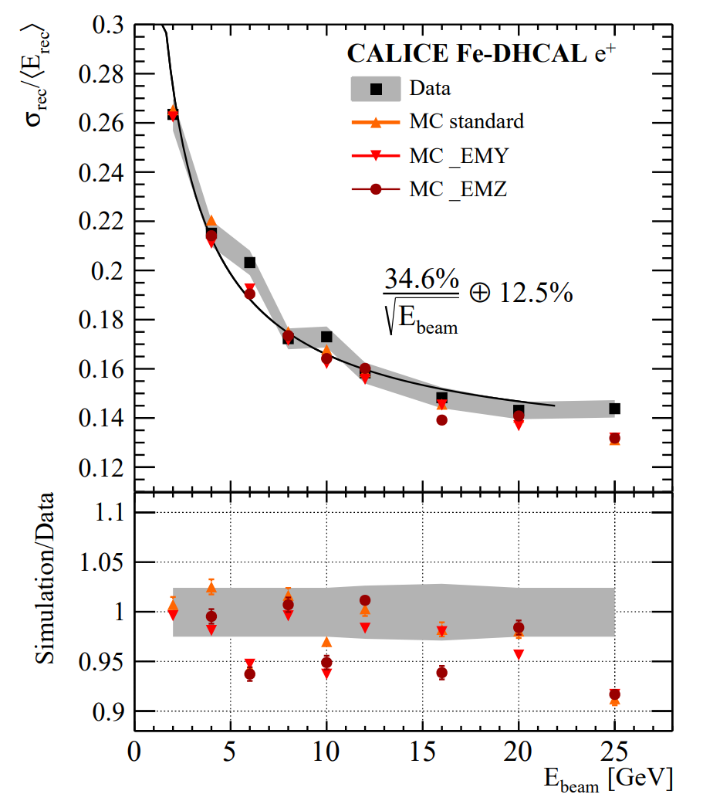
$e^{+}$ energy resolution

Slide 10
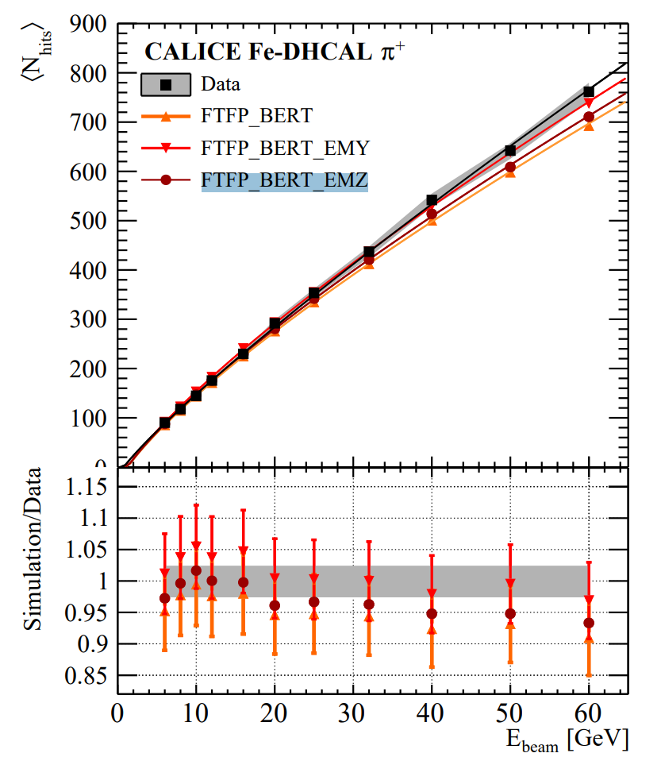
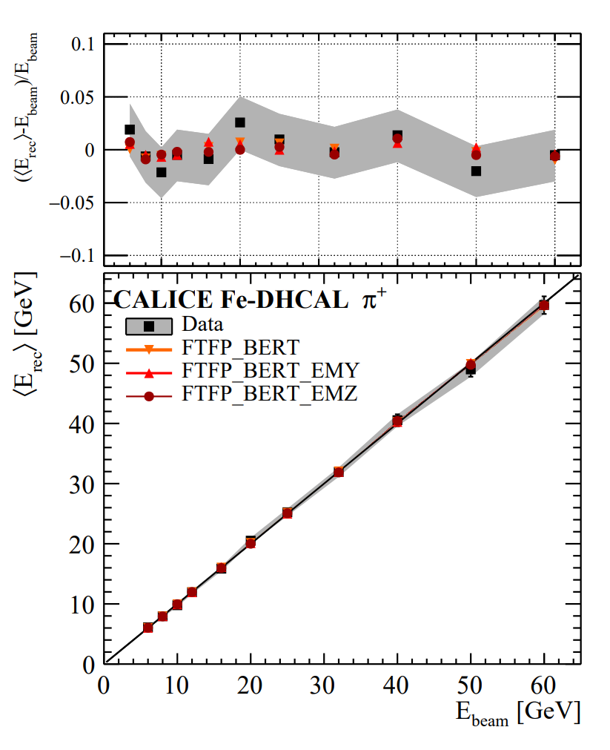
$π^{+}$beam

Slide 11
RPCs for cosmic ray showers detection
Extensive air showers generated by the primary cosmic rays can be studied with ground based detectors giving relevant information about cosmic radiation
The energy of the primary cosmic ray is estimated by the number of detected hits
Full coverage detectors allow to study the shower core, containing most of the shower particles, with an unprecedented detail
The usual digital read out can be completely saturated by the core hits density
The analog read out shows a much wider dynamic range extending up to ${2 10}^{4} hits/ m^{2}$

Slide 12
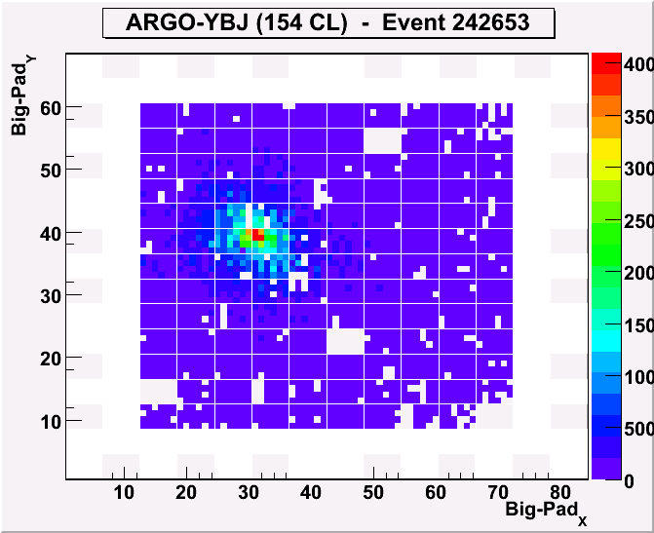
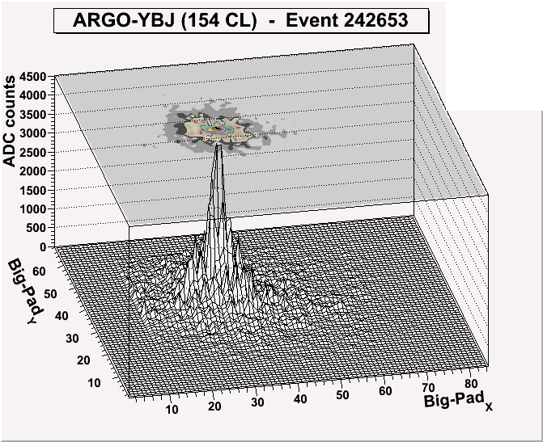
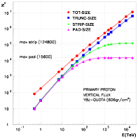
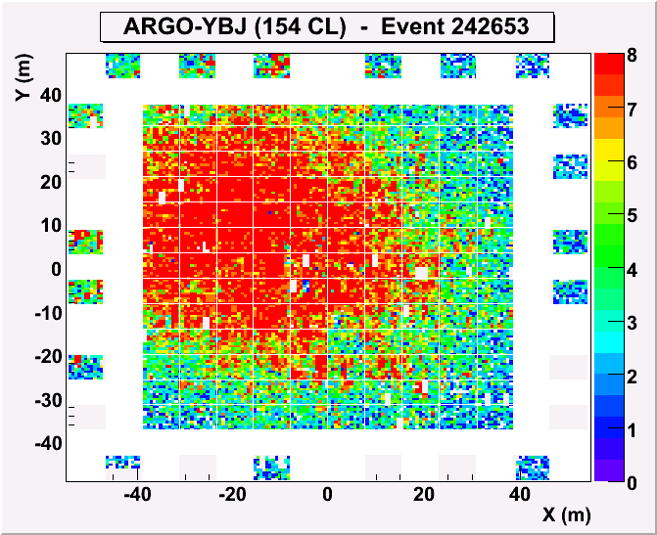
The RPC analog readout
Extending the dynamical range up to PeV
Is crucial to extend the covered energy range above 100 TeV, where the strip read-out saturates
Max digital density ~20/m² Max analog dens ~10⁴/m²
Access the LDF in the shower core
Sensitivity to primary mass
Info/checks on Hadronic Interactions
0
4000
3500
3000
2500
2000
ARGO event
1500
0
4000
0
1000
3500
3000
500
2500
d
Fs: 4000 -> 1300/m²

Slide 13
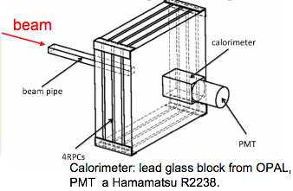
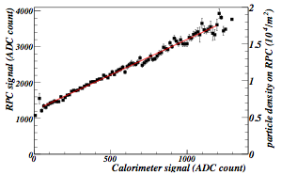
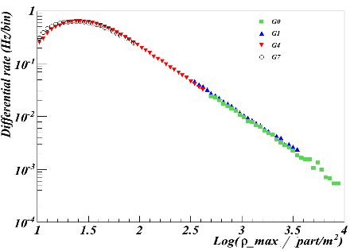
Intrinsic linearity: test at the BTF facility
Linearity of the RPC @ BTF in INFN Frascati Lab:
electrons (or positrons)
E = 25-750 MeV (0.5% resolution)
<N>=1÷10⁸particles/pulse
10 ns pulses, 1-49 Hz
beam spot uniform on 3⨉5 cm
4 RPCs 60 x 60 cm²
The RPC signal vs the calorimeter signal
Good overlap between 4 scales with the maximum density of the showers spanning over three decades
Astrop. Phys. 67 (2015) 47
➔ Linearity up to ≈ 2・10⁴ particle/m²

Slide 14
Calorimetric approach to the study of cosmic ray showers
This suggests that a multilayer RPC detector with interleaved 1 X₀ Lead plates would be a calorimeter much more efficient than usual detectors
Typical size: 2-3 layers of ${2 10}^{4} m^{2}$ !
An ideal detector of low energy gamma ray showers
If located at 5000 m asl it could reduce the gamma ray energy threshold down to 100 GeV or less
Energy calibration with the moon shadow method

Slide 15
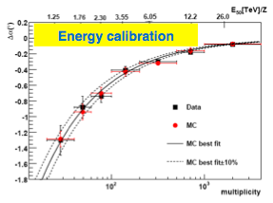
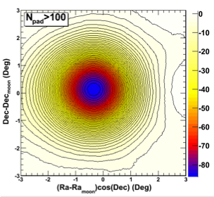
Energy scale calibration
N ≈ 21 · (ETeV/Z)^{1.5}
10% uncertainty estimated in the energy range
1 – 30 (TeV/Z).

Slide 16
RPCs with semiconducting electrodes
The idea of using electronic semiconductors as RPC electrodes is mainly motivated by their lower resistivity which allows to increase the RPC rate capability
Small size RPCs with Silicon and GaAs electrodes have been successfully tested [A. Rocchi et al 2019 JINST 14 C12005]
Their potential rate capability could be $MHz/ cm^{2}$
RPC with semiconductor electrodes in addition to give an opportunity to extend the RPC range of applications, can offer an unmprecedented opportunity of studying the gas-to-solid interface

Slide 17
RPCs as investigation instruments outside of particle detection outside of particle detection
Our community of detector creators should take this opportunity, not only to get a deeper understanding of the RPC detector physics but also to have some discovery chance in a relatively unknown field like that of the solid-to-gas interface under an extremely high electric field
This reinforces the idea that RPCs are not only a detector for particle and astroparticle physics. They are themselves an ideal discovery instrument to explore new physics sectors

