Slide 1

MRPC technology used in muon tomography
X.L Chen
xiaolongc126@126.com

Slide 2
Contents
Background
Position resolution MRPC
MRPC for TUMUTY system
Large sensitive area MRPC development
SMRPC development
Position resolution MRPC simulation and Machine learning for data processing
Summary
Notes:
7 points

Slide 3
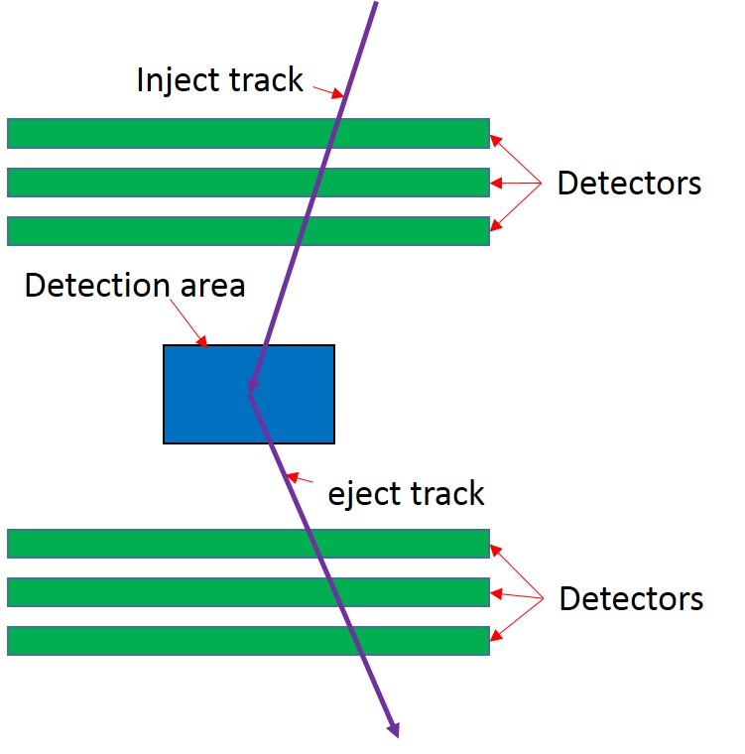
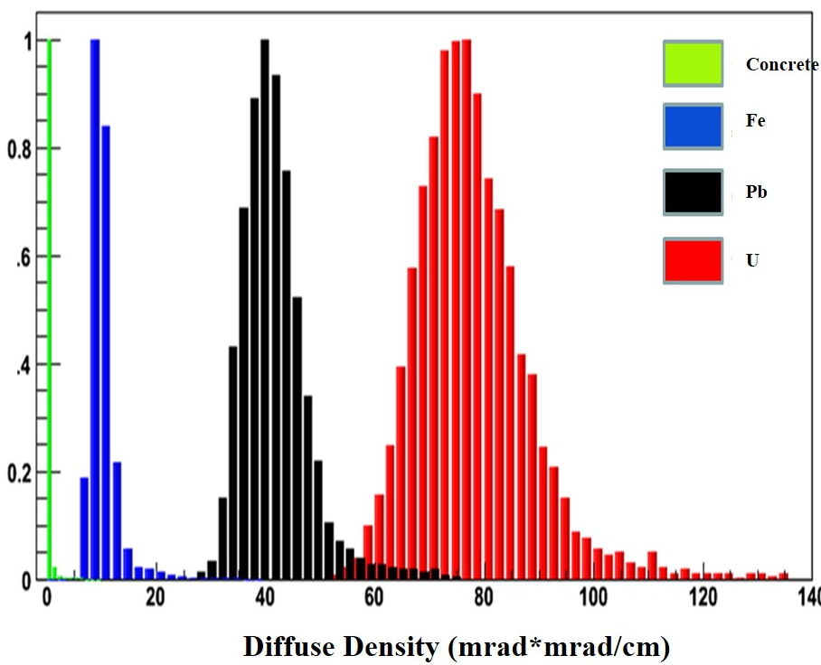
What’s muon tomography
When muon past through H-Z object, big diffuse angle
Through track detector get inject and eject tract
Get the diffuse angle and scatter point, reconstruction detection area information
The key point is track detector

Slide 4
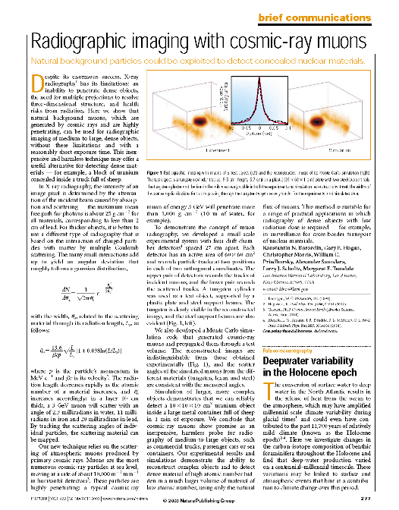
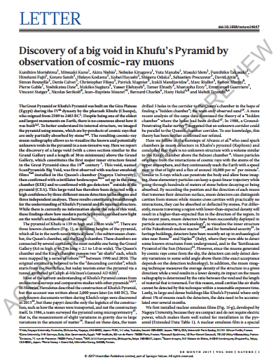

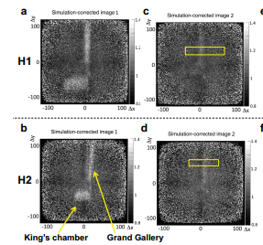
Muon tomography system in the word
 | Institution | Detector
USA | LANL | Drift tube
 | FIT | GEM
Russia | IHEP | Drift tube
Italy | INFN | Drift chamber
Canada | AECL(CRIPT) | Scintillator and Drift chamber
UK | AWE | RPC
Different system and track detector
LANL and Khufu's Pyramid muon tomography system
K. N. BOROZDIN, et al., “Radiographic Imagingwith Cosmic Ray Muons,” Nature, 422, 277 (2003).
Morishima K, Kuno M, Nishio A, et al. Discovery of a big void in Khufu's Pyramid by observation of cosmic-ray muons[J]. Nature, 2017.

Slide 5
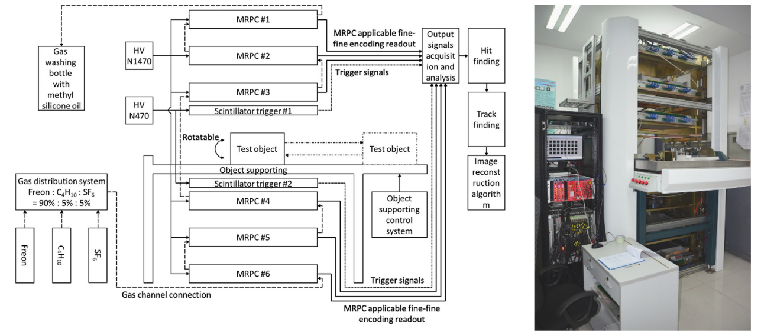
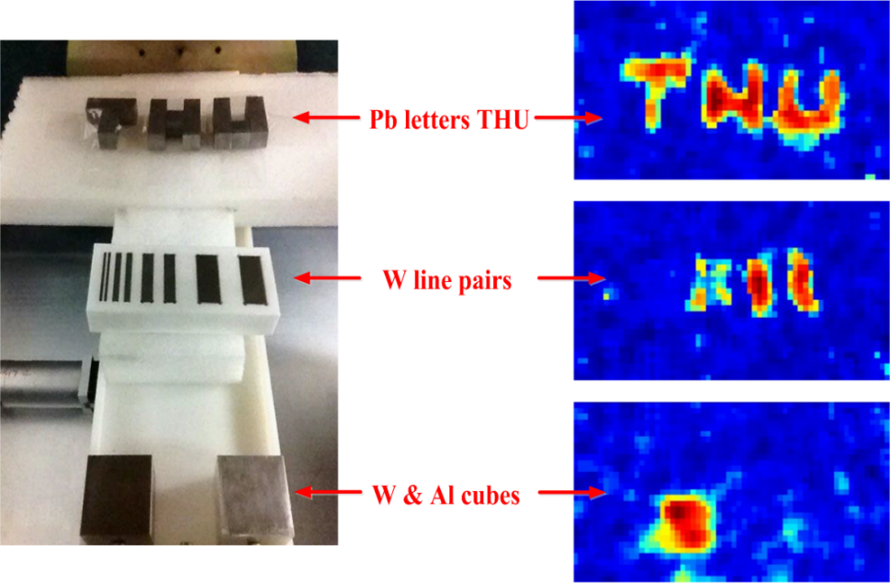
Tsinghua university TUMUTY
The “TUMUTY” system and imaging results
Height: 3 m
6 groups of detectors
Each group includes 2 MRPCs, can realize the 2D readout.
Detector area: 720mm×720mm
2cm lead get imaging result “THU”
the 10 mm line pairs can be distinguished
the tungsten cube can be identified while the aluminum cube is invisible due to its small density

Slide 6
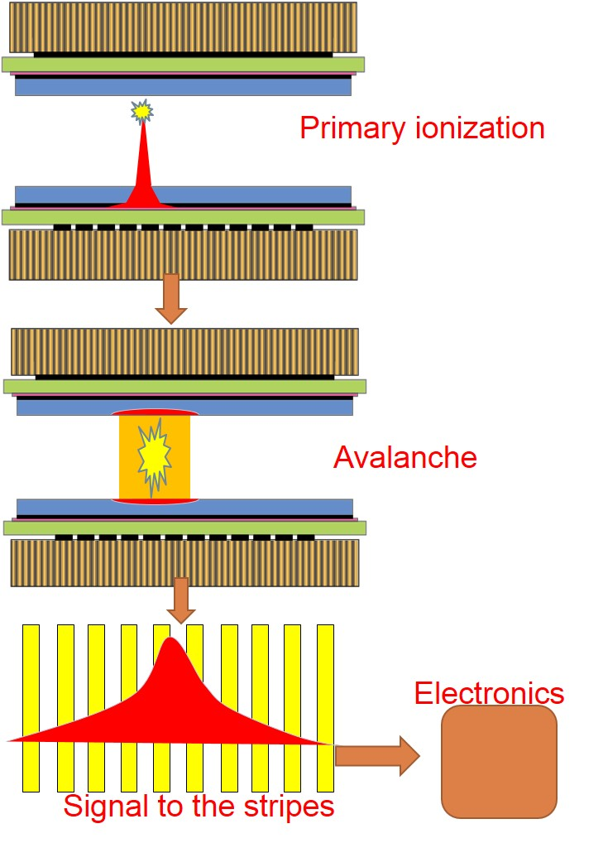
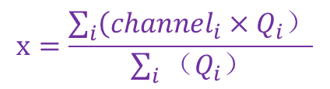
Position resolution MRPC
Time | Scientist | Type | Size | Gap | Strip width | Result
2003 | T. Francke | RPC | 5cm×5cm 10cm×10cm | 0.1-4mm | 30μm-50μm | 50μm
2012 | A. Blanco | MRPC | 8cm×8cm | 0.35mm×5 +0.8mm×2 | 4mm | 70μm
2012 | M. Petris | MRPC | 46cm×180cm | 0.14mm×14 | 2.54mm | ~500μm
2012 | P. Baess | RPC | 58cm×58cm | 2mm | 1.5mm | 800μm
2013 | Li Qite | RPC | 20cm×20cm | 2mm | 2.54mm | 900μm
Position resolution RPC-type detector development history
$$x=\frac{\sum_{i}{\left({channel}_{i}×Q_{i}）\right.}}{\sum_{i}{（Q_{i}）}}$$
RPC-type detector can develop for position resolution
Can reach position resolution under mm level
Low cost, high efficiency, easy production, large sensitive area
RPC-type detector for position resolution
Notes:
work process；The position of the inject muon；Charge center of gravity

Slide 7
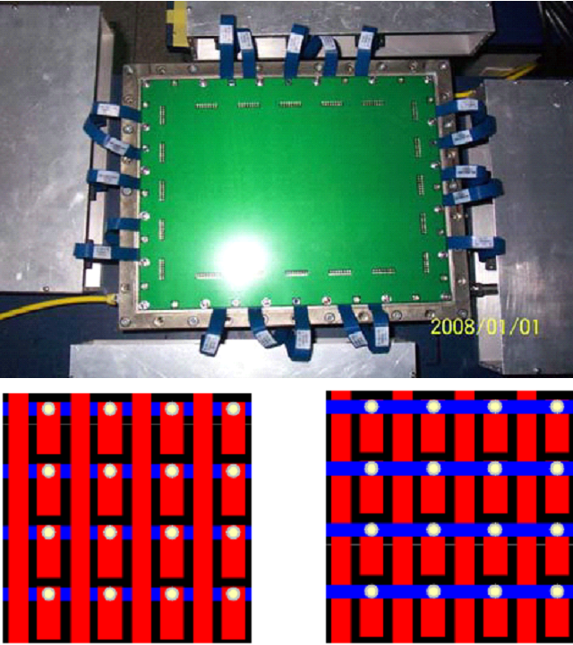
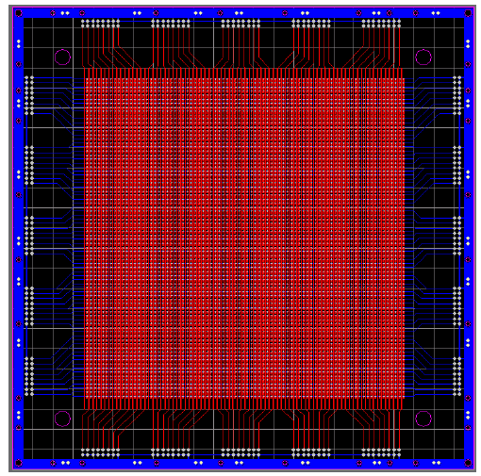
MRPC for tomography
Ye Jin MRPC and PCB board design
One PCB board for X-Y readout, strip for X , block for Y, center distance 2mm
Size:50cm*50cm,5 gaps, gap size:0.33mm, Position resolution reach 500 μm
Study about influence carbon film resistivity to MRPC signal
PCB design is complex and hardly reach more larger sensitive area
Notes:
Micron：微米

Slide 8
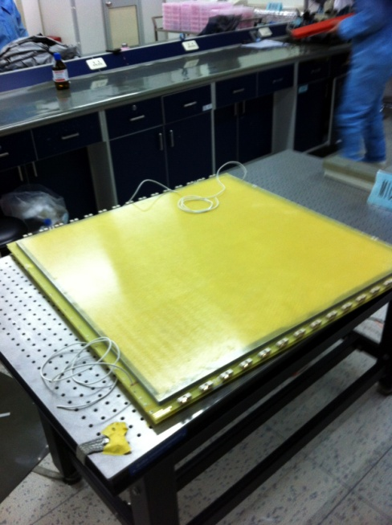
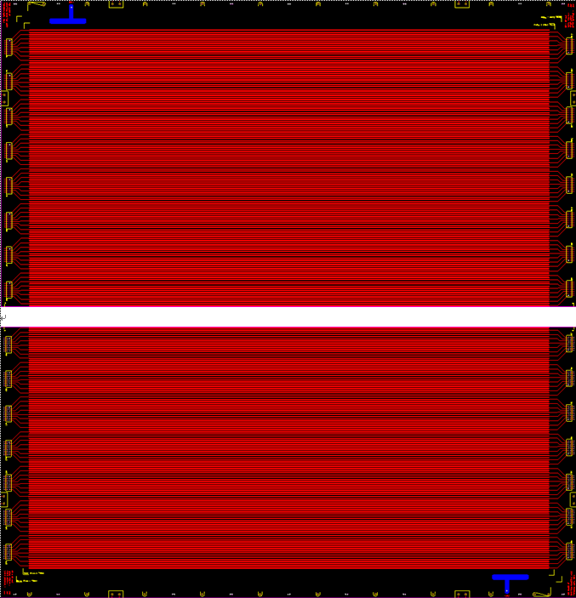
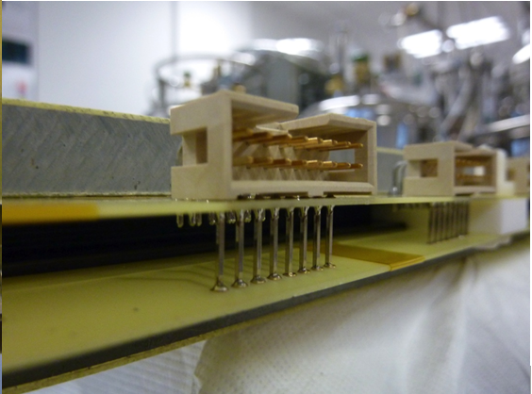
Large sensitive area position resolution MRPC
TUMUTY MRPC and readout PCB
Single MRPC 1 dimension readout, 1 set two MRPCs for X-Y readout
Size 800mm*800mm, sensitive area 720mm*720mm
6 gaps, gap size 0.25mm,strip pitch:2mm+1mm
Readout electrode consists of two PCB boards

Slide 9
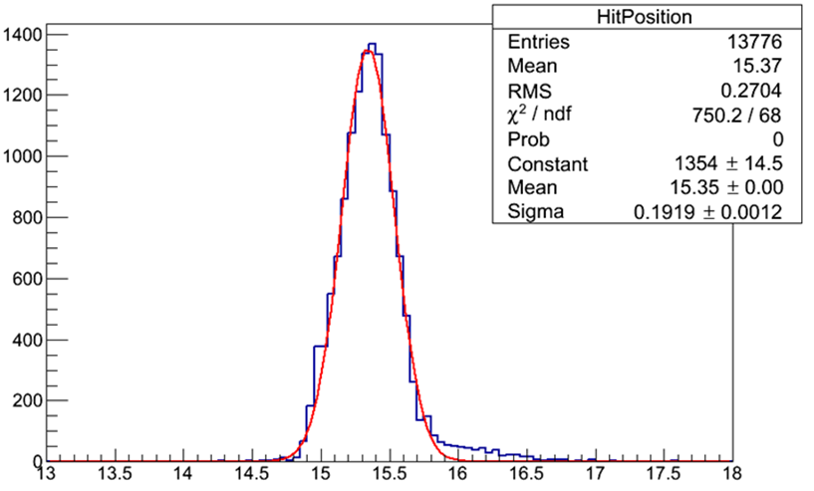
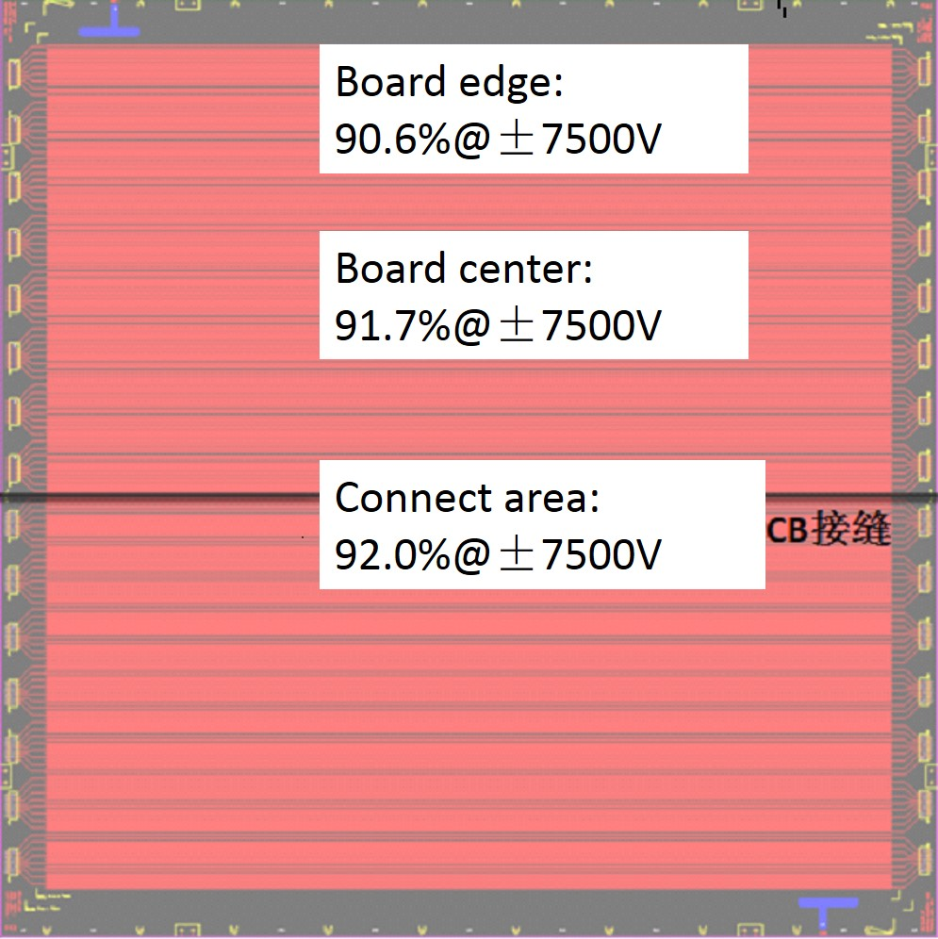
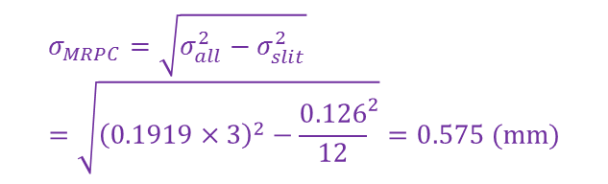
Study on TUMUTY MRPC
$$σ_{MRPC}=\sqrt{σ_{all}^{2}−σ_{slit}^{2}}=\sqrt{{\left(0.1919×3\right)}^{2}−{\frac{0.126}{12}}^{2}}=0.575 (mm)$$
Position resolution reach 575μm@±7900V
Two PCB connect area have good efficiency
Big sensitive area have detection uniformity
Notes:
Differential voltage：差分电压

Slide 10
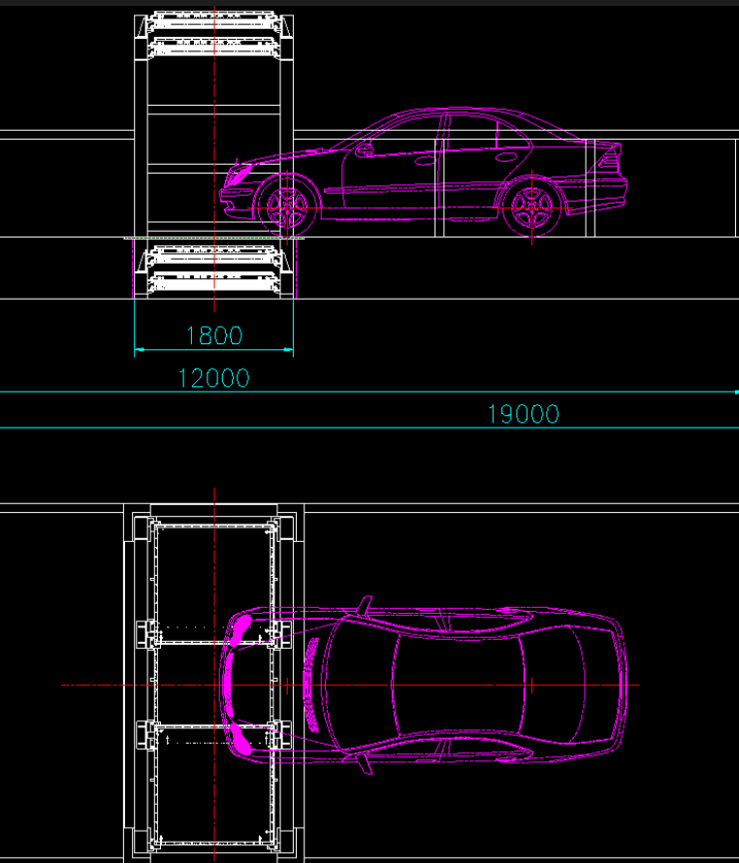
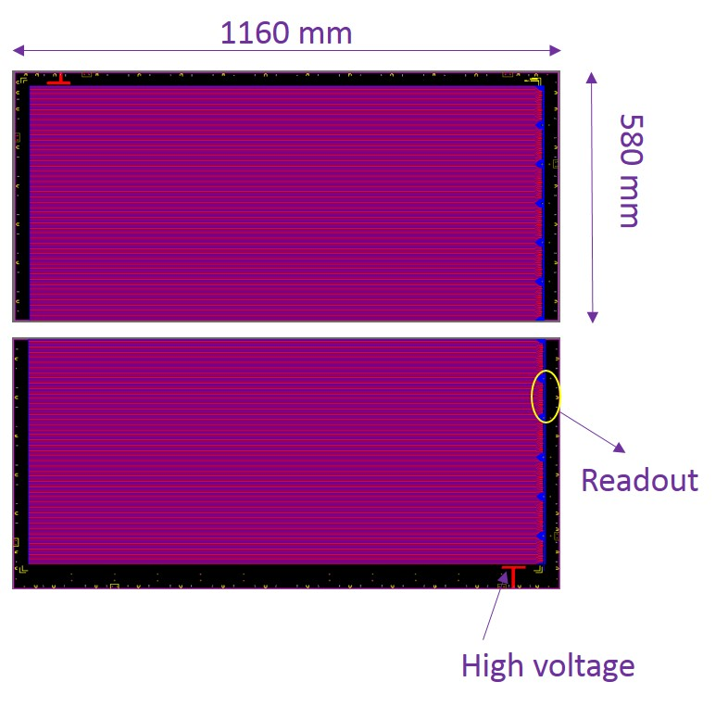
Second generation MRPC for car detection
Readout PCB for new MRPC
Car detection for industrial application
Project has four layers, each layer sensitive area reach 1m*3m
Need: larger sensitive area and smart structure to MRPC
Work stably at difference temperature
Also two board in one readout electrode

Slide 11
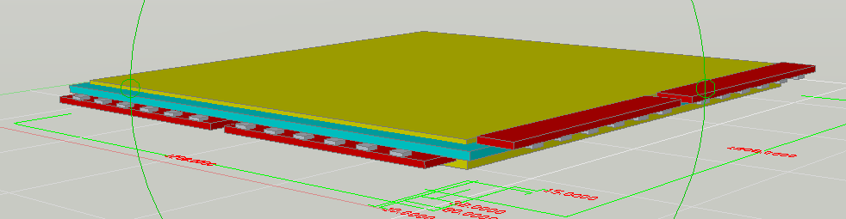
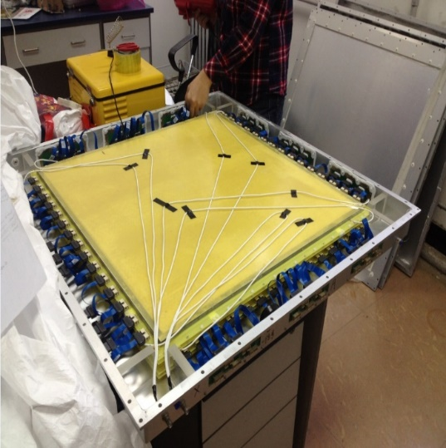
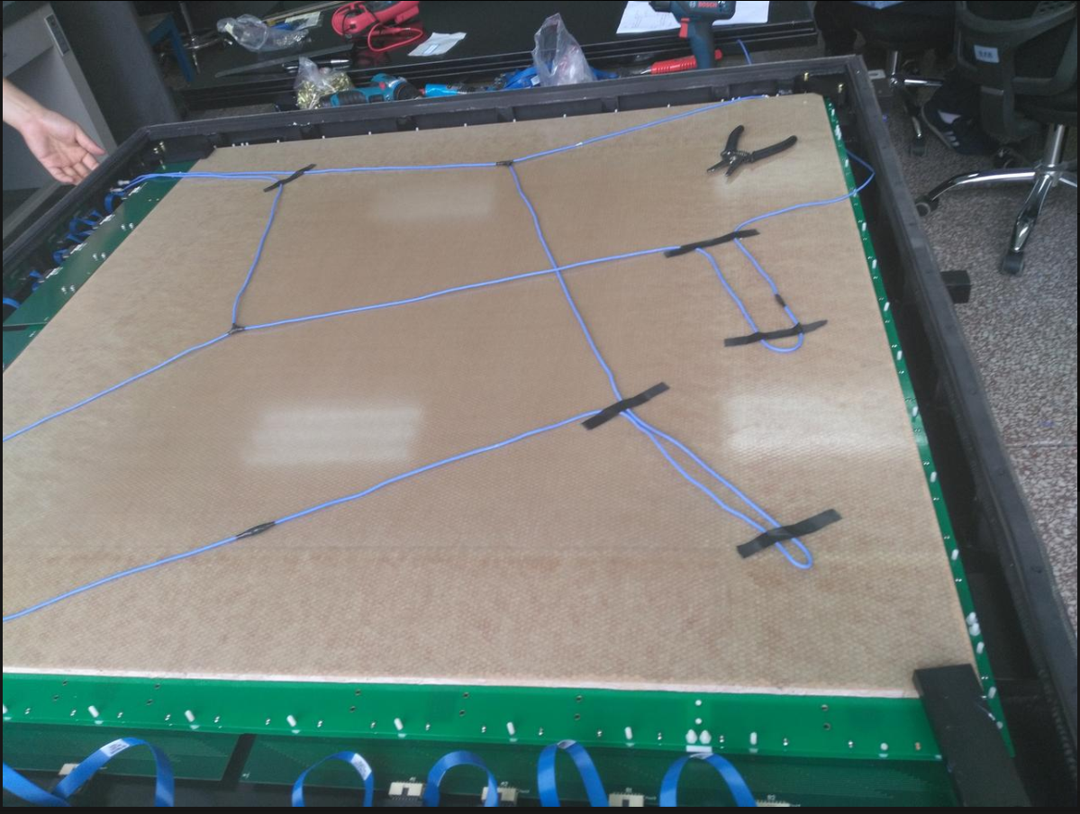
TUMUTY MRPC and Car detection project MRPC
 | TUMUTY MRPC | New MRPC
Pats of MRPC | Size（mm）
PCB | 800*800 | 1160*1160
Sensitive area | 720*720 | 1072*1072
Mylar | 750*750 | 1110*1110
Honeycomb panels | 750*750 | 1100*1100
Inner glass | 736*736 | 1100*1100
Outer glass | 756*756 | 1100*1100
Carbon film | 740*740 | 1092*1092
Read out strip | 2 | 1.44
Gap | 1 | 1.1
Gas gap | 0.25 | 0.25
TUMUTY MRPC and new MRPC
Large sensitive area reach 1 m²
Single MRPC for X-Y two dimension readout
Take encoding readout device in the box for stably data transmission

Slide 12
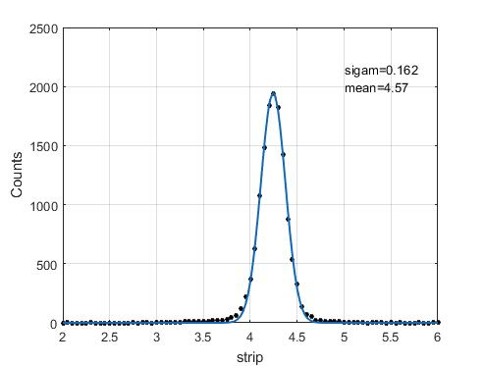
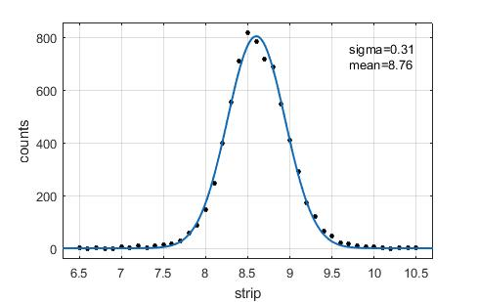
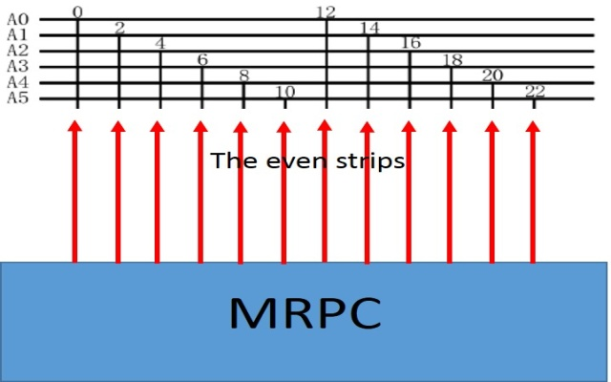
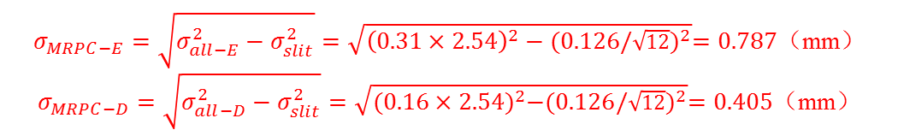
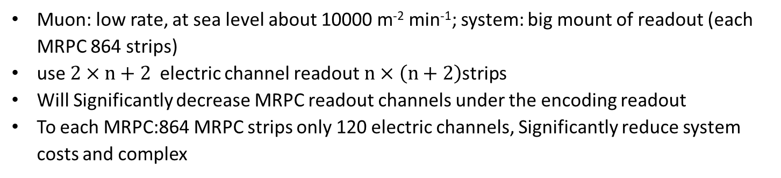
Encoding readout to MRPC
Directly readout(left) and encoding readout(right)
$σ_{MRPC−E}=\sqrt{σ_{all−E}^{2}−σ_{slit}^{2}}=\sqrt{{\left(0.31×2.54\right)}^{2}−{(0.126/\sqrt{12})}^{2}}=0.787$（mm）
$σ_{MRPC−D}=\sqrt{σ_{all−D}^{2}−σ_{slit}^{2}}=\sqrt{{(0.16×2.54)}^{2}−{(0.126/\sqrt{12})}^{2}}=0.405$（mm）
Muon: low rate, at sea level about 10000 m⁻² min⁻¹; system: big mount of readout (each MRPC 864 strips)
use $2×n+2$electric channel readout$n×\left(n+2\right)$strips
Will Significantly decrease MRPC readout channels under the encoding readout
To each MRPC:864 MRPC strips only 120 electric channels, Significantly reduce system costs and complex

Slide 13
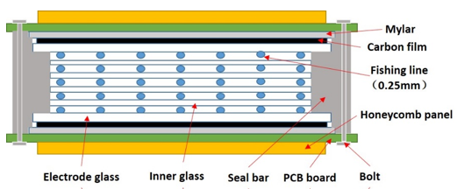
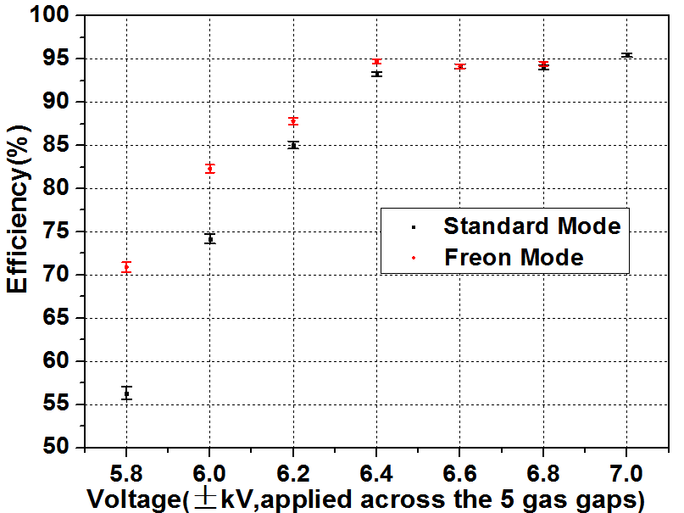
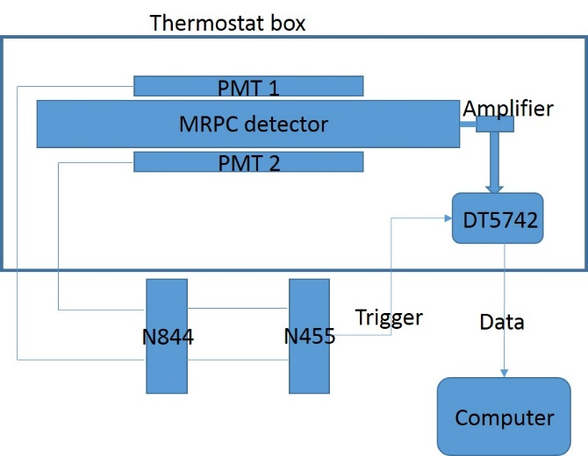
Temperature study about MRPC
Important set right working point at different temperature for muon tomography system
Prototype: 5 gaps, 0.25mm gap width
Through thermostat precise control MRPC working temperature.
Learn MRPC performance under two gas mode at different temperature from
-15℃ to 25 ℃
Notes:
thermostat

Slide 14
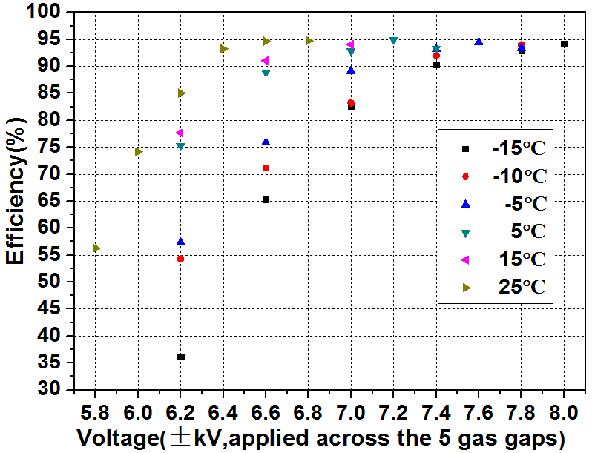
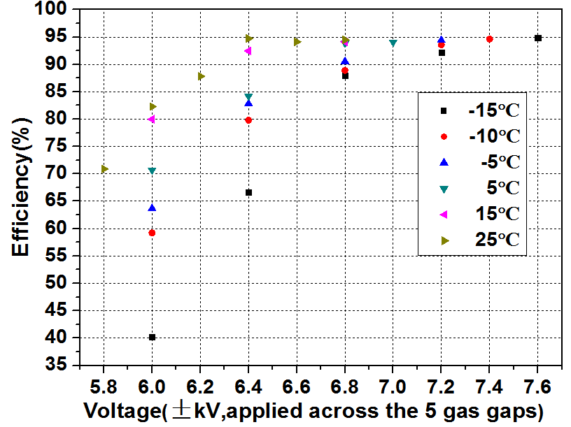
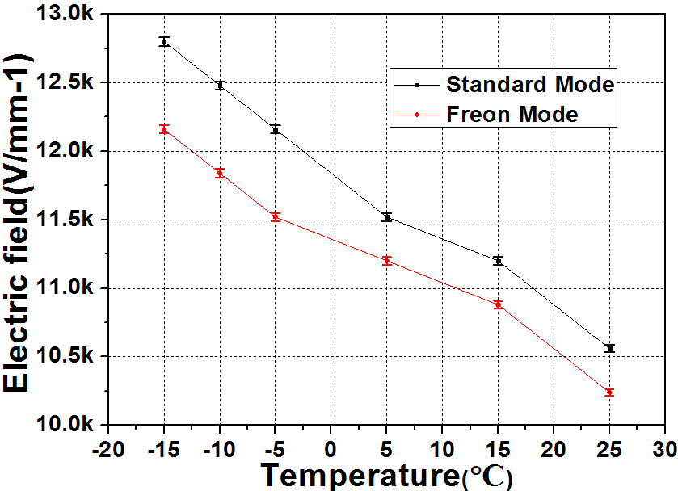
MRPC at different temperature
Efficiency at different temperature(left: standard gas; right: Freon gas)
Low temperature make efficiency curve right shift
Freon gas mode has lower working voltage than standard gas mode
About 320V/mm electric field change for 5℃ temperature change based on 25 ℃

Slide 15
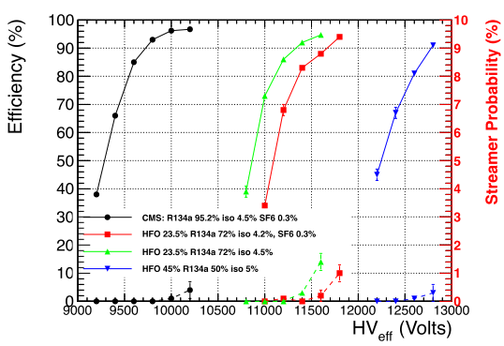
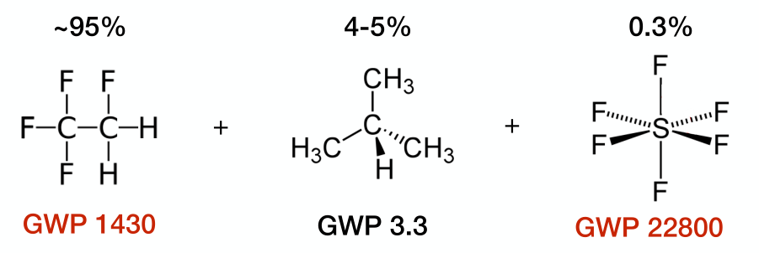
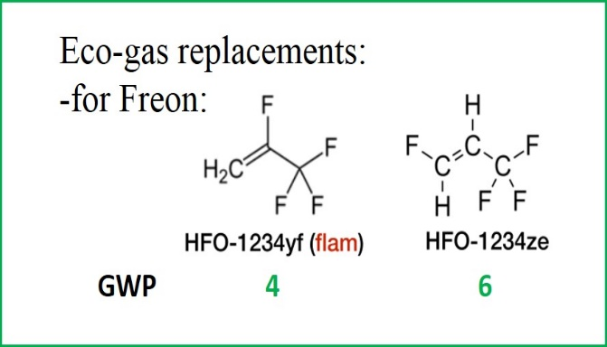
SMRPC(sealed MRPC) development
Motivation:
European Union “F-gas regulation”: Limiting the total amount of F-gases that can be sold in the EU; Banning the use of F-gases in many new types of equipment; Preventing emissions of F-gases from existing equipment
High working point
High cost, 5-7 times cost than Freon
Eco-gas still on study
Notes:
Many research institutions

Slide 16
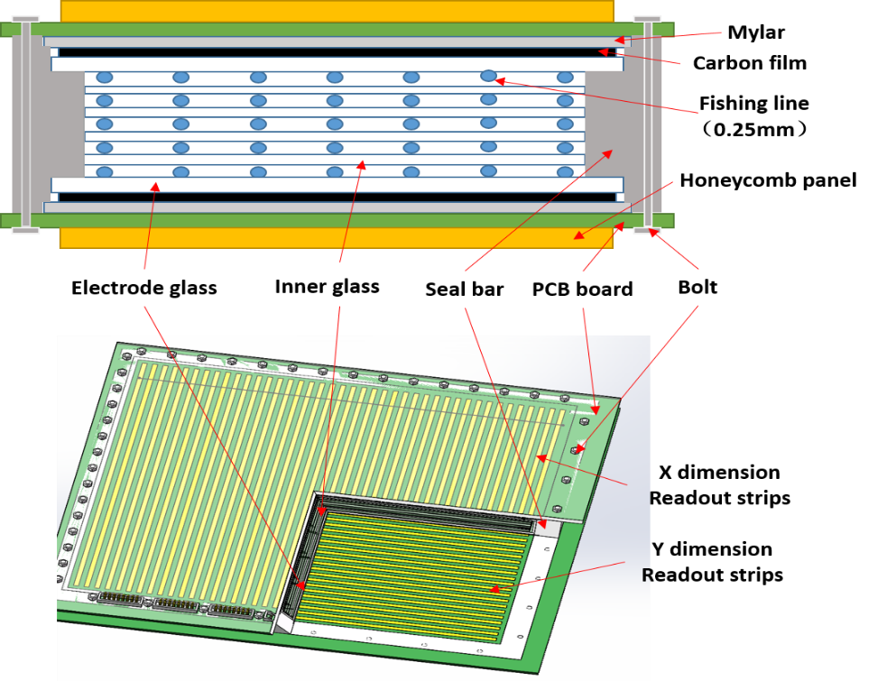
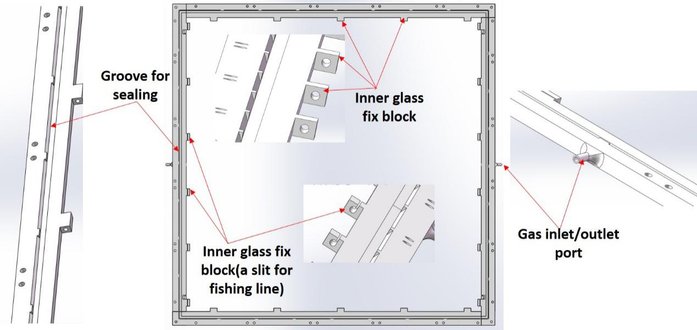
SMRPC design
Through low inlet gas flow to reduce the F-gas pollution
Low rate muon at sea level, low avalanche pollution for the detector gas
Through design reduce MRPC self component outgas pollution the MRPC working gas
Seal bar and outside glass make space for MRPC working
Made by 3D printer
5 gaps, gap thickness 0.25mm,sensitive area 420mm*420mm

Slide 17
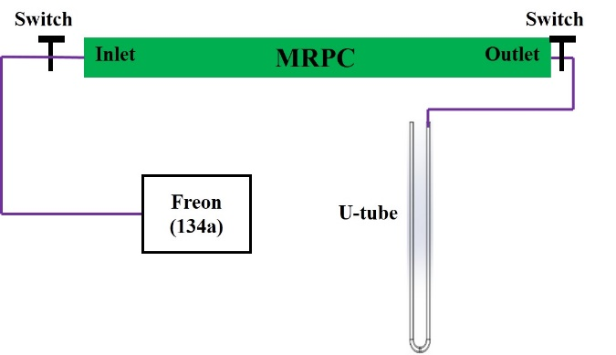
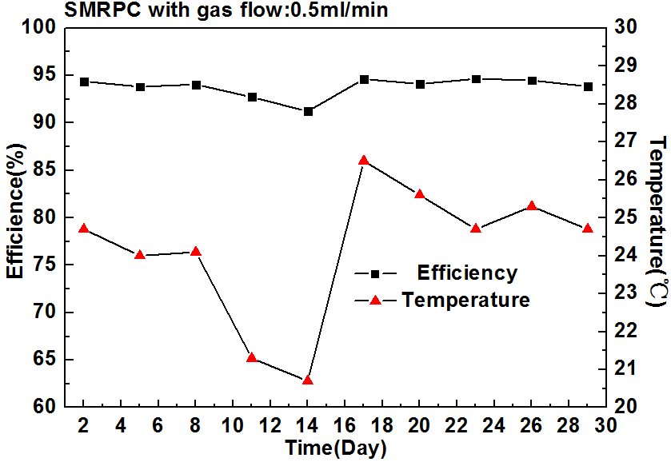
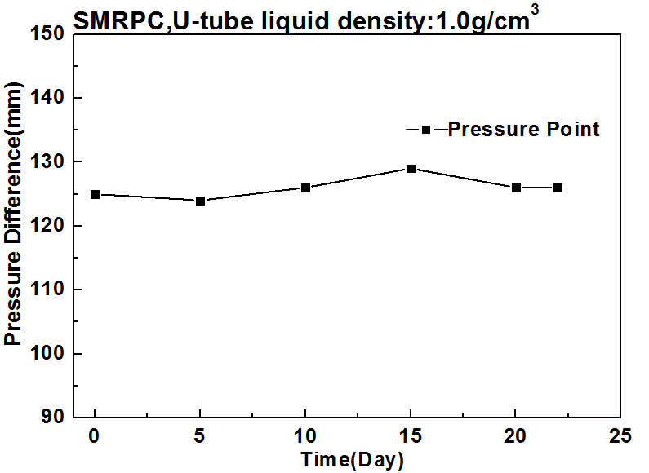
Tightness and extremely gas flow performance
Show good tightness in about 22days test
Test at Freon gas mode
Working stably at working point(±6400V) at gas flow 0.5ml/min for more than one month
Efficiency around 95%

Slide 18
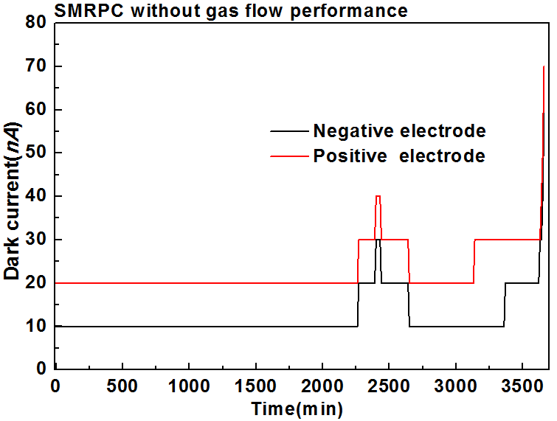
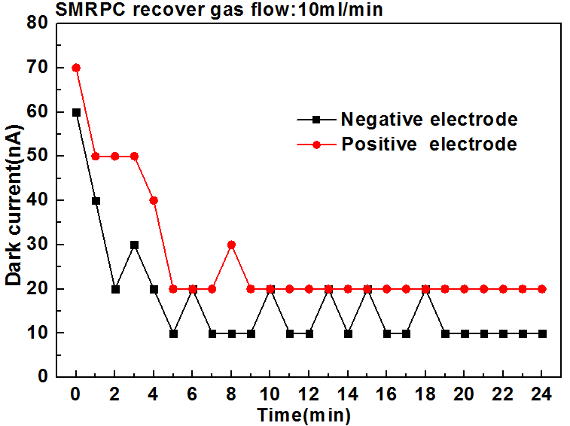
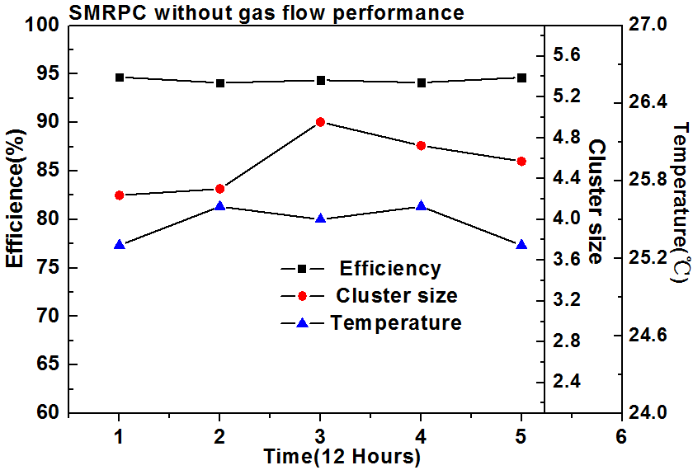
No gas exchange
No gas exchange can work more than 60 hours
Efficiency around 95%
Re-inject gas total volume equal capacity of detector chamber (220ml),detector works can recover
In the no gas exchange mode, Equivalent to average gas flow reduce 0.05ml/min

Slide 19
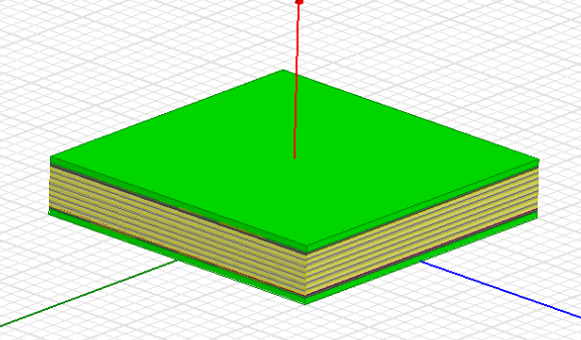
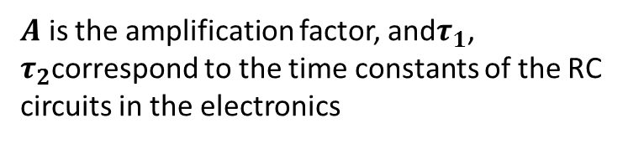
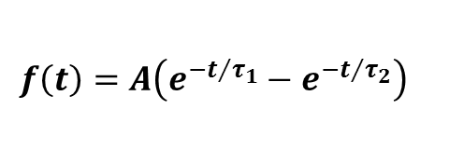
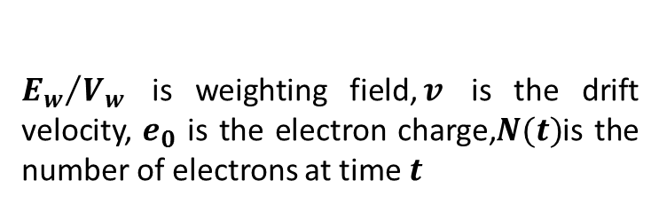

Position resolution MRPC for future
The frame of MRPC simulation
the particle source, type, position and angle of the incident particles
particles impinging on the detector and the primary interactions
the drifting and the signal induction in the MRPC
the electronics response to the induced current signal
The first and second process by GEANT4
Front- end electronics response:
$$f\left(t\right)=A\left(e^{{−t}/{τ_{1}}}−e^{{−t}/{τ_{2}}}\right)$$
$A$ is the amplification factor, and$τ_{1}$, $τ_{2}$correspond to the time constants of the RC circuits in the electronics
The current signal induced on an electrode by Shockley-Ramo:
$$i\left(t\right)=\frac{E_{w}∙v}{V_{w}}e_{0}N(t)$$
${E_{w}}/{V_{w}}$ is weighting field,$v$ is the drift velocity, $e_{0}$ is the electron charge,$N(t)$is the number of electrons at time$t$
The realistic configuration of a six-gap MRPC modeled with ANSYS Maxwell
Get weighting field in the MRPC
Notes:
impinging

Slide 20
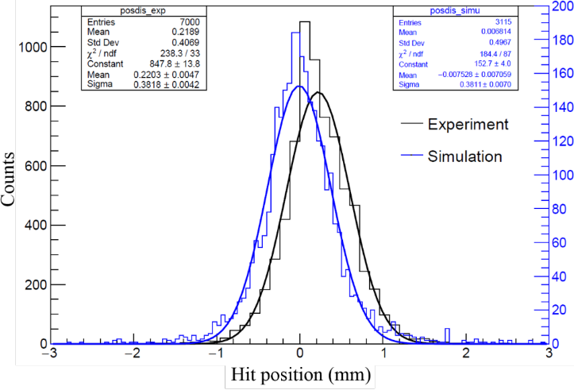
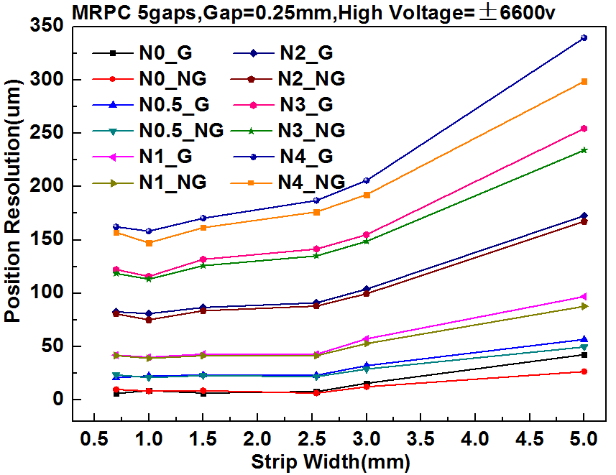
Position resolution simulation
The position resolution of MRPC. The blue lines simulation,black lines are experiment
MRPC position resolution to Strip width under different noise
Simulation and experiment result fit very well
MRPC mode with 5 gaps and gap width 0.25mm with difference strip width at different noise was simulated
Nosie have a great affect to MRPC position resolution, strip width 1mm can get better position resolution
Other influence of the position resolution to MRPC can also study by this simulation frame, such as gap width, copper width in the strip

Slide 21


Machine learning to position resolution MRPC
New analysis method —— introducing neural network to reconstruct the inject muon position.
Simulation data used for training, experiment data for testing.
Position resolution can be much improved! 416μm position resolution for old method, and 301μm for neural network .
More details see talk of Yancheng Yu: A neural network based algorithm for MRPC position reconstruction

Slide 22
Summary
MRPC is cheap, robust structure, high position resolution, easy large sensitive produce, make it very suitable for muon tomography.
The MRPC for muon tomography developed for three stages in our study. Large sensitive area to more large sensitive area, and environment friendly low cost.
Many key technology study for MRPC to muon tomography application
Position resolution MRPC simulation by ANSYS Maxwell+GEANT4 was built for the our future MRPC design.
New analysis method—neural network was introduced to reconstruct the inject particle position in our study.
THANKS FOR YOU LISTENING
Notes:
Make you confused

