Slide 1
Iniziative Software
Workshop organized within the
EIC Software Consortium
EIC Software Working group (co-chair)
To discuss the needs of both upgrades for MC Event generators and needs of improved detector simulations
https://indico.desy.de/indico/event/22030/
https://agenda.infn.it/event/17249/

Slide 2

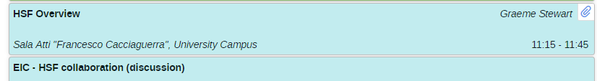
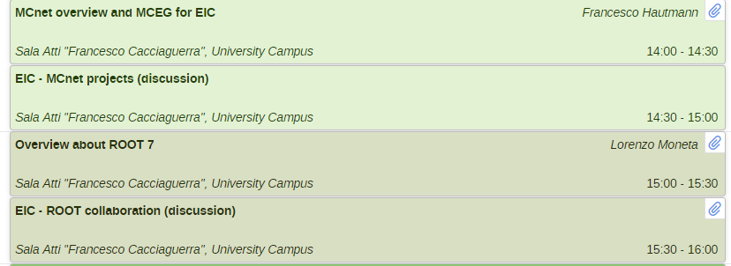
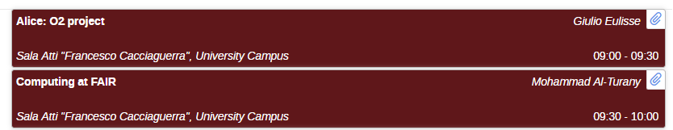

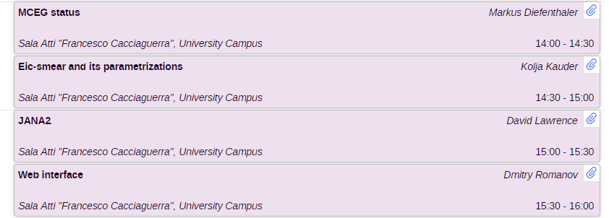
EIC Software Meeting in TS

Slide 3
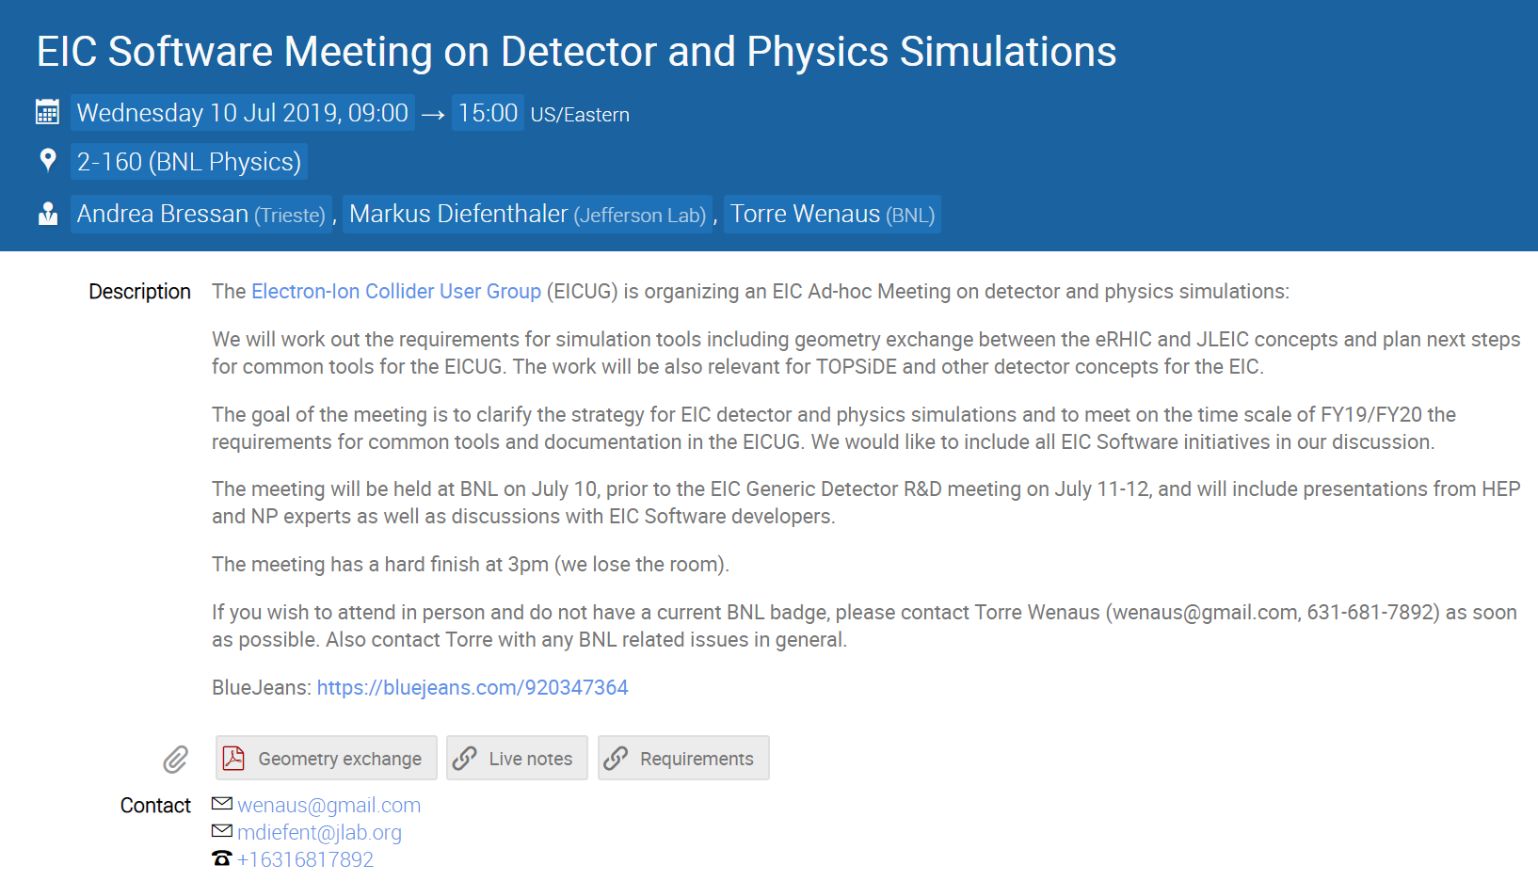
Iniziative Software
https://indico.bnl.gov/event/6336/

Slide 4
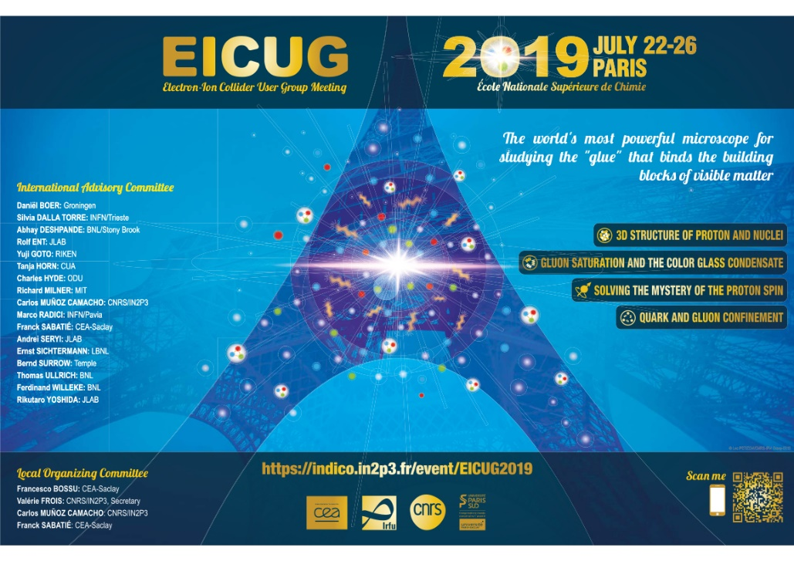
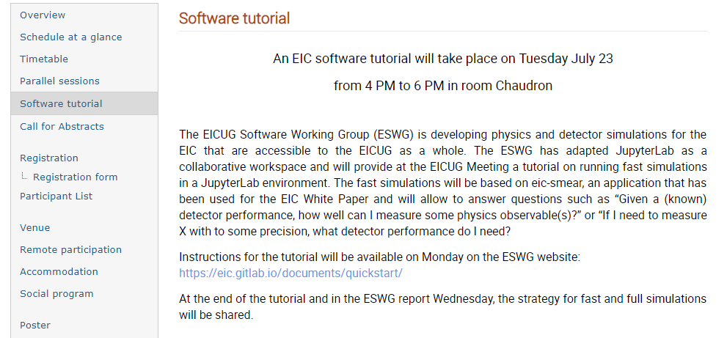
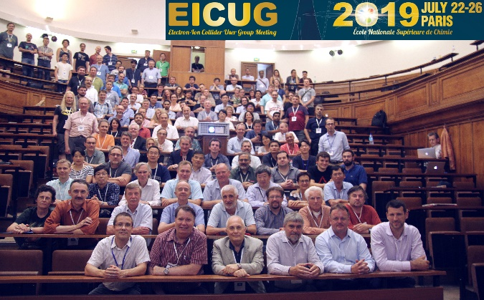
Iniziative Software
https://indico.in2p3.fr/event/18281/

Slide 5
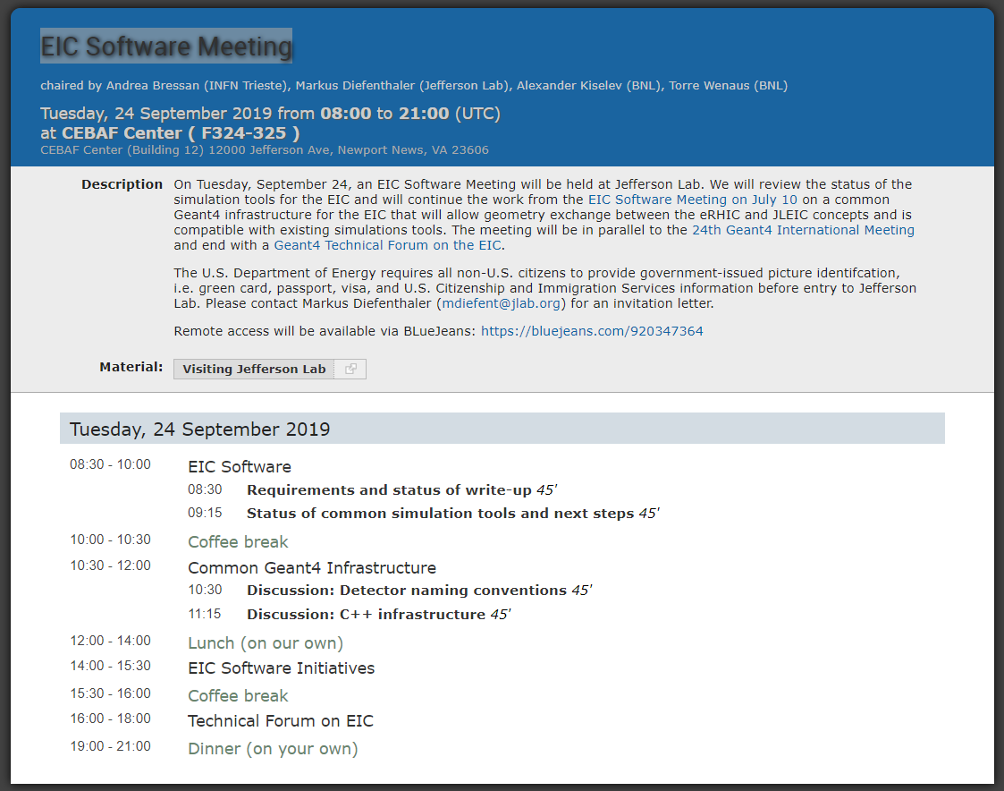

Next steps: JLAB in September
EIC Software Meeting (https://www.jlab.org/indico/event/339/)
https://www.jlab.org/conference/2019/Geant4Collab

Slide 6
Next Steps: Vienna in November
MCEG for future ep and eA facilities
Dates November 5-7 2019
Location Erwin Schrödinger International Institute for Mathematical Physics in (ESI)
Agenda
We would like to focus the discussion on the simulation of eA processes but also follow up on the previous workshop (TMD MCEG, validation of ep simulations with HERA data).

Slide 7
Next Steps: November 20
Wednesday, November 20
14:00 - 15:00 Welcome and status
  Summary of workshop series: Where we are?
    Wish candidate: Markus Diefenthaler (Jefferson Lab)
15:00 - 18:00 eA: MCEG and Theory
  Challenges for MCEG for eA and what is needed from nuclear theory (30+15minutes):
    Wish candidate: Leif Lönnblad (LUND) (Simon)
  Summary from eA theory for light ions, where MCEG could help, and what is needed from MCEG for descriptions of eA processes (30+15minutes):
    Wish candidate: Christian Weiss (Jefferson Lab), alternative Gerald Miller (INT)
  Summary from eA theory for heavy ions, where MCEG could help, and what is needed from MCEG for descriptions of eA processes (30+15minutes):
    Wish candidate: Ivan Vitev (LANL)

Slide 8
Next Steps: November 21
Existing MCEG for eA and pA processes:
  Angantyr
    Wish candidates: Christian Bierlich
  BeAGLE:
    Wish candidate: Tu Zhoudunming
  JETSCAPE:
    Wish candidate: Kolja Kauder
  Simulations for spectator tagging
    Wish candidate: Christian Weiss et al.
  ALICE
    Wish candidates: Roberto Preghenella
  Saturation with MCEG:
    Wish candidates: TBD
  Satre:
    Wish candidate: Tobias Toll or Thomas Ullrich
  Jet substructure
    Wish candidate: Felix Ringer
Nuclear PDFs and nuclear TMDs
  Nuclear PDFs
    Wish candidate: Pia Zurita
  Nuclear TMDs
    Wish candidate: Aleksander Kusina

Slide 9
Next Steps: November 22
Validation of ep processes with HERA data
Update on TMD MCEGs

