Slide 1
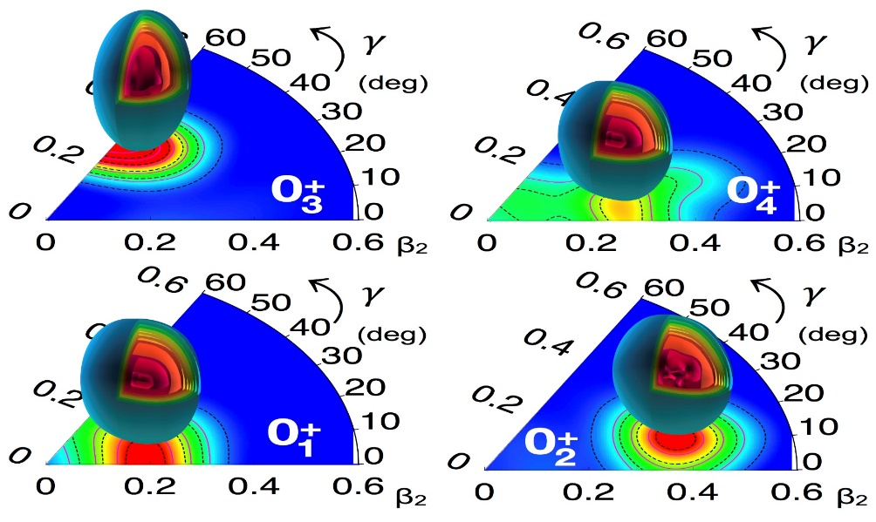
Multiple shape coexistence in the Cd isotopes
Paul Garrett
University of Guelph

Slide 2
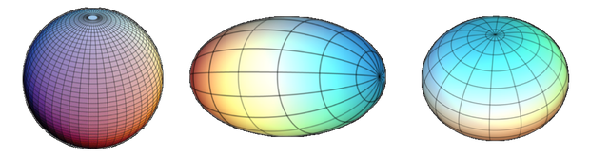
Why are shape coexistence studies interesting?
What do we mean by shape coexistence?
  presence of states in the same nucleus within a narrow energy range of two (or more) states that have well defined and distinct properties that can be interpreted in terms of different intrinsic shapes
The shapes we observe, e.g., spherical, prolate, oblate,
  emerge as a consequence of the nucleon-nucleon interaction manifest in a many-body system
The presence of competing shapes due to effects of correlations, especially pairing and quadrupole-quadrupole correlations amongst nucleons, overcoming cost of energy promoting particles into different orbits – even across major shell gaps
Studies of shape coexistence enables us to study effects of correlation energies on deformation (or vice versa) within a system having the same number of protons and neutrons
Heyde and Wood, RMP 83, 1467 (2011)

Slide 3
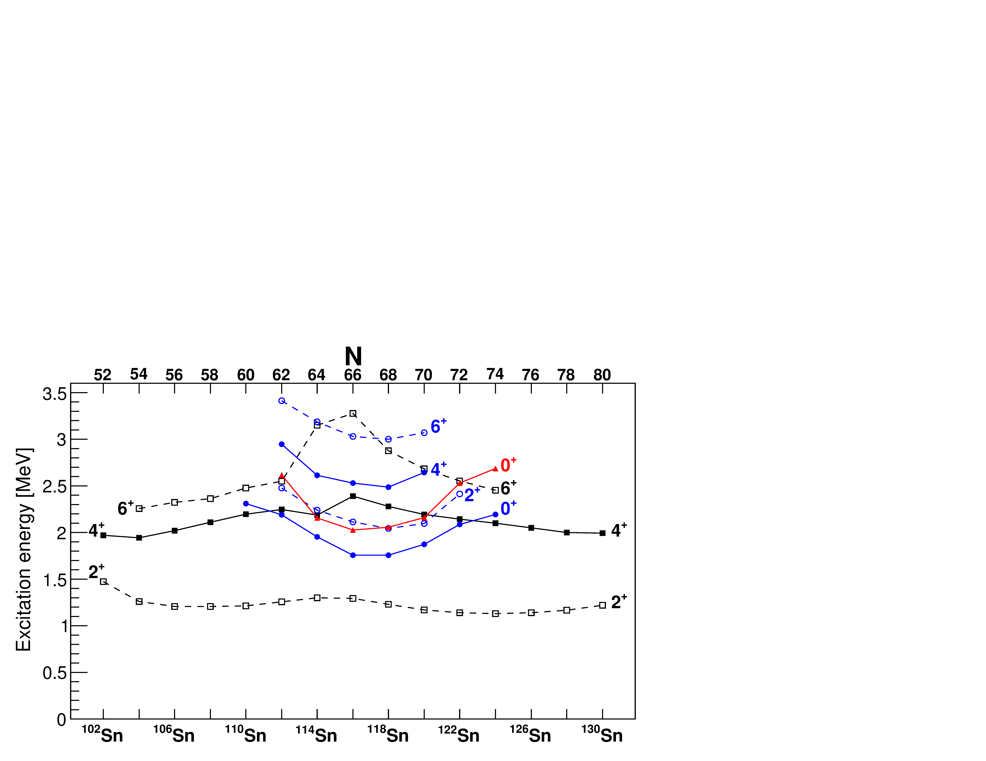
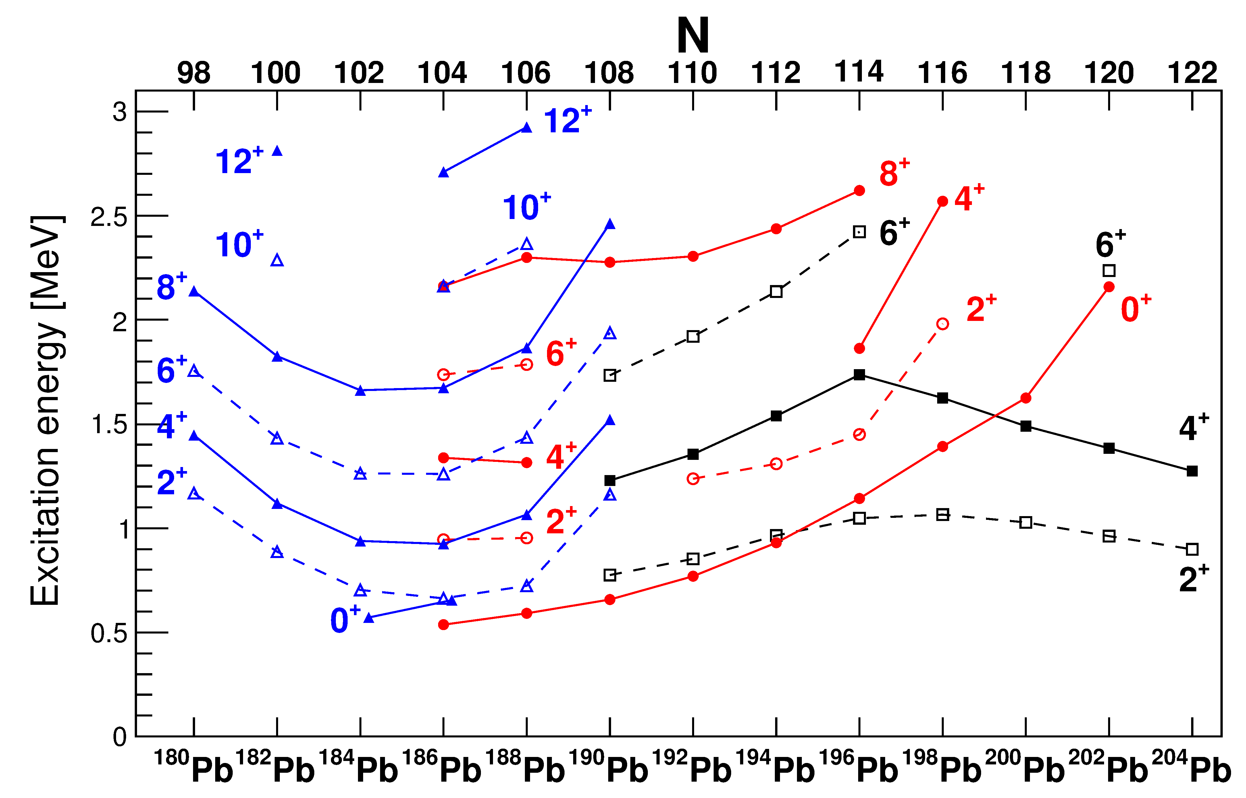
Characteristic pattern of deformed intruder bands at closed shells
Spherical states
Deformed states
neutron midshell
neutron midshell
Garrett, Zielińska, & Clement, PPNP 124, 103931 (2022)

Slide 4
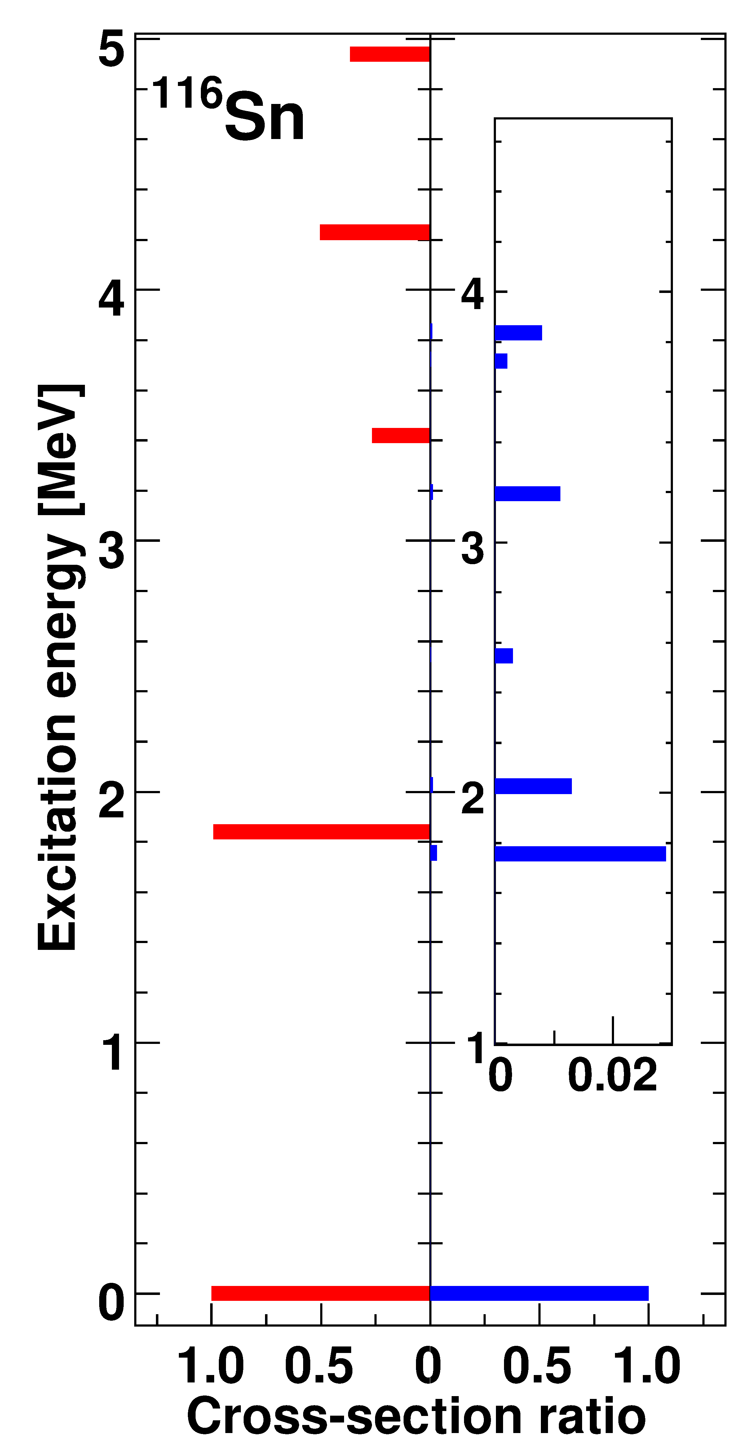
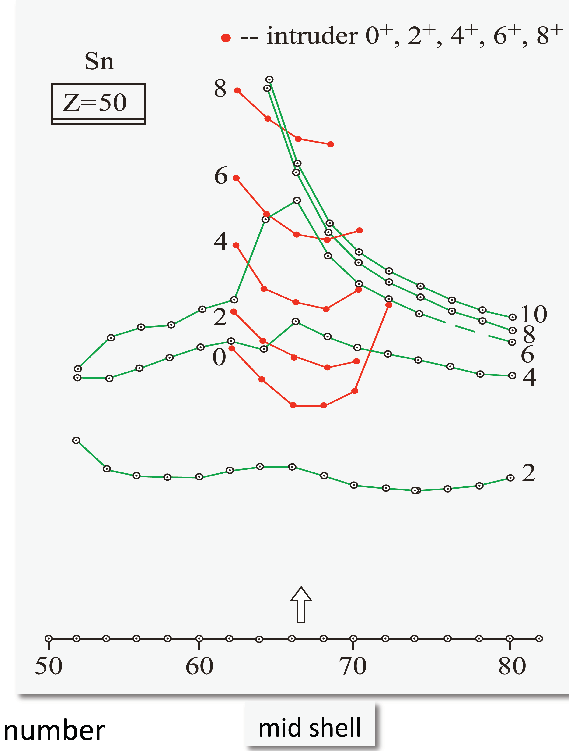
Characteristic pattern of deformed intruder bands at closed shells
In normal or superfluid nuclei, the two-nucleon-transfer should be dominated by ground state-to- ground state transitions – typically >95% of L=0 strength to the ground state
Near Z=50, two-proton transfer strongly populates excited 0⁺ state – reminiscent of proton pairing vibration → 2p-2h excitation across Z=50 closed shell
(³He,n)
(p,t)
Garrett, Zielińska, & Clement, PPNP 124, 103931 (2022)
Fielding et al., Nucl. Phys. A281, 392 (1977)

Slide 5
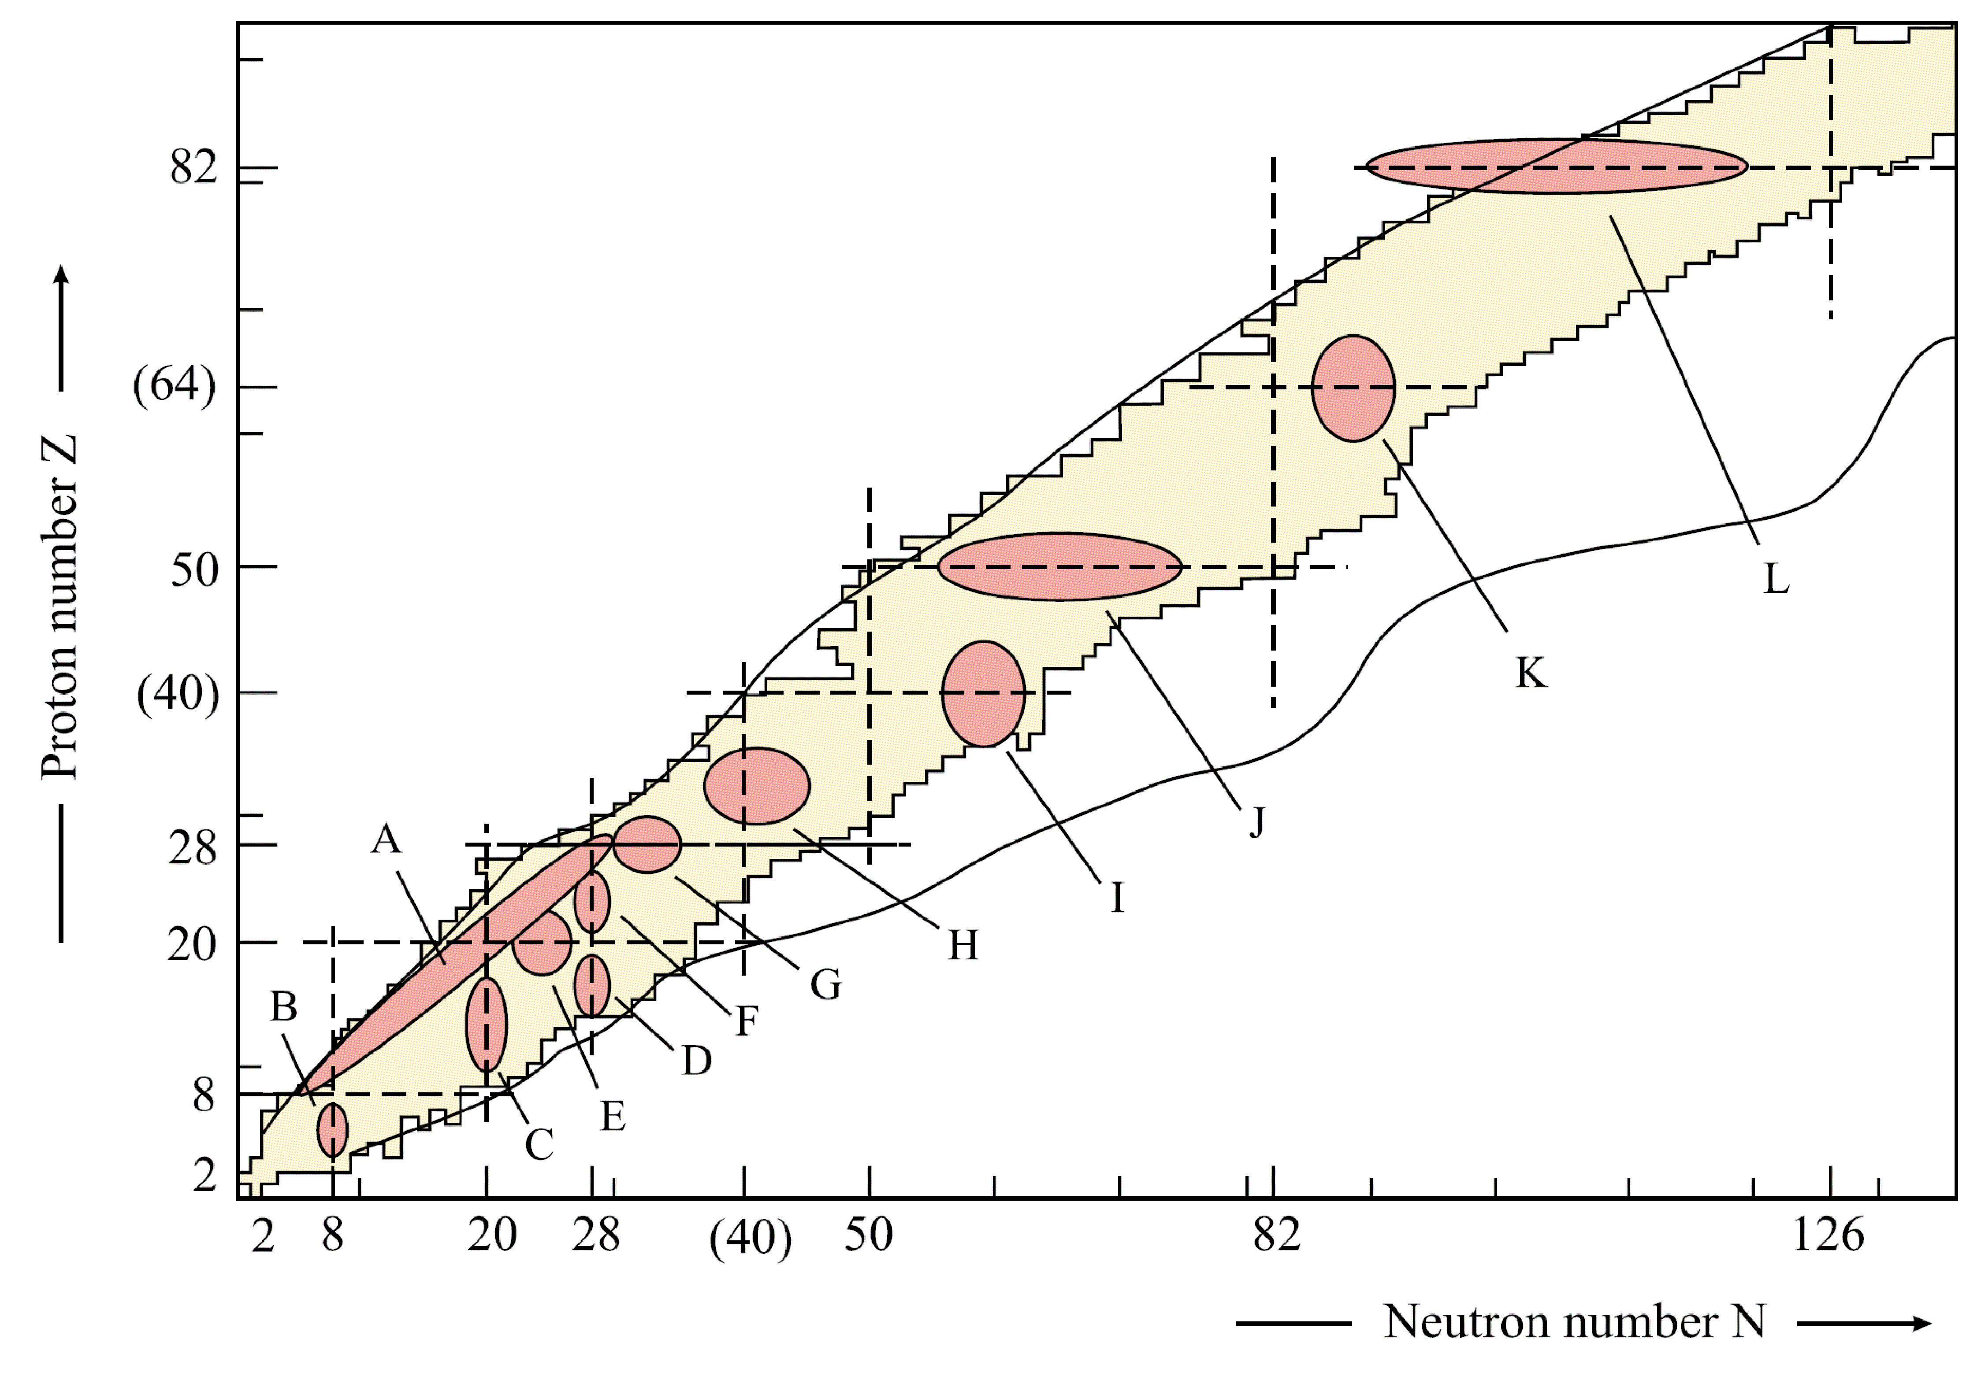
Shape coexistence in the Z = 40 – 50 region
Shape coexistence at low spin initially observed and thought to occur near major shell closures
Recent work also has observed shape coexistence at subshell closure Z=40
Heyde and Wood, RMP 83, 1467 (2011)
  ^{96,98}Sr – Clément et al. PRL 116, 022701 (2016)
  ⁹⁶Zr – Kremer et al., PRL 117, 172503 (2016)
  ⁹⁴Zr – Chakraborthy et al., PRL 110, 022504 (2013)

Slide 6
Shape coexistence in the Z = 40 – 50 region: ⁹⁶⁻¹⁰²Mo show clear evidence
Detailed Coulomb-excitation studies enable extraction of shape invariants indicating clearly different shapes for 0₁⁺ and 0₂⁺ states
prolate
triaxial
oblate
Zielińska et al., NPA 712, 3 (2002), Wrzosek-Lipska et al., PRC 86 064305 (2012)
B(E2) (Wu)
10³ρ²(E0)

Slide 7
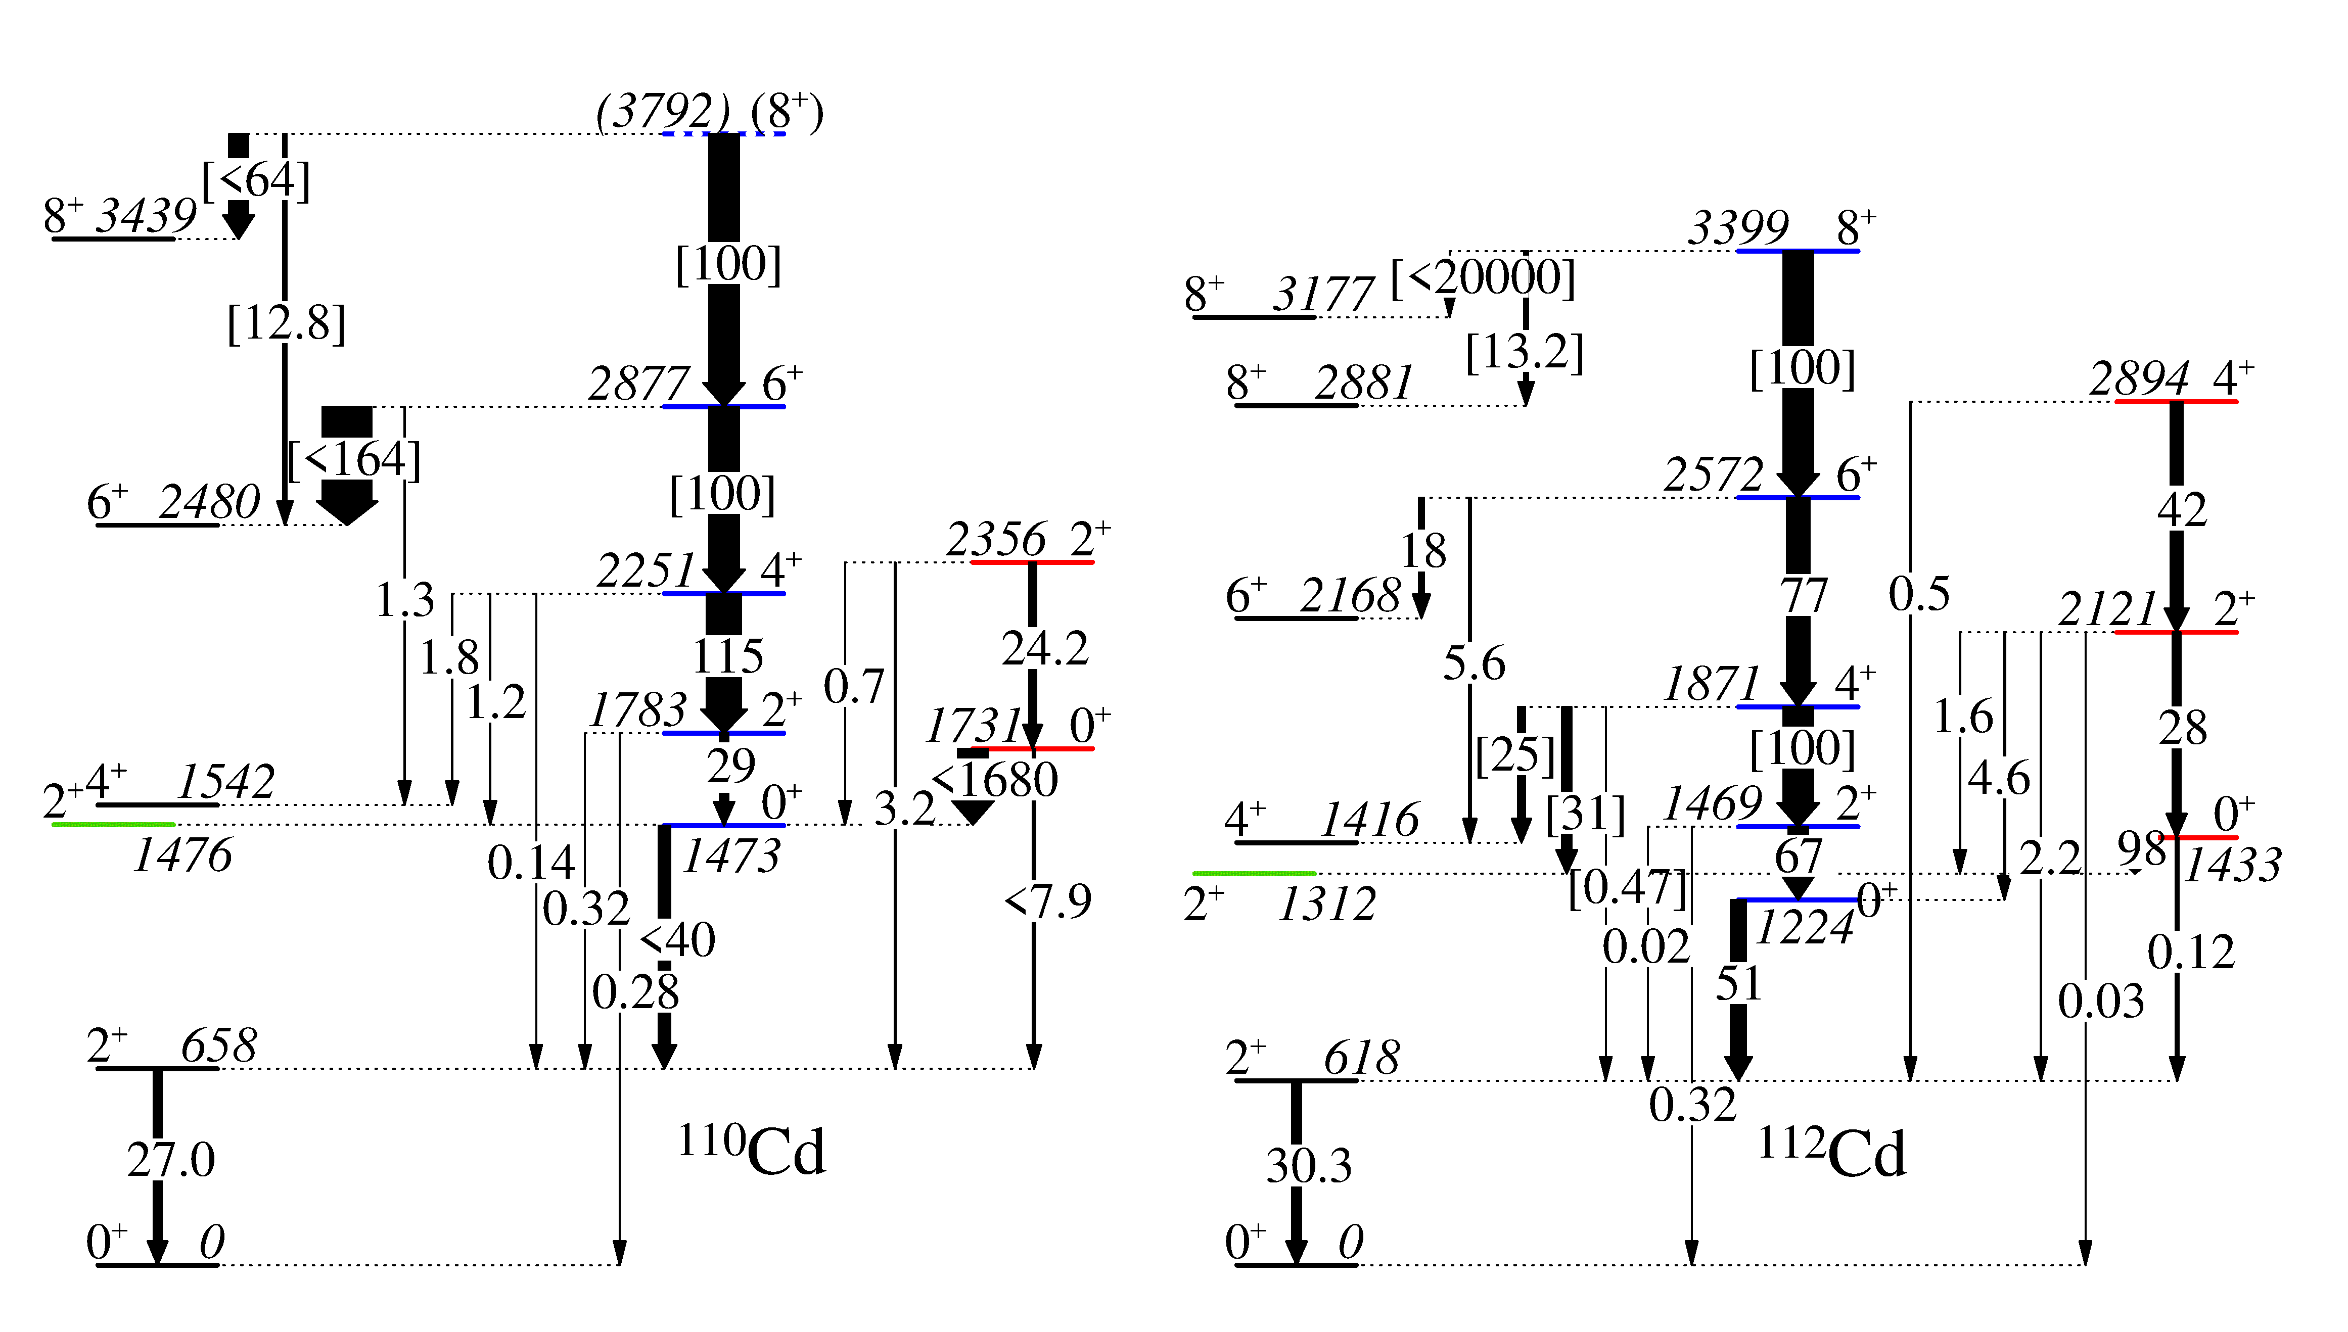
Energy systematics Cd isotopes
0₂⁺ level considered as π2p-4h intruder band head, exchanges character with 0₃⁺ state in ¹¹⁶Cd
Beyond ¹¹⁶Cd, picture is unclear
  Appears to be an intruder band based on 0₃⁺ level in ¹¹⁸Cd, but nature of 0₂⁺ changes from that of ¹¹⁶Cd
Also candidates for band members based on 0₃⁺ state with enhanced B(E2;2⁺ →0₃⁺) values
B(E2) (Wu) [Rel. units]
Best examples of bands based on 0₂⁺ and 0₃⁺ states
Results combining β-decay data and lifetimes from (n,n′γ) reaction
Garrett, Zielińska, & Clement, PPNP 124, 103931 (2022)

Slide 8
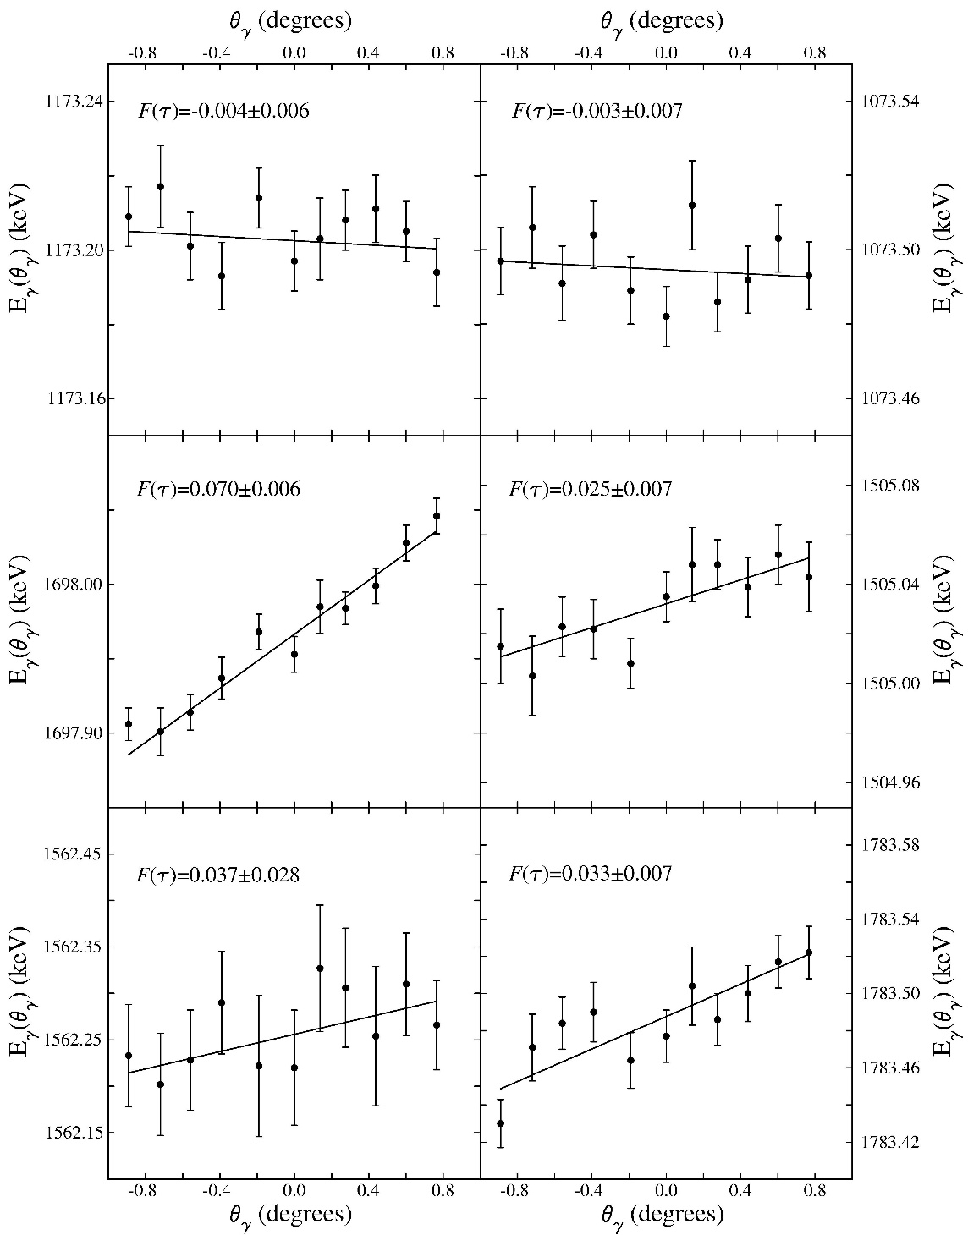
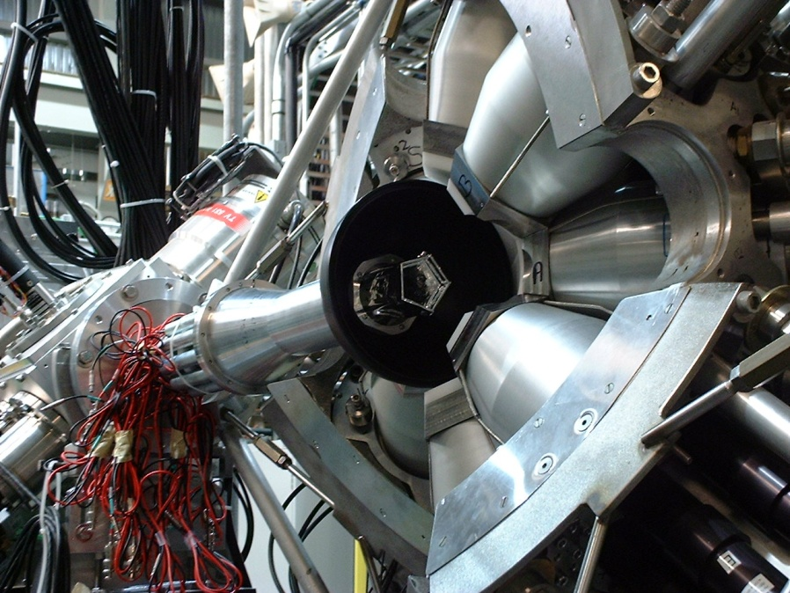
Cd isotopes systematically studied with β decay and (n,n′γ) reaction
Stable even-even Cd isotopes studied with neutron inelastic scattering at University of Kentucky
  Detailed spectroscopy of low-spin states
  Lifetimes from DSAM
^{110,112}Cd studied via β-decay using 8π spectrometer at TRIUMF-ISAC
Doppler-shifted γ-ray energies

Slide 9
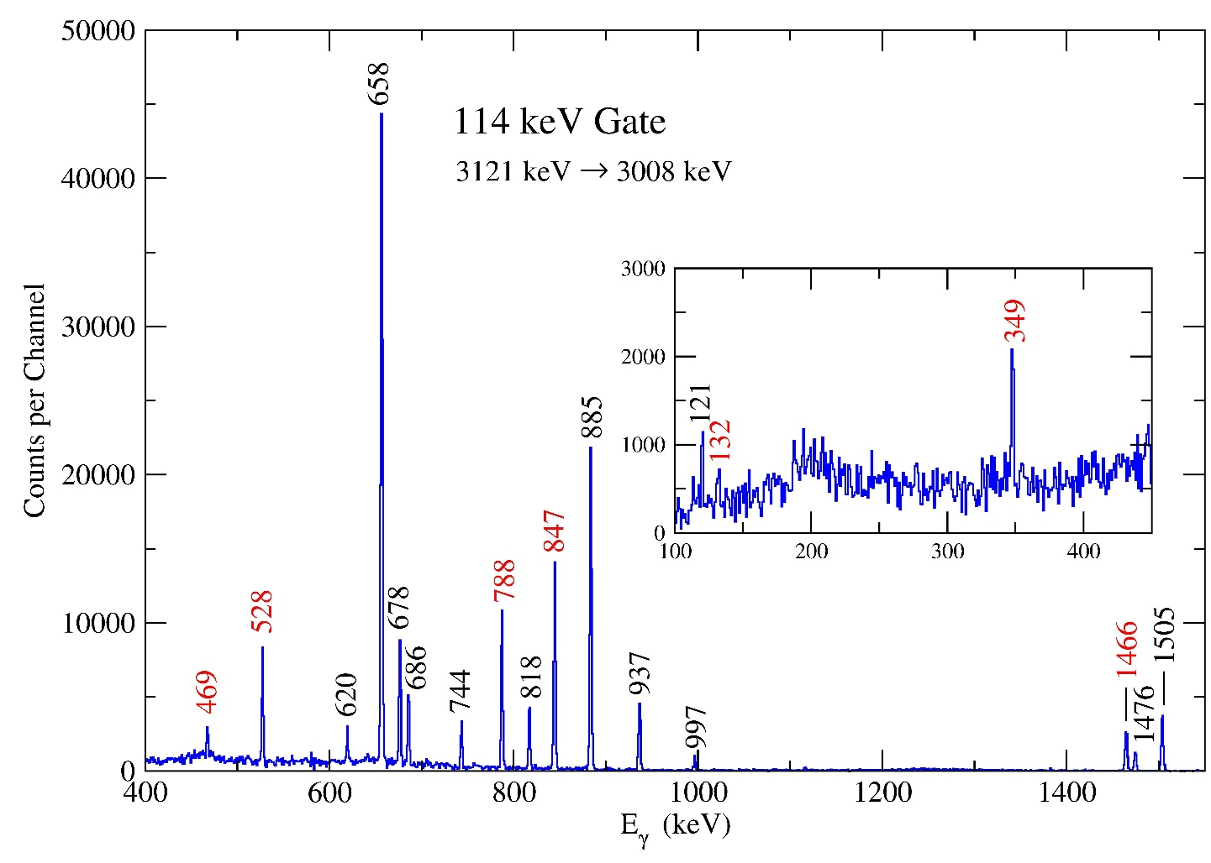
Example of the spectroscopy: Establishment of new 3008 keV 5⁺ level in ¹¹⁰Cd
Results from 7⁺ ¹¹⁰In decay observed with 8π@TRIUMF-ISAC
6⁺
3121
114
5⁺
3008
132
349
469
6⁺
528
2876
788
5⁻
2660
847
5⁻
2540
1466
6⁺
2480
4⁺
2220
3⁺
2162
4⁺
1542
Garrett et al., PRC 101, 044302 (2020)

Slide 10
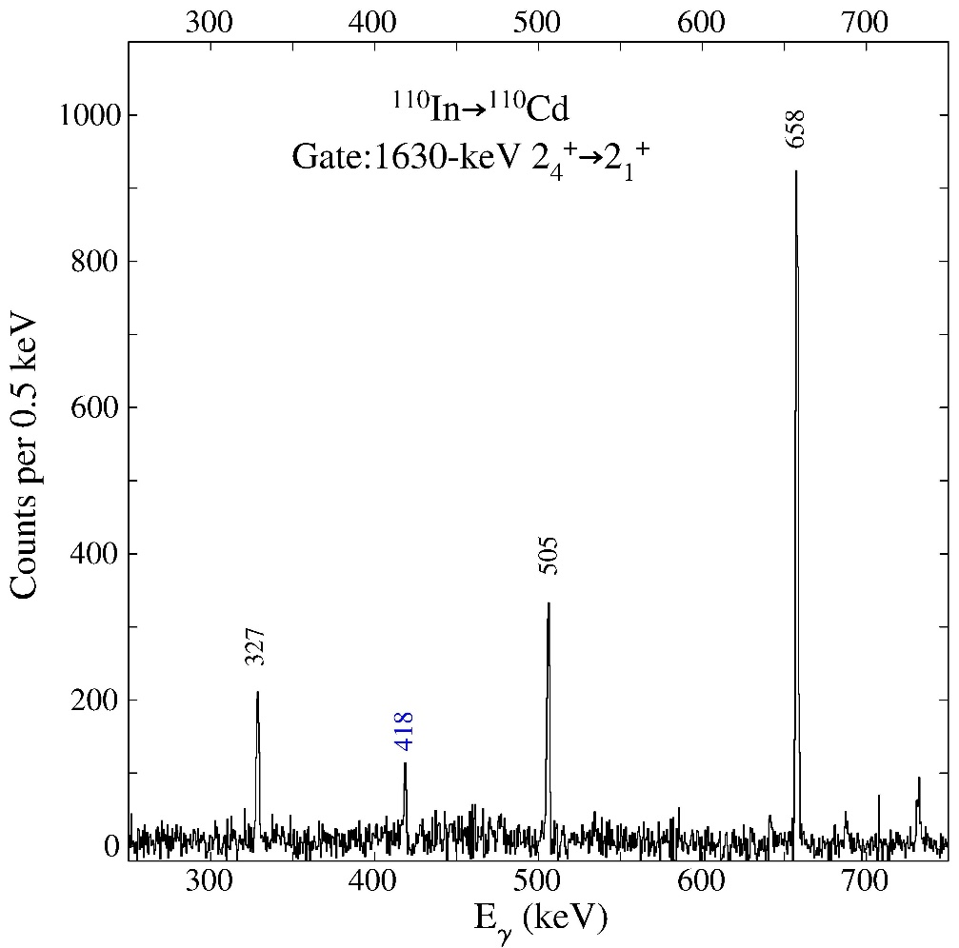
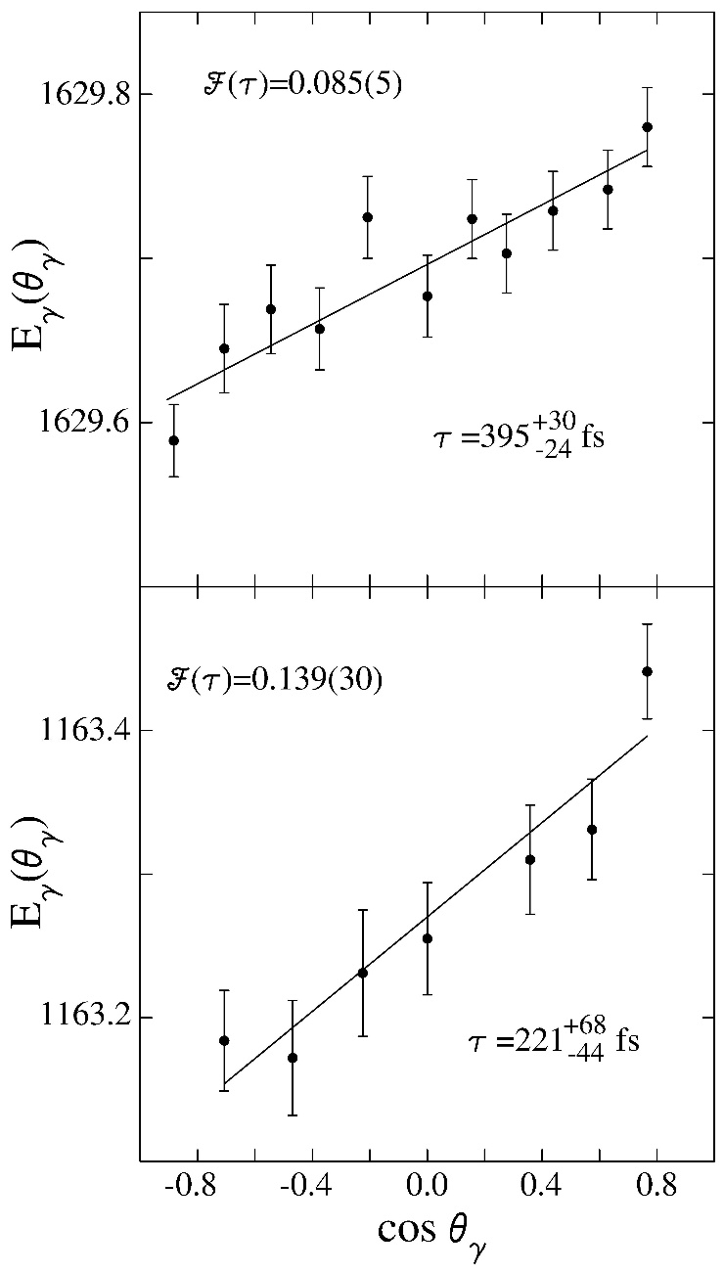
Results from 7⁺ ¹¹⁰In decay, and lifetime from DSAM following INS
4₅⁺
2706
418
2₄⁺
2287
1630
2₄⁺
2₁⁺
658
4₅⁺
418-keV transition has branching ratio = 0.0057(3), resulting in B(E2;4₅⁺→2₄⁺) = 55 ± 14W.u.
Garrett et al., PRC 101, 044302 (2020)

Slide 11
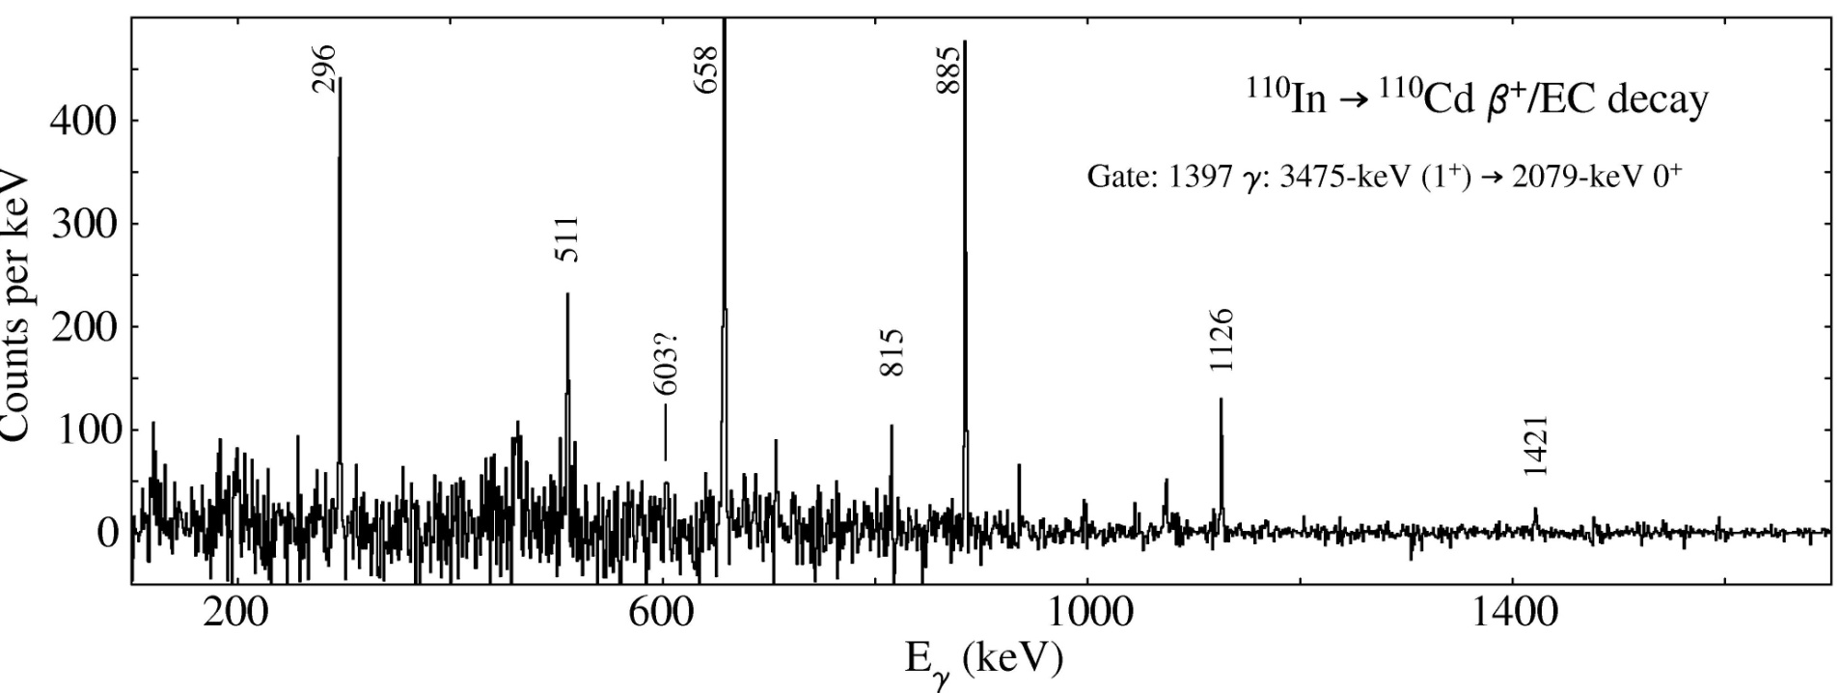
Decay of the 2079-keV 0₄⁺ level in ¹¹⁰Cd – preferred decay to deformed intruder configuration
0₄⁺ level strongly preferred decay to 2₃⁺ level – weak decay to 2₁⁺ and no observed decay to 2₂⁺ state
1397
0⁺
2079
2079
3⁻
296
X
1783
2⁺
603
1421
2⁺
1475
4⁺
1542
1473
0⁺
Garrett et al., PRC 86, 044304 (2012)
2⁺
658
Transitions
in keV
0⁺
0

Slide 12
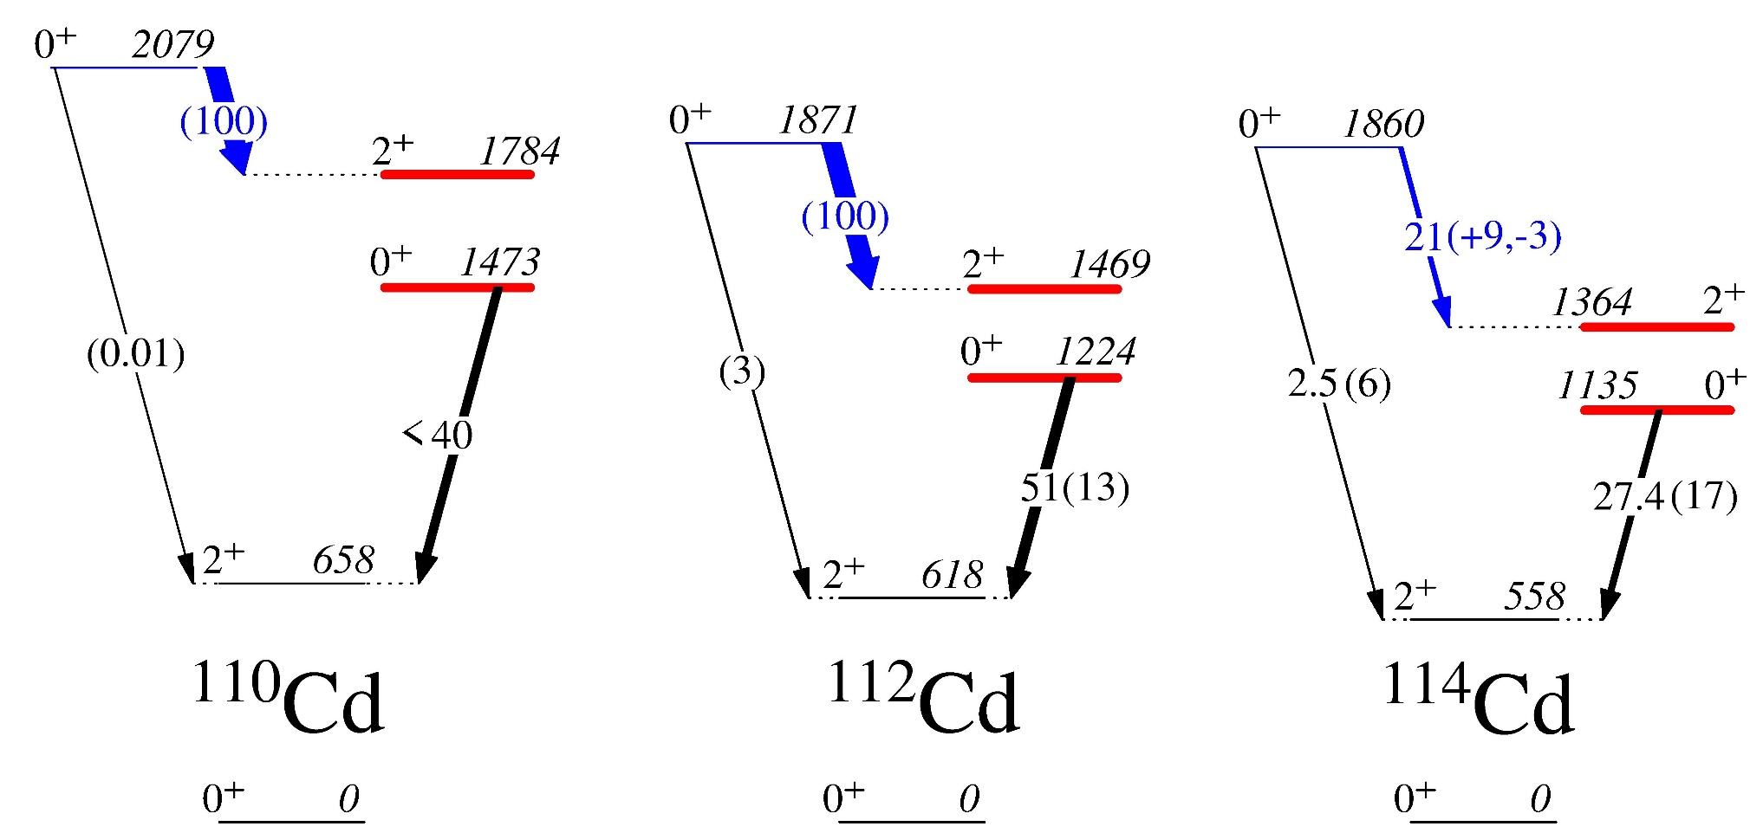
0₄⁺ level preferentially decays to 2⁺ intruder band member in the Cd isotopes
  Enhanced 0₄⁺ →2₃⁺ decay observed in ¹¹⁴Cd
Relative B(E2)values
Absolute B(E2) in W.u.

Slide 13
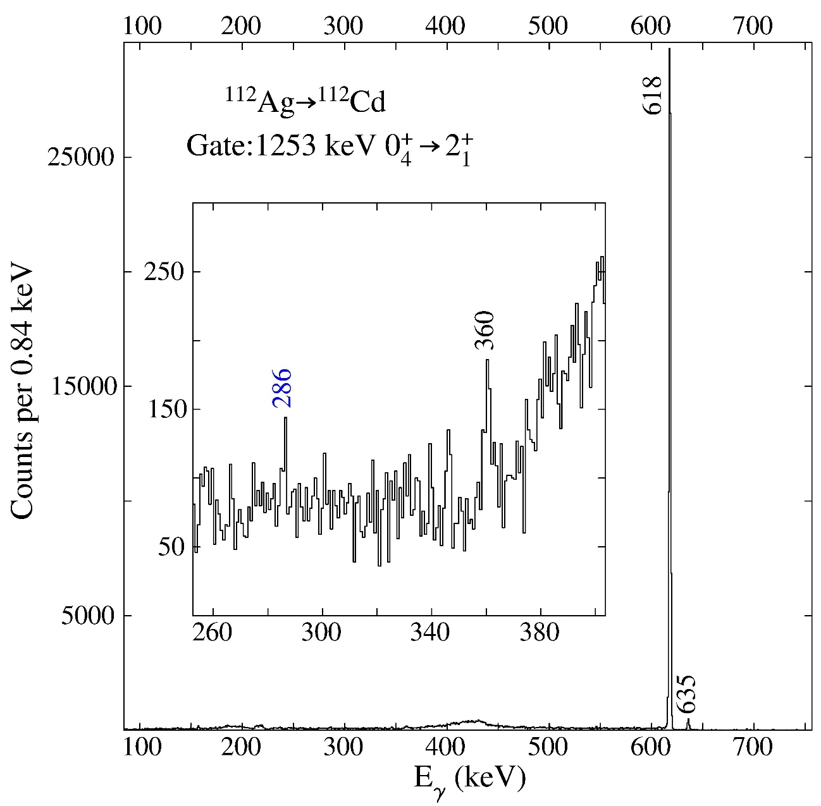
Search for very weak, low-energy γ branches in ¹¹²Cd via β-decay
2⁺
2231
2⁺
2156
360
286
0⁺
1871
1253
4⁺
1416
2⁺
1312
2⁺
617
Transitions in keV
¹¹²Cd
0⁺
0
286-keV transition is a 7.9(33)×10⁻⁴ γ branch from 2156-keV level, → 34(15) W.u. transition
Garrett et al., PRC 101, 044302 (2020)

Slide 14
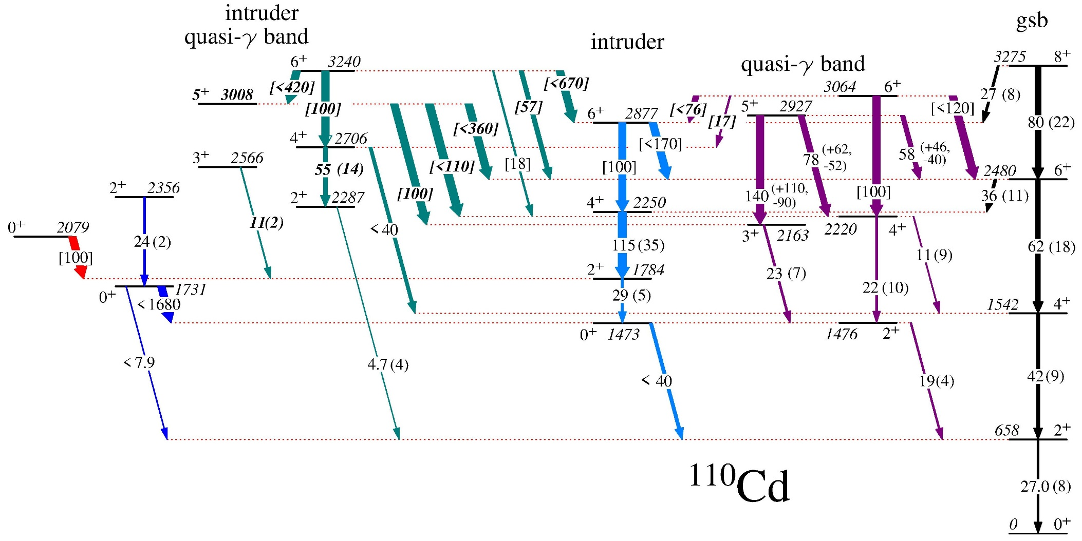
¹¹⁰Cd band structure
Transitions labelled with B(E2) in W.u.
Square brackets indicate relative B(E2) values
Very weak transitions removed
  Most of the upper limits are due to unknown E2/M1 mixing ratios

Slide 15
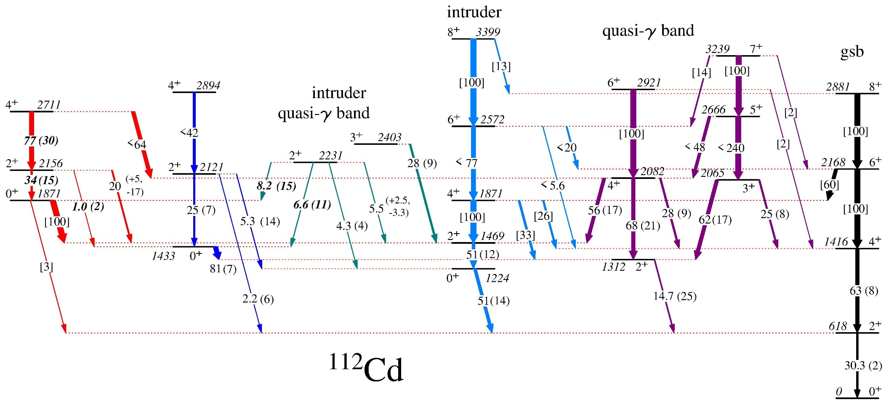
¹¹²Cd band structure
Transitions labelled with B(E2) in W.u.
Square brackets indicate relative B(E2) values
Very weak transitions removed

Slide 16
Results interpreted with aid of BMF calculations
BMF calculations using symmetry-conserving configuration mixing method (SCCM) with Gogny D1S energy-density functional
“Shoulders” on PES, but the rich variety of shapes not readily apparent
Exact angular momentum and particle number restoration
Calculations by T. Rodriguez
Garrett et al., PRC 101, 044302 (2020)

Slide 17
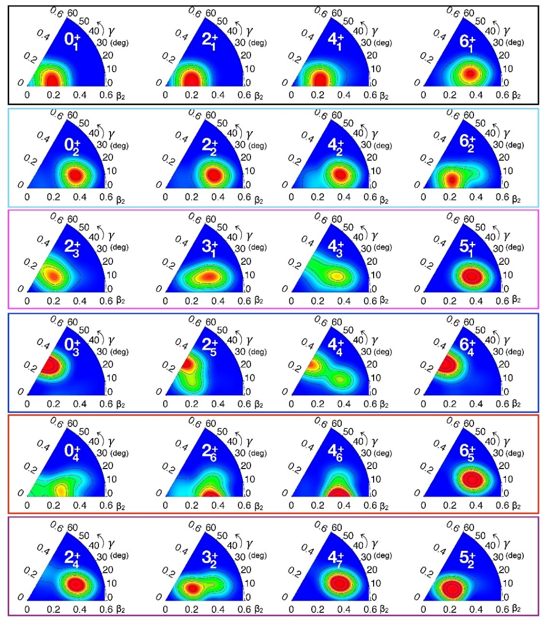
Results interpreted with aid of BMF calculations
Includes axial and non-axial shape mixing
Occupation numbers for 0⁺ states computed using the 0s, 0p, 1s0d, 1p0f, and 0g9/2 orbits as the reference to deﬁne the particle-hole structure for both protons and neutrons
Wave function probability distributions in (β,γ) plane
Garrett et al., PRC 101, 044302 (2020)

Slide 18
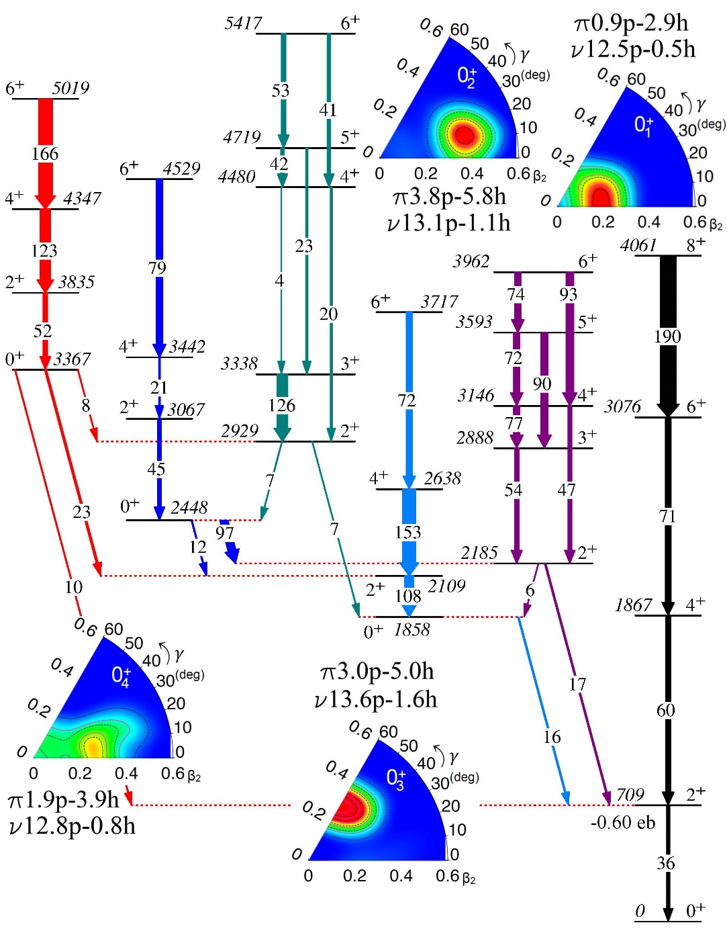
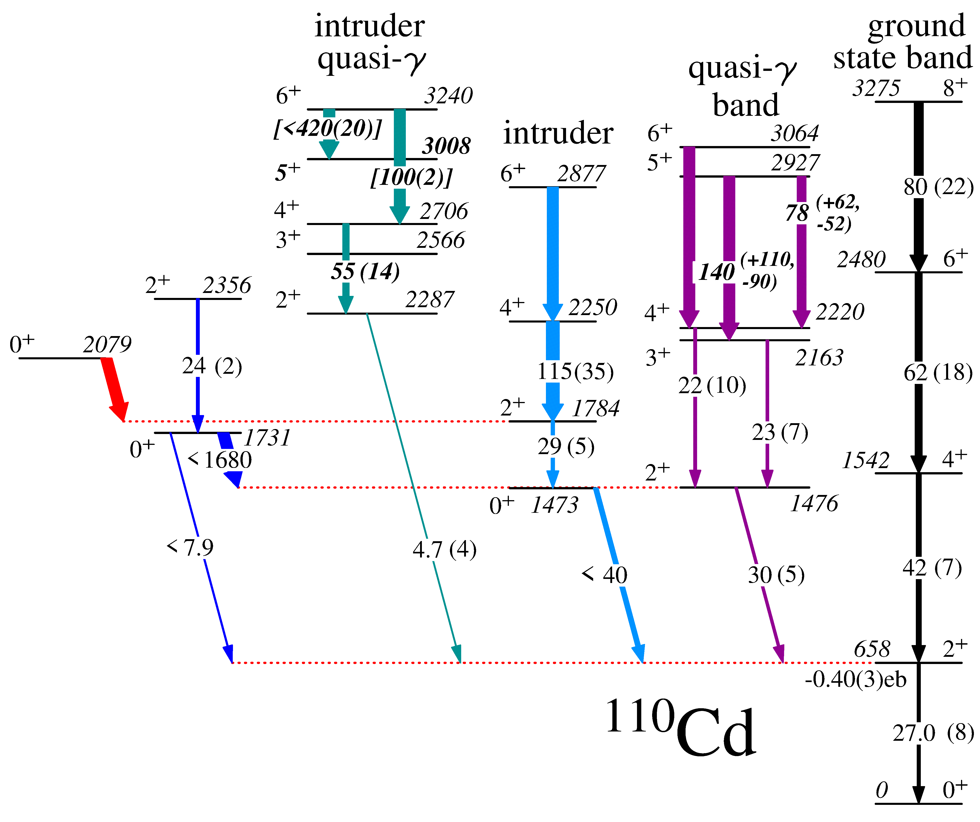
4 distinct shapes predicted for 0⁺ bands
0₁⁺ – β ≈ 0.20 prolate
0₂⁺ – β ≈ 0.4, γ ≈ 20°
0₃⁺ – β ≈ 0.30 oblate
0₄⁺ – β ≈ 0.25 prolate
Favoured decays of 0₂⁺→2₁⁺, 0₃⁺→2₂⁺, 0₄⁺→2₃⁺ reproduced
experiment
P.E. Garrett et al., PRL 123 (2019) 142502

Slide 19
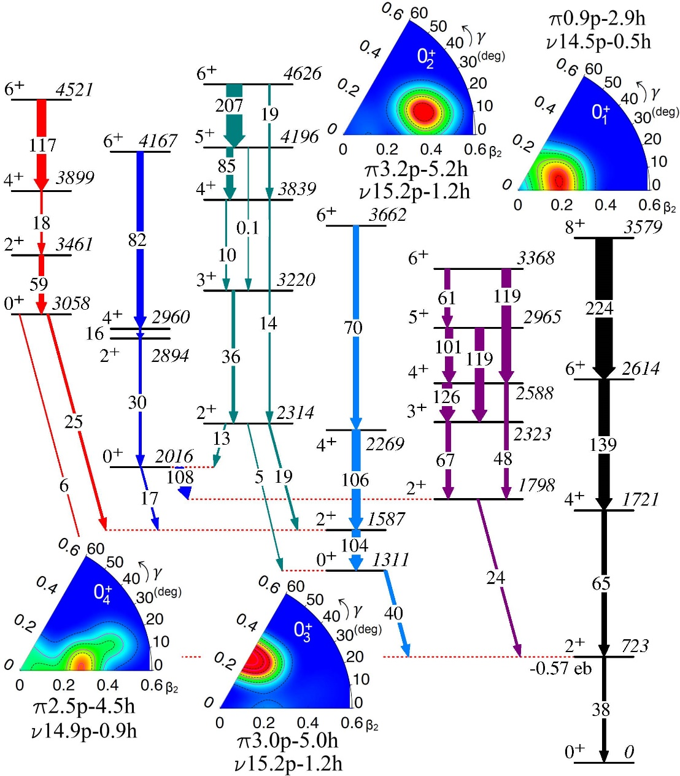
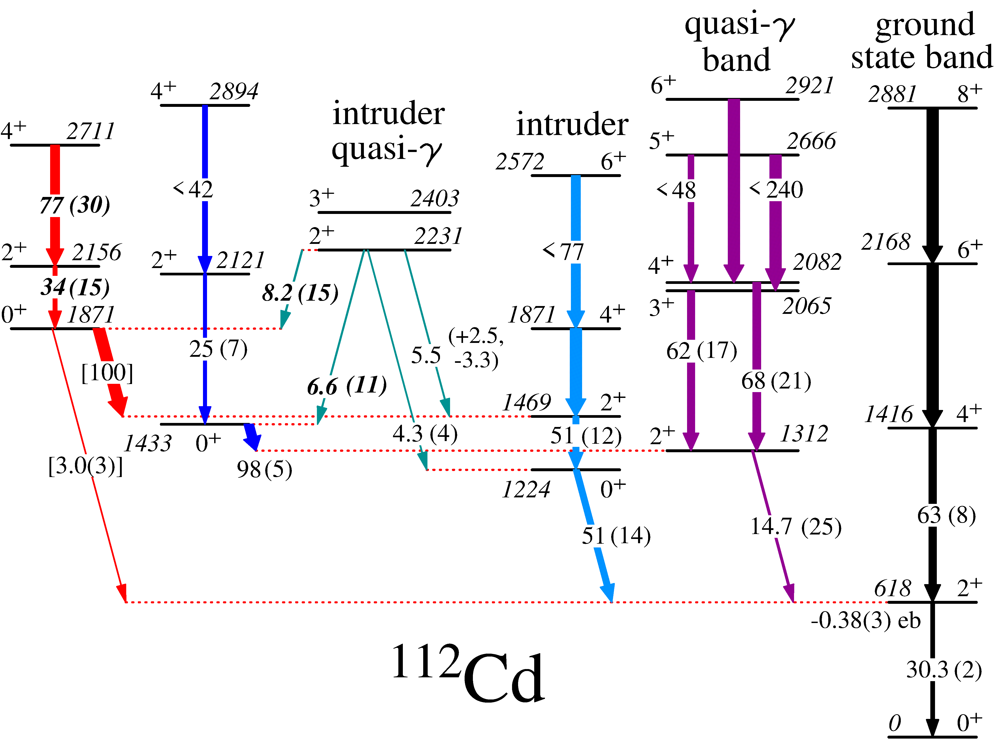
4 distinct shapes predicted for 0⁺ bands
0₁⁺ – β ≈ 0.20 prolate
0₂⁺ – β ≈ 0.4, γ ≈ 20°
0₃⁺ – β ≈ 0.30 oblate
0₄⁺ – β ≈ 0.25 prolate
Favoured decays of 0₂⁺→2₁⁺, 0₃⁺→2₂⁺, 0₄⁺→2₃⁺ reproduced
experiment
Garrett et al., PRL 123, 142502 (2019)

Slide 20
Known data of shape-coexisting Cd candidates
Very similar decay properties observed for low-lying 0⁺ states across the Cd isotopic chain
  Are there multiple shapes in other Cd nuclei?
(³He,n) intensity
Garrett, Zielińska, & Clement, PPNP 124, 103931 (2022)
<Q²> (e²b²)
B(E2) W.u.
ρ²(E0) mUnits

Slide 21
The BMF calculations suggest yes, in ¹⁰⁶⁻¹¹⁸Cd
LSSM using model space π(p_{1/2}g_{9/2}) ν(g_{7/2}d_{5/2}d_{3/2}s_{1/2}h_{11/2}) could reproduced magnitude of gs β, but failed to reproduce degree of triaxiality in ¹⁰⁶Cd

Slide 22
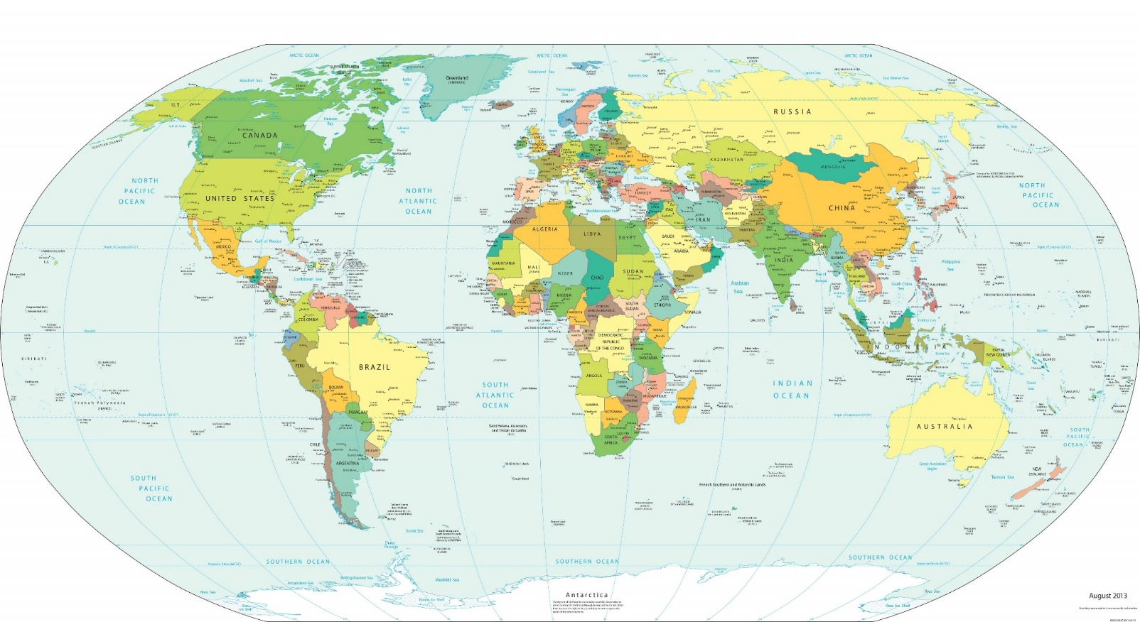
What are we doing to test our hypothesis?
¹⁴N,³²S+¹¹⁰Cd Coulex EAGLE@HIL Warsaw
Spokespersons: K. Wrzosek-Lipska, P. Garrett, & S. Yates
^{110,112}Ag β-decay approved with GRIFFIN@TRIUMF-ISAC
¹¹⁰Cd+²⁰⁸Pb Coulex GRETINA@ANL completed Apr. 2022
Spokespersons: P. Garrett & K. Wrzosek-Lipska
⁶⁰Ni+¹¹⁰Cd Coulex AGATA@LNL Legnaro
Scheduled in June 2022

Slide 23
What do we conclude?
Shape coexistence is a persistent phenomena in the Z=40 – 50 region
  Proven conclusively with detailed Coulex studies and ρ²(E0) measurements in some cases, e.g. Mo isotopes
New data for ^{110,112}Cd consistent the possibility the low-lying 0⁺ states exhibit multiple shape coexistence, and suggestions from BMF calculations that this occurs many nuclei in the Cd isotopic chain
  Spectroscopic evidence that the 0⁺ states have very similar structures across the isotopic chain, so if multiple shapes confirmed in ^{110,112}Cd, likely to occur throughout
This hypothesis needs to be thoroughly tested – Coulomb excitation program under way to do this at Heavy Ion Laboratory (Warsaw), Legnaro with AGATA+SPIDER, and Argonne with GRETINA+BAMBINO
  ¹¹⁰Cd Coulex with ¹⁴N, ³²S, ⁶⁰Ni, ²⁰⁸Pb
Complemented by transfer data from the Q3D at Munich – (p,t), (d,p), In(p,α)&(d,³He) – and ¹¹²Cd+¹²C Coulex, γ spectroscopy using FIPPS at the ILL – ^{111,113}Cd(n,γ) – and γ spectroscopy following β decay of ^{110,112}Ag with GRIFFIN at TRIUMF-ISAC
  Guelph, Warsaw, Saclay, Florence, ILL, Kentucky, LNL, ANL, Madrid collaboration

Slide 24
Collaborators
Universidad Autónoma de Madrid – T.R. Rodríguez
University of Guelph – A. Diaz Varela, K.L. Green, J. Bangay, A. Finlay, V. Bildstein, S. Valbuena, C. Burbadge, B. Jigmeddorj, A.D. MacLean, G.A. Demand, P. Finlay, D.S. Bandyopadhyay, K. Mashtakov, A.A. Phillips, A.J. Radich, E.T. Rand, W. Rocchini, M.A. Schumaker, C.E. Svensson, C. Sumithrarachchi, J. Wong
TRIUMF – A.B. Garnsworthy, G.C. Ball, A.C. Morton, C.J. Pearson, D.S. Cross, G. Hackman
Technische Universität München – T. Faestermann
Universität zu Köln – N. Warr, J. Jolie
Ludwig Maxillimians Universität – R. Hertenberger, H.-F. Wirth
St. Mary’s University – R.A.E. Austin, S. Colosimo
Georgia Tech – W.D. Kulp, J.L. Wood
University of Kentucky – S.W. Yates, E. Peters
University of Regina – G.F. Grinyer
University of Warsaw – K. Wrzosek-Lipska, P. Napiorkowski, K. Hydynska-Klek, M. Palacz
Saclay – M. Zielińska, D. Kalaydjieva
ILL – C. Michelagnoli, G. Colombi
University of the Western Cape – S. Triambak,
University of Florence – A. Nannini, N. Marchini
ANL – M. Siciliano

Slide 26
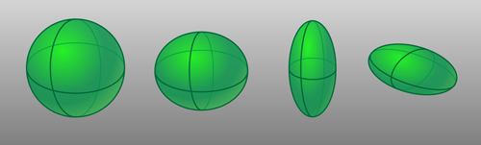
Rotational invariant quantities; Kumar-Cline sum rules
In mechanics, inertia tensor of any object can be represented by ellipsoid of inertia – completely reproduces the rotational dynamics of object
  Rank 2 spherical tensor
Analogously, E2 properties – E2 operator also a rank 2 spherical tensor – are completely reproduced by charged ellipsoid with deformation variables Q and δ – these can be related to collective model variables β and γ

Slide 27
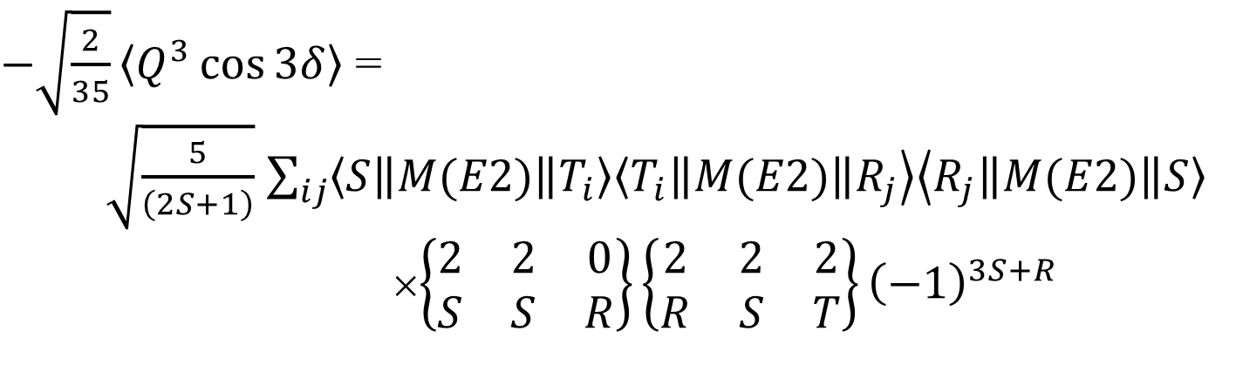
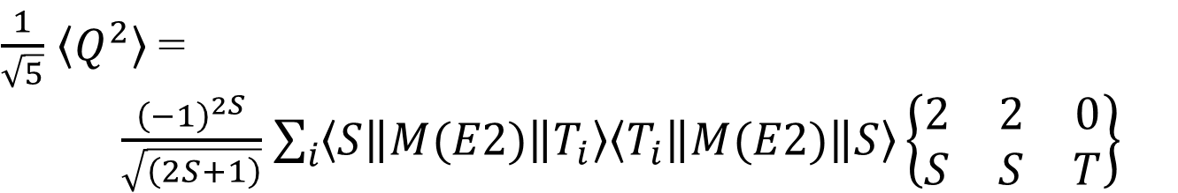
Going beyond B(E2)’s – Kumar-Cline sum rules
Quadrupole invariants
$\frac{1}{\sqrt{5}}$ $\left\langle Q^{2}\right\rangle$ =
$\frac{{\left(−1\right)}^{2S}}{\sqrt{\left(2S+1\right)}}$ $\sum_{i}{\left\langle S\left\|M(E2)\right\|\right.\left.T_{i}\right\rangle \left\langle T_{i}\left\|M(E2)\right\|\left.S\right\rangle \right.}\left\{\begin{matrix}2 & 2 & 0 \\ S & S & T\end{matrix}\right\}$
$−\sqrt{\frac{2}{35}}\left\langle Q^{3}\cos{3δ}\right\rangle$ =
$\sqrt{\frac{5}{\left(2S+1\right)}}$ $\sum_{ij}{\left\langle S\left\|M(E2)\right\|\right.\left.T_{i}\right\rangle \left\langle T_{i}\left\|M(E2)\right\|\right.\left.R_{j}\right\rangle \left\langle R_{j}\left\|M(E2)\right\|\left.S\right\rangle \right.}$
×$\left\{\begin{matrix}2 & 2 & 0 \\ S & S & R\end{matrix}\right\}\left\{\begin{matrix}2 & 2 & 2 \\ R & S & T\end{matrix}\right\}{\left(−1\right)}^{3S+R}$

Slide 28


Rotational invariant quantities – Kumar-Cline sum rules for <Q²> invariant
Coupling scheme for < Q² > for, e.g., for 0⁺ states
Summing over ME² of all transitions into and out of level of interest – independent of sign of ME
$\frac{1}{\sqrt{5}}$ $\left\langle Q^{2}\right\rangle$ = $\sum_{i}{\left\langle 0\left\|M(E2)\right\|\right.\left.2_{i}\right\rangle \left\langle 2_{i}\left\|M(E2)\right\|\left.0\right\rangle \right.}\left\{\begin{matrix}2 & 2 & 0 \\ 0 & 0 & 2\end{matrix}\right\}$
$$q_{0}=\frac{3}{4π}ZR_{0}^{2}$$
$$\left\langle Q^{2}\right\rangle =q_{0}^{2}\left\langle β^{2}\right\rangle$$
β is Bohr model deformation parameter

Slide 29
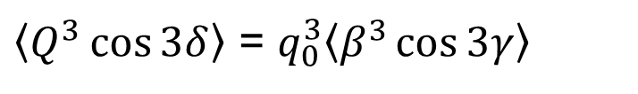
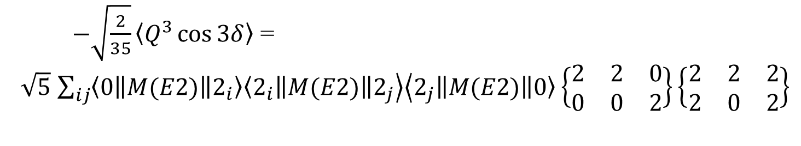
Formation of <Q³cos3δ> invariant
Coupling scheme required for <Q³cos3δ>
$−\sqrt{\frac{2}{35}}\left\langle Q^{3}\cos{3δ}\right\rangle$ =
$\sqrt{5}$ $\sum_{ij}{\left\langle 0\left\|M(E2)\right\|\right.\left.2_{i}\right\rangle \left\langle 2_{i}\left\|M(E2)\right\|\right.\left.2_{j}\right\rangle \left\langle 2_{j}\left\|M(E2)\right\|\left.0\right\rangle \right.}\left\{\begin{matrix}2 & 2 & 0 \\ 0 & 0 & 2\end{matrix}\right\}\left\{\begin{matrix}2 & 2 & 2 \\ 2 & 0 & 2\end{matrix}\right\}$
$\left\langle Q^{3}\cos{3δ}\right\rangle$ = $q_{0}^{3}\left\langle β^{3}\cos{3γ}\right\rangle$
β and γ are Bohr model deformation parameters

Slide 30
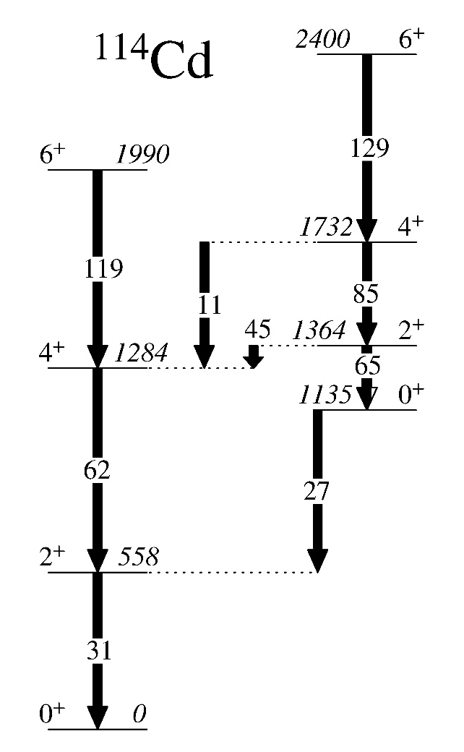
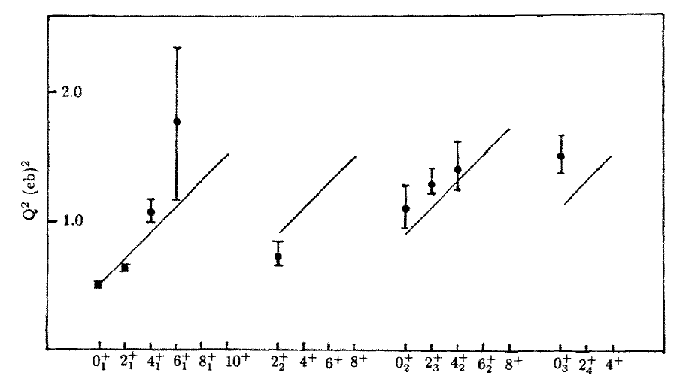

¹¹⁴Cd deformation parameters from rotational invariants
Most detailed Coulex study to date on Cd isotopes [Fahlander, NPA 485, 317 (1988)] ¹⁶O, ⁴⁰Ca, ⁵⁸Ni, ²⁰⁸Pb on ¹¹⁴Cd
Intruder band
β=0.33
Yrast band
β=0.28(3)
<cos3δ>~0.9
prolate
β=0.187(3)
<cos3δ>~0.2
Intruder band
B(E2) W.u.
$\frac{1}{\sqrt{5}}Q^{2}$=$\sum_{i}{\left\langle 0\left\|M(E2)\right\|\left.2_{i}\right\rangle \left\langle 2_{i}\left\|M(E2)\right\|\left.0\right\rangle \right.\right.}\left\{\begin{matrix}2 & 2 & 0 \\ 0 & 0 & 2\end{matrix}\right\}$
$$Q^{2}={\left(\frac{3}{4π}ZR_{0}^{2}\right)}^{2}β_{0}^{2}$$
harmonic vibrator value

Slide 31
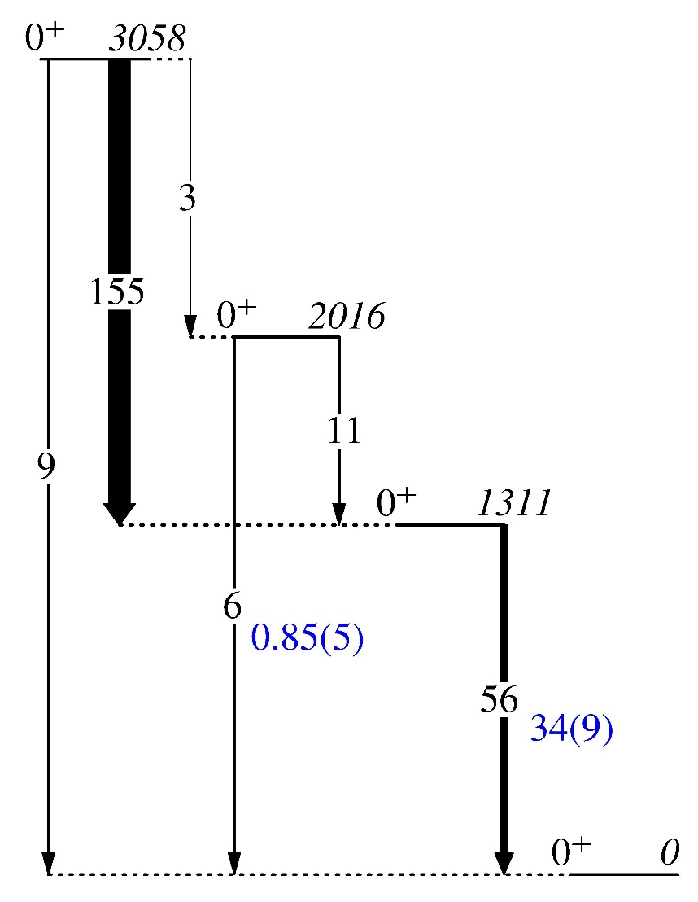
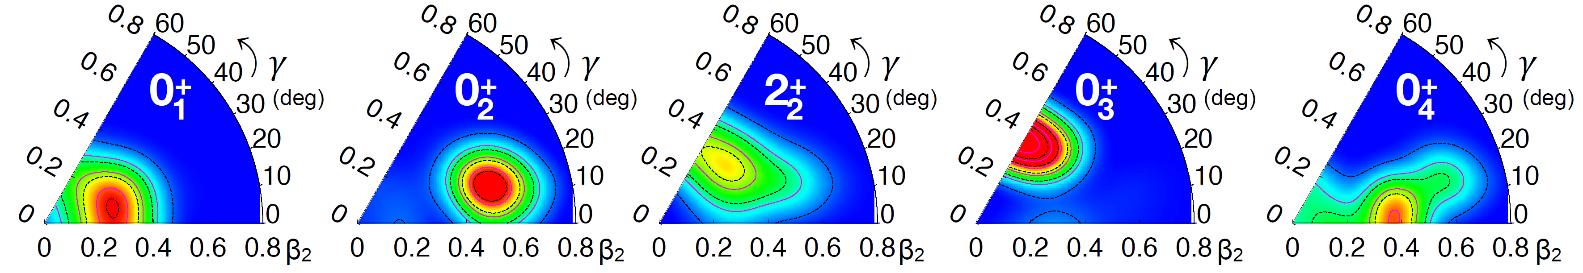
Detailed results for the calculated 0⁺ states – ¹¹²Cd
B(E2) values in W.u.
1000×ρ²(E0) values
Calculated values in black Experimental values (blue) Relative values in brackets

Slide 32
Revealing the underlying structure
The favoured and enhanced decay of the excited non-intruder 0⁺ state to the 2₂⁺ state, rather than 2₁⁺ state, common feature in Cd, Te, Pd, Ru, Mo, Xe,…
If multiple shape coexistence can be firmly established in, e.g., Cd, this repeating pattern suggests that it may exist across the region.
B(E2) in W.u.
Shape coexisting structure

Slide 33
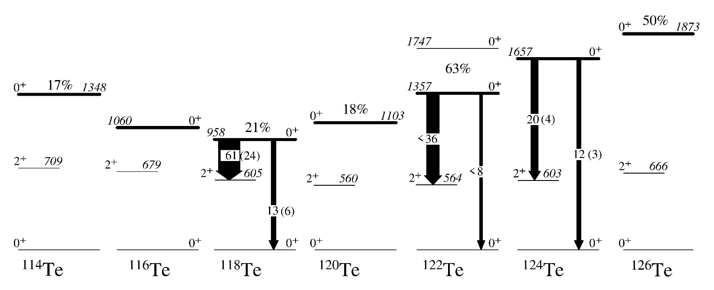
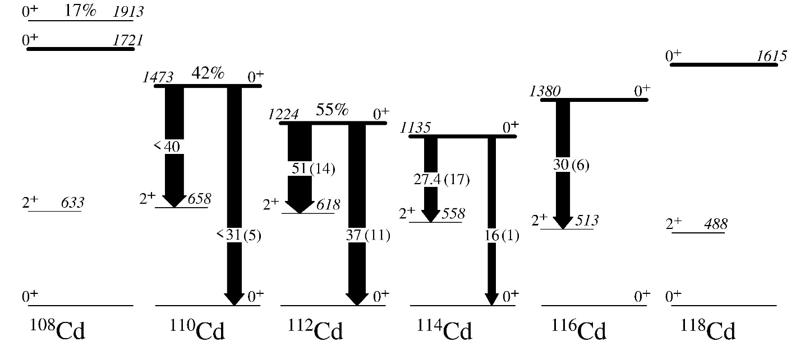
Strong similarity in structure of Cd and Te nuclei – properties of 0₂⁺ states in Te match intruder 0⁺ states in Cd
Suggested intruder band heads in the Te isotopes
10³ρ²(E0)
Population in % relative to gs in (³He,n) reactions
0⁺ states identified as intruder band heads in the Cd isotopes
B(E2) (Wu)
PG, J. Phys. G 43, 084002 (2016).

Slide 34
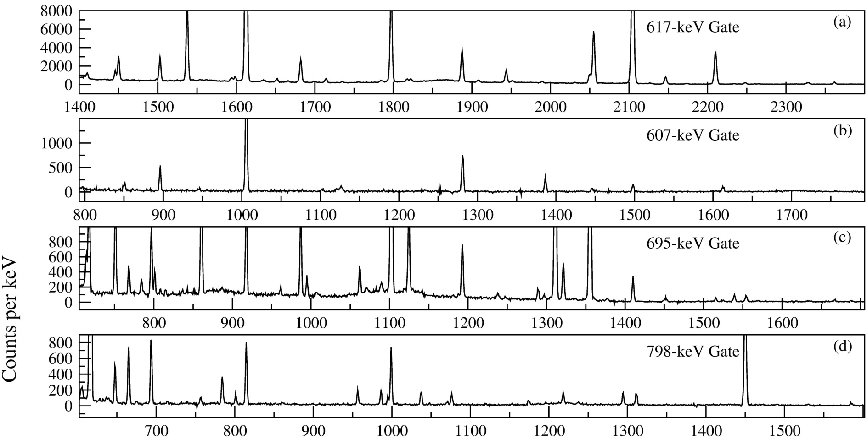
Is the phonon decay strength fragmented? Analysis of 2⁺ states in ¹¹²Cd fed in β-decay
γ rays feeding 2⁺₁ state
γ rays feeding 0⁺₃ “two-phonon” state
γ rays feeding 2⁺₂ “two-phonon” state
γ rays feeding 4⁺₁ “two-phonon” state
2121 keV 2⁺
2231 keV 2⁺
2506 keV 2⁺
2674 keV 2⁺
2765 keV 2⁺
2945 keV 2⁺
2156 keV 2⁺
2723 keV 2⁺
2853 keV 2⁺
2980 keV 2⁺
2₄⁺ state
2₁₃⁺ state

Slide 35
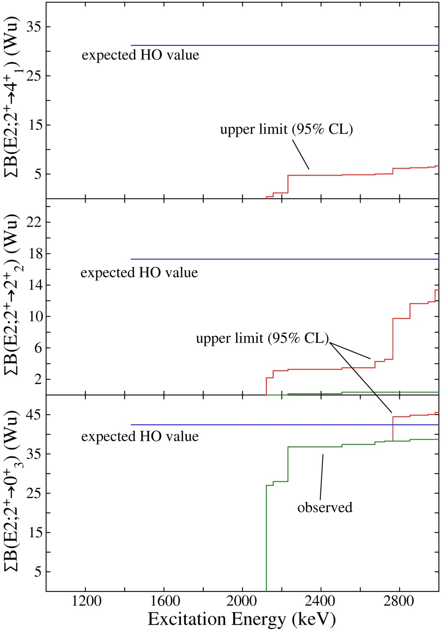
Summation of upper limits of B(E2) from excited 2⁺ states to 2-phonon states
Sum of B(E2) strength to 0₃⁺ level in agreement with harmonic expectations if it is the 2-phonon state
But strength to 2₂⁺, and especially 4₁⁺, well below expectations
E2 strength to 2⁺ and 4⁺ 2-phonon levels does not appear to be fragmented, but missing
  either non-existent or pushed beyond 3 MeV (5ω)
No observed strength!
observed strength
Expected (HV)
2⁺
42
¹¹²Cd
31
observed strength
17
0⁺
2⁺
4⁺

