Slide 1
Ferrimagnetic switching driven by stochastic resonance in multiferroic (Ge,Mn)Te
Juraj Krempaský :: Photon Science Division :: LNO :: Paul Scherrer Institut
LEAPS meets Quantum Technology, Elba Island, Italy

Slide 2
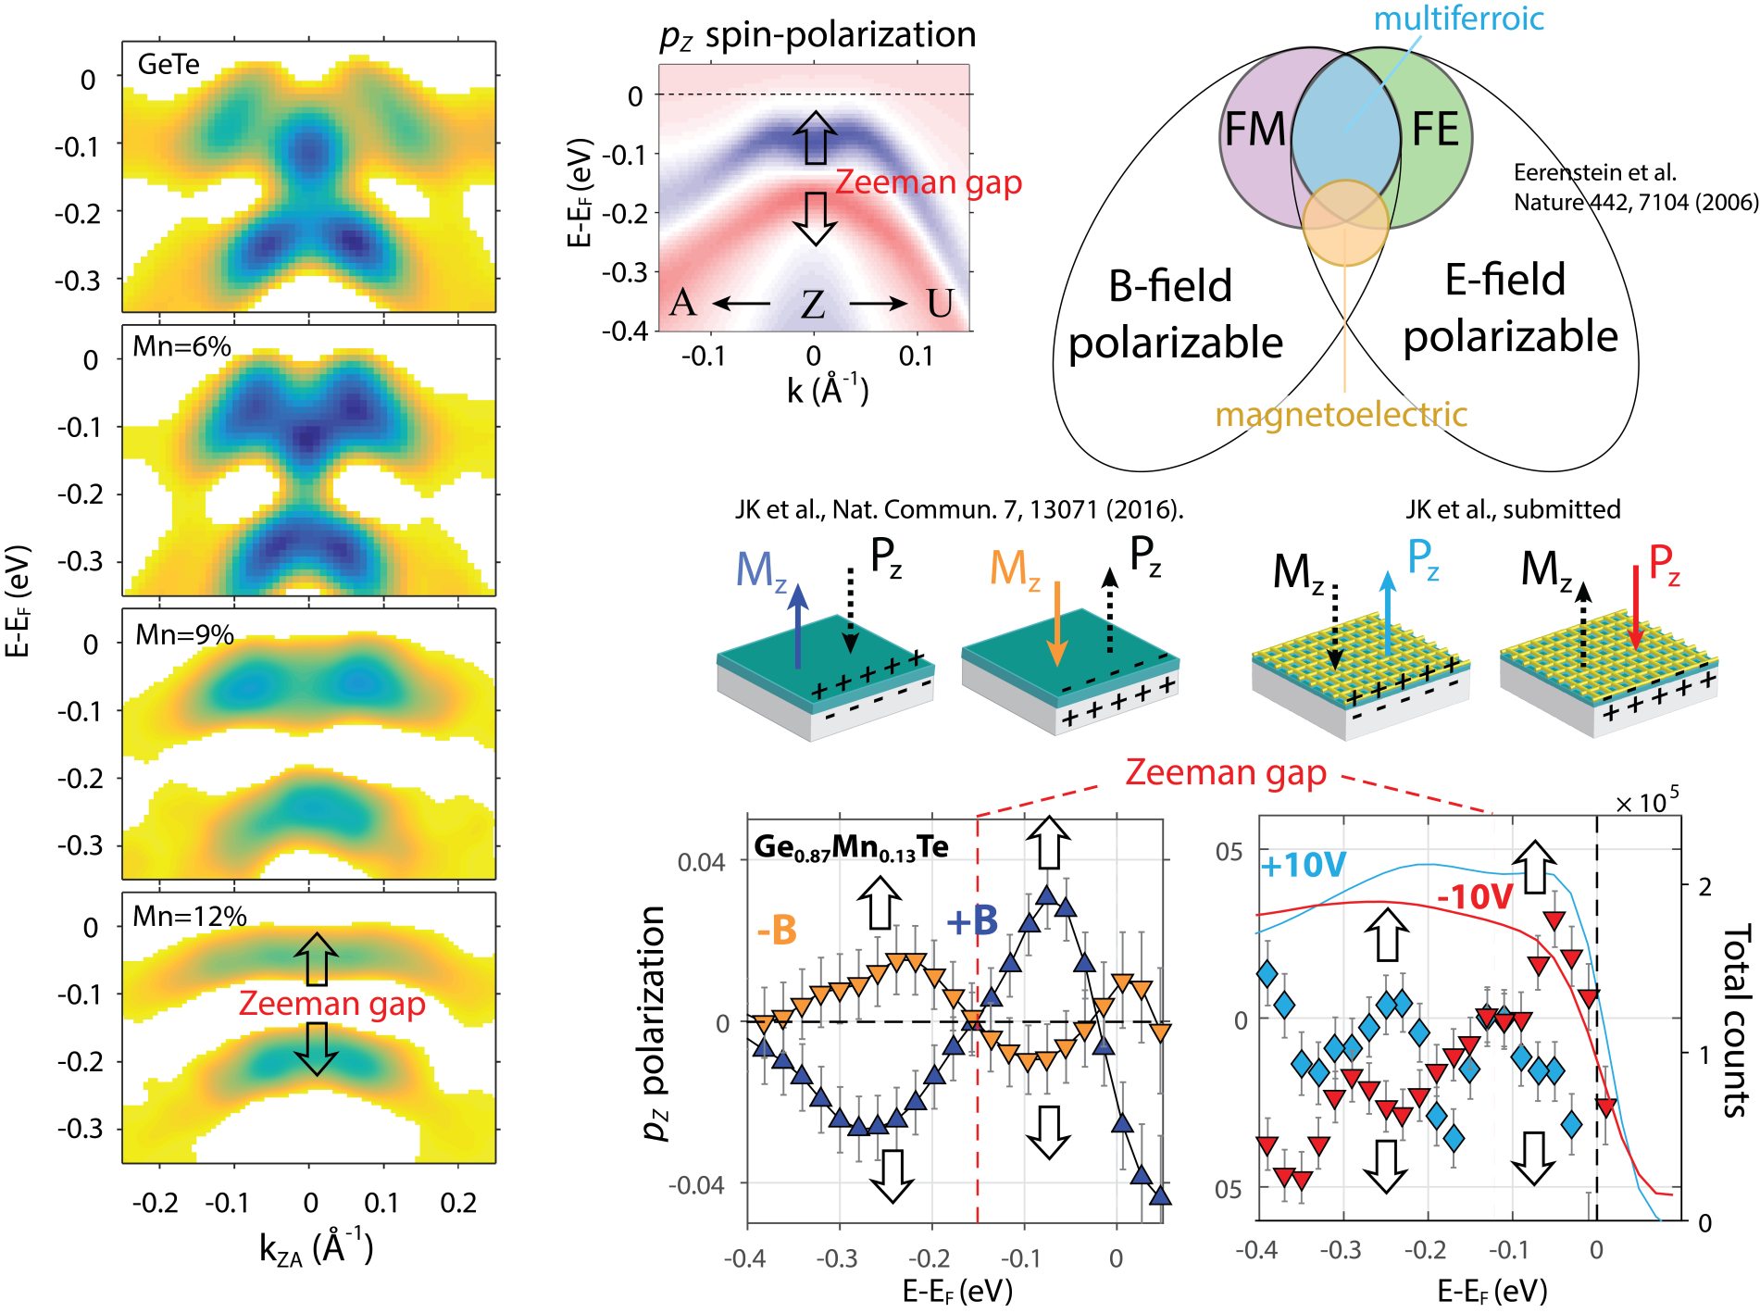
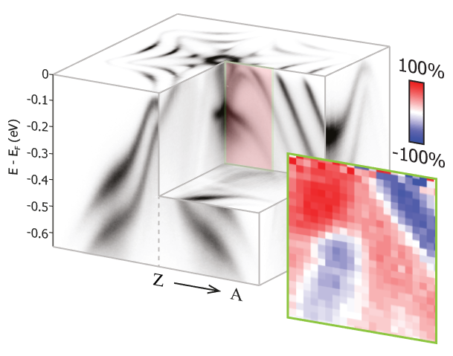
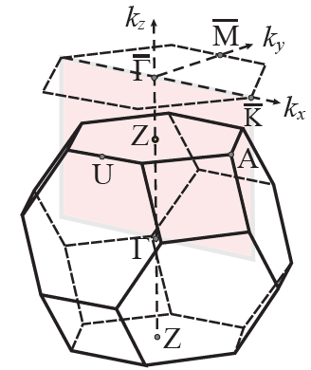
From GeTe to (Ge,Mn)Te
Simplest binary ferroelectric material
Di Sante et al., Adv. Mat. 25, 509 (2013)
JK. et al., PRX 8, 021067 (2018)
JK et al, PRR , 003000 (2020)

Slide 3
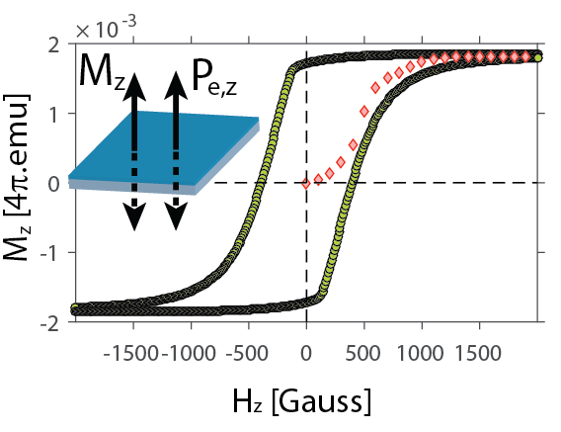
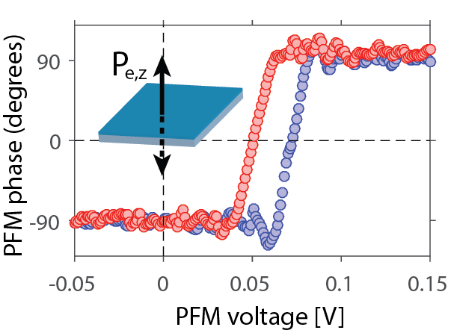
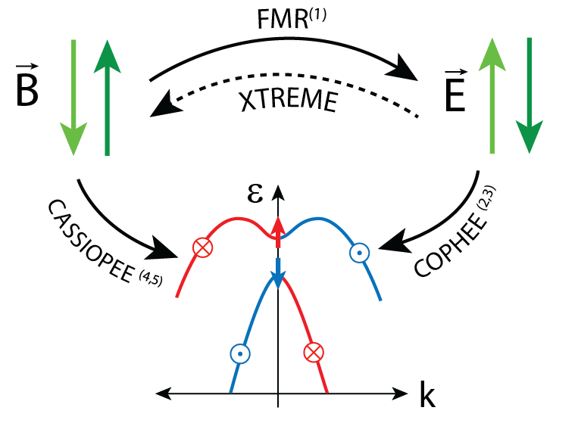
Magnetoelectric switching entangled with Rashba-Zeeman splitting
(1) H. Przybylinska et al., PRL.112, 047202 (2014) (2) JK. et al., PRB 94 205111 (2016)
(3) JK. et al., PRX 2018
(4) JK. et al., Nat. Comm. 7 13071 (2016)
(5) JK. et al., JPChS 1–8 (2017)

Slide 4
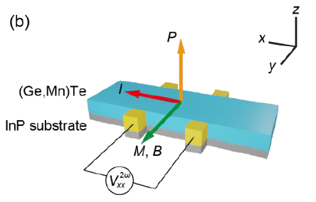
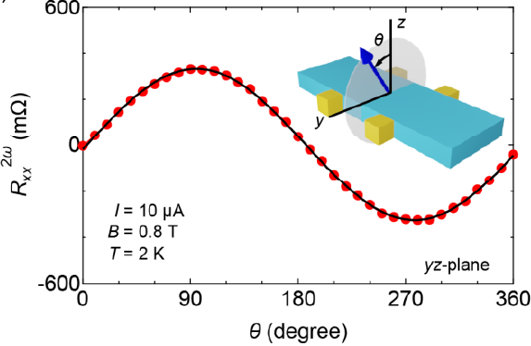
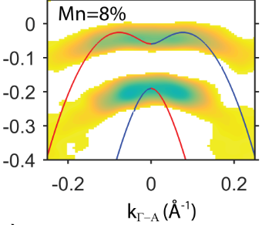
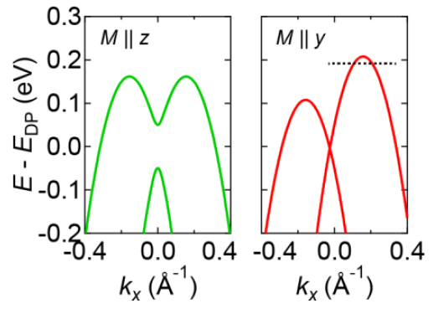
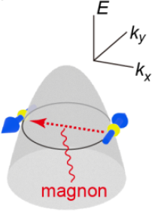
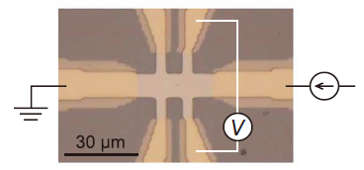
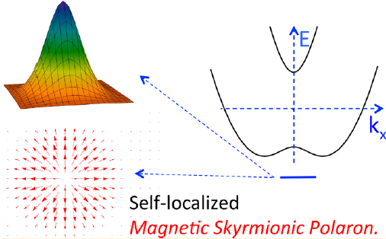
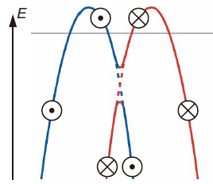
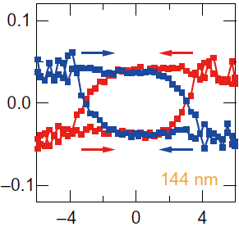
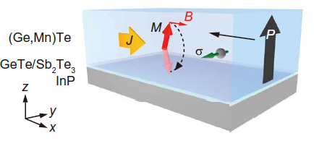
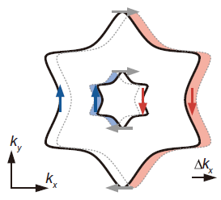
(Ge,Mn)Te
R. Yoshimi et al., arXiv2022
Nonreciprocal electrical transport
JK et al., Nat. Comm. 7 13071 (2016)
E-E_{F} (eV)
L. Brey, Nano Lett. 2017, 17
Yoshimi et al., Sci. Adv. 2018; 4
Current driven magnetization switching

Slide 5
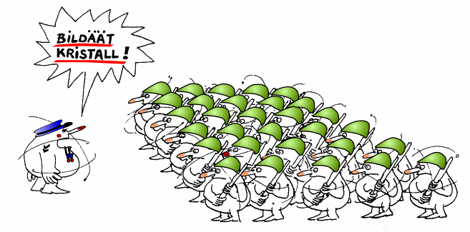
IV-VI MBE (Ge,Mn)Te
„epi-taxis“ = on top,
in perfect military formation
GeTe
ATOMIS
GROWER
Mn
Slide courtesy of G. Springholz, JKU Linz

Slide 6
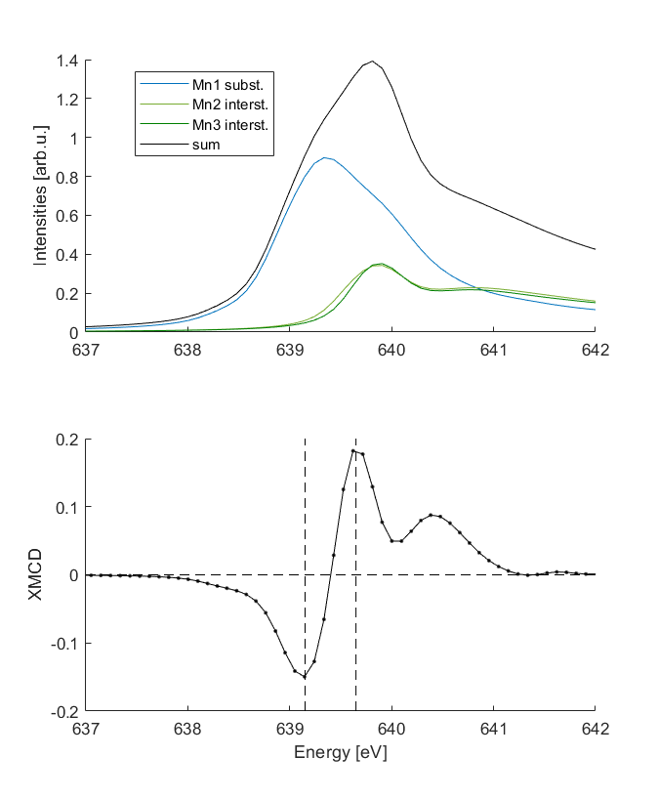
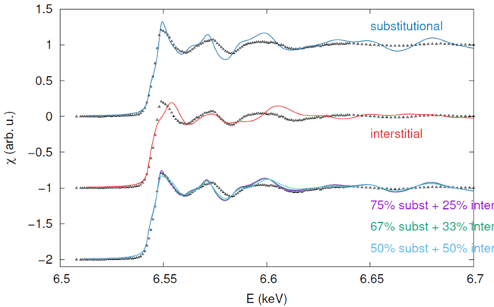
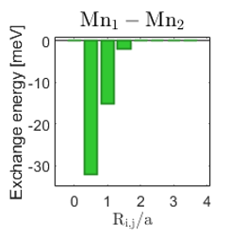
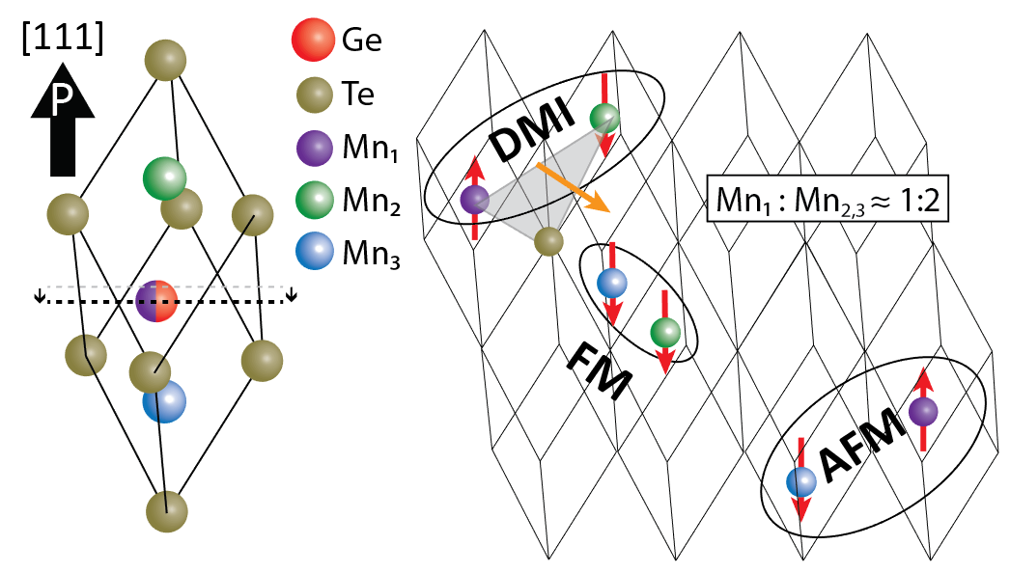
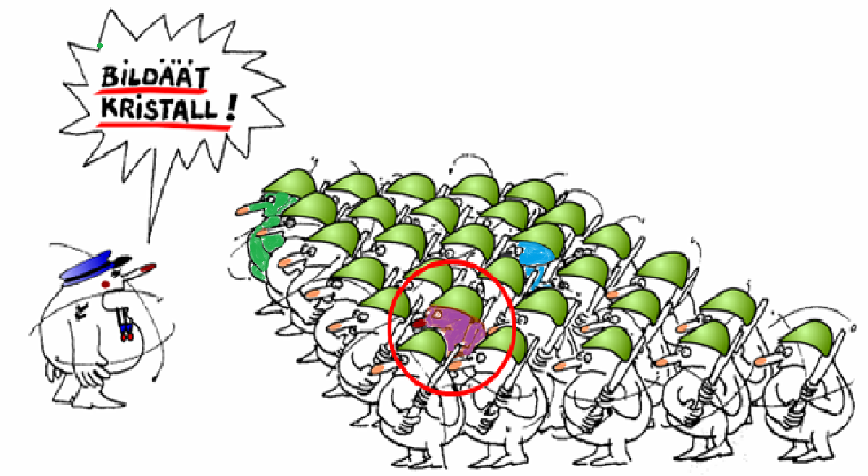
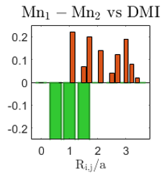
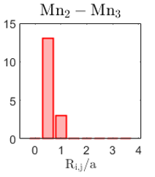
(Ge,Mn)Te: the SPR-KKR-CPA model
SPR-KKR-CPA: scattering model based on occupation probability rather than a superlattice
2:1
≈0.5 eV

Slide 7
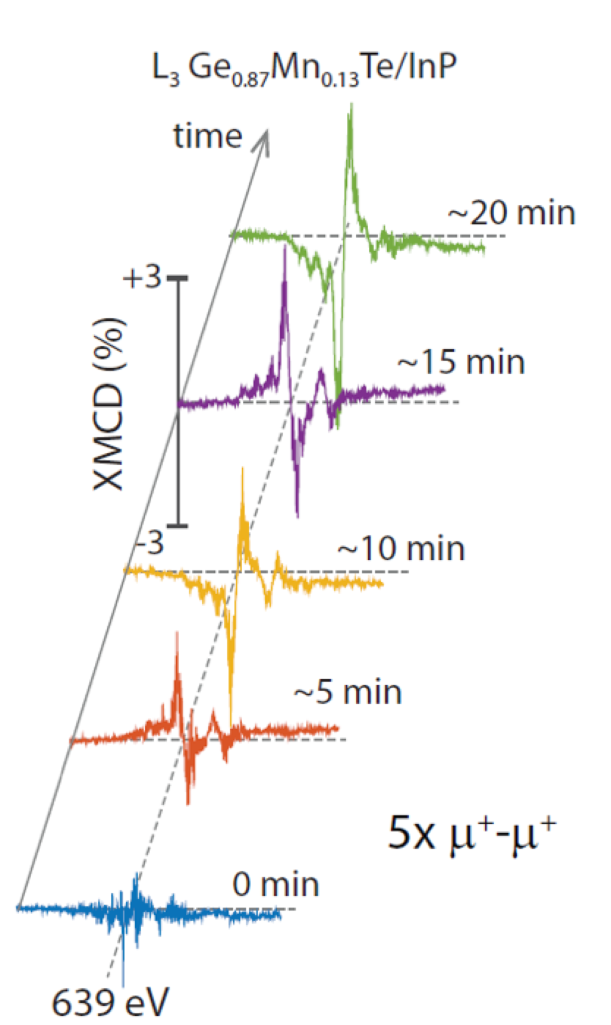
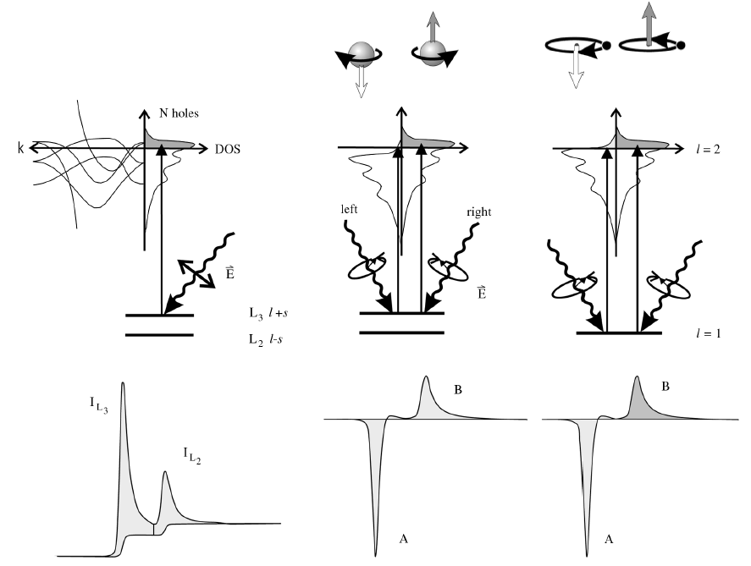
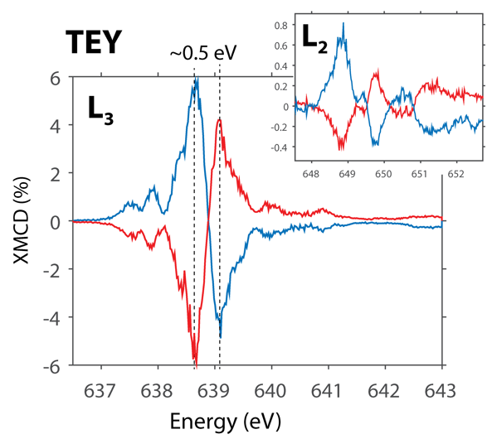
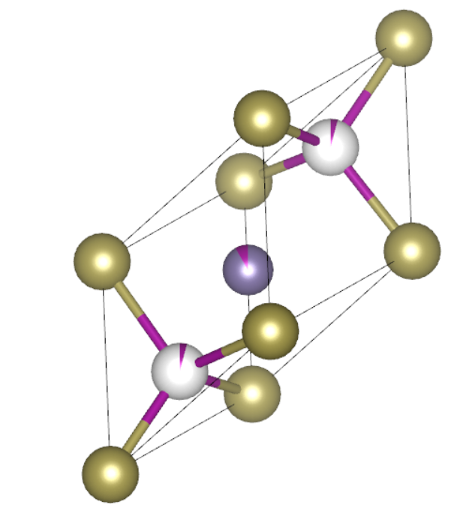
Light-induced magnetization switching
J. Stöhr, JMM 200 (1999) 470}497
Mn₂
Mn₁
Mn₃
Sign of XMCD signal switches spontaneously
Collective bulk effect
Switching is also observed when only one light helicity is used!
Non-thermal switching

Slide 8
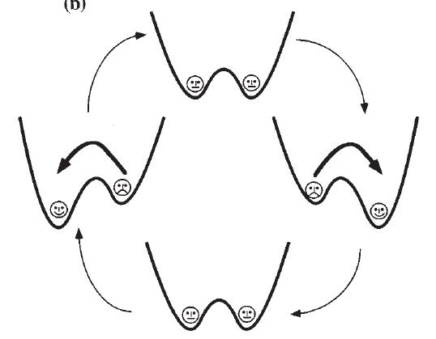
Stochastic Resonance (SR) in a nutshell
For bistable systems SR are ‘‘noise benefit effects’’ where input/output signal performance is tunable via a combination of a periodic single-frequency T_{Ω} input signal and broadband noise D∝k_{B}T. SR effects can be controlled by:
T= ½T_{Ω} optimal synchronization of the driving signal with the switching process
tuning the noise level with temperature D ∝ k_{B}T (T_{Ω} held constant)
periodic drive T_{Ω} (noise D held constant)
If the “stochastic switch” does no happen here…
…next chance is here!
Gammaitoni et al.: Stochastic resonance, RMP, Vol. 70, No. 1, 1998

Slide 9
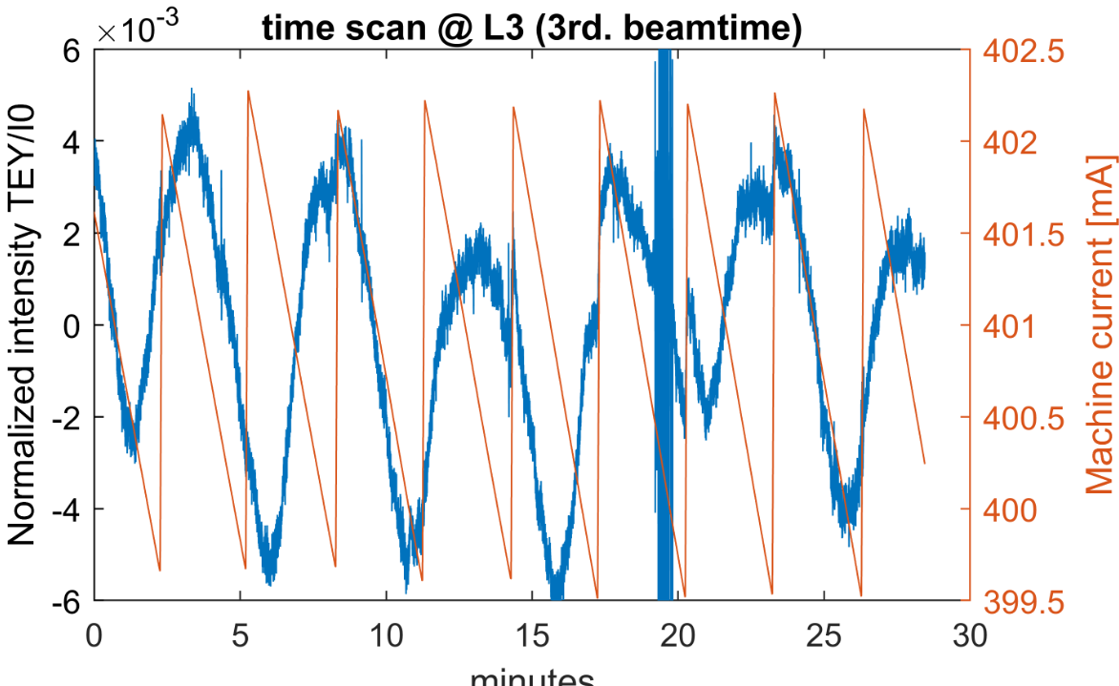
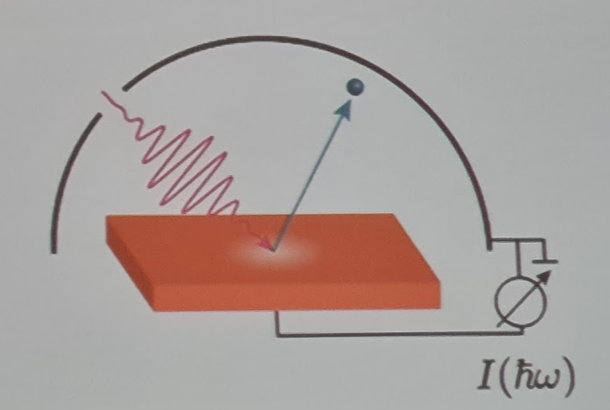
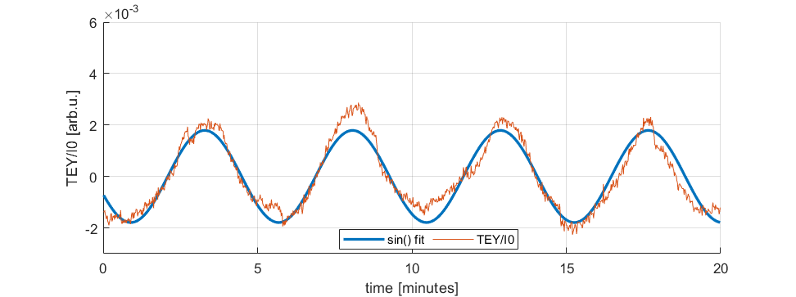
Stochastic Magnetization Resonance (1)
we observe oscillatory TEY

Slide 10
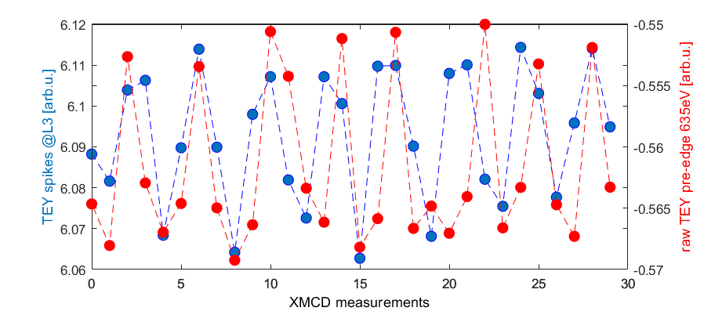
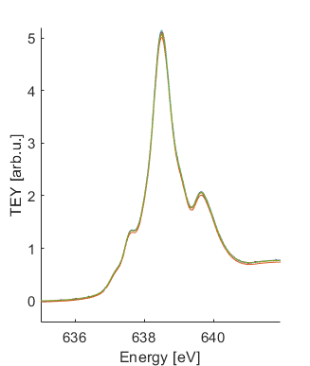
Stochastic Magnetization Resonance (2)
P
V

Slide 11
Stochastic Magnetization Resonance (3)
…very short TEY increase during Mn(L3) absorption
XMCD1
T_{Ω}
XMCD2
T_{Ω}
XMCD3…
T_{Ω}/2
T_{Ω}/2
C+ E₁ ➔ E₂
E₂➔E₁
C- E₁ ➔ E₂
E₂➔E₁
J. Krempaský et al.,, “Synchronized monochromator and insertion device energy scans at SLS,” AIP Conference Proceedings, vol. 1234, no. 1, Jun. 2010.

Slide 12
Stochastic Magnetization Resonance (4)
TEY_{MnL3}
TEY_{BKG}
TEY_{MnL3} and TEY_{BKG} are TWO “synchronized” signals➔ SMR ON
TEY_{BKG} is a frequency modulated signal
TEY_{MnL3} is an amplitude modulated signal (TEY_{MnL3} ≈2xTEY_{BKG})

Slide 13
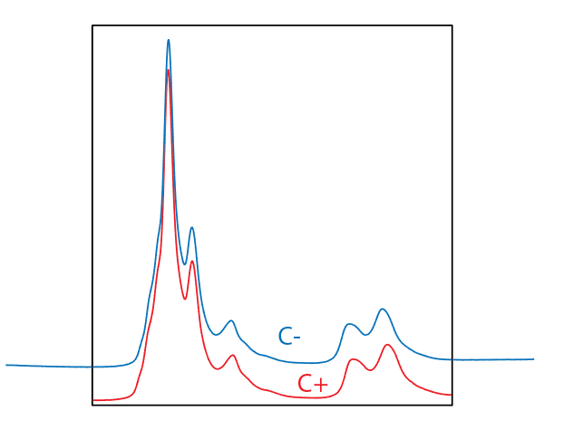
Stochastic Magnetization Resonance (5)
T₁
T₂
T₁
T₂
XMCD
E₁
➔E₂
E₃
➔E₄
TEY_{MnL3} and TEY_{BKG} are TWO non-synchronized signals
➔SMR OFF

Slide 14
Stochastic Magnetization Resonance on/off
XMCD1
XMCD2
XMCD3…
T_{Ω}
T_{Ω}
T_{Ω}
T₁
T₂
T₁
T₂
T₁
T₂
C+ E₁ ➔ E₂
E₂➔E₁
C- E₁ ➔ E₂
E₂➔E₁
*
Stochastic Magnetization Resonance ON T₁=T₂=T → T= ½T_{Ω}
Stochastic Magnetization Resonance OFF T₁>T₂→ T₁,T₂ ≠ ½T_{Ω}
*Rule #1: optimal stochastic resonance condition

Slide 15
Stochastic resonance on/off comparison
0T (≈6%)
≈6%

Slide 16
Quantifying the SMR switching
1
0
0
1
1
We count AFM switching events, i.e. evaluate a binomial distribution as “switch” or “no switch” in a set of n*T_{Ω} XMCD measurements
We count SR retention times, i.e. how many T_{Ω} cycles it takes before an AFM switch occurs
3
0
0
2
1
2
3
Example: In these series of 40 XMCD measurements there are 15 switches out of 40 measurements, so the switching probability is 15/40=0.375. Retention time estimates: bottom-up I see that before the first switch there are 6 spectra that look the same, or without switching, and the next switch happens after 5 XMCD cycles, etc… The retention times are summed for all experiments made at the same temperatures and T_{Ω}.
Retention
times
0
5
switches
6

Slide 17
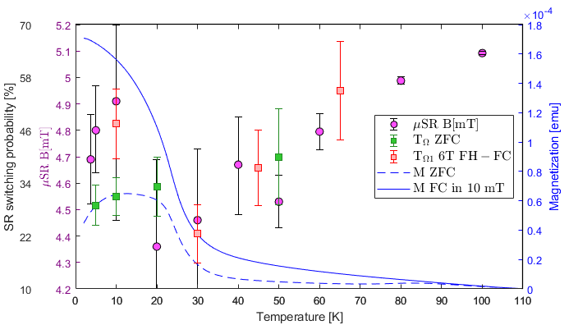
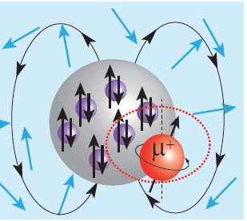
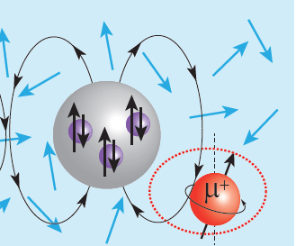
Switching probability and spin glass
≈35 K
Switching probability follows M(T) curves below T=35K
Above 35K thermally activated
Switching has to be collective !
Splitting of FC and ZFC curves indicates spin glass
μSR ”negative B-shift” of local B-mean field is characteristic to diluted magnetic semiconductors where magnetic clusters form out of spin glass

Slide 18
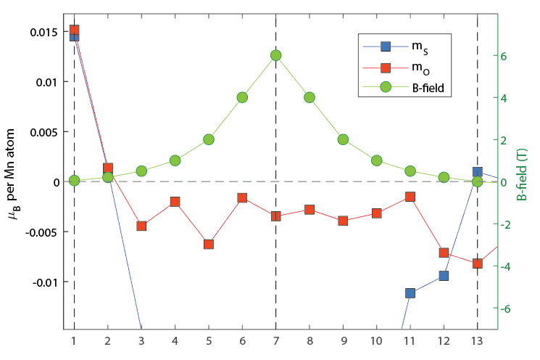
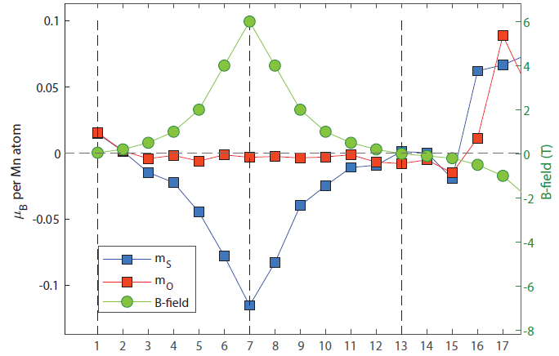
Spin and Orbital moments under SMR
FH-FC @ 6T, 10K
init
coalescence
fluctuations
measurements
measurements

Slide 19
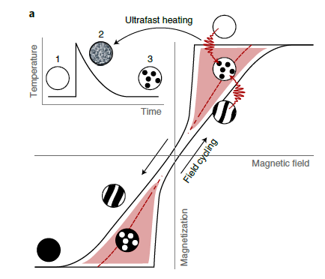
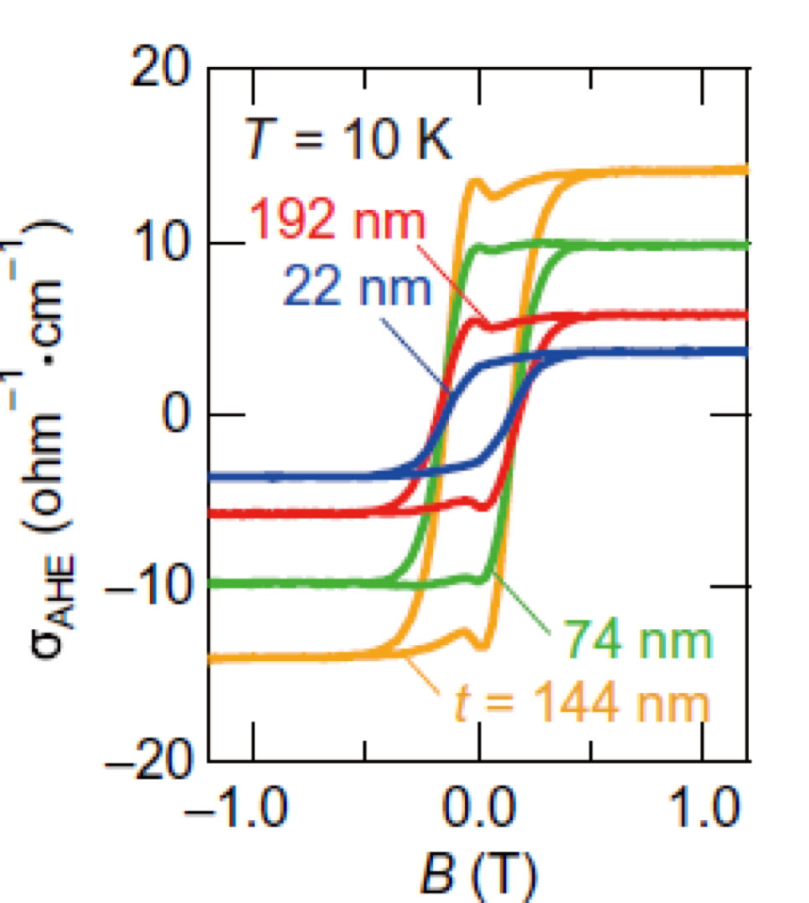
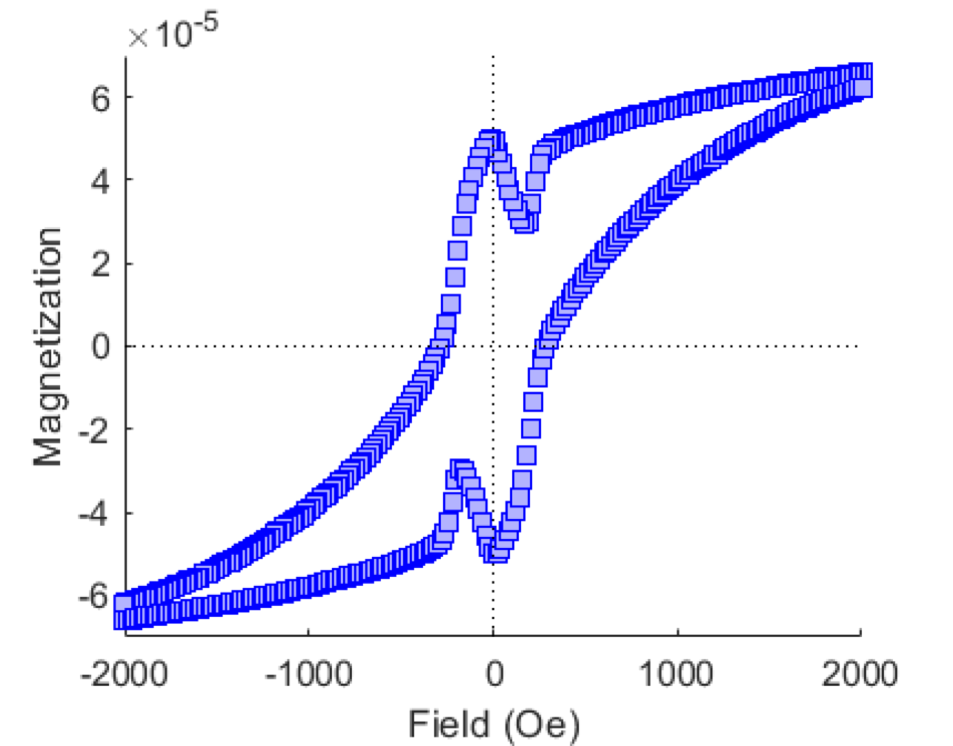
Spin and Orbital moments under SMR
Yoshimi et al., Sci. Adv. 2018
Coercive field of ~0.05T
Saturation at ~0.1T
Cusps in magnetisation before reaching remanence, also observed in anomalous Hall coefficient
Suggested to be related to skyrmions
F. Büttner et al., Nat. Mat. 20, 2021
measurements

Slide 20
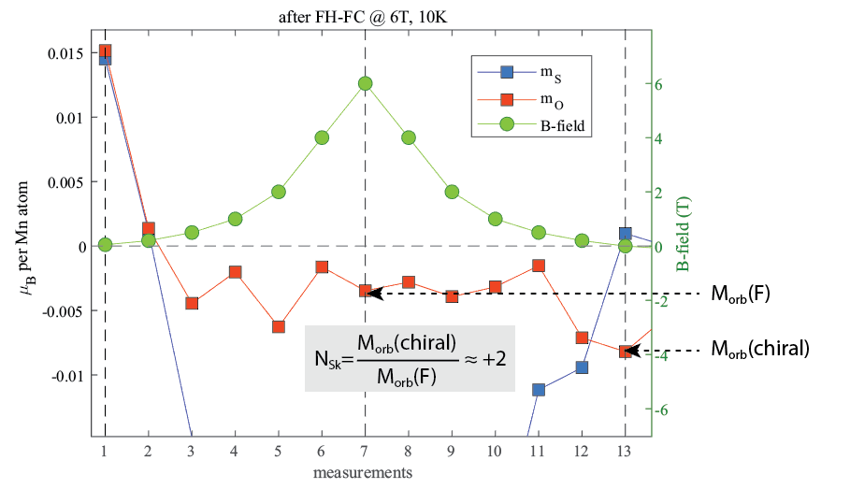
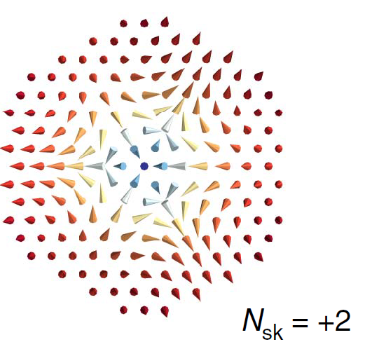

Slide 21
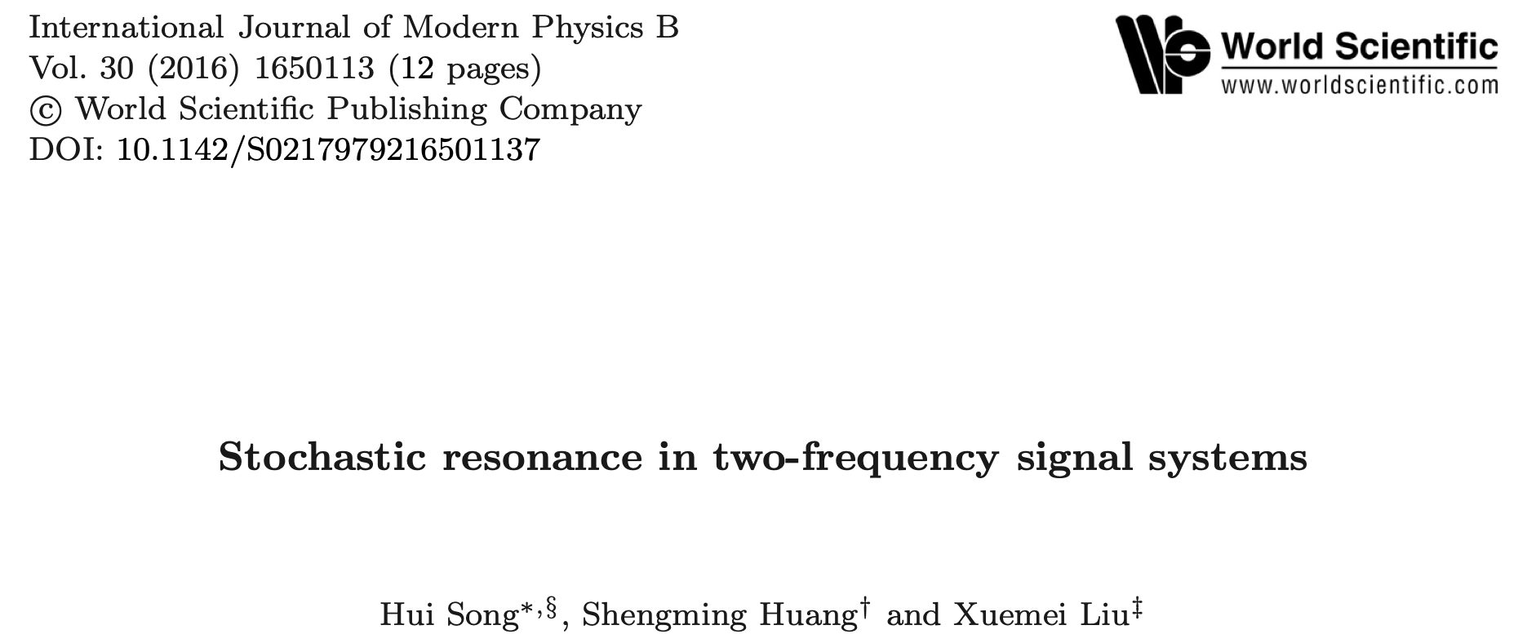
Conclusions
Direct evidence of light-induced, non-thermal ferrimagnetic switching
Theoretical model of magnetostochastic resonance is developed. It is shown that in the presence of noise the signal-to-noise ratio for a bistable uniaxial ferromagnet can be a million times greater than that for a one-stable ferromagnet.
Combination of FM and AM frequency signal can turn stochastic resonance on and off

Slide 22
Conclusions
Direct evidence of light-induced, non-thermal ferrimagnetic switching
Spin glass collective magnetization switching
Spin glass collective dynamics with skyrmion-like excitations

Slide 23
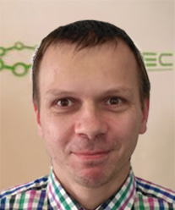
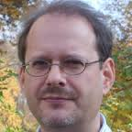
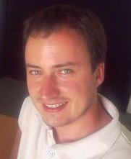
Acknowledgements
Spin-Orbit Interaction Spectroscopy group
PSI: SIS beamline
COPHEE
Ondrej Caha
Masaryk Univ. Brno
Gunther Springholz
Hugo Dil
µSR experiments and analysis
Zaher Salman
Jan Minar Sunil D’Souza
Martin Gmitra
XMCD support and PSI sample characterization
Cinthia Piamonteze
Valerio Scagnoli
Carlos Vaz

