Slide 1
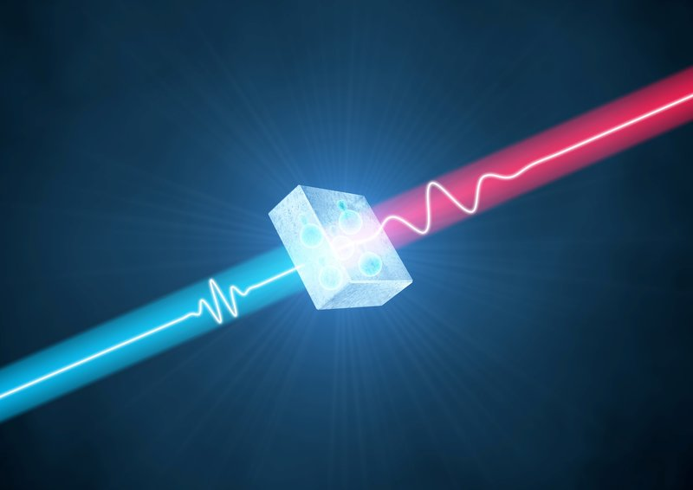
Quantum Imaging with X–Ray Radiation
Sharon Shwartz
Bar Ilan University, Israel
Notes:
Hello, my name is Edward Strizhevsky
I am very excited to be here and present our work.
This work is the first demonstration of beam splitter interaction with heralded single X-ray photon.
It was performed by our research group from Bar Ilan University in Israel which includes me, Denis Borodin, Avia Schori and our group leader Sharon Shwartz.
And our colleagues from DESY Germany - Sonia and Ralf

Slide 2
Acknowledgments
Bar Ilan
Denis Borodin (HP)
Aviad Schori (startup)
Edward Strizhevsky
Sason Sofer
Sergey Volkovich
European Synchrotron Radiation Facility
Federico Zontone
PETRA III
Sonia Francoual
DESY/Jena
Ralf Röhlsberger
SPring8
Kenji Tamasaku

Slide 3
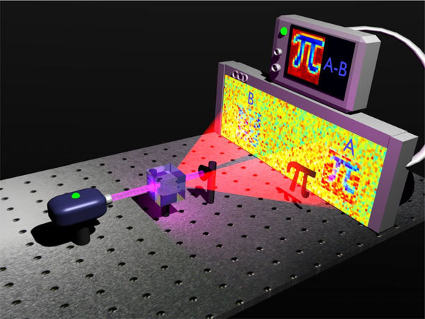
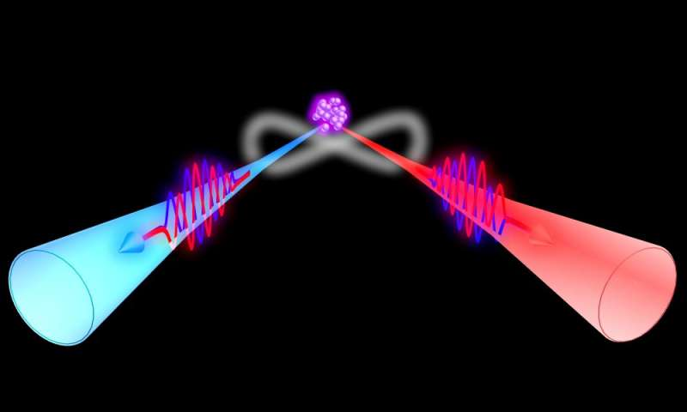
Quantum optics
Generation and manipulation of quantum states of light
( single photons, squeezed light, NOON states…)
Measurement improvement
Quantum imaging
Quantum metrology
Quantum sensing
Fundamental Physics
Entanglement
Bell inequality violation
Quantum discord
Notes:
https://pubs.acs.org/doi/pdf/10.1021/acs.jpcc.5b00894

Slide 4
Why x-ray quantum optics?
Test of fundamental quantum effects in a new regime
Detectors: 1.High quantum efficiency
2. Low dark count rate
3. Resolve photon number
Improve spatial and temporal resolution (Angstrom and sub attosecond)
Reconstruct complex structures
Improve stability (high phase sensitivity) and noise reduction
X-rays are ionization radiation- quantum optics can reduce radiation damage

Slide 5
How to generate quantum states of radiation

Slide 6
Spontaneous parametric down-conversion
The pump photons interact with the vacuum fluctuations of the EM field → generate signal and idler photon pairs that are always correlated in space and time
All the frequencies exist in the vacuum
⍵_{s} signal
⍵_{p}
Nonlinear Medium
⍵_{i} idler
Energy and momentum conservation (phase matching)
The signal and idler are anti-correlated in energy and in k-vector

Slide 7
Properties of down-converted photons
Always generated in pairs- the existence of one photon implies the existence of the second
Entanglement in time-frequency and in momentum (and sometimes in polarization)- can measure both space and momentum and time and frequency beyond the uncertainty principle and violate the Bell’s inequality
Squeezing- one beam, with low noise below the shot noise limit (depends on the conversion efficiency)

Slide 8
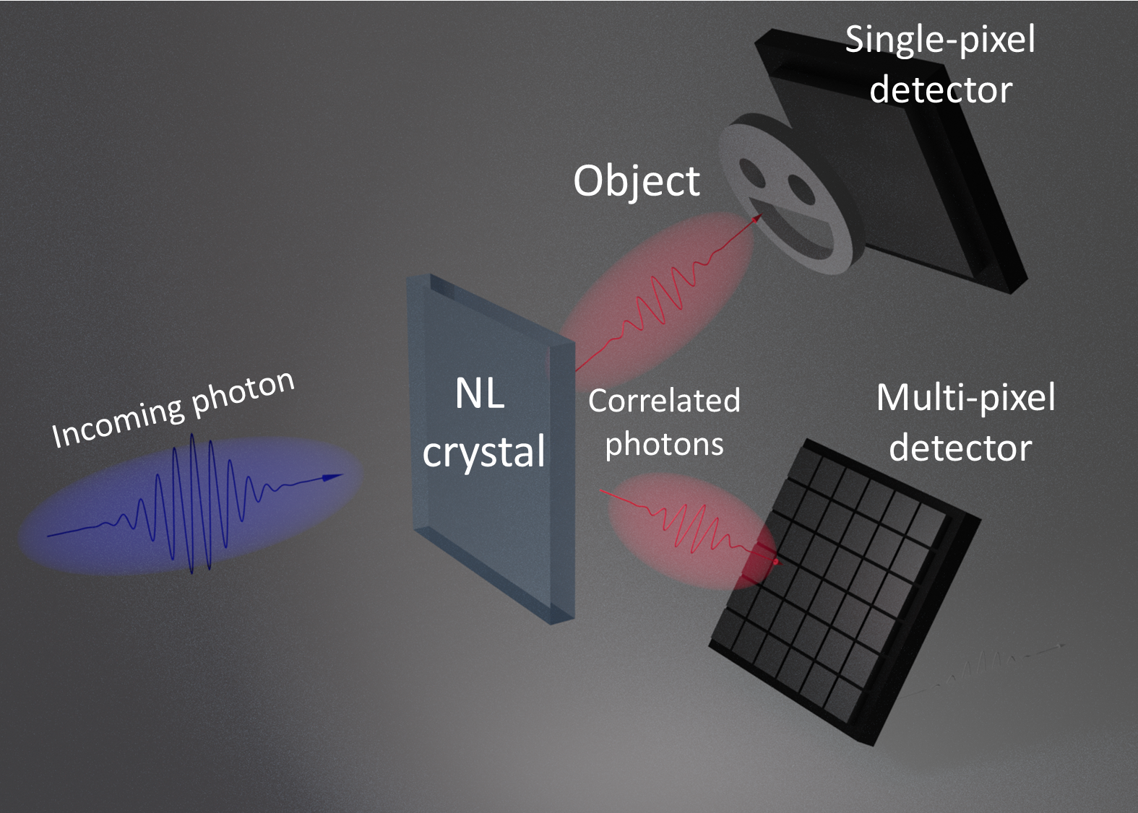
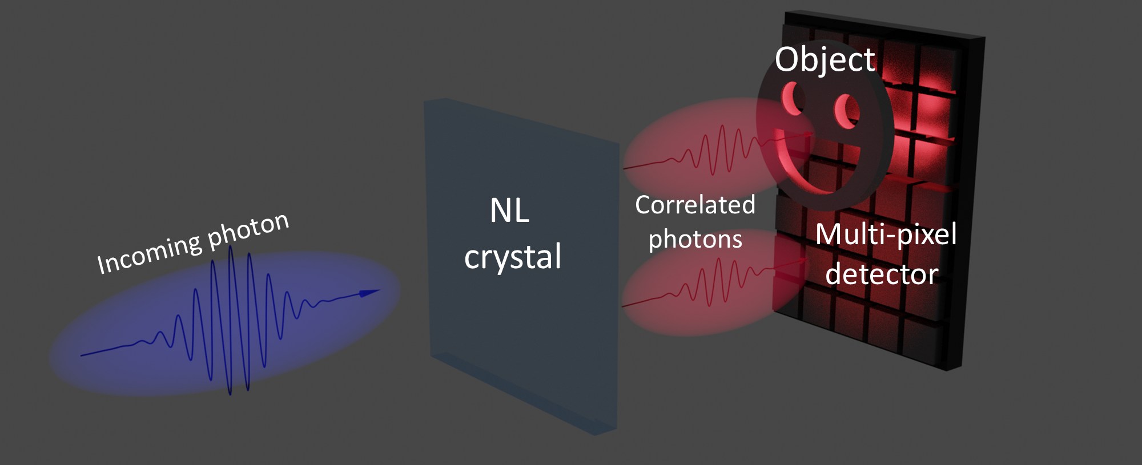
Schemes for quantum imaging at low light levels
Ghost imaging/single pixel imaging
P.A. Morris, et al. Nat. Comm. 6, 5913 , 5913 (2015)
Twin beam correlation
G. Brida et al. Nature Photon 4, 227 (2010).

Slide 9
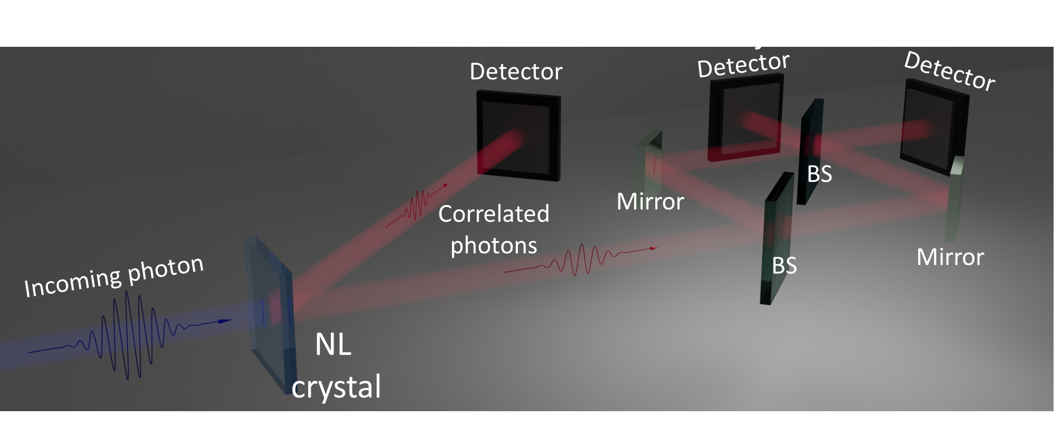
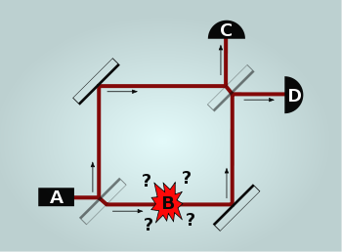
Schemes for quantum interferometry
Single photon interferometer
”Interaction free” measurement- information from wave function interaction
A. Elitzur, L. Vaidman, Lev , Foundations of Physics. 23 , 987 (1993)

Slide 10


X-ray nonlinearity
X-rays photon energies >>binding energies of the electrons
Model for nonlinearity – cold plasma model
$$\frac{∂\vec{v}}{∂t}+\left(\vec{v}⋅∇\right)\vec{v}=−\frac{e}{m}\left(\vec{E}+\vec{v}×\vec{B}\right)$$
Equation of motion
$$\frac{∂ρ}{∂t}+∇\left(ρ\vec{v}\right)=0$$
Continuity equation
Nonlinear interaction exists even in centrosymmetric crystals

Slide 11
Phase-matching
Atomic planes
is the angle between the pump k vector and the atomic planes of the crystal.
is the reciprocal lattice vector

Slide 12
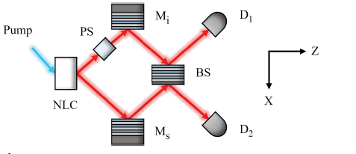

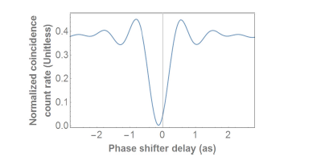
Sub-Attosecond Correlation Time –X-Ray PDC
Hong-Ou-Mandel effect
S. Volkovich and S. Shwartz, Opt. Lett. 45, 2728 (2020).

Slide 13
Experiments

Slide 14
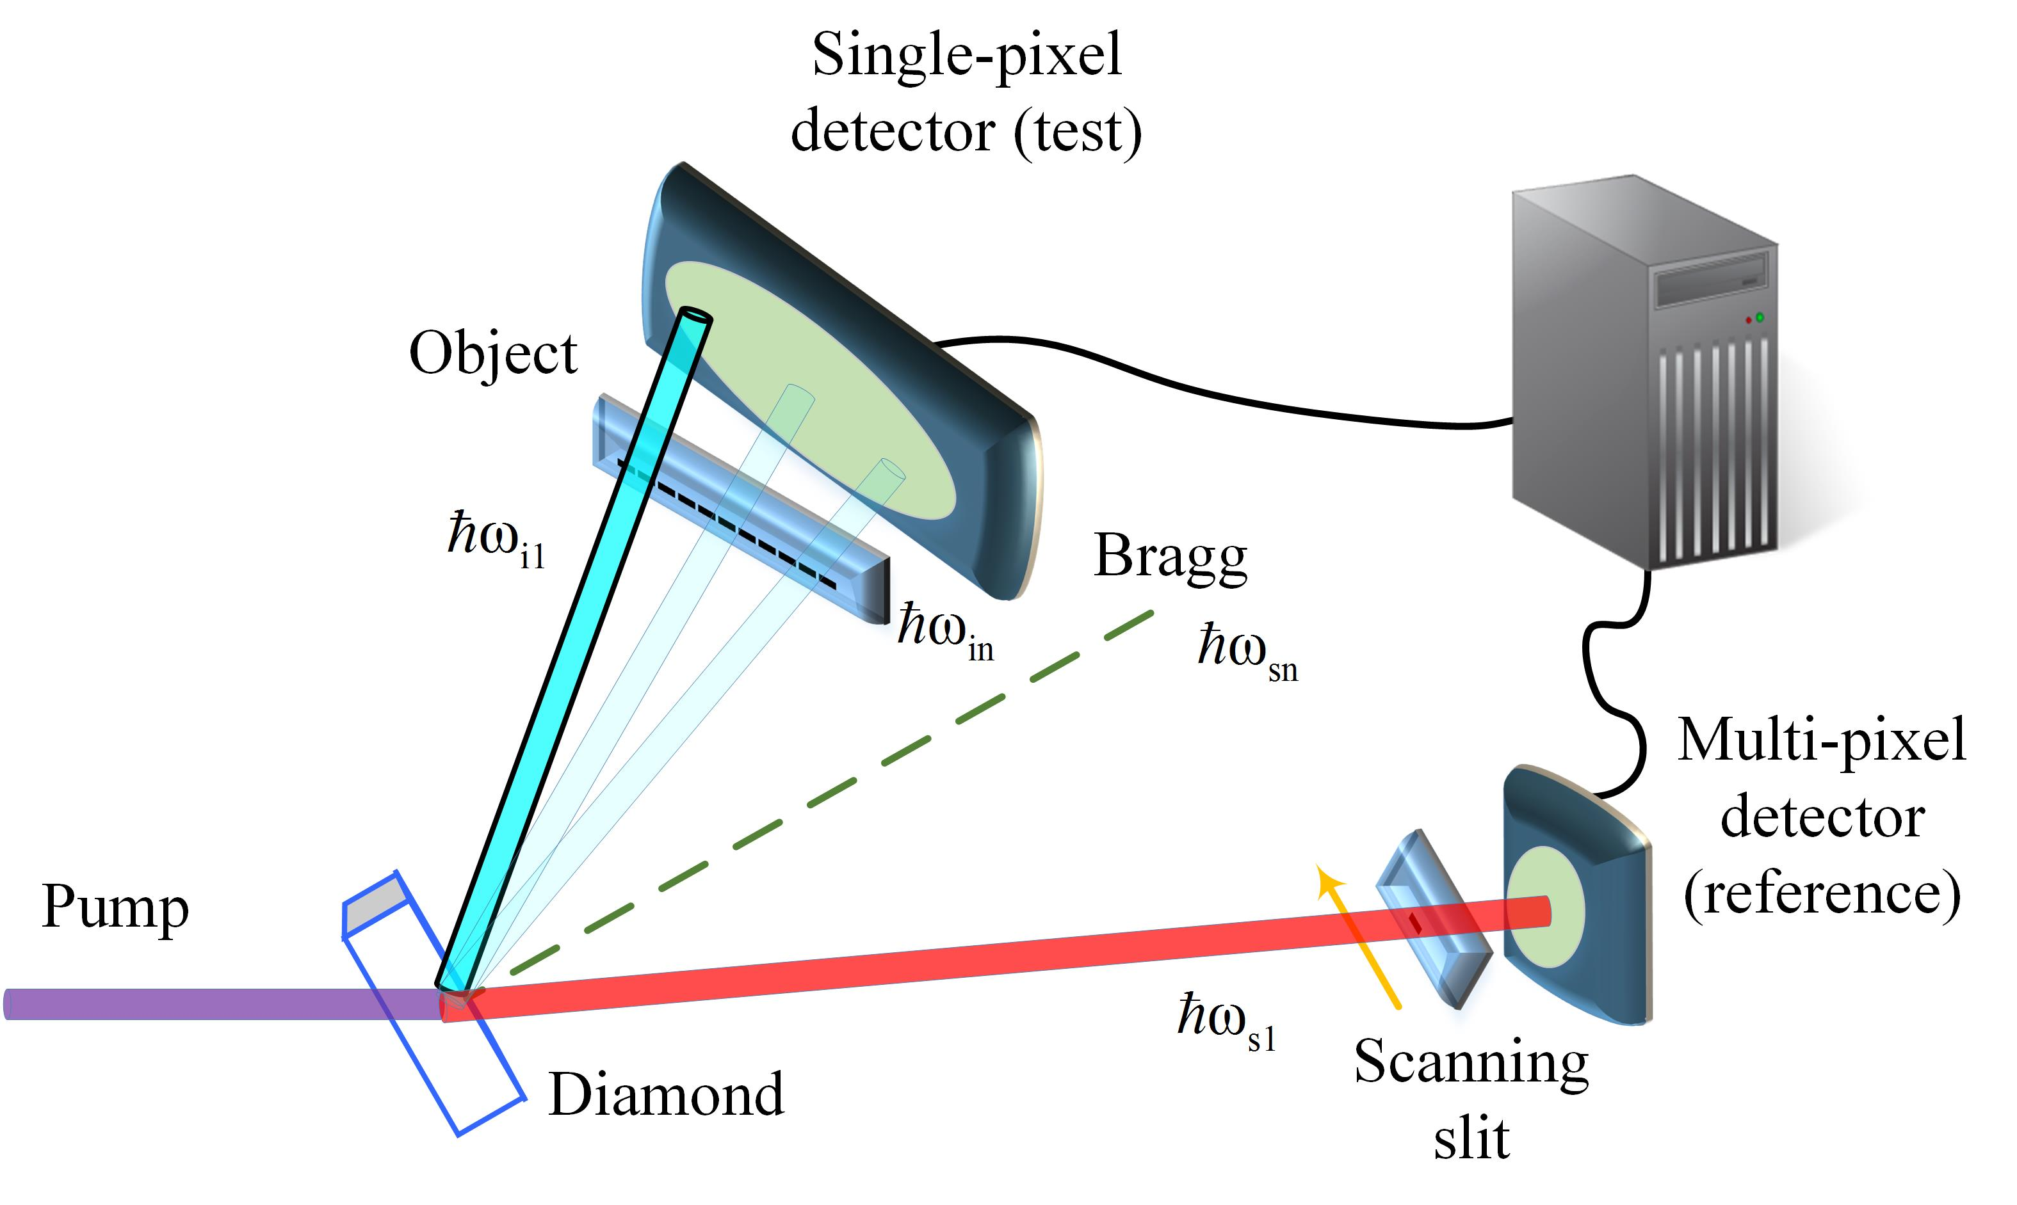
Experimental System
Monochromatic input (22.3 keV)
C(660)

Slide 15
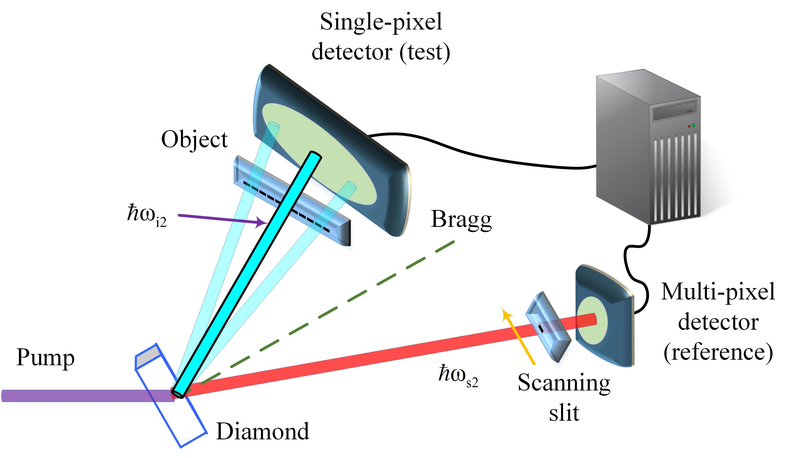
Experimental System
Monochromatic input (22.3 keV)
C(660)

Slide 16
Ghost Imaging Results
4 mm slit
2 μm slit
A. Schori, D. Borodin, K.Tamasaku, and S. Shwartz Phys. Rev. A, 97, 063804 (2018)

Slide 17

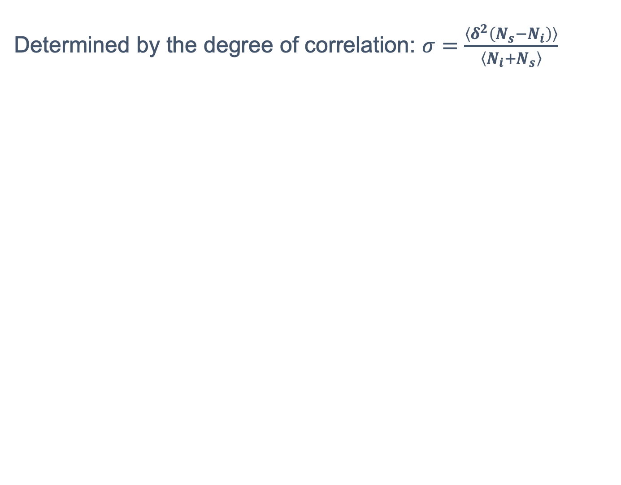
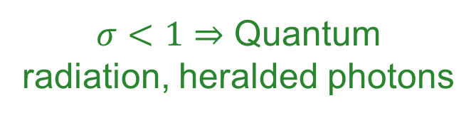
Single Photons
Determined by the degree of correlation: $σ=\frac{〈δ^{2}\left(N_{s}−N_{i}\right)〉}{〈N_{i}+N_{s}〉}$
$σ<1⇒$ Quantum radiation, heralded photons
$σ≥1⇒$ Classical beams

Slide 18
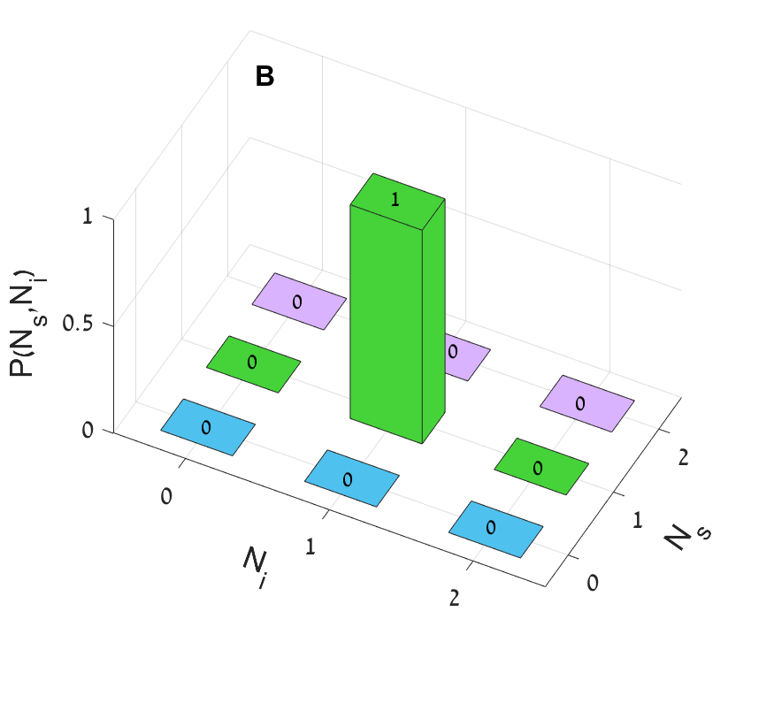


Experimental results: demonstration of single photon statistics
$σ=\frac{〈δ^{2}\left(N_{s}−N_{i}\right)〉}{〈N_{i}+N_{s}〉}$ =0
Energy conservation filter $ω_{p}=ω_{s}+ω_{i}$
Time filter $t_{s}=t_{i}$
S. Sofer, E. Strizhevsky, A. Schori, K. Tamasaku, and S. Shwartz Phys. Rev. X 9 , 031033

Slide 19
Quantum illumination
Quantum Illumination – target detection in a noisy environment
Improve detection even when the entanglement is lost
Seth Lloyd, Science 321, 1463 (2008)
Classical detection
Quantum illumination

Slide 20

Quantum enhanced x-ray detection
X-ray PDC is the source for entangled photons, use two single pixel detectors (scanning mode)
Noise sources – Compton scattering and fluorescence (4 orders of magnitude stronger than the signal)-lead to random false coincidences
Energy conservation filter $ω_{p}=ω_{s}+ω_{i}$
Time filter $t_{s}=t_{i}$

Slide 21


Quantum enhanced x-ray detection- imaging of a triple slit
Quantum radiation-$visibility \sim 0.99$
Direct image- $visibility \sim 0.23$
Quantum radiation shows much higher visibility !
S. Sofer, E. Strizhevsky, A. Schori, K. Tamasaku, and S. Shwartz Phys. Rev. X 9 , 031033 (2019)

Slide 22
X-ray Quantum Optics –
What Do We Need?
Quantum statistics
with these devices:
Optical components:
  Available!
X-ray Optical Components
Parametric Down Conversion:
  Available!
Silicon Drift Detectors:
  Available!
X-ray Quantum State of Light
X-ray Quantum Optics
Good Detectors
Notes:
Talk:
What do we need for X-ray quantum optics?
Click
Click:
We need X-ray quantum state of light –
We generated quantum light by parametric down conversion – I will elaborate about it a bit later
We need good X-ray detectors
We have Silicon drift detectors – which have nearly ideal efficiency and practically zero dark count rate
We need X-ray optical components
There are optical components – beam splitters and mirrors
But quantum statistics with these devices was never demonstrated

Slide 23
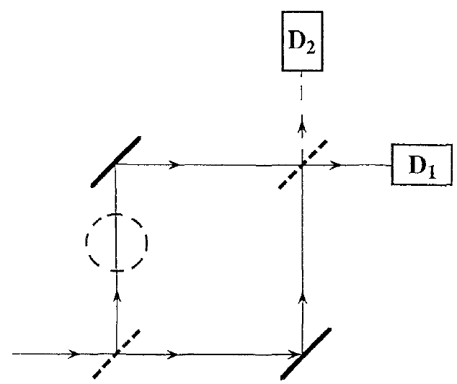
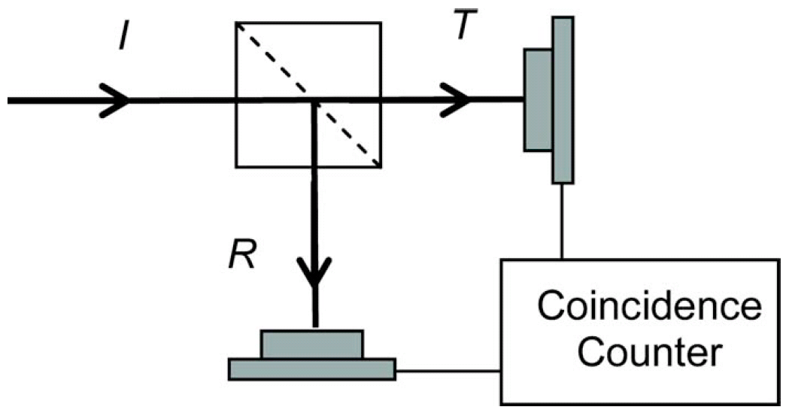
Fundamental Optical Component – Beam Splitter!
Essential for quantum optics
Superposition of photon states:
  Mach-Zehnder interferometer
  Interaction-free measurements
  Hong-Ou-Mandel experiment
Light intensity interferometer (HBT):
  Single photon input – zero correlations!
  No classical analog – unique to quantum optics!
A. C. Elitzur and L. Vaidman, Found. Phys. 23, 987 (1993)
P. Grangier, G. Roger, and A. Aspect, Europhys. Lett. 1, 173 (1986)
C. K. Hong, Z. Y. Ou, and L. Mandel, Phys. Rev. Lett. 59, 2044 (1987)
R. H. Brown and R. Q. Twiss, Nature 177, 27 (1956)
M. Beck, J. Opt. Soc. Am. B 24, 2972 (2007)
Notes:
The optical component that we chose for the demonstration of X-ray quantum behavior is a beam splitter.
Click
It is an essential optical component for quantum optics.
Bean splitters are in the heart of famous experiments that measure quantum properties of light
Click
Some of them demonstrate superposition of photon states - few examples are
- The mach zehnder interferometer with single photons
- Interaction free experiment which is also based on Mach Zehnder interferometer
- And the Hong-Ou-Mandel experiment
Click
Another famous demonstration of quantum statistics is the intensity interferometer or Brown and Twiss experiment
Click
This is the type of interferometer that we used in our experiment
Click
It has a unique result for single photon input.
For this case, there will be zero correlation between the two outputs of the beam splitter.
In other words – single photon could be detected by only one of the detectors – it could be either transmitted or reflected but never both simultaneously
Click
It has no classical analog – since the intensity of a classical bean could be measured simultaneously at the two outputs

Slide 24
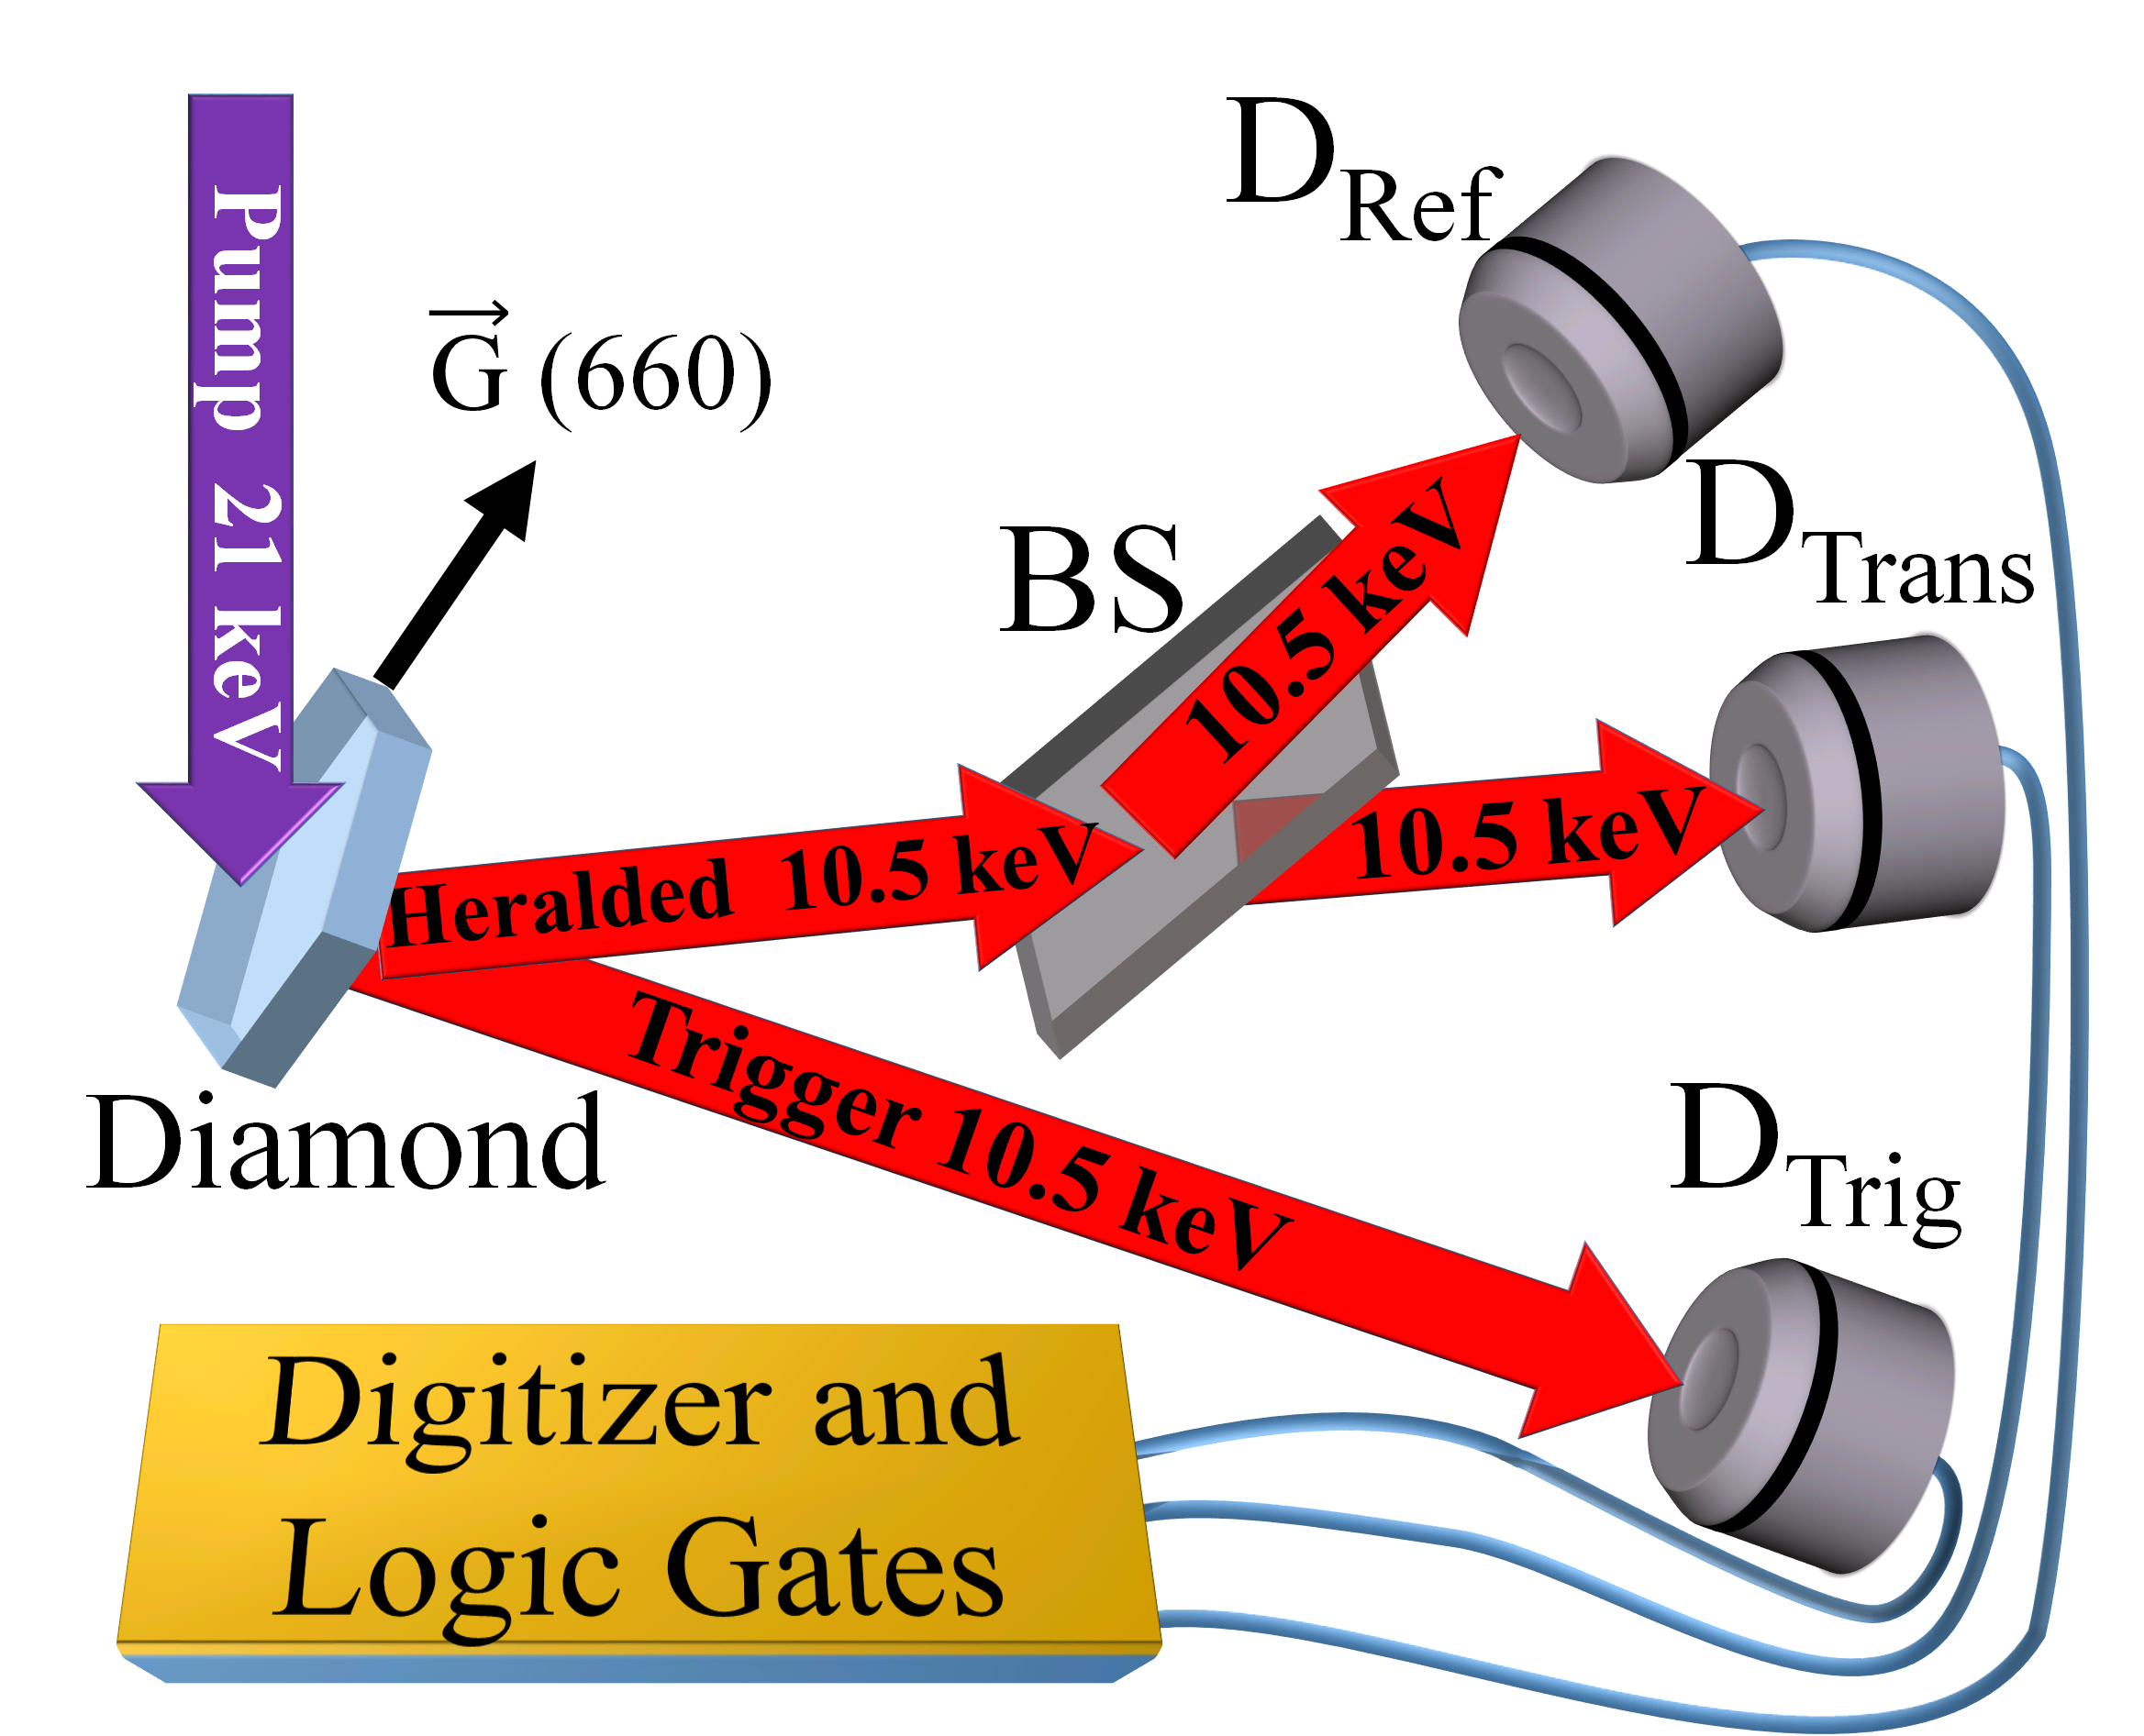

Use Beam Splitters for Quantum Optics
Heralded photons
Pure quantum result!
$$α=\frac{N_{RT}N_{Trig}}{N_{R}N_{T}}$$
Zero
E. Strizhevsky. et al. Phys. Rev. Let. 127, 013603 (2021)
Notes:
Talk:
Now I will present the experimental setup and the measurement logic
Click:
The synchrotron beam – the pump photon – hits the nonlinear crystal – the diamond.
Click:
A photon pair is generated – one, which we call trigger, goes to trigger detector DTrig the other goes to the beam splitter.
At the two outputs of the beam splitter there are two detectors for Reflected and Transmitted photons.
Click:
To identify the PDC photon pair from the background noise, we need two things:
First, we need photons that are detected simultaneously at the trigger detector and at least at one of the detectors at the outputs of the beam splitter.
We use logic gates for this.
Click:
Second, these simultaneously arriving photons should conserve energy with the pump photon
We use for this the energy resolution of our detectors.
Click:
After we verified that we have a PDC photon pair – we know that we have heralded single photon before the beam splitter
Click:
To show the quantum statistics we calculated the anticorrelation criterion.
It measures in how many events we measured two photons at the outputs of the beam splitter.
For heralded single photon it should be zero – because one photon cannot split!
Click:
This is a pure quantum behavior!

Slide 25


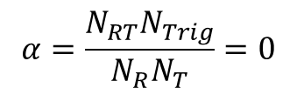
Single Photon Cannot Split!
Only heralded single photons:
No heralding - same number of pairs:
No heralding – 100 times more pairs:
$$α=\frac{N_{RT}N_{Trig}}{N_{R}N_{T}}=0$$
$$α=0.02±0.006$$
$$α=0.0168±0.0006$$
E. Strizhevsky. et al. Phys. Rev. Let. 127, 013603 (2021)
Notes:
Talk:
After we showed that the beam splitter is efficient, we can demonstrate X-ray quantum statistics with it.
We compare the anticorrelation criterion for heralded single photons and simultaneously arriving background noise that does not conserve energy
Click:
We see that for true heralded single photons there is zero correlation as predicted by quantum theory
For noise with the same number of simultaneously arriving background photons there is non-zero correlation
And when we increase by a factor of hundred the number of pairs, the number of correlation events at the beam splitter outputs also increased – as expected from non single photon light source

Slide 26
Summary and outlook
First proof of principle experiments on quantum imaging with x-rays- demonstrate the feasibility
Main challenges:
  Low efficiency
  Integration with optics
High repetition rate FELs can make quantum imaging practical (# photons per mode)
X-ray-optical SPDC can provide higher rates

Slide 27
Potential advantages
  Low irradiation levels (to prevent sample damage)
  Noise immunization
  Very high temporal resolution (sub attosecond)
  Recontraction of complex objects at high resolution
  Phase sensitivity

