Slide 1
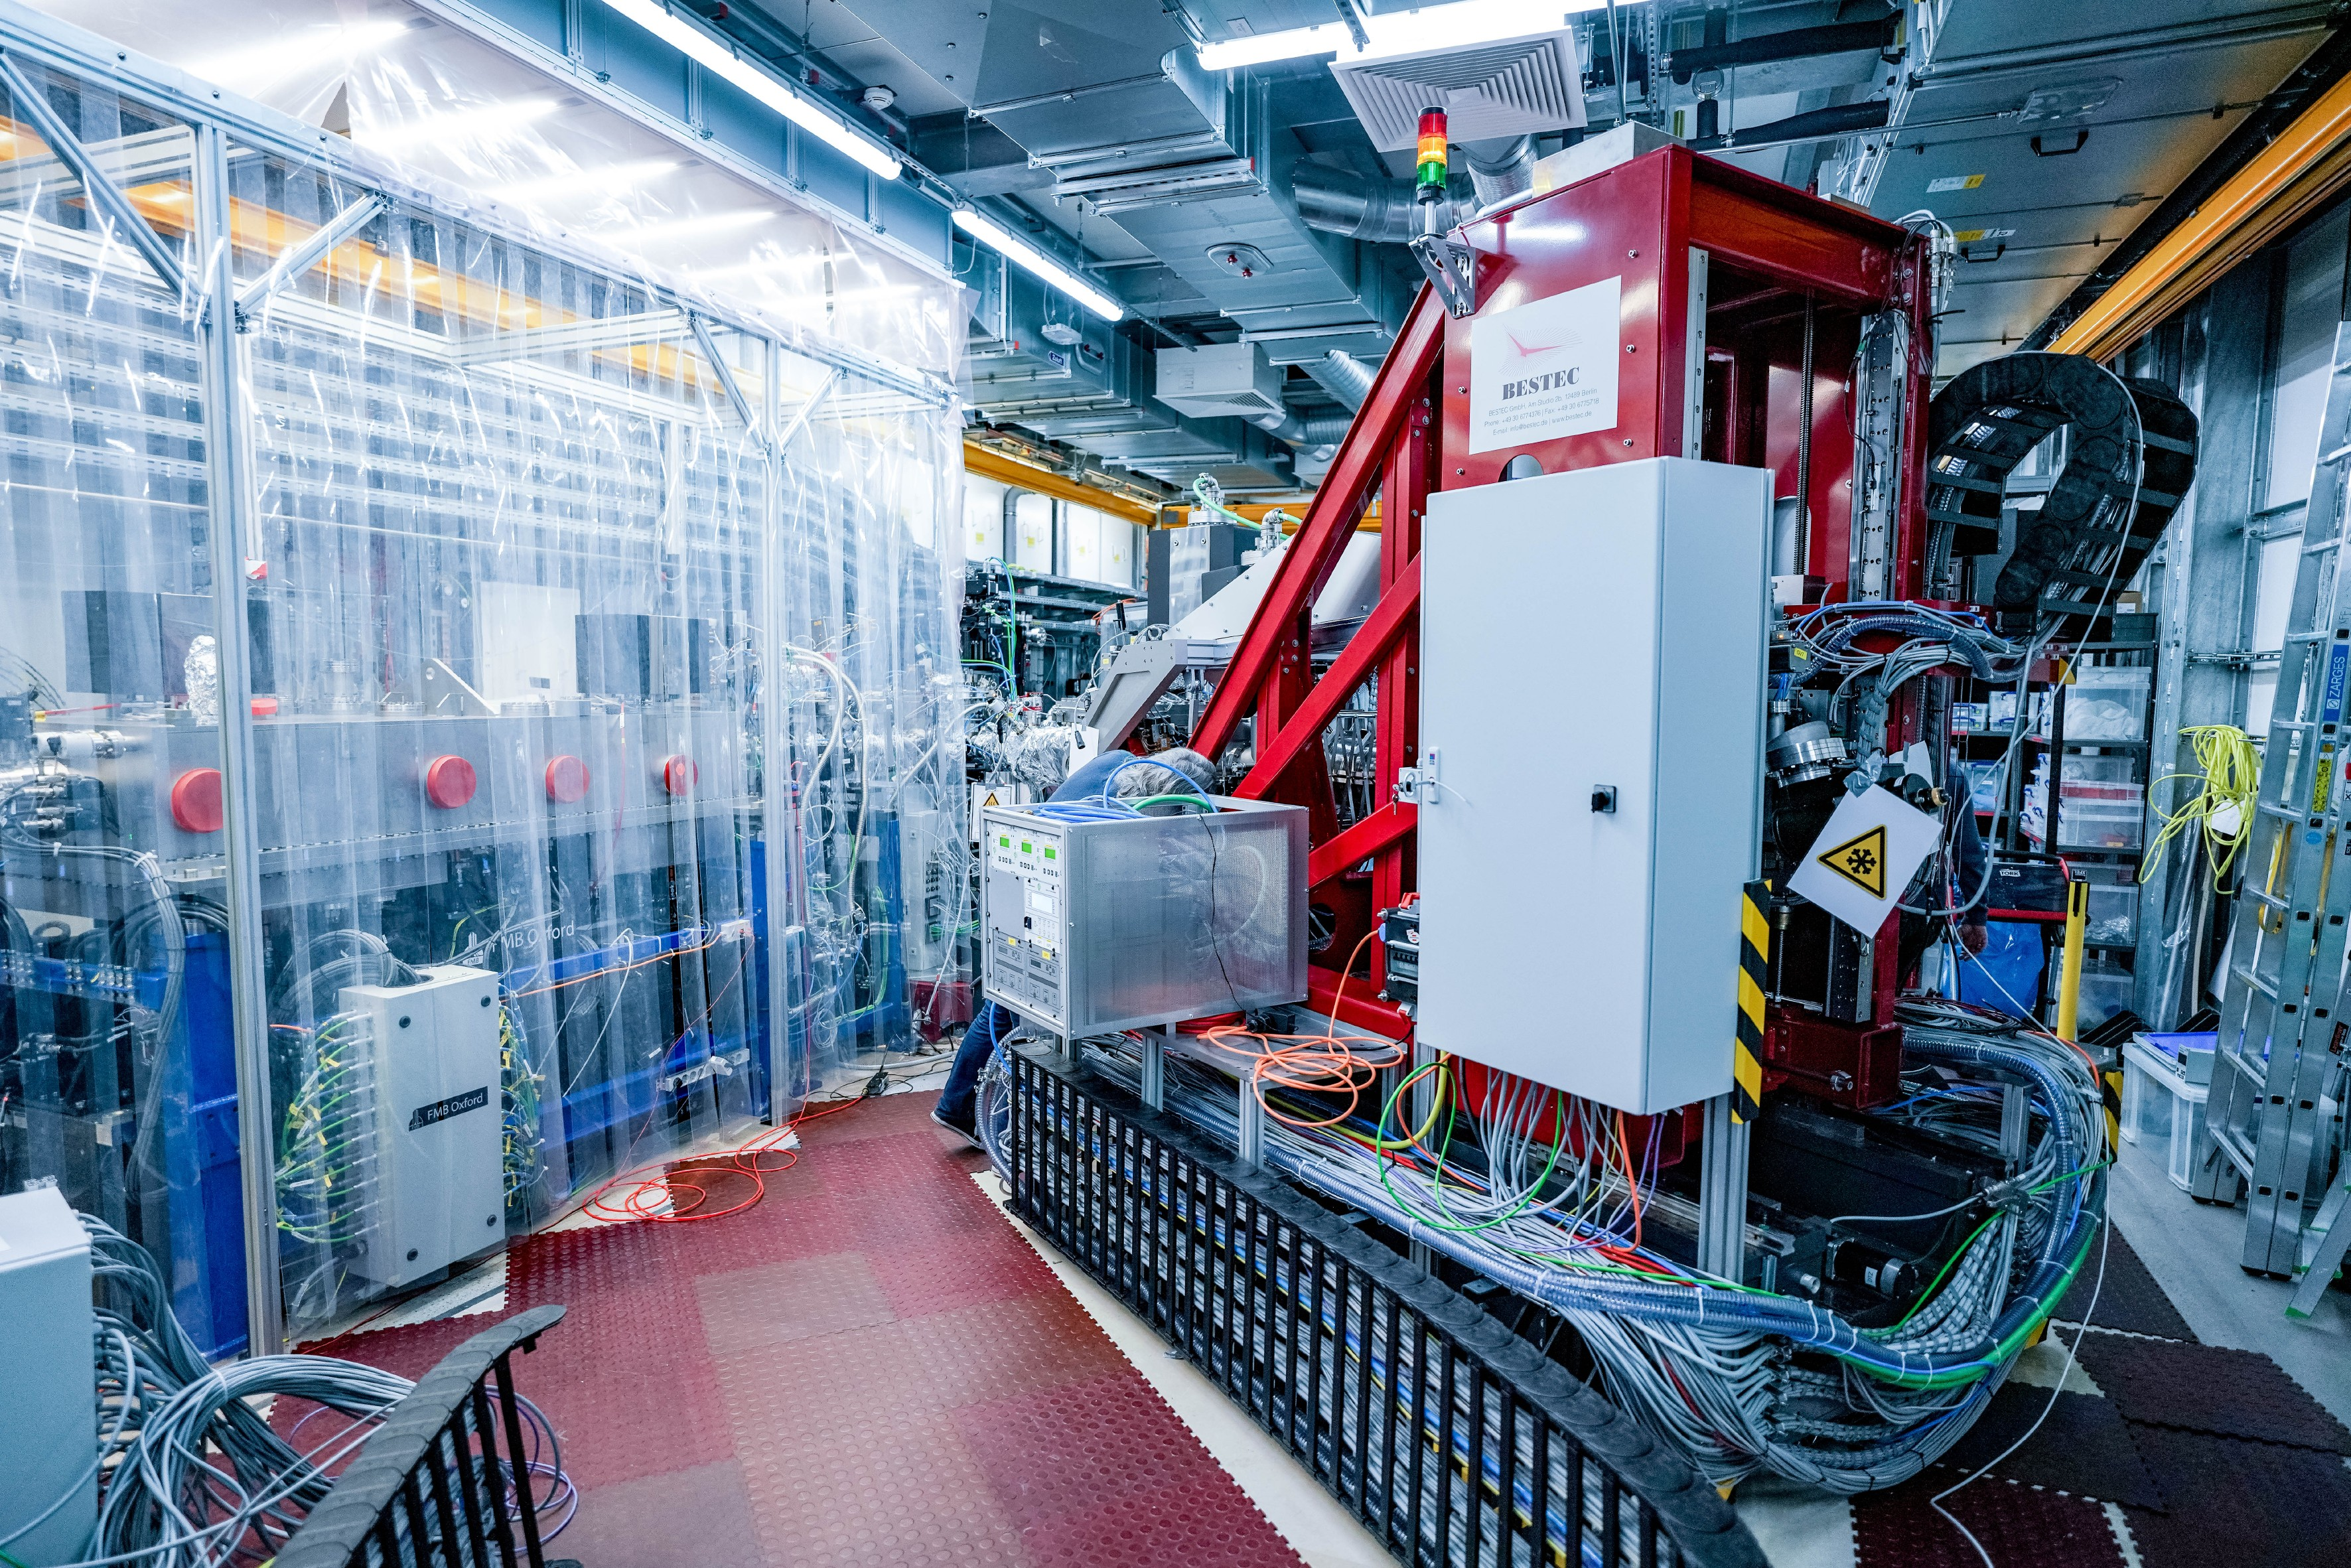
Opportunities to unravel the electronic and structural properties of quantum materials and complex system nanostructures on femtosecond time scales at SCS instrument
Andreas Scherz
Spectroscopy and Coherent Scattering
(SCS instrument)
LEAPS, 15-20 May 2022

Slide 2
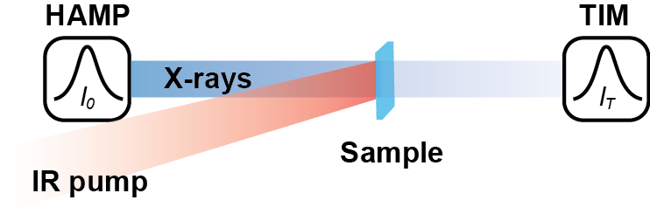
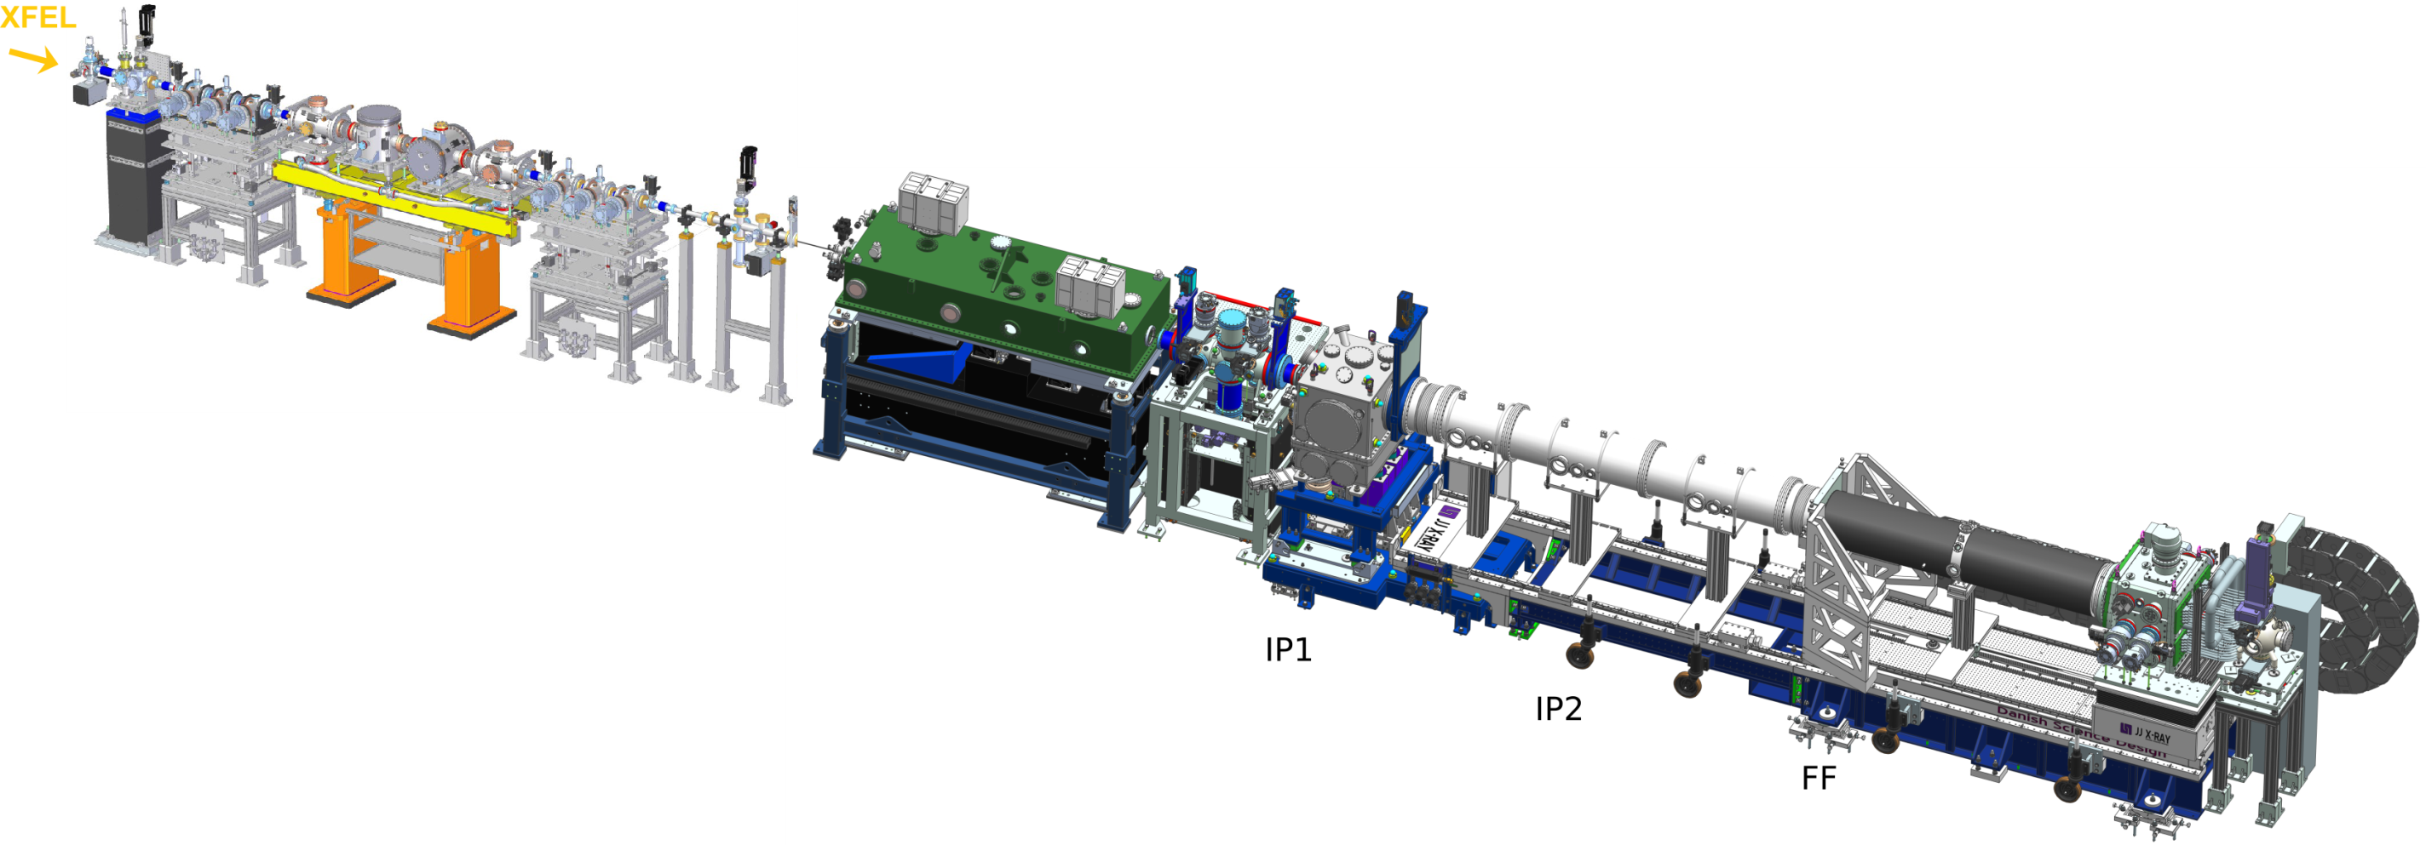
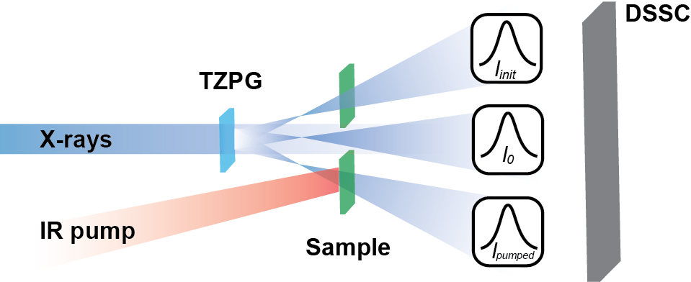
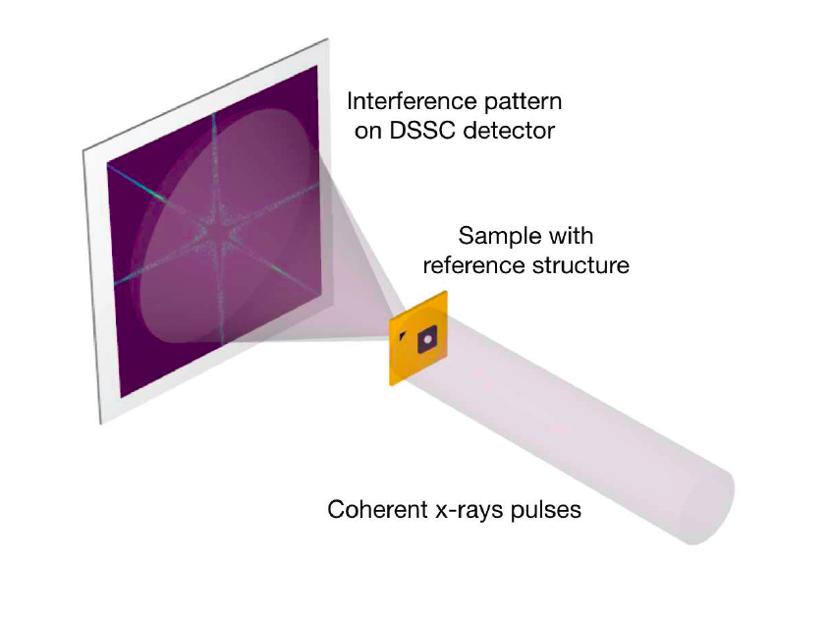
SCS instrumentation for forward scattering geometries
Spectroscopy
Coherent Scattering
SAXS
Spectroscopy and
Coherent Scattering (SCS):
Soft x-ray beamline 0.5 – 3keV
Time-resolved/ non-linear x-ray spectroscopies
Time-resolved/ non-linear x-ray diffraction
Forward- / small-angle scattering geometries
Notes:
TZPG- Zone plates are available for users.

Slide 3
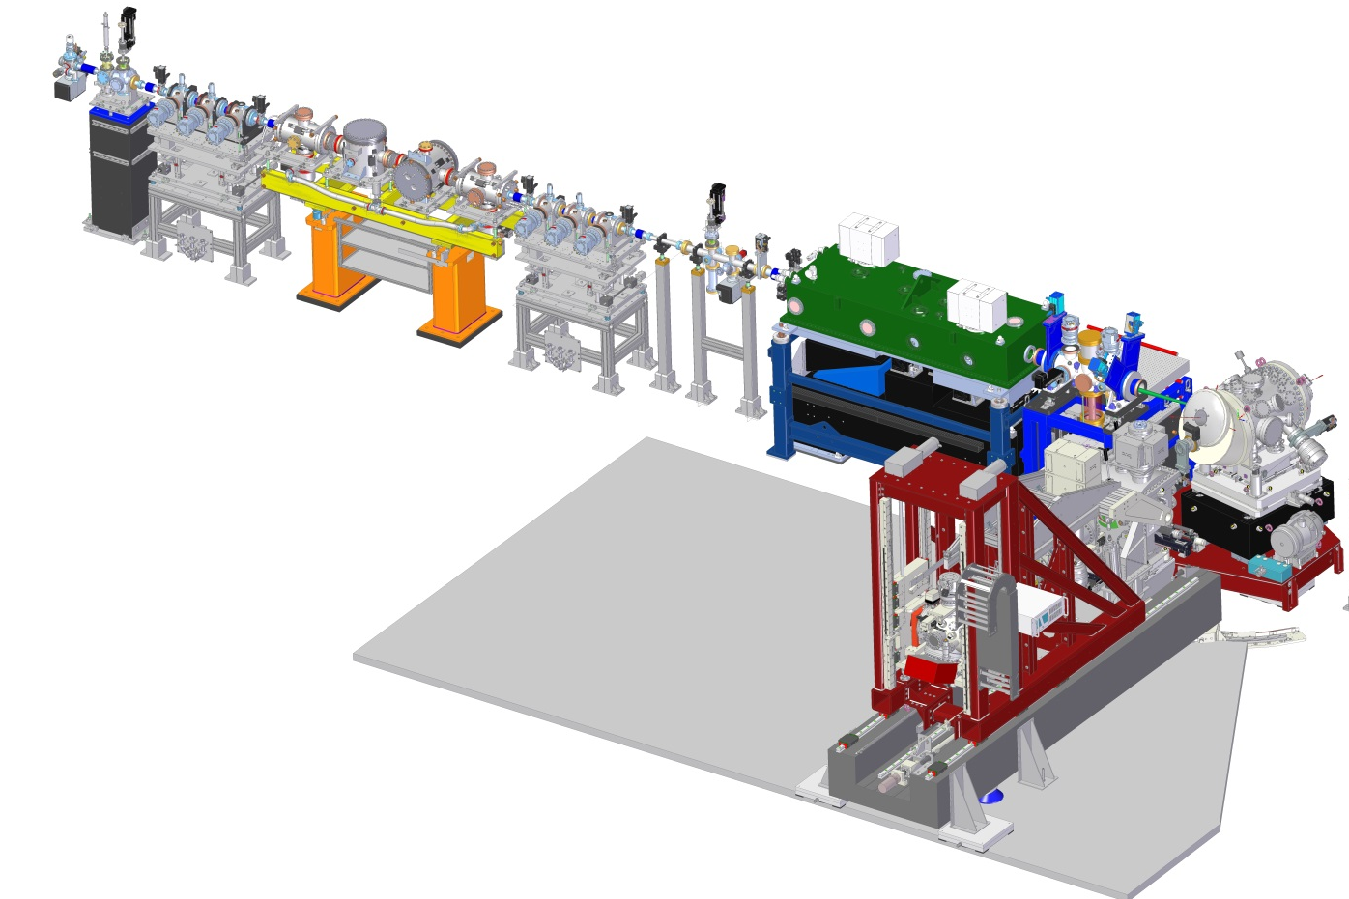
SCS Instrument: RIXS and XRD offer new suite of experimental capabilities
SCS beamline
Spectroscopy and Coherent Scattering (SCS):
Soft x-ray beamline
Time-resolved/ non-linear x-ray spectroscopies
Time-resolved/ non-linear x-ray diffraction
Forward- / small-angle scattering geometries
Reflection- / backscattering geometries
RIXS
Solid samples
Liquid-jet samples
Heisenberg RIXS (hRIXS) spectrometer

Slide 4
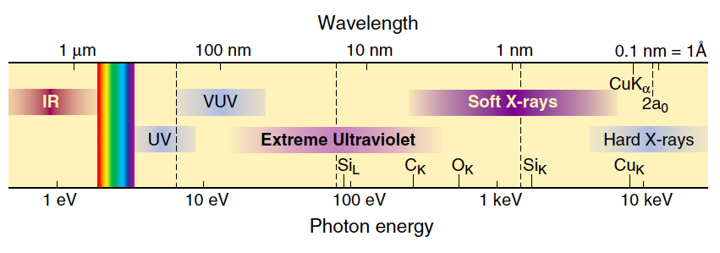
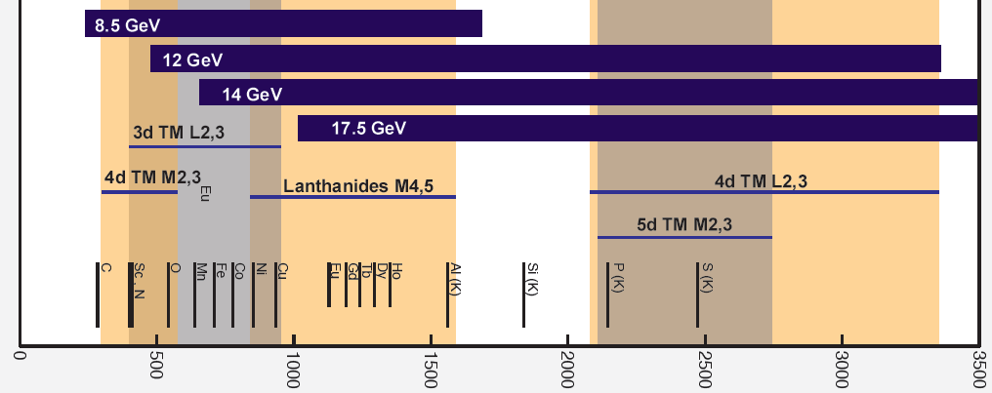
Soft X-ray region: probing electronic structure on nanometer length scales
Photon energy (eV)
adopted from D. Attwood:
Soft X-Rays and Extreme Ultraviolet Radiation

Slide 5
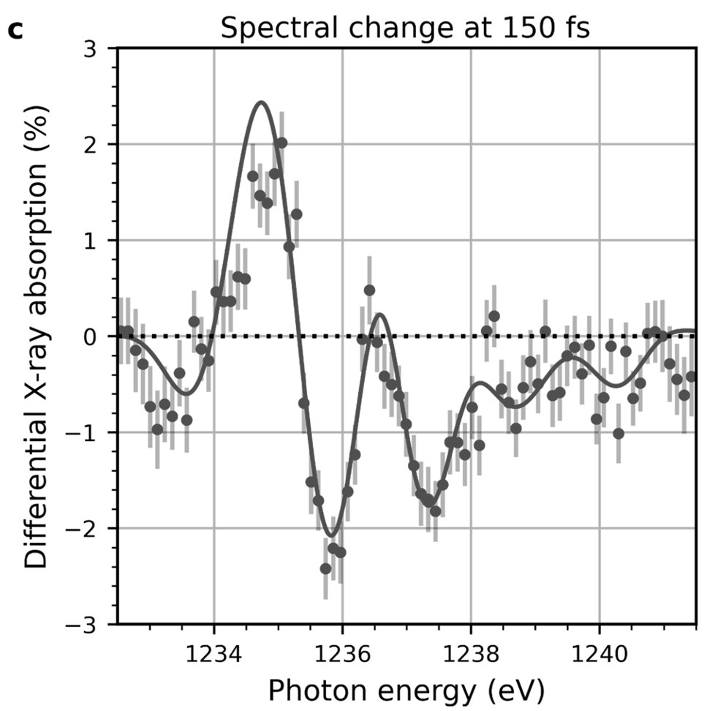
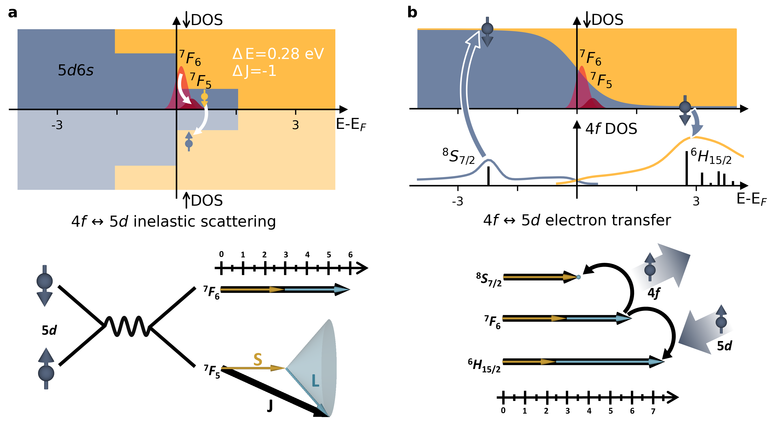
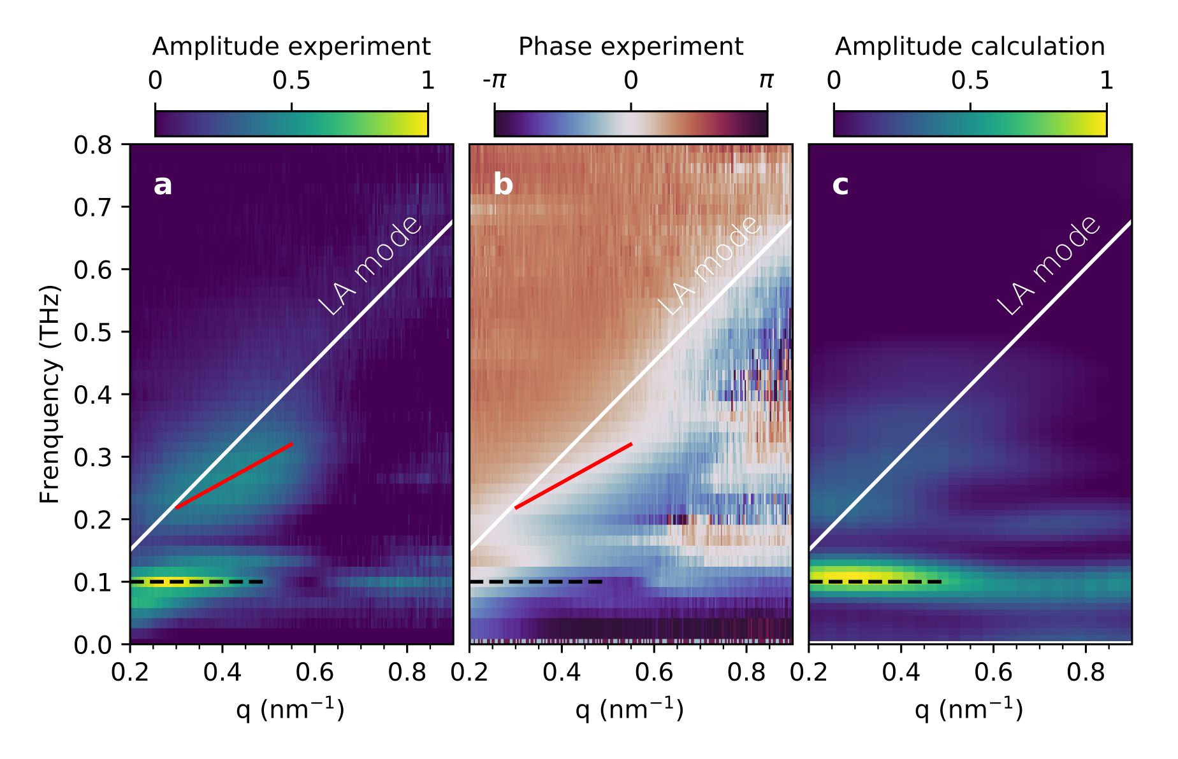
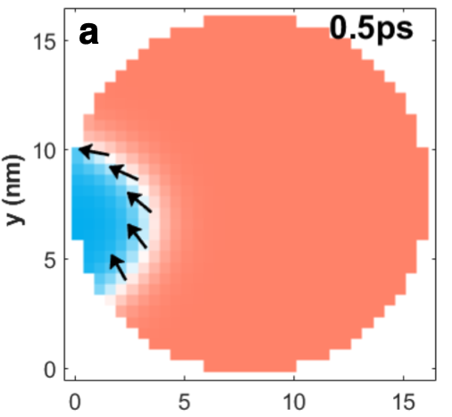
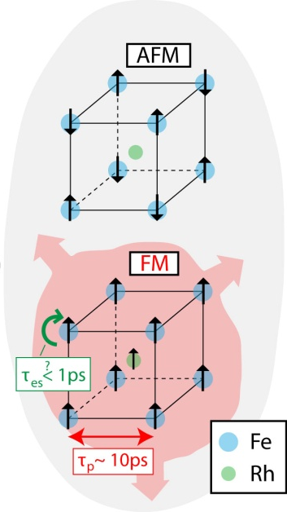
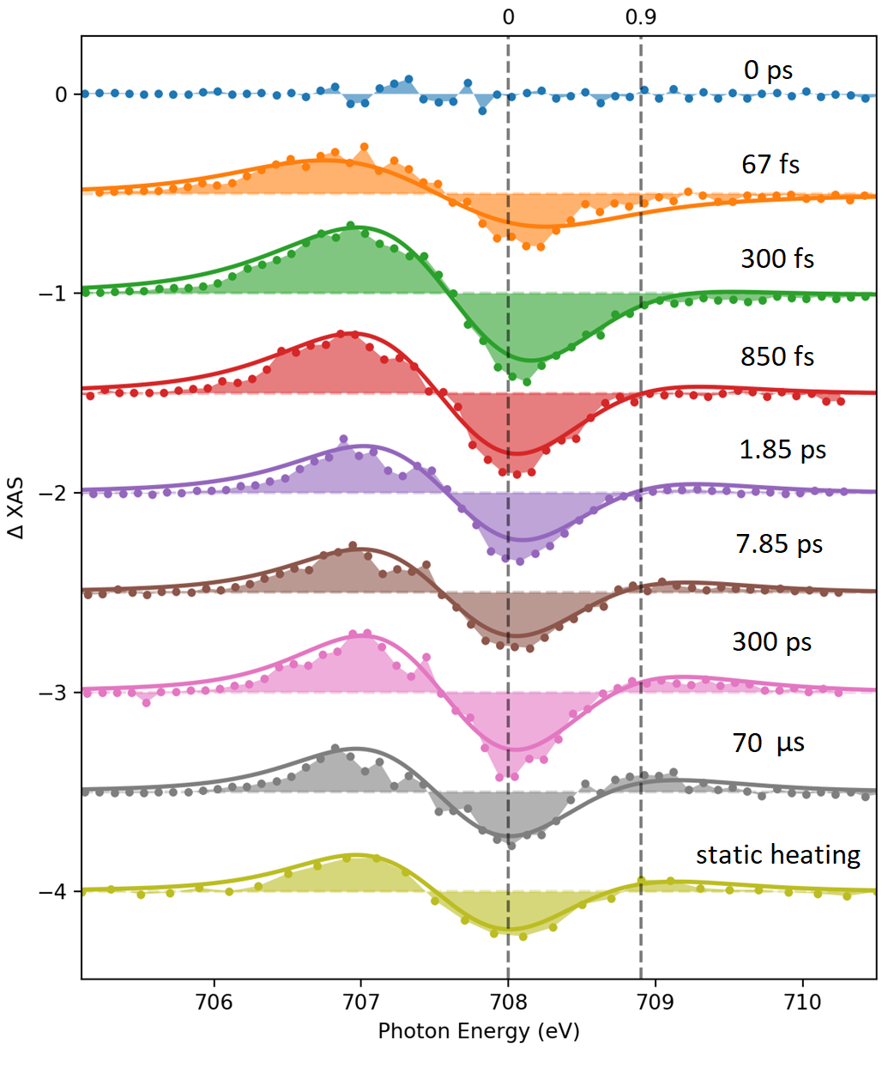
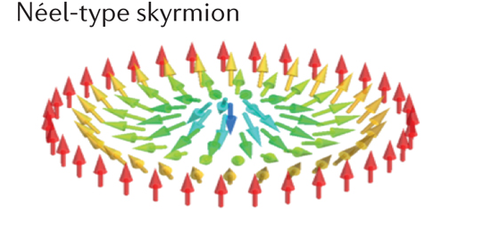
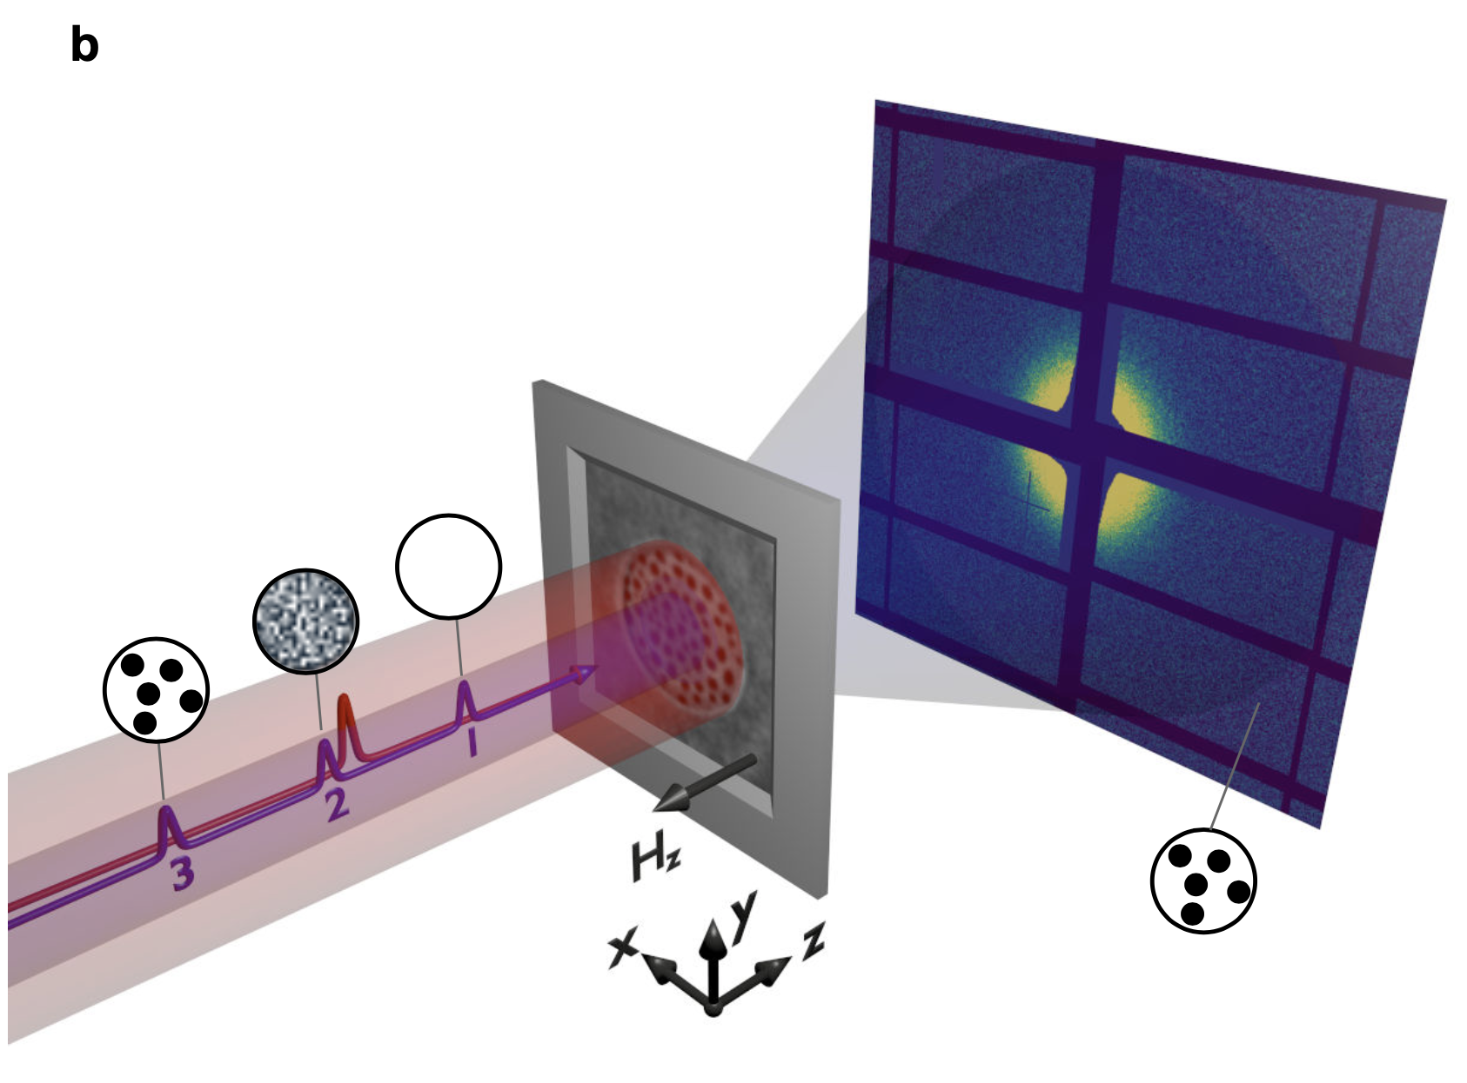
Science at SCS
Spin-lattice coupling in nanostructures
Study of electron and spin dynamics
Turenne et al., Science Advances (2022)
Spin-wave solitons
Thielemann-Kühn, et al.., arXiv:2106.09999
(2021)
Laser-driven phase transitions
Spin-orbit-driven topological systems
Büttner, et al.., Nature materials (2021)
DMI
Agarwal, PhD thesis (2022)
Notes:
various science topics that we covered so far at our instrument

Slide 6
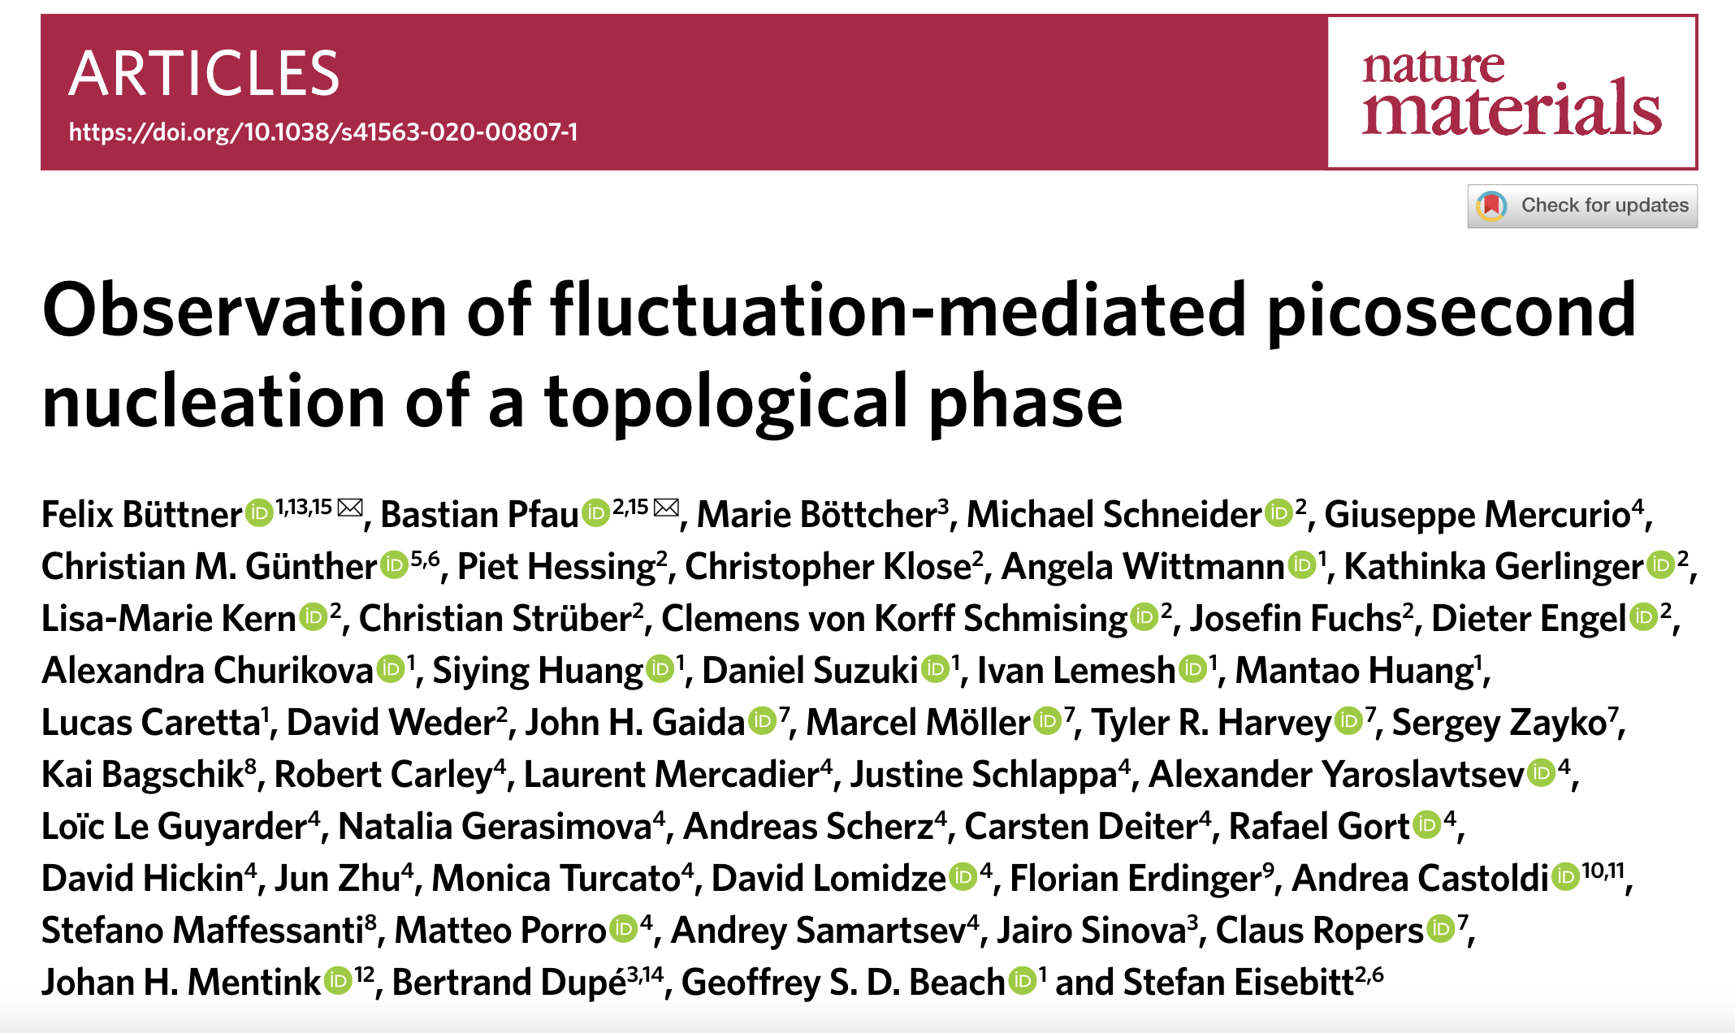
Notes:
Felix Büttner at HZB, and Stefan Eisebitt at MBI, Geoffrey Beach MIT

Slide 7
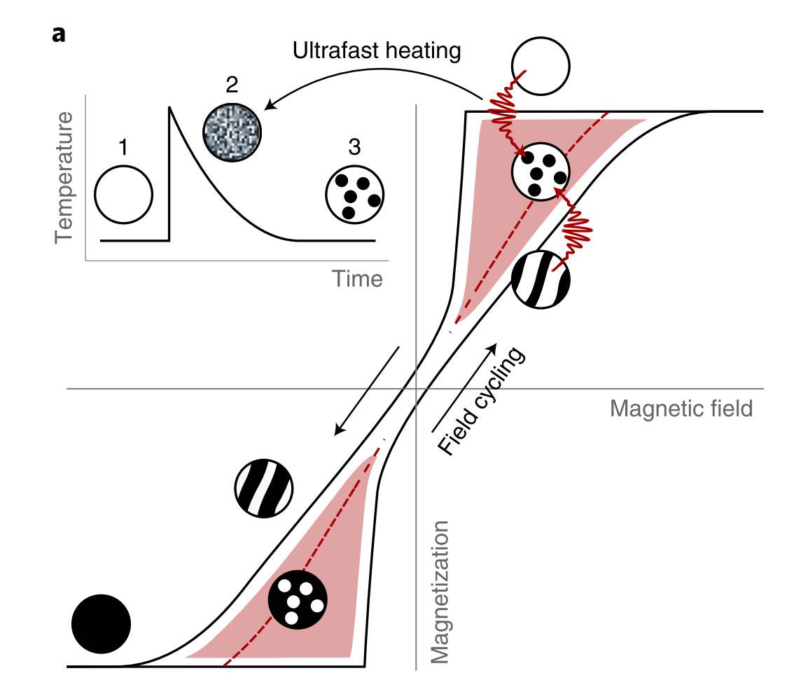
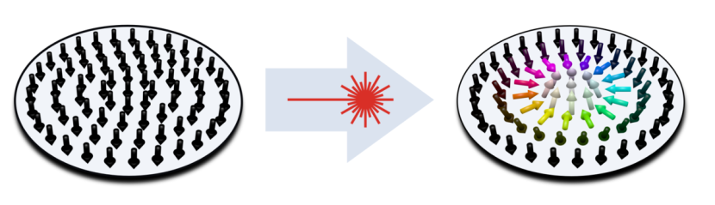
Perpendicular magnetic thin-film ferromagnets to investigate the dynamics of global topological phase transitions
responsive to femtosecond laser pulses, i.e
ultrafast demagnetization and all-optical switching
exhibit a topological skyrmion ground state at RT (nonlocal stray fields, DMI)
topological protected: skyrmion phase often hidden during adiabatic field cycling
Büttner, Pfau et al., Nature materials (2020)
Notes:
Phase transitions that involve net topological switching, here referred to as global topological phase transitions, are conceptually different and much less understood. In particular, although the annihilation dynamics of a topological state was recently reported, the formation of topological phases has been observed only under quasi-static conditions, which leaves the mechanism and speed of such phase transitions largely unexplored.
Owing to the large topological energy barriers, which often exceed 100 times the thermal energy at room temperature, it is expected that the transition into the topological phase is governed by rare, heterogeneous switching events followed by domain wall motion dynamics on a nanosecond timescale or slower
entering the topological phase by spatial heterogenous or dynamical pumping

Slide 8
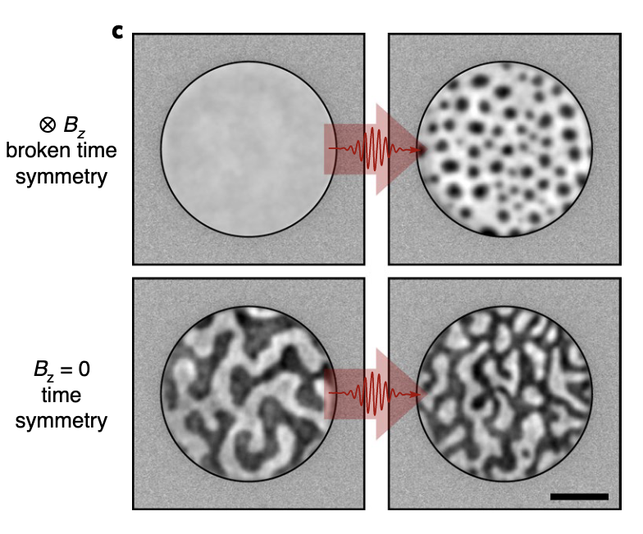
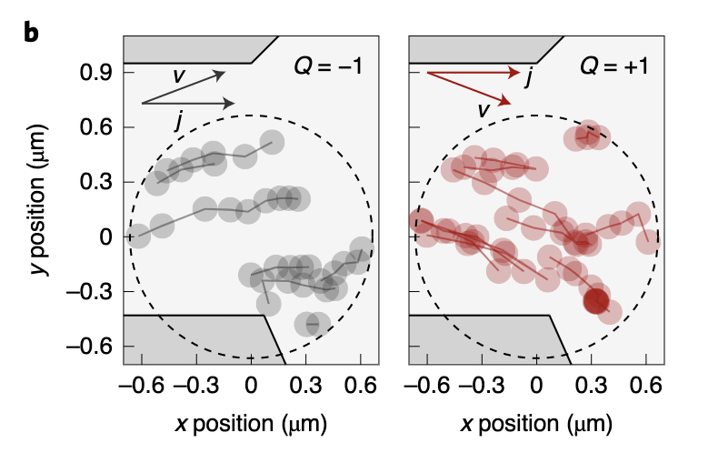
All-optical topological switching
laser-driven generation of pure skyrmion states
Tracking of spin-orbit-torque current-driven motion
Büttner, Pfau et al., Nature materials (2020)
Notes:
these field-induced states can be transformed into pure skyrmion states by single femtosecond laser pulses, provided that time-reversal symmetry is broken by an out-of-plane magnetic field or at least by a notable remanent magnetization of the sample
Without such symmetry breaking we observed no skyrmion formation at any laser fluence below the destruction threshold of the material
To demonstrate the topology of the laser-induced magnetic textures, we tracked their spin–orbit torque current-driven motion,
This is due to the skyrmion Hall effect and confirms that the observed domains are homochiral skyrmions.

Slide 9
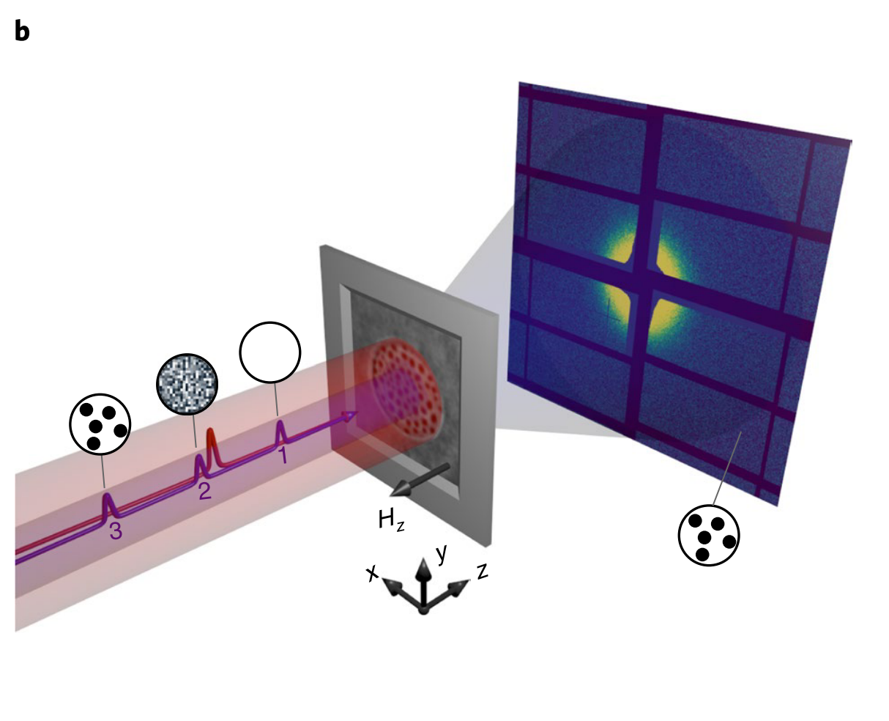
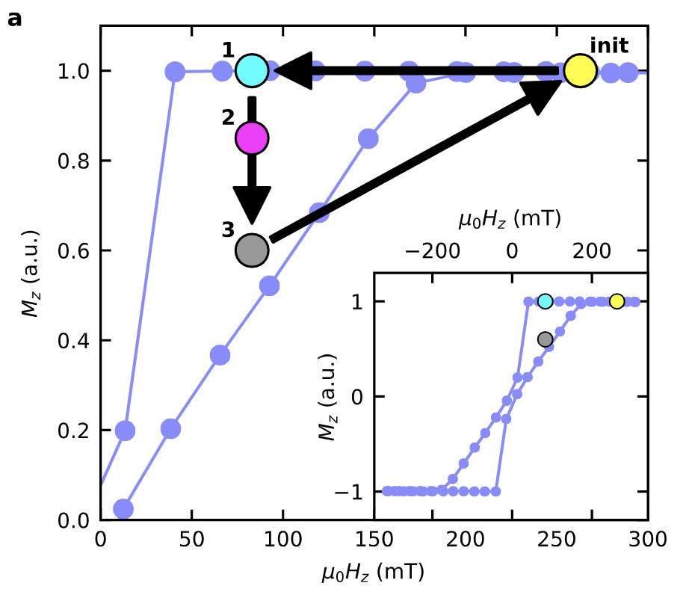
Single-shot and time-resolved resonant SAXS at the Co L3 edge
Initial
Transient
Final
captured within X-ray pulse train with MHz DSSC detector
Büttner, Pfau et al., Nature materials (2020)
Notes:
these field-induced states can be transformed into pure skyrmion states by single femtosecond laser pulses, provided that time-reversal symmetry is broken by an out-of-plane magnetic field or at least by a notable remanent magnetization of the sample
Without such symmetry breaking we observed no skyrmion formation at any laser fluence below the destruction threshold of the material
To demonstrate the topology of the laser-induced magnetic textures, we tracked their spin–orbit torque current-driven motion,
This is due to the skyrmion Hall effect and confirms that the observed domains are homochiral skyrmions.

Slide 10
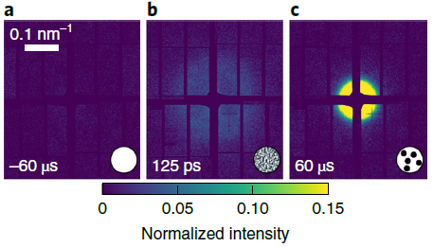
Condensation of skyrmions on picosecond time scale from fluctuating phase
Büttner, Pfau et al., Nature materials (2020)
Notes:
DMI: Dzyaloshinskii – Moriya Interaction – the interaction prefers spin canting

Slide 11
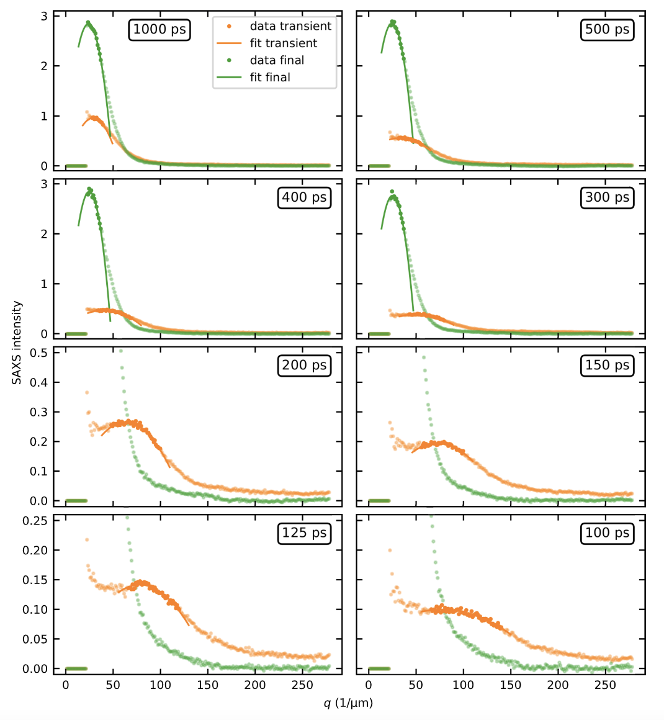
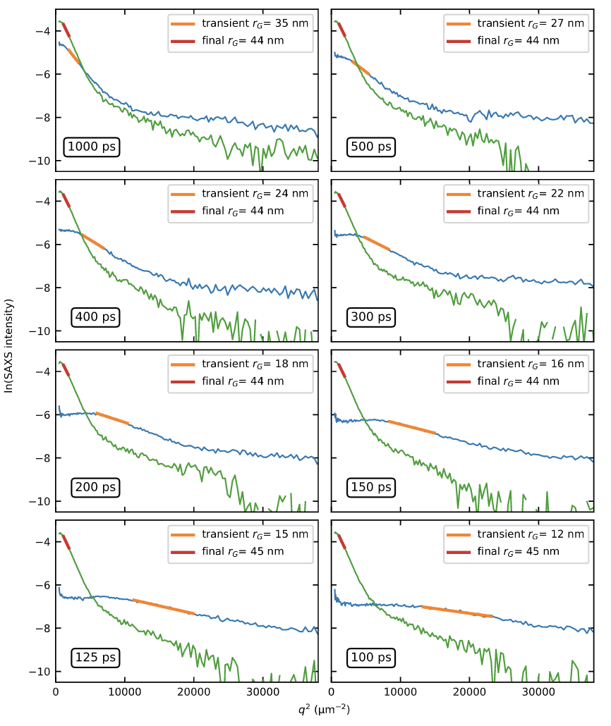
Correlation length: average distance of skyrmions
Size of skyrmion from Guinier fits
Büttner, Pfau et al., Nature materials (2020)

Slide 12
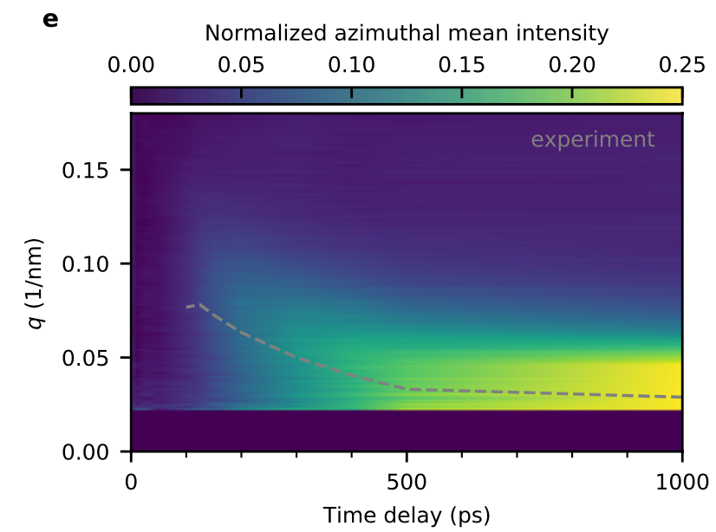
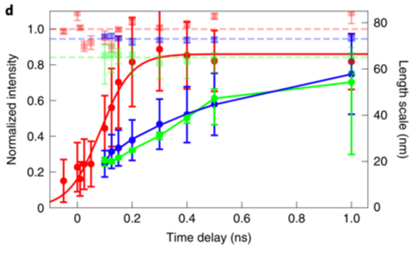
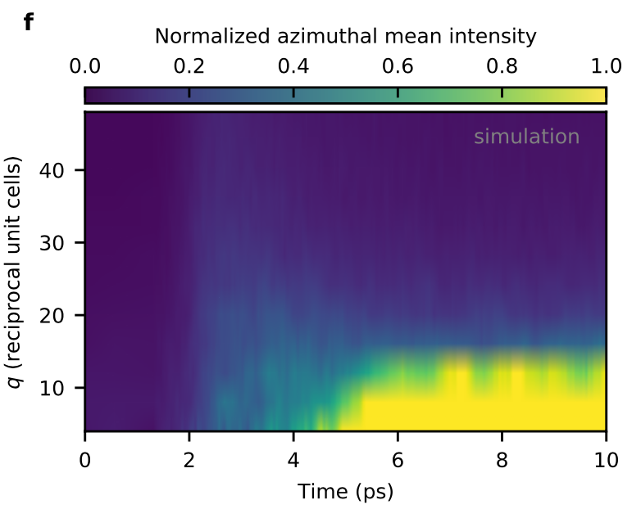
Observation of fluctuation-mediated picosecond nucleation of a topological phase
fluctuation phase
nucleation
coalescence
Total scattering Intensity
Correlation length x 0.25
Skyrmion diameter
Büttner, Pfau et al., Nature materials (2020)
Notes:
Normalized total scattered intensity (red), correlation length × 0.25 (green) and skyrmion diameter (blue)
However, shortly after the bath was heated to the intermediate region, we additionally observed topological switching, that is, a deviation of q+ and q− and non-zero Q. This is topologically allowed in the intermediate region because enough energy is available for thermally activated switch-ing of a cluster of a few spins35,36, as required for skyrmion formation in our high-damping material

Slide 13
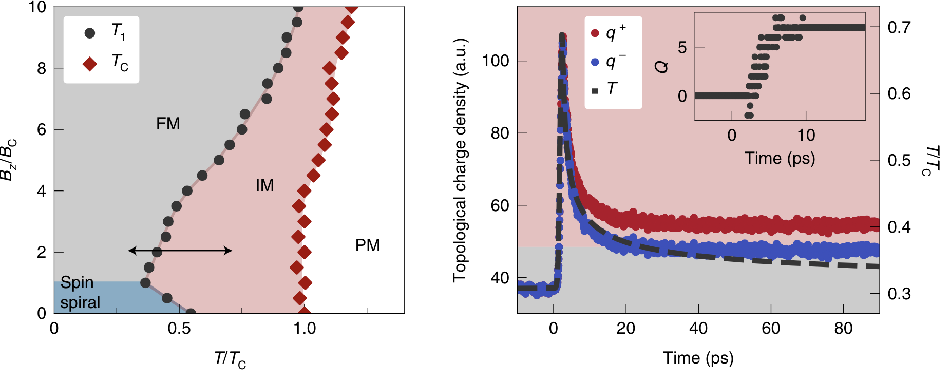
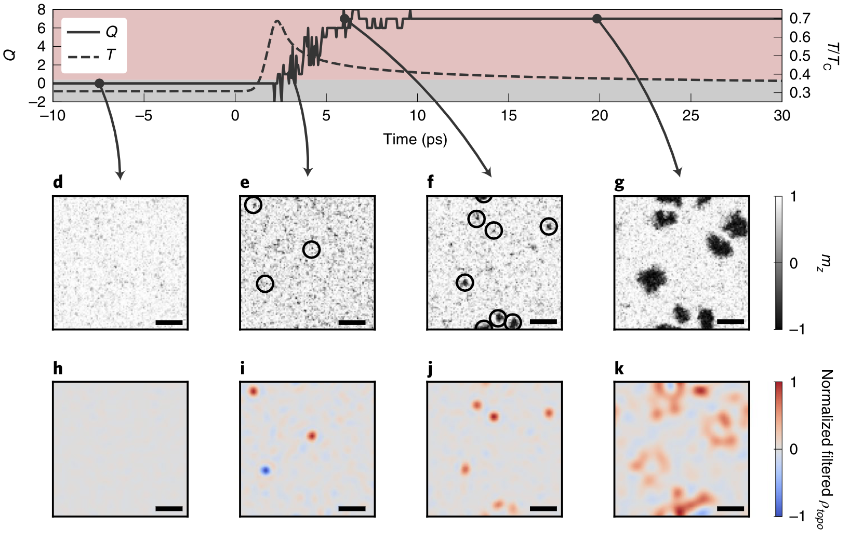
Atomistic LLG simulations of topological switching dynamics
Notes:
MODEL: exhibits long-ranged ordered spin-spiral and uniform ferromagnetic states at low temperatures.
However, shortly after the bath was heated to the intermediate region, we additionally observed topological switching, that is, a deviation of q+ and q− and non-zero Q. This is topologically allowed in the intermediate region because enough energy is available for thermally activated switching of a cluster of a few spins, as required for skyrmion formation in our high-damping material
skyrmions and antiskyrmions did not form in pairs. Both position and time of creation of the skyrmions and antiskyrmions appeared uncorrelated. Antiskyrmions were created less frequently and their lifetime was much shorter than that of skyrmions
This explains the steady increase of total topological charge of the system. The more the system cooled down, the less frequently we observed nucleation or annihilation events.
on longer times thermal fluctuations only changed the skyrmion shape but not their existence

Slide 14
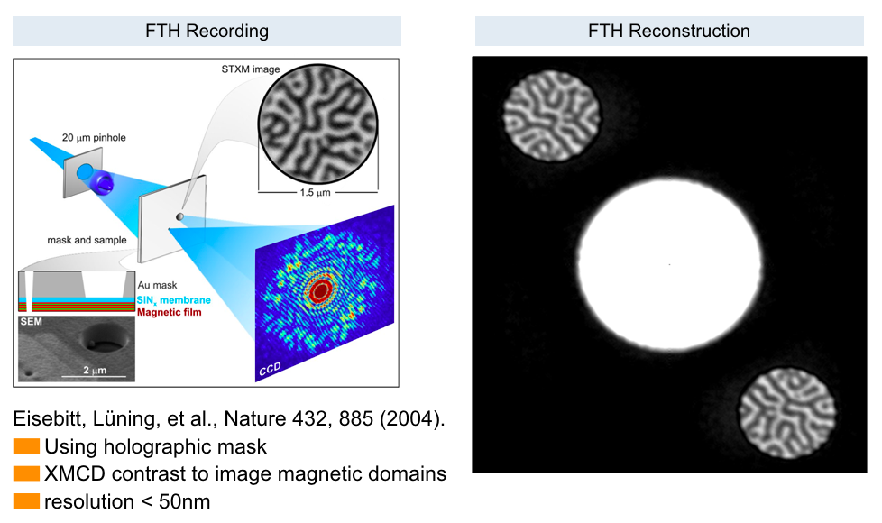
Fourier Transform Spectro-Holography

Slide 15
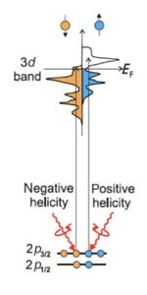
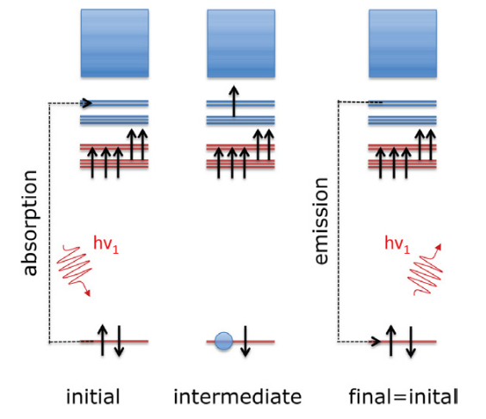
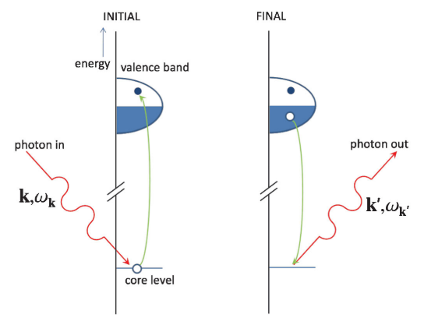
X-ray Spectroscopies
X-ray absorption
Resonant elastic scattering
Resonant inelastic scattering
Stöhr, Siegmann, Magnetism Springer
Fink et al, Rep. Prog. Phys. 76, 056502 (2013)
Ament et al, Rev. Mod 83, 705 (2011)

Slide 16
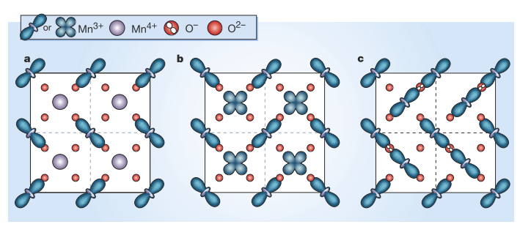
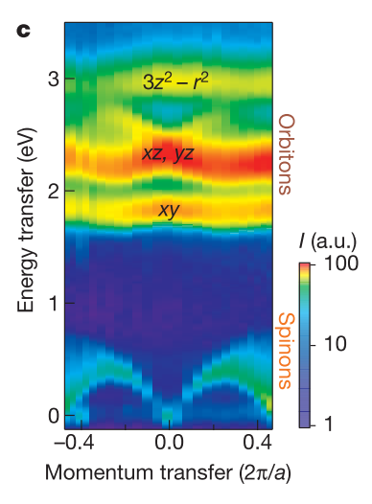
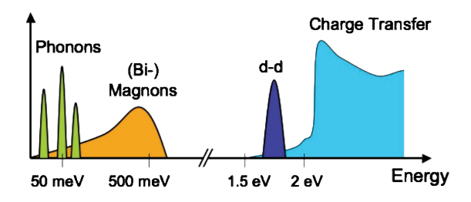
X-ray Spectroscopy
Resonant elastic scattering
Resonant inelastic scattering
Schlappa, et al., Nature 485, 82 (2012)
Coey, Science 430, 155 (2004)
Low energy excitations
and dispersion
Valence long-range order of charge,
orbital and spin
Ament et al, Rev. Mod 83, 705 (2011)
Notes:
﻿left: The chequerboard charge-ordered arrangement of Mn3+ and Mn4+ ions, originally proposed for (La0.5Ca0.5)MnO3 by Goodenough4.
﻿right : RIXS intensity map of the dispersing spin and orbital excitations in Sr2CuO3 as functions of photon momentum transfer along the chains and photon energy transfer

Slide 17
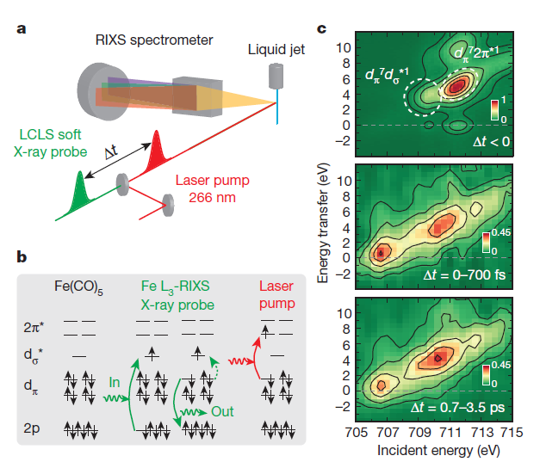
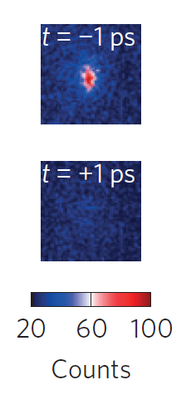
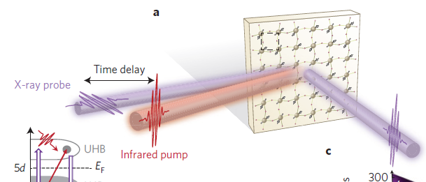
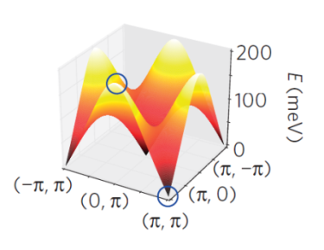
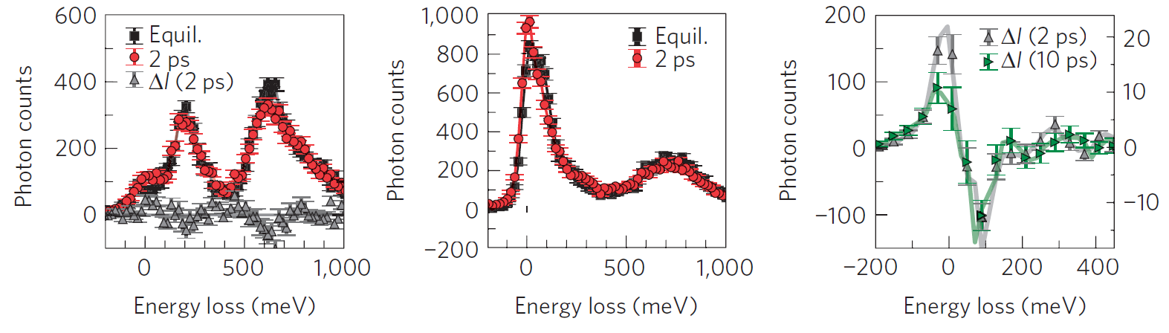
Scientific Motivation for Time-Resolved RIXS
Photochemical dynamics in transition metal complexes:
Magnetic correlation dynamics in 3D and 2D:
CHEM
XRD
P. Wernet et al., Nature 520, 78 (2015).
M. Dean et al., Nature Mat 15, 601 (2016).
Notes:
photo-doping of Mott insulator, ﻿Sr2IrO4.
loss of long range magnetic Bragg peak
induces nonthermal 2D magnetic correlations which recover fast within few ps.
long range 3D magnetci correlations only recover on 100ps time scales
Chem -> initially cylindrical jets -> liquid jet in transmission flat jets
XRD does Resonant X-ray diffraction on Bragg peaks and also RIXS

Slide 18



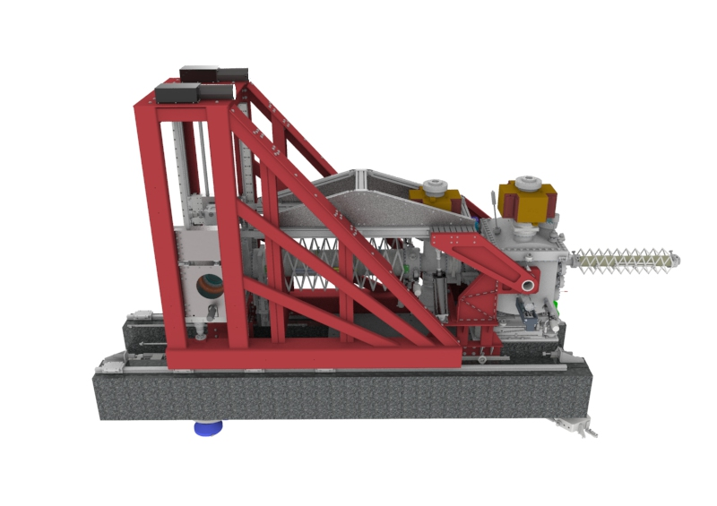
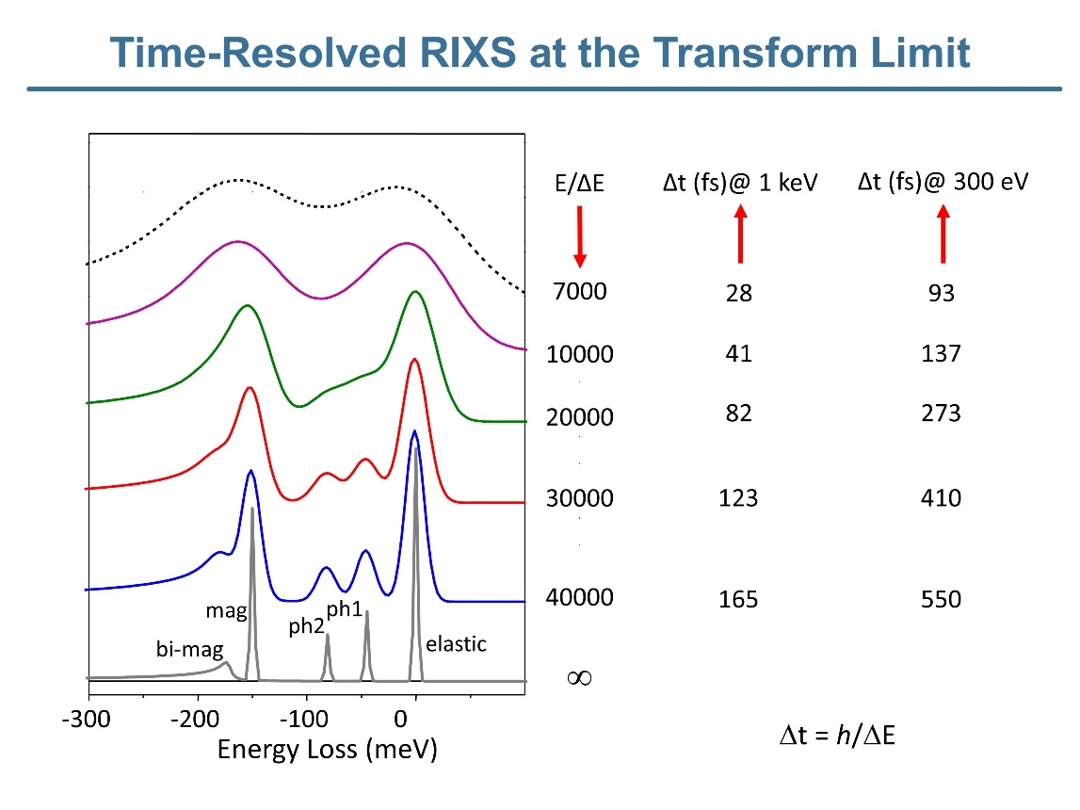







High-resolution spectrometer of the Heisenberg RIXS User Consortium
Aim:
Time-resolved Resonant inelastic x-ray scattering (RIXS) at the transfer limit
hRIXS Proposal, User Consortium
J. Schlappa, B. van Kuiken, J. T. Delitz, A. Scherz,
S. Neppl, F. Senf, C. Weniger, A. Föhlisch,
T. Reuss, S. Techert, T. Laarmann,
Y. Peng, G. Ghiringhelli, S. Huotari.

Slide 19
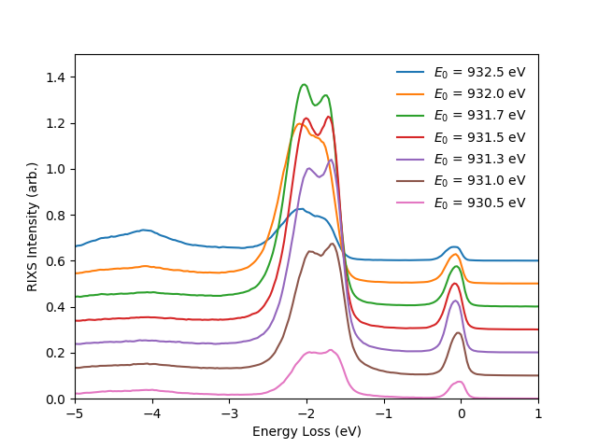
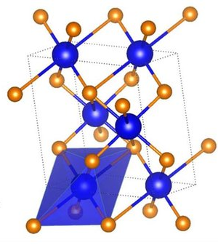
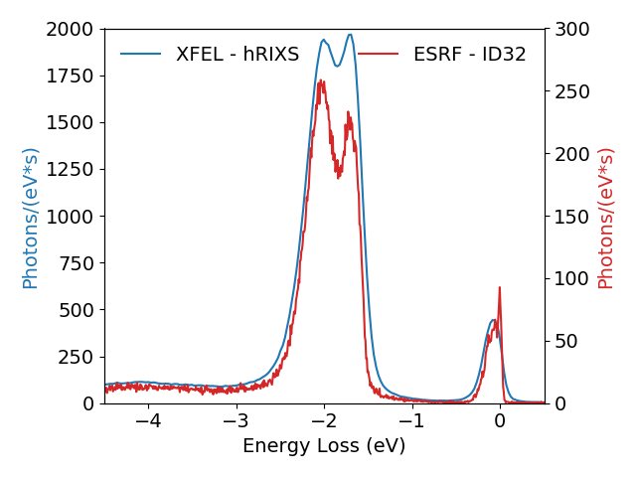
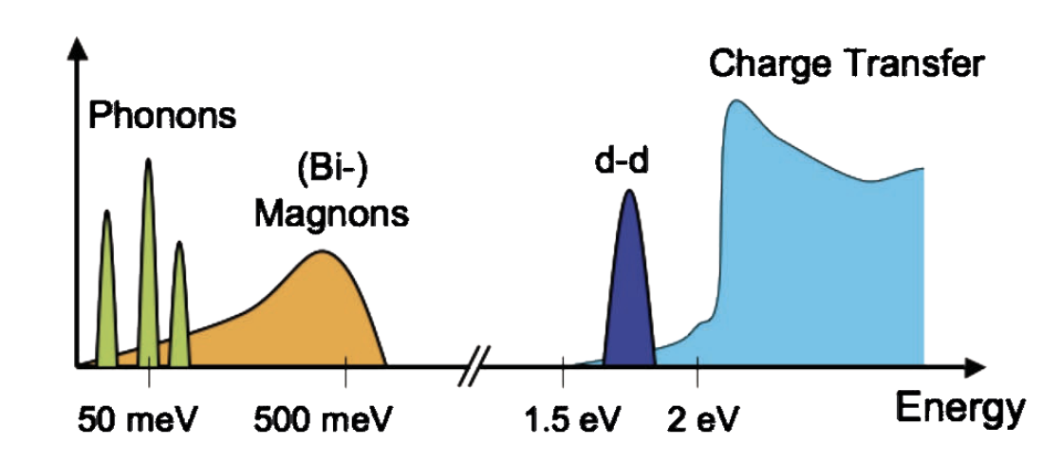
Heisenberg RIXS Spectrometer at the SCS instrument:
Commissioning and first RIXS data in Spring 2021
Cu L-edge RIXS: CuO
EuXFEL vs. ESRF
competitive with synchrotrons offers time-resolution at femtosecond time scales
Measurement Count Rates
Incident Beam 1.3 x 10¹³ ph/s
Ament et al., Rev. Mod. Phys. 83, 705 (2011)

Slide 20
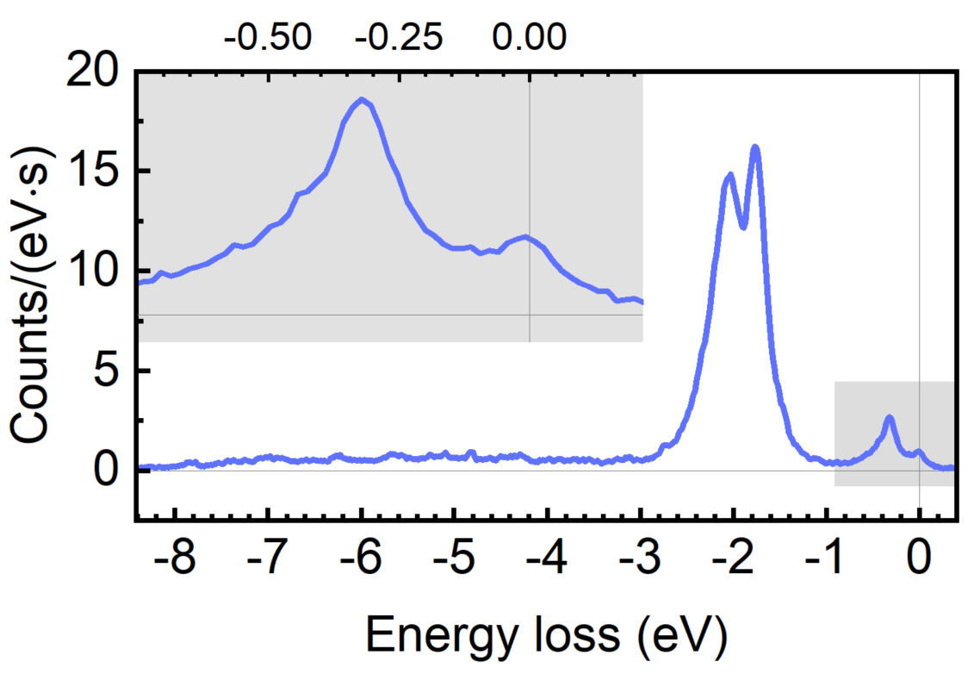



La₂CuO₄: AF insulator, parent compound of LSCO and LBCO HTC cuprate superconductors.
Spectrometer calibration
Spin
Elastic
hRIXS instrument paper, in preparation (2022)
Boulanger, Marie-Eve, et al., Nat. comm., 11.1 (2020): 1-9.

Slide 21

NiO test case for RIXS recorded at MHz repetition source (4000 pulses/sec)
incident photon energy (eV)
Ghiringhelli, et al.,
Journal of Phys: Condens. Matter, 17, 5397(2005)
hRIXS instrument paper, in preparation (2022)

Slide 22
Acknowledgement
European XFEL:
Justine Schlappa, Ben van Kuiken, Natalia Gerasimova, Piter Miedema, Martin Teichmann, Jan Torben Delitz, Carsten Broers, Luigi Adriano, Giuseppe Mercurio, Nahid Ghodrati, Le Phuong Hoang, Zhong Yin, Sergii Parchenko, Robert Carley, Manuel Izquierdo, Alexander Reich, Andreas Scherz @ SCS
Marijan Stupar, Bernard Baranasic, Hector Vega Perez, Joern Reifschlaeger @ EEE
HZB / Uni Potsdam:
Stefan Neppl, Fred Senf, Christian Weniger, Annette Pietzsch, Robby Buechner, Sebastian Eckert, Chung-Yu Liu, Vinicius Vaz da Cruz, Frank Siewert, Christian Sohrt, Alexander Foehlisch
Politecnico di Milano:
Yingying Peng, Giacomo Ghiringhelli
DESY:
Tim Laarmann, Torben Reuss, Sreeju Sreekantan Nair Lalithambika, Simone Techert
University of Helsinki:
Simo Huotari
BNL: Mark Dean, Xi He, Ivan Bozovic
ERSF: Nick Brookes

Slide 24

Small-angle x-ray scattering during a magnetic field sweep recorded with various attenuation levels of the x-ray beam
Büttner, Pfau et al., Nature materials (2020)

Slide 25

Notes:
skyrmions and antiskyrmions did not form in pairs. Both position and time of creation of the skyrmions and antiskyrmions appeared uncorrelated. Antiskyrmions were created less frequently and their lifetime was much shorter than that of skyrmions. This explains the steady increase of total topological charge of the system. The more the system cooled down, the less frequently we observed nucleation or annihilation events. Eventually, all the switching events stopped. At this point, thermal fluctuations only changed the skyrmion shape Bz/BCQTopological charge density (a.u.) but not their existence. This transition occurred at ~10 ps in the sim-ulation, which marks the end of the fluctuation state. In agreement with the experiment, only skyrmions were observed in the final state

Slide 26


Laser-driven Electron and Spin and Lattice Dynamics
XAS
Femtosecond X-ray Absorption Spectroscopy
excited electronic occupation
electronic band structure evolution
(lattice changes, magnetic changes)
core level
Hellman & al., Rev. Mod. Phys. 89, 025006, (2017)

Slide 27

Beam-splitting off-axis zone plate for shot-noise limited MHz transient absorption spectroscopy with the DSSC detector
NiO – Ni L edge
APPLE-X: Helical and linear polarization
dXAS @ 1ps delay
Le Guyader, et al., in preparation (2022)
UP 2589, Eschenlohr et al., in preparation (2022)

Slide 28

Soft-X-ray Monochromator upgrade with higher-resolution grating:
Resolution optimization of HRGR by aligning angle of LE premirror at Ne absorption lines 1s-3p (867.1 eV), 1s-4p
New 150 l/mm grating (HRGR)
funded by hRIXS project
1yr from order, integration during
winter shutdown and commissioning
in 2021-I by SCS, XRO, and
vacuum group
Resolving power >7000 (Ne lines)
resolving power > 10.000 confirmed
at 530eV and 930eV using the
hRIXS spectrometer (combined res.)
LRGR, measured
HRGR, measured
wavefront propagation
Transmission of SASE3 beamline in 1st and 2nd diffraction orders for LRGR (solid lines and circles), HRGR (dash lines and open circles)

Slide 29


Monochromator settings SCS beamline:
The use of monochromator leads to pulse stretching.
Resolution has to be compromised for time resolution.
Time delay:
Low-resolution grating
High-resolution grating
LR grating
Line density | 50 l/mm
Resolving power | 3.000 (1st order)
Pulse stretching | 30-50 fs
X-ray pulse energy | up to 30 µJ
HR grating
Line density | 150 l/mm
Resolving power | Up to 10.000 (1st order)
Pulse stretching | 80-150 fs
X-ray pulse energy | up to 5 µJ
Moderate combined energy resolution
High temporal resolution
High combined energy resolution
Moderate temporal resolution

Slide 30



hRIXS – Mono Combined Resolution
Elastic Line from Crystalline NiO
Raw Data
Curvature Corrected
Summed Spectra
* not enough time to optimize
Edge | Energy (eV) | ΔE (meV) | E/ΔE
Cu L₃ | 930 | 106 | 8 700
Ni L₃ | 853 | 122* | 6 900*
O K | 530 | 49 | 10 400

Slide 31

SCS group 2021
Young Yong Kim, Martin Teichmann, David Hickin (Controls), Nahid Ghodrati (PhD student), Cammille Carinan (Data Analysis), Jan Torben Delitz, Zhong Yin, Alexander Reich, Justine Schlappa, Maria Peter (Admin. Assistant Experiments), Andrey Tsapurin(Master student), Giuseppe Mercurio, Naman Agarwal (PhD student), Benjamin van Kuiken, Natalia Gerasimova, Carsten Broers, Andreas Scherz, Laurent Mercadier, Sergii. Parchenko, Le Phuong Hoang (PhD student),
not on the picture: Luigi Adriano and Robert Carley
Notes:
8 newcomers: Young Yong Kim, Zhong Yin, Nahid Ghodrati, Andrey Tsapurin, Le Phuong Hoang, Sergii Parchenko, (Piter Miedema), Luigi Adriano

