Slide 1


Combined Proton Therapy and Magnetic Fluid Hyperthermia for Pancreatic Cancer Treatment PROTHYP – 2020 experiments
Partecipanti - Unità di Milano, di Roma3 e di Pavia FTE/year
Alessandro Lascialfari – PO - UNIMI – responsabile Milano 0.5
Daniela Bettega – PA – UNIMI Milano 0.75
Flavia Groppi – PA – UNIMI Milano 0.1
Cristina Lenardi – PA – UNIMI Milano 0.2
Ivan Veronese – RI – UNIMI Milano 0.4
Paolo Arosio – RTDA – UNIMI Milano 0.4
Paola Calzolari – Tecnico – UNIMI Milano 0.75
Francesco Orsini – Tecnico – UNIMI Milano 0.4
Simona Argentiere – postdoc – UNIMI Milano 0.2
Salvatore Gallo – postdoc – UNIMI Milano 0.6
Simone Manenti – postdoc – UNIMI Milano 0.1
Antonio Antoccia – PA – Roma 3 Roma3 1
Antonella Sgura – RI – Roma 3 Roma3 1
Manuel Mariani – RI – UNIPV Pavia 0.3
Francesca Brero – PhD – UNIPV Pavia 0.3
Davide Cicolari – PhD – UNIPV Pavia 0.3
Partecipanti esterni :
Dipartimento di Chimica, Università di Firenze – C. Sangregorio (CNR-ICCOM), C. Innocenti, M. Albino
Fondazione CNAO – Pavia ; Istituto Nazionale Tumori – Milano
E. Sabbioni, INFN

Slide 2
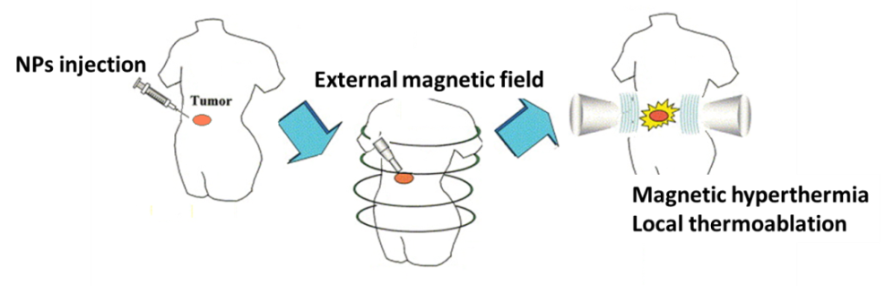
Reminding the scientific novelty of PROTHYP
targeted proton therapy deposits most energy on target;
(B) conventional radiation therapy deposits
Illustration of MFH concept
Proton Therapy and Magnetic Hyperthermia are new and interesting treatments for cancers where the “classical” therapies fail.
The goal of the project is the investigation of the possible combined action of the two therapeutic techniques, for going one step beyond the state of art of pancreatic cancer (PANC-1 and BxPC3 tumour cells) therapy. X-rays irradiation is used as control and comparison technique. AFTER HADROCOMBI AND HADROMAG

Slide 3
Workpackages
WP1 Nanoparticles synthesis and characterization (participants: Firenze, Milano, Pavia)
WP2 Irradiation experiments with protons (participants: Milano, Roma3, CNAO-PV, INT-MI)
WP3 Magnetic Fluid Hyperthermia experiments (participants: Milano, Pavia)
WP4 Responses of tumor pancreatic BxPC3 cells (participants: Milano, Roma3)
WP5 Imaging Techniques (participants: Milano)

Slide 4
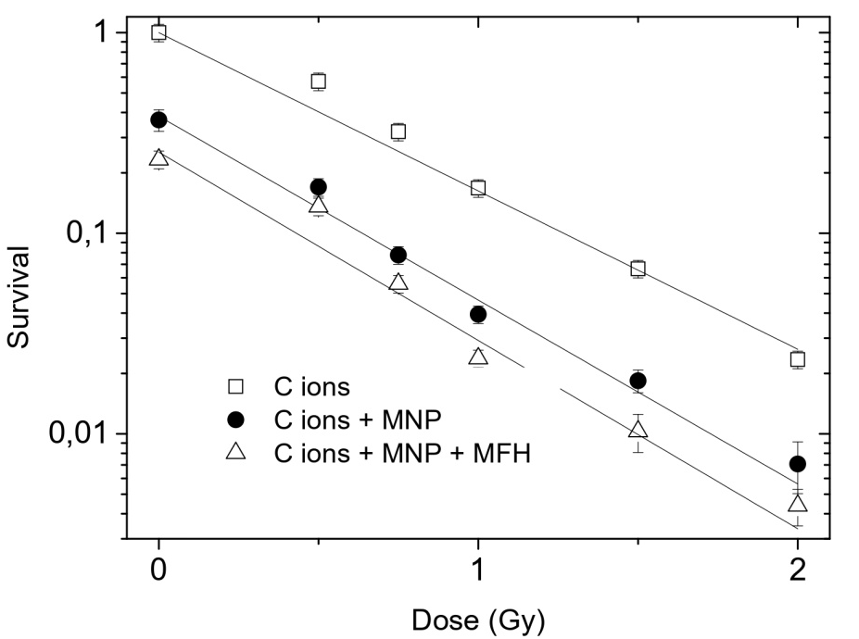
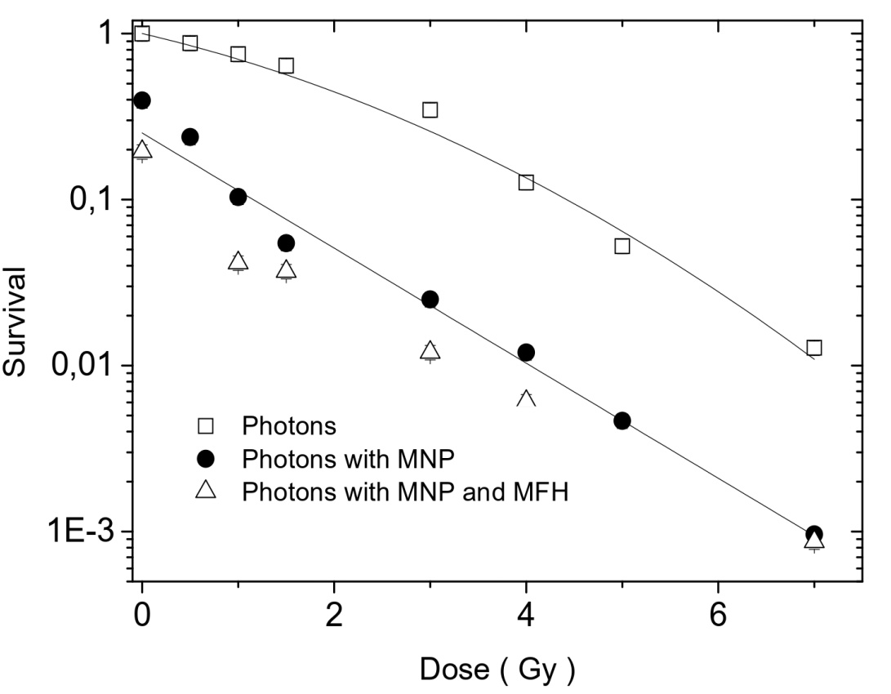
Hadromag main results – survival test
Results of :
(i) above, 3 averaged CNAO
Experiments;
(ii) below, 1 INT experiment.
(1 INT and 1 CNAO more under
Analysis)

Slide 5
Main results – Double-Strand- breaks - number of foci
Analysis of 53BP1 and γ-H2AX foci induction after 6 and 24 hours from the exposure to 0.75 and 1.5 Gy of carbon ions in combination with magnetic fluid hyperthermia (here named I) in BxPC3 pancreatic tumor cells; NP indicates magnetic nanoparticles. Data represent mean ± s.d. (n=3). * P < 0.05, ** P < 0.01, *** P <0.001 (Student’s t-test).

Slide 6
Main results – Double-Strand- breaks - number of foci
Analysis of 53BP1 and γ-H2AX foci induction after 6 and 24 hours from the exposure to 1.5 and 4 Gy of photons in combination with magnetic fluid hyperthermia (here named I) in BxPC3 pancreatic tumor cells. NP indicates magnetic nanoparticles.

Slide 7
Conclusion : combined MFH+HT better than single ones

Slide 8
Combined Proton Therapy and Magnetic Fluid Hyperthermia for Pancreatic Cancer Treatment
PIANO irraggiamenti+ipertermia (4 con ioni carbonio e 2 con fotoni già espletati)
settembre 2019 : 3^ esperimento fotoni-INT
gennaio/febbraio 2020 : 1^ esperimento protoni -CNAO
aprile 2020 : 2^ esperimento protoni -CNAO
giugno 2020 : 3^ esperimento protoni -CNAO
sett/ott 2020 : 4^ esperimento protoni -CNAO

Slide 9
PROTHYP - Spese annue previste (2020) per 4 esperimenti
Sintesi e caratterizzazione di nanoparticelle magnetiche (Firenze) 4 k €
Esperimenti di Magnetic Fluid Hyperthermia e NMR (Milano) 3 k €
Radiotraccianti e arricchimento MNPs (Milano) 2 k €
Irraggiamenti, sopravvivenza clonogenica, manutenz (2) (Milano) 8 k €
Microscopia confocale, SEM, ICP-MS,DLS 3 k €
Studi di cinetica, DSB-rejoining (Roma3) 3.5 k €
Caratterizzazione magnetica e NMR alto campo di MNPs e cellule con MNPs (PV) 4 k €
Missioni presso CNAO dell’Unità di Milano 1 k €
Trasporti radioattivi 0.5 k €
Missioni presso CNAO dell’Unità di Roma3 2 k €
TOTALE 31 k €

