Slide 1
Status of a_{μ} analysis
Marco Incagli – INFN Pisa
Pisa, 2 July 2019

Slide 2
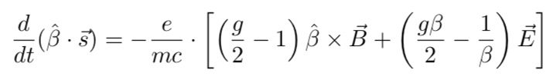
The spin equation
spin vector projection on momentum angle in presence of static B and E fields changes with time according to:
neglecting beam size and oscillations, assuming that all muons momentum is p_{magic}=3.01GeV/c and is perpendicular to B, than the above expression greatly simplifies to:
from which:
pitch
magic
ω_{μ,p} = precession
ω_{c} = cyclotron

Slide 3
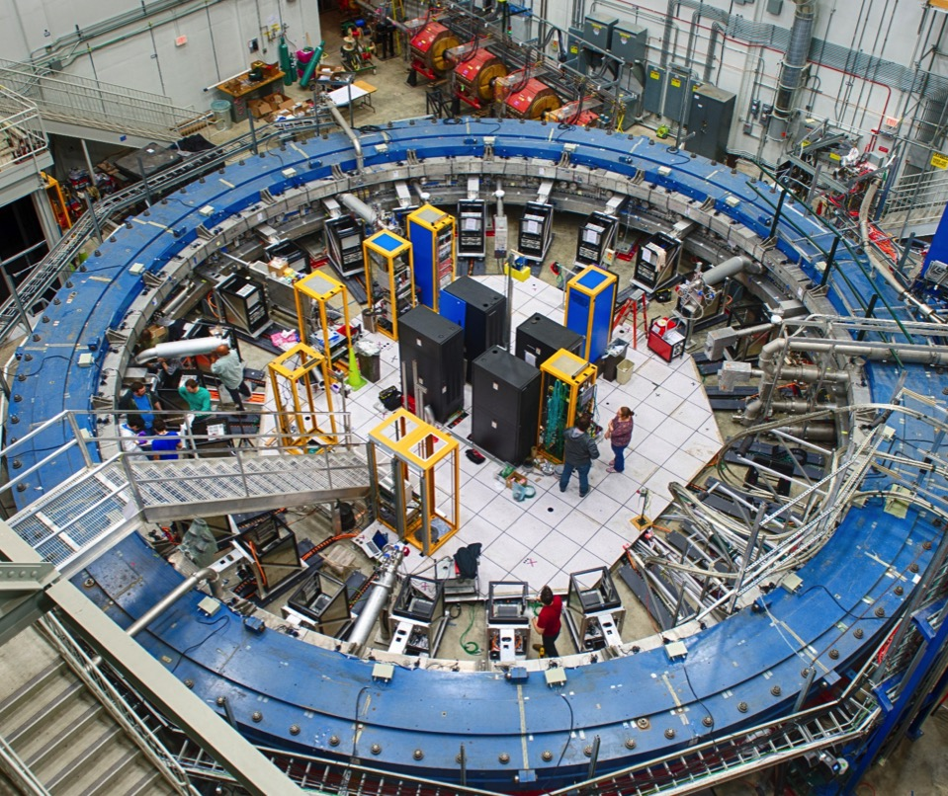
RING
FIELD
muons
Inflector
DETECTORS
QUADS
24 Calorimeters + 2 trackers located all around the ring
NMR probes and electronics located all around the ring
Kicker

Slide 4
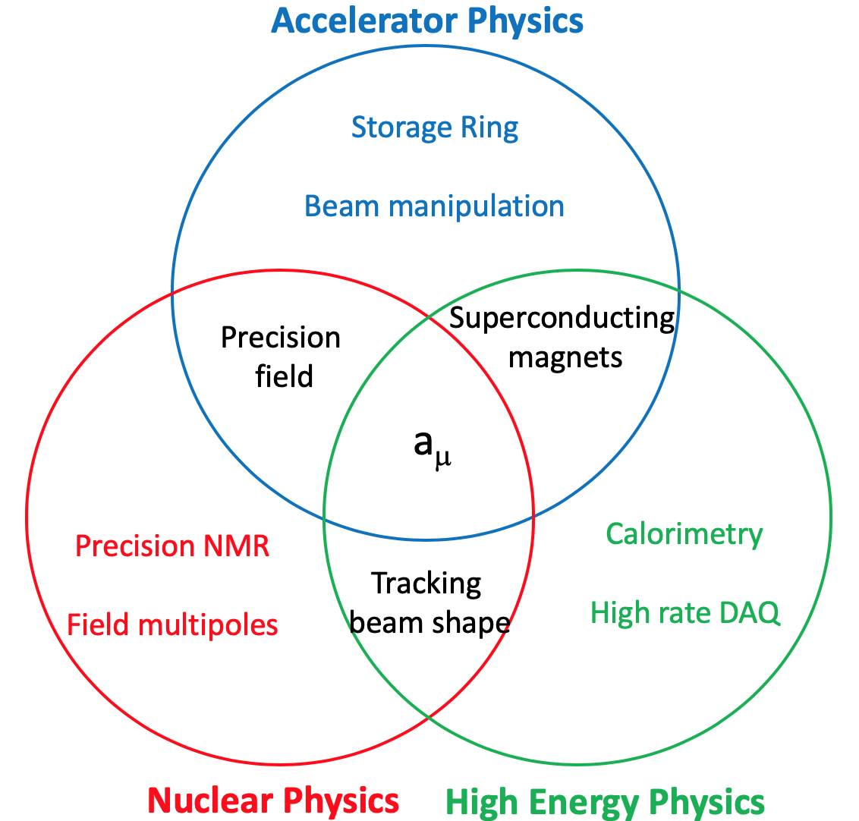
Three different communities converging to measure a_{μ}

Slide 5
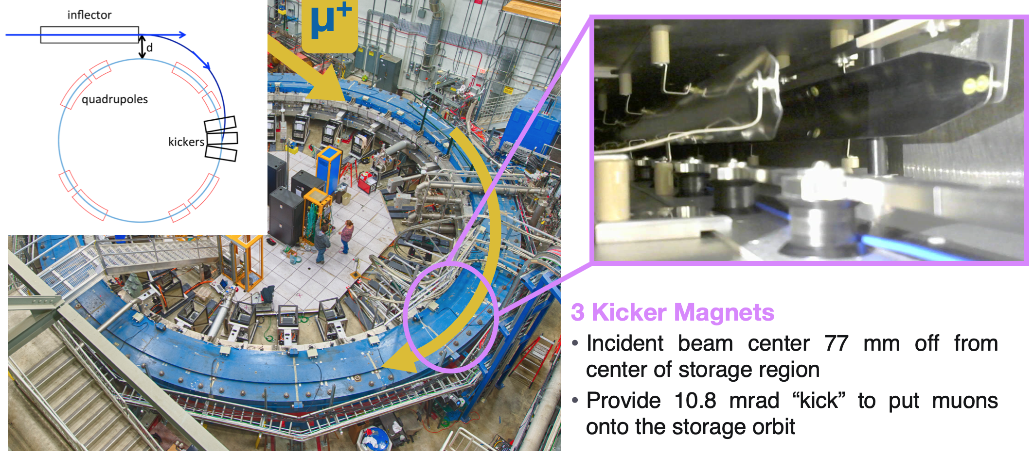
Muon beam storage and focusing

Slide 6
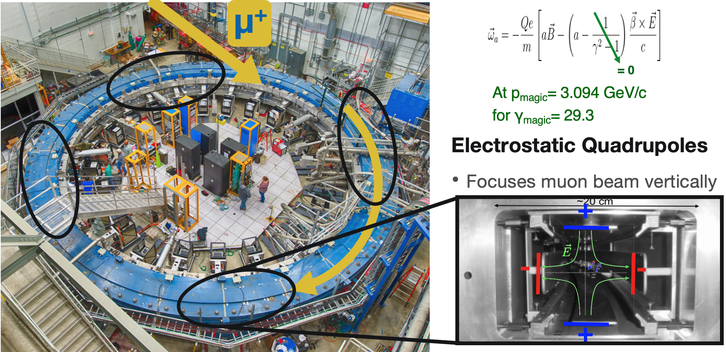
Muon beam storage and focusing

Slide 7
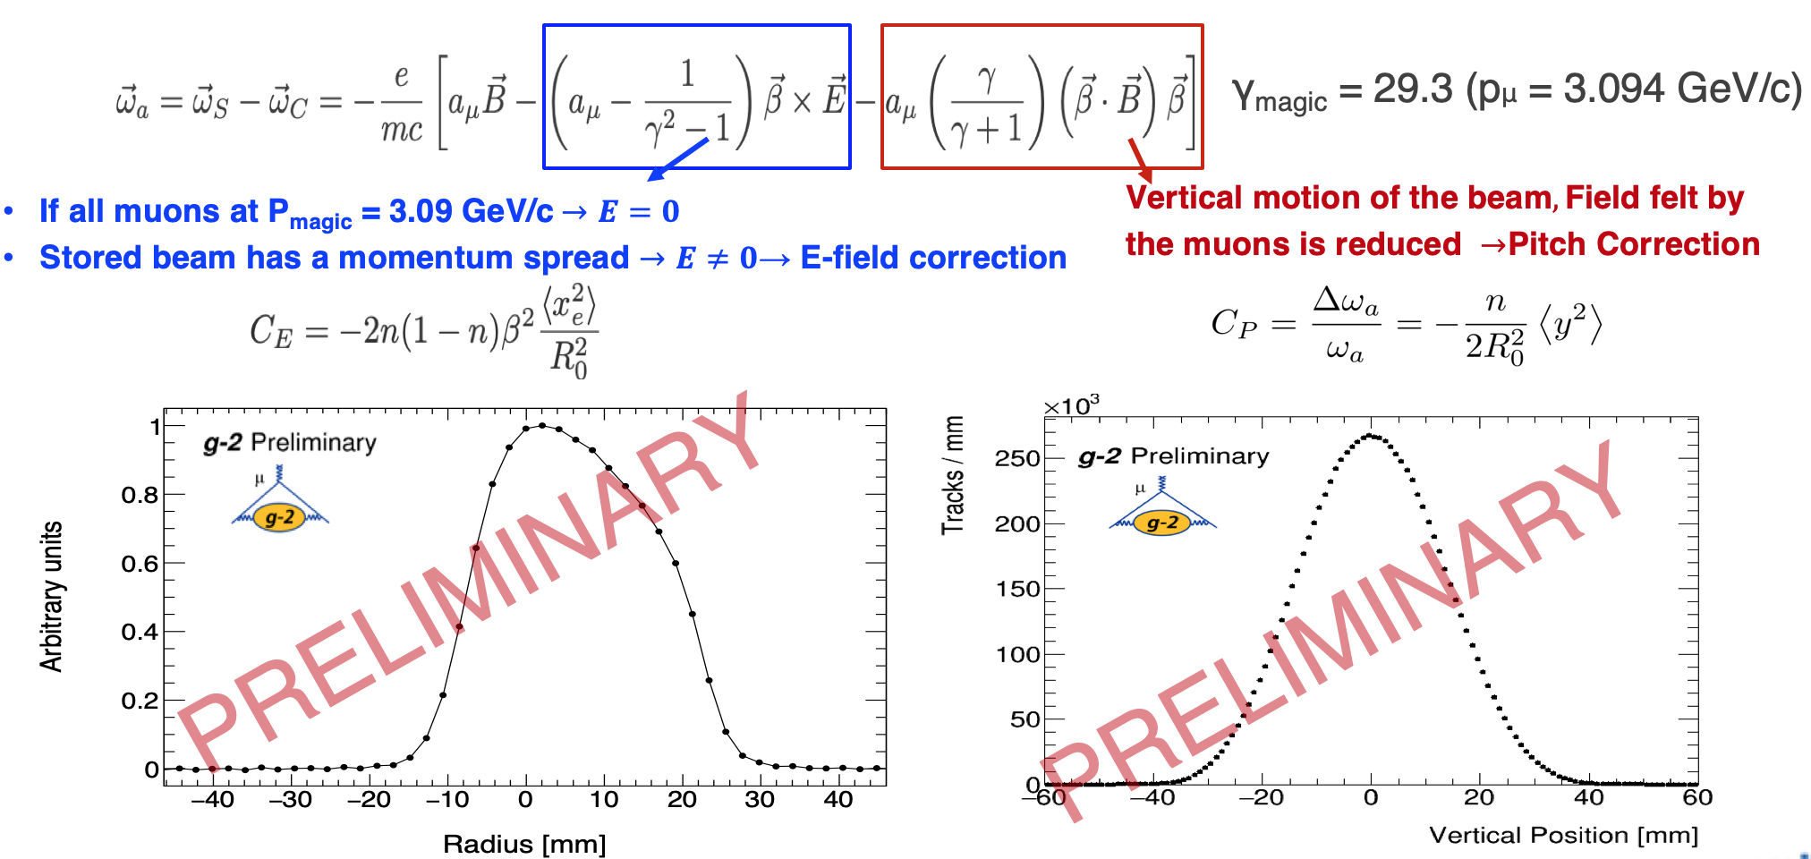
Effects of Beam Dynamics
Systematics related to knowledge of beam position and spread

Slide 8
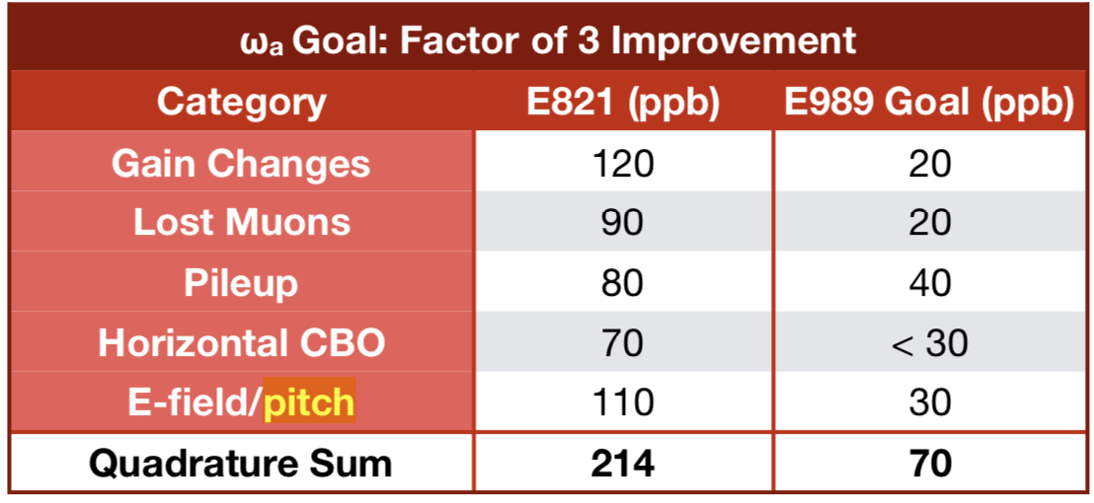
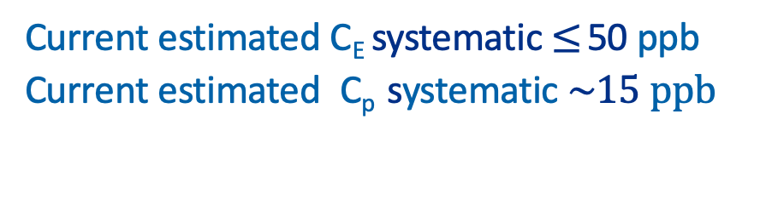
Other Beam Dynamic Corrections
Current estimated C_{E} systematic $≤$ 50 ppb
Current estimated C_{p} systematic $\sim 15 ppb$
For 0.3X BNL statistics

Slide 9
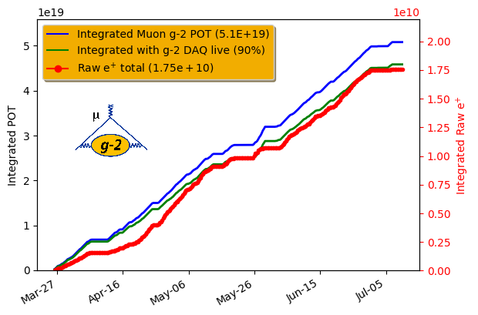
Run 1 Overview
Data taking period: April—July 2018
Accumulated ~ 1.3 x BNL statistics (after data quality cuts) — δωa(stat) ~ 350 ppb (BNL δωa(stat) ~ 460 ppb)
Field uniformity ~ 2x better than BNL
Accumulated statistics
BNL

Slide 10
Run 1 Overview
In Run1, data have been taken in different Quad and Kicker conditions, while optimizing Storage Ring operations (Run2 data are much more uniform)
Six datasets identified:
Name | Date acquired | Quad n | Kicker [kV] | Positrons
60 hour | 22-25 / 4 | 0.108 | 128-132 | 1.0B
High Kick | 26/4 - 2/5 | 0.120 | 136-138 | 1.2B
9 day | 4-12 / 5 | 0.120 | 128-132 | 2.4B
Low Kick | 17-19 / 5 | 0.120 | 123-127 | 1.2B
Superlow Kick | 2-6 / 6 | 0.108 | 117-119 | 0.5B
End Game | 6-29 / 6 | 0.108 | 122-127 | 4.0B
Relative
unblinding

Slide 11
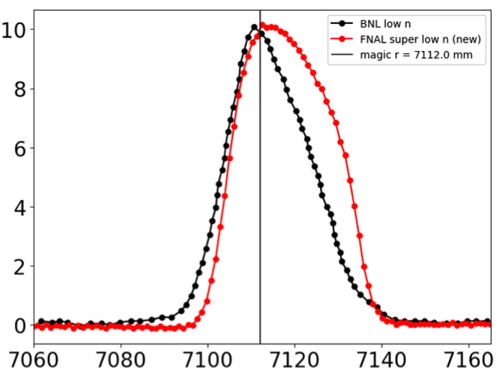
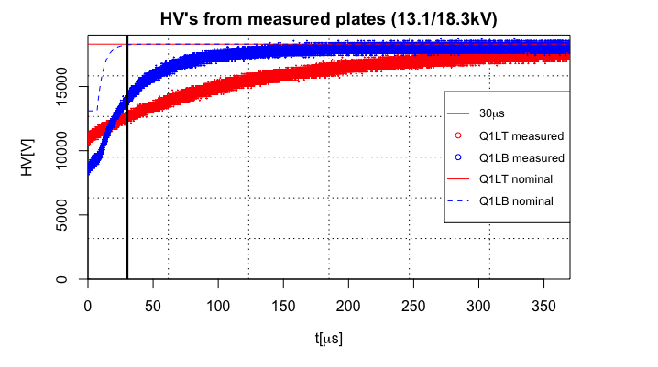
Problems related to Storage Ring in Run1
Two main problems observed in storing muons:
  bad resistor (QUAD)
  low current (KICKER)
High Voltage
intensity (a.u.)
Time (ns)
r-coordinate (mm)
Two resistors providing HV to the vertical plates of QUAD1-L had a slow recovery time (fixed for Run2)
The beam slowly moved vertically during fill.
Radial profile corresponding to a ring acceptance Δp = ±0.5%
Asymmetry due to not perfect kick

Slide 12
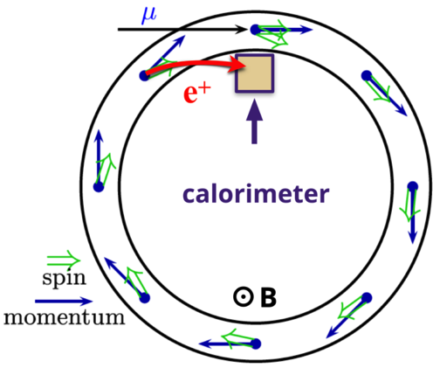
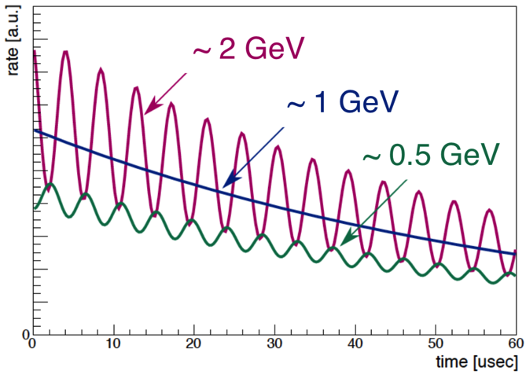
ω_{a} principle of measurement
μ⁺ Center of Mass
μ⁺
ν
e⁺
Maximum p : parallel
Minimum p : antiparallel
ν
ν
ν
e⁺
spin rotates faster than momentum in costant B
positron direction correlated with muon spin direction
correlation depends on positron momentum : the Asymmetry A(E) can be positive, null or negative

Slide 13
The wa analysis strategy
6 independent analysis groups using different Reconstruction algorythms and different Fit methods
One method is completely different from all others (Q-method); it has a larger error → used as crosscheck
2 Independent Reconstruction algorythms developed (East, West); the Europa team contributes to both algos providing the SiPM gain functions
Team | Reconstruction | Analysis
CU (Cornell) | East | T,E
UW (Washington) | West | T,A
Europa (INFN+UK) | West/Europa | T,A
SJTU (Shangai) | West | T,E
BU (Boston) | West | T,R
Uky (Kentucky) | Q | Q

Slide 14
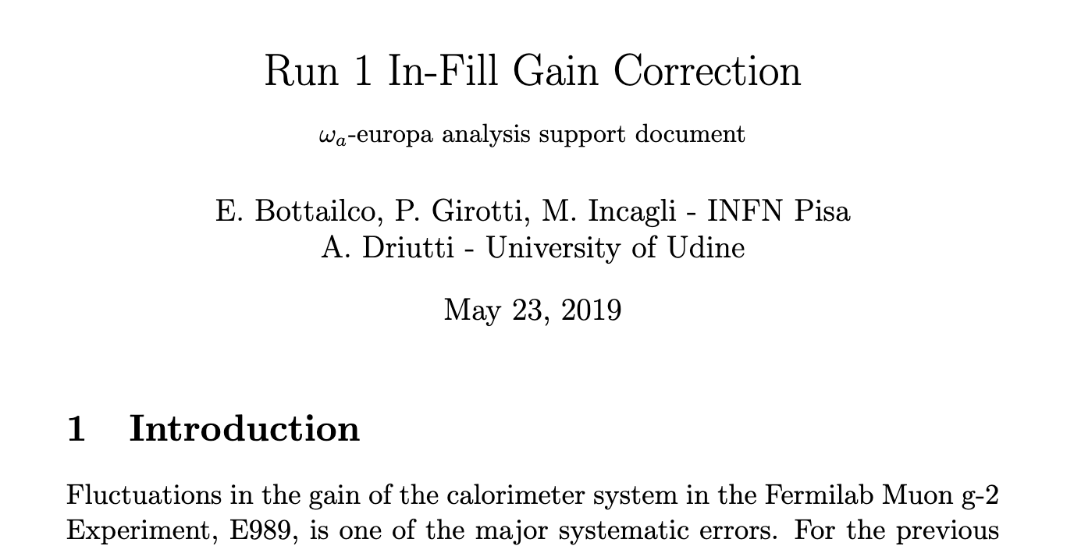
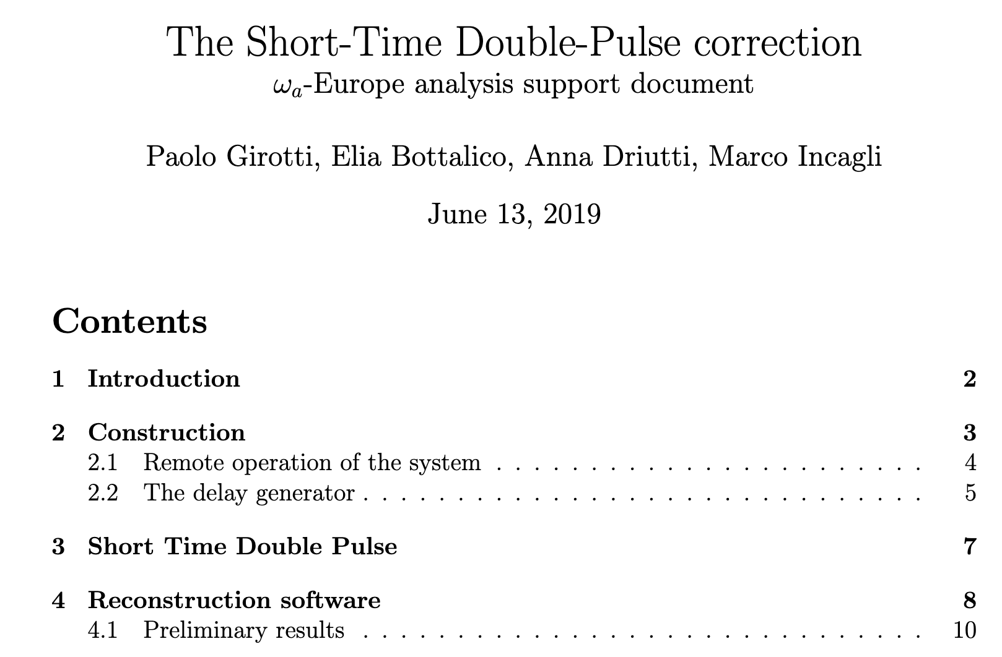
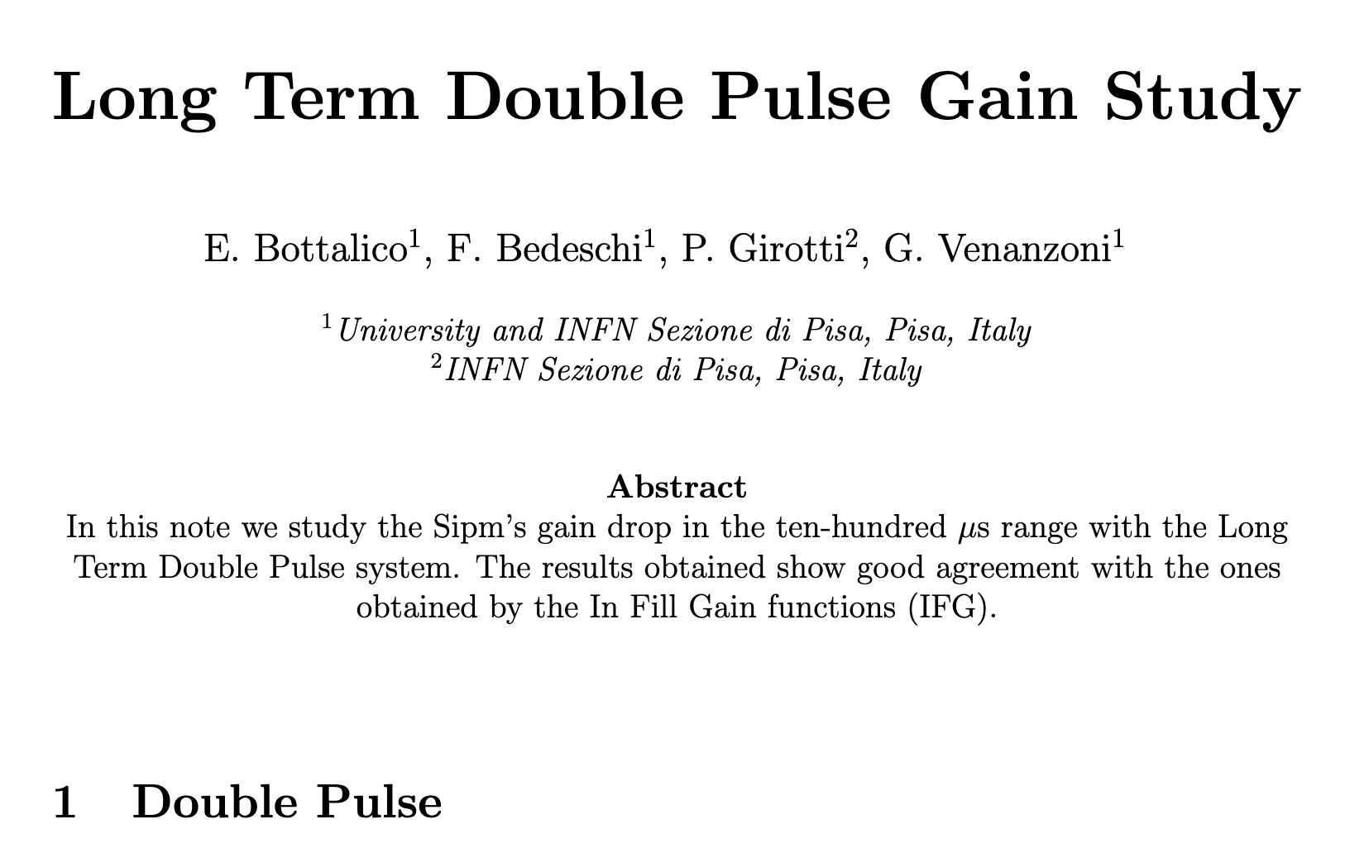
INFN contribution to SiPM gain corrections
the gain corrections due to «muon splash» or to «close-by» positrons is an evident contribution of the INFN component to the g-2 analysis

Slide 15
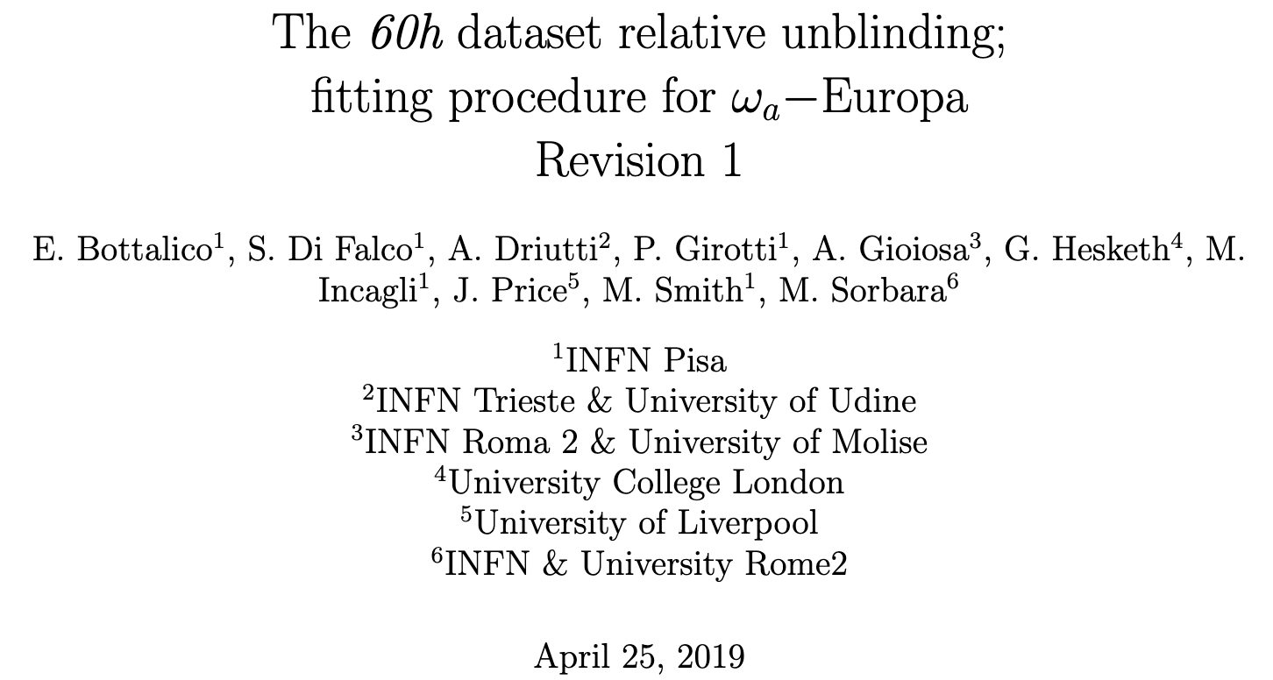
The wa-europa ω_{a} analysis group

Slide 16
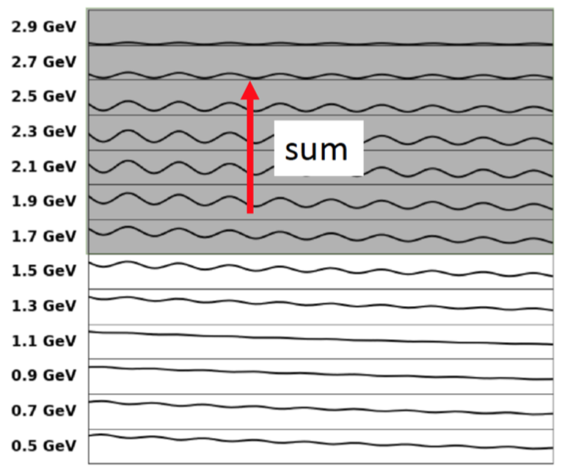
The methods
T-method: count all positrons with E>1.7GeV and plot them vs time to get the «Wiggle plot» ; reference method
E-method (Energy binned) : fit each energy slice, combine the resulting values for wa
A-method (Asimmetry weighted) : weight each event with its own contribution to asimmetry A(E). From the statistical point of view, this method uses most of the information.

Slide 17
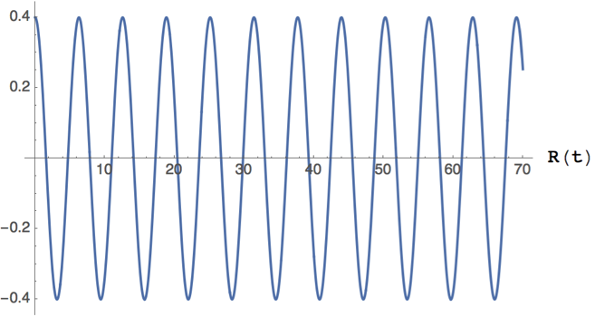
R-method (Ratio)
Ratio method: randomly split dataset in 2 subsets shifted by ±half a g-2 period
Build combinations of the 2 subsets which eliminates the exponential behaviour and leaves just a sinusoidal term
3 parameters fit: less sensitive to slow effects which divide out

Slide 18
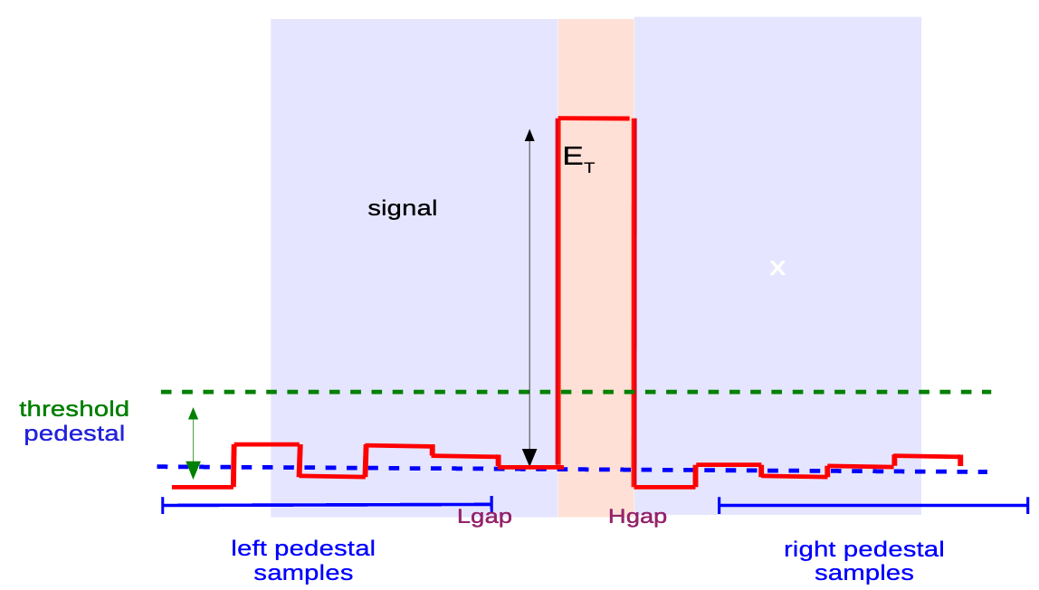
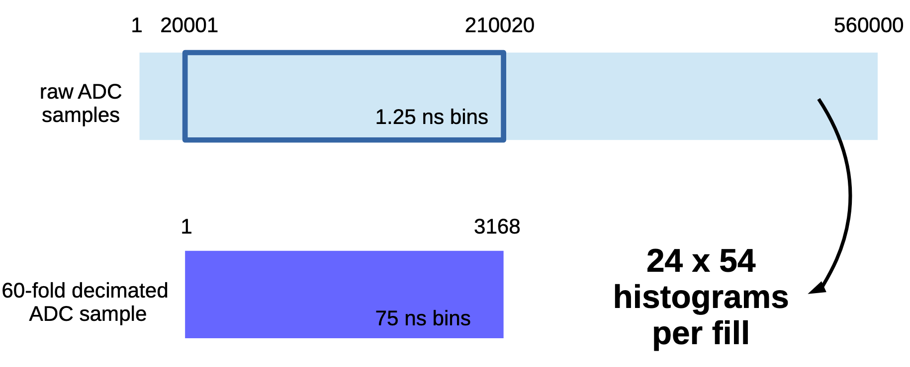
Q-method
No clustering: just integrate energy above threshold (in theory no threshold should be applied) for each crystal
To reduce the amount of data stored offline, time bins are summed up in groups of 60
The total energy per event fluctuates with ω_{a} frequency

Slide 19
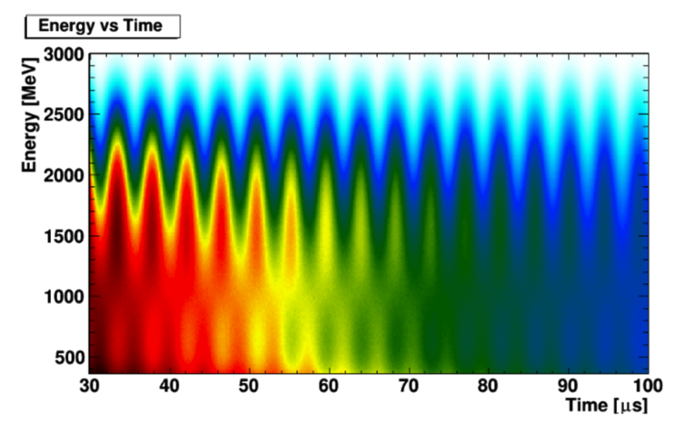

Building the histogram
The collected events are plot as a function of the muon decay time (clock) and of the positron energy (polarimeter)
Note that the phase depends on the positron energy
If the energy threshold varies during the muon fill then wa is systematically shifted: $ω_{a}t+φ\left(t\right) \sim (ω_{a}$+$φ′)t+ φ_{0}$

Slide 20
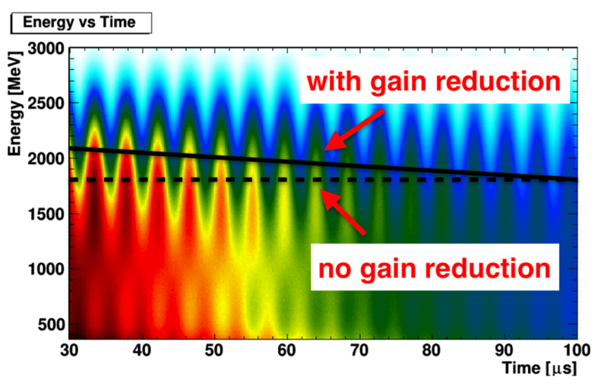
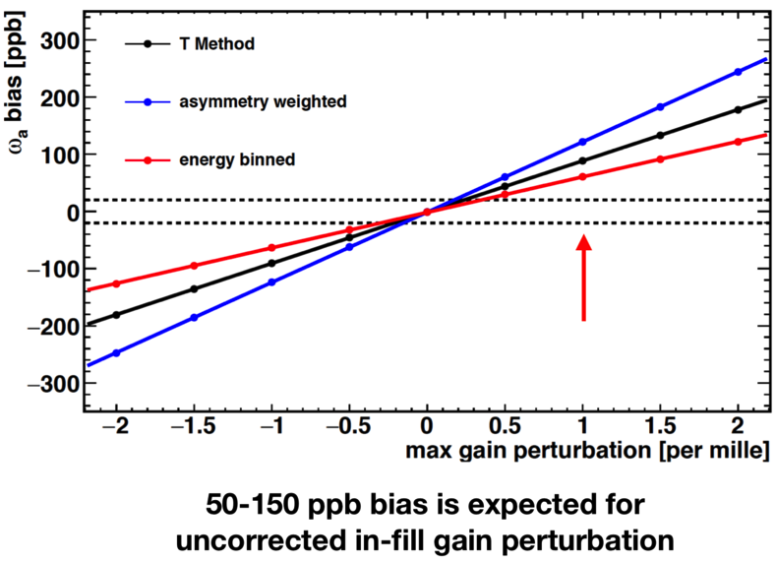
Gain stability
SiPM gain variations during fill, due to initial “splash” or to the overlap of close-in-time events, mixes different energies in the same plot → phase variation effect corresponding to bias on wa
A 1 per mille uncorrected gain variation causes a 100 ppb shift of wa
The laser system measures and corrects for this gain sag effect

Slide 21
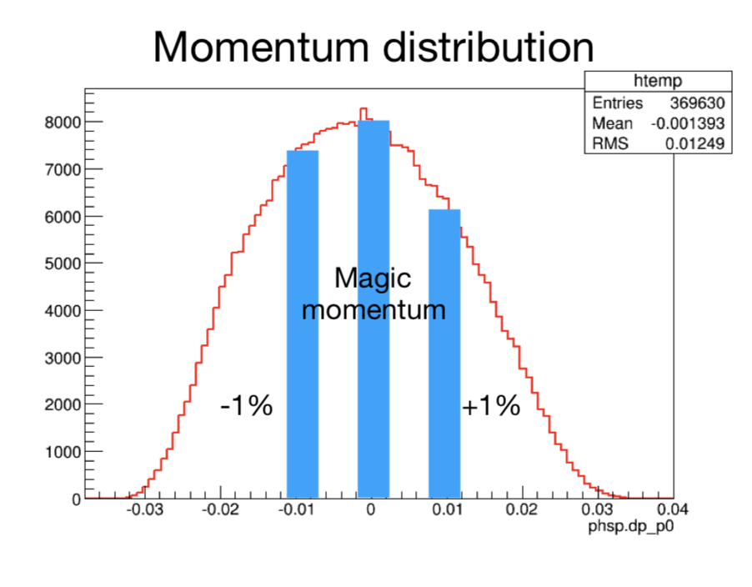


Muon Phase-Momentum Coupling
If the average muon phase varies during the fill, then wa is sistematically shifted: $ω_{a}t+φ\left(t\right) \sim (ω_{a}$+$φ′)t+ φ_{0}$
This can happen in case of phase-momentum correlation
$\text{Bias}$in $ωa. :Δωa\text{=}\frac{d<φ> }{dt}$ = $\frac{dφ}{d<p>}$ . $\frac{d<p> }{dt}$
Measured with dedicated systematic runs
Take data at higher than nominal momentum
Compare higher momentum phase to nominal momentum phase
phase shift (rad)

Slide 22

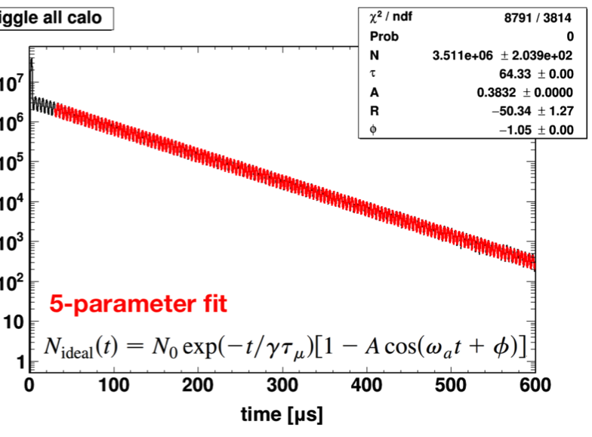
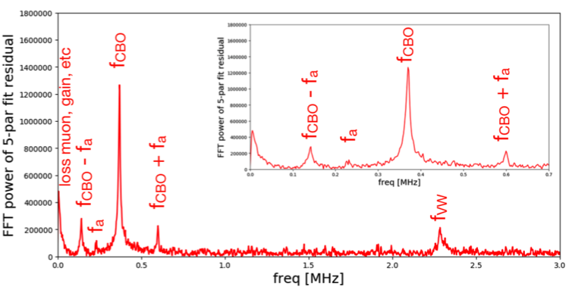
The 60h dataset: 5-par fit
Simple (ideal) positron oscillation:
This simple fit is clearly not sufficient and typical resonances are observed in the residuals
muon lifetime: γ=29.3
NOTE: blinding on ω_{a}!

Slide 23
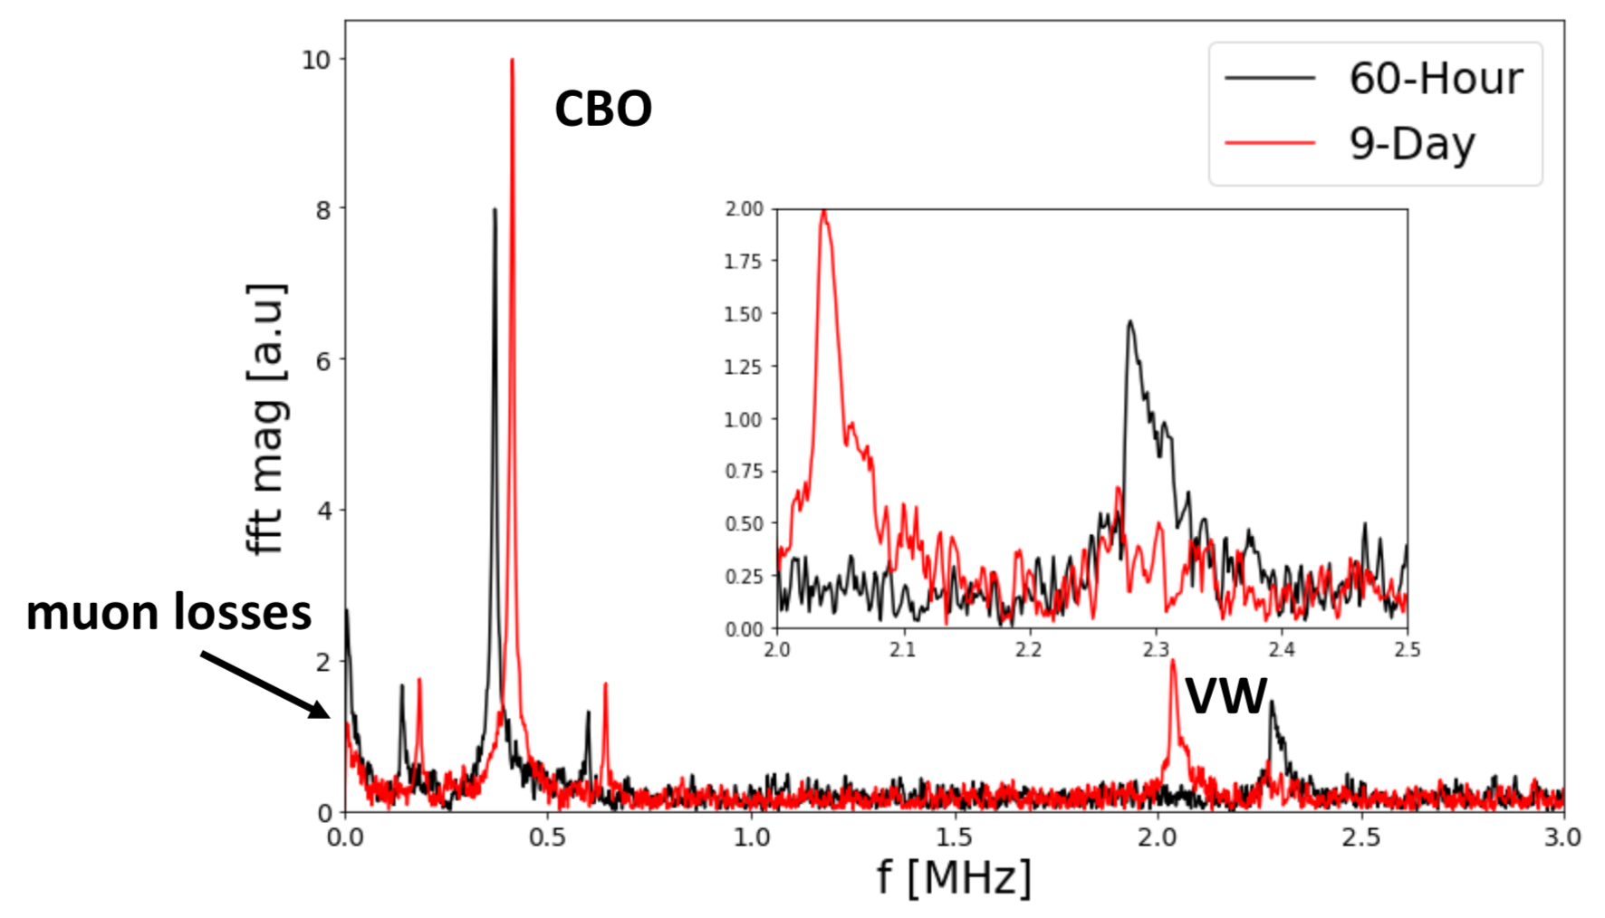
Residuals for two datasets
The betatron oscillations depend on the beam parameters → different for each Run1 dataset → datasets cannot be combined and must be fitted separately

Slide 24
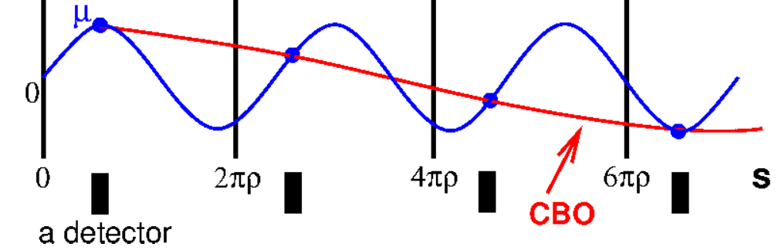
Structure in residual: Beam Oscillations
Coherent Betatron Oscillations (CBO) sampled by each detector at one point around the ring
Beating effect: the frequency measured by any one detector is f_{CBO} = f_{C} - f_{x} (much smaller than both individual freqs)
Similar effect in vertical direction
24

Slide 25
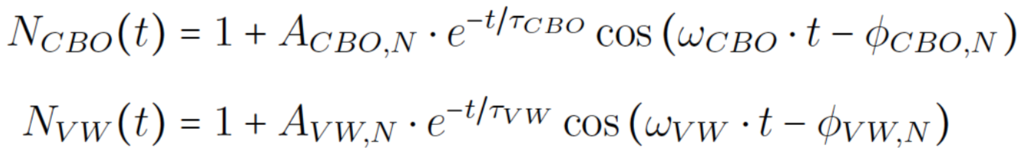
Typical 18 (or 22) parameters fit function
ω_{CBO} and ω_{VW} are not constant due to QUAD HV faulty resistor:
  ω_{CBO}(t) = ω_{CBO}(0) * (1 + δ_{CBO}(t) )
(similar for ω_{VW}). The number of parameters depends on the parametrization of the correction δ_{CBO}
The first term in parenthesis corresponds to the lost muons term → next slide

Slide 26
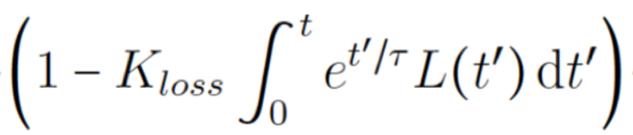
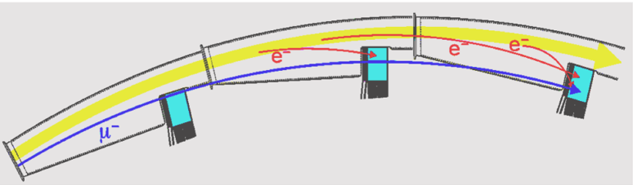
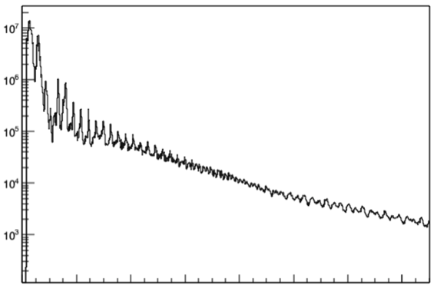
Distorting muon life time: lost muons
Muons with r > 45mm wrt magic radius hit the collimators and bend (tipically) inward
Correction to "wiggle function” :
Lost muons selected as MIP particles which hit 2 (or 3) calos with Δt=6.2 ns
Fraction of lost muons for t>30μs is <10⁻⁴
wa-europa: Di Falco, Sorbara, Gioiosa
Numero di Lost Muons
0 20 40 60 80 100 120 140
time (μsec)

Slide 27
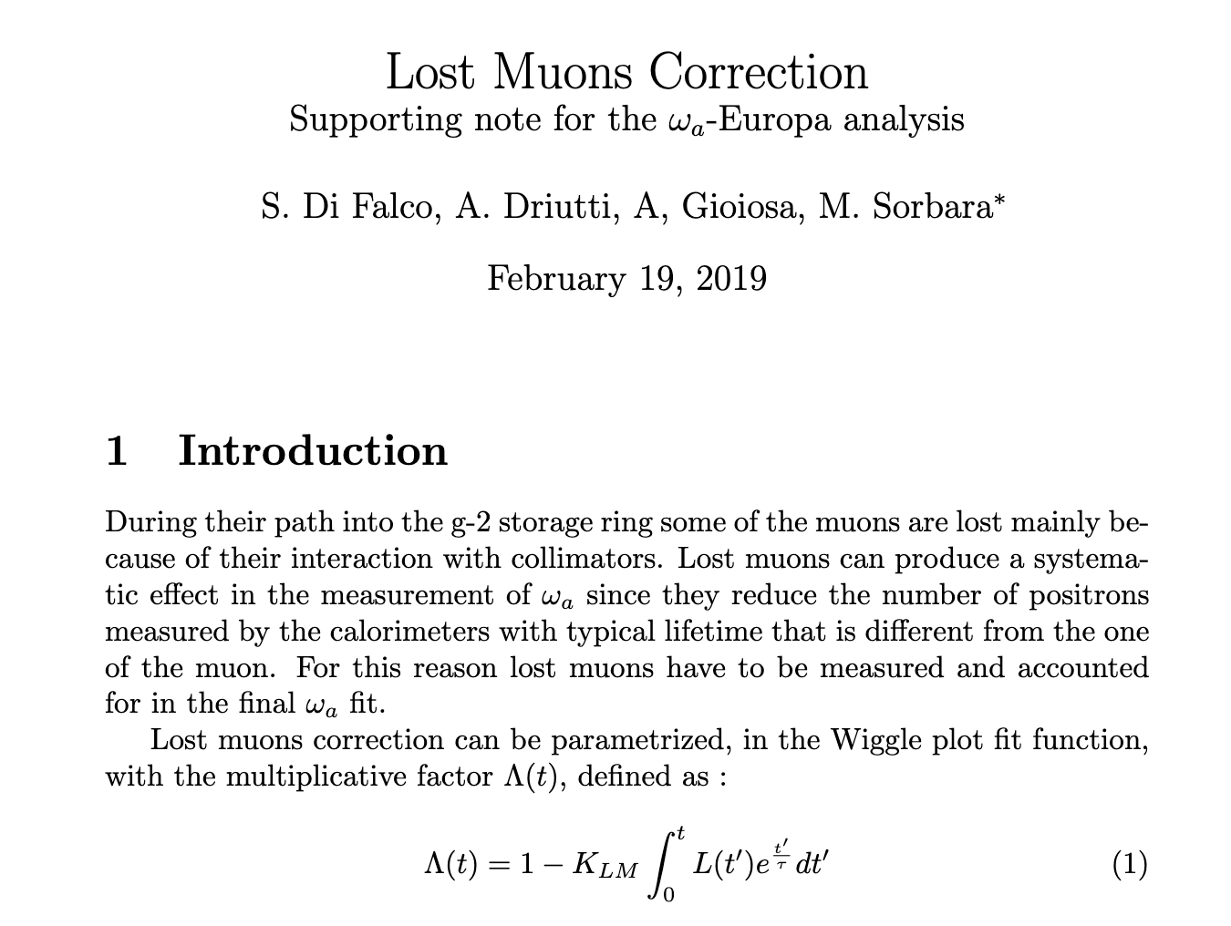
Internal Note on Lost Muons Corrections

Slide 28
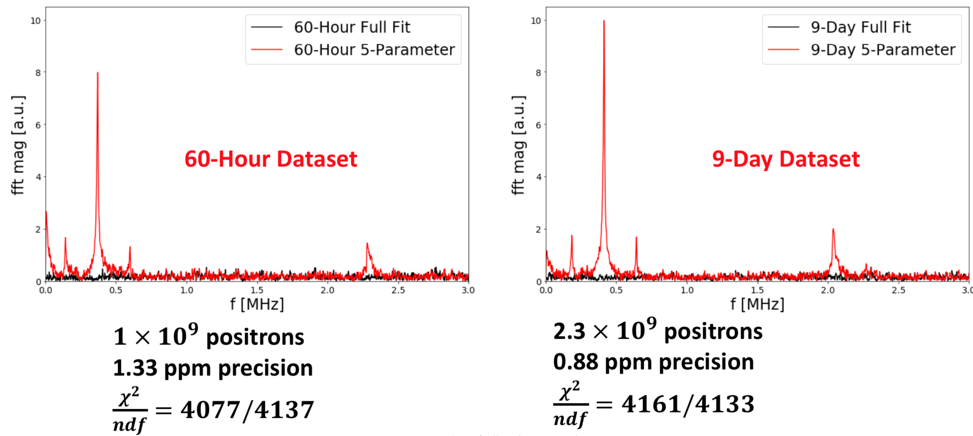

Slide 29
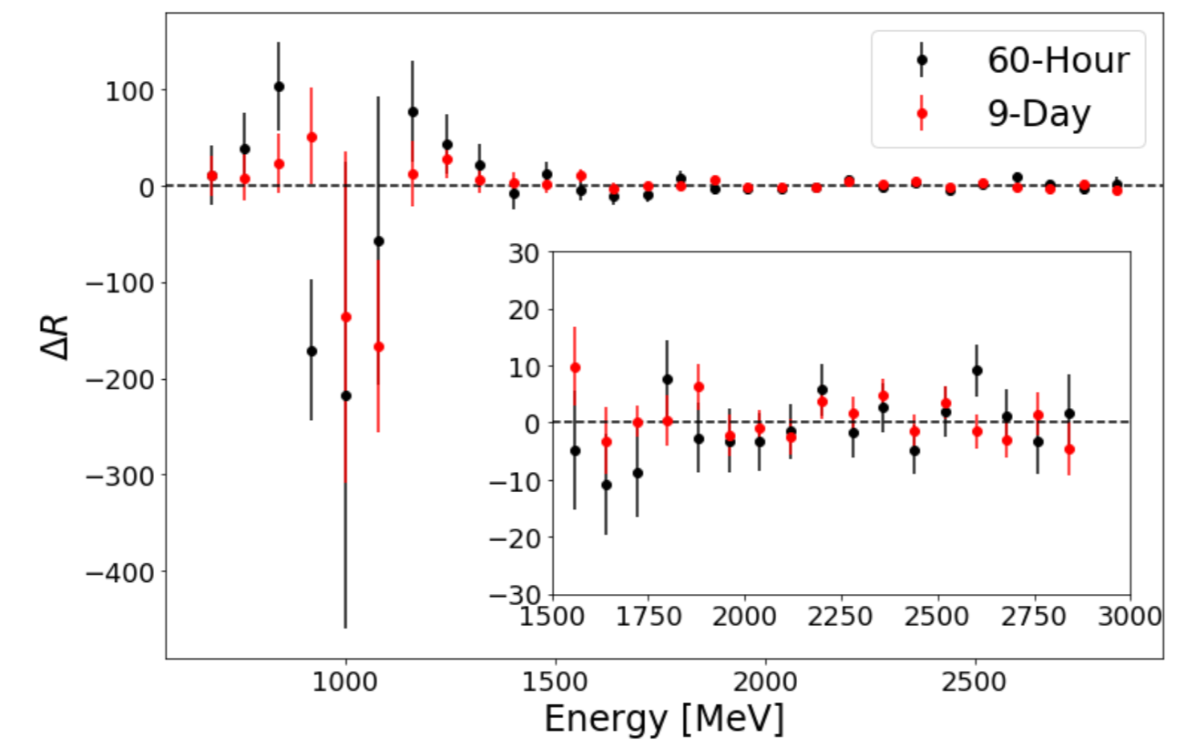
R vs positron energy
Due to blinding, we do not measure directly wa, but a variable R which is a fractional offset (in ppm) from some unkown (blinded) value

Slide 30
First combination of results
In Elba Physics Week, results presented separately by the different analysis groups on wa and wp have been compared for the first dataset (the 60h dataset)
The T-method is used as a reference

Slide 31
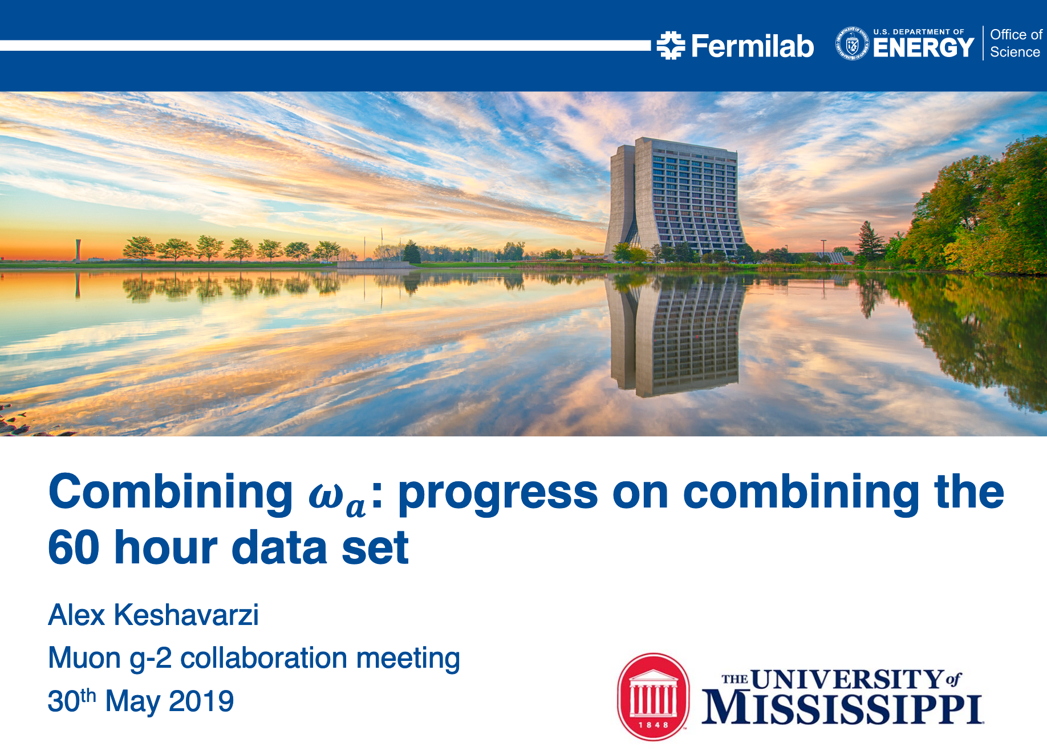
Combining ω_{a}

Slide 32
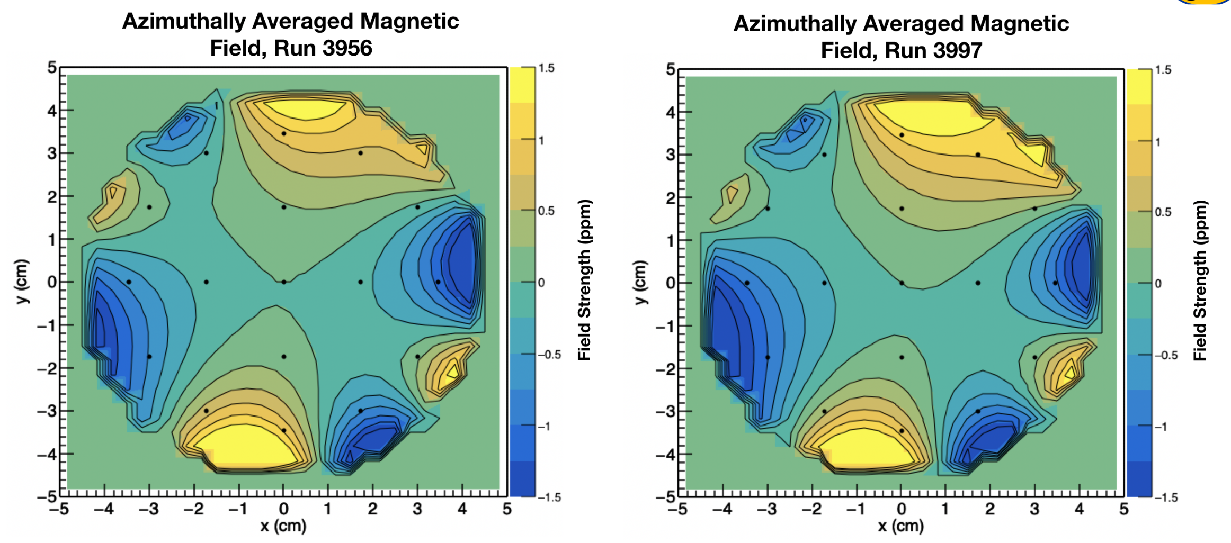
What about wp ?
Two trolley runs, one before and one after the 60h dataset, fix the magnetic field:

Slide 33
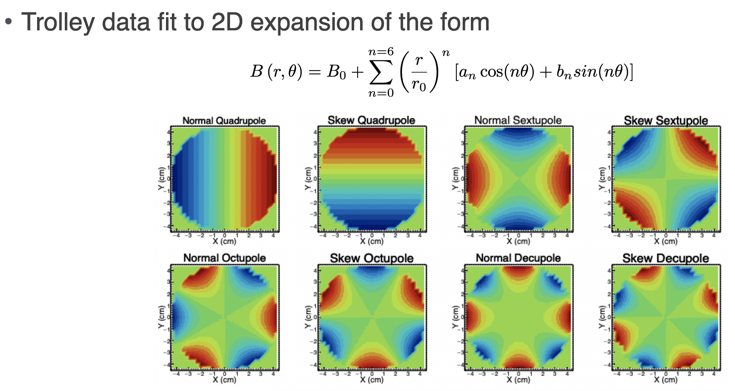
Multiple expansion

Slide 34
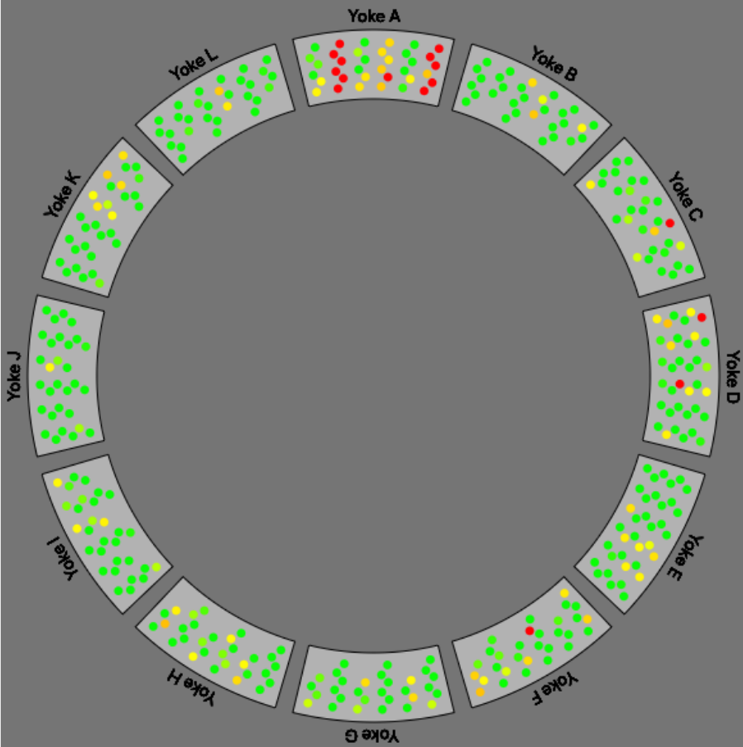
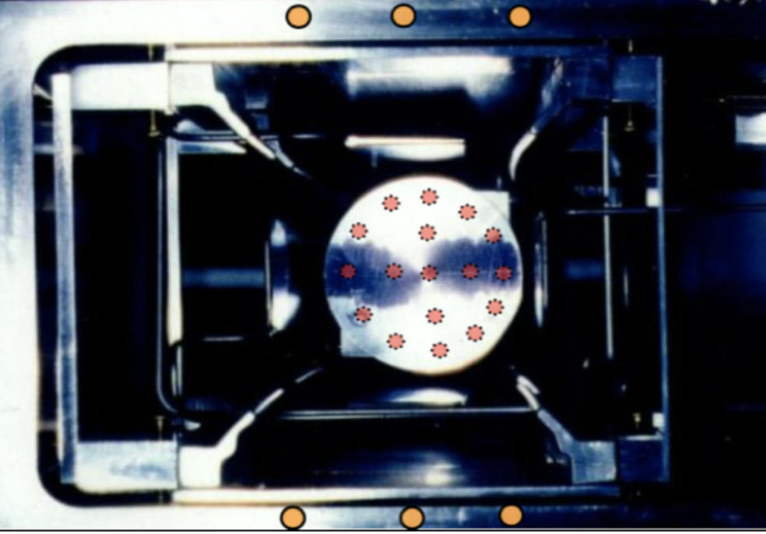
How to extrapolate during 60h?
Fixed probes are used to extrapolate, but
  far from beam center
  4 or 6 probes per station: only first multiples tracked

Slide 35
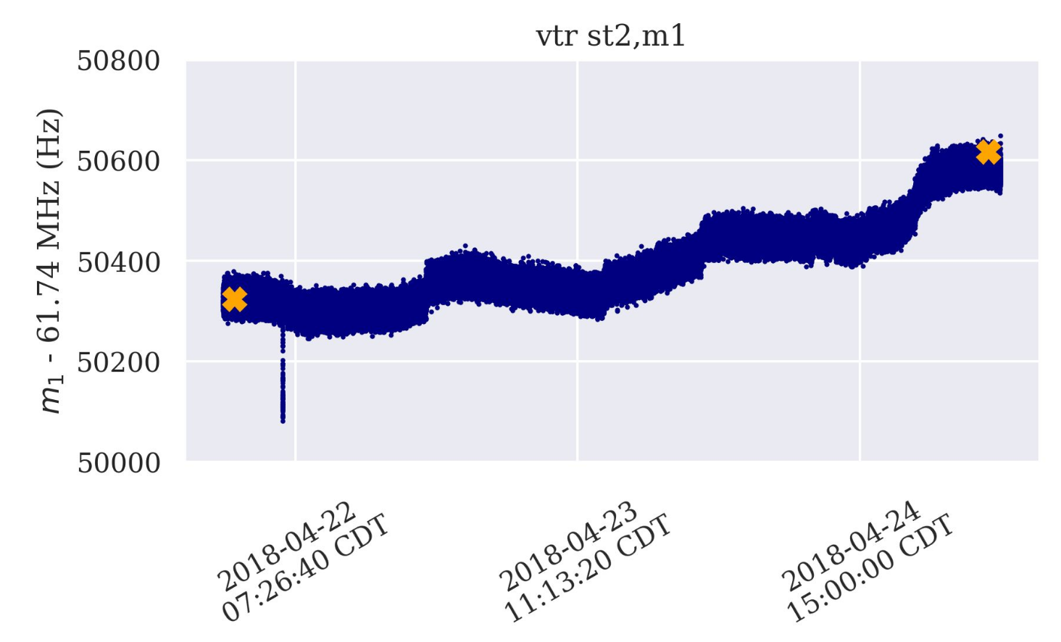
Interpolation effect
Interpolating between two trolley runs using fixed probe stations is the largest source of incertitude in B measurement
x yellow crosses = trolley probes; blue point = fixed probes
60h dataset

Slide 36
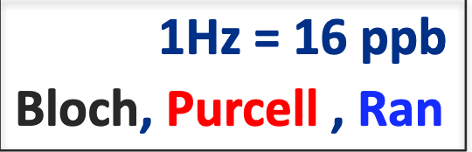
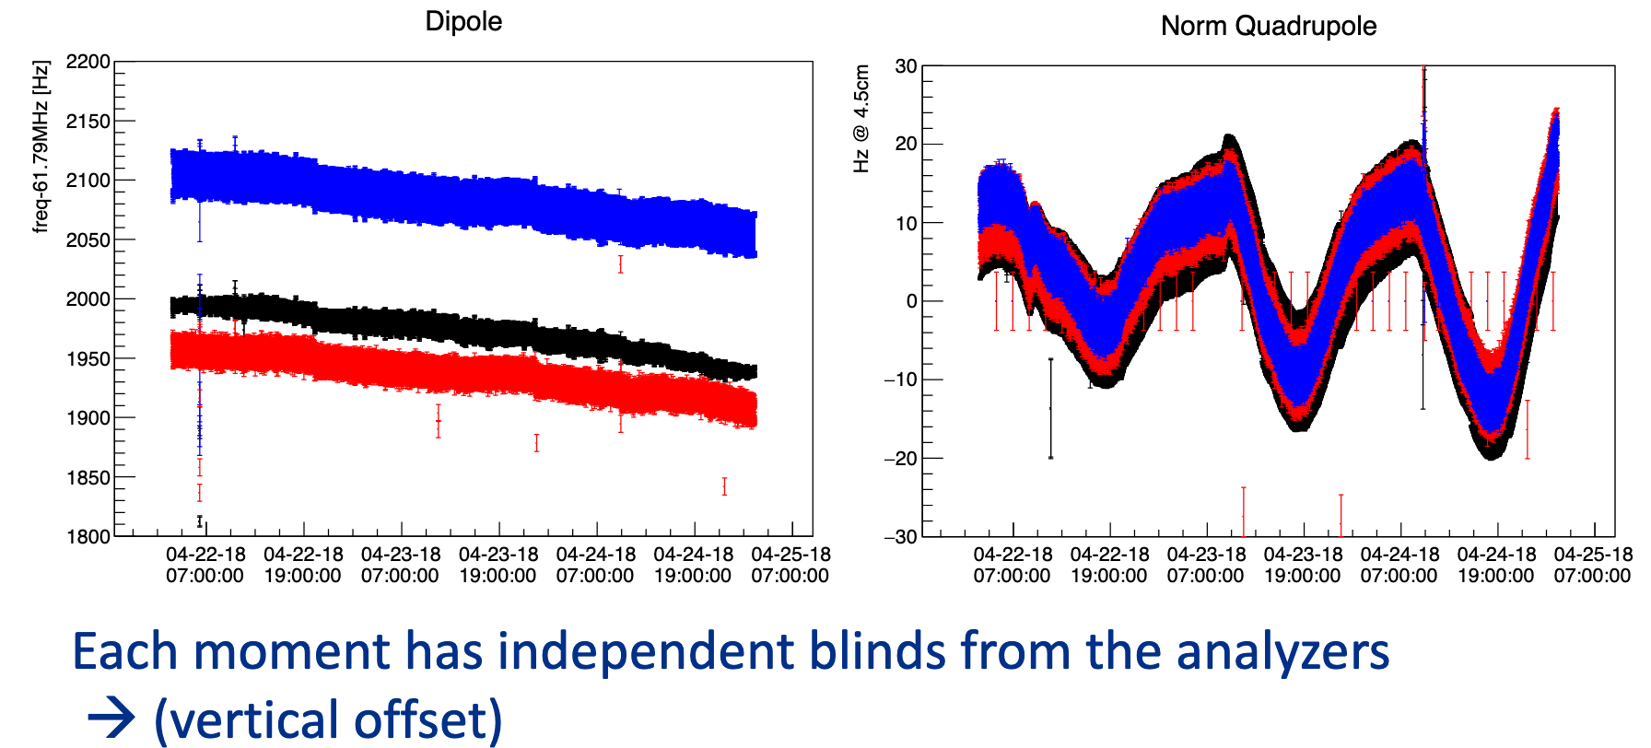
Blinded comparison
Three independent analyses performed on wp
Not authorized to show unblinding here ...

Slide 37
Summary - 1
Analysis of Run1 going on
6 datasets to be studied independently and combined
1 analysis completed (60h), 2 well advanced (9d + endgame), corresponding to ~70% of Run1
High visibility of INFN contribution to the analysis
  many analysis tools, mostly, but not only, related to gain functions
  leading role in data production and reconstruction (Anna Driutti)
  leading role in wa analysis (wa-europa)
  reviewer of wp analysis (M.I.)
  important role in Data Quality Control
  slow control monitoring (Antonio Gioiosa)
  ...

Slide 38
Summary - 2
Publication expected by calendar year 2019 ... but ... should we wait for Run2?
  more stable conditions
  no competition
  must be sure to do it right
... tough decision

