Slide 1


COMPANY PRESENTATION
Ginevra - CERN

Slide 2
Space Windows
ProgeM has designed, manufactured, assembled and tested, two different assemblies of space windows for a major european customer. These windows will be installed on a space module that will fly in 2022.
The unique Know-How gained with this project worthed a parnership with The Boeing Company and Elbit
7mm

Slide 3
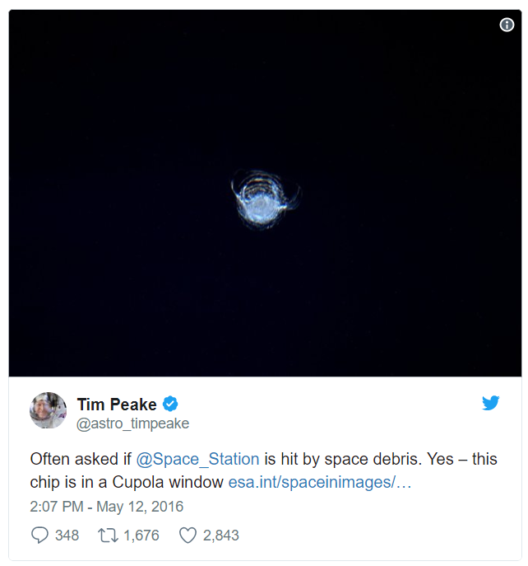
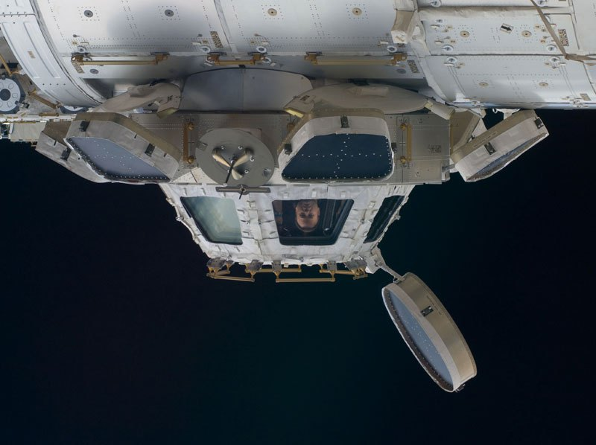
Carbon Fiber Strain Gauge
But what if not visible?
The II Axiom of the Structural Health Monitoring states:
“The assessment of damage requires a comparison between two system states“
That’s why it is important to monitor the windows from an early stage: starting from the assembly and testing through the launch up to the operative on-orbit state.
7mm

Slide 4

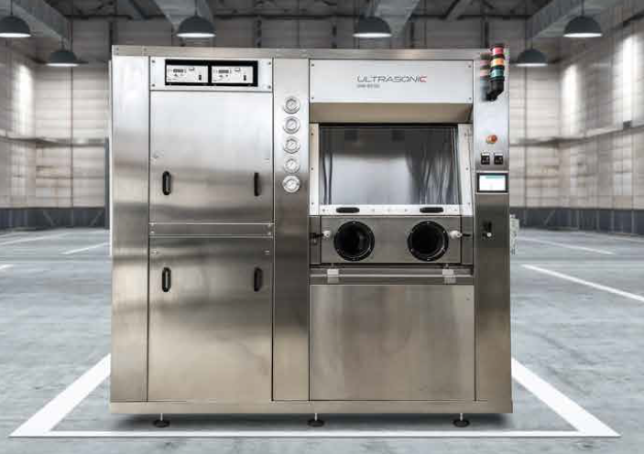
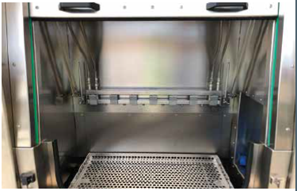
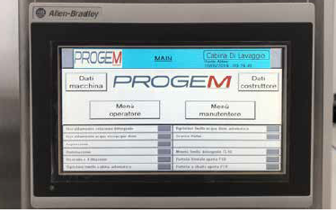
ProgeM design produce and assemble customized Ultrasonic Cleaner
7mm

Slide 5
TOUGH & COMPETENT

