Slide 1
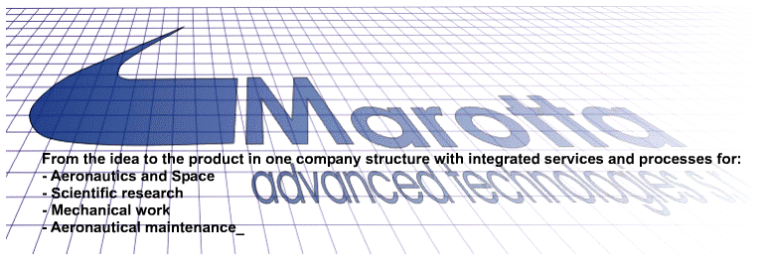
Via G. Marconi 18/a 80040 Cercola (Na) tel. 0039 0817331454 Fax 0039 0817332611 www.marottasrl.it info@marottasrl.it

Slide 2
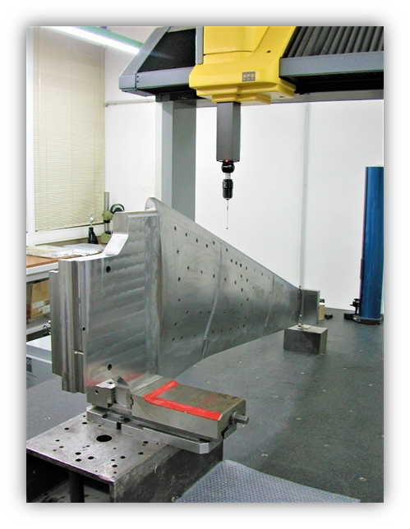
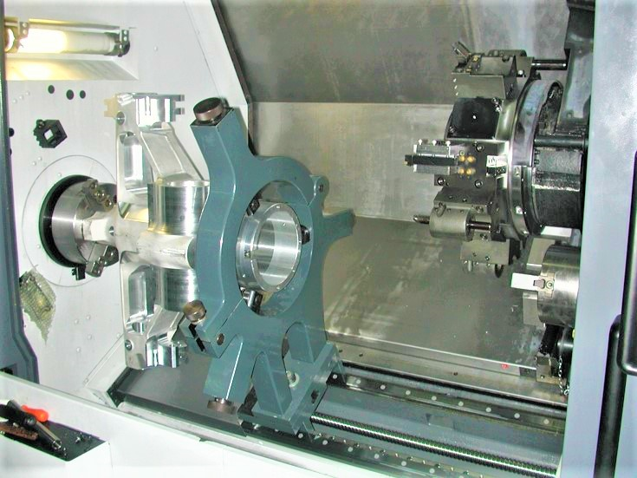
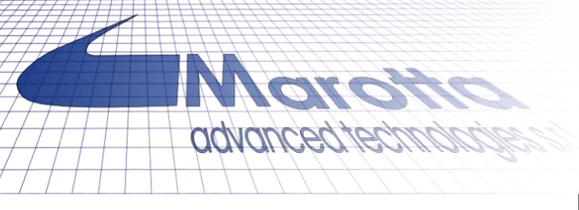
Who we are
Marotta S.r.l is specialized in the manufacturing of high precision mechanical components for aeronautics, military and space applications. The company was founded in 1957 starting with traditional manufacturing technologies. During the years, traditional technologies have been replaced by CAD/CAM automatic systems and currently the company has a production area of 1500 sq meters constituted by the following typology of CNC machines:
• CNC Turning Machines up to 4 axis.
• CNC Milling Machines up to 4 axis.
• CNC Grinding Machine.

Slide 3
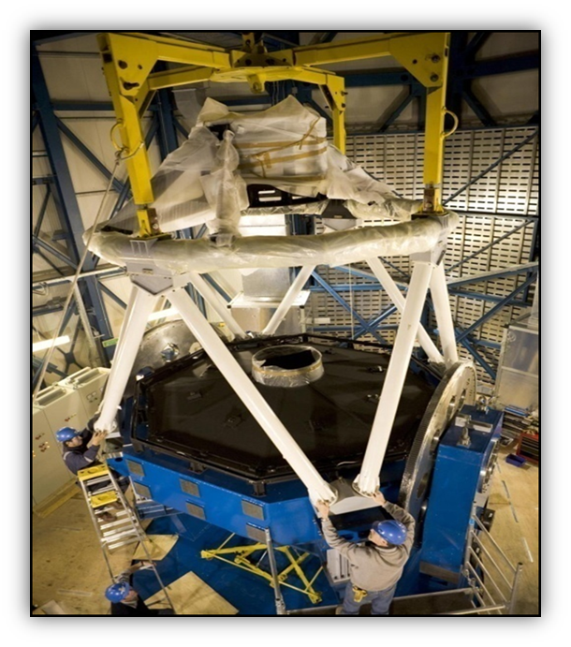
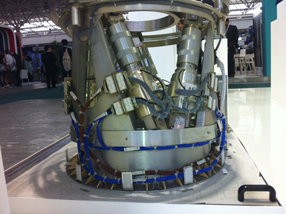
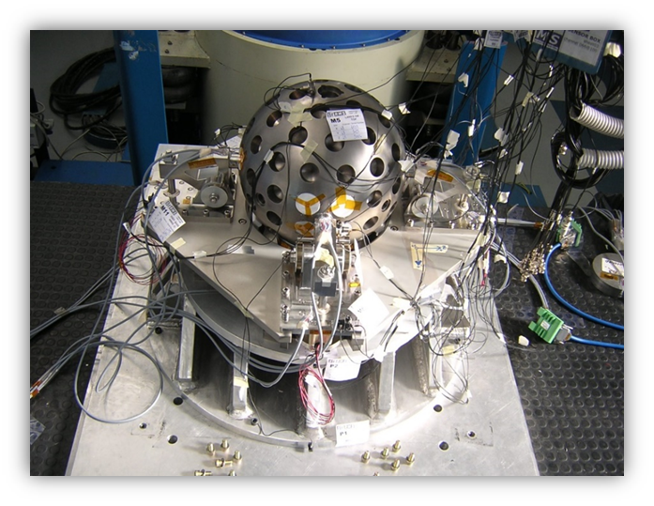
Products & Services: Design & Research
Thanks to the involvement in many European Projects as Horizon 2020 and collaboration with aerospace research centres as CIRA, the company has developed capabilities in design of scientific tools for research in aerospace.
The main areas concerning Science and Research are:
Observation from the Earth and Space
Structures for space application
Phisics of particles
Scientific experimentation in the aeronautic field
Monitoring and enviroment surveillance in critical conditions

Slide 4
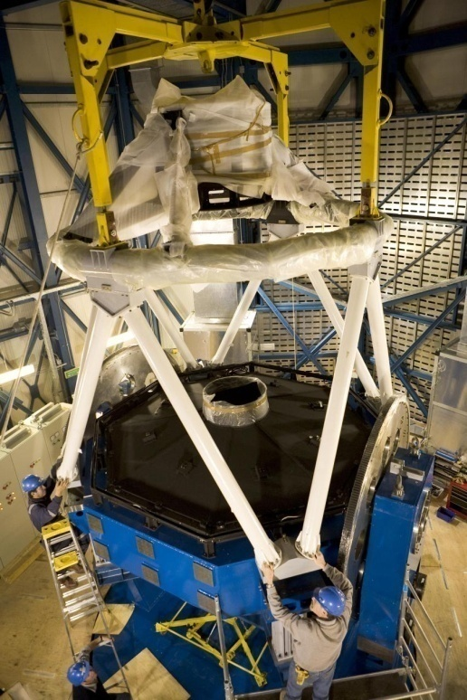
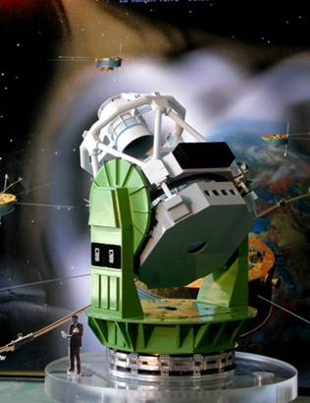
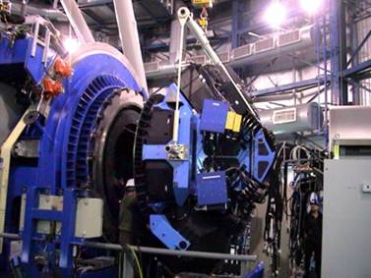
Manufacturing and Integration for scientific instrumentation:
VST (VLT Survey Telescope) :
is a 2.61 m diameter telescope conceived for the Paranal Observatory to support the VLT through its wide-field capabilities and to perform stand-alone survey projects. Marotta s.r.l. has joined the realization of prototypes of all actuators for active optics. Supervisioning engineering and production for the implementation of structural steel and its mechanical components
VIRMOS:
The Franco-Italian VIRMOS project has delivered the VIMOS
spectrograph for the European Southern Observatory Very Large
Telescope (ESO-VLT). The Marotta A.T. s.r.l. was responsible for the
construction of all units and related subsystems.

Slide 5
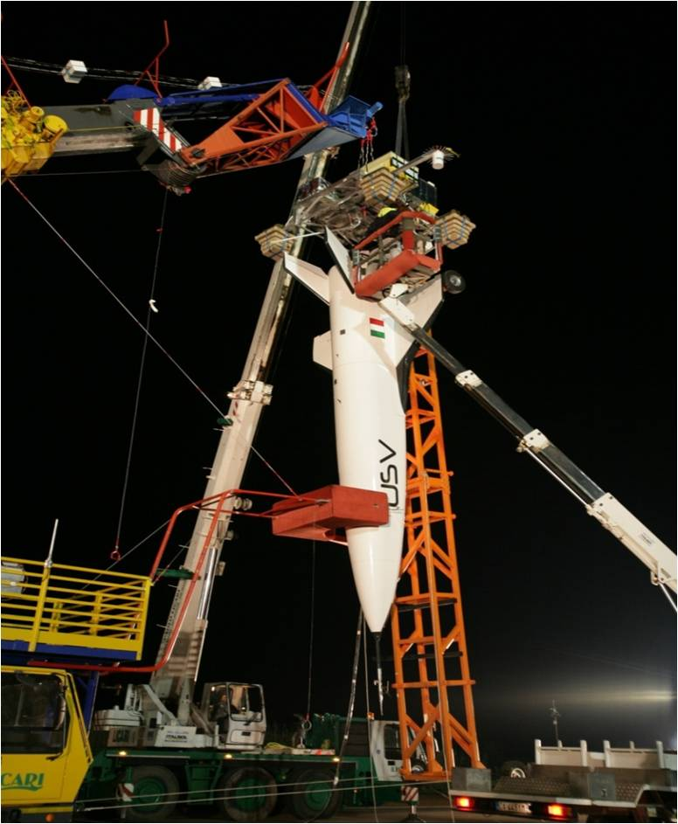
USV – Unmanned Space Vehicle (CIRA Project)

