Slide 1

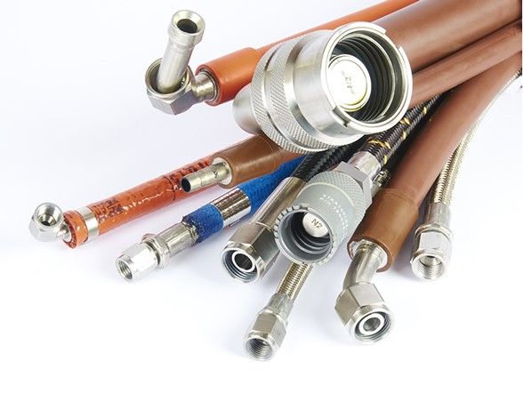

Paolo Biffi | Metrology Manager
p.biffi@jointek.eu
Italian Companies at CERN
September, 19th 2019
RESTRICTION ON DISCLOSURE AND USE OF DATA
This document (the “Document”) has been drafted by Jointek s.r.l. for information purpose only of the recipient (the “Recipient”).
The information contained in the Document is submitted as the privileged and confidential property of Jointek s.r.l. and Parker Hannifin Corporation if any.
The Document has been drafted by Jointek s.r.l. using (i) company proprietary information and (ii) Parker Hannifin Corporation proprietary information provided by “Parker Hannifin Corporation - Aerospace Group - Stratoflex Products Division”.
The information contained in the Document shall not be duplicated, used, or disclosed in whole or in part outside the Recipient organization without the express written consent of Jointek s.r.l. and Parker Hannifin Corporation if any. This restriction does not limit the Recipient’s right to use information contained in the Document if it is obtained from another source without restriction.
The Document contains information whose import/export could be restricted by European Union, United States and other national or international Law and/or Regulations concerning import/export of defense-related and/or dual-use articles and services. Violations of these Law and/or Regulations are subject to severe penalties. The information subject to restriction is contained in all pages of the Document.
© 2019 Jointek s.r.l. All Rights Reserved.
.

Slide 2
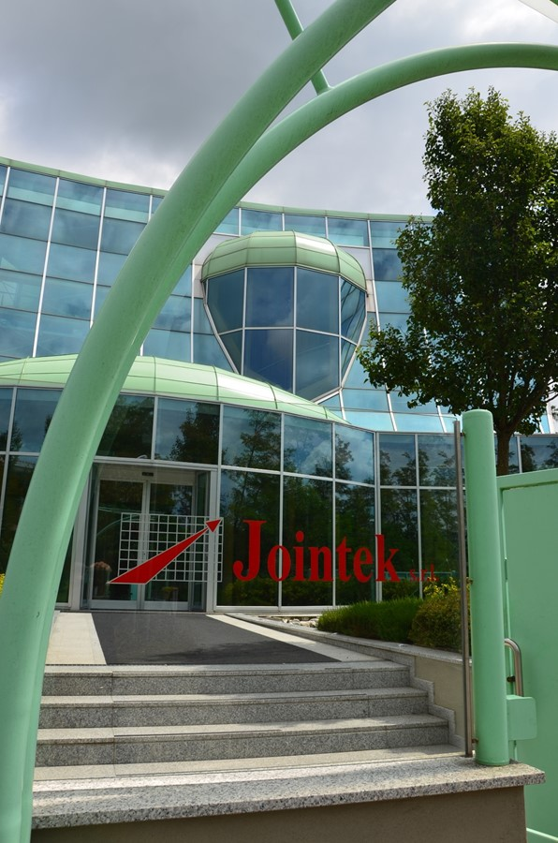
COMPANY OVERVIEW
Incorporated in 1991, since 1994 is Authorized Fabricator and Distributor of Parker Hannifin Co.- Stratoflex Products Division.
Over 30 years of fluid conveyance extensive engineering expertise.
Build-to-Print & Build-to-Spec manufacturing.
Jointek is capable to address high-performance custom requirements, both in terms of design-specifications, small-quantity-batch, and fragmented delivery date.
Located close to Intl. Airport of Malpensa-Milan-Italy, Jointek operates 3 divisions:
  Aerospace;
  Motorsport & Racing;
  Metrological & Technical Services.

Slide 3
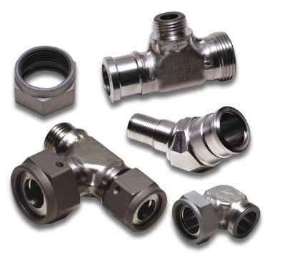
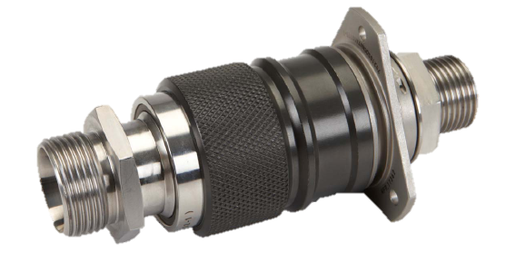
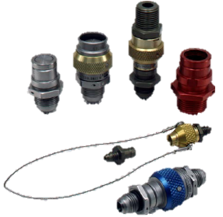
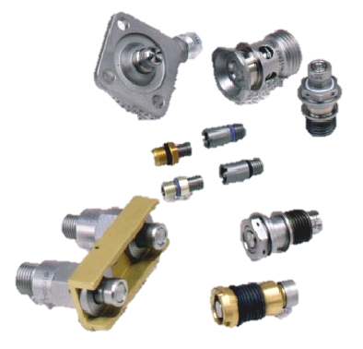
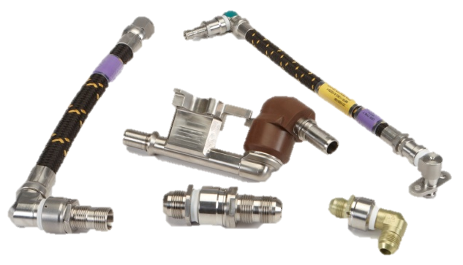
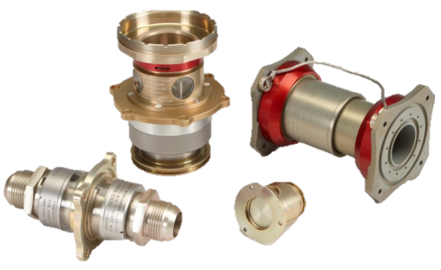
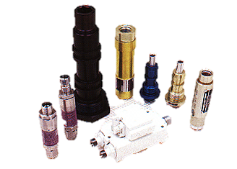
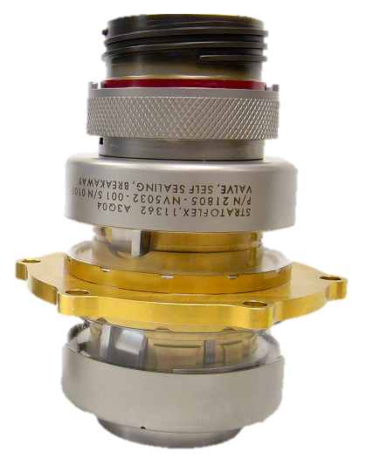
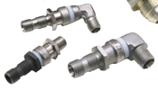
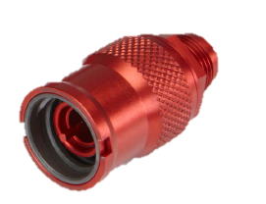
WE SUPPLY
Comprehensive Product Portfolio for Aerospace Fluid Conveyance & other Performance-Critical market
FLEXIBLE
HOSE ASSEMBLIES
SPECIAL
FITTINGS
QUICK DISCONNECT COUPLINGS
SWIVEL
JOINTS
MECHANICAL
VALVES
HYDRAULIC FUSES & FLOW REGULATORS

Slide 4
Main Customers & Approvals
Quality & Certifications
Aerospace & Defence OEMs, Tier 1, Tier 2
Leonardo Helicopters & Aircraft Divisions
Eurofighter
Boeing International Inc.
Dassault Aviation
Diamond Aircraft
Marshall Aerospace
Mecaer Aviation Group
O.M.A. - Officine Meccaniche Aeronautiche
Piaggio Aero Industries
Pilatus Aircraft
Saab Aircraft
TAI - Turkish Aerospace Industries
Thales Alenia Space
Motorsport OEMs & F1 Top Teams
Ferrari
Mercedes
Red Bull
Scuderia Toro Rosso
Haas
Sauber
Williams
Brembo Racing
Ducati
ISO 9001
EN 9100
EASA PART 21-G
AUTHORIZED
FABRICATOR & DISTRIBUTOR of

