Slide 1
ELBa
(Experiments with Laser-driven particle Beams)
Proposta di nuovo esperimento - CSN5
Responsabile nazionale
Dario Giove (Milano)
Unità partecipanti
Pisa - Resp Luca Labate
Bologna, Firenze, Napoli

Slide 2
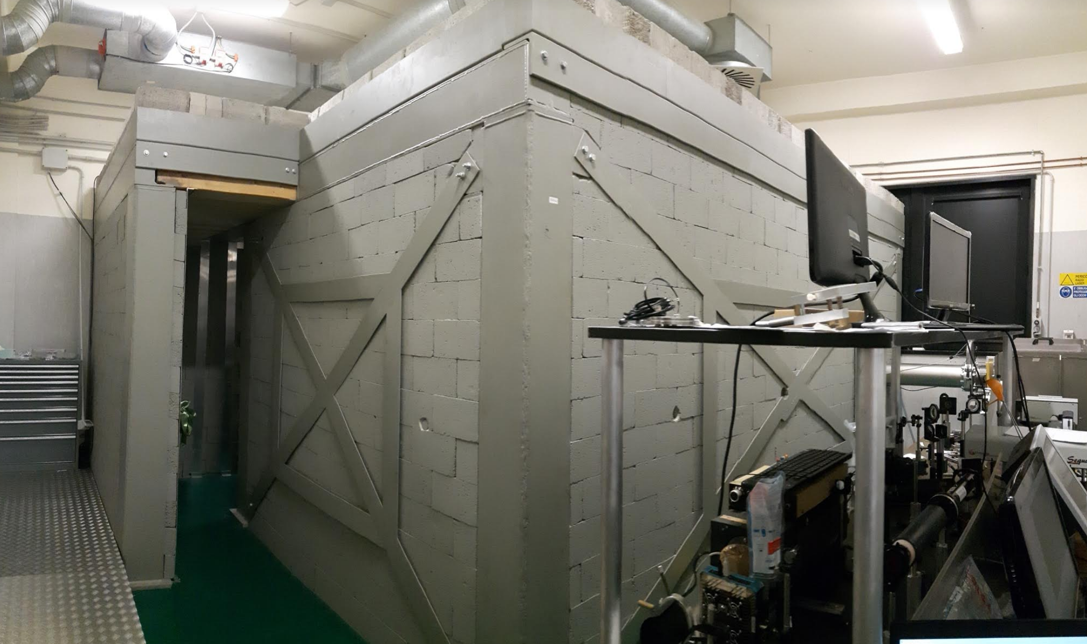
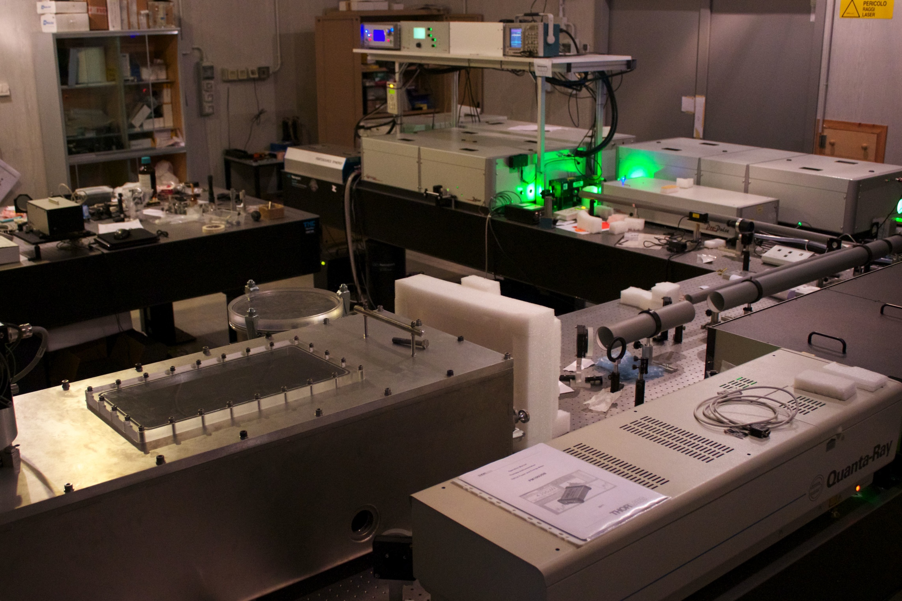
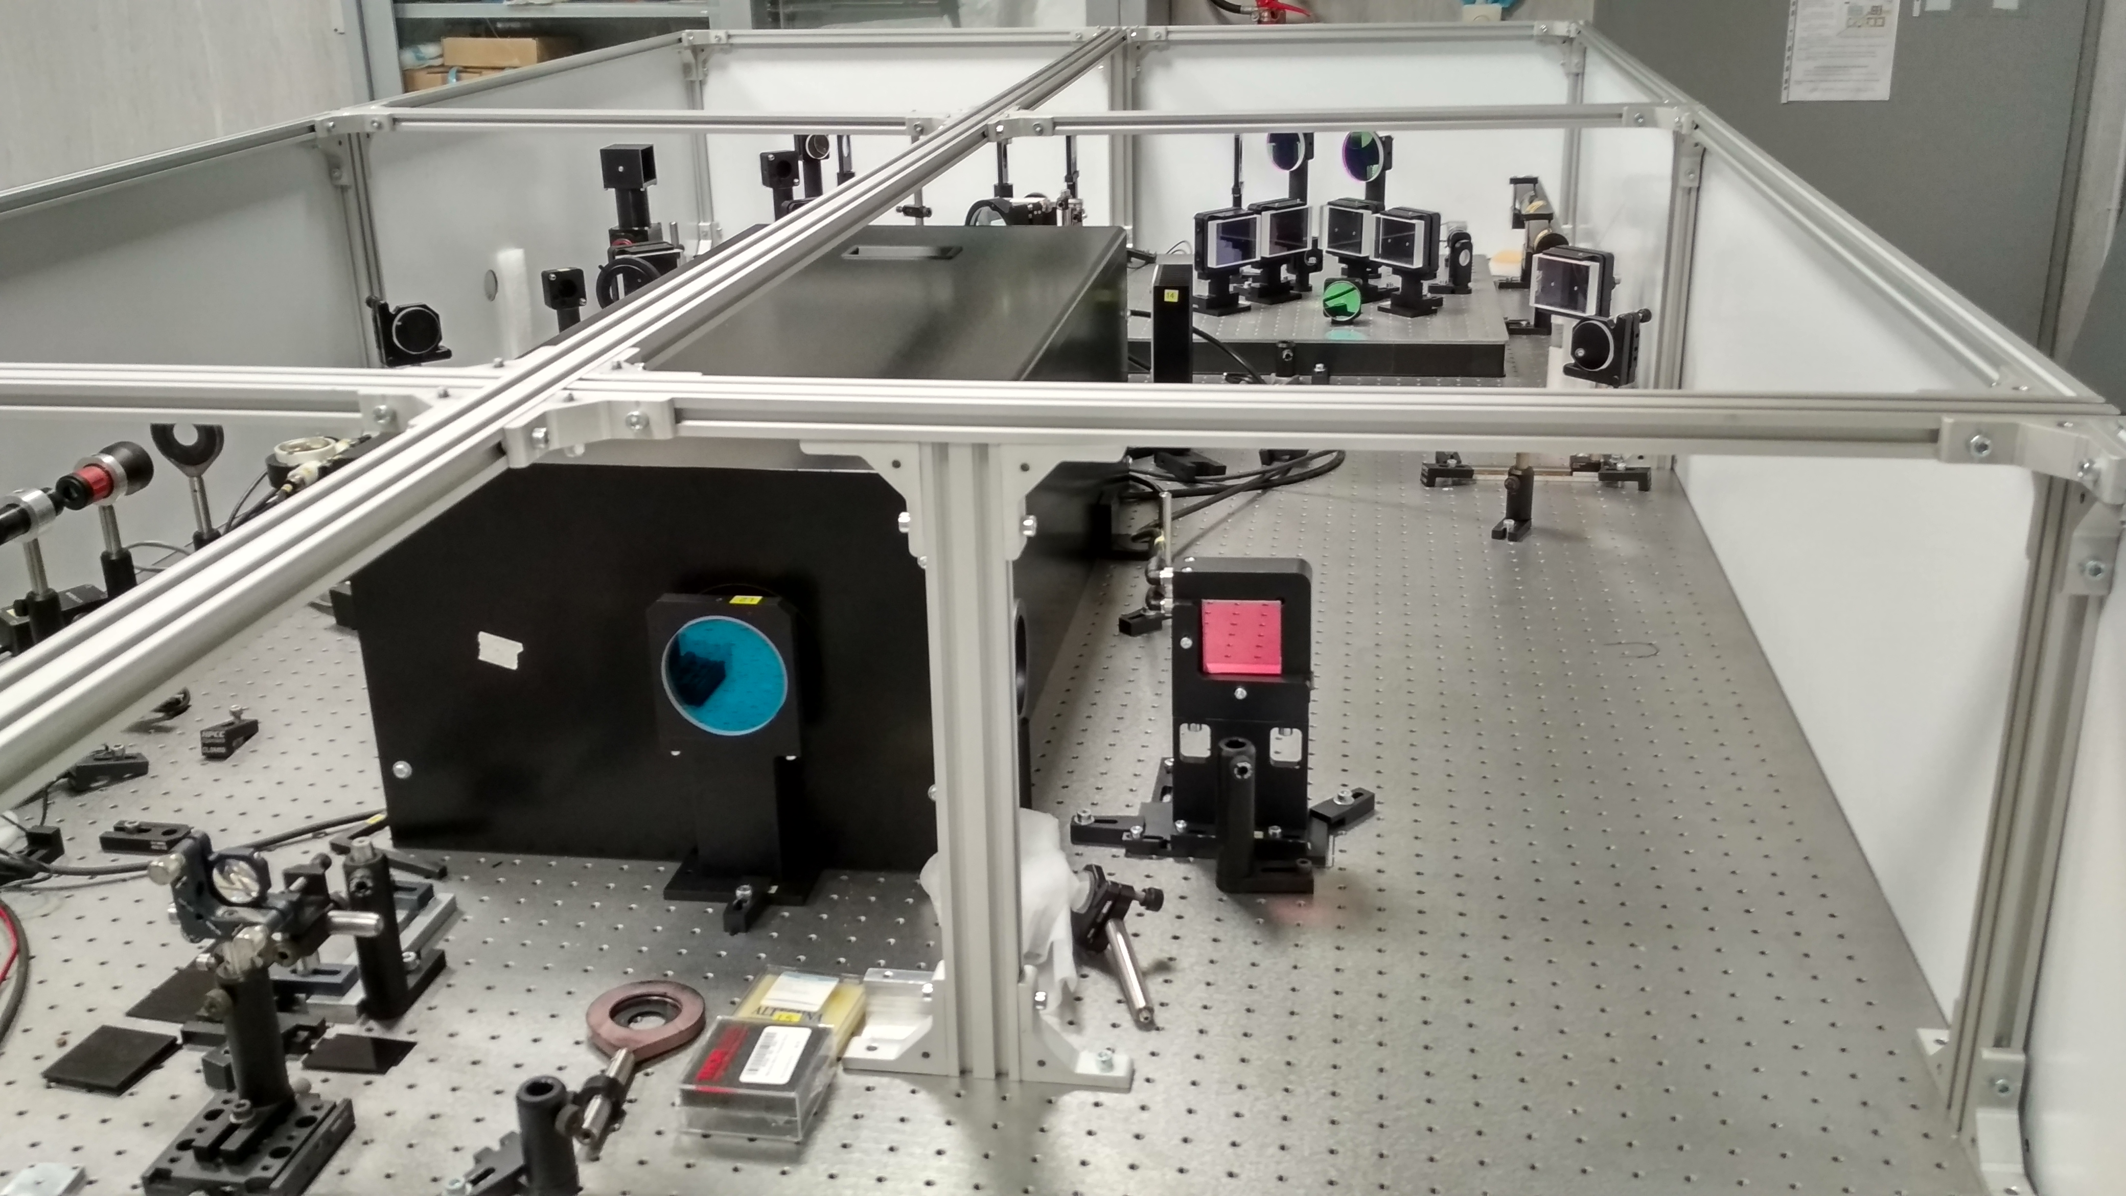
Background 1/2
The Intense Laser Irradiation Laboratory (ILIL) of the CNR-INO in Pisa, after a major upgrade carried out over the past few years, now features a 100TW class laser system* and a a shielded Target Area
*Current laser power: ~150TW
To be further upgraded to 200TW

Slide 3
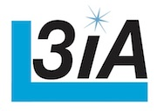
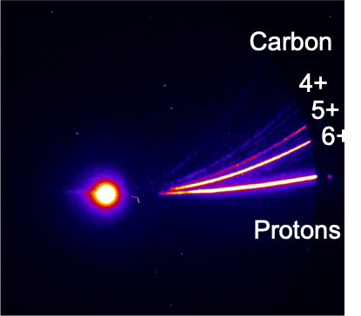
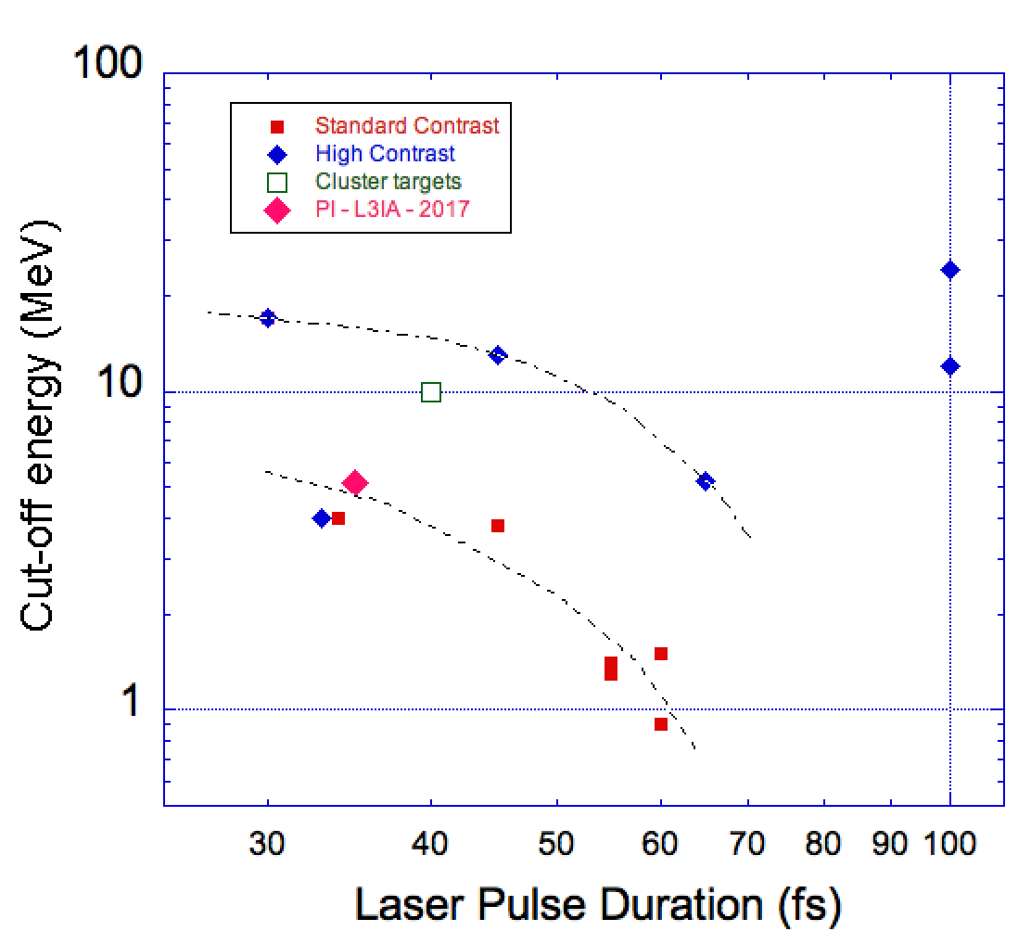
Background 2/2
In the framework of the L3IA CSN5 experiment (started in 2017), laser-driven proton /light ion acceleration based on the TNSA mechanism has been successfully established
Main achievements in 2018-2019: flat targets
Experimental results with flat targets
Current maximum cut-off energy: 6.6 MeV
(with laser energy ~3J)
Experimental campaign ongoing with laser energy ~4.5J
Best experimental results so far show proton cut-off energy exceeding typical (literature) values w/o plasma mirrors
[1] L.A. Gizzi et al., Nuclear Instruments and Methods in Physics Research A829, 144–148 (2016)
[2] L.A. Gizzi et al., Nuclear Instruments and Methods in Physics Research A909, 160–163 (2018)
[3] H. Daido et al., Rep. Prog. Phys. 75, 056401 (2012)
[4] C. Benedetti et al., IEEE TRANSACTIONS ON PLASMA SCIENCE, 36, 1790 (2008).

Slide 4
Perspectives for 2020 and beyond
Currently the beam-line is unique in Italy and one of the few in Europe suitable to carry out experiments with a high energy particles (protons, ligh ions, electrons) and radiation (X/gamma).
Concerning proton/ion acceleration, INFN contributed to set-up a dedicated vacuum chamber for experiments isolated from the main interaction chamber. This results in lower EMP disturbances and better measurement resolutions (energy, transverse spatial distribution, …). Furthermore, beam formation experiments are scheduled to be carried out within the end of 2019 and the PMQ based scheme will be part of the beamline.

Slide 5
Rationale and objectives
Work/results achieved so far suggest to propose a new activity, with a focus on the exploitation of the available beamline.
Unique possibility to carry out experimental activities in the following areas:
Studies aimed at improving the quality of laser-driven particles (protons, carbon ions, electrons) to extend applications
Novel concept targets for high repetition rate laser-driven particle acceleration
Study of new possibilities open up by laser based acceleration schemes in radiation therapy, according to emerging scenarios
Demonstration of PIXE analysis for cultural heritage studies with table top, laser-driven accelerators
All this is in resonance and competition with similar large EU initiatives (ELI) and national development programmes (Germany, UK, France, Spain …)

Slide 6
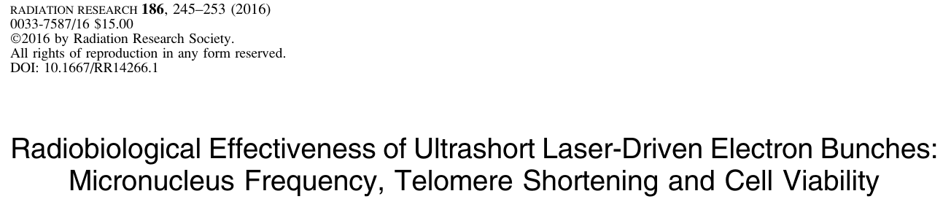
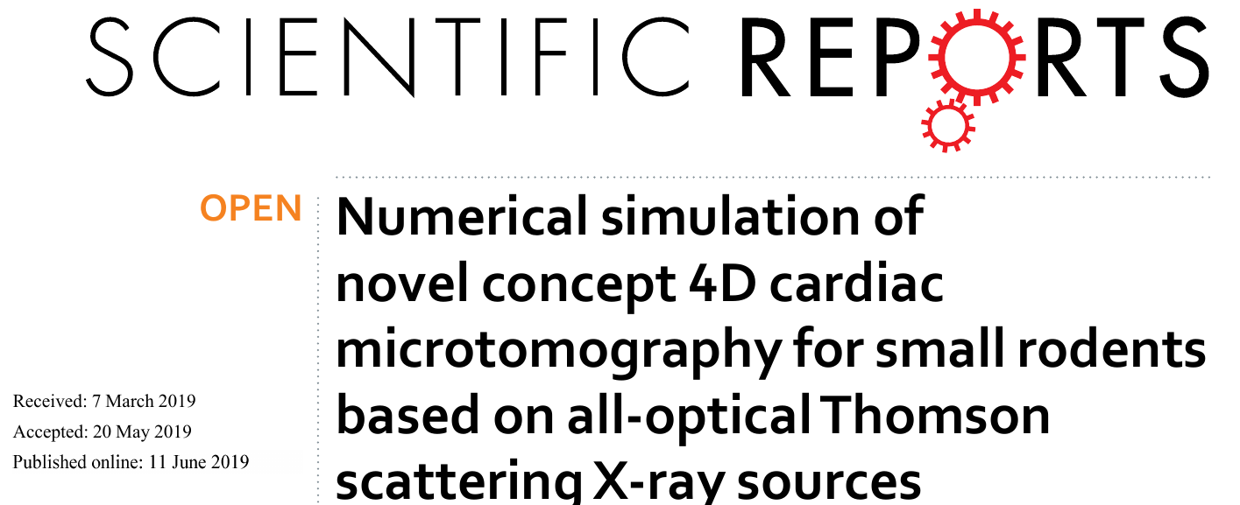
Merging with know-how in the field of radiobiology and medicine at CNR-INO
Over the past few years, several experimental campaigns have been being carried out using the 100TW class laser system at ILIL, aimed at
- characterizing electron bunches in the 10-200 MeV range in terms of their dosimetric properties
- studying/assessing radiobiological effects of ultrashort (ultrahigh instantaneous dose rate) electron bunches
Established collaborations:
Istituto di Fisiologia Clinica – CNR, Pisa
dosimetry of electrons, ions and X/gamma rays, study of cell damage after ionizing radiation exposure
U.O. Fisica Sanitaria, Azienda Ospedaliero-Universitaria Pisana
Further collaborations are expected to be established in the framework of the present proposal (see below)

Slide 7
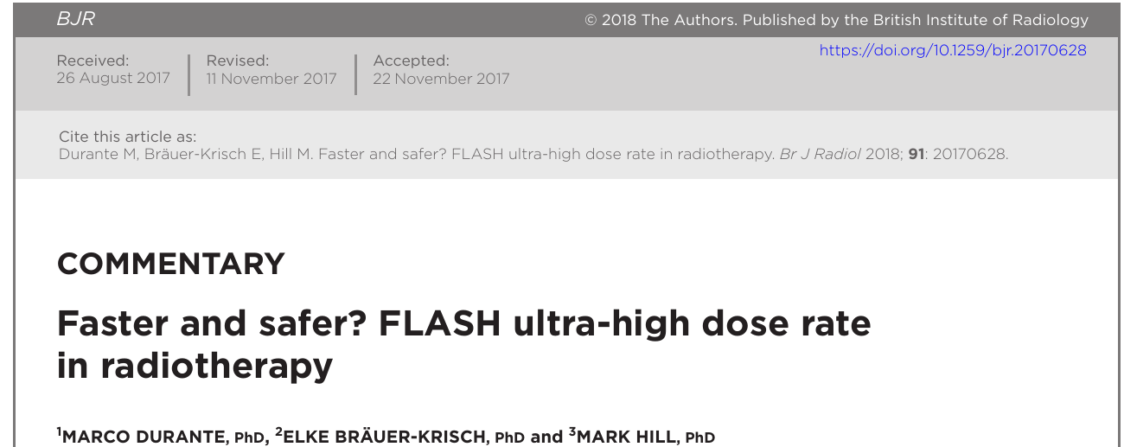
Activities foreseen in the field of radiobiology/medicine applications
- Radiobiology studies aimed at assessing the effects of ultrahigh instantaneous dose rate particle beams (FLASH therapy, ...)
- Particle beam formation for applications in medicine
- Study of detectors and dose monitors (collaboration with CERN; see below)

Slide 8
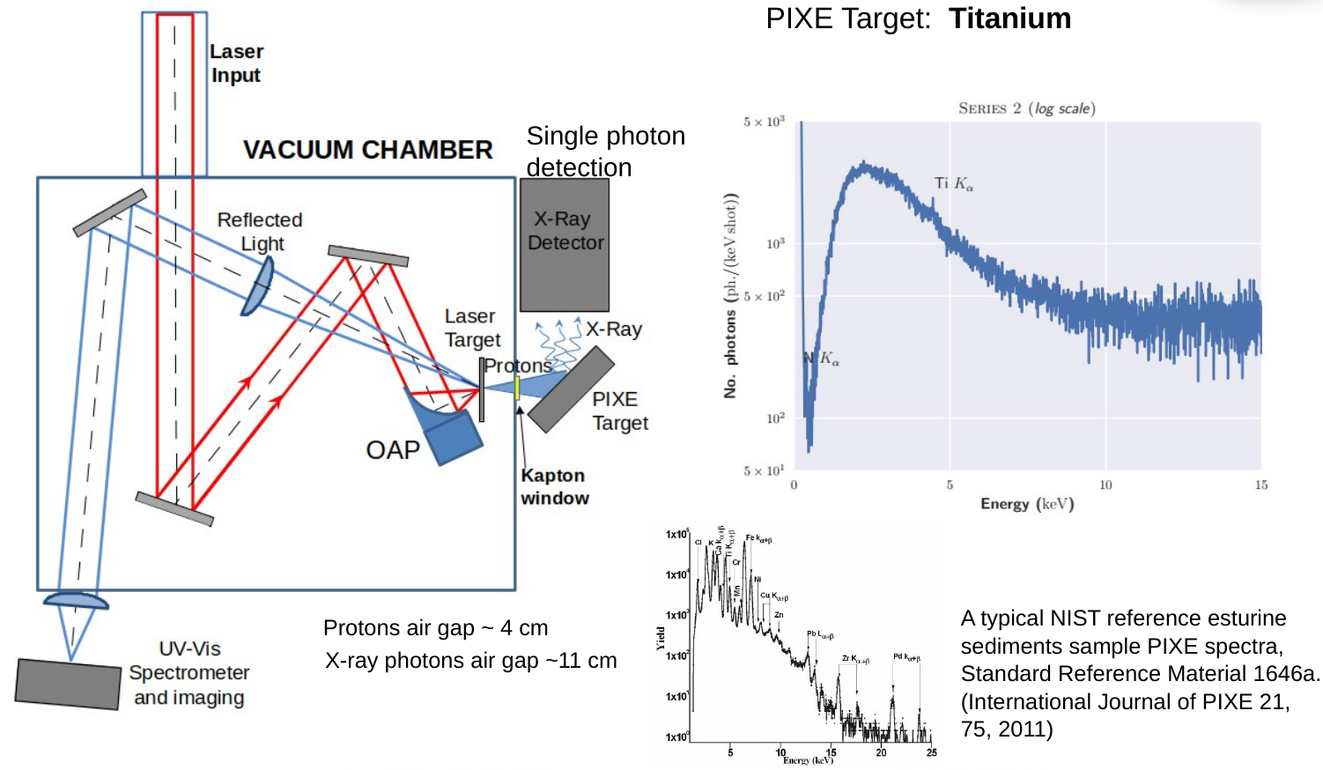
Application of laser-driven proton beams to cultural heritage: laser-driven PIXE
Results from a recent pilot experiment carried out at the ILIL laboratory

Slide 9
Preliminary proposal
INFN Milano > 3 FTE (including contribution from Politecnico of Milano and HSRF)
INFN Pisa > 1 FTE (new request of association, replacement of retired people)
CNR Pisa beside to people from CNR-INO, people from CNR – Istituto di Fisiologia Clinica (Pisa) are expected to join the activity
INFN Bologna 1 FTE
INFN Firenze (Labec) 1 FTE
INFN Napoli 1 FTE
Official letter of support from IEO that will provide the support for radiobiological studies along with the HSRF colleagues and CNR Institute of Clinical Physiology (D. Panetta and P. Salvadori)
Official letter of support from CERN that will provide the support for GEMPIX like detectors
People from IEO will ask to be associated to INFN researches at INFN Milano
Financial plan: total request of 200 Keuro (3 years)
No foreseen request on INFN Pisa workshop or electronics services

