Slide 1
HighQ
(High Quality laser-plasma acceleration)
Bando 2019 per proposte progettuali “Call” della CSN5 dell’INFN
Responsabile nazionale
M. FERRARIO (LNF)
Unità partecipanti
PISA - Resp L. A. GIZZI
INFN ROMA TOR VERGATA - Resp A. CIANCHI

Slide 2
Contents
Motivation;
Background of the proposal;
Short review of laser-plasma acceleration of electrons;
Ongoing developments and EuPRAXIA
Proposed activity
Participation and skills
Personnel and requested funding

Slide 3
Background 1/2
This proposal
  follows the perparatory work done for the design study of the EuPRAXIA infrastructure;
  builds on the work carried out at the participating labs LNF (Sparc-lab) and Pisa (ILIL) where plasma acceleration has been established and Eupraxia developments are in progress;
The project deals with high-gradient plasma acceleration of electrons driven by high intensity lasers, namely laser-wakefield acceleration (LWFA);
The focus of the proposal is the control of electron bunch properties, namely energy spread and emittance of electron energies starting at >200 MeV (Eupraxia injector);

Slide 4
Background 2/2
The proposal will demonstrate feasibility of a new acceleration and injection scheme (ReMPI) that has already passed a complete start-to-end modelling test;
The objective is to demonstrate feasibility of a laser-driven scheme with energy spread below 1% and emittance below 1 mm mrad.
The project will develop and test the main components required for the proposed scheme and will integrate them for a pilot demonstration activity;

Slide 5
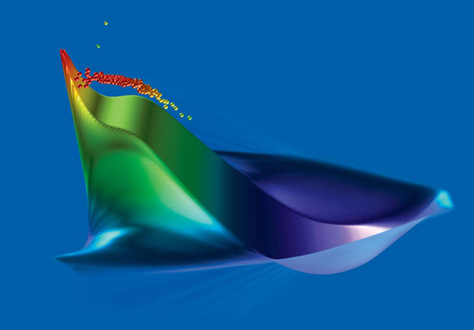
Laser plasma acceleration of electrons
C. Huang, Los Alamos National Laboratory

Slide 6
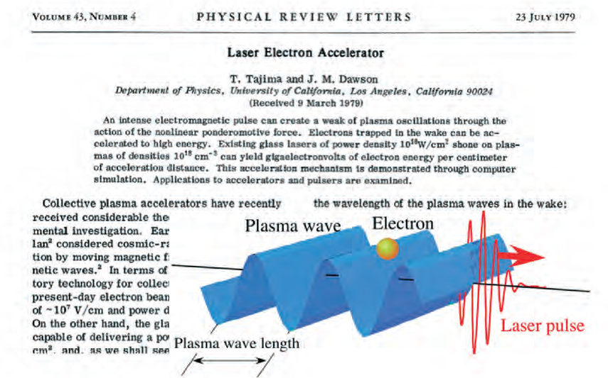
THE ORIGINAL IDEA

Slide 7
PARTICLE ACCLERATION: WHY A PLASMA?
no structural limits to the accelerating electric fields;
electron plasma waves (e.p.w) fit requirements for particle acceleration:
- intense longitudinal electric fields;
- phase velocity very close to the speed of light;
How to create high amplitude e.p.w. ?
Ponderomotive force;
Coulomb force;
(Use laser pulses or charged particles)

Slide 8
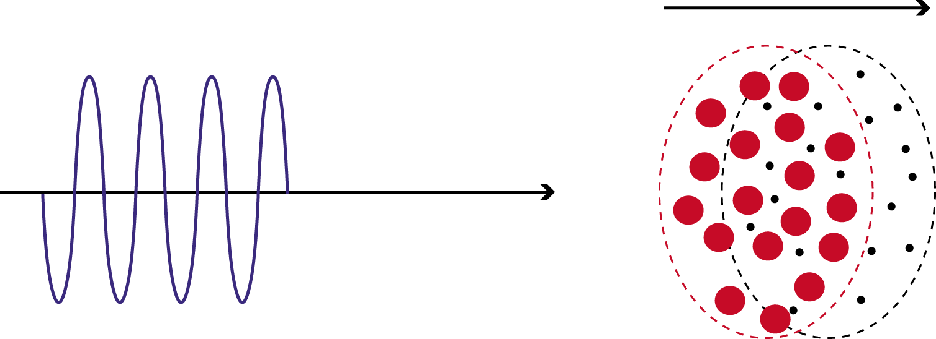
LASER-PLASMA INTERACTION
(high intensity, fs pulses)
Collisions become ineffective and ponderomotive force dominates
Electrons are relativistic and ions remain at rest
Laser pulse

Slide 9

WAKE WAVES
BOAT / LASER PULSE
Wake wave/ PLASMA WAVE

Slide 10
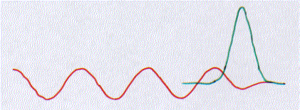
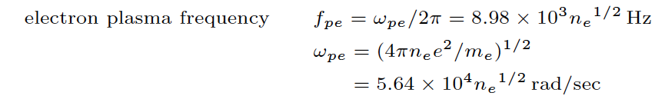
LASER WAKEFIELD
Electron plasma wave excitation by laser wakefield
second push
first push
v_{g} _{LASER}
E.P.W.
Quasi-resonance condition:
E(GeV)≈100 (n₁₈)^{1/2}
Phase velocity
Accelerating fields
≈ 10-100 GV/m
Tajima & Dawson, PRL 1979

Slide 11
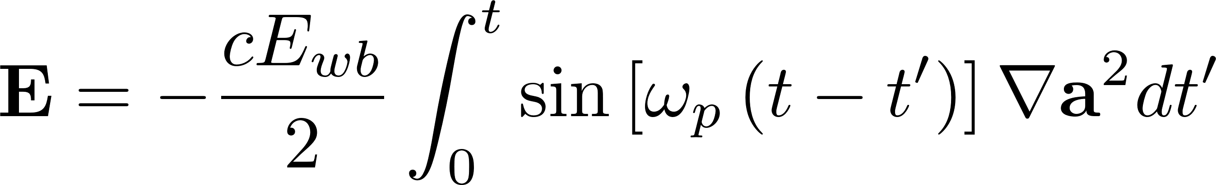
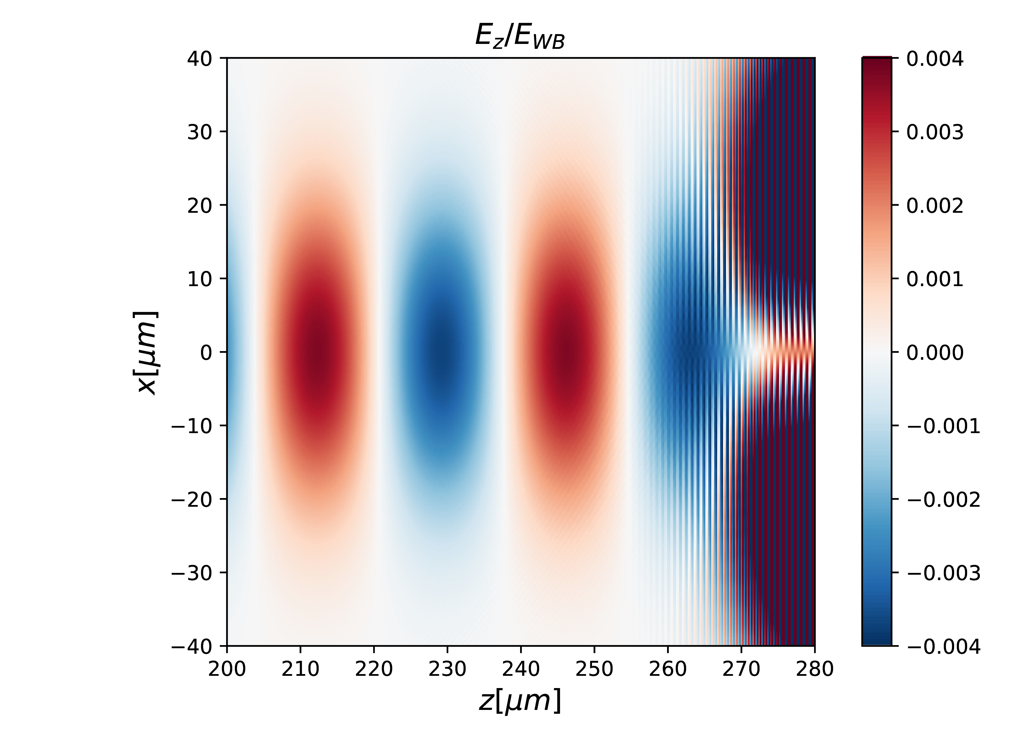
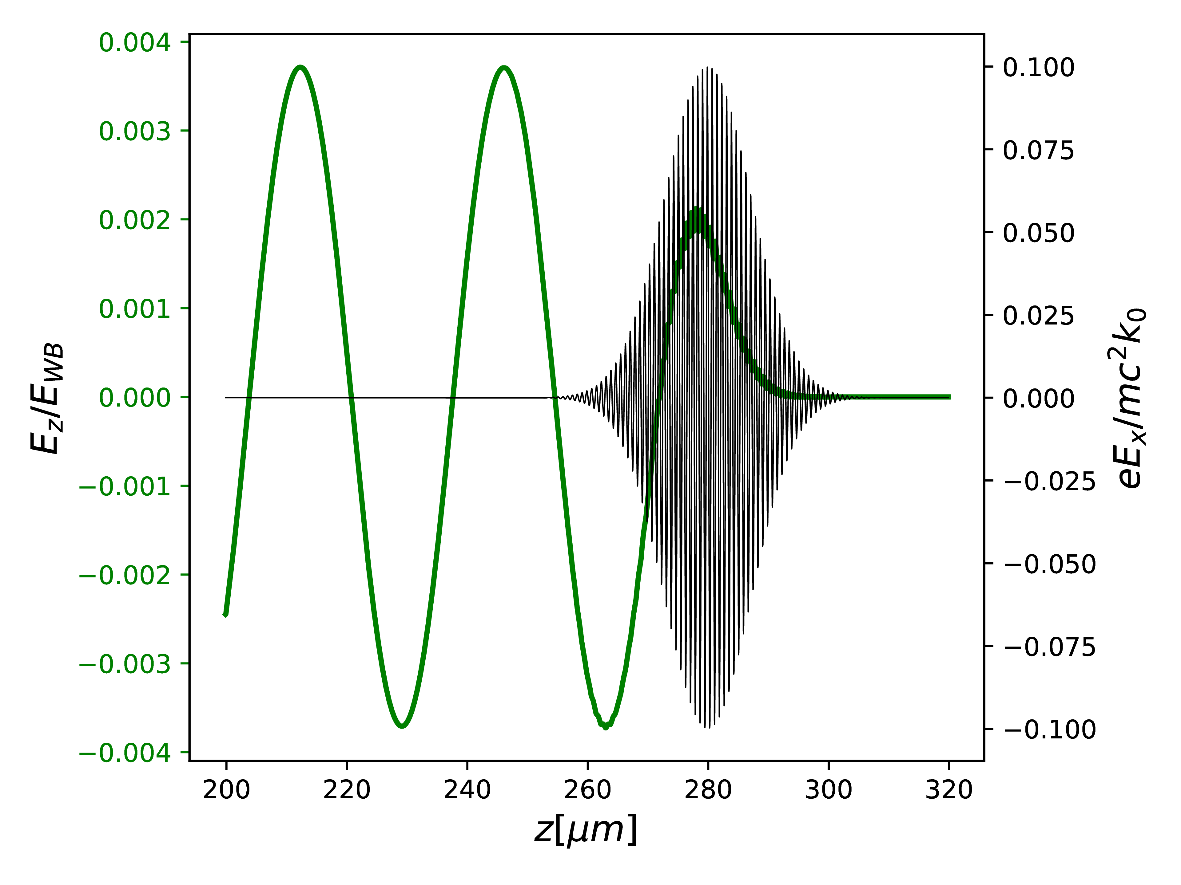
LWFA - Linear regime
Solution can be obtained analitically – the system is linearly coupled
=>Injection: external or internal (self-injection)
Davide Terzani, PhD 2019

Slide 12

Injection?

Slide 13
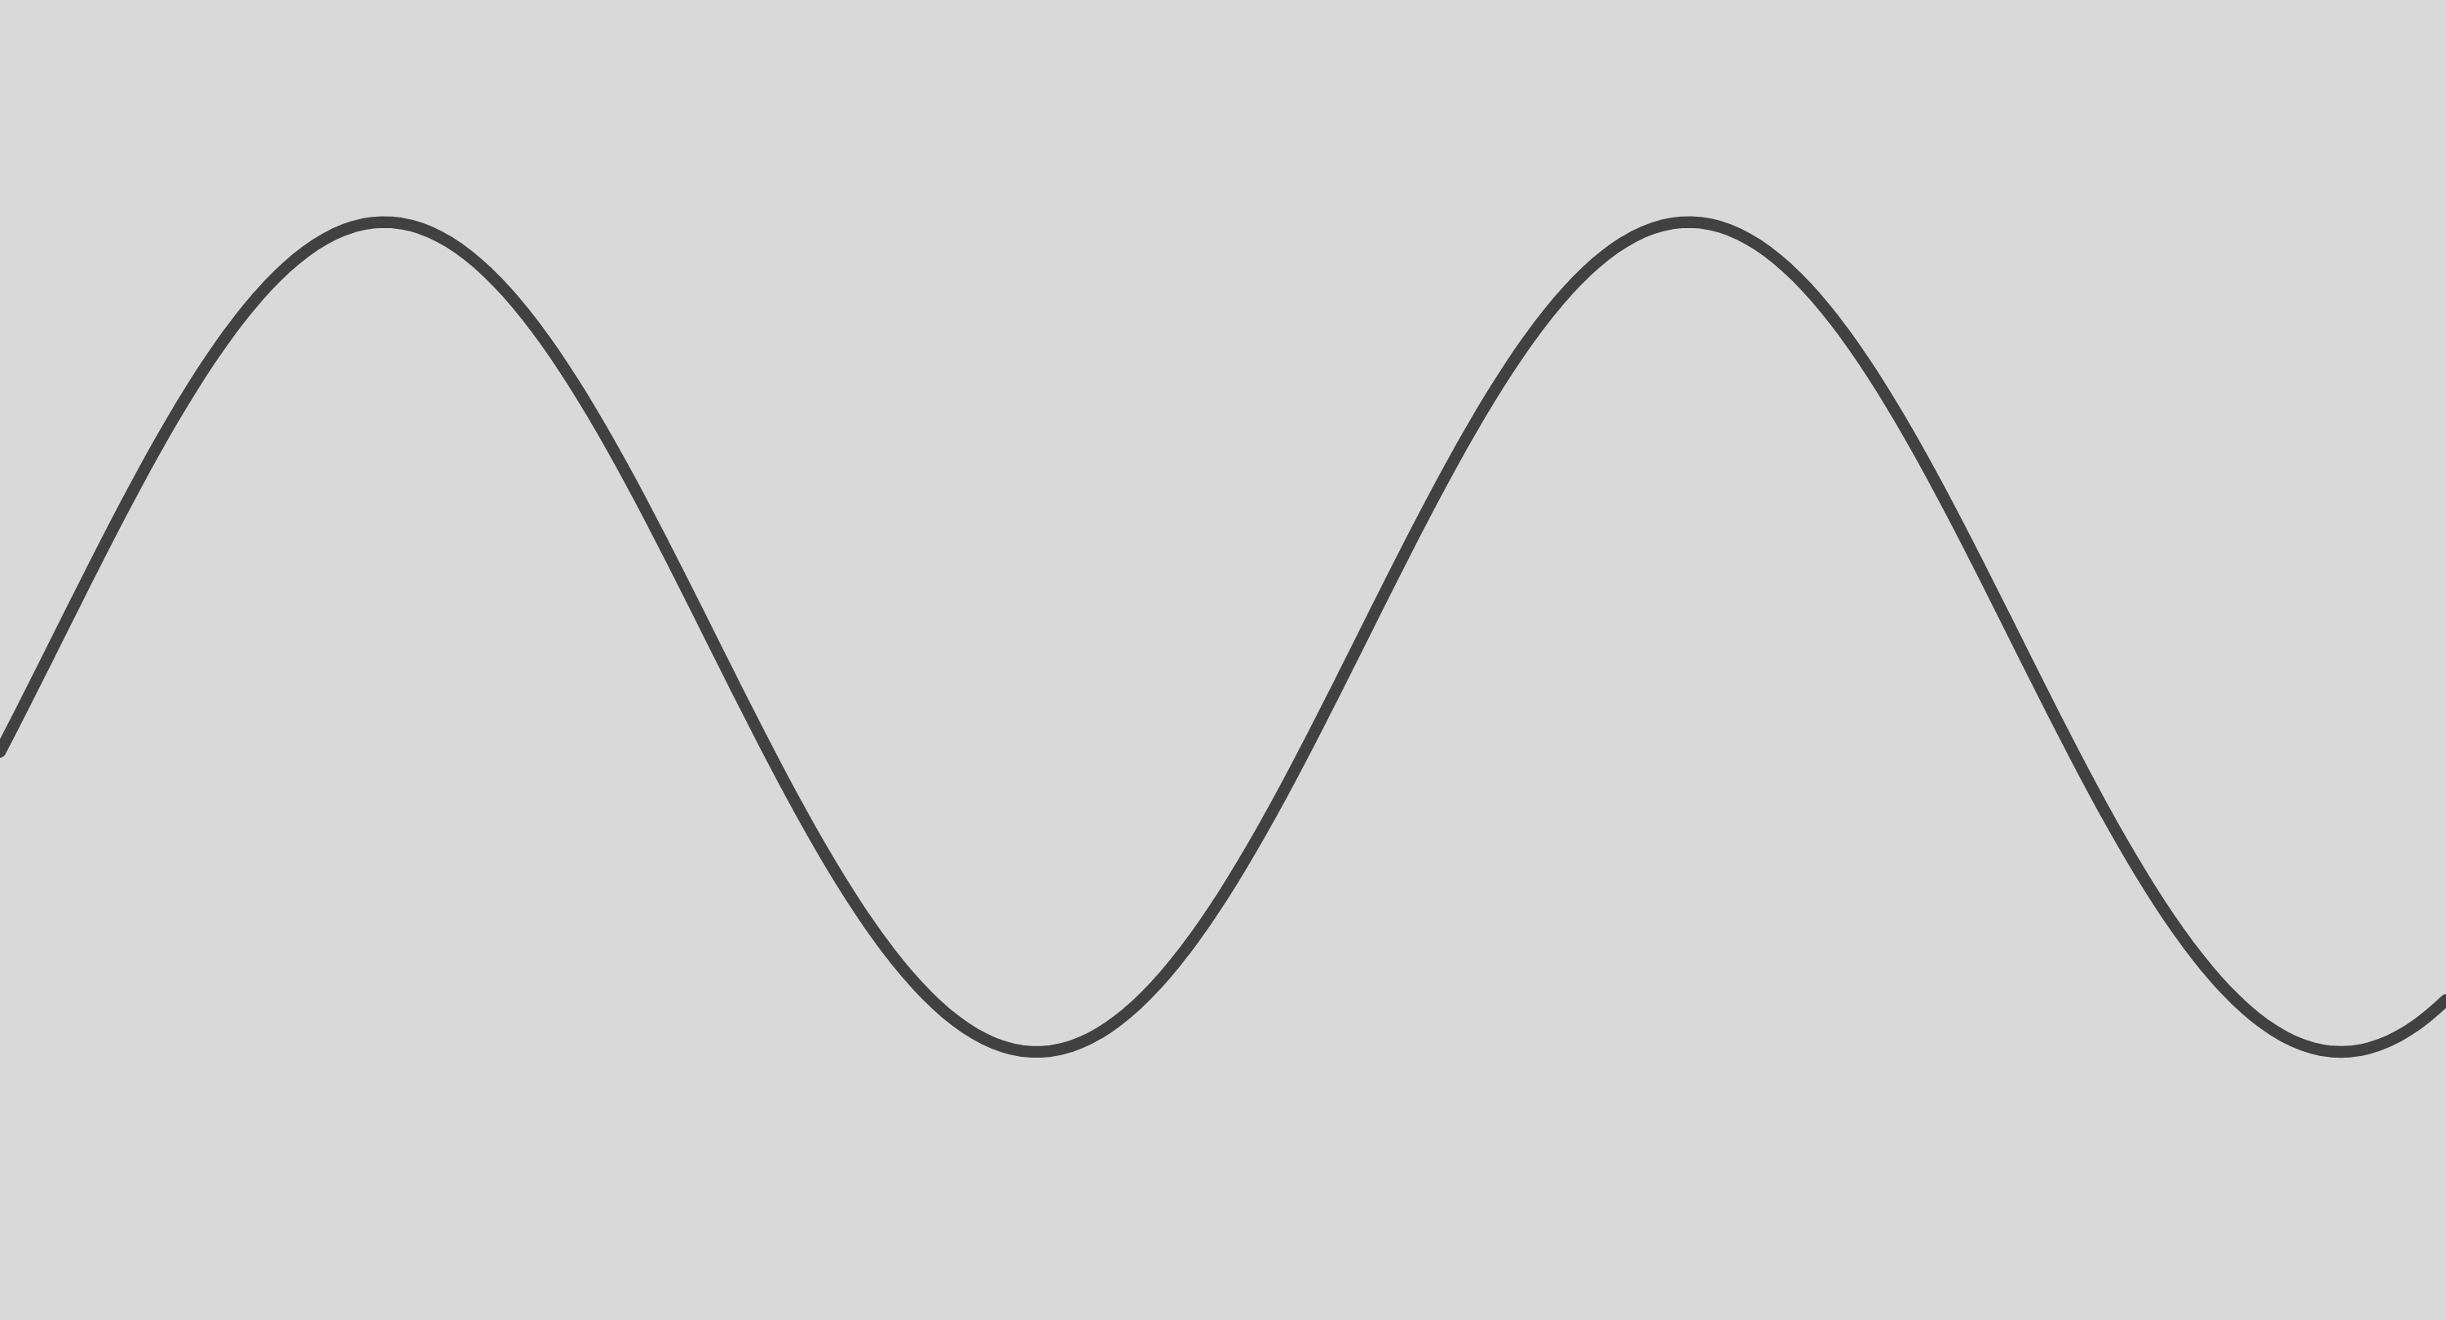

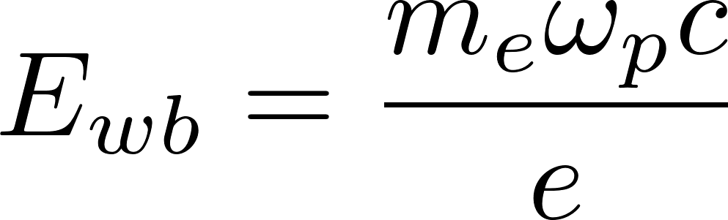
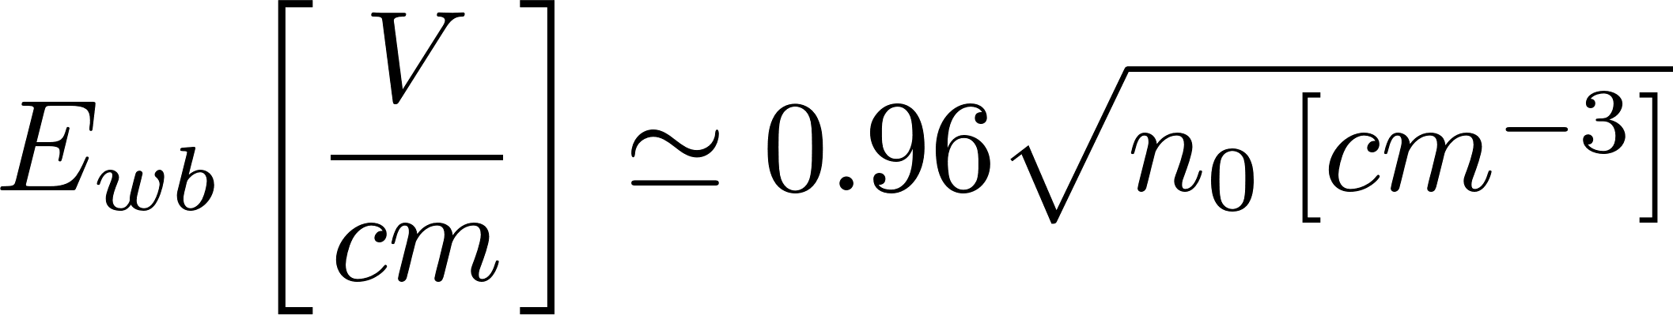
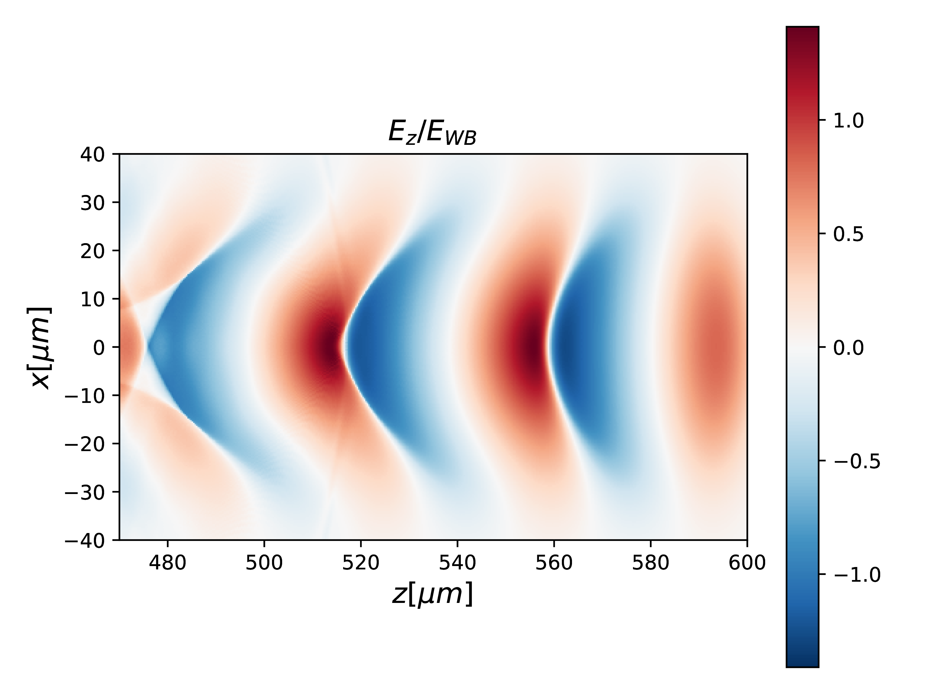
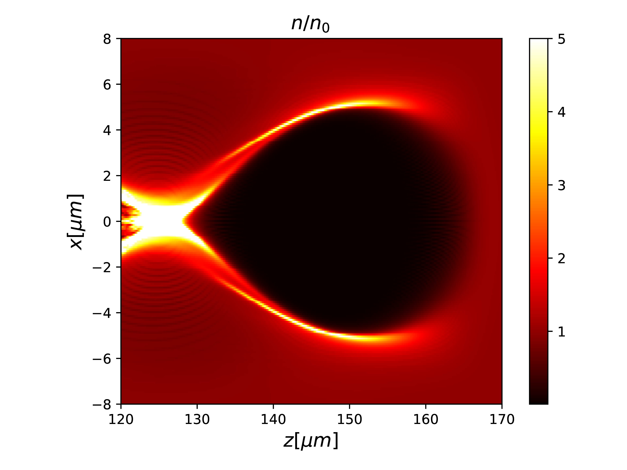
LWFA - NONLINEAR REGIME AND WAVE BREAKING
If the perturbation is of the order of:
Electrostatic waves steepen up to the wave breaking
[Dawson, PR, 1958]
Accelerating fields up to 100 GV/m
Mildly relativistic
Plasma bubble (strong 3D correlation)
Simulations by D.Terzani, Ph.D 2019
P. Tomassini, M. Galimberti, A. Giulietti, D. Giulietti, L.A. Gizzi, L. Labate, F. Pegoraro, Phys. Rev. ST - Accelerators and Beams 6, 121301 (2003)

Slide 14
SELF-INJECTION – “BUBBLE” REGIME
S.P.D. Mangles et al., Nature, 431, 535 (2004); C.G.R. Geddes et al., Nature, 431, 538 (2004); J. Faure et al., Nature, 431, 541 (2004);

Slide 15
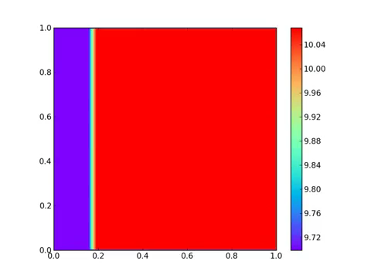

NUMERICAL SIMULATION
Jasmine - a hybrid (CPU+GPU) e.m. particle in cell codes,
F.Rossi, P. Londrillo (Univ. and INFN, Bologna); D.Palla, PhD, 2017

Slide 16
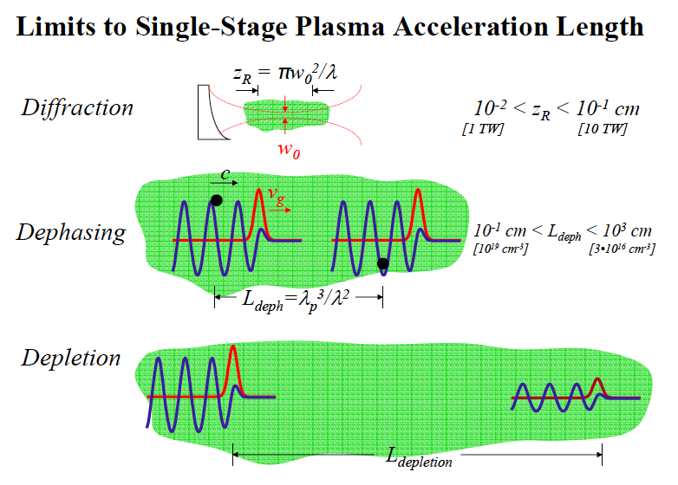
PHYSICAL LIMITATIONS OF LPA

Slide 17
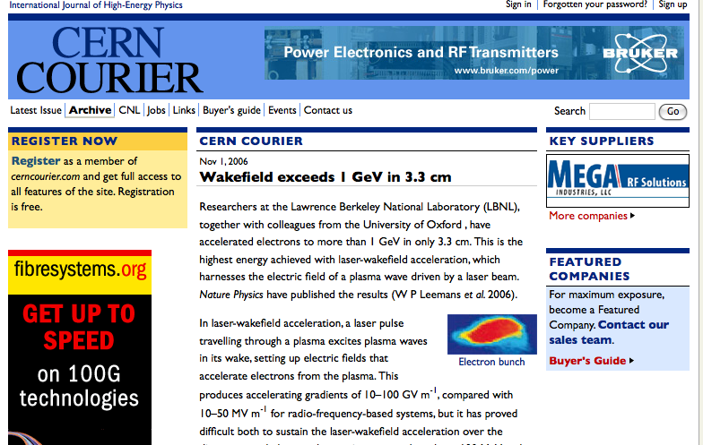

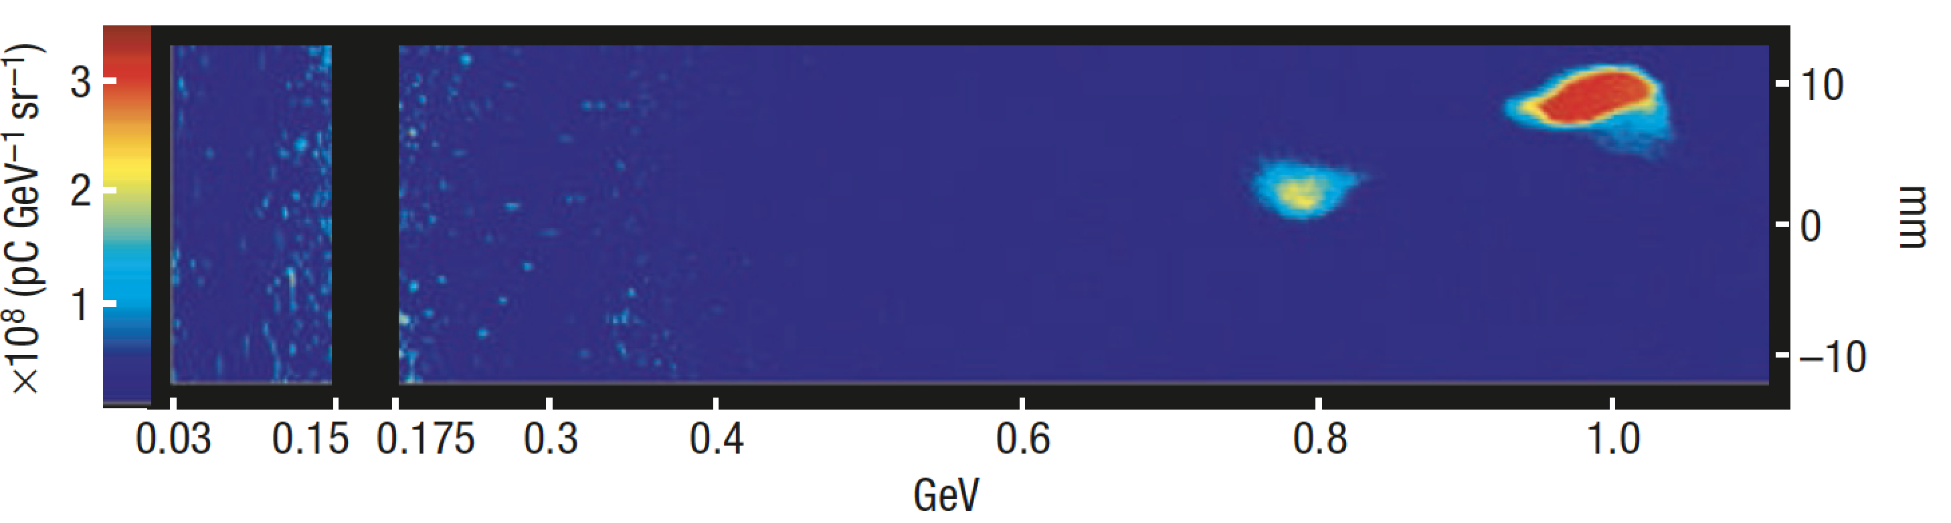
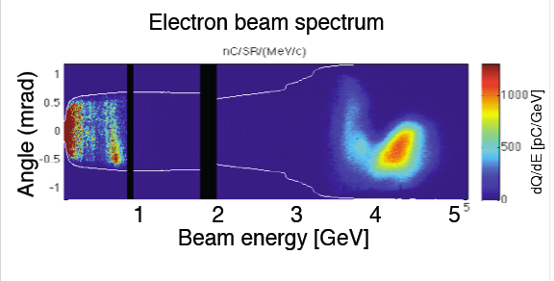

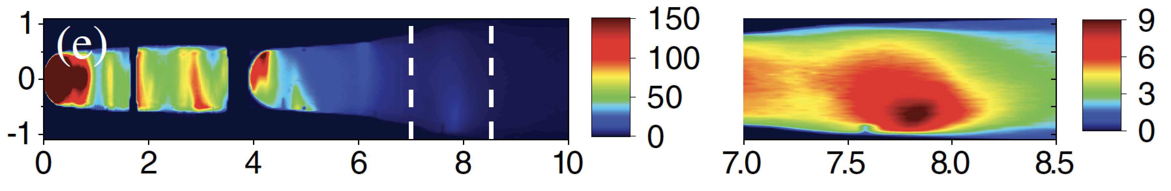
Main results after “dream beam” (2004)
Laser power: 40TW, Max electron energy 1 GeV (30 pc), 3.3 cm, 3E18 cm⁻³
W.P. Leemans et al., Nature Physics 2, 696–699 (2006)
Laser power: 300 TW, Max electron energy 4.2 GeV (6 pc), 9 cm, 7E17 cm⁻³
W.P. Leemans et al.,PRL 113, 245002 (2014)
Laser power: 850 TW, Max electron energy 7.6 GeV (5 pc), 20 cm, 3E17 cm⁻³
A. J. Gonsalves et al., PRL 122, 084801 (2019)

Slide 18
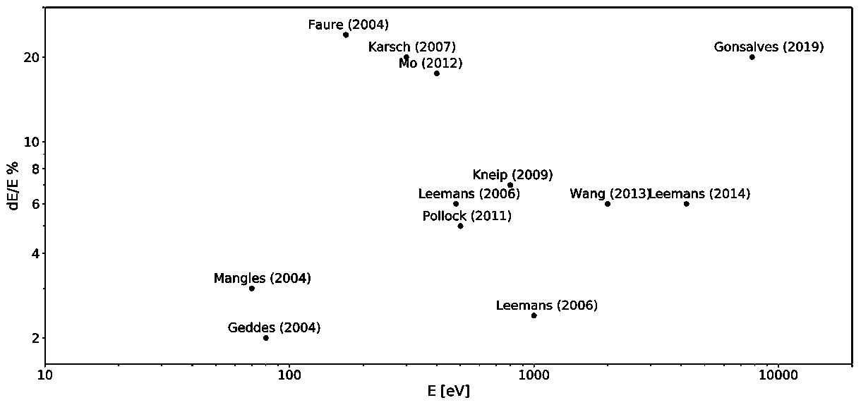
Beam quality
Energy spread still above the few % level and beam emittance typically high (quanto?)

Slide 19
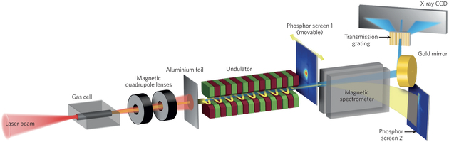

Plasma based X-Ray Free Electron Laser?
1mrad
≈1mrad
1mrad

Slide 20
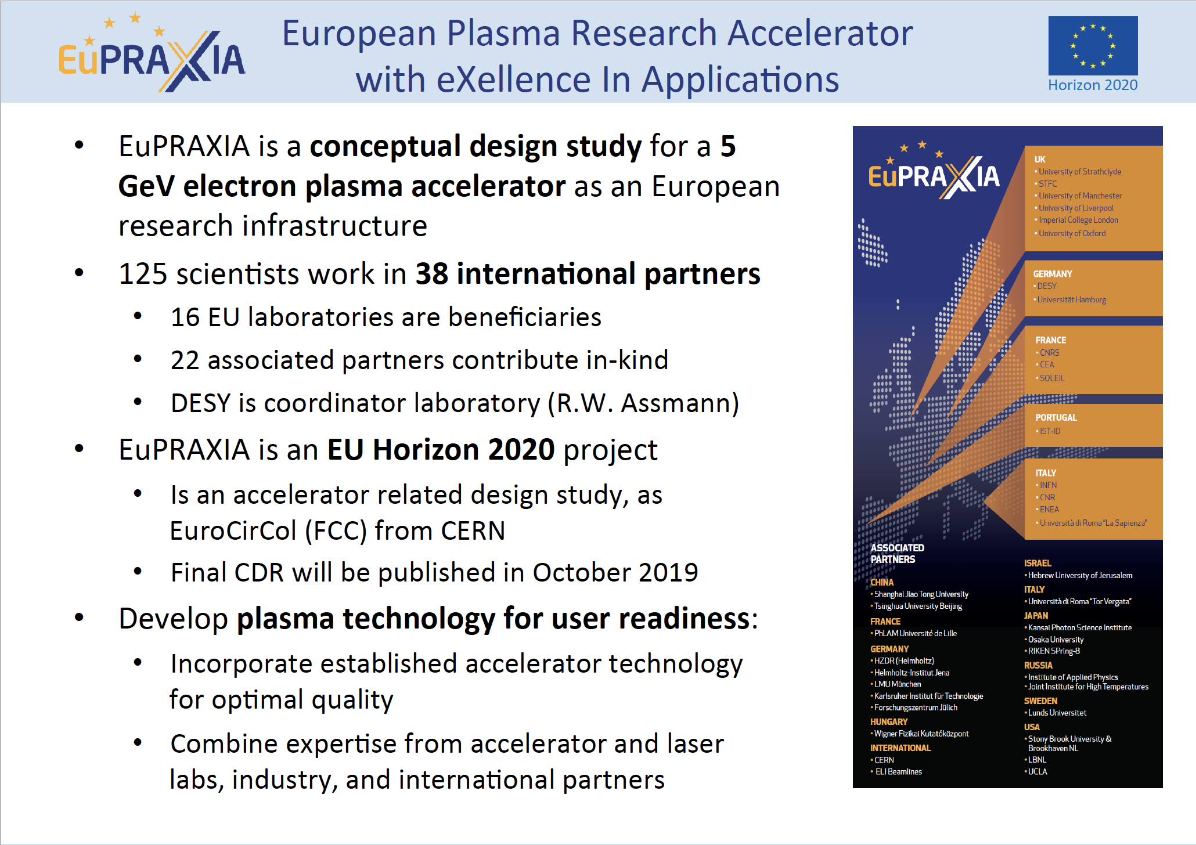
EuPRAXIA Summary

Slide 21
EuPRAXIA requirements
Critical parameters of the electron beam
for Injection or Acceleration stages
Further requests
(from beam transport analysis, A.Chancé, Phi Nghiem)
ε² = σ (x)² σ (x’)² – σ (x x’)²
γ = σ (x’)²/ε
γ < 200 m⁻¹

Slide 22
BEYOND HIGH GRADIENT
Since 2004, systematic production of self-injected electron bunches with energy up to GeV range and moderate energy spread (5-10%)
Exploration of applications ongoing worldwide.
Main goal: X-ray FEL => EuPRAXIA
Self-injection powerful but uncontrollable;
Need of controlled injection of electrons in a well-formed wake wave
BUNCH QUALITY: energy spread, emittance, beam divergence …
=> CONTROL WAKEFIELD GENERATION AND INJECTION SEPARATELY

Slide 23
CONTROLLED INJECTION MECHANISMS
Principle: match velocity of plasma electrons and wake phase velocity at the accelerating region of the wake:
Ponderomotive
Plasma tailoring
Make new electrons “emerge” in the right position of the wake.
Ionization injection

Slide 24
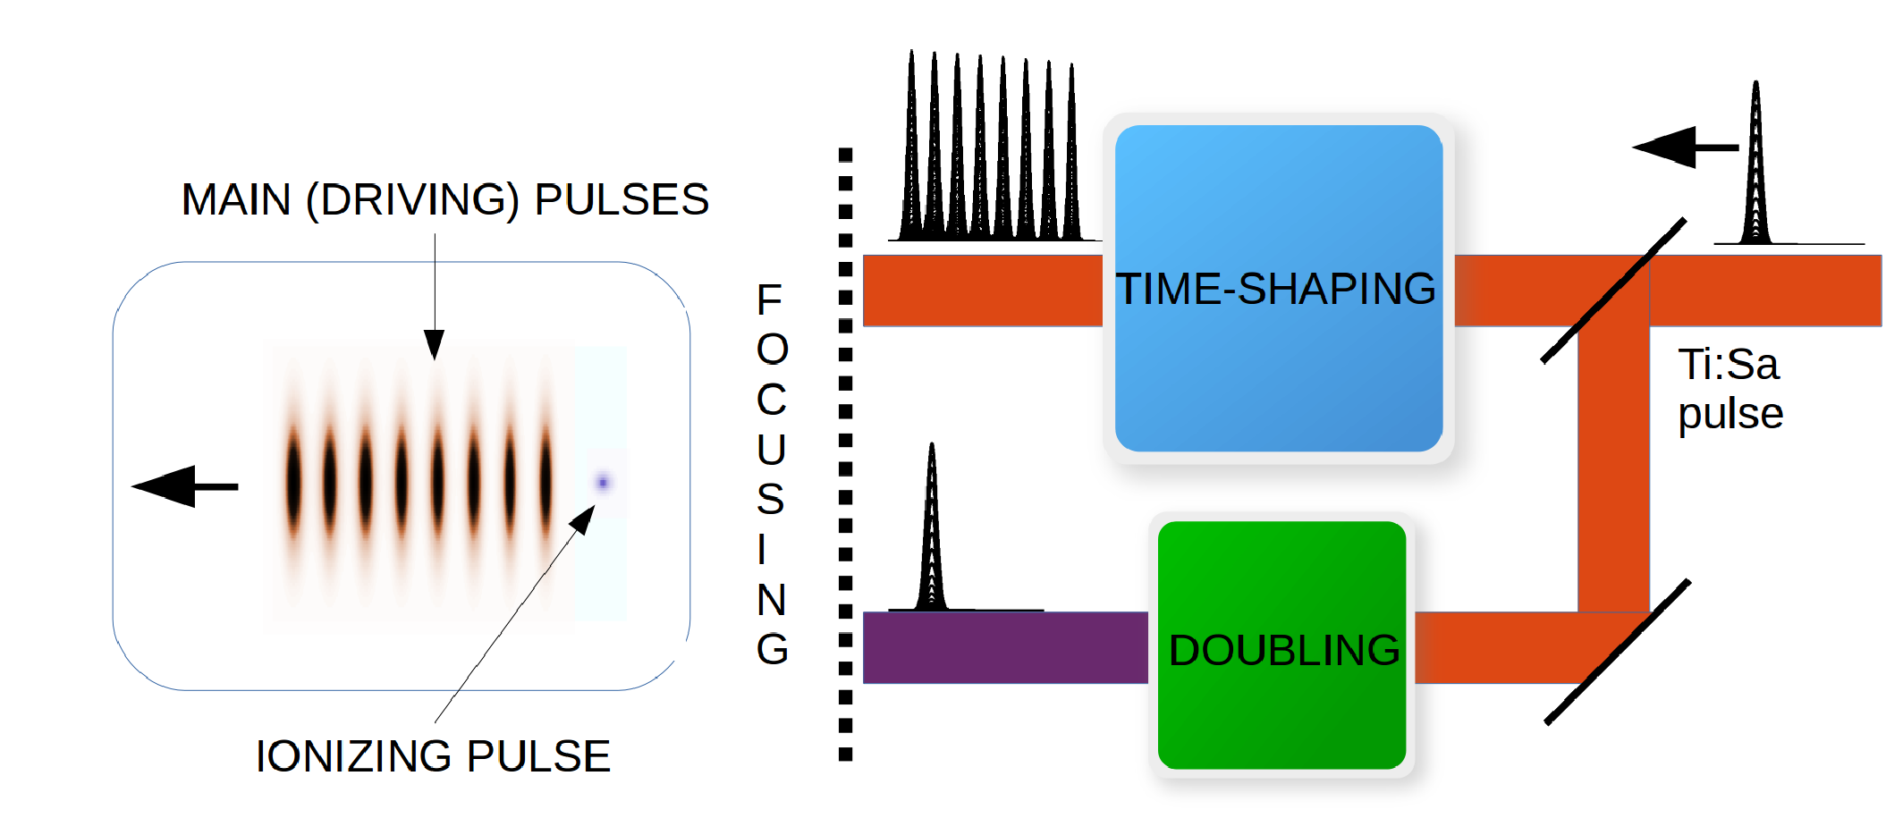
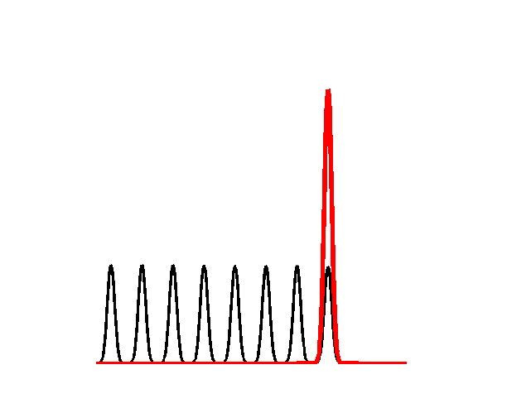


OUR ACCELERATION/INJECTION SCHEME
The Resonant Multi-Pulse Ionization injection [P. Tomassini et al., Phys. Plasmas 24 (2017) ] is a new bunch injection scheme aiming at generating extremely low-emittance bunches [as low as 0.06 mm mrad]
ReMPI requires ONE short-pulse 100-TW class (e.g Ti:Sa) laser system. Since a unique very large-amplitude Ti:Sa pulse would fully ionize the atoms (N5+ or Ar8+ ), the pulse is shaped as a resonant sequence of sub-threshold amplitude pulses.
ReMPI
Ionization Threshold
A new scheme to generate the train of pulse in a stable, efficient and feasible way « Quasi Lossless Pulse Train generation by Early Amplitude division »
has been recently proposed by L. Labate et al. (submitted)

Slide 25
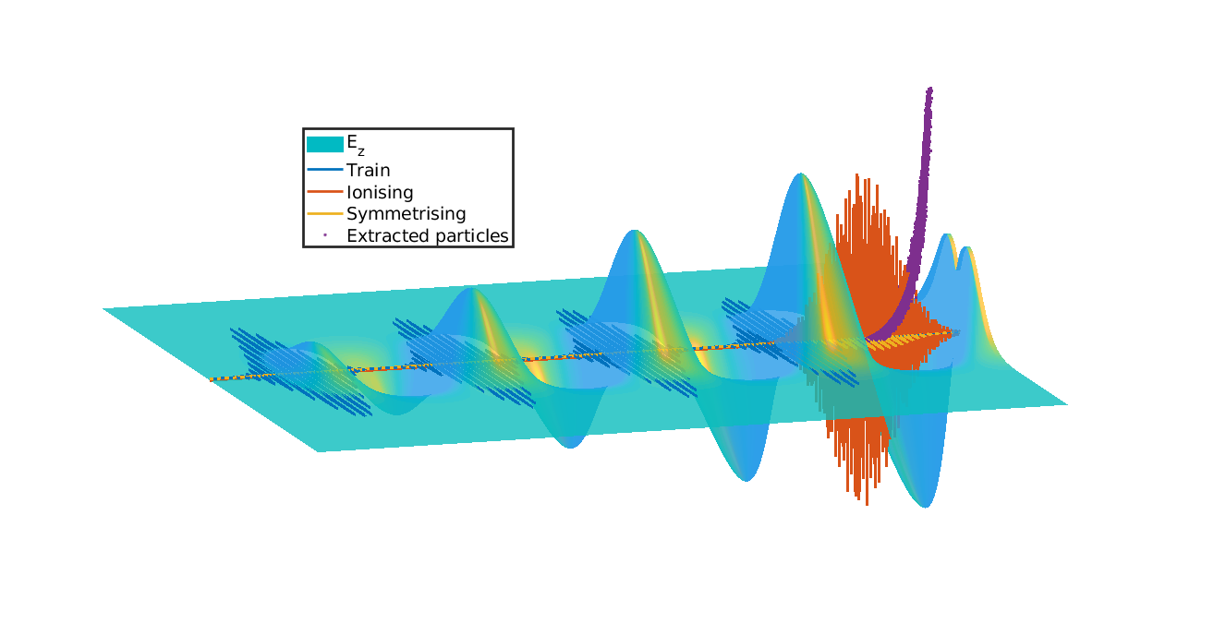
The Resonant Multi-Pulse Ionization Injection
Ionizing pulse
Extracted particles
Wake driving pulse train
Longitudinal electric field
P. Tomassini et al., Physics of Plasmas 24, 103120 (2017)

Slide 26
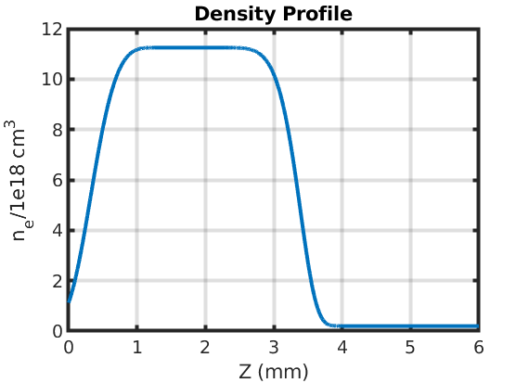
ReMPI Parameters set baseline
4x 30fs FWHM pulses (+ pre and post) with delay 105 fs, w₀=28 μm , 3.5 J on TEM00
1x 45fs FWHM ionization pulse in III harmonics, w₀=3.7 μm , 70 mJ on TEM00
Nitrogen plasma, n₀=1.1E18 cm⁻³ after , 2 mm plateau
NO guiding needed
A gas-cell with density 1E16 cm⁻³, 3 mm long is placed after downramp
(passive Plasma Lens) to further reduce Twiss Gamma parameter
Plasma lens to reduce beam divengence and control emittance growth due to residual chromaticity
Downramp
Injection
Acceleration
Plasma Lens

Slide 27
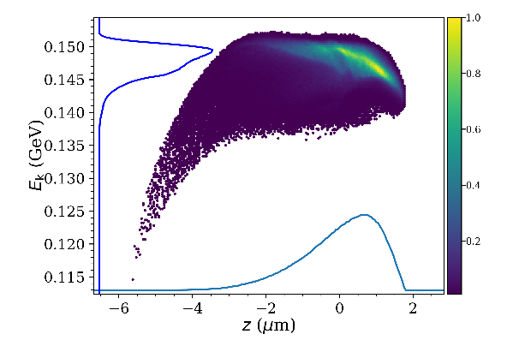
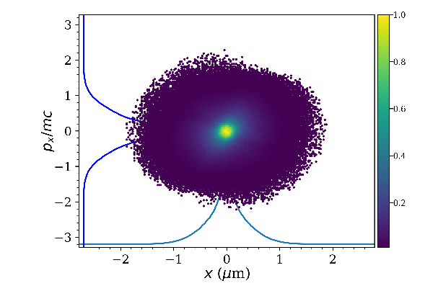
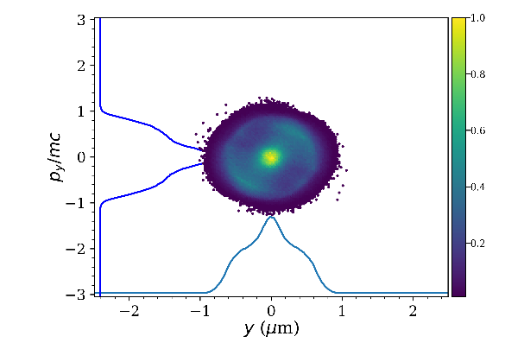
BEAM SPECS Before downramp
Beam quality (before downramp)
Longitudinal
Transverse (X)
Transverse (Y)
Charge | Energy | Energy spread | Duration
32 pC | 140 MeV | 1.65% rms | 3 fs

Slide 28
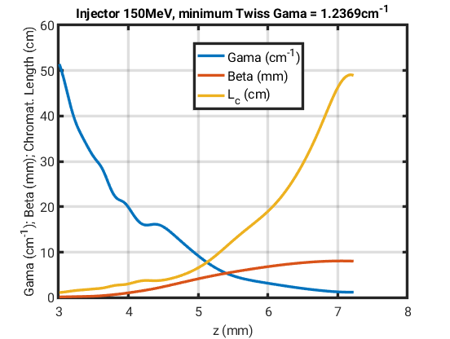
AFTER PLASMA LENS
α | β | γ | L_{c}
-1.33 | 8.1 mm | 130 m⁻¹ | 46 cm
BEST POINT
Twiss parameters (and Chromaticity Length) evolution
Passive Plasma Lens
Downramp

Slide 29
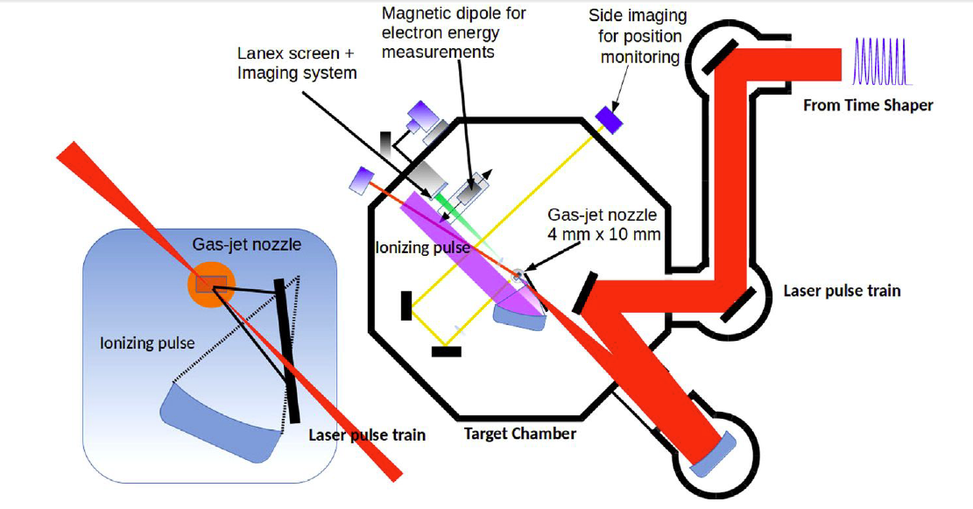
EXPERIMENTAL SET UP
A frequency doubled (400 nm) auxiliary pulse forms the ionizing pulse.
The pulse train is focused on the gas target with a long focal length off-axis parabolic mirror and drives a large amplitude plasma wave.
The set up is fully compatible with both the ILIL laser at CNR-INO and the FLAME laser at LNF

Slide 30
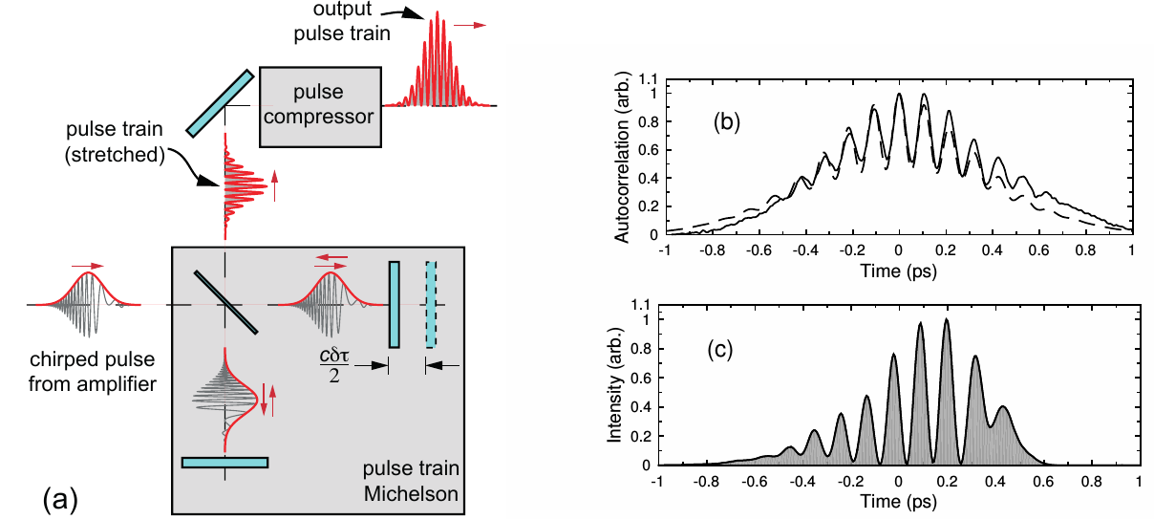
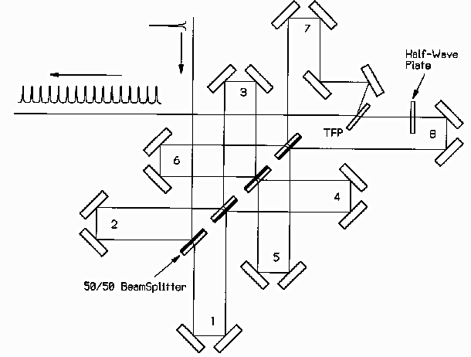
PULSE TRAIN GENERATION
Generation of trains of high intensity laser pulses with 100 fs temporal spacing is required. Preliminary demonstration was obtained by J. Cowley et al., using a Michelson type interferometer at the end of the laser chain:
Issues with this scheme:
Energy loss (≈50%)
Relative pulse intensity
Large optics required
A similar scheme can be scaled to generate equal intensity pulses (C.W.Siders et al.,
Main issue: placed after the compressor (if one wants to retain both the polarizations), involves the use of large aperture optics;
J. Cowley et al., PRL 119, 044802 (2017); C.W. Siders et al., Appl. Optics 37, 5302 (1998)

Slide 31
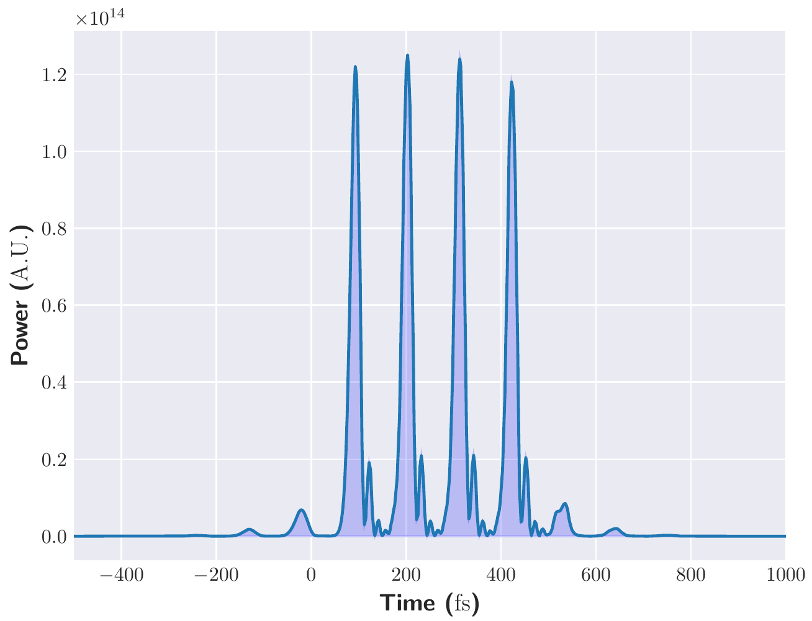
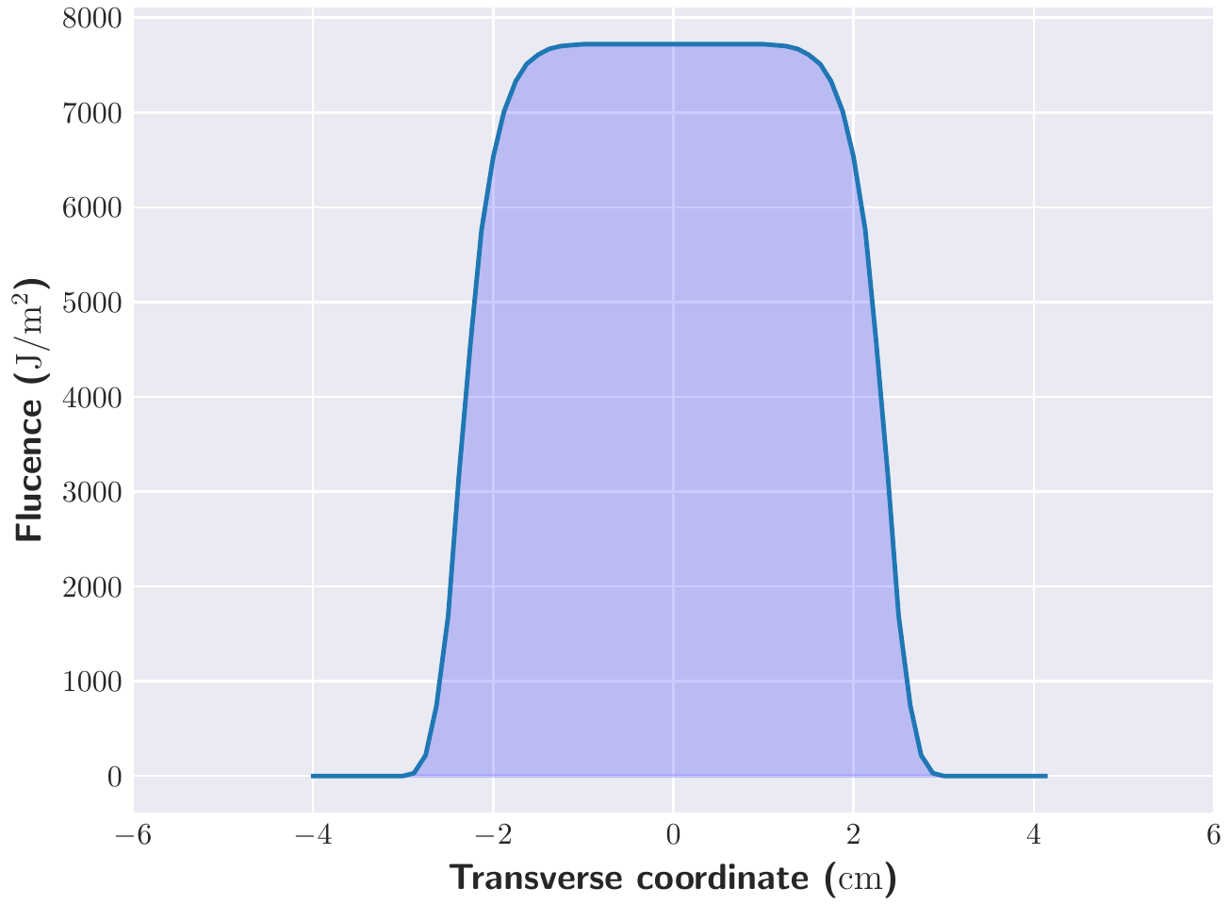
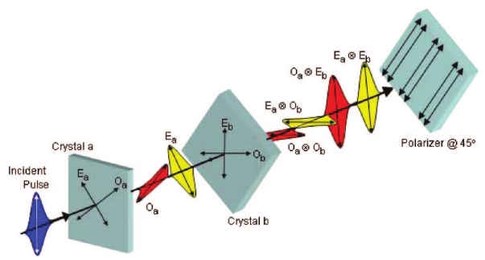
ALTERNATIVE SCHEME (TEMPI*)
Starting from generation of ultrashort pulses from a birefringent crystal array*
Simulation carried out in the case of the EuPRAXIA laser 1
Pulse stacking occurring just after the front-end:
Input pulse: 1.5J
Energy loss: 50%
Booster amplifier considered (to recover the full energy from the front-end)
Simulation carried out using the MIRO code
Relatively low-power pulses also appearing after each pulse (acceptable as for the wake excitation)
No transverse spatial effect observed
B. Dromey et al., Applied Optics 46, 5142 (2007)
*A quasi lossless Train gEneration by an early aMplitude dIvision (TEMPI), L.Labate et al., Submitted

Slide 32
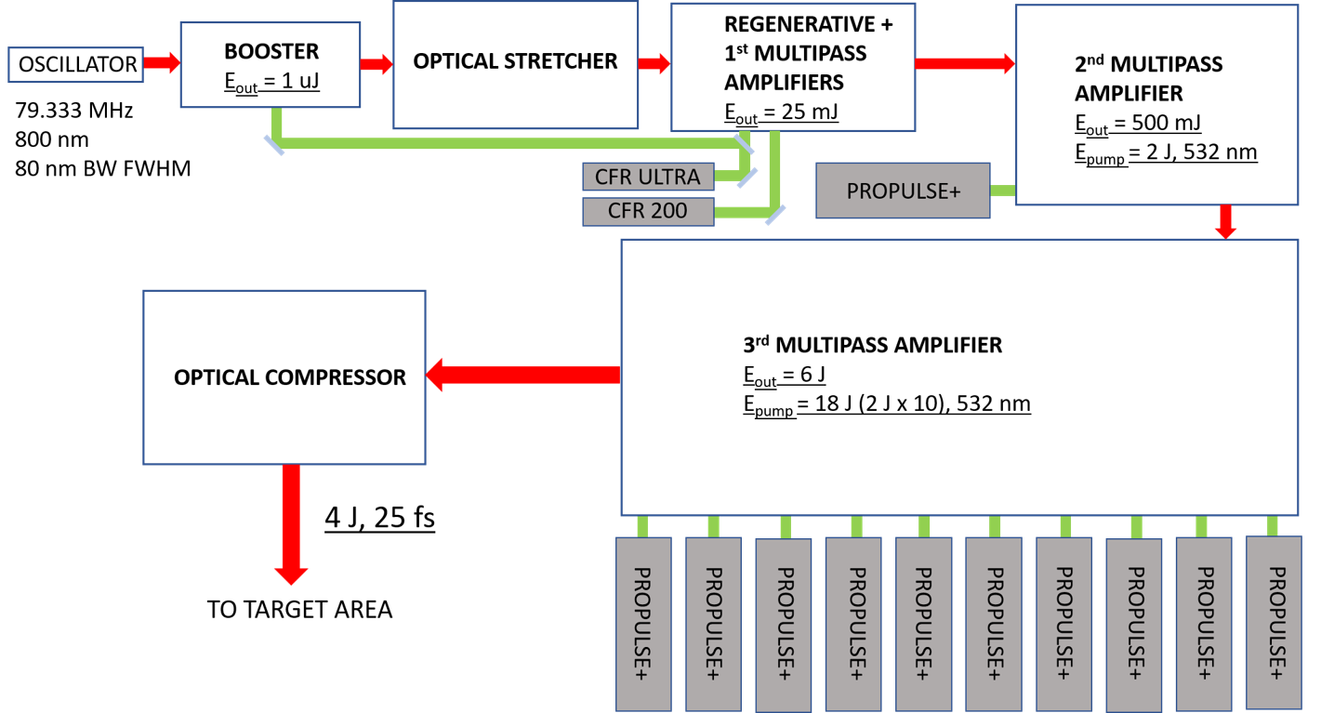
The FLAME Laser
Bisesto F., et al. "The FLAME laser at SPARC_LAB." NIM A 909 (2018): 452-455.

Slide 33
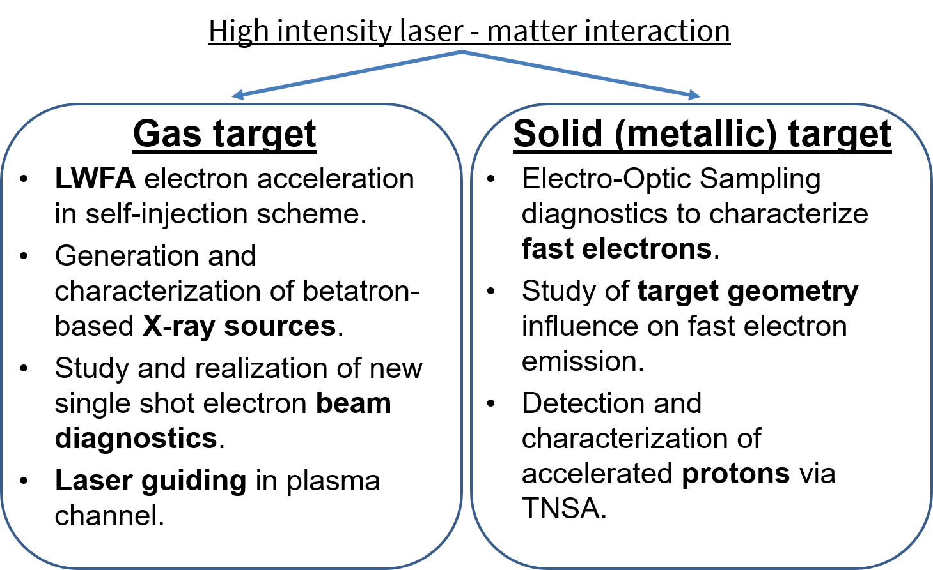
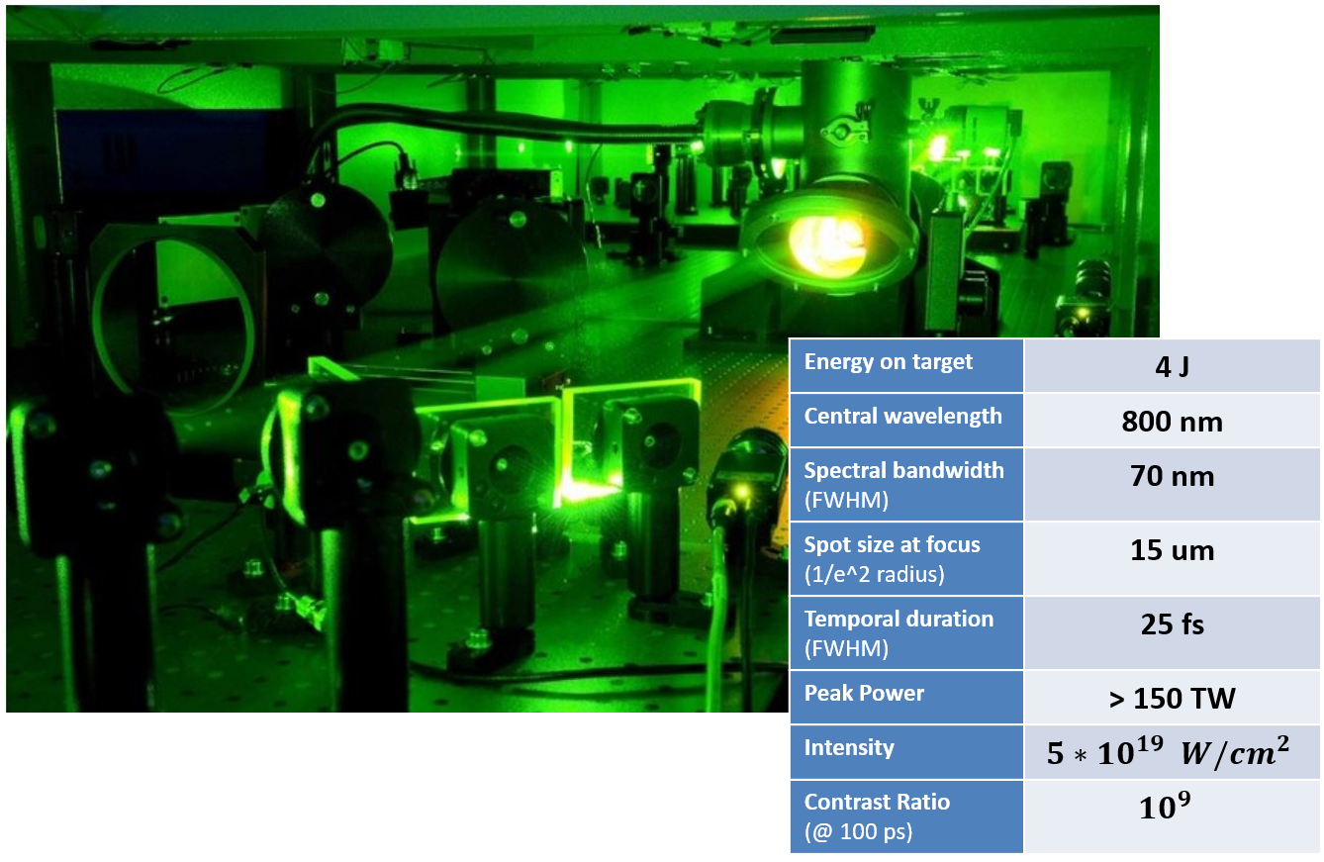
FLAME ACTIVITIES

Slide 34
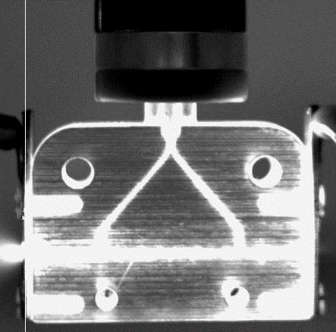
CAPILLARY GAS DISCHARGE
Parabolic density
transverse profile:
It is possible to extend the accelerator length up to several centimeters!
3D printed plastic capillary for plasma production from gas discharge as employed at SPARC_LAB. Typical size: 1-20 cm length, 0.2-2 mm diameter.

Slide 35
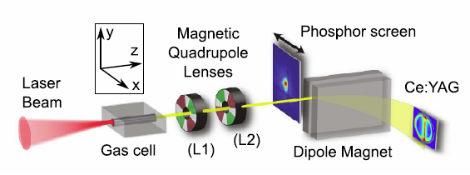
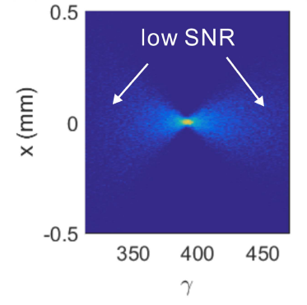
Electron diagnostics
Single shot diagnostics are highly desirable in plasma acceleration
The transverse emittance is the most difficult parameter to measure
We consider to explore several methods, more suited for LWFA electrons
Permanent quadrupoles can produce, after a dipole, a focusing size different at different energies. It is a sort of quad scan in single shot.
R. Weingartner and al., PRST-AB 15, 111302 (2012),
Barber, S. K., et al., Physical Review Letters 119.10 (2017): 104801

Slide 36
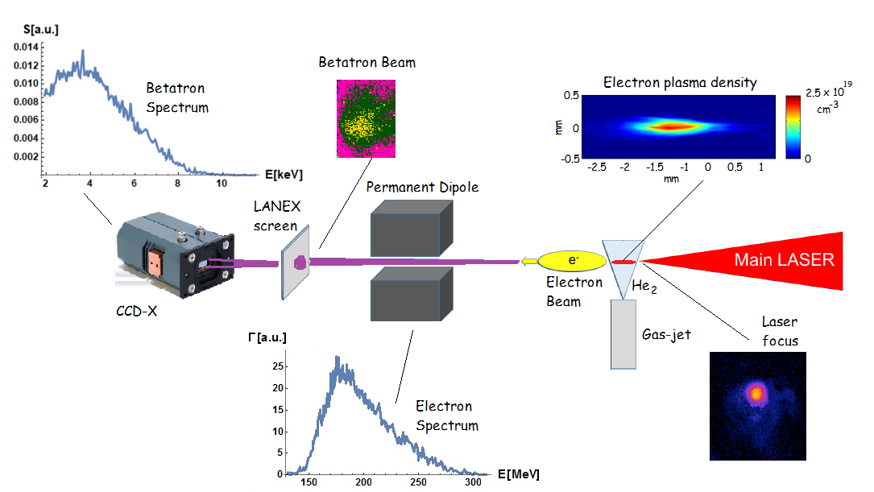
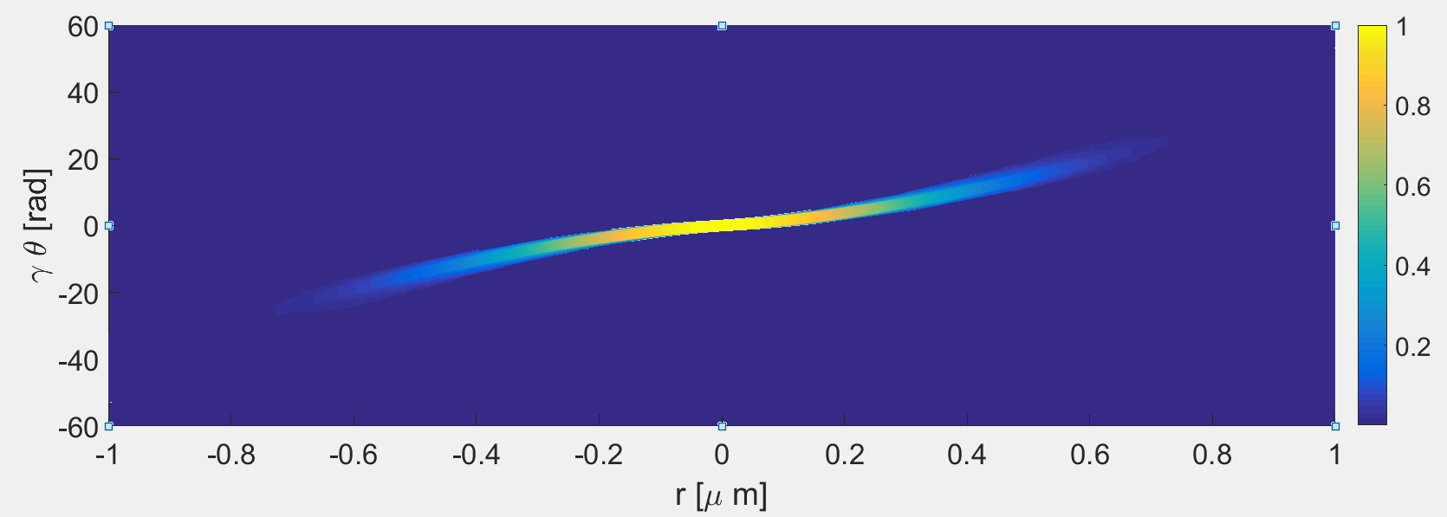
Betatron radiation
Simultaneous measurement of the betatron spectrum, the beam energy spectrum and the plasma density
Measurement of the emittance including the correlation term
The beam profile is retrieved not simply the average dimensions
An expression is given for the correlation function between the betatron oscillation amplitude and the divergence of the single accelerated electrons, i.e. the angle with respect the acceleration axis, in order to obtain the distribution of the electron divergences.
Curcio, A., et al. "Trace-space reconstruction of low-emittance electron beams through betatron radiation in laser-plasma accelerators." Physical Review Accelerators and Beams 20.1 (2017): 012801.

Slide 37
STRUTTURA DEL PROGETTO – WP1
WP1 - MODELLING
• Responsabile
P. Tomassini .
• Anagrafica delle persone partecipanti al WP con indicazione dei mesi/persona
P. Tomassini (CNR, 0.5 FTE), D. Terzani (CNR, 0.5 FTE)), L. Labate (CNR and INFN, 0.3 FTE)
• Descrizione delle attività previste
Start to end simulations of the acceleration scheme, including detailed description of laser
specifications and transport of the accelerated bunch outside the acceleration stage.
• Milestones
M1 Definition of the modelling framework (M6)
M2 Full modelling with definition of the working point for laser and plasma (M12)
• Deliverables
D1 Modelling Report

Slide 38
STRUTTURA DEL PROGETTO - WP2
WP2 PULSE TRAIN AND INJECTION PULSE DEVELOPMENT
• Responsabile F. Bisesto & L. Labate
• Anagrafica delle persone partecipanti al WP con indicazione dei mesi/persona
L. Labate (CNR and INFN, 0.3 FTE), L. Fulgentini (CNR, 0.5 FTE), F. Baffigi (CNR, 0.5 FTE), F. Bisesto
(LNF, 0.5 FTE), M.P. Anania (LNF, 0.3 FTE), G. Costa (LNF, 0.3 FTE)
• Descrizione delle attività previste
Modelling and realization of the experimental set up for generation of the pulse train for wake wave
development and injection pulse, starting from available laser specifications at ILIL and at FLAME.
• Milestones
M3 Multipulse design
M4 Experimental test
• Deliverables
D2 Technical design report on pulse train delivery at target

Slide 39
STRUTTURA DEL PROGETTO – WP3
WP3 LASER-PLASMA CHANNELING AND COUPLING
• Responsabile L. Gizzi & F. Bisesto
• Anagrafica delle persone partecipanti al WP con indicazione dei mesi/persona
L. Gizzi (CNR, 0.3 FTE), F. Brandi (CNR, 0.5 FTE), P. Koester (CNR, 0.5 FTE), D. Palla (CNR, 0.5 FTE), F.
Bisesto (LNF, 0.5 FTE), M.P. Anania (LNF, 0.3 FTE), G. Costa (LNF, 0.3 FTE), A. Biagioni (LNF, 0.2 FTE)
• Descrizione delle attività previste
Modelling, design and realization of the experimental set up for generation of the pulse train for
wake wave development and injection pulse, starting from available laser specifications at ILIL and at
FLAME.
• Milestones
M5 Gas target definition and channel formation model
M6 Channel formation and control test
• Deliverables
D3 Technical design report on channel formation

Slide 40
STRUTTURA DEL PROGETTO – WP4
WP4 ELECTRON BEAM DIAGNOSTICS
• Responsabile C. Vaccarezza & A. Cianchi
• Anagrafica delle persone partecipanti al WP con indicazione dei mesi/persona
C. Vaccarezza (LNF, 0.2 FTE), A.Cianchi (INFN TOV, 1.0 FTE), D. Palla (CNR, 0.5 FTE),
• Descrizione delle attività previste
M7 Modelling, design and construction of custom electron spectrometer
M8 Modelling, design and construction of custom electron emittance diagnostics
• Deliverables
D4 Technical design report on electron spectrometer
D5 Technical design report on emittance measurement

Slide 41
STRUTTURA DEL PROGETTO - WP5
WP5 INTEGRATION
• Responsabile M. Ferrario, L.A.Gizzi
• Anagrafica delle persone partecipanti al WP con indicazione dei mesi/persona
M. Ferrario(LNF, 0.3 FTE), L. Gizzi (CNR, 0.2 FTE), F. Brandi (CNR, 0.5 FTE), P. Koester (CNR, 0.5 FTE),
• Descrizione delle attività previste
Integration and acceleration test
• Milestones
M9 Demonstration of multipulse wake generation
M10 Test of Injection
• Deliverables
D6 Technical design report of ReMPI acceleration scheme
D7 Report on role of ionization injection on acceleration and electron specifications

Slide 42
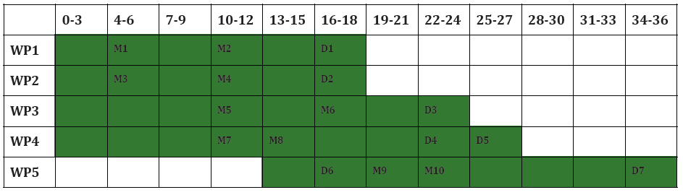
CRONO-PROGRAMMA

Slide 43
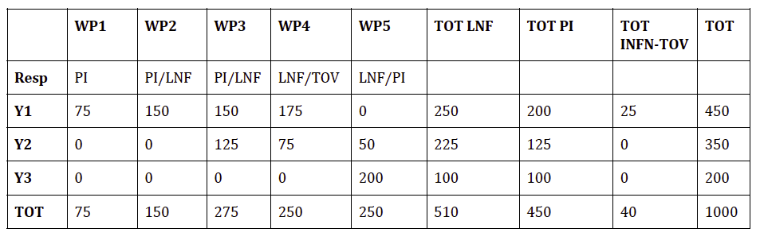
RICHIESTE FINANZIARIE PER UNITÀ

Slide 44
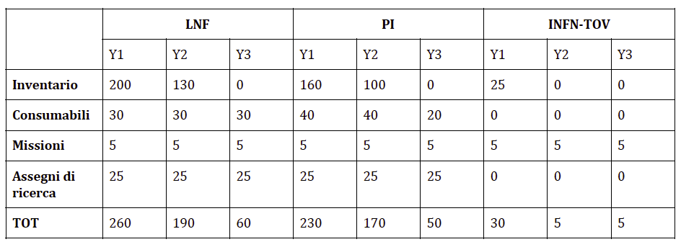
RICHIESTE FINANZIARIE PER VOCE

Slide 45
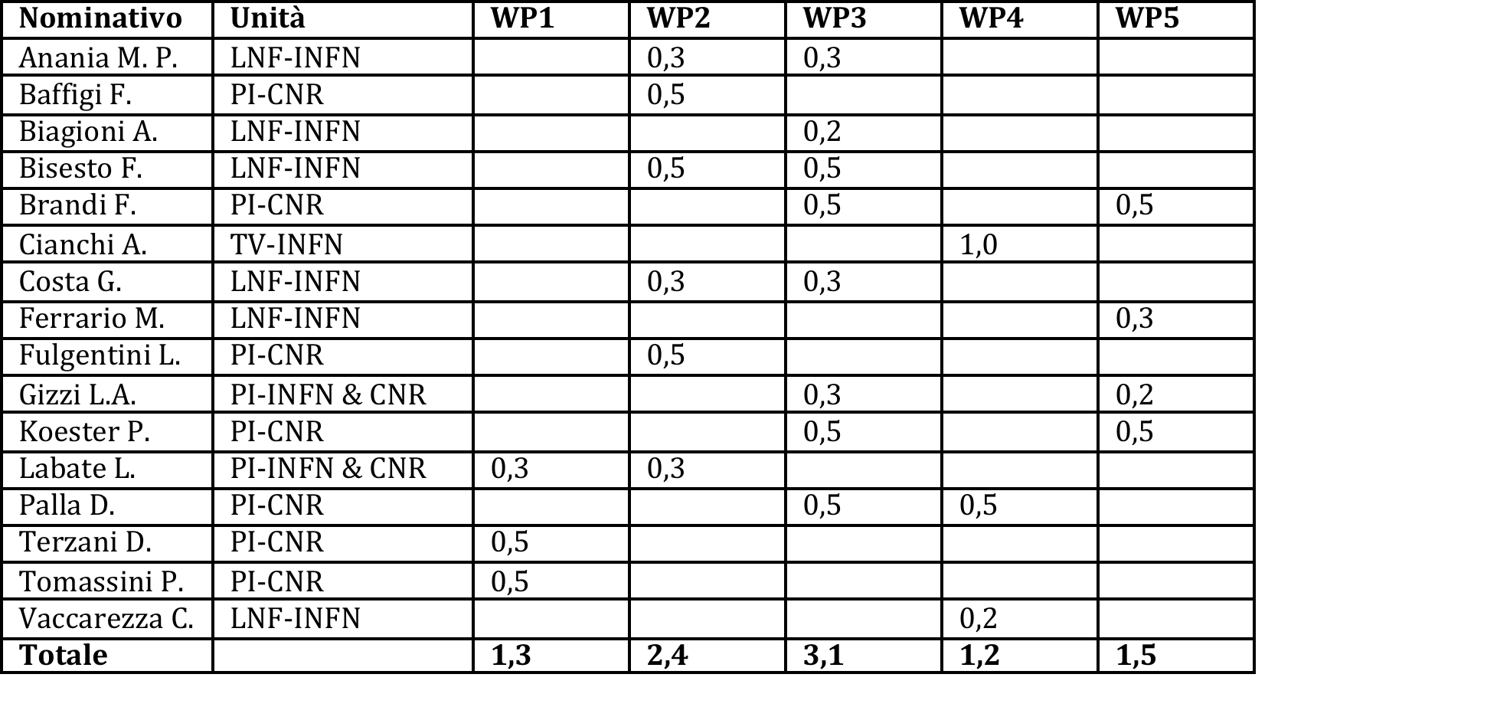
PERSONALE

