Slide 1
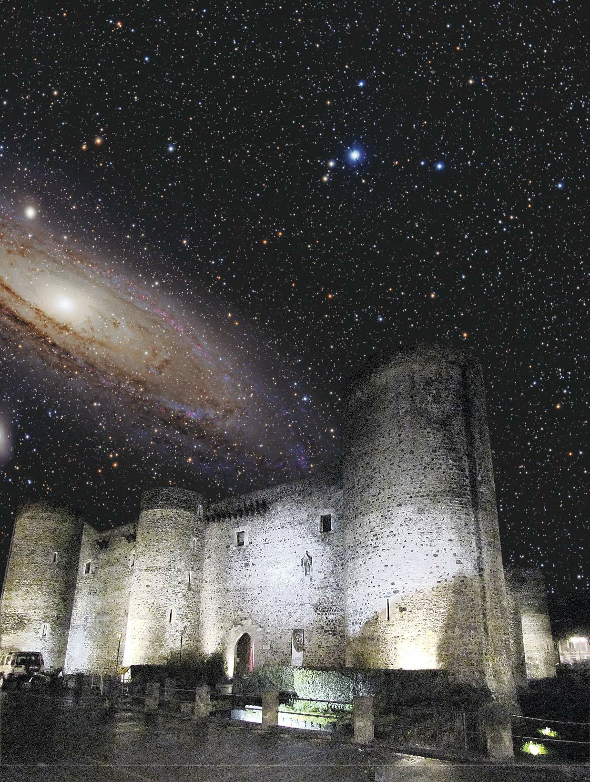
Gruppo III – ASFIN2
Consiglio di Sezione
INFN – Padova
25 giugno 2019

Slide 2
Nuclear Astrophysics

Slide 3
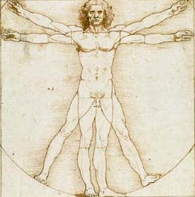
Human Body
99% of our bodies consist of six elements:
Oxygen, Carbon, Hydrogen, Nitrogen, Calcium and Phosphorus.
Element | Percentage in Mass (%)
Oxygen | 65
Carbon | 18
Hydrogen | 10
Nitrogen | 3
Calcium | 1.5
Phosphorus | 1.2
Potassium | 0.2
Sulfur | 0.2
Chlorine | 0.2
Sodium | 0.1
Magnesium | 0.05

Slide 4
Nuclear Astrophysics
The ultimate goal of Nuclear Astrophysics is to understand how nuclear processes generate the energy of stars over their lifetime and, in doing so, synthesize heavier elements from the primordial hydrogen and helium produced in the Big Bang, which led to the expanding universe.
We humans are mostly (83%) oxygen and carbon. We understand in a general way the chemistry and biology involved, but we certainly do not understand the nuclear astrophysics which produced the oxygen and carbon in our bodies.
Each of us, in a sense, has been inside a star and truly and literally consists of stardust. Every molecule in our bodies contains matter that once was subjected to the tremendous temperatures and pressures at the center of a star. This is where the iron in our blood cells originated, the oxygen we breathe, the carbon and nitrogen in our tissues and the calcium in our bones. (W.A. Fowler)

Slide 5
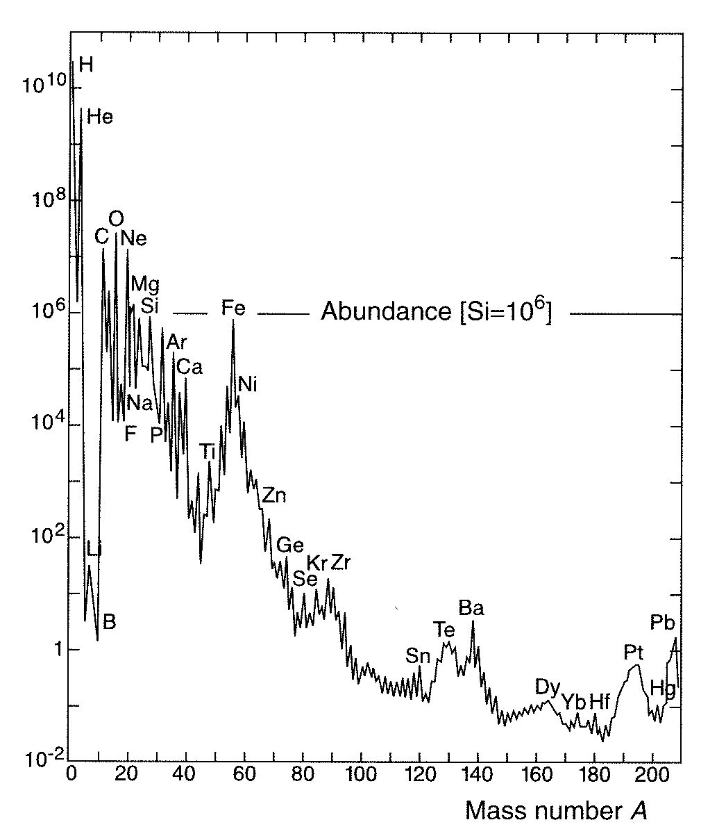
Solar Abundance Distribution
Data sources:
Earth, Moon, meteorites, cosmic rays, solar and stellar spectra…
Features:
Distribution everywhere similar
12 orders-of-magnitude span
H ~ 75%, He ~ 23%
C → U ~ 2% (“metals”)
D, Li, Be, B under-abundant
Exponential decrease up to Fe
Flat distribution beyond Fe

Slide 6
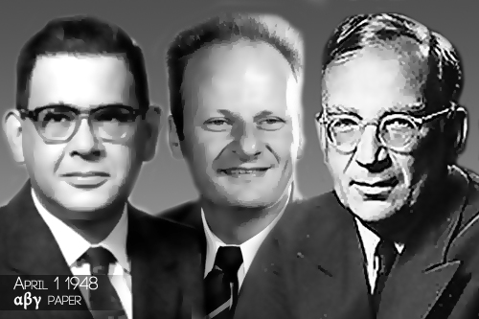
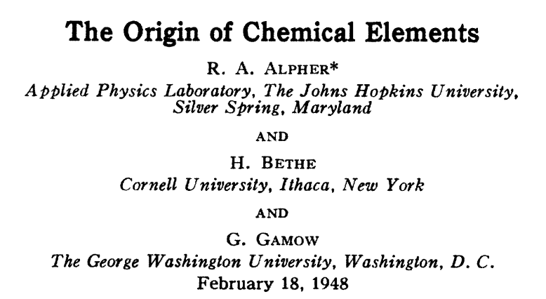
αβγ-paper (1948)
An approximately inverse relationship between neutron-capture cross sections and the relative abundances of elements in the solar system was noted. For the first time, a clear connection between nuclear reactions and element synthesis was established.

Slide 7
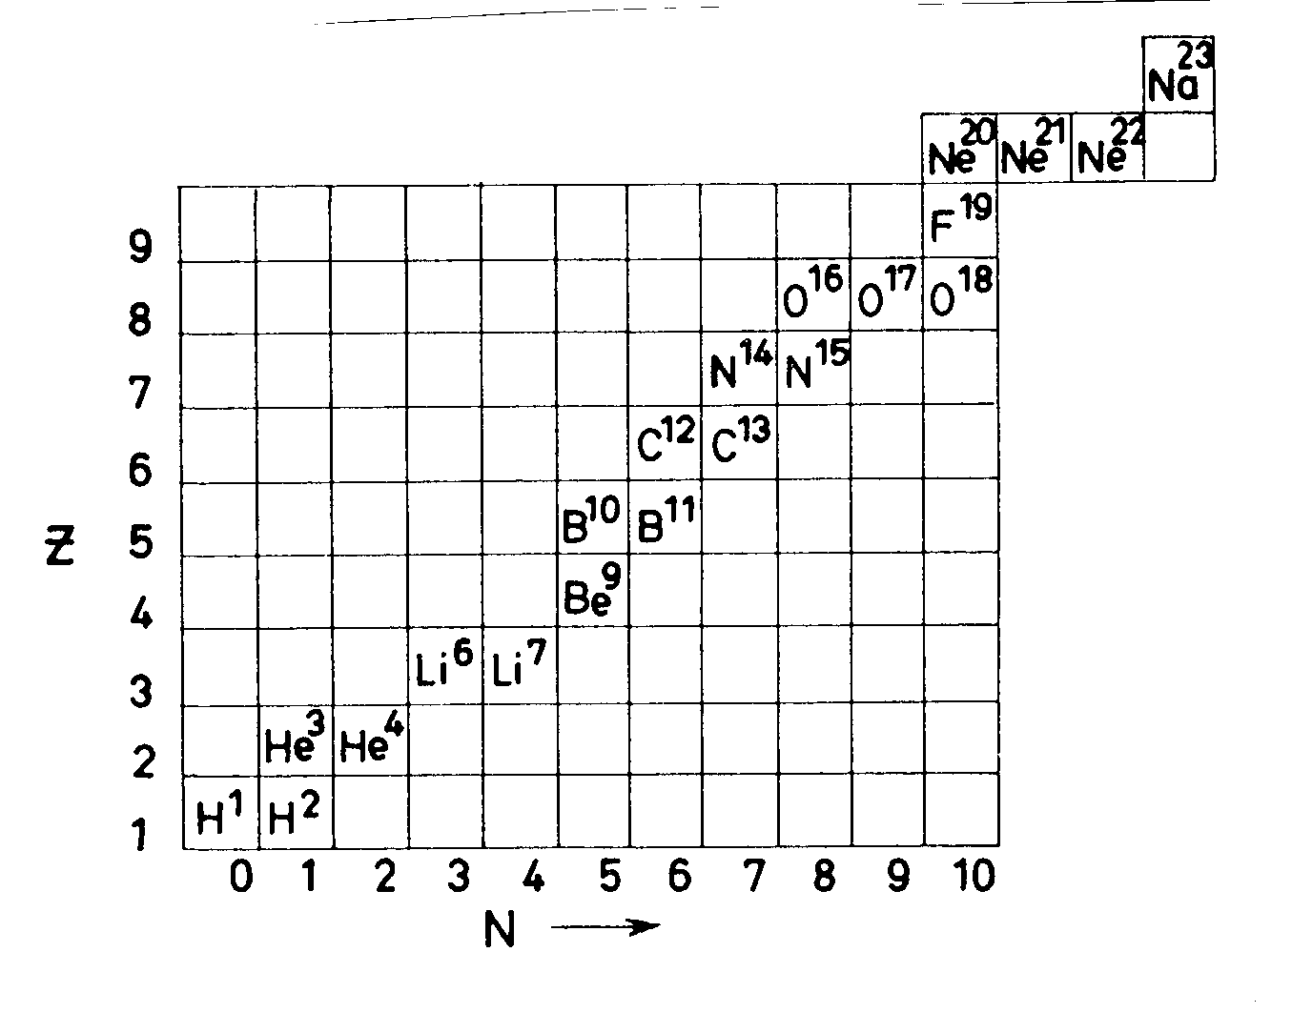
αβγ-paper (1948)
All elements formed from primordial protons and neutrons
through sequence of n-captures and β decays soon after the Big Bang
NO STABLE nuclei with A=5 or A=8
A = 5
A = 8
Composition of Universe soon after Big Bang: ¹H, ²H, ^{3,4}He, e⁻ and γ

Slide 8
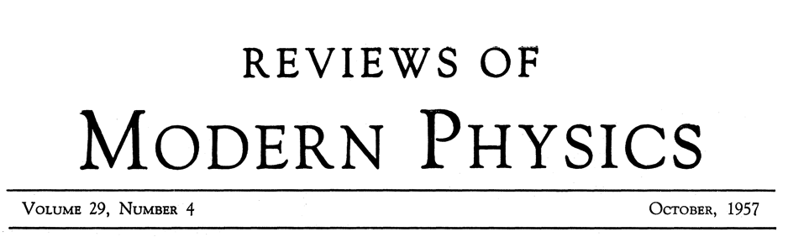
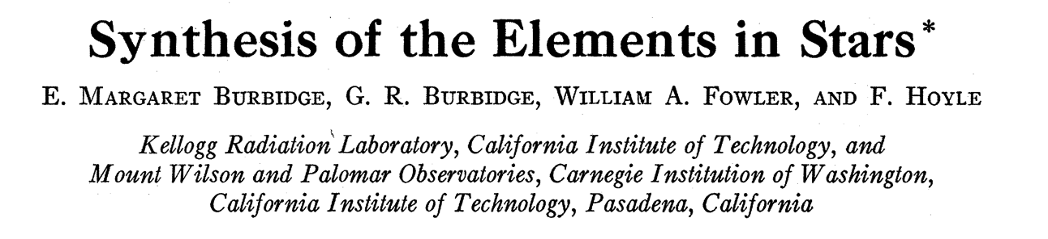

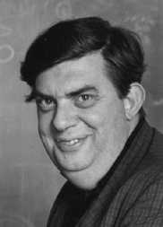
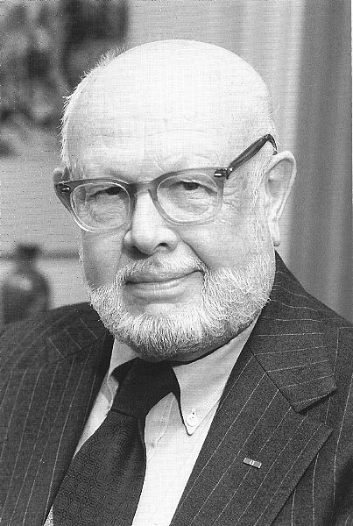
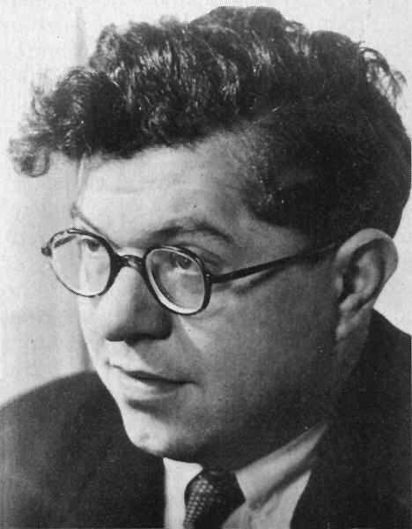

B²FH-paper (1957)
Burbidge
(1919)
Burbidge
(1925-2010)
Fowler
(1911-1995)
Hoyle
(1915-2001)
1983
Nobel Prize
"for his theoretical and experimental studies of the nuclear reactions
of importance in the formation of the chemical elements in the universe"

Slide 9
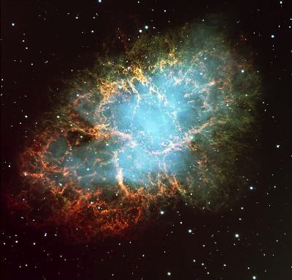
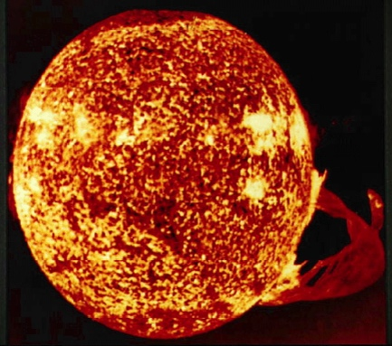

B²FH-paper (1957)
Interstellar
Medium
BIRTH
Gravitational
Contraction
Stars
Explosion
Ejection
DEATH
Energy Production
Stability against Collapse
Synthesis of “Metals”
All elements from Carbon to Uranium were produced entirely within stars.

Slide 10
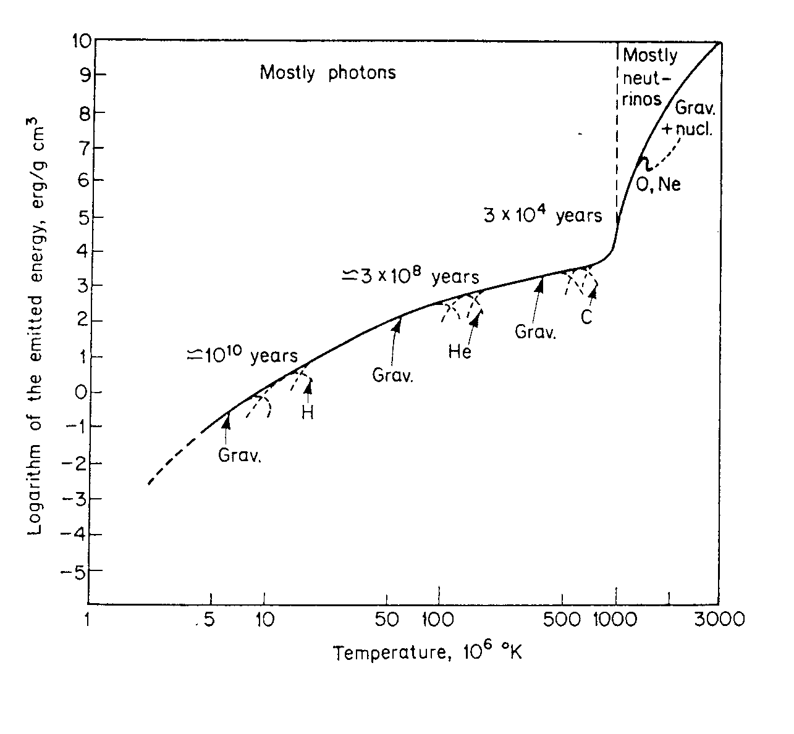
Principles of Stellar Evolution
Main Parameters:1) Initial Star Mass ( ⇒ Central Temperature)
2) Initial Star Chemical Composition ( ⇒ Nuclear Processes)
Energy Generation Rate
ε ~ T^{n}
n ~ 4 (H-burning)
n ~ 30 (C-burning)
Quiescent burning
Pre-Supernova
Super Giant
~ 3x10⁴ y
O, Ne …
Red Giant
~ 3x10⁸ y
Innermost regions only
contribute to nuclear burning,
e.g. 1/10 Mass for H-burning
and less for subsequent stages
Main
Sequence
~ 10¹⁰ y
C
He
H
Gravitational
Contraction
H-burning ≡ Main Sequence
longest stage of star’s lifetime

Slide 11
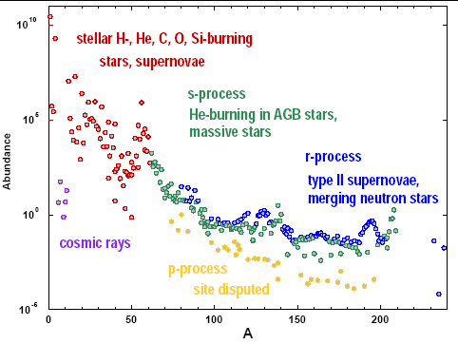
Distint Epochs of Nuclear Processes

Slide 12
Indirect Methods

Slide 13
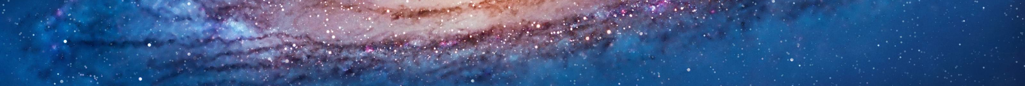

Nuclear astrophysics input
Nuclear parameters (cross sections, …)
Elemental yield → comparison with abundances observed in stars and meteorites to validate models
The purpose of nuclear astrophysics is to provide reliable nuclear physics input
Astrophysical models: how a star works
Model input parameters: magnetic field, metallicity, …
Change the model until observables are matched by predictions
Astrophysical models are very complex: assumptions on stellar structure and on stellar parameters (age, mass…) → need of multiple independent constrain
Key information: how does the mixing mechanism work? Mixing transports the produced nuclides from stellar inner layers to the surface where they are observed

Slide 14
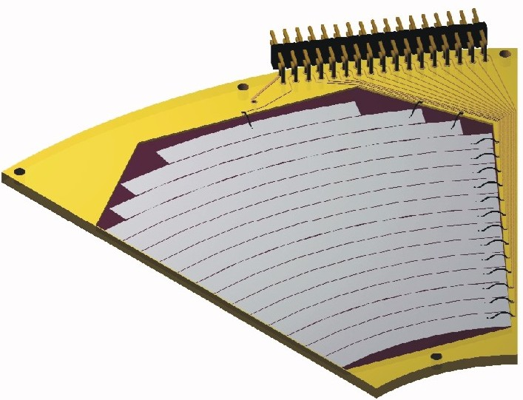
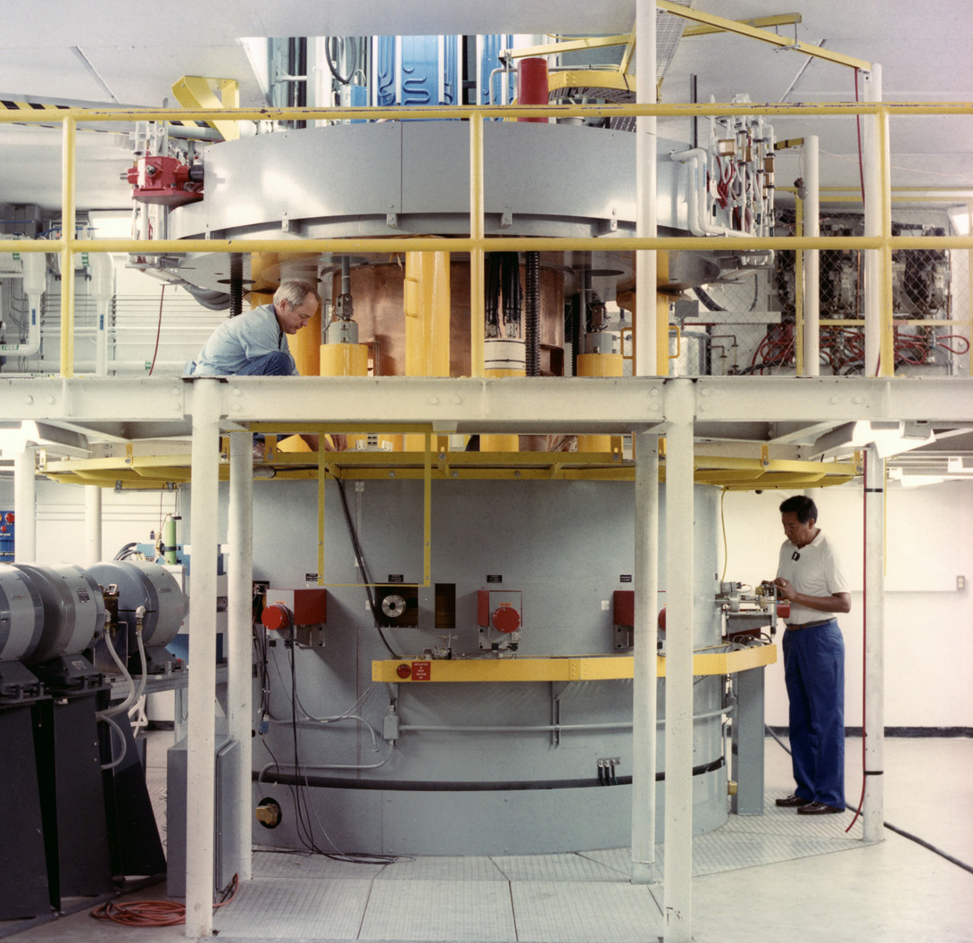
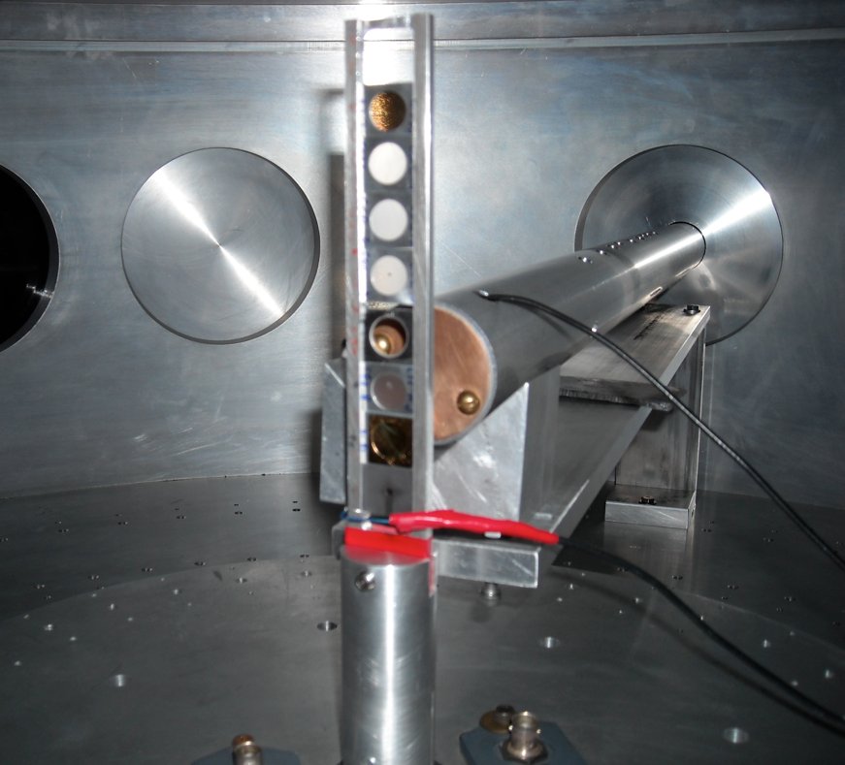
Recipe for direct measurements
How to measure the A+x→c+C reaction in a direct way?
Detector → kinematic observables
- Energy
- Emission angle
+ Particle identification
Reaction
product (c)
Beam (x)
Target (A)

Slide 15
Astrophysical S-Factor
Geometrical Factor
(particle’s de Broglie
wavelength)
Interaction
Matrix Element
Penetrability Probability
depends on projectile’s
angular momentum  and energy E
σ (E) = exp(-2πη) S(E)
(for s-waves only!)
non-nuclear origin
STRONG energy dependence
nuclear origin
WEAK energy dependence
Above relation defines ASTROPHYSICAL S(E)-FACTOR
(units: keV barn, MeV barn, …)

Slide 16
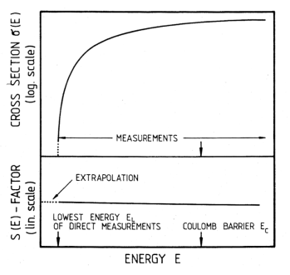
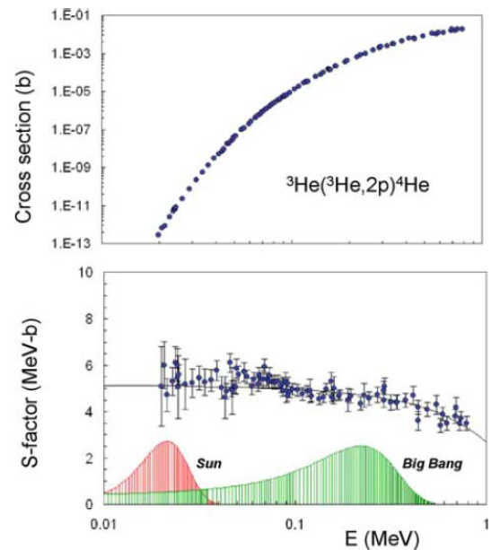
Examples of S-Factor

Slide 17
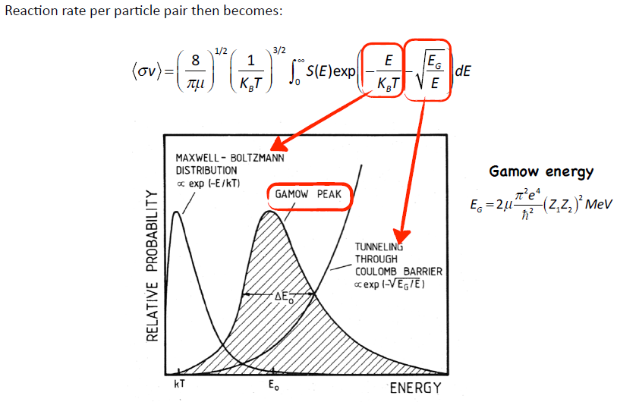
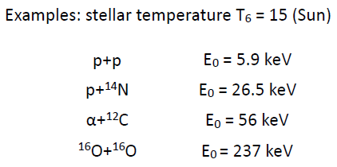
Gamow Peak Energies

Slide 18
Direct vs. indirect measurements
Indirect measurements:
Complicated but rewarding
High energy experiments: up to several hundreds MeV
→ no Coulomb barrier suppression
→ negligible straggling
→ no electron screening
Indirect measurements are the only ones allowing you to measure down to astrophysical energies with the present day facilities
Nuclear reaction theory required
→ cross checks of the methods needed
→ possible spurious contribution
→ additional systematic errors (is the result model independent?)
... Indirect techniques are complementary to direct measurements
Examples: Coulomb dissociation, ANC and Trojan horse method

Slide 19
Indirect Techniques: a cartoon
Several reaction mechanisms link the two channels
Entrance channel:
A+a
Reaction products
C+c+…
Only one reaction mechanism has to be selected, for which the reaction theory we have developed applies. A careful experimental & theoretical investigation is necessary
To recall the previous sketch:
Nuclear reaction theory
R. Tribble et al., Rep. Prog. Phys. 77 (2014) 106901

Slide 20
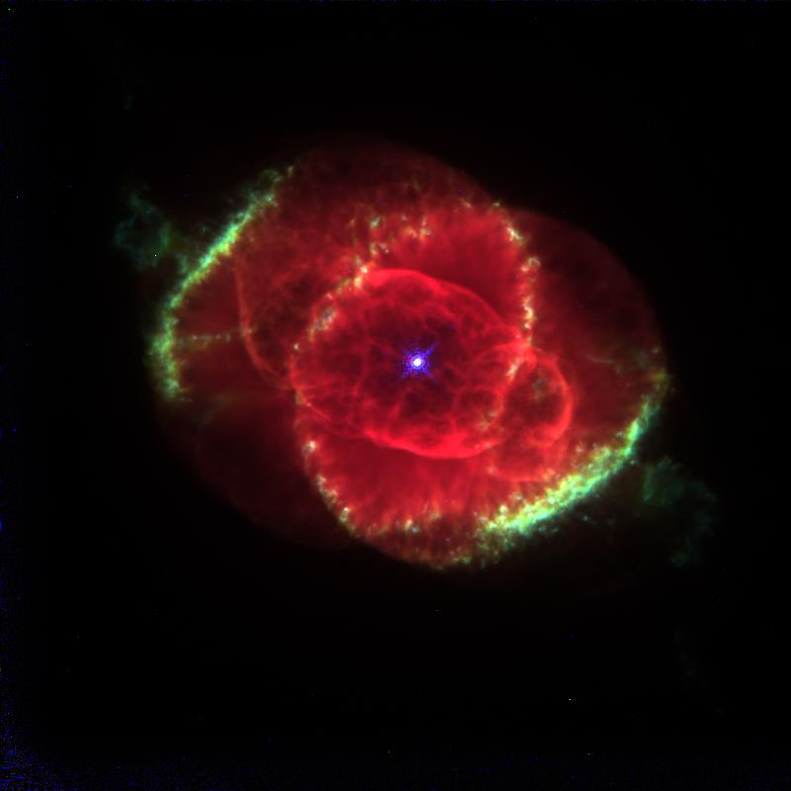
Indirect techniques: a comparison
In the Coulomb dissociation, a virtual photon beam is used to a photodisintegration reaction; the detailed balance principle is then used to recover the cross section of the relevant radiative capture reaction
a
a
γ
c
A
C
a
s
In the Asymptotic Normalization Coefficient (ANC) approach, a transfer reaction to a bound state is measured to deduce the normalization constant of the bound state wave function, prop. to the A(x,γ)F c.s.
x
A
F
a
s
In the Trojan Horse Method, a transfer reaction to an unbound system is used to measure the c.s. of the A(x,c)C process. C and c can be charged or neutral particles (no photons)
x
c
A
F*
C

Slide 21
Basic Theory of THM
Basic idea:
Is it possible to extract astrophysically relevant two-body cross sections
B + x → C + D
from the quasi-free contribution
of an appropriate three-body reaction?
A + B → C + D + S
Main Application:
Charged particle bare nucleus cross section measurements at astrophysical energies

Slide 22
Quasi-Free Mechanism
The A nucleus presents a strong cluster structure: A = x ⊕ S clusters
x
C
B
The x cluster (participant) interacts with the nucleus B
B + x → C + D
D
A
S
x
C
The S cluster acts as a spectator (it does not take part to the reaction) and should retain the same momentum it had in the entrance channel
B
D

Slide 23

Trojan Horse Method
The incoming energy E_{A} of the incident particle is larger than the Coulomb barrier for the reaction A + B (V_{CB})
E_{A} > V_{CB}
This implies that B and x have a non-negligible probability to be very close.
A
S
x
C
B
D
Nucleus A can be brought into nuclear field of nucleus B and cluster x induces the reaction B + x → C + D
Coulomb effects and electron screening are negligible

Slide 24
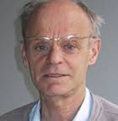


The Builders
G. Baur, 1986
C. Spitaleri, 1990

Slide 25
Plane Wave Impulse Approx. (PWIA)
Virtual decay of nucleus A → x+S “First vertex”
A
S
x
C
B
D
Virtual reaction x + B → C + D: “Second vertex”
Second vertex
d³σ
∝
dσ
KF
[Φ(q)_{xs}]²
dE
d
Ω
c
d
Ω
D
dΩ
x + B→ C + D
C
First vertex
KF kinematical factor
|Φ(q_{xS})|² describes the intercluster (x-S) momentum distribution
(dσ/dΩ) two-body cross section of the virtual reaction x + B → C + D

Slide 26
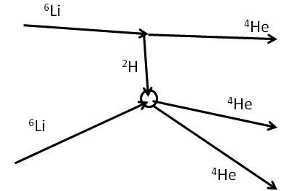
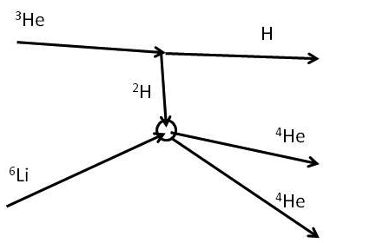
Pole Invariance
⁶Li break-up
³He break-up

Slide 27
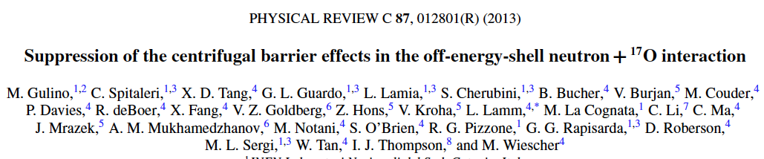
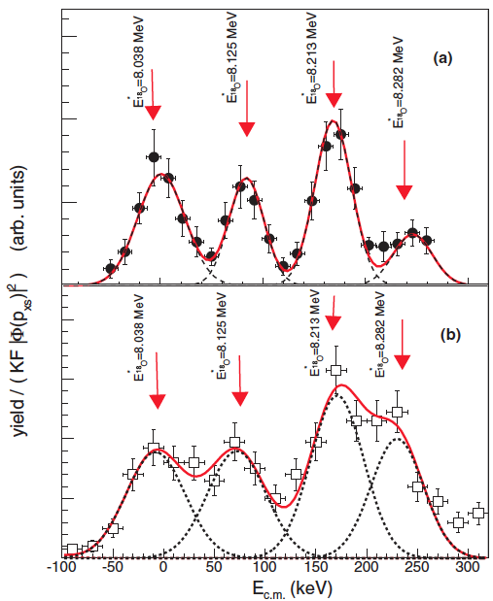
Reactions Induced by Neutrons
²H
QF break-up
p
n
¹⁴C
¹⁷O
α
Two experimental runs performed in Catania and South Bend (Notre Dame University);
First detection of the 8125 keV level as ¹⁷O-n (l=3);
No centrifugal effects in the entry channel;

Slide 28
Reactions Induced by RIB
First run @ CRIB (Japan)
Further run @ MARS (USA)

Slide 29
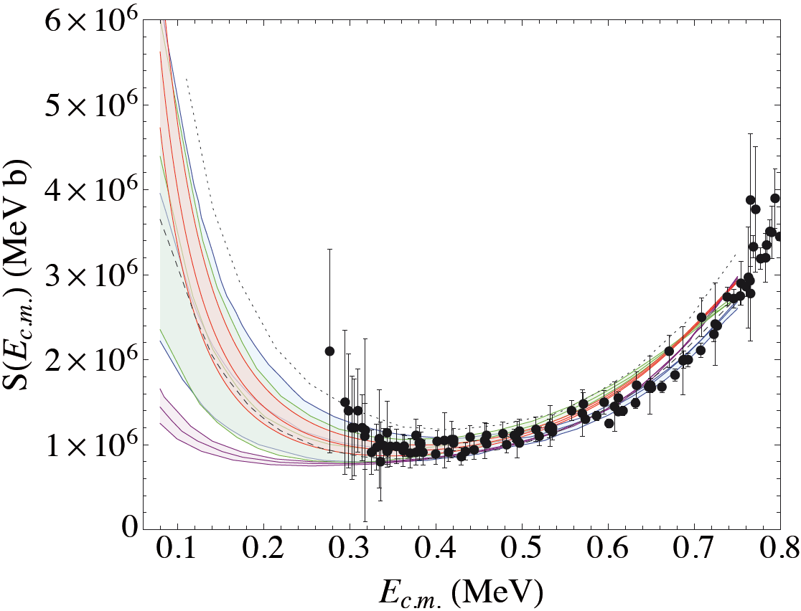
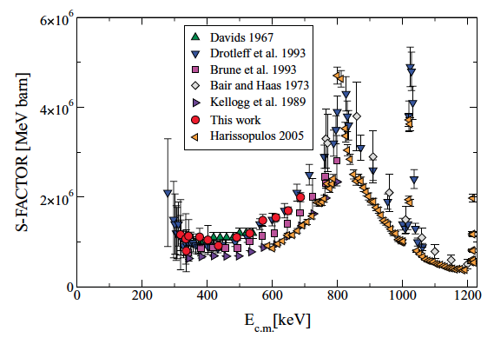
Sub-Threshold Resonances
Indirect measurements of the -3 keV resonance in the ¹³C(α, n)¹⁶O reaction, main source of neutrons for the s-process (⁶Li beam at 8 MeV).
THM: RED BAND
Good agreement with previous data
Uncertainty greatly reduced
No data at astrophysical energies
Extrapolation subject to big uncertainties owing to the poor data presently available

Slide 30
Three-Body Reaction of Interest
⁷Li(p,α)⁴He studied via the ⁷Li(d,αα)n with THM.
D was chosen since its simple clusterization and low binding energy. ⁷Li was chosen as beam with energy 19.5 MeV.
TH – Nucleus | Binding Energy (MeV) | Clusters | Intercluster Motion
d | 2.225 | p+n | l = 0
t | 6.257 | n+d | l = 0
³He | 5.494 | p+d | l = 0
⁶Li | 1.475 | α+d | l = 0
⁹Be | 2.467 | α+⁵He | l = 0

Slide 31
Beam Energy
²H
n
α
p
⁷Li
α
E_{qf} = E_{c.m.}– B
E_{c.m.}: beam energy in the center of mass of the 2-body reaction
B: binding energy of the two clusters inside the TH nucleus.
ASTROPHYSICAL CASE: E_{qf} ≈ 0
E_{qf}: energy between ⁷Li and transferred particle (p)

Slide 32
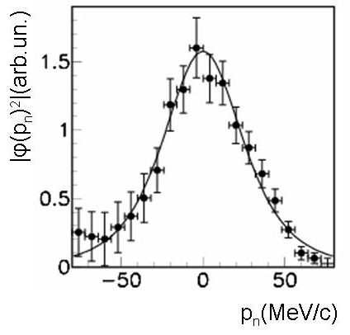
Quasi-Free Mechanism
The angles of the detectors are chosen in order to maximize the quasi-free contribution.
In fact, once the beam energy is selected, only for certain angular pairs we will have quasi-free conditions, i.e. the momentum of the spectator particle p_{s} = 0.

Slide 33
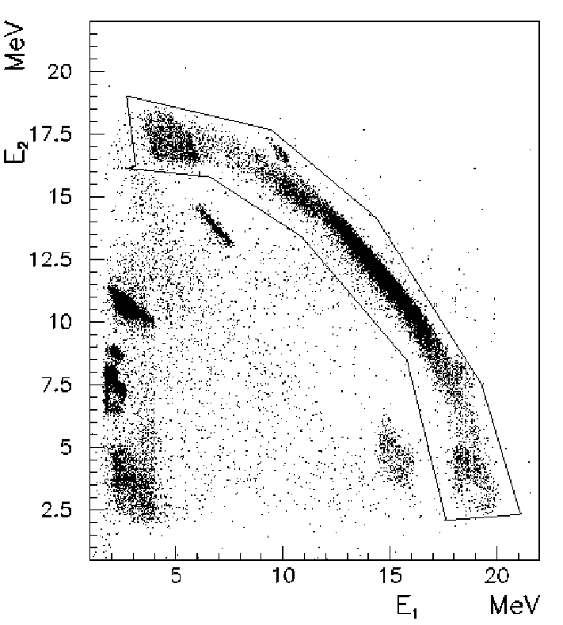
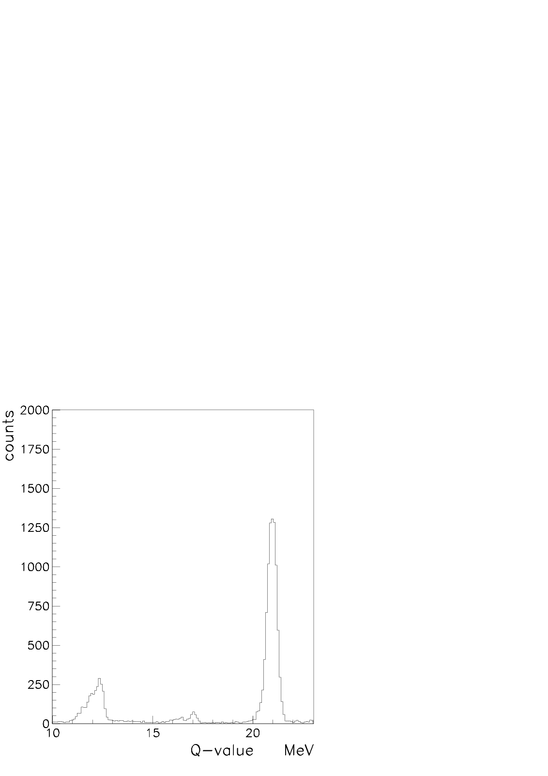
Q_{value} Reconstruction
To verify the calibration and to select the reaction (among all the other reactions possibly occurring between target and projectile) the Q_{value} spectra and kinematic locus are studied.

Slide 34
Rejection of Sequential Mechanism
Mechanisms other than QF must be discriminated and not taken into account in the further analysis.
One example: sequential mechanisms.
²H
n
²H
a
a
p
n
⁷Li
a
⁷Li
⁵Li*
a
These processes have same ejectiles of QF, but proceeds via some intermediate states, clearly evident in the relative energy spectra.

Slide 35
Momentum Distribution
Once the QF contribution is estabilished, only these data (p_{s}<30 MeV/c) will be considered for further analysis.
Distortions in the momentum distributions are taken into account.
Next step is the extraction of the cross section of astrophysical interest from the measured 3-body reaction.

Slide 36
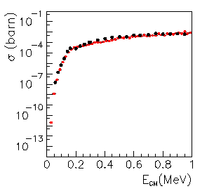
Cross Section Extraction
•
THM data (2003)
•
Direct data
THM results should be normalized to direct data at the higher energies.

Slide 37
Pro’s
Advantages of the THM
A - Possibility to measure the bare nucleus cross section (or the bare nucleus Astrophysical Factor) at Gamow energies for reactions involving charged particles and neutron.
No extrapolation needed
B - It is possible to measure excitation functions in a “relatively” short time, because the typical order of magnitude for a three-body cross-section is in the mb range.
C - One of the few ways to measure the electron screening effect via the comparison with direct data.
D - Possibility (already verified) of application to the radioactive beam measurements.

Slide 38
Con’s
Main Limitations of the THM
A - Preliminary studies of the quasi-free mechanism and tests of validity are necessary. Presence of different three-body reaction mechanisms (Sequential Decay – Quasi-Free).
B - No absolute cross section is measurable: excitation functions at energies above/below the Coulomb barrier must be known from direct measurements.
C - Measurements with high angular and energy resolutions are needed.
D - Theoretical analysis is needed: PWIA, …

Slide 39
Recent Highlights

Slide 40
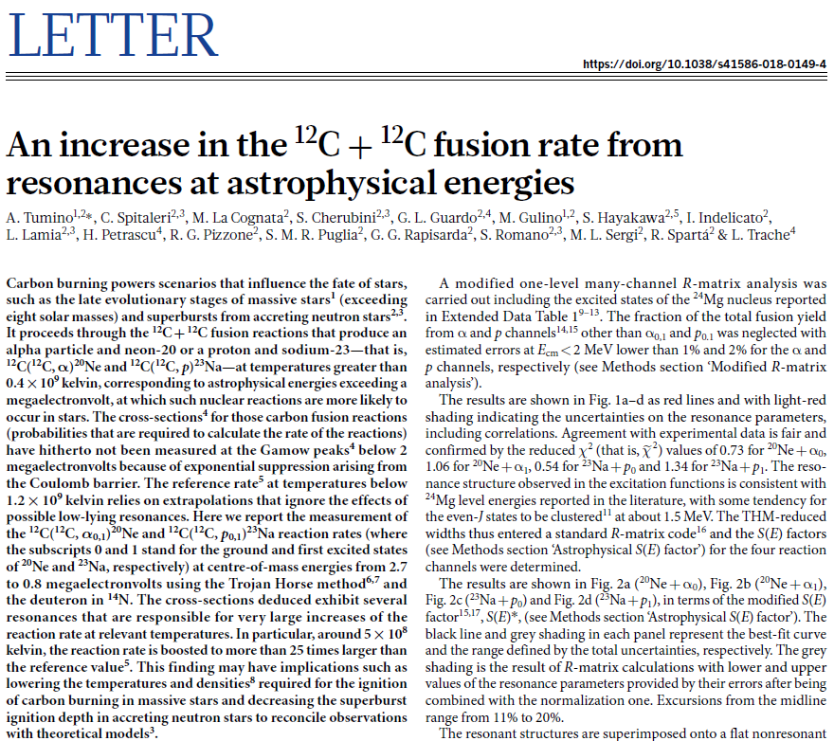
#1: ¹²C + ¹²C

Slide 41
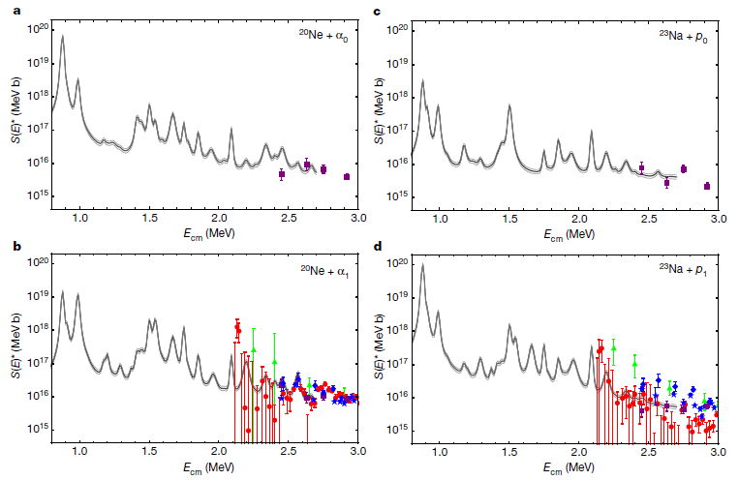
Astrophysical S-Factor

Slide 42
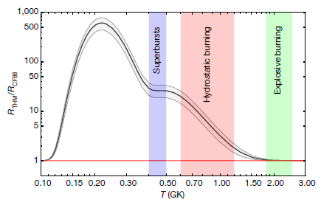
Reaction Rate Enhancement

Slide 43
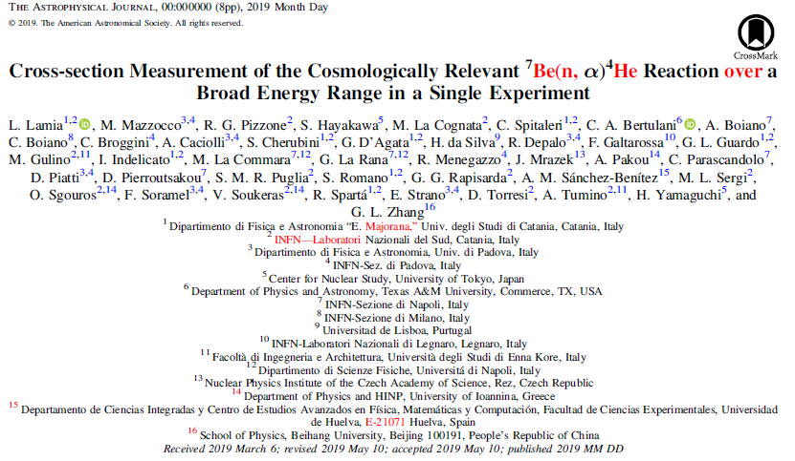
#2: ⁷Be + n

Slide 44
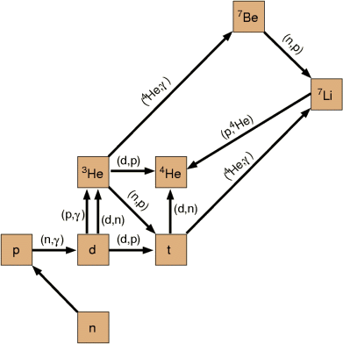
BBN: THM for primordial nucleosynthesis
12 relevant reactions were selected whose importance is connected with formation and destruction of the “primordial” isotopes.
6 of them were studied by THM (marked in red)
³He(n,p)³H recently studied.
Primordial isotopes:
H and D
³He and ⁴He
⁷Li (partially)
BBN network and observed isotopes
(n,α)
By modeling the abundances of those isotopes and observing their “primordial” abundance one can get hints on BBN and the baryon to photon ratio, thus testing the Big Bang Model.

Slide 45
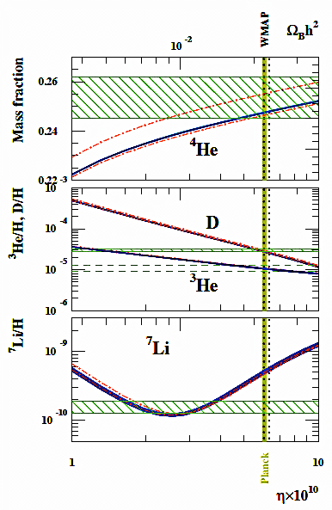
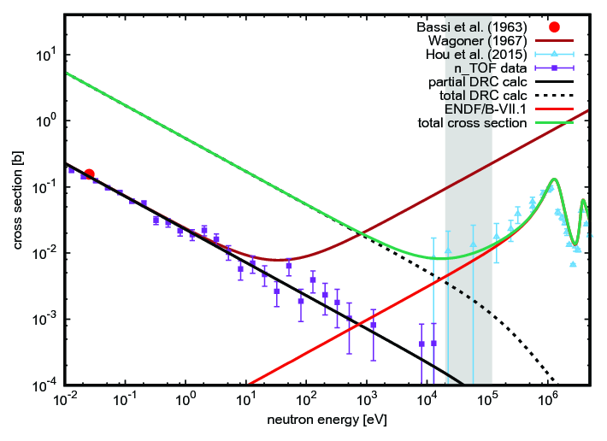
Cosmological ⁷Li Problem
Discrepancy of a factor 3 between predictions and observation for ⁷Li abundances in metal-poor stars.
Recent measurement of the n + ⁷Be → α + α reaction at n-TOF.
M. Barbagallo et al., PRL 117 (2016) 152701

Slide 46
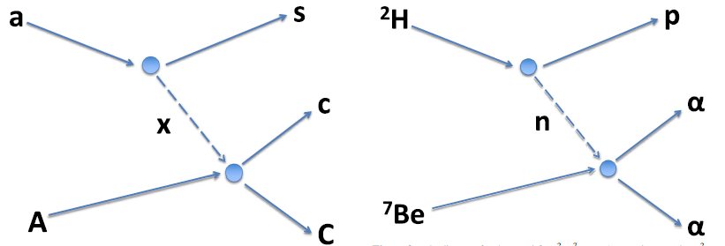
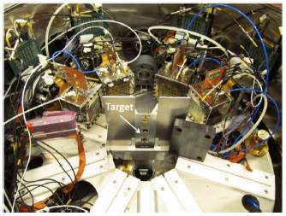
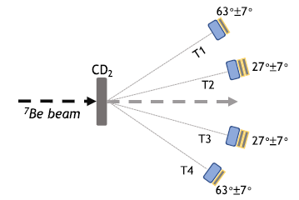

Slide 47
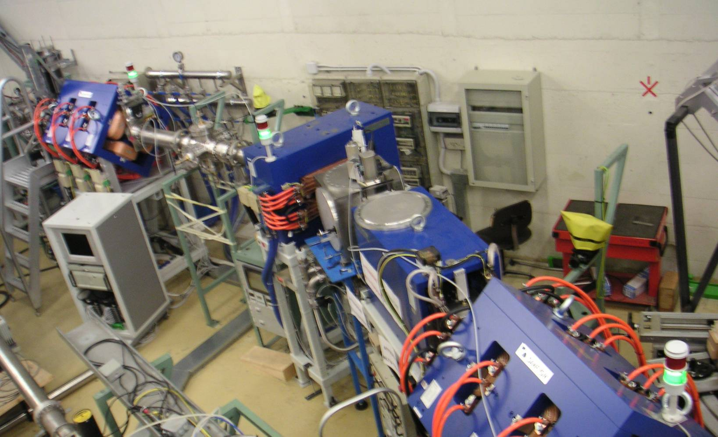
The Facility EXOTIC at LNL
I. PRODUCTION
Gas Target
1st Quadrupole Triplet
30°-Dipole Magnet
Wien Filter
II. SEPARATION
2nd Quadrupole Triplet
4 Slit Systems
III. EXPERIMENT

Slide 48
Light RIBs at EXOTIC
¹⁷F E = 3–5 MeV/u Purity: 93-96 % Intensity: 10⁵ pps
⁸B E = 3–5 MeV/u Purity: 30-43 % Intensity: ~ 10³ pps
⁷Be E = 2.5–6 MeV/u Purity: 99 % Intensity: 10⁶ pps
¹⁵O E = 1.3 MeV/u Purity: 97-98 % Intensity: 4*10⁴ pps
⁸Li E = 2–2.5 MeV/u Purity: 99 % Intensity: 10⁵ pps
¹⁰C E = 4 MeV/u Purity: 99 % Intensity: 5*10³ pps
¹¹C E = 4 MeV/u Purity: 99 % Intensity: 2*10⁵ pps

Slide 49
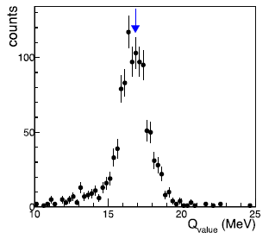
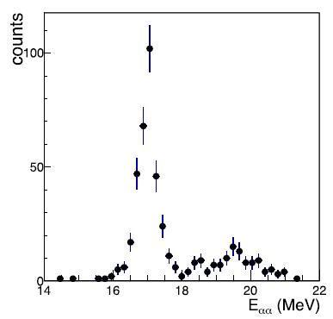
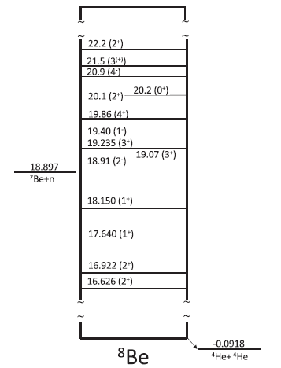
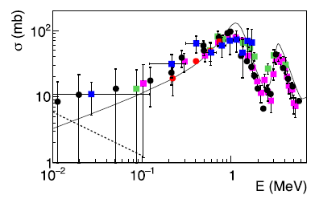

Slide 50
Our Background

Slide 51
Our Capabilities
Production of light RIBs
Charged Particle Spectroscopy with DSSSDs
Angular Distribution Measurements
Coincidence Measurements
Qvalue and Erel reconstruction
Reaction Dynamics Studies
Data Analysis and Result Interpretation
Simulations

Slide 52


⁷Be,⁸B + ²⁰⁸Pb

Slide 53

Reaction Cross Sections

Slide 54


Coincidence Measurements

Slide 55
Summary 2012-2017

Slide 56
ASFIN was since its beginning (1992) applying the Trojan Horse Method (THM) for reactions of astrophysical interest. Indirect methods are complementary to direct ones for understanding the low-energy behaviour of astrophysically relevant cross sections.
THM was first applied to reactions induced by stable nuclei and allowed the extraction of the bare nucleus cross section at energies relevant for astrophysics. Moreover the electron screening effect was studied for several reactions.
Many astrophysical contexts were then explored:
Primordial nucleosynthesis
Light elements depletion
Stellar nucleosynthesis
It was later shown (2012 – 2017) that also reaction induced by neutrons and/or radioactive ion beams could be studied by means of THM thus opening new fields of application to the method e.g. Novae nucleosynthesis (¹⁸F(p,a)¹⁵O) and BBN with exotic nuclei ⁷Be(n,p) and ⁷Be(n,a) reactions.
We would like to continue this task not only focusing on stable isotopes but also starting a campaign for exotic beams (taking advantage of SPES in the future).

Slide 57
Activity 2012-17

Slide 58
Bibliometria 2012-2017
Pubblicazioni ISI: 112 (+4 submitted)
Pubblicazioni totali: 128 (4 sub.). Fonte: NASA ADS
120 talks a conferenze internazionali di cui circa 50 su invito (talk e lezioni)

Slide 59
Coming Years

Slide 60
ASFIN2
Nuclear astrophysics
A large amount of activity will be devoted to RIBs (e.g. 26Al) with activities in LNS, GANIL, LNL, RIKEN and in future SPES
In this framework expertise is needed
Collaborations –> new researchers in ASFIN
ASFIN LNS & ASFIN PG +:
ASFIN-PD : the longstanding expertise on RIBS (former Exotic collaboration) will be the core of the future activity in Ganil and Spes with RIBS (Al26 LOI@SPES & LNS). The collaboration has proven to be fruitful e.g. the 7Be(n,a) case at LNL.
ASFIN-NA: RIBS experiments would need the detection apparata already available within ASFIN (CLAD, ASTRHO, TECSA). Improved portable DAQ is necessary and will be done in Naples with experts in the field. Possible application with GET?
In the next years we will focus on:
- Explosive nucleosynthesis with RIBs
-indirect methods (THM & ANC)
-n-induced reactions
-photodissociation reactions
-astrophysical implications
-fusion in laser induced plasma

Slide 61



n+RIBs with THM @LNS & SPES
²⁶Al*(n,α)²³Na via ²⁶Al*(d,α²³Na)p
²⁶Al*(n,p)²⁶Mg via ²⁶Al*(d,p²⁶Mg)p
Investigation of reactions involved in the r-process: n+radioactive nuclei
In both cases THM offers a unique possibility to study reactions among two unstable systems
LOI @
Observation of 1808.65 keV γ-rays from the decay of ²⁶Al to ²⁶Mg in the interstellar medium demonstrates that ²⁶Al nucleosynthesis does occur in the present-day Galaxy
Tracking of active nucleosynthesis sites in the Galaxy
Investigation of massive stars
Applying to MAECI grants for scientific exchanges ITALY-MEXICO

Slide 62

AGATA at LNL

Slide 63
Activity 2020

Slide 64
Exclusive measurement of the cross sections of the ²⁶Al+n reactions by means of the THM
ASFIN (M. La Cognata) + AGATA + VAMOS + MUGAST collaborations @ GANIL
²⁶Al is a key isotope in astrophysics: (1) probe of stellar nucleosynthesis
g.s. T_{1/2}=7 10⁵ y (2) index of NS formation rate
i.s. T_{1/2}=6.35 s (3) heat source for Earth formation
²⁶Al(n,p)²⁶Mg and ²⁶Al(n,𝛼)²³Na reactions will be studied using THM, using deuteron as n-virtual source
Existing data are very poor or absent at astrophysical energies, especially for the reactions involving ²⁶Al isomeric state
Measurement with ²⁶Al g.s. and 228 keV isomeric will be carried out at GANIL – SPIRAL
Exclusive measurement using AGATA to tag the population of ²⁶Mg and ²³Na excited states

Slide 65

²⁴Mg states at 14-17 MeV excitation energies investigated with ²⁰Ne+𝛼 resonant scattering at the ACTAR demonstrator
LOI Spokeperson: A. Caciolli, T. Marchi, D. Mengoni, M. La Cognata, …
¹²C+¹²C fusion is of paramount importance in nuclear physics and nuclear astrophysics:
Understanding of the fusion mechanism (hindrance?)
Evaluation of type II supernovae and NS formation rate
It establishes the value of the critical mass for which quiescent carbon burning is ignited
It influences the synthesis of many nuclides including ²⁶Al
THM indirect measurements (so far confirmed by STELLA) seem to point to a large reaction rate at stellar temperatures then presently believed
ACTAR TPC will be used to
measure the ²⁰Ne+𝛼 resonant
scattering to perform the
spectroscopy of ²⁴Mg and
constrain ²⁴Mg spin, parity and
partial widths of states of
astrophysical interest

Slide 66
¹³N Production Test at EXOTIC LNL
A ¹³N secondary beam could be produced at EXOTIC with an intensity around 10⁵ pps by means of the two-body reaction: p(¹³C,¹³N)n
Ultimate goal: Determination of the Astrophysics S-Factor for the reaction ¹³N(p,g)¹⁴O by means of the investigation of the reaction ¹³N(d,n)¹⁴O (ANC indirect method).
In collaboration with Institute of Nuclear Physics, Academy of Science of Uzbekistan.
Bime Time request: 2 days

Slide 67



²⁷Al(p,α)²⁴Mg via d(²⁷Al,α ²⁴Mg)n @LNS
Spokeperson: S. Palmerini (PG)
²⁷Al @ 60MeV
Al
Mg
The source of ²⁶Al in the present day and in the ancient Galaxy is an important issue in nuclear astrophysics. From the ratios of the abundances ²⁶Mg/²⁴Mg and ²⁶Mg/²⁷Al it is possible to estimate the ²⁶Al/²⁷Al ratio in the ancient Galaxy and date meteorites (or early solar system solids). For this reason, it is crucial to know with high precision the nucleosynthesis process not only of ²⁶Al but also of ²⁷Al and ²⁴Mg
!!!
^{⚠︎27}Al(d,α)²⁵Mg
Iliadis et al. Nucl.Phys. A841 (2010)
Preliminary results are promising
but a second run is needed to increase the statistics.
²⁷Al + d →²⁴Mg + α + n

Slide 68


⁴He(¹⁰Be,⁸Be)α at LNS TANDEM (Spokesperson: A.Di Pietro, LNS)
¹⁰Be+⁴He --> ⁸Be+⁶He on thick target to investigate α-α-⁶He chain-states in ¹⁴C.
RIB intensity on target 10⁹ pps
Experimental set-up
ΔE(ch)
⁴He gas
¹⁰Be beam
⁶He
α
E (ch)
In a previous ¹⁰Be+⁴He experiment observation of large ⁶He contribution. Evidence of α-α-⁶He cluster configuration in ¹⁴C and information on the astrophysically relevant ¹⁰Be(a,n)¹³C reaction

Slide 69

⁸He + ²⁰⁸Pb at GANIL (in coll. I. Martel, K. Rusek)
Investigation of 2n- and 4n-transfer to highly excited states in ^{210,212}Po in the reaction ⁸He+²⁰⁸Pb. (PRC 94 & PRC 98)
Goals of the new measurement: exclusive measurement of ⁴He and ⁶He (GLORIA) in coincidence with neutrons (NEDA+NW) and gamma rays (EXOGAM)
→ Complete dynamical characterization.
⁶He
⁴He
⁶He
⁴He
Bime Time request: 30+3 BTU

Slide 70
Richieste

Slide 71
25 FTE complessivi
LNS (18.05 FTE)
PG (2.8 FTE)
S. Palmerini (50%)
M. Busso (50%)
A. Chieffi (50%)
M. Limongi (30%)
M.C. Nucci (100%)
NA (3 FTE)
M. La Commara (70%)
N. Murano (100 %)
A. Ordine (30%)
S. Silvia (100%)
PD (1.1 FTE)
M. Mazzocco (80%)
F. Soramel (30%)

Slide 72
Piano finanziario 2018-2022
 | 2018 k€ | 2019 k€ | 2020 k€ | 2021 k€ | 2022 k€
Missioni | 125 | 125 | 110 | 110 | 100
CONS. | 50 | 40 | 40 | 40 | 40
INV. | 25 | 25 | 10 | 10 | 10
Tras. | 10 | 10 | 10 | 10 | 10
Totale | 210 | 200 | 170 | 170 | 160
Fondi esterni ricevuti
FIRB 2010 – 2015 800 keur
Premiale Astrofisica Nucleare 2012-16 5000 keur.

Slide 73
Richieste Economiche (preliminari)
Missioni (4.5 k€, di cui 1.2 k€ sj)
1. ²⁶Al+n reactions by means of the THM (Ganil): 1 ric x (10 * 130 € + 300) = 1.6 k€
2. ²⁰Ne+𝛼 resonant scattering at the ACTAR demonstrator (LNL): 1 ric * 500 € = 0.5 k€
3. Test 13N @EXOTIC LNL: 1 ric * 500 € = 0.5 k€
4. Experiment 27Al(p,a) via THM at LNS 1 ric x (8 * 60 € + 250) = 0.7 k€
5. ⁸He + ²⁰⁸Pb a GANIL (sj): 1 ric * (7 * 130 + 300) = 1.2 k€
Inventariabile (2 k€)
Attuatori e servomeccanismi per focalizzazione fascio

Slide 74
Richieste ai Servizi
Officina Meccanica: 1 mese/uomo (max)
Aggiustamenti di meccanica, installazione valvole e pompe da vuoto linea di fascio LNL.
Laboratorio Elettronica: 1 mese/uomo (max)
Manutenzione moduli elettronici e servomeccanismi.
Servizio Progettazione: 1 mese/uomo (max)
Collegamento linea Exotic-Agata (con GAMMA)

Slide 76


The electron screening effect.
Thanks to recent experimental developments, measurements have been extended to the energies of interest for several reactions.
This lead to the discovery of electron screening: a such low energies atomic degrees of freedom cannot be neglected.
Pictorial view: Experimentally:
Exponential enhancement!
∝
The electron cloud shields the nuclear charge thus the projectile meets a reduced Coulomb barrier → enhancement of the reaction probability as tunneling is more likely.
Bracci et al., NPA 513 (1990) 316
Rolfs & Rodney, Cauldrons in the Cosmos (Univ. Chicago Press) 1988
Strieder et al., Naturwissenschaften 88 (2001) 461

