Slide 1
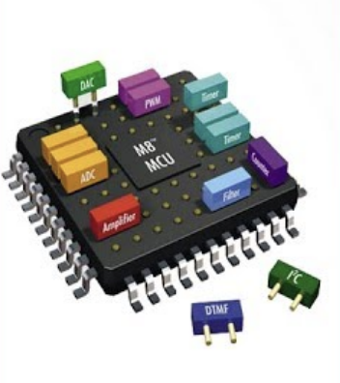

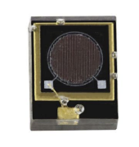
SLICE
(Soc eLectronIcs Compact dEtector)
INFN Roma: Valerio Bocci (Resp Nazionale),Francesco Iacoangeli
INFN Roma2: Davide Badoni (Resp Locale), Matteo Salvato, Mattia Scagliotti
Sviluppo di rivelatori All-In-One (detector,elettronica ,DAQ) utilizzando sistemi su circuiti integrato (SoC) commerciali di ultima generazione.
Particle
Detector
photon
Detector
Analog
conditioning
SoC
Trasmission
Layer
Formatted DATA
SLICE Valerio Bocci 2019

Slide 2
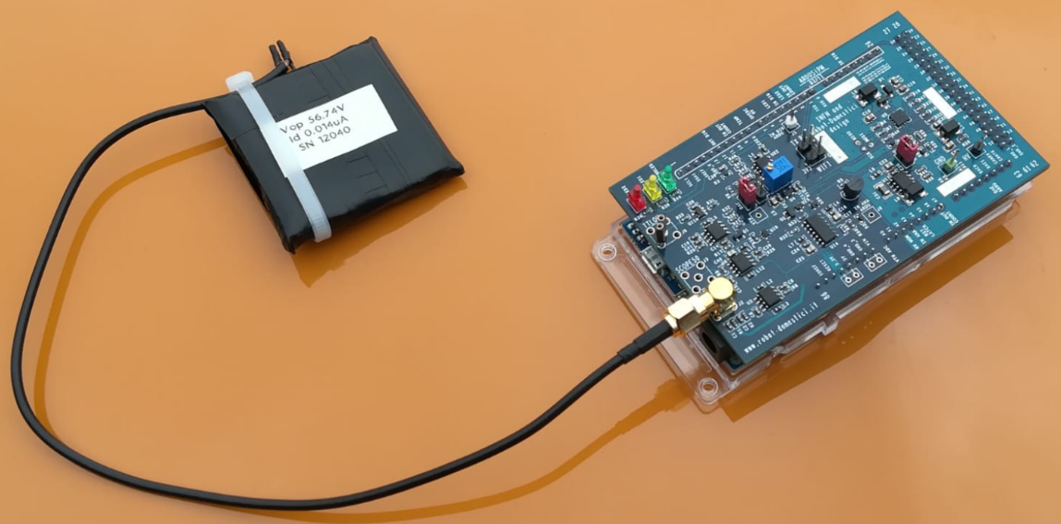

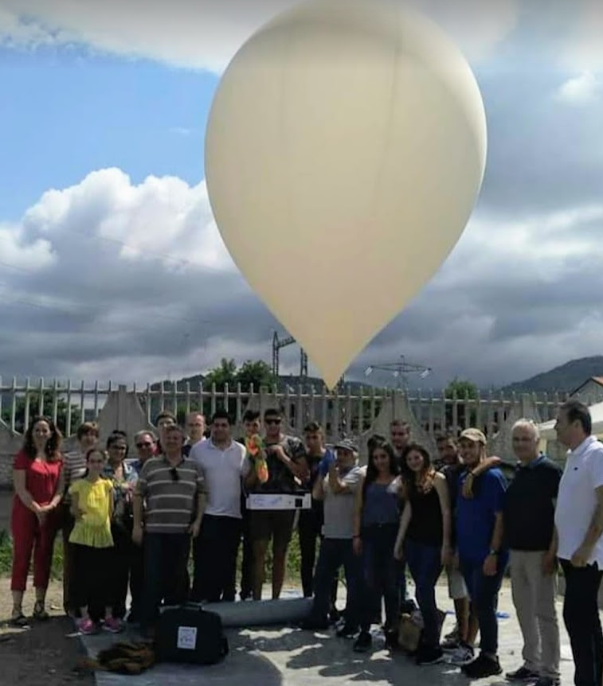
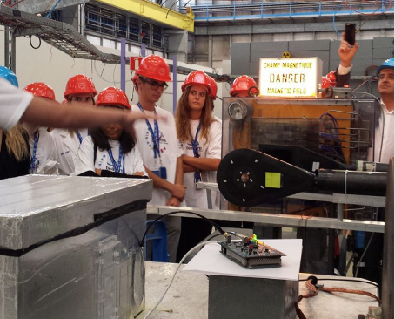
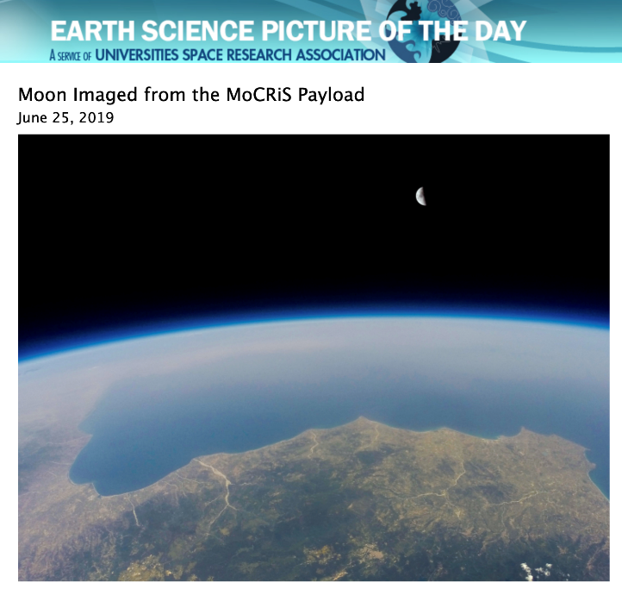
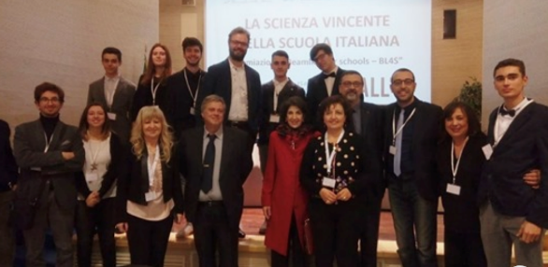
ArduSiPM as starting point
The first scintillator detector All in One in literature using a microcontroller as main component (2014, V.Bocci ,G.Chiodi, F. Iacoangeli L. Recchia) DOI: 10.1109/NSSMIC.2014.7431252
Low Price
(now 350 € ,prevision in large quantity < 150 €)
Tecnology Transfer 2016
Application :
Chirone Surgery Probe (Gr5), UA9 beam monitor(Gr1)
Now (2019) around 100 unit around the world.
Main application: School,University Lab, Beam test,Outreach.
Scintillator
ArduSiPM Shield+Arduino Due
SiPM
Suitable for any SiPM with bias voltage 10-90 Volt ,any size (1x1,3x3,6x6 …mm)
< 1 ns time resolution with internal analog discriminator
25 ns Time resolution with internal TDC
12 bits Internal peak hold ADC
All-in-One system, scintillator,SiPM,power supply,DAQ.
Synchronizable with GPS Clock (25 ns precision timestamp)
2.5 watt, <200 grams , few cm3 volume (shrinkable)
Simple Interface with PC (USB),Storage (SD Card),IOT(WiFi)
Many schools projects:
Used from winners of CERN BL4S 2017
Measuraments of cosmic ray flux using light balloon up 33.5 Km, EOS Project 2018, MoCRiS OCRA project 2019.
SLICE Valerio Bocci 2019

Slide 3
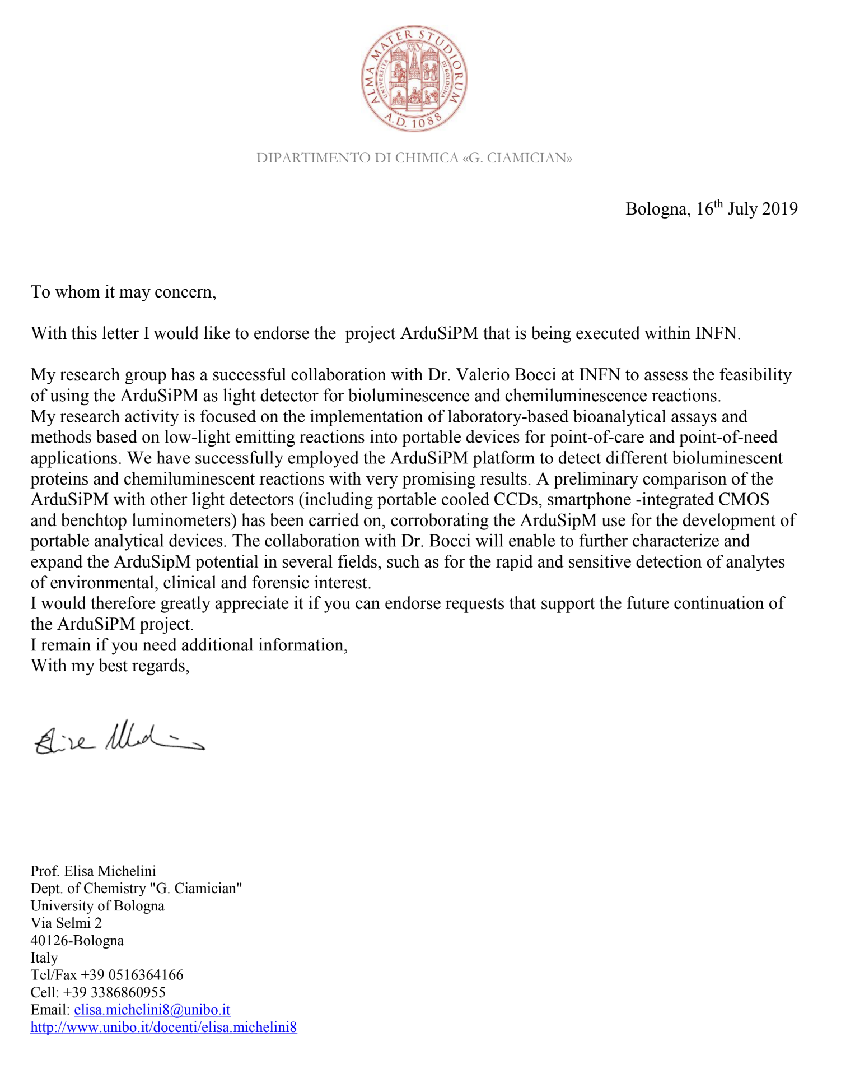
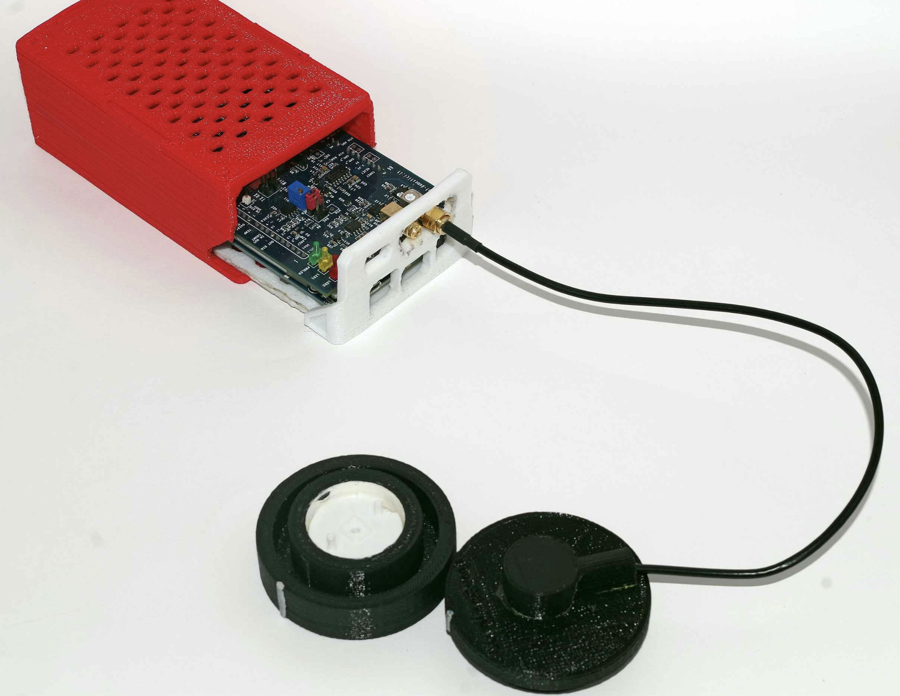
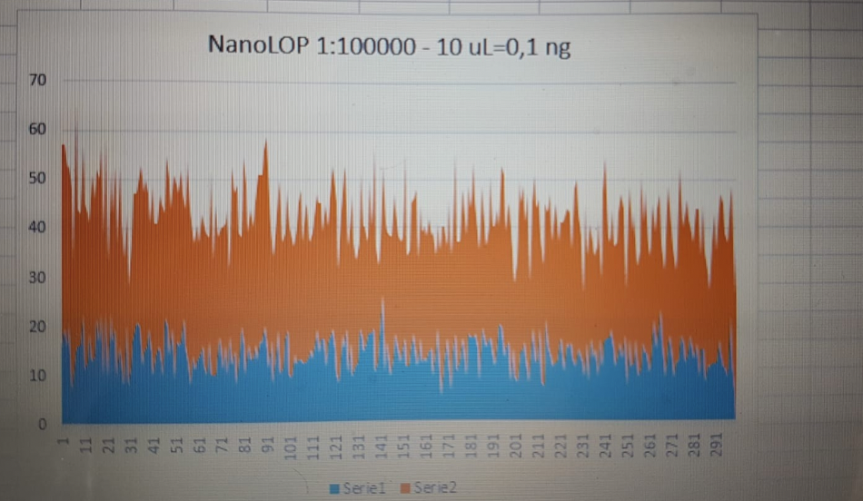
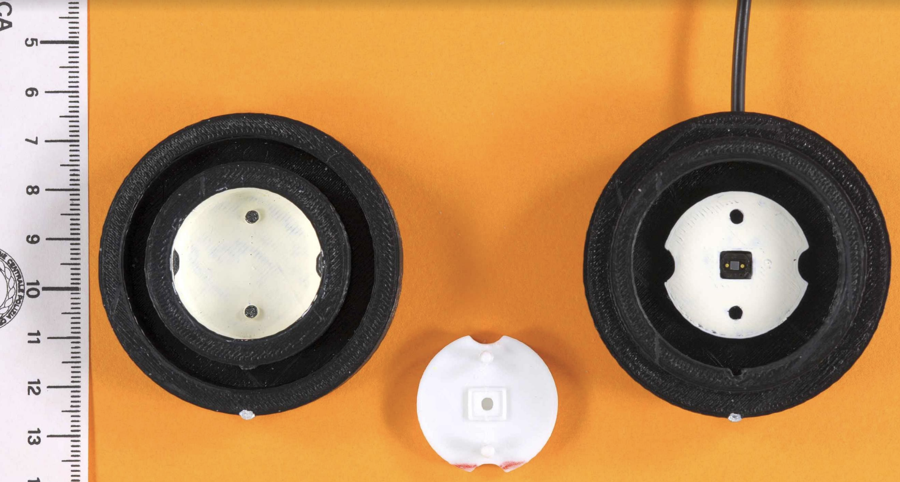
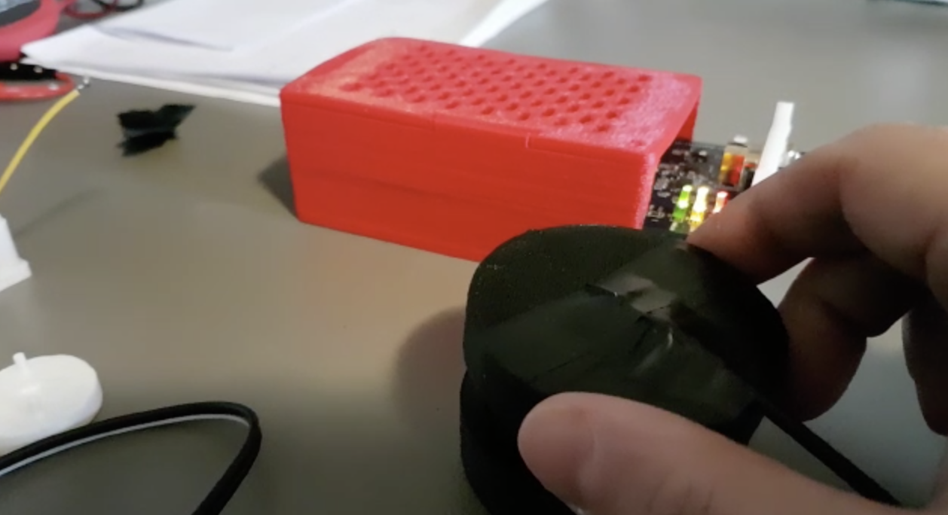
Non solo particelle, sviluppi interdisciplinari :
rivelatori portatili di reazioni di bioluminoscenza/chemiluminoscenza
Prof Elisa Michelini (Univ Bologna) Dr. Marcello D’Elia (Direttore Aree Laboratori forensi Polizia di Stato)
«ArduSiPM platform to detect different bioluminescent
proteins and chemiluminescent reactions with very promising results».
ArduSiPM
Porta campioni
SiPM
3 mm
3 mm
21.2 mm³
SLICE Valerio Bocci 2019

Slide 4
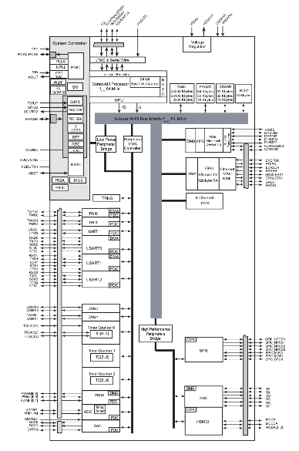
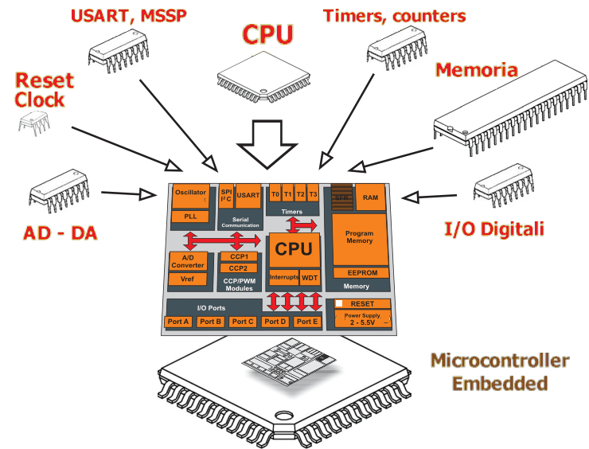
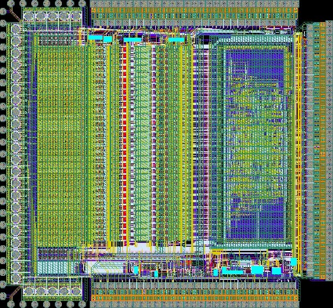
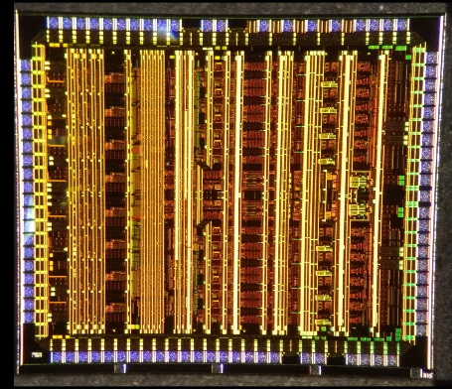
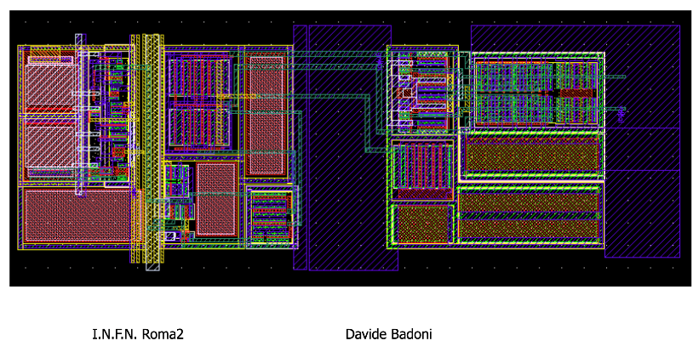
ASIC Way: Readout of detectors using ASIC (Application Specific Integrated Circuit)
SLICE way: Readout of detectors using generic mixed design (Analog/Digital) SoC (System On Chip) as main element.
Pro:
General application but custom use with different firmware.
Very low price also for single piece (<5 euro)
Free software or low cost development software.
Internal clock can be used for timing measuraments (order of nanoseconds).
Cheap Picoseconds scale TDC available as small external peripheral now (on chip in the future)
The best technology available in the market.
CPU Inside and many internal communication interface (WiFi, Ethernet, Bluetooth)
One channel modularity (maximum scalability)
Contro:
Need conditioning of analog signal.
Software optimization is not easy, there is a need for a deep knowledge of the functionality of the chip.
Low speed ADC and DAC (changing with technology trend)
Number of channels limited from peripherals available
Pro:
1) Custom design, fitting perfectly the application .
2) Many channels integration
Contro
1) High design and development cost .
2) Expensive production and high cost CAD needed
3) Strong dependence from technology and foundry, minimum quantity production.
SLICE Valerio Bocci 2019

Slide 5

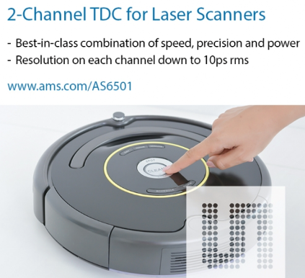
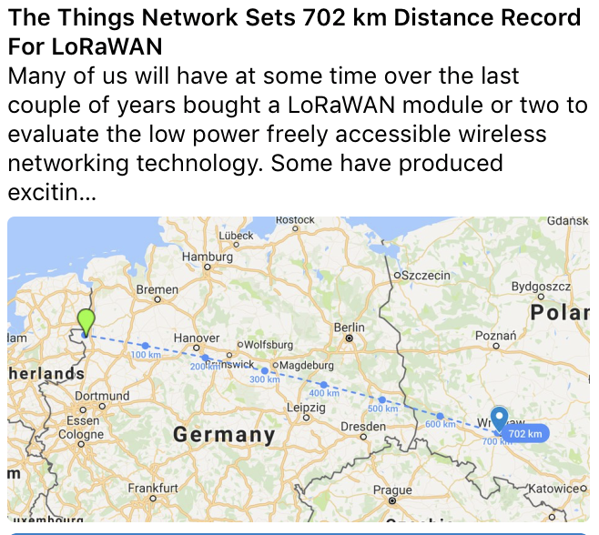
Goal of SLICE: Investigate and characterize commercial available chips for All-in-one platfom detector.
Clock Reference Chip
Accurate TDC from the market
Chip Scale Atomic Clock
10 ps RMS TDCs
SoC ,Analog Chip,GPS SoC, Oled Display
GPS time receiver
Very low power data radio transmission
Generic SOC
Analog signal conditioning
SLICE Valerio Bocci 2019

Slide 6
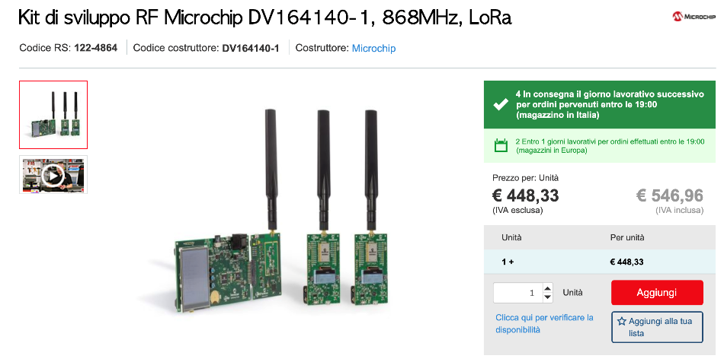
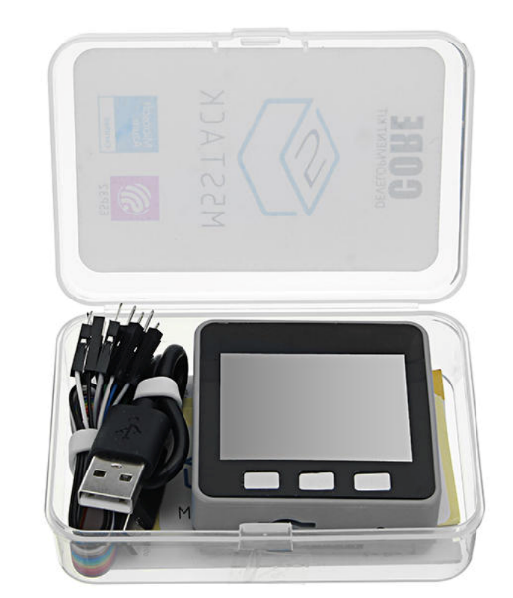
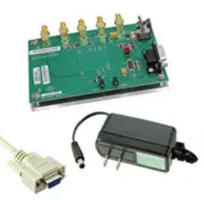
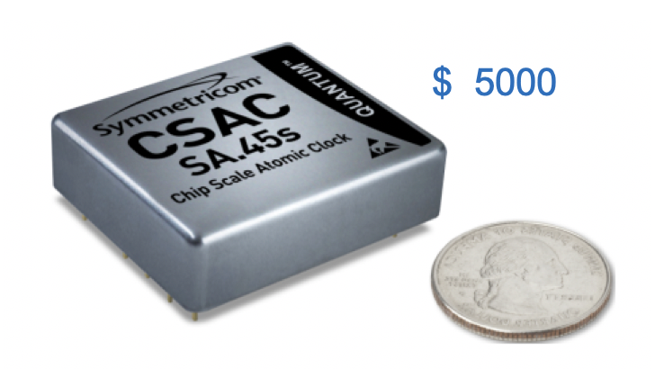
SoC ,LoRa, Chip Scale Atomic Clock,TDC Platforms
LoRAWan Gateway
SoC Evaluation Boards
Chip Scale Atomic Clock
Chip Scale Atomic Clock
Evaluation Board
TDC Evaluation Boards
SLICE Valerio Bocci 2019

Slide 7
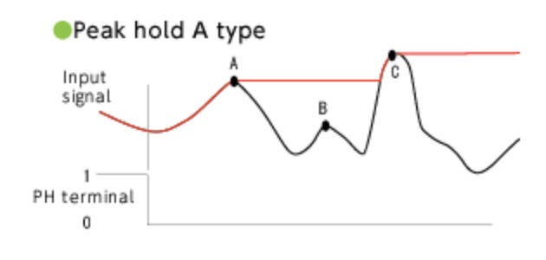
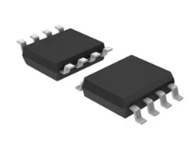
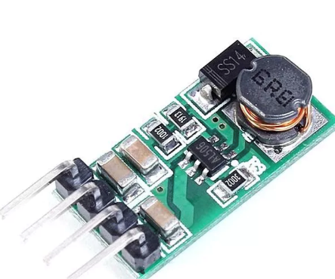
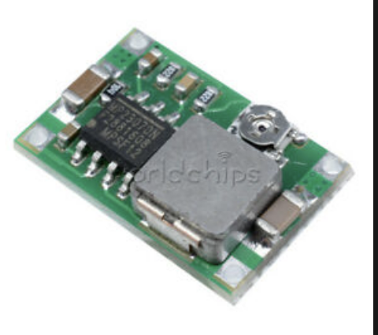
Analog Circuits
Controlled DC-DC converter
Chips and evaluation Boards
Fast Discriminator
Time Over Threshold
SLICE Valerio Bocci 2019

Slide 8
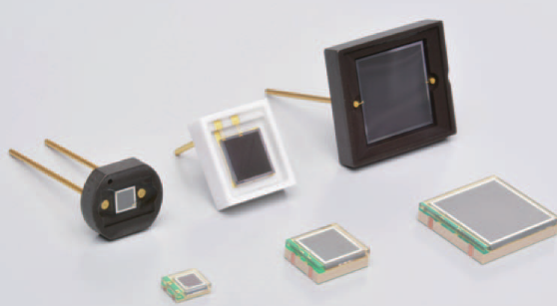
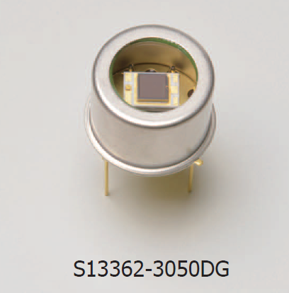
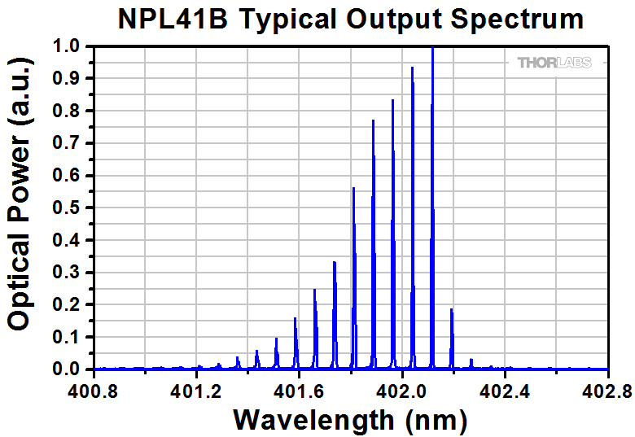
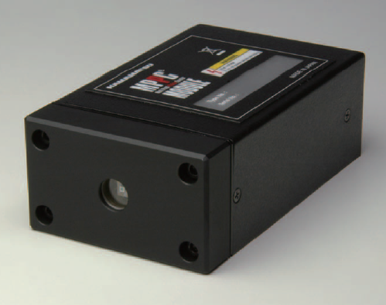
Integration test with SiPMs
MPPC 13360 serie with low dark count and crosstalk (3%)
Dark Box testbench
S13360-3050CS (3x3 mm² , 3600 pixel)
S13360-1350CS (1,3x1,3 mm² ,667 pixel)
Thermoelectric cooled MPPC 13362 series
with reduced dark count and crosstalk
S13362-3050DG (3x3 mm² , 3600 pixel)
S13362-1350DG (1,3x1,3 mm² ,667 pixel)
MPPC Module C13366 as reference
Photo counting module for TE-cooled MPPC
High voltage power supply
Amplifier
Temperature control circuit
Low threshold comparator
Digital output for external scaler
Laser Pulse module
SLICE Francesco Iacoangeli 2019

Slide 9
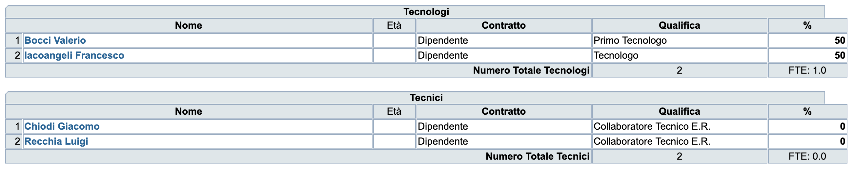
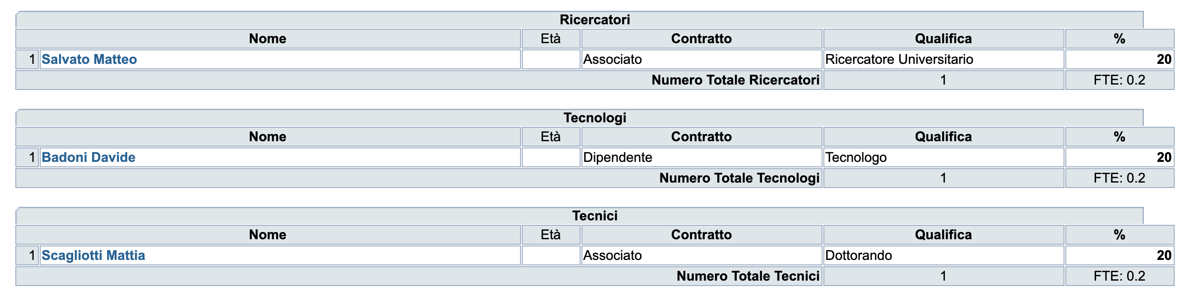
Anagrafica
INFN Roma1 Valerio Bocci (Resp Nazionale/Locale). 1 FTE
INFN Roma2 Davide Badoni (Resp Locale). 0.6 FTE
SLICE Valerio Bocci 2019

Slide 10
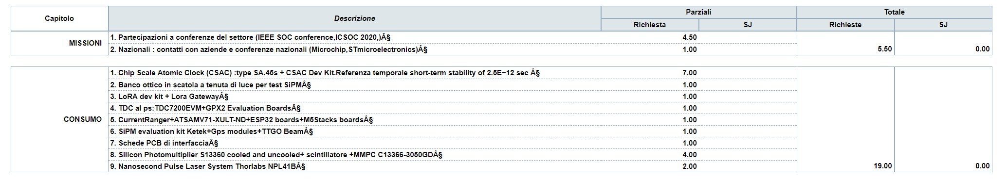
INFN Roma1
INFN Roma2
SLICE Valerio Bocci 2019

Slide 11
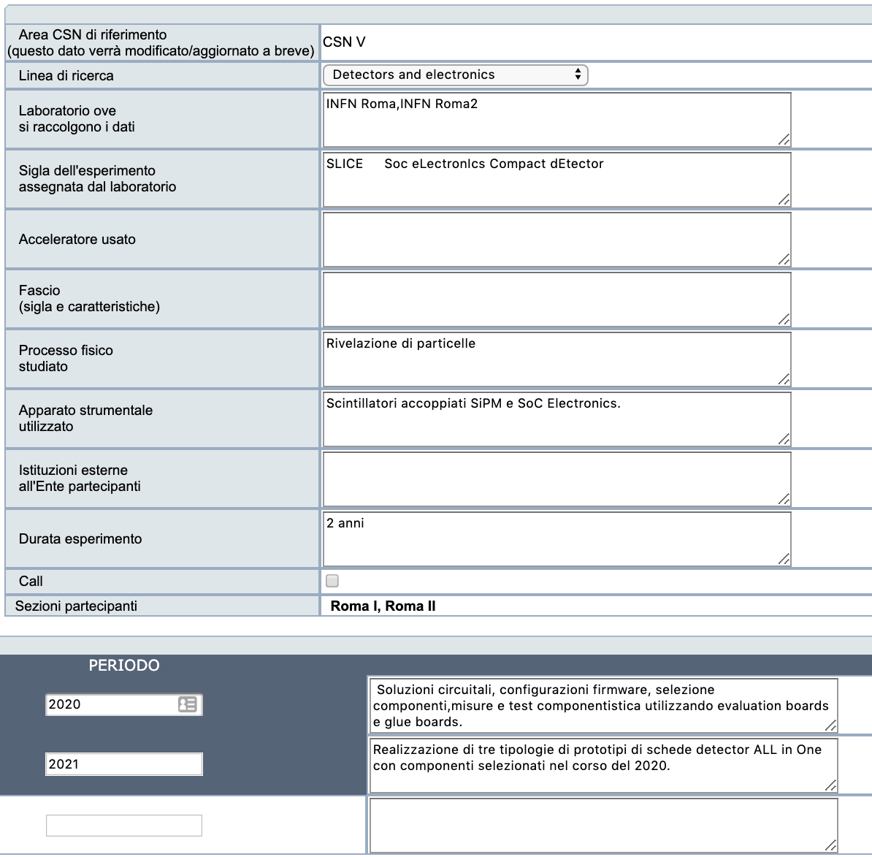
SLICE Valerio Bocci 2019

Slide 12
Materiali 2020
Evaluation Boards per SOC, Analog, TDC
Evaluation Boards e gateway LoRA
Referenza temporale con CSAC (Chip Scale Atomic Clock)
SiPMs ,Scatola test SiPMs , SiPM reference Electronics
Consumo vario
PCBs
SLICE Valerio Bocci 2019

Slide 13
Attività 2020:
Valutazione diversi SoC : Microchip, STM, Infineon, Esprissif
Test TDC commerciali ai Picosecondi
Test Stabilità oscillatori per ottimizzazioni tag temporali e utilizzo del Chip Scale Atomic Clock
Test di Configurazioni analogiche
Test trasmissioni dati radio a bassa potenza (LoRA, Wifi,gold, Low power Bluetooth)
Test SiPM + Scintillatori
SLICE Valerio Bocci 2019

