Slide 1

ML Applied To Data Certification
Status and Perspective
F.Fiori (INFN, Firenze)
on behalf of the CMS DQM team

Slide 2
Outline
The Data Certification procedure
Motivation to exploit ML models
Overview of past studies
Weak points and plans for Improvement
Proposal of an alternative two-step approach
Summary and Conclusions

Slide 3
The Data Certification Procedure in CMS
Based on the feedback of subdetector experts on Prompt-Reco Data
  Prompt Feedback Groups (PFG) delegated to set quality flags for each subsytem
  DQM GUI: main tool for the checks
Quality flags set on the basis of distributions integrated over full runs
  Need of training, documentation, focus ... highly human resources (and time) consuming
Per lumisection certification come mainly from automatic flagging (DCS bit)
  Rarely humans revert the flag
The Golden JSON file obtained by the AND of the full set of quality flags
  DPG/POG + DCS bit, single lumisection granularity
Overall, very good performance: more than 94% of GOOD data in 2018
  Certified as GOOD/Recorded, significant cost in terms of EPRs

Slide 4
Motivation to introduce ML in DC (ML4DC)
Save person-power (the main motivation!)
  Possibility to automate the certification chain as much as possible with a grain of “intelligence” (or even fully automate it)
  Especially appealing for Run3, when the Phase2 upgrade will absorb a significant amount of human resources
Quality flags not subject to human interpretation/bias
  Machines do not attend meetings ☺
  Humans will anyway cross check results in a first stage of integration
Possibility to check data quality with single lumisection granularity
  Long standing project in CMS (already discussed in Run 1)
  The automatic DCS bit flag will be preserved anyway
Can give real-time response on complex checks (ML4DQM)
  More relevant for Online monitoring, not covered in this talk
  Anyway a significant overlap with the Offline/DC case

Slide 5
Overview of past studies

Slide 6

ML4DC Quick Historical Overview
Effort started in 2016 in collaboration with Yandex and CERN Openlab/IBM
  ML4DQM: dedicated to “real time” data monitoring, algorithms developed independently by subsystems (not covered in this talk)
  ML4DC: application to Data Certification (the subject of this talk)
    Biweekly meetings https://indico.cern.ch/category/3904/
  Issues experienced in the collaboration of the two external companies for their internal policies (i.e IBM PowerAI system never used for CMS studies)
Several ML model prototypes and results presented in computing related conferences (CHEP, ACAT, see backup for references)
  A systematic review of the work done for CMS DC started last January
  This talk covers only general approaches to the DC procedure (no subsystem work)
Very nice overview talk given by Mantas S. at the 2019 ML Alice workshop
  https://indico.cern.ch/event/766450/
  Shows that CMS work in this direction is way more advanced wrt other LHC experiments
Two main approaches will be presented in the following: Supervised and Semi-Supervised anomaly detection models, the ones we can reasonably pursue during LS2
General Plan: ML + human double check in Run3 (fully automated in Run4)

Slide 7
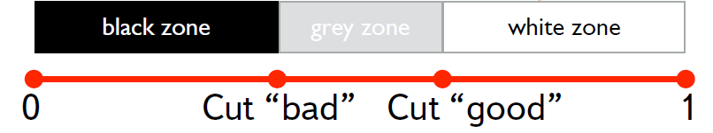
The Yandex Supervised Prototype
Fedor Ratnikov et Al.
Goal to establish a procedure to split the data in three categories
  Black (definitely BAD), White (definitely GOOD) and Grey (to be double checked by experts)
  Goal to set automatic flags on “obvious cases” and let experts dealing with not trivial ones
  Single Lumisection granularity
Use of basic physics object data: muons, electrons, photons, jets ...
  7 features for each variable (pT, Eta, Phi ...): quantiles (0., 0.25, 0.5, 0.75, 1) + mean + RMS
    About 2500 features describing a single lumisection
  Continuous Supervised Learning approach: the model is trained on historical labels (set by humans), and, continuously, on newly available labeled samples
  Gradient Tree Boosting classifier
Select two probability thresholds upon analysis of test data: cut_bad, cut_good
  Study based on 2010B Open Data, MinimumBias, Muons and Photons PDs
FalsePositive < cut_bad
FalseNegative < cut_good

Slide 8
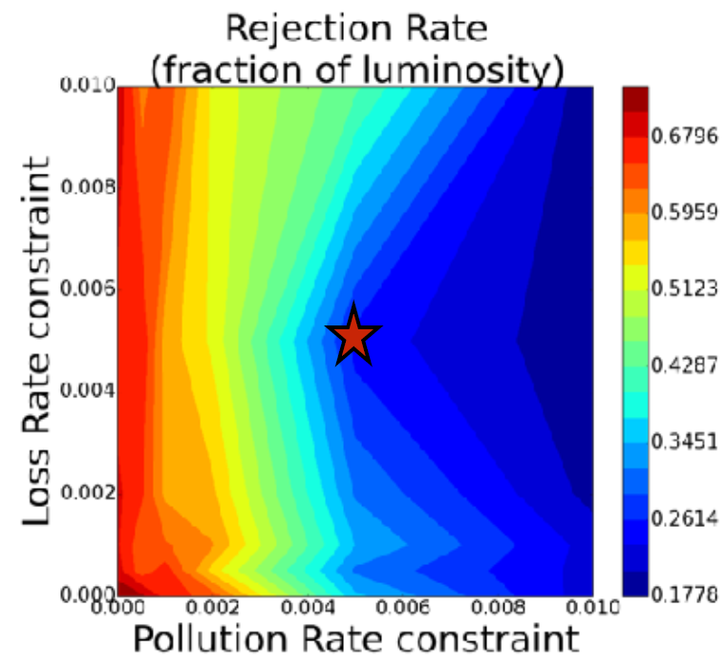
The Yandex Prototype: results
∼80% “saving on manual work”
quoted for PR and LR at 5‰
Loss rate (LR) : “truly good” LS classified as “bad”
  LR = FN(“black”) / (TP(“white”) +FN (“black”))
Pollution Rate (PR): “truly bad” LS is classified as good”
  PR = FP(“white”) / (TP(“black”) + FP(“white”))
Rejection Rate (RR): fraction of all LS which are not classified as “black” or “white”
  RR = (“grey”) / (“black” + “grey” + “white”)
  Expert work measured by RR
20% of Lumisections left for human checks
  With PR and LR at the level of 5‰
  This will actually increase the current human work by a factor of O(100) (we currently flag entire runs not single LS!)
Not viable for single LS flagging!
  Nevertheless, the “grey-zone” approach is interesting …
Average number of lumisection in a 2018 run is ~500, 20% being ~100. PFGs would have to check 100 times the plots they are currently checking for a single run

Slide 9
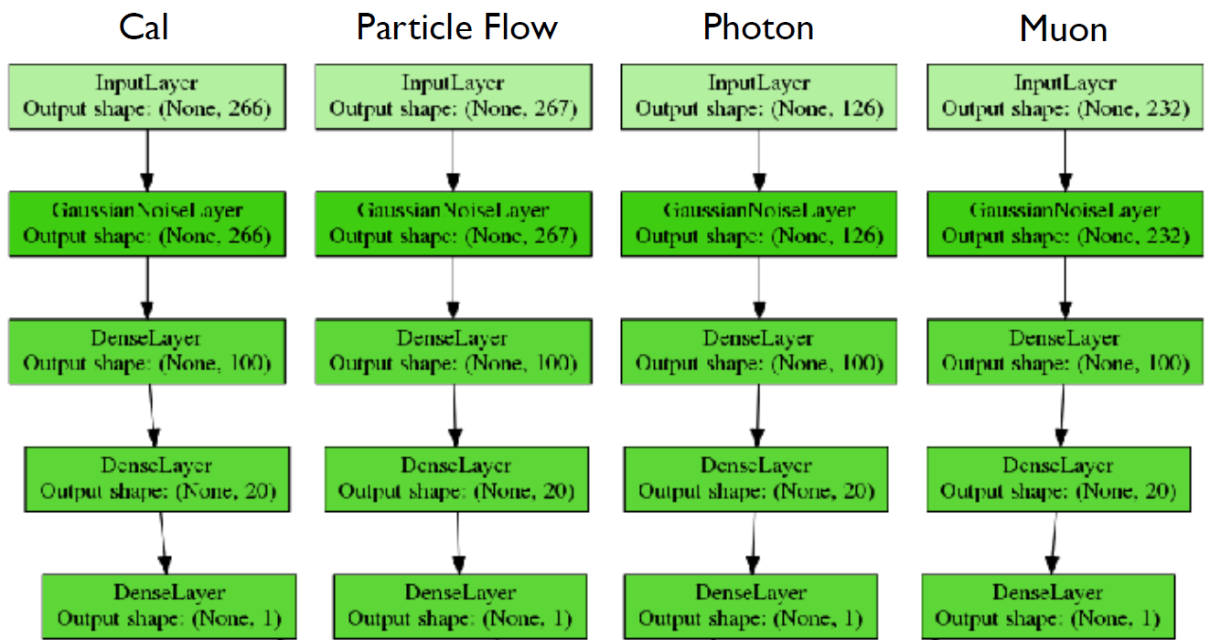
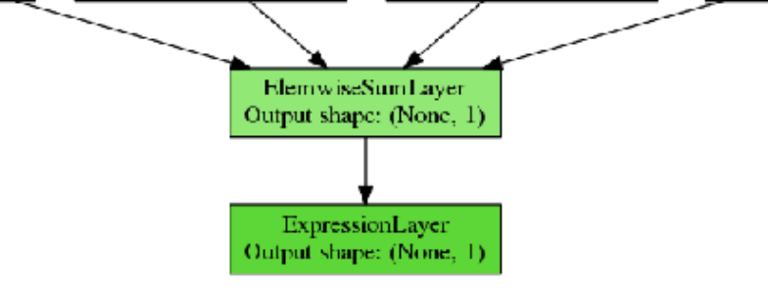
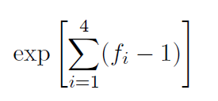
A Second Prototype by Yandex
Factorize the NN architecture on the basis of data content
Goal to detect anomalies on individual “channels”:
  Which plots should be cross checked by experts?
  Can we use, e.g, Muon data if only Photons give a BAD score
  More similar to the actual workflow of PFGs
3 Layer NN for each channel
  Score close to 1 for GOOD LS
  Score close to 0 for BAD LS
“Fuzzy AND” combination

Slide 10
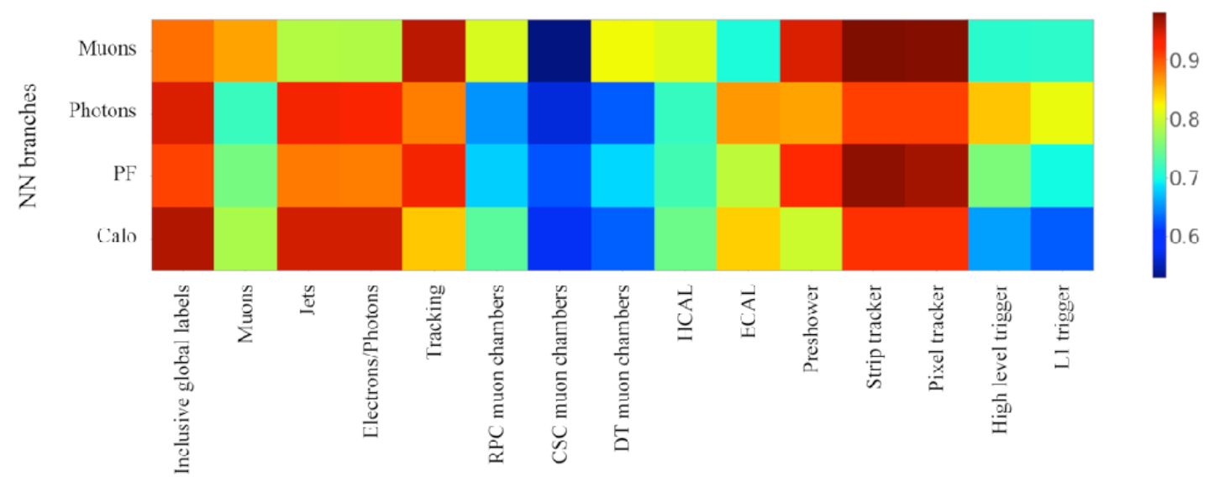
A Second Prototype by Yandex: results
Interesting approach, although results are not easily interpretable
  e.g Muons NN flags seems to be only weakly dependent on muons system status (?)
ROC AUC for the corresponding NN branch against subsystem labels
Goal: understand which feature is more relevant for each channel

Slide 11

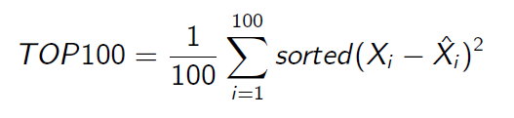
The Autoencoder Prototype
Adrian Alan Pol et Al.
Why Autoencoders?
  Potentially can spot any (unexpected) anomaly
  The source of a given anomaly can be traced back (interpretability of results)
  No need of BAD data for training (reduced effect of class imbalance)
Semi supervised anomaly detection on GOOD data only:
  Minimization of the Mean Square Error (MSE)
  Decision function: mean squared error of 100 worst reconstructed features
  Anomalies detected as large reconstruction errors
Same variable schema used in the Yandex approach
  Each lumisection is an independent sample
  The same 5 quantiles + mean and RMS
Dataset used: 2016 data
  160k samples, (7 x 401) 2807 features per sample, trained only on JetHT dataset
  Training on the (chronologically) first 80% of the sample and tested on the rest of data
    Note: Strip dynamic inefficiency issue is part of the training sample ... not that optimal

Slide 12
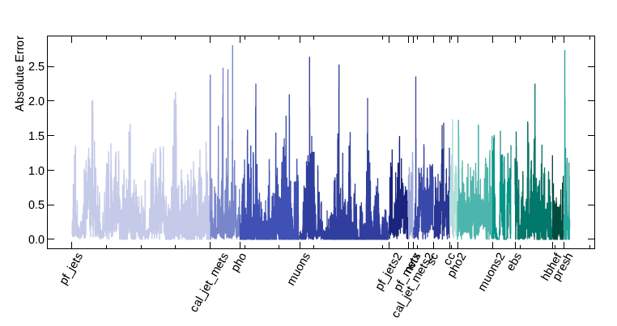
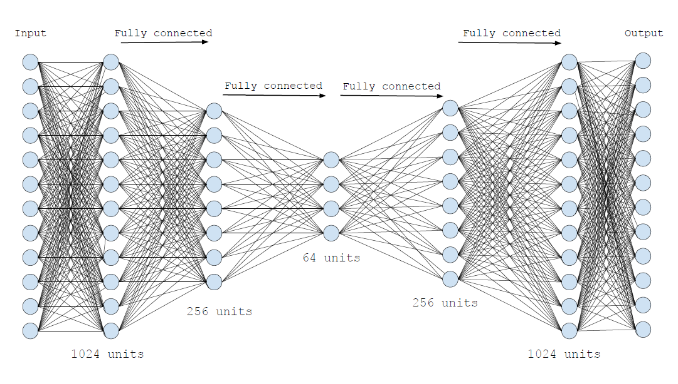
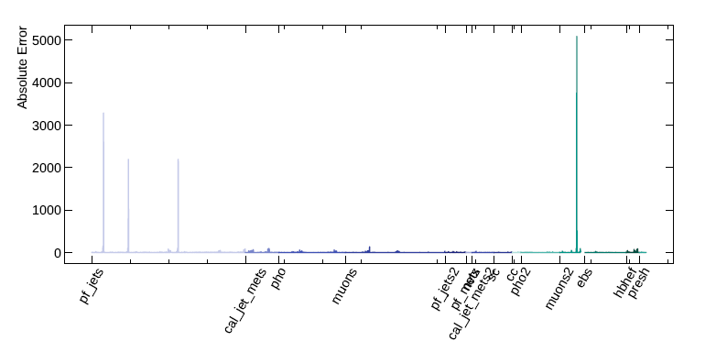
The Autoencoder Prototype (II)
GOOD lumisection representation
Trained with Keras/TensorFlow
  About 24h needed using current Cern GPUs
low error values
BAD lumisection representation
high error values
architecture optimized with a grid search
The feature(s) responsible for the large error is immediately identified

Slide 13
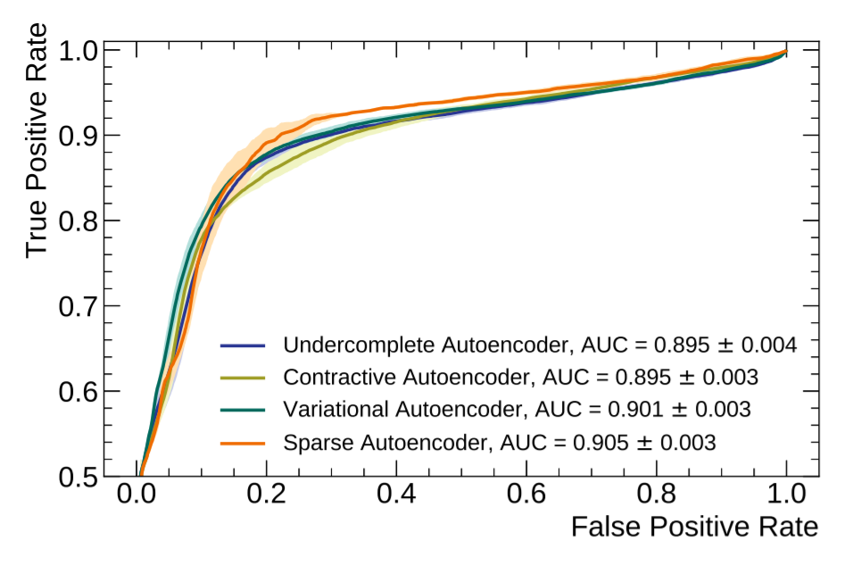
The Autoencoder Prototype: results
Different types of Autoencoders tested with similar performance
  ROC AUC ~ 0.90, depending on the test sample used
  Optimistically 1-2% of BAD LS, to be double checked by PFGs (no grey-zone)
O(10) lumisections on average per run
to be inspected by humans, still too much an increase of needed person power!

Slide 14
Weak points of the current approaches and plans for improvement

Slide 15
Weak Points: BAD Data
Only a small fraction of “genuine” BAD data is available for testing
  Given the high efficiency of current DC procedure (94%)
  Lead to Class Imbalance issues
Are CMS BAD data really suitable to test ML models?
  Single lumisections are mainly set as BAD by the automatic DCS bit propagation (99% of the cases), no need of ML to check if a detector is OFF!
  Only few entire runs flagged as BAD (~1%), mainly representative of obvious failure in a given subdetector
    e.g in 2018 a single case of powering issue in a Pixel Barrel sector (overlapping in the four layers), and a bunch of lumisections with the HCAL laser firing during collisions
Human labels are not always rigorous, borderline cases often decided after long discussions
None of the models mentioned in the previous slides succeeded to reproduce human labels!

Slide 16
Weak Points: Features and Datasets
An Extremely high number of features (~2800) is used with respect to what is currently used by PFGs (wouldn’t be better to start with a bottom-up approach?)
The choice of the variables seems somehow sub-optimal, and weakly reflecting the current DC procedure
  Fundamental quantities are missing (e.g no use of “generalTracks”)
  Review the choice of quantiles (are the min and max of a distribution really relevant?)
  Often statistics of feature are not enough to compute 5 quantiles
  Too many “high-level” objects (e.g both ak4PFJetsCHS and ak8PFJetsCHS)
Seen a dependence on PU and Inst. Lumi (see backup) but none of them is used as a “feature” in the model training
  Both available per event
All the features are used for every Primary Dataset, while in current DC only specific quantities are inspected per PD
  e.g Tracker and Tracking PFG use ZeroBias, Muon POG/DPG use SingleMuon ... etc.

Slide 17
More General Weak Point: Per LS Data
We are discussing about a double check made by experts in borderline cases, but how should this be done?
  At present we do not have in hands DQM data per lumisection!
The first priority, in order to move the certification at LS level, is to provide efficiently per LS DQM data!
This can be achieved exploiting at best the potential of the DQMIO format
  DQMIO contains much more information wrt Harvesting output (i.e GUI data)
  Internally split with “reco-job” granularity, can be moved to per LS granularity
    The cost being an increase in size, which, however, should be manageable if only a subset of DQM plots is saved by LS
  In 2017 UL the ZeroBias DQMIO files will contain a full copy of DQM histograms per LS (the file size should stay anyway below the MiniAOD)
DQMIO does not contain enough information to extract physics results, can be shared with external collaborators as OpenData
  Currently data for ML studies are generated with ad-hoc analyzers, not straightforward to be integrated in production
  DQMIO, per LS data, would be easily available by the production wf

Slide 18
Plans For Improvement: BAD data and Features
BAD data can be (artificially) produced using “failure scenarios”
  Plan to reprocess GOOD runs with a combination of different failures
  Would cure the class imbalance issue
Map specific features to specific Primary Datasets, to mimic, as much as possible, the current PFG procedures (similar to Yandex factorization)
  It would reduce the complexity of ML models (i.e Muons features are not relevant if looking to ZeroBias data)
  It would possibly enhance the reproducibility of human flags
Integrate the set of Features with obvious ones (i.e tracks, PU, Inst. Lumi) and prune those which looks redundant (i.e use only one of ak4PFJetsCHS and ak8PFJetsCHS)
  Would need some feedback from PFGs to understand what can be a minimum set for a given PD

Slide 19
Proposal for an alternative two-step approach

Slide 20
Proposal For An Alternative approach: two steps
The automatic DCS bit flagging will stay, ML applied on top of it
Automatize the DC procedure in two steps:
  Step 1: Provide a reliable quality flag per Run using the Yandex grey-zone approach and Supervised models (artificial BAD data can be used for training)
    Could also exploit available subsytems work
  Step 2: Use Autoencoders only on the grey-zone with the goal to search for anomalous LS and flag them automatically, human double check at this stage
    Say we have 20% of grey runs (this would really save 80% of PFG work), and 2% of anomalous LS to be double checked manually, the final human work will basically be unchanged wrt the current DC procedure
Upon some (extensive) performance studies we could possibly decide to fully automate the procedure
  Is really a human double check mandatory or can we survive without?

Slide 21
RUN 123456
LS1 | LS2 | LS3| LS4 | LS5…..LS# | LS(n-2) |LS(n-1) |LS n
DCS bits
LS1 | LS4 | LS5|…..LS# | LS(n-1) |LS n
SingleMuon
EGamma
ZeroBias
JetHT
μ features
e/γ features
tracking
Jet features
STEP 1
Supervised
+
+
+
fuzzy AND
GOLDEN JSON DATA
GREY RUN
GOOD RUN
LS1 | LS4 | LS5|…..LS# | LS(n-1) |LS n
SingleMuon
EGamma
ZeroBias
JetHT
μ features
e/γ features
tracking
Semi-supervised
STEP 2
Jet features
+
+
+
fuzzy AND
human check of BAD LS
LS4 | LS5|….. | LS(n-1)

Slide 22
Implementation
Make use only of the PDs used currently for DC
  ZeroBias, SingleMuon, JetHT, EGamma
Develop ML Supervised Models to flag entire runs
  Use the failure scenario approach mixed with historical BAD data for training
Develop a set of “simpler” Autoencoders mapped to the relevant PD to flag single LS in the grey-zone runs
  i.e Tracking-Autoencoder with an appropriate number of input nodes to reproduce Tracking related features and applied only to the ZeroBias PD. Similarly a JetMET-Autoencoder will be used on the JetHT PD, and so on ...
  4 different Autoencoders, one for each PD, then outputs combined with some fuzzy AND logic to get the final flag for single LS
After a feasibility study based on current ROOT n-tuples, switch to the use of DQMIO per LS data for a smoother integration in production
Provided the availability of dedicated (and ML educated) person-power, it seems reasonable in 1 year timescale ... unfortunately this is not guaranteed

Slide 23
Openlab/IBM collaboration renewed
In 2019 a new contract with IBM/Openlab has been subscribed
Collaboration more tailored toward cern experiments needs
  e.g the Minsky cluster is now under the CERN IT responsibility
A regular meeting with IBM and Openlab responsibles is in place
  Restricted to few ongoing projects (CMS DC among them)
Hands-on session to exploit the potential of PowerAI architecture done recently
  We logged in and try some simple model ☺
  Proven to reduce by a factor of ~10-30 the training time of our current unsupervised models
    may be more for simplified models
  The machine not yet ready to be exploited at best
Great opportunity to give a boost to DQM-DC activities!

Slide 24
Summary and Conclusions
ML application to DC is appealing mainly to reduce the needed person power
A significant amount of prototyping work has been done, but no suitable solution is already in hand
Room for improvement with different approaches to the architectures (simplify, mimic PFGs), datasets (artificial BAD data, map features to PDs, introduce per LS DQMIO) and procedure (two steps semi-automated DC)
Critical lack of dedicated person power in the DQM team to provide a central, shared, ML based approach to DC
  We have EPRs! If interested , please contact us! cms-PPD-conveners-DQM-DC@cern.ch
LS2 is an extraordinary opportunity for ML4DC
  Access to PowerAI IBM technology (trainings faster by a factor of > 10)
  The UL reprocessing can provide an extraordinary dataset for ML studies
To be fully realistic, there is no guarantee this project will be pursued to the end, but we will try our best

Slide 25
Backup

Slide 26
References
Borisyak M, Ratnikov F, Derkach D and Ustyuzhanin A: “Towards automation of data quality system for CERN CMS experiment”, arXiv:1709.08607 [physics.data-an], September 2017
Virginia Azzolini et al, “Deep learning for inferring cause of data anomalies”, 2017, http://inspirehep.net/record/1637193/files/arXiv:1711.07051.pdf
Virginia Azzolini et al, “Improving the use of data quality metadata via a partnership of technologies and resources between the CMS experiment at CERN and industry”, CHEP 2018, https://indico.cern.ch/event/587955/contributions/2935731/
Adrian Alan Pol et al, “Anomaly detection using Deep Autoencoders for the assessment of the quality of the data acquired by the CMS experiment”, CHEP 2018, https://indico.cern.ch/event/587955/contributions/2937523/
Adrian Alan Pol et al, “Online detector monitoring using AI: challenges, prototypes and performance evaluation for automation of online quality monitoring of the CMS experiment exploiting machine learning algorithms”, CHEP 2018, https://indico.cern.ch/event/587955/contributions/2937517/
Mantas Stankevičius et al, “Comparison of Supervised Machine Learning Techniques for CERN CMS Offline Data Certification”, Baltic DB&IS2018, http://ceur-ws.org/Vol-2158/paper18dc6.pdf
Fedor Ratnikov, “Towards automation of data quality system for CERN CMS experiment”, http://iopscience.iop.org/article/10.1088/1742-6596/898/9/092041

Slide 27
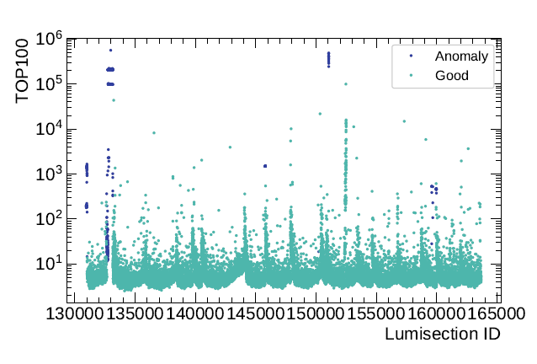
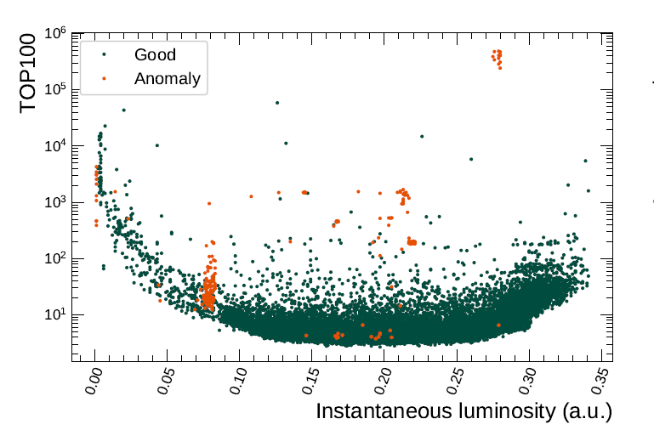
Autoencoders and Inst. Lumi
Waves dependent by Inst. Lumi variations
Anomaly = Human label

Slide 28
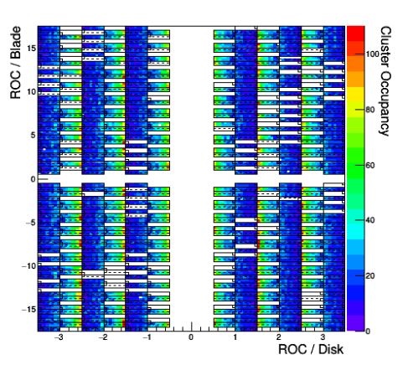
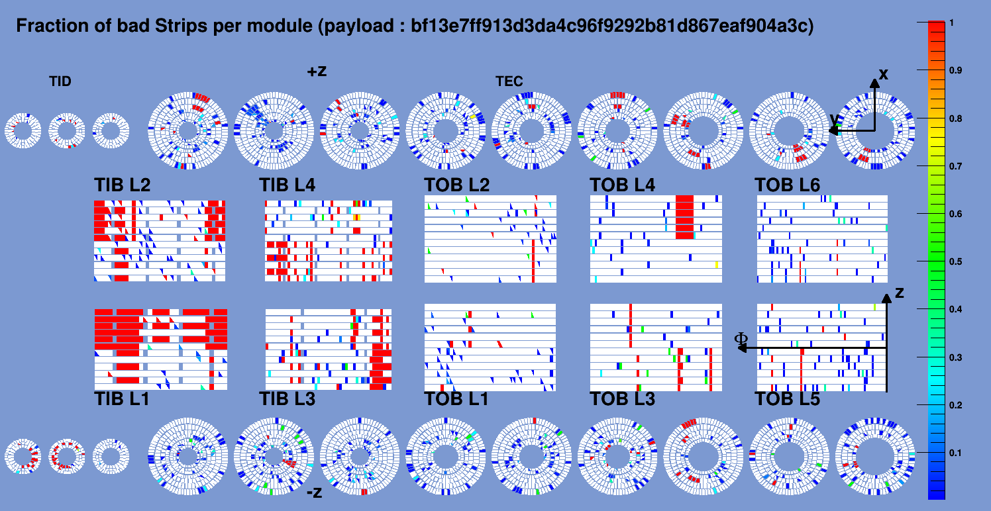
Failure Scenarios
Available only for Strip and Pixel so far
Mimic failures at the module level (also extended failures)

Slide 29
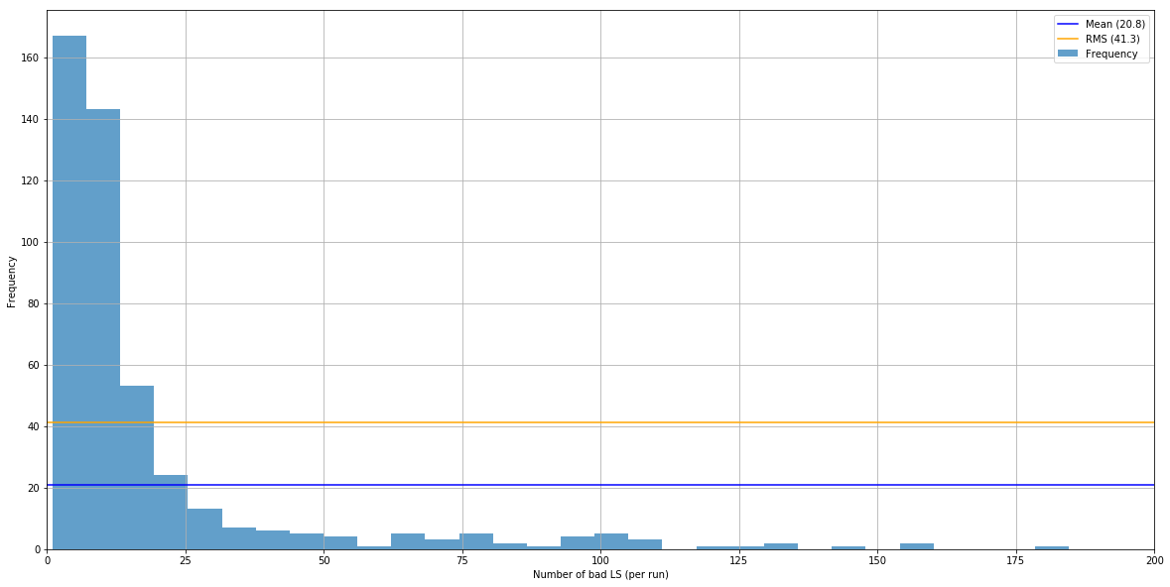
Average number of LS flagged as BAD
Using only GoldenJSON runs, no distinction between DCS and human flags
On average 20 LS are flagged as BAD in “good” runs
Introduction of ML would not decrease this number

