Slide 1
Belle II detector performance/commissioning
Shoji Uno (KEK)
JENNIFER2 kick off meeting
2019.9.12
Wien
1

Slide 2
SuperKEKB
2

Slide 3
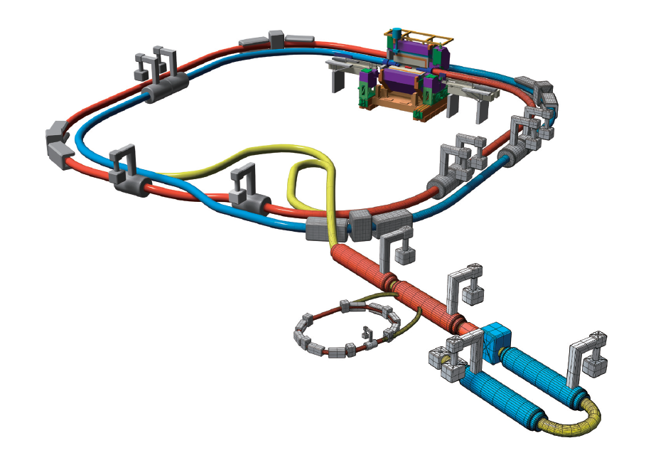

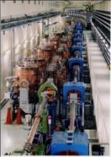

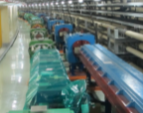


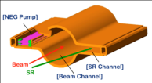
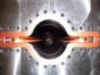

SuperKEKB and Belle II
Belle II
New superconducting final focusing quads near the IP
New IR
Colliding bunches
e⁺ 4GeV 3.6 A
e⁻ 7GeV 2.6 A
SuperKEKB
Target: L = 8x10³⁵/cm²/s
Replace short dipoles with longer ones (LER)
Add / modify RF systems for higher beam current
Positron source
New positron target / capture section
Redesign the lattices of HER & LER to squeeze the emittance
Damping ring
Low emittance positrons to inject
TiN-coated beam pipe with antechambers
Low emittance gun
Low emittance electrons to inject
3

Slide 4
Phase 3 operation
Phase 3 operation stared from March 11th and ended on July 1st .
Unfortunately, serious fire accident occurred and we lost 3 weeks.
  It affected our operation strategy significantly.
QCS quenches also damaged Belle II detector.

Slide 5
Continuous injection
Continuous injection was successfully applied both for LER and HER from May.
  Thanks for good tunings for injection parameters and movable masks
It is essential to obtain higher integrated luminosity and also machine tuning.

Slide 6
Squeezing β_{y}*
β_{y}* was squeezed gradually.
Belle II took data at β_{y}* = 3 mm, mostly. L = 0.5×10³⁴cm⁻¹sec⁻¹
Finally, the luminosity increased as expected at β_{y}* = 2 mm.
  L = 1.2×10³⁴cm⁻¹sec⁻¹
  Unfortunately, Belle II was off at that time due to higher beam background. There is no time to make careful tuning for the movable masks.
  It is quite promising for higher luminosity in further squeezing (design: 0.3 mm).

Slide 7
Belle II
13

Slide 8
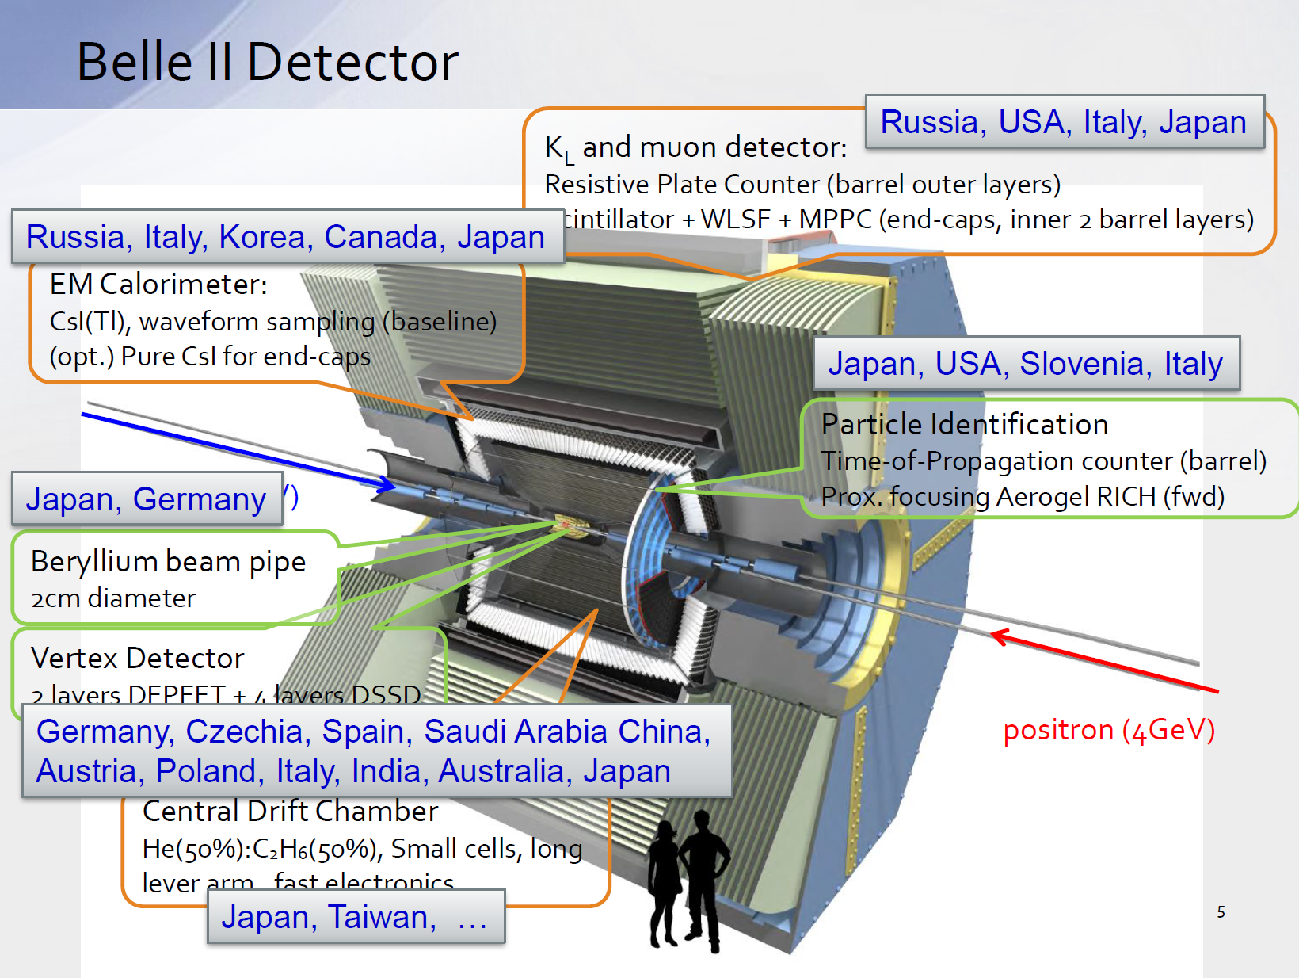
Japan, Taiwan, Turkey
15

Slide 10
Start of the Phase 3 run
18

Slide 12
Beam background
Beam gas (vacuum condition) >> Touschek (beam size and intensity)
  Further vacuum scrabbling is desired.
LER >> HER
  Vacuum pipe
    Reused : HER
    New : LER
  New movable mask in LER during the 2018 summer
More LER movable mask will be installed in coming winter shutdown.

Slide 13
PXD
Full coverage in Phase 3
Impact parameter resolution is quit good as expected.
Further improvements are required.
  ROI readout for higher trigger rate
  Gated mode for higher background during continuous injection
Worry: Radiation damage after QCS quench

Slide 14
SVD

Slide 15
CDC
Basically working
Slightly larger constant term
  Further alignment work
  Magnetic field
    Measured vs simulation
  And other?
Persistent current problem
  Cured by one layer off (L54) or higher water contamination (1000 → 2000 ppm) or other reasons?

Slide 16
CDC dEdx
Resolution is sufficient enough for the particle identification of low momentum tracks.
So far, the gas gain drop has not been observed.

Slide 17
TOP
Basically working.
Further calibration is necessary to obtain expected performance?
  Stable enough? (my personal worry)
Radiation damage
  Conventional PMTs
  Hit rate
    1 MHz is desired.
    ~2MHz in Phase 3

Slide 18
ARICH
Working well in Phase 3 after improved cooling system.
Calibration was done.
  Reasonable number of photons and chrenkov angle resolution were obtained.
Further performance study is necessary using hadronic events (D or so).
  More integrated luminosity

Slide 19
ECL
Working well.
Stable operation. No serious problems.
Timing calibration was done to get better trigger event timing. ➔ Good for SVD.
Higher beam background as same as other detectors.

Slide 20
KLM
Working significantly better in Phase3 than Phase 2
  Due to more power supplies for electronics
  and better readout firmware
I suppose more works are necessary to get better performance.
  Lower fake rate is desired, especially for the endcap.

Slide 21
Tracking
Tracking software is working well.
There is some degradation in FW and BW regions due to beam background and cross talk in CDC.
  SVD can help to recover those tracks.

Slide 22
Mass peaks

Slide 23
Vertexing
Photon conversion
Proton pair

Slide 24
Particle Identification
Intense calibration was performed.
  Agreement between data and MC improved significantly.
But, still more works are necessary to get better performance.

Slide 25
Summary
Phase 3 operation started from March, 2019.
  SuperKEKB performance improved gradually.
  Continuous injection was successfully applied.
  Luminosity increased as a function of 1/β_{y}* until β_{y}*=2mm.
Beam background is still high.
  BG is higher than KEKB even if the luminosity is lower.
  Further vacuum scrabbling is desired.
  More masks may help to reduce BG, I hope.
Full Belle II detector is working well.
  Intense calibration and alignment works were done.
  The performance study shows quit promising.
    My personal worry: stability
Fruitful physics will come soon.
  Please come to KEK more frequently and stay longer.
25

