Slide 1
R&D for surface properties validation
R. Cimino LNF
The problem from the LHC side: Electron cloud issues
What (I understand) is the problem from LHCspin side
Experimental approach and studies
R&D we plan to do (submitted for funds at NSC5)
Conclusion

Slide 2
Scientific background
In LHC and in most of the highest performance present and planned circular accelerators of positive particles (positrons, protons) the circulating beam can interact with the accelerator vacuum components causing detrimental effects. Vacuum degradation, beam instabilities up to beam losses may easily occur.
Those interactions strongly depends on material properties.

Slide 3
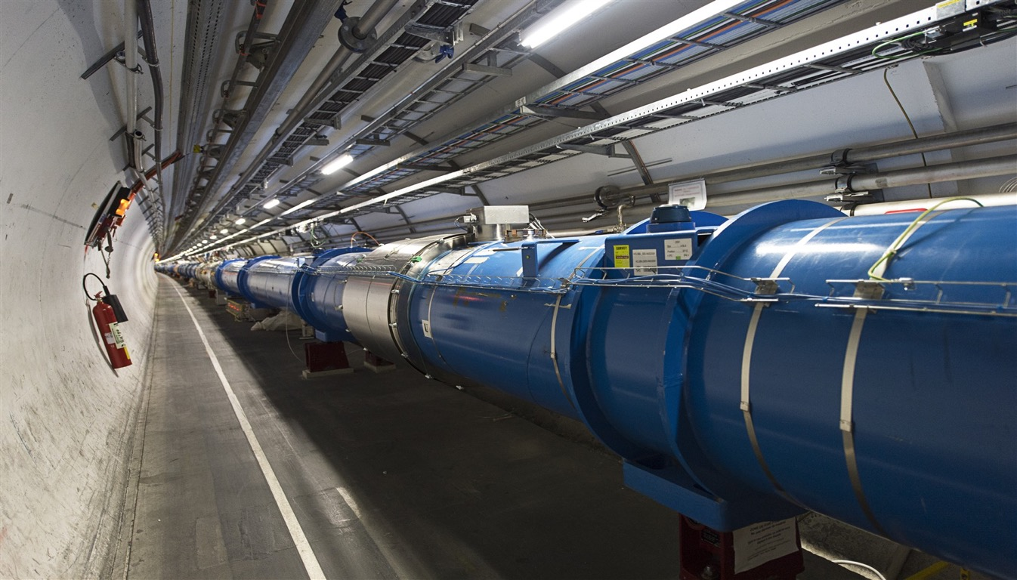
Let us see this in details for
the LHC case

Slide 4
One real example to see what the beam does to Vacuum:
8-10-2010
450 GeV – 150 ns bunch spacing: Merged vacuum @ LHC

Slide 5
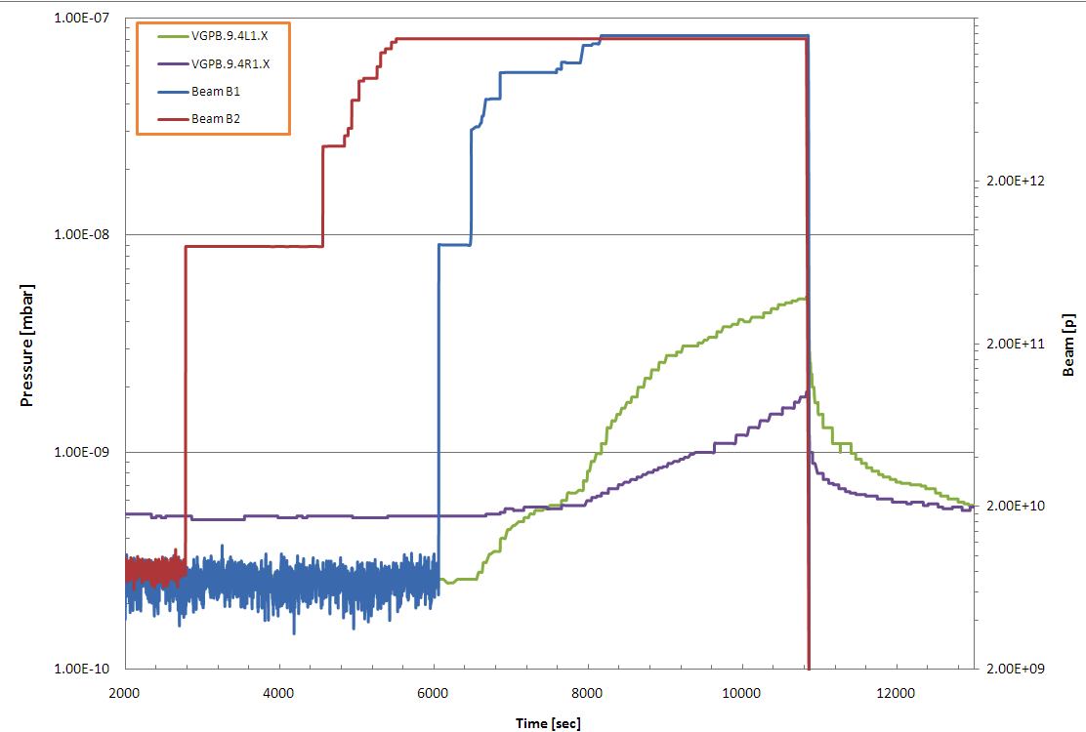
Exotic Vacuum behavior @ LHC:
Beam 2
Beam 1
Pressure Increase
No pressure Increase
450 GeV – 150 ns bunch spacing: Merged vacuum
8-10-2010

Slide 6
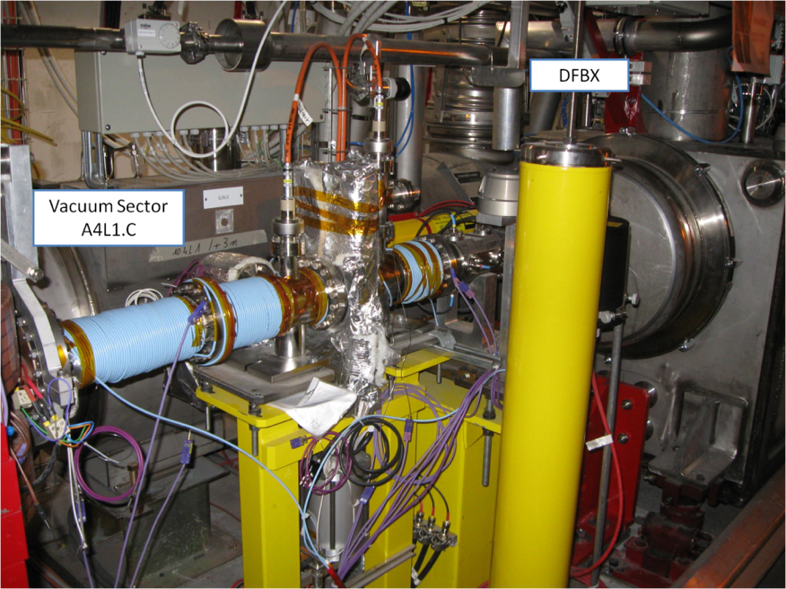
Easily solved: Installation of Solenoids
Solution: Solenoids have been wrapped around the vacuum system!!!

Slide 7
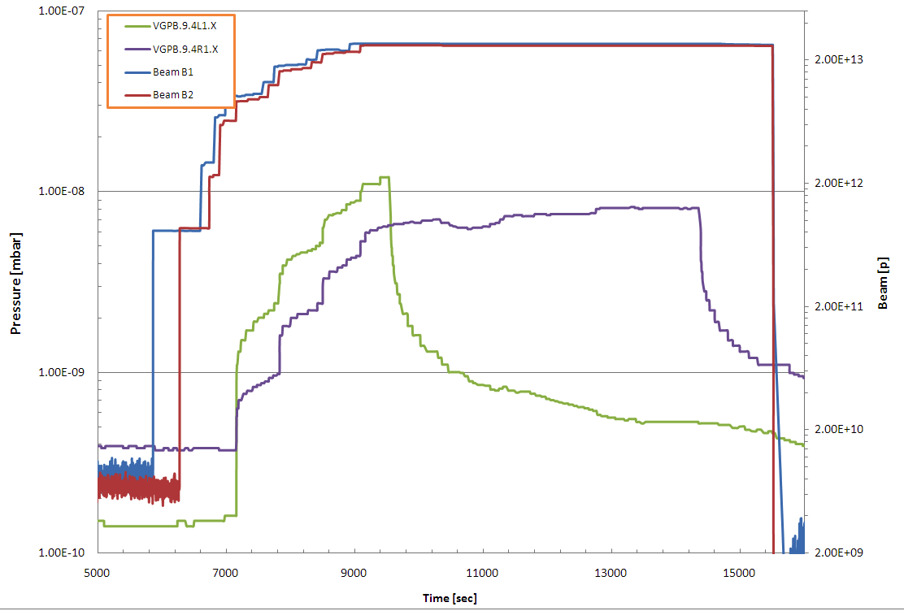
Solenoids have effect on pressure!!!
Solenoid ON
A4L1
Solenoid ON
A4R1
Beam Intensity
After 20 min
ΔP ≈7·10⁻¹⁰
After 20 min
ΔP ≈7·10⁻¹⁰
Remove multipacting
Still primary electrons

Slide 8
Solenoids have effect on pressure!!!
Evidence for:
e-Cloud
Instabilities
due to the interaction between beams and Vacuum system walls
Solenoid ON
A4L1
Solenoid ON
A4R1
Beam Intensity
After 20 min
ΔP ≈7·10⁻¹⁰
After 20 min
ΔP ≈7·10⁻¹⁰
Remove multipacting
Still primary electrons

Slide 9

Vacuum in new generation accelerators is much “more” than a technical issue!
Let us see what may cause such beam and/or pressure instabilities.
The case of the:
LHC arcs

Slide 10
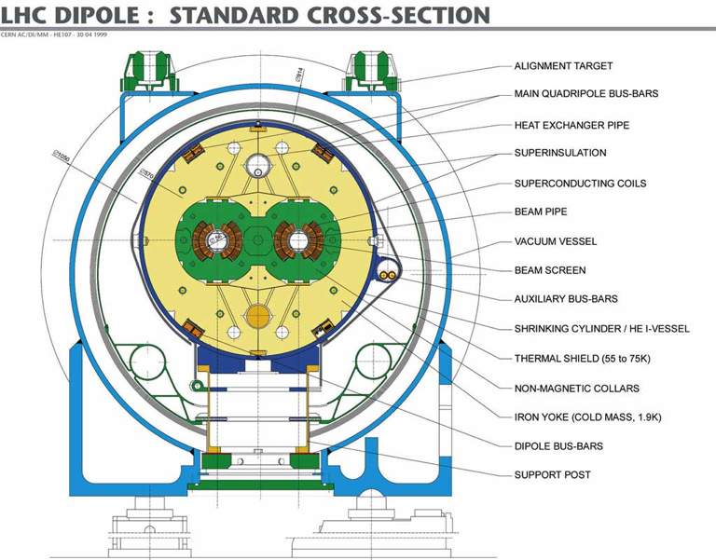
Static Vacuum
Cold Bore @ 1.9 K
Extreme High Static Vacuum
(<< 10⁻¹³ mbar)

Slide 11
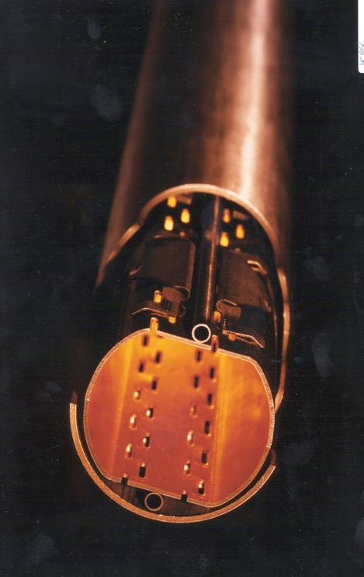
Cold Bore @ 1.9 K
CB
BS
Need of a Beam Screen
@ 5K< T <20K
to reduce heat load (SR, Eddy current, Impedance, etc…) on Cold bore for thermal load issues
Radial Distance
BS
CB
T=0, without beam

Slide 12
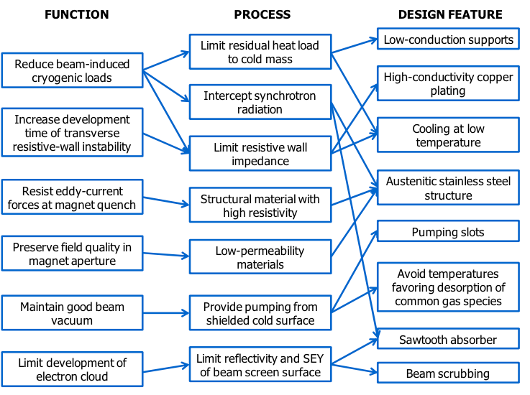
The Beam Screen is a complex technological product!
Cu layer
Pumping slots
shields
Cooling tubes
“Saw teeth”
Pumping slots

Slide 13
Why do we need Vacuum???
CB
BS
Radial Distance
BS
CB

Slide 14


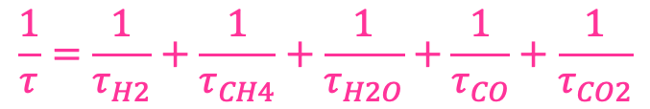
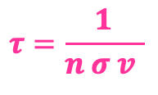

This define: Vacuum
Beam Life time (τ)
Beam – Gas Interactions
Where: σ is the cross section i.e. the probability the beam interacts with the atoms of target
I is the beam intensity
        n is the atomic density of a target of thickness dx
        v is the beam velocity
CB
BS
The beam interacts with the residual gas:
$$\frac{dI}{dt}=−I n v σ$$
$$dI=−I σ n dx$$
Radial Distance
+ +
+ + + +
+ + + + + +
+ + + +
+ +
$$τ=\frac{1}{n σ v }$$
p ⁺
$$\frac{1}{τ}=\frac{1}{τ_{H2}}+\frac{1}{τ_{CH4}}+\frac{1}{τ_{H2O}}+\frac{1}{τ_{CO}}+\frac{1}{τ_{CO2}}$$
BS
$$I={I_{o} e}^{−\frac{t}{τ}}$$
CB
The vacuum life time must be much larger (i.e. >> 24 h) than other life times such as e.g. the particle loss due to the collisions

Slide 15
Beam – Gas Interactions: ion production
CB
BS
Radial Distance
+ +
+ + + +
+ + + + + +
+ + + +
+ +
p ⁺
BS
CB
Ionisation cross section is a function of the speed & the charge of the projectile and of the nature of the residual gas
Heavy gas must be avoided

Slide 16
Ions interact with accelerator wall: Ion desorption yield
Varies with: - the material,
- the ion energy
- and ion species
CB
BS
Unbaked
stainless steel
Radial Distance
N₂⁺
+ +
+ + + +
+ + + + + +
+ + + +
+ +
p ⁺
BS
A.G. Mathewson, CERN ISR-VA/76-5
CB
Several molecules can be desorbed per ion ➔ Sputtering
induced ion desorption: pressure, beam-ion interaction (and desorption) increase.
It is a resonant phenomenon causing Vacuum instability
Above a certain critical beam current, there will be a pressure runaway.

Slide 17
Cold Bore @ 1.9 K
CB
BS
Let us see what happens during operation and beam passage to:
The vacuum system
the Beam screen Surface
Radial Distance
BS
CB
T=0, without beam

Slide 18
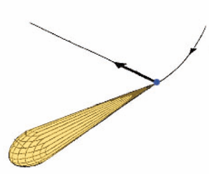
calculation
Synchrotron Radiation
Critical energy:
divide the power spectrum in two equals parts
CB
BS
A charged particle which is accelerated produce radiation
For a relativistic particle, the radiation is highly peaked (opening angle ~ 1/γ)
Radial Distance
+ +
+ + + +
+ + + + + +
+ + + +
+ +
p ⁺
BS
CB
Time = 0

Slide 19
calculation
Synchrotron Radiation
CB
The average power
emitted by the beam
per unit length is:
BS
Radial Distance
+ +
+ + + +
+ + + + + +
+ + + +
+ +
p ⁺
BS
CB
Time = 0
For LHC: P = 0.17 W/m/apert.

Slide 20
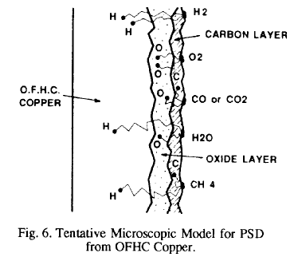
Photo-desorption:
CB
BS
Radial Distance
+ +
+ + + +
+ + + + + +
+ + + +
+ +
O. Gröbner et. al. EPAC 1992
BS
CB

Slide 21
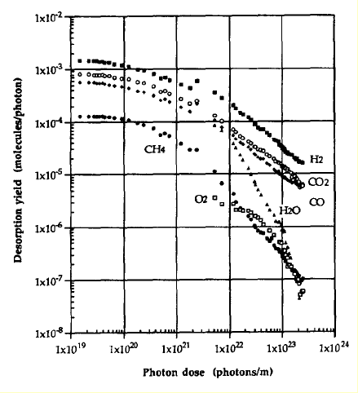
Photo-desorption:
CB
BS
The dynamic pressure decrease by several orders of magnitude with photon dose: “photon conditioning”
The photon desorption yield is characterised by η_{photon}
Radial Distance
+ +
+ + + +
+ + + + + +
+ + + +
+ +
Cu baked at 150°C
BS
CB
O. Gröbner et al.
J.Vac.Sci. 12(3), May/Jun 1994, 846-853
See: talk from Marco Angelucci on “Windy”

Slide 22
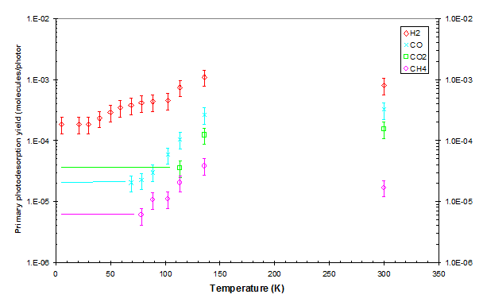
Photo-desorption at LT:
See: talk from Marco and Luisa
CB
BUT at LT:
presence of physisorbed molecule
BS
Initial yield, η₀, are smaller than at room T temperature
Radial Distance
+ +
+ + + +
+ + + + + +
+ + + +
+ +
BS
CB
DAΦNE-L Beamlines & setups are unique tools to perform those studies at LT

Slide 23
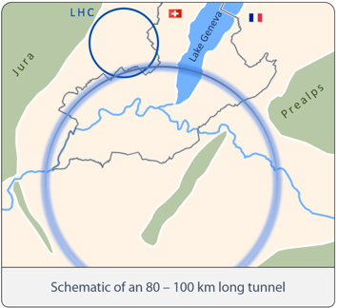
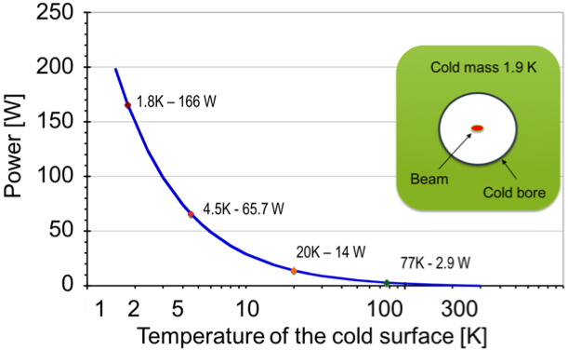


Photons induce Heat load:
CB
BS
Parameters LHC H-L LHC FCC-hh
Radial Distance
+ +
+ + + +
+ + + + + +
+ + + +
+ +
P_{TOT} $\sim 3 GW$
Heat Load Dissipation VS Temperature
Power to dissipate 1W (W)
BS
P_{TOT} $\sim 80 MW$
CB

Slide 24
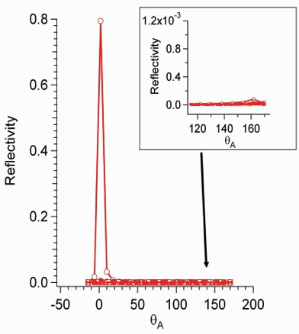
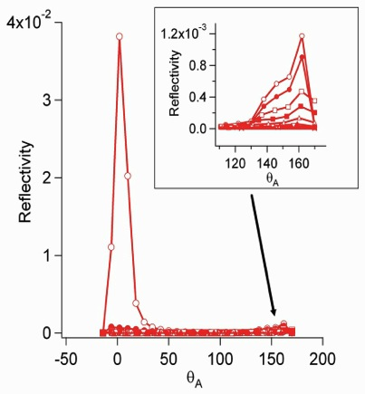
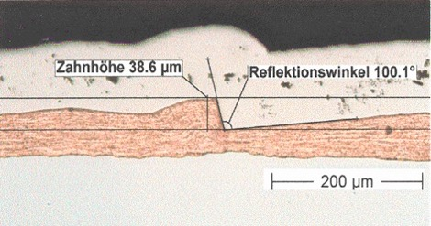
Photon reflectivity:
See Andrea Liedl talk
CB
BS
Radial Distance
+ +
+ + + +
+ + + + + +
+ + + +
+ +
The LHC BS has a Sow tooth structure in the h plane
BS
CB
N. Mahne et al. App. Surf. Sci. 235, 221-226, (2004).
PS: reflected photons do NOT induce HL.
See: R. Cimino V. Baglin and F. Schäfers PRL 2015

Slide 25
SR induce Photoemission:(vs. hν, Q, E,T, B)
    R. Cimino, V. Baglin, I. R. Collins.
    Phys.Rev. ST-AB 2 63201 (1999).
CB
BS
Radial Distance
+ +
+ + + +
+ + + + + +
+ + + +
+ +
p ⁺
BS
CB
Time = 5 ns
Produced e⁻ (PY): important for single beam instabilities (K.Ohmi PRL 2000)

Slide 26
Beam induced el. acceleration
CB
BS
(F.Zimmermann)
Radial Distance
At the moment of creation
+ +
+ + + +
+ + + + + +
+ + + +
+ +
p ⁺
BS
After acceleration
CB
60
80
100
Energy (eV)
0
20
40
Time = 10 ns

Slide 27
e⁻ induced e⁻ emission
CB
BS
Radial Distance
+ +
+ + + +
+ + + + + +
+ + + +
+ +
SEY (Secondary El Yield)
BS
CB
R. Cimino et al Phys. Rev. Lett. 93, 14801 (2004).
Time = 15 ns

Slide 28
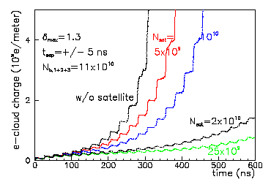
e⁻ cloud Build-up
CB
BS
Radial Distance
+ +
+ + + +
+ + + + + +
+ + + +
+ +
+ +
+ + + +
+ + + + + +
+ + + +
+ +
P ⁺
P ⁺
BS
CB
Time = 25 ns
(F. Zimmermann)
Time structure & simulations.

Slide 29
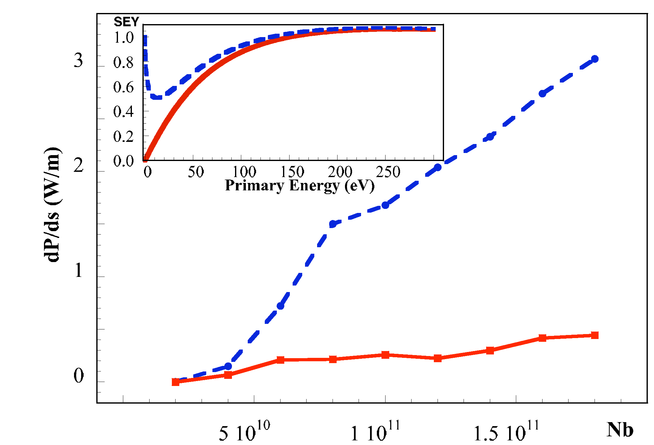
e⁻ cloud Build-up
R. Cimino et al
Phys. Rev. Lett. 93, 14801 (2004).
CB
BS
Radial Distance
+ +
+ + + +
+ + + + + +
+ + + +
+ +
+ +
+ + + +
+ + + + + +
+ + + +
+ +
P ⁺
P ⁺
BS
CB
Time = 25 ns
e⁻cloud build up causes Heat load!

Slide 30
e⁻ cloud Build-up
CB
Dynamic
pressure
increase !!!
BS
Radial Distance
+ +
+ + + +
+ + + + + +
+ + + +
+ +
+ +
+ + + +
+ + + + + +
+ + + +
+ +
Desorbed gas
P ⁺
P ⁺
BS
Governed by: η
Electron Desorption Yield
CB
Time = 25 ns
It is a beam/Vacuum issue!
See: Luisa Spallino Talk

Slide 31
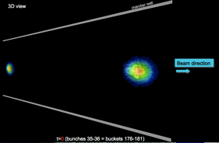
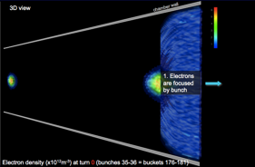
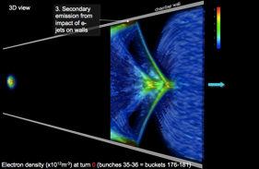
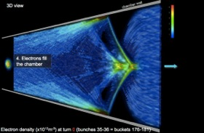
e⁻ cloud induced Beam blow up
Jean-Luc Vay
IPAC’2012
CB
BS
Radial Distance
+ +
+ + + +
+ + + + + +
+ + + +
+ +
+ +
+ + + +
+ + + + + +
+ + + +
+ +
+ +
+ + + +
+ + + + + +
+ + + +
+ +
+ +
+ + + +
+ + + + + +
+ + + +
+ +
+ +
+ + + +
+ + + + + +
+ + + +
+ +
+ +
+ + + +
+ + + + + +
+ + + +
+ +
+ +
+ + + +
+ + + + + +
+ + + +
+ +
+ +
+ + + +
+ + + + + +
+ + + +
+ +
+ +
+ + + +
+ + + + + +
+ + + +
+ +
+ +
+ + + +
+ + + + + +
+ + + +
+ +
+ +
+ + + +
+ + + + + +
+ + + +
+ +
P ⁺
P ⁺
BS
CB
Time = 25 ns
e⁻cloud build up It affects beam quality!
!

Slide 32
Electron cloud in accelerators
The Surface Science properties of relevance:
SEY (Secondary Electron Yield);
PY (Photo Yield);
R (photon Reflectivity)
Data are needed to correctly simulate accelerator behaviour but also to trigger R&D on various mitigation strategies
Low SEY materials - Low Desorption – Low/high Reflectivity and PY
R. Cimino and T. Demma
“Electron cloud in Accelerators” Int. J. Mod. Phys. A 29 (2014) 1430023 (pag. 65).

Slide 33
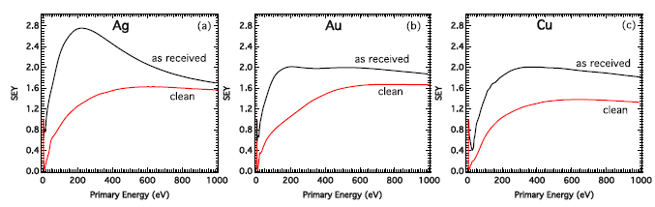
Surface sensitivity of SEY
SEY is an intrinsic material property strongly sensitive to the surface composition and chemical state
Effect of contaminants of the atmosphere at room temperature
L. A. Gonzalez et al., AIP Adv. (2017)
Chemisorbed/physisorbed compounds modify the metal surface

Slide 34
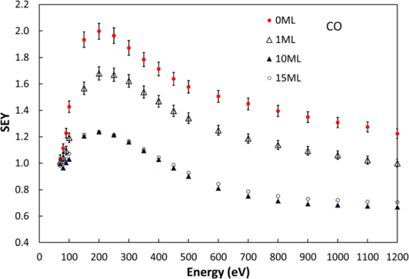
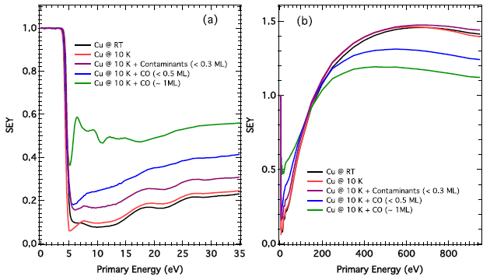
Surface sensitivity of SEY
SEY is an intrinsic material property strongly sensitive to the surface composition and chemical state
CO thick layer coverage
SEY of cold surfaces influenced by gas physisorption
Residual gas in cryogenic vacuum
Kuzucan et al., J. Vac. Sci. Technol. A (2012)
SEY is highly sensitive to the presence of adsorbates, even at sub-monolayer coverage
L. A. Gonzalez et al., AIP Adv. (2017)

Slide 35
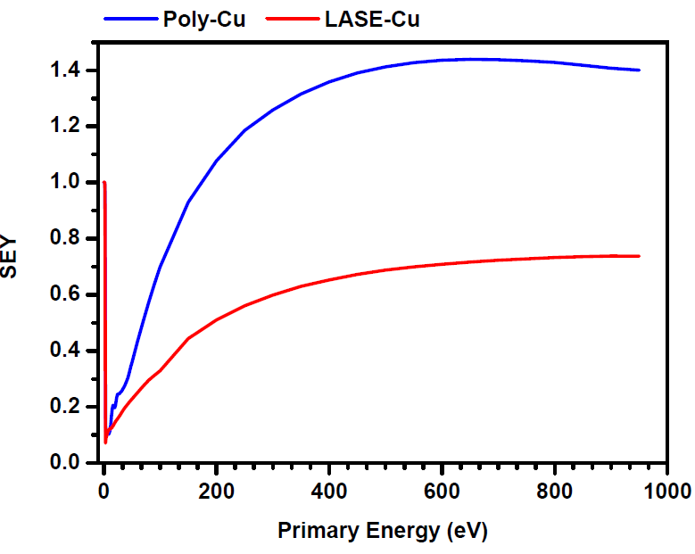
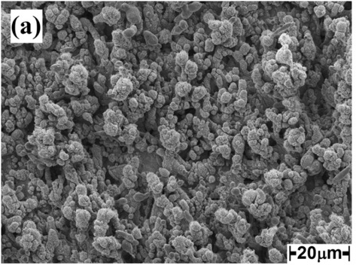
Surface sensitivity of SEY
SEY is an intrinsic property of materials, strongly sensitive to the surface morphology
Engineering the surface morphology
Laser ablation on Cu substrate
(LASE-Cu)
R. Valizadeh et al. , Appl. Surf. Sci. (2017)
e⁻ cloud mitigation strategies

Slide 36
Strategy and experimental set-up at LNF
Low Temperature
Temperature variations/photons/electrons
Gas Adsorption
Gas Desorption
SEY variation
Pressure variation
SEY, Mass Spectrometry, Thermal Programmed Desorption (TPD) and XPS (as soon)
as useful techniques to quantitatively follow adsorption/desorption kinetics

Slide 37
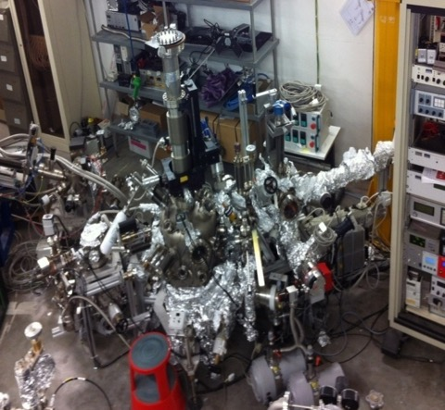
Strategy and experimental set-up at LNF
Ultra high vacuum systems
Secondary Electron Yield (SEY) measurements
Equipment : Electron gun, Faraday cup
preparation
chamber
main chamber
fast-entry lock
LNF-cryogenic manipulator
Sample at 15-300 K
Temperature Programmed Desorption (TPD) and Mass Spectrometry measurements
Equipment : QMS (Hiden HAL 101 Pic)

Slide 38
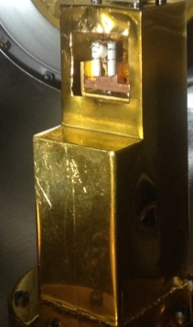
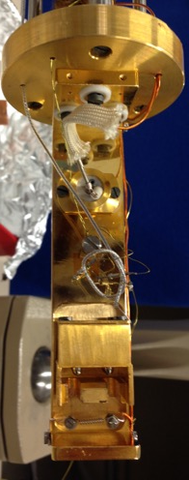
Strategy and experimental set-up at LNF
Screen
Heater
T Sensor
Sample
Sample Holder

Slide 39
Strategy and experimental set-up at LNF
Electron gun
Retractile gas dosing system

Slide 40
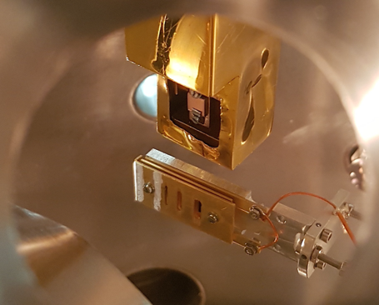
Strategy and experimental set-up at LNF
I_{out}
Faraday
SEY = δ =
I_{in}
I_{in}
+
-
V_{bias}
Sample
I_{Sam}
-
+
V_{bias}
Sample
Faraday Cup

Slide 41
Strategy and experimental set-up at LNF
I_{out}
I_{in} - I_{sam}
Faraday
SEY = δ =
=
I_{in}
I_{in}
I_{in}
+
-
V_{bias}
Sample
I_{Sam}
-
+
V_{bias}
Sample
Faraday Cup

Slide 42
Results
  TPD from LASE-Cu for temperature induced vacuum transients study
  SEY to probe the surface coverage
  Electron desorption studies: preliminary results

Slide 43

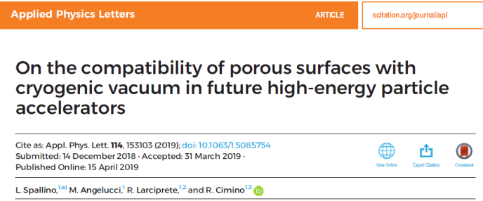
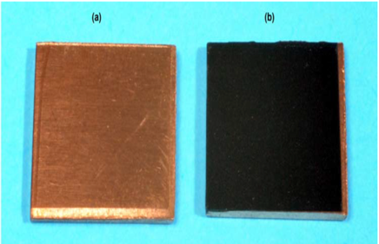
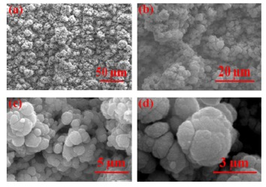
TPD from LASE-Cu for temperature induced vacuum transients study
poly-Cu
Representative of Laser treated Cu
What about the influence of the surface features on the vacuum stability?
Comparative study of Ar TPD from flat poly-Cu and LASE-Cu samples

Slide 44
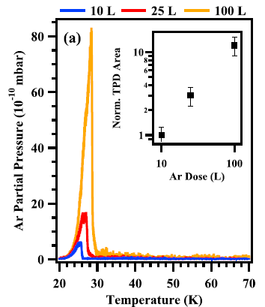
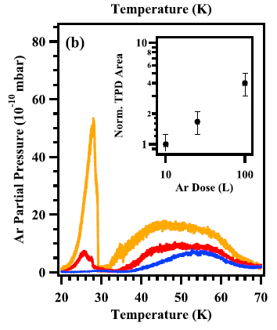
TPD from LASE-Cu for temperature induced vacuum transients study
Single TPD peak at ~30 K corresponding to the desorption of a condensed thick Ar layer
Desorption temperature determined by the weak Ar-Ar van der Waals interaction energies
poly-Cu
L. Spallino et al. , Appl. Phys. Lett. (2019)
LASE-Cu
TPD peak at ~30 K corresponding to the desorption of a condensed thick Ar layer together with a broad TPD profiles, whose peak temperatures and widths depend on the Ar dose
TPD characteristics determined by the sponge-like structural features

Slide 45
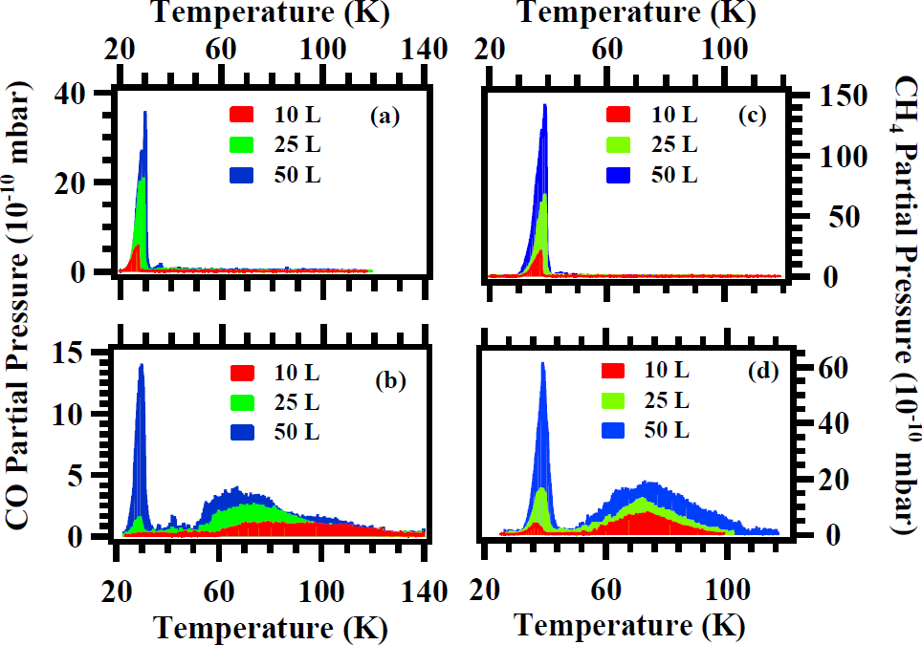
TPD from LASE-Cu for temperature induced vacuum transients study
Conceptually identical results have been obtained with CO and CH₄
poly-Cu
+ CO
+ CH₄
LASE-Cu
+ CO
+ CH₄
L. Spallino, M. Angelucci and R. Cimino, to be published

Slide 46
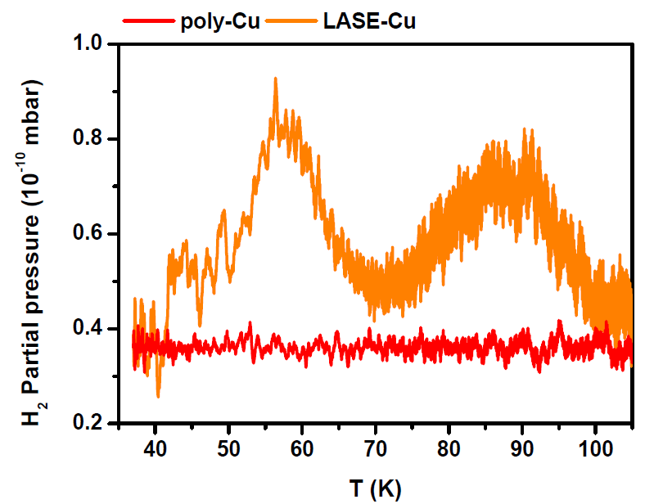
TPD from LASE-Cu for temperature induced vacuum transients study
TPD of 100 L H₂ dosed on poly-Cu and LASE-Cu samples held at T~15-18 K
H₂
No TPD signal should be observed by considering the H₂ vapor suture pressure curve!!!
The wide distribution of high energy adsorption sites within the inner pore is responsible for the H₂ TPD signal from LASE-Cu sample
L. Spallino, M. Angelucci and R. Cimino, to be published

Slide 47
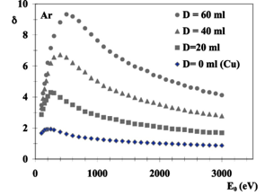
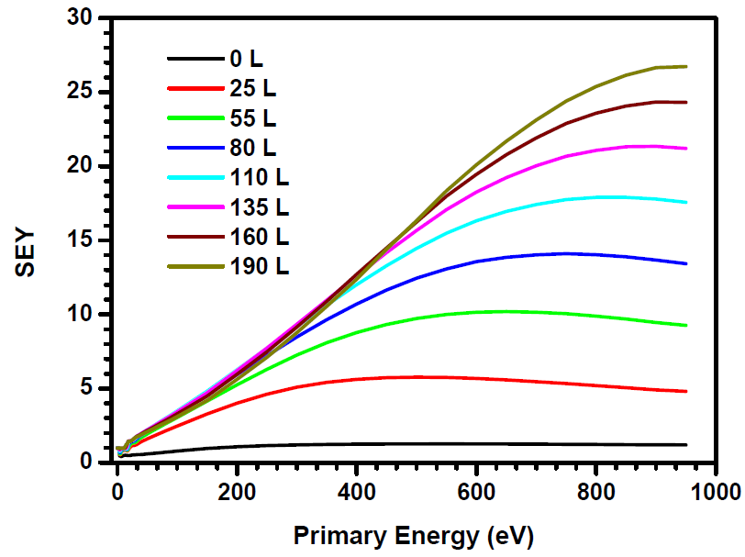
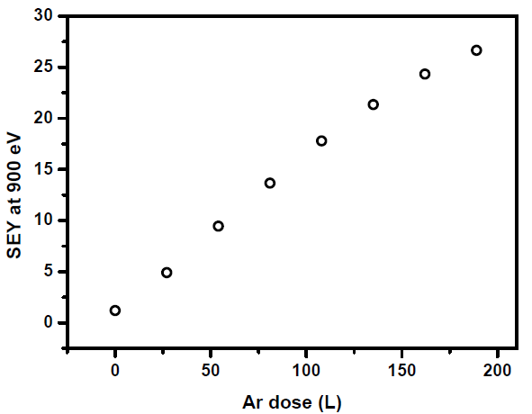
SEY to probe surface coverage
J. Cazaux et al.; Phys. Rev. B, 71 (2005)
Ar adsorption on polycrystalline-Cu substrate as a test system
SEY strongly changes with adsorbed gas
L. Spallino, M. Angelucci and R. Cimino, to be published
SEY could be used to follow gas coverage variations and make coverage calibration

Slide 48
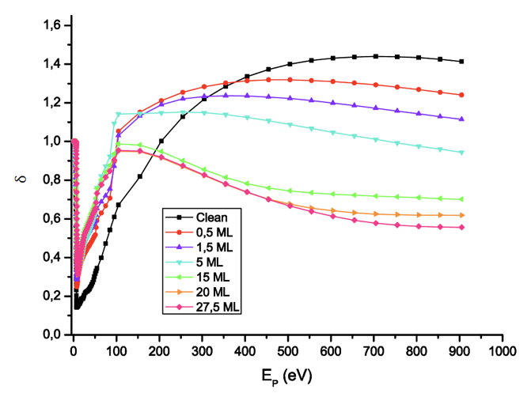
How a Coating modify SEY?
(the case of c on Cu)
Increasing C
We followed the growth of thin C layers on Cu with XPS to measure its thickness
We simultaneously follow SEY changes

Slide 49
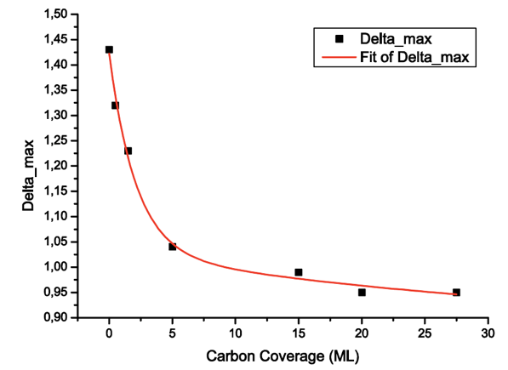
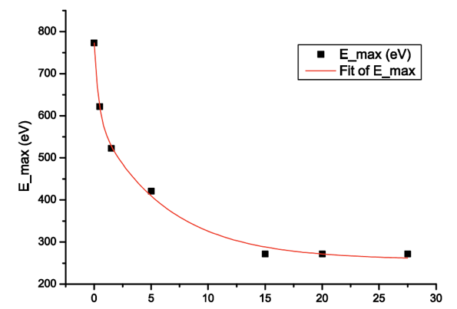
How a Coating modify SEY?
(the case of c on Cu)
E_{max}
δ_{max}
Could follow δ_{max} vs C coverages
Could follow Ε_{max} vs C coverages
15-20 Ml (~ 5-6 nm) of C determines SEY properties.
What about Water on C (or on Cu)?

Slide 50
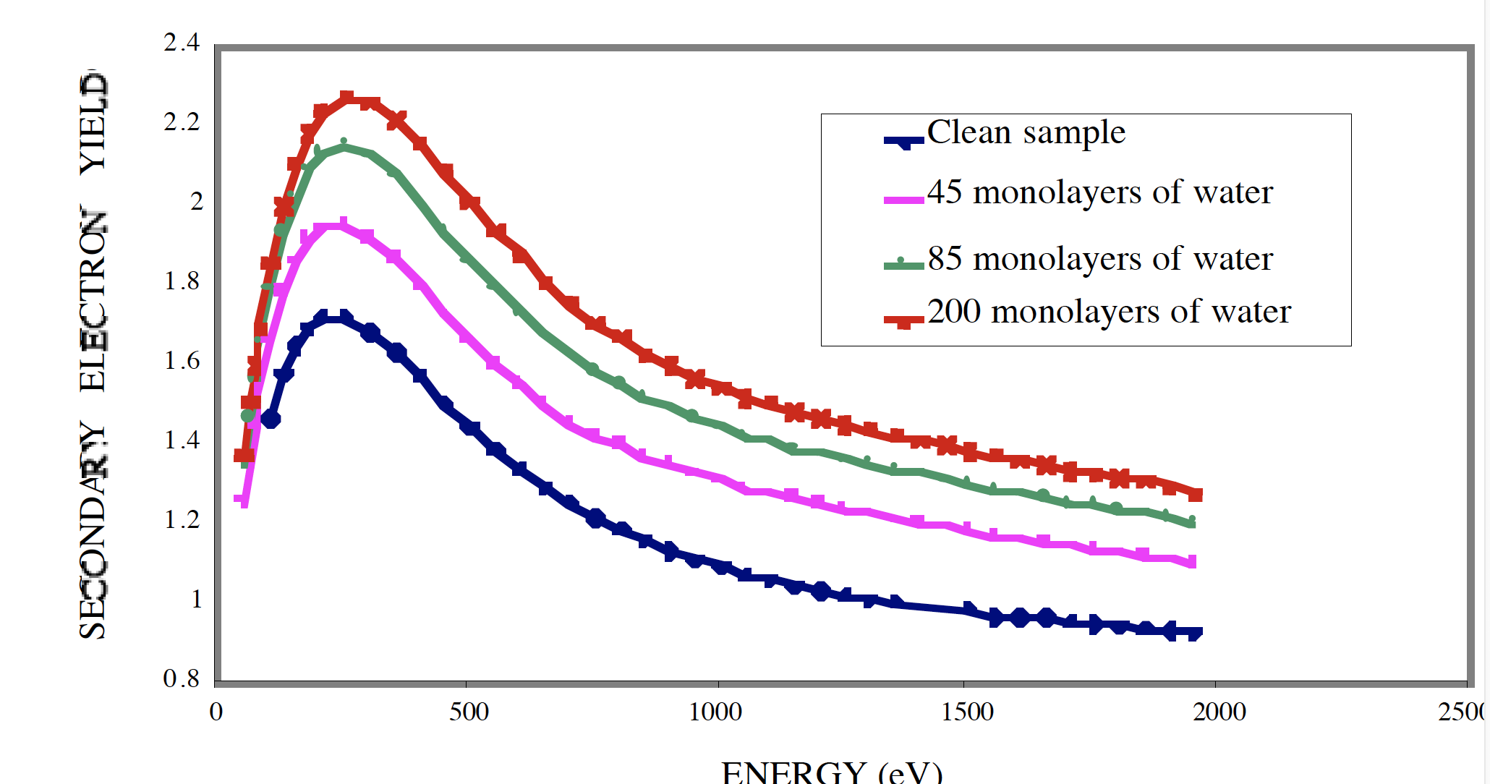
What about Water on Cu?
V . Baglin, J. Bojko1, O. Gröbner, B. Henrist
THE SECONDARY ELECTRON YIELD OF TECHNICAL MATERIALS AND ITS VARIATION WITHSURFACE TREATMENTSV Proceedings of EPAC 2000, Vienna, Austria
Moreover It
charges up!

Slide 51
(Tentative) Work to do for LHCspin:
Given the facts (to be better identified) that:
Water Ice grow differently ad different T
Water will affect SEY (as a function of thickness and growth morphology)
Thick Ice will charge up (no good) and may have high SEY
We need to study, as a function of substrate (best if flat) and substrate Temperature:
  SEY as a function of Water thickness (the idea is to choose a T where Ice is compact and the thickness is optimum for maintaining H polarization with minimum influence on SEY)
  See whether the interaction with of Atomic H modifies SEY and other surface Properties.
  ...?

Slide 52
New experiment for 2020-2024:
ARYA
SurfAce and mateRial studies for Accelerator
TechnologY And related topics
INFN has a longstanding tradition and a series of highly developed competences on issues related to various aspects of accelerator’s R&D.
The ARYA project is subdivided in Working Packages (WP’s).
All the WP’s will tackle research ew challenges which are studied in international collaborations, more specifically, for HL LHC, FCC and others.
The goal of this proposal is to grant the necessary resources to best contribute to the ongoing and future collaborations highlighting INFN role on studies on collective effects and of material properties for future accelerators.

Slide 53
ARYA WP’S
WP | TITLE | UNITS INVOLVED | RESPONSIBLE
WP1 | Electron Stimulated desorption studies | LNF-INFN CERN | L. Spallino & R. Cimino
WP2 | Material properties under photon irradiation. | LNF-INFN CERN | M. Angelucci & R. Cimino
WP3 | LHCspin: surface properties validation | LNF-INFN CERN | P. Di Nezza & R. Cimino
WP4 | Beam dynamics studies and material properties for future accelerators | Rome1-INFN Na-INFN LNF-INFN CERN | M. Migliorati
WP5 | Impedance Study and measurements of new LESS | Na-INFN Rome1-INFN CERN LNF-INFN | M.R. Masullo
WP6 | Low SEY thin films technology for aerospace applications | GSSI, Uni Aquila e LNF-INFN | M. Passacantando & R. Cimino

Slide 54
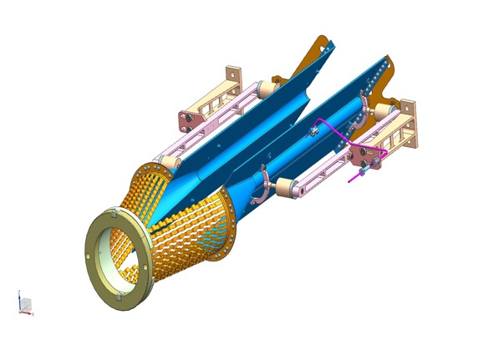
WP3 | LHCspin: surface properties validation | LNF-INFN CERN | P. Di Nezza & R. Cimino
This WP will be an R&D for the storage cell to be placed in front of LHCb detector during the long shutdown 3. This new vacuum chamber will be filled with various gasses and, in particular, with polarized atomic Hydrogen and Deuterium, bringing, for the first time, polarized physics at the LHC.
Define a cold narrow coated tube to inhibit recombination.
Should fulfill LHC requirements on Vacuum, e- cloud etc.
Graphite, covered by a thin water layer should be the solution to be studied, optimized and validated.

Slide 55
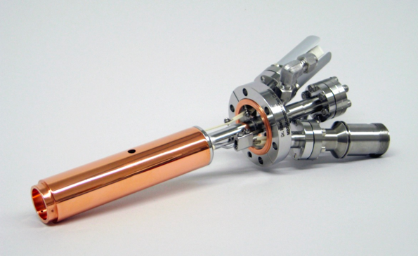
WP3 | LHCspin: surface properties validation | LNF-INFN CERN | P. Di Nezza & R. Cimino
Coverage and T dependent SEY studies should be conducted on H₂O on differently compact a-C substrate (from graphite to highly disordered porous a-C) .
The effect of Absorption on those Surfaces of atomic Hydrogen (or Atomic Deuterium) to see if they remain unperturbed or are somehow perturbed by it.
This WP will be only on NSC5. It will use the Set-up at LNF. We need a UHV H cracker and the H or D supply.
WP3: Foreseen Requests 2020
    Mobility: 10 k€
    Consumable: 10 k€
    H cracker 32 k€

Slide 56
Conclusion:
There is a lot to do!
LHCspin community have a lot to teach us!
The R&D needed is extremely challenging but of great (general) interest
Experimental set-up mainly there (?)
Man power is THE issue!

Slide 57
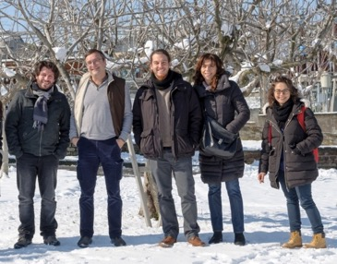



Thank you for your attention
Thanks to the low temperature team at LNF:
M. Angelucci, A. Liedl, R. Larciprete e L. Spallino.
Tanks to the technical support of DAФNE-L Team:
A. Grilli, M. Pietropaoli, A. Raco, V. Tullio, V. Sciarra and G. Viviani
Thanks to EuroCirCol project and to its scientific community
Thanks to MICA supporting project funded by INFN-SNC5

