Slide 1
A polarized internal target at the LHC:
general requirements
P. Lenisa – Università di Ferrara and INFN
For the LHC-spin study group
P. Di Nezza (Frascati & LHCb)
V. Carassiti, G. Ciullo, P. Lenisa, (INFN Ferrara)
L. Pappalardo (INFN Ferrara & LHCb)
E. Steffens (Erlangen)
A. Vasilyev et al (Gatchina & LHCb)
In collaboration with:
A. Nass, R. Engels, F. Rathmann (FZ Jülich)
J. Depner (Erlangen)
D. Reggiani, C. Baumgarten (PSI)
LHC-spin kickoff meeting, Ferrara, 15.07.19

Slide 2
Introduction
The LHCb Spectrometer detects particles from collisions at IP 8. Primary and Secondary vertices are reconstructed by the Vertex Locator (VELO). The overlap of the colliding bunches is measured via scattering on the residual gas.
To increase the precision of the luminosity measurement, a gas injection system (SMOG) for Ne (He) has been added. Among several measurements, SMOG has been used for the measurement of antiproton production in pHe Fixed Target (FT) collisions [arXiv:1808.06127v1].
The LHCspin group has completed a design of an improved SMOG system with additional storage cell upstream of the VELO detector: SMOG2. It has been approved by LHCb and LHC committees, and installation will be in fall of this year 2019.
As a next step, the design of a polarized gas target (PGT), similar to the HERMES target, in the VELO alcove is being studied. Preliminary ideas and results are presented here.

Slide 3
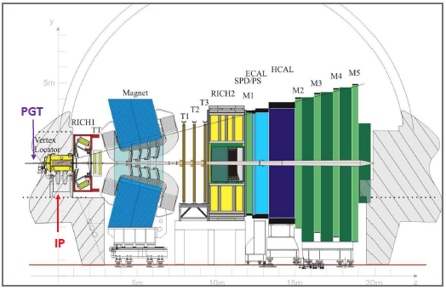
Side view of the LHCb Detector

Slide 4
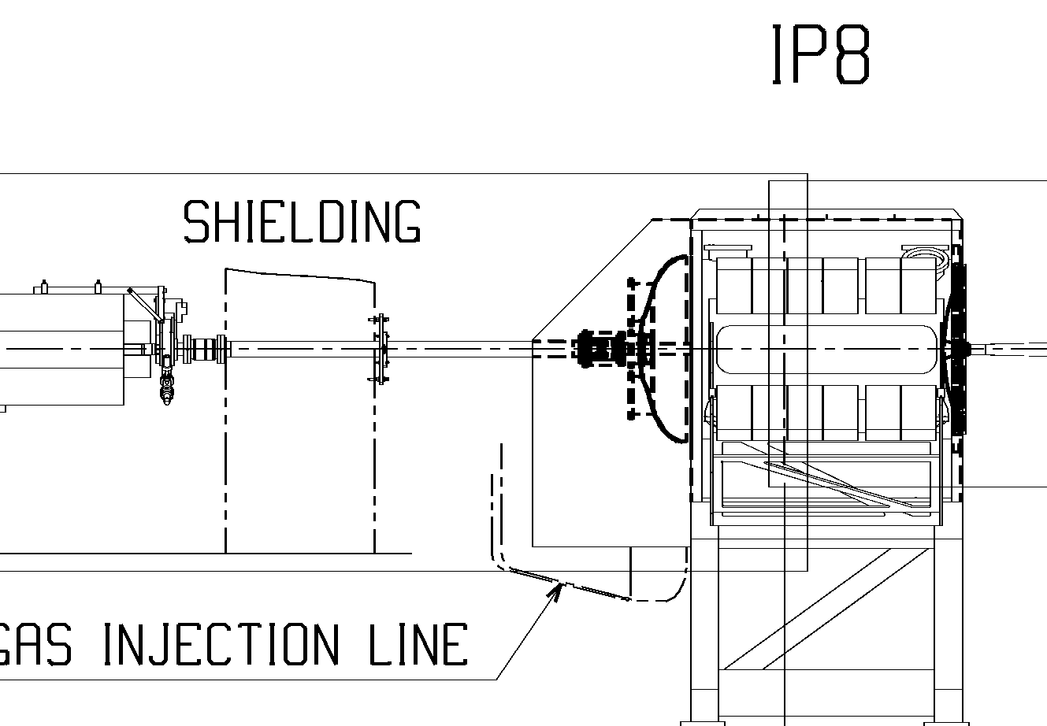
Arrangement in the tunnel:
available space upstream of the VELO vessel
Along the beam:
About 1m, limited by shielding wall.
Could be moved, but important for the PGT to stay as close to the VELO as possible!
In transverse direction:
Enough to place ABS and diagnostics in the horizontal plane (→ B_{guide} vertcal)

Slide 5
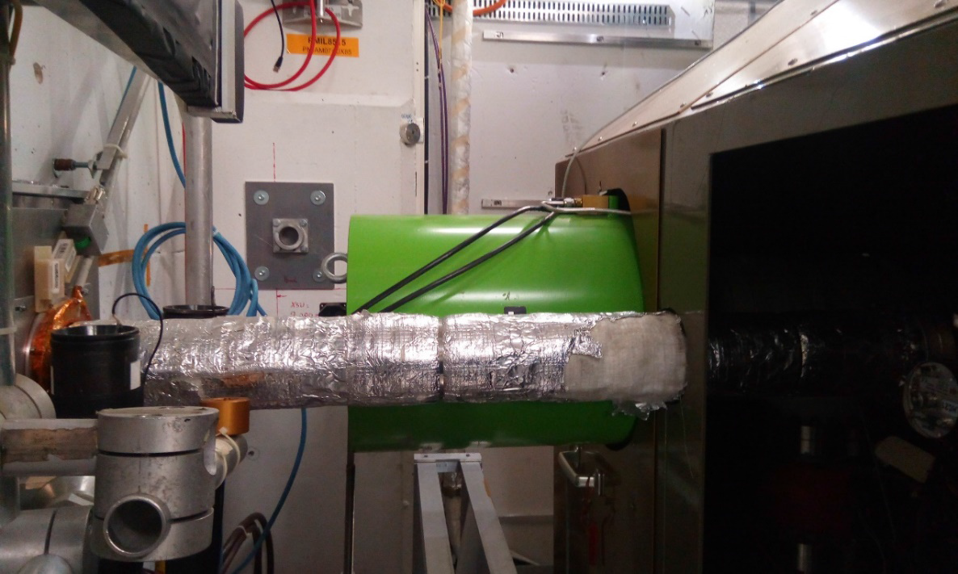
Arrangement in the tunnel:
view of the target area before LS2 (≤ 2018)
In the foreground: beam tube
Now with additional sector valve for temporary installation of dedicated experiments (e.g. ‘bent crystals’)
In green: pneumatic cylinder of all-metal valve GV302/SMOG.
To be replaced this shut-down by flat gate valve.

Slide 6
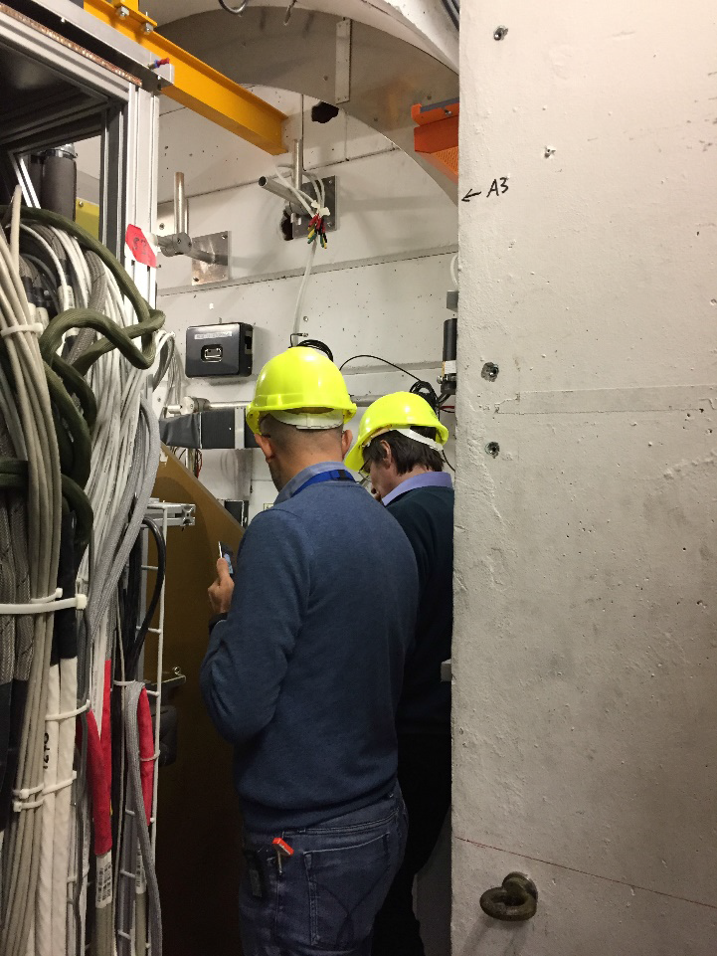
Visit at IP8 (03/2018):
upstream-right
Pasquale and Alexander at the Alcove
Left: VELO cable rack.

Slide 7
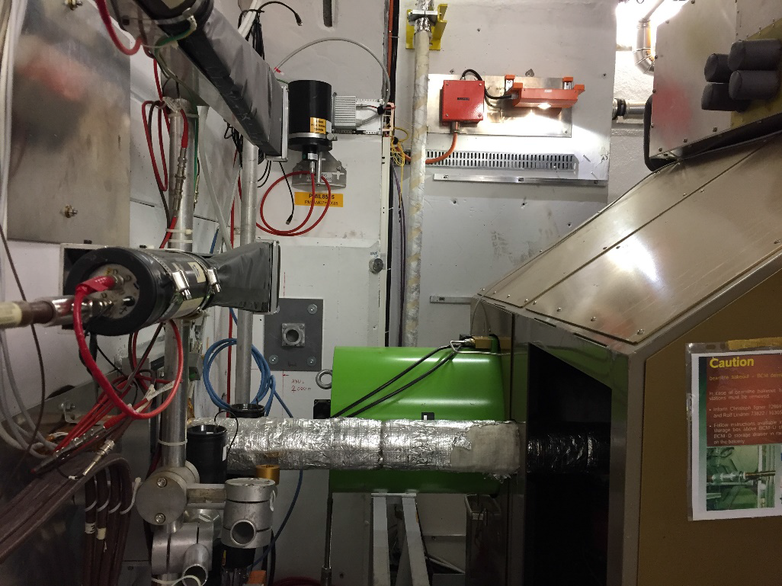
Visit at IP8 (03/2018):
upstream-right
Side view of beam line and protective cover

Slide 8
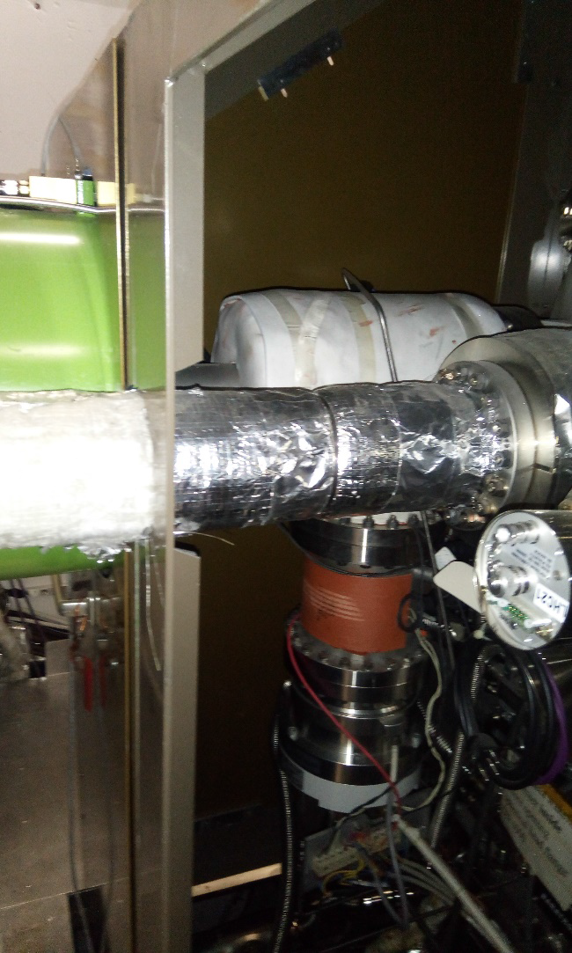
Visit at IP8 (03/2018):
upstream-right
Beam tube (foreground) and TP 301 with valve GV 302

Slide 9
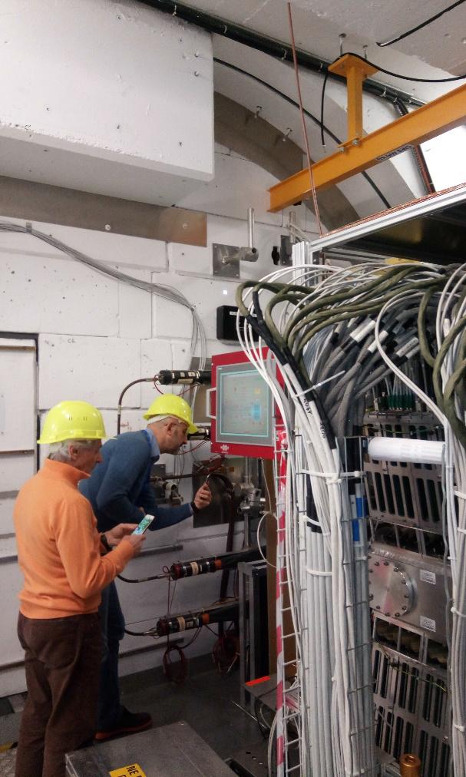
Visit at IP8 (03/2018):
upstream-left
Vito and Pasquale on the other side

Slide 10
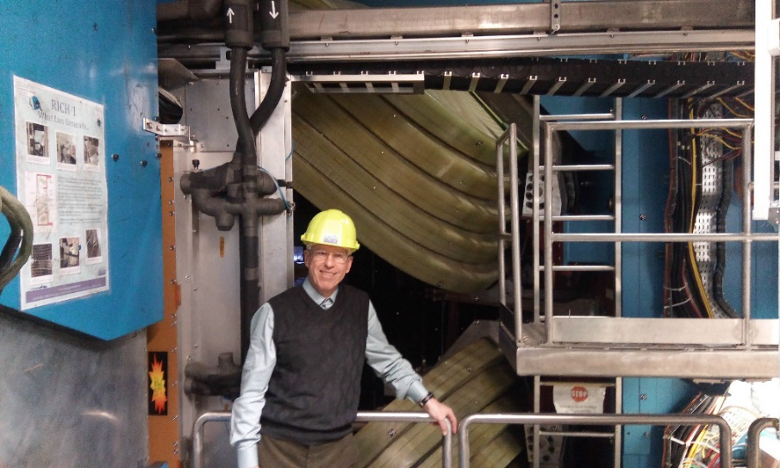
Visit at IP8 (03/2018):
upstream-left
Erhard at the Dipole coils

Slide 11
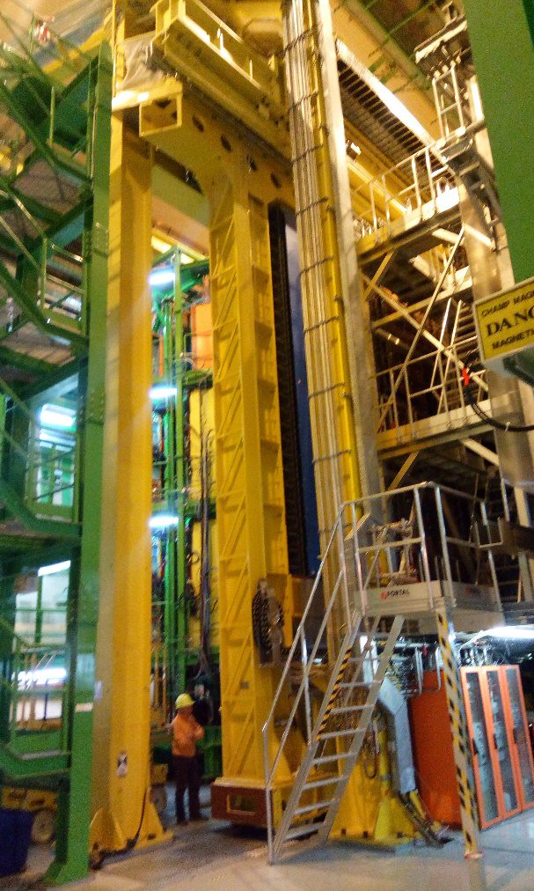
Visit at IP8 (03/2018):
upstream-left
LHCb scaffolding

Slide 12
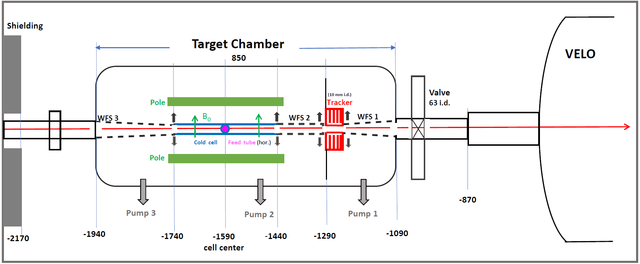
PGT topology
Beam line upstream of VELO:
Target Chamber
Cell with beam tube (300 mm long)
Gridded tube WFS 2 for differential pumping (200 mm)
Tracker with 10 mm-opening
Conical wake-field suppressors WFS 1 + 3.
New sector valve (installed in LS2) and the entrance region of the VELO vesseL.
Upstream beam tube and shielding.
Opening of the elements is indicated by black arrows.

Slide 13
PGT topology
The PGT can not be located close to or even inside the VELO vessel because of the relatively high gas flow which requires differential pumping on a separate target chamber (or with appropriate openable diaphragms in between).
An analytic estimate (ES) of the peaked flow out of the downstream cell opening shows that 3 % of down-stream flow passes the 10 mm opening in the Tracker, 350 mm from cell center.
For the full ABS flow, this would correspond to less than 10⁻⁶ mb l/s of recombined H , i.e. within the tolerable range.
MolFlow simulations planned (including pumping by NEG coating) to calculate maximum capacity/running time.
The vacuum group is worried about risks of large gas quantities and working on cryo-deposition from cold to worm transitions.

Slide 14
Requirements for a PGT at the LHC
All narrow openings in the LHC, like the VELO detector, have to be openable during injection and tuning (r_{min} ≈ 27 mm at IP8). This holds for the PGT set-up as well, with cell, wake field suppressors, detectors, diaphragms etc.
The design value of the PGT gas flow rate which could be 10x higher than for SMOG2, has to be fixed in a realistic range, enabling a reduction of the size of the target.
Beam-induced depolarization (BID) by the bunch fields has to be suppressed by proper (non-resonant) choice of the guide field.
For positive beam charge, the formation of e-clouds and the accompanying transverse instability must be prevented, i.e. the surfaces close to the beam must have low Secondary Emission Yield (SEY).
The coating of these surfaces is extremely important!

Slide 15
Machine issues I: electron clouds
Electron Cloud (EC) effects are observed in accelerators with positive particles (ions).
Slow electrons produced by various ionization processes are trapped near the beam. They are accelerated by the bunches, producing Secondary Electrons which may lead to an Avalanche multiplication effect, forming dense Electron Clouds (EC).
Primary slow electrons are produced on the walls and trapped in the positive beam charge.
They are accelerated by the bunch fields and produce fast secondary electrons; depending on the SEY they produce a number of slow electrons
By simulations: for SEY ≥ 1.5, dense EC‘s are formed.
As a result, transverse instabilities may occur, i.e. transverse oscillations with exponential growth, resulting in dangerous beam losses.

Slide 16
Machine issues I: electron clouds
It is evident that an elevated residual gas pressure in the target region favors EC formation, as well as chamber walls with high Secondary Electron Yield (SEY).
EC formation can be analyzed by means of simulations which allow for a prediction of thresholds for the SEY below which stable beams can be expected.
As coatings for surfaces close to the LHC beam, materials with SEY ≤ 1.4 are allowed, only. These are:
Non-Evaporable Getter (NEG) (standard)
Amorphous Carbon (a-C) (tested and applied more frequently)
A NEG coating for the tube’s inner surface is excluded because of its pumping action which will result in embrittlement and possible disintegration of the coating.
Amorphous Carbon (a-C) is the only viable solution!
Amorphous graphite is already applied in accelerators, incl. the SPS and the LHC.

Slide 17
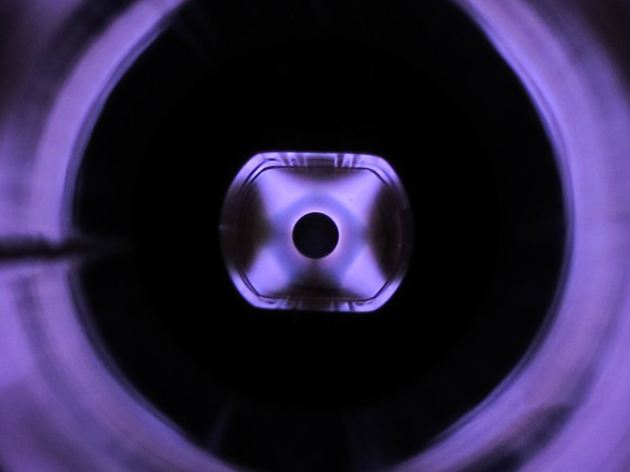
Blue light: from Argon discharge for sputtering Carbon.

Slide 18
Machine issues II: impedance
When a beam of particles traverses a device which is not smooth or not a perfect conductor, it will produce e.m. wakefields:
wakefields (in time domain)
impedance (in frequency domain).
Effect of e.g. impedance:
Energy is lost by the beam dissipated in surrounding chambers → beam induced heating!
Resonant kicks to following particles → instabilities → beam loss and blow up!
Can cause severe damage to the machine and its components, in particular in case of the LHC where a sophisticated collimator and beam dump system protects the machine.
All parts installed into the LHC are carefully inspected and approved by the Impedance group using Simulations and RF measurements.

Slide 19
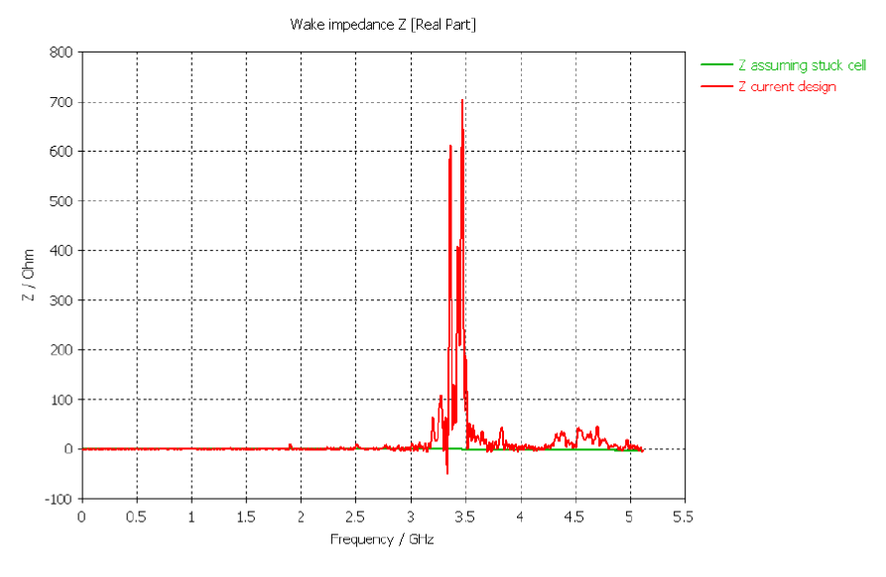
Simulation of the SMOG2 cell with gap between RF foil and cell, connected via RF contacts, but path for RF currents too long:
Impedance Z (f) for direct connection (green),
compared with old design (red)
now improved, but not simulated, yet.
The cell prototype, when ready, has to be tested with RF measurements and compared with simulations!

Slide 20
Open issues
In a first conceptual design, the main requirements were presented and discussed:
30 cm long-cell
Cold cell (100 K) coated with a-C graphite
≈ 0.3 T vertical field
openable
WFS system all along the beam;
Tracker downstream
10 mm opening
EC and Impedance problems to be simulated
no show-stopper expected;
Beam-induced Depolarization estimated: more favorable than at HERMES (-> ES talk) ;
Target densities and lumi depend on the gas load permitted: quite high (-> ES talk).

Slide 21
To be solved:
Cell surface with a-C coating:
Effect of a-C on target polarization needs to be studied
Juelich setup?
Needs a thin water/ice layer to suppress recombination (and thus depolarization).
Can be produced in dynamical equilibrium by injecting a low water fraction together with the polarized H atoms, set by the O₂ admixture in the dissociator gas H₂.
The SEY of this surface is unknown: needs to be studied.
Which dissociator technology with extreme reliability to be used?
No coolant must flow into the vacuum system
Space is tight, in particular on the side of the beam foreseen for diagnostics.
How would a minimal BRP and TGA look like?
Is there a pp channel we could use for polarimetry?
see RHIC jet polarimeter detecting recoil p’s from CNI region?
NICA is also planning a similar polarimeter
How to enable assembly, service and repair within the limited space?

