Slide 1
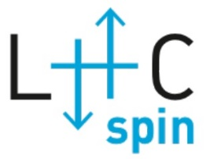
Polarized Gas Target: LHC vs. HERA
Erhard Steffens – FAU Erlangen-Nürnberg
Erhard.Steffens@FAU.de
for the LHCspin Study Group
P. Di Nezza (Frascati & LHCb)
V. Carassiti, G. Ciullo, P. Lenisa, (INFN Ferrara)
L. Pappalardo (INFN Ferrara & LHCb)
E. Steffens (Erlangen)
A. Vasilyev et al (Gatchina & LHCb)
In collaboration with:
A. Nass, R. Engels, F. Rathmann (FZ Jülich)
J. Depner (Erlangen)
D. Reggiani, C. Baumgarten (PSI)
Introduction
Comparison of PGT for LHC with HERA-e
Beam-induced depolarization (BID)
Important open problem
2019-07 PGT Kick-off Ferrara
E. Steffens (FAU): PGT - LHC vs. HERA
1

Slide 2
            Comparison HERA(e) – LHC(p)
Beam parameter | HERA (e) | LHC (p)
E_{max} /GeV | 27.5 | 7 000 | final beam energy
γ_{Lorentz} | 53 816 | 7 463
I_{beam} /A | 0.06 | 1.1 (HL-LHC)
R_{average} /m | 1 000 | 4 260 m
P_{SR} prop. γ⁴ I_{beam} /R [A/m] | 5.03 ∙ 10¹⁴ | 8.01 ∙ 10¹¹ | total P_{SR} (P_{LHC} ≈ 1.6 ∙ 10⁻³ x P_{HERA})
Self-polarization | yes ( → pol. beam) | no ( → unpol. beam)
Instabilities | damping to equilibr. emittance (cooling) | no damping, i.e. kicks add up → instab. grow
E_{final} / E_{inj} | 27.5 / 14 = 2.0 | 7 000 / 450 = 15.6
ε_{geom.} = ε_{invariant} / β γ adiabatic shrinking during acceleration | ε_{geom.} at injection 2 x bigger | ε_{geom.} at injection 16 x bigger | HERA: fixed collimator and cell; LHC: narrow passages to open during injection!
2019-07 PGT Kick-off Ferrara
E. Steffens (FAU): PGT - LHC vs. HERA

Slide 3
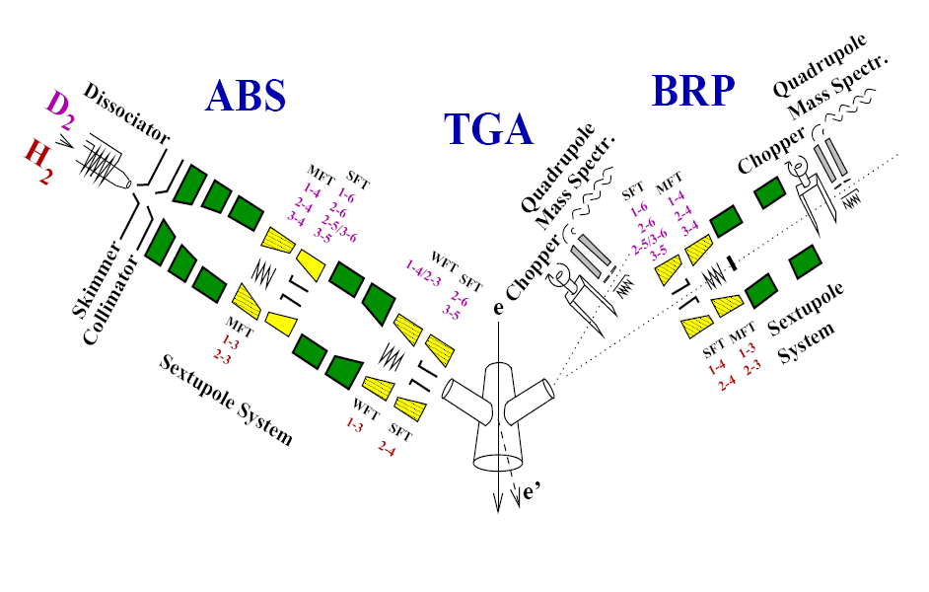
Overview: Polarized Gas Target for the LHC
Design considerations for a PGT
Physics accessible at LHC (unpolarized beam!): Single Spin Azimuthal Asymmetries (SSAA), measured with transverse polarization of the target S_{T} and Φ-dependence of the final-state hadrons.
Required: Polarized gas target similar to HERMES (see sketch), incl. Atomic Beam Source (ABS), Storage Cell (SC) target with strong transverse guide field, target gas analyzer (TGA) and polarimeter (BRP), powerful differential pumping, etc.
All narrow openings in the LHC, like the VELO detector, have to be openable during injection and tuning (r_{min} ≈ 27 mm at IP8). This holds for the PGT set-up as well, with cell, wake field suppressors, detectors, diaphragms etc.
2019-07 PGT Kick-off Ferrara
E. Steffens (FAU): PGT - LHC vs. HERA

Slide 4
                What can we learn for the LHC target
                from HERMES?
Concept of Storage Cell, fed by ABS, with Sampling Polarimeter (TGA +BRP) is proven technology: pure target of high polarization.
Experience with cell Coating! → Cold cell surface (≤ 100 K) with water coating: best performance.
Transverse running 2002 – 2005: Beam-induced depolarization (BID) studied experimentally → extrapolation to performance with LHC beam!
2019-07 PGT Kick-off Ferrara
E. Steffens (FAU): PGT - LHC vs. HERA

Slide 5
                HERMES hydrogen/deuterium target
A. Airapetian et al, Nucl. Instr. and Meth. A540 (2005) 68
Operated 1996 – 2000 with long. pol. (H, D) and 2002 – 2005 with transverse H target
Atomic Beam Source (ABS) with permanent sextupole magnets and a flexible system of rf-transitions in between and after the 6-poles, allowing for a high vector (P_{z} for H & D) and tensor (P_{zz} for D) polarization of the target gas.
Absolute polarimeter, consisting of a Target Gas Analyzer (TGA → α = degree of dissociation) and a BR-polarimeter (BRP → substate population n_{i}).
The average number of wall collisions for an atom during its passage through the cell is about 300, imposing a high demand on the quality of the cell wall. The better the wall, the higher P_{av} is, and the more uniform the distribution of polarization and α along the cell will be.
Simulations of the molecular flow allow one to relate the density-averaged target polarization P and degree of dissociation α to the parameters mea-sured on the sample beam extracted in the cell center.
2019-07 PGT Kick-off Ferrara
E. Steffens (FAU): PGT - LHC vs. HERA

Slide 6
                Rough comparison (see table)
At HERA, the target was located in a separate electron beam line. Strong pumping (2x TPH-2200) with unlimited capacity was applied on the target chamber.
At the LHC, a future PGT will be located in an evironment with NEG-coated surfaces of very limited capacity*.
Consequently, the gas flow into the neighboring chambers has to be mimized, e.g. the on-axis flow from the target cell.
Such limits will enter the design value of the PGT gas flow rate which could be 10x higher than for SMOG2 which is located in the VELO vessel.
Beam-induced depolarization (BID) by the bunch fields has to be suppressed by proper (non-resonant) choice of the guide field.
For positive beam charge, the formation of E-clouds and the accompanying transverse instability must be prevented, i.e. the surfaces close to the beam must have low Secondary Emission Yield (SEY). Here the coating of these surfaces is extremely important!
*) Regeneration: baking → huge effort!
e.g. VELO vessel: venting, removal of detectors → possible during shut-down, only!
2019-07 PGT Kick-off Ferrara
E. Steffens (FAU): PGT - LHC vs. HERA

Slide 7
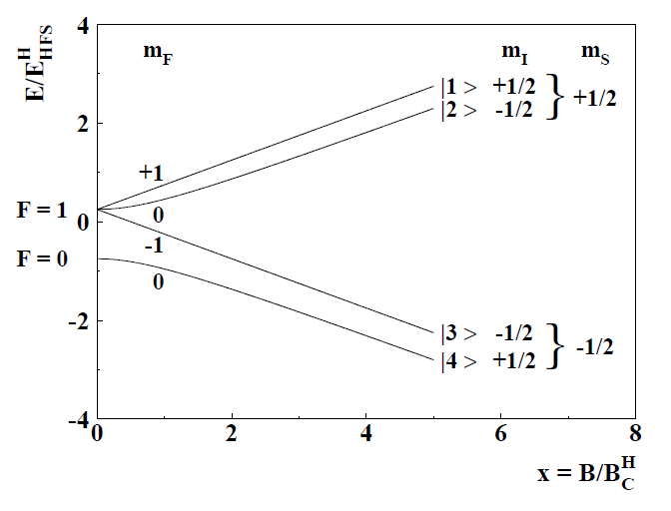
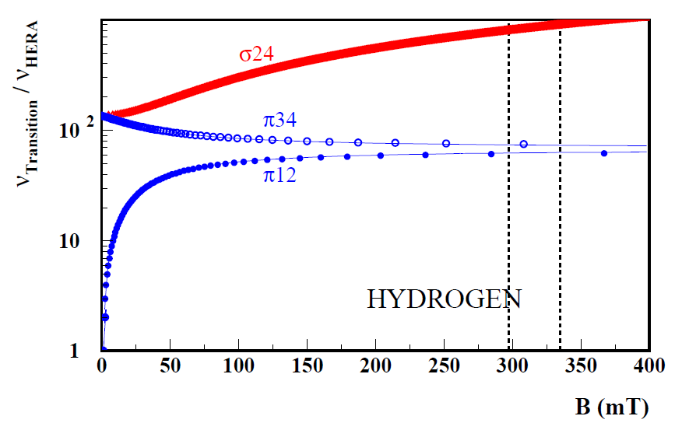
                Beam-induced depolarization (BID)
After its 1st observation at VEPP-3, this effect has been studied at HERMES, see first measurement with B_{long} publ. in PRL 82 (1999) 1164, and analyzed together with B_{transv} in Diss. Ph. Tait, Erlangen (2006): http://www.hermes.desy.de/notes/pub/06LIB/pntait.06-060.thesis.ps.gz .
BID is based on resonant transitions caused by the beam field acting on the polarized H-atoms in an external guide field B₀ ≈ 300 mT. There are different classes of transitions, depending on the relative orientation of the guide field B₀ and B₁, the beam field component.
  π resonances for B_{1 ┴} B₀ ΔF = 0, ±1 Δ_{mF} = ± 1, and
  σ resonances for B₁ ═ B₀ ΔF = ±1 Δ_{mF} = 0.
Some of these resonances change nuclear polarization. For longitudinal guide field, only the π resonances are present. For transverse field, like at LHCspin, both types of resonances are present. The σ resonances, interchanging states 2 and 4, are densely spaced, i.e. its prevention requires a very high homogeneity of the guide field.
1 - 2
2 - 4
3 - 4
Hydrogen hfs diagram
B_{crit} = 50.7 mT
2019-07 PGT Kick-off Ferrara

Slide 8
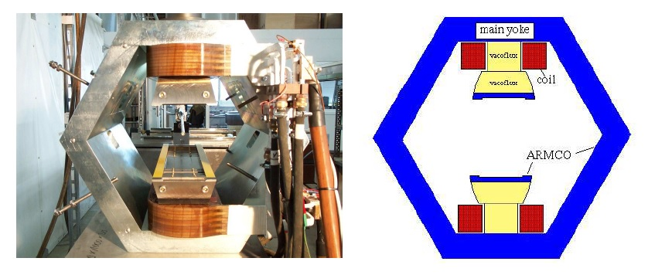
                Transverse guide field magnet (HERMES)
In order to resolve the σ₂₄ resonances, a field homogeneity in the order of their spacing is required (0.37 mT in the high-field limit).
A special magnet with large gap height and high field quality had been built. With the help of shims and correction coils a high homogeneity could be achieved.
2019-07 PGT Kick-off Ferrara
E. Steffens (FAU): PGT - LHC vs. HERA

Slide 9
                Observation of the π resonances
A practical method to detect the π resonances was the wide range Flip-in method: States |1> and |4> are injected by the ABS, and states |2> and |3> are mea-sured by the BRP. With e beam, the population of the cell gas is changed and detected by the BRP.
As an example, the BRP rate is shown as function of the current I in the transverse magnet. The π reso-nances 3-4 and 1-2 are clearly visible. At high field the spacing is wide, and individual resonances can be easily selected.
This is different for the σ₂₄ resonances with narrow spacing. In order to suppress them, the B-field must be set to the minimum in-between.
Wide Range measurement of the π resonances induced by the beam field. At high field, individual resonances can be selected.
2019-07 PGT Kick-off Ferrara
E. Steffens (FAU): PGT - LHC vs. HERA

Slide 10
                HERMES transverse Running (2002-2005)
During transverse running (2002 – 2005), careful studies to optimize the target polari-zation have been performed - see a final result of Diss. Tait on the σ₂₄ resonance taken by the target polarimeter (BRP) where the nuclear polarization P_{z±} is shown as function of B₀.
Two polarization minima caused by the σ₂₄ resonances are clearly visible at a distance in field of about 0.36 mT as expected, demon-strating the high field quality of this rather open magnet. For the WP in between the resonances, a 2% increase in P is obtained.
2019-07 PGT Kick-off Ferrara
E. Steffens (FAU): PGT - LHC vs. HERA

Slide 11
Comparison of BID for HERA and LHC
Key parameters of both machines:
Machine | N_{Bunch} | f_{Bunch} MHz | I_{beam} A | σ_{z} cm | σ_{t} ps | α = 1/σ_{t}² ps² | 1/e width of Fourier spectrum | I₀ Peak current (A)
HERA-e | 210 | 10.41 | 0.04 | 0.93 | 31 | 5.203 10⁻⁴ | 5.1 GHz | 57.3
LHC | 2600 | 40.08 | 1.0 | 7.55 | 253 | 7.81 10⁻⁶ | 0.63 GHz | 41.2
Assumptions:
The trajectories of the MolFlow simulation are equivalent (see Tait Fig. 4.7 on the right: trajectories are shown in red, blue dots at cell wall are wall bounces, blue dots within the cell: crossings of a resonance).
Inhomogeneity equivalent, i.e. the shape of the resonant surfaces are similar (see Tait Fig. 4.6) → duration of resonance crossings have the same statistical distribution.
Beam size very small compared to cell radius
The main differences come from the bunch frequency, and the longitudinal width in z or in t (σ_{z/t}) (see Table).

Slide 12
                Comparison of BID for HERA and LHC
Spin-flip Probability for crossing a σ₂₋₄ resonance, with θ = mixing angle, τ = crossing time and n index of passage (Tait Equ. 4.11):
In summary, the main differences between HERA-e and LHC are:
Bunch frequency f_{B}: 10.41 MHz vs. 40.08 MHz. This results for the LHC in a 4x larger spacing of the ‘resonant B-values’, i.e. it reduces requirements on field quality.
Width of the Fourier spectrum: 5.1 GHz vs. 0.63 GHz. This leads to a rapid fall-off of the relevant Fourier amplitudes of the σ₂₋₄ resonance (8.54 GHz) at the LHC.
The comparison suggests that BID at the LHC is less dangerous as at HERA-e! - Clearly, this needs to be confirmed by a systematic study of BID at the LHC!
B|| is the RF field parallel to B₀ (guide field, ≈ 300mT),
B|| = B₀ for θ = 90°.
With our assumptions, we estimate the relative strength of BID by the ratio of the square of B|| for both beams. For the k-th harmonic of the Fourier spectrum (Tait 2.59) we obtain at the σ₂₋₄ transition frequency of 8.54 GHz with the parameters of the table
LHC: F₂₁₃ = 2 ∙ 1.0 A ∙ 1.53 10⁻²⁰
HERA: F₈₂₀ = 2 ∙ 0.04 A ∙ 7.53 10⁻²
We conclude that resonant depolarization at the LHC via the σ₂₋₄ transition is negligible compared to HERA, despite the 25x higher beam current!
2019-07 PGT Kick-off Ferrara
E. Steffens (FAU): PGT - LHC vs. HERA

Slide 13
                Estimate of the areal density of the PGT
Assumed:
I_{H} (100 % HERMES ABS flow) = 6.5∙10¹⁶/s, may be limited by LHC vacuum constraints or space limitations for the PGT;
Cell 30 cm long, 1.0 cm i.d., at 100K, with standard feed tube 10 cm long, 1.0 cm i.d.
The resulting 100% density of the polarized gas target is θ = 1.2 ∙ 10¹⁴/cm², comparable with HERMES.
For the future HL-LHC-25ns, the Luminosity achievable with the PGT would be up to 8.3 ∙ 10³²/ cm² s. To which extent such densities can be realized and exploited in a real experiment, depends on many factors and has to be investigated in more detail.
2019-07 PGT Kick-off Ferrara
E. Steffens (FAU): PGT - LHC vs. HERA

Slide 14
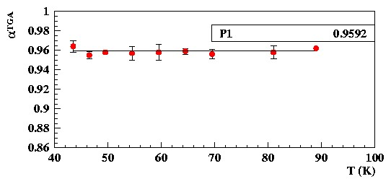
                Important open problem (there are more…)
Cell surface with a-C coating: needs a thin water/ice layer to suppress recombination (and thus depolarization)
see HERMES measurement indicating close-to-zero recombination!
A water layer can be produced in dynamical equi-librium by injecting a low water fraction together with the polarized H atoms, set by the O₂ admix-ture in the dissociator gas H₂. The setting of T_{cell} has a strong effect, too; i.e. lowering T results in a thicker water layer at the same O₂ flow.
The SEY of this surface is not known to us and needs to be studied.
HERMES-target: Degree of dissociation α as function of the cell temperature T. The cell was in use for an extended period (not a new cell).
note: α = 1 indicates no molecules detected by TGA!
2019-07 PGT Kick-off Ferrara
E. Steffens (FAU): PGT - LHC vs. HERA

Slide 15
Thank You !

