Slide 1
Production of Electrodes for the ‘small FTM’
Piet Verwilligen INFN Bari 18-06-2019

Slide 2
Reminder: Design of the small FTM
Main Idea:
- well isolated low noise detector to demonstrate the FTM principle: time resolution vs number of layers
- Make small area prototype, with only 2 electrodes: top & bottom
- Go back as much as possible to the design of the original prototype (with resistive kapton XC)

Slide 3
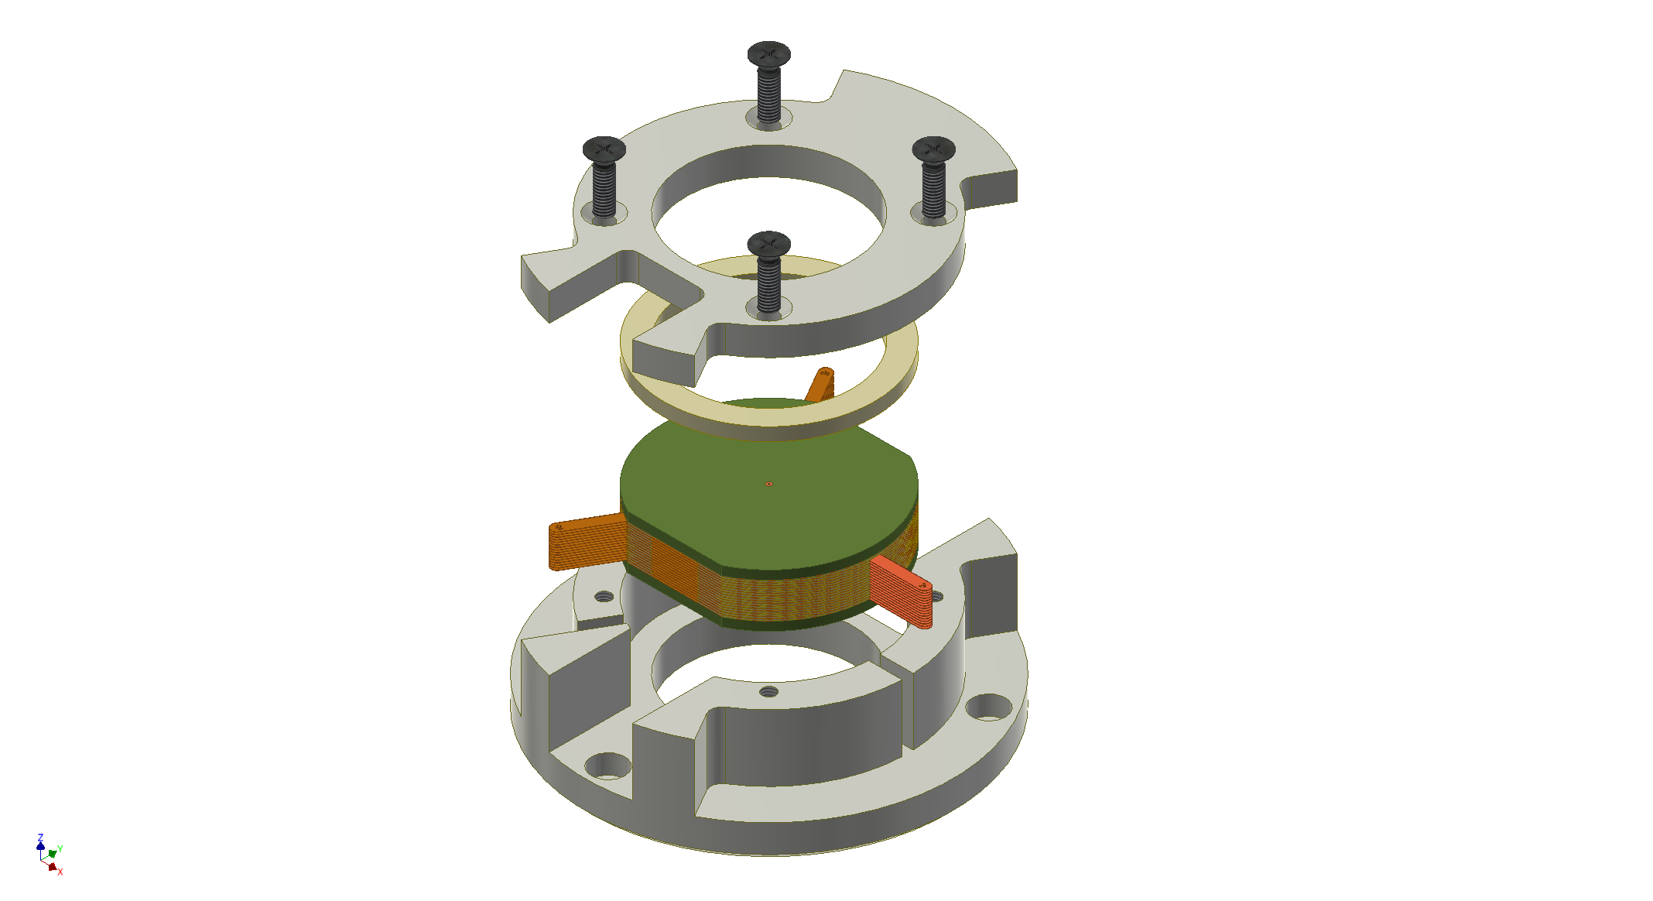
Mechanical Design Internal Foil holder

Slide 4
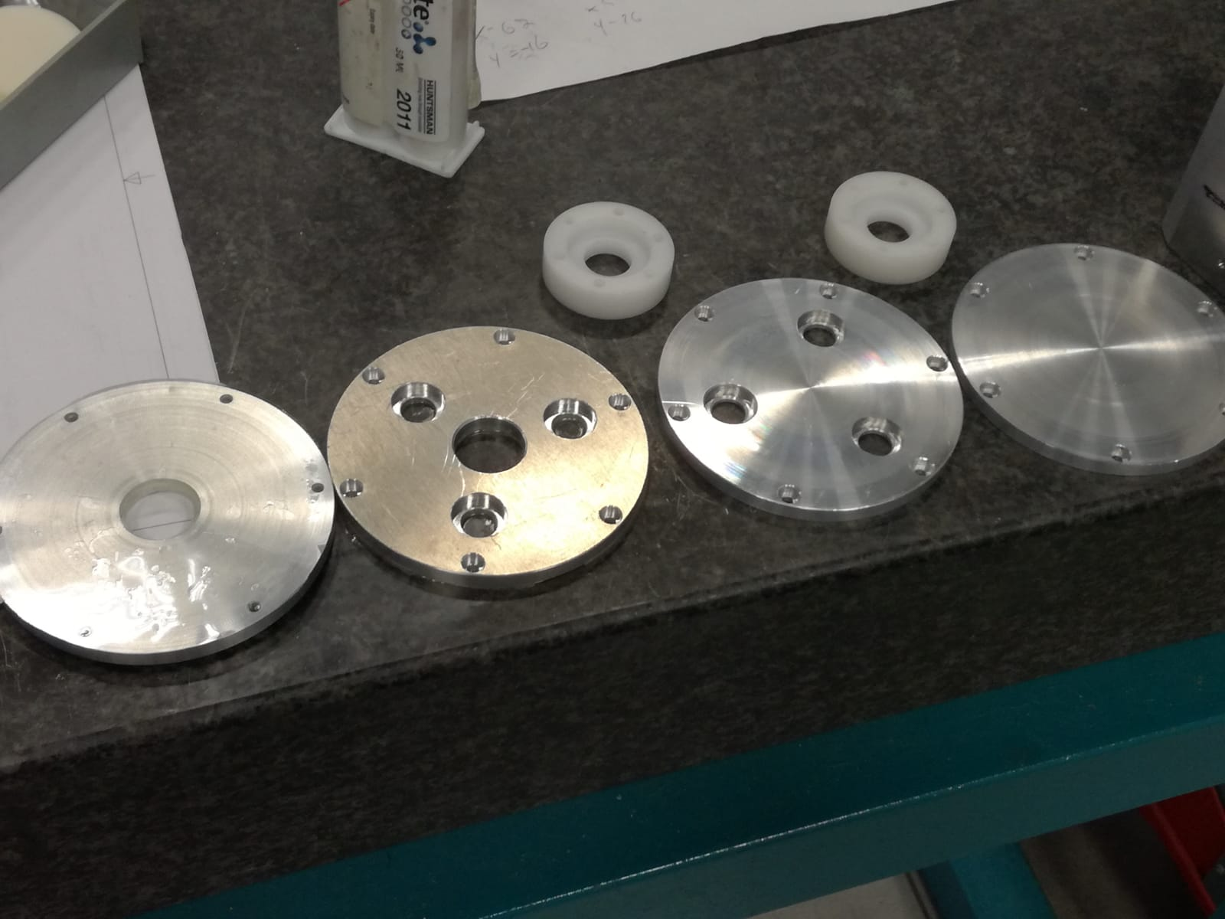
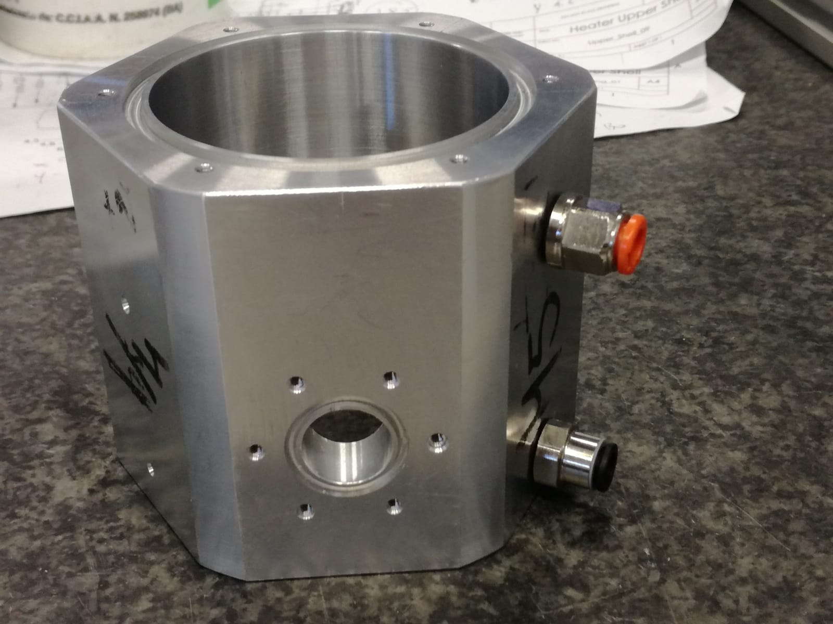
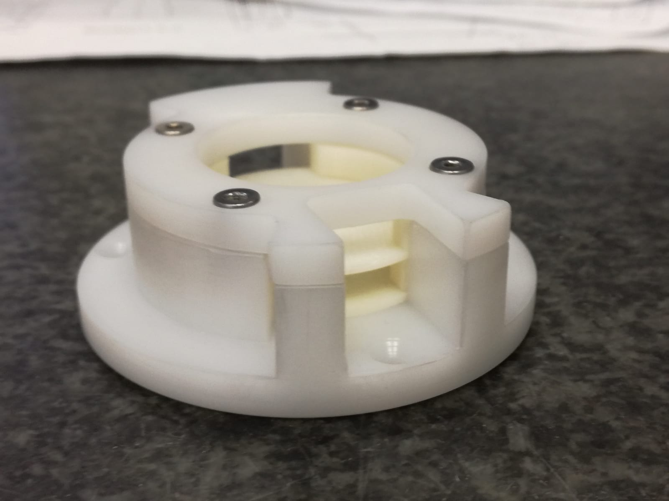
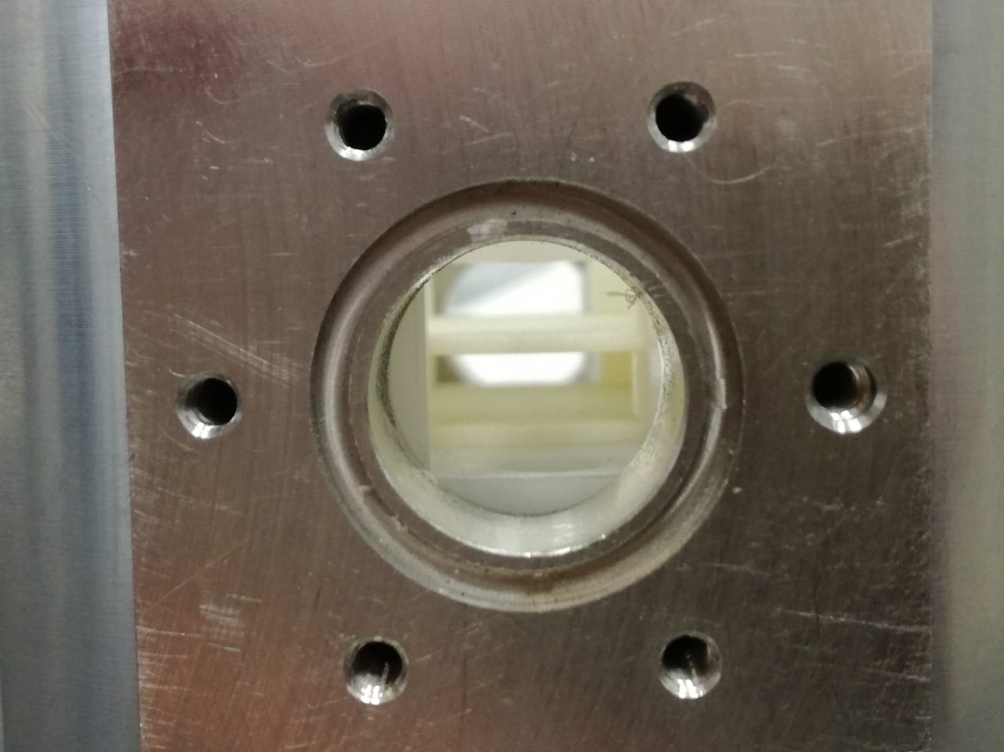
Mechanical Design External + Internal holder

Slide 5
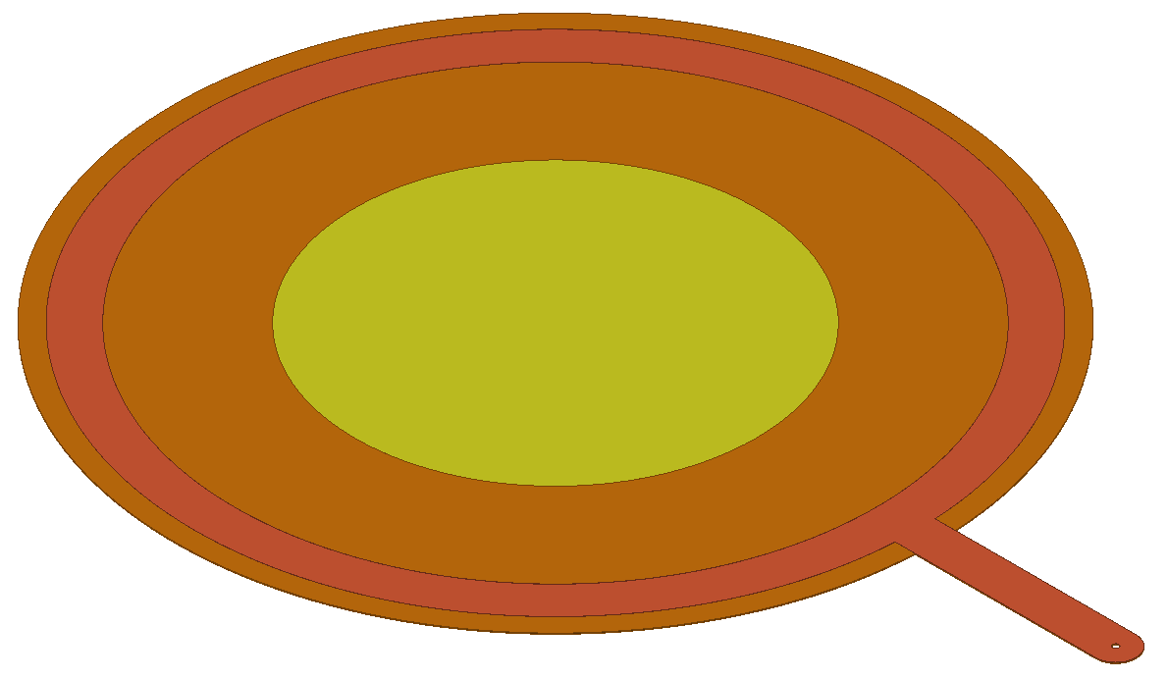
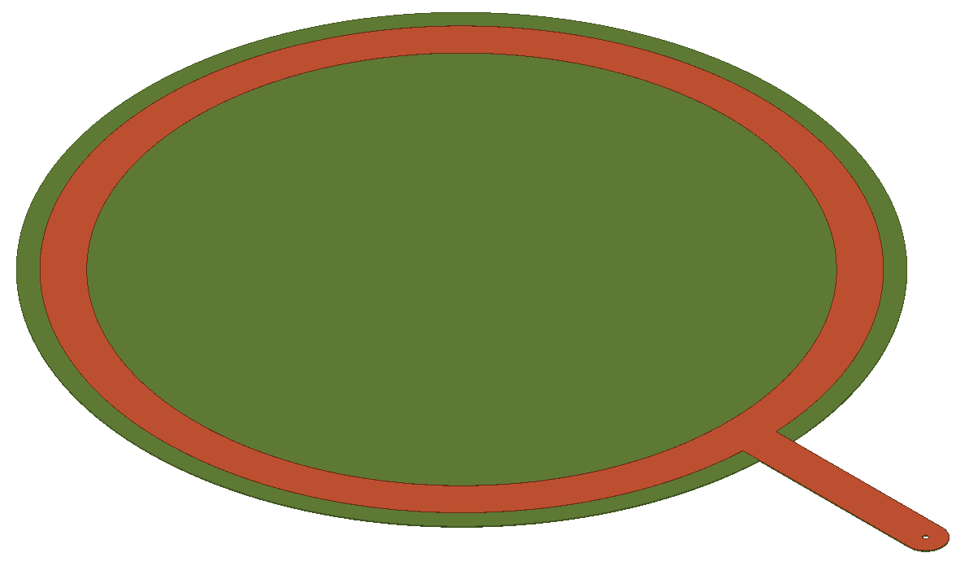
Disks to be produced by EP-DT-EF-MPT Workshop
DLC Coated (USTC) 50um thick Polyimide r_{disk} = 19 mm
Both disks:
r_{disk} = 19 mm
Cu electrode with «tongue» r₁=16mm, r₂=18mm
«Amplification foil» (2x)
DLC covered Polyimide (50um)
Active Area: r_{active} = 10 mm
50um holes at 140um pitch
Top hole diam: 50um, bottom hole diam: 70um
«Drift foil» (4x)
Resistive Kapton XC (25um)
Yellow: active (holes) r_{active} = 10 mm Orange: plain DLC
Cu ring (5um thick) r₁=16 mm, r₂=18mm
Resistive Kapton XC

Slide 6
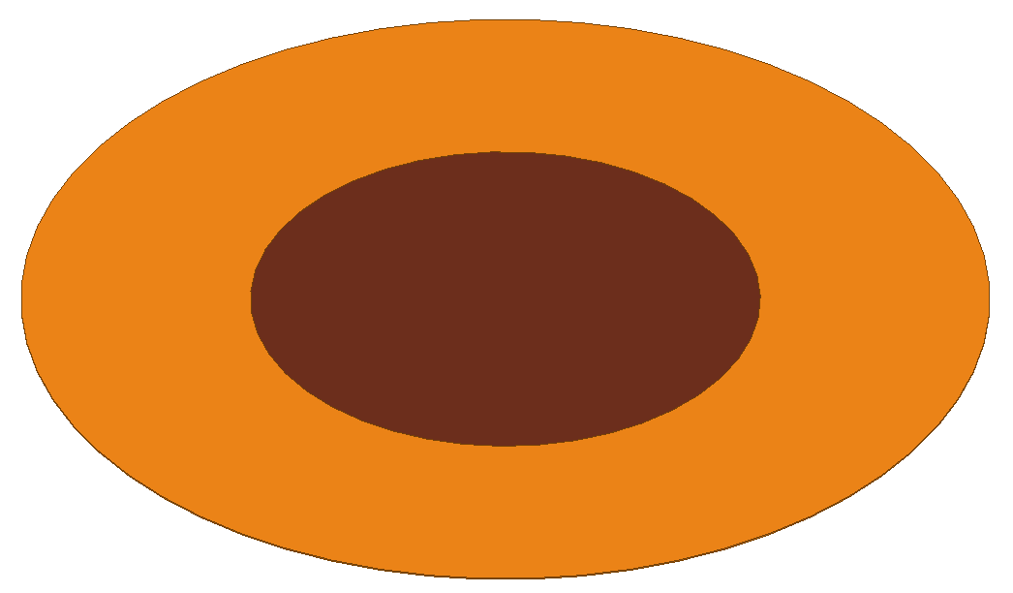
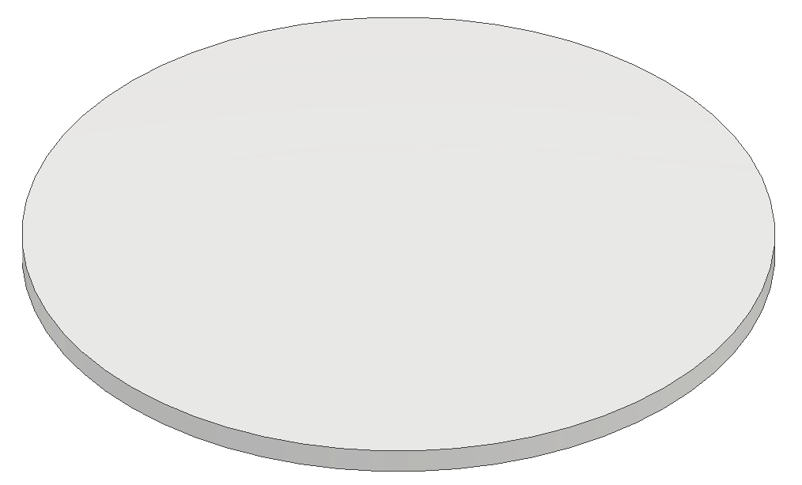
Disks to be produced by EP-DT-EF-MPT Workshop
50um thick Polyimide r_{disk} = 19 mm
Both disks:
r_{disk} = 19 mm
«Readout foil»
Plain 50um polyimide foil
Central Cu disk (r_{active} = 10 mm)
Central via that allows to solder wire at the bottom side of the readout foil
«Insulation foil»
Mylar
As thin as reasonably possible: 5-10um
Cu (readout) 5um r_{active} = 10 mm with central via to solder wire
Mylar (5-10um)

Slide 7
Detection Concept: Single detection layer of FTM
Signal Wire (to SMA)
Outline of a Single Detection layer for the small FTM
I want to make the detector with 2 layers of 5mm drift
Spacers made by INFN-Bari
Important to have via on top and bottom Readout foil
If signal can be picked-up and discriminated then I will go to 4 layers of 2.5mm; 8 layers of 1mm; …
I would like to order:
2 x Readout foil
4 x Drift foil
2 x Amplification foil
2 x thin Mylar disk
Design is very simple, DXF available, need conversion to GERBER
Top Readout (PI)
Mylar Isolation (thin)
Drift Electrode (XC)
Gas Gap (5mm)
Amp Electr (DLC + PI)
Bottom Electrode (XC)
Mylar Isolation (thin)
Bottom Readout (PI)
Signal Wire (to SMA)

