Slide 1
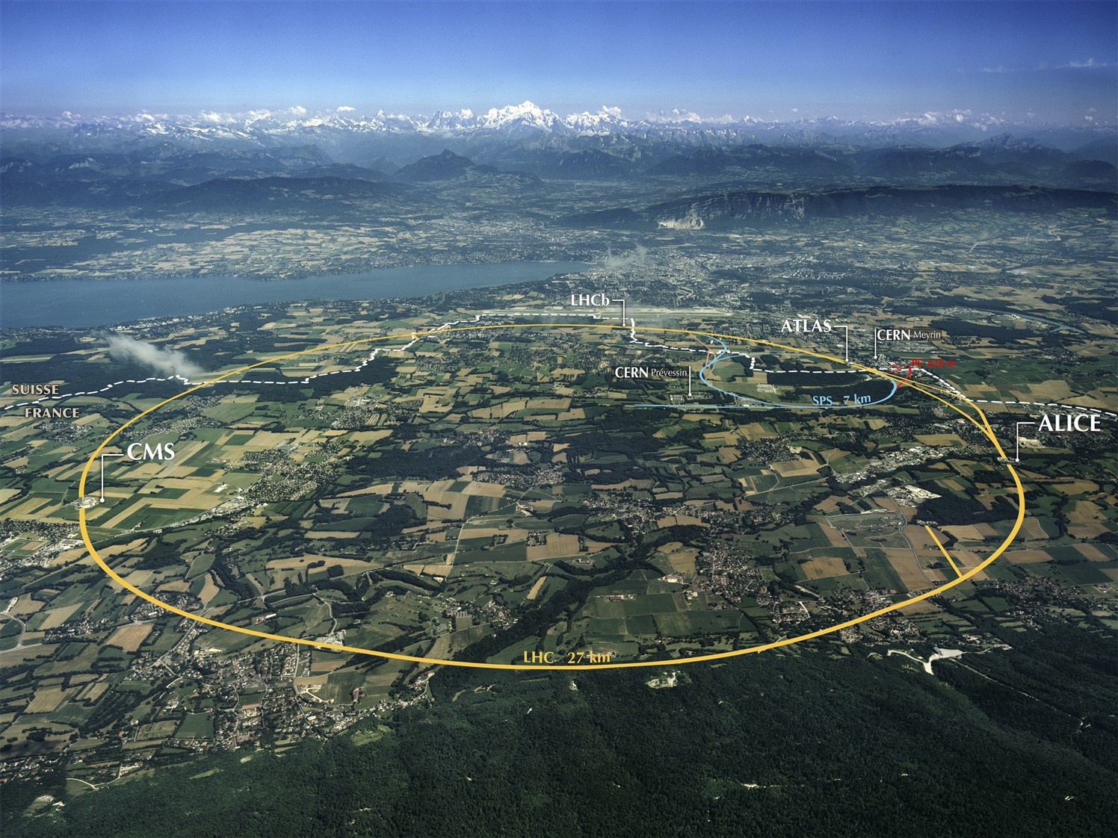

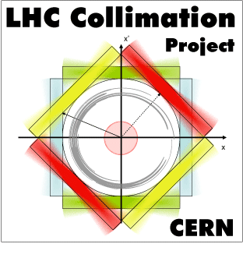

Status-of-art
LHC machine crystal simulations
D. Mirarchi,
A. Fomin, S. Redaelli, W. Scandale
Workshop on electromagnetic dipole moments of unstable particles
Milano, 4th October 2019

Slide 2

Outline
LHC Collimation and layout conceptual idea
Layout design
Operational scenario
Expected performance
Conclusions

Slide 3
Outline
LHC Collimation and layout conceptual idea
Layout design
Operational scenario
Expected performance
Conclusions

Slide 4
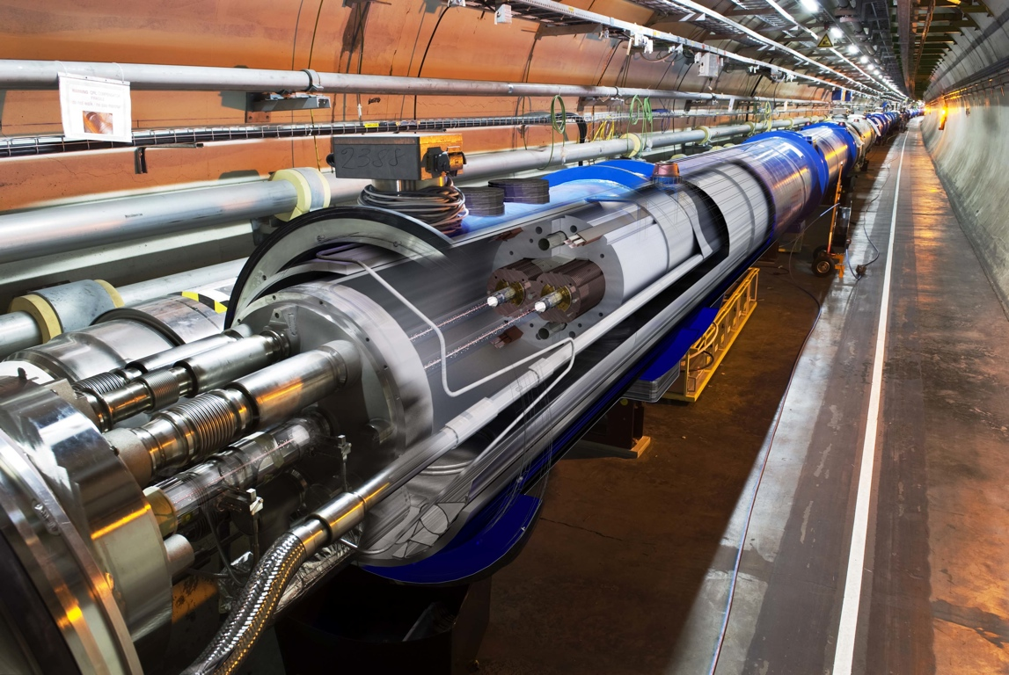
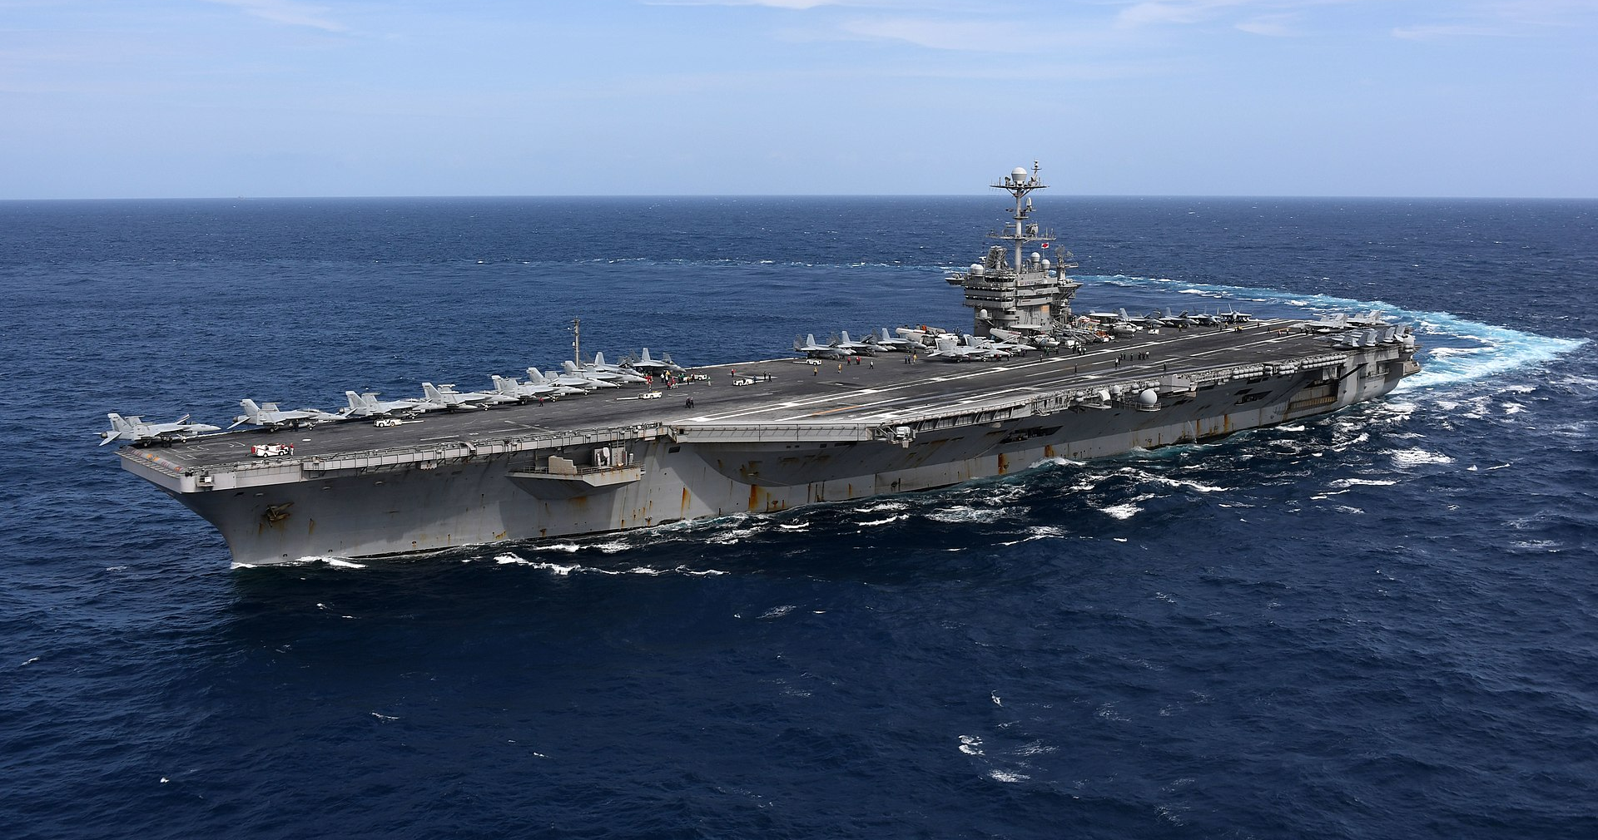

Introduction
The LHC: biggest and most powerful particle accelerator ever built
What does it mean?
Stored energy
Quench limit
LHC design 360 MJ
15-50mJ/cm³
And in HL-LHC stored energy
increased to ~ 700 MJ
USS carrier (Nimitz-class)
At ~5.2 knots
Ladybug at same speed
Very sensitive machine, several constrains for operations with high intensity beams!
Highly efficient collimation system needed for a safe beam disposal at any time!

Slide 5
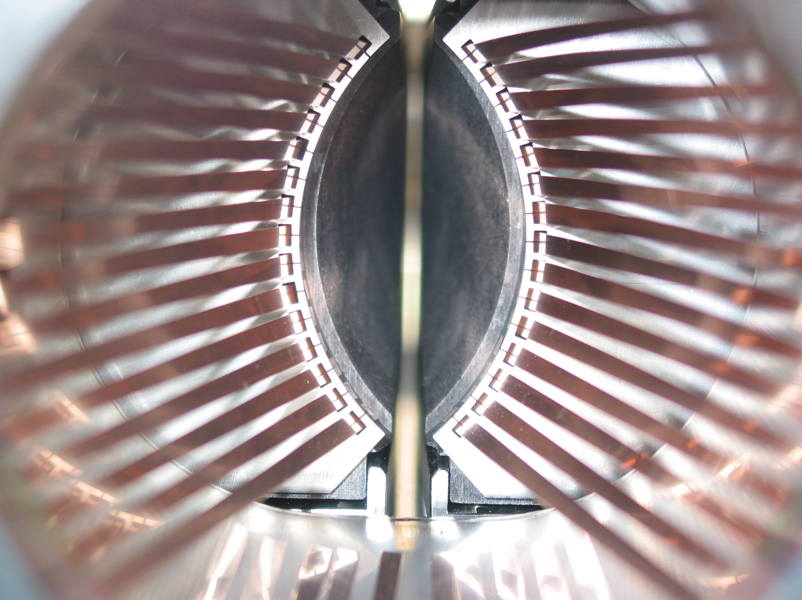
LHC collimation system
Cold
Warm
Cold
Secondary halo
Tertiary halo
+ hadronic shower
Circulating
beam
Primary halo
Insertion
Arc
IP
Protection
Devices
(TCD)
Primary
Collimators
(TCP)
Secondary
Collimators
(TCSG)
Absorbers
(TCLA)
Tertiary
Collimators
(TCT)
Bottleneck
Multi-stage cleaning with about 50 collimators per beam,
two dedicated insertions
Movable collimators:
ensure required performance along the entire cycle
Beam
At 6.5 TeV/c: ~2 mm gap with 5 μm resolution!

Slide 6
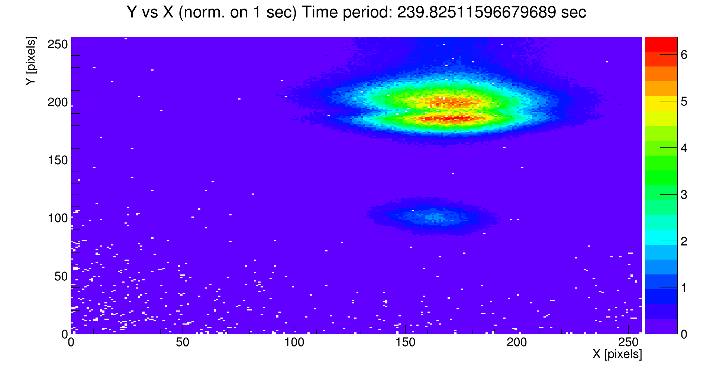
Conceptual idea
Beam halo deflected by a bent crystal (Crystal 1) : aperture Crystal 1 > TCP
Deflected halo impacts on a target
Interaction products channelled by a second bent crystal (Crystal 2)
Dedicated absorber to intercept deflected halo that did not interact with target
Deflected halo
by Crystal 1
Double channelling scheme proved at SPS by UA9!
Channelling of secondary halo proved at LHC!
Shadow
Crystal 2
Second channelling
by Crystal 2!
A. Natochii
D. Mirarchi, Workshop on electromagnetic dipole moments of unstable particles

Slide 7
Outline
LHC Collimation and layout conceptual idea
Layout design
Operational scenario
Expected performance
Conclusions

Slide 8
Main goals and constraints
Main goals:
Maximise the proton on target (PoT) while keeping the losses on
superconducting magnets below standard collimation losses
Maximise number of Λ_{c} at the exit of Cry₂, given the acceptance of the detector
Main constraints:
Space availability
Enhance the displacement of channelled halo and channelling efficiency of multi-turn halo
Absorption efficiency of interactions products
Clearance between deflected halo and machine aperture & circulating beam
Avoid the possibility to get hit by the beam during an asynchronous dump

Slide 9
Simulation tools
Semi-analytical tools developed for quick evaluation of feasible layouts
Complete multi-turn simulations using SixTrack
6D and fully chromatic tracking taking into account interaction with collimators and aperture model of the machine
Dedicated routine to treat interactions in bent crystals
Benchmarked in the energy range from 180 GeV/c to 6.5 TeV/c
Prediction of expected density of protons lost with accuracy of 10 cm over 27 Km!

Slide 10
Optimized layout in IR8
Natural choice: use of LHCb detector given its asymmetric orientation (Beam 1 direction)
4 LHC-type collimators
Cry1
can be revised as a function of the operational scenario
Bending = 150μrad
Length = 1.2cm
R = 80 m
Angular cut ~60 μrad
5 mm long target of W (can be tuned depending on experimental needs)
Bending angle Cry2 = 14 mrad, length = 7cm: send decay products into LHCb acceptance

Slide 11
Optimized layout in IR3
Still Beam 1 orientation: possible debris from absorbers goes to IR4 rather than to ALICE
Warm insertion as opposed to the superconducting magnets present in IR8
Angular cut ~20 μrad
Cry1
Bending = 50μrad
Length = 4mm
R = 80 m
Mirror layout in Beam 2?
Same parameters as crystals in LHC!
5 mm long target of W (can be tuned depending on experimental needs)
Bending angle Cry2 = 5 mrad, length = 7.5 cm (avoid double channelling of 6.5 TeV protons)
Drift space of about 70 m to fit a dedicated experimental apparatus

Slide 12
Outline
LHC Collimation and layout conceptual idea
Layout design
Operational scenario
Expected performance
Conclusions

Slide 13
Operational scenario definition
Observable: is the loss pattern affected by the insertion of the Cry₁+target+Cry₂ assembly?
NO: measurements during standard physics operations could be allowed
Parasitic operations
YES: limit on maximum stored intensity
Dedicated operations
LHC running configuration in 2018 used
Dedicated optics would imply dedicated operations
β Coll.
TCP
TCSG
ATLAS
δp/p
Coll.
ATLAS
CMS
TCLA
Dump
LHCb
IR7-DS
ALICE
RF

Slide 14
Maximum stored intensity
Several configuration tested: Cry₁ from 5σ to 8σ with 1σ step
IR8 layout:
Cry₁ at 5 σ
(as IR7-TCPs)
Cry₁ at 6 σ
Losses compatible only with dedicated operations
(i.e. maximum ∼250 bunches)
Losses compatible with parasitic operations (i.e. ∼2500 bunches)
Cry₁ at 5 σ
(as IR7-TCPs)
Losses always compatible
with parasitic operations
(i.e ∼2500 bunches)
IR3 layout:

Slide 15
Outline
LHC Collimation and layout conceptual idea
Layout design
Operational scenario
Expected performance
Conclusions

Slide 16
Expected PoT
Loss sharing
H/V planes
Cry₁ channeling
efficiency
Flux of proton lost
taking into account burn-off in 4 IPs
Fraction on impacts
on the Cry₁
IR8 layout
IR3 layout
Cry₁ at 5 σ excluded for both layouts due to machine protection constraints
Values at 5 σ to be considered as the asymptotic performance reach

Slide 17
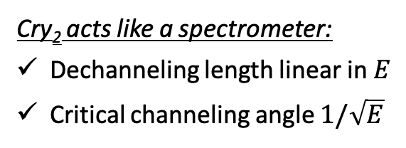
Λ_{c} channeling efficiency
Impacting distribution of protons on the target from SixTrack
Distribution of Λ_{c} emerging from target obtained with Pythia8.240
Expected channeling efficiency of Cry₂
Cry₂ acts like a spectrometer:
Dechanneling length linear in $E$
Critical channeling angle $1/\sqrt{E}$
Decay of Λ_{c} in the Cry₂ taken into account as:

Slide 18
Expected Λ_{c} yield in a 10h fill
Total Λ_{c} production
in 5mm long W target
Λ_{c} channeling
efficiency
Integrated PoT
over 10h
Λ_{c} spectrum
Decay in the target
~70 Λ_{c}
~10⁴ Λ_{c}
Significantly larger integrated yield of Λ_{c} in IR3
For both layouts Cry₁ at 5σ to be considered as the asymptotic performance reach

Slide 19
Optimized operational scenario
Main question: what is the minimum settings achievable for the Cry₁?
  Avoid to become primary collimation stage
  Avoid high cold losses for both channeling and amorphous orientation
  Avoid dump on losses in case of lifetime drops
Both layout could be used in parasitic mode and full machine with Cry₁ at 5.5 σ!
Expected PoT(t) rate
Expected Λ_{c} yield in a 10h fill
~200 Λ_{c}
~10 Λ_{c}

Slide 20
Margins and further constraints
Increased target length
To be studied in detail increase of losses in the machine (bkg to the detector, etc…)
Germanium crystals
To be studied in detail increase of Λ_{c} channeling efficiency
Factor 2 in bunch in intensity in HL-LHC (hard to scale tails pop. and diffusion rate, i.e. PoT)
Selective bunch train excitation in the vertical plane
To be studied in detail luminosity loss in main experiments
Challenging conditions in HL-LHC (Crab-Cavities failure, optics correction, …)
Allowed Cry₁ settings may be larger than the 5.5 σ considered in these studies
Maximum sustainable PoT rate during operations and failure scenarios to be defined
LHCb experiment is operated at levelled luminosity: dynamic setup changes

Slide 21
Outline
LHC Collimation and layout conceptual idea
Layout design
Operational scenario
Expected performance
Conclusions

Slide 22
Conclusions
Studies for fixed-target experiments on-going in the Physics Beyond Collider framework
Design of two possible layouts finalized
IR8 to profit ot the LHCb detector
IR3 to overcome intrinsic limitations in IR8
Intrinsic limitations in IR8:
Bending of Cry₂ of at least 14mrad (LHCb acceptance)
Proximity to IP8 leads to large angular cut of absorbers and Cry₁ bending
Main limitation of IR3:
Dedicated detector to be built (70 m of available longitudinal space)
Expected PoT(s) with optimized scenario ~10⁶ p/s, leading to ~10(200) Λ_{c} per fill in IR8(IR3)
Paper accepted for publication on EPJC

Slide 23
Outline
Thank you for your attention!

Slide 24
Outline
BACKUP

Slide 25
Further considerations
Controls:
Crystals and target inserted only in SB and to be considered as VELO and XRP
Static limits on position to safely dump if devices accidentally moved
Impedance:
Optimized design needed for all components to be inserted with high intensity beams
Vacuum:
Present IR7 goniometers already compliant with all constraints
Operations:
Same commissioning, validation and operations as XPRs
ecloud:
Present IR7 goniometers never exposed to 25ns beams: SEY meas. recommended
Background to experiments:
No impacts expected on loads on TCTs
Assessment of local losses under the responsibility of LHCb

Slide 26
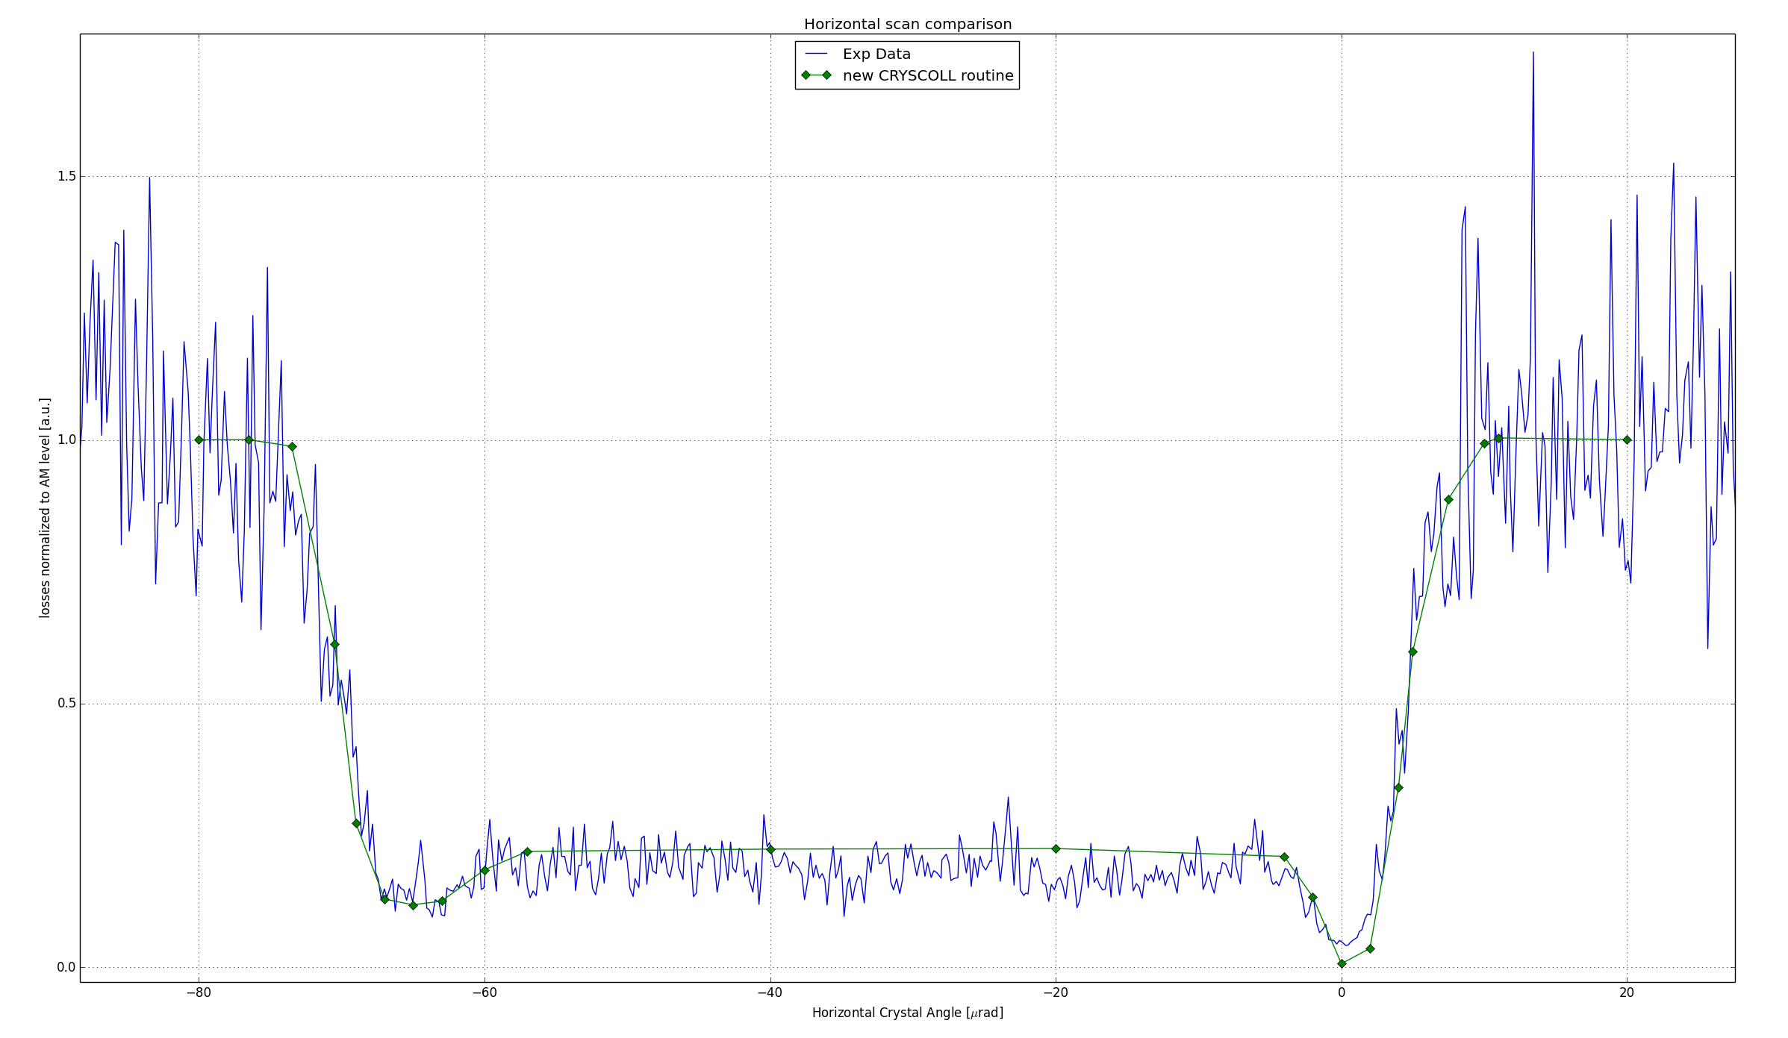
Code Benchmarking
Crystal routine physics:
D. Mirarchi, et al, “Crystal implementation in SixTrack for proton beams.”,
CERN Yellow Reports: Conference Proceedings (CERN, 2018).
URL https://cds.cern.ch/record/2646800
Examples of benchmarking:
At the SPS extraction line (180 GeV/c & 400 GeV/c)
In the SPS and LHC rings
(270 GeV/c, 450 GeV/c, 6.5 TeV/c)
Coherent effects
Nuclear interactions
Angular scan at 6.5 TeV/c
NIMB 355, 378 (2015)
NIMB 355, 378 (2015)
LHC: CERN-THESIS-2017-424
SPS: CERN-THESIS-2015-099

Slide 27
Channeling efficiency in LHC (I)
450 Z GeV/c lead beams

Slide 28
Channeling efficiency in LHC (II)
6.5 Z TeV/c lead beams

Slide 29
Channeling efficiency in LHC (III)
~50 urad bending
4 mm long
~65 urad bending
4 mm long
Too close to critical bending radius!
Known poor nuclear channeling description in the routine for these extreme bendings

Slide 30
Cry₁ channeling efficiency

Slide 31
Integrated PoT
IR8
IR3

Slide 32
Local losses Cry₁ at 5σ in IR8

Slide 33
Source of losses with Cry₁ at 5σ in IR8
Main limitations:
Large angular cut from TCSGs due to large β
Significant single diffractive production in the Cry₁ due to required length

Slide 34
Λ_{c} spectrum

Slide 35
Impacts distribution on target

Slide 36
LHC running conditions
Sharing losses
H/V planes
CH eff. of the Cry₁
Flux of proton lost
taking into account burn-off in 4 IPs
Fraction on impacts
on the Cry₁
Estimated protons lost in IR7 during 2017 using RadMon ~ 1.7e15
Estimated protons lost in IR7 during 2017 using formula above ~ 1.6-2.1e15
Assuming 2018 running conditions and:
τ = 200h
τ_{BO} = 20h
256 bunches with 1.1x10¹¹ p per bunch for Cry₁ in IR8 at 5 σ
2556 bunches with 1.1x10¹¹ p per bunch for all other scenarios
Fill length = 10 h

Slide 37
LHC parameters in 2018

