Slide 1
Overview of channeling in bent crystals
Vincenzo Guidi
guidi@fe.infn.it
University of Ferrara and INFN - Italy

Slide 2
Outline
Orientational coherent interactions in bent crystals
Experiments with bent crystals at different energies and particles
Summary

Slide 3
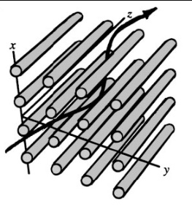
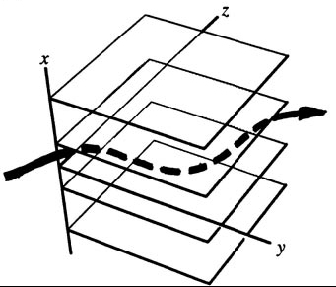
Orientational coherent interactions in bent crystals
Channeling is the confinement of charged particles traveling through a crystal within atomic planes or strings
Planar Channeling
Axial Channeling
Channeling occurs as the trajectory of particles forms an angle lower than the critical angle [1]
[1] J. Lindhard, K. Dan. Vidensk. Selsk. Mat. Fys. Medd. 34 (1965) 14.

Slide 4
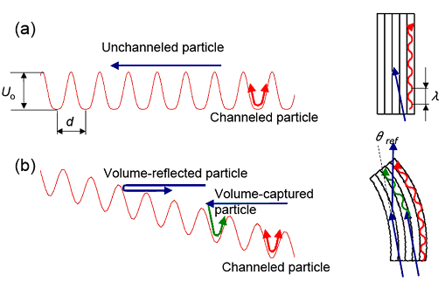
Planar phenomena
(a) Straight Crystal
(b) Bent Crystal
Volume reflection was predicted by Taratin and Vorobiov in 1988

Slide 5
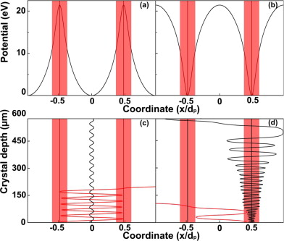
Positive- vs. negative-particle dechanneling
Channeled negative particles are dechanneled faster than positive ones due to higher probability to suffer incoherent scattering with nuclei.
Ultra thin bent crystals are required for efficient deflection of negative particles

Slide 6
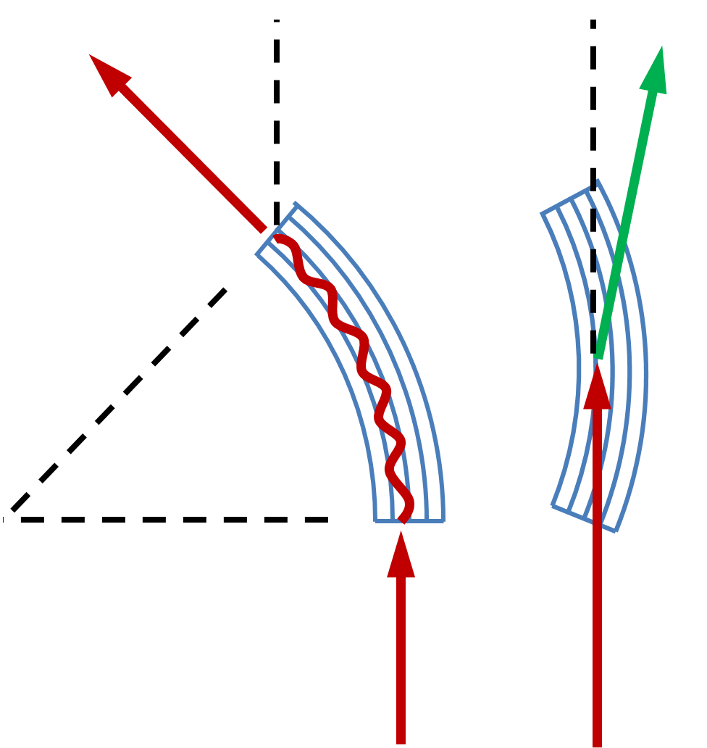
Channeling and volume reflection in a bent crystal
~θ_{bending} [1]
~θ_{critical} [2]
Bent crystals can be used in an accelerator for particle beam manipulation:
extraction of particles from the circulating particle beam;
collimation of the beam;
focusing
splitting
With short bent crystals (~ mm), it is possible to deflect ultra-high-energy particles in CERN (SPS or LHC) with angles (100 µrad – 1mrad) achievable by 1000 Tesla magnets having a similar size.
θ_{bending}
[1] Tsyganov (1976)
[2] Taratin and Vorobiov (1988)

Slide 7
Labs for channeling experiments
2 MeV
3-10 GeV
INFN exp.
Since 2003
NTA_HCCC
Coherent
Icerad
Chanel
Axial
CRYSBEAM
UA9
0.195 – 0.855 GeV
120-270 GeV
400 GeV
7 TeV
SPS
LHC

Slide 8
Sub-GeV electrons
195-855 MeV
CHANEL exp. & X1 experiments
195-855 MeV electrons
Mainzer Mikrotron – University of Mainz (Germany)

Slide 9
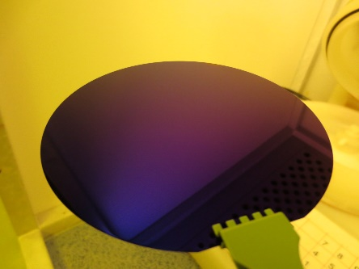
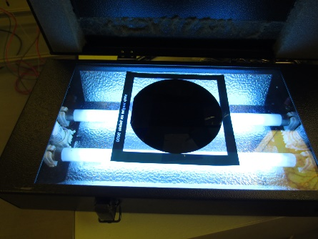
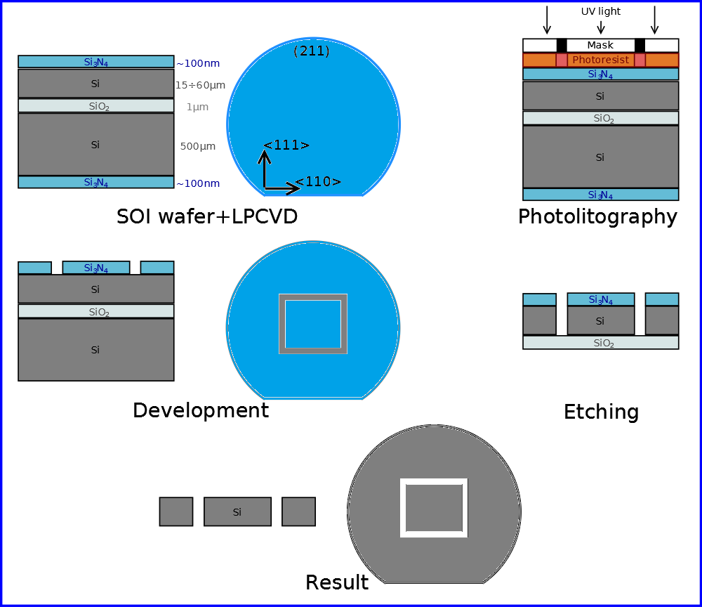
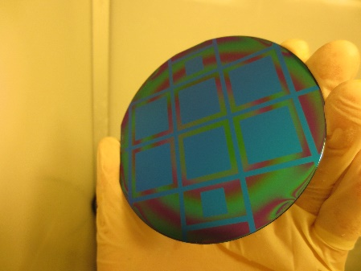
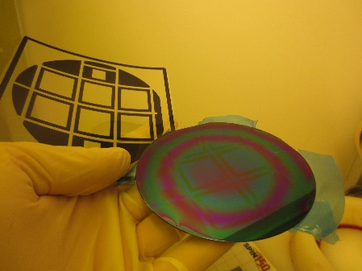
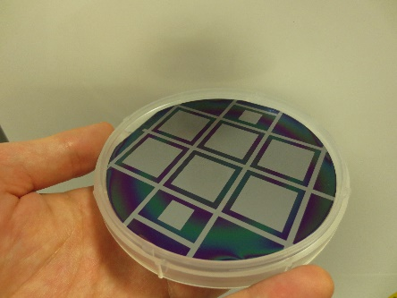
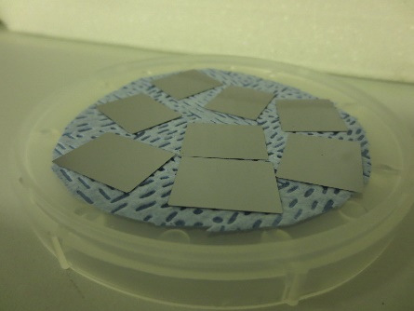
Quasi-mosaic crystals fabrication
G. Germogli, A.Mazzolari et al., Nucl. Instr. Meth. B 355 (2015)

Slide 10
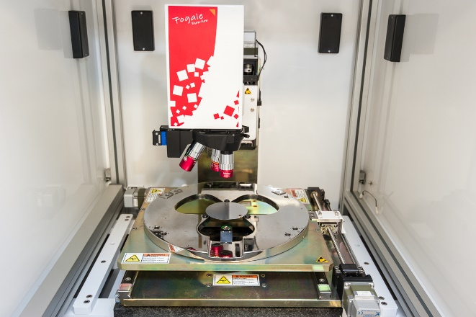
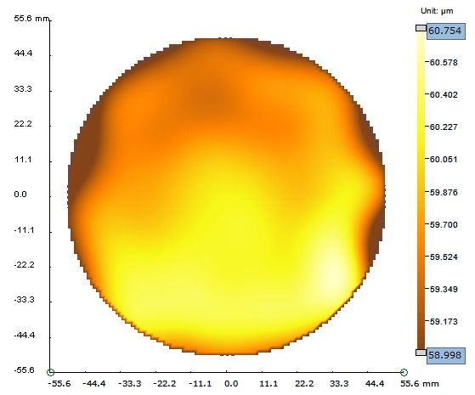
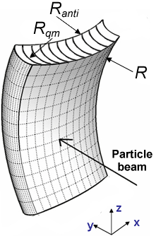
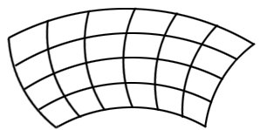
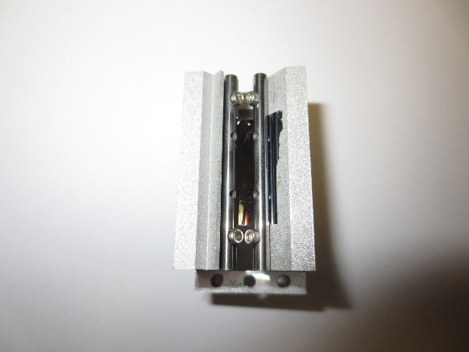
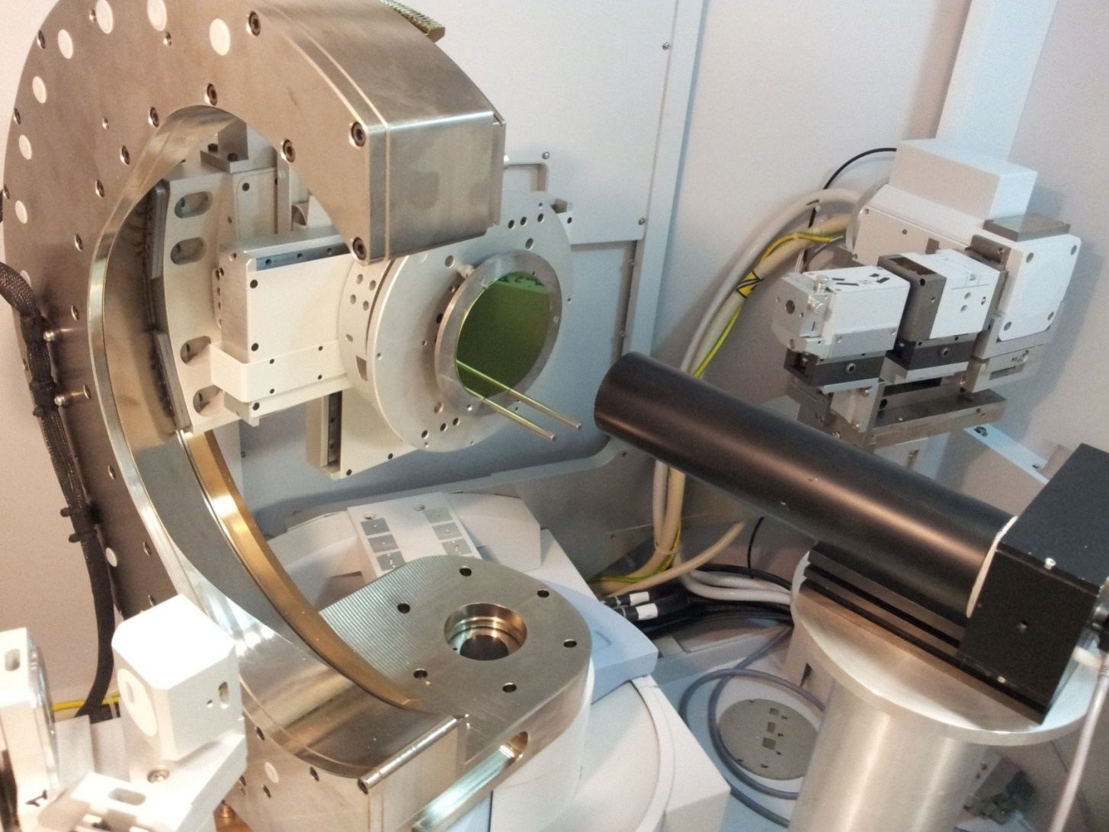
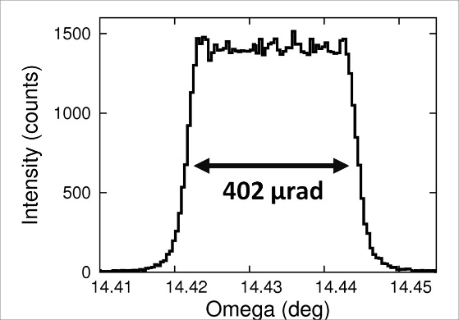
Crystal bending and characterization
<211>
<111>
[1] Y. M. Ivanov, JETP Lett. (2005).
FOGALE TMAP 4: thickness measurement
Quasi-mosaic crystal [1]:
Anticlastic curvature suppressed due to strong bending along principal direction
Crystal mounted onto bending holder
Panalytical X’pert Pro x-rays: bending angle estimation

Slide 11
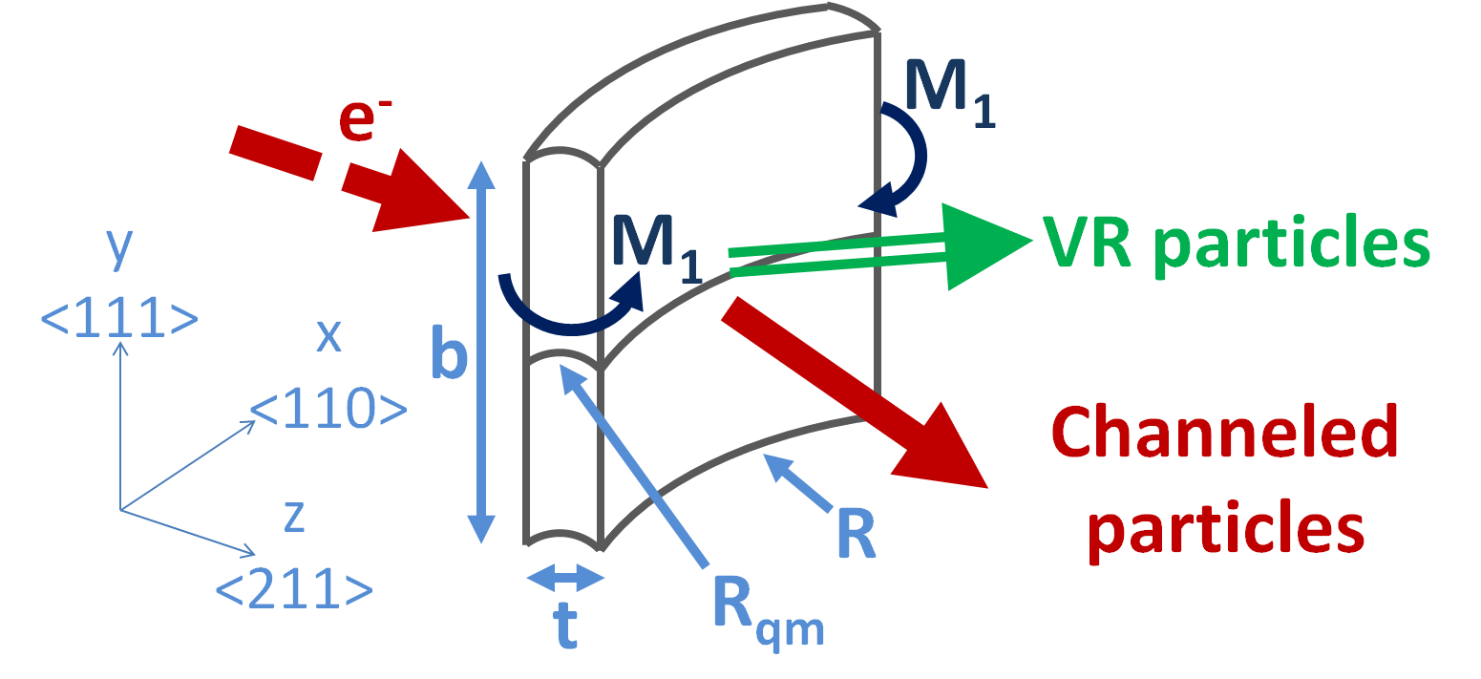
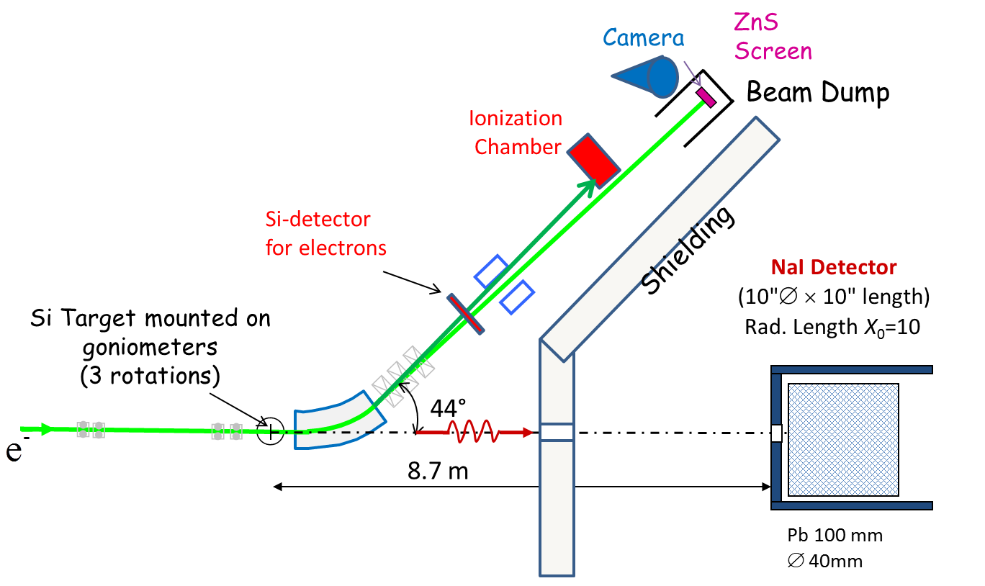
Experimental setup at the MAinzer MIkrotron
Crystal parameters:
T = 30.5 µm
R_{qm} = 33.5 mm
(111) Bent planes
U₀= 23 eV
θc= 220 µrad
855 MeV electron beam characteristics:
Beam-Spot size σ_{hor} = 200 µm,
Beam Divergence σ'_{hor} = 70 µrad
Beam-Spot size σ_{vert} = 70 µm,
Beam Divergence σ'_{vert} = 30 µrad
D. Lietti et al. Rev. Sci. Instr. 86 (4), 045102 (2015)

Slide 12
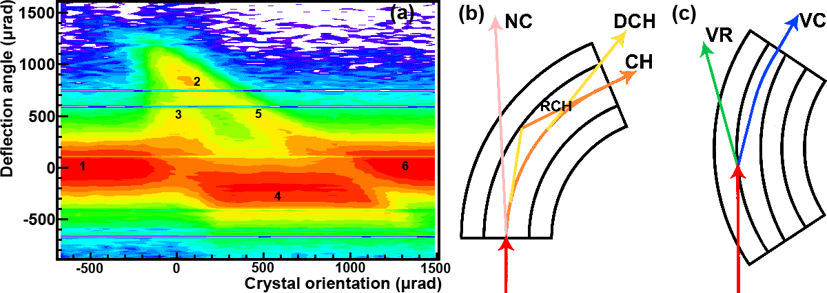
Experimental results on beam steering
(a) Angular scan for deflected beam distribution: (1) and (6) nonchanneling regime; (2) channeling; (3) dechanneling; (4) volume reflection; and (5) volume capture.
(b) Crystal aligned with the beam: multiple scattering causes dechanneling and rechanneling.;
(c) crystal is not aligned with respect to the beam, but the beam trajectory becomes tangent to the atomic planes inside the crystal bulk. VR or the competitive process of volume capture occurs.
A. Mazzolari et al., Phys. Rev. Lett. 74 (2014) 2740

Slide 13
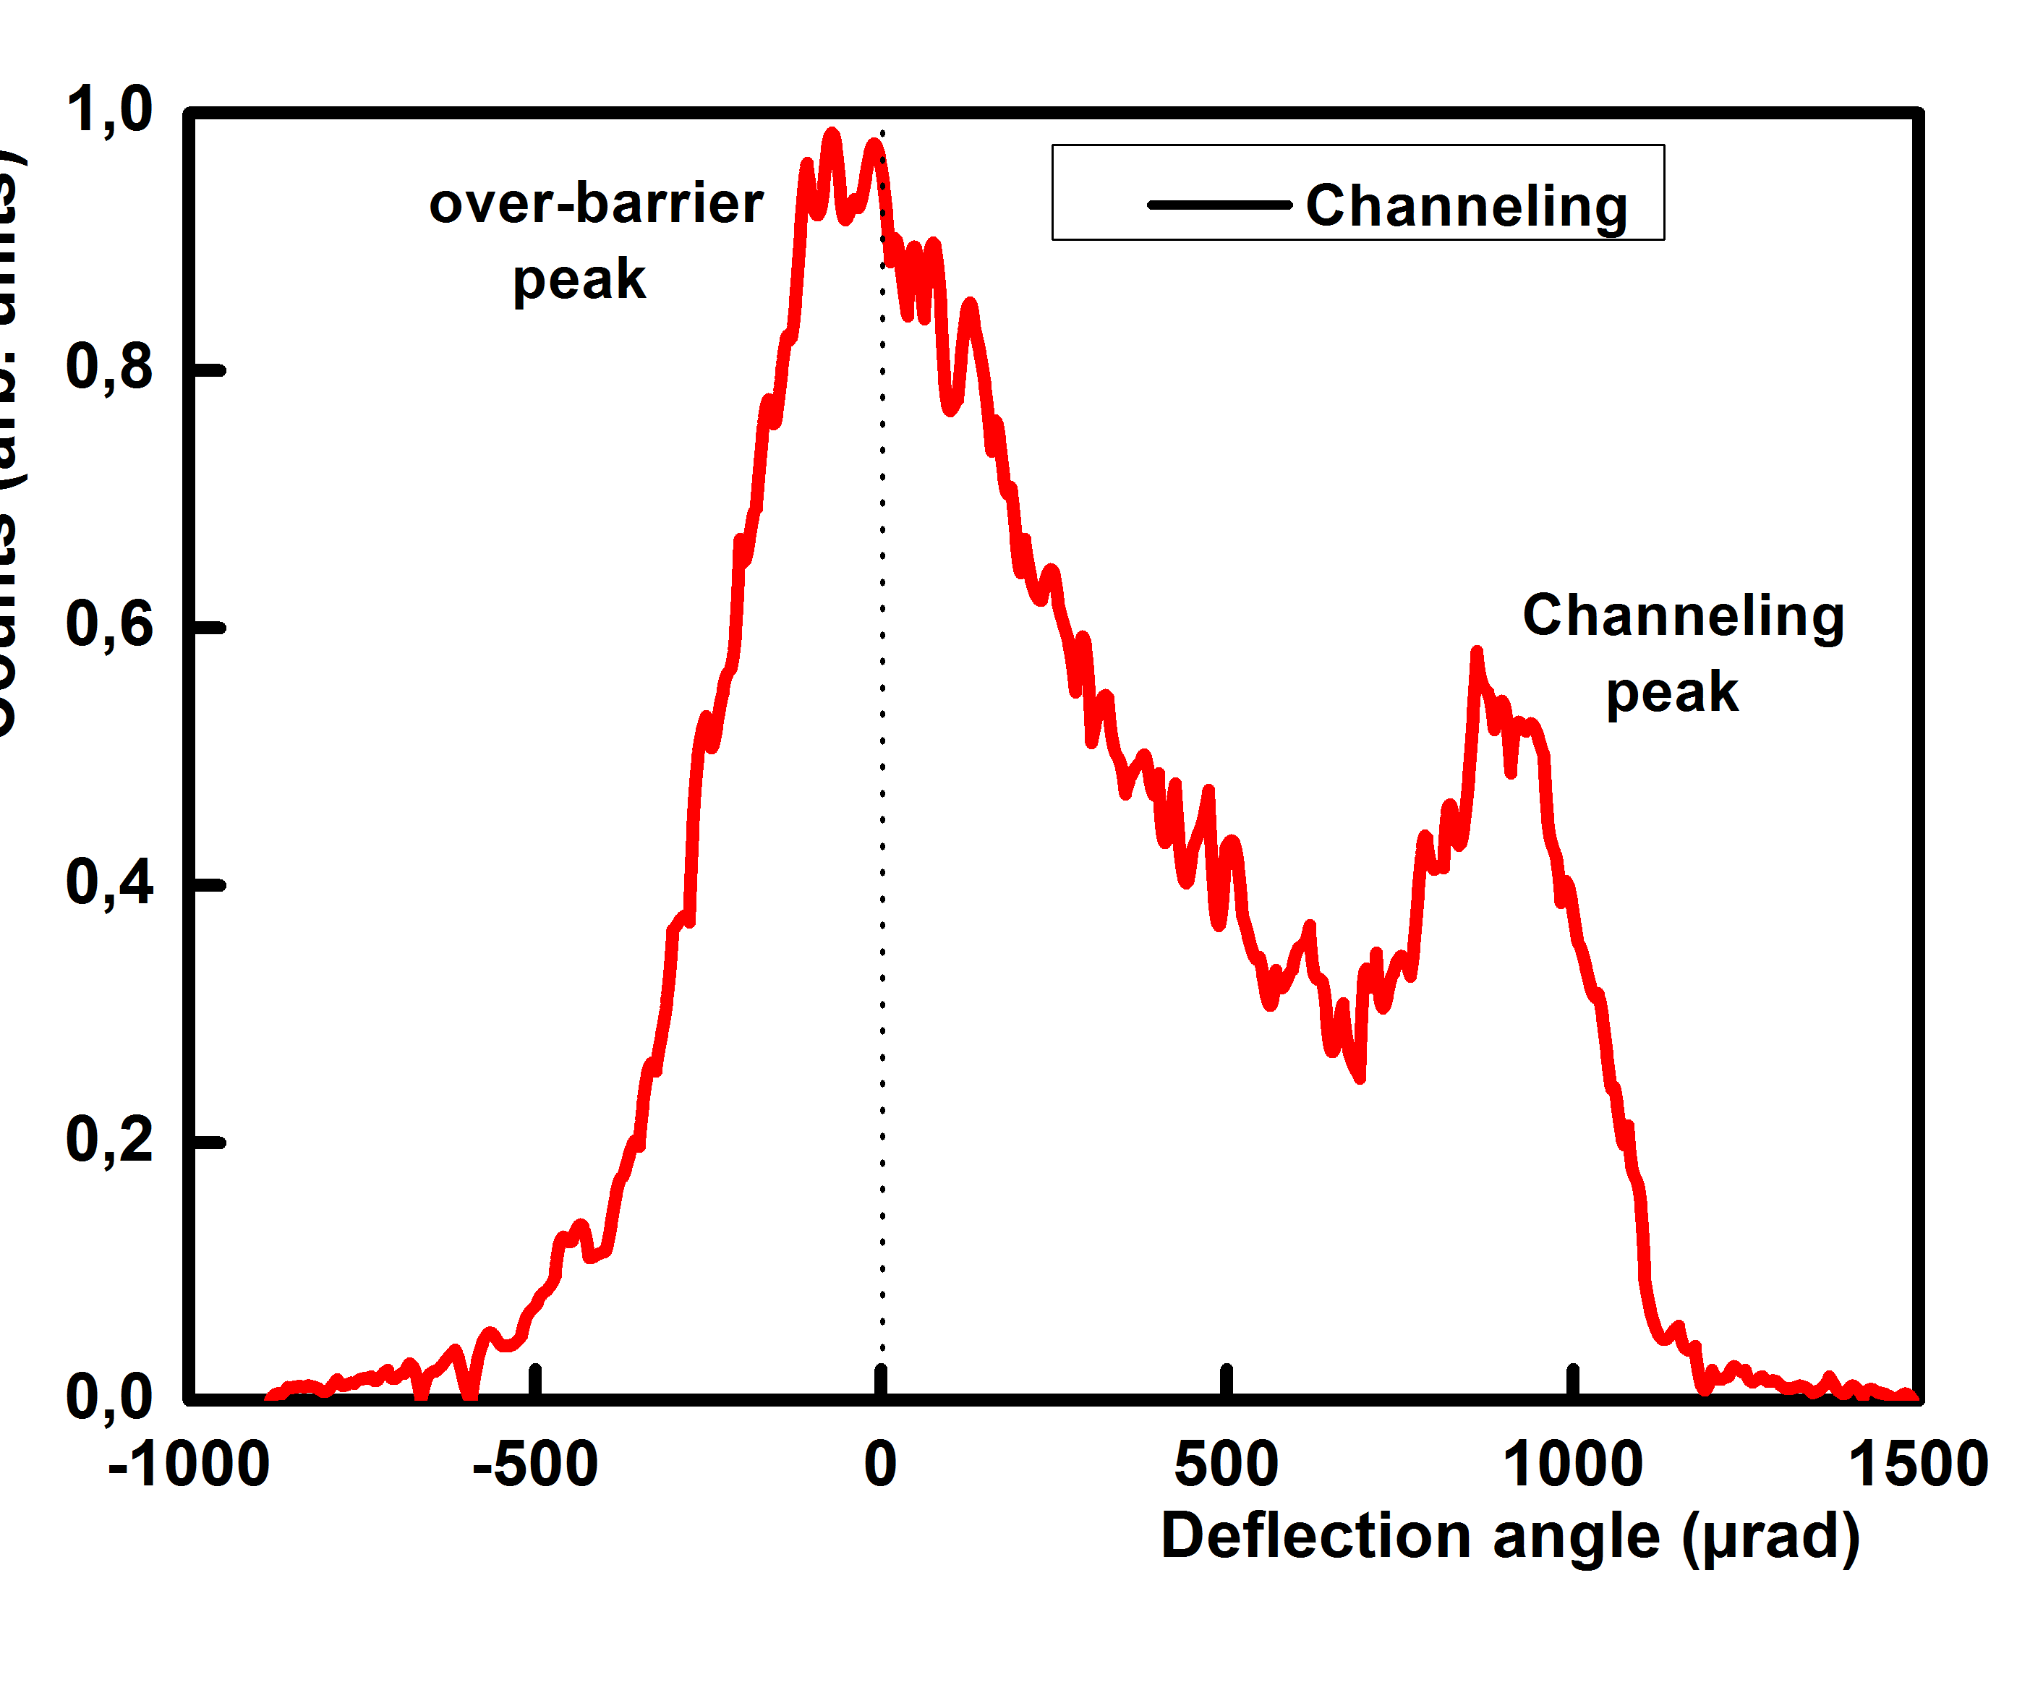
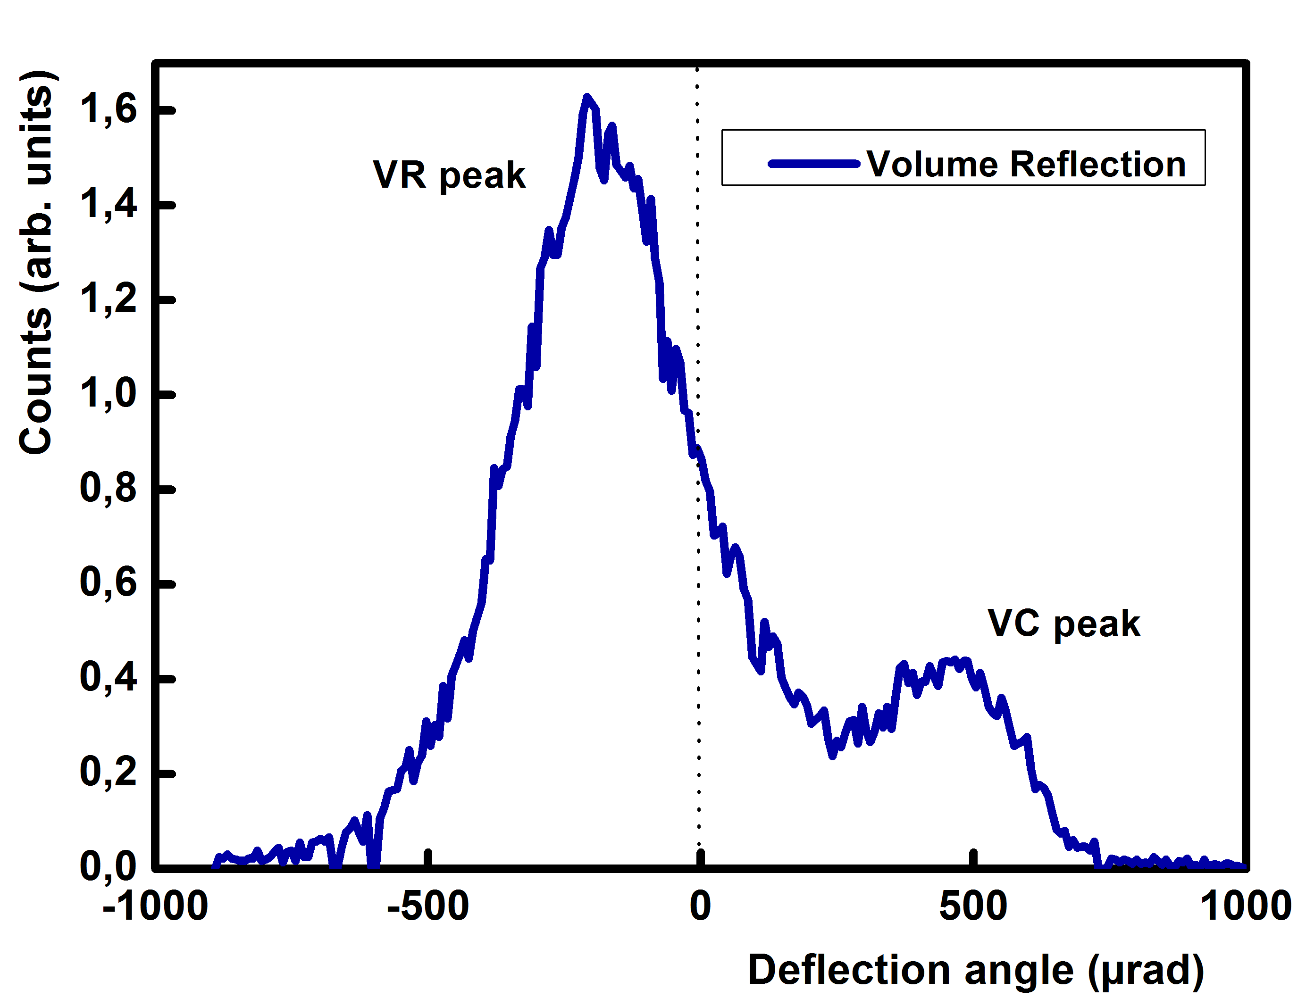
Experimental results on beam steering
CHANNELING
VOLUME REFLECTION
Θ_{inc} ~ 0 µrad Deflection = 910±5 µrad
Fraction of channeled is 20.1±1.2%
Θ_{inc}~450 µrad Deflection =191±10 µrad
Fraction of reflected is 76.7±1.1%
First experimental observation of efficient steering of negative particles in the sub-GeV energy range
A. Mazzolari et al., Phys. Rev. Lett. 74 (2014) 2740

Slide 14
GeV electrons
3.35 -14 GeV
T513 exp. & CHANEL exp.
3.35-14 GeV electrons
Stanford Linear Accelerator Center– Menlo Park, California (USA) in collaboration with Aarhus University (Denmark)

Slide 15
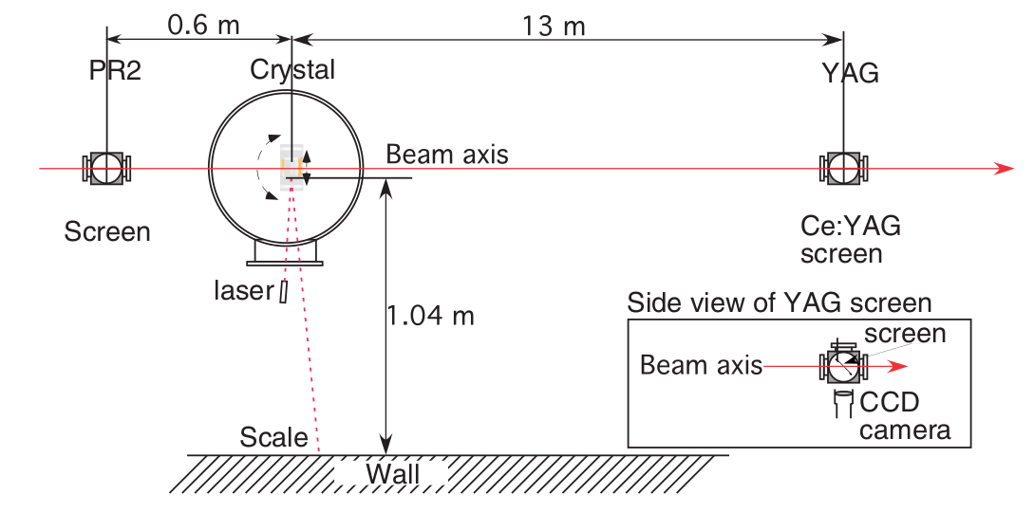
Experimental setup at SLAC
http://estb.slac.stanford.edu
The crystal was mounted in a scattering chamber in the End Station A Test Beam. A Newport AG-PR100 precision rotational stage allowed rotation of the crystal with step sizes nominally down to 5 µrad. A YAG screen with a camera 13 m downstream of the crystal provided the main diagnostics detecting the effect of the crystal on the beam.

Slide 16
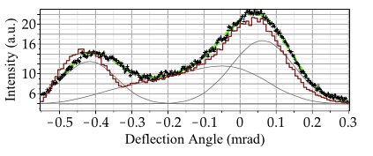
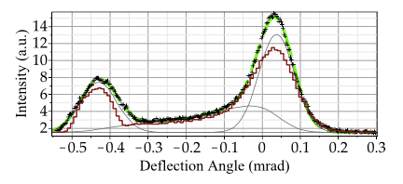
Experimental results
3.35 GeV electrons
6.3 GeV electrons
Channeling efficiency: 24%
Channeling efficiency: 22%
Comparison with Monte Carlo simulation through
DYNECHARM++ code
U Wienands et al., Phys. Rev. Lett. 114 (2015) 074801

Slide 17
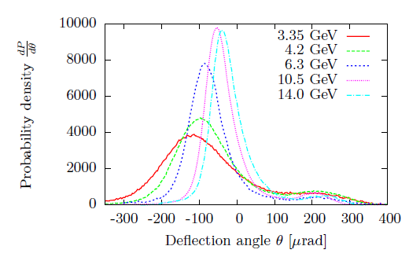
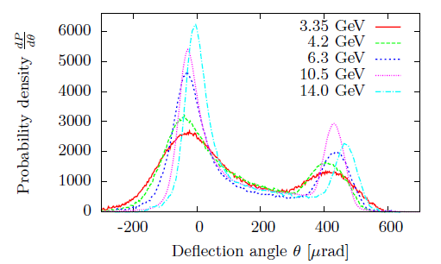
Deflection efficiency vs. beam energy
CHANNELING
VOLUME REFLECTION
T513 crystal: Si (111), 60.0 µm thick, bending angle = 402 µrad
TN Wistisen et al. A study of Channeling, Volume Reflection and Volume Capture of 3.35-14.0 GeV Electrons in a bent Silicon Crystal, SLAC-PUB-16435 (submitted to Physics Letters B)

Slide 18
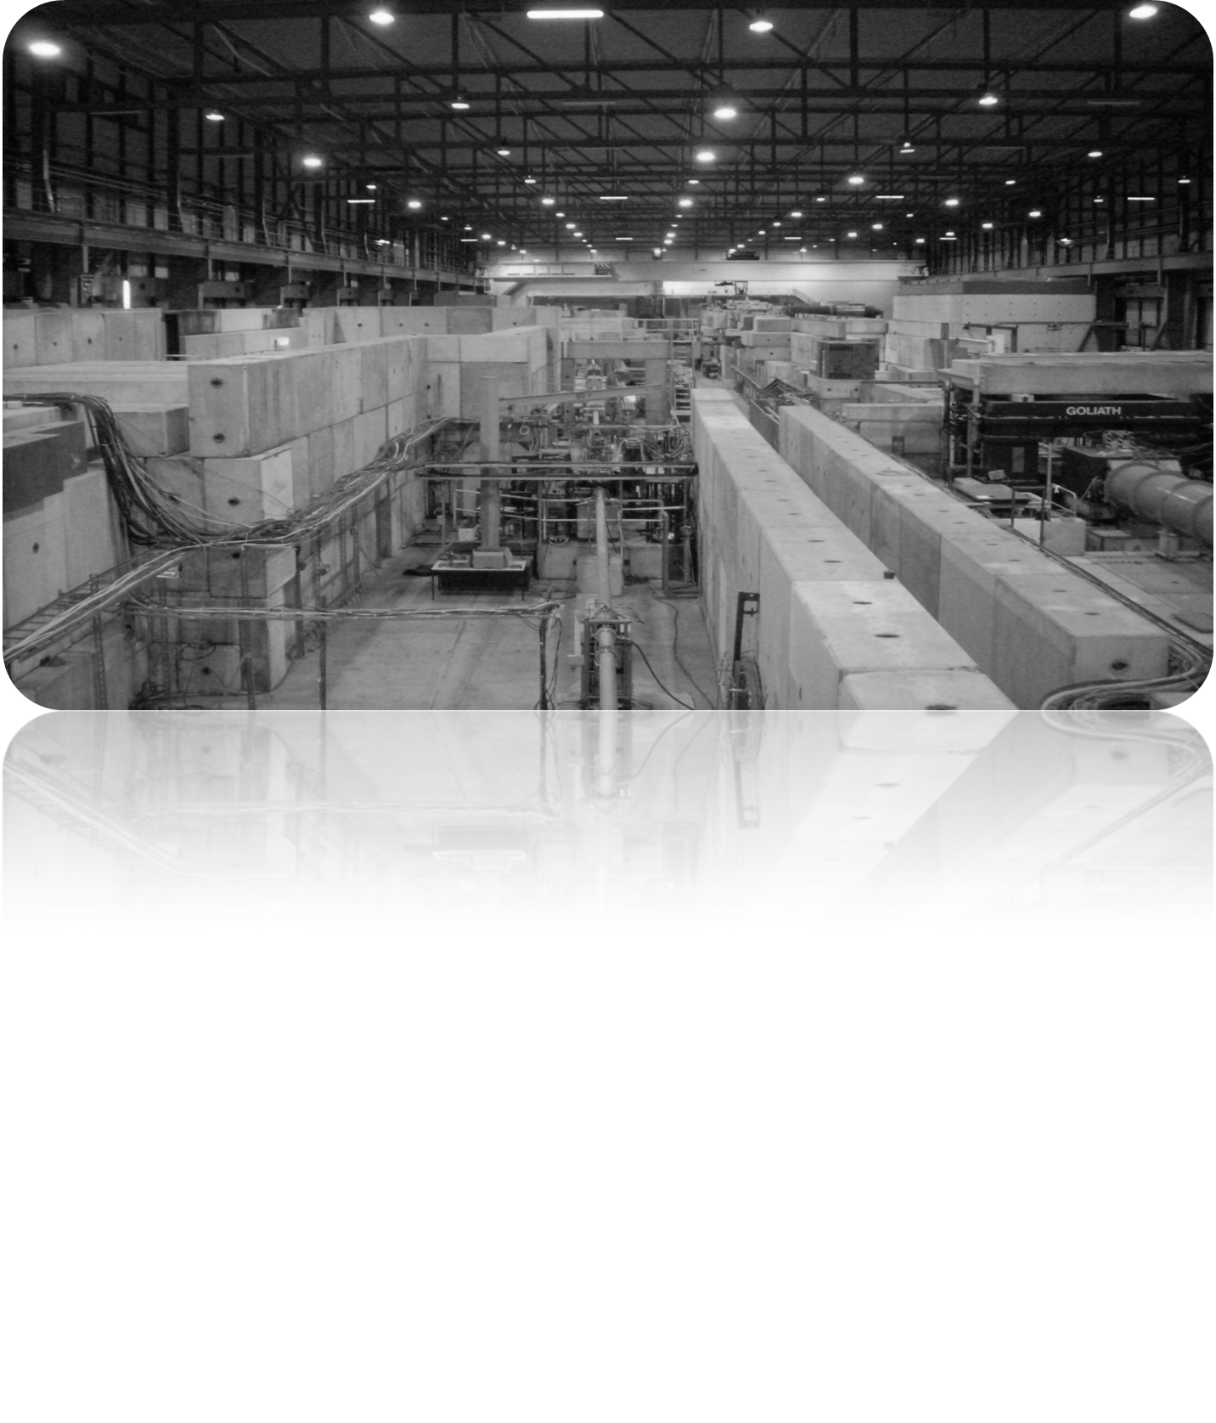
Hundreds-GeV beams
120-400 GeV/c
UA9 & H8RD22 collaborations
INFN CHANEL and AXIAL experiments
120 GeV/c e⁻, 150 GeV/c π⁻, 400 GeV/c p
SPS and SPS-extracted lines H4 & H8

Slide 19
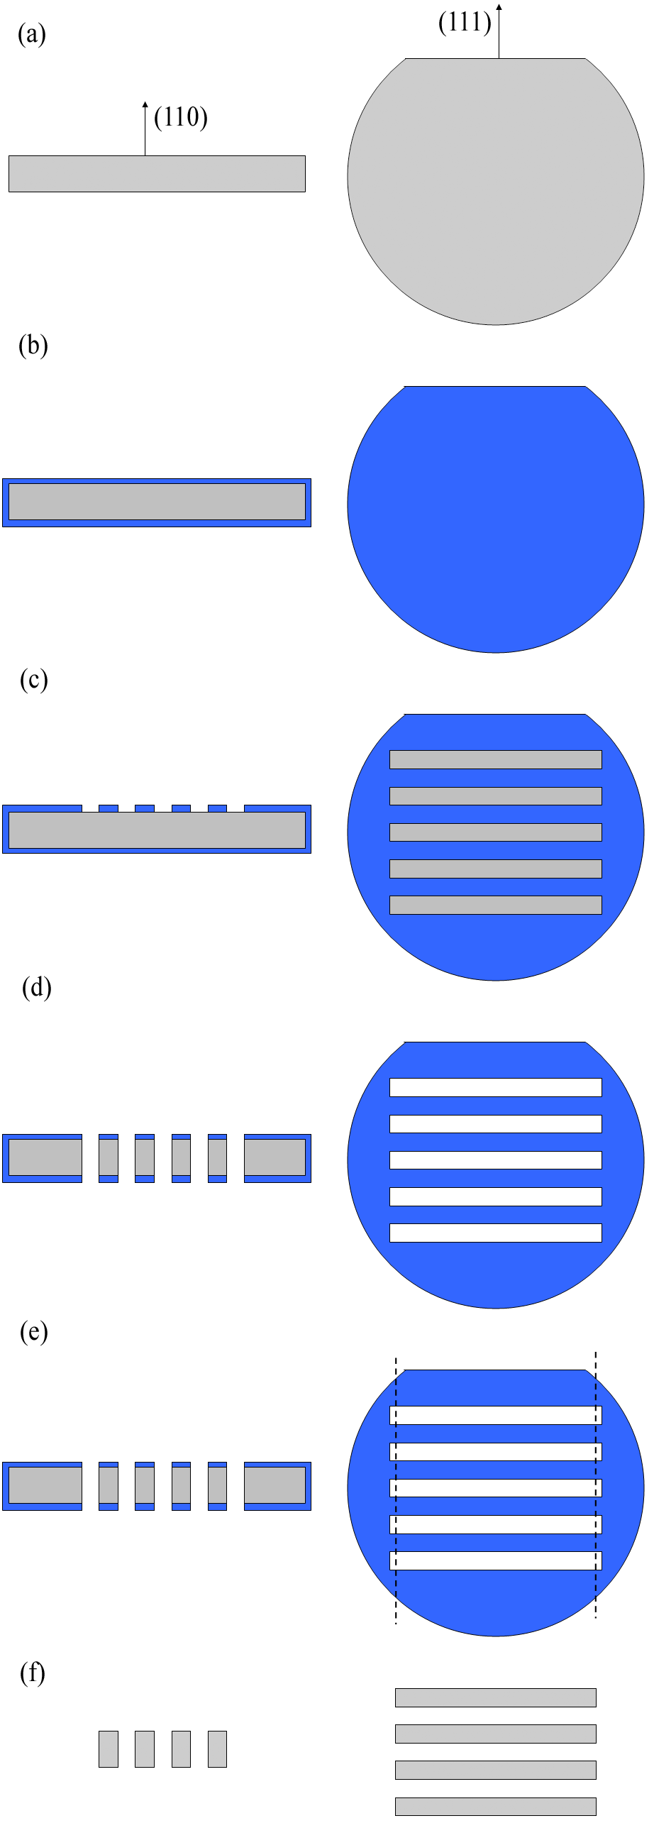
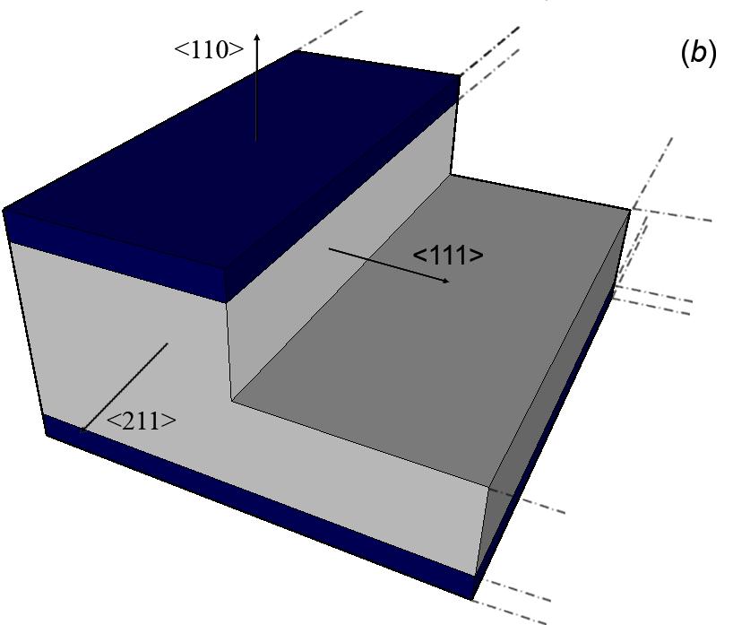
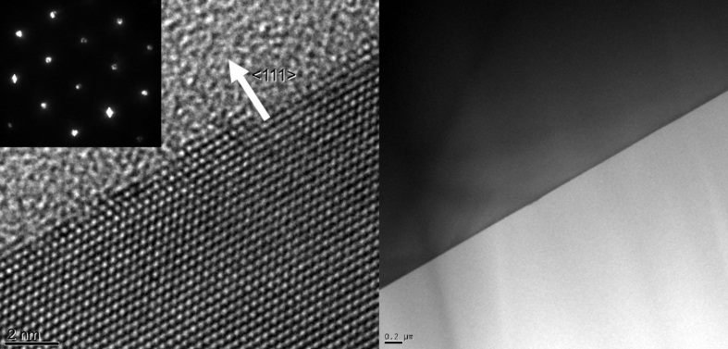
Crystal fabrication
LPCVD deposition of silicon nitride thin layer
Anisotropic etching:
Etching rate on different silicon planes for KOH 20% at 40 °C
Silicon nitride patterning
Crystalline surfaces
[1] S. Baricordi et al., Journal of Physics D: Applied Physics 41 (24), 245501
[2] S. Baricordi et al., Applied Physics Letters 91 (6), 061908
Notes:
Non altero la qualità cristallina originaria

Slide 20
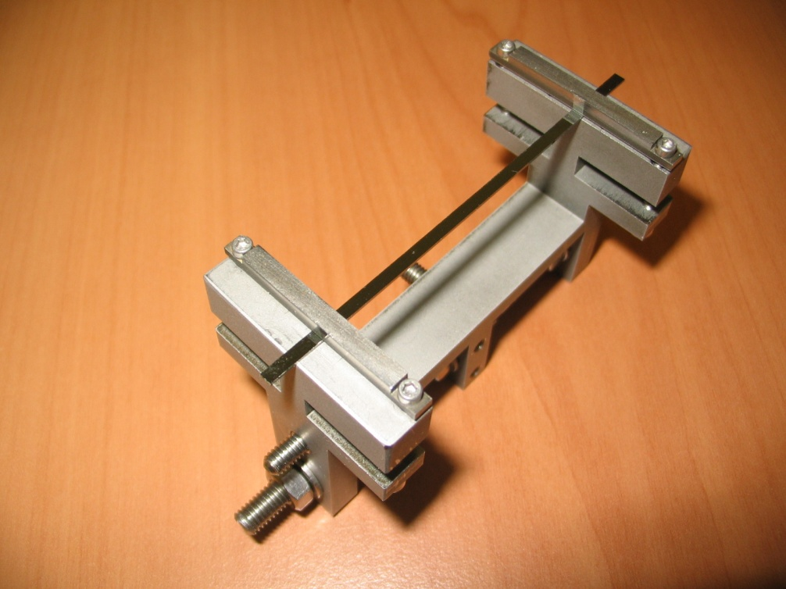
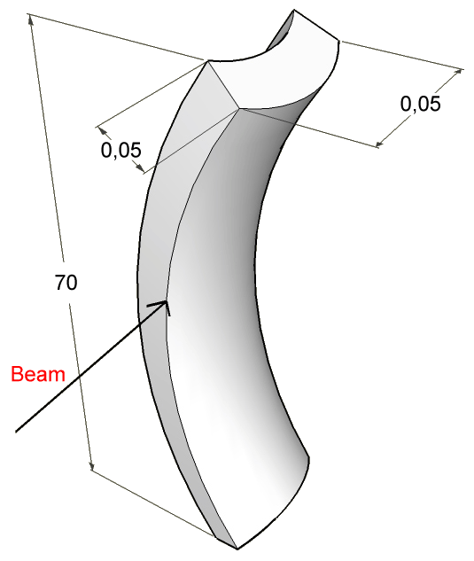
Crystal bending
Beam
JAP 107 (2010) 113534
A primary curvature is imparted by mechanical external forces, which result in a secondary (anticlastic) curvature.
The mechanical holder imparts a primary strain and can be set far apart from the beam hence reduceing unwanted interaction with the beam.

Slide 21
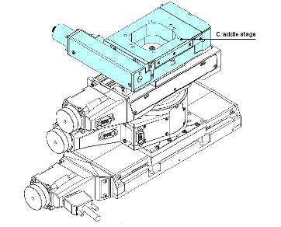
Experimental Setup on CERN-SPS external beamline (H8-H4)
Double sided silicon detectors* DsX (300μm)
High-precision goniometer
Spatial resolution
~5 μm
Angular Resolution
~1 μrad
Goniometer resolution
~1 μrad
Notes:
SISTEMA DI TRACCIAMENTO X e Y
POSIZIONE Z DATA DA POSIZIONE RIVELATORI
NECESSARI 3 DETECTOR -> COSTRUZIONE ANGOLO DI DEFLESSIONE
SUFFICIENTI 3 DETECTOR -> MENO DIFFUSIONE MULTIPLA
DISTANZA 10 m fra DETECTOR per CALCOLO ANGOLO
RISOLUZIONE SPAZIALE 5 MICRON-> ANGOLARE 0.5 MICRORAD

Slide 22
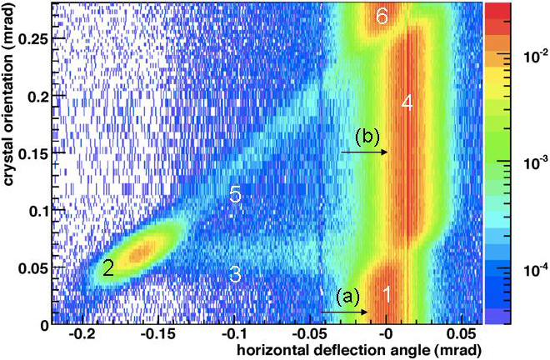
Planar case: 400 GeV/c protons
Unperturbed beam
Channeling
Dechanneling
Volume reflection
Volume capture
Unperturbed beam
W. Scandale et al.,PRL 98 (2007) 154801
Channeling
Volume reflection
Deflection angle: full bending angle, i.e. 170 µrad
Efficiency: ~ 70 - 80%
Limited angular acceptance
Deflection angle: 13.5 µrad
Efficiency: > 95%
Large angular acceptance equal to the bending angle
Notes:
22

Slide 23
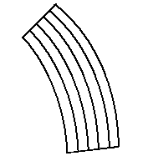
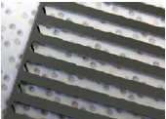
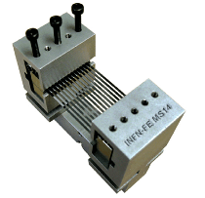
The concept of multiple VR
A multistrip is a crystal for multiple VR
θ_{ref}
θ_{ref}
θ_{ref}
V. Carassiti Rev. Sci. Instrum. 81, 066106 (2010)
V. Guidi et. al., J. Appl. Phys. 107, 113534 (2010).

Slide 24
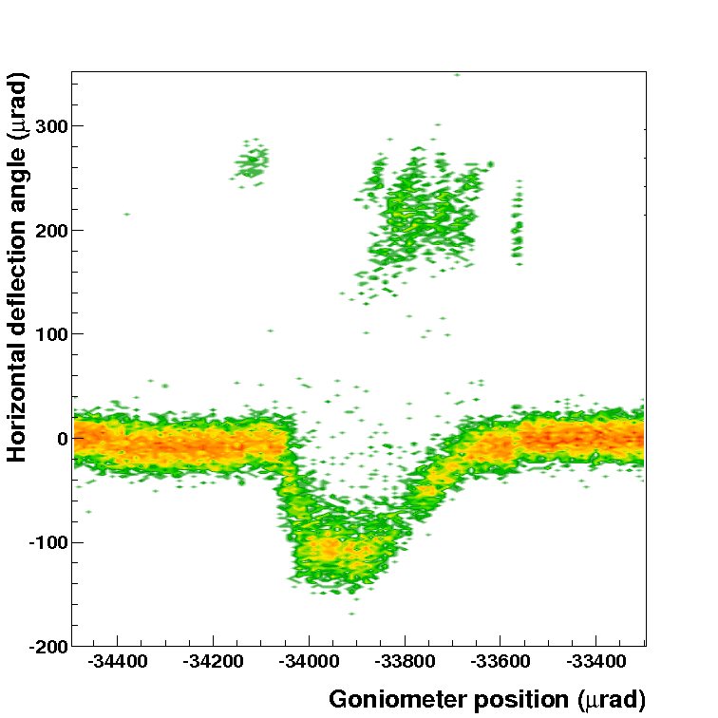
Observation of MVR
It combines wide acceptance with very high efficiency
Installation of a unit in the SPS by CERN
PLB 688 (2010) 284
JINST 7 (2012) P04002
Deflection angle: 109 μrad
Efficiency: 94%

Slide 25
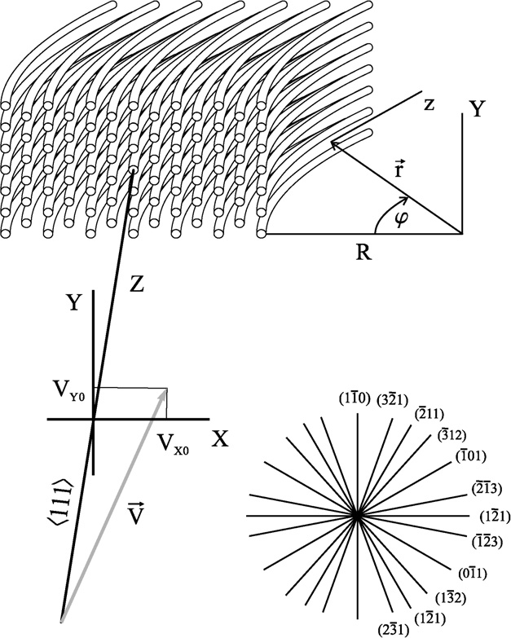
MVR in one crystal
MVR from different planes of one bent crystal becomes possible when particles move at a small angle with respect to a crystal axis
Potential along [111] direction in silicon crystal
V. Tikhomirov PLB 655 (2007) 5
Notes:
25

Slide 26
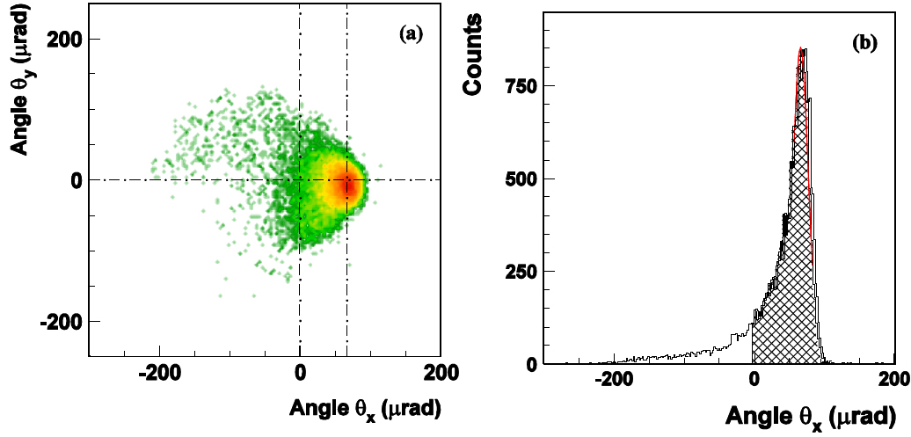
MVROC observation
Amplification of deflection angle of a factor 5
Deflection efficency as high as 84%
PRB 682 (2009) 274

Slide 27
Crystal assisted beam collimation
A “smart target” which kicks all particles in only one direction
a) multi-stage collimation system: an amorphous material spread the primary halo so that it can be intercepted by a secondary collimator.
b) crystal-assisted collimation: a curved crystal deviates the halo directly to the primary absorber.
c) Essential tool for halo collimation in the LHC with 7 TeV protons

Slide 28
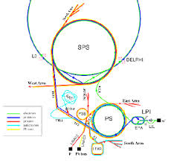
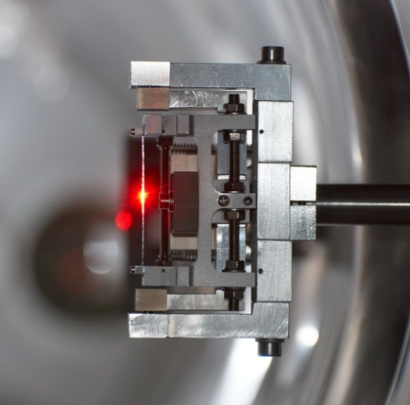
The UA9 experiment at
Super Proton Synchrotron
The high deflecting power of short bent crystal can be exploited in the collimation systems of LHC
The UA9 experiment investigates the possibility of using bent silicon crystals as primary collimators for HE protons and ions
Notes:
28
Aggiungi qualche commento

Slide 29
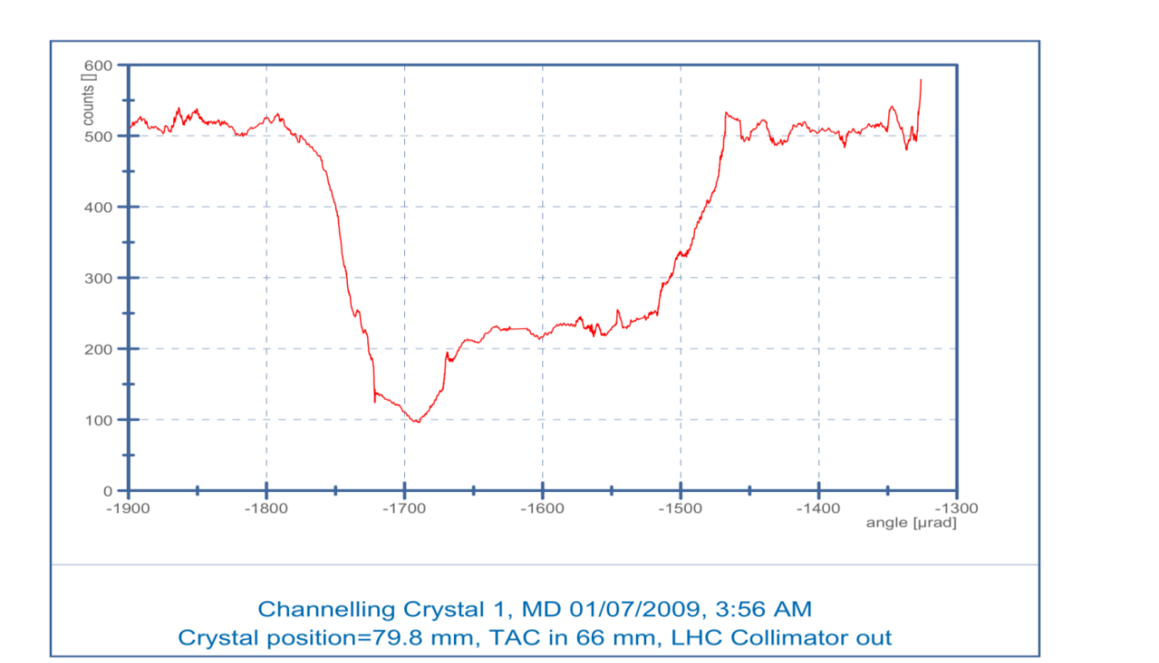
Collimation of protons
Amorphous orientation
Amorphous orientation
VR
Channeling
Halo loss rate due to nuclear inelastic interactions of 120 GeV/c protons/Pb ions in the aligned crystal results to be smaller of up to 5-6 times for protons and up to 3 times for Pb ions than for its amorphous orientation.
Channeled efficiency was ~ 80-85% for protons and 74% for Pb ions by intercepting the deflected beam with another collimator located between the crystals and the absorber.
[1] W. Scandale et al. PLB 692 (2010) 78
[2] W. Scandale et al. PLB 703 (2011) 547
Notes:
29
Aggiungi qualche commento

Slide 30
Collimation of lead ions
Collimation of 120 GeV/c per charge lead ion beam
Deflection by 170 urad with efficiency up to 74% like for 120 GeV/c protons
Loss rate due to nuclear inelastic interaction drops by factor of 3 (6 for protons)

Slide 31
TeV beams
6.5 TeV/c
Extension of UA9 exp. to LHC
6.5 TeV/c protons
Large Hadron Collider

Slide 32
LUA9: Crystal channeled the 6.5 TeV proton beam in the LHC
FERRARA Si strip crystal installed in the LHC
Nov 6th 2015: Beam steering via channeling in a bent crystal in the LHC.

Slide 33
UA9: Crystal channeled the 6.5 TeV proton beam in the LHC
Beam losses vs. orientation
Operation at injection 450 GeV
Operation at 6.5 TeV
W. Scandale et al. PLB 758 (2016) 129

Slide 34
Summary
Coherent interactions in bent crystals are powerful tools to manipulate the trajectories of particle beams
Such technique works over several decades of particle energies, particle’s charge and mass
Several orientational effects can be used for particle steering

Slide 35
Thank you for your attention

