Slide 1

Fabrication Test 1
Francesco Mattioli, F. Chiarello, G. Torrioli
¹Istituto di Fotonica e Nanotecnologie

Slide 2
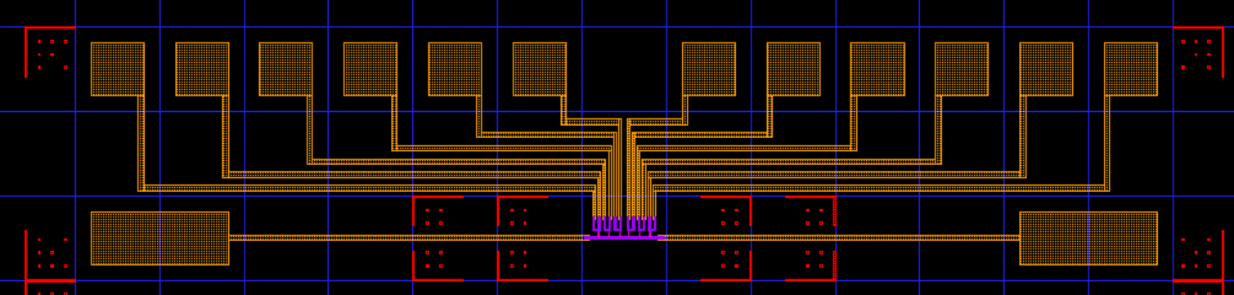
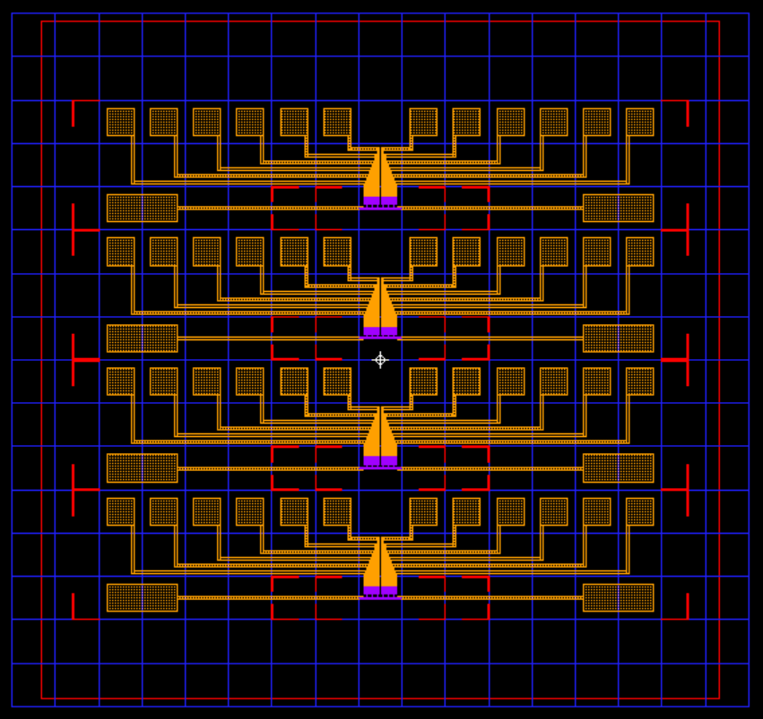
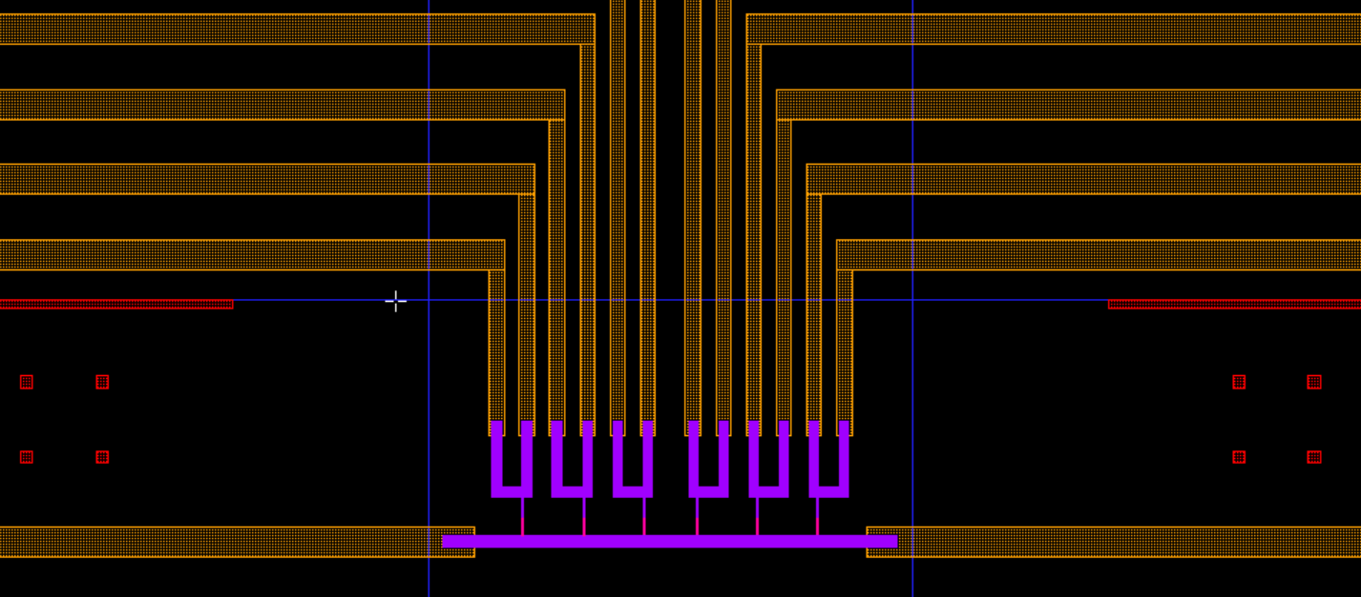
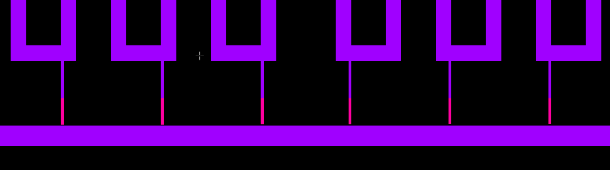
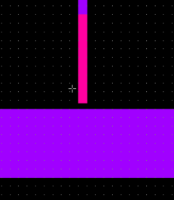
Geometry
Chip 1
Dose 718 687 656 625
μC/cm²
300 400 500 600 700 800
Gap (nm)

Slide 3
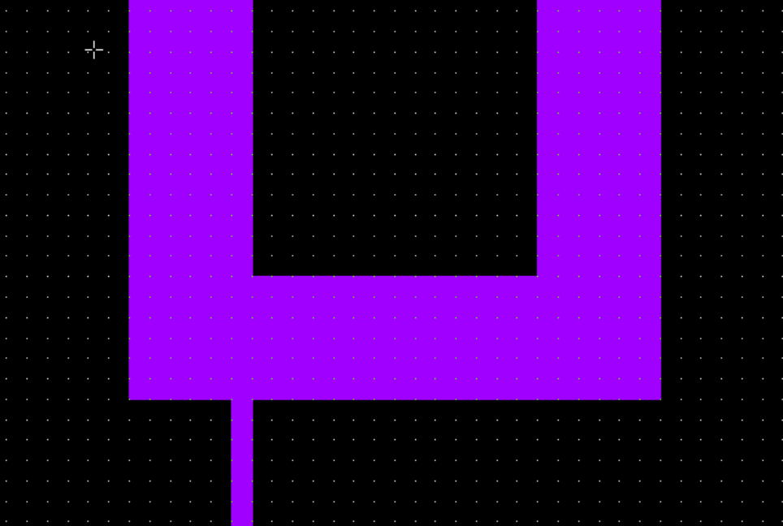
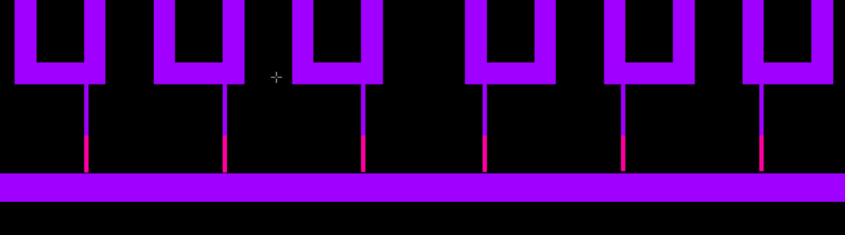
Bilayer and undercutting
COP 33 10% AR-P 617.10 spessore 1031 nm
PMMA 6% AR-P 669.06 spessore totale 1720 nm

Slide 4
Bilayer and undercutting
COP 33 10% AR-P 617.10 spessore 1031 nm
PMMA 6% AR-P 669.06 spessore totale 1720 nm
Undercutting 360nm

Slide 5
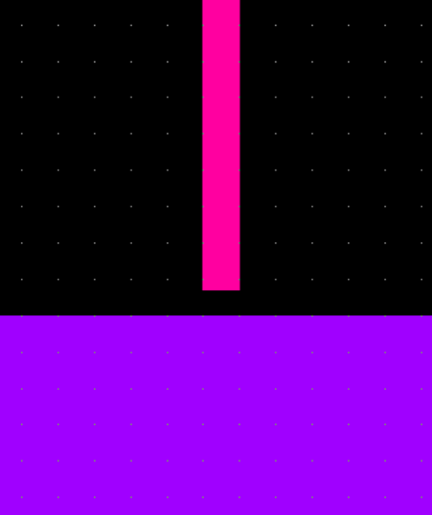
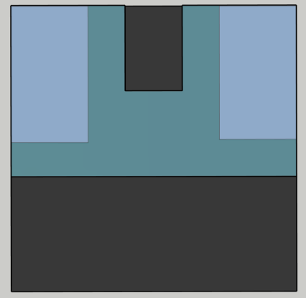
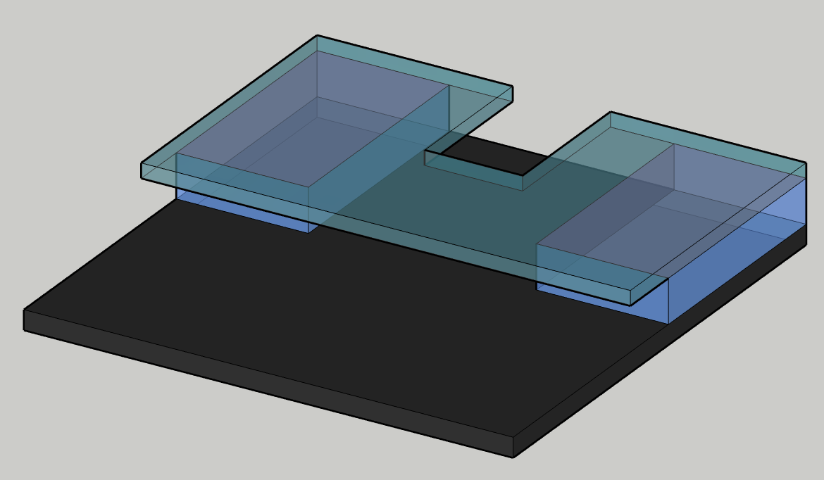
Bilayer and undercutting
COP 33 10% AR-P 617.10 spessore 1031 nm
PMMA 6% AR-P 669.06 spessore totale 1720 nm

Slide 6
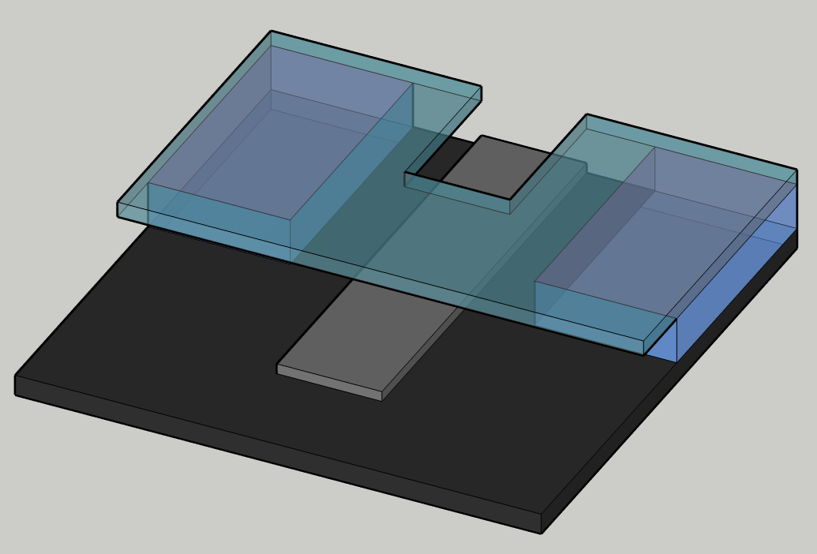
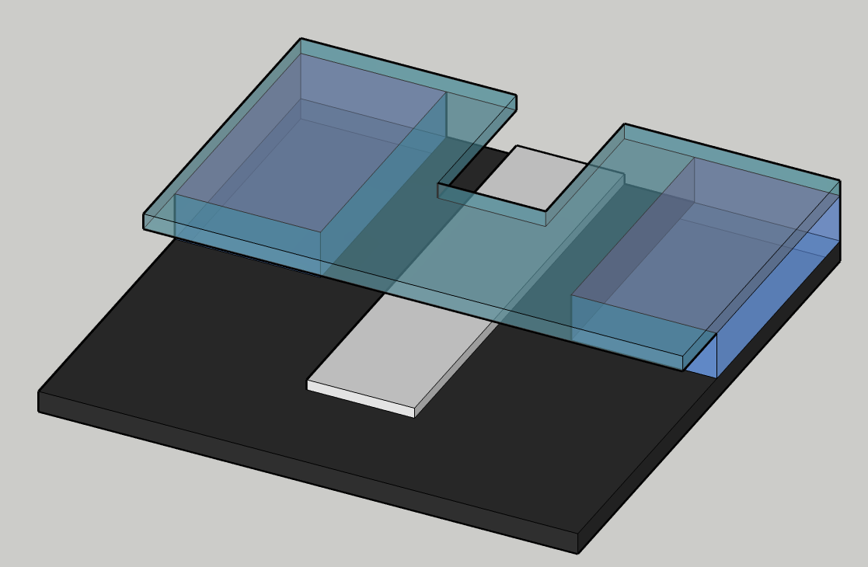
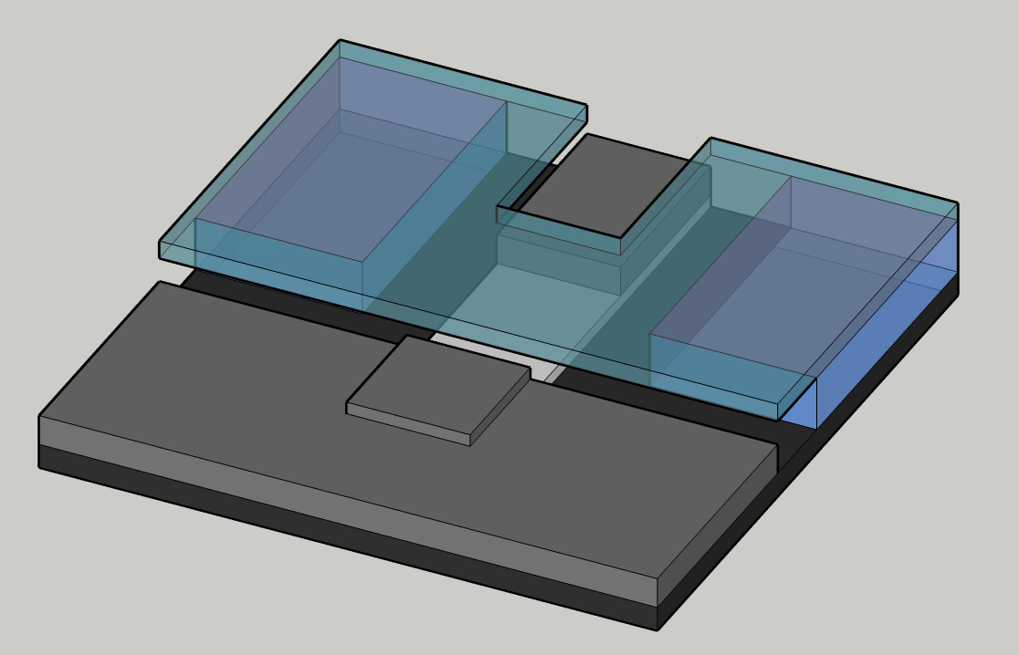
Fabrication of the tunnel junction
155° 300 Å Al
O₂ 5 min. 1.0 mbar
90° 300 Å Al

Slide 7
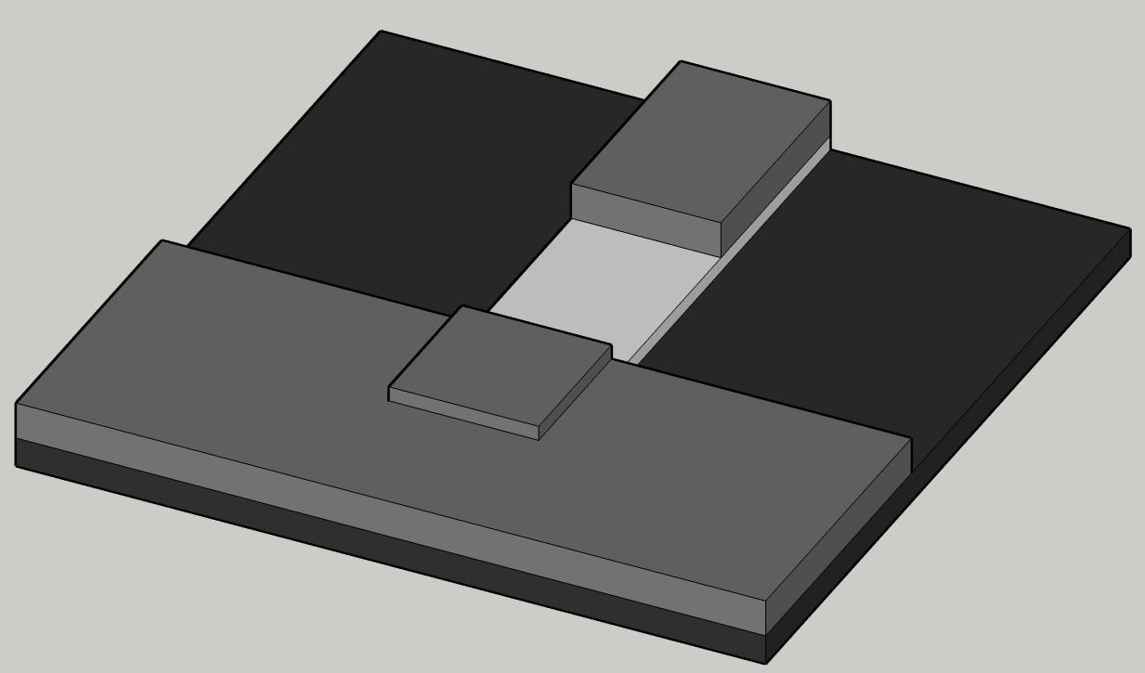
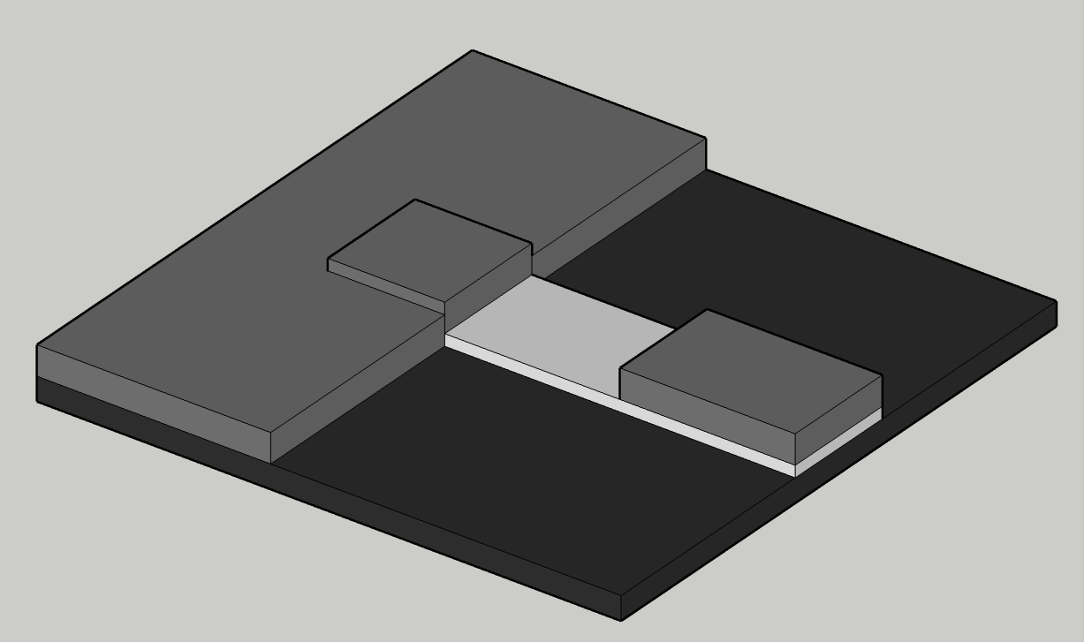
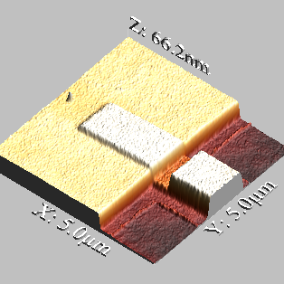
Fabrication of the tunnel junction
Lift off

Slide 8
Fabrication of the tunnel junction
300nm

Slide 9
Fabrication of the tunnel junction
400nm
500nm
600nm
700nm

Slide 10
Fabrication of the tunnel junction
700nm
700nm
800nm
600nm
600nm
500nm
500nm
Gap
400nm
400nm
400nm

Slide 11
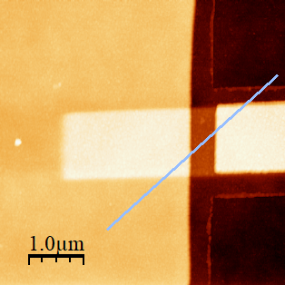
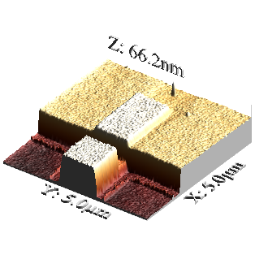
Fabrication of the tunnel junction
400nm

Slide 12
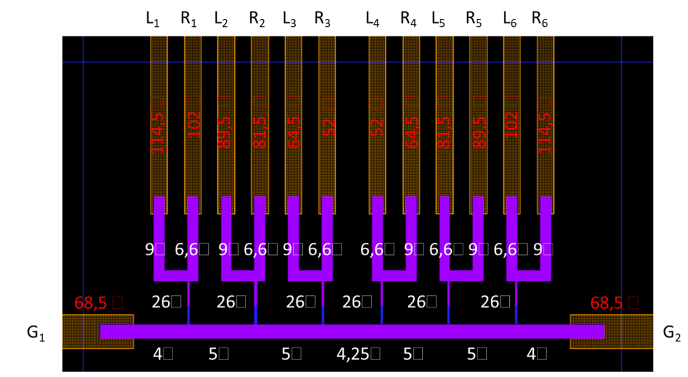
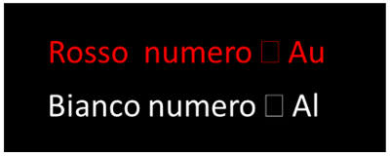
Fabrication of the tunnel junction
D 2 656 μC/cm² | L₁ Ω | R₁ Ω | L₂ Ω | R₂ Ω | L₃ Ω | R₃ Ω | L₄ Ω | R₄ Ω | L₅ Ω | R₅ Ω | L₆ Ω | R₆ Ω
Gap | 300 nm |  | 400 nm |  | 500 nm |  | 600 nm |  | 700 nm |  | 800 nm
G₁ | 38 | 38 | 42 | 39 | 40 | 38 | 39 | 41 | 68 | 69 | 53 | 64
G₂ | 53 | 55 | 51 | 45 | 43 | 43 | 41 | 42 | 64 | 62 | 47 | 50
 | L₁ R₁ | / | L₂ R₂ | / | L₃ R₃ | 11 | L₄ R₄ | 8 | L₅ R₅ | 53 | L₆ R₆ | 37
 | G₁ G₂ |  |  |  |  |  | 63
D 2 656 mC/cm² | L₁ W | R₁ W | L₂ W | R₂ W | L₃ W | R₃ W | L₄ W | R₄ W | L₅ W | R₅ W | L₆ W | R₆ W
Gap | 300 nm |  | 400 nm |  | 500 nm |  | 600 nm |  | 700 nm |  | 800 nm
G₁ | 38 | 38 | 42 | 39 | 40 | 38 | 39 | 41 | 68 | 69 | 53 | 64
G₂ | 53 | 55 | 51 | 45 | 43 | 43 | 41 | 42 | 64 | 62 | 47 | 50
 | L₁ R₁ | / | L₂ R₂ | / | L₃ R₃ | 11 | L₄ R₄ | 8 | L₅ R₅ | 53 | L₆ R₆ | 37
 | G₁ G₂ |  |  |  |  |  | 63
D 3 687 μC/cm² | L₁ Ω | R₁ Ω | L₂ Ω | R₂ Ω | L₃ Ω | R₃ Ω | L₄ Ω | R₄ Ω | L₅ Ω | R₅ Ω | L₆ Ω | R₆ Ω
Gap | 300 nm |  | 400 nm |  | 500 nm |  | 600 nm |  | 700 nm |  | 800 nm
G₁ | 55 | 59 | 64 | 68 | 72 | 77 | 84 | 84 | 85 | 86 | 86 | 87
G₂ | 86 | 84 | 84 | 83 | 83 | 83 | 77 | 73 | 69 | 65 | 60 | 57
 | L₁ R₁ | 55 | L₂ R₂ | 54 | L₃ R₃ | 53 | L₄ R₄ | 53 | L₅ R₅ | 54 | L₆ R₆ | 55
 | G₁ G₂ |  |  |  |  |  | 77

