Slide 1




Attività e richieste
2020
Alexis Pompili
(in rappresentanza del Gruppo CMS-Bari )
19 giugno 2019 - Riunione Gr.I/INFN-Bari - Aula multimediale

Slide 2
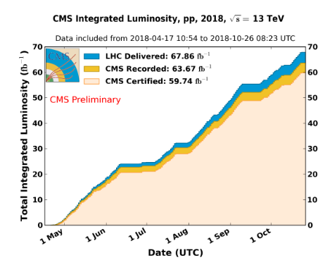
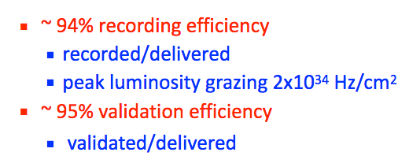
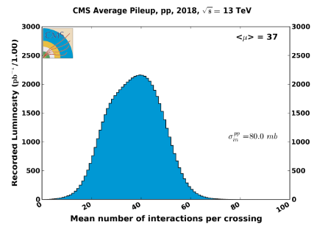
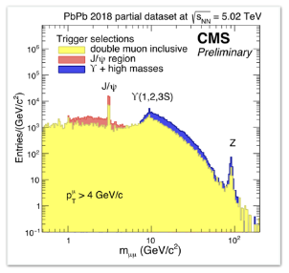
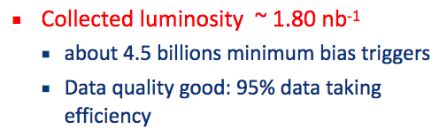
End of Run-2 & Status of CMS - I
The LHC machine and the CMS detector had very well performing in 2018 data taking:
pp run
PbPb run
L. Silvestris : Run Coordinator
2

Slide 3
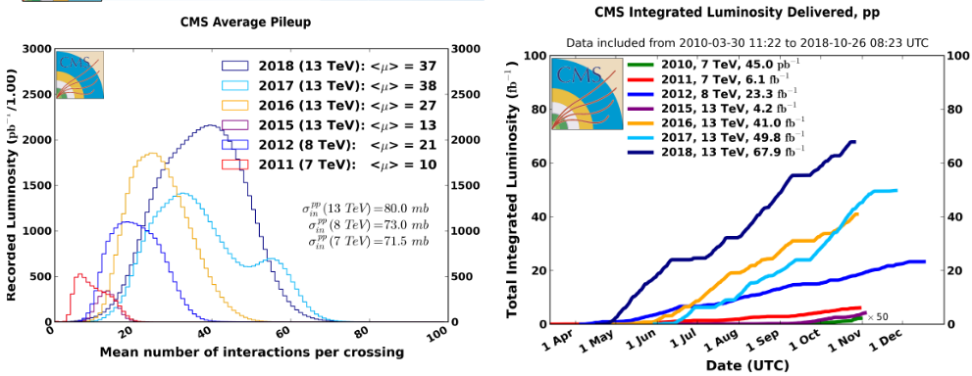
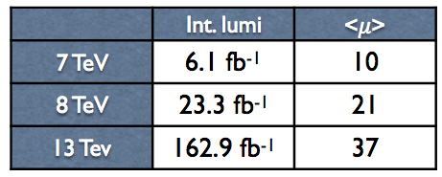
End of Run-2 & Status of CMS - II
Runs 1-2 summary:
3

Slide 4
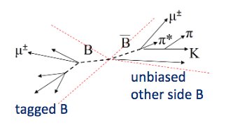
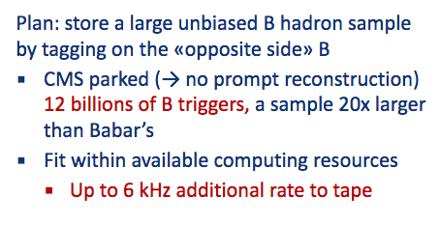
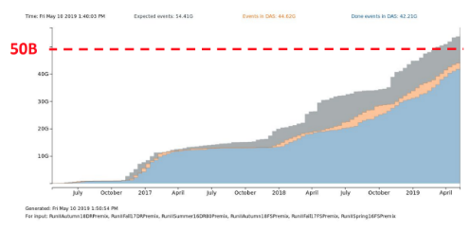
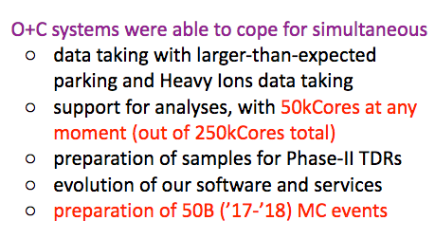
End of Run-2 & Status of CMS - III
2018 Non-orthodox data taking :
B-parking - a swiss knife for Heavy Flavour studies
Offline & Computing
Long shutdown periods are the most busy for computing :
- Full Run-2 reprocessing
- Get prepared for Phase-2: adapt to GPUs, FPGAs, via an heterogeneous framework
4

Slide 5
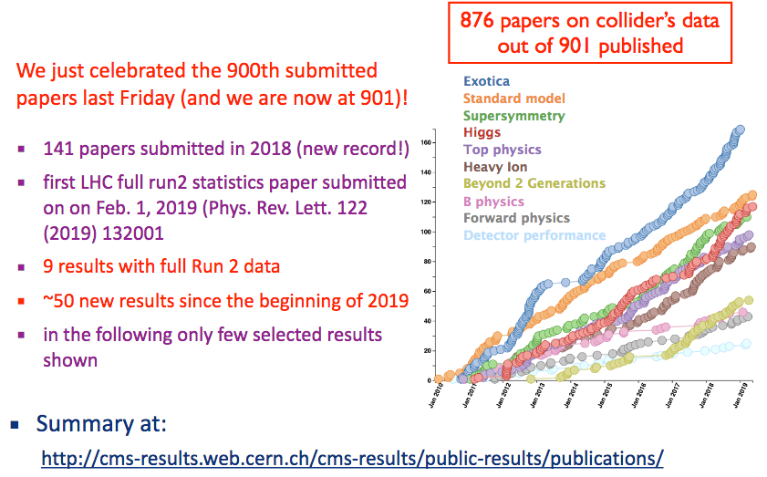
End of Run-2 & Status of CMS - IV
Impressive physics output :
From L.Malgeri @ LHCP2019
CMS-Bari - participated actively to some of them
- also provided ~10 Collaboration Wide Reviews (and participated to ARCs)
5

Slide 6
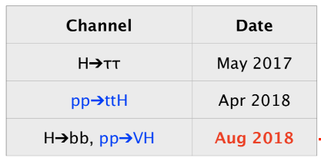
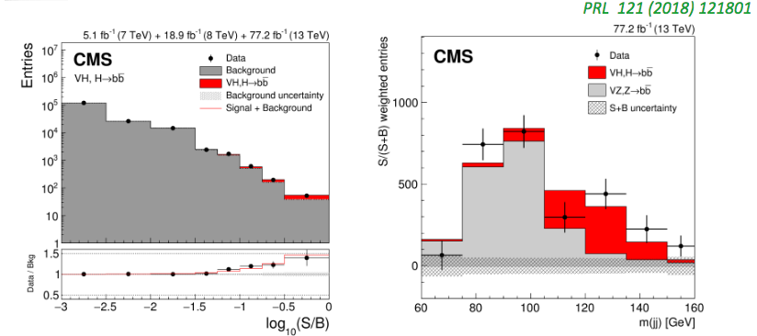
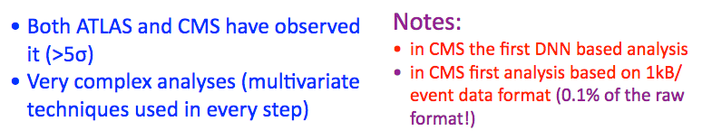

Physics Highlights - I
Since last year : Higgs to bottom Yukawa couplings
$$H→b\overline{b}$$
observation :
6

Slide 7



Physics Highlights - II
Many other important results (for instance among them, recently@ LHCP2019)
Updated results on ttH
Z production cross section @ 13TeV (testing high order EW & QCD corrections)
search for low mass resonances (ISR tag in trigger to explore low mass region)
search for delayed jets (long-lived particle in SUSY models can originate jets far from IP)
search massless dark photons coupling to Higgs
observation of and states and measurement of mass
$$B_{c}(2S)$$
$B_{c}^{∗}(2S)$
$$B_{c}(2S)$$
7

Slide 8
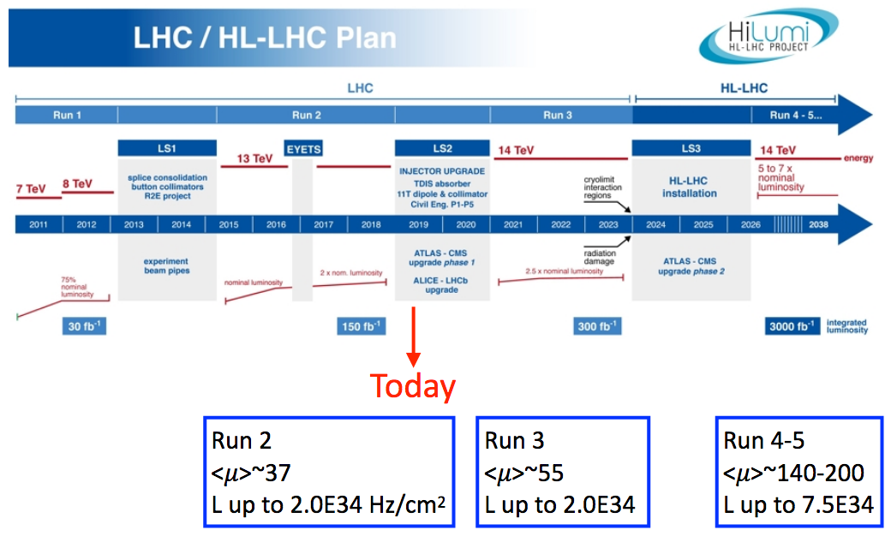
Long-shutdown (LS2) has started in 2019
LS2 will continue through 2019 till full 2020 :
From L.Malgeri @ LHCP2019
2019-
2020
2015-2018
2021-
2023
8

Slide 9
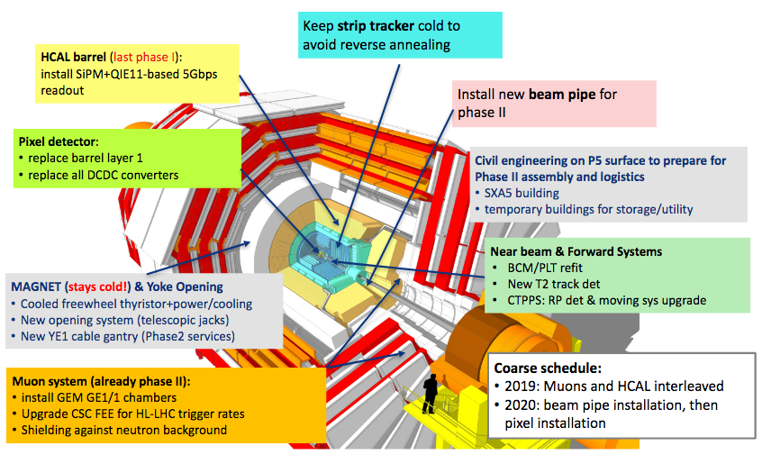
Long-shutdown (LS2) will continue in 2020
LS2 will continue for 2020; activities foreseen:
From L.Malgeri @ LHCP2019
Phase-1 upgrade is almost done (and in line with the planned schedule providing benefits already during Run-2)
Phase-2 upgrade started (Run-3 will benefit from part of them; will be continued in LS3 -2024/5)
9

Slide 10
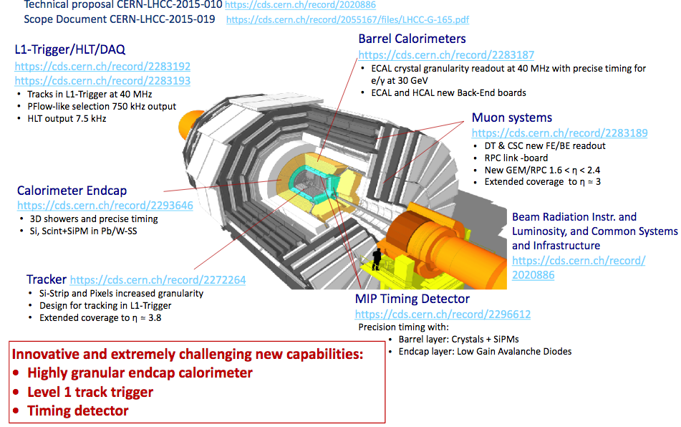
CMS HL-LHC Upgrade (Phase-2)
From L.Malgeri @ LHCP2019
10

Slide 11
Current analysis activities with CMS-Bari involvement
11

Slide 12
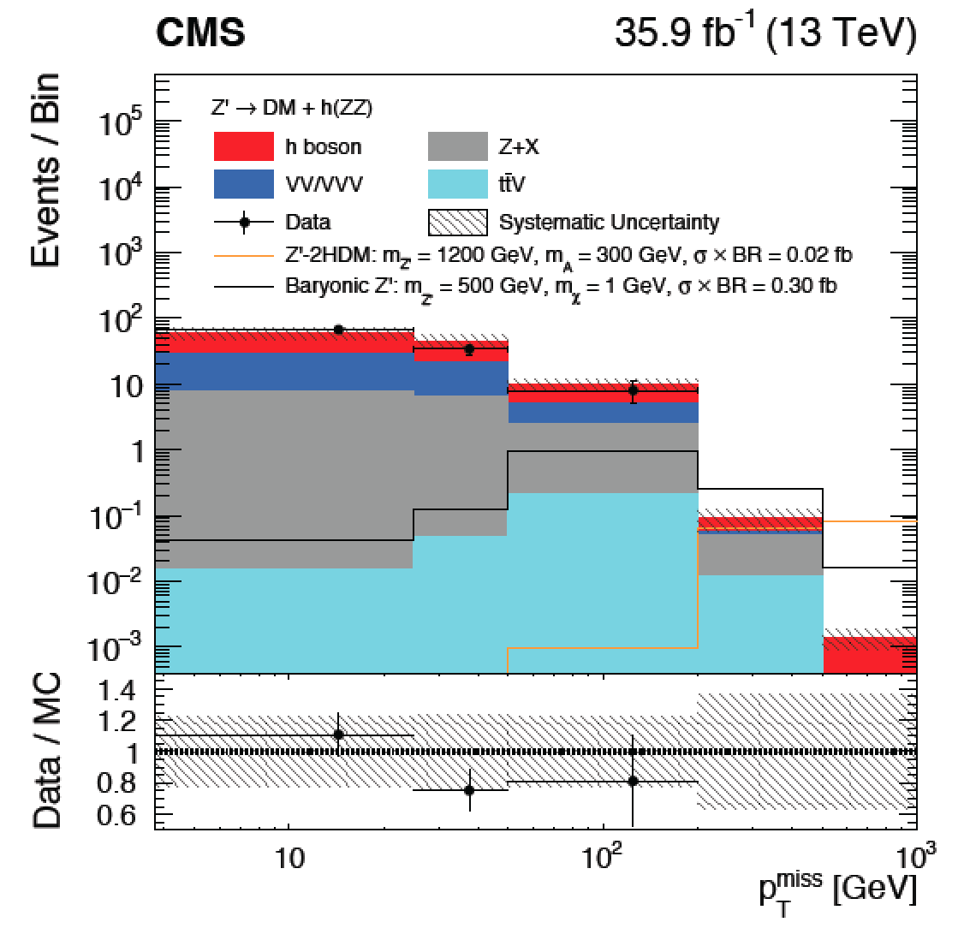
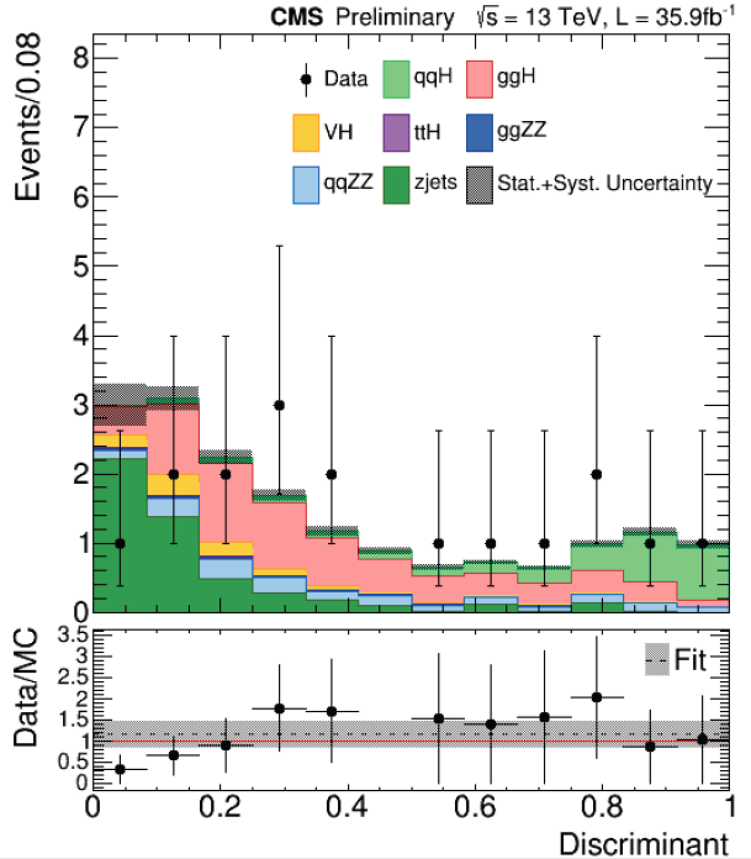
Data Analysis Activities - I
Higgs Physics + DM search
Ricerca di materia oscura con la segnatura di “MonoHiggs”, H+MET, con H→ZZ→4l
(R. Aly, N. De Filippis)
  Analisi con dati 2016 pubblica EXO-18-009 e finalizzata in un paper EXO-18-011 (Final reading) in combinazione con le altre analisi monoHiggs
  Analisi dati 2017 e 2018 in corso
Misura della sezione d’urto di produzione del bosone di Higgs in topologia di fusione di bosoni vettori: VBF H→ZZ→4l (W. Elmetenawee, N. De Filippis)
  AN_2018_120 con i dati 2016
  analisi con dati 2017 and 2018 in corso
Determinazione self-coupling dell’Higgs attraverso la ricerca di eventi di produzione di HH→bbZZ→ bb4l
(A. Taliercio (now in Louvain) I. Margjeka, N. De Filippis)
+ studi finalizzati nello Yellow Report per HL-LHC:
“Higgs Physics at the HL-LHC and HE-LHC”,
https://arxiv.org/abs/1902.00134
N. De Filippis: “Higgs Future Analysis” convener, Sept.2018-20
12

Slide 13
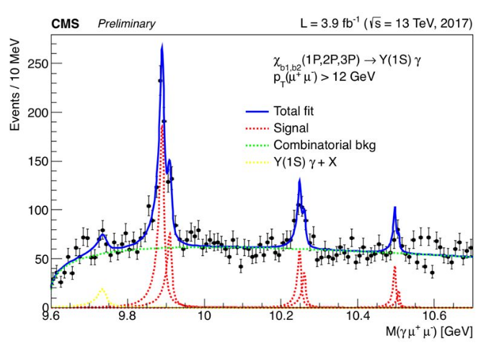
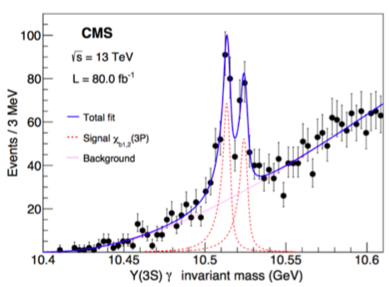




Data Analysis Activities - II
B-physics & quarkonia
L. Cristella + A.Pompili + A. Di Florio + V. Mastrapasqua (similfellow junior) + N. Sur (TIFR)
- charged exotic Z spectroscopy with the 3-body decay
${ B}_{d}^{0}→J/ψKπ$
(full amplitude fit on GPUs) [BPH-14-003]
- enough statistics with 2012 data - going to pre-approval
A. Di Florio + A.Pompili
- inclusive search for exotic X(4140) state & partners in the final state
J/ψ $ϕ$
- use late 2017-2018 data (dedicated triggers) - going to preapproval
S. Lezki + A.P. + A. Di Florio + CMS CINVESTAV(Mexico City) [Progetto MAECI Italia-Messico 2018-2020]
$χ_{b1}(1P)ππ$
Y$(1S)ππ$
- inclusive search for exotic X_{b} state [beauty partner of X(3872)] in the final states &
- use 2017-2018 data
A. Pompili “B-Physics” convener, Sept.2019-21
+ CMS representative in HFLAV cross-experiment group since 2018 [ https://hflav.web.cern.ch/ ]
13

Slide 14


More Data Analysis Activities & Computing activities
To be mentioned (for activities till end 2018)
Search for high-mass resonances into two muons (contribution to dilepton final states) [ ]
Z’$→μμ$
F. Errico⁽¹⁾ + R. Radogna⁽²⁾ + A. Colaleo (contributing within Z’ task force)
⁽¹⁾ now in CMS @ Florida Univ. ⁽²⁾ now @ University College London (no more in CMS)
R. Venditti + F. Simone + A. Colaleo + P. Verwilligen (+ laureande : C. Aruta, L. Lorusso)
starting a new search :
$$τ→3μ (LFV)$$
Deep Learning for tracking (with GPUs usage): A. Di Florio + A. Di Pilato (dottorato industriale)
Statistical analysis studies (using GooFit on GPUs):
- Clustering technique to include Look-Elsewhere-Effect (LEE) in the global significance estimation
- Check of Trial factors method for LEE (Gross-Vitells approx.)[presented to XIII Quark Confinement: statistics session]
A. Di Florio + A. Pompili
CMS experiment has a workload management system that …
schedules & executes production and user tasks in a distributed Grid infrastructure.
Submission is performed via the tool CMS Remote Analysis Builder (CRAB),
… developed & maintained by L. Cristella.
14

Slide 15
Computing infrastructure & activities (Bari Tier2)
15

Slide 16
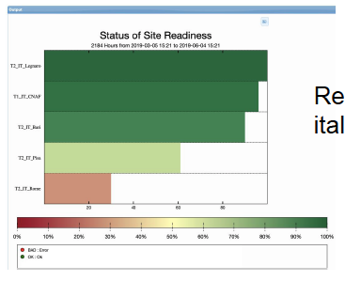
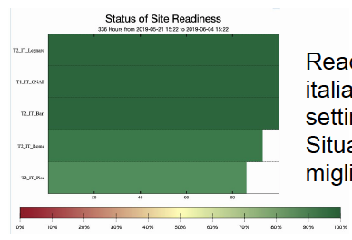
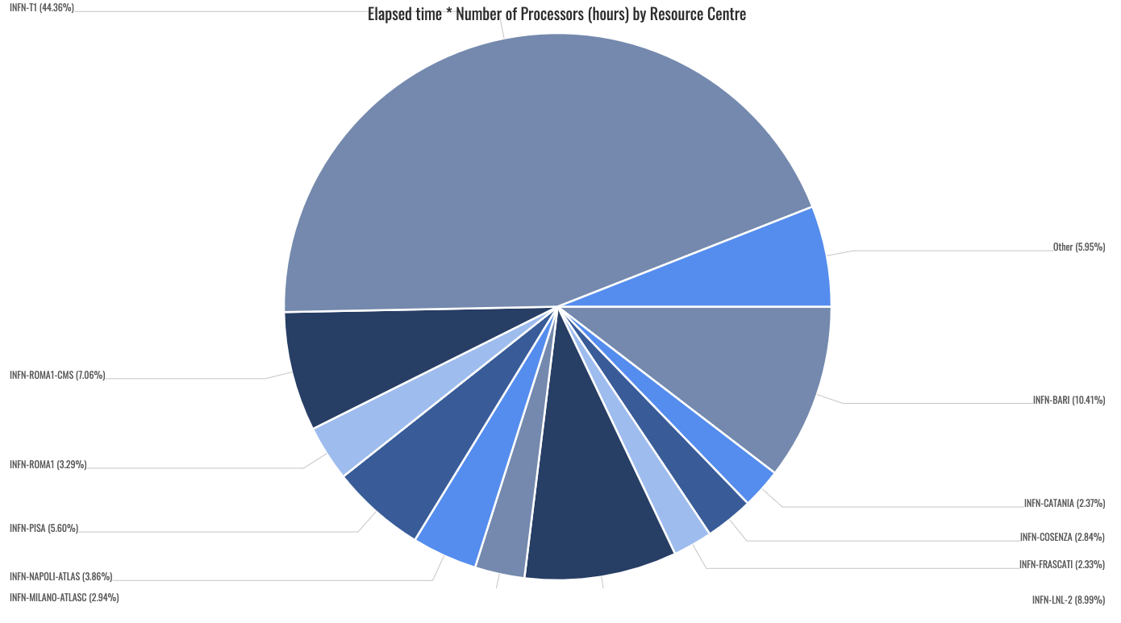
CMS-T2 operational status - I
Last 3 months
The Bari CMS-T2 is the 2nd best reliable site in Italy (even considering long time periods)
It is the 2nd site in Italy after the T1 as far as the CPU resources’ usage is concerned :
Last 2 weeks
16

Slide 17
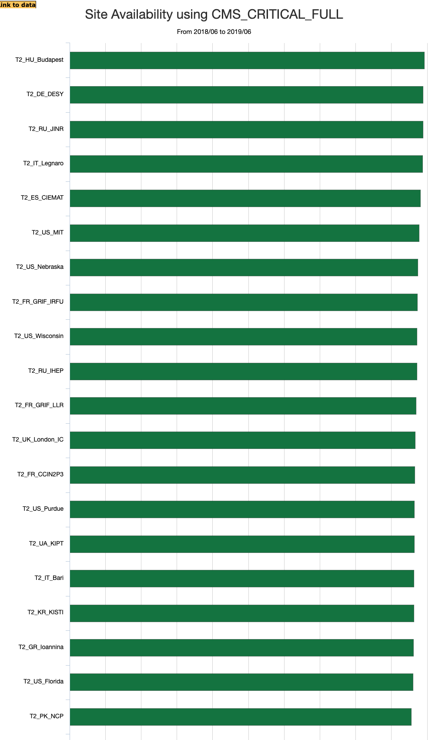
CMS-T2 operational status - II
The Bari CMS-T2 is a reliable site also considering the international «landscape»:
G. Donvito is replacing G. Maggi as CMS-T2 manager
G. Donvito, G.Maggi, L. Cristella (CMS side) et al.,
but - regardless the official affiliations/tags –
all IT group (staff & TD) collaborates, at different
levels of involvement, to the maintenance of
infrastructure and computing resources !
17

Slide 18
CMS-T2 : tenders’ status & new resources
New purchases on 2018 funds for the Bari T2 concern only storage : 600TBN (Lenovo) are arriving
The situation of italian pledges is not good (well <13% of CMS)
Italian T2s are requesting in 2020 to rescue the cuts experienced in 2019.
Future purchases on 2019 funds (2020 requests), either for CPUS and storage,
will be (fully) funded but on funds of PON IBISCO, for the Bari T2
Let us consider the standard scenario (1. flat distribution of new resources among the 4 italian T2s,
2. missing pledges to be fully rescued)
IBISCO
18

Slide 19
CMS-T2 requests in 2019-21 (IBISCO for Bari)
However the problem is that IBISCO tenders will be concentrated in just one (!) either for CPU & storage
at the end of 2020 (or even beginning 2021); thus new computing resources will arrive only in 2021!
This is a relevant issue because of the obsolescence of wide part of the CPUs .
In the next 3 years the Bari T2 will be bringing into production 2.7PB of disk & 4000 cores !
Considering only the resources pledged for CMS it would be like doubling the current farm.
IBISCO will be much wider than that! [ see G.Donvito’s presentation on projects/external funds ]
19

Slide 20
CMS Phase-2 Upgrade & related activities : TRACKER
20

Slide 21
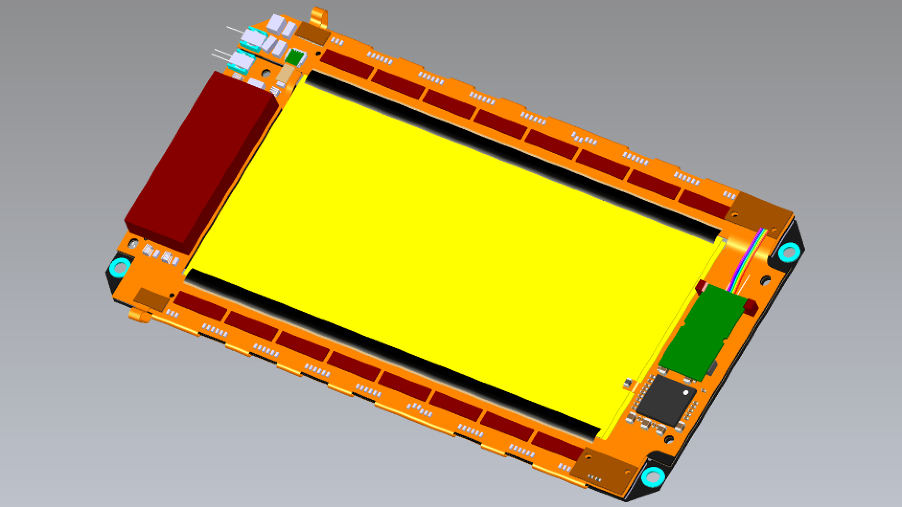
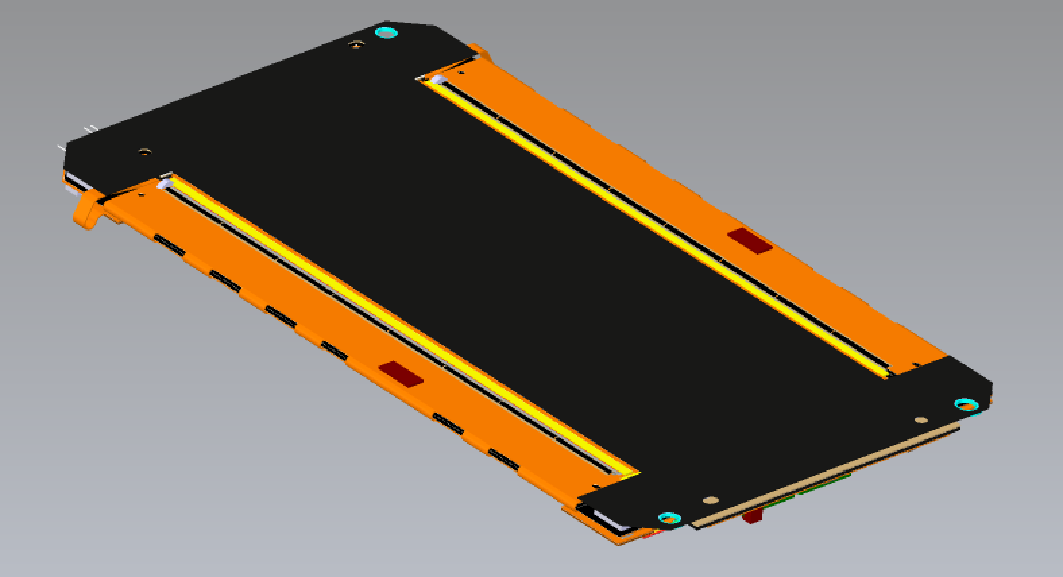
INFN-Bari Outer Tracker (OT) Phase-2 contribution
Deliver Tilted Inner Tracker mounted, integrated and tested with 1956 PS modules
(≈ 40 m² surface detector)
Development and Qualification
  Service Hybrid testing (Genova)
  FE Hybrids testing (Catania)
  Silicon Sensors Process Qualification (Perugia)
Construction and integration of PS Modules (1956 installed)
  module assembly, wire bonding and testing (Bari, Perugia)
  module Burn in and Calibration (Pisa)
  module mechanical integration and testing in 72 rings (Pisa + all)
Contribution to development, qualification of commons systems
  Track Trigger electronics system (Pisa)
  Power supply system (Firenze, Perugia)
  DAQ and Control Systems (Pisa, Catania, Bari)
  Safety System (Pisa)
  D. Creanza is the Responsible Person of the OT module construction in Italy
  - D. Creanza
  - M. de Palma
  - L. Fiore (Resp. of Center)
  - S. My
- A. Mongelli
(Mech. Design Service)
Clean Room (P. Cariola)
Mech. Service
21

Slide 22
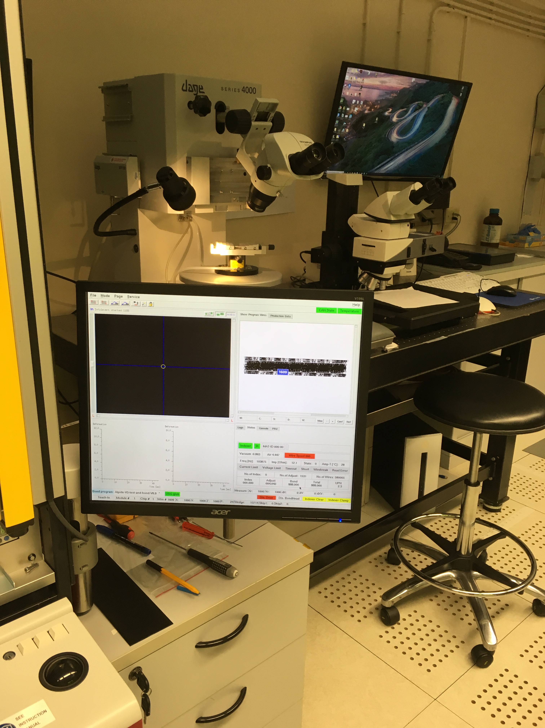
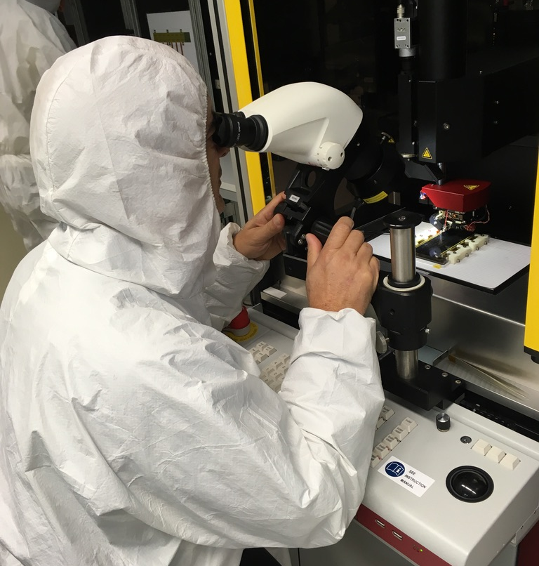
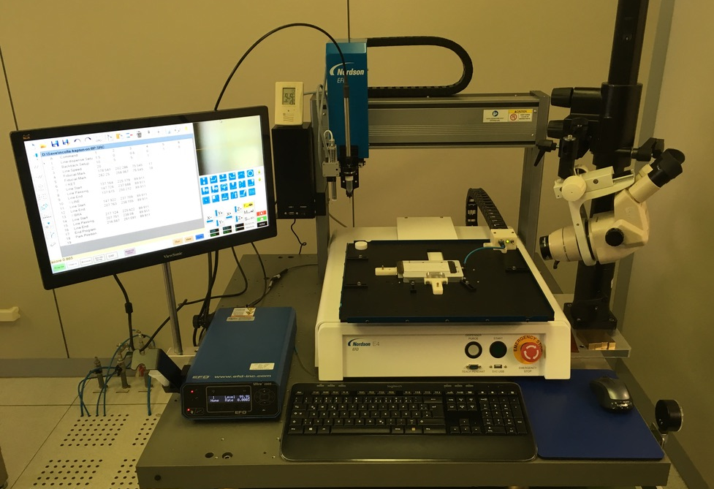
OT activities : operational infrastructure
Pull Tester Dage 4000
Glue robot
Delvotec G5 Bonder
Recent purchase & setup of the Bari glue robot
The Pull tester & the bonder were intensiveley used for the
ALICE modules and now are ready to deal with the CMS PS modules
22

Slide 23
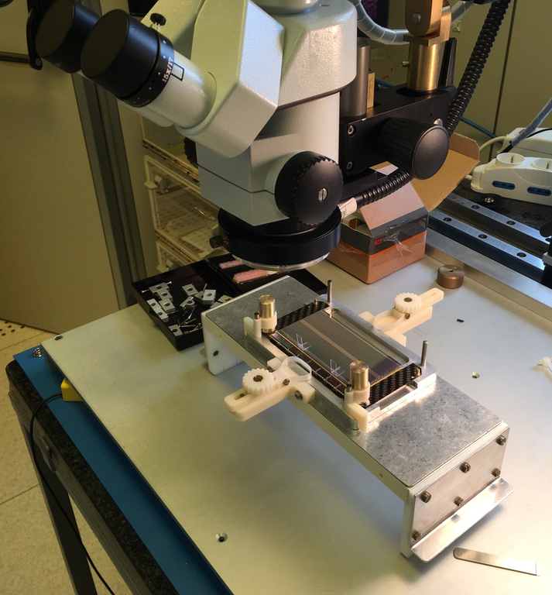
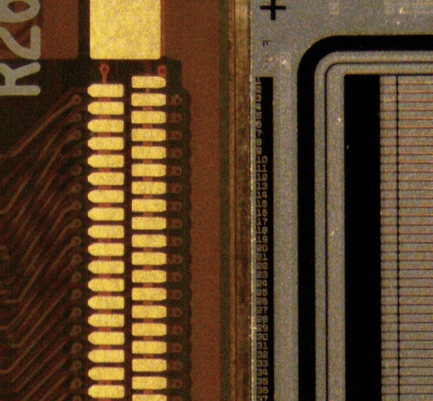
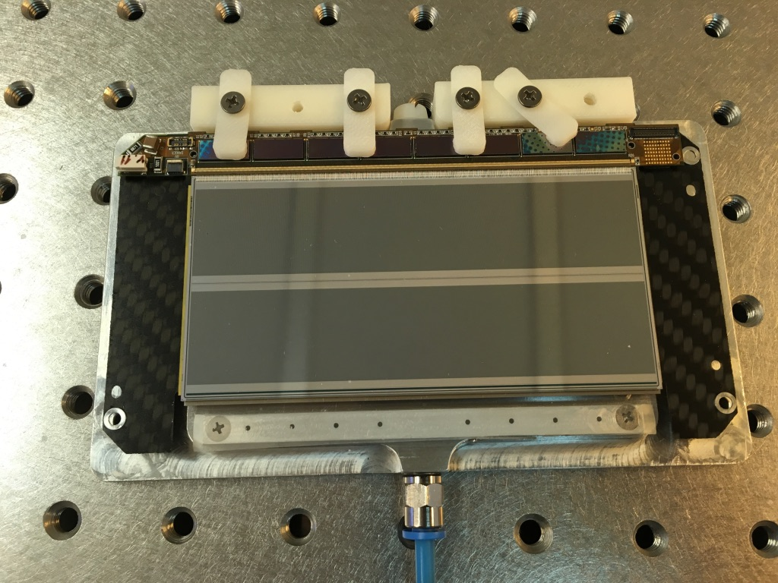
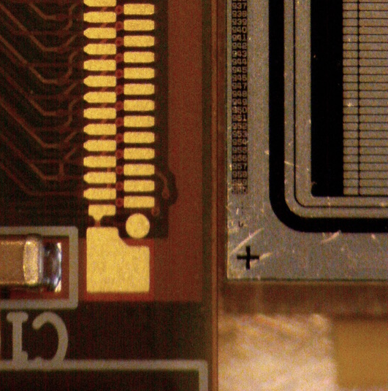
OT activities : test of readout hybrid assembly jig
The alignment of the hybrid bonding pads vs the sensor pads has been done necessarily using a microscope
Mechanical PS module after a bonding test
23

Slide 24
OT activities : 2019-2020 plan
So far : 2 mechanical modules has been assembled using the prototype jigs,
just to setup the infrastructure (assembly lines) in the Clean Room.
In the fall of 2019 we should get the final set of jigs
We plan to build at least 3 dummy modules within the end of 2019 to allow
... the assembly of the 5 functional modules during 2020, to qualify the Assemby Center
So far we have only 5 PS-S dummy sensors (2 or 3 more are coming) and we are waiting
for the full set of components.
24

Slide 25
OT activities : requests for 2020
In order to get 5 functional modules done for the center qualification we need to:
finalize & optimize the assembly jigs
fine tune the test system
study meticulously the procedure for the modules’ production
Correspondingly our personpower requests for 2020 are (evaluated in mesi persona):
SERVICE | REQUEST | Activity
Progettazione Meccanica | 6 | jigs’ design
Officina meccanica | 3 | jigs’ optimization
Camera Pulita | 12 | functional modules
We are optimizing the 2020 funding requests together with the other Tracker sites
... under the coordination of the Tracker activity responsible (RA)
In 2020 we’ll have an «assegno di ricerca tecnologico» for 2 years
(assigned on central funds and according to the plan in the CTS doc)
25

Slide 26
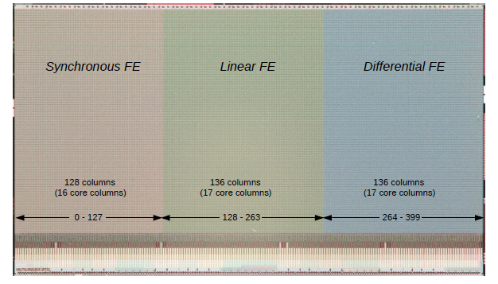
CMS Pixel Chip for Inner Tracker (IT) : development for Phase-2
Activity started in 2013 within the Collaboration RD53 & the experiment CHIPIX65 (INFN-Gr.V)
Purposes/timeline :
1. Study of the radiation tolerance of the TSMC CMOS 65nm technology, to evaluate
the adequacy for the more inner layers of the tracker (radiation level > 500Mrad)
2. Development of a Front-End library & IP blocks on the basis of the CMS & ATLAS
requirements/specs
3. Design, production & test of a pixel chip demonstrator (64x64) within Chipix65 (2016)
4. Design, production & test of a pixel chip demonstrator (large scale «RD53A») (2017-2018)
5. Design of the «production» pixel chip for CMS & ATLAS (2018-2020) on the basis of the
measurements carried out on the RD53A demonstrator and of the final specs of the two
experiments.
RD53A:
size: 20.066 x 11.538 mm
400x192 pixel array
26

Slide 27
CMS-Bari contribution to IT
Personpower : F. Loddo, G. De Robertis, M. Ince
Responsibilities :
- since June 2016: F. Loddo is Project Engineer,
with responsibility of the overall coordination and the chip integration
- since May 2018: F. Loddo is responsible of the development of the pixel ASIC
within the “IT coordination” for the Phase-2 upgrade
Design :
- 10-bit Digital-to-Analog Converter for the bias of the analog Front-End
- architecture & implementation of the bias circuit
- chip Floorplan
- study & implementation of circuit design solutions
to enhance the chip testability during the production phase
Activity foreseen in 2019-2020 :
- participation to the pixel chip design & submission to factory (foundry) foreseen for :
- Q3 2019 for the Atlas version of the chip
- Q2 2020 for the CMS version (CROC) of the chip
27

Slide 28
CMS Phase-1/2 Upgrade & related activities : MUON SYSTEM
A. Colaleo, Muon System Manager
G. Pugliese, RPC System Manager
28

Slide 29
Overwiew of CMS-Bari Muon system activities
5
RPC Ecogas Studies
- poss. replacement
R134 → HFO
- studies under bkg
radiation in GIF++
4
RPC Leak Repair campaign
- priority for CERN to reduce
GWP exhaust to environment
- heavy CMS-Bari involvement
3
Improved RPC
(RE3/1 & RE4/1)
- prototype Tests
- services installation
ME0
1
GEM GE1/1 Project (CMS Phase-1 upgrade)
- Construct & Qualify 144 Triple-GEM detectors
- installation during LS2
Priority of CMS during LS-2 all eyes are on us!
GEM Phase-2 upgrades: GE2/1 & ME0
- prototype Design & Construction
- discharge tests @ Neutron Facility
- simulation of various HW design
- simulation of HGCAL & Neutron Bkg
2
29

Slide 30
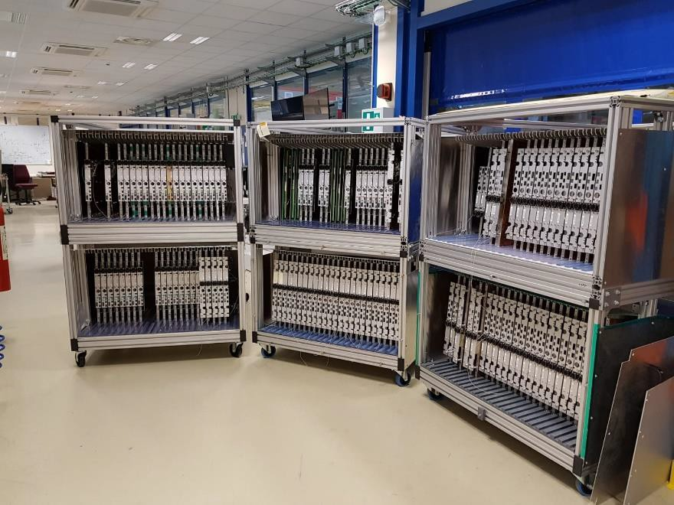
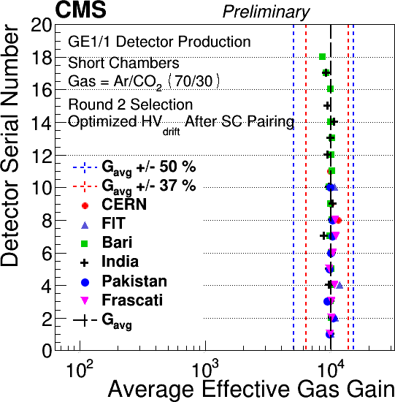
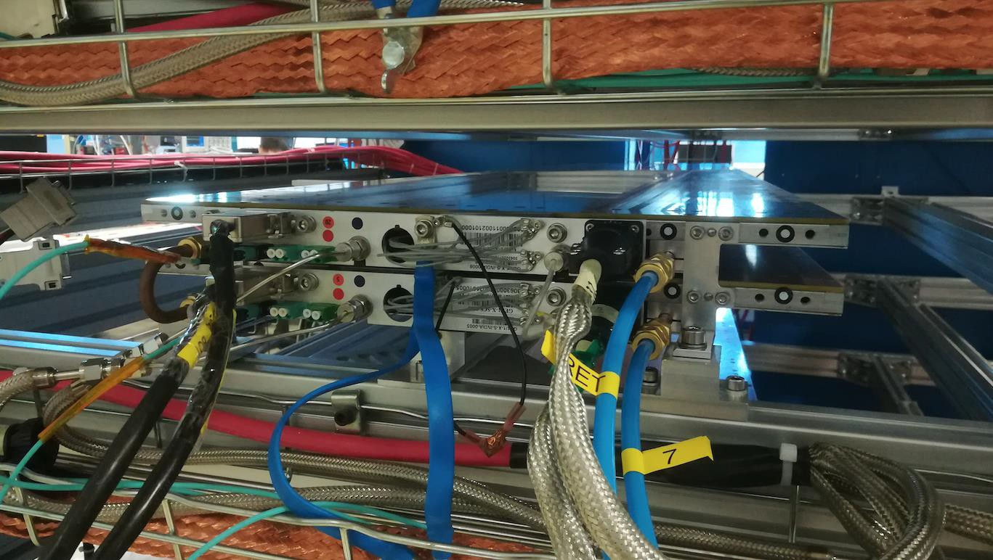
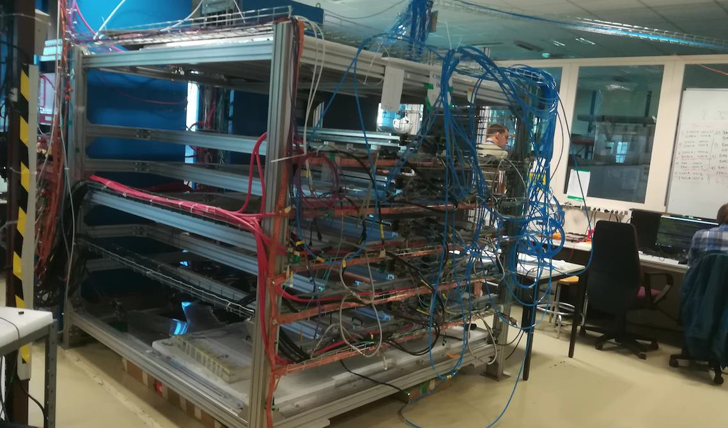
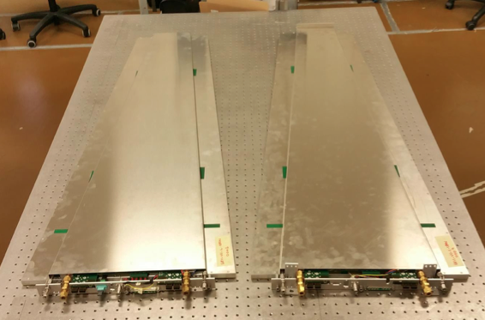
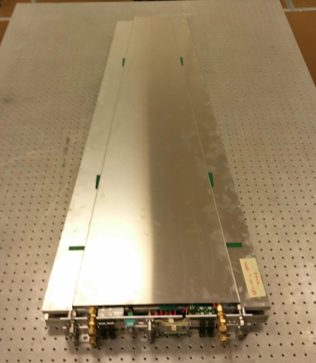
Construction & Test of GE1/1 detectors
1
GE1/1 Production finished (160 constructed / 154 valid - 144 needed)
  - Bari produced 18 chambers in 2018; first site to finish production
  - also contribution in testing & installing the chambers, installing the services.
  - A. Ranieri, S. Nuzzo, R. Venditti, A. Sharma, E. Soldani, P. Verwilligen, F.Simone
  + technicians (M. Franco, N. Lacalamita, S. Martiradonna, D. Dell’Olio)
  + students (C. Aruta, F. Ivone)
Super Chamber (SC) assembly ongoing:
- equip 2 chambers w/ electronics
- J. Merlin (GEM production manager), S. Nuzzo
+ technicians (P.Dipinto, D.Dell’Olio)
- Analysis of Chamber data x matching: E. Soldani
QC6-7-8 ongoing at CERN: Cosmic-Ray Stand
  - Bari physicists in leading role: M. Maggi (GEM Run coordinator),
  F. Simone
160 chambers ready
Super Chamber in Cosmic Stand
VFAT3 design, production/test & packaging
G. De Robertis, F. Licciulli (+ P. Mastrapasqua)
matching
2 single GEM Chambers
CERN Cosmic Stand
30

Slide 31
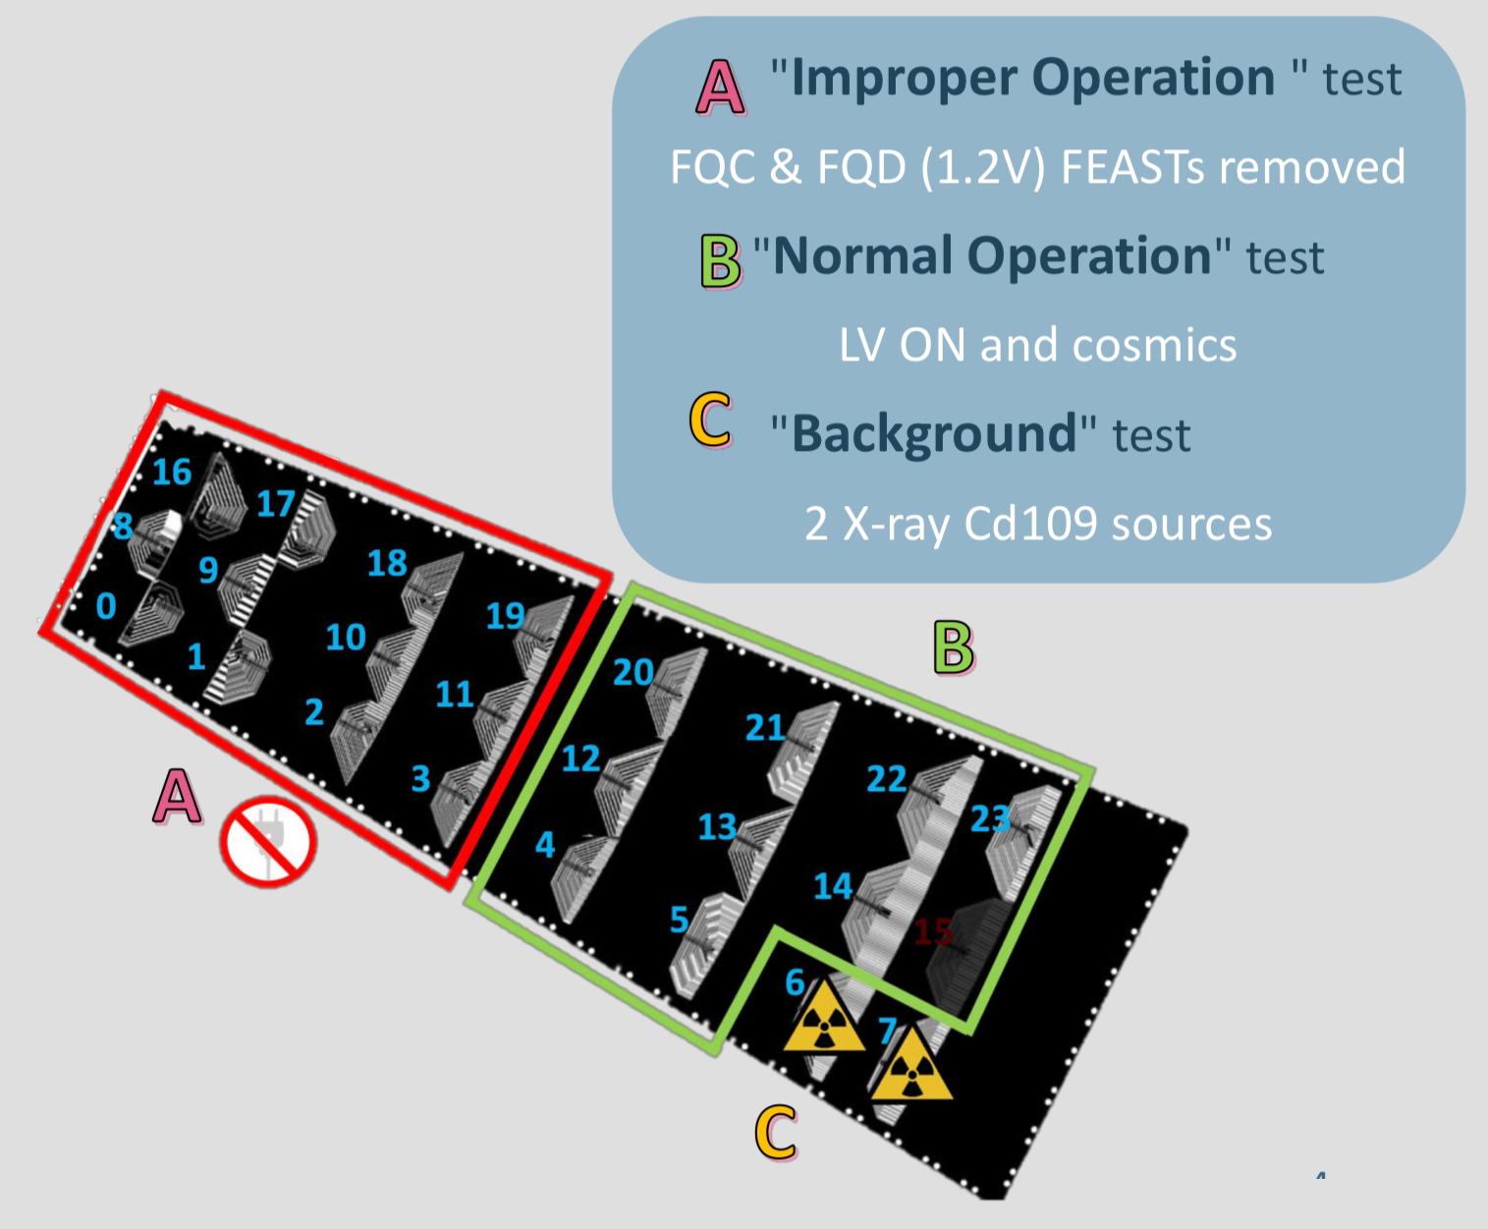
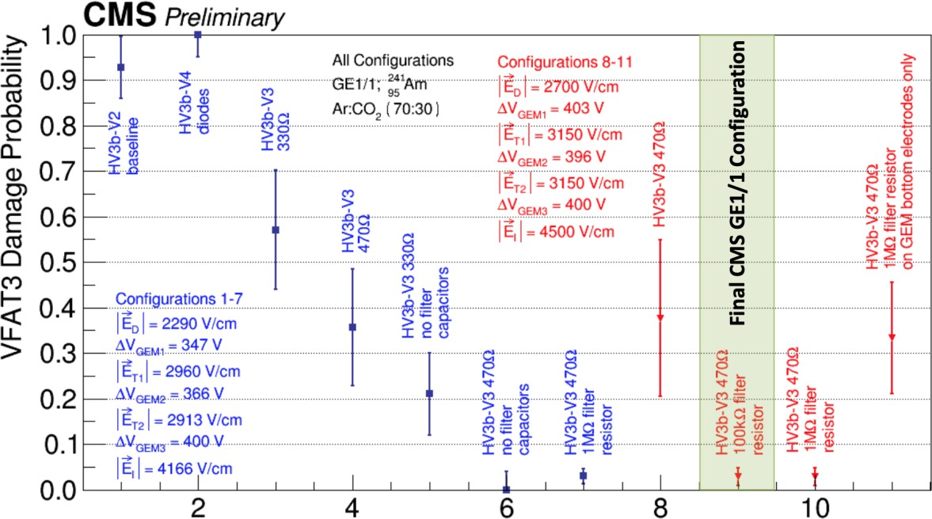
GEM Sustained Operation Studies
1
Slice-Test (2017-2018) was a success:
Integration in central CMS operations (DCS & DAQ)
Experience in running GEMs under high background
--> found abnormal channel dead rate
Creation of workgroup to reproduce in Lab & Mitigate for final installation
- Bari Expertise on electronics indispensable: G. De Robertis & F. Licciulli
- F. Simone + students (F. Ivone, C. Aruta) (all giving crucial contribution)
R&D campaign (GEM «Sustained Operation») lauched this summer to
understand the origin of the channel loss
study the effect of discharges on VFAT3 --> spark-resistant version of hybrid
designed under coordination of Bari electronics team
(after intense test campaign v3 VFAT3 hybrid was selected for GE1/1)
reduce sparks in future Triple-GEM detectors:
  Double-segmented foils for GE2/1 & ME0
F. Simone, C. Aruta & F. Ivone
A. Colaleo, M. Maggi,
J.Merlin, P.Verwilligen,
F. Licciulli, G. De Robertis
Discharge Investigations
GEM aging studies (V. Mastrapasqua)
31

Slide 32
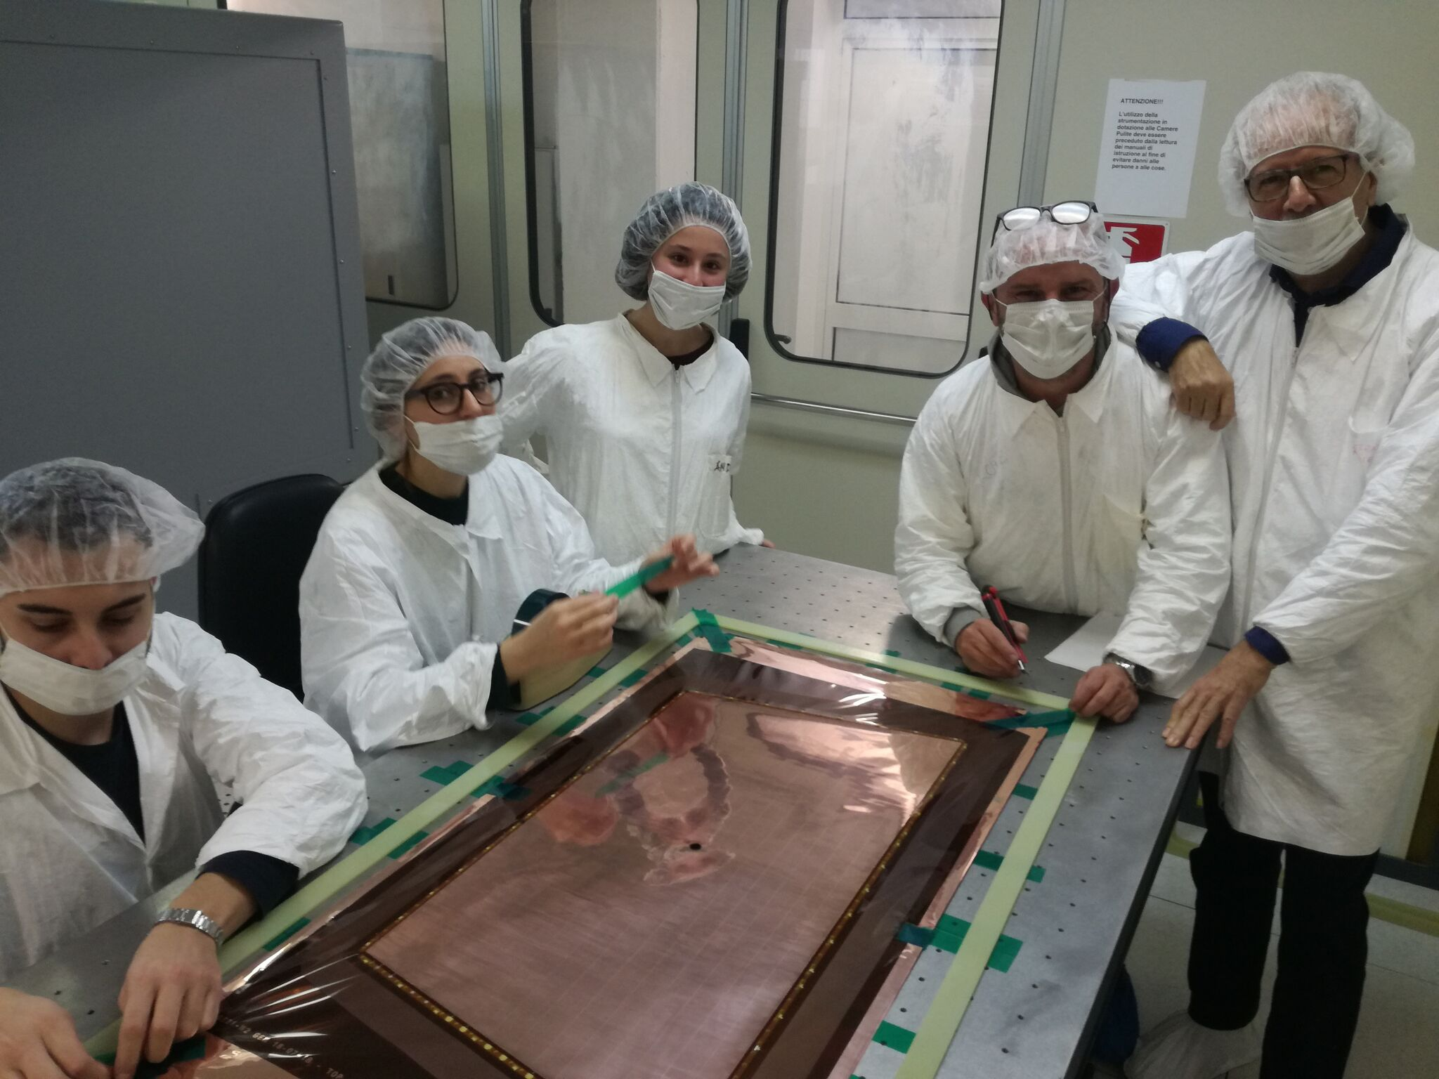
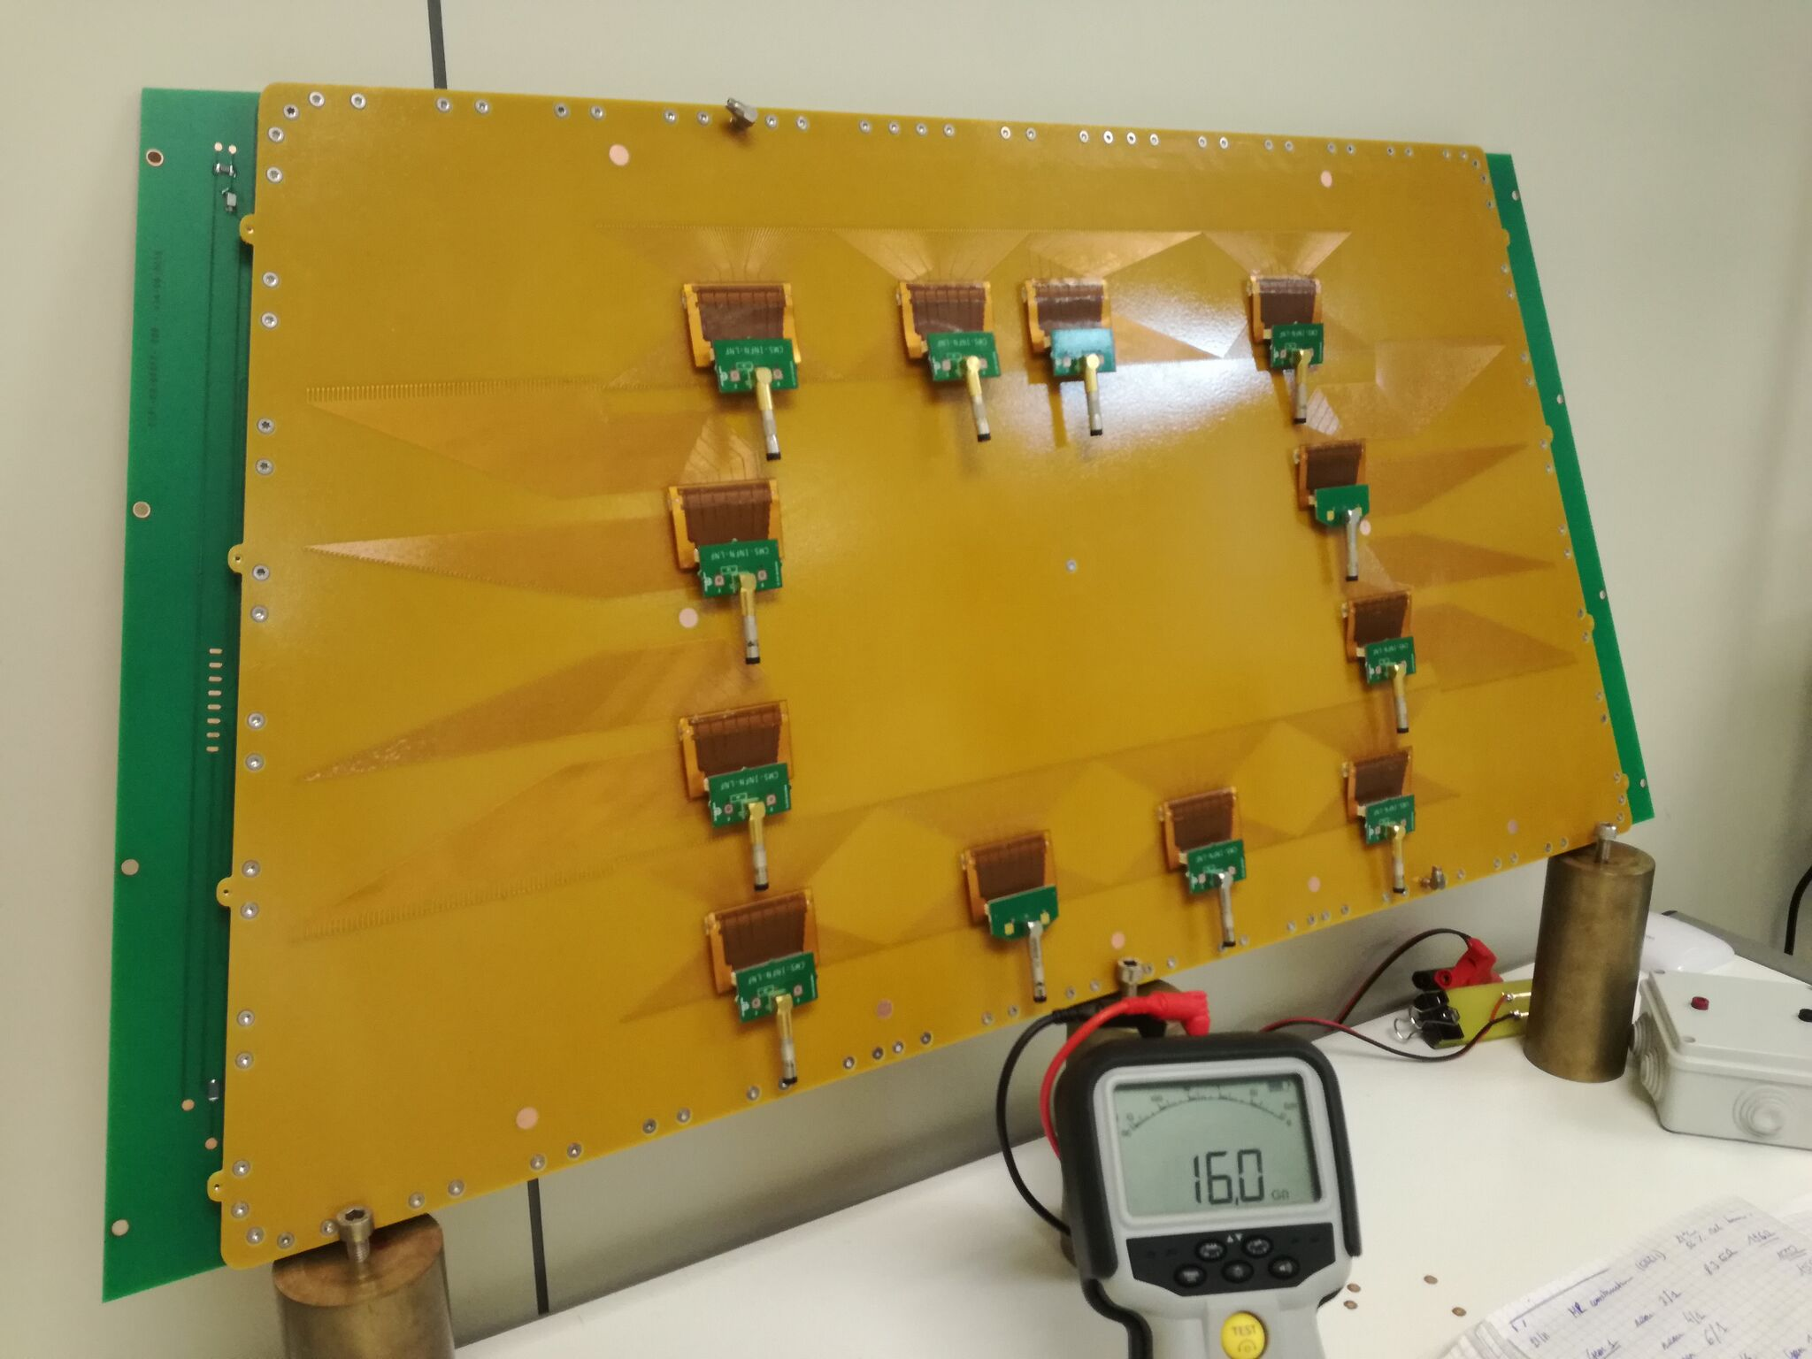
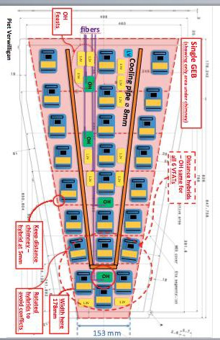
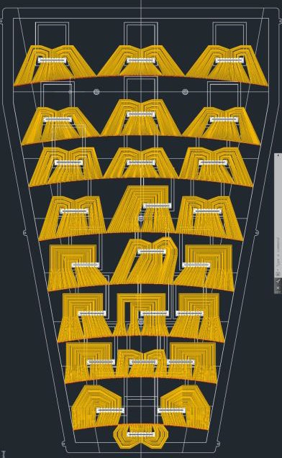
GEM Phase-2 activities
2
CMS-Bari also involved in GEM Phase-2 activities:
Construction & Test of GE2/1 Prototypes A.Ranieri, R.Venditti, J.Merlin (GE2/1 prod. manager) & P.Verwilligen
Design of ME0 Readout Board (complex interplay between services, readout, daq & detector) P. Verwilligen
Stand-Alone & CMSSW integrated simulation of GEM Detectors Simulation coordinated by P. Verwilligen
Preparation of Phase-2 Electronics: packaged VFAT3: design & tender GEM Electronics coordinated by F. Licciulli
Preparation for Neutron Beam Test (Discharges) in October 2019 – in collaboration with INFN Pavia
Construction & Test GE2/1
Design of ME0 readout
32

Slide 33
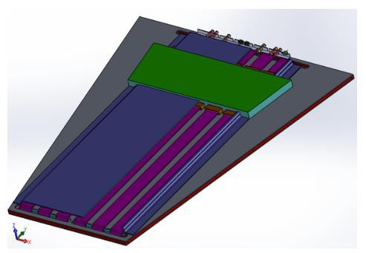
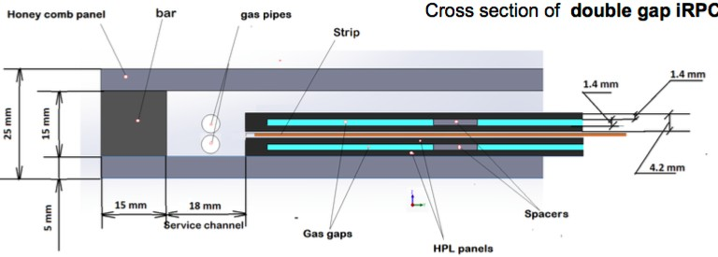





iRPC Design for RE3/1 & RE4/1 : 2D readout
3
The design of the improved RPC has been defined
2D readout design:
Readout Strips (with a pitch ≈0.6÷1.0 cm) are readout from both-ends
and connected to a new Front-End Boards equipped with a TDC
 | iRPC | RPC
High Pressure Laminate thickness | 1.4 mm | 2 mm
Num. of Gas Gap | 2 | 2
Gas Gap width | 1.4 mm | 2 mm
Resistivity (cm) | 0.9 - 3 x 10¹⁰ | 1 - 6 x 10¹⁰
Charge threshold | 50 fC | 150 fC
h segmentation | 2D readout | 3 h partitions
Two full size-RPCs with new FEBs have been tested at GIF++:
- Coaxial design: strips connected to FEB through coaxial cables
- Return design: return lines embedded on PCB
Return design adopted for ease of constr & impedance match
Validation of new FEB_V1 (PETIROC) ongoing @ 2kHz/cm² $γ$
Prototypes tested at GIF++ by A. Gelmi, R. Aly
RE3/1 & 4/1 Services
installation by N. Lacalamita
R&D upgrade W.Elmetenawee, I.Margjeka
adapt. ^{coax}board
adapt.
board coax
Coax iRPC
FE
GND
Return iRPC
Return iRPC
strip
33

Slide 34

RPC Gas Leak reparation
4
In 2018, the RPC gas system was operated with:
Total flow ~8800 l/h
Leak rate: ~900 l/h (constant)
Leaky chambers are located:
63 in the Barrel → 800-850 l/h
8 in the Endcap → 50-100 l/h
In the framework of CMS strategy for GHG emission reduction,
a massive leak repair campaign started in March 2019.
carried out by G. Pugliese, M. Franco
Encap region: five leaky chambers have been replaced with spare chambers, leading to a leak reduction of ~ 35 l/h.
Barrel region:
Access to the positive side from April to June 2019. All leaky chambers have been first
inspected to localize the source of leak.
A new procedure to repair the leaky RPCs was also successfully implemented allowing
access to the broken gas component by a partially extraction of the station (RPC & DT).
Strong contribution of Bari Technicians in all phases !
27% of leaky chambers have been repaired. Leak reduction of ~ 90 l/h.
34

Slide 35




RPC & iRPC Longevity studies @ GIF++
5
Main goal: validate existing RPCs & iRPC for HL-LHC (1C/cm²); test iRPC prototypes rate-capability
GIF++ is interesting place to study RPC detector performance & investigate new GWP-neutral gas mixtures
  5 RPCs (2 CMS, 1 ATLAS, 1 Alice, 1 EP-DT) under test in common project; 1 RPC with CMS electronics
  Ecogas mix based on HFO1234ze (C₃H₂F₄) under study: 45% HFO, 50% CO₂, 4% iC₄H₁₀
  2kV shift of HV Working Point @ 250Hz/cm² – in agreement with TDR (Cosmics only)
  Study of HF production (2.5 x higher) & Study of Cluster Size & Cluster Charge ongoing
carried out by G. Pugliese, A. Gelmi
Cosmics TDR
35
HF production in P5 also under study!

Slide 36

RPC & GEM personpower requests for 2020
GEM Activities 2020:
[at CERN] Installation 2nd endcap GE1/1; Services GE1/1 & GE2/ [Technicians]
[at CERN] Data taking & Analysis @ Cosmic Stand; Commissioning @ P5; Global Runs [Phycisists]
[in Sezione] Construction & Test GE2/1 (40 modules) [Tech & Phys]
RPC Activities 2020:
[at CERN] Leak Repair Campaign (expertise Bari) + Services RE3/1 & RE4/1 [Technicians]
[at CERN] Commissionning @ P5 (RE4); GIF++ (ecogas); Global Runs. [Phycisists]
36

Slide 37
Miscellanea
In 2019 we have done a CMS-Masterclass & participated to the ERN (CMS virtual visit)
We will host CMS-Italia annual meeting (2019 november 13th-15th)
37

Slide 38
Final numbers/names/responsibilities/requests
38

Slide 39
Anagrafica for CMS-Bari 2020 – in preparation
Some colleagues left (F. Errico, R. Radogna, C. Calabria, A. Sharma)
Some colleagues arrived (J. Merlin - starting; M. Gul - will start soon;
new PhD students + new master students)
EXCEL file for Anagrafica 2020 available (in GOOGLE DRIVE; link circulated among staff)
https://drive.google.com/file/d/1u0jjYD35y43sdbDMTnUaRnpfV1UzWmnZ/view?usp=sharing
39

Slide 40
CMS overall request for INFN-Bari services in 2020 - Recap
Overall requests evaluated in “mesi persona” :
SERVICE | TRK | GEM | RPC
Progettazione Meccanica | 6 | 2 | -
Officina meccanica | 3 | 8 (2+6@Cern) | 6(@Cern)
Camera Pulita | 12 | (6 access only) | -
Servizio Elettronico | - | 3 | -
8
5+12(@CERN)
12
3
40

Slide 41

Current/future Contributions/Responsibilities within CMS
2019 2020
ends august 2019
starts september 2019
Tot.: 52
Other involvements in Committees :
M. de Palma (Career committee)
N. De Filippis (Schools & PhD Thesis awards commitees)
Team responsibilities :
A. Pompili (Team Leader)
S. My (deputy Team Leader / Tracker IB representative)
P. Verwilligen (deputy Team Leader / Muon IB representative)
41

Slide 42
Trimestral support for young students @ CERN
In the period 2016-2019 CMS-Bari benefitted from six 3-month scolarships funded by INFN (“similfellow junior”) to support activities of our young students @ CERN, provided through a public call on a merit basis [related to their academic path (marks reported, final degree evaluation)].
This number is well beyond the average over the all INFN CMS groups!
Name | Current position
A. Di Florio | INFN post-doc
F. Simone | Phd student
A. Taliercio | Phd student (@Louvain)
F. Ivone | Master student
V. Mastrapasqua | Graduate student
A. Zaza | Master student
42

Slide 43

Wide support to conference/workshop participation
In 2018 CMS-Bari supported a rather wide participation to Conferences & Workshops,
(a large part for the non-staff members of the group); this table is the comparison with other INFN CMS groups (not normalized to the number of group members).
Our involvement is higher than the average over the all INFN CMS groups.
43

