Slide 1
Development of J-PEM based on Plastic scintillator and WLS
Shivani
On Behalf of J-PET Collaboration
Notes:
Make dark part light………..

Slide 2
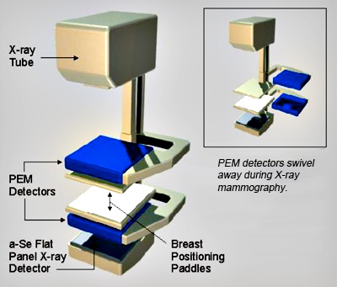
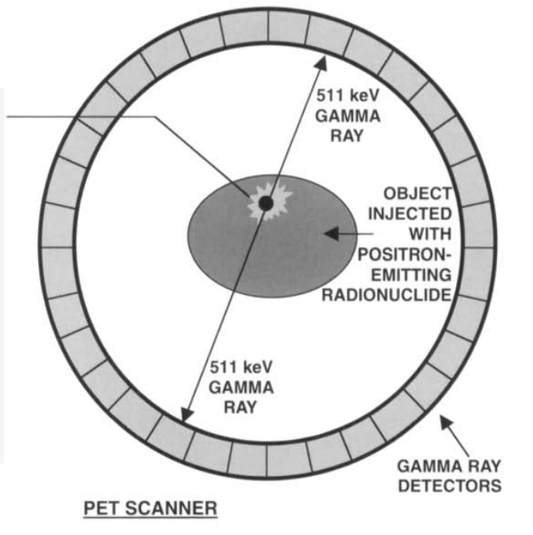
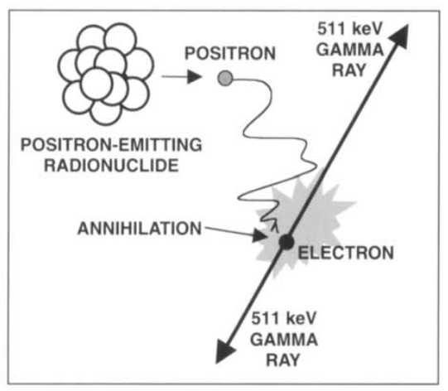
Positron emission mammography
Positron emission tomography
The dose of radio tracer that is required in PEM, is very less as compared to whole body PET imaging.
localized field of view, so misses on distant metastases which is not the problem in whole body PET.
Number of new cases in 2018, females, all ages in Poland - 22.4% (in 2018)
Notes:
Positron emission mammography (PEM) is a nuclear medicine imaging modality used to detect or characterise breast cancer. Mammography typically refers to x-ray imaging of the breast, while PEM uses an injected positron emitting isotope and a dedicated scanner to locate breast tumors
Positron Emission mammography (PEM) is a very good diagnostic tool for diagnosing breast cancer. It has revolutionized mammography imaging and has the ability to replace normal mammography in future. One very big advantage over normal mammography is that it is not affected by breast density. Few article find it better than MRI in terms of differentiating between benign and malignant lesions, lesion localization, number of lesions especially if they are small and axillary nodal staging. It is very useful in finding out small satellite nodules , thereby ruling out futile breast conserving surgeries. Newer radio tracer can be used for finding out ER/PR status, though they are in research state at present.
However, there are certain cons also; first being the cost, though I feel that it only transient as the dose of radio tracer that is required in PEM, is very less as compared to whole body PET imaging. Second is - localized field of view, so misses on distant metastases which is not the problem in whole body PET. Similarly using whole body PET with newer tracers like F-18 fluoroestradiol, we can see the estrogen receptor status of the metastases as well and used it for monitoring the response of treatment administered.
In my opinion, PEM is useful in doubtful cases i.e. BIRADS III & IV or when there is strong suspicion of breast cancer like family history or ovarian cancer. In cases of proven metastases, whole body PET is useful.

Slide 3
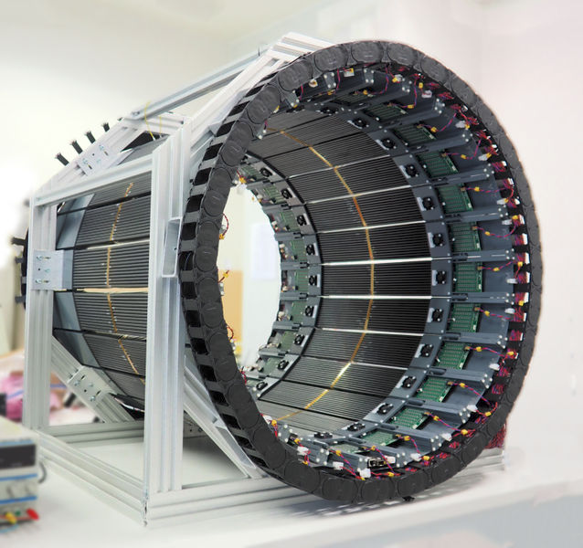
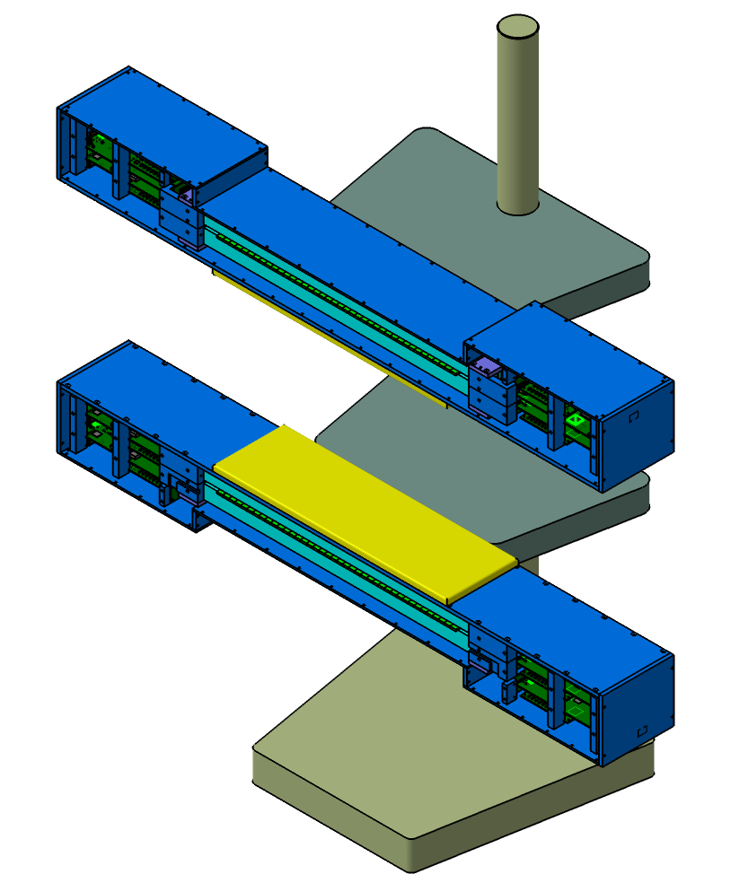
To the Future...
24 modules(one module consist of 13 plastic scintillator) 48 boards
2 modules(one module consist of 26 plastic scintillator and 40 WLS) 12 boards .

Slide 4
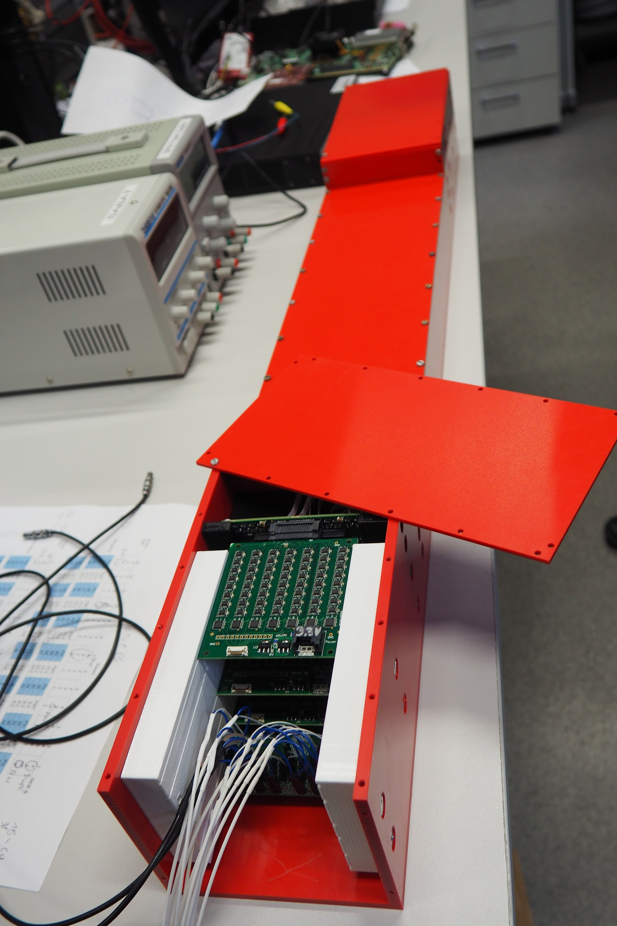
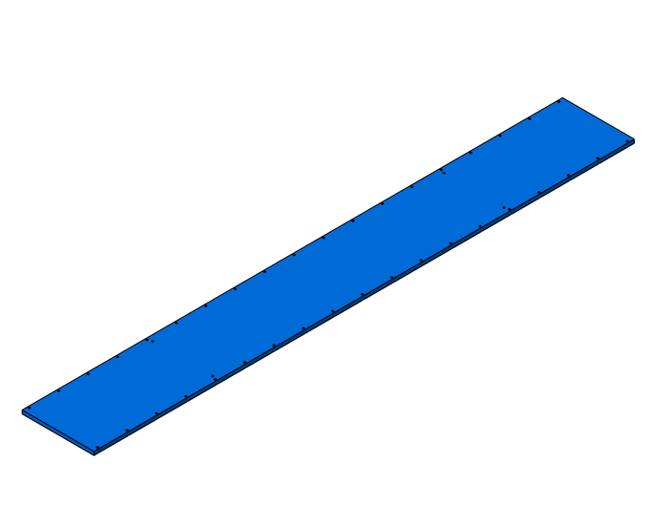
J-PEM - Jagiellonian Positron emission
mammography

Slide 5
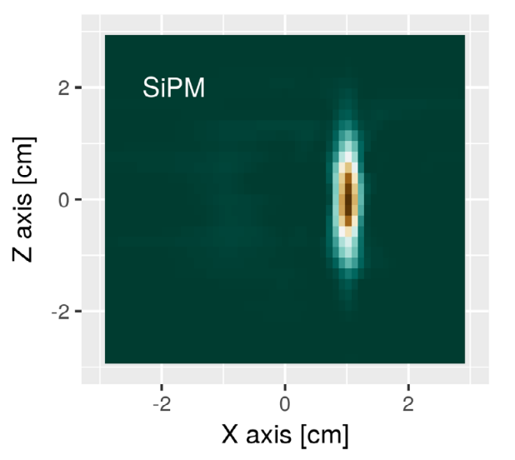
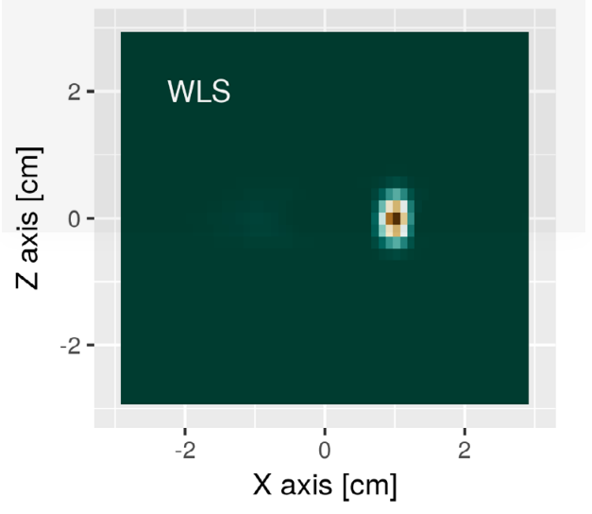
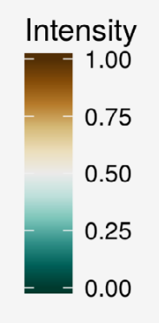
Why WLS? Simulation Result
Reconstruction of the source placed in the centre of the tomograph
Reference : P Kowalski et al 2018 Phys. Med. Biol.63 165008
Notes:
reconstruction of the source placed in the centre of the tomograph may be seen in figure 15(geometry was fixed to the single layer chamber with a diameter of 85 cm and strips of length 50 cm and thickness equal to 4 mm; silicon photomultipliers were used as photodetectors)

Slide 6
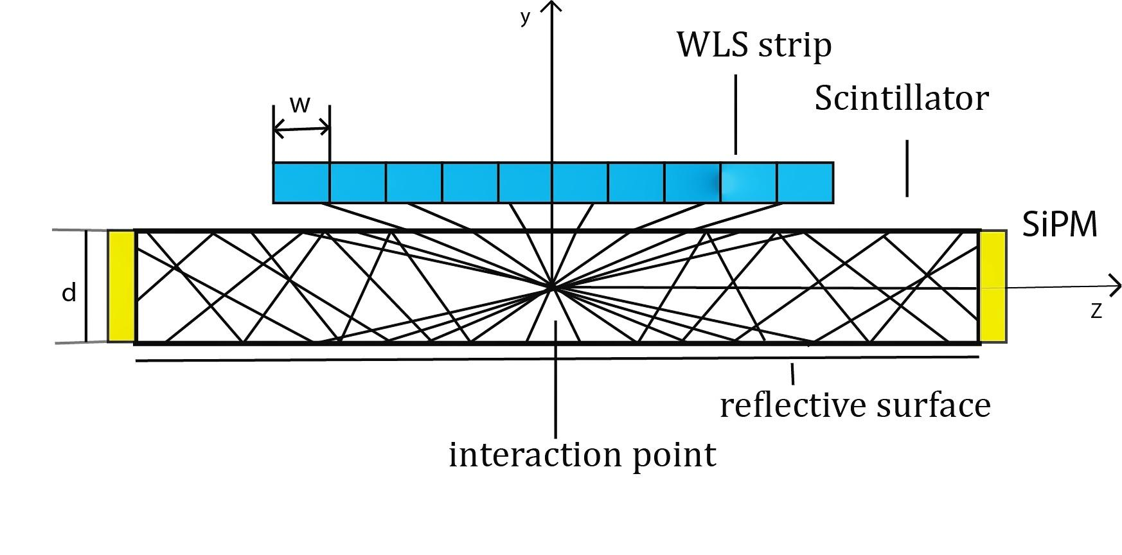
Wavelength shifter
Side view of a scintillator strip and a set of parallel WLS strips placed above the scintillator

Slide 7
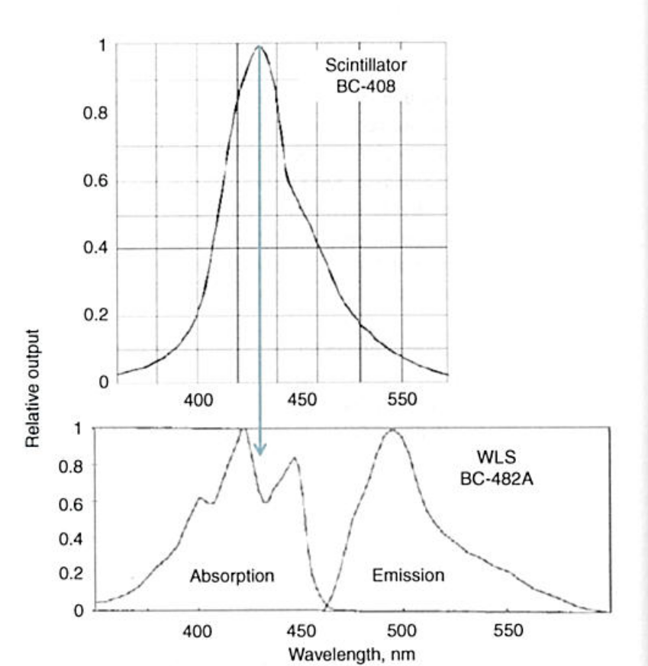
Wavelength shifter
Emission spectra plastic scintillator
Emission and Absorptions spectra
of WLS

Slide 8
Wavelength shifter
Secondary photons trapped in WLS fiber and propagate towards the SiPMs

Slide 9
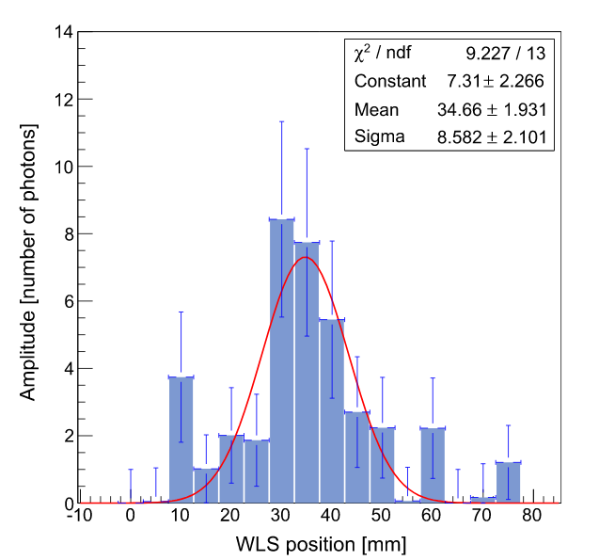
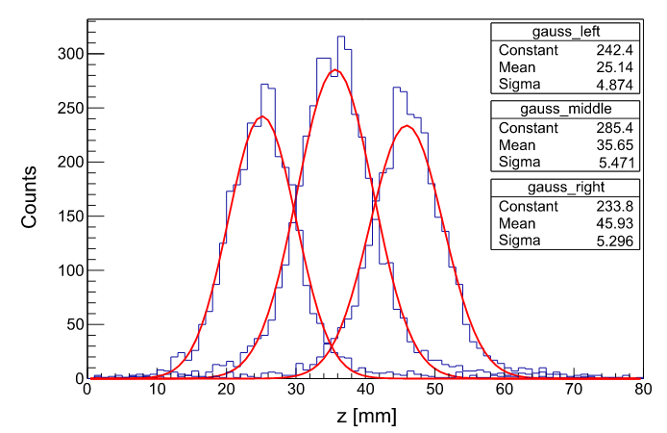
Experimental Result
Fig.1 Amplitudes measured in individual
WLS strips.
Fig.2 .Distributions of reconstructed z–coordinates of the gamma quantum interaction for three different positions of the22Na source.
Reference: J. Smyrski,et,.al Nuclear Instruments and Methods in Physics Research A 851 (2017) 39–42
Notes:
A bar of BC-420 scintillator with a length of 300 mm, a width of19 mm and a thickness of 5 mm is used for the registration of gammaquanta, and this is shown schematically inFig. 2. The type anddimensions of the scintillator bar are identical with the ones used inthe J-PET prototype scanner[11]. The scintillator bar was read out oneach end by three Hamamatsu S12572-050P silicon photomultipliers(SiPMs). Photons escaping from the bar through a 5 mm wide side wallwere registered with an array of 16 WLS strips placed parallel to thewall with a 1.5 mm air gap left in between the WLS strips and thescintillator. The remaining three side walls of the scintillator werecovered with reflective aluminium foil

Slide 10
Assembly of J-PEM

Slide 11
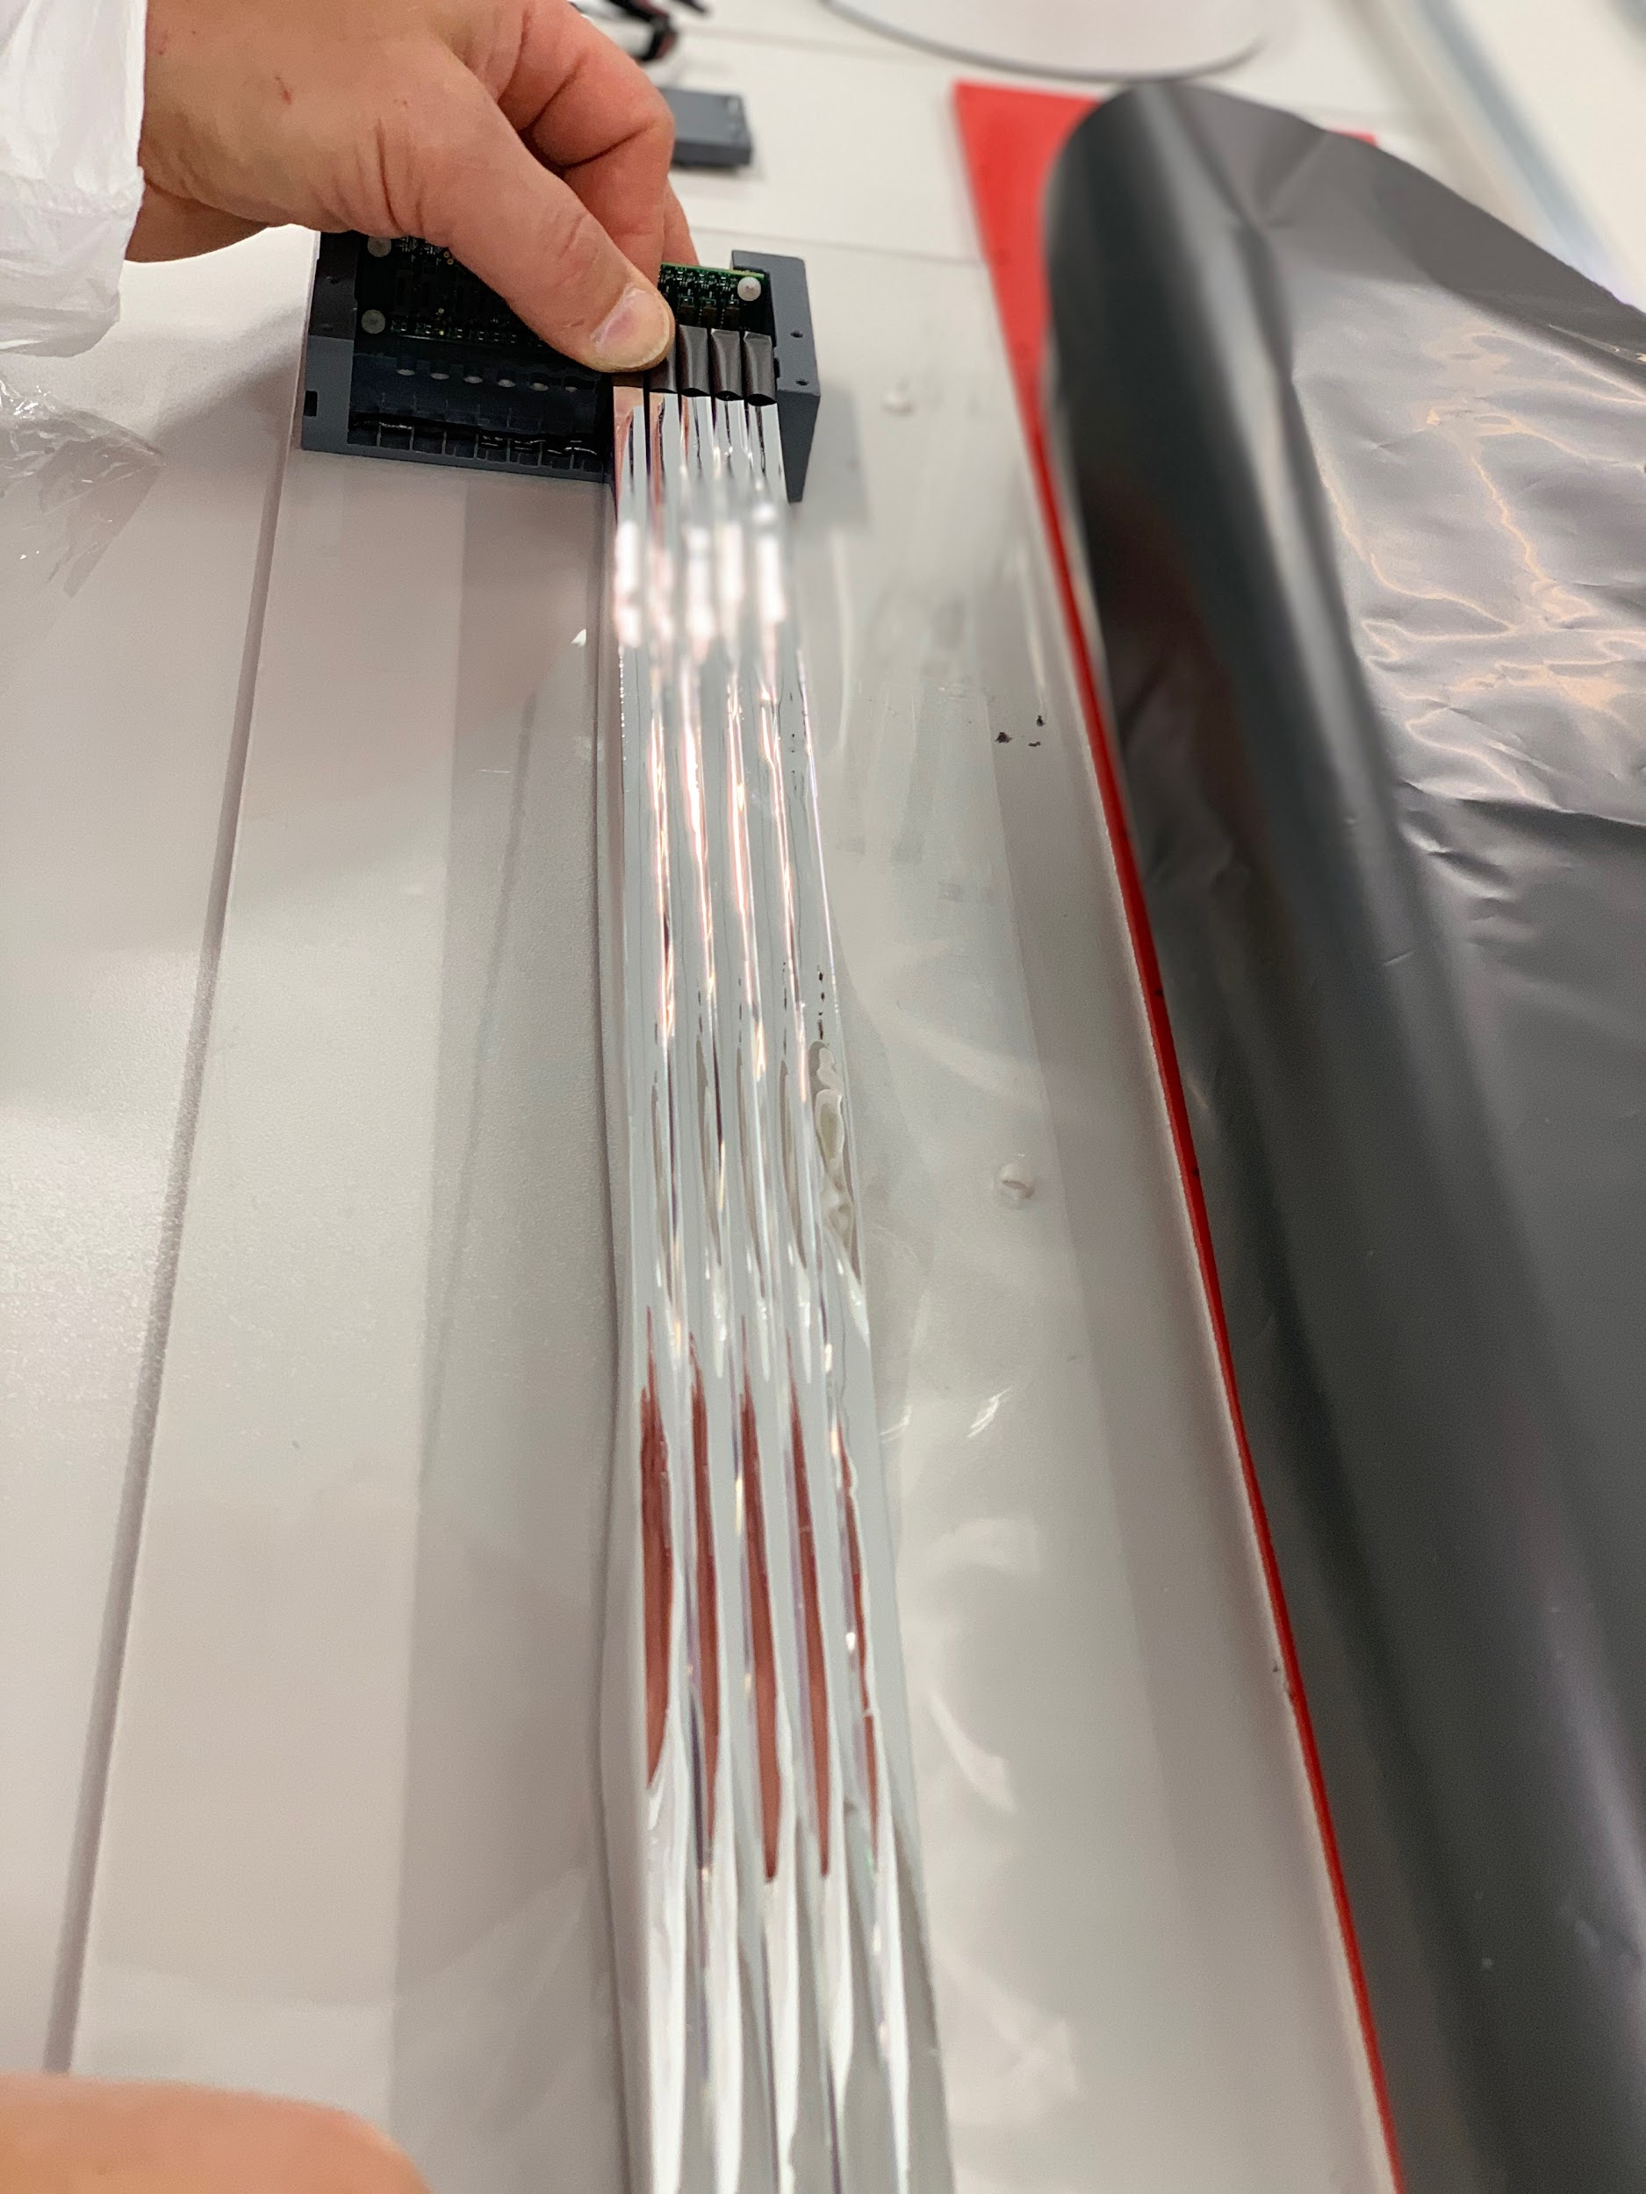
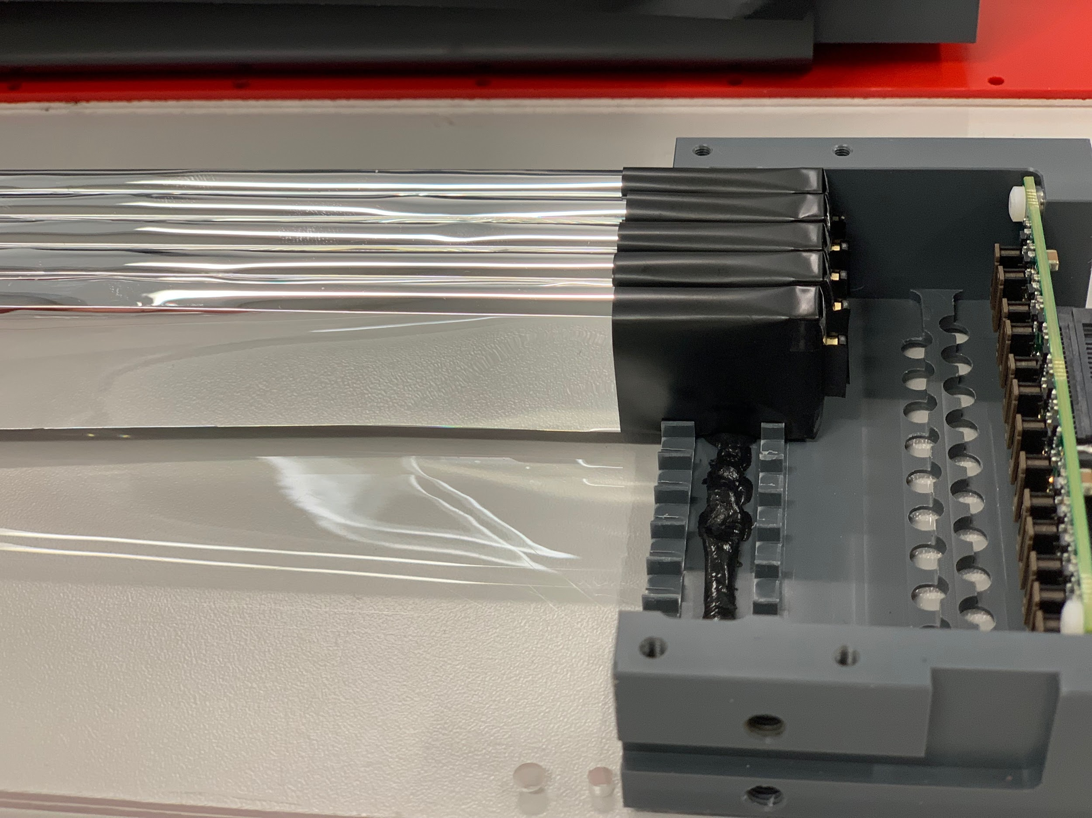
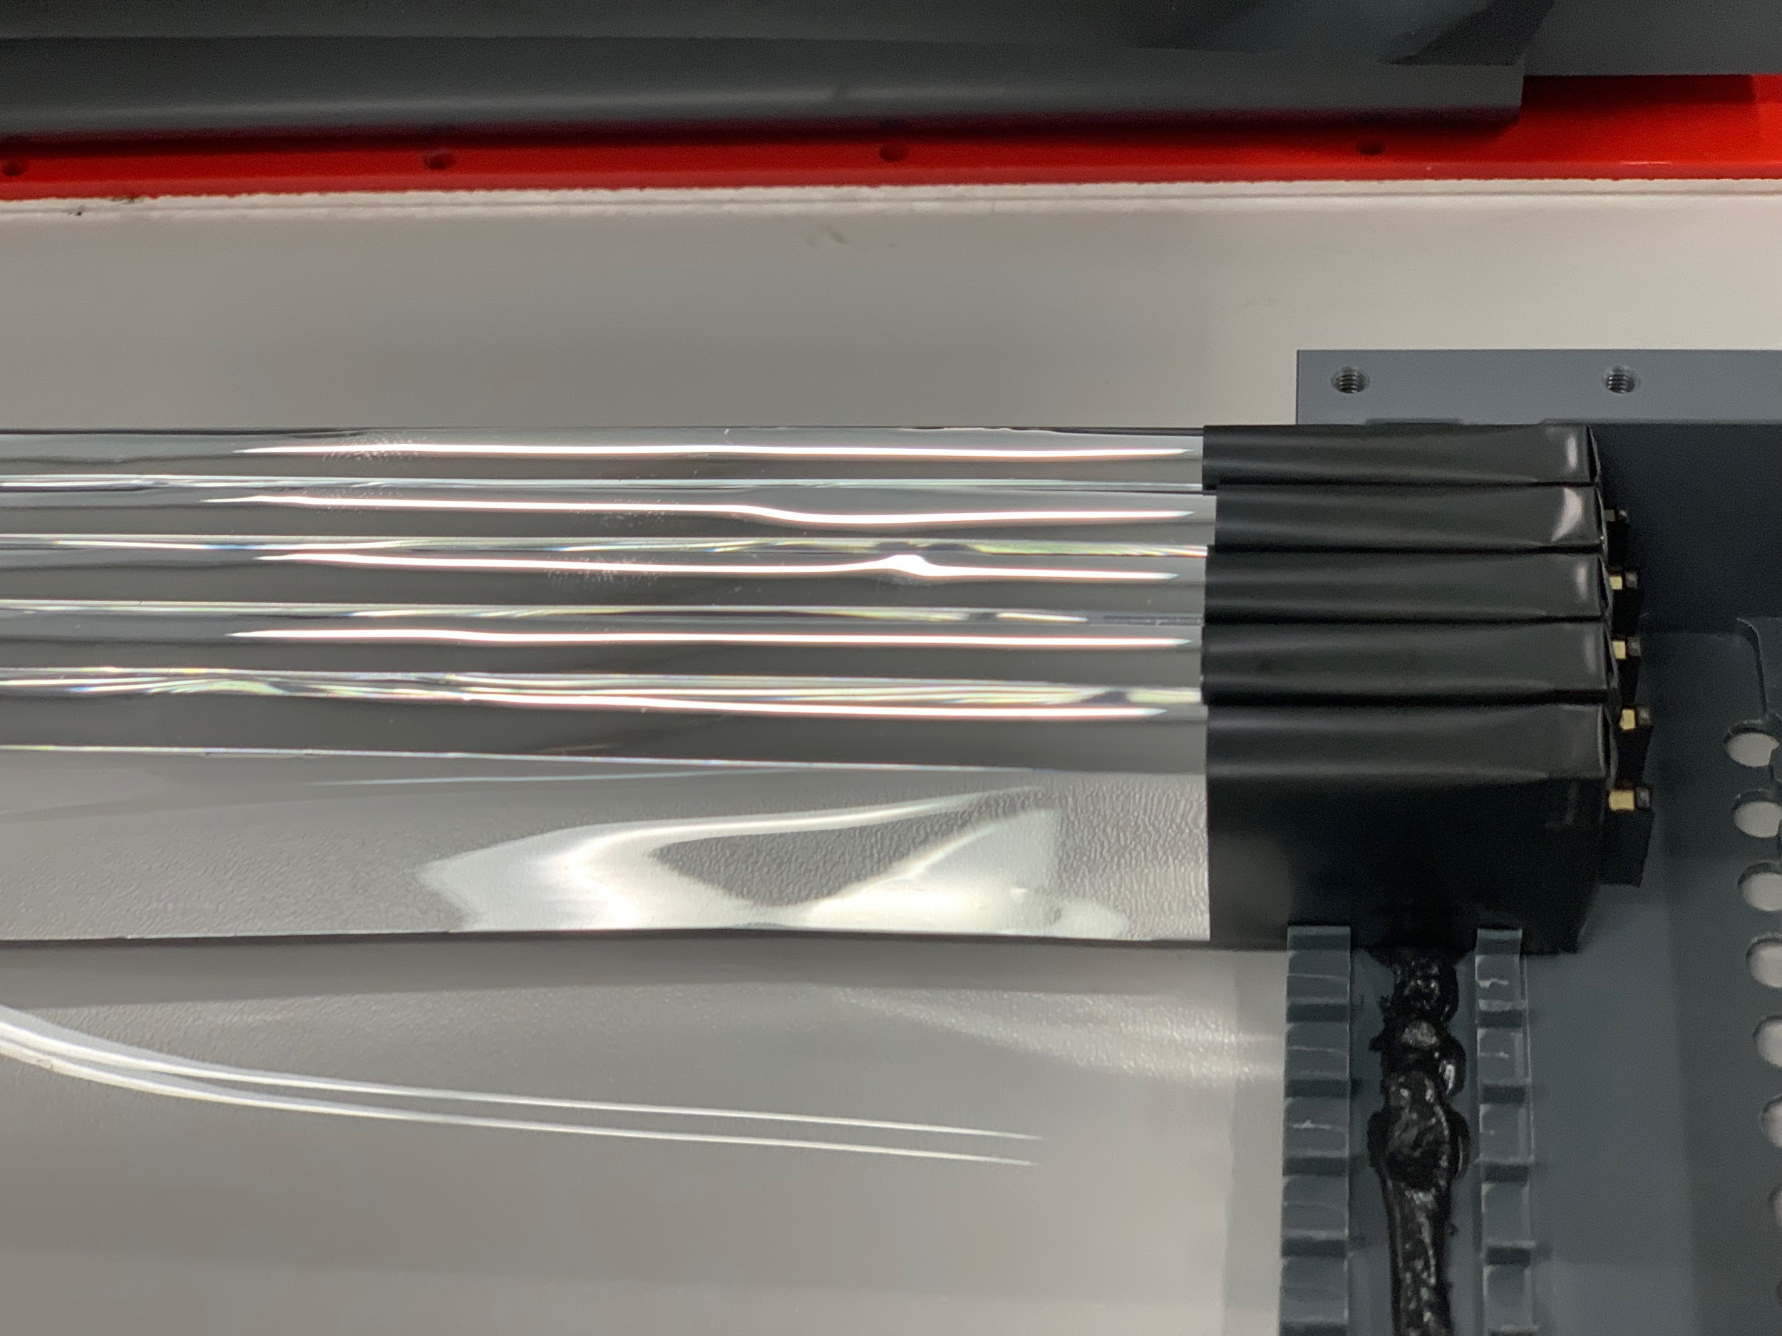
First layer
Scintillators are wrapped from three side with vikuiti

Slide 12
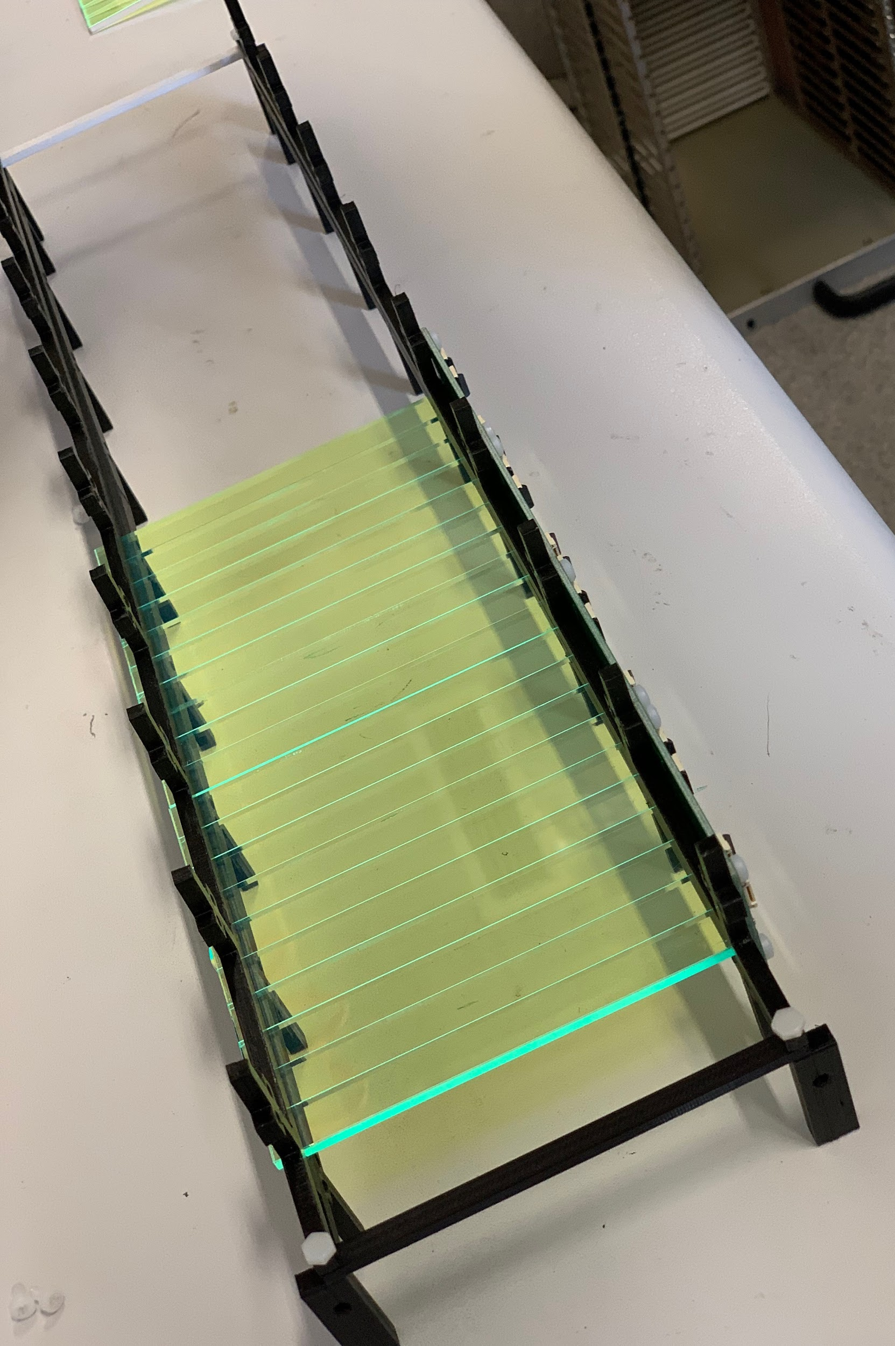
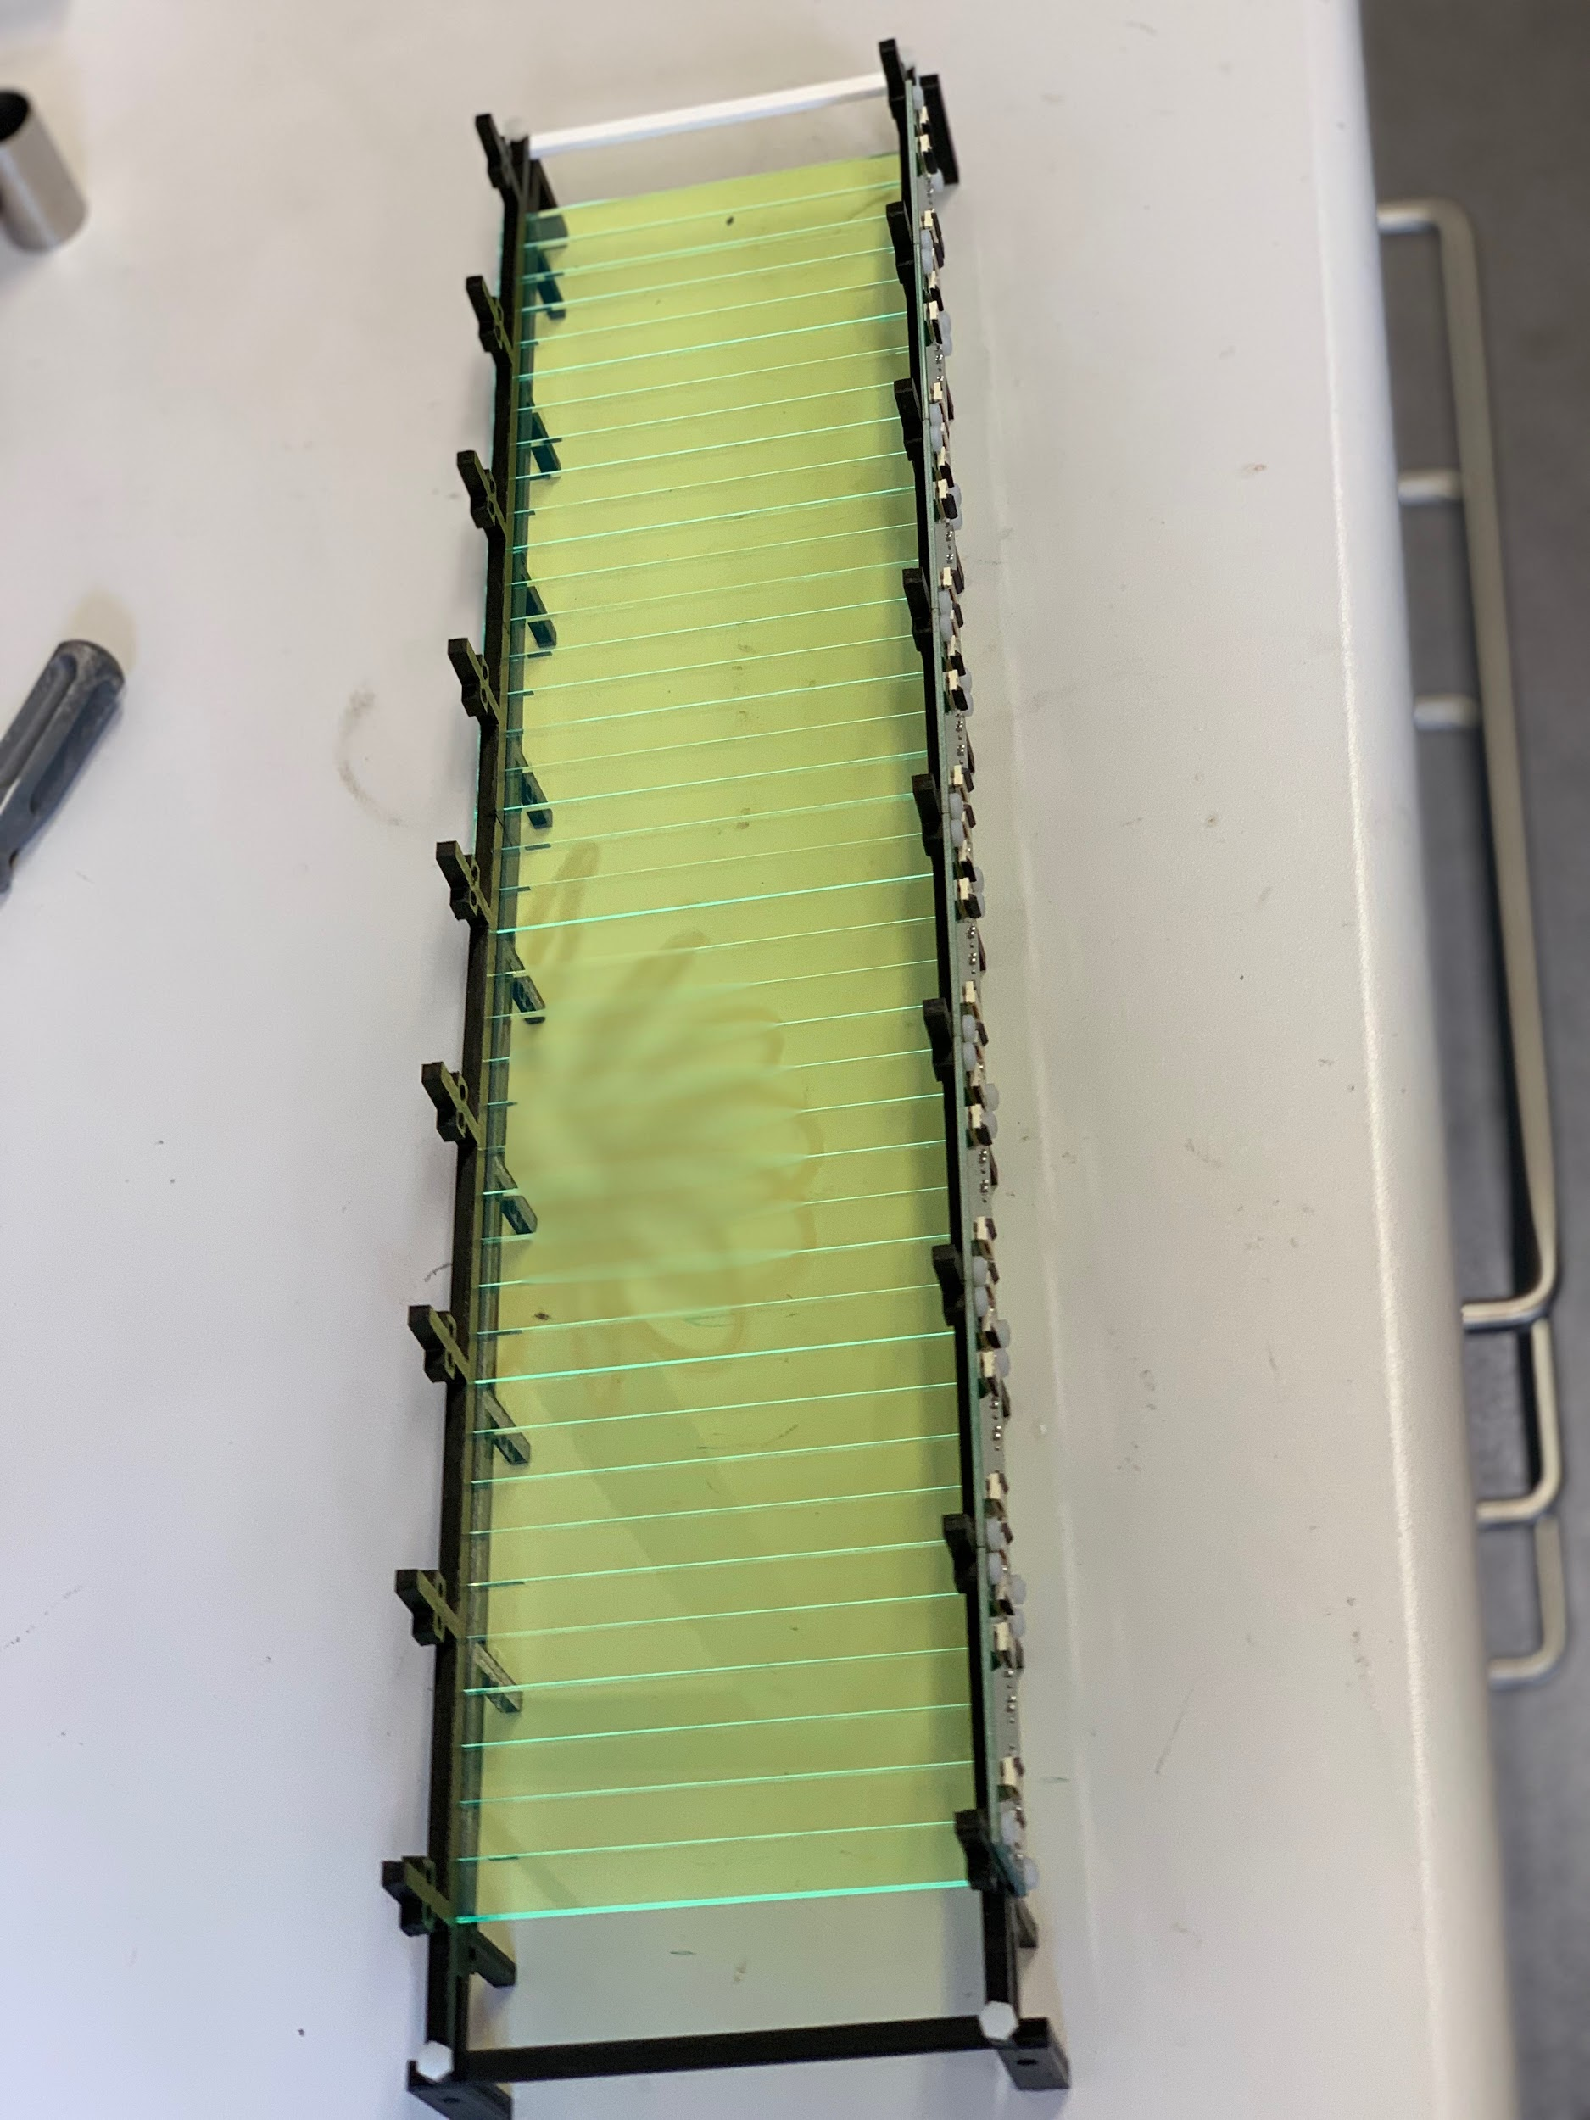
Second Layer
Notes:
40 wls in total

Slide 13
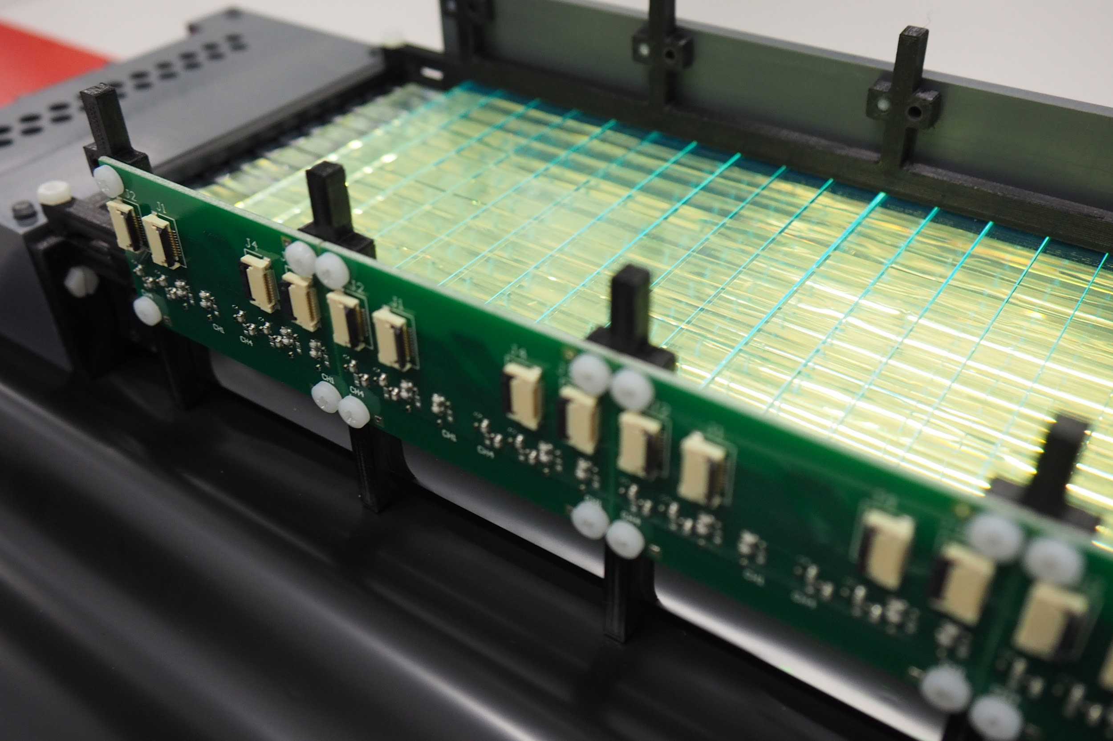
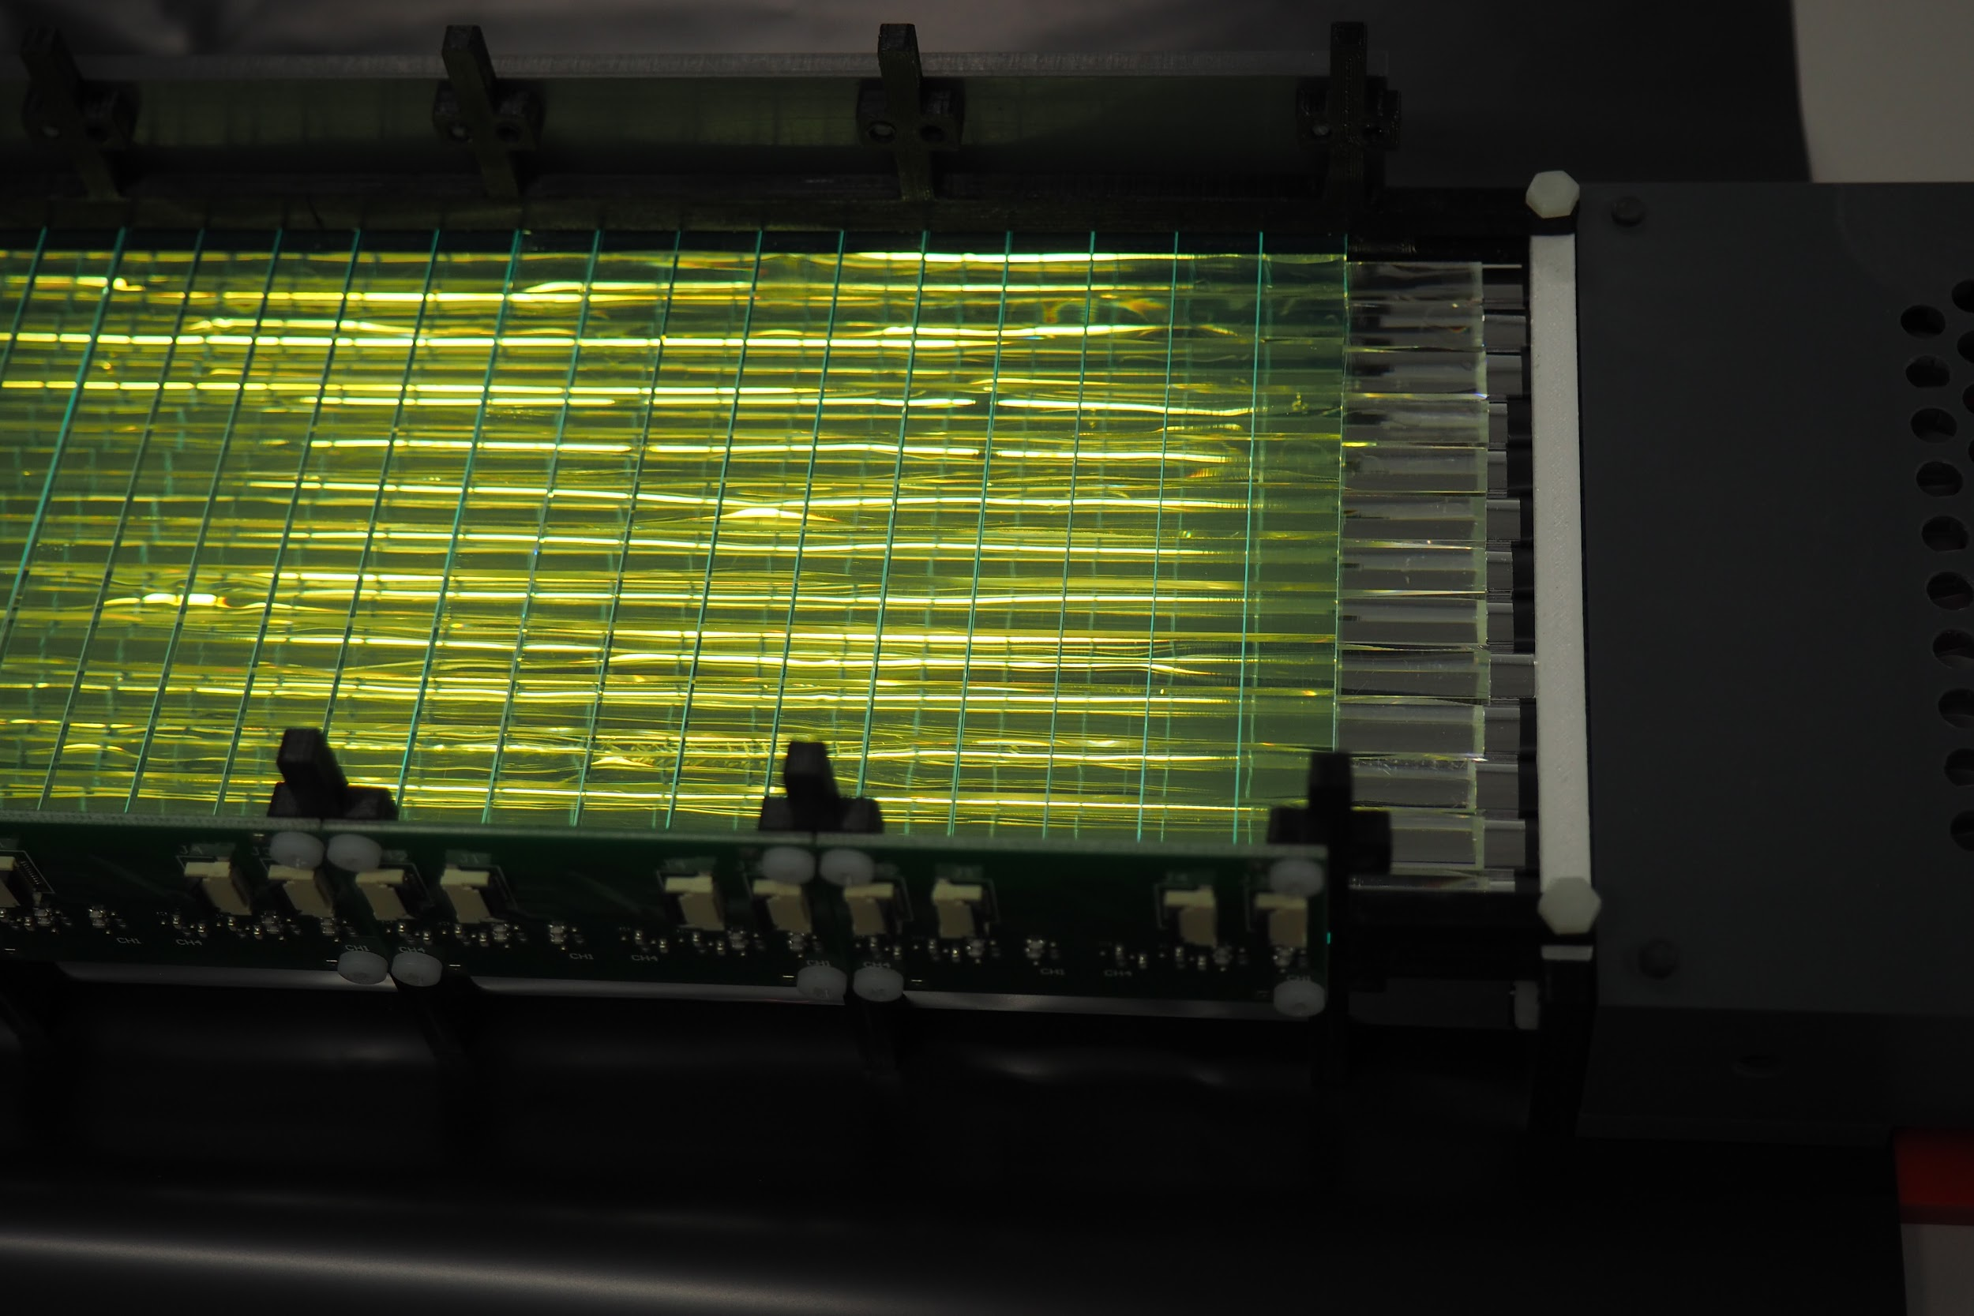
Two layer assembly - WLS placed arranged to Scintillator layer
WLS readout

Slide 14
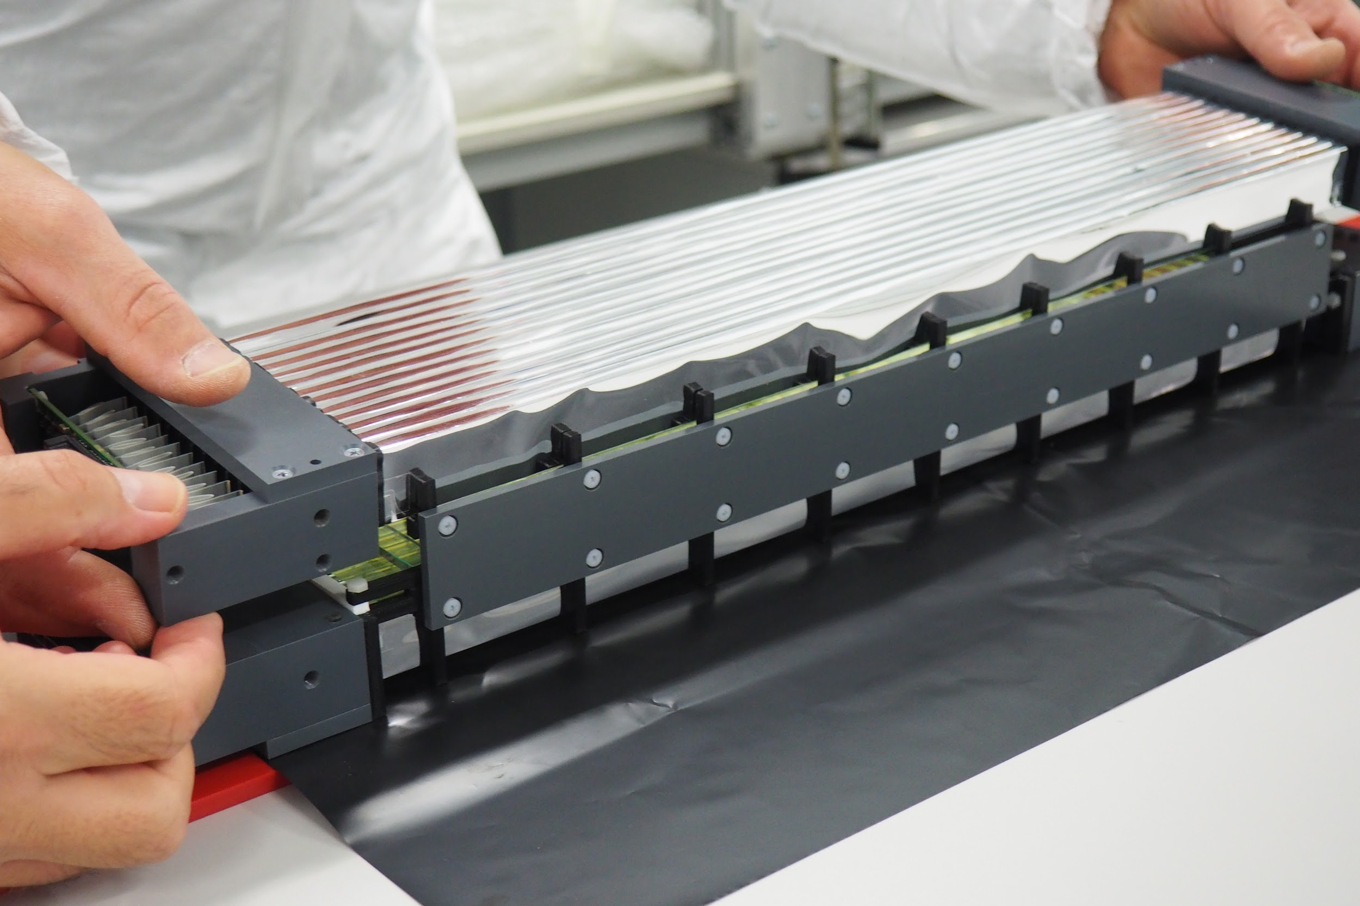
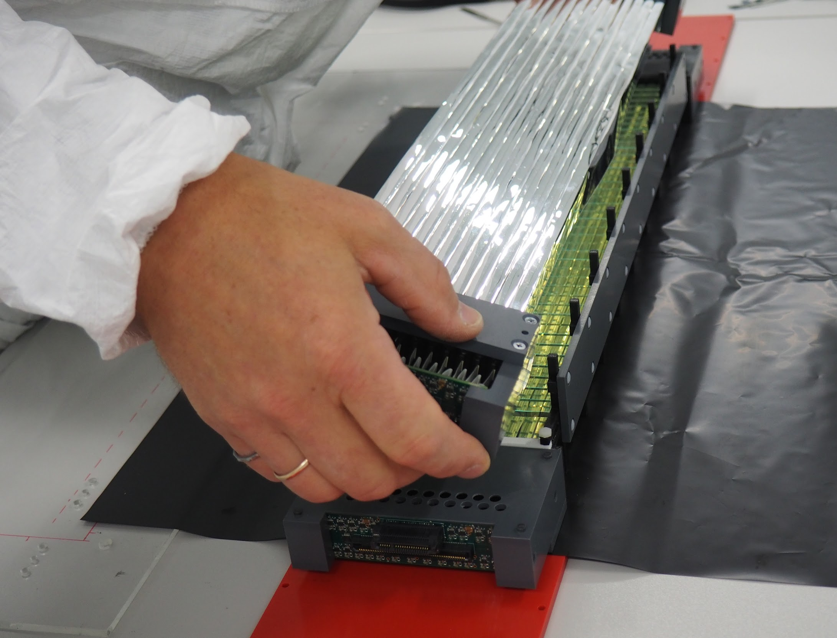
Third layer mounting

Slide 15
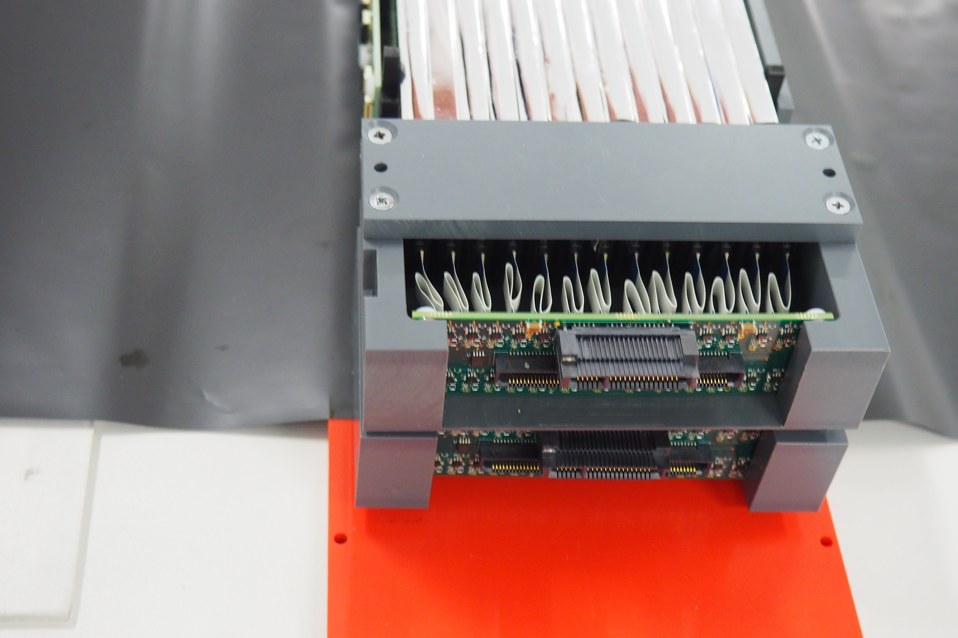
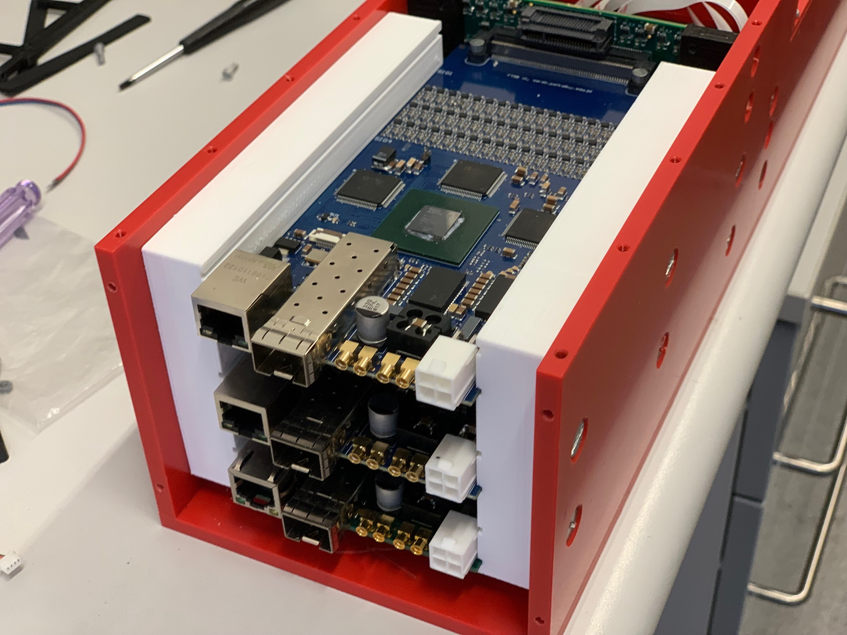
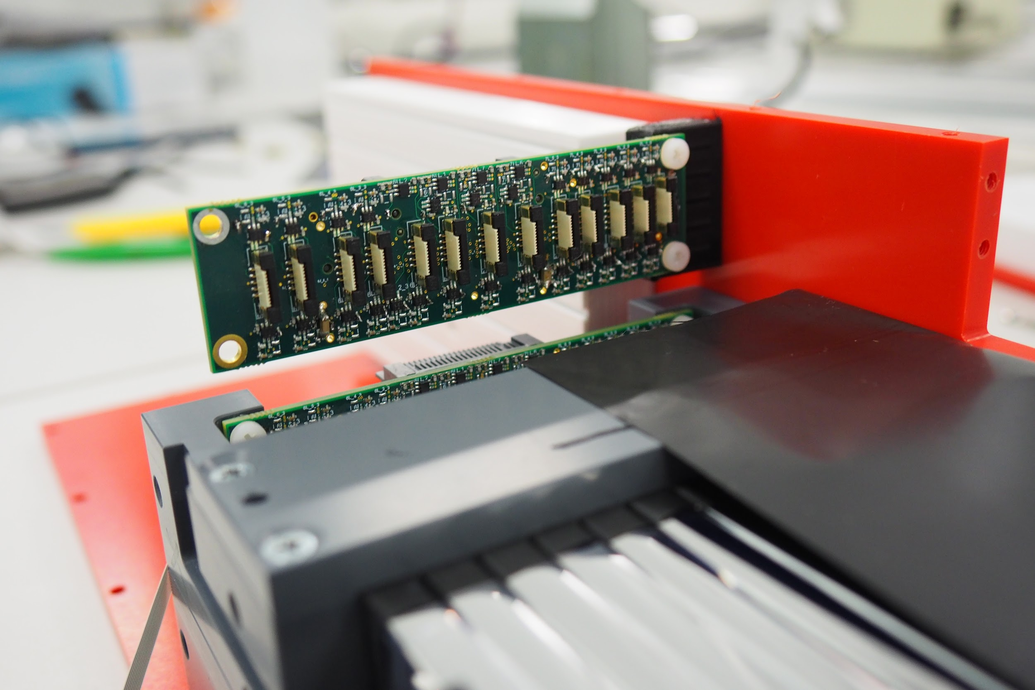
Readout boards

Slide 16
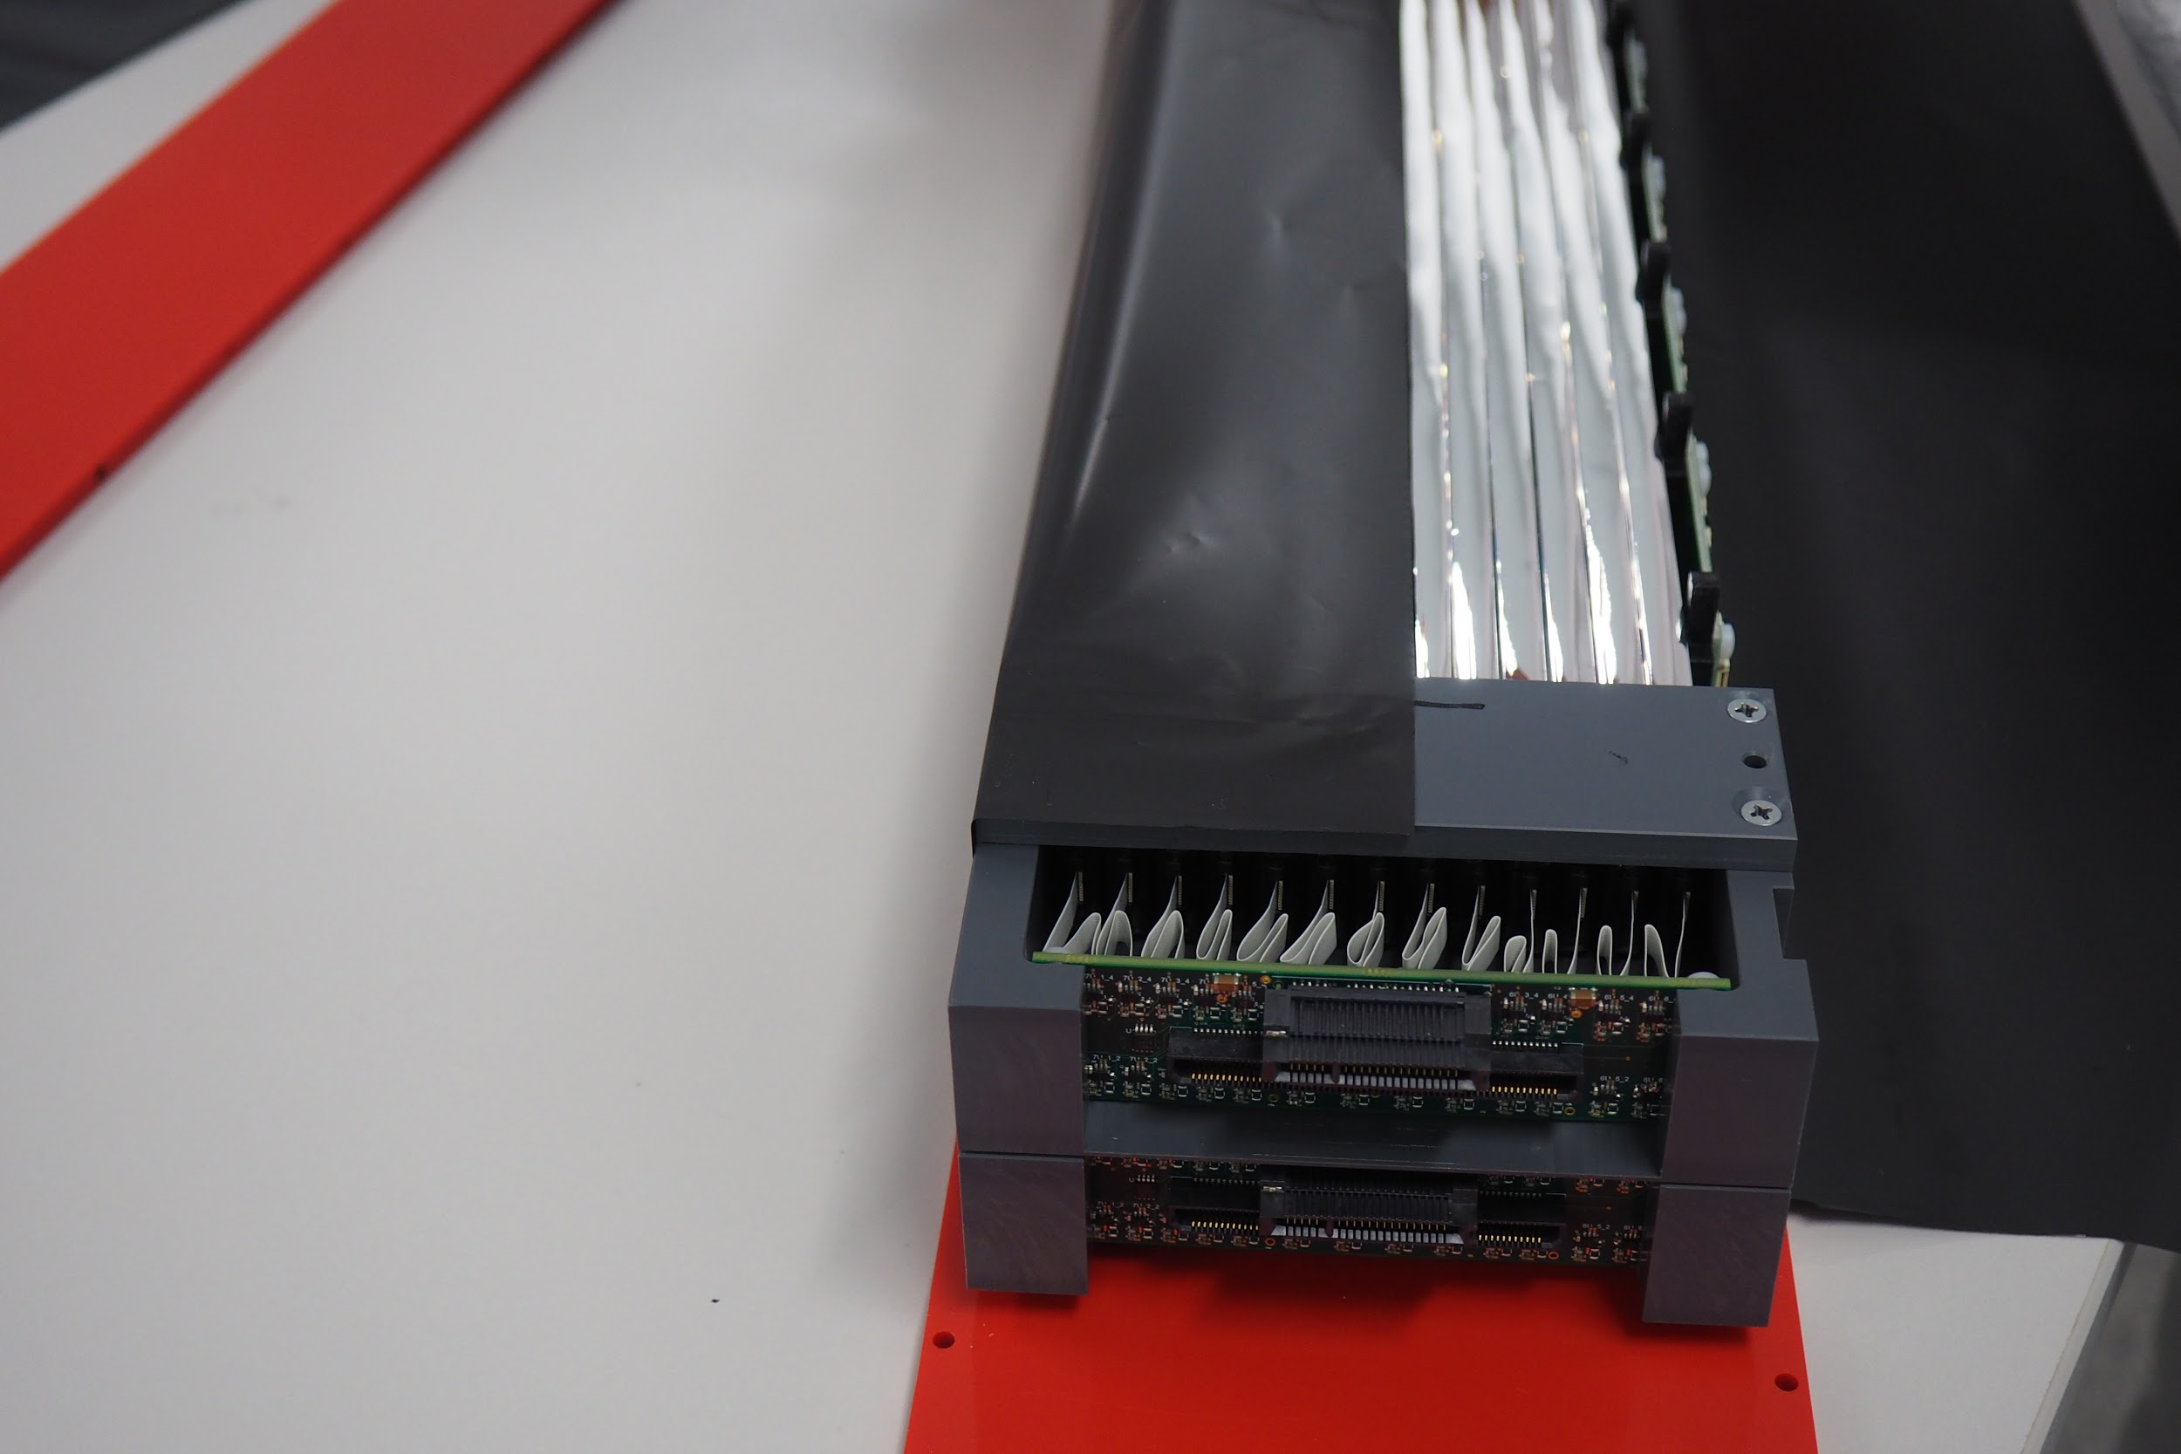
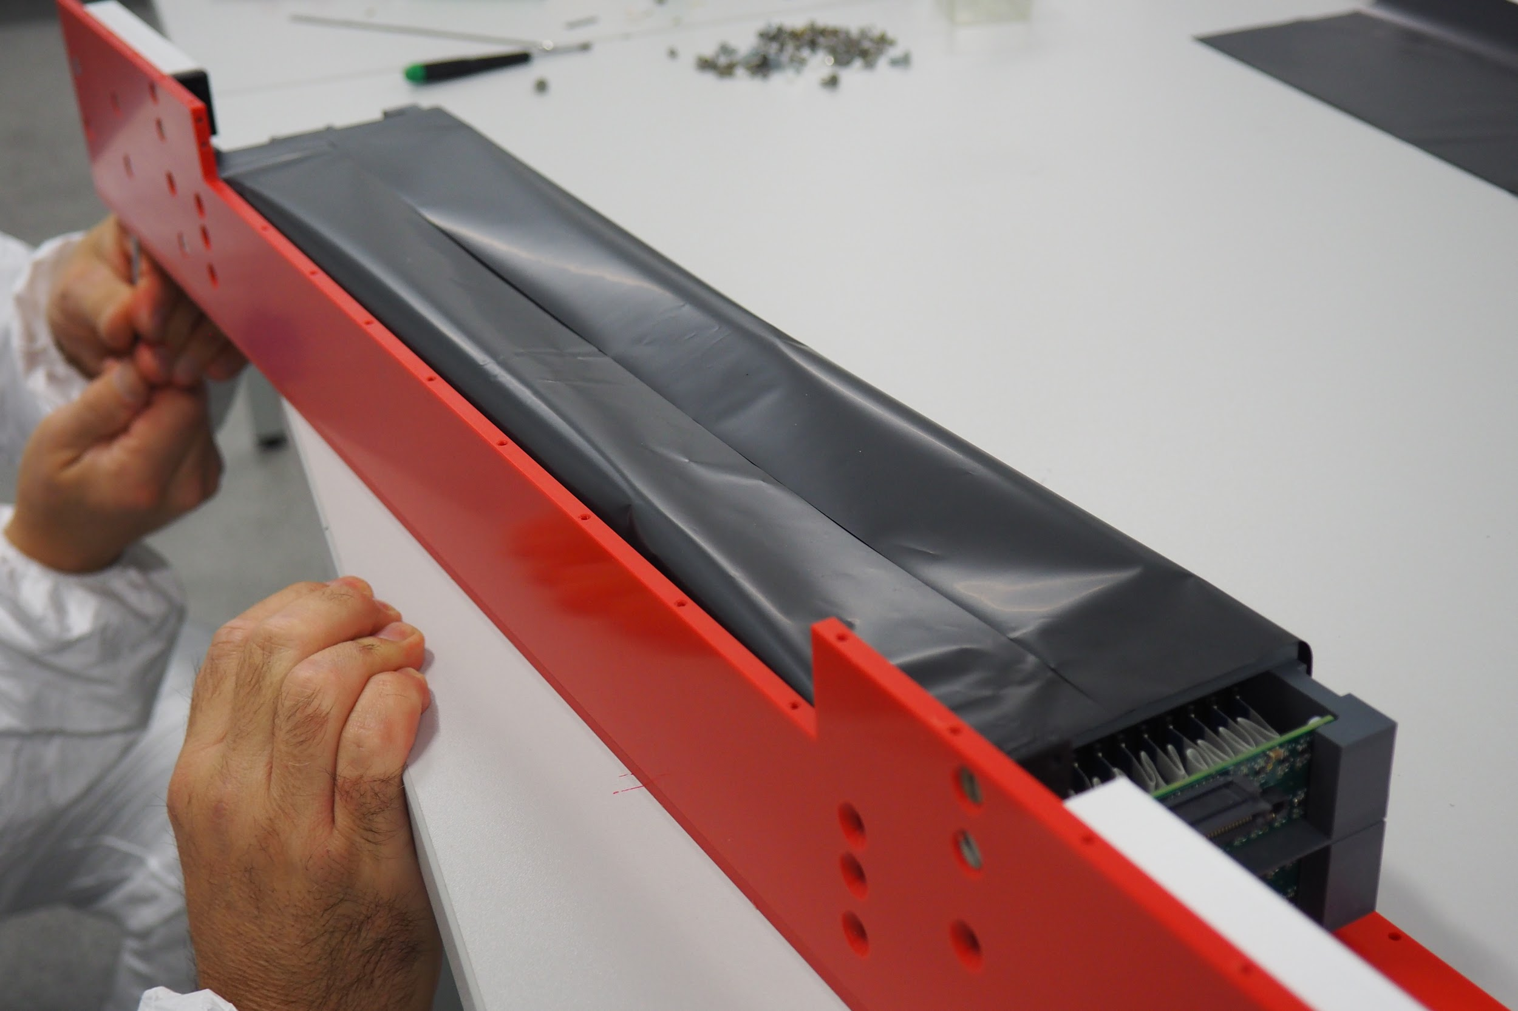
Whole module

Slide 17
Preliminary test Result

Slide 18
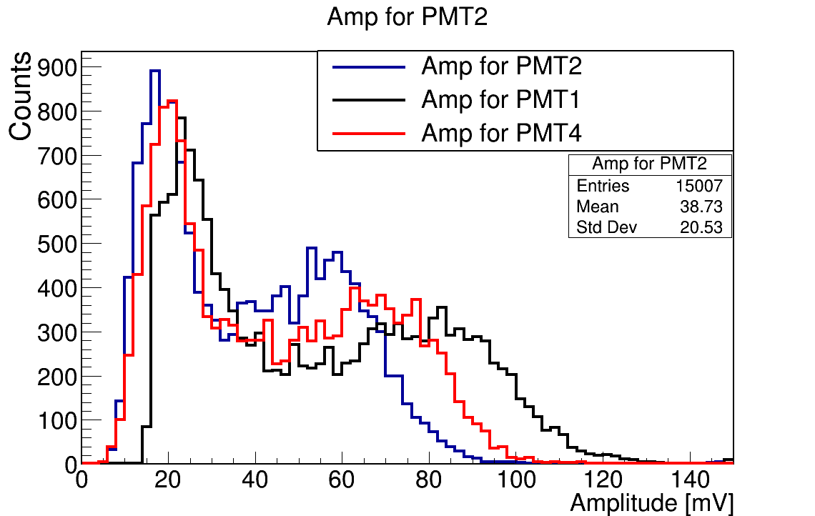
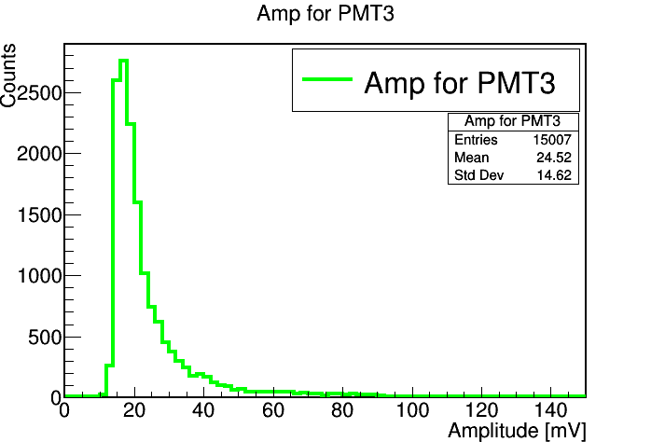
Amplitude Spectra
WLS
3
1
Plastic scintillator
4
2
Plastic scintillator
WLS

Slide 19
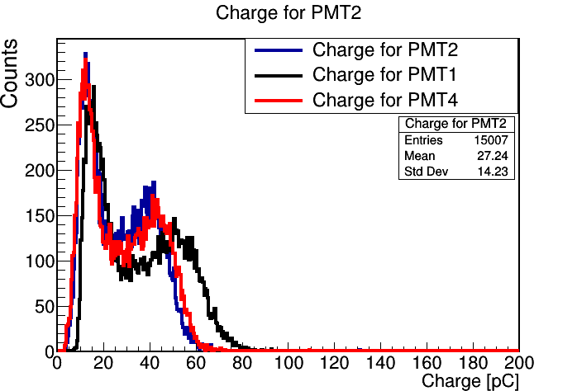
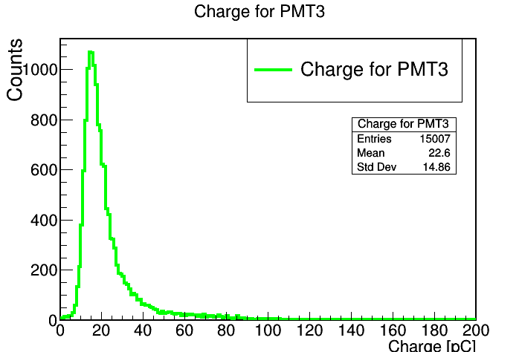
Charge Spectra

Slide 20
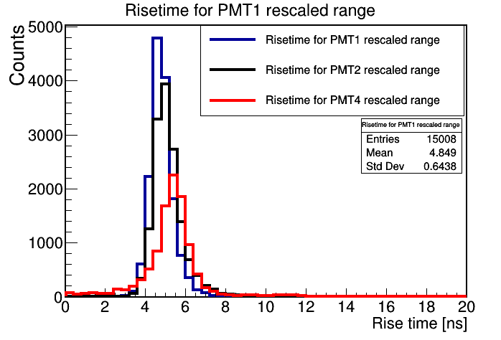
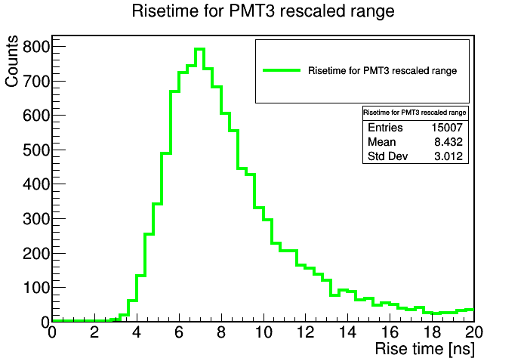
Rise Time Spectra

Slide 21
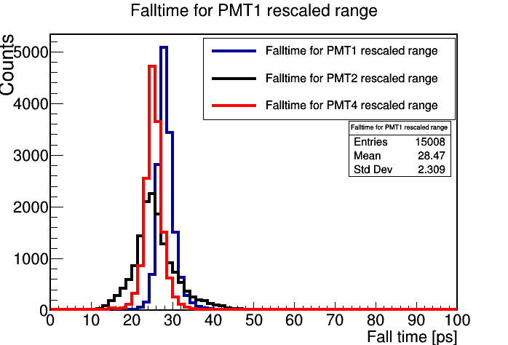
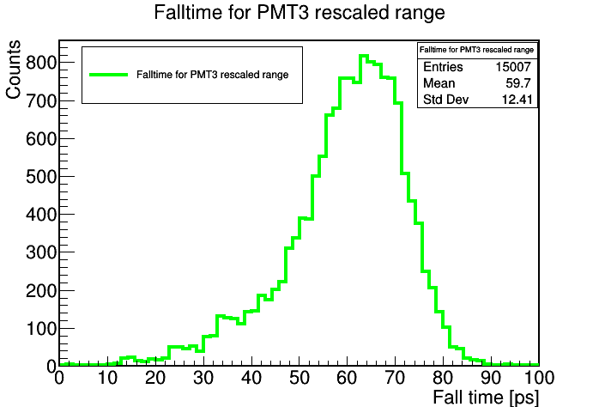
Fall Time Spectra

Slide 22
Summary
We have assembled prototype with WLS.
More precise test to be performed soon.

Slide 23
Thank you

Slide 25
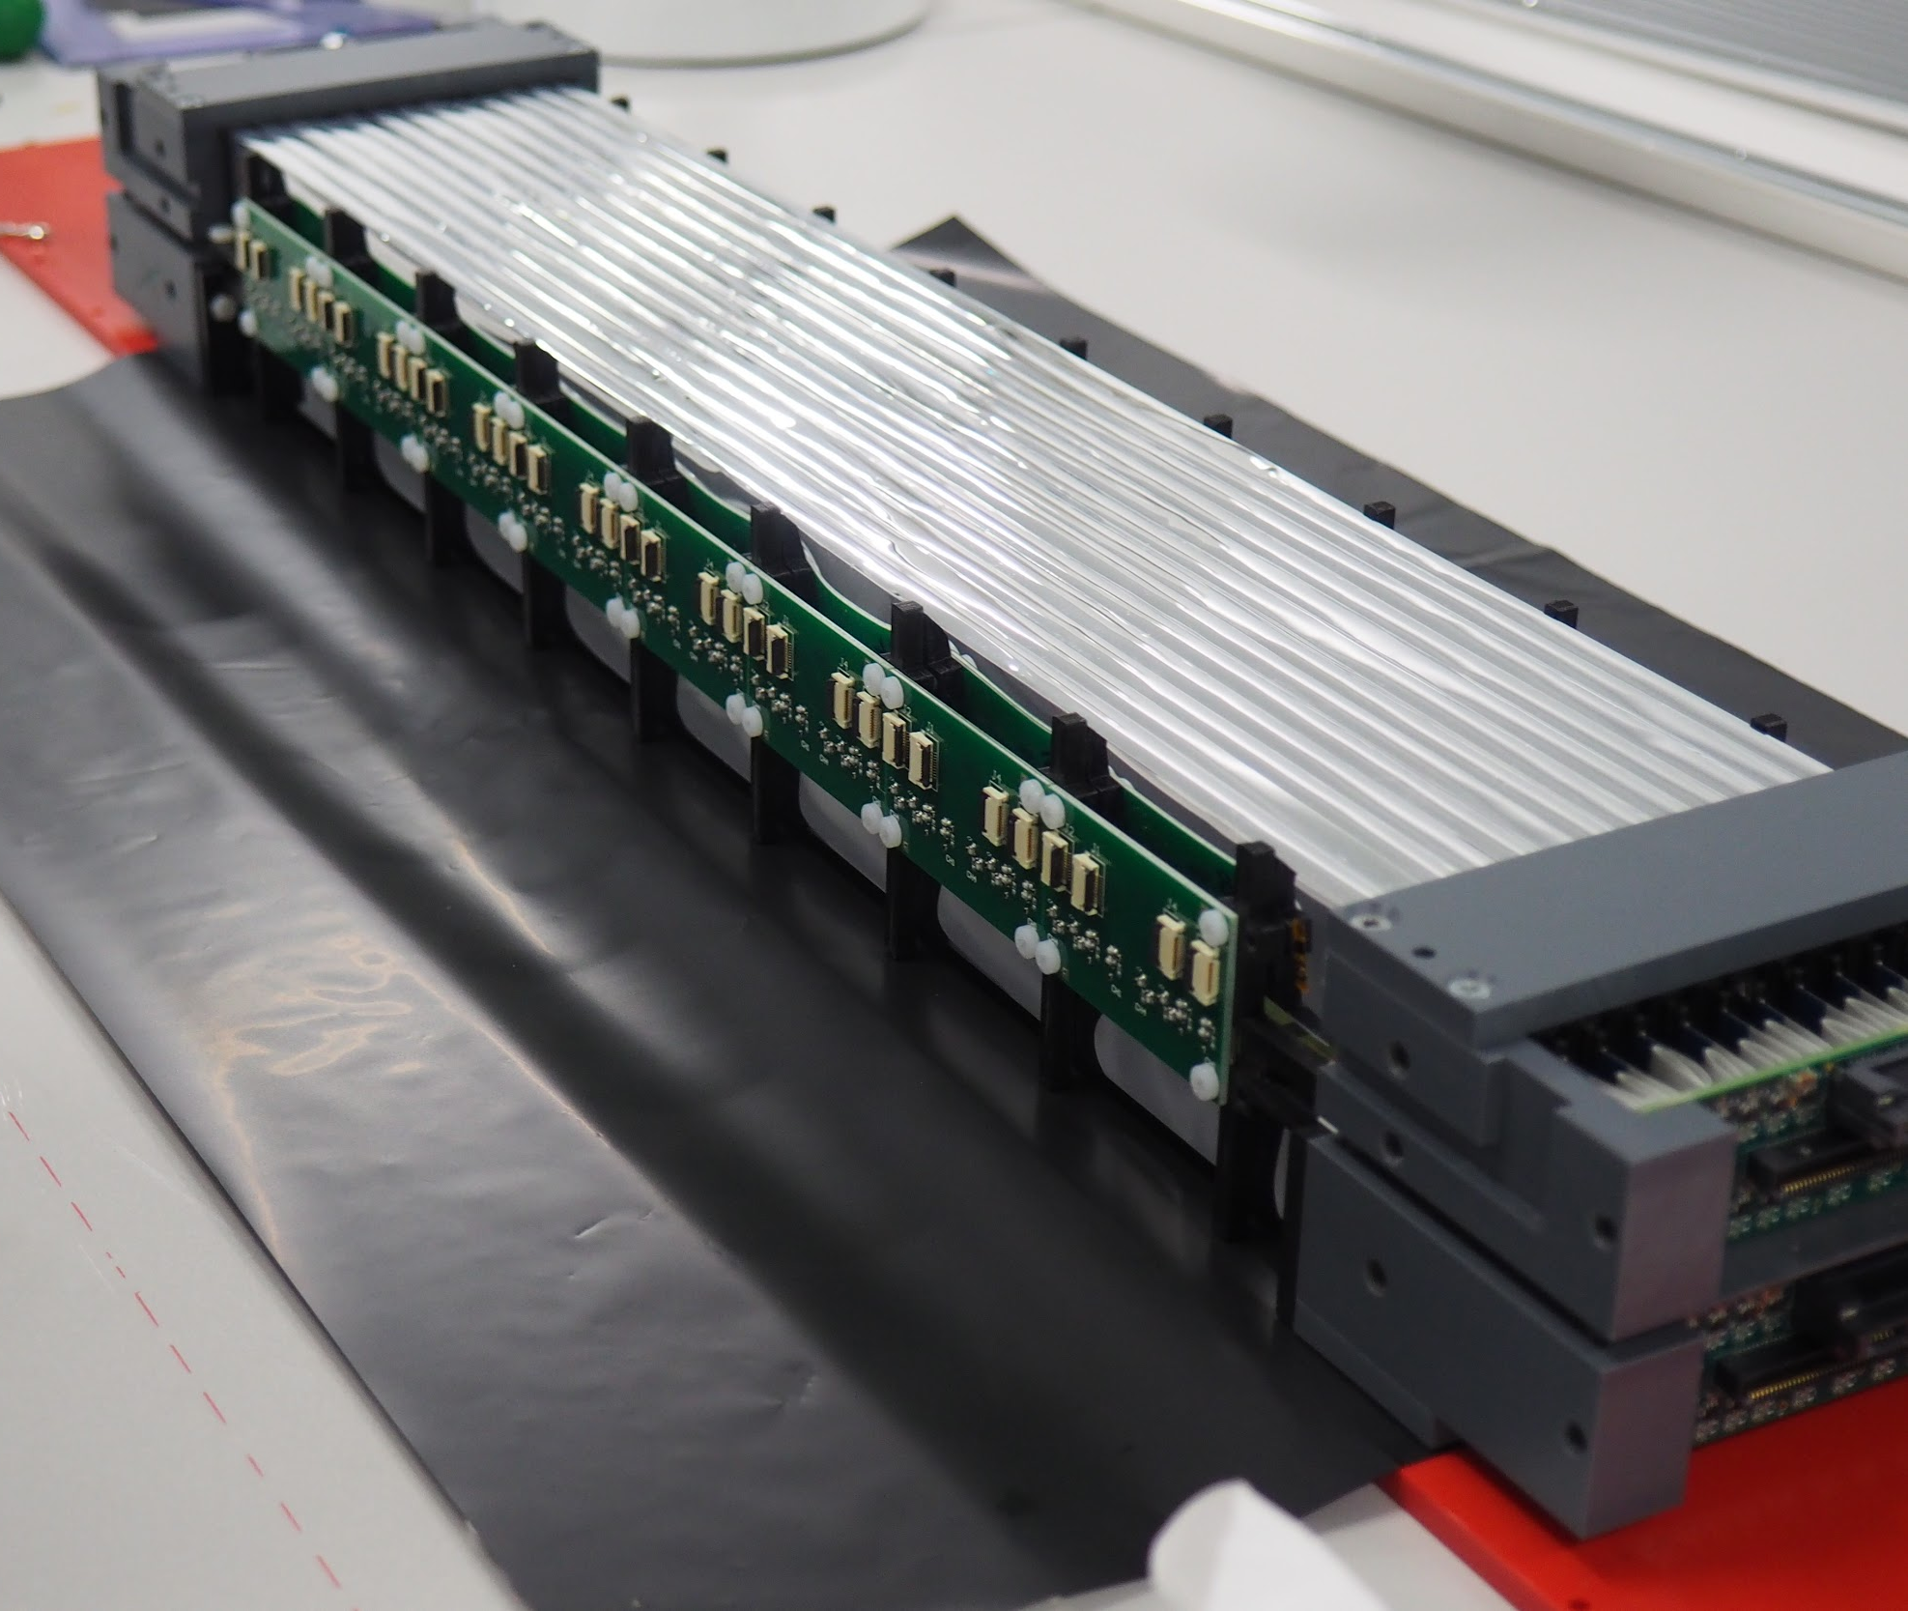
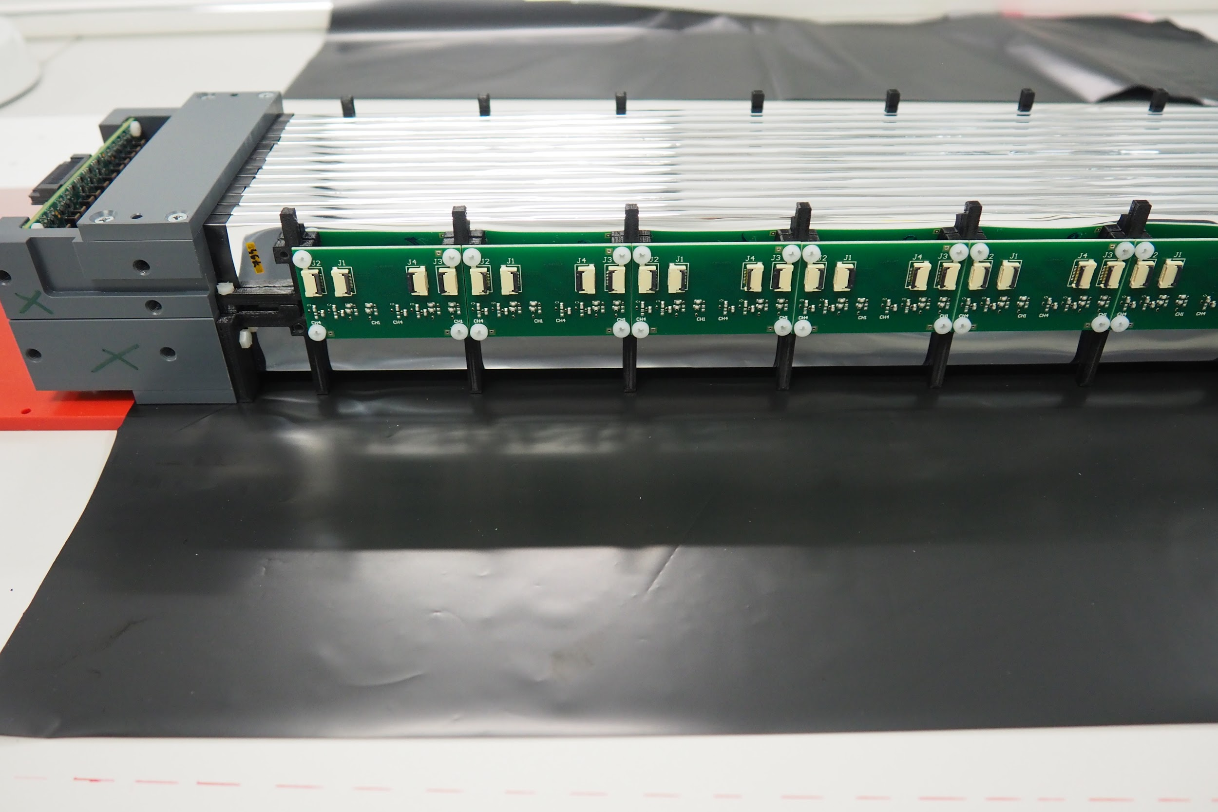

Slide 26
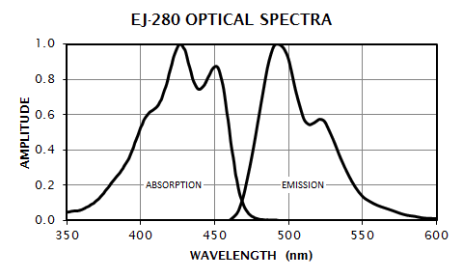
Which side ofscintilltor intreaction will happen amd what percentage of light will be tlost and transmitted by WLS

