Slide 1
Background rate simulation for EcoGas set up @ GIF++
21/06/2019
Andrea Gelmi (University and INFN Bari (IT))

Slide 2
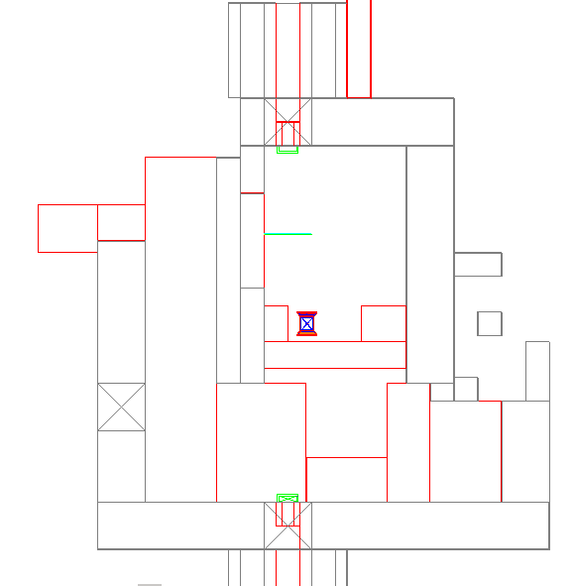
GIF++ GEOMETRY
x
z
Dorothea Pfeiffer (“The radiation field in the Gamma Irradiation Facility GIF++ at CERN”, arXiv:1611.00299v3 8 June 2017)

Slide 3
Ecogas setup @ GIF++
To obtain more precise results, others set up present in the GIF++ upstream area have been simulated to take into account the possible backscattering:
CMS iRPC behind ecogas chambers
CMS-RPCs TROLLEY-1 (6 chambers) behind ecogas trolley

Slide 4
CMS-RPC geometry has been used for all detectors
Layer n° | Material | Density [g/cm³] | Thickness [mm]
1 | Aluminium | 2.69 | 0.500
2 | Aluminium core | 0.5 | 5
3 | Aluminium | 2.69 | 0.500
4 | C10H8O4 PET | 1.37 | 0.188
1 | C6H10O5 cellulose | 0.3 | 1
6 | Copper | 8.96 | 0.380
7 | C10H8O4 PET | 1.37 | 0.188
8 | C10H8O4 PET | 1.37 | 0.188
9 | EVA (10%etylene + 90%vinyl acetate) | 0.934 | 0.150
10 | Graphite | 1.7 | 0.001
11 | HPL | 1.4 | 2
12 | Gas gap | 3.569 | 2
13 | HPL | 1.4 | 2
14 | Graphite | 1.7 | 0.001
15 | EVA (10%etylene + 90%vinyl acetate) | 0.934 | 0.150
16 | C10H8O4 PET | 1.37 | 0.188
17 | C10H8O4 PET | 1.37 | 0.188
18 | Copper | 8.96 | 0.380

Slide 5
SIMULATION DETAILS
Number of simulated events per ABS: 5*10⁸
2 day cpu
High statistics $σ$<1%
To compare the rate simulated and measured:
Rate simulated * ($\frac{real events}{simulated events})$
Source activity:
$A_{0}=14 TBq$ spring 2015
Spring 2019 = 4 years later T= $1.261 ⋅10^{8}$ sec
$Cs^{137 }$half life $⇒$ ${τ_{1/2}}_{}^{}= 30.19 years = 9.52 ⋅10^{8}s$
${τ_{1/2}}_{}^{}=1/λ$ $⇒ λ=1/{τ_{1/2}}_{}^{}= 1/9.52 ⋅10^{8} = 1.054∗10^{−9}$
$$A_{4y} = A_{0}⋅e^{−λT}$$
$$A_{4y} = A_{0}⋅e^{−λT}=14⋅10^{12}⋅e^{−1.054∗10^{−9}⋅1.261⋅10^{8}}=12.25∗10^{12}=12.25 TBq$$
$A_{4y}$/N simulated = 24500

Slide 6
SIMULATION DETAILS
Simulation performed using Geant4.9.6
• Physics List: G4EmLivemorePhysics()
• Energy Threshold in Geant4 are expressed in terms of range. Used standard Geant4 cuts : Gammas 1 um
In the GEANT simulation the number of events with a signal in the detector has been defined when a charged particle interact in a gas volume.
$NHIT$ = if ((particleCharge !=0) && (edep !=0) && (volName == "GasGap1") || (volName == "GasGap2"))
Has been assumed that each produced charged particle generates a signal in the readout strips on arriving at the gas gaps. If more than one charged particles reaches the gas gap, only the first one is assumed to produce a signal.
Statistical uncertainty: BINOMIAL DISTRIBUTION $σ_{p}=\sqrt{\frac{p−(1−p)}{N}}$

Slide 7
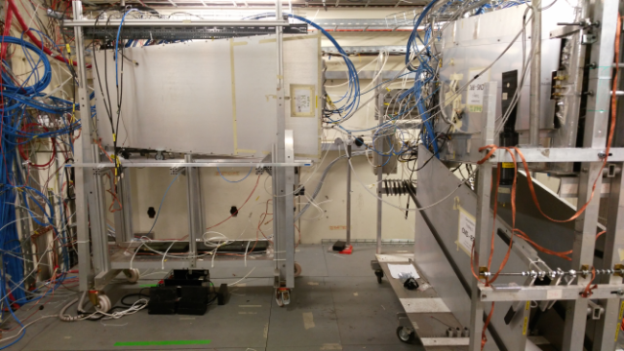
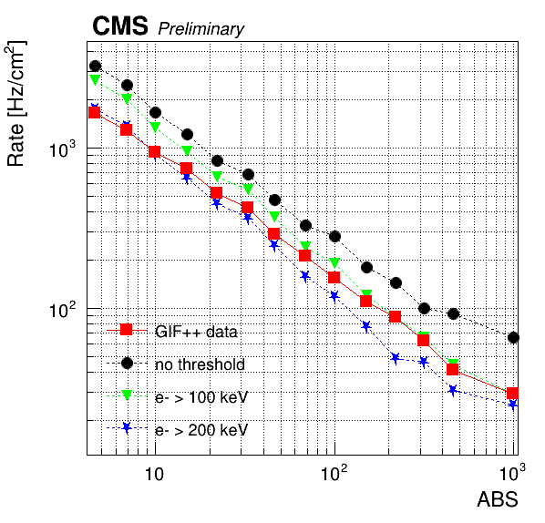
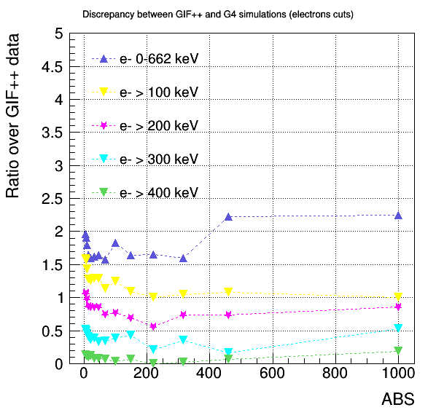
Charged particles threshold
From previous CMS-RPC experience:
Optimal charged particles threshold > 100 keV
iRPC
GIF++ experiments results vs simulation results
*More results in backup
For ECOGAS simulation a “simulated threshold” cut = 2 is directly
applied on the hit rate, taking into account the previous results (discrepancy)

Slide 8
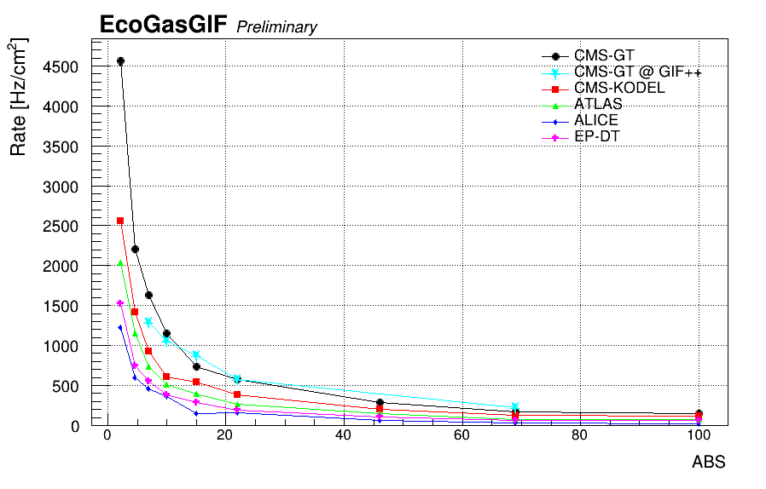
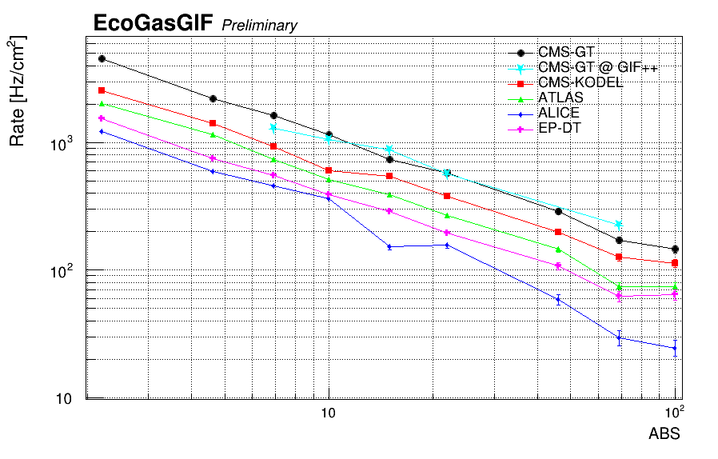
BACKGROUND RATE
Cluster rate normalized for the detector surface.
$$R= \frac{N HIT }{gap surface}$$
Good agreement between simulated rate and rate measured @ GIF++ (CMS-GT 2mm)

Slide 9
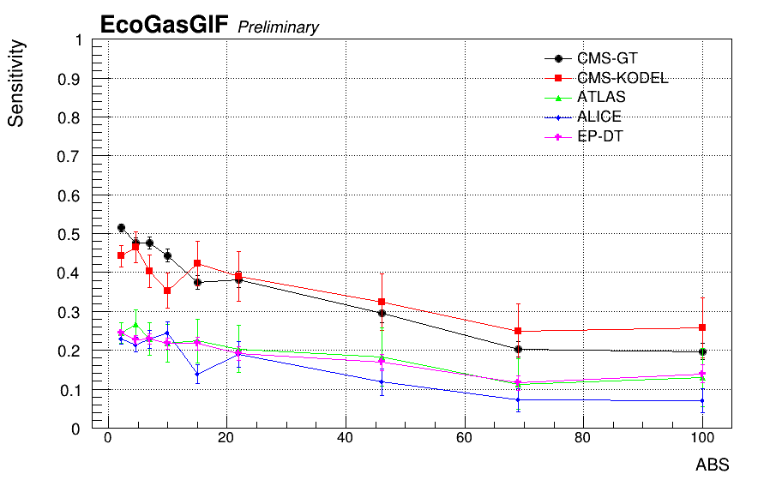
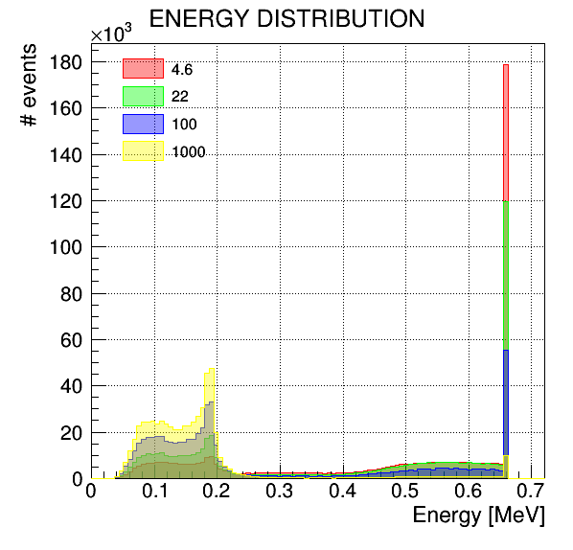
SENSITIVITY
S(ABS) = $\frac{N_{HIT}}{N\text{bkg}}$ (ABS)
RPC sensitivity increases @ low ABS due to the different gammas energy distribution →
@ low ABS more gammas at nominal energy (662 kev)
Double gap RPC have sensitivity ~ 2 times higher

Slide 10
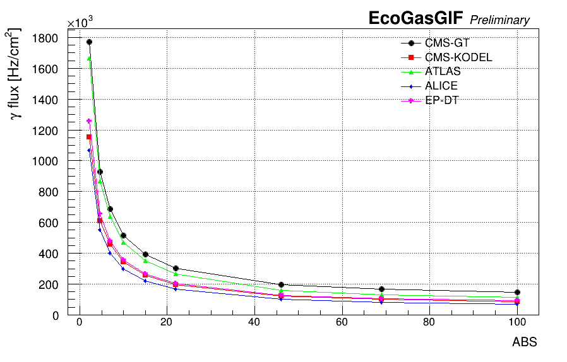
INCIDENT PARTICLES
$$Φ= \frac{Nbkg incident paricles}{detector surface}$$
Knowing the incident gamma flux, one could rescale it using a “specific sensitivity” (optimized for the detector and electronics) and better define the hit rate

Slide 11
BACK UP
SLIDES
Some results from the CMS iRPC simulation and comparison with real data @ GIF++

Slide 12
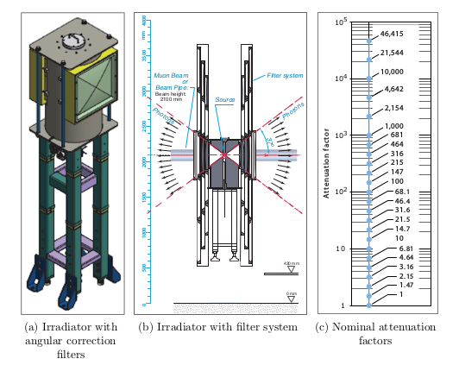
GIF++ Irradiator
ID scan | ABS upstream
2363 | 4.6
2361 | 6.9
2360 | 10
2364 | 15
2359 | 22
2370 | 33
2356 | 46
2374 | 69
2358 | 100
2371 | 150
2357 | 220
2372 | 316
2362 | 460
2365 | 1000
Source Cs¹³⁷
Nominal energy gammas = 662 keV
Filter | Material | ABS
A1 | Empty | 1
A2 | Pb | 10
A3 | Pb | 100
B1 | Empty | 1
B2 | Al | 1.5
B3 | Pb | 100
C1 | Empty | 1
C2 | Pb | 2.2
C3 | Pb | 4.6
Aluminium support

Slide 13
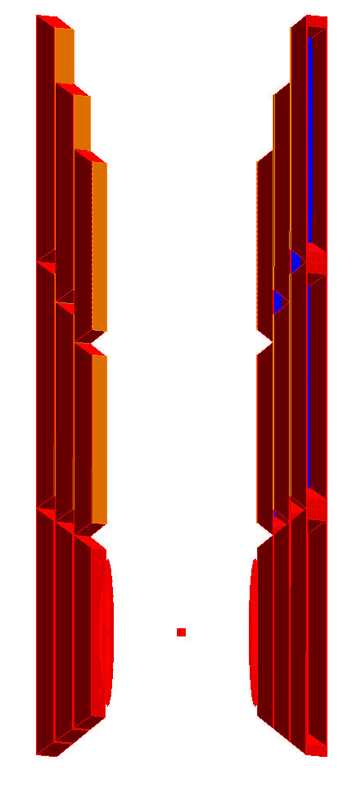
GIF++ Irradiator
The gammas interact with the materials present in the GIF++:
lead (absorbtion filters, collimators, lense),
steel (absorbtion filters frame, source capsule, floor),
aluminium (absorbtion filters),
concrete (surrounding bunker enclosure).
absorption filters
collimator
source
absorption filters
lens
lens
absorption filters
source
Notes:
Thickness lens: 0.01-3.47 mm
Thickness collimators: 0.05 – 26.68 mm

Slide 14
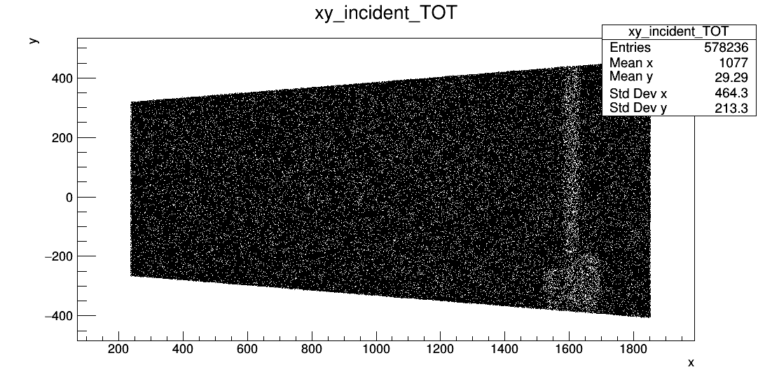
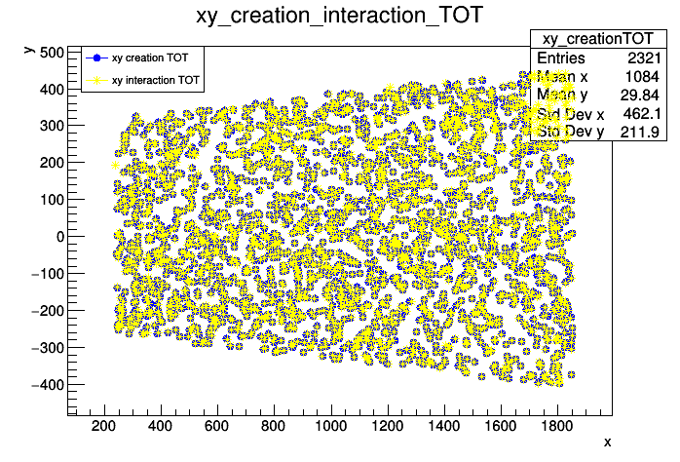
GIF++ photons spatial distribution
The ± 37° panoramic collimators and the angular correction lens allow to replace the $1/{r^{2}}$ dependence of the photon current by a uniform current in each X-Y plane. This is confirmed by the G4simulation gammas incident distribution.
X-Y gammas incident
X-Y electrons creation-ionization
Uniform gammas incident distribution
X-Y distribution: electrons creation and electrons ionization.

Slide 15
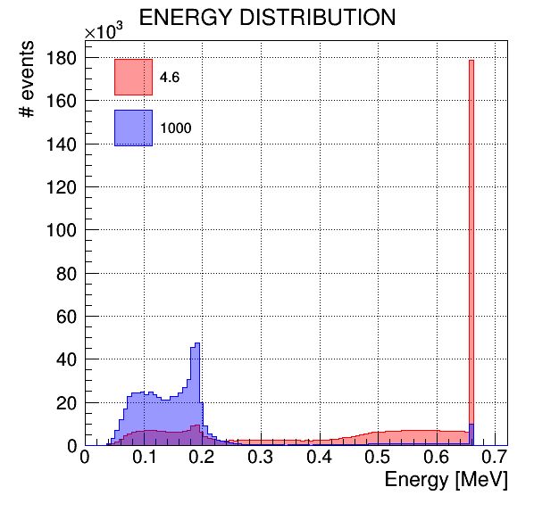
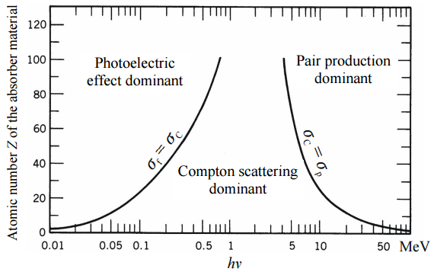
GIF++ photons energy spectrum
GIF++ photons energy distribution: not monoenergetic!
For γ energies of 662 keV or below, the main processes are Compton scattering and photoelectric Effect.
GIF++ nominal photons energy 662keV
P₂ 80 keV
Pb atom de-excitation
P₁ 184 keV
Compton scattering (Tmax)
$Z_{Al}=$ 13
$Z_{conc}=$ 11.6
$Z_{Pb}=$ 82
Notes:
Clearly visible in the spectra are the back-scatter peak at 184 keV and the characteristic 82 Pb K-shell X-ray peaks around 80 keV

Slide 16
GIF++ photons energy spectrum

Slide 17
GIF++ photons energy spectrum
For energies of 662 keV or below, the main processes are Compton scattering and photoelectric Effect.
$Z_{Al}=$ 13
$Z_{conc}=$ 11.6
$Z_{Pb}=$ 82
The photons arrive already at the attenuation filters with low energy component, the source capsule and the irradiator collimator already cause an amount of scattering that broadens the spectrum.

Slide 18
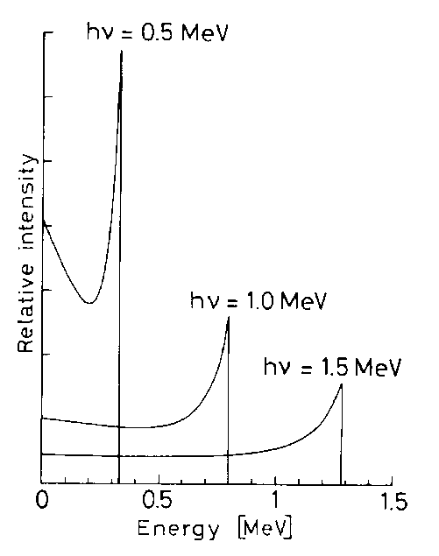
GIF++ photons energy spectrum
Why the photons pick (p1) at ~ 200 keV ?
Kinetic energy distribution of Compton scattered electrons
T_{max} is known as the
Compton Edge

Slide 19
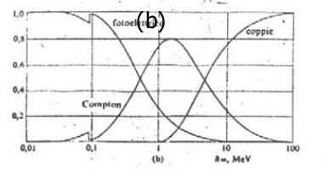
GIF++ photons energy spectrum
Why the photons pick (p2) at ~ 100 keV ?
photoelectric
Pb
The gammas with energy of 0-300 keV have an high probability to interact by photoelectric effect. The X-rays emitted because of the Pb atom de-excitation from K-shell have an energy around 80 keV.

Slide 20
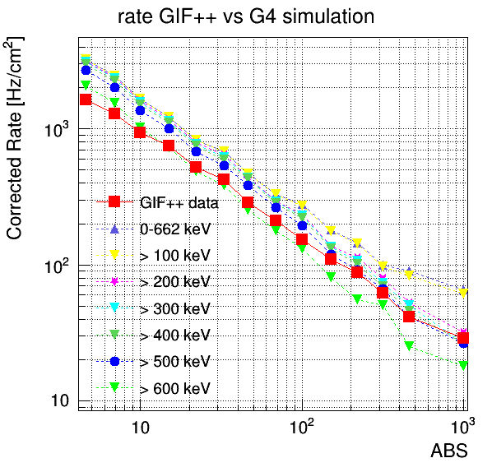
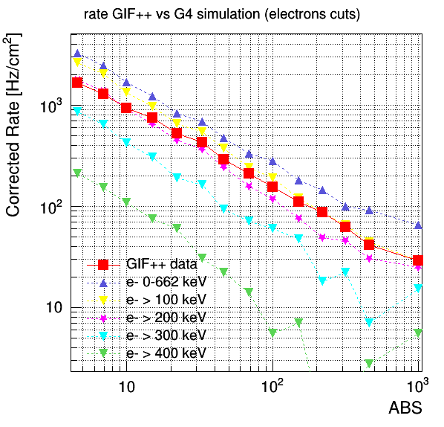
Rate GIF++ vs G4 simulation

Slide 21
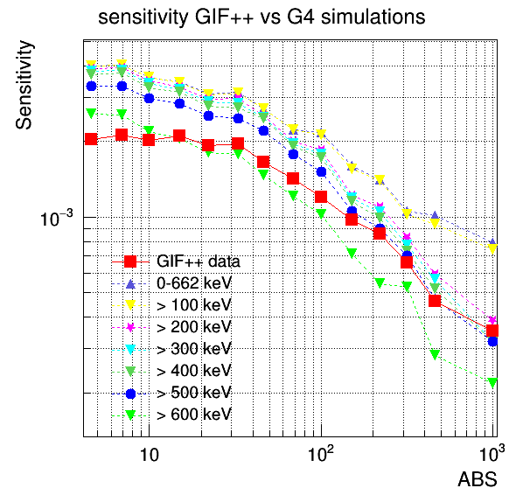
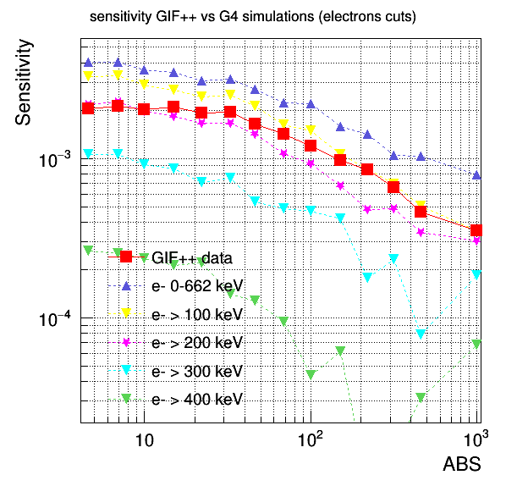
Sensitivity GIF++ vs G4 simulation

Slide 22
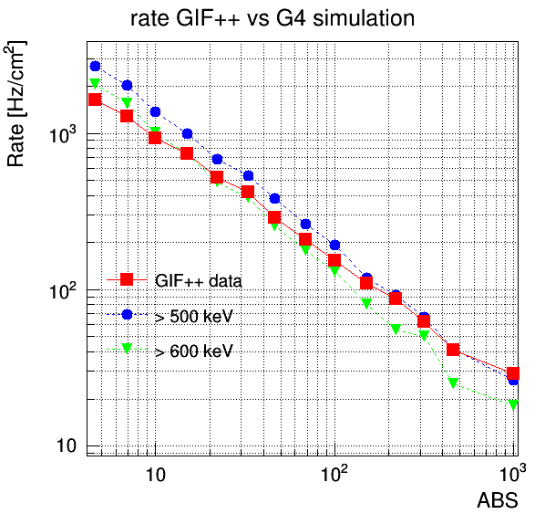
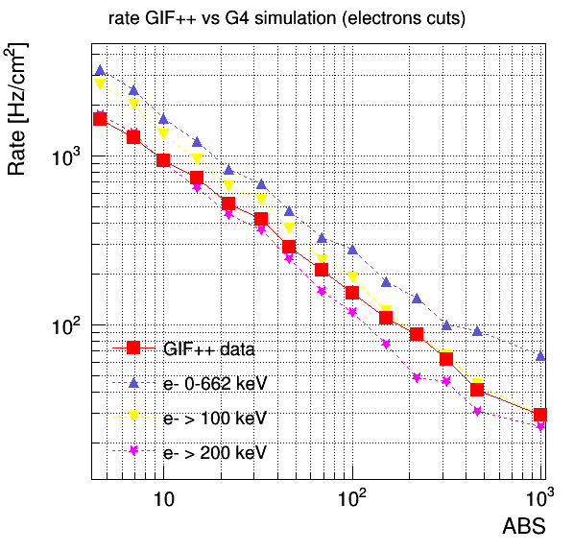
Rate GIF++ vs simulation
$$R_{corr}=\frac{Hit Rate}{Cluster size}+{Rate}_{inef}$$
$R_{simulated}=$ N events with an electron that ionizes in one of the two gas gaps or both
γ energy cuts
e- energy cuts

Slide 23
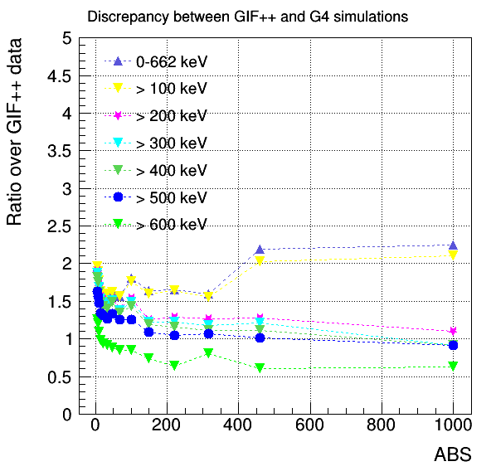
Discrepancy GIF++ vs simulation
γ energy cuts
e- energy cuts

Slide 24
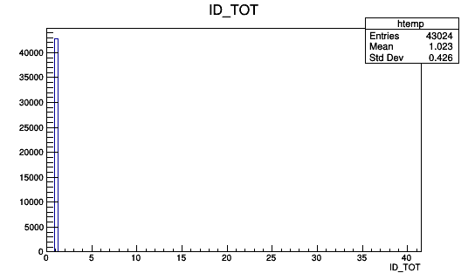
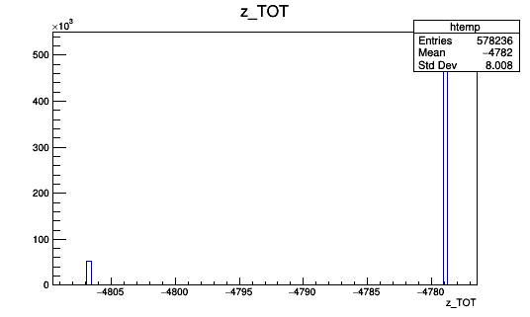
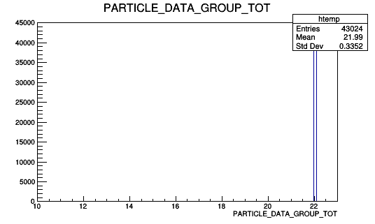
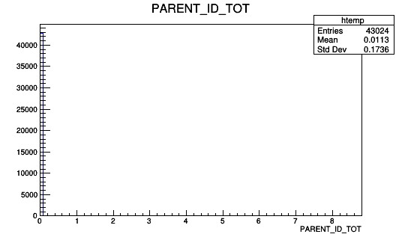
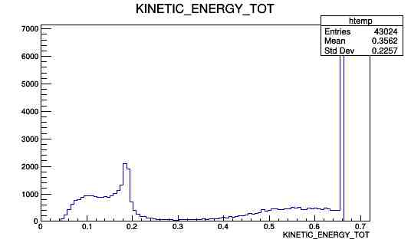
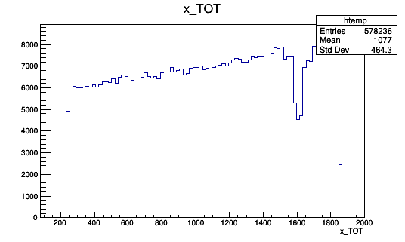
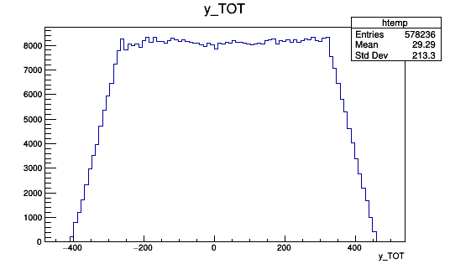
SIMULATION DETAILS
Incident particles (TOP,BOT, TOTAL):
Number of particles,
Particle Data Group,
ID,
Parent ID,
Kinetic energy,
X position,
Y position,
X-Y position,
Z position,

Slide 25
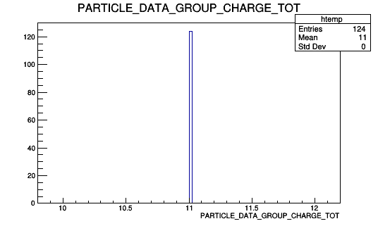
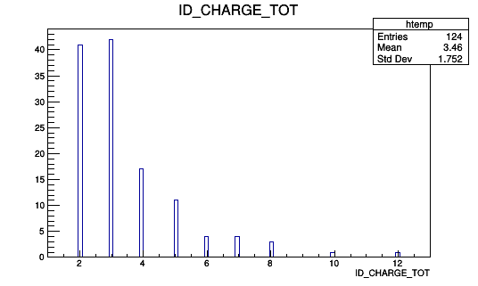
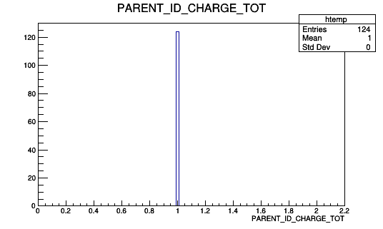
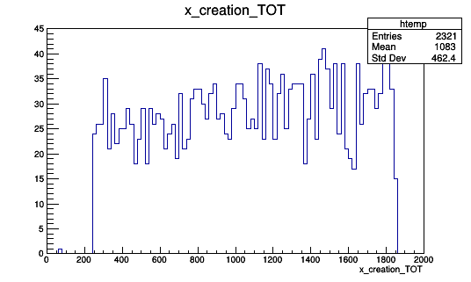
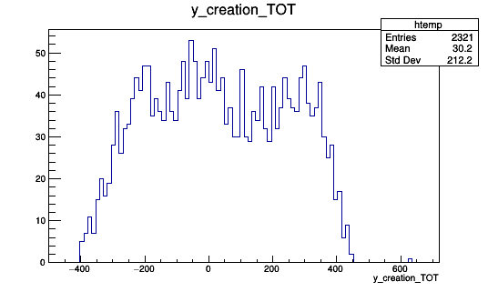
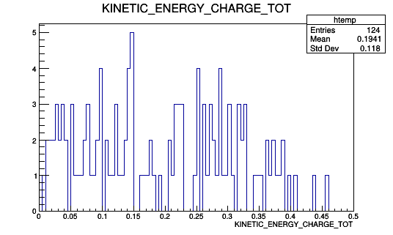
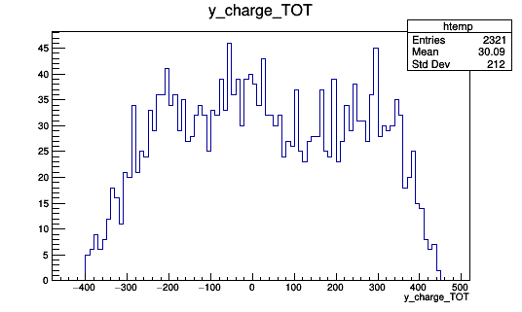
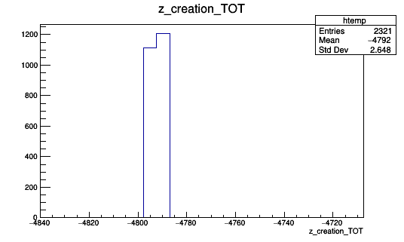
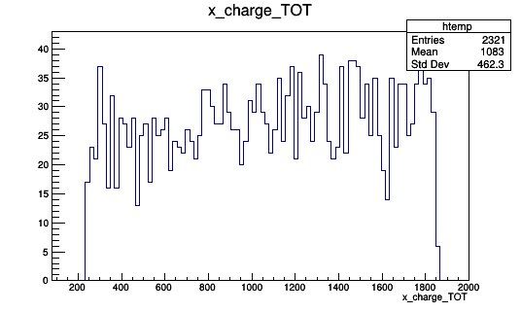
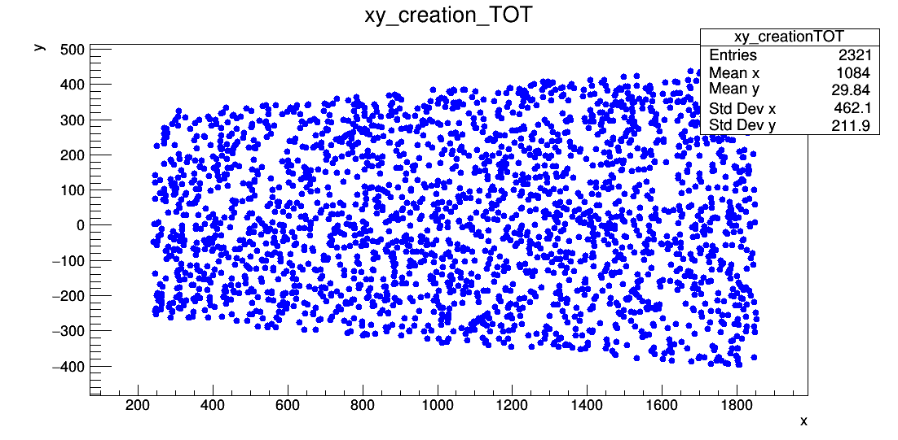
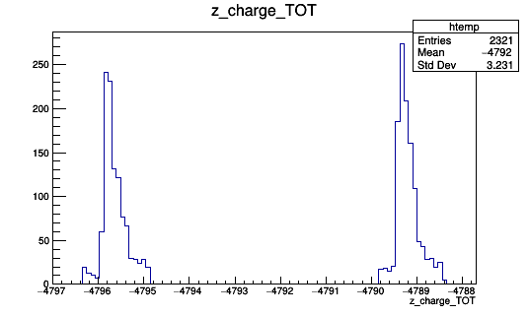
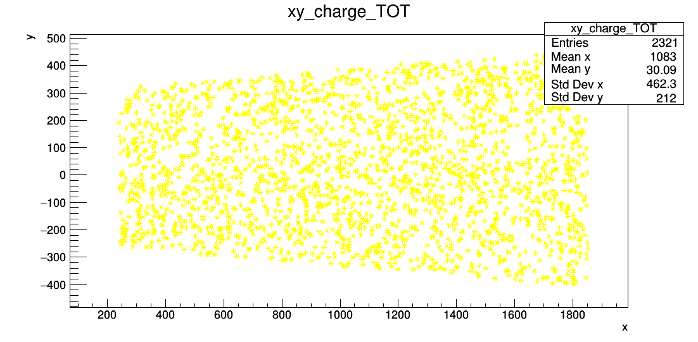
SIMULATION DETAILS
Charged particles (GAP1, GAP2, TOTAL):
Number of particles,
Particle Data Group,
ID,
Parent ID,
Kinetic energy,
X position creation,
Y position creation,
X-Y position creation,
Z position creation,
X position interaction,
Y position interaction,
X-Y position interaction,
Z position interaction,

Slide 26
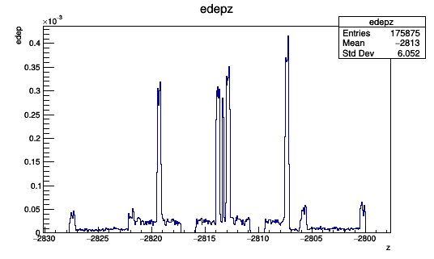
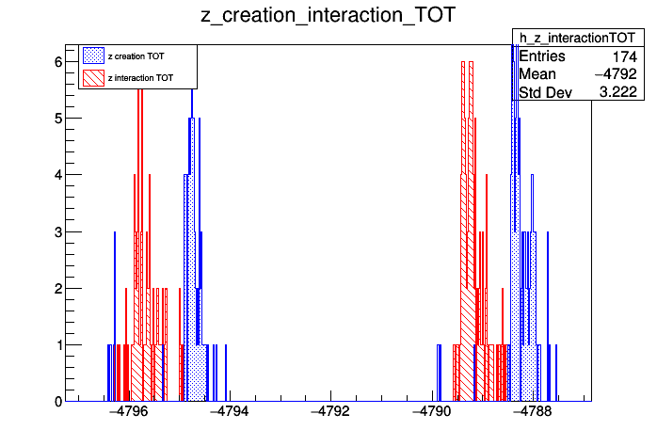
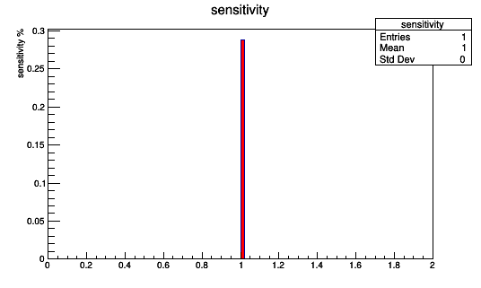
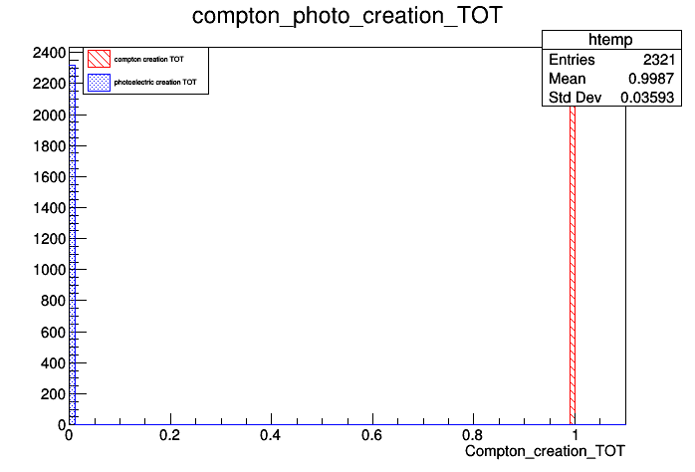
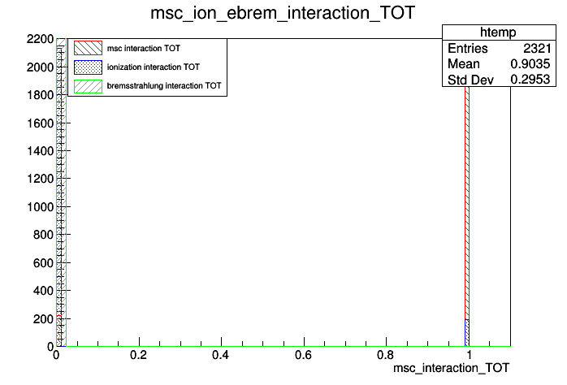
SIMULATION DETAILS
Charged particles (GAP1, GAP2, TOTAL):
X-Y creation vs interaction,
Z creation vs interaction,
Creation Compton vs Photoelectric,
Interaction mcs vs ion vs eBrem,
Energy deposited,
Sensitivity.

