Slide 1
The Ultra Advanced RF Electron Gun
TUAREG
David Alesini
(INFN-LNF, Frascati)
LNF, 9 July 2019

Slide 2

OUTLINE
RF PHOTO-GUN: applications and state of the art
WHY it is extremely interesting to design and test a C-band (5.712 GHz) RF gun with cathode peak field exceeding the 200 MV/m and at the kHz rep. rate regime
BREAKDOWN CONTROL IN HIGH GRADIENT NC STRUCTURES AND C-BAND GUN DESIGN CRITERIA
POSSIBILITY TO OPERATE THE GUN UP TO THE kHz REP. RATE REGIME
GOAL OF THE PROJECT AND WORK ORGANIZATION
TIMESCHEDULE
FINANTIAL REQUESTS
FUTURE AND PERSPECTIVES: C-BAND ELECTRON SOURCE AND POSSIBILITY OF A GUN TEST FACILITY @ LNF
2/20

Slide 3
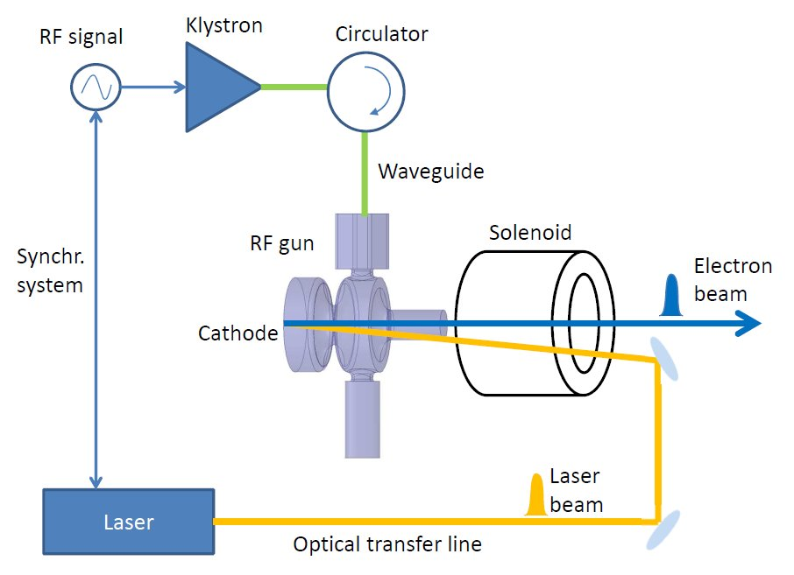
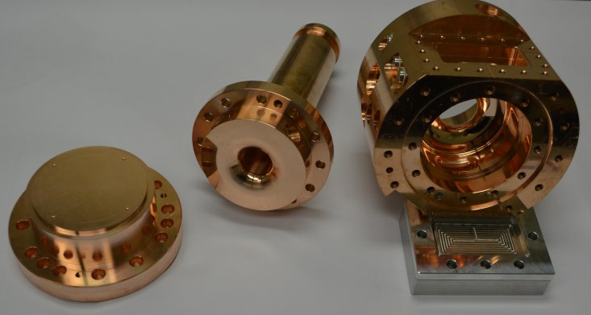
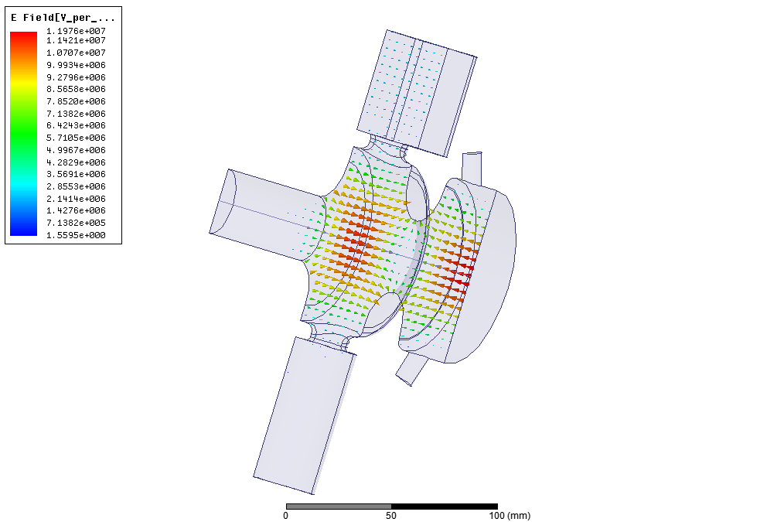
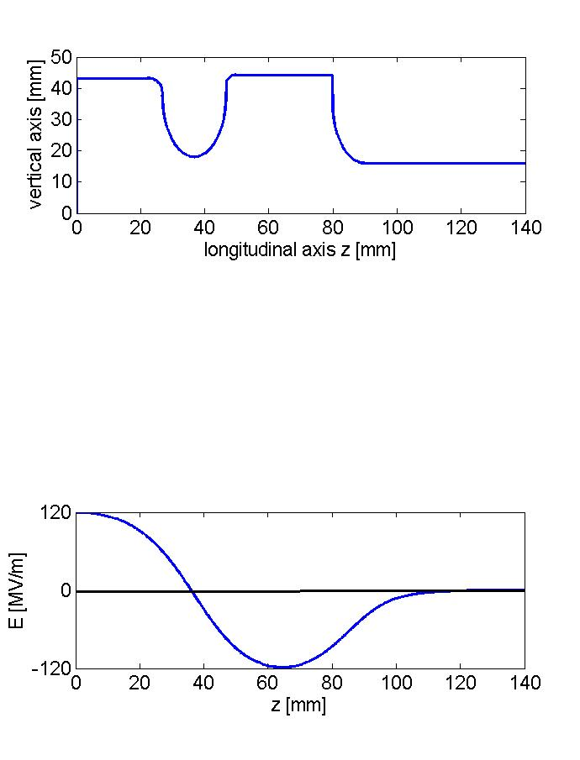
RF PHOTO-GUN: applications
Photocathode RF guns [1] are the most common electron sources for FELs, TeraHertz and Compton sources and electron diffraction microscopes [2-15] since they allow reaching very low emittances and high beam brightness.
They are multi-cell standing wave (SW) structures powered by μs RF pulses of tens of MW, in which the electron beam is generated by photo-emission illuminating the cathode surface with a drive-laser pulse.
The beam is then immediately accelerated by the high electric field (>100 MV/m) on the cathode itself and typically focused with a solenoid field around, or immediately after, the gun.
The combination of high cathode Electric peak field and solenoidal fields allows to limit the emittance degradation due to the space charge effects.
Input wavegide
cathode

Slide 4
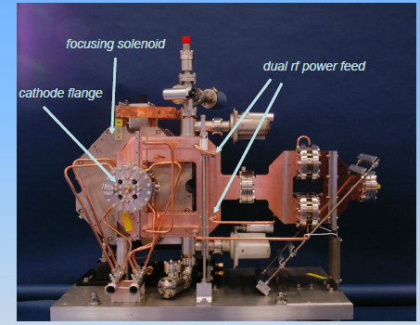
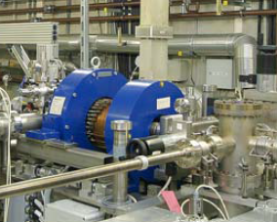
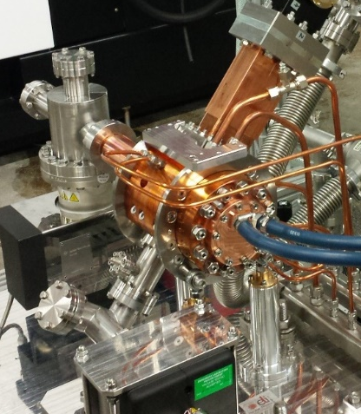
RF PHOTO-GUN: state of the art
Since the achievable beam brightness is proportional to the peak field at the cathode, in the last generation of RF guns a great effort has been put to increase the field amplitude, and, at the same time, to reduce the breakdown rate due to the high electric fields (BDR).
This requires a proper RF design of the structures, to minimize the surface electric and magnetic peak fields [16-18] and appropriate realization techniques in terms of surface finishing (typically below 200 nm) and cleaning procedures.
Moreover for all mentioned applications the possibility to increase the repetition rate at the level of 500 Hz-1 kHz is extremely attractive to increase electron and photon fluxes.
LCLS
Frequency = 2,856 MHz
Gradient = 120 MV/m
Exit energy = 6 MeV
Copper photocathode
RF pulse length ∼2 μs
Bunch repetition rate = 120 Hz
PITZ L-band Gun
Frequency = 1,300 MHz
Gradient = up to 60 MV/m
Exit energy = 6.5 MeV
Rep. rate 10 Hz
Cs₂Te photocathode
RF pulse length ∼1 ms
800 bunches per macropulse
ELI-NP
Frequency = 2,856 MHz
Gradient = 120 MV/m
Exit energy = 6 MeV
Copper photocathode
RF pulse length ∼1.5 μs
Bunch repetition rate = 100 Hz
Multi-bunch operation

Slide 5
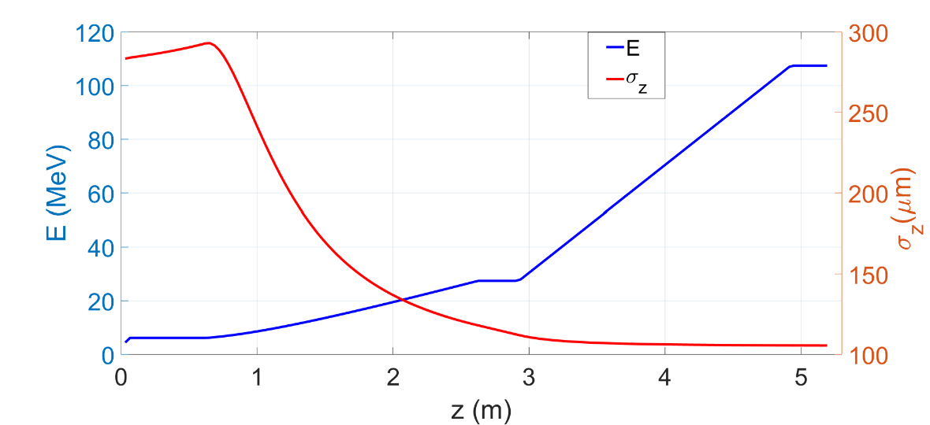
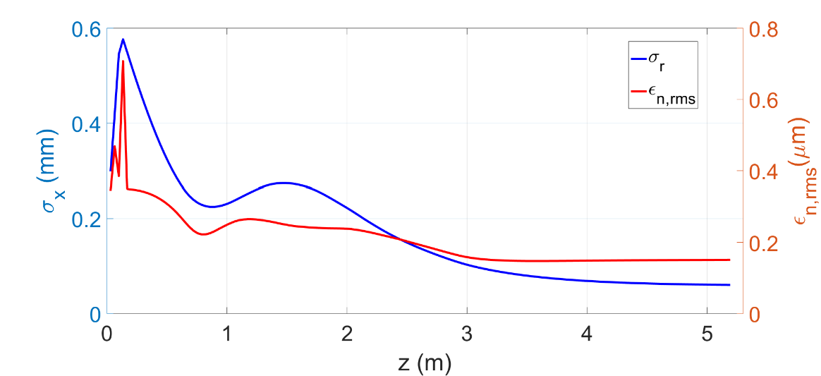
WHY it is EXTREMELY interesting a RF gun with cathode peak field >200 MV/m
There are several possible schemes that allow reaching extremely high brightness and/or extremely low beam emittances in several configurations using C-band guns with cathode peak field >200 MV/m.
Moreover in the context of EUPRAXIA@SPARC_LAB the possibility to implement a full C-band injector is attractive for both reachable beam parameters and compactness [20] (saving a factor 2 in the injector length) as recommended also by the CDR Reviewer’s.
This possibility is also extremely attractive in the context of the COMPACT_LIGHT Design study (H2020) [21] where the full C-band injector option is being considering the baseline of this possible future machine.
M. Croia
Parameter | w/o BC with BC
Bunch charge [pC] | 75
Beam emittance [mm⋅mrad] | 0.15
Bunch length [μm] | 295 105
Beam Energy [MeV] | 170 107
Peak current [A] | 22 60
Beam energy spread [%] | 0.6 1.4

Slide 6
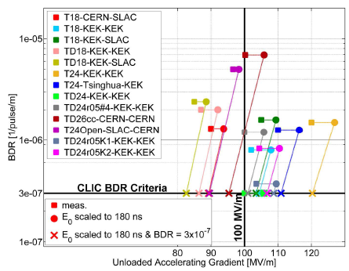
BREAKDOWN CONTROL IN HIGH GRADIENT NC STRUCTURES
There are three main quantities that play a role in the BDR control: peak E field, modified Poynting vector (S_{c}) [18], RF pulse length (t_{p}) and Pulsed Heating (ΔT) [16,17,22]. The control of these quantities in an RF structure allows to control and predict the final BDR. The scaling law are frequency-independent.
From X-band high gradient tests (last 20 years at SLAC and CERN) we have that:
E_{surf}=220-240 MV/m
t_{p}=180-200 ns
S_{c}=4-5 W/µm²
ΔT<40 deg
Allow keeping the BDR<10⁻⁶ bpp/m
W. Wuensch, IPAC2017 [23]
Short RF pulses (fast guns) relatively easy to achieve in TW structures while require high peak power for SW structures
Proper design of the input coupler
Proper design of accelerating cells and couplers
4/20

Slide 7
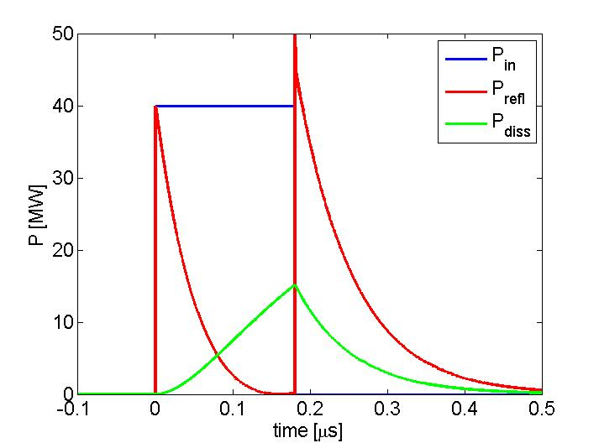
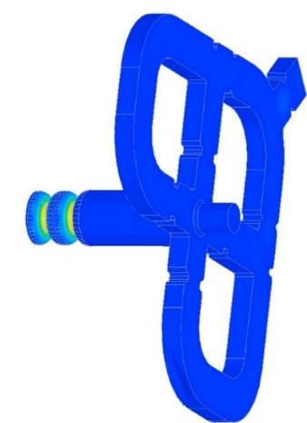
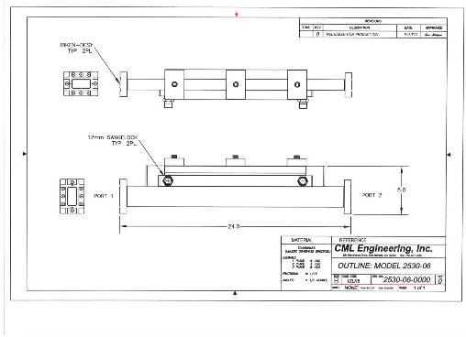
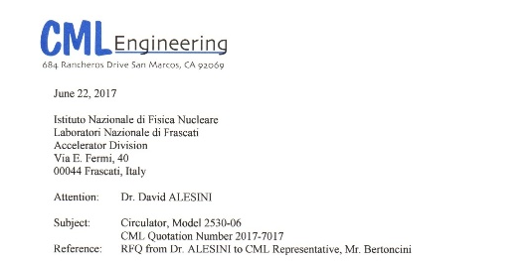
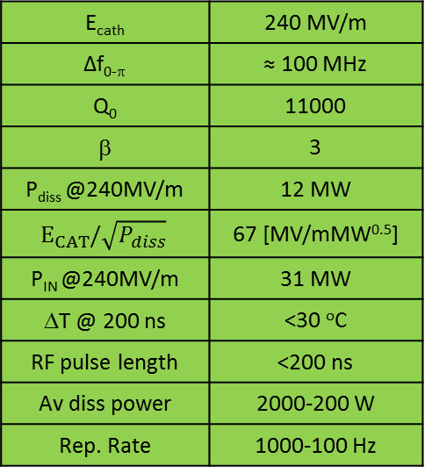
C-BAND GUN DESIGN CRITERIA
AND POWERING SCHEMES
According to the previous considerations the gun has to be designed in order to:
Be powered with extremely short RF pulses (< 200 ns)
With a cell profile and coupler to take under control E_{peak}, S_{c} and the pulsed heating
<0.200 μs 40 MW
E_{cath} | 240 MV/m
Δf_{0-π} | ≈ 100 MHz
Q₀ | 11000
β | 3
P_{diss} @240MV/m | 12 MW
$$E_{CAT}/\sqrt{P_{diss}}$$ | 67 [MV/mMW^{0.5}]
P_{IN} @240MV/m | 31 MW
ΔT @ 200 ns | <30 ºC
RF pulse length | <200 ns
Av diss power | 2000-200 W
Rep. Rate | 1000-100 Hz
KLY
circ
β=3
GUN

Slide 8
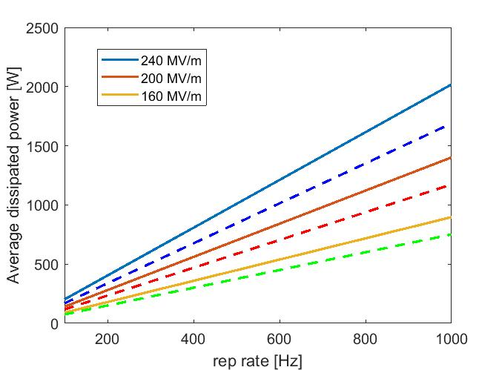
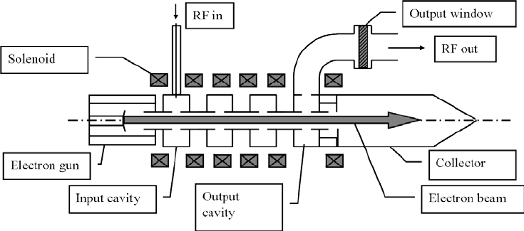
POSSIBILITY TO OPERATE THE GUN UP TO THE kHz REP. RATE REGIME
The possibility to operate such a devices (and the overhall injector) up to the kHz regime is also extremely attractive for all mentioned applications. Current room temperature facilities operate, in fact, at the ∼100 Hz regime and there is an extremely strong interest (Compact Light, as example) to reach the possibility of kHz operation.
The high repetition rate operation is limited by two effects:
The average dissipate power in the structure. This power because of the RF gun we are proposing and based on extremely short pulses can be managed, in principle, even at the high gradients of 240 MV/m
The klystron power available at high rep. Rate. This is the real limitation and it is due to the maximum power can be released on the collector
Cont. Line: t_{p}=200 ns
Dashed Line: t_{p}=100 ns
Preliminary calculations done for the TOSHIBA klystron E37212 seem indicate that the 1 kHz operation it is feasible.
The cooling system has to be properly designed

Slide 9
GOALS OF THE PROJECT AND WORK ORGANIZATION
Design and realization of the C band gun:
              RF design, mechanical drawings, realization (LNF)
              Thermal analysis 1 kHz regime (LNF and INFN ROMA)
Design realization of the mode launcher (INFN ROMA)
High power test of the gun and mode launcher at PSI or at SPARC_LAB (LNF)
Beam dynamics studies for different working points: Eupraxia@SPARC_LAB, Compact Light, Electron beam diffraction sources (LNF)
Solenoid design for a complete C-band based photo-injector (LNF)
Dark current simulations and cathode material sudies (LNF)
Laser injection system (LNF)
Diagnostics for the C-band photo-injector (LNF and INFN ROMA)

Slide 10
PARTICIPANTS
PARTICIPANT |  | FTE
LNF | David Alesini (DT) | 0.3
 | Alessandro Gallo (DT) | 0.2
 | Cristina Vaccarezza (PT) | 0.2
 | Massimo Ferrario (DR) | 0.1
 | Bruno Buonomo (PT) | 0.2
 | Luca Foggetta (T) | 0.2
 | Angelo Stella (T) | 0.1
 | Domenico Di Giovenale (T) | 0.1
 | Marco Bellaveglia (T) | 0.1
 | Giampiero Di Pirro (PT) | 0.2
 | Andrea Ghigo (DT) | 0.1
 | Luigi Pellegrino (PT) | 0.1
 | Alessandro Vannozzi (AR) | 0.3
 | Fabrizio Bisesto (T) | 0.1
 | Jessica Scifo (AR) | 0.2
 | Luigi Faillace (AR) | 0.3
 | Michele Croia (AR) | 0.2
 | Andrea Liedl (AR) | 0,2
 | Bruno Spataro | -
INFN ROMA | Luca Ficcadenti (T) | 0.4
 | Andrea Mostacci (PA) | 0.2
 | Luigi Palumbo (PO) | 0.1
 | Valerio Pettinacci (T) | 0.1
TOTAL |  | 4

Slide 11
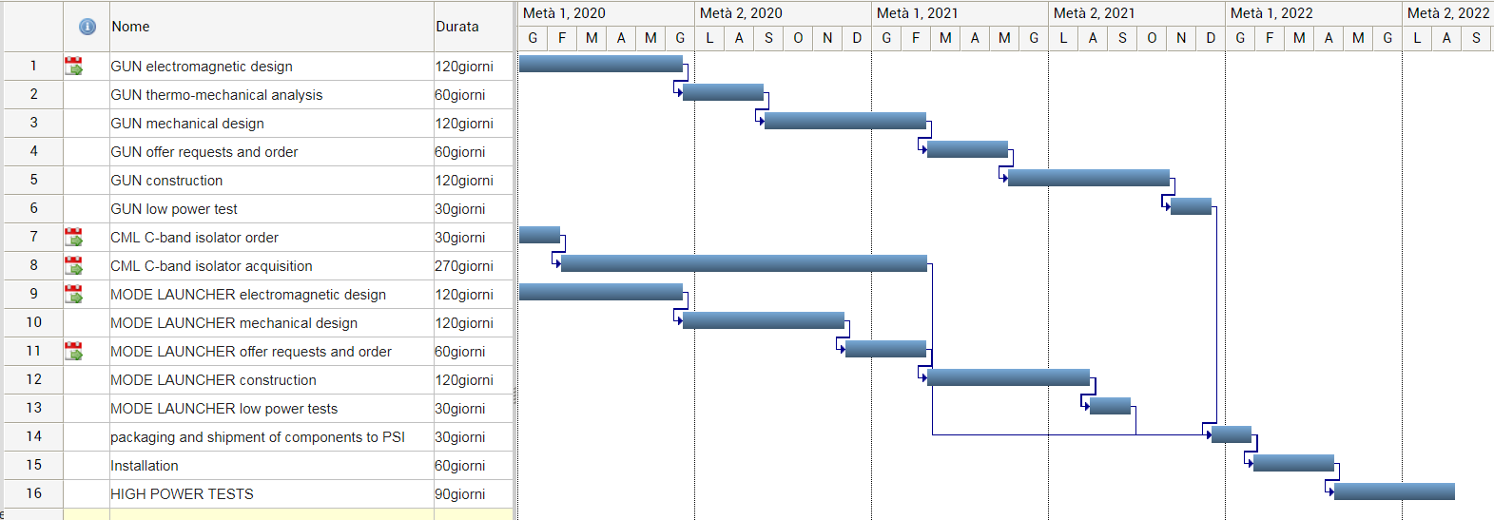
TIMESCHEDULE
1st year: isolator acquisition, gun and mode launcher design and other design activities in parallel
2nd year: RF gun acquisition , mode launcher design and other design activities in parallel
3rd year: mode launcher acquisition, installation and tests

Slide 12
FINANTIAL REQUESTS
Component | Cost (Included VAT) kEuro
Isolator | 60
RF gun | 50
Mode launcher | 40
Missions, Work supervision at Companies during components realization, Installation at PSI, test, meetings | 20
TOTAL (3 years) | 170

Slide 13
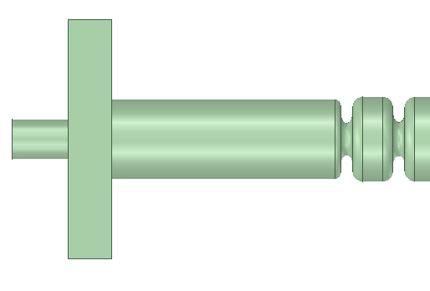
FUTURE PROGRAMS AND PERSPECTIVES: C-BAND ELECTRON SOURCE
The realization and high power test of the C-band gun at E_{acc}>200 MV/m is the first fundamental step to study the feasibility of this type of sources;
This is the most critical component of a real full C-band injector;
Because of the possibility to operate at high repetition rate, this source can be also conceived as a stand-alone source for Ultrafast Electron diffraction experiments with MeV beams.
Phase I
KLY
circ
<0.2 μs, 20-50 MW, 100-1000 Hz
High power test @ PSI or INFN
LASER up to 1 kHz
Phase III
Solenoid
Ultrafast Electron Diffraction Experiments up to
1 kHz
Diagnostics,
Spectrometer,…
Phase II

Slide 14
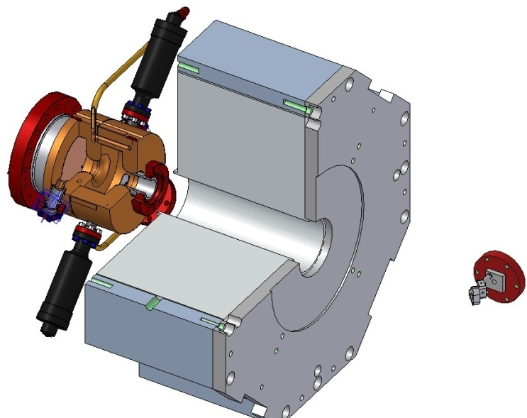
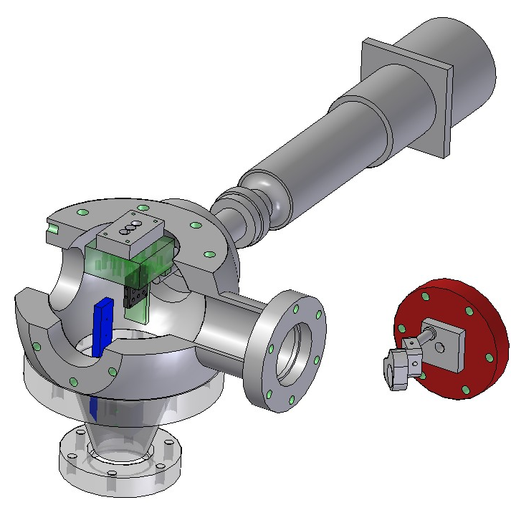
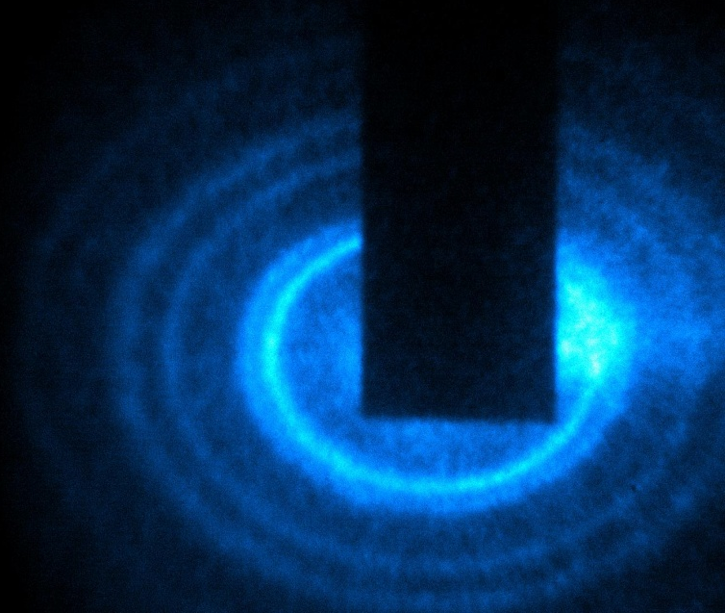
Frontiers in Relativistic Ultrafast Electron Diffraction
Pump-probe technique to study ultrafast structural dynamics
Monitor atomic rearrangements at ultrafast time-scales by recording diffraction patterns
Also called “Poor man X-FEL”
Courtesy Prof. P. Musumeci (UCLA)
State-of-the-art ASTA Facility @ SLAC
Weathersby, S. P., et al. "Mega-electron-volt ultrafast electron diffraction at SLAC National Accelerator Laboratory." Review of Scientific Instruments 86.7 (2015): 073702.
Over 30 high impact scientific publications in last 3 years
https://oraweb.slac.stanford.edu/apex/slacprod/slacesaf.pubs_ued
UCLA Pegasus setup
Musumeci, P., et al. "Laser-induced melting of a single crystal gold sample by time-resolved ultrafast relativistic electron diffraction." Applied Physics Letters 97.6 (2010): 063502.
High sensitivity, high spatial resolution detector
1mm
RF gun
x
x
x
x
x
x
o
o
o
o
o
Sample-holder
o
Frontier directions:
Higher SNR on low signal diffraction features -> increase repetition rate (currently @ 360 Hz)
Higher Q-resolution -> Improve emittance. Cathode studies + high cathode extraction field (currently LCLS gun @ 120 MV/m)
Photocathode driver laser pulse
Collimating hole
Pump pulse
Delay stage

Slide 15
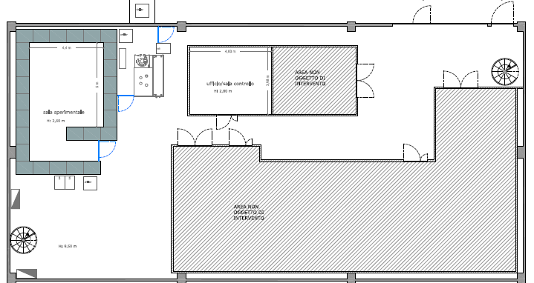
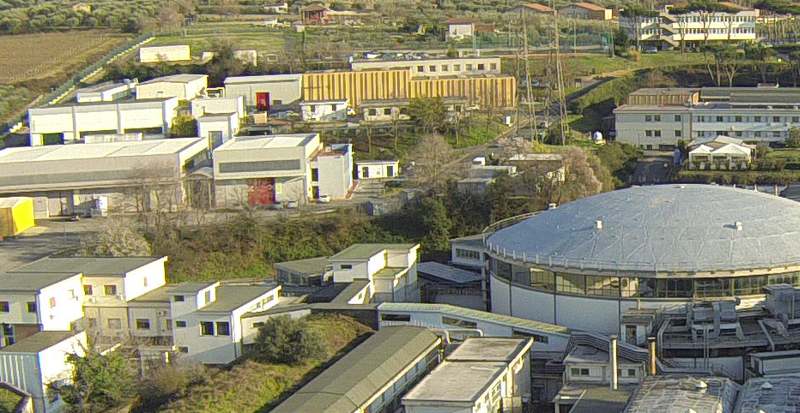
POSSIBILITY OF A GUN TEST FACILITY @ LNF
The LNF-INFN will host an X-band station for high power test (Frascati X-box, duplication of the CERN X-box #2) within one year. One possibility for the C-band gun test facility (under discussion) is to couple this station with a C band power station. The advantages are also related to possible future extensions/upgrades of such implementation with a laser system (that can be installed in the clean room in front of the shielded area) and the coupling of the C-band acceleration with an X-box buncher/booster for extremely interesting Electron Diffraction Experiments.
EUPRAXIA@SPARC_LAB
SPARC_LAB
Building #7
4.4 m
X-band
Control room
5 m
C-band
laser
Clean room
The Frascati X-box will be located in LNF building #7, very close to the SPARC_LAB area, formerly used for testing and conditioning of the DAFNE RF power plants and cavities
S. Incremona
19/20

Slide 16
REFERENCES
[1]D.Palmer PhD thesis “The next Generation Photoinjector”, June 1998
[2]P.G. O’Shea, et al., in: Proceedings of the Particle Accelerator Conference, 1991, p. 2754.
[3]D.H. Dowell, et al., Appl. Phys. Lett. 63 (1993) 2035.
[4]R. Dei-Cas, et al., Nucl. Instr. and Meth. A 296 (1990) 209.
[5]S. Schreiber, in: Proceedings of the European Particle Accelerator Conference, 2000, p. 309.
[6]R. Akre, et al., Phys. Rev. ST Accel. Beams 11 (2008) 030703.
[7]H.S. Kang, S.H. Nam, in: Proceedings of the 32nd International Free Electron Laser Conference, 2010, p. 155.
[8]R. Kuroda, Nucl. Instr. and Meth. A 593 (2008) 91.
[9]C. Yim, et al., in: Proceedings of the International Particle Accelerator Conference, 2010, p. 1059.
[10]J.B. Hasting, et al., Appl. Phys. Lett. 89 (2006) 184109.
[11]R. Li, et al., Rev. Sci. Instrum. 80 (2009) 083303.
[12]J. Yang, et al., Rad. Phys. Chem. 78 (2009) 1106.
[13]P. Musumeci, et al., Rev. Sci. Instrum. 82 (2010) 013306.
[14]J.-H. Han, Phys. Rev. ST Accel. Beams 14 (2011) 050101.
[15]R. Kuroda, et al., Nucl. Instr. and Meth. A 637 (2011) S183.
[16] V. A. Dolgashev et al., High Magnetic Field in couplers of X-band Accelerating structures, in Proceedings of the 2003 Particle Accelerator Conference, p. 1267.
[17] V. A. Dolgashev et al., RF breakdown in normal conducting single-cell structures, in Proceedings of the 21st Particle Accelerator Conference, Knoxville, TN, 2005 (IEEE, Piscataway, NJ, 2005).
[18] A. Grudiev, S. Calatroni, and W. Wuensch, New local field quantity describing the high gradient limit of accelerating structures, PHYSICAL REVIEW SPECIAL TOPICS - ACCELERATORS AND BEAMS 12, 102001 (2009)
[19] J.B. Rosenzweig, E. Colby, TESLA-95-04
[20] D. Alesini et al., TUPTS024, IPAC 19
[21] http://www.compactlight.eu/Main/HomePage
[22] D. P. Pritzkau, SLAC-Report-577, Ph.D. Dissertation,2001
[23] W. Wuensch, IPAC2017
[24] Weathersby, S. P., et al. "Mega-electron-volt ultrafast electron diffraction at SLAC National Accelerator Laboratory." Review of Scientific Instruments 86.7 (2015): 073702.
[25] Musumeci, P., et al. "Laser-induced melting of a single crystal gold sample by time-resolved ultrafast relativistic electron diffraction." Applied Physics Letters 97.6 (2010): 063502.

