Slide 1
Consiglio di Laboratorio Preventivi 2020 Singularity CSN5
Stefano Pioli
2019/07/09

Slide 2
Outline
Context
Singularity Project
Hw Development
Personnel Safety System
Machine Protection System
Sw Development
Middle Layer
Apps
Machine Learning
SWOT Analysis
Cost Estimation
Resources
Gantt chart
Stefano Pioli

Slide 3
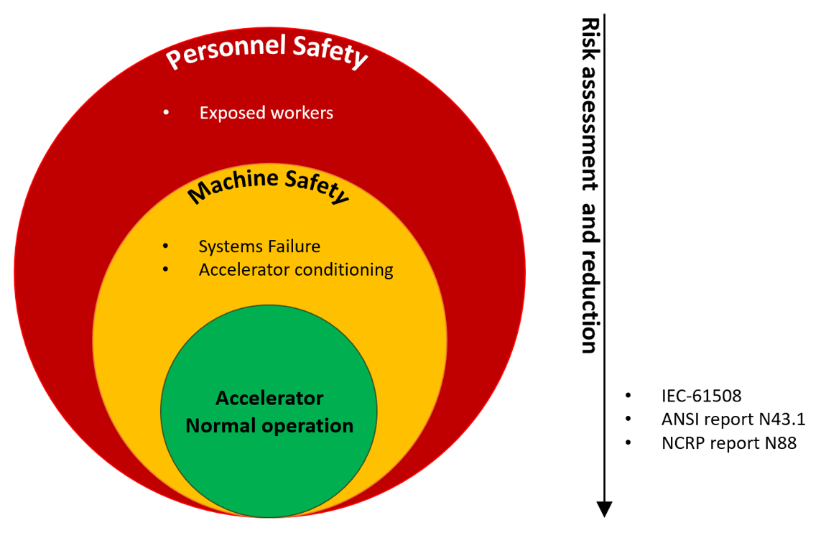
Context
Failure Handling
LNF Facilities and Projects
Risk and Cost Management
Maintenance
INFN and other
Operation Up-time optimization
Technology Transfer
Stefano Pioli

Slide 4
Singularity Project
Aim: investigate the feasibility of a complete automation of an accelerator facility through the combined development of artificial intelligence (AI) based software applications and a safety hardware.
Personnel Protection System
Real-time safety devices
IEC-61508, ANSI 43.1 and
NCRP 88 compliant
Failure Handling
LNF Facilities and Projects
Modular scalable design
!CHAOS, LabView, EPICS capable
Matlab, Python, C/C++, … ready
Risk and Cost Management
Maintenance
INFN and other
Machine Protection System
Operation Up-time optimization
Technology Transfer
AI-based
Middle Layer
Fully automated processes
On-line operation AI supervisor
Stefano Pioli

Slide 5
Hw Development
A FPGA-based device will be developed to meet accelerator demands and guarantee high level of reliability to match requirements for both Machine Protection System (MPS), to protect accelerator systems from faults and damages induced by beam itself, and Personnel Safety System (PSS), against workers exposure risks from prompt ionizing radiation.
The minimal features of the device will include:
Response time able to perform real-time intervention (for accelerators with repetition rate of at least 1 kHz);
Dual Modular Redundancy to maximize system reliability and availability;
Modular and distributed design to scale the system through a multi-node network with optical links to fit with the architecture of large facilities;
Fail-safe and fool-proof design to maintain the safety of the facility even in case of equipment malfunction;
Scalable design to acquire/produce digital signals where needed from the infrastructure;
Compliance with the IEC-61508 standard on “Functional Safety”, NCRP reports 88 on “Radiation Alarms and Access Control Systems” and ANSI reports 43.1 on “Radiation Safety for the Design and Operation of Particle Accelerator” integrated in both hardware and software design.
Stefano Pioli
Notes:
The safety life cycle is defined as an engineering process that includes all of the steps necessary to achieve required functional safety.
This also includes assigning a safety integrity level (SIL) or risk reduction factor required for each safety function. Safety integrity levels are order of magnitude levels of risk reduction.
Safety plan for desuign e maintenance

Slide 6
Hw Development
System
Requirements
Verification
validation
IEC-61508 – “Functional Safety”
The safety life cycle can be viewed as a logical “identify-assess-design-verify” closed loop.
Design sw and hw to match the required Safety Integrity Level (risk reduction magnitude to properly minimize the failure rate of the system).
System Architecture
Integration Testing
Software Design
Integration Testing
NCRP reports 88 - “Radiation Alarms and Access Control Systems”
ANSI reports 43.1 - “Radiation Safety for the Design and Operation of Particle Accelerator”
Fail-safe and Fool-proof criteria.
Hardware Design
Hardware
Bench-testing
Coding
Safety Systems
life-cycle V-shaped model
Stefano Pioli
Notes:
The safety life cycle is defined as an engineering process that includes all of the steps necessary to achieve required functional safety.
This also includes assigning a safety integrity level (SIL) or risk reduction factor required for each safety function. Safety integrity levels are order of magnitude levels of risk reduction.
Safety plan for desuign e maintenance

Slide 7
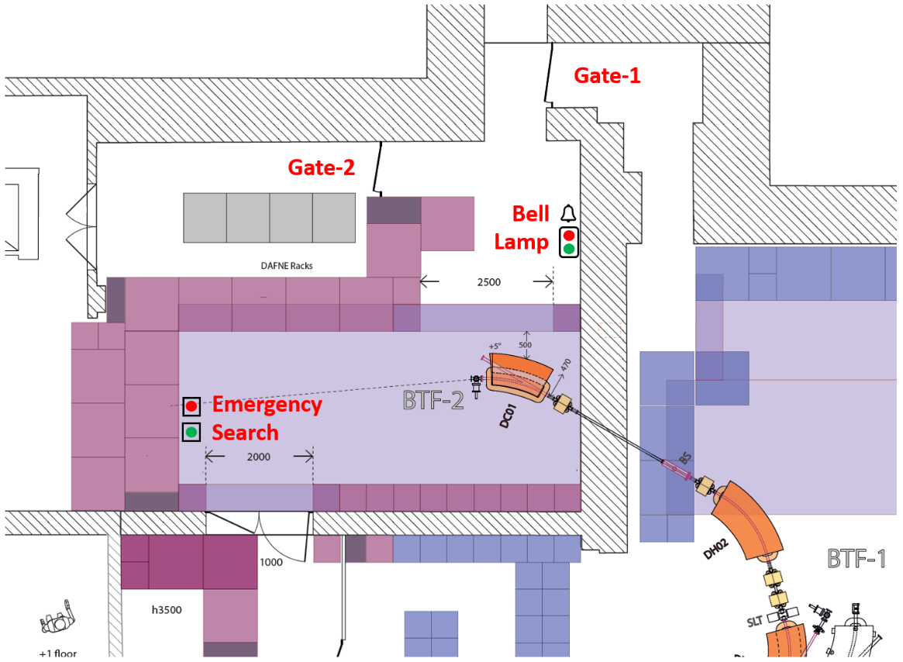
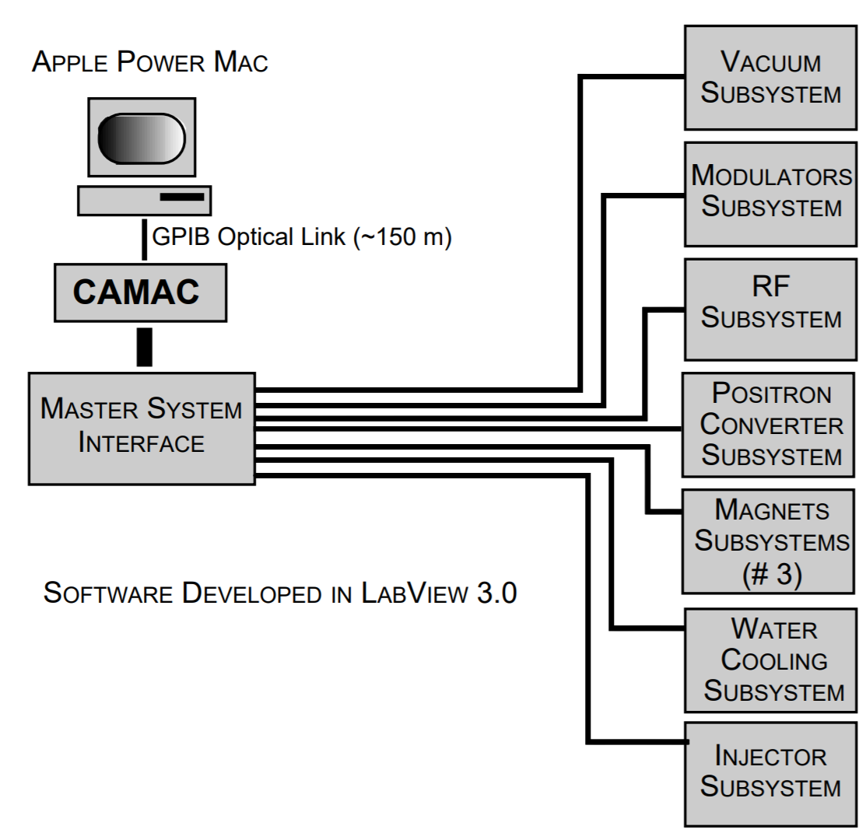
Hw Development – Test Cases
Personnel Safety
Machine Safety
Benchmark:
overall method
reliability
fail-safe and fool-proof criteria
compliancy with the IEC standard, NCRP and ANSI reports
Benchmark:
response-time
modularity
scalability
compliancy with the IEC standard
Stefano Pioli
Notes:
The safety life cycle is defined as an engineering process that includes all of the steps necessary to achieve required functional safety.
This also includes assigning a safety integrity level (SIL) or risk reduction factor required for each safety function. Safety integrity levels are order of magnitude levels of risk reduction.
Safety plan for desuign e maintenance

Slide 8
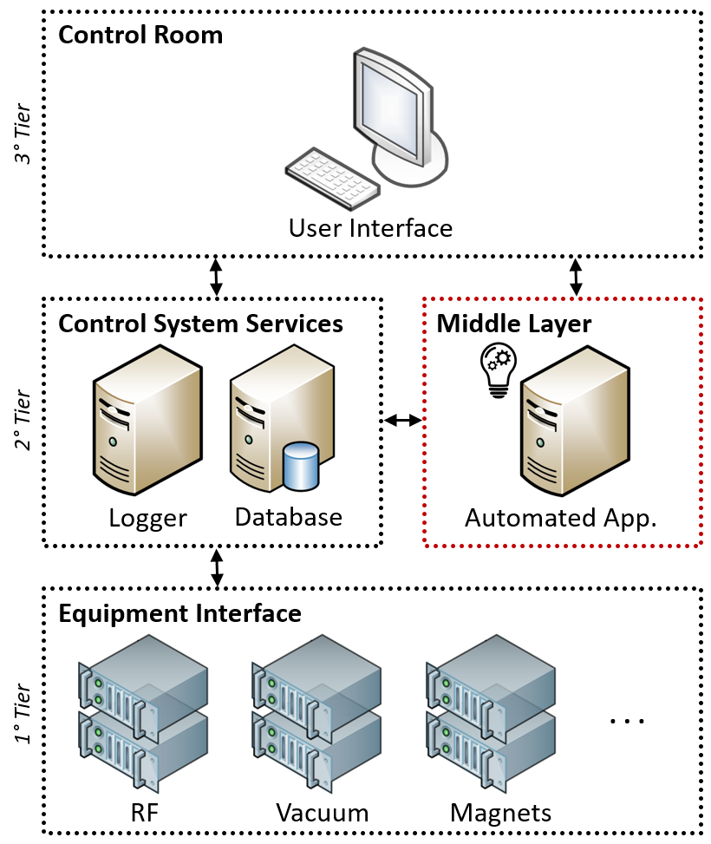
Sw Development – Middle Layer
User experience working with middle layer should be about the difficulty of making a PowerPoint presentation.
The main reasons for introducing middle layer:
Middle Layer solves the problem of compromise between variability of general control system and functionality of a specialized one. Bottom layer can therefore stay a general purpose control system without need for special modification. Middle Layer functions are developed modular and, wherever possible, are written in a machine independent way.
Middle Layer gives the end-users a safe opportunity to perform basic maintenance tasks by themselves without call the bottom-layer integrator to perform relatively simple tasks. This leads to user discomfort, waste of time, increased costs and overwhelming demand on the control system programmers.
Separation of critical control and user-defined logic is safer.
By shifting some advanced functionality from top to the middle layer, simplify the interaction also of the unskilled-user with top layer and allow integrating time-consuming software and related expensive hardware into the middle layer inside the control system framework.
Stefano Pioli
Notes:
The safety life cycle is defined as an engineering process that includes all of the steps necessary to achieve required functional safety.
This also includes assigning a safety integrity level (SIL) or risk reduction factor required for each safety function. Safety integrity levels are order of magnitude levels of risk reduction.
Safety plan for desuign e maintenance

Slide 9
Sw Development - Apps
Operation – Operation mode able to preserve, tune and optimize accelerator working points.
Online trajectory and emittance feedback
Conditioning – Operation mode able to turn on the accelerator RF system up to nominal operation parameters.
Warm-up RF systems
Working Point Save/Restore
Accelerating Structures Conditioning
Fault Detection – Applications monitoring anormal behaviour of devices isolate them and evaluate fault trends.
RF sources phase stability
Vacuum devices monitoring by region
Beam Position and Current monitor consistency
Beam Diagnostics – Applications devoted to characterize the particle beam online and offline.
Phase scan
Magnet cycling
RF Gun Quantum Efficiency
Dark Current
Spot Size
Beam Envelope
Beam Energy and Energy Spread
RF Gun Energy
Beam Length
Longitudinal Phase Space
Emittance
Accelerating Structures Energy Scan
Virtualized Beam Diagnostics
Stefano Pioli
Notes:
The safety life cycle is defined as an engineering process that includes all of the steps necessary to achieve required functional safety.
This also includes assigning a safety integrity level (SIL) or risk reduction factor required for each safety function. Safety integrity levels are order of magnitude levels of risk reduction.
Safety plan for desuign e maintenance

Slide 10
Sw Development - AI
weak-AI
When the application control a well know a priori environment with deterministic states, the weak-Ai approach will be preferred.
Supervised learning - is the task of inferring a classification or regression from labeled training data of a well described a priori environment. In its most abstract form, supervised learning consists in finding a function $f:X→Y$ that takes as input $x∈X$ and gives as output $y∈Y$ (X and Y depend on the application) to achieve $y=f(x)$. A supervised learning algorithm can be viewed as a function that maps a dataset of learning samples $\left(x,y\right)≈(X,Y)$ into a model.
Unsupervised learning - is the task of drawing inferences from datasets consisting of input data without labelled responses. Unsupervised learning is a branch of machine learning that learns from data that do not have any label. It relates to using and identifying patterns in the data for tasks such as data compression or generative models.
Reinforcement learning (RL) - is the task of learning how agents ought to take sequences of actions in an environment in order to maximize cumulative rewards. A key aspect of RL is that an agent learns a good behaviour. This means that it modifies or acquires new behaviours and skills incrementally. Another important aspect of RL is that it uses trial-and-error experience. Thus, the RL agent does not require complete knowledge or control of the environment.
Artificial Intelligence
strong-AI
Supervised Learning
Neural Network
Unsupervised Learning
Clustering
Reinforcement Learning
Markov Decision Process
Stefano Pioli
Notes:
The safety life cycle is defined as an engineering process that includes all of the steps necessary to achieve required functional safety.
This also includes assigning a safety integrity level (SIL) or risk reduction factor required for each safety function. Safety integrity levels are order of magnitude levels of risk reduction.
Safety plan for desuign e maintenance

Slide 11
SWOT Analysis
Strengths – The development of in-house safety hardware, following popular international industrial standards, open two prospective.
1. We are going to develop a new type of access control system for radiation protection environments with compliancy, performances and reliability over the state-of-art.
2. The FPGA-based system feasible for both Machine and Safety protection, thanks to its scalability and modularity, could be easily installed on new or legacy facility taking advantage of the risk and cost reduction due to risk assessment and cheaper technology.
About software development, according with state-of-art, there are a lot development on AI tools on different fields related to particle accelerators. Nevertheless, the proposed Middle Layer will be the first including strategies to handle overall activities of the accelerator in parallel with hardware infrastructure to provide the proper safety.
All these topics will be highlighted from four different integration strategy implemented at Dafne LINAC and BTF, SPARC_LAB and CNAO user facilities.
Weaknesses – As common for scientific software suites, the best results to increase the diversity and capability of the applications in the layer could be not based on an internal development team but it should be supported by a community of users.
Stefano Pioli

Slide 12
SWOT Analysis
Opportunities – The development proposed in this project give the opportunity for hosting facilities to enhance the User Experience (UX) with affordable safety risk assessment. Such aspect could be useful for the institute for two reasons:
1. Realize devices, based on common industrial standards, and software suite for the autonomous control of an accelerator could be interesting from the Technological Transfer point-of-view and suitable as standalone product or as additional product in bundle with other products.
2. The FPGA-based device produced, currently focused on digital signal analysis, could drive the development of new devices like, in e.g., an outstanding digital LLRF in X-Band over the state-of-art for the EuPRAXIA project, able to sample RF signal (reference at 11 GHz) and provide power and phase feedback for RF sources, Beam-Loading compensation, integrated fast-interlock based on RF pulse shape analysis.
Threats – The installation phase for the hardware and the testing of the software must submit to other activities of the hosting facilities. Due to these reasons, a rescheduling or a de-scoping could be required.
Stefano Pioli

Slide 13
Cost estimation (3 years)
Equipment | Cost [k€] | Type
Missions at CNAO and conferences | 45 | Missioni
Safety Hardware
16x Xilinx ZinQ boards with: | 55 | Costr. Apparati
Signal conditioning boards
16x Serdes modules
Optical patch-coords
Cabling 6x Racks 40U | 20 | Costr. Apparati
Middle Layer
Dell Server Xeon CPUs with 32 threads, 64 GB of RAM, 1TB of SSD disk. | 15 | Inventario
Total | 135
Stefano Pioli

Slide 14
Resources
Risorsa | Ruolo | Struttura | FTE
S. Pioli | Tecnologo | INFN-LNF | 0.9
B. Buonomo | Tecnologo | INFN-LNF | 0.3
C. DI Giulio | Tecnologo | INFN-LNF | 0.2
L. G. Foggetta | Tecnologo | INFN-LNF | 0.1
R. Pompili | Ricercatore | INFN-LNF | 0.1
P. Valente | Ricercatore | INFN-Roma1 | 0.1
A. Variola | Ricercatore | INFN-Roma1 | 0.1
E. Leonardi | Tecnologo | INFN-Roma1 | 0.2
 |  | Tot. | 2.0
LINAC DA Staff | Technical | INFN-LNF | 1.0
SEA DR Staff | Technical | INFN-LNF | 1.0
The CNAO particle therapy center will join the project as test-site for the Middle Layer proving beam shifts and development support from control system and beam dynamics teams.
During the first year we will looking for a master thesis student and/or a 1st year PhD student.
Stefano Pioli

Slide 15
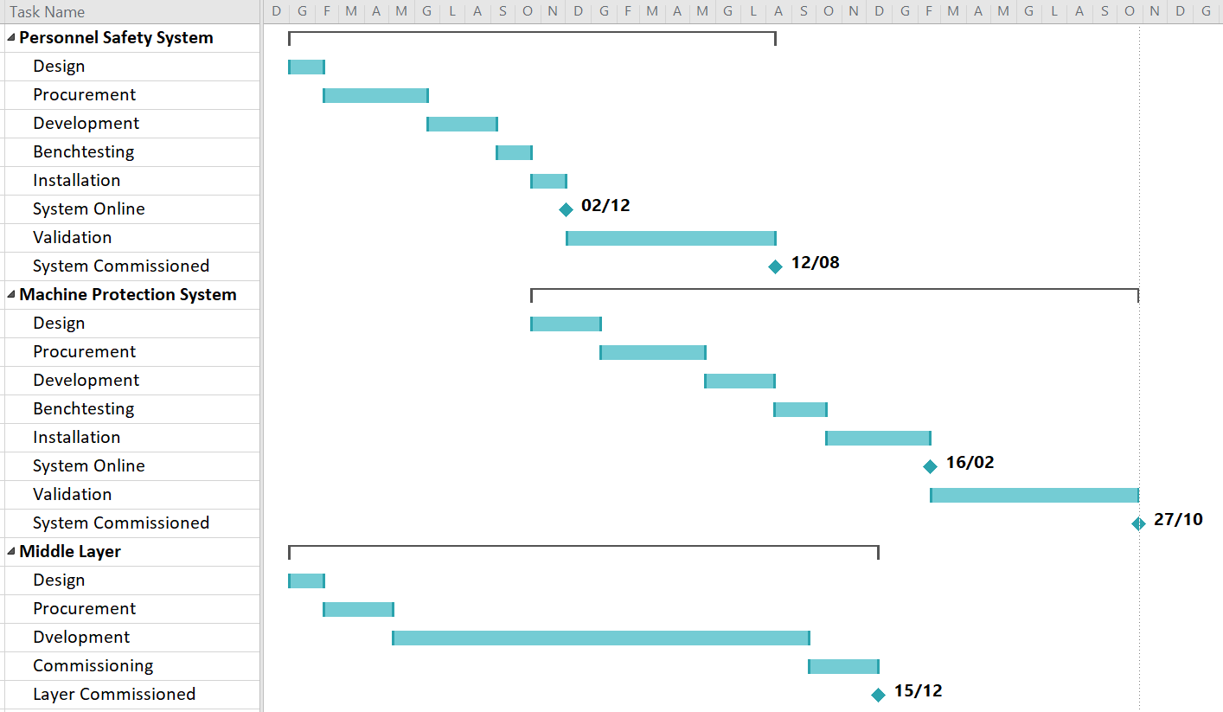
Gantt chart
1° Year
2° Year
3° Year
Stefano Pioli

Slide 16
Thank you for the attention.

