Slide 1






Relazione Coordinatore CSN3@LNF
Consiglio Laboratorio Aperto 09 Luglio 2019
Alessandra Fantoni
CERN Fisica: QGP 10.0 FTE
CNAO/TIFPA/
LNS/BTF Fisica: framm. Nucleare 2.1 FTE
JLAB Fisica: adronica 3.1 FTE
Bonn/Mainz Fisica: adronica 1.2 FTE
LNF Fisica: nucleare 14.8 FTE
LNGS Fisica: nucleare 6.6 FTE
JLAB/RHIC Fisica: adronica 0.3 FTE
CERN Fisica: astrofisica nucleare 1.0 FTE
F. Ronchetti
E. Spiriti
M. Mirazita
Totali: 39.1 FTE (Ric.+Tecnol.) + Tecnici
P. Levi Sandri
C. Curceanu
C. Curceanu
VIP
sotto DTZ
EIC_net
F. Murtas

Slide 2
Nuclear Physics Exp. @ LNF in 2019
Funding 2019, SJ 2019 at the level of 0.5 kE
Exp | Res | Tec | FTE | MIS | CON | APP | INV | OTHER
ALICE | 9 | 3 | 10 | 34 | 3.5 |  | 8 4.5 | 11.5
FOOT | 1 | 4 | 2.1 | 8.5 | 9 | 95 8.5 |  | 0.5
JLAB | 3 | 1 | 3.2 | 17 | 4 | 150 |  | 3
KAONNIS | 20 | 4 | 14.7 | 12 | 21.5 |  | 35 | 16
MAMBO | 2 | 0 | 1.2 | 8 3.5 | 3
VIP | 10 | 2 | 6.4 | 20 3 | 16.5 |  | 12.5 2 | 16
DTZ | 37 | 10 | 37.6 | 31 | 10.5 |  | 20 | 8

Slide 3

Group, Responsibilities & Activities
The LNF Group Joined ALICE in 2006
Researchers and Technologists: 7FTE
Danè E. 0.4
Fantoni A. 0.9
Gianotti P. 0.7
Larionov P. 1.0
Muccifora V. 0.9
Pisano S. 1.0
Ronchetti F. 0.9
Spiriti E. 0.3
Toppi M. 0.8
Technicians:
Orlandi A., Paoletti E., Passamonti L.,
Pierluigi D., Russo A., Viticchié A. (ret.)
Responsibilities at CERN
Run Coordinator (FR, 2015)
Period Run Coordinator (AF, 2015)
LS1 Consolidation ALICE Task Force (FR, 2013-14)
Period Run Coordinator (FR, P. Di Nezza, 2012)
EMCAL Deputy Project Leader (AF, 2013-; NB, 2007-2012)
EMCAL/DCAL Euro-Asian Coordinator (AF, 2008-2012)
EMCAL System Run Coordinator (FR, 2011-12)
EMCAL High Level Trigger Coordinator (FR, 2009)
ALICE Activities at LNF
ITS Upgrade production Local Technical Coordinator (FR, 2016-19)
Physics Analysis Coordinator (SP, 2016-)
EMCAL/DCAL production Local Technical Coordinator (AF, 2010-11)
EMCAL production Local Technical Coordinator (FR, 2006-09)

Slide 4



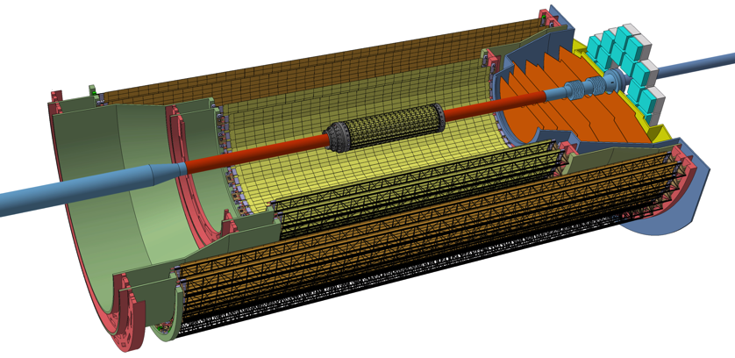
LNF Production Summary
Production at LNF started in Feb 2018 and ended in June 2019:
LNF quota (27 staves) was fully produced
Very long preparation and development phase: 2016-17
The LNF group also contributed to the development and debug of the procedures
Debug of the readout system
Development of wire bond repairs using conductive glues
Development of mechanical procedures and tooling to rework finished staves
“Stave”
Outer Layers
Middle Layers
Inner Layers

Slide 5
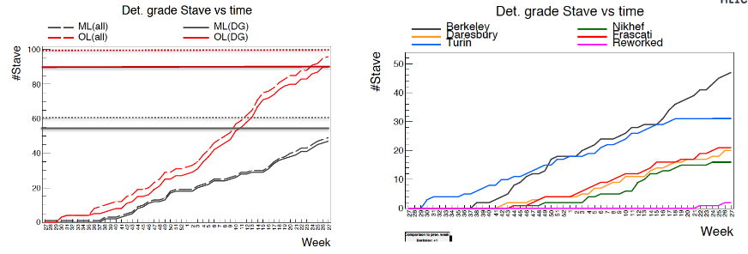
LNF Production Summary
  GOAL:
  ML: 54 + 6 spares
  OL: 90 + 10 spares
  Produzione INFN all (detector grade):
  LNF: 27 (26) – unico sito disponibile produzione evt ulteriori spares
  Torino: 34 (32)

Slide 6
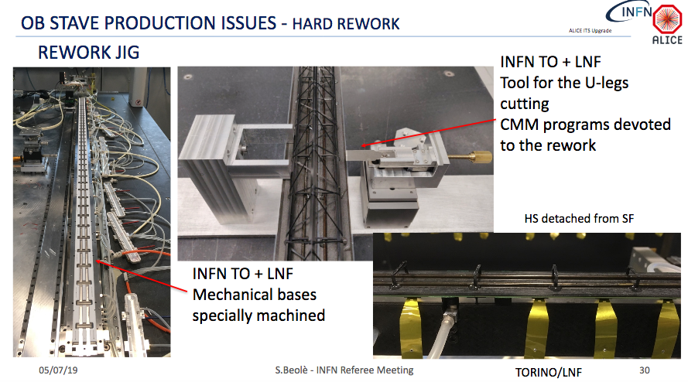
LNF Production Summary

Slide 7
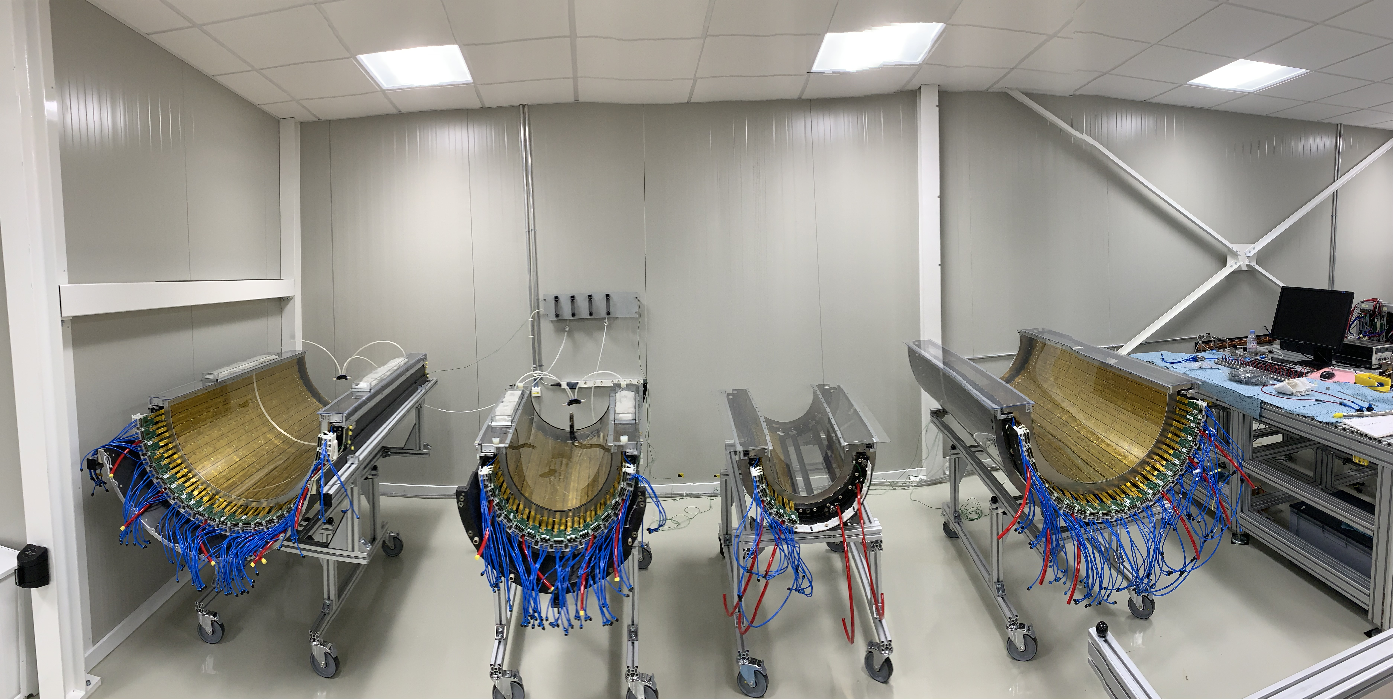
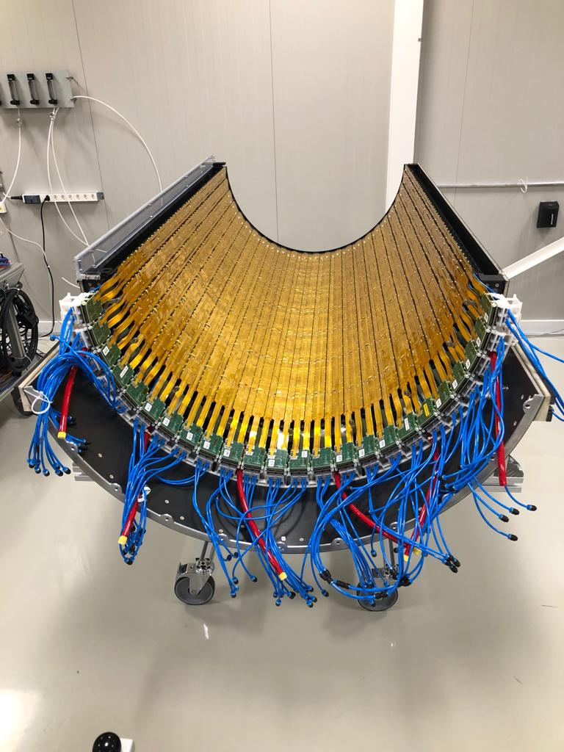
CERN ITS Facility

Slide 8
ITS Schedule
IB construction finished
OB (Middle and Outer) layer production finishing
Commissioning at CERN about to start
OB Production tails in LNF (on demand)
Riconoscimento dell’eccellente lavoro fatto ai LNF:
Produzione (quantità e qualità)
Sviluppo tools e diverse migliorie meccaniche
GRAZIE a tutti ☺
Global assembly

Slide 9
P. Larionov ITSsa
S. Pisano TPC
M. Toppi TOF
Preliminary results approved at May Physics Forum
and shown at SQM 2019

Slide 10
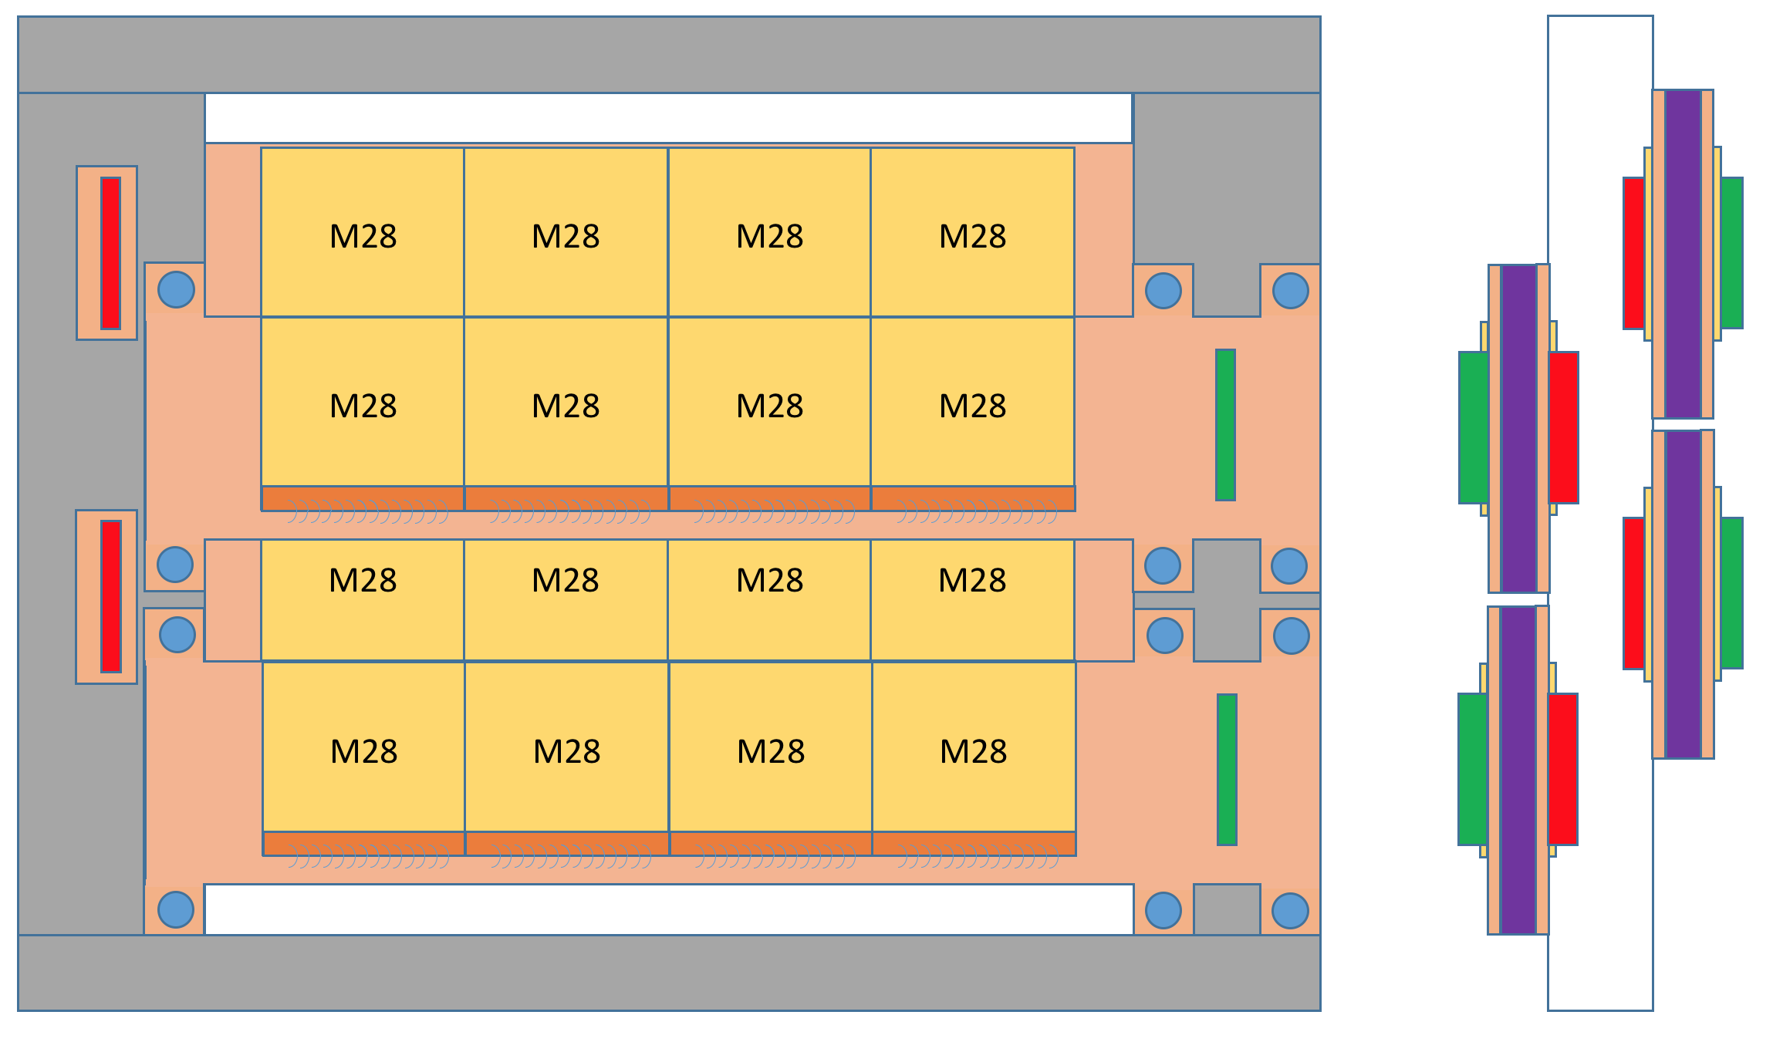
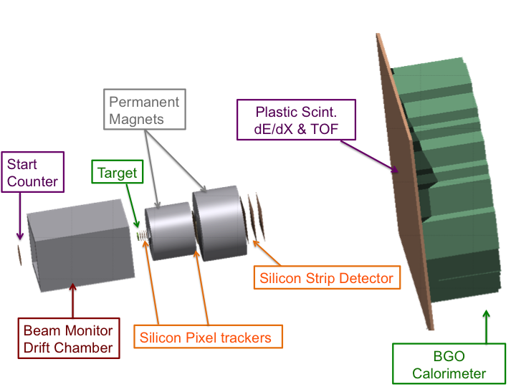
FOOT
5 Physicists for 2.1 FTE
Average participation of 42%
CSN3:
New experiment in 2017, approved as R&D
Financial plan approved in september 2017
CDR: https://pandora.infn.it/public/36683d
1 modulo = 4 sensori Mimosa M28
1 Ladder = 2 moduli accoppiati
1 Layer = 2 Ladder
Inner tracker = 2 Layer (4 Ladder)
LNF responsibility:
Pixel tracking system
Notes:
Target: system used for the FIRST experiment, equipped with two M26 Mimosa sensors => to be replaced with four new boards redesigned to host one M28 sensors each

Slide 11
Activity (june 2019) @ LNF: Inner Tracker - magnet bid - mechanical setup Critical points
Magnet bid
Contract awarding FAILED.
Tender to be repeated with
New contractual conditions
Larger budget (+40k)
At least 4/6 months delay
Inner Tracker
module Kapton PCB in production
G&A company (take care of module assembly) waiting to start working on ladders
Two more boards needed (delayed by learning a new electronic CAD system)
Mechanical setup waiting to be finalized by:
Final magnet design (after new magnet bid)
Inner Tracker ladder assembly procedure definition by G&A company. Delayed by kapton PlumeM28 PCB availability.

Slide 12
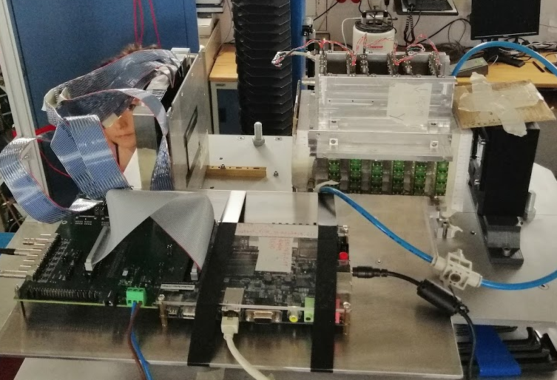
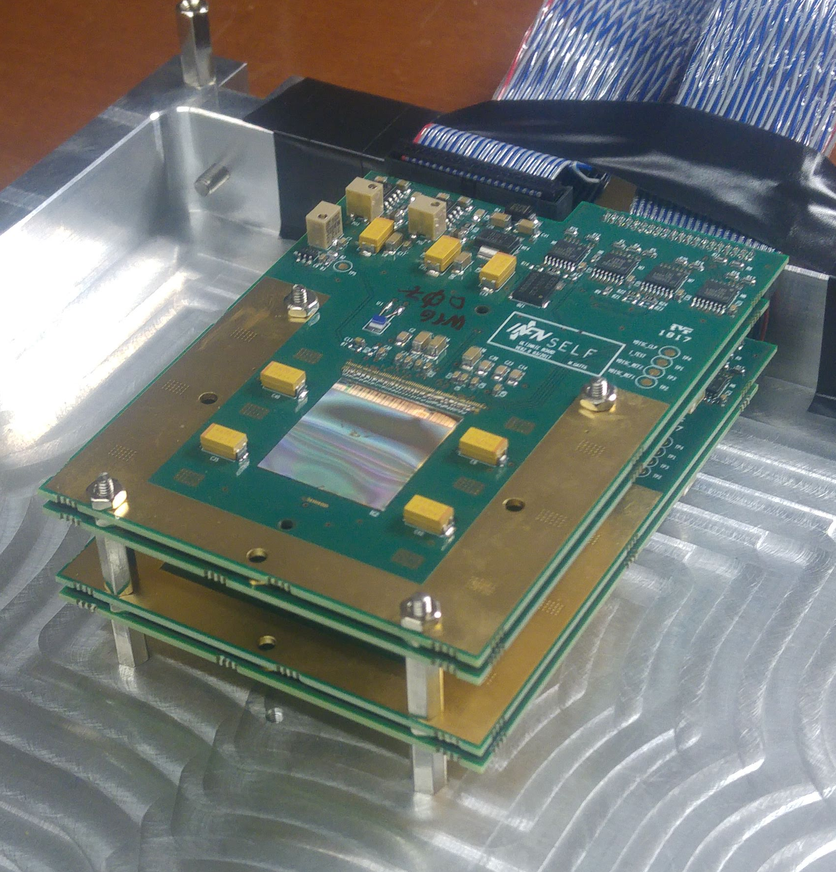
Activity (june 2019) @ LNF: FOOT Vertex tested at GSI beginning of April 2019
Vertex
box
Vertex
readout
Drift
chember
Start
counter
Pixel Vertex: 4 planes of M28 sensor, 50𝝁m thick

Slide 13
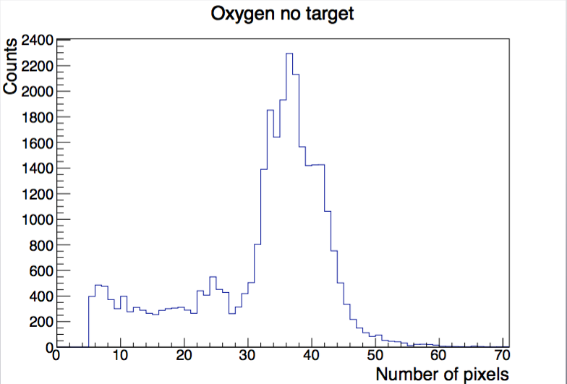
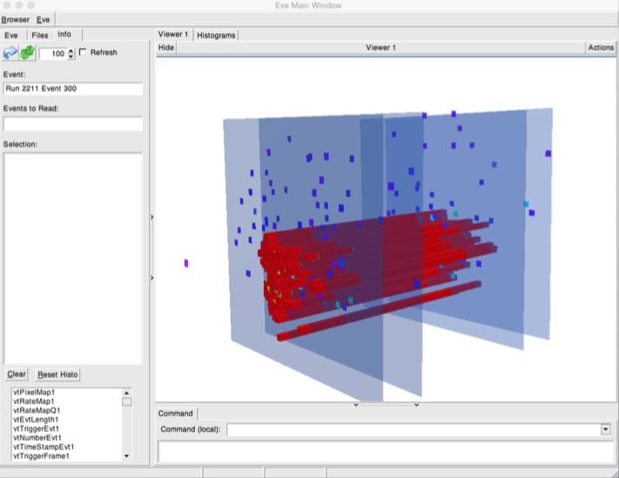
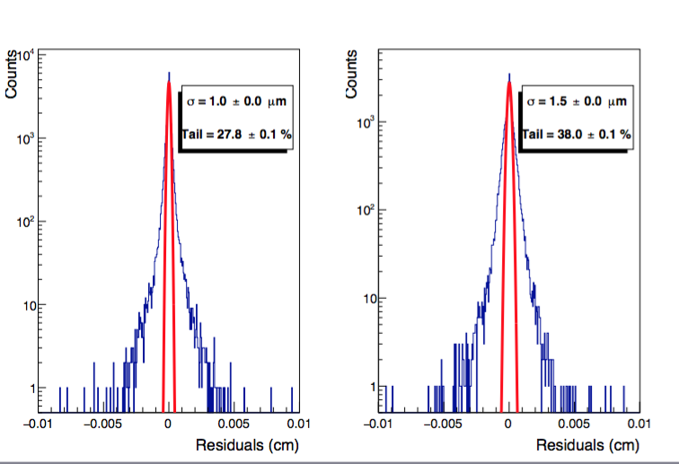
Activity (june 2019) @ LNF: FOOT Vertex tested at GSI beginning of April 2019
Vertex tracks
on event display
Cluster size produce by Oxygen beam: ~40 pixels/cluster
( 20.7x20.7 𝜇m pixels size )
Alignment resolution:
𝝈 = 1.0 μm X axis
𝝈 = 1.5 μm Y axis

Slide 14
Attività 2020
Attività 2020 sul tracciatore a pixel di FOOT
Due rilevanti imprevisti producono uno slittamento dell’attività prevista nel 2019 all’anno 2020:
Indisponibilità del software Cadence per il disegno di PCB
Non aggiudicazione della gara dei magneti dovuta principalmente a condizioni contrattuali non adeguate.
Fine costruzione e test dell’FPC (Flexible Printed Circuit) per il Tracciatore intermedio ( SEA )
Fine gara e acquisto dei magneti permanenti del tracciatore
Test dei magneti FOOT presso il Laboratorio Misure Magnetiche dei LNF
Costruzione (G&A) e test dell’Inner Tracker ( SEA )
Sviluppo di un sistema di readout integrato per il tracciatore intermedio ( SEA )
Progettazione del sistema di supporto integrato con le readout board del tracciatore intermedio ( SPAS )
Fine progettazione e realizzazione della meccanica di supporto del sitema di tracciamento composto da:
start counter, beam monitor, rivelatore di vertice, tracciatore intermedio, magneti, MSD ( SPAS )
Secondo RUN di presa dati al GSI con il rivelatore di vertice e possibilmente Inner Tracker ( almeno parziale )
Primo RUN di presa dati al CNAO ( setup come sopra )
Studio di possibili nuovi sensori a pixel “analogici” (progetto STRONG2020: LNF, Trento, Bari, Strasburgo, GSI, DMKZ)

Slide 15
Attività 2020
Richieste (indicative) servizi:
SEA 5 mu
SPAS 4 mu
Off. Mecc. 4 mu
Lab. Mis. Magnetiche 3 mu
Richieste finanziarie:
Missioni 12 k€ ( riun. collaborazione, presa dati)
Apparato 10 k€ ( Meccanica, Inner Tracker, Read Out )
Consumo 10 k€ ( Materiali per test magnetici, meccanica)
Trasporto 2 k€ ( per test GSI, CNAO)
Ricercatori & Tecnologi
Raffone G. 0.5
Sanelli C. 0.0
Sciubba A. 0.9
Spiriti E. 0.6
Tomassini S. 0.1
Totale 2.1
Le richieste finanziarie presuppongono un possibile riutilizzo
come residui di parte dei fondi del 2019 ( vedi ritardi citati )

Slide 16
JLAB
Ricercatori & Tecnologi 3.1
V. Lucherini 0.9
M. Mirazita (Resp.) 0.9
P. Rossi (part time) 0.2
S. Tomassini 0.1
O. Soto (Post-doc INFN) 1.0
C. Pecar (DOE/INFN Summer Student)
+ D. Orecchini, A. Orlandi (tecnici)
Attività del gruppo al Jefferson Lab in Hall B con il rivelatore CLAS12
studio della struttura 3D del nucleone
  misure di Deep Inelastic Scattering semi-inclusivo e esclusivo;
  estrazione di TMD e GPD
  fisici dei LNF spokeperson di numerosi esperimenti in corso o programmati per i prossimi anni in CLAS12
costruzione di un RICH per l’identificazione di K
  primo modulo installato nel 2018
  secondo modulo in costruzione
Altre attività:
partecipazione a EIC con piccole percentuali: modular RICH
partecipazione a STRONG 2020 in WP sulla struttura del nucleone, misura di GPDs, infrastrutture per misure di DIS

Slide 17
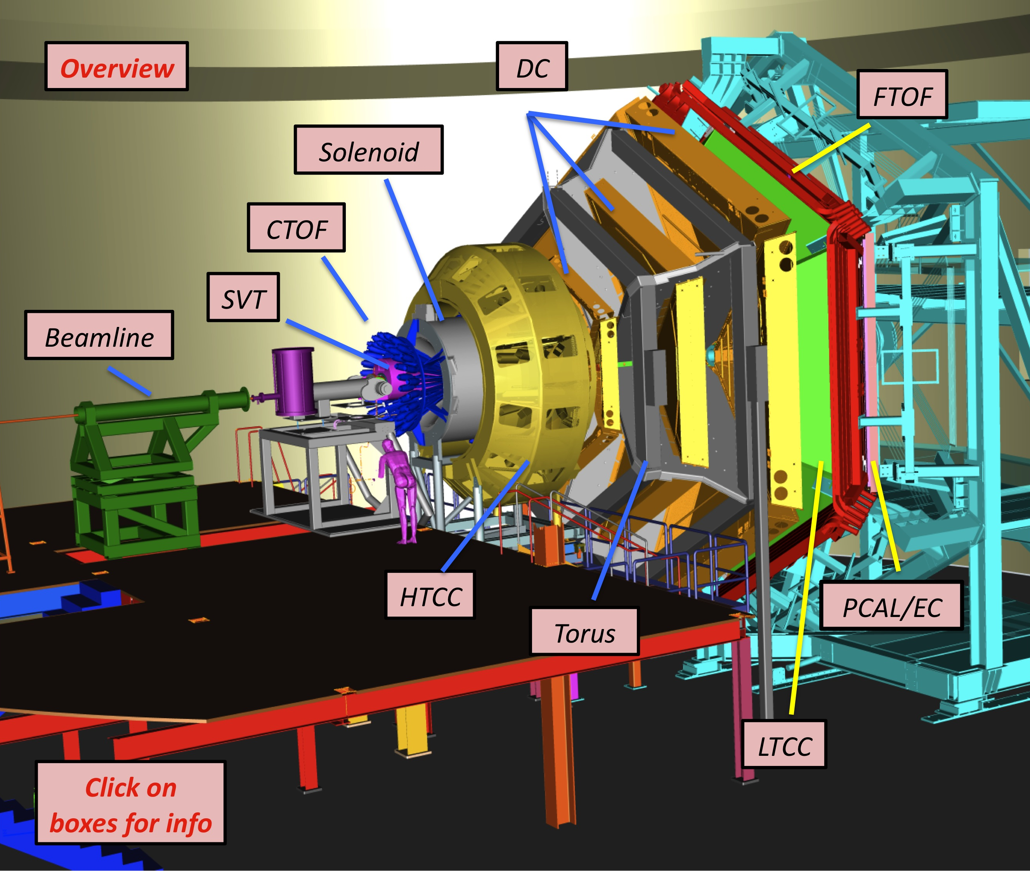
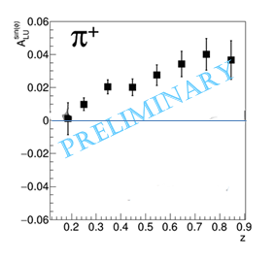
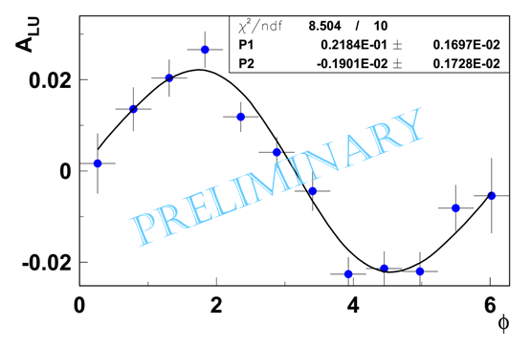
CLAS12 data taking
CLAS12 restarted the data taking in Feb. 2018
polarized beam on unpolarized liquid H target
polarized beam on unpolarized liquid D target
First release of preliminary data (hydrogen):
M. Mirazita, SPIN conference (Sept. 2018)
π⁺ Beam Spin Asymmetry
One day of data taking

Slide 18
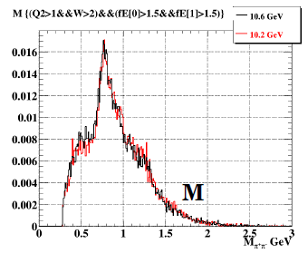
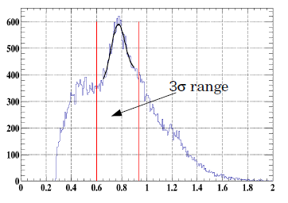
CLAS12 LNF analysis
CLAS12 experiments with LNF spoke-person (unpol. target)
Di-hadron BSA in SIDIS
Lambda polarization in SIDIS
DVCS on the neutron
Di-hadron electroproduction: e p → e’ π+ π- X
Beam Spin Asymmetry:
Access to PDF e(x) → scalar charge of the nucleon
$$A_{LU}=\frac{N^{+}−N^{−}}{N^{+}+N^{−}}∝\frac{σ_{LU}}{σ_{0}}$$
O. Soto
Analysis in progress on proton and deuterium target
proton target
deuterium target
few hours of data taking
Flavor separation

Slide 19
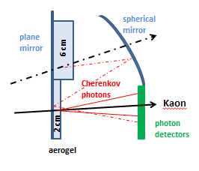
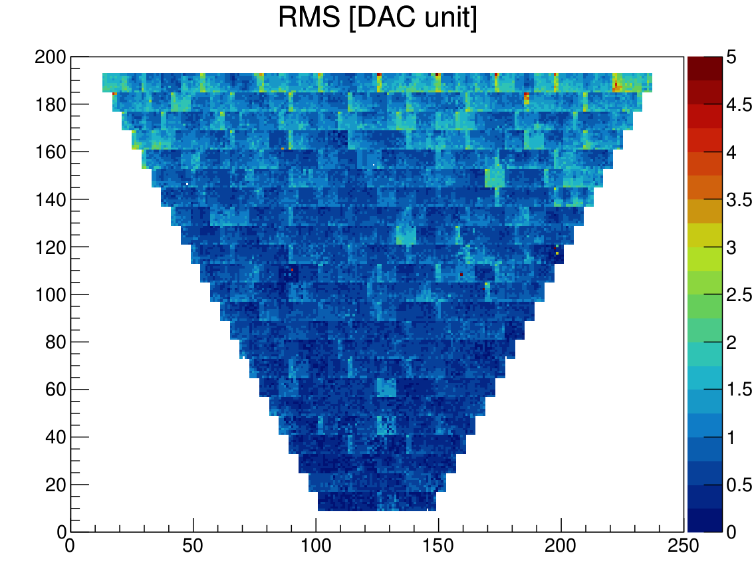
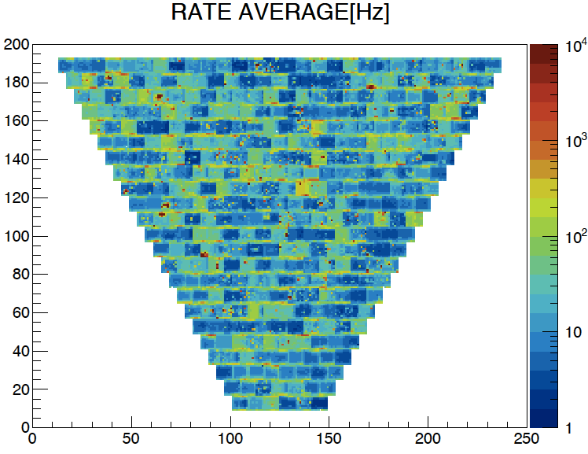
RICH
Extend PID capabilities of CLAS12 to kaons in the 3-8 GeV/c momentum range
hybrid solution: proximity gap plus mirror focusing
First module installed in January 2018 and was smoothly operated since then
No major hardware problem have been reported
Several quantities continuously monitored at the single channel level
PMT dark counts
PMT gains
FE readout preamp gains and thresholds
timing performance
plus the services: electronics cooling system, nitrogen supply
dark counts map
99% below 100 Hz
Pedestal map
average few mV

Slide 20
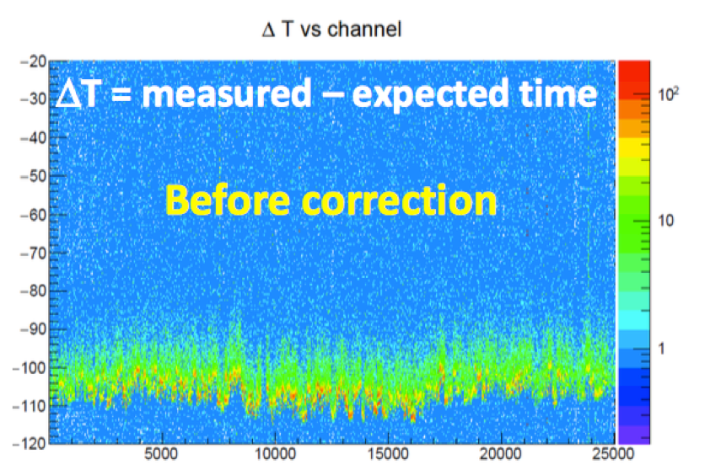
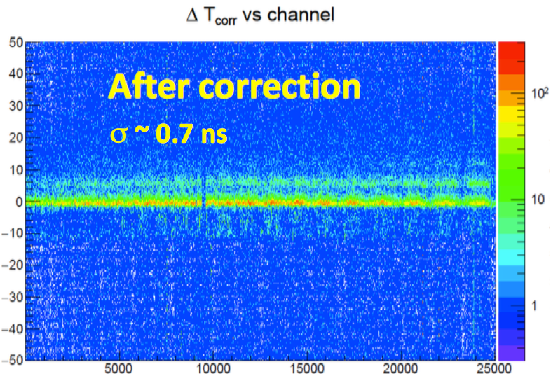
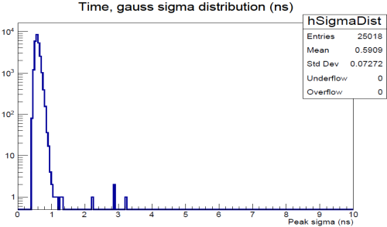
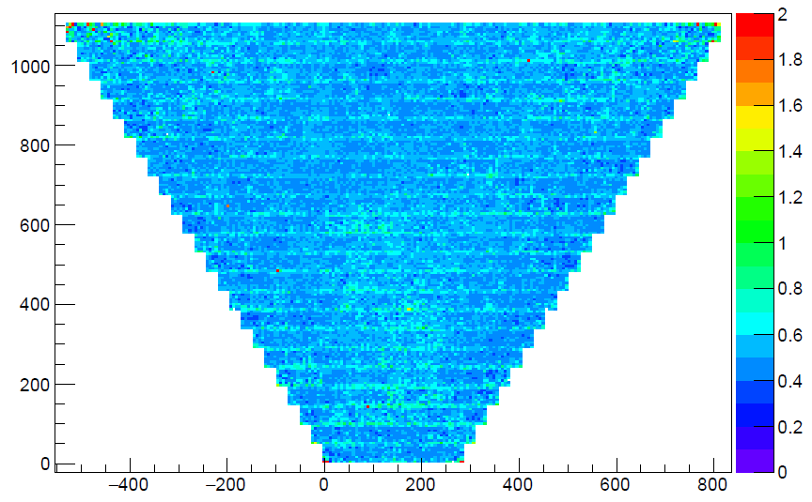
RICH Time calibration
The time calibration is performed against the vertex time provided by the CLAS12 detector. Two steps process: 1) time offsets, one per channel; 2) time walks, one function per PMT
Time resolution
Required σ<1 ns to distinguish direct from reflected photons
achieved
<σ>=0.59 ns

Slide 21
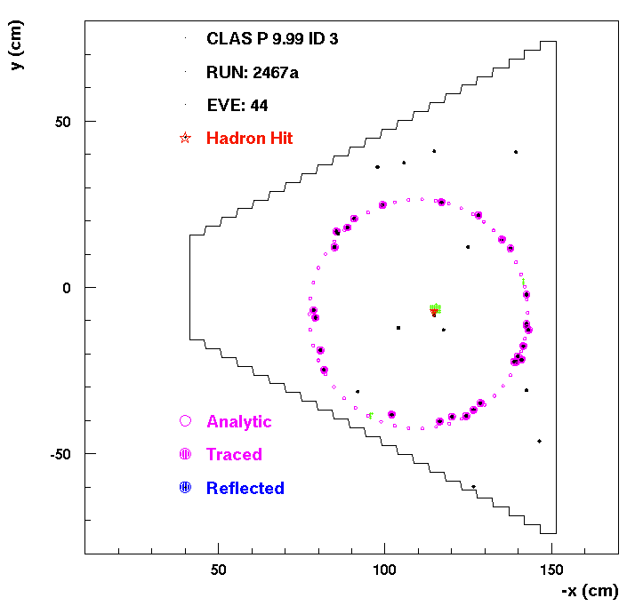
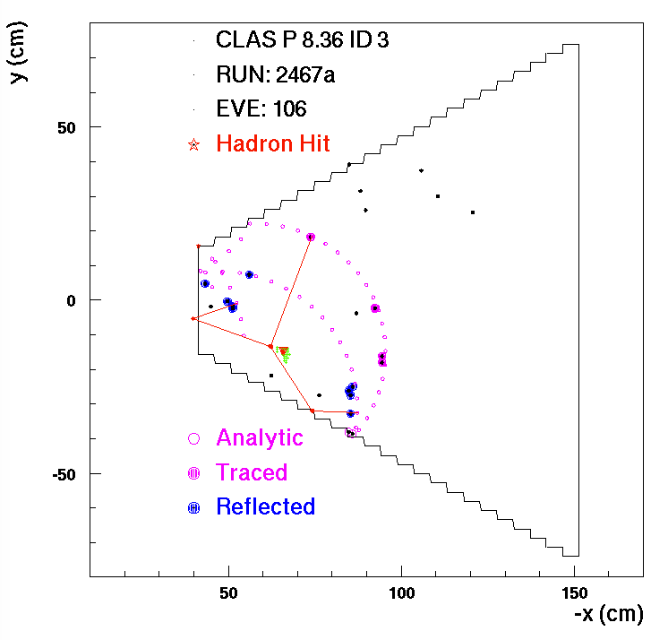
RICH Cherenkov angle reconstruction
Analytic solution
  exact calculation, but valid only for direct detection of the photons
Ray tracing solution
  assumes prior knowledge of the aerogel refractive index
  valid for any photon
Fully direct ring
Partially reflected ring

Slide 22
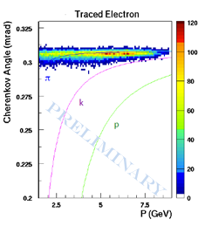
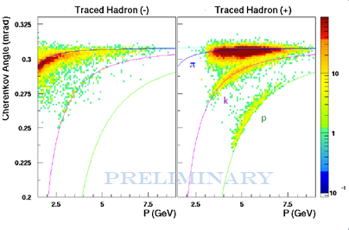
RICH PID
Electrons identified in CLAS12
clear RICH signal
saturated Cherenkov angle
cannot distinguish from pions
Hadrons
pion band partly overlap with electrons
well separated kaon signal

Slide 23
RICH module 2
The second module of the RICH will have the same geometry of the first one with minimal modifications
The construction started last year:
aerogel purchase in progress
purchase of planar mirrors almost completed
mechanical structure construction started
readout chips purchased
MAPMTs: started (by JLab)
to be started: spherical mirrors, production of the electronics
Installation in CLAS12 foreseen in 2021
Notes:
Soluzione diversa per SiPMT abbandonata (anche per mancanza di tempo per nuova progettazione)
E' stato deciso di non cambiare il totale delle richieste di JLAB12 per il 2020 del piano presentato per il triennio 19-21 presentato da Contalbrigo in commissione l'anno scorso, tuttavia le richieste del RICH
saranno un po' piu' alte rispetto a quel piano. Il motivo essenzialmente e' che l'MRI che abbiamo sottomesso al DOE non e' passato (anche se ancora manca la comunicazione ufficiale) e quindi
servono piu' soldi per i PMT per essere in grado di installare nel 2021.
Questa richiesta di incremento di spesa per il RICH verra' quindi fatta a scapito di altre attivita' di JLAB12 che ridurranno le loro richieste.
Per contro la buona notizia e' che il jlab ha deciso di contribuire in parte all'acquisto dei PMT.

Slide 24
Richieste
Richieste finanziarie
Apparati 200k (photodetectors and spherical mirrors)
Consumo 3k
Trasporti 5k
Missioni 35k
Richieste ai servizi
Progettazione 6 m.u. costruzione secondo settore RICH
Officina meccanica attacchi specchi
sistema di cooling
Prototipazione rapida (3D) vari componenti RICH
RICHIESTE DA DISCUTERE NELLA PROSSIMA RIUNIONE NAZIONALE DI JLAB12
Notes:
Non sono 6 mesi di progettazione ma 6 mesi di Dario Orecchini per l’installazione

Slide 25
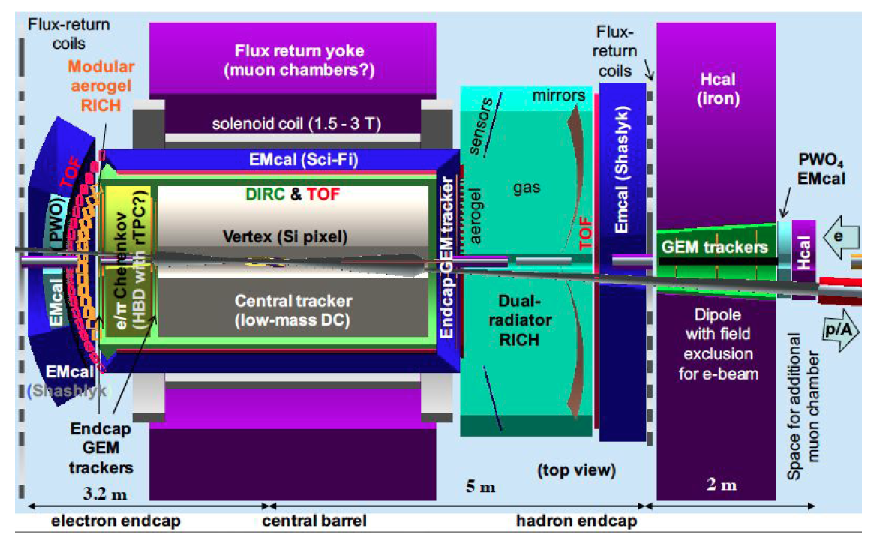
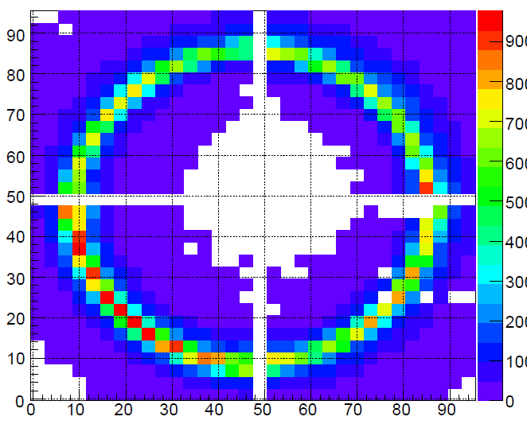
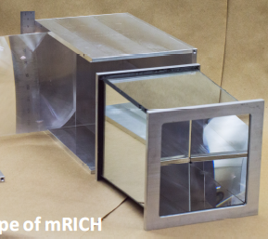
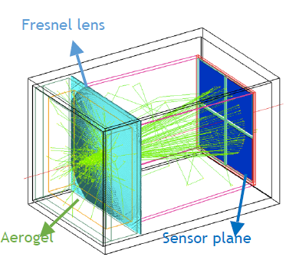
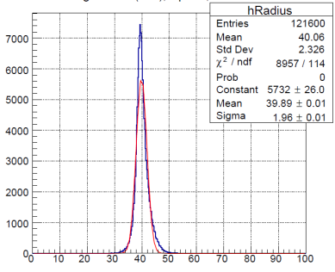
EIC activity
Ricercatori/Tecnologi
Lucherini 0.1
M. Mirazita 0.1
P. Rossi 0.1
CSN3:
apertura sigla 2019 come EIC_net sotto DTZ (5 FTE)
Responsabile Nazionale S. Dalla Torre (TS)
JLEIC detector
(JLab proposal)
R&D activity on the RICH
modular RICH (mRICH): electron end-cap
dual RICH (dRICH): hadron end-cap
Testbeam at Fermilab in 2018 with a prototype of a mRICH, analysis in progress
1 aerogel tile, 4 H13700 and Fresnel lens
RICHIESTE
4k consumo e missioni 2.5k+2k sj per test prototipo dRICH
Ring radius

Slide 26
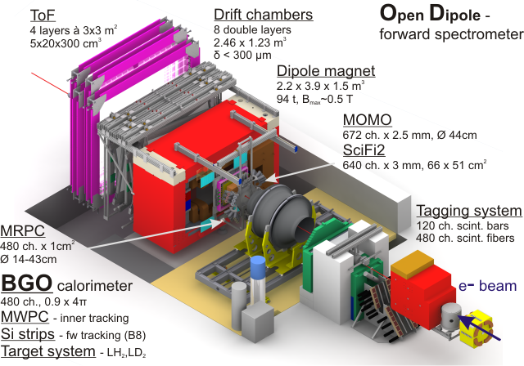
LNF activities
2 researchers for 1.2 FTE
Total INFN ~11 FTE
Nucleon excited states via meson photoproduction at MAMIc (A2@Mainz) and ELSA (BGOOD@Bonn)
Transition form factor
η’ threshold anomaly.
  International collaboration: Bonn PI, Bonn HISKP, (Gießen), ISS, LNF, Messina(not INFN), Pavia, Roma2, Torino, Glasgow, Basel, PNPI Gatchina, INR Mosca, IHENP Kharkov Lamar U. (Texas)
P. Levi Sandri 0.8
D. Pietreanu 0.4
LNF responsibilities (Levi Sandri):
Co-spokesperson BGO-OD
RN
MC coordinator
η’ beam asymmetry and x-sect
hardware responsibilities
BGO (+ Roma2)
Barrel (+ ISS)
MRPC (+ Roma2)

Slide 27
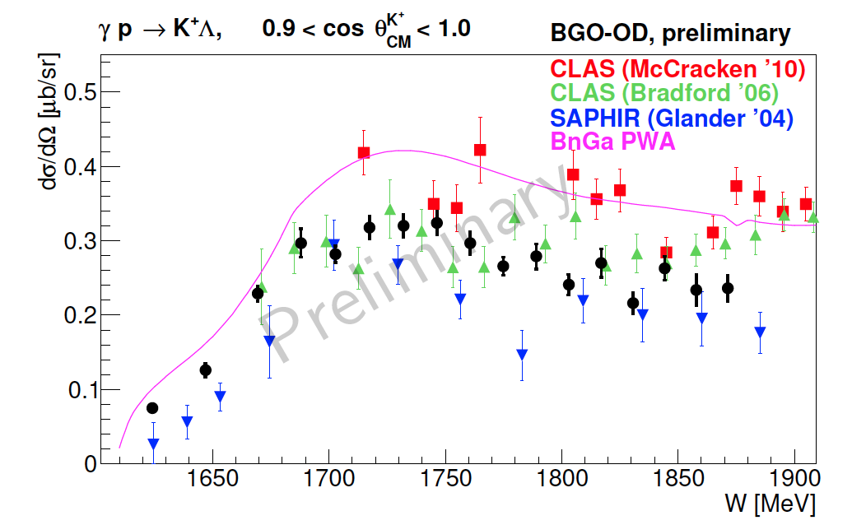
ELSA (Bonn) beamline S - Status
Responsabilità INFN status:
MWPC: Commissioned
MRPC: Final commissioning
Calorimetro e barrel in funzione
MonteCarlo in continuo sviluppo, generatore di eventi
(LNF/Messina/Roma2).
Coordinamento del gruppo di simulazione/analisi (LNF)
Due run di presa dati nel 2018 con bersagli di H2 e D2
Uno/due run di presa dati 2019 (Klystron ELSA da sostituire)
Co-spokesperson dell’esperimento BGO-OD (LNF)
Spokesperson della misura di fotoproduzione η’ (LNF)
Responsabile nazionale (LNF)
(prelim) forward K⁺

Slide 28
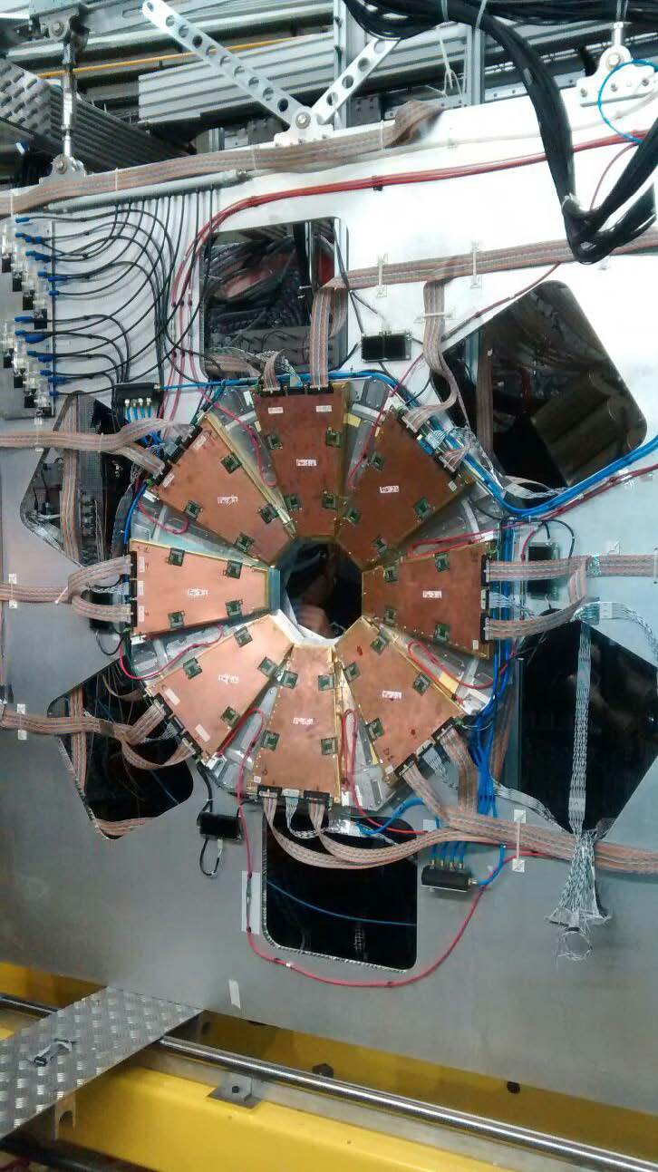
Programma futuro
PI e Università di Bonn garantiscono il funzionamento di ELSA per esperimenti fino a tutto il 2020 (#2 Finanziamenti DFG approvati)
Problema ELSA: un klystron da sostituire ➝ solo 1 run 2019?
2020 richieste 1500 ore di beamtime per completare la raccolta dati su bersaglio di H, D
2021 Li-6, C-12
2022 possibile estensione per completamento statistiche
Richieste economiche complessive 25kEuro :
MI | ME | TRA | INV | C.APP | CON | Totale
2 | 13 | 0 | 0 | 0 | 10 | 25
Richieste ai servizi LNF: nessuna salvo imprevisti

Slide 29
LNF activities
24 researchers for 14.8 FTE
Average participation of 62%
Total INFN ~16 FTE
1. M.Cargnelli 0.5
2. M. Bazzi 1.0
3. M. Bragadireanu 1.0
4. A. Clozza 0.4
5. C. Curceanu 0.7
6. S. Dabagov 0.2
7. R. Del Grande 0.7
8. L. De Paolis 1.0
9. D. Hampai 0.2
10. M. Iliescu 1.0
11. P. Levi Sandri 0.2
12. A. Khreptak 1.0
13. M. Merafina 0.6
14. C. Milardi 0.1
15. M. Miliucci 0.7
16. S. Niedzwiecki 0.5
17. E. Pace 0.2
18. A. Scordo 1.0
19. D. Sirghi 0.7
20. F. Sirghi 1.0
21. M. Skurzok 1.0
22. A. Spallone 0.6
23. O. Vazquez D. 0.5
24. J. Zmeskal 0.5
+ C. Guaraldo
KAONNIS= Low energy kaons interaction studies at Daφne
Integrated initiative (SIDDHARTA + AMADEUS)
Precise measurement of kaonic atoms X-ray transitions and of the charged kaons nuclear interaction processes
  International collaboration: INFN; SMI-OAW (Austria); IFIN-HH (Romania); Politecnico MI; TUM, Helmholtz I. (Germany); RIKEN, Tokyo U. (Japan); Jagellonian U. (Poland); Victoria U. (Canada); Zagreb U. (Croatia) + ELPH Tohoku University & CERN
Spokesperson + ALL Responsabilities in LNF
STRONG2020:
WP8-JRA, WP16-NA, TA3-LNF
Bando regionale SICURA
Croatian Science Foundation research project 8570
20 Publications (2018-2019)
The modern era of light kaonic atom experiments, Rev. Mod. Phys. 91, 025006 (2019)
Prog. di grande rilevanza MAECI:
“Strangeness in the compact stars?”
Italy-Japan 2017-2019
Events (2018-2019)
Symposium, Dec 2018 @ LNF
STRANEX, Oct. 2019 @ ECT*

Slide 30
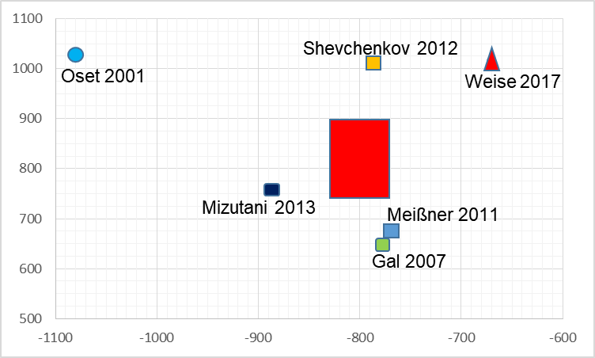
SIDDHARTA-2: aim and goal
To perform precision measurement of kaonic atoms X-ray transitions
-> unique info about the QCD in non-perturbative regime in the strangeness sector not obtainable otherwise ; impact in astrophysics (EOS neutron stars)
Precision measurement of the shift and of the width of the 1s level of kaonic hydrogen and the of kaonic deuterium and of other types of kaonic atoms
Comparison with many different theory models
width [eV]
shift [eV]

Slide 31
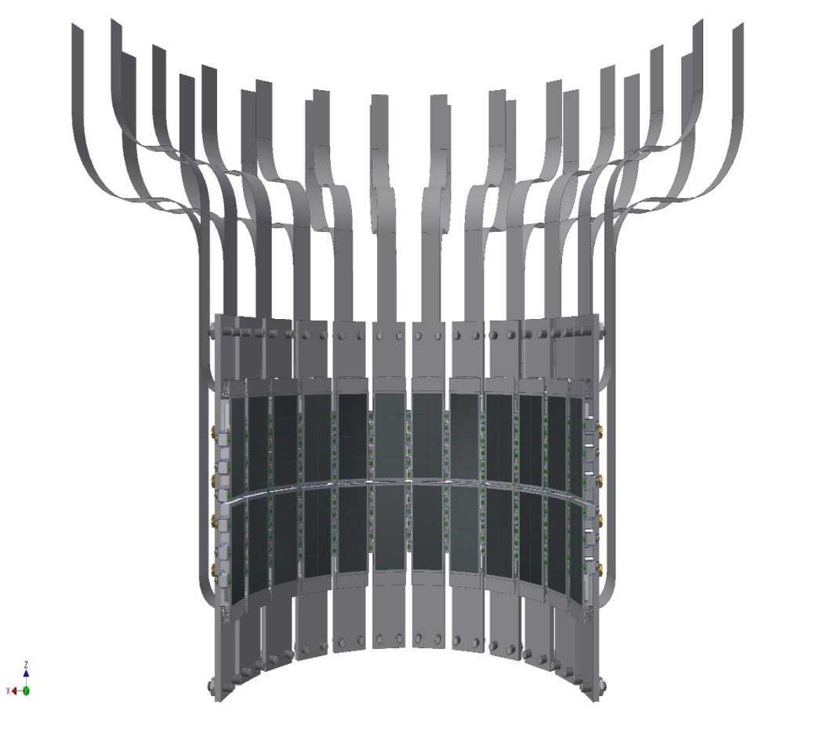
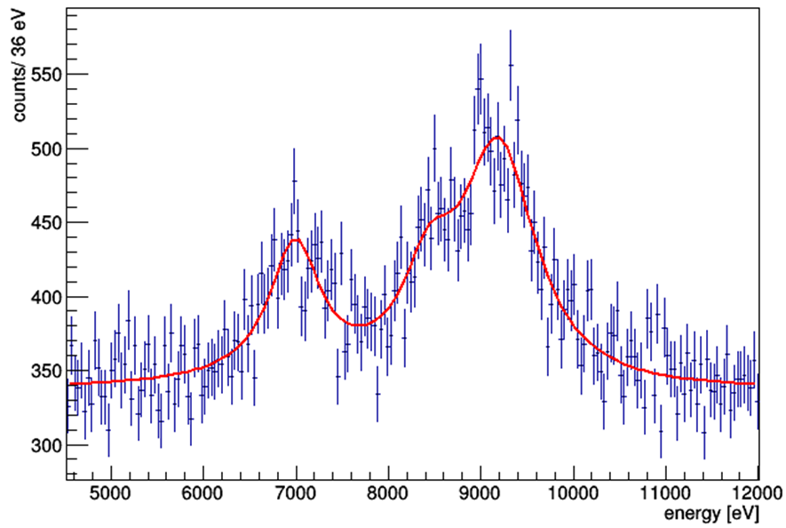
SIDDHARTA-2: phase 1 + phase 2
Phase 1 with SIDDHARTINO (8 SDDs KHe)
Technical run (2019)
  target position 100 mm higher in order to install the DAΦNE luminosity monitor for optimal beam tuning!
  with 8 SDDs (one DAQ bus subsystem)
  with complete Veto I + II
  SIDDHARTA-2 luminosity monitor
  SIDDHARTINO (8 SDD) completely installed in April 2019
  similar beam/background conditions are reached as compared
  with SIDDHARTA (S/B>100) => tested with kaonic helium indicators
achievable precision:
shift: 30 eV
width: 75 eV
K_{high}
K_{β}
Phase 2 with SIDDHARTA (48 SDDs KD)
Physics run: kaonic deuterium run in 2020 (2021?)
final installation in Daφne on 2019 request of 800 pb⁻¹ on tape to perform the first measurement of the strong interaction induced energy shift and width of the Kd ground state (similar precision as K⁻p)
In parallel with SIDDHARTA-2 Kd measurement: feasibility tests for future measurements with Ge and VOXES detectors
K_{α}
QED
Notes:
This window of opportunity should be realized.
Geant4 simulated K⁻d Xray spectrum for 800 pb⁻¹
31

Slide 32
SIDDHARTA-2 future perspectives
Plans for the extension of the scientific program:
4 proposals submitted at ICFA mini-workshop on DAFNE as Open Accel Test Facility (LNF dec.2018):
GeKA => selected Kaonic Atoms with High Purity Germanium detectors
Knscat => Low-energy kaon-nucleon scattering
WiKAMP => kaonic atoms with ultra-high energy resolution detectors
KAHEL => QCD with strangeness
Kaon mass - precision measurement at a level < 7 keV
Kaonic helium transitions to the 1s level
Other light kaonic atoms (K⁻ O, K⁻ C,…) TES -> Japan
Heavier kaonic atoms (K⁻ Si, K⁻ Pb…)
Radiative kaon capture – Λ(1405) study
Investigate the possibility of the measurement of other types of hadronic exotic atoms (sigmonic hydrogen ?)
Alessandra Fantoni – CL preventivi 2020

Slide 33
Richieste 2020 (preliminari)
Richieste finanziarie 120k
Consumo 50 kE
Inventariabile 30 kE
Manutenzione 15 kE
Missioni 25 kE
Richieste ai servizi
Progettazione : 6 m.u. supporteria/schermature più nuovo rivelatore veto; misure test Ge e VOXES
Officina meccanica: 6 m.u. per costruzioni supporterie, schermature, frame nuovo veto, test setup
Tecnici: 2 x 0.5 FTE installazioni e costruzioni varie
Notes:
Richieste finanziarie:
kaonic deuterium run (gas cryo, shielding and degrader optim., maintenance, magazzino, …)
in SIDDHARTA-2 other kaonic atoms measurements, feasibility studies and R&D for new scientific program

Slide 34
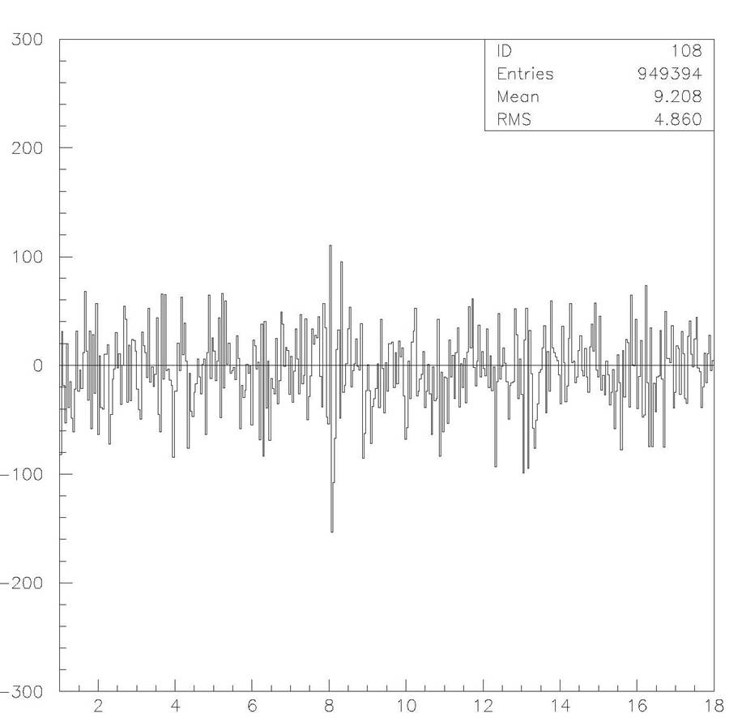
LNF activities
12 researchers for 6.6 FTE
Average participation of 55%
VIP
1. S. Bartalucci 1.0
2. M. Bazzi 0.5
3. M. Benfatto 0.5
4. A. Clozza 0.3
5. C. Curceanu 0.3
6. R. Del Grande 0.3
7. J. Marton 0.5
8. M. Miliucci 0.3
9. E. Pace 0.6
10. K. Piscicchia 1.0
11. D. Sirghi 0.3
12. L. Sperandio 1.0
+ C. Guaraldo 0
VIP=Violation Pauli Exclusion Principle (PEP)
Perform experimental test of PEP for e⁻ with a clean method
Located at LNGS to reduce X-ray background
  International collaboration: LNF, LNGS, Ts INFN; SMI-OAW (Austria); IFIN-HH (Romania); Neuchatel U. (Switzerland); Rennes U. (France); Uni & INFN BO
VIP already established a probability of PEP violation β²/2<4x10⁻²⁹
previous limit <1.7x10⁻²⁶ PLB 328 (1990) 438 => improvement 3 orders magnitude
VIP upgrade (CCD detectors replaced by SDD) : VIP-2 in data taking at LNGS
Other tests of Quantum Mechanics (collapse models)
ALL Responsabilities @ LNF
VIP-2 => new detectors SDD:
higher resolution: 190eV (fwhm)
faster (triggerable)=> VETO system
higher acceptance
higher current => low background
higher efficiency
International Journal of
Quantum Information 9 (2011) 145
Notes:
Spatial resolution 300 um
Acceptance 2.8%
New setup => more compact

Slide 35
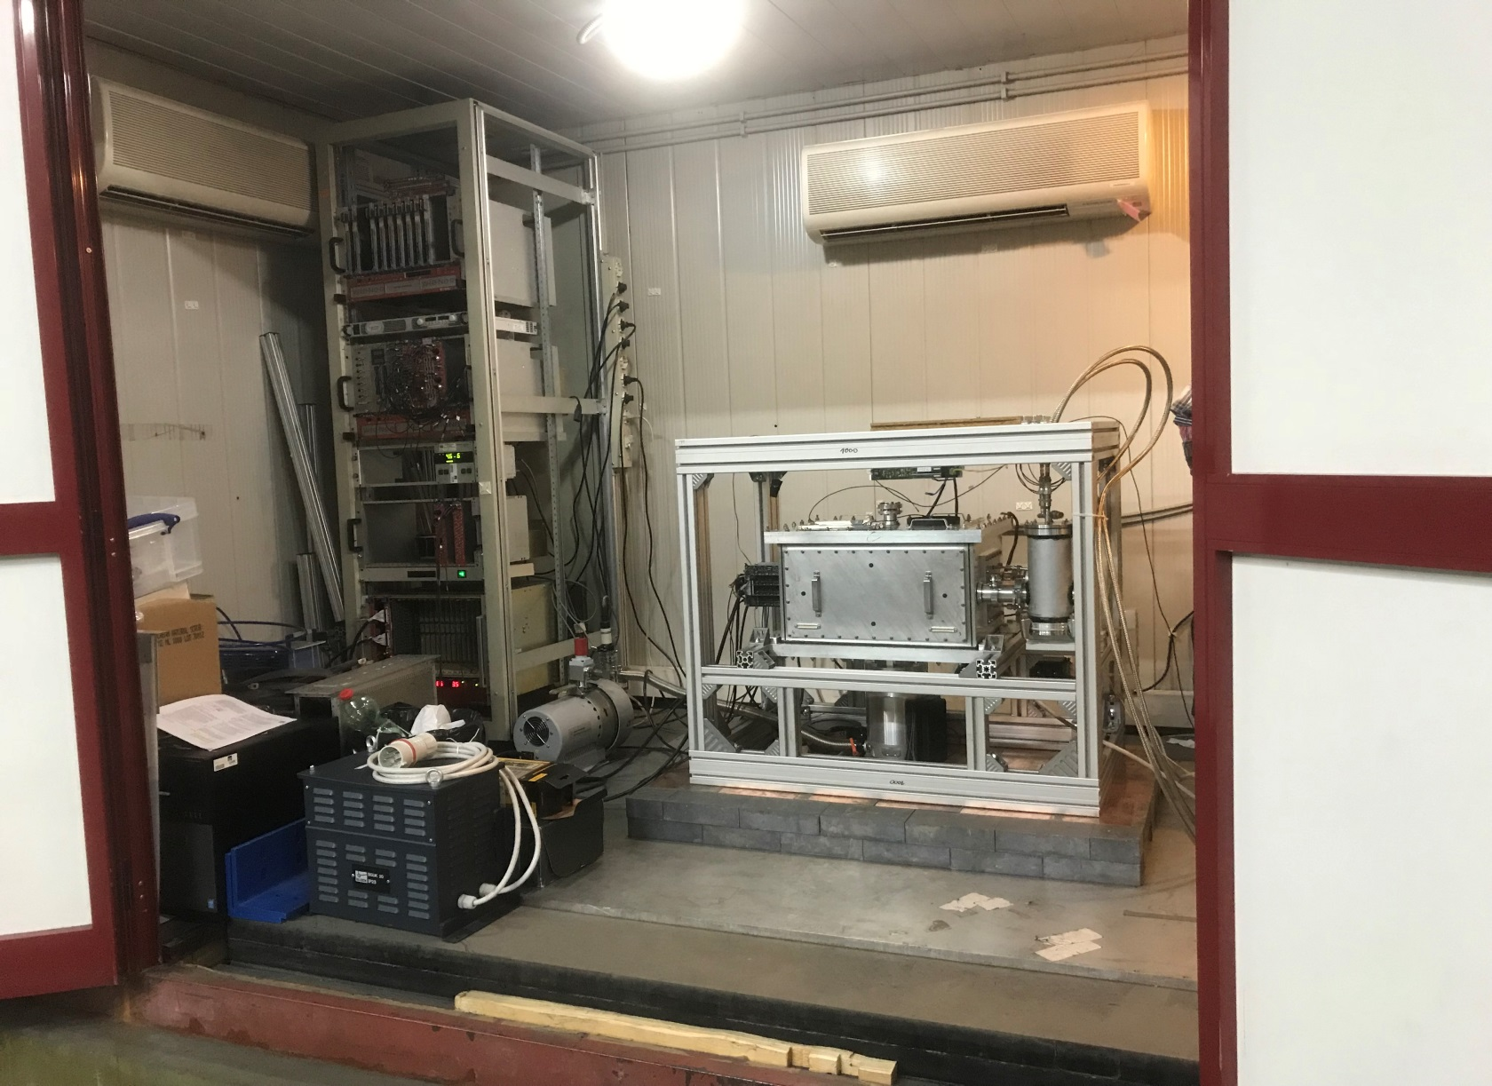
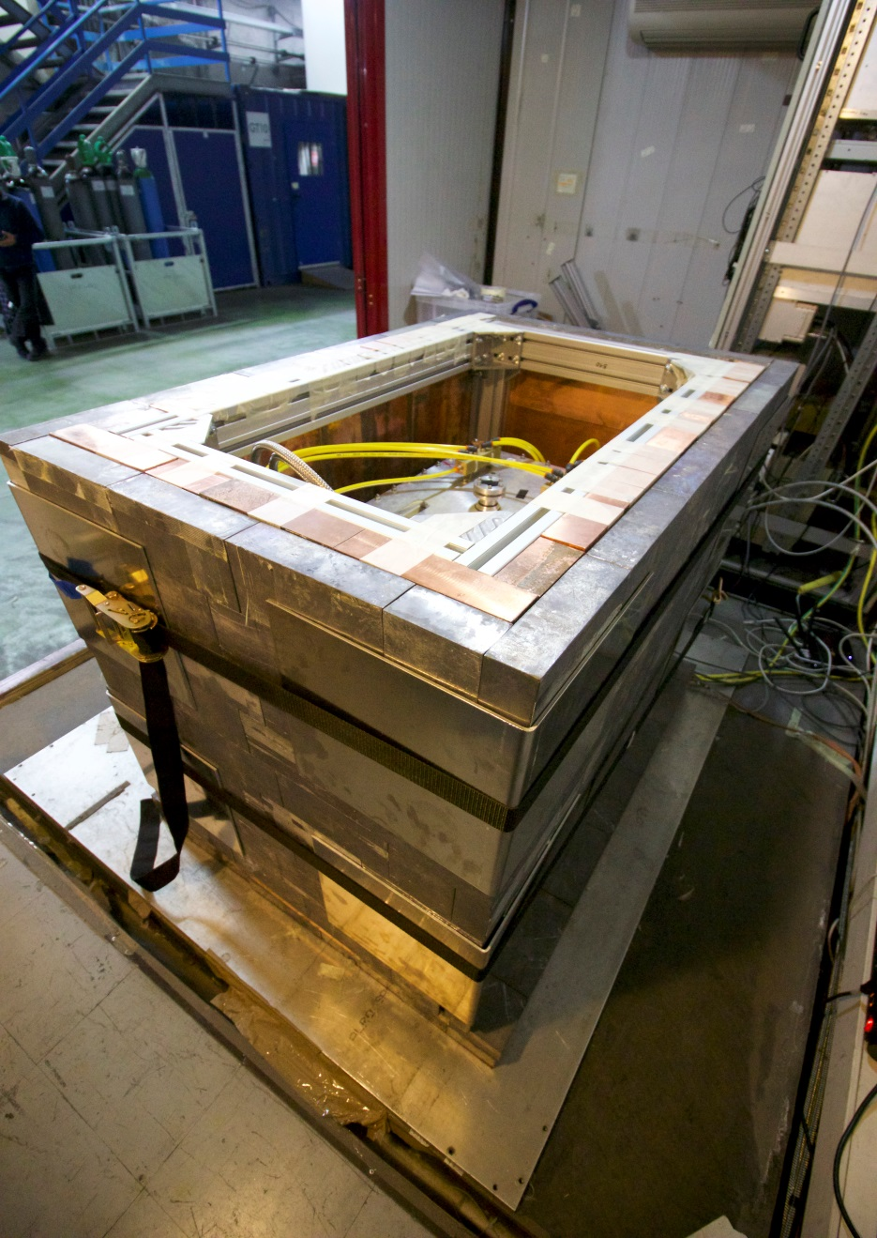
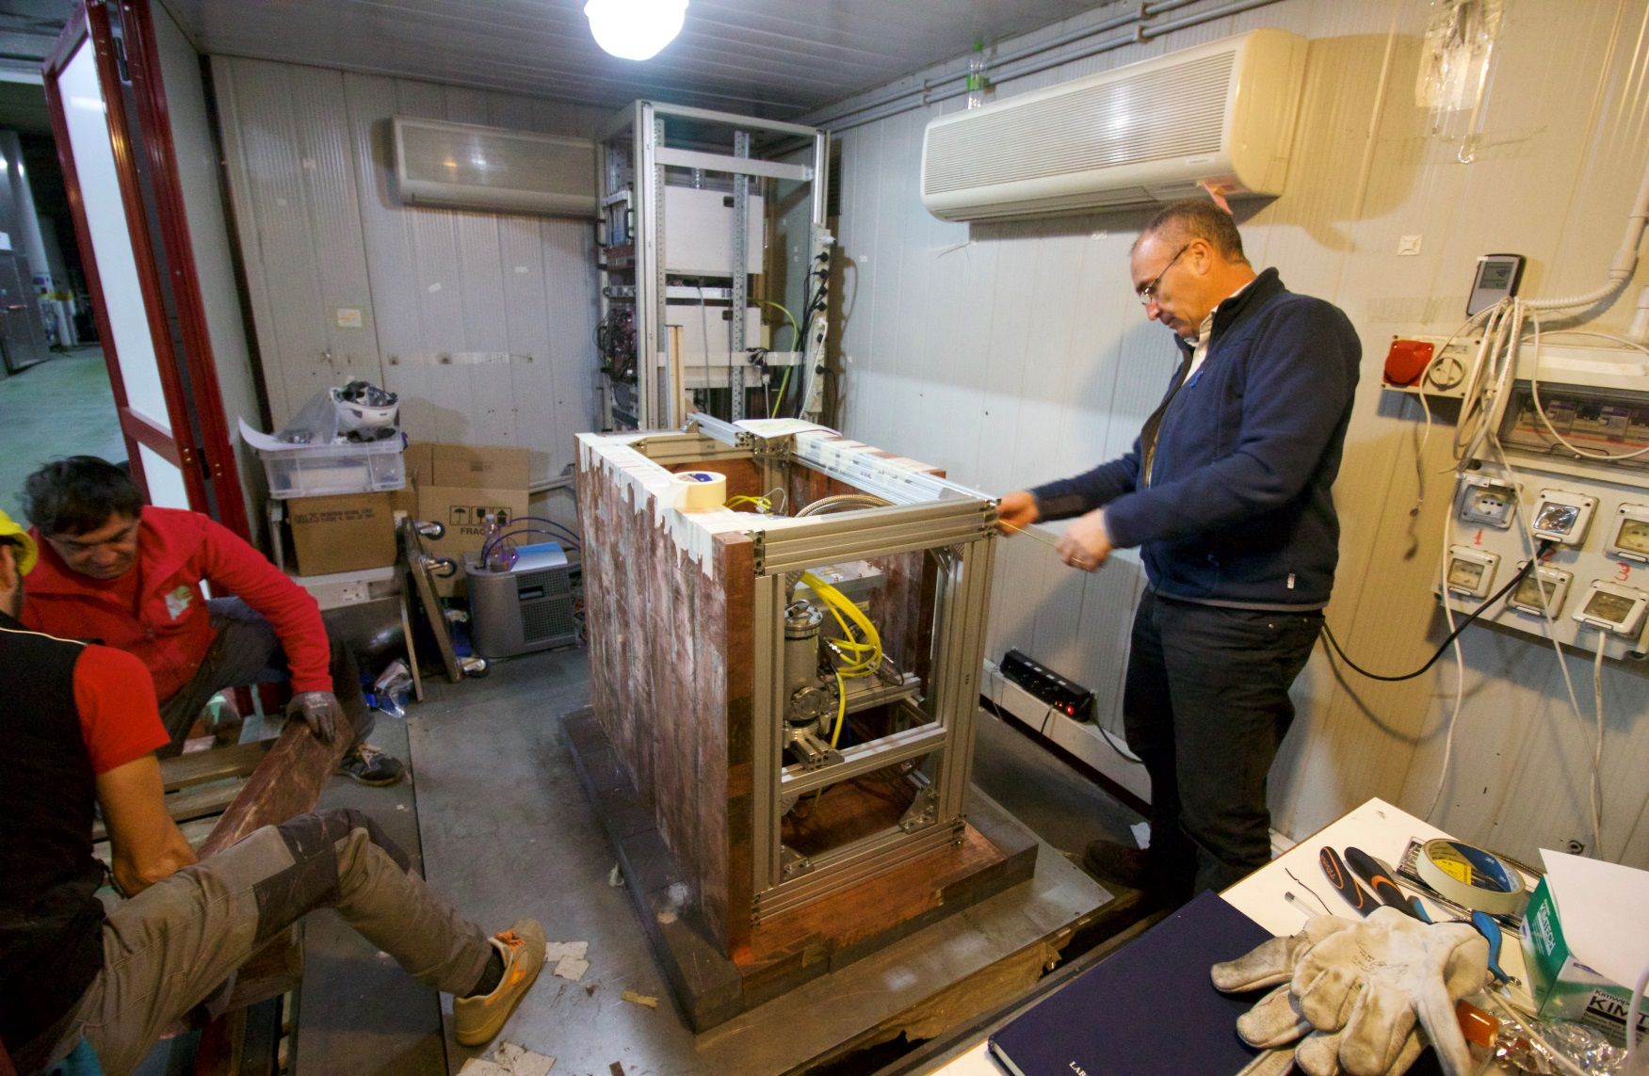
VIP-2 setup and data taking
VIP-2 with 6 SDDs (SIDDHARTA type) installed at LNGS end of 2015 –
data taking (no shielding) till end of 2017
2) VIP-2 with final SDDs (4 arrays of 2x4 SDD detectors) installed at LNGS in
April 2018; test and data taking without shielding till November 2018
3) Shielding installed in November 2018 – data taking ongoing
4) Optimization of the veto system ongoing

Slide 36

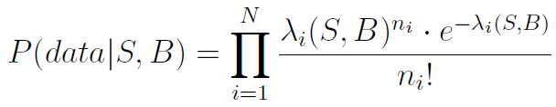
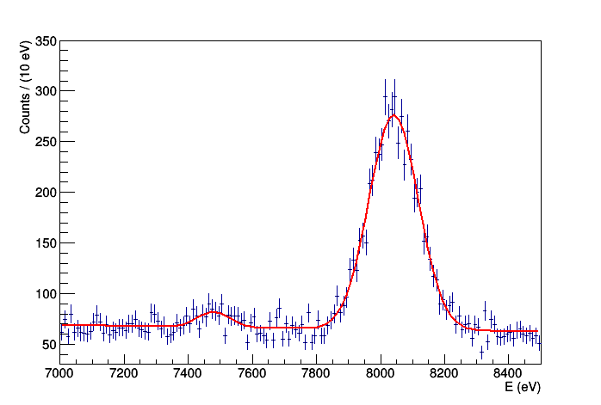
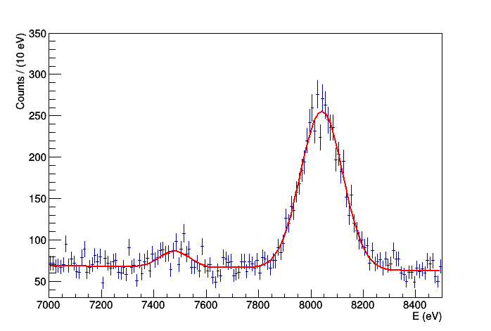

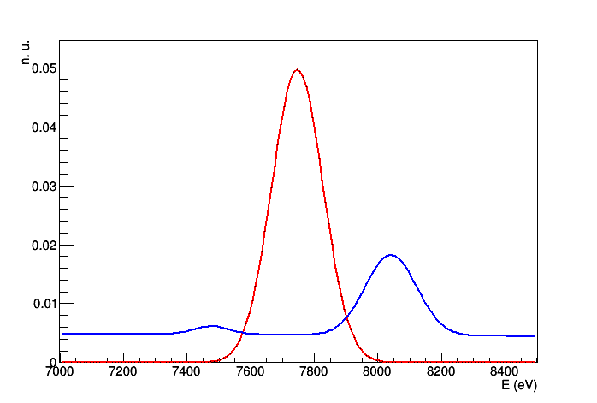
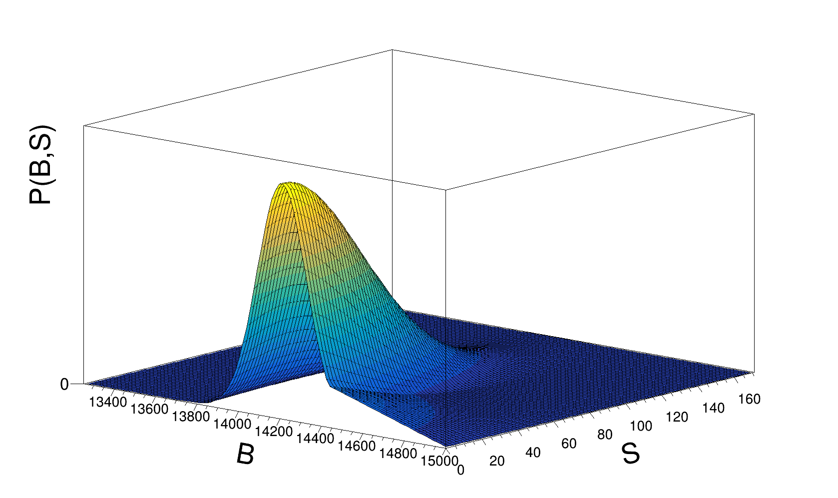
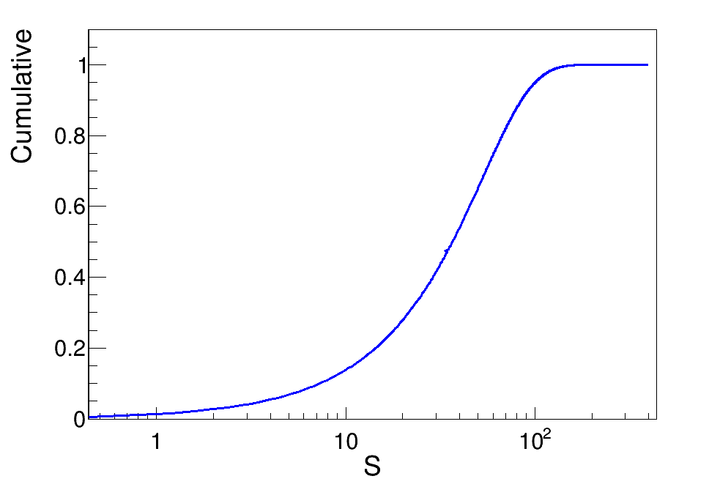
April 2019 – July 2019 Data analysis (shielding)
According to the requirements of the referees improved Bayesian data analysis procedure was implemented:
Likelihood:
Normalised spectrum
without current
Spectrum
with current
PEP violation
transition E
Normalised shape of the background
Posterior calculated with
Markow chain
Monte Carlo techniques
SDD's resolution
Joint p.d.f.
Eur. Phys. J. C (2018) 78:319
preliminary
upper limit on the PEP violation probability (90% Probability):
β ²/2 < 2.6 · 10⁻³⁰
almost one order of magnitude improvement w.r. to VIP

Slide 37
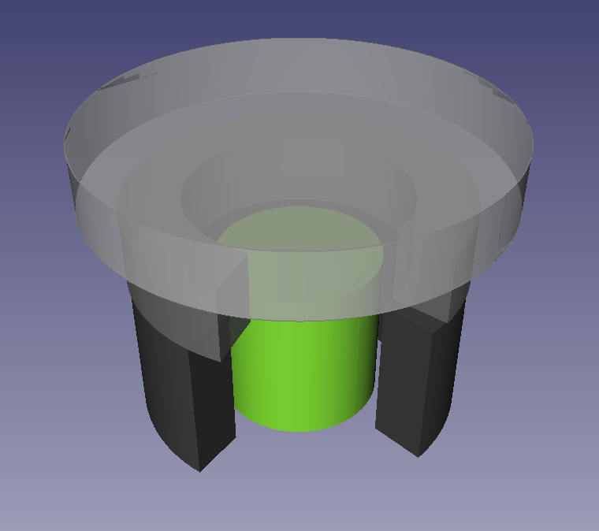



VIP-Lead
High purity Ge detector measurement (M. Laubenstein):
- Ge detector surrounded by roman lead target + complex electrolytic Cu + Pb shielding
- 10B-polyethylene plates reduce the neutron flux towards the detector
- shield + cryostat enclosed in air tight steel housing flushed with nitrogen to avoid contact with external air (and thus radon)
Extremely low bkg in the two ROI regions compatible with the mean bkg: b = 4.4 counts/keV
Paper finalised to be submitted to EPJ C
M. Veith bechelor thesys
La Sapienza
Test of the CSL and gravity-related collapse models
Notes:
Nuovo paradigma modelli quantum gravity da testare senza corrente ma con elettroni di conduzione.
Re-shape completo dell’esperimento
Primo studio di fattibilità, ottimo risultato (4 ordini di grandezza articolo Elliot 2012)
Si può usare anche per modelli di collasso

Slide 38
Future plans - VIP-2 setup (open system)
- Finalize and submit for publication the papers on data analyses up to now (at least 1 paper)
- Study and Optimization of a new veto system (lower threshold – about 50 keV)
- Data taking for 2.5 years -> estimate gain factor 15 from statistics, 4-5 from background, 1.5 - 2 from
higher current (new cryogenic system for target)
- Refined statistical data analyses continued
- Refined calculation electrons path inside bulk material
- Continuation of Monte Carlo simulations and studies for optimization of the run
- Study of cross talk background
Future plans - VIP-Lead or other materials (closed system)
- Finalize and submit for publication the paper on theoretical interpretation and VIP-lead results (at least 1 paper)
Refined data analyses for additional targets: V, Pt, Hf, Ta /existent) and study of the limit of PEP-violation on various materials
10⁻⁴⁵ for non-commutative space-time models
- Intensive collaboration with theoreticians (in particular with Addazi and Marcianò) for the interpretation of the VIP-results
- Studies in Frascati laboratory of a possible setup to test anisotropy effects – quantum-gravity tests
Dissemination activities: presentation of the VIP-2 results in at least 3 events (Workshops/conferences) and in Dissemination
events – such as Open Labs (May 2019) and in talks/seminars at schools.

Slide 39
Richieste 2020 (preliminari)
Richieste finanziarie
Consumo 40 kE
Inventariabile 20 kE
Manutenzione 10 kE
Missioni 25 kE
Richieste ai servizi
Progettazione: 2 m.u. supporteria/schermature upgrade del sistema di veto (lower threshold); HPGe setup per future misure collasso
Officina meccanica: 2 m.u. per costruzioni supporterie, schermature, frame nuovo veto, test setup
Tecnici: 0.5 FTE installazioni e costruzioni varie
39
Notes:
Richeste finanziarie:
VIP-2 run, new veto system optimization (lower threshold), maintenance, magazzino, …
other measurements related to VIP-Lead (Quantum-Gravity) and Collapse Models tests
39

Slide 40



nTOF: Motivazioni Scientifiche
Obiettivo: Sezioni d’urto ad alta accuratezza di reazioni indotte da neutroni per:
Tecnologie Nucleari
(prodotti di fissione &
Materiali strutturali)
n_TOF Italia
22 ricercatori (INFN, Università)
15.5 FTE su 6 sedi INFN
Stretta collaborazioni con ENEA-Bologna, INAF-Teramo, CNR-Bari
Astrofisica
Nucleare
(nucleosintesi)
Reattori di nuova generazine
(attinidi)
Astrophysics
Aperture nuove sigle:
LNF, Pavia, Roma
LNF per:
Beam monitor (area beam dump)
nuovi rivelatori neutroni basati su GEM (Beam4Fusion)
Fisica Medica
Fissione: (n,f)
(attinidi)
Cattura: (n,γ)
Particelle cariche: (n,cp)
Notes:
Nucleosintesi stellare: li elementi più pesanti del Fe si formano attraverso processi di cattura neutronica

Slide 41



Timepix Neutron Beam Monitor at nTOF
nTOF EAR1
Beam image
In 2018 a beam monitor based on 2 Quad Timepixes has been installed in nTOF EAR1
It has been used for the beam alignment and will be used for flux measurements in 2021
We propose to realize a second system in EAR2 for beam alignment

Slide 42

Borated GEM: multiborated head-on converter
The borated GEM was proposed for the first time by Cascade project
but problems on boron deposition stability
and GEM reliability.
In three years several attempts have been made in collaboration with Milano Bicocca, CERN and ESS Liopking
and now a new etching and Boron deposition procedure has been defined
We are assembling a detector for the first characterization.
Good prospective for high efficiency thermal neutron imaging for nTOF.

Slide 43
Financial requests
Ricercatori & Tecnologi
F. Murtas 0.5
G. Claps 0.3 (ENEA)
Pietropaolo 0.2 (ENEA)
Richieste Finanziarie
10 Keuro Beam Monitor (2 quad Timepix, 2 readout system, 2 movable stage)
4 Keuro Thermal neutron detector (nuove GEM Borate 10x10 cm²)
1 Keuro clean room consumable
Richieste Finanziarie Missioni
4 Keuro installatione al CERN
3 Keuro test beam per rivelatore neutroni termali
Richieste LNF Facility: camera pulita nel capannone Gran Sasso

