Slide 1
Monte Carlo simulations and n-p differential scattering data measured with Recoil Proton Telescopes
n_TOF Italian National Meeting, Catania, LNS, 20 June 2019
N. Terranova, A. Manna, C. Massimi

Slide 2
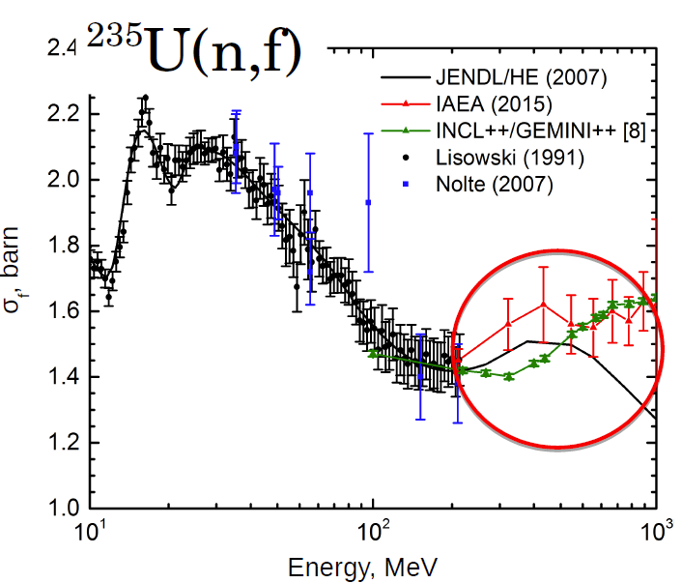
Context
${}_{92}^{235}{U(n,f)}$ cross section is one of the most important standard @ thermal energy and @0.15MeV -200MeV
20-200MeV only few measurements
No data above 200MeV
IAEA demand for fission experiments relative to n-p scattering between 20MeV and 1GeV
From: S. Lo Meo et al., Nucl. Ph. A 933, 43-67, (2015).
Comparison between JENDL/HE evaluation (2007), IAEA evaluation (2015) and calculation using INCL++/GEMINI++.

Slide 3
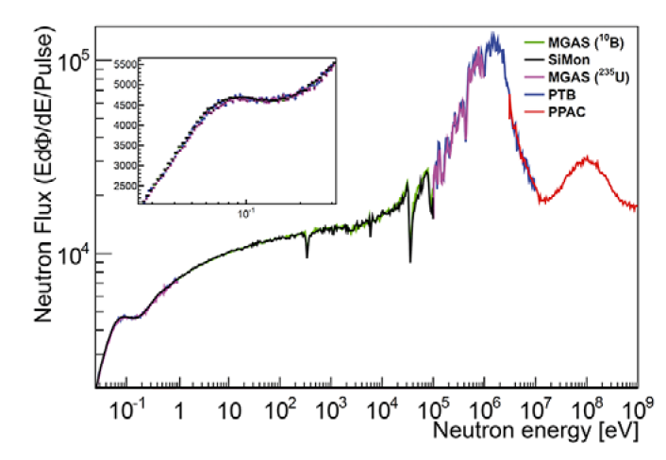
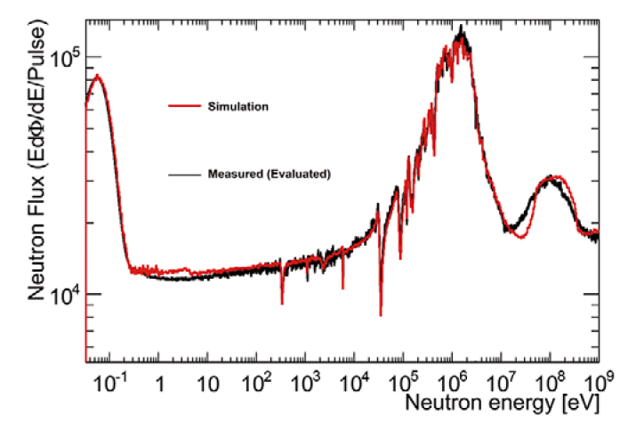
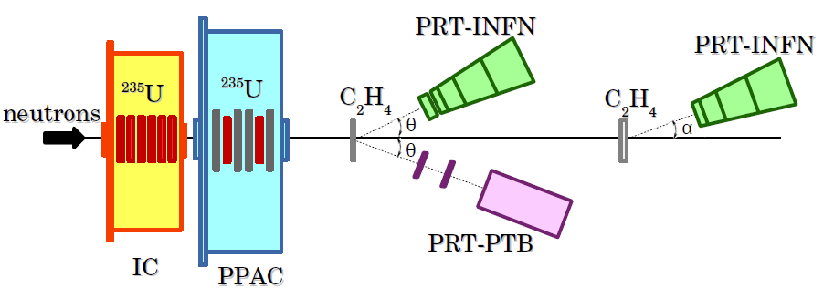
Context (cont’d)
Measurement of the ²³⁵U(n,f) cross section relative to n-p scattering up to 1 GeV at n_TOF:
2 Fission chambers: IC + PPAC
3 Proton Recoil Telescopes (PRT) for n-p scattering (2 on a thin target one on a thick one).
Courtesy of A. Manna
From: M. Barbagallo et al., Eur. Phys. J. A 49, 156, (2013).

Slide 4
Aim of the work
INFN-PRT detectors characterization
Background estimation
Multiple-scattering
Efficiency determination
Uncertainty quantification
A Monte Carlo simulation application has been developed to support the INFN-PRT experimental measurements using the Geant4 toolkit

Slide 5
Outline
PRT description
Monte Carlo application development using Geant4
Preliminary Results
Outlook

Slide 6
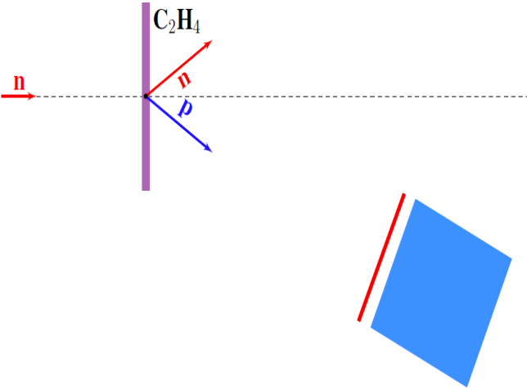
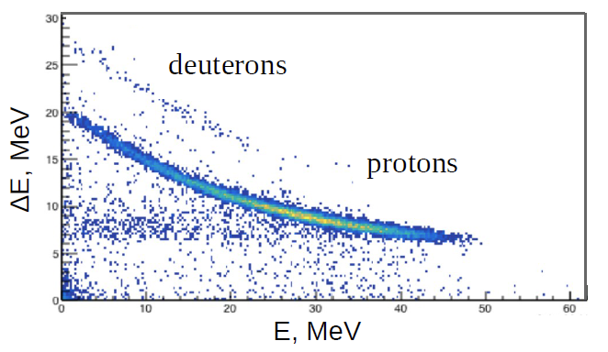
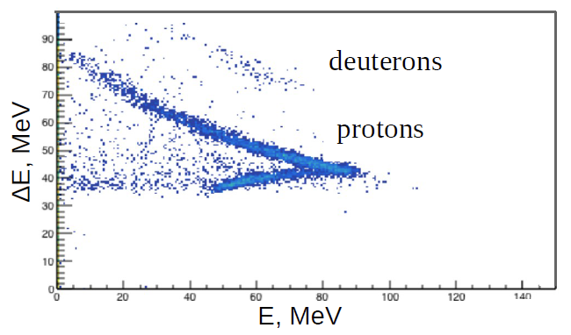
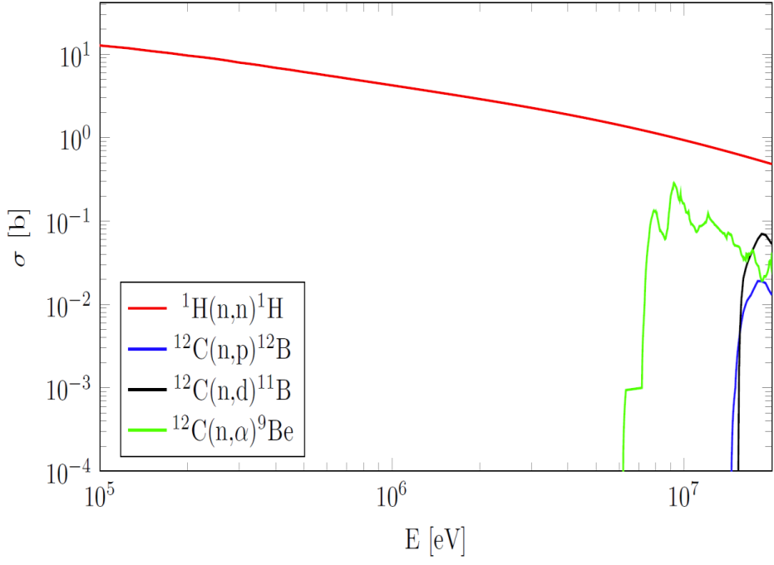
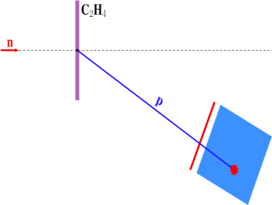
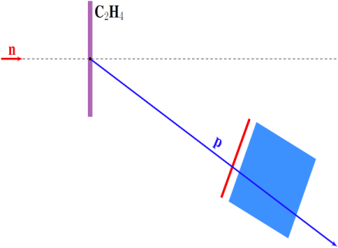
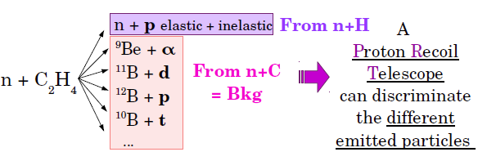
PRT (Proton Recoil Telescope)
Particle discrimination
$$∆E∙E∝k∙z^{2}∙M$$
$k$ : material characteristics
$z, M, E$ : interacting particle properties
$∆E$-detector
$E$-detector
n + p n + p
Pure Hydrogen cannot be used as a target
Polyethylene is used instead (C₂H₄)
n+¹²C —> ⁹Be +a : Q =-5.7; th=6.18 MeV
n+¹²C —> ¹²B +p : Q =-12.6; th=13.6 MeV
n+¹²C —> ¹¹B +d : Q =-13.7; th=14.9 MeV
n+¹²C —> ¹⁰B +t : Q =-18.9; th=20.5 MeV
$$E_{p}=E_{n}\cos^{2}θ$$

Slide 7
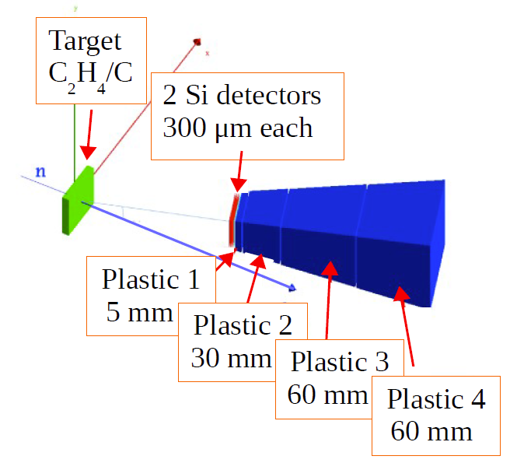
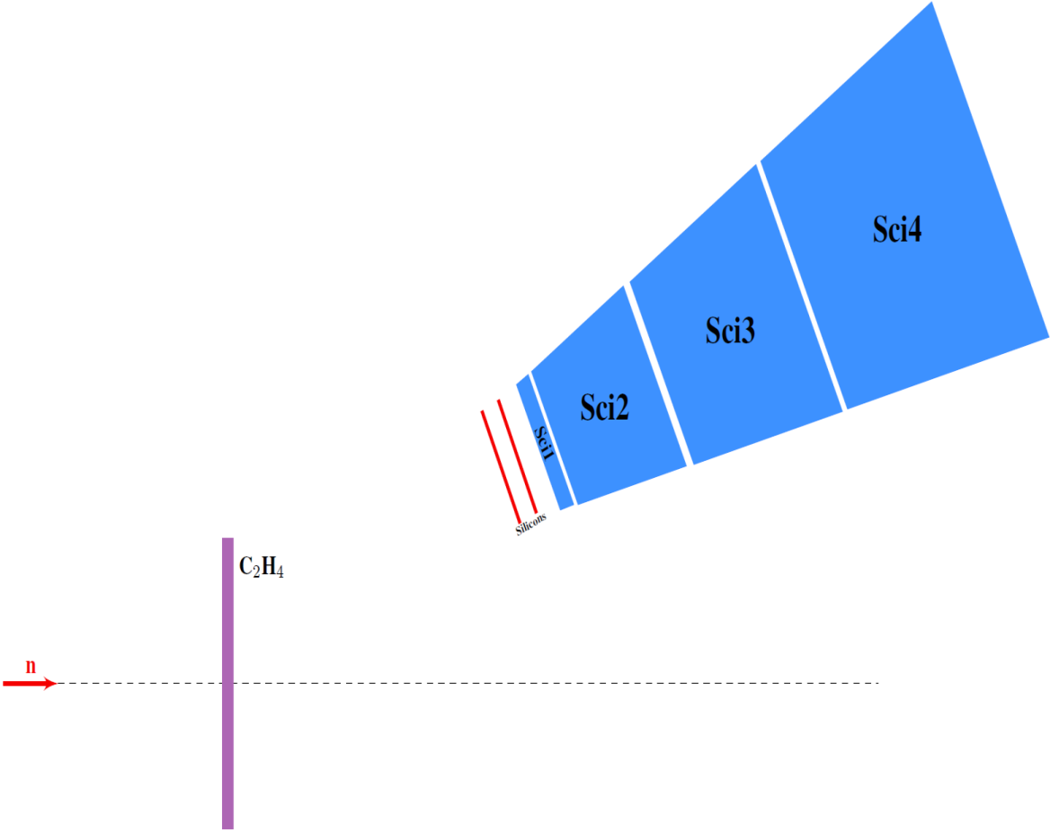
PRT (Proton Recoil Telescope) (cont’d)
INFN-PRT Description
Coincidences:
1° & 2° Silicon -> $E_{n}<15MeV$
+ 1° Scintillator -> $E_{n}=15−35MeV$
+ 2° Scintillator -> $E_{n}=35−70MeV$
+ 3° Scintillator -> $E_{n}=70−130MeV$
+ 4° Scintillator -> $E_{n}>130MeV$
PRT-L
PRT-H towards the thick target is identical, without Si detectors

Slide 8
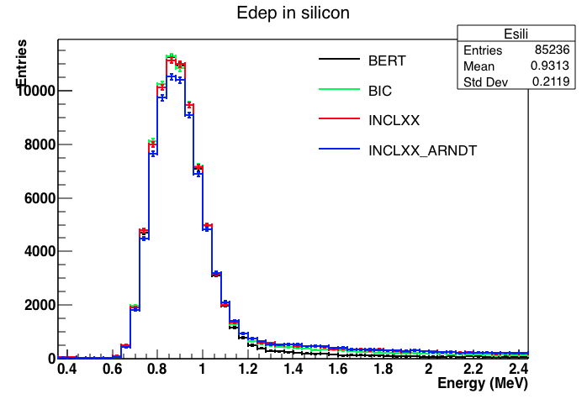
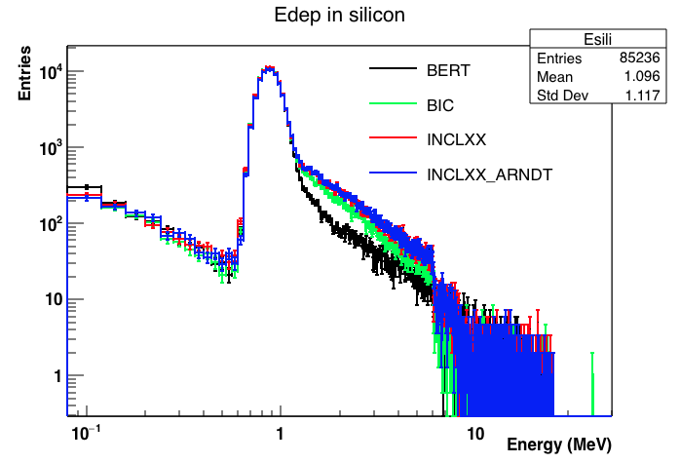
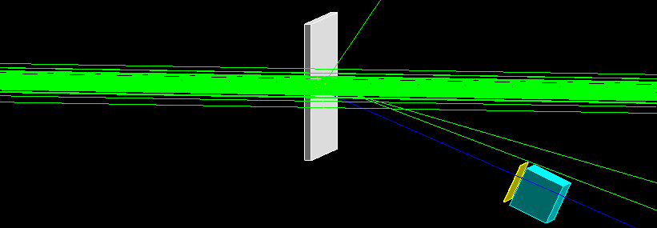
Physics Lists (PL)
n-p scattering Arndt Evaluation: NEANDC/INDC standard for x-sec measurements 20-350MeV
SIMPLIFIED GEOMETRY:
0.5cm thick sample
Si 3x3x0.03cm³ Sci 3x3x3cm³ @16cm (gap 2cm), angle -25°
New Elastic Scattering Model (custom) -> forces Arndt 1998-evaluation data (tables between 10 and 1200MeV) for n-p scattering only
n@50MeV
10⁹ neutrons
Gaussian profile ($σ$=0.5cm)
Polyethylene (H or C, see in the following)
Simple $∆E∙E$ detector (Si + plastic scintillator)
Drawback: INCL++ and Arndt slow down the calculation :
+10% in CPU time for INCL++ vs BERT
+13% for INCL++/Arndt vs BERT
(1E8n, simplified geometry, single thread)
In the PLs ARE DEFINED BY THE USER (app. developer) AND THEY ARE PROBLEM-DEPENDENT

Slide 9
Carbon contribution preliminary estimation
Physics List | Any particle | Protons | Deuterons
BERT | 76700+/-300 (7830) | 76200+/-300 | 450+/-20
BIC | 82600+/-300(85200) | 82100+/-300 | 430+/-20
INCLXX | 85800+/-300(89200) | 83600+/-300 | 1970+/-40
C₂H₄
Physics List | Any particle | Protons | Deuterons
BERT | 6790+/-80 | 6120+/-80 | 610+/-30
BIC | 13700+/-100 | 13100+/-100 | 530+/-20
INCLXX | 17600+/-100 | 14900+/-100 | 2500+/-50
C
Physics List | Any particle | Protons | Deuterons
BERT | 71583+/-300 | 71566+/-300 | 2+/-1
BIC | 71582+/-300 | 71538+/-300 | 19+/-4
INCLXX | 71600+/-300 | 71581+/-300 | 6+/-3
H
SIMPLIFIED GEOMETRY
n @50MeV
Threshold 200keV

Slide 10
Monte Carlo simulation development for detector characterization
Geometry:
Angle: 25,07°
Si in a $156μm$-thick case made of Aluminum
Frontal Al foil of $30μm$
Plastic (polyvinyl-toluene) scintillators wrapped in Mylar and Teflon cases (not visible)
Neutron beam in air
Slabs of Polyethylene and Carbon (10x10cm) of different thicknesses
No surroundings

Slide 11
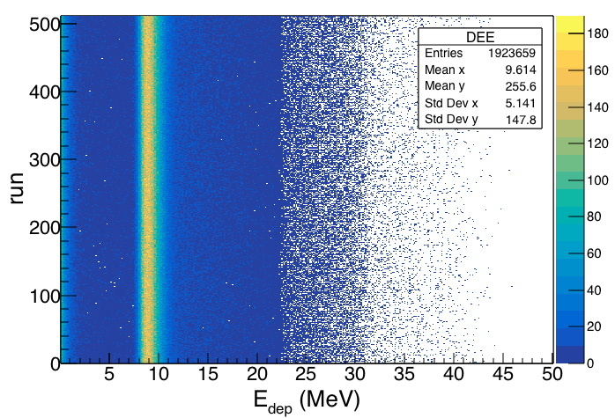
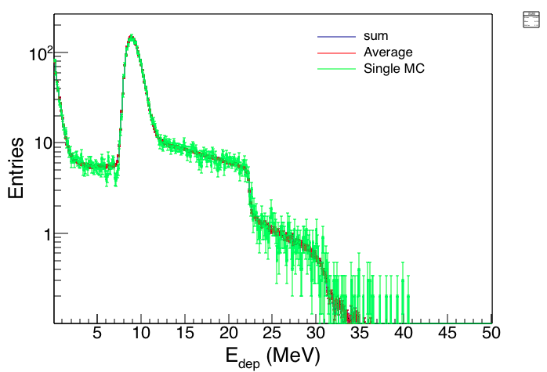
Statistical considerations
512 runs
A single thread simulations -> not feasible, or poor FOM (Figures of Merit)
Multi-thread simulations are necessary, but they can take days
E.g. 25000 entries (in coincidence Sci1+Sci2, any particle) for 10⁹ neutrons @50MeV
Due to limited execution time for a single job:
Parallel simulations using MPI
C++11 std::seed_seq used to initialize Ranecu engine
Batch averages
$E_{dep}$ in the first Scintillator

Slide 12
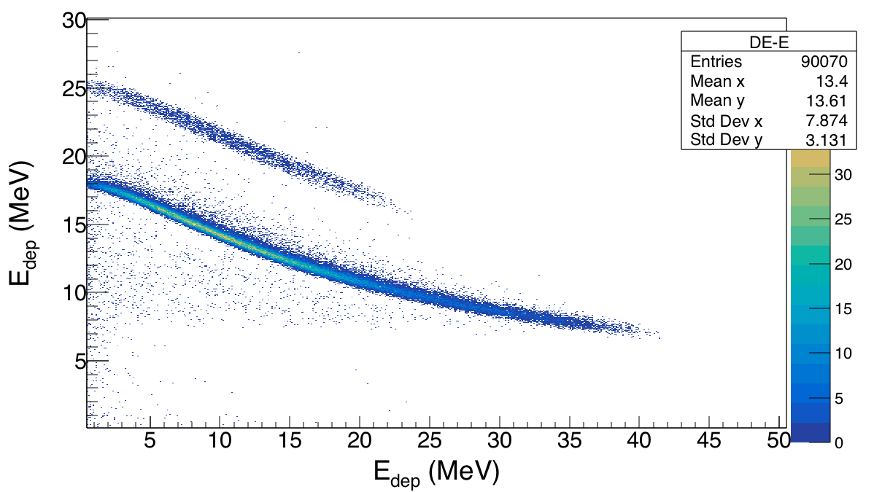
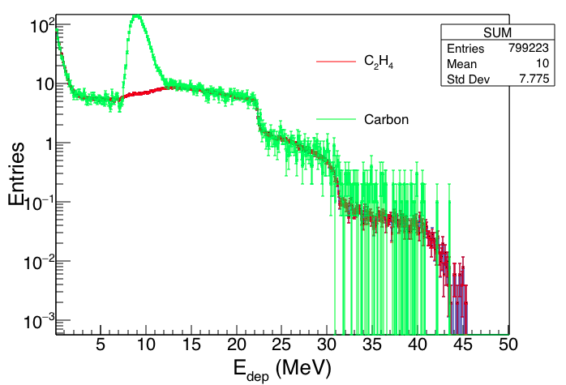
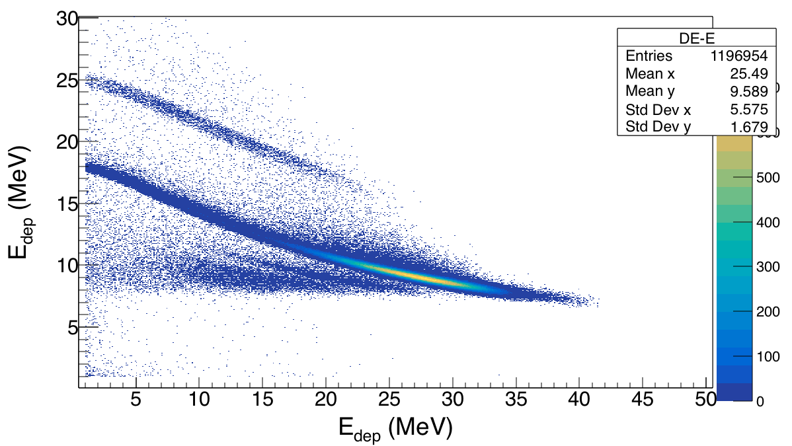
Preliminary background calculations
To estimate background due to reactions on Carbon (C2H4)
Carbon target of equivalent thickness
n@50MeV
Carbon
C₂H₄
First scintillator
$$∆E_{3}−E_{4}$$
3-first sci
4-second sci

Slide 13
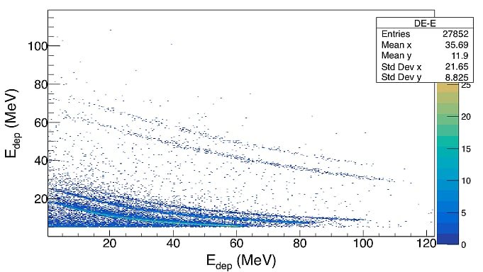
Preliminary background calculations (cont’d)
Backscattering from the second (thicker) target on the first
Background on PRT-L is negligible according to preliminary estimations. (n@50MeV)
From the first (thinner) target on the second PRT-H telescope:

Slide 14
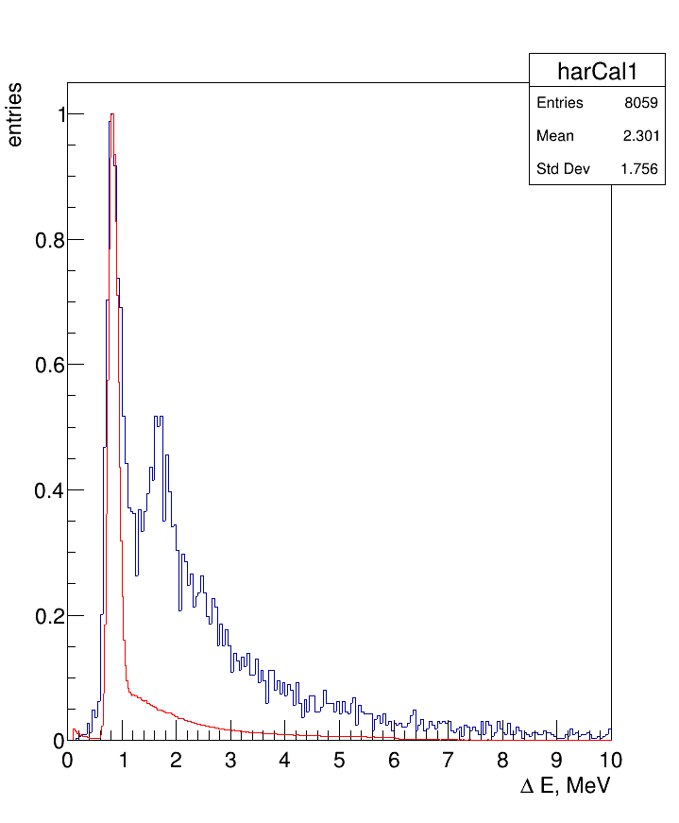
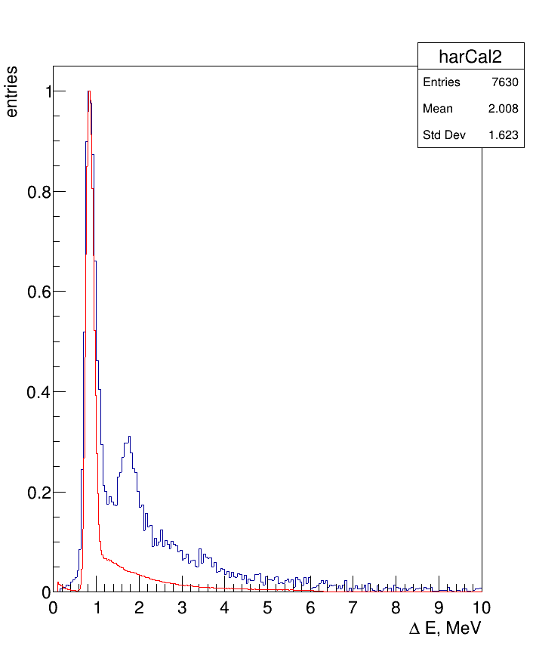
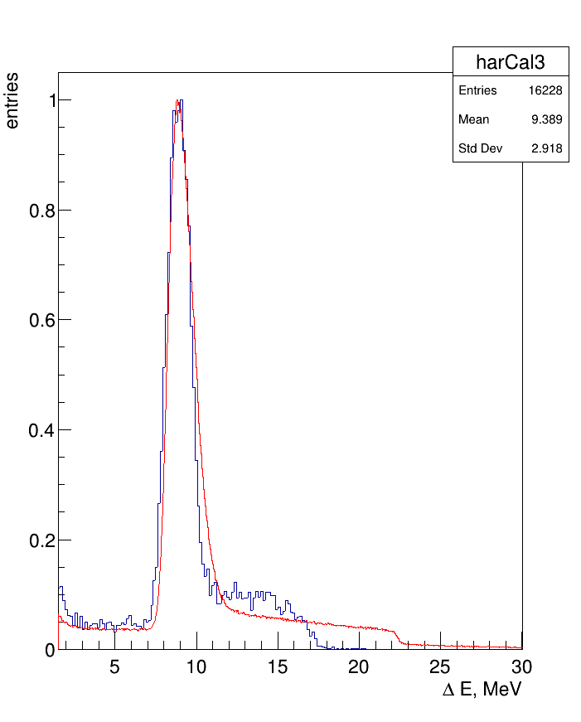
Comparisons to experimental data
n @ 48-52MeV
MC
Exp
First silicon
Second silicon
First scintillator

Slide 15
Cluster upgrade at Cloud@CNAF
Old machine: 16 cores, 8 Gb RAM, 10Tb Storage @Tier1
UPGRADE:
4 identical machines
In total: 64 (16x4) cores, 32 (8x4) Gb RAM, 10 Tb Storage @Tier1
+ 1Tb shared storage at Cloud@CNAF

Slide 16
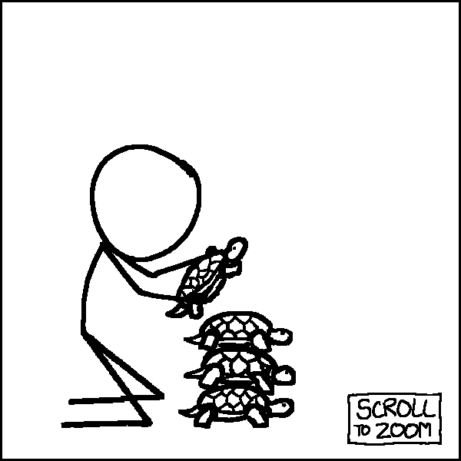
Computational needs
Rough calculation:
E=100-200MeV:
20 points, 2 samples, 2 thicknesses, 2 detectors (H-L) = 160 simulations;
MPI: 160 x N=64(?, optimistic) = 10240
10240 x 2h (roughly for 1E8 n, maybe less) = 853 CPU-days
853 / 64 (unrealistic) = 13,3 days
Ok, let’s say 26 days -> 1 month (real time)

Slide 17
Discussion with PTB Summary by E. Pirovano
Simulation 1: explaining why the telescope was built as it is, giving the detection limits (minimum detected energy, punch-through) / like the SRIM calculations but more proper - pencil beam of p, d, alphas, parallel to the telescope axis - energy uniformly distributed from 10 MeV to 500 MeV
Simulation 2: detection efficiency for protons (and deuterons) - beam of p, d; Gaussian profile with sigma=0.5 cm; emission uniform on the 4 pi (or uniform in the solid angle covered by the telescope) - telescope at 25 degrees (20 degrees) - same as the October campaign - energy uniformly distributed from 10 MeV to 500 MeV
Simulation 3: “real” efficiency (np cross section included) - neutron beam; distribution as per the n_TOF official flux - CH2 radiator + comparison with the experimental data (CH2 data, not corrected for the carbon)

Slide 18
Conclusions and Outlook
Geometries for both telescopes are completed and outputs can be printed on a root file
Simulations are ongoing, scheduling future simulations
Comparison to MCNP ?
New machines at Cloud@CNAF, new users ?

Slide 19
THANK YOU FOR YOUR ATTENTION
nicholas.terranova@enea.it

Slide 20
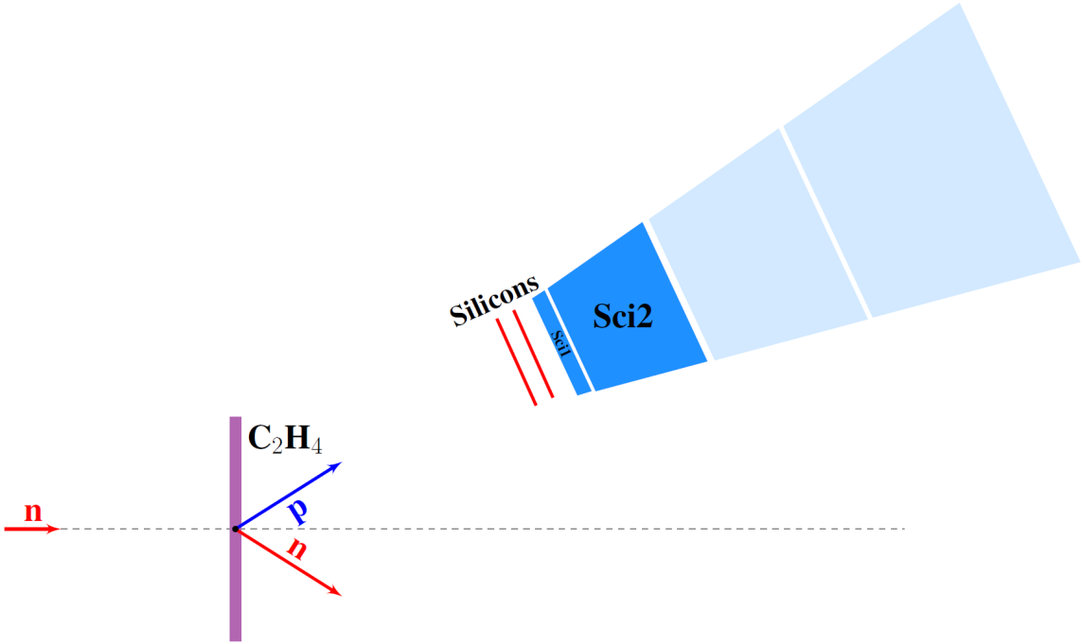
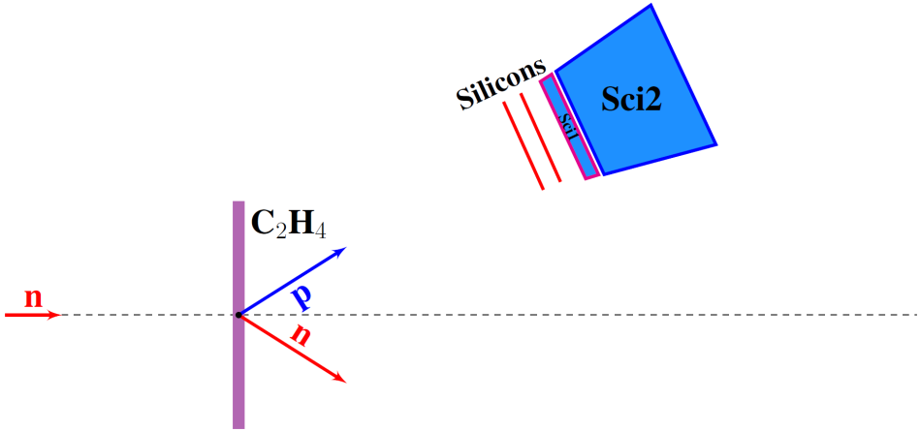
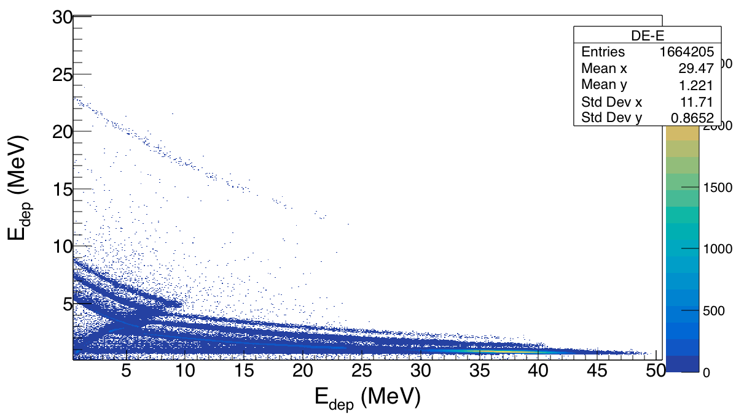
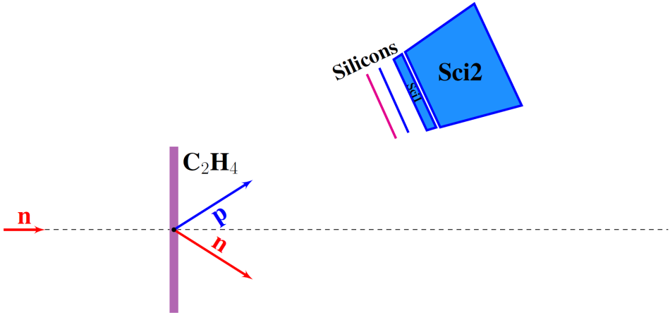
PRT detector characterization Particle identification capability
Reactions on Carbon -> secondary particles (background)
MULTI-STAGE DETECTOR
$α$ particles

Slide 21
Carbon contribution preliminary estimation
C₂H₄
C₂H₄
protons only
C
C
protons only
H
H
protons only

Slide 22
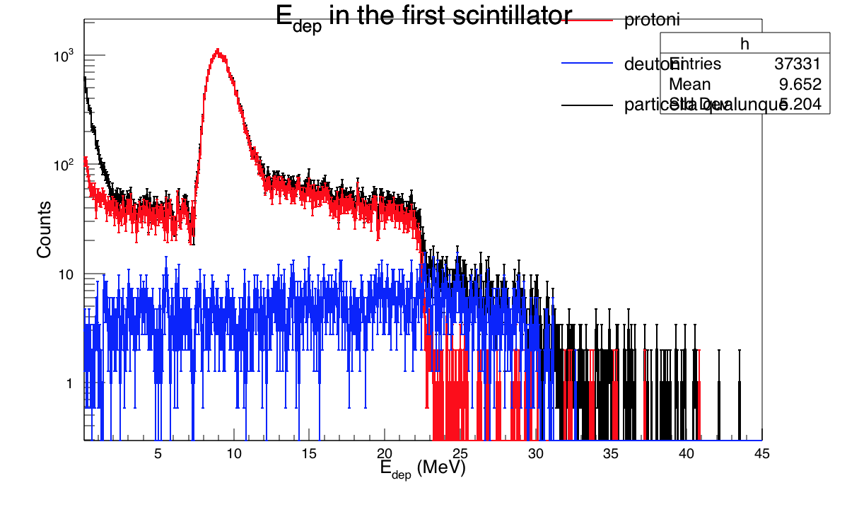

Slide 23
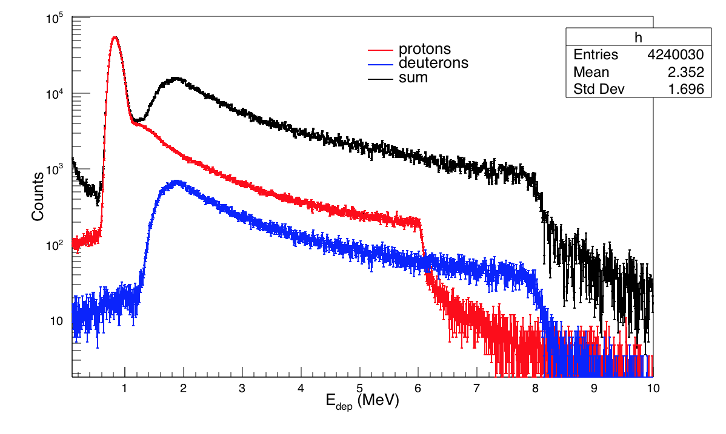

Slide 24
