Slide 1
Timepix and Beam monitor
F.Murtas
INFN - Laboratori Nazionali di Frascati and CERN
Timepix as user friendly silicon detector
Installation of Timepixes and Timepix3 in Ua9-SPS at CERN
Instrumentation for extracted beams
nGEM : a gas chamber for thermal neutron high efficiency

Slide 2
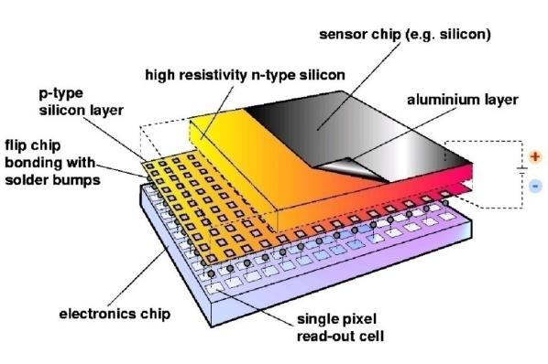
Hybrid Silicon Pixel Detectors
Standard CMOS can be used allowing on-pixel signal processing
Sensor material can be changed according to the application(Si, GaAs, CdTe..)
Notes:
Mention signal generation Add X section?

Slide 3
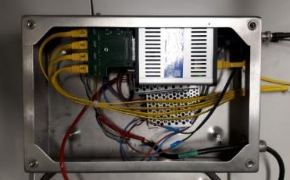
The UA9 SPS experimental setup 2018
~ 44 m
~ 6 m
~ 43 m
~ 85 m
Crystal
1 2
2 Timepixes
Crystal
3 4
Collimator
Graphite 1m
1 Timepix3
2 Timepixes
RP0
RP1
RP3
Beam Pipe
QF 52210
QF 52010
QD 52310
Primary Beam
QD 52110
Absorber
Absorber
W 60cm
Absorber
W 100cm
IHEP
GONIO1
RP0
IHEP
GONIO2
RP1
CpFM
RP3
BLM
BLM
Collimator
Graphite 1m
BLM
BLM
BLM
BLM
BLM
M
L
B
1 Timepixes
We doubled the number of Timepix detectors
A third Roman Pot was installed on
January 2018 with 2 Timepixes
A new Timepix3 has been installed in June
on Roman Pot 1 external side
Katrine readout of Timepix3
(P. Burian)

Slide 4
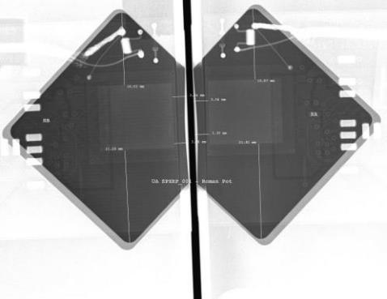
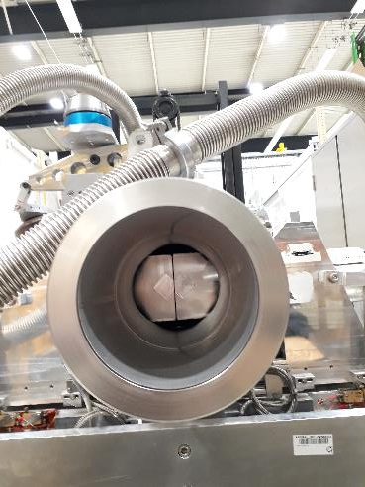
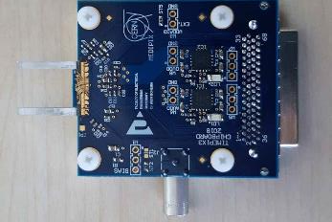
Old Roman Pot
New design
of Timepix board

Slide 5
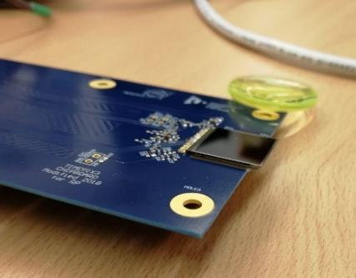
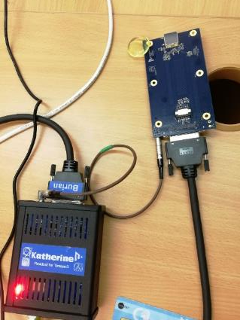
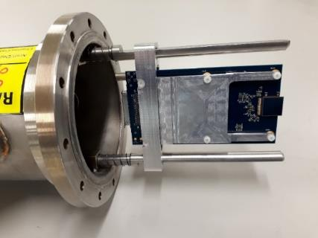
The UA9 detectors : Timepix3
Based on silicon sensor 300 μm thick 14x14 mm² active area (2 cm²)
Chips provided by Medipix Collaboration
Timepix3 board designed and built by University of West Boemia and IEAP in Prague
Also the holder was realized by the same group
designed also for the chip heat extraction
Data acquisition with time frame and continuous
  1.56 ns resolution
  charge and time at the same time
Possibility to read the beam without dead time
(Data Driven Mode)
Petr Burian (Technical Coordinator)
Pavel Broulím (HW designer)
Lukáš Pušman, (mechanics designer)
Benedikt Ludwig Bergmann (data evaluation)
holder
Timepix3 data acquisition system

Slide 6
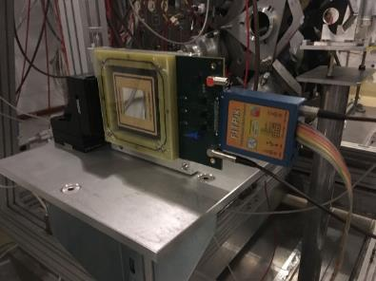
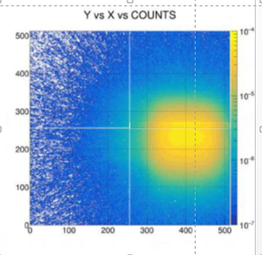
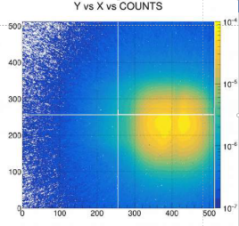
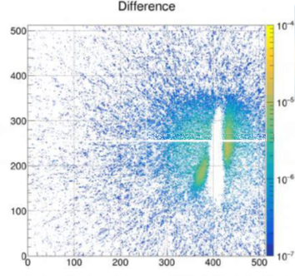
TimepixQuad detector for test on beam extraction
Without any object
on the beam
Crystal in VR
+ septum
subtraction
We have used two quads as beam monitor near the crystals
in counting mode for studies on beam extraction
Image subtraction
Volume
Reflection
Chanelling
F.Murtas, A. Natochi, W.Scandale

Slide 7
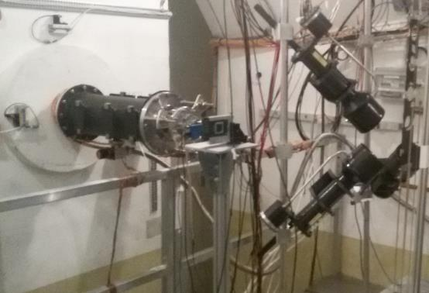
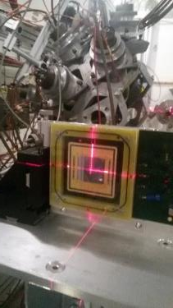
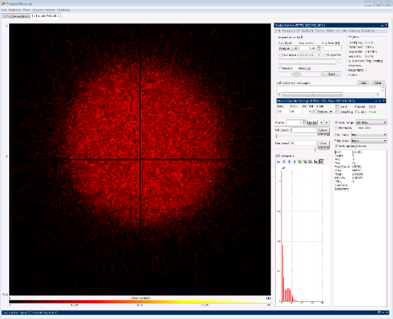
Measurements on neutron beam (nTOF@CERN)
There is a big interest in the Neutron Spallation Source
for a good monitoring of beam position and intensity
The Timepix-quad has been recently
used for the beam alignment at nTOF faclity at CERN

Slide 8
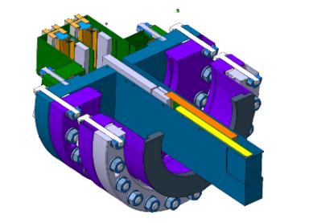
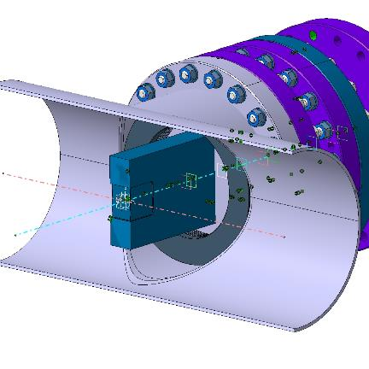
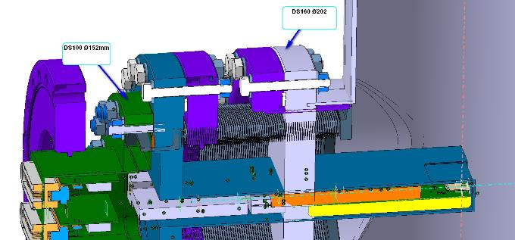
New design
New Roman Pot
Structure
Vacuum chamber

Slide 9
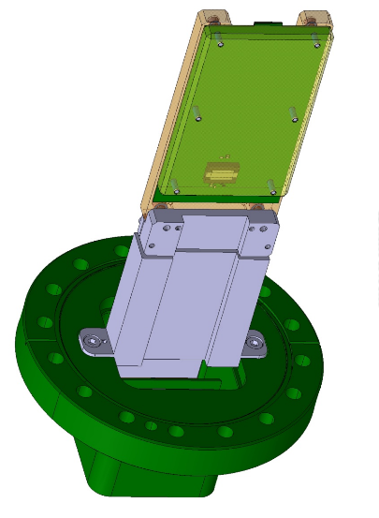
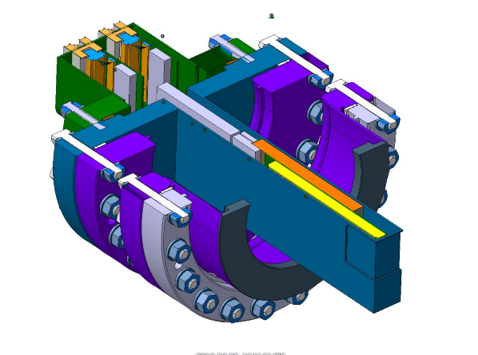
New Roman Pot
Feed Through
New Roman Pot
Structure
Timepix Board

Slide 10
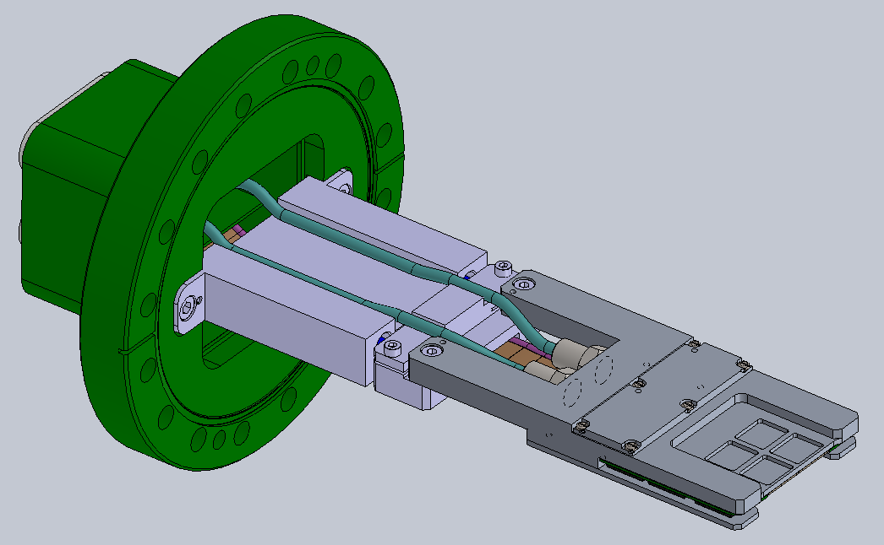
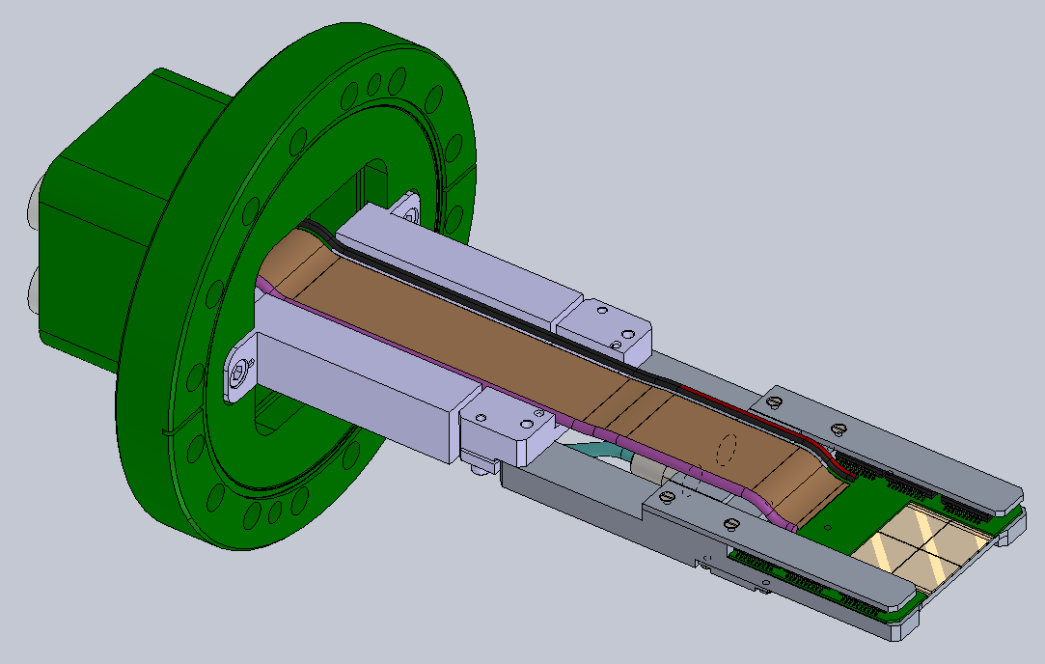
Timepix for BIM

Slide 11
Beam Monitor
for thermal neutron

Slide 12
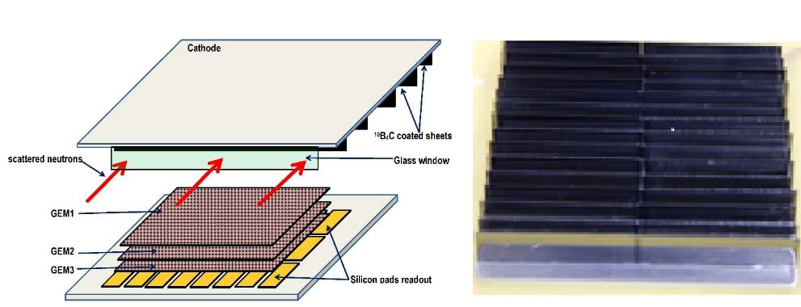
The side-on nGEM detector
Borated Slides
α
THERMAL NEUTRON
1 mm
2 mm
1 mm
Borated Slides
Detector cross section
30% neutron detection
efficiency at 25 meV

Slide 13
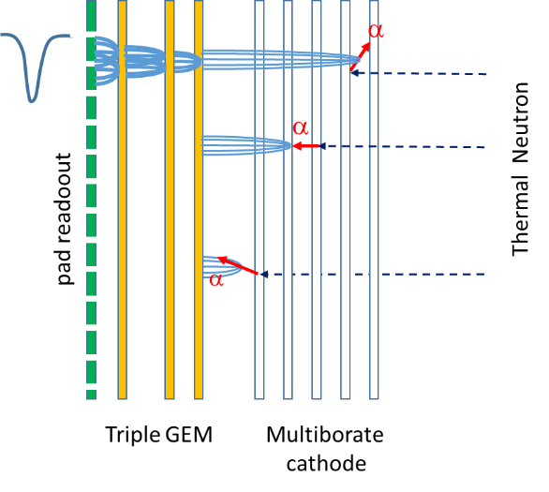
Future project : multiborated head-on converter
Proposed for the first time by Cascade project
but problems on boron deposition stability.
Preliminary good results on B₄C deposition on GEM foils
within a Milano Bicocca,
CERN and Liopking collaboration.

Slide 14
Summary
Timepixes (Timepix, Timepix3, Quads, Diamondpix, GEMPix )
show good performances in high intensity beam monitoring.
They have been installed successfully in different facility
(UA9, NToF @CERN and CNAO and BTF in Italy …. but also in ISS)
and they provide useful information on beam characteristics
and they become important for future project .
Improvement on acquisition software are fundamental
Waiting Timepix2 test and results on performances
Waiting results on borated GEM prototype performance

Slide 15
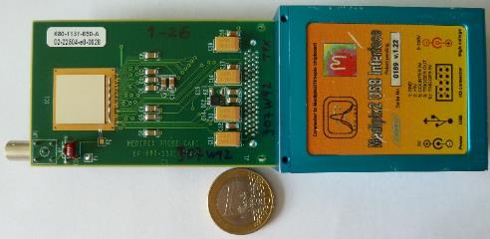

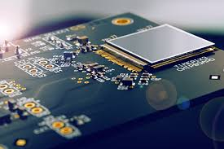
Timepix family
Timepix :
Time frame oriented
Counting mode or
Time of arrival or
Charge
Dead Time
> 5 keV
10 ns resolution
kB/s
Timepix3
Pixel oriented
Counting mode and
Time of arrival and
Charge
Continous measurement
> 3 keV
1.5 ns resoution
MB/s
High Temperature
Timepix2
Pixel oriented
Time frame oriented
?
?

Slide 16
DIAMONDPix
Higly pixelated diamond detector

Slide 17
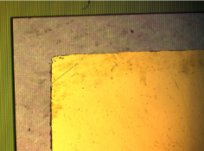
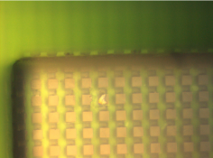
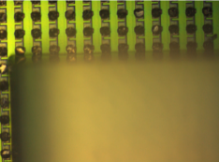
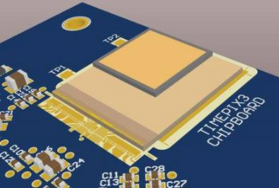
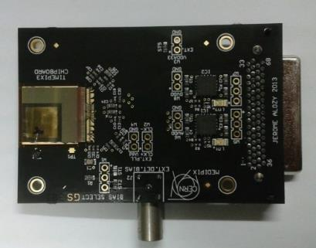
Diamondpix : a radiation hardness detector
Made by Element6 and Fraunhofer IZM
Gold cathode on diamond
upward surface
Pads on diamond
downward surface
Timepix3 Pads
Recently two Diamondpix have been tested on
charged and neutron beam for future applications.

Slide 18
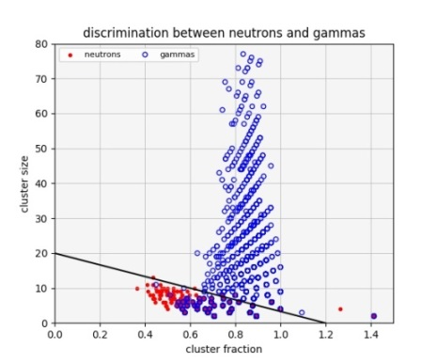
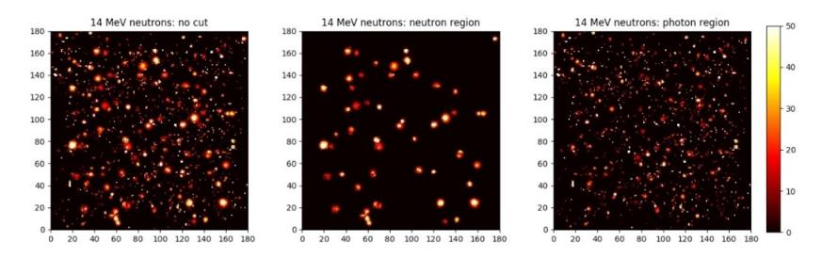
Diamondpix : a radiation hardness detector
Beam image
Neutrons
Gammas
Neutron / Gamma discrimination
G.Claps, F, Cordella, C.Digiulio, L. Foggetta
Details on :
Diamondpix: a CVD diamond detector with Timepix3 chip interface TNS 00581-2018-R1

