Slide 1
A prototype of an ultra-light drift chamber with new materials for the next generation of lepton colliders
AIDA++ DCH#2 LoI
F. Grancagnolo
INFN – Lecce

Slide 2
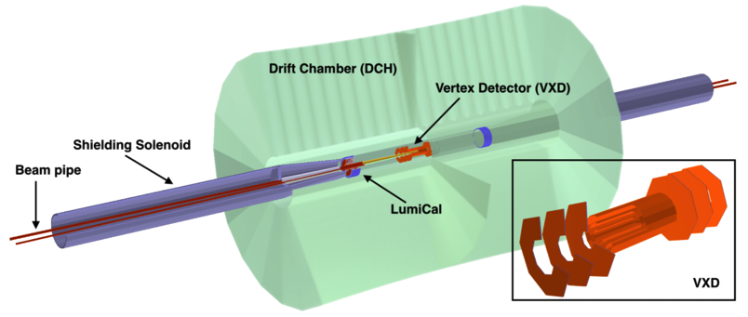
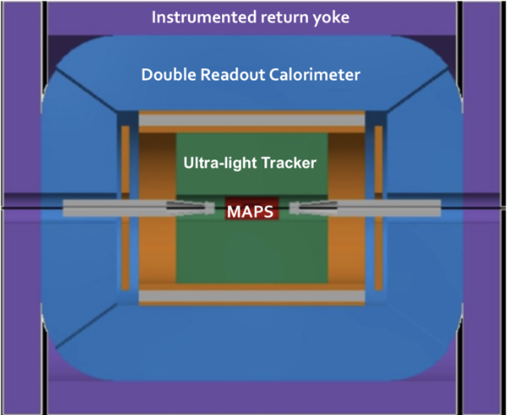
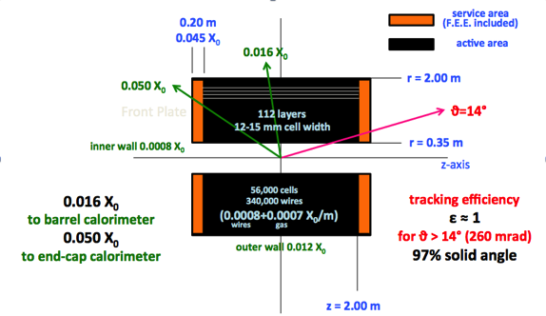
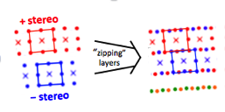
The IDEA Drift Chamber
The IDEA Detector at
FCC-ee at CERN
CEPC at IHEP-China
The IDEA
Drift Chamber

Slide 3
Wire length problem
T = wire tension
C = capacitance per unit length
V₀ = anode-cathode voltage
L = wire length, w = cell width
Electrostatic stability condition
IDEA Drift Chamber: C = 10 pF/m, V₀ = 1500 V, L = 4.0 m, w = 1.0 cm
T > 0.32 N
20 μm W sense wire (Y.S. ≈ 1200 MPa): T_{max} = 0.38 N (marginal)
40 μm Al field wire (Y.S. ≈ 300 MPa): T_{max} = 0.38 N (marginal)
=> shorten chamber (loss of acceptance)
=> widen cell size (increase occupancy)
=> increase wire diameter (increase multiple scattering and endplate load)
or,
=> replace 40 μm Al with Titanium (Y.S. ≈ 550 MPa): T_{max} = 0.70 N
but Ti G5 (90%Ti-6%Al-4%V) hard to draw in such sizes ("galling phenomenon")
=> replace 40 μm Al with 35 μm Carbon monofilament
(Y.S. > 860 MPa): T_{max} > 0.83 N

Slide 4
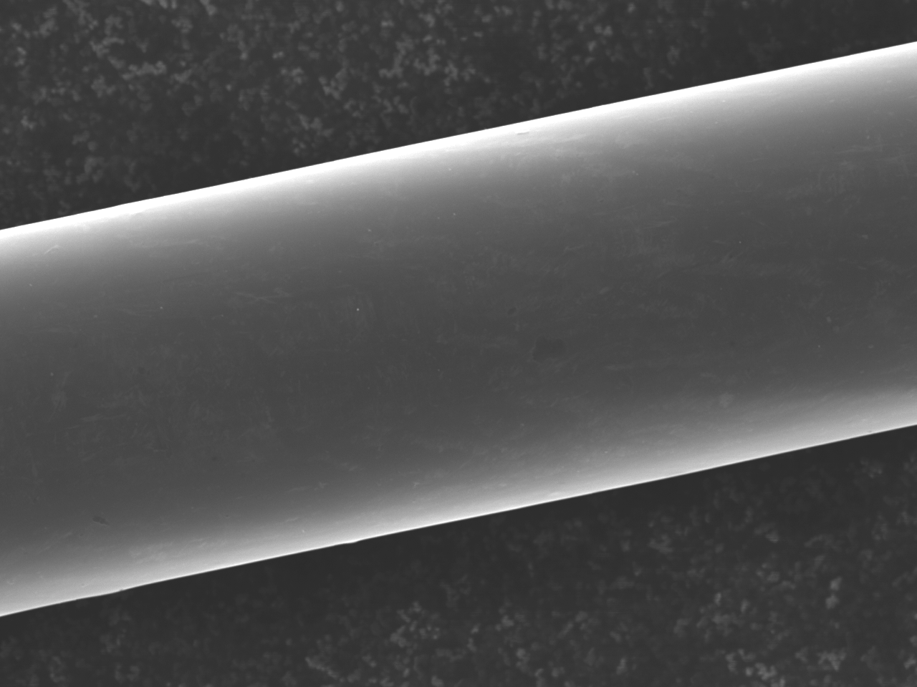
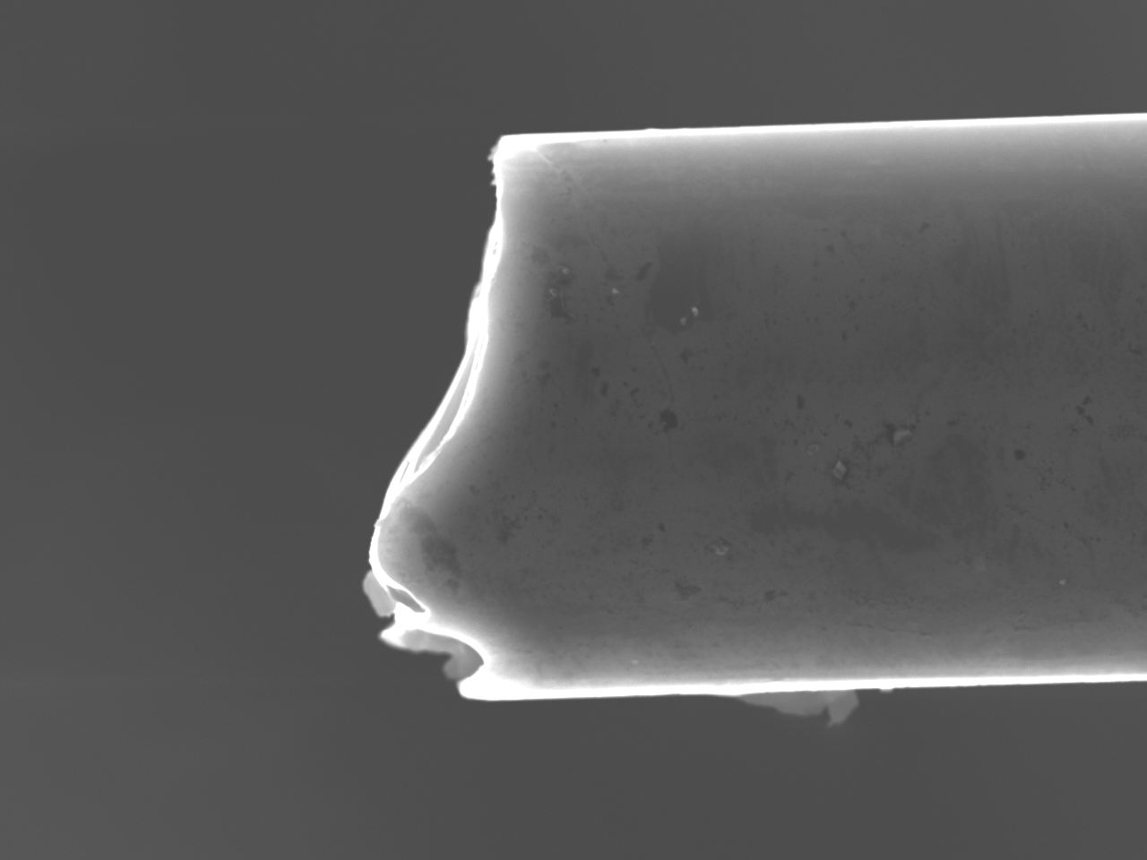
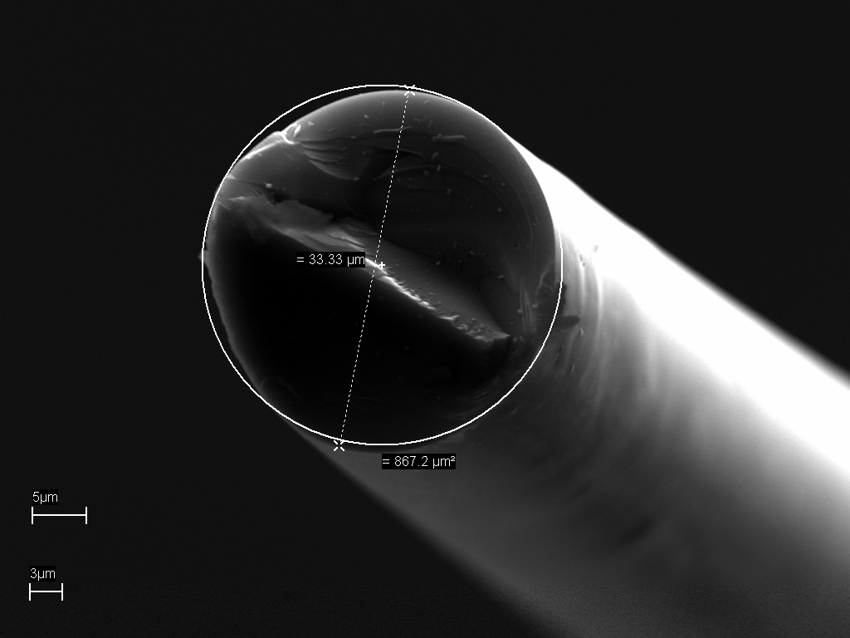
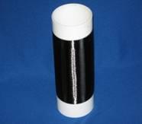
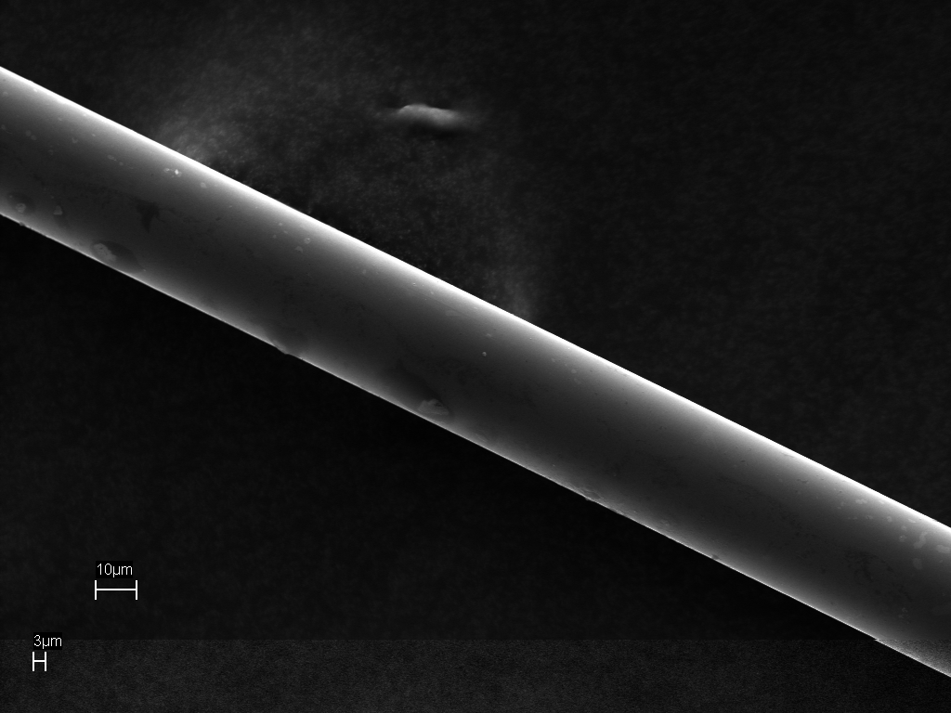
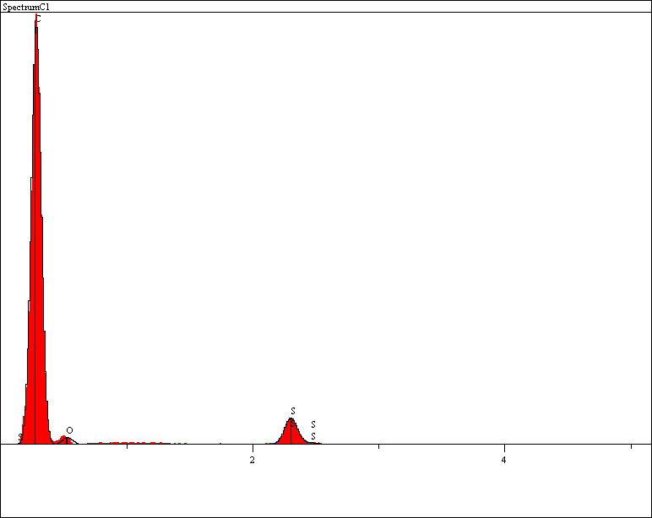
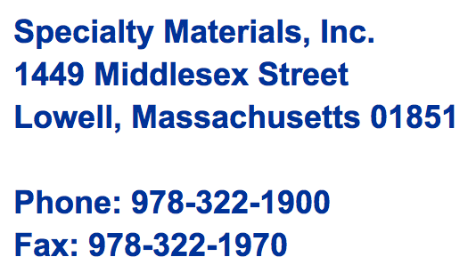
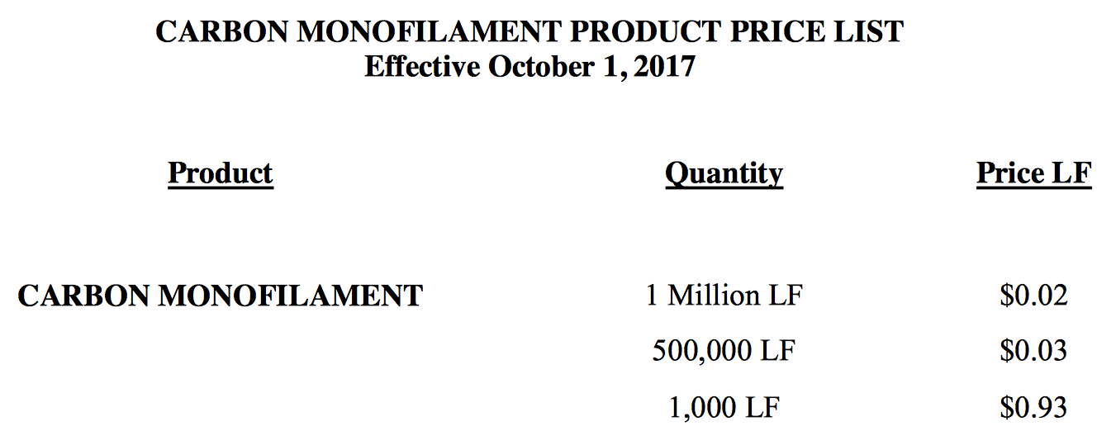
New wires: Carbon monofilaments

Slide 5
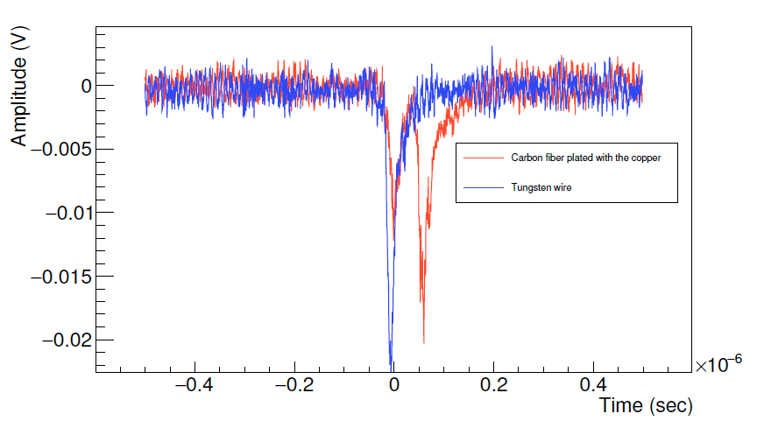
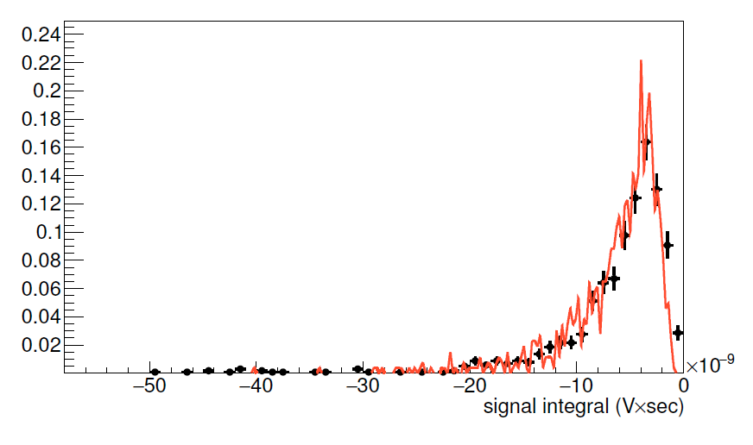
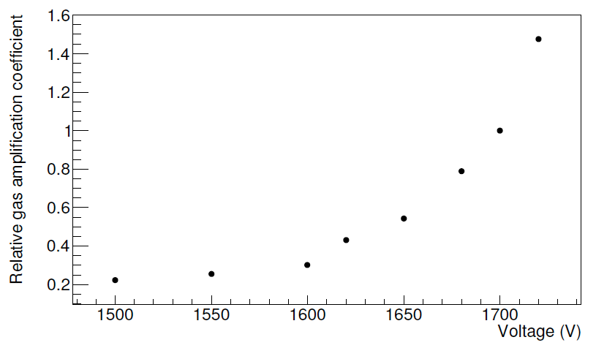
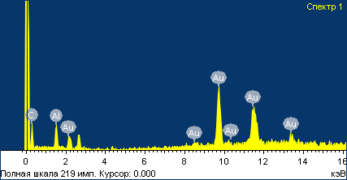
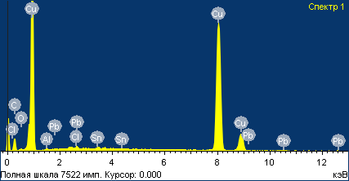
C wire metal coating
BINP
A. Popov
V. Logashenko
HiPIMS: High-power impulse magnetron sputtering
physical vapor deposition (PVD) of thin films based on magnetron sputter deposition (extremely high power densities of the order of kW/cm² in short pulses of tens of microseconds at low duty cycle <10%)
10 nm Cr
50 nm Au
INFN-Le + BINP
Au+Pb+Sn
Cu
C
Drift tube
Au
35 μm C wire
20 μm W wire
soldering attempt
good solder wettability
on Cu
Lead forms intermetallic compound with gold and completely dissolves the 50 nm Au layer.
Charge distribution
Exponential amplification

Slide 6
C wire metal coating
Considerations:
Cu coating test of 35 μm carbon monofilament very successful on short samples with HiPIMS at BINP, Novosibirsk
Investigation of magnetron sputtering facility at INFN LNL in progress
Industrialization of process for coating continuous monofilament under spooling very costly (estimate 200,000 euro)
Alternatives?

Slide 7
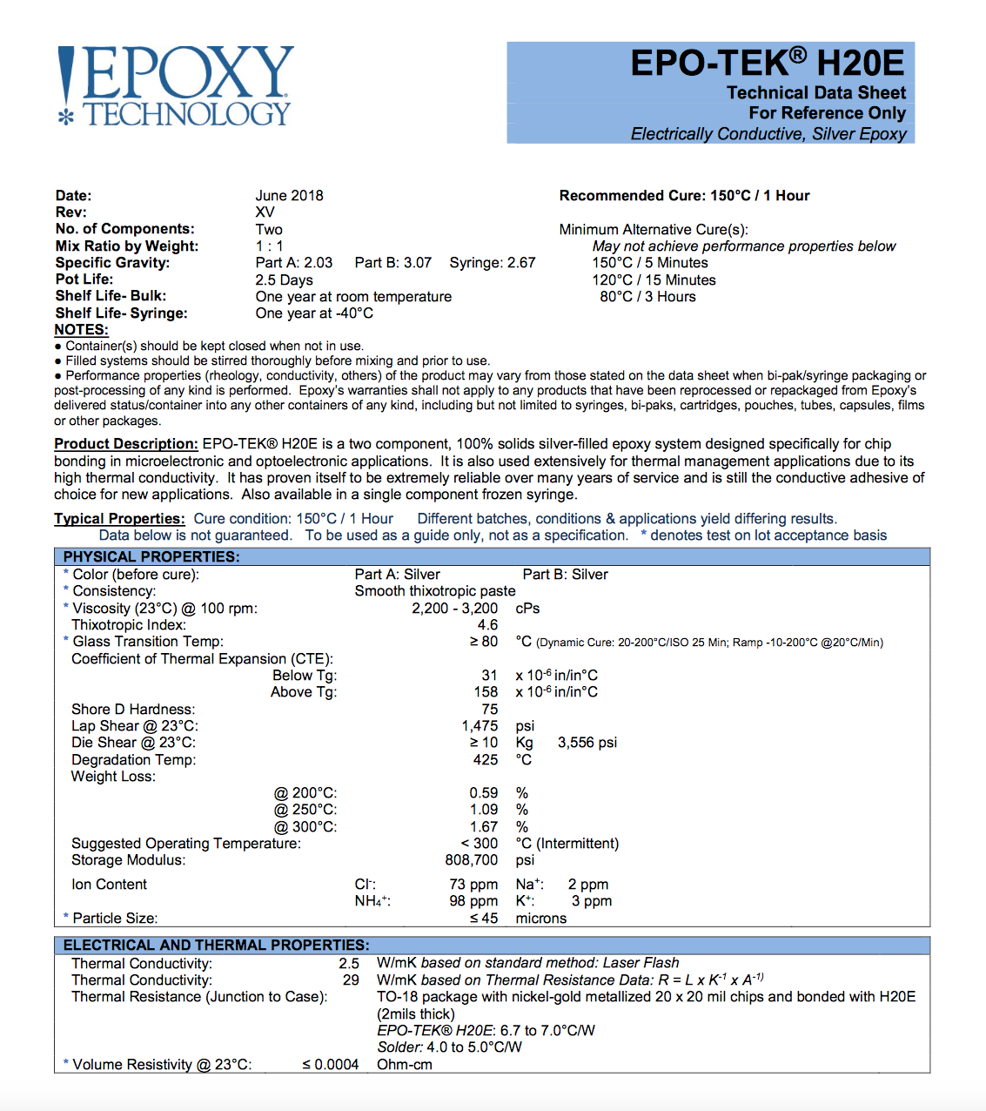
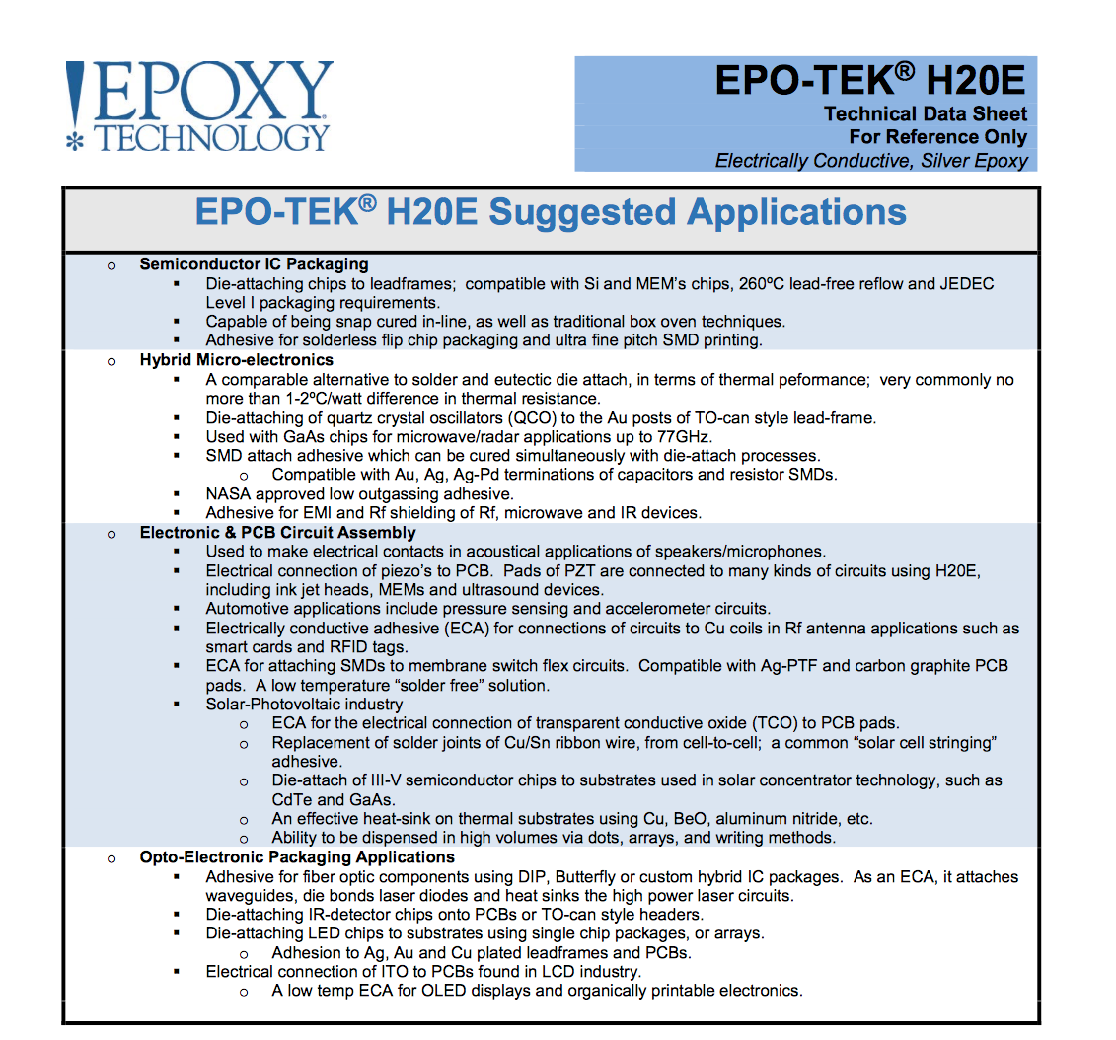
C wire Ag gluing
drawbacks:
curing time
dispensing
cost

Slide 8
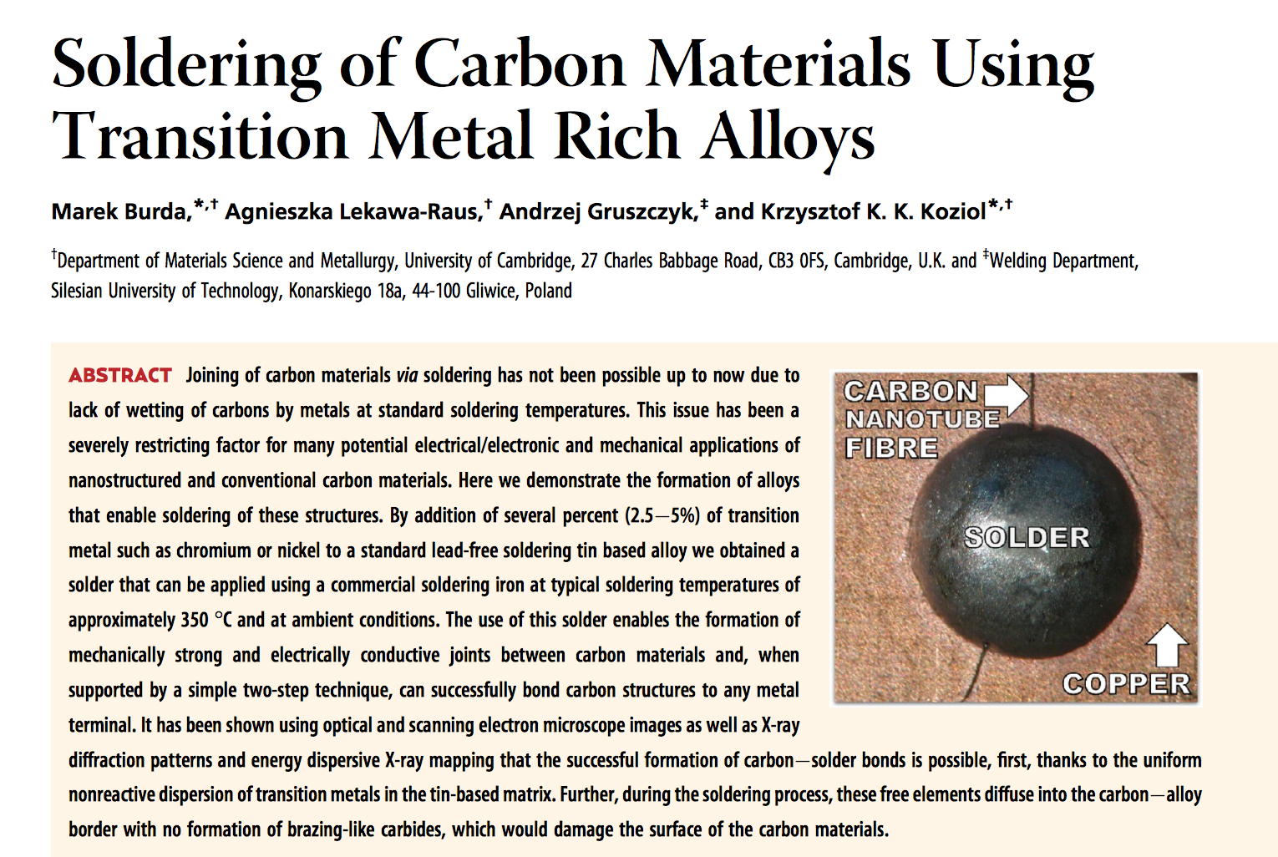
C wire soldering without metal coating

Slide 9
Goal of the AIDA++ call
The goal of the proposed activity is
to seek industrial partners willing to investigate the possibility of industrializing a PVD or similar processes to metal coat carbon monofilaments or alternative polymeric fibers, to be used as cathode wires for drift chambers at the next generation of lepton colliders;
to build full length (at least 4 m long) drift chamber prototypes to test the electrostatic stability against the drift cell size and the mechanical wire tension applicable to these new wires;
to develop specific first stage front end electronics, since the unusual drift chamber length and the consequent increased cell capacitance and sense wire resistance might affect the performance of the cluster counting/timing techniques in addition to the rate behavior limitations due to the cathode wires resistance.
Contacts - Partners
F. Grancagnolo – INFN Lecce
M. Panareo – Università del Salento e INFN Lecce
N. De Filippis – Politecnico di Bari e INFN Bari
I. Logashenko – Budker Institute for Nuclear Physics, Novosibirsk, Russia

